Slide 1

CEPC SR and applications
The 2021 International Workshop on the CEPC （Nov.8-12 2021, IHEP）
Yongsheng Huang
School of Science, SYSU
2021.11.09

Slide 2
Outline
CEPC CDR: parameters and baseline layout
SR design in the CEPC CDR
The new design: parameters, baseline and the applications
The vacuum chamber design and the requirement to the bend magnetic
Tunnels, halls and vertical shafts for the SR stations
The challenges and the next works
Summary

Slide 3
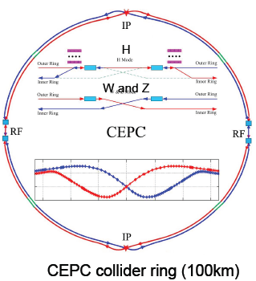
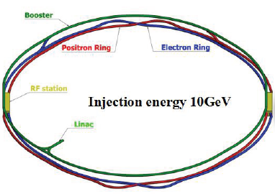
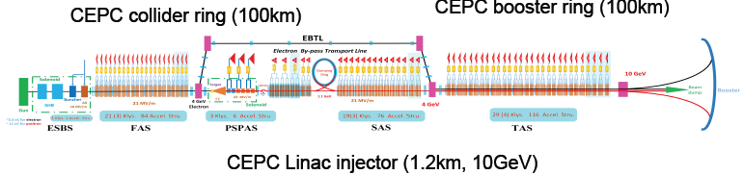
CEPC CDR baselines layout
Notes:
Considering : radiation power, the baseline layout, the cost and the polarization for Z or W mode. If we add wiggler, it maybe useful for polarization, but increase the radiation power also the cost.

Slide 4
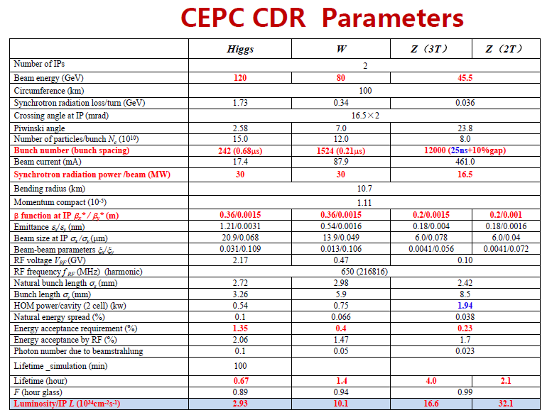
Notes:
The bunch number: 0.68us the dynamic imagination, the time resolution
The bunch length:90ps: 2.72mm

Slide 5
Outline
CEPC CDR: parameters and baseline layout
The design: parameters, baseline and the applications
The vacuum chamber design and the requirement to the bend magnetic
Tunnels, halls and vertical shafts for the SR stations
The challenges and the next works
Summary

Slide 6
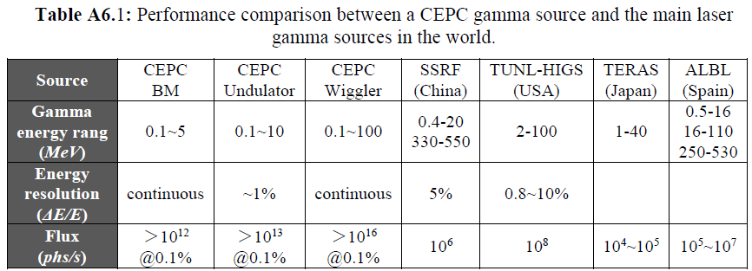
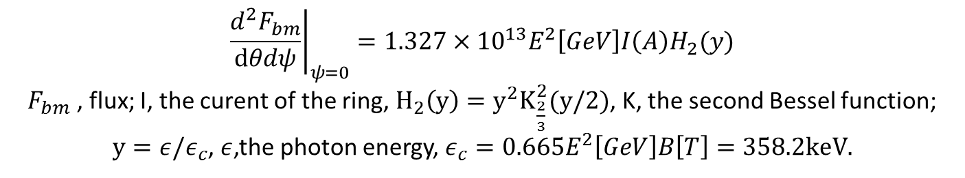
Central intensity of Synchrotron radiation,[photon/s/mrad2/0.1%b.w.]
$${\left.\frac{d^{2}F_{bm}}{dθdψ}\right|}_{ψ=0}=1.327×{10}^{13}E^{2}\left[GeV\right]I\left(A\right)H_{2}(y)$$
$F_{bm}$ , flux; I, the curent of the ring, $H_{2}\left(y\right)=y^{2}K_{\frac{2}{3}}^{2}(y/2)$, K, the second Bessel function;
$y=ε/ε_{c}$, $ε$,the photon energy, $ε_{c}=0.665E^{2}\left[GeV\right]B\left[T\right]=358.2keV.$
Notes:
IN these calculations, the Increment of the radiation power is not considered. It is a big problem. Another problem: do we need undulator and wiggler together? Maybe, just wiggler Is Ok. The gamma energy from the wiggler can cover that from undulator. Also the spectrum from undulator is not monoenergetic too. The another problem is: there are no so many users of the high energy gamma-ray.

Slide 7
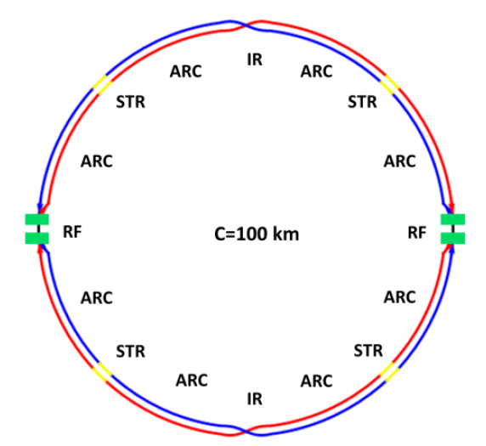
Total design of the SR stations
Two beamlines：
S1+S2
bending magnetic field line：0.1-5MeV, >10^12@0.1%,
High energy X-ray diffraction/scattering/transmission beam line
Hard X-ray micro/nano probe beamline
High voltage extreme condition beam line
wiggler beamline：0.1-100MeV,>10^14@0.1%
Photon-nuclear physics science
Others high energy gamma-ray station, GRB simulations
S1+S2:wiggler+MWCS energy calibration+ Bend

Slide 8
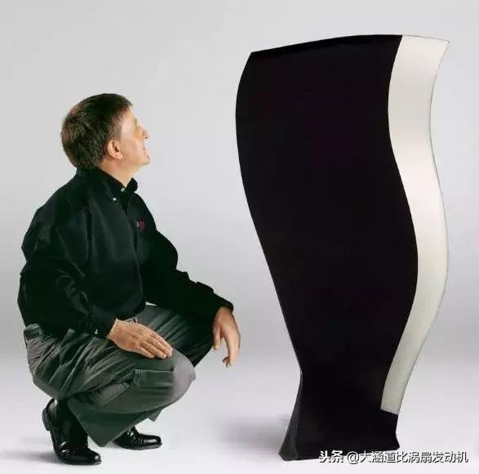
S1 SR from bending magnetic field：0.1-5MeV, >10^12@0.1%
High energy X-ray diffraction/scattering/transmission beam line
In-situ observation and structural analysis of aircraft engine blade growth process
Structural changes of special steel
Observation of special welds
Hard X-ray micro/nano probe beamline
High voltage extreme condition beam line
Structural changes of special materials under dynamic and high pressure conditions of 1000GPa
Study on the equation of state of special materials under static high pressure and high temperature/low temperature

Slide 9
CEPC high-flux γ beamlines
Complementary with the third generations of synchrotron sources, spallation neutron sources, industrial CT, and LCS gamma sources:
7.5cm steel penetration, several micron resolution, high flux fast imagination
Static imaging - engine blade inspection: 6cm thick steel, 1-5 micron resolution
Dynamic imaging---metal phase change process-droplet solidification/seawater corrosion mechanism: us, 6cm thick steel, 1-5 micron resolution
Image reso.
Spallation neutron source
mm
Third generations
Synchrotron radiation source
High energy CT
10um
CEPC-SR γ
（static & dynamic）
LCS γ
um
Micro-nano CT
mm/keV-10keV
cm/100keV
10cm/MeV
penetration/energy

Slide 10
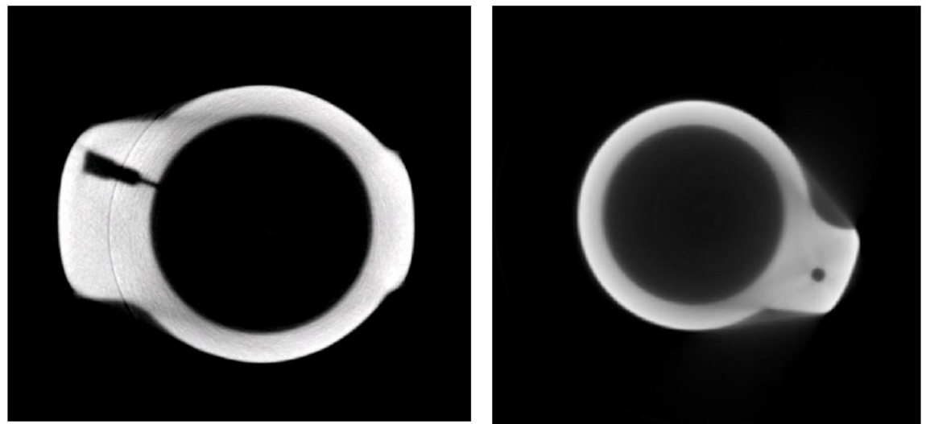
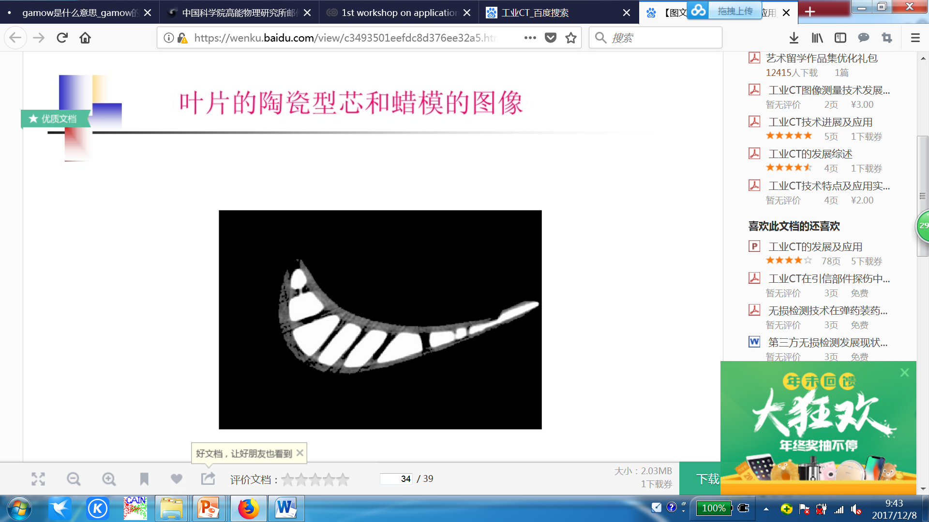
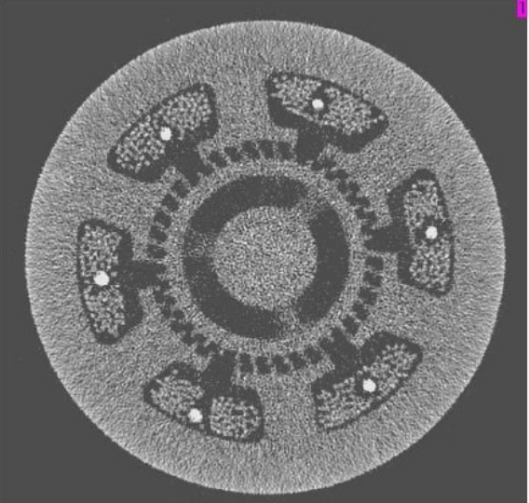
CEPC-SR：Applications—Industrial, material applications
1. Measurement of the internal structure of precision workpieces in the aerospace, aerospace and other industries and the detection of defects;
2. Inspection of ammunition packing density and quality inspection of key components of weapons in the weapon industry;
3. Non-destructive testing of key components in the automotive industry
4. Online monitoring and quality inspection of products in the steel industry: Engine blade ( *um/1cm)
5. Evaluation of samples in geology and archaeology;

Slide 11
Science Case : Time-resolved XRS probes the growth behaviors of nucleus
Applications of Synchrotron Radiation X-ray Scattering on Interfacial Structure and Physics，Huan-Hua Wang
Islands structure on growing SrTiO₃ by PLD
DXRS intensity ring reveals the islands’ separation
Strontium titanate

Slide 12
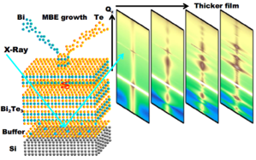
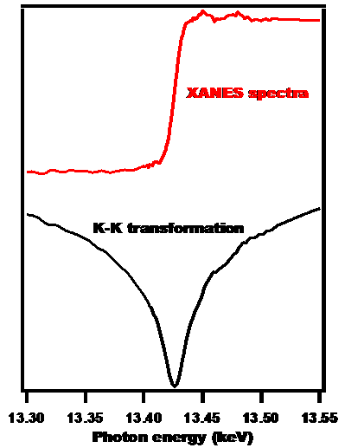
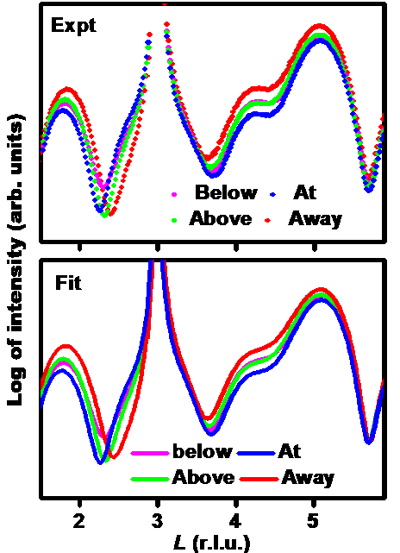
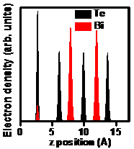
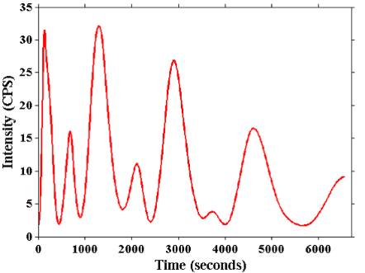
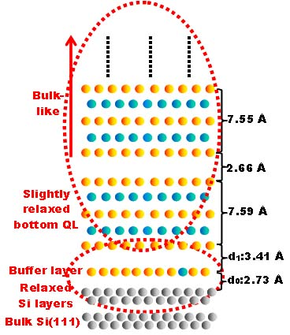
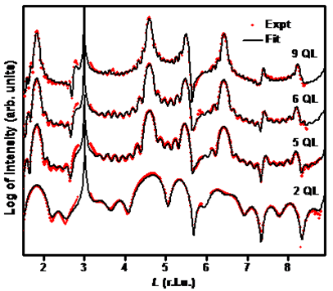
Science Case : Thin film growth and interface structure by in-situ (Resonant) SXRS
Applications of Synchrotron Radiation X-ray Scattering on Interfacial Structure and Physics，Huan-Hua Wang
Composition？Thickness?
Out-of-plane relaxation?
In-plane structure？
Resonant XRS: Bi L3 edge; EXRR; Structure
Time-resolved XRS intensity oscillations at (0 0 ½)

Slide 13
Science Case : Oxygen Octahedral Rotation (OOR) detected by XRD
Applications of Synchrotron Radiation X-ray Scattering on Interfacial Structure and Physics，Huan-Hua Wang
Doubled lattice periods resulting from OOR lead to half integer Bragg peaks

Slide 14
Science Case : Interfacial Structure and Multi-interactions coupling at FeSe/SrTiO₃ interface
1st→2nd ML: Sudden in-plane structure change
Key: in-situ interfacial structure information
Applications of Synchrotron Radiation X-ray Scattering on Interfacial Structure and Physics，Huan-Hua Wang

Slide 15
S2: SR from wiggle magnetic field：0.1-100MeV, >10^14@0.1%
Photon-nuclear physics science
Gamma assisted transmutation
Giant resonance,
Nuclear resonance fluorescence
a “mini” giant dipole resonance it is often called pygmy dipole resonance (PDR).
¹²C(α,γ)¹⁶O reaction: the "Holy Grail" of nuclear astrophysics.
Others high energy gamma-ray station, GRB simulations
radio-pharmaceuticals production

Slide 16
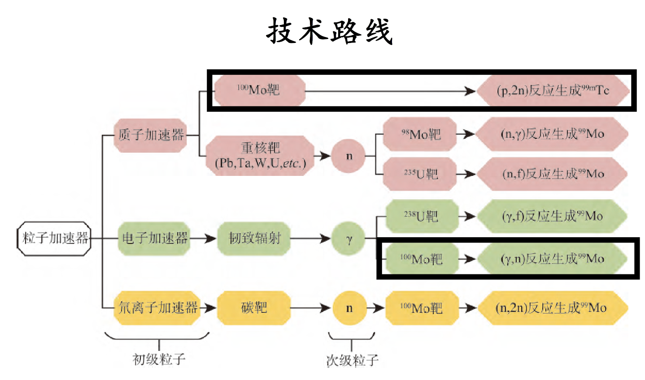
Scarce radioactive medical isotope preparation

Slide 17
CEPC-SR：Applications on Nuclear Physics
Wang Naiyan: High-intensity γ-rays for nuclear science research
Photonuclear action is a valve-like reaction
The valve energy of the (γ, n) and (γ, p) reactions is the binding energy of the last neutron and proton in the target nucleus.
The data of the binding energy of the last neutron can be accurately obtained by measuring the (γ, n) reaction threshold.

Slide 18
CEPC-SR：Applications
Wang Naiyan: High-intensity γ-rays for nuclear science research
Giant resonance for photonuclear reaction:
By measuring the excitation function of the photonuclear reaction giant resonance, information on the nuclear deformation can be obtained.
Giant resonance absorption is not the only mechanism of photonuclear reaction: by measuring the ratio of (γ, p) and (γ, n) reaction yield Y(γ, p) / Y(γ, n) indicates that it is larger than predicted by the resonance absorption mechanism. Much more, this may be due to the existence of a direct interaction process in the photonuclear reaction, and the giant resonance absorption is not the only process.

Slide 19
Wang Naiyan: High-intensity γ-rays for nuclear science research
The important role of high-intensity γ-rays in the study of Nuclear transmutation

Slide 20
Wang Naiyan: High-intensity γ-rays for nuclear science research
There have been a small number of studies in the world (as opposed to a large number of neutron metamorphosis studies)
Most of them use the bremsstrahlung gamma source generated by high-power laser to high Z target, which is less efficient.
I only see an experiment in Japan that uses an inverse Compton scattering gamma source with electron beam and laser collision.
→ The conclusion is that it is feasible to use gamma for tens of kilograms of nuclear waste!

Slide 21

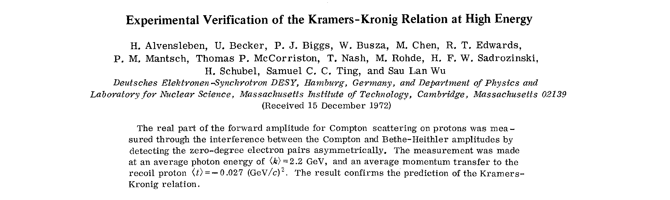
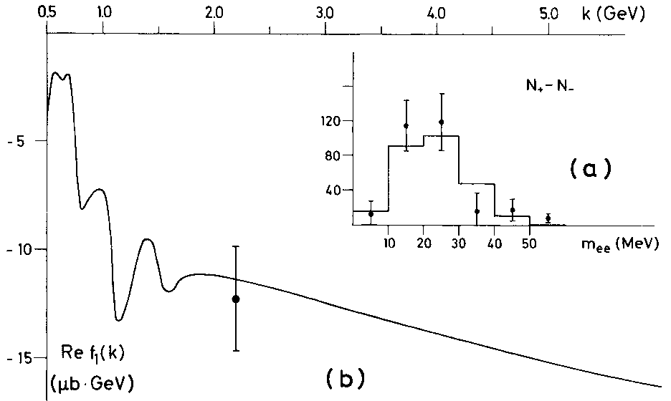
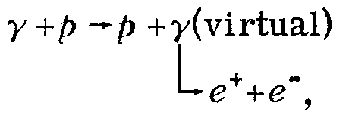
On the CEPC-γ source
2.2 GeV
γ + N → ?
100 MeV γ, λ ≈ 12.4 fm
PRL 30, 328(1973).
CEPC-γ CJLin@ciae.ac.cn 20

Slide 22


Poison and Holy Grail in the Evolution of Stellars
--- Based on the gamma light device, He Jianjun
Poison in the process of slow neutron capture
The first
¹⁷O(n, γ)¹⁸O
The second
¹³C(n, γ)¹⁴C
s-process
s-process

Slide 23

Poison and Holy Grail in the Evolution of Stellars
--- Based on the gamma light device, He Jianjun
¹²C(α,γ)¹⁶O Holy Grail
(Hoyle grail)
¹²C(α,γ)¹⁶O The reaction plays a key role in the evolution of all M > 0.55 M⊙ stars. The reaction cross section has a decisive influence on the synthesis of medium-quality nuclei up to iron and the evolution of large-mass stars. It is known as the "Holy Grail" of nuclear astrophysics.

Slide 24
Photonuclear reaction¹⁶O(γ, α) ¹²C measurement
University of Stuttgart, Germany：¹²C(α,γ)¹⁶O
Beam：400 μA (2.5×10¹⁵ pps),
Target thickness：2×10¹⁸ atom/cm³
Time ：150h
Photonuclear reaction：¹⁶O(γ, α)¹²C
Target thickness：×1000times
Cross section：×100times
α/γ Detection efficiency ratio ： ×20times
time：150h
beam：≥ 10⁹ photon/s
Time projection room technology(TPC)

Slide 25
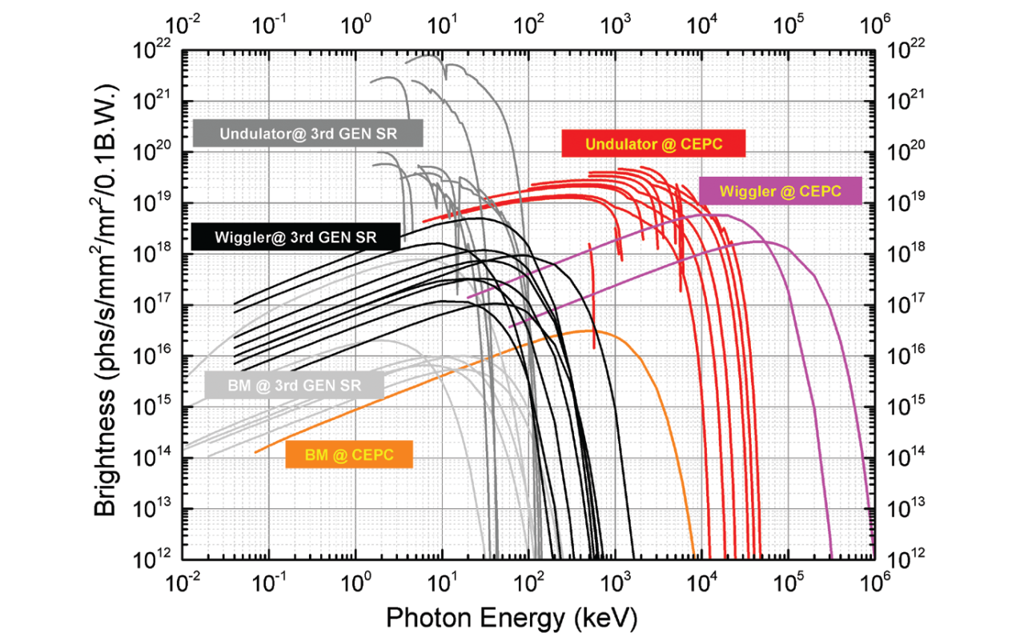
Holy Grail and Poison: need wiggler field in CEPC
The gamma from the Wiggler field response to 8.3MeV for the Holy Grail ！

Slide 26
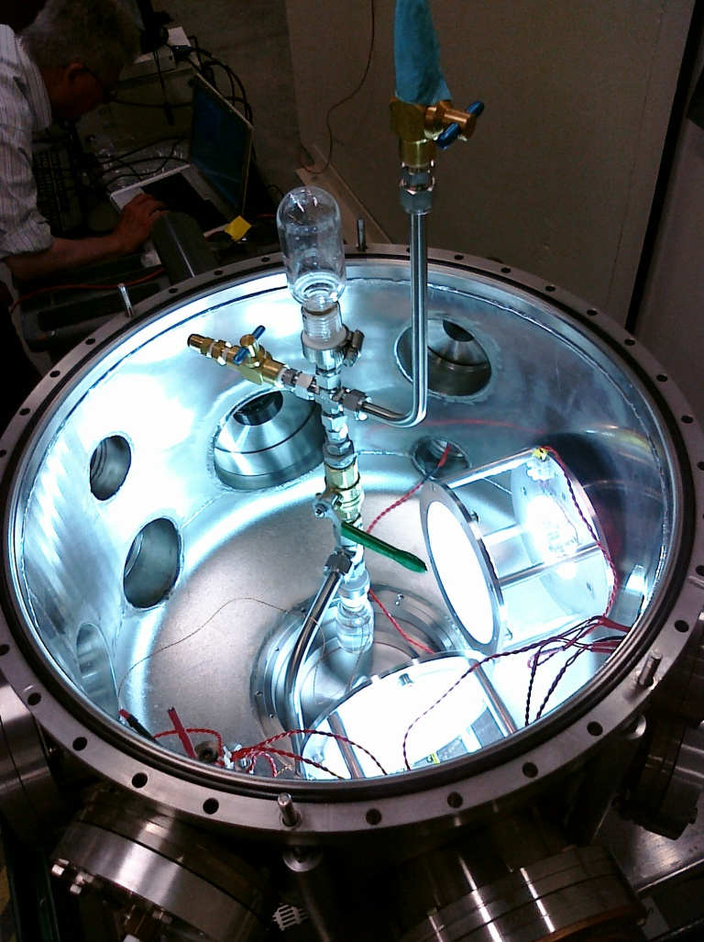
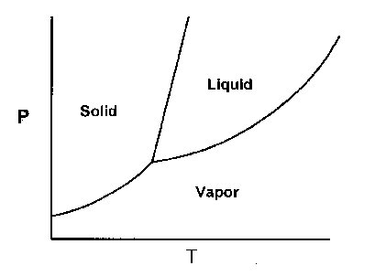
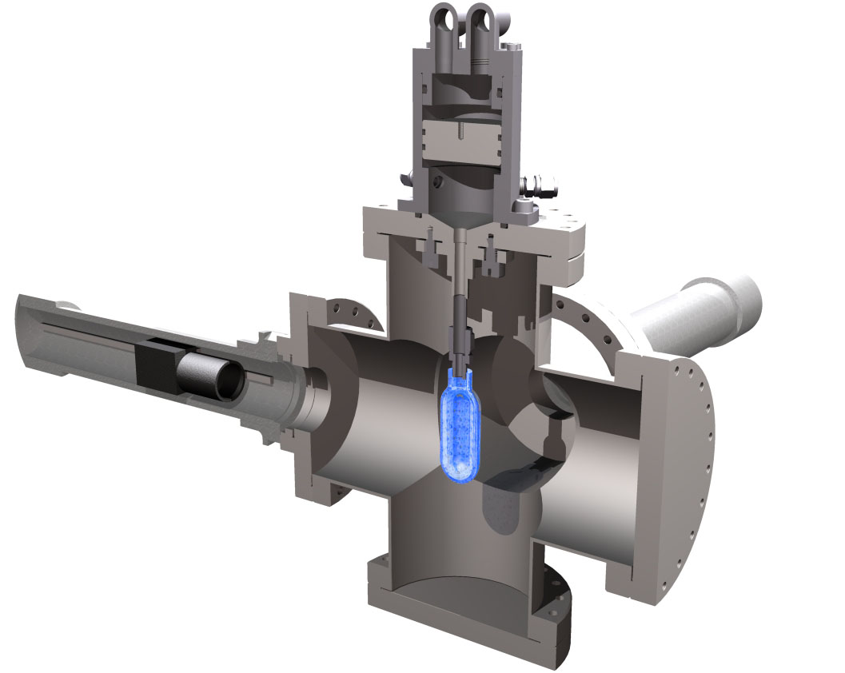
Proof of Principle of a superheated bubble chamber for the ¹⁹F(γ,α)¹⁵N reaction
P~ 1-6 atm T~20-50 C
2 fast cameras

Slide 27
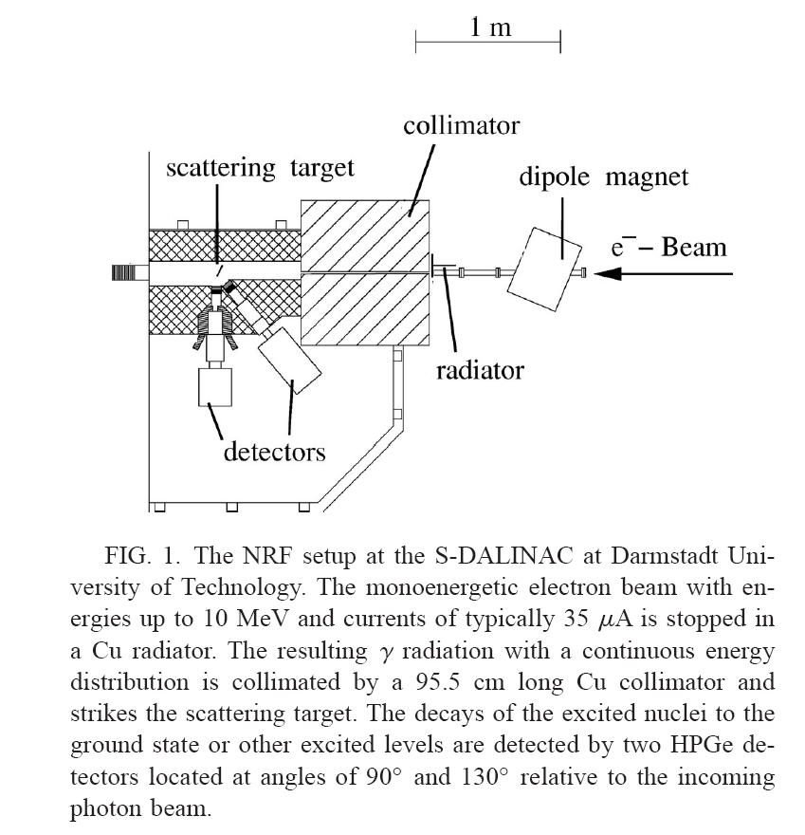
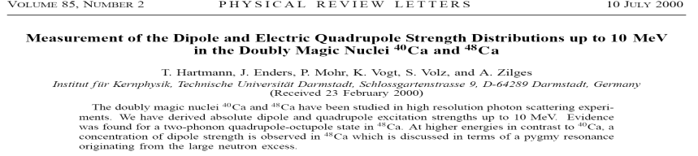
Quasi monoenergetic γ nuclear reactions, Qiao Huan, Zhang Chunlei , Baichun Lin
In a classical picture the excess neutrons form a skin around the proton/neutron core with N Z. An oscillation of the skin vs the core would lead to an electric dipole excitation mode. Because this mode bears resemblance to a “mini” giant dipole resonance it is often called pygmy dipole resonance (PDR).
perform very sensitive Ca(γ , γ、 ) experiments up to an excitation energy of 10.5 MeV
performed photon scattering experiments on ⁴⁰Ca and ⁴⁸Ca

Slide 28
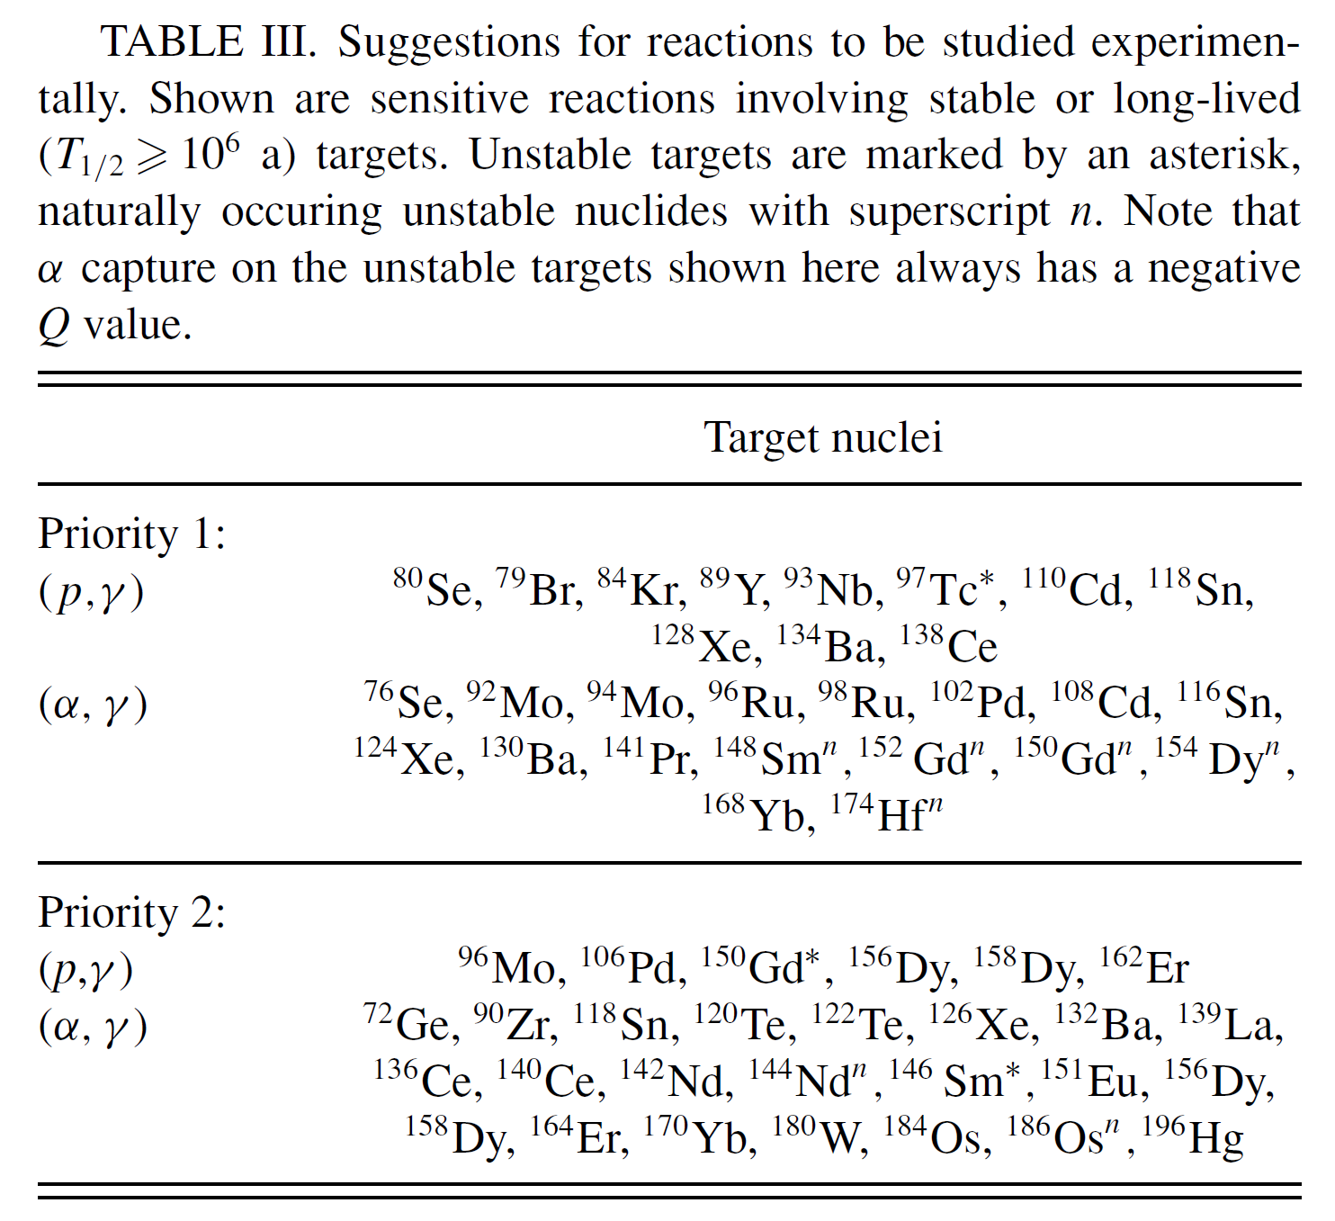
Suggestions for reactions to be studied experimentally
Photodisintegration reaction measurement: a probe of p-process for nuclear astrophysics, Liuchun He, Bao-Hua Sun, Li-Hua Zhu, Jian-Wei Zhao, Meng Wang, Kang Wang
Proposed photonuclear reactions for research in astrophysics!
Thomas Rauscher, PRC, 73, 015804 (2006)
Notes:
A well-known deficiency in the model is the underproduction of the Mo-Ru region, but the region 151 A 167 is also underproduced, even in recent calculations [3].
In this work the sensitivity of the location of the γ process path to reaction rates is investigated, showing which nuclei should be preferred in experimental studies.
表左：产率具有较大误差的核素，下角标表示与（g,n）反应产率接近的反应。
表右：优先进行实验研究的核素。

Slide 29

¹²C(α,γ)¹⁶OHoly Grail
第1瓶
¹⁷O(n, γ)¹⁸O
Photoreaction threshold
s-process
圣杯(Holy grail)
Gamma assisted transmutation
Giant resonance,
Nuclear resonance fluorescence
s-process
γ + N → ?
100 MeV γ, λ ≈ 12.4 fm
第2瓶
¹³C(n, γ)¹⁴C
industry,
Heavy material inspection
Archaeology, etc.
a “mini” giant dipole resonance it is often called pygmy dipole resonance (PDR).

Slide 30
Outline
CEPC CDR: parameters and baseline layout
The design: parameters, baseline and the applications
The vacuum chamber design and the requirement to the bend magnetic
Tunnels, halls and vertical shafts for the SR stations
The challenges and the next works
Summary

Slide 31
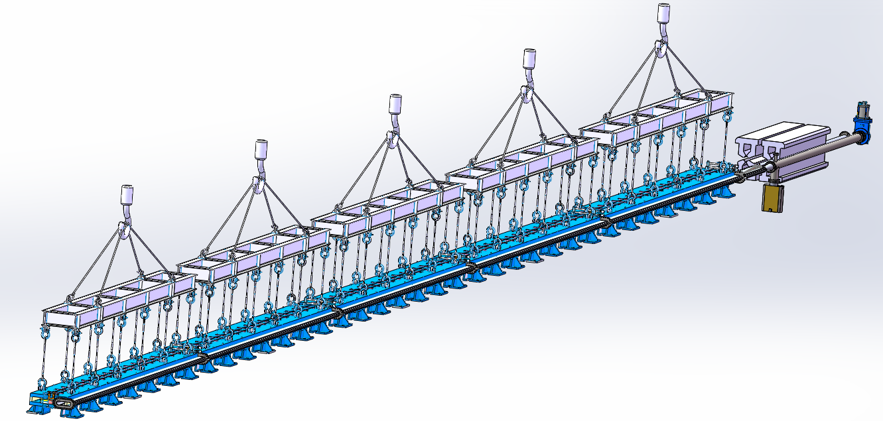
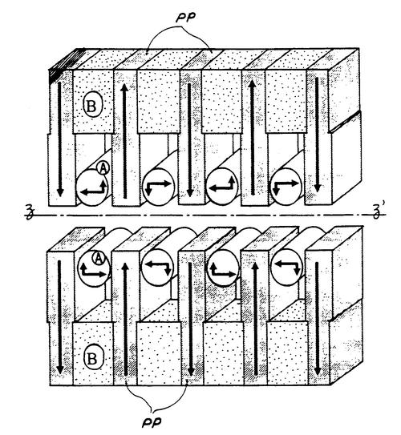
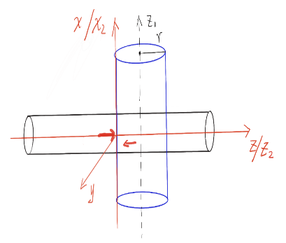
The vacuum chamber design
The first diode vacuum box in the first 28-meter diode vacuum box
The first meter diode vacuum box remains unchanged
The second meter diode vacuum box needs to be extended by 150mm
微波管
束流管
王鹏程，黄永盛，王毅伟，杨梅
电子束团与微波光子180度相互作用

Slide 32
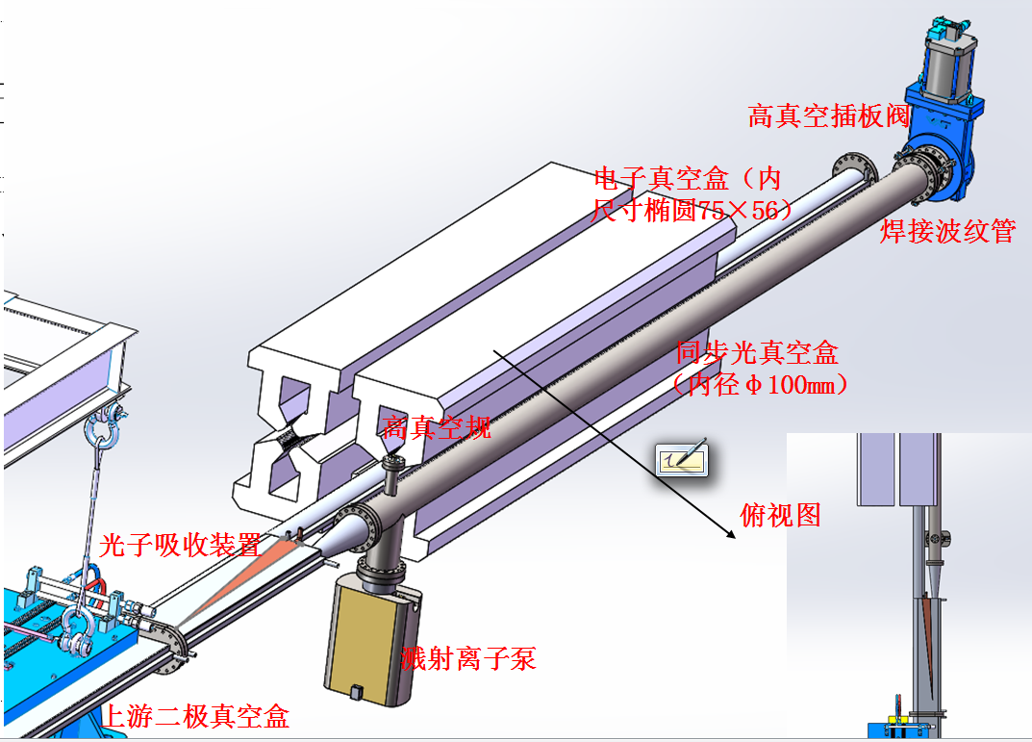
真空管分叉、二级铁末端与四级铁

Slide 33
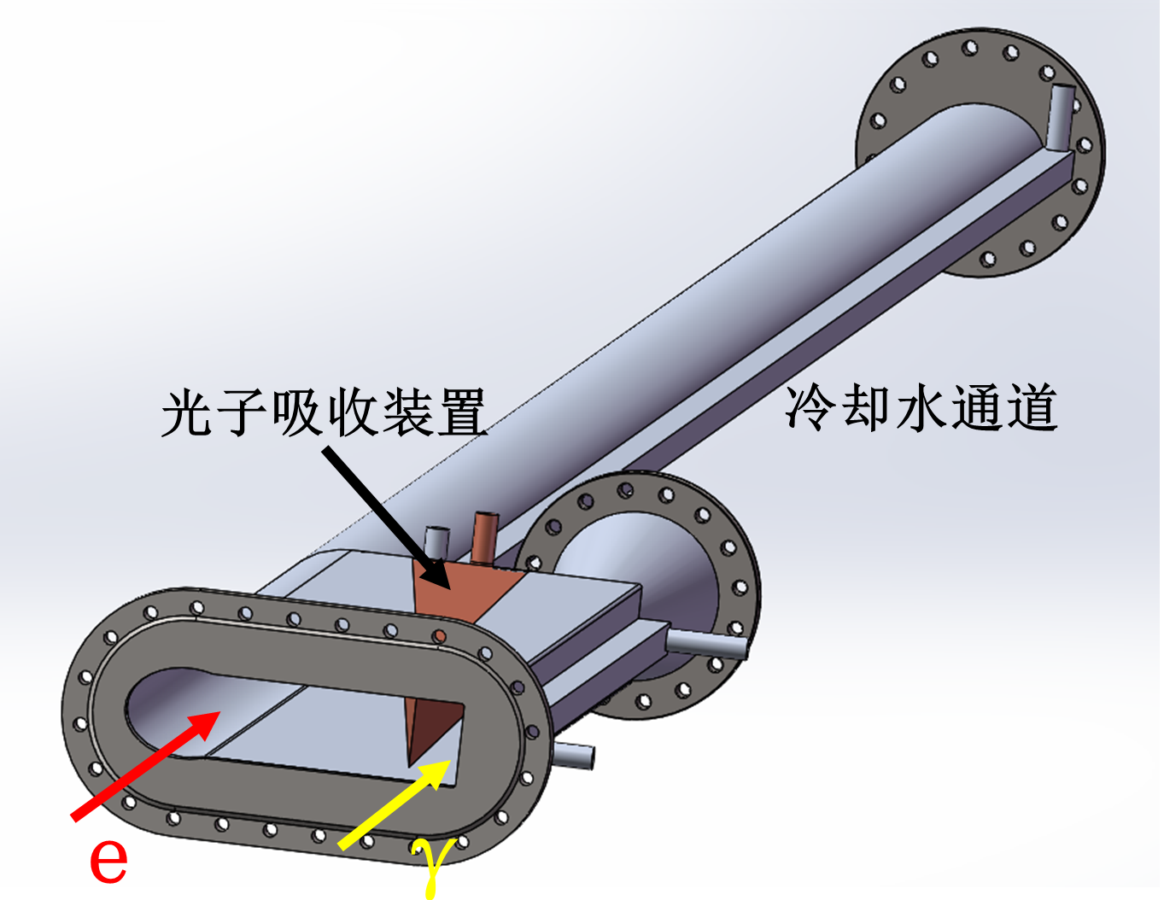
The vacuum chamber design

Slide 34
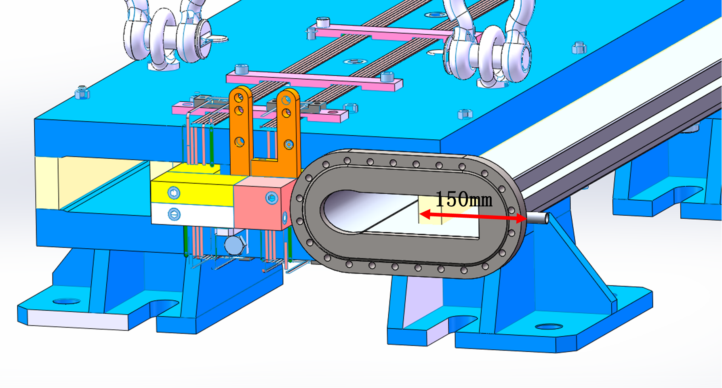
Vacuum piping in dipole iron and requirements for side ends of the iron

Slide 35
The discussions
1. The length of the beam line exceeds 700 meters, and the vacuum system is recommended to be composed of getter films (NEG films) + ion pump.
2. All the beam lines can be divided into 8 sections, each section is separated by all-metal ultra-high vacuum valves (9 valves), and each section has a separate rough suction port and gas filling port, and each section 5-10 ion pumps are uniformly distributed in the section (used to pump out gases that are not easy to pump out of getter films such as CH4), and the inner walls of all vacuum boxes are plated with NEG films.
3. The material of the vacuum box can be 304 stainless steel (the inner size is φ100, the wall thickness is 3mm).
4. Vacuum measurement adopts 2 measurement points in each section, and cold cathode vacuum gauge is used for measurement.
5. In the photon collimation area, it is necessary to arrange temperature measurement points in the nearby vacuum box to monitor the temperature change of the outer wall of the vacuum box.

Slide 36
Outline
CEPC CDR: parameters and baseline layout
The design: parameters, baseline and the applications
The vacuum chamber design and the requirement to the bend magnetic
Tunnels, halls and vertical shafts for the SR stations
The challenges and the next works
Summary

Slide 37


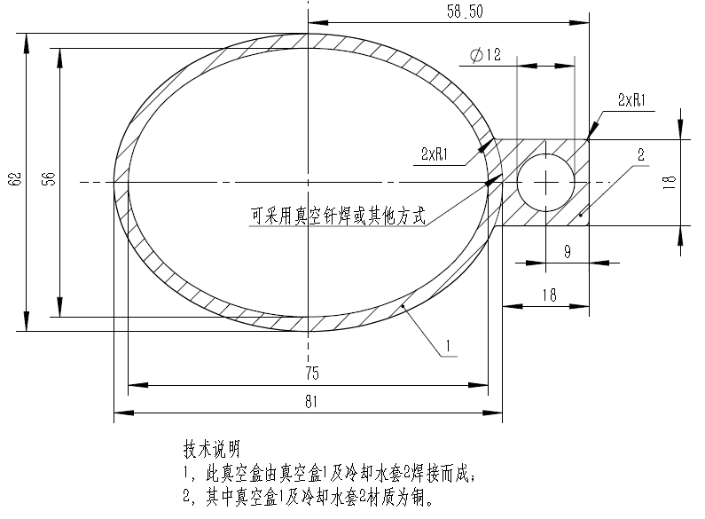
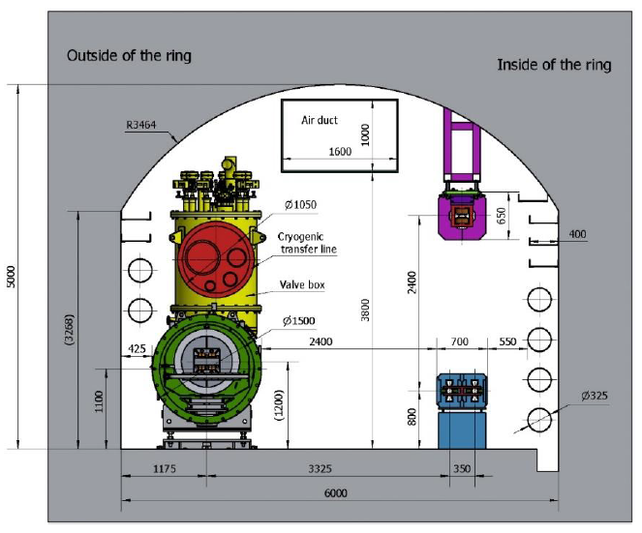
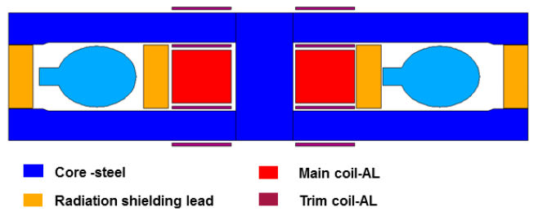
Vacuum chamber, dipole and tunnel
93mm
dvc=0.075/2 m; ! distance from the gamma ray to the inner wall of vacuum chamber
dwall=4.5 m; ! distance from the gamma ray to the wall
4500
Notes:
Synchrotron radiation exits from the tangential direction. Since our radius is so large, the direction is almost the vacuum pipe direction. The pipe of SR need pass through several radiation shielding lead of the magnetic. Maybe we can extend the magnet steel a few centimeters outward

Slide 38
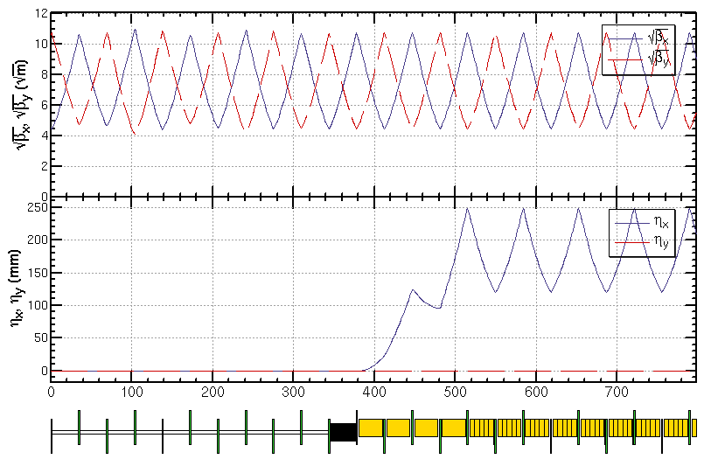
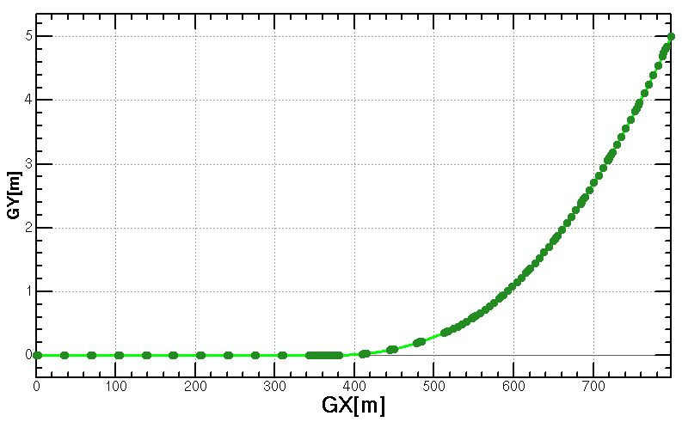
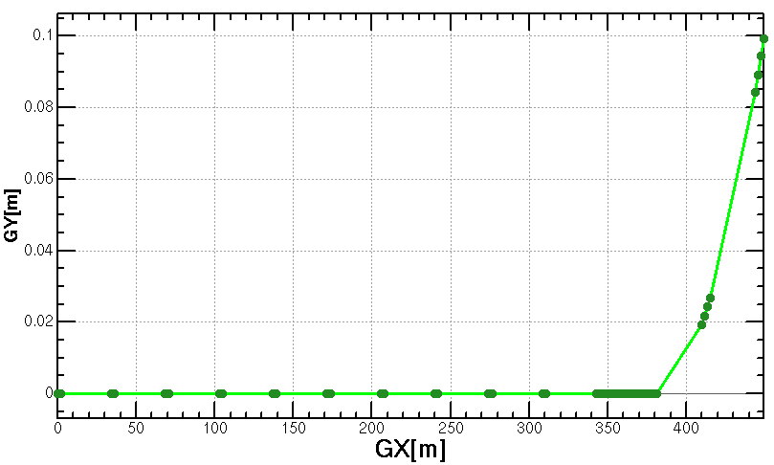
Add Wiggler
Lp=0.32m, Np=4, L=1.28m, B=2.0T
wiggler
dvc=0.075/2 m; ! distance from the gamma ray to the inner wall of vacumn chamber
dwall=4.5 m; ! distance from the gamma ray to the wall
The angle between gamma ray and the vacumn chamber and bend is very small.
The vacumn chamber, bend at these regions need to be carefully design to solve the problem of geometry conflict and impedance.
Notes:
The figures show the properties of the CEPC synchrotron radiation γ-ray source from wiggler. The length of the wiggler is 32m, period length is 320mm, periods number is 100, the minimum Gap is 82mm, the maximum magnet field is 2.0T, the maximum K is 59.7.
The energy can get tens MeV, where the flux is about 10¹⁵ phs/s/0.1% B.W.. the critical energy is 19.2MeV. The maximum power is 20MW, the maximum power density is 428MW/mrad². 2.4times30MW too large

Slide 39
Tunnels, halls and shafts
Tunnel cross section :3m * 3m
15m
The door on the shield wall:2m*3m
HALL:
15m * 20m * 5m(高)
with overhead crane
300cm
vacuum
pipe
20m
80cm
20cm
8m
100cm
200cm
Shield wall:1m
Door
上一页各束线的终点坐标，从这个点开始，沿着束线方向，向岩石内挖3X3米的隧道，
挖到10米处是防护门，然后是大厅。见右图。
束线S1和S2的大厅处，需分别有吊装竖井和载小货物电梯
电梯：2m*2m*3m，称重>2顿。
Channel
10m

Slide 40
Outline
CEPC CDR: parameters and baseline layout
The design: parameters, baseline and the applications
The vacuum chamber design and the requirement to the bend magnetic
Tunnels, halls and vertical shafts for the SR stations
The challenges and the next works
Summary

Slide 41
The challenges and the next to do
1) The focalization of gamma-ray: larger than MeV
2) The detection of the energy distribution and the spatial distribution of the SR from bending magnetic and wiggler

Slide 42
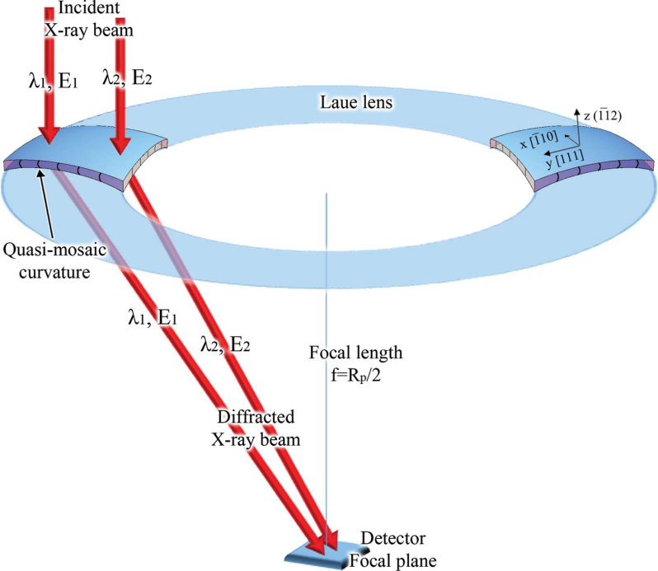
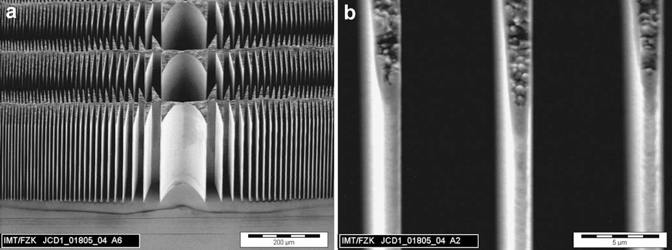
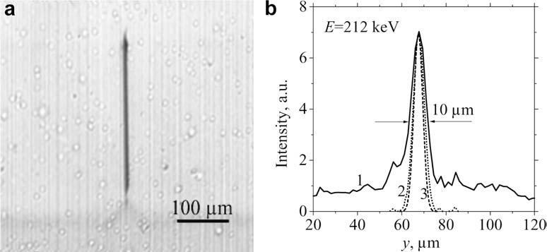
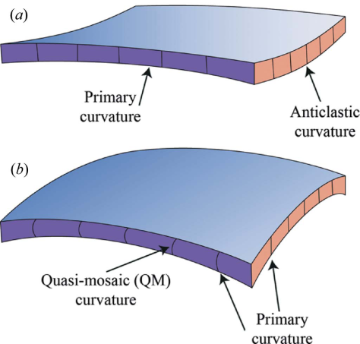
The focalization of hard x-ray
And soft gamma-ray 100keV-1MeV, 1MeV still problem?
LIGA fabrication of X-ray Nickel lenses
100keV-1MeV : Microsystem Technologies 11 (2005) 292–297
Schematic representation of a Laue lens based on QM crystals. J. Appl. Cryst. (2015). 48, 977–989

Slide 43
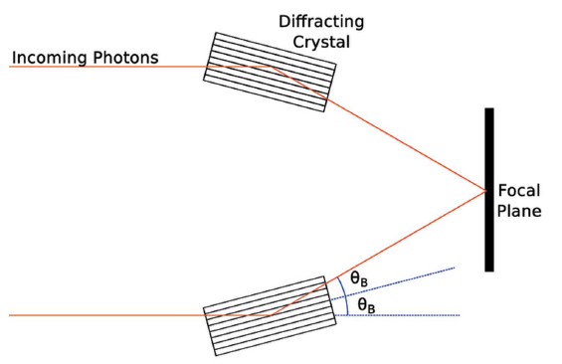

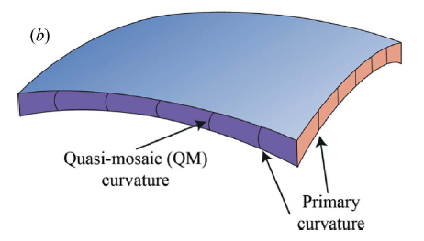
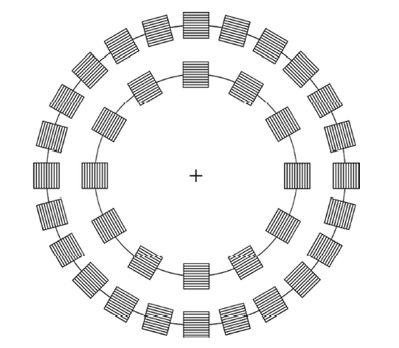
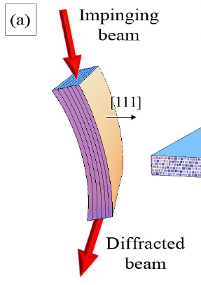
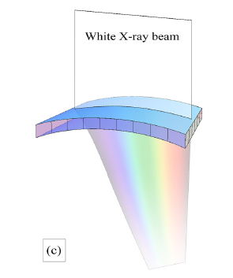

For high-energy photons, the Bragg angle is very small, and even in small beams the crystal must be large to diffract. Therefore, Laue geometry represents a more convenient choice.
Perfect crystal, mosaic crystal,
the maximum reflectivity is 1/2
Curved diffraction plane crystal (CDP), quasi-mosaic (QM) crystal, peak reflectance is not limited by 1/2

Slide 44

Choice of crystal
For various crystals, the peak reflectance at 100 keV, 500 keV, and 1 MeV energies, Z (atomic number) increases from left to right.
As can be seen from the figure on the right, at high energy, the higher reflectance is a crystal with higher Z; on the other hand, at low energy, the higher reflectance is a crystal with lower Z.

Slide 45


Material selection of MeV focusing lens: Pb, Au
图 : 假设是镶嵌晶体，镶嵌度 Ω 为 30arcsec，微晶厚度 t0 为 5µm，晶体厚度 T0 可由 (3.11)式算出，但被限制在 1 ∼ 25mm 范围内。Si、Ge、Cu、Au 和 Pb 峰值反射率随能量的变化。
图 : 18 种晶体的能量分别在 0.1MeV、0.5 MeV、1 MeV 和 1.5 MeV 时的峰值反射率，按原子序数从左到右逐渐增加排列。假设是镶嵌晶体，镶嵌度 Ω 为 30arcsec，微晶厚度 t0 为 5µm，晶体厚度 T0 可由 (3.11) 式算出，但被限制在 1 ∼ 25mm 范围内。

Slide 46



Preliminary scheme of MeV focusing lens
选择劳厄透镜的焦距为 20m，因为 20m 是天体物理学应用中通常会考虑到的焦距。
所以可以算出，当能量为 0.8MeV 时，半径最大为 131.66mm，当能量为 1.2MeV 时，半径最小为 87.78mm。晶体环排列越紧密，相邻环的能量重叠越多，劳厄透镜衍射的能量越平滑，则这个劳厄透镜由 5 个晶体环组成，且每个环上都排列尽可能多的
晶体，这可以使得劳厄透镜的有效面积最大。
估价-100万左右
Figure 2: 0.8-1.2MeV Laue lens geometry
Figure 1: (a) Au Crystal arrangement ，(b)Au Crystal size ，(10×10×3)mm2

Slide 47



MeV array/imaging gamma detector
Det：Array Cerium-doped gadolinium gallium aluminum multi-component garnet GAGG：150mm*150mm，0.2mm one unit
Elctronics：SiPM array 50um pixel 实现阵列像素4块75mm*75mm的拼接 or 3mm array of SiPM
30-50 Micron plate GAGG Screen
10 Micron particle size GAGG Powder screen

Slide 48
Summary
Considering the layout of CEPC, the radiation power and the possible polarization requirement, four beamlines are designed;
The basic parameters of the wigglers are given;
The possible applications of the beamlines are discussed, especially for the gamma-ray imagination ;
The key challenges need to be study are proposed: the focus of MeV gamma-ray beam and the detection design.

Slide 49
Thank you very much for
your support and attention!

