Slide 1
Progress of CEPC detector Mechanical Design
Zhang Junsong
2021.11.13

Slide 2
Contents
1.Preliminary design of CEPC detector installation scheme
2.Iron yoke design
3.Heat transfer analysis of beampipe
4.Summry

Slide 3
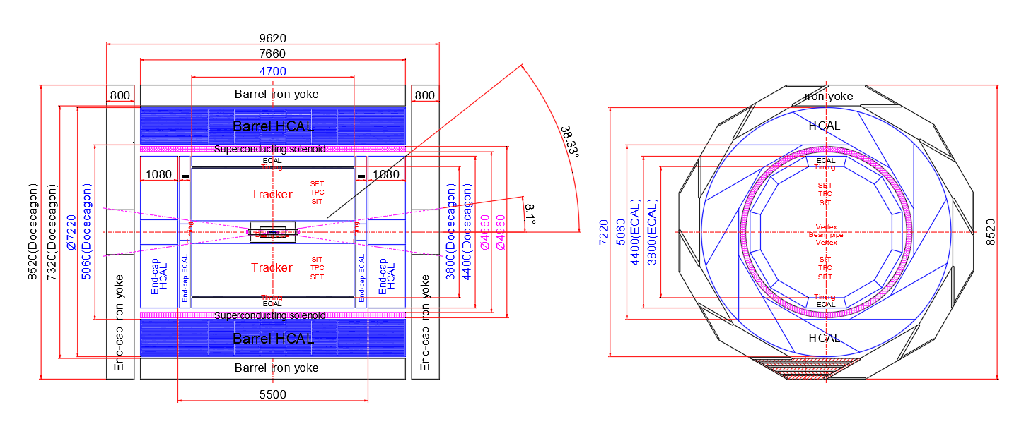
1. Preliminary design of CEPC detector installation scheme
Overview

Slide 4
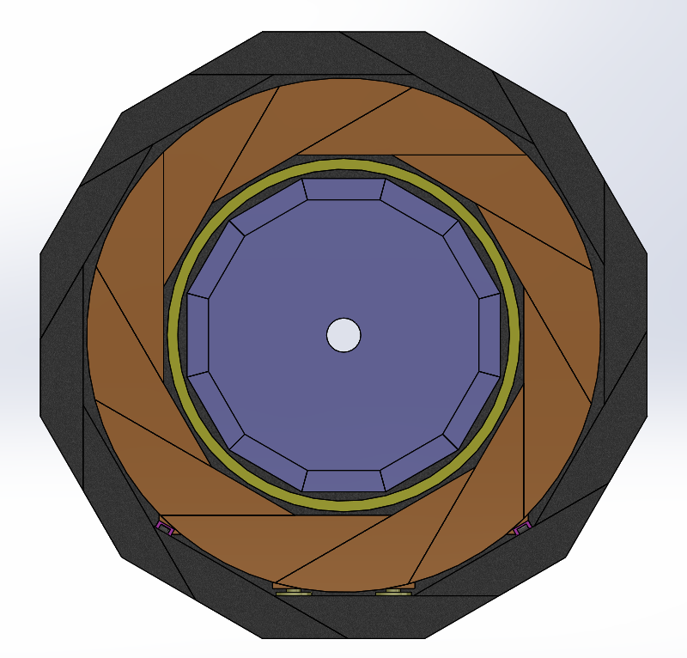
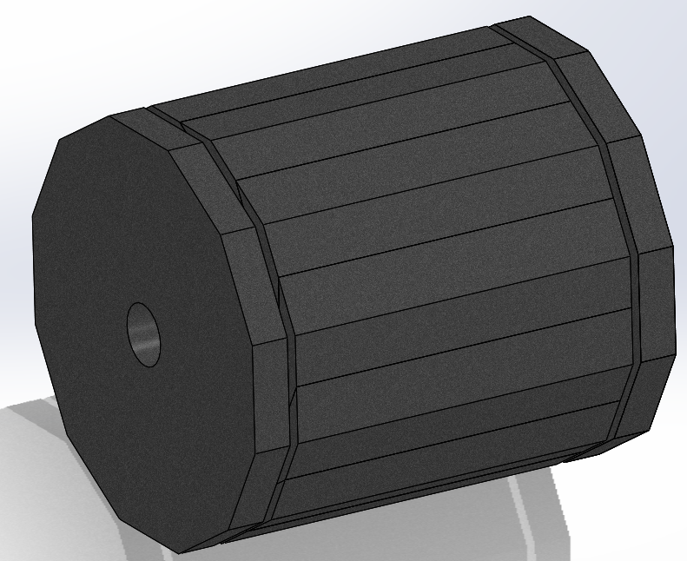
1.1 Weight Distribution
SN | Name | Total weight（ton） | Number | Weight of each（ton） | Boundary Dimension | mounting clearance
1 | Barrel iron yoke | 1200 | 12 | 100 | Φ8520，L:7660mm | /
2 | HCAL | 1200 | 12 | 100 | Φ7220，L:7660mm | 50mm
3 | Superconducting solenoid | 30 | 1 | 30 | Φ4960，L:7660mm | 50mm
3 | ECAL | 120 | 12 | 10 | Φ4400，L:4700mm | 50mm
4 | SET+TPC+SIT | ？ | Entirety | ？ | Φ3800，L:4700mm | /
5 | End-cap iron yoke | 500 | 5 | 100 | Φ8520，L:800mm | 180mm
6 | End-cap ECAL | 100 | 1 | 100 | Φ7220，L:1080mm | 50mm

Slide 5
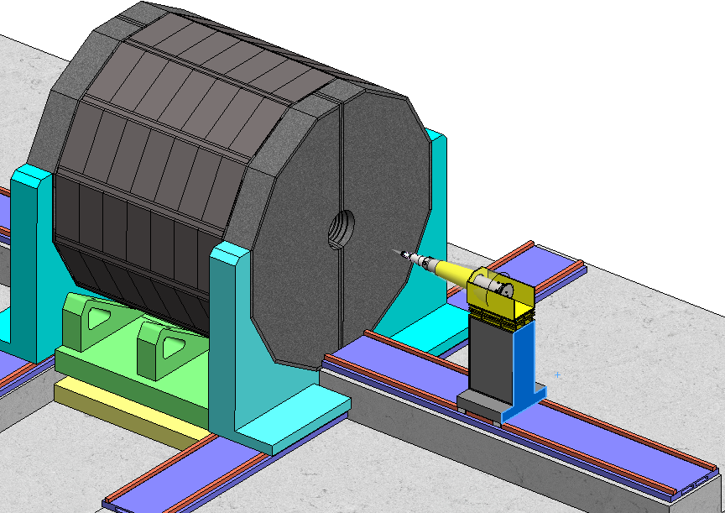
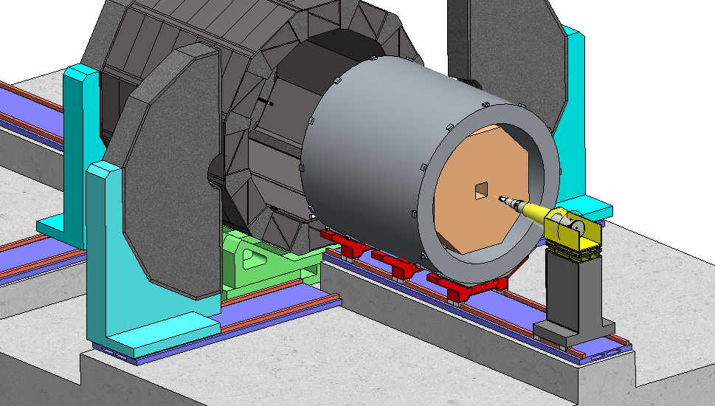
1.2 General Installation Roadmap
Installation at collision point, permanent guide, share the guide.
Reduce temporary installation tools.
Question：The weight of ECAL is about1200 tons, the gap is only 50mm, which guide can be use?
$$F_{push}=mgμ$$
Low friction coefficient, easy installation.

Slide 6
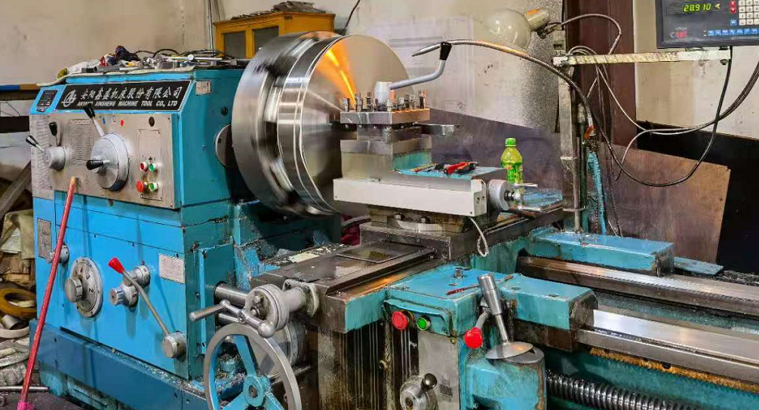
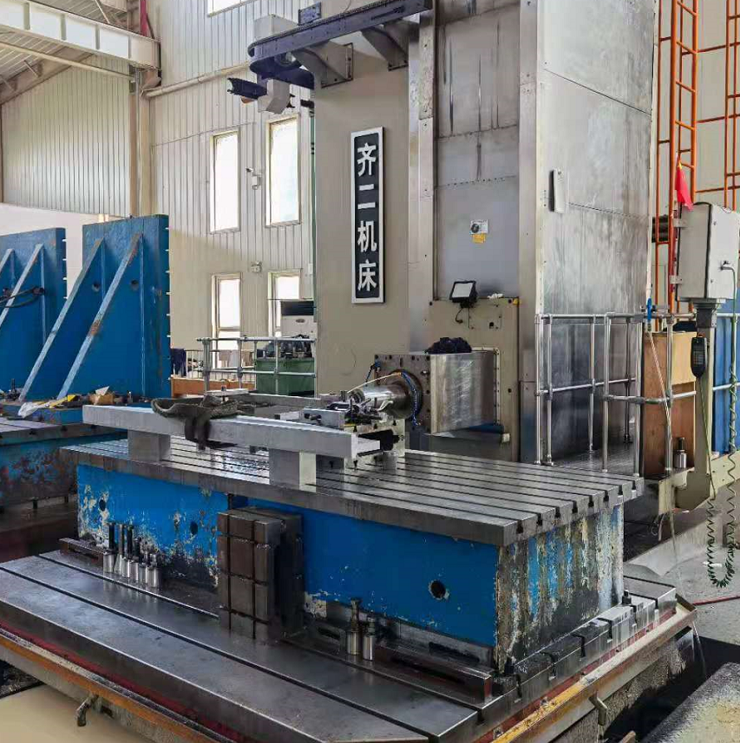
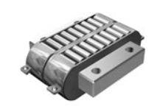
1.3 The Survey of heavy duty guide
1） Rolling and sliding guide rails
 | Friction coefficient | Permissible contact pressure（MPa） | Application area | Push Force for CEPC(KN)
roller guide | 0.01 | Maximum single load : 50ton | CNC | 120
Plastic coated guide（Teflon） | 0.05 | 1~2 | BESIII | 600
Cast iron rail | 0.15 | 1~2 | center lathe | 1800
Guide rail inlaid with metal composite board | 0.1 | 10~50 | Power tool | 1200

Slide 7
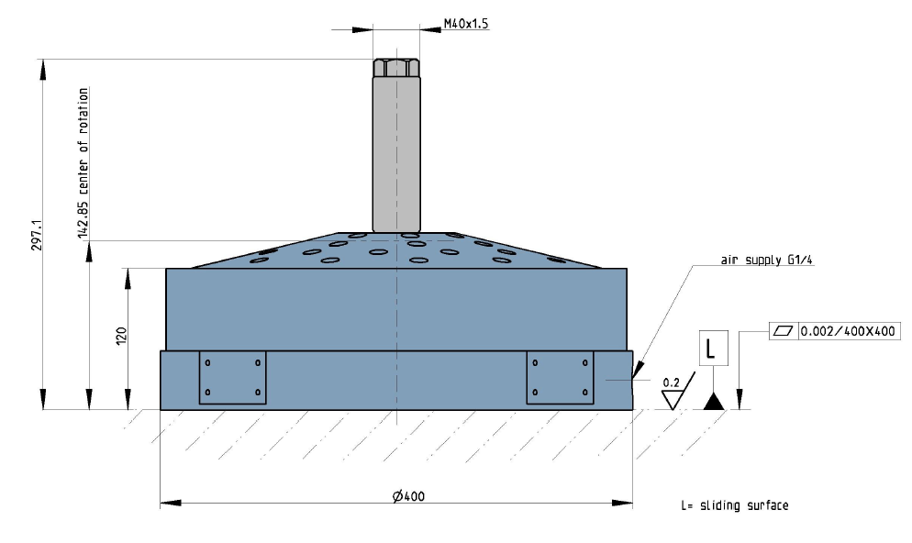
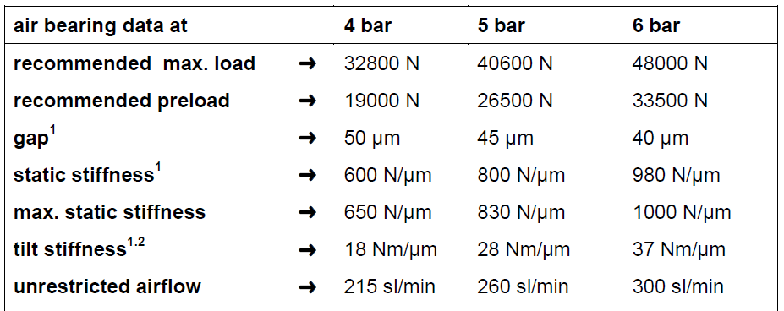
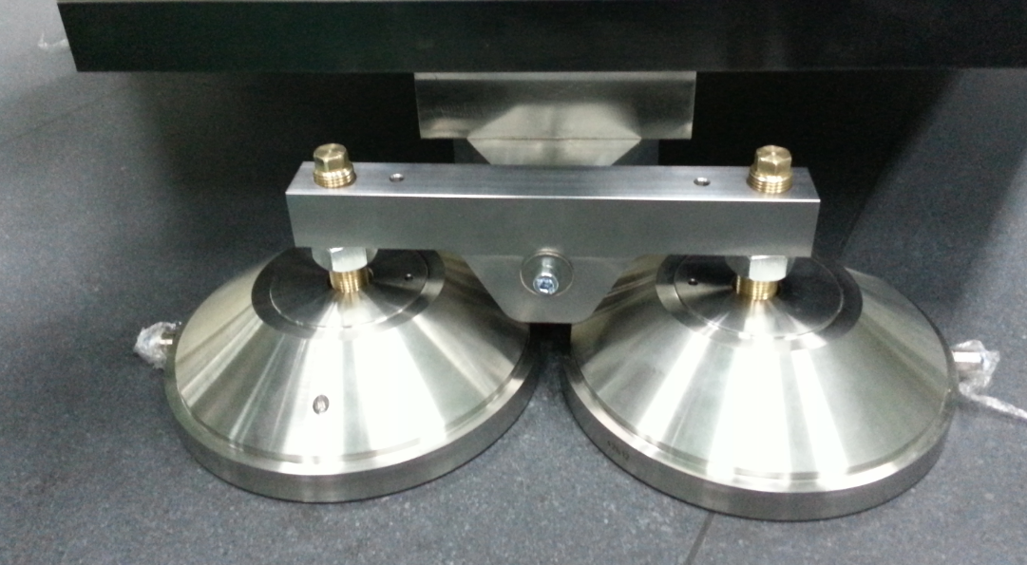
1.3. The Survey of heavy duty guide
2）Air-pad bearing
No contact, no friction.
The maximum load of single air pad is 4.8 tons, air gap is only 50 microns.

Slide 8
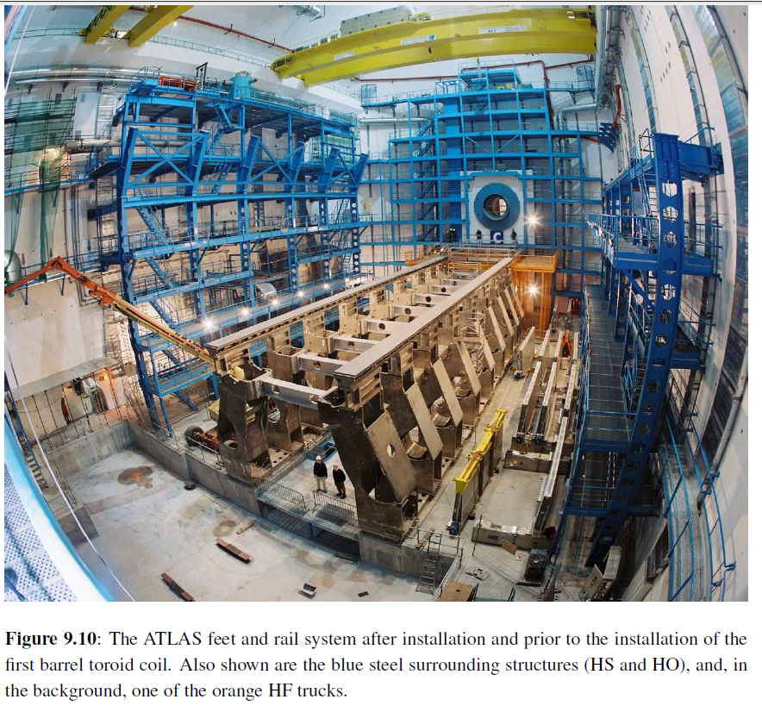
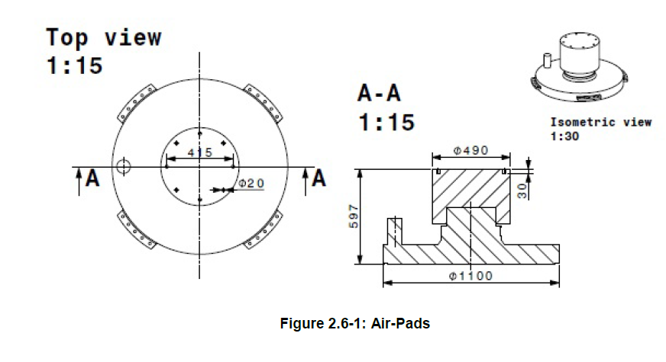
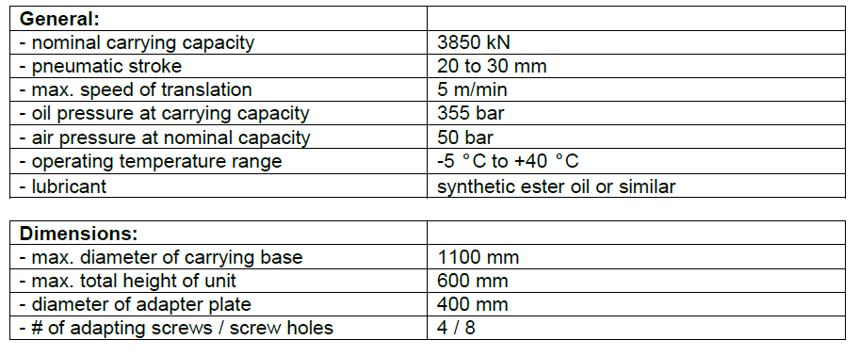
1.3. The Survey of heavy duty guide
3） Air pad of ATLAS/CMS
Max load：250ton/4MPa，385ton/5MPa.
Air gap：1mm.
Friction coefficient：0.01.
Total flatness requirements for guide rail:1mm.
Local flatness requirements for guide rail :0.2mm/m.
两组液压缸推动；
尺寸：1000×320mm;

Slide 9
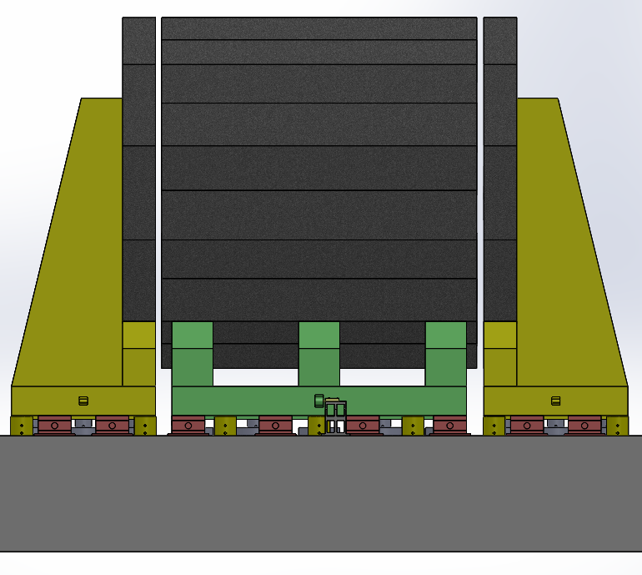
1.4 Preliminary design of installation scheme by air pad support
1）The overall layout
The end yoke is supported separately from the mass.
The main part is supported by 10 sets of air pad, which is used for moving and horizontal fine-tuning. The single air pad capacity is 250 tons.
Use 6 sets of hydraulic cylinders to adjust the height, the capacity of which is 800 tons .
The final support adopts 8 sets of inclined iron support.

Slide 10
1.4 Preliminary design of installation scheme by air pad support
800 ton grade jack, piston diameter 317mm, maximum working pressure 70MPa;
Outer diameter 530mm, stroke 50mm;
2） the support device
Air pad with total load :250ton(40bar);
Diameter:1.1m，air gap:1mm;

Slide 11
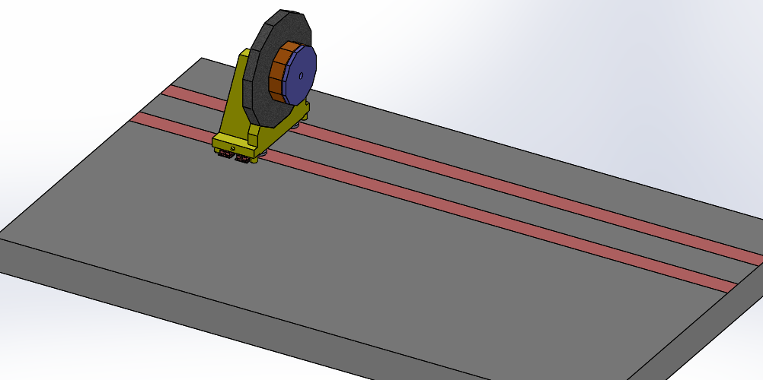
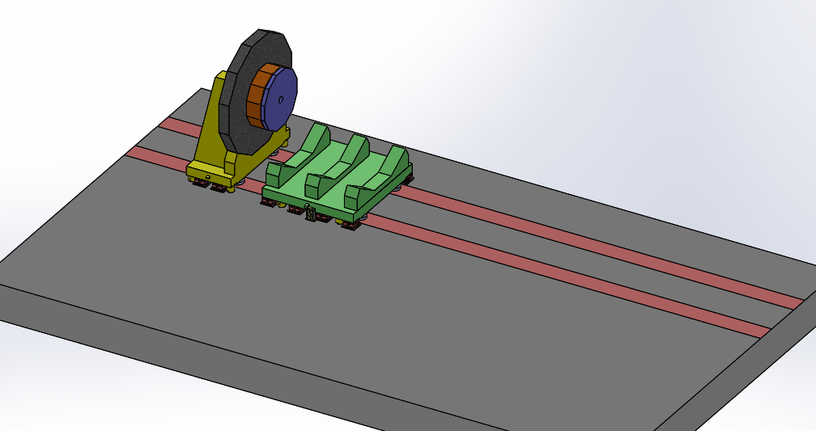
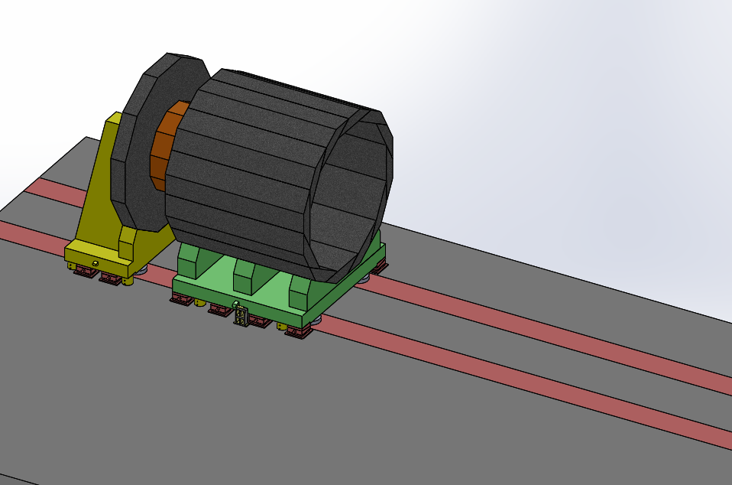
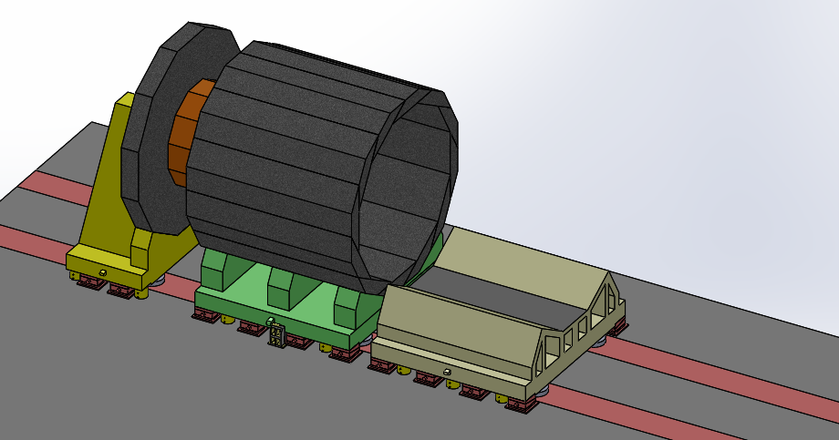
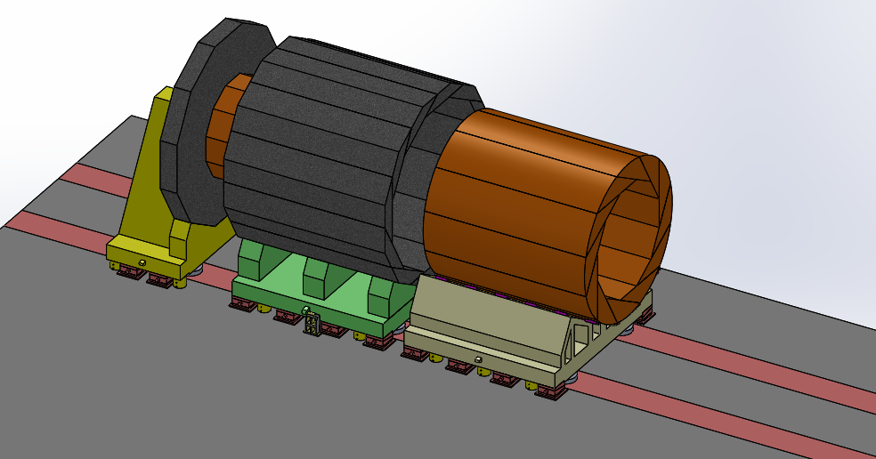
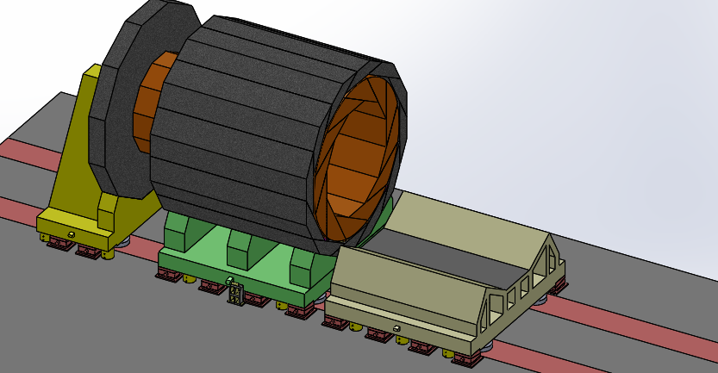
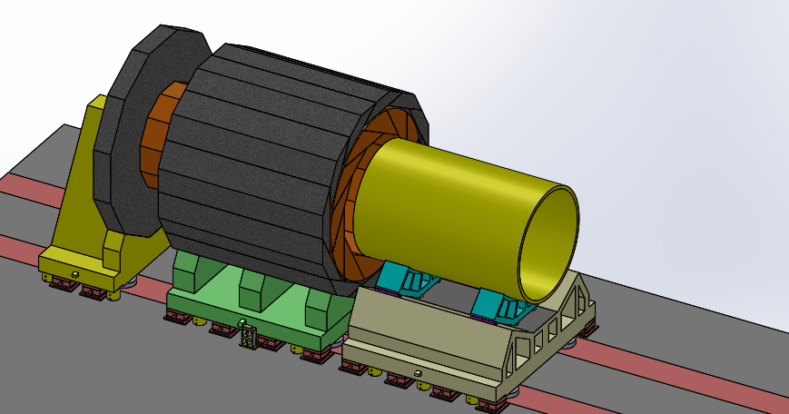
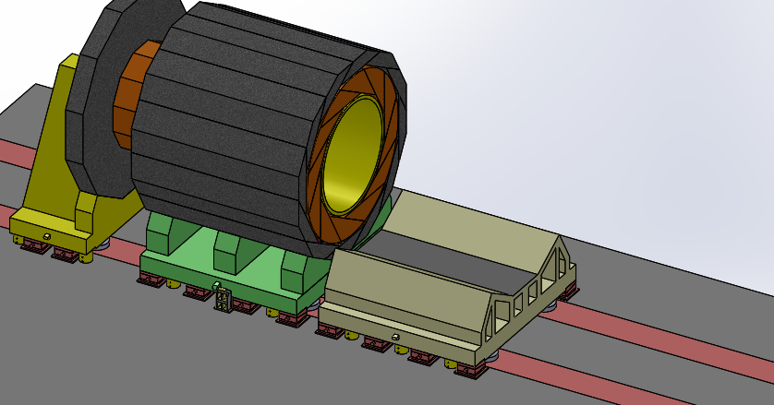
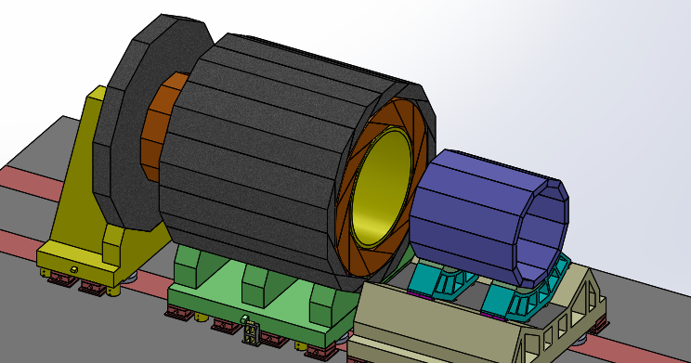
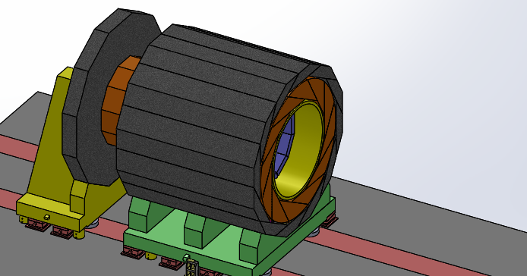
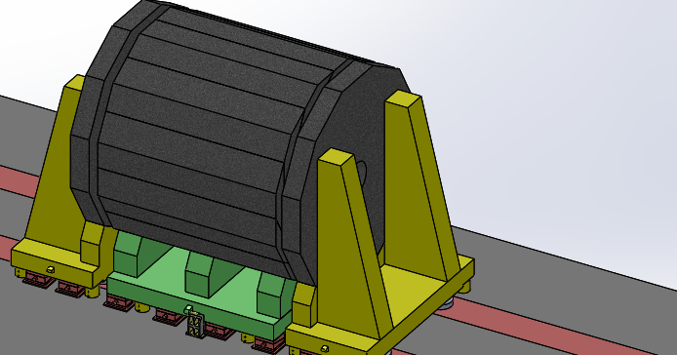
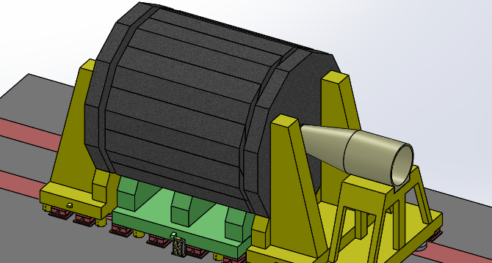
1.4 Preliminary design of installation scheme by air pad support
3） Installation process
4. Temporary mounting base assembly
1. End yoke assembly
2. Yoke iron base assembly
3. Polygonal ion yoke assembly
5. HCAL is hoisted in
6. HCAL is pushed in
7. Superconducting magnet is hoisted in
8. Superconducting magnet is pushed in
9.ECAL is pushed in
10. Removal of temporary base
11. End yoke is push in
12.MDI docking

Slide 12
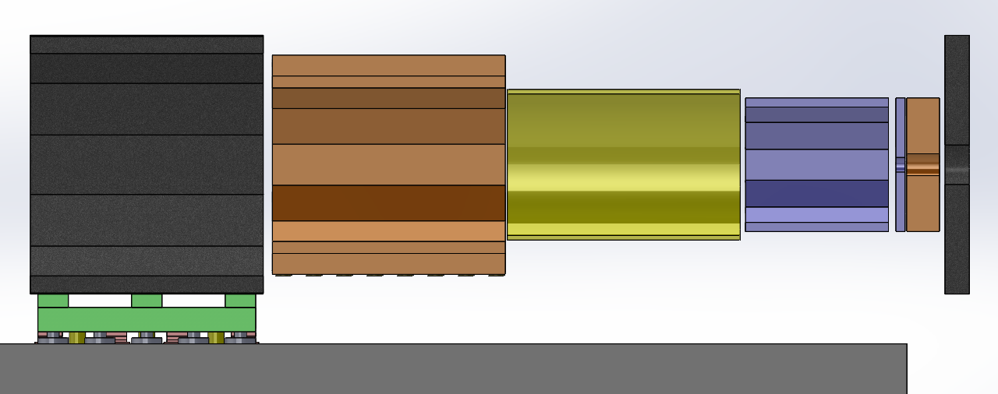
1.4 Preliminary design of installation scheme by air pad support
4） Technical difficulties of sharing guide rail
1. External air pad can be shared, but the air pad in the yoke iron can not be shared 。
2. Each part must be pushed in, and the bottom height of each part is inconsistent, which make temporary tooling must be used。
3. The end yoke height is the lowest and the temporary mounting base must be lifted to push the end yoke next to the barrel yoke。
4. It is very difficult to push the HCAL into iron yoke with the weight of 1200Ton 。
Another idea: the end yoke is flat open, the difficulty is that the end yoke thickness is only 800mm

Slide 13
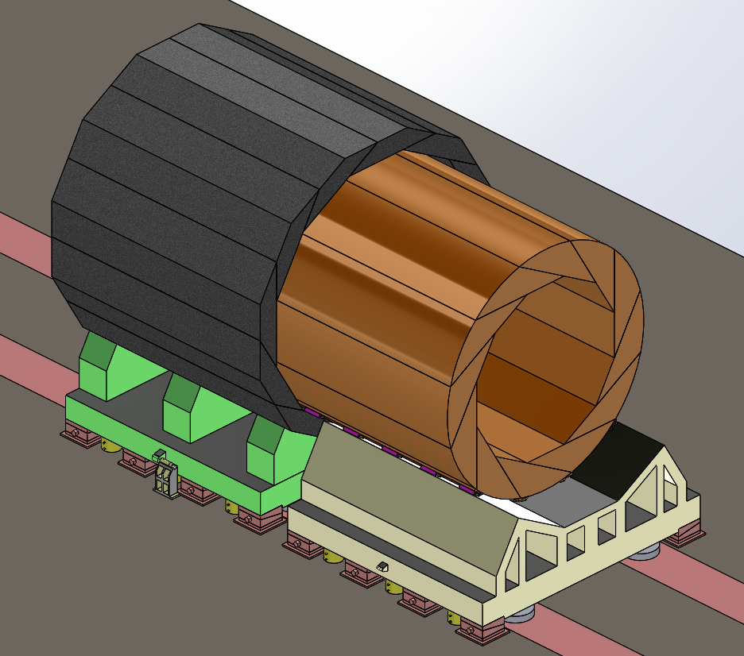
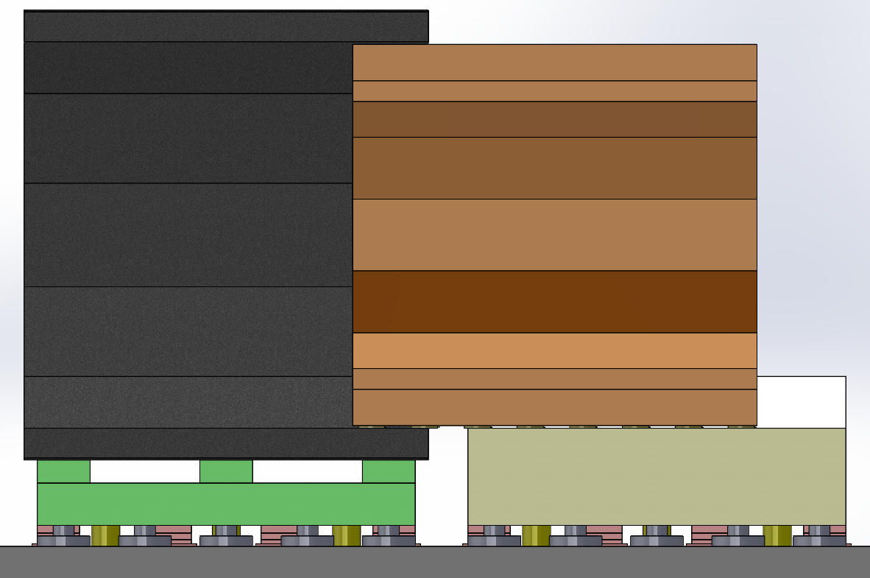
1.4 Preliminary design of installation scheme by air pad support
4） Technical difficulties of sharing guide rail
Difficult：It is very difficult to push the HCAL into iron yoke with the weight of 1200Ton
Another idea: Open cover construction with iron yoke and HCAL.
Another idea: Iron yoke and HCAL form a whole and are divided into several parts.

Slide 14
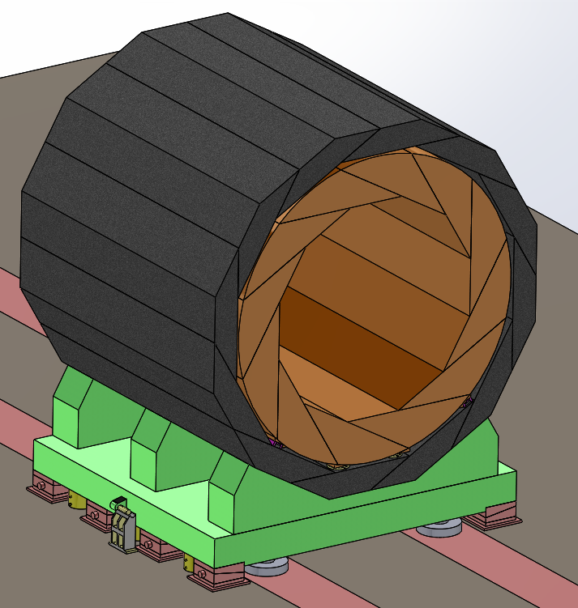
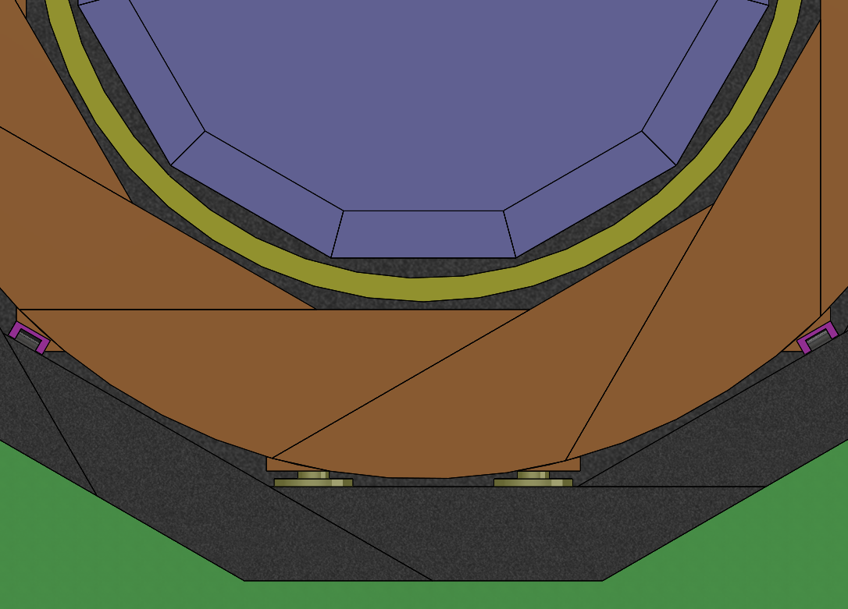
1.4 Preliminary design of installation scheme by air pad support
4） Technical difficulties of sharing guide rail
50mm
Difficult： There is not enough space for support and adjustment mechanism within 50mm clearance.
Another idea: CMS experience

Slide 15
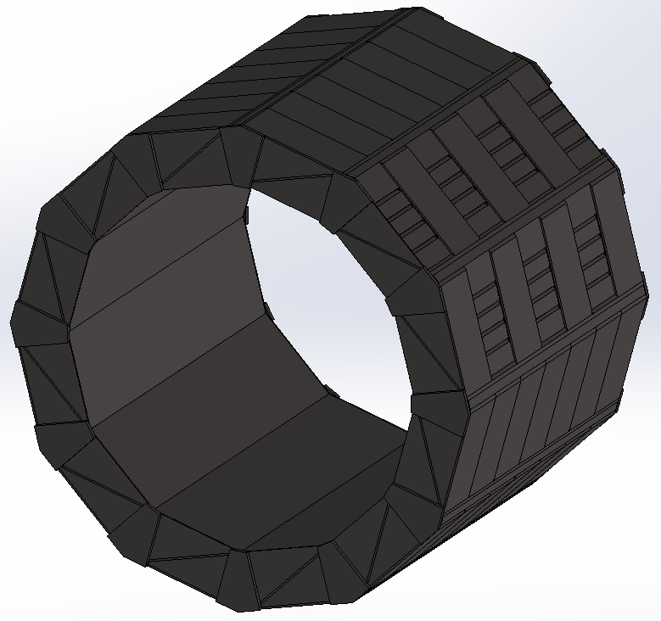
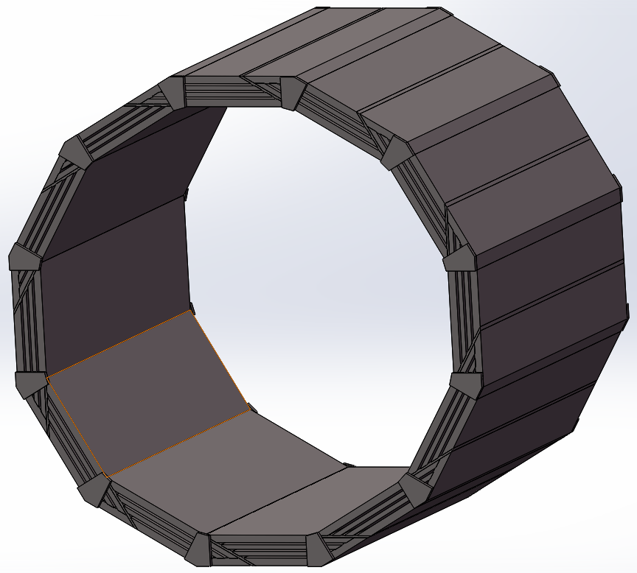
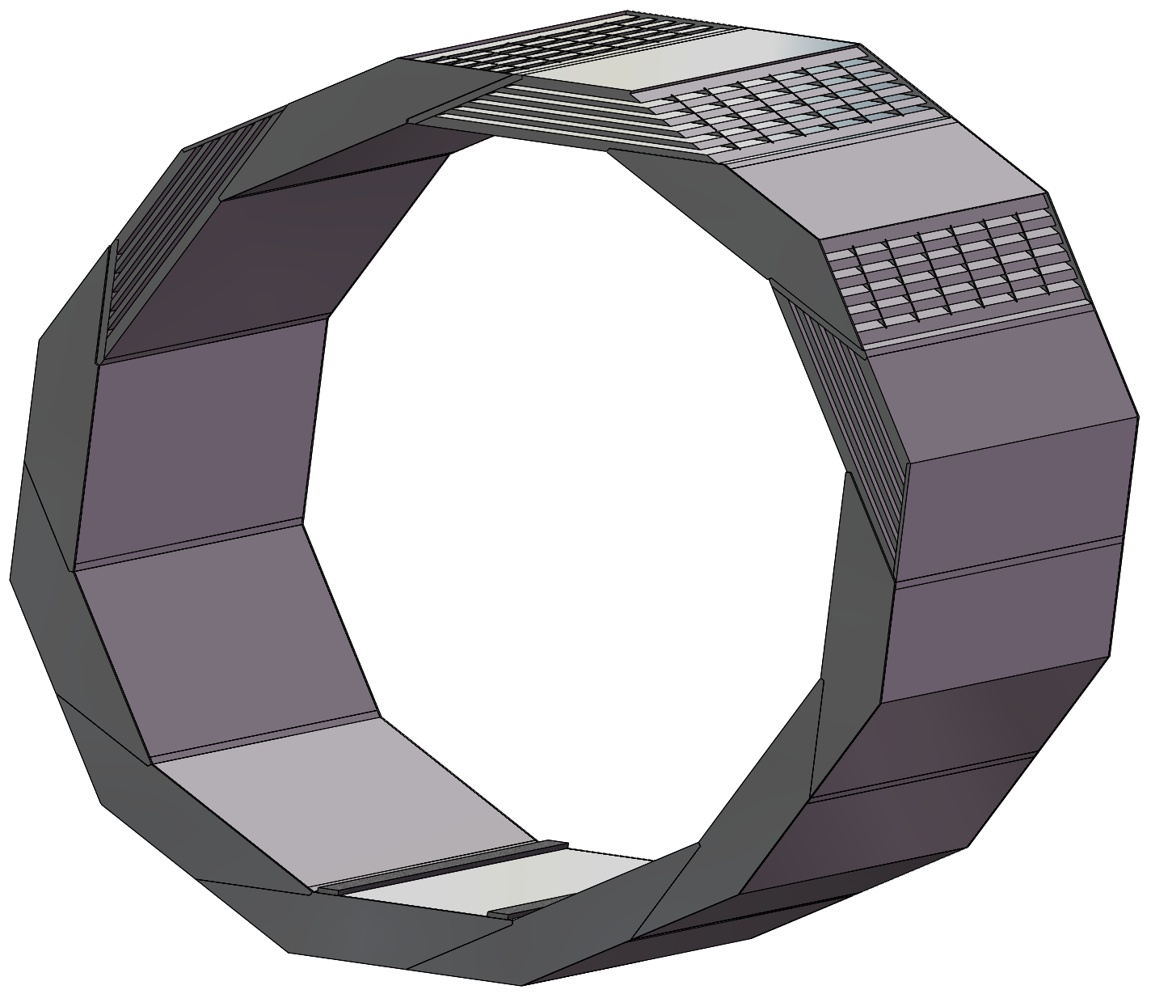
2.Iron yoke design
Jan 16, 2020
Dec 26, 2018
March 23, 2021
Thickness: 1460mm
Muon: 4 layer
Height: 12120mm
Weight: 3180 t
Thickness: 600mm
Muon: 3 layer
Height: 9600mm
Weight: 920 t
Thickness: 600mm
Muon: 5 layers
Height: 8520mm
Weight: 760 t
Weight reduction
Save material costs
Other costs

Slide 16
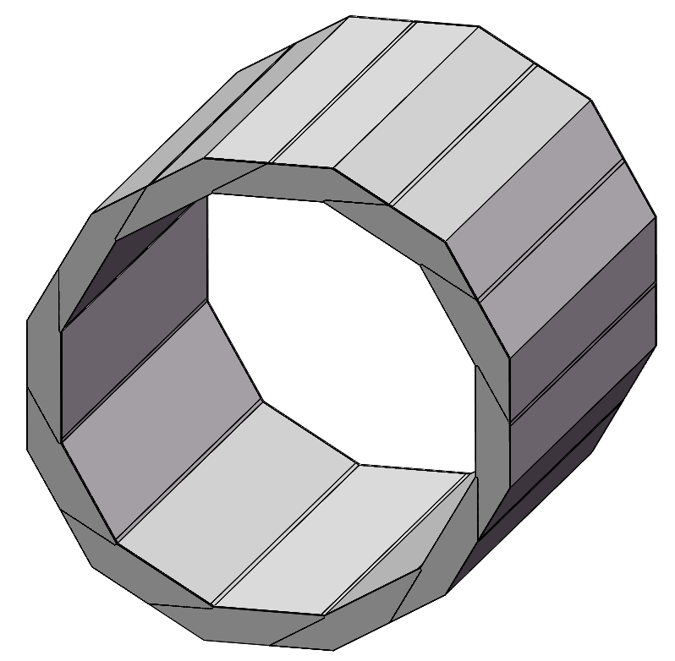
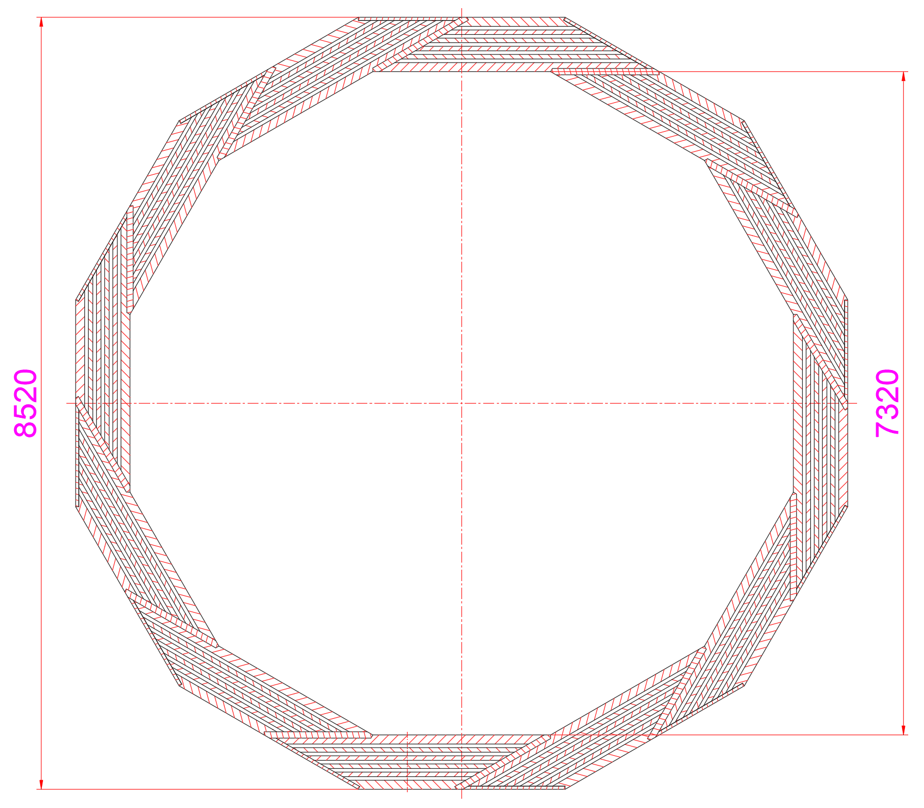
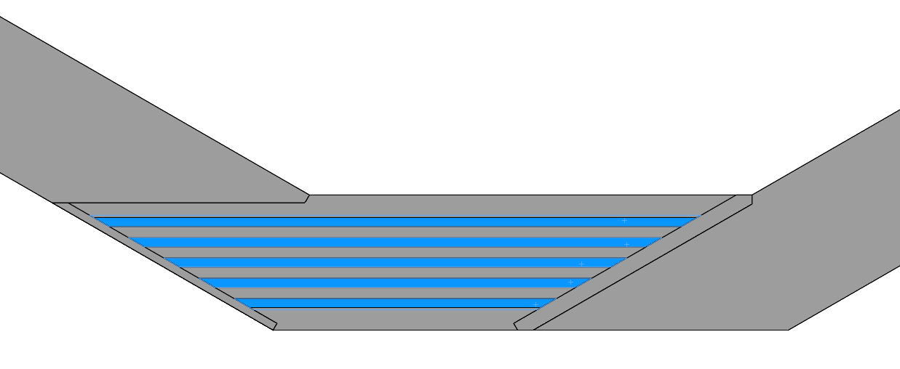
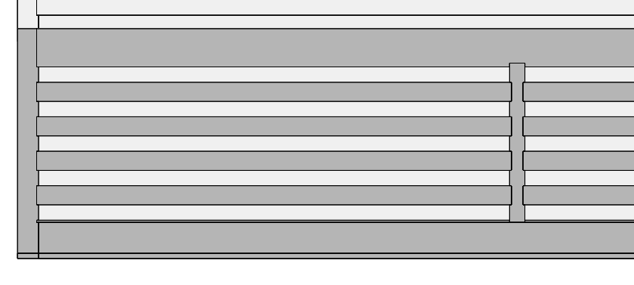
2.Iron yoke design
Dimension
Length: 8960mm
Outer height: 8520mm
Inner height: 7320mm
8960
Spiral structure
About 760 t
In the direction of length,
six trapezoidal vertical plates
were added
Each unit is made up of six iron plates,
which can place five layers of muon detector

Slide 17
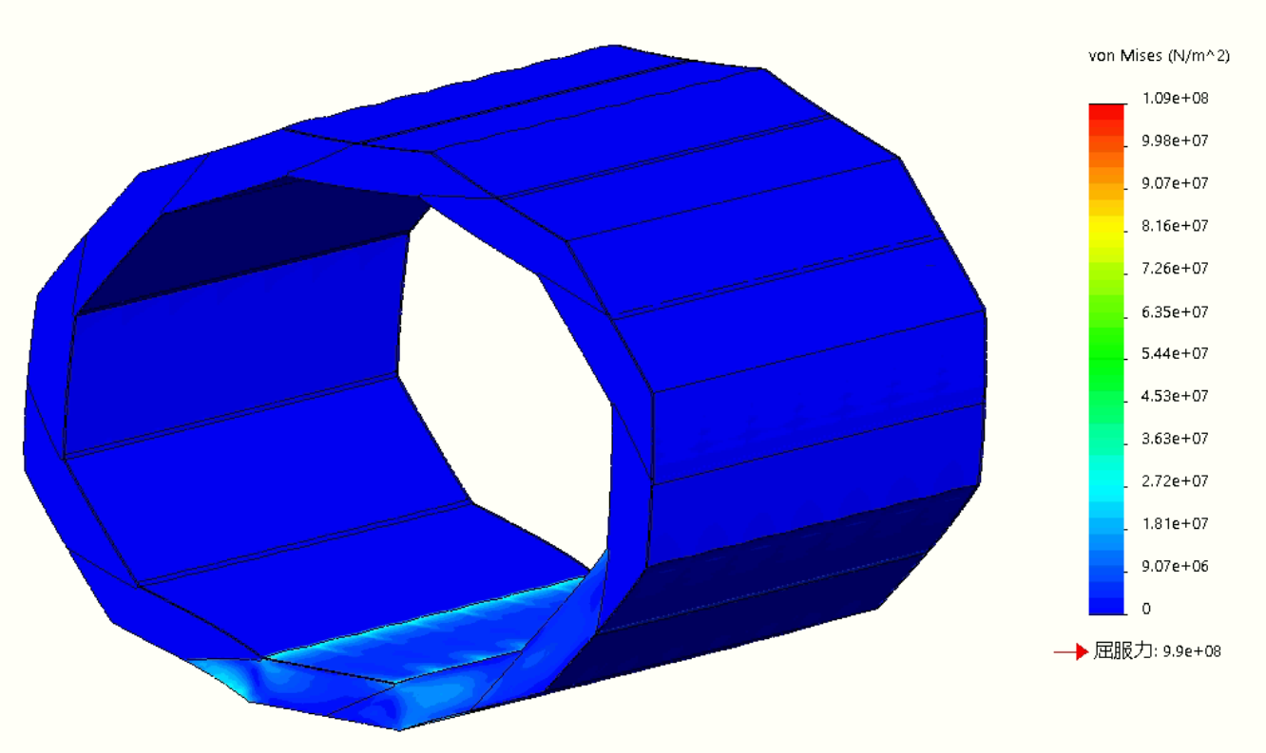
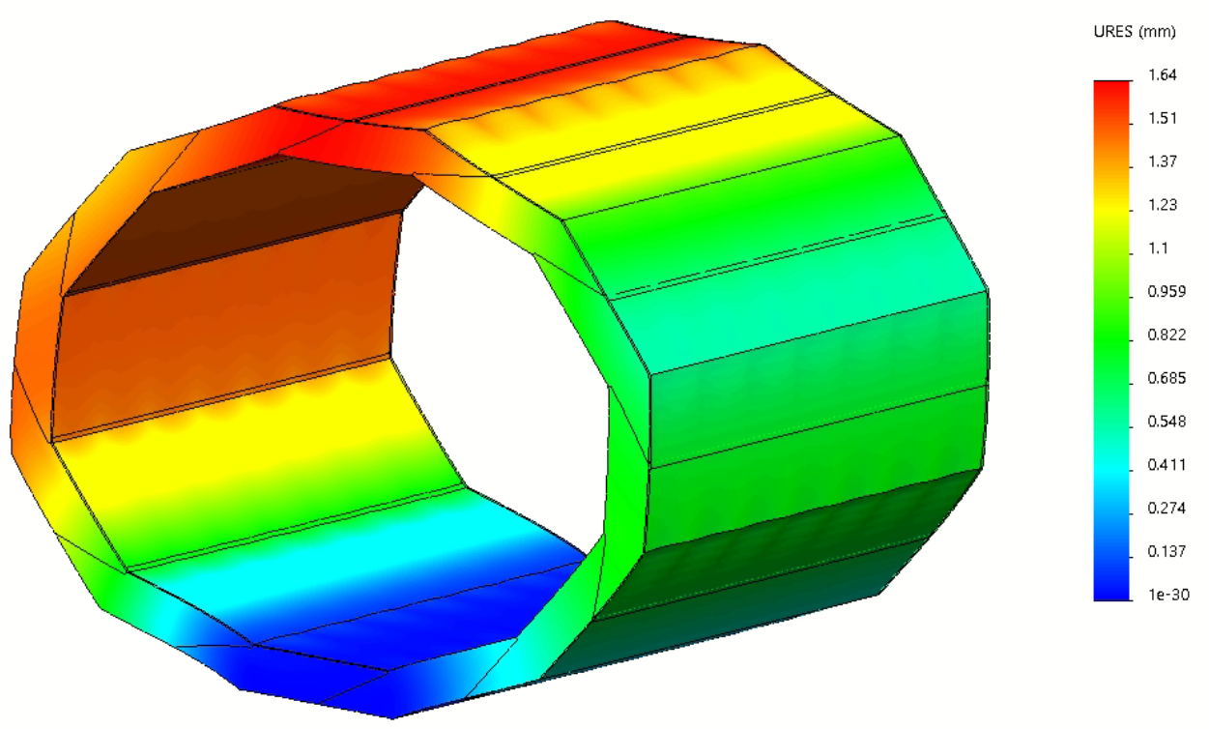
2.Iron yoke design
Calculation conditions:
Material --- T10
Load --- Self weight of yoke （760 t）
Conclusion: Safety
Stress cloud
Deformation cloud
Maximum stress: 109MPa
Maximum deformation: 1.65mm

Slide 18
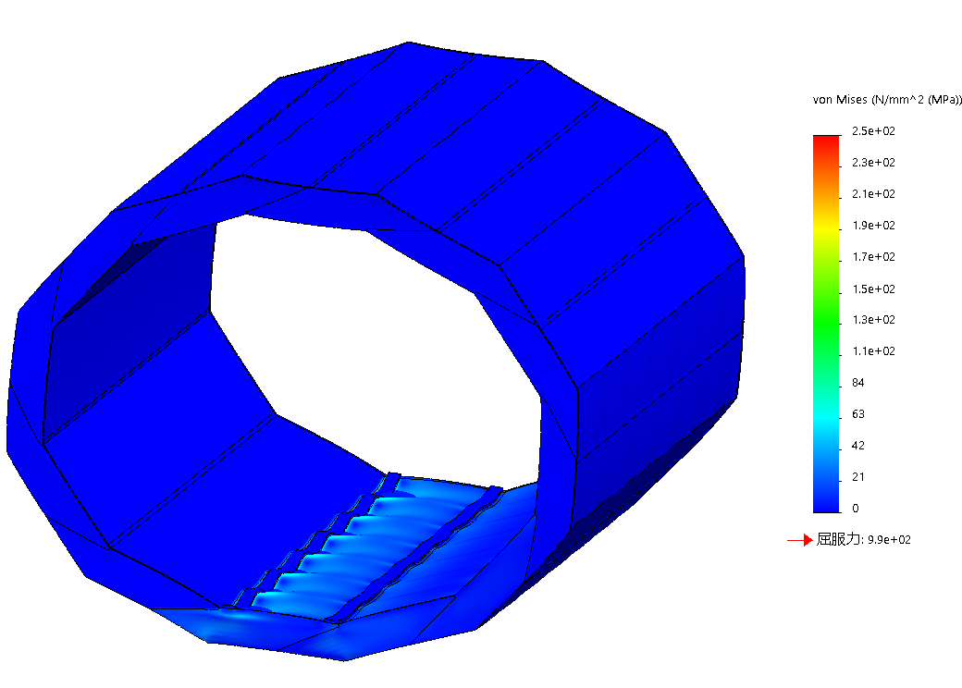
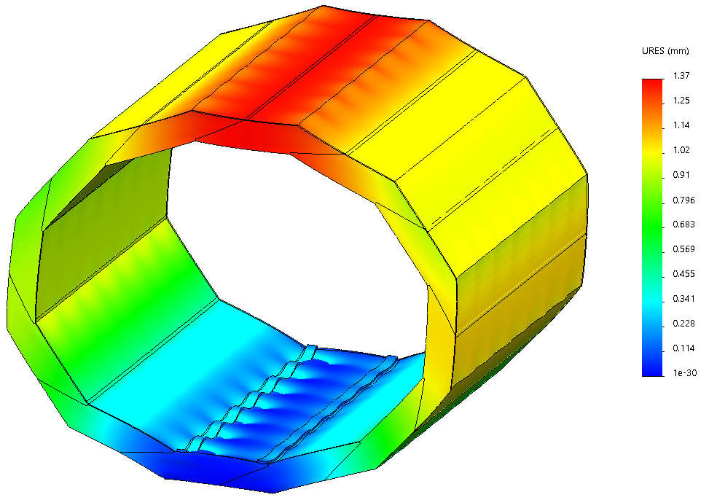
2.Iron yoke design
Deformation and stress of yoke after installing all sub-detectors
Conclusion: Safety
Calculation conditions:
Material --- T10
Load --- Self weight of yoke + weight of the all sub-detectors
self weight of yoke : 760 t
weight of the all sub-detectors : 1600 t (estimate)
Stress cloud
Deformation cloud
1600 tons uniformly loaded on
the upper surface of two guide rails
（Assuming: each rail is 200 mm wide）
Schematic diagram
of detector reloading
Maximum stress: 250MPa
Maximum deformation: 1.37mm

Slide 19
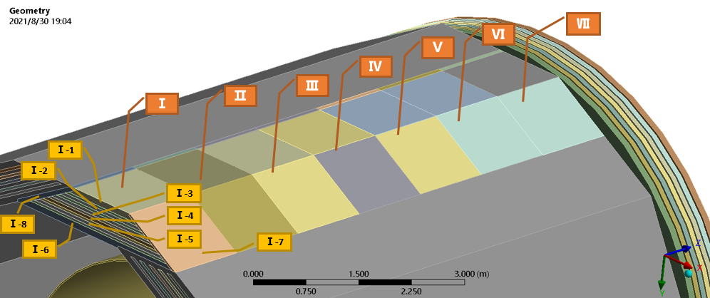
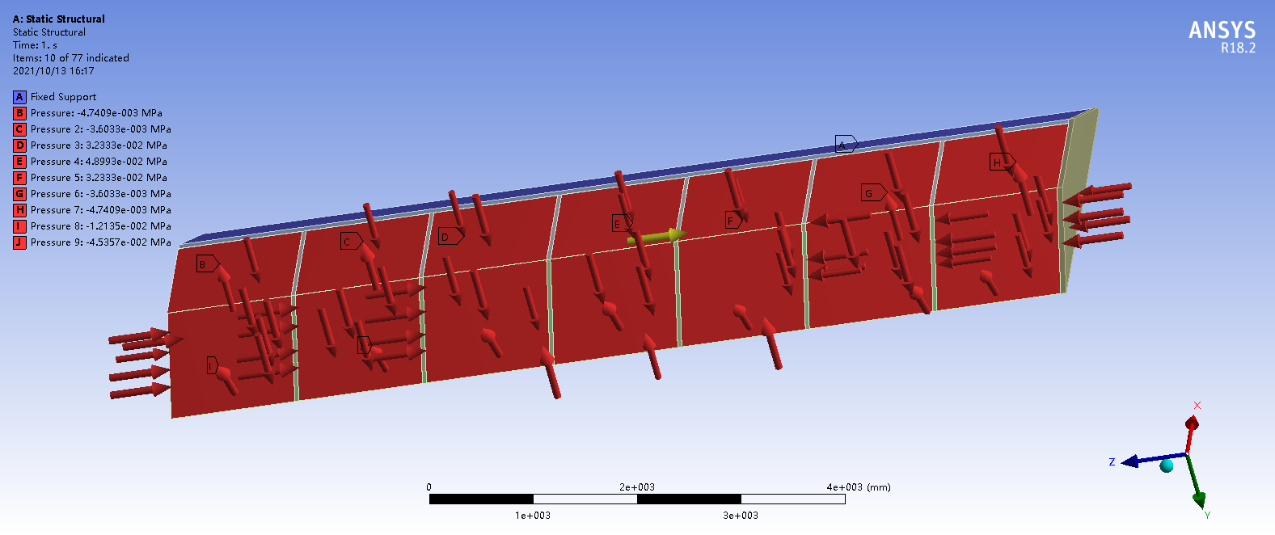
2.1 Structural analysis of iron yoke under magnetic force
Loading of magnetic force
A unit of the yoke is combined to analyze the magnetic force structure；The magnetic field intensity is 3T；Gravitational field, calculating the maximum force in the vertical direction
A unit is divided into 7 pieces (divided according to the ribs)
Each piece has a total of 8 force surfaces, and the magnetic field forces are loaded separately. The magnetic field forces include radial and axial.

Slide 20
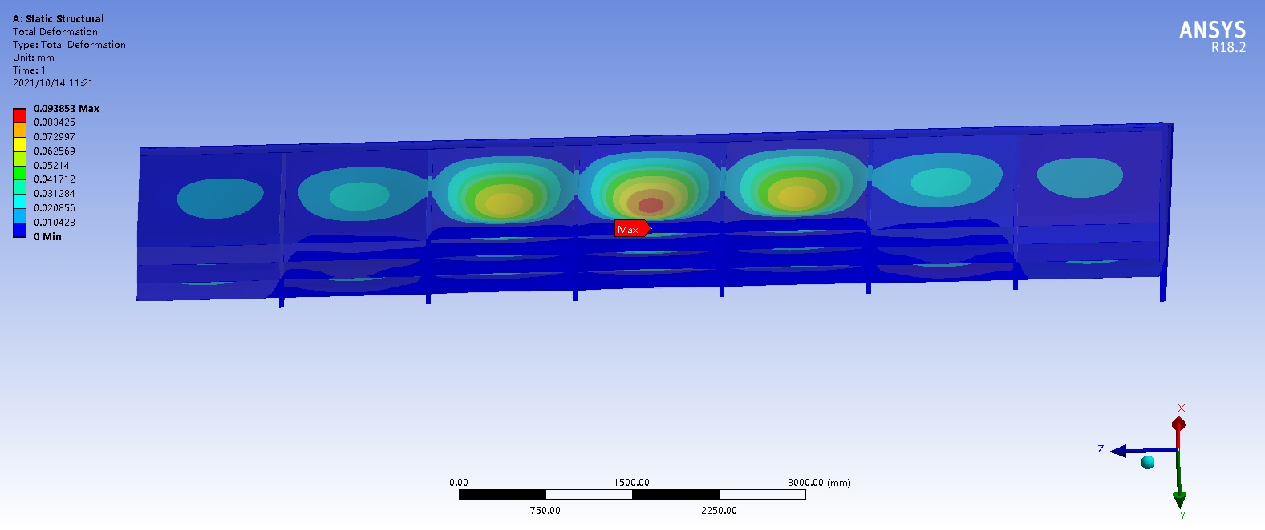
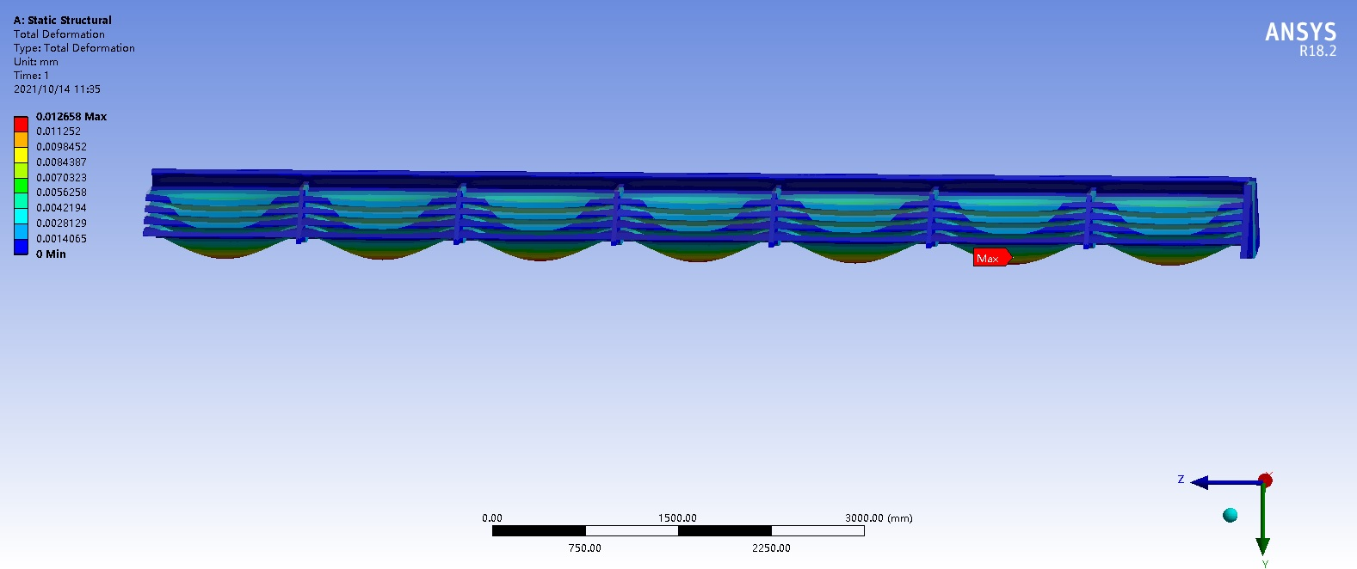
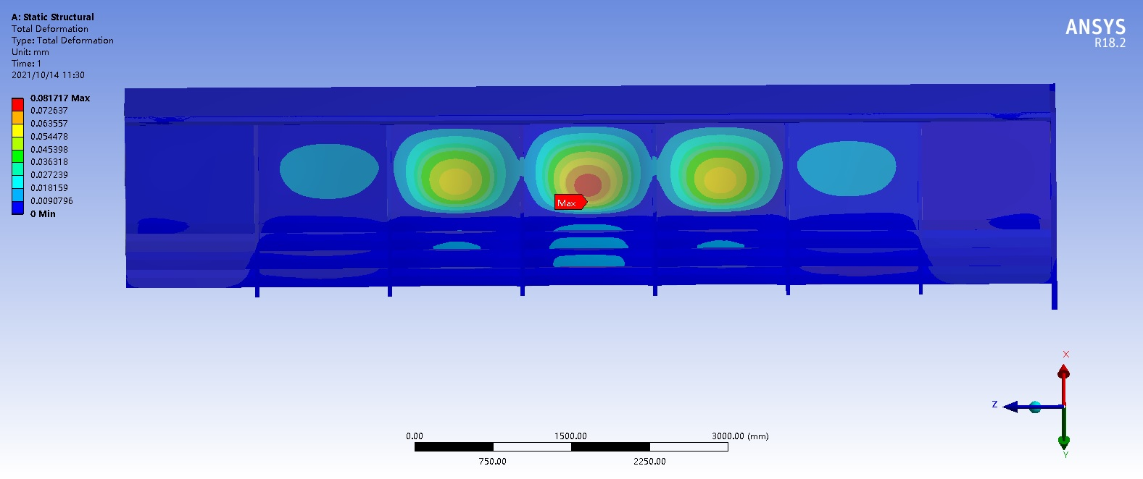
2.1Structural analysis of iron yoke under magnetic force
Loading conditions | Max deformation mm | Max stress Mpa
gravity and magnetic forces | 0.094 | 11
magnetic forces | 0.082 | 8.9
gravity | 0.012 | 2.8
The deformation of magnetic field force is small and needs further verification and calculation

Slide 21
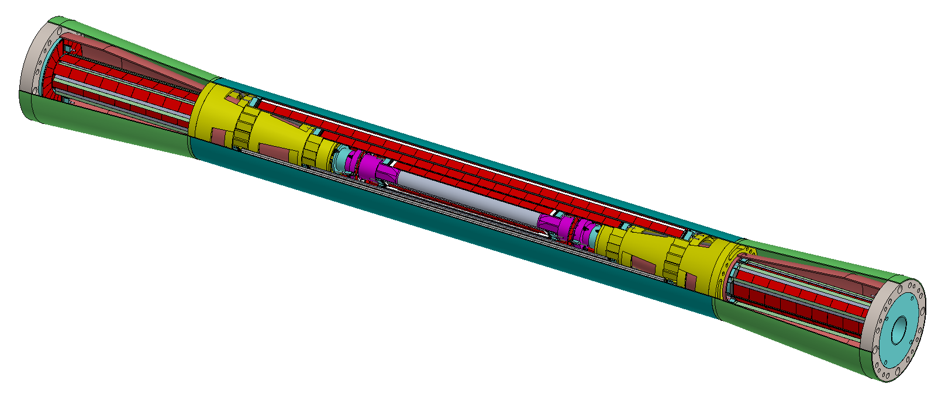
3. Heat transfer analysis of beampipe
Beam pipe:
High-order mode heat
Uniformly distributed
Total heat load：
1692W@Z;
5097W@HZ
Heat transfer of Be pipe
Vertex detector：
chips：50mW/cm²
Electronic equipment: 412.1mW/cm²
Analysis of flow characteristics in the detector cavity

Slide 22
3.1 Basic structure of beampipe Basic structure of beampipe
Oil inlet
Oil outlet
Water inlet
Water outlet
Extending AL pipe
Be pipe
Coolant: water
Inlet temperature: 23℃
Flow rate: 3.4L/min
Coolant: paraffin /water
Inlet temperature: 23℃
Flow rate: 1.3~2m/s
Critical dimension:
Be Length:240mm
Outer Be pipe: 0.25mm
Inner Be pipe: 0.35mm
Cooling channel: 0.5mm
Viscous model: Laminar
Heat transfer requirement：
Meet the pressure requirements.
The detector requires that the temperature difference between the two ends of the outer beryllium tube is less than 5 degrees.
The smaller the mass, the better.

Slide 23
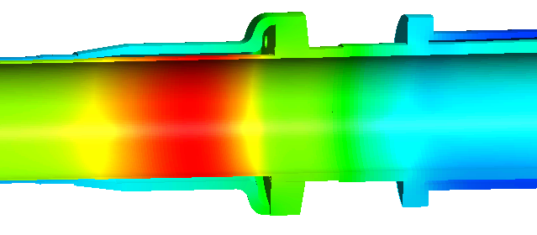
3.2 Heat transfer of Be pipe and extending AL pipe (Φ28mm)
(1) Results of paraffin cooling in Z mode(1692W)
Paraffin flow parameters:
Flow rate: 1.7L/min
Inlet velocity: 1m/s
Velocity in ring pipe: 0.6m/s
Inlet temperature: 20℃
Max.t of extending AL: 31.8℃
Δt of detector installation: 4.4℃
Δp of paraffin: 23.3kPa
Δp of water: 14.8kPa
Max.t of AL: 42.4℃
Cooling well!
Max.t of outer Be: 24.3℃
Max.t of detector installation: 26.5℃
Max.t of transition AL: 32.7℃

Slide 24
3.2 Heat transfer of Be pipe and extending AL pipe (Φ28mm)
(2) Results of paraffin/water cooling for HZ mode(5097W)
Paraffin cooling for Be pipe:
Flow rate: 3.4L/min
Inlet velocity: 2m/s
Velocity in ring pipe: 1.2m/s
Δp=49.1kPa (Δp in BEPCII: ≤10kPa )
Max.t of outer Be: 24.6℃
Δt of detector installation: 5.3℃
High flow rate is required to meet the cooling requirements
High pressure drop
Will the high flow rate cause vibration exceeding the requirements?
Temperature distribution
Water cooling for Be pipe:
Flow rate: 1.7L/min
Inlet velocity: 1m/s
Velocity in ring pipe: 0.6m/s
Δp=13.4kPa
Max.t of outer Be: 24.5℃
Safety!
The corrosion of Beryllium by water？
Δt of detector installation: 4.4℃
Temperature distribution

Slide 25
3.3 Analysis of flow characteristics in the whole detector cavity
（1）calculation model
(1) Purpose: Determine the cooling flow rate of the vertex detector
(2) Difficulty: Complex structure
Limited by the configuration of the computer,
high quality grid can not be drawn.
Model simplification
outlet
inlet
Detector cavity
chips
PCB
Simplify
outlet
Carbon fiber
Only carbon fiber
inlet
Only doing flow calculation
Extracting fluid domain
Calculation model：K-Epsilon
Simplify
u=15m/s
Hollow carbon fiber
Solid carbon fiber
Flow calculation model

Slide 26
3.3 Analysis of flow characteristics in the whole detector cavity
（2）Velocity distribution
The average velocity in detector cavity is very low.
0.40 m/s
0.98 m/s
0.41 m/s
0 m/s
Velocity distribution
Velocity distribution
(cross section)
inlet u=15m/s
Streamline

Slide 27
3.4 Heat transfer analysis of Vertex Detector
(1) Calculation model and condition
Calculation model
Section profile
①
②
inlet
Air average velocity: 0.4m/s
outlet
⑦
t_{in}=20℃
u=2.17m/s
Silicon strip in the first layer
Outer surface: 10 chips
Material property
Inner surface: 9 chips
Number | Material | thickness | density | Specific heat | Conductivity
 |  | μm | kg/m3 | J/(kg.K) | W/(m.K)
① | Si | 50 | 2419 | 713 | 148
② | Si | 50 | 2419 | 713 | 148
③ | PCB | 70 | 1417 | 1260 | 0.2
④ | glue | 25 | 1190 | 710 | 0.1
⑤ | graphene | 100 | 1810 | 710 | Kx=1000; Ky=1000; Kz=1
⑥ | glue | 25 | 1190 | 710 | 0.1
⑦ | carbon fiber | 100 | 1810 | 710 | 200
50mW/cm2
412.1mW/cm2
t=25℃
t=20℃
Problems left over from last year: PCB is insulated.
It means:
λ_{pcb}=0 W/(m.K), Ⅹ λ_{pcb}≈0.2 W/(m.K), √

Slide 28
3.4 Heat transfer analysis of Vertex Detector
(2) Results
New calculation
Surface temperature distribution
The max. temperature of chip: 164.4℃.
The temperature difference in the chip is very large.

Slide 29
3.5 Stress analysis of beampipe structure
(1)Case1： Cantilever installation ignoring detector load
Deformation distribution
Calculation model and condition
1. Fixed support
2. Standard earth gravity
3. Regardless of detector load
The maximum deformation:0.14mm
3. Ignore detector load
Stress distribution
The maximum stress: 3MPa

Slide 30
3.5 Stress analysis of beampipe structure
(2)Case2： Working state, fixed at both ends
Calculation model and condition
4. Displacement:
Axial: free
Radial: fixed
Deformation distribution
1. Fixed support
2. Standard earth gravity
The maximum deformation:0.002mm
3. Adding detector load
Stress distribution
The maximum stress: 0.3MPa

Slide 31
3.5 Stress analysis of beampipe structure
(3)Case3： Installation, adding 0.2MPa axial pressure
Calculation model and condition
4. Displacement:
Axial: free
Radial: fixed
Deformation distribution
1. Fixed support
2. Standard earth gravity
3. Adding detector load
5. pressure: 0.2MPa
The maximum deformation:0.015mm
Stress distribution
The maximum stress: 13.9MPa

Slide 32
3.6 Stress analysis of beampipe structure
(5) Summary of stress calculation
Stress analysis of the latest beam tube structure
Case | constraint | Deformation/mm | Stress/MPa
1 | Ignore detector load; Fixed at one end | 0.14 | 3
2 | Add detector load; One end is fixed; The other end is radial constrained | 0.002 | 0.3
3 | Add detector load ; One end is fixed; The other end is radial constrained and axial pressured 0.2MPa | 0.015 | 13.9
With carbon fiber tube, the overall structure is stable and safe.

Slide 33
4.Summary
Air pad support installation scheme can be referred to .
Air pad support can achieve low friction coefficient, small driving force of detector movement .
At present, the air pad support scheme has not realized the idea of sharing guide rail, and no reduction in installation tooling.
Iron yoke design: The results of magnetic field force analysis show that the deformation caused by magnetic field force can meet the requirements of use.
The deformation of magnetic field force is small and needs further verification and calculation

Slide 34
4. Summary
On Heat transfer analysis of beampipe
(1)Be pipe
Z mode: Safety!
HZ mode: Paraffin cooling requires high flow rate to meet the requirements, but it is unclear whether the flow rate causes vibration exceeding the requirements. Therefore, water cooling may be required, but the corrosion of Beryllium by water needs to be studied.
(Coolant velocity VS Vibration? Corrosion of Beryllium by water?)
(2)Vertex detector
Air cooling with remote heat conduction can not reduce the chip temperature to the engineering requirements.
(3) Beampipe structure stress
With carbon fiber tube, the overall structure is stable and safe.

Slide 35
Thank you for your attention

