Slide 1
CEPC Injection/Extraction system including kicker technologies
The 2021 international workshop on the CEPC，Nov. 8-12, 2021 on-line
Jinhui Chen, Lihua Huo , Yuwen Wu, Hua Shi , Guanjian Wu, Zilin Chen, Guanwen Wang, Lei Wang, X.H. Cui, D. Wang, Yiwei Wang
Injection group
2021-11-9

Slide 2
Outline
1
Overview of CEPC Inj./Ext. systems
2
Ferrite core kicker magnet systems
3
Kicker Ceramic vacuum chamber with coating
4
Summary

Slide 3
Overview of the CEPC injection and extraction systems

Slide 4
CEPC injection and extraction systems
In CEPC accelerator complex, there are 9 injection and extraction sub-systems, including:
DR injection and Extraction system(e+)
Booster LE injection system (e+,e-)
Booster Extraction system1 (e+,e-)
Collider off-axis injection system (e+,e-)
Booster Extraction system2 (e+,e-)
Booster HE injection system (e+,e-)
Collider swap out injection system (e+,e-)
Collider swap out extraction system (e+,e-)
Collider beam dump system(e+,e-)
Off-axis injection
(in W and Z mode)
On-axis injection
(only in Higgs mode)
③
④
⑤
⑦
①
②
Linac
Booster
⑥
⑧
Collider
⑨
dump
1.1GeV
10~120GeV
120GeV
DR

Slide 5
Inj./ext. hardware type selection strategy
Septa:
Lambertson magnet is the first choice for CEPC because it is more reliable than other types of septa with typical septum wall width from 2mm to 10mm.
Kicker:
Which type of kicker to been chosen is determined by the injection scheme, the waveform of pulse and required kick strength. The waveform of kicker pulse is determined by injection scheme, filling pattern and revolution period.
 | Sub-system | Kicker Type | Kicker waveform | Septa Type | Thickness of septum
1 | Damping ring inj./ext. | Slotted-pipe kicker | Half-sine/250ns | H. LMS | ф22/3.5mm
2 | Booster LE inj. | Strip-line kicker | Half-sine/50ns | H. LMS | ф55/5.5mm
3 | Booster ext. for CR off-axis inj. | Delay-line dipole kicker | Trapezoid /440-2420ns | V. LMS | Ф55/6mm
4 | Collider off-axis inj. | Delay-line NLK kicker | Trapezoid /440-2420ns | V. LMS | Ф75x56/2mm
5 | Booster ext. for CR on-axis inj. | Lumped parameter dipole kicker | Half-sine/1360ns | V. LMS | Ф55/6mm
6 | Booster HE inj. | NLK or Pulsed sextupole | Half-sine/0.333ms | V. LMS | Ф55/6mm
7 | Collider swap out inj. | Lumped parameter dipole kicker | Half-sine/1360ns | V. LMS | Ф75x56/6mm
8 | Collider swap out ext. | Lumped parameter dipole kicker | Half-sine/1360ns | V. LMS | Ф75x56/6mm
9 | Collider beam dump | Delay-line dipole kicker | Trapezoid /440-2420ns | V. LMS | Ф75x56/6mm

Slide 6
Hardware R&D activities towards TDR
In IHEP, one team is in charge of both HEPS and CEPC inj. & ext. system. A part of hardware R&D for 2 projects are overlapping. The experience of R&D could be shared.
Hardware R&D activities :
Lambertson septa magnets
In-air magnet: Septum thickness ≥3.5 mm
Half in vacuum magnet: Septum thickness =2 mm
Kicker systems
Strip-line kicker and super fast pulser（PW=10~50ns）
Slotted-pipe kicker and fast pulser（PW=250~300ns）
Ferrite core kicker （in-air） and pusler
Lumped parameter dipole kicker（half-sine PW=1.36us ）
Distributed parameter dipole kicker（trapezoid PW=440~2420ns ）
Distributed parameter Nonlinear kicker（trapezoid PW=440~2420ns ）
Ceramic vacuum chamber and coating
Overlapping part
In prototyping phase
Special for CEPC
Initiate

Slide 7
Ferrite core kicker magnet systems

Slide 8
Ferrite core kicker design parameters
parameter | Unit | BST-ext.-kicker1 （for CR off-axis inj.） | BST-ext.-kicker2 （for CR on-axis inj.） | Collider-inj.-kcker1 (off-axis) | Collider-inj.&ext.-kcker2 (on-axis inj. & ext.)
Quantity | - | 2 | 2 | 2 | 2
Type | - | In-air delay-line dipole kicker | In-air lumped parameter dipole kicker | In-air delay-line NLK | In-air lumped parameter dipole kicker
Deflect direction | - | Horizontal | Horizontal | Horizontal | Horizontal
Beam Energy | GeV | 80 | 120 | 80 | 120
Deflect angle | mrad | 0.2 | 0.1 | 0.1 | 0.1
Magnetic effective length | m | 1.4 | 0.7 | 0.45 | 0.952
Magnetic strength | T | 0.06 | 0.06 | 0.06 | 0.042
Integral magnetic strength | T·m | 0.08 | 0.04 | 0.027 | 0.04
Beam pipe aperture(H×V) | mm | 55×55 | 55×55 | 75×56 | 75×56
Good field region(H×V) | mm | ? | ? | ? | ?
Field uniformity in good field region | - | ±1.5%？ | ±1.5%？ | ±1.5%？ | ±1.5%？
Repetition rate | Hz | 1k | 1k | 1k | 1k
Amplitude repeatability | - | ±0.5% | ±0.5% | ±0.5% | ±0.5%
Pulse jitter | ns | ≤5 | ≤5 | ≤5 | ≤5
Bottom width of pulse(5%-5%) | ns | Trapezoid：440~2420 | Half-sine：1360 | Trapezoid：440~2420 | Half-sine：1360
Tr/Tf(5%-95%) | ns | <200 | <680 | <200 | <680
40~2000ns
1kHz
200ns
200ns
1360ns,1kHz

Slide 9
Kicker magnet physics design consideration
Ferrite core kicker
Ferrite core kicker design parameters | BST | CR
Magnetic field B (T) | 0.06 | 0.042
Inner aperture of ceramic vacuum chamber (mm×mm) | 55×55 | 75×56
Ceramic vacuum chamber outer aperture (mm×mm) | 60×60 | 85×66
Magnet aperture w × h (mm×mm) | 68×64 | 100×80
Length of magnet l(m) | 1.4 | 0.952
Inductance of magnet L(μH) | 1.8683 | 1.496
Magnet exercitation current I (kA) | 3 | 2.67
Impedance Z(Ω) | 10 | 10/12.5
Voltage of magnet U(kV) | 30 | 26.7/33.4
Time constant τ (ns) | 187 | 149.6/120
w
h
L=$μ_{0}\frac{w}{h}l$
I=$\frac{B}{μ_{0}}h$
U=I$∙Z$
$$τ=\frac{L}{R}$$
Kicker magnet type | Pulse discharge mode | Magnetic field rise time Tr (5%-95%)
Lumped parameter | Shorted end | 3τ=561ns/448.8ns/360ns
Lumped parameter | Matching | 3τ/2=280.5ns/224.4ns/180ns
Distributed parameter (Delay-line) | Matching | τ=187ns/149.6ns/120ns
1360ns,1kHz
40~2000ns
1kHz
200ns
200ns

Slide 10
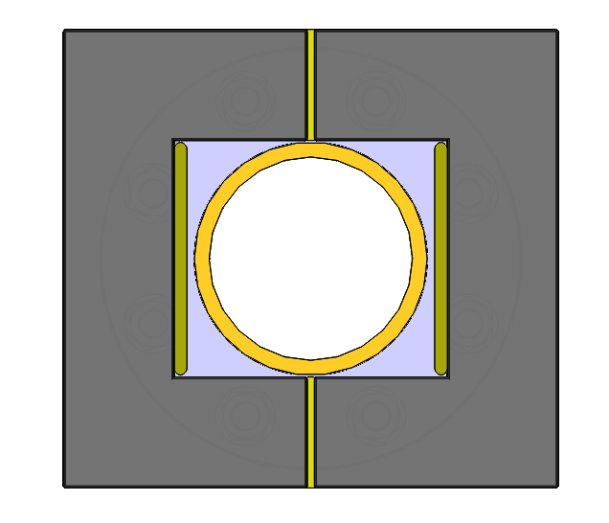
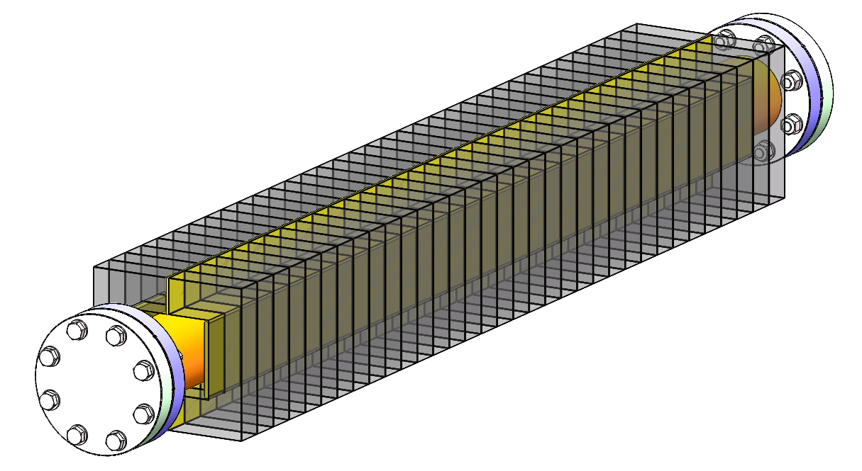
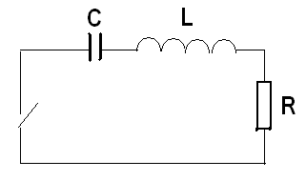
1. Lumped parameter dipole kicker system
The structure of in-air lumped parameter kicker is simpler.
Eddy current Shielding plate
HV conductor
Ceramic vacuum chamber
Ferrite core
For a half-sine kicker system, LC resonance discharge circuit is common. Here, the kicker magnet acts as a part of lumped inductor( L )in the pulse discharge circuit.
<1360ns,1kHz

Slide 11
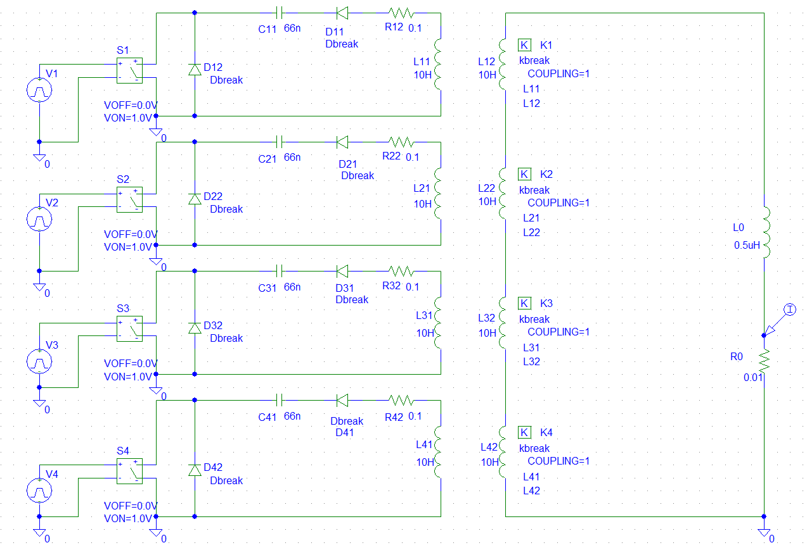
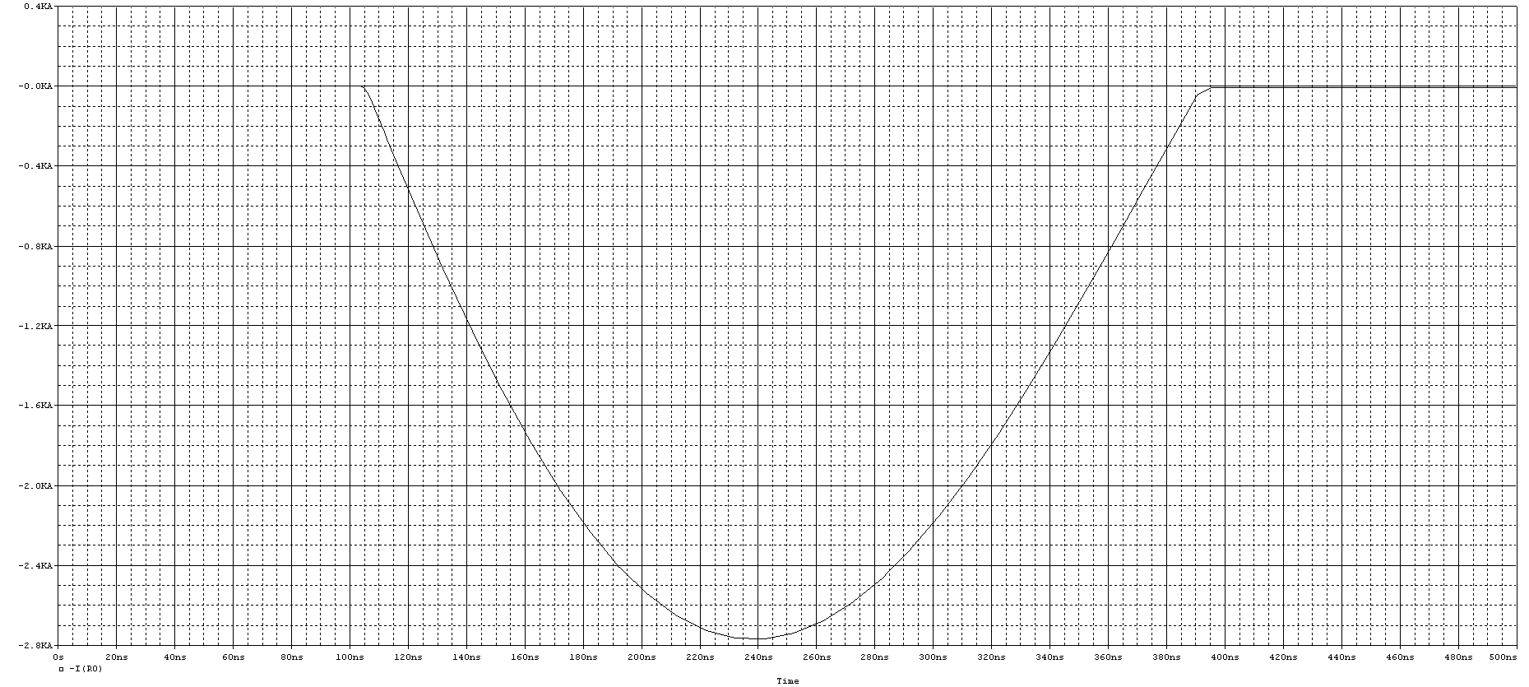
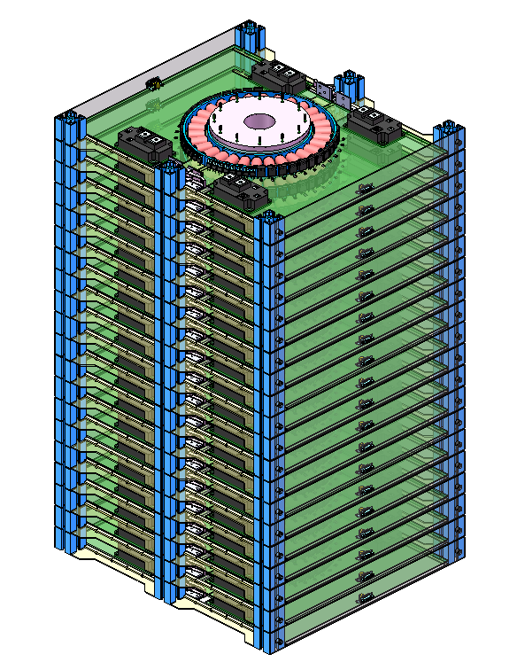
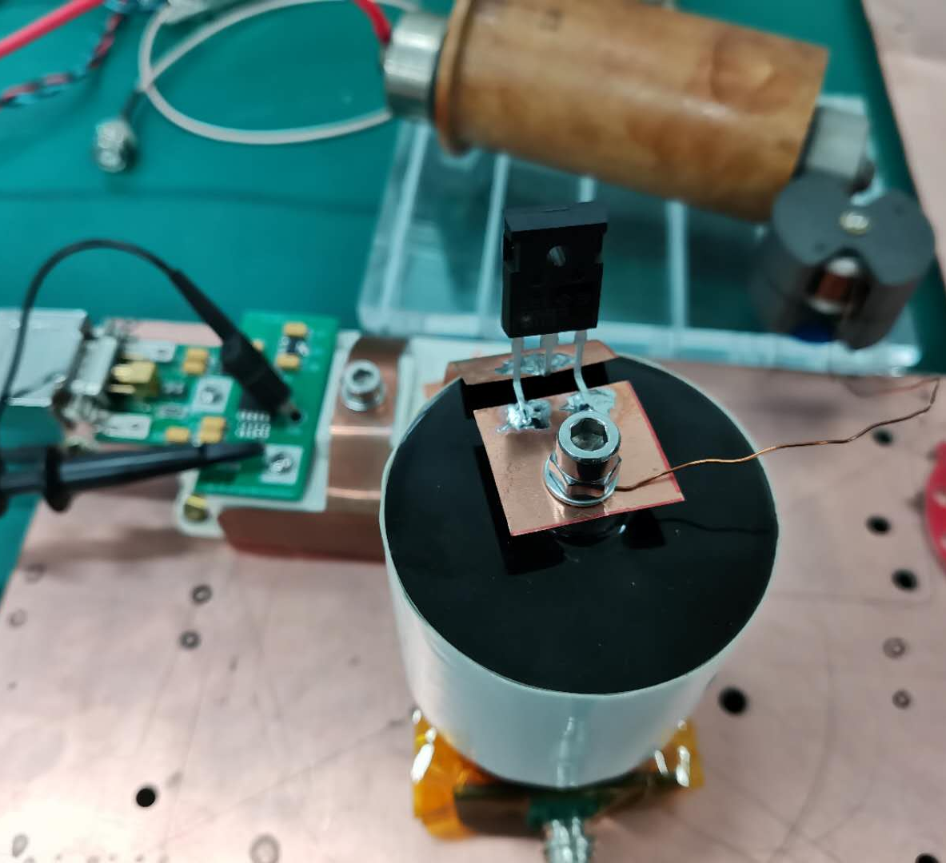
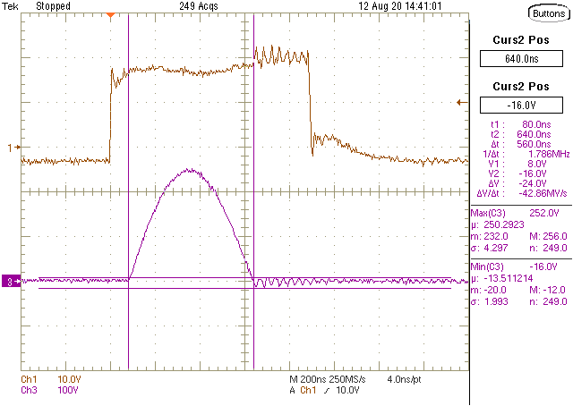
Novel half-sine wave pulser
Considering the requirement of kicker repetition rate 1kHz, solid-state pulser is better for the CEPC.
A novel topology of pulser was proposed: LV LC resonance discharge circuit (IGBT+SBD) + Inductive adder
Imax=2326.5A(2500A)
L=194nH(250nH)
C=25nF
Tw=π√LC=248.4ns
Z=√L/C=3.16Ω
U=7357V(8000V)
IGBT quantity=10*4=40
IGBT
SIC 1200V SBD
920mm
564mm
510mm

Slide 12
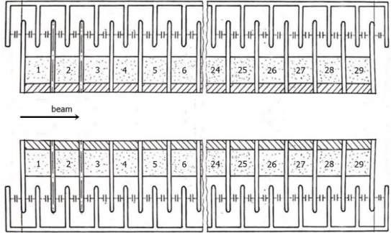
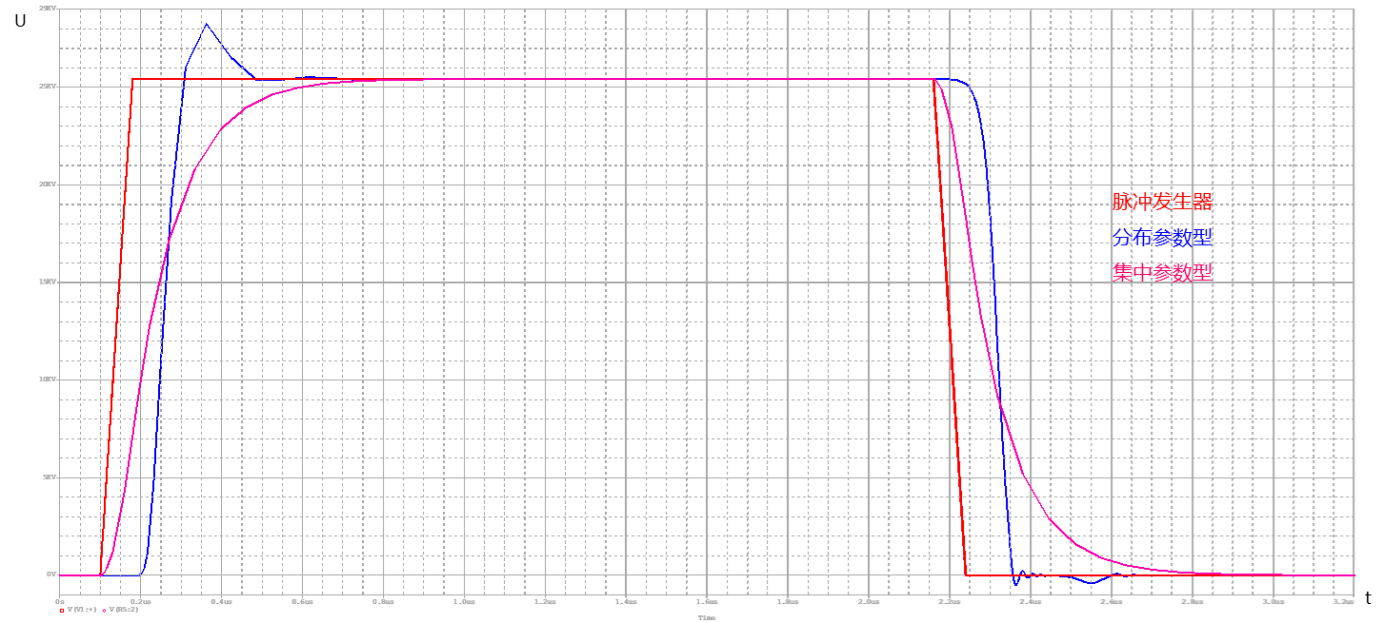
2. Delay-line dipole kicker system
The structure of delay-line kicker is complicated, but helps to achieve ideal trapezoid waveform.
For a ideal trapezoid kicker system, the kicker magnet is a part of matched transmission line.
40~2000ns
1kHz
200ns
200ns
challenges
Delay-line kicker magnet
PFN
Pulser
Delay-line kicker
Lumped parameter kicker

Slide 13
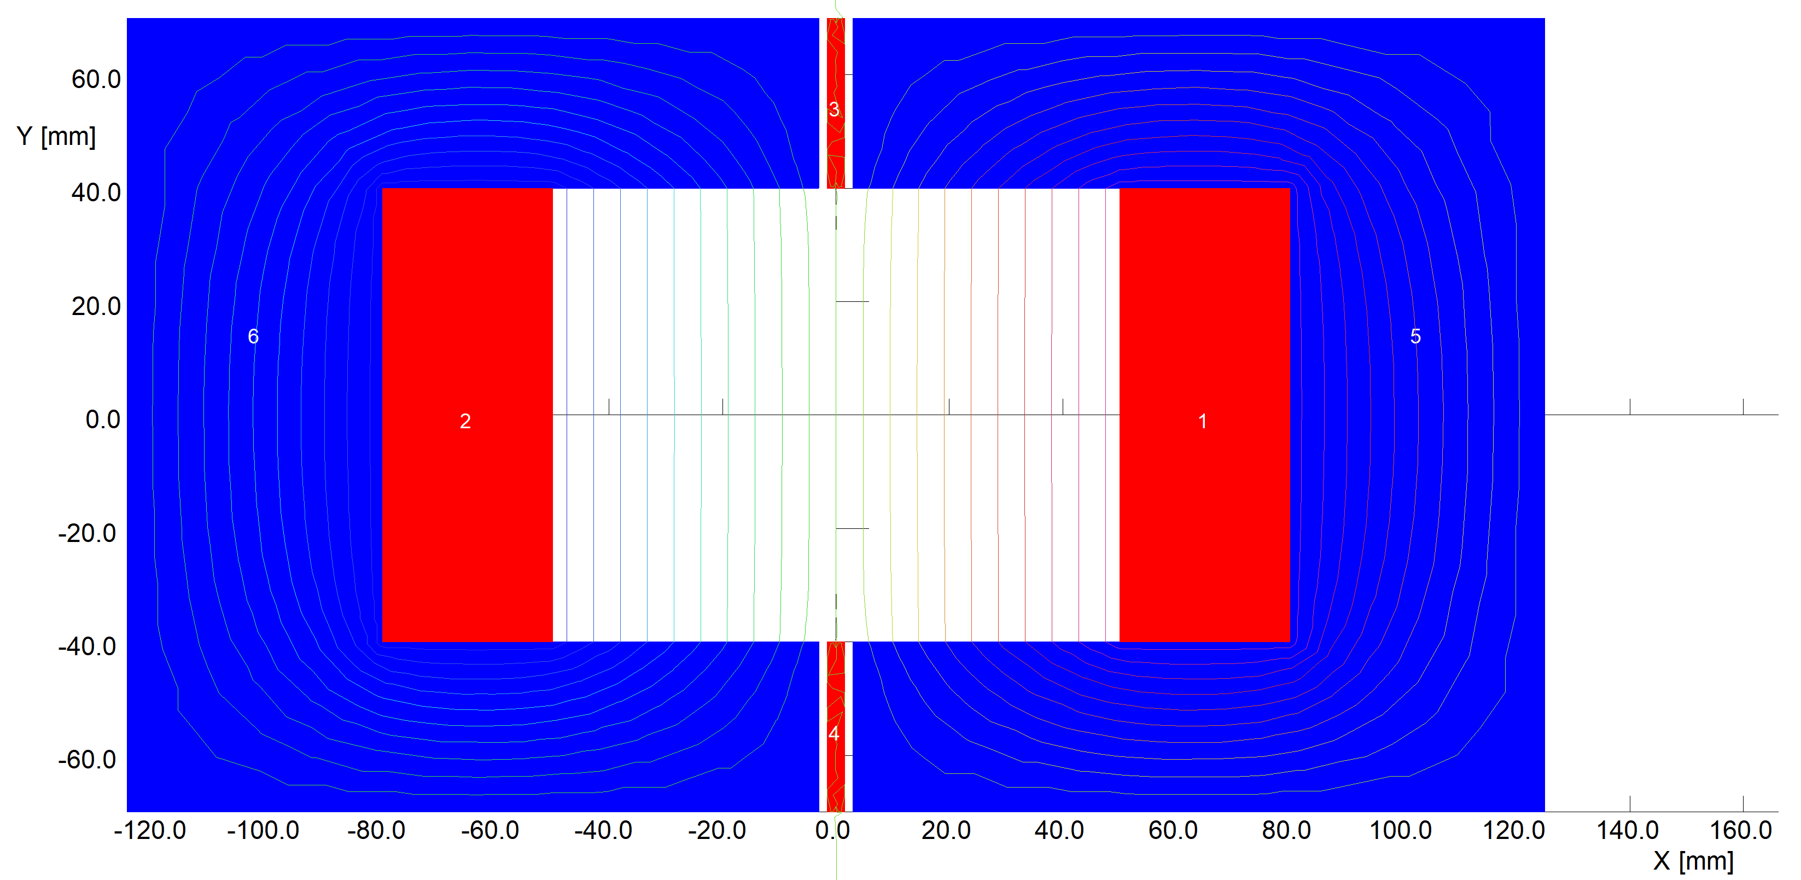
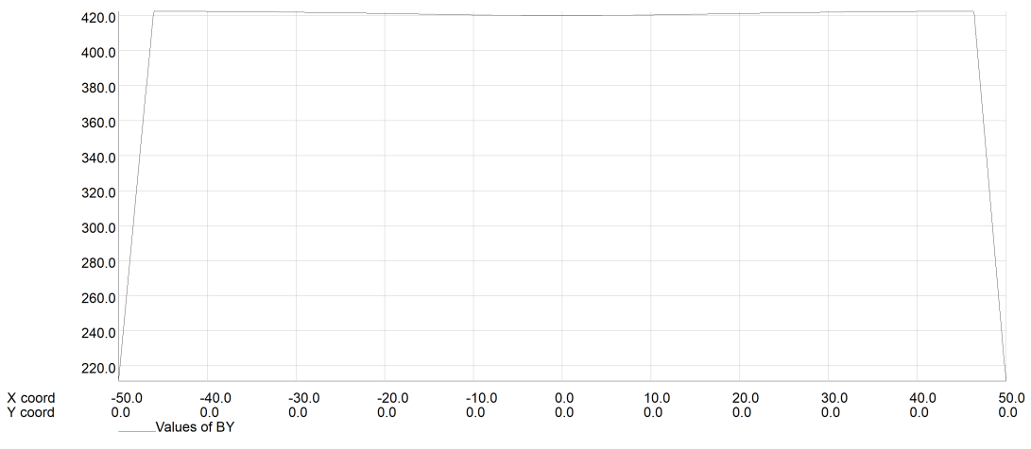
Dual-C type delay-line dipole kicker design
2D model without metallic coating of ceramic vacuum chamber
Parameters(unit) | value
Magnet aperture（mm） | 100×80
Length of cell （mm） | 36
Quantity of cell | 26
Characteristic impedance（Ω） | 12.5
Magnet effective length（mm） | 942
Magnet mechanical length（mm） | 1018
Inductance of cell（nH） | 56.6
Inductance of magnet（nH） | 1471.6
Capacitance of cell（pF） | 362
Capacitance of magnet（nF） | 9.412
Magnetic B field （Gs） | 425
Exciting current（A） | 2703
Operating voltage（V） | 33791
Zoom in
A little high for magnet in the air

Slide 14
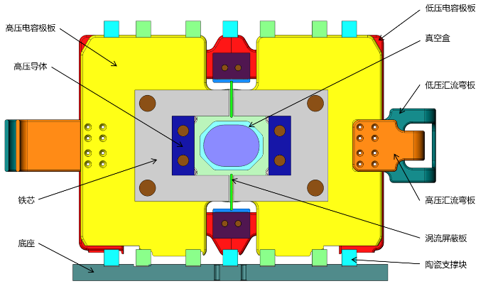
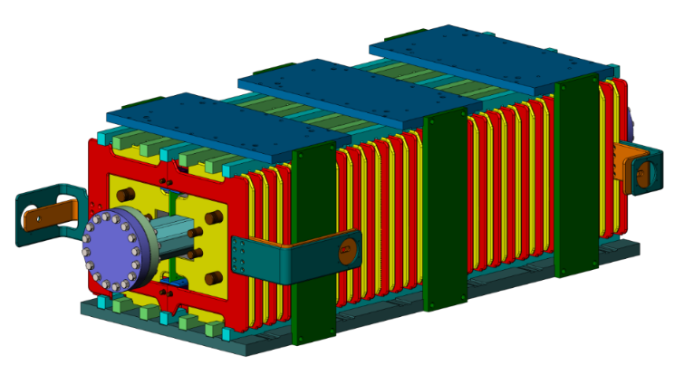
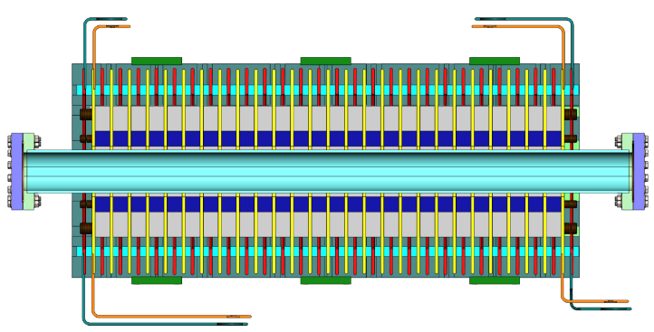
Structure mechanical design
Capacitor plate@
High potential
Capacitor plate @
Ground potential
Ceramic Vacuum chamber
HV conductor
ground potential Lead
Ferrite core
High potential Lead
Eddy current Shielding plate
Base
Ceramic support
Dual-C type delay-line dipole kicker

Slide 15
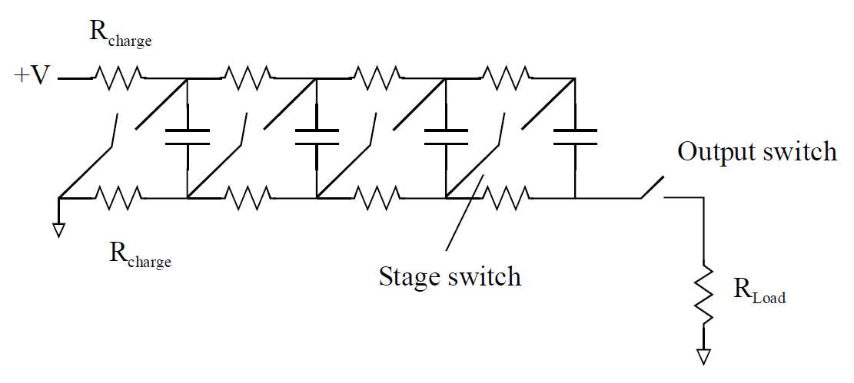
Trapezoid wave pulser
Considering the requirements of 1kHz repetition rate, 200ns fast rise time and adjustable pulse width, the trapezoid waveform pulser is built based on SiC MOSFET
Energy storage component
Capacitor ： Flat-top dropping compensate topology
PFN ：low impedance, need 2 times of voltage of stored energy
Power stacking topology
inductive adder: not fit for long pulse
Marx generator: hard to control structure impedance
40~2000ns
1kHz
200ns
200ns
challenges
Solid-state switches（SIC MOSFET）
Delay-line kicker magnet
PFN
Or
Cap.
Marx generator
Inductive adder

Slide 16
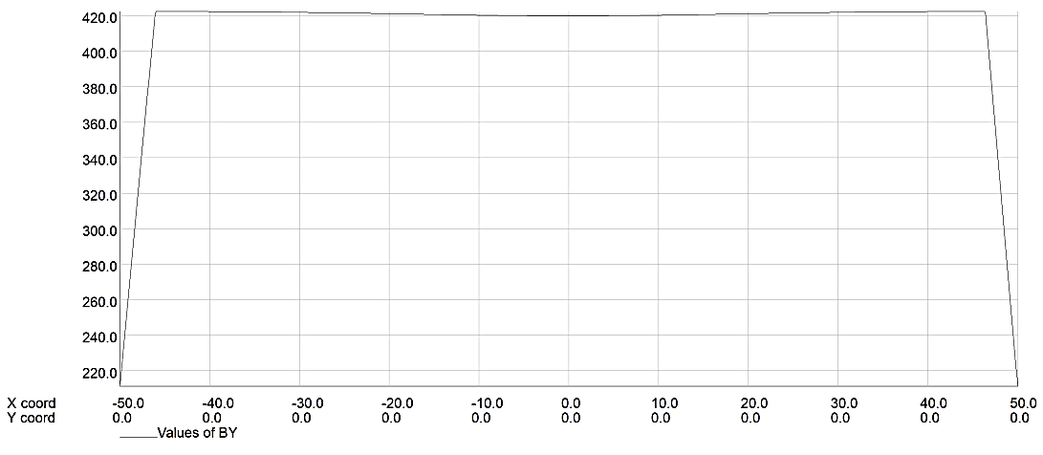
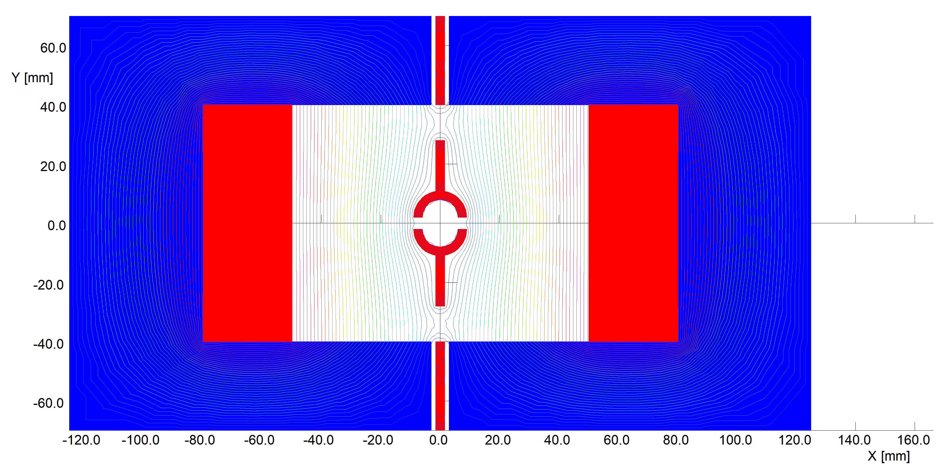
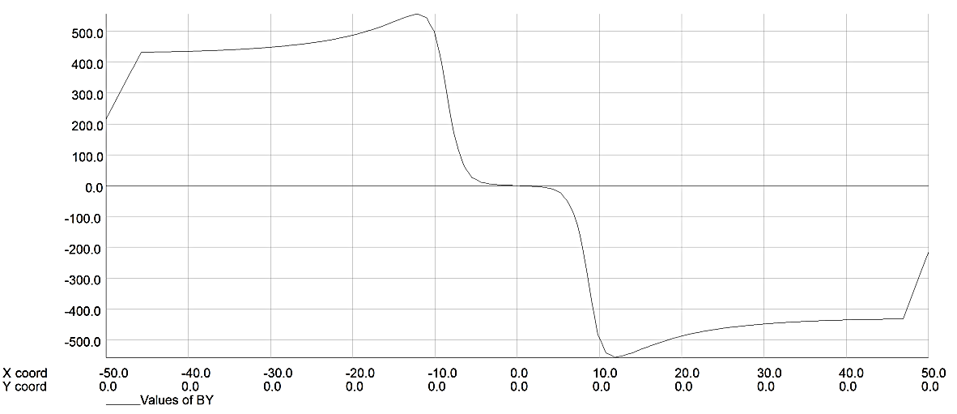
3. Delay-line Nonlinear Kicker (NLK)
Thinking about if the nonlinear kicker injection is possible for CEPC, after all this kind of top-up injection scheme should loose the requirement of DA.
More physics parameter inputs are needed for the magnet design.
Dipole B field
Differential mode exciting
Extended eddy current Shielding plate
Injected bunch
Nonlinear B field
stored bunch
Common mode exciting

Slide 17
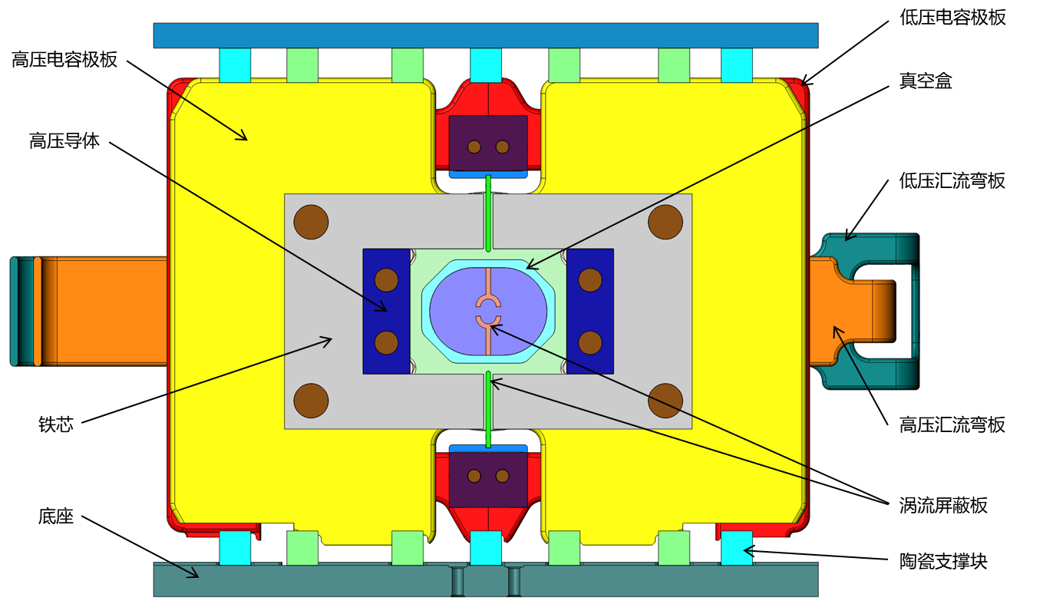
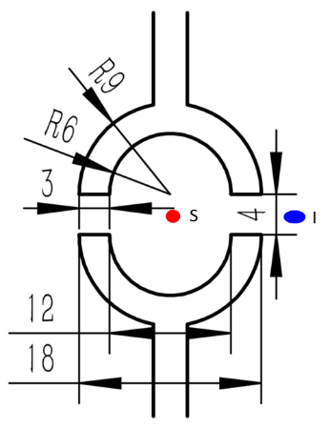
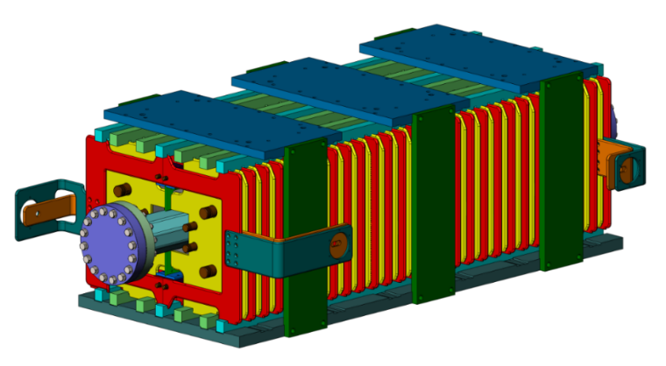
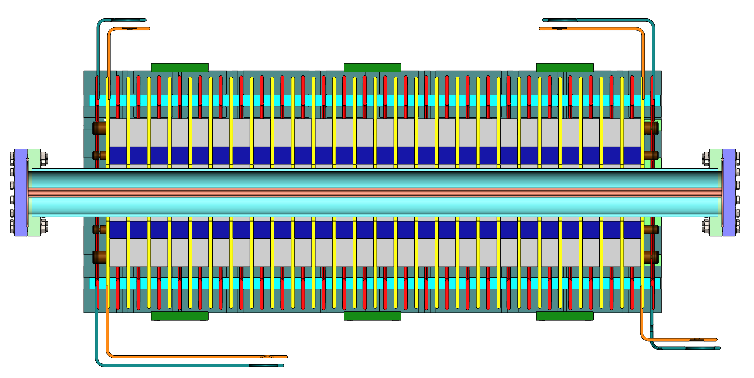
Structure mechanical design
Capacitor plate@
High potential
Capacitor plate @
Ground potential
Ceramic Vacuum chamber
HV conductor
ground potential Lead
Ferrite core
High potential Lead
Base
Eddy current Shielding plate
Ceramic support
Delay-line NLK

Slide 18
Kicker Ceramic vacuum chamber with coating

Slide 19
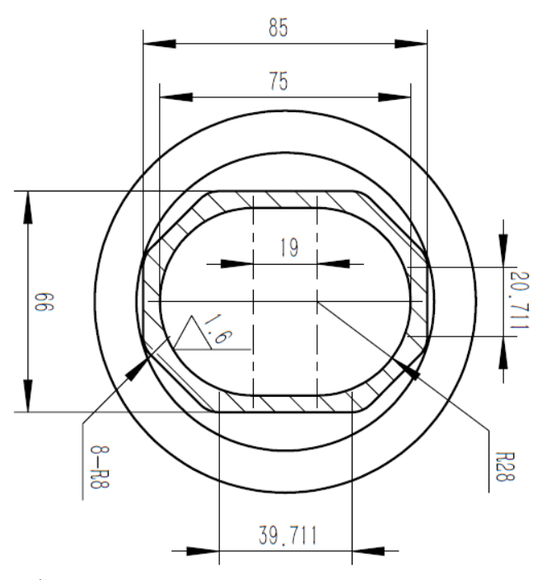
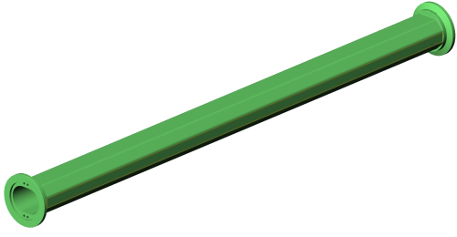
Ceramic vacuum chamber fabrication
Ceramic vacuum chamber with special pattern metallic coating is key component for in-air kicker magnet.
ellipse
octagon
Race track
√
Ceramic material: 99% AL₂O₃
L=1.2m，thickness=5mm
Integrated sintering process

Slide 20
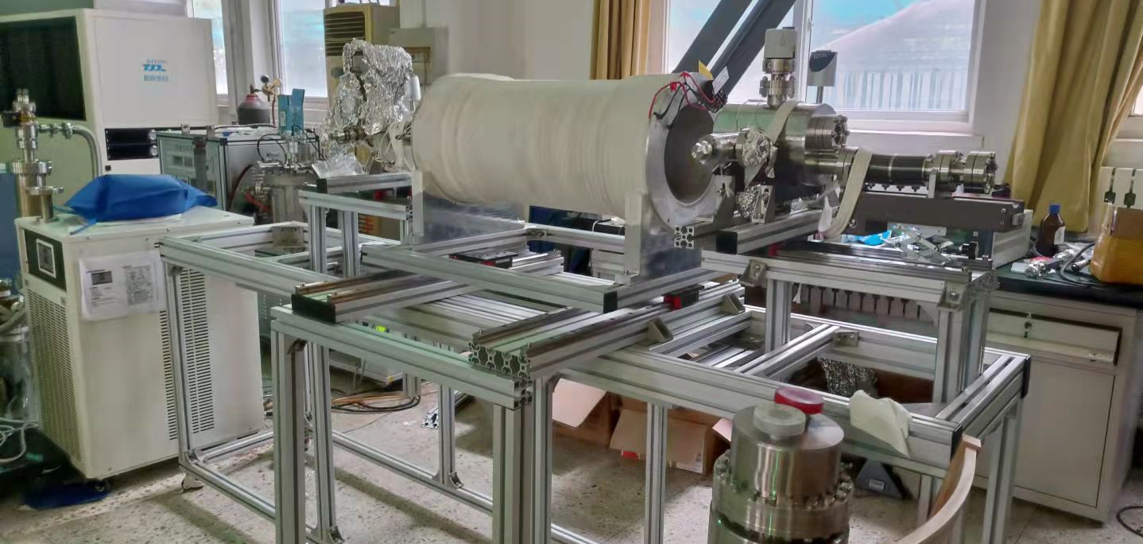
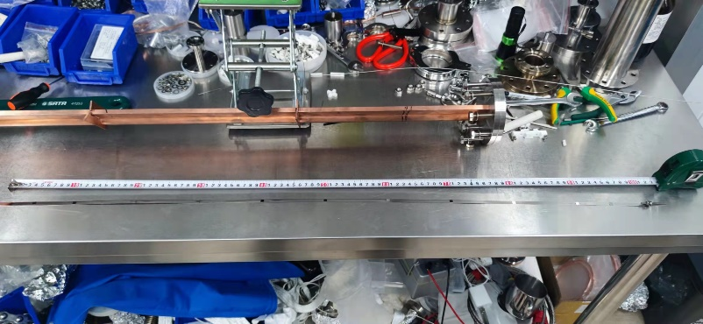
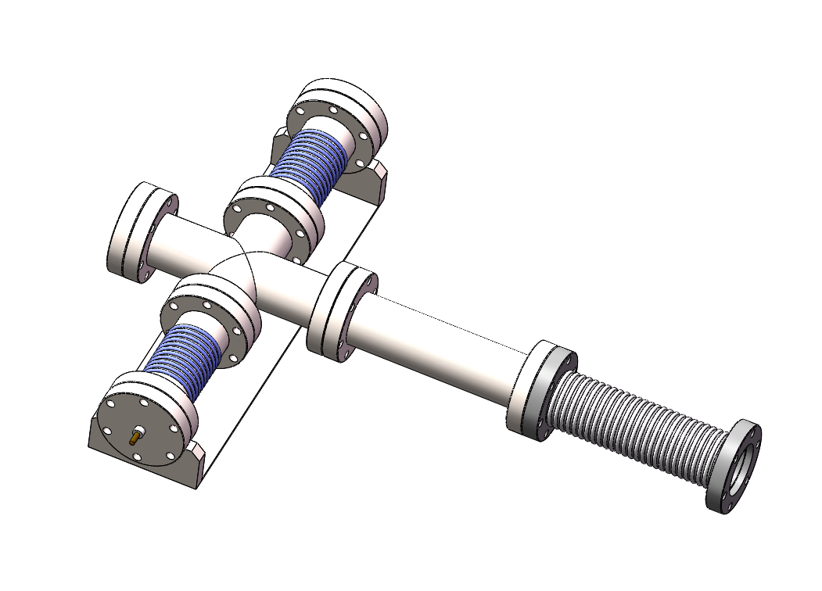
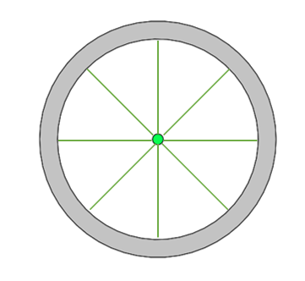
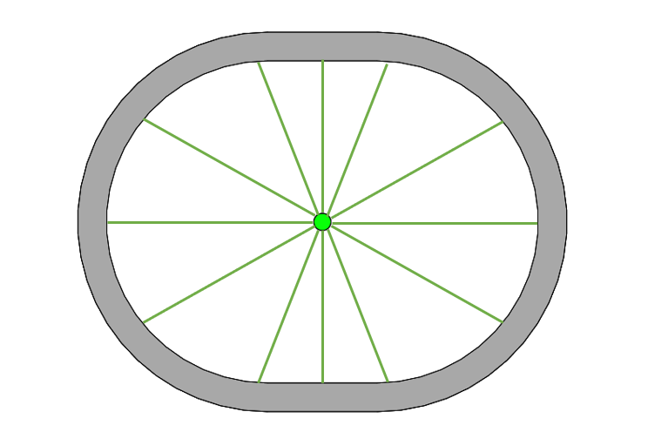
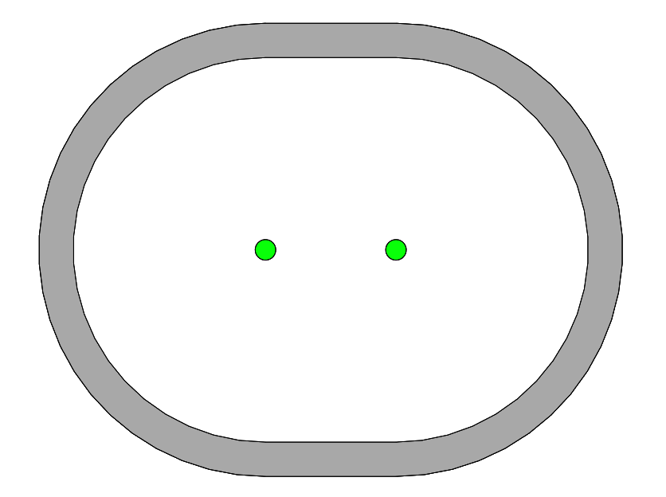
Magnetron sputtering coating prepare
According to the experience of coating, the cathode target discharge is unstable for long vacuum chamber more than 600mm and it is easy to cause ignition or local film formation failure.
So, sectional coating method by a movable solenoid is proposed for our ceramic vacuum chamber of 1.2m. The coating experiment shows uniform coating can be achieved in one antechamber of 1m for HEPS.
In order to obtain uniform coating on race-track shape vacuum chamber, a horizontal movable cathode wire target solution is proposed.
Solenoid coil
Inner diameter=208mm
Length =700mm
Good field region=500mm
1m
The antechamber for HEPS
(inner aperture=6mm)
Movable solenoid
Graduated bellows is used to adjust the horizontal position of cathode wire (compression at one end and tension at the other end)
view window
Cathode wire
Moving track
Cathode pole

Slide 21
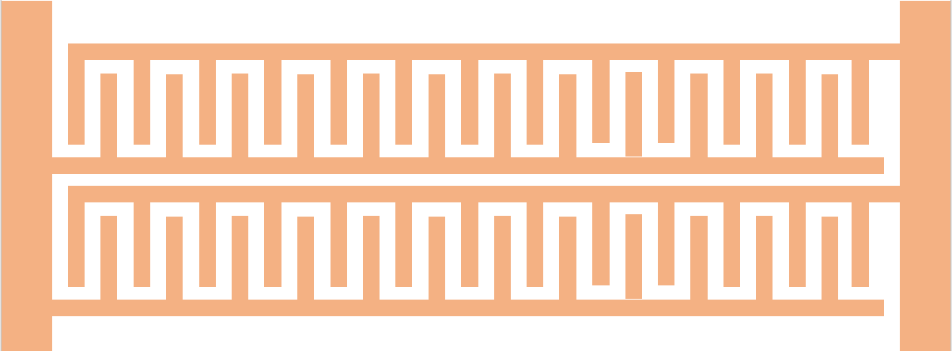
Film pattern study
Metallic coating on the inner wall of ceramic vacuum chamber is provided for beam mirror current as a path.
The continuous uniform film can form large loop eddy current under fast pulse magnetic field, which has magnetic shielding effect.
An appropriate coating pattern can solve this contradiction at the same time.The design principles of coating pattern are as follows:
The upstream and downstream of films are not connected to prevent the occurrence of large loop;
The films should cross to form a capacitor structure as far as possible to provide a path for high-frequency beam mirror current.
×
Mesh film
×
Strip film
√
Comb film
√
Ladder film
Spiral film
√

Slide 22
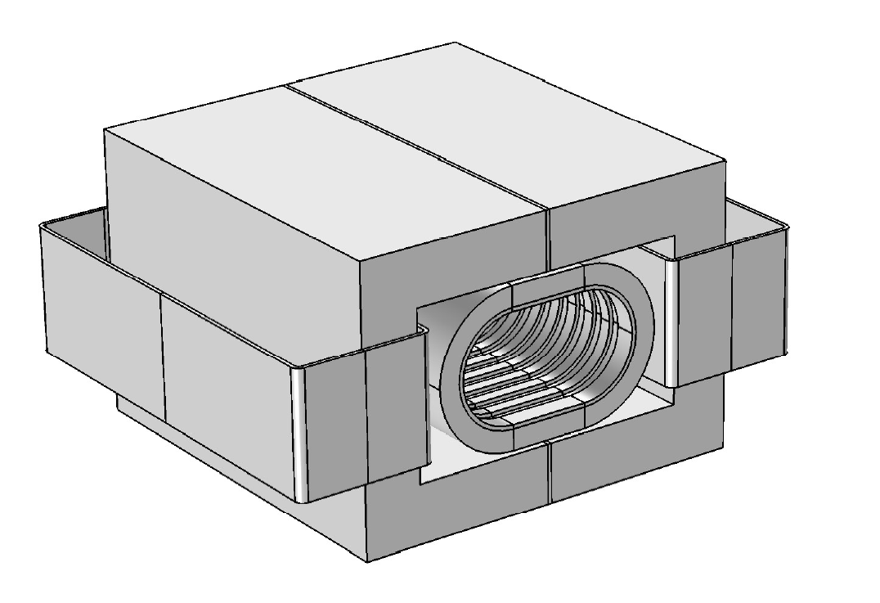
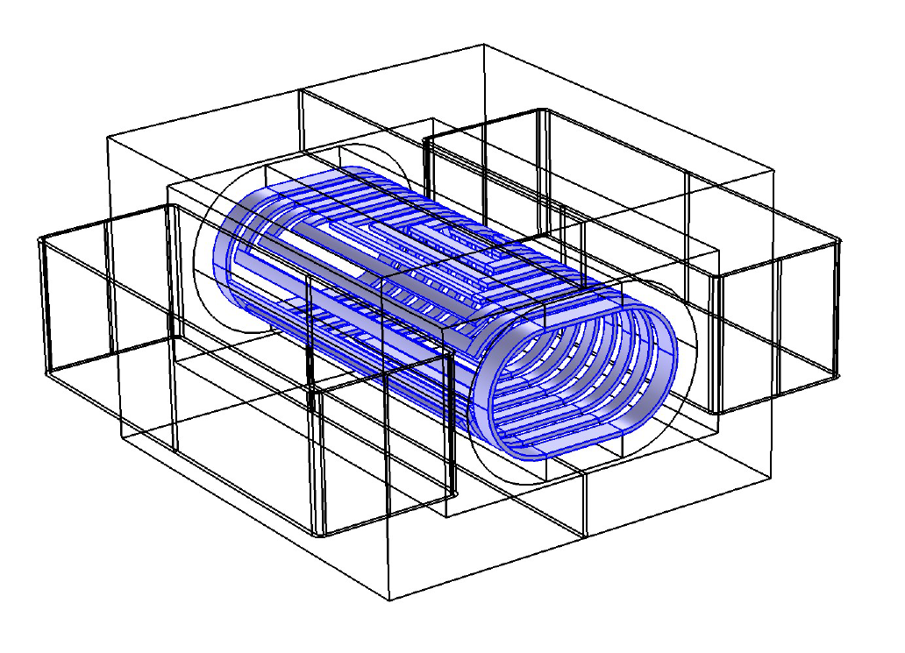
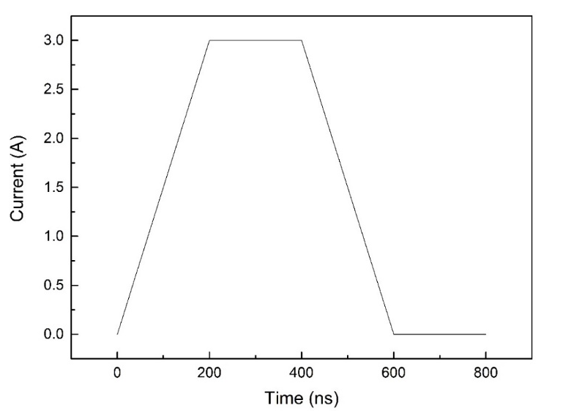
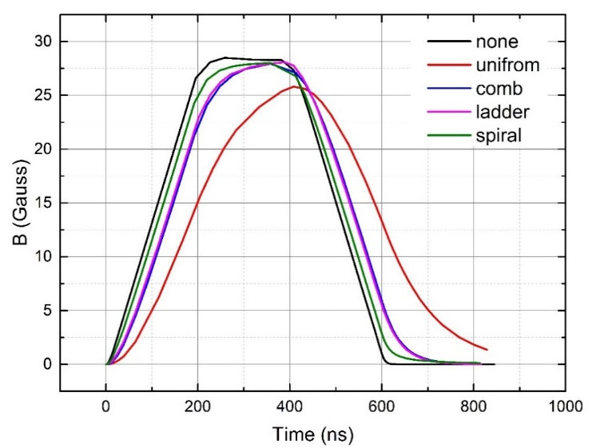
Eddy current shielding simulations
3D model was built in COMSOL to simulate eddy current shielding effect.
The film square resistance is set to 0.2 Ω (equivalent to 86nm copper film or 1.1 μm TiN film)
Material conductivity is set to 5000S / m, and the corresponding thickness is 1mm.
ferrite
Ceramic vacuum chamber
Metallic film(spiral)
coil
COMSOL 3D Model
Coil exciting current pulse
Central field deformation caused by different pattern films

Slide 23
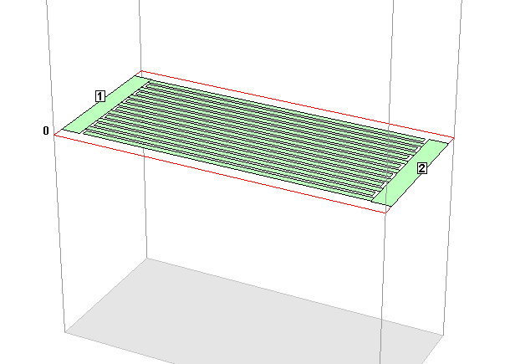
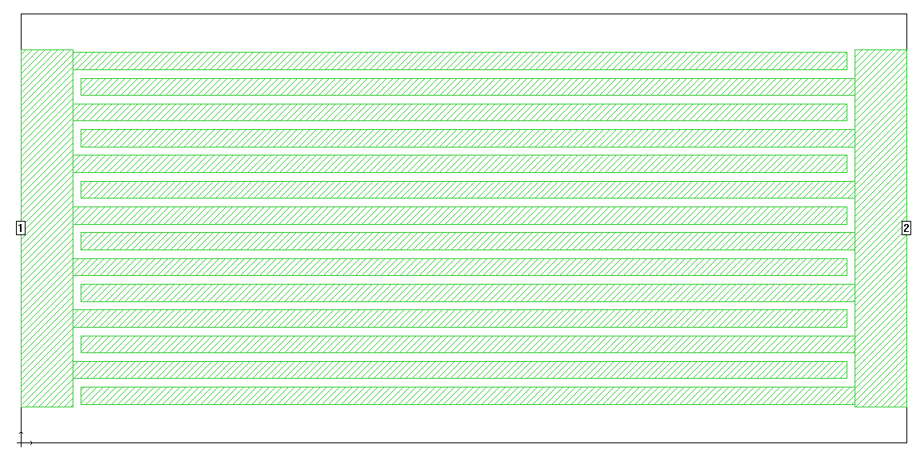
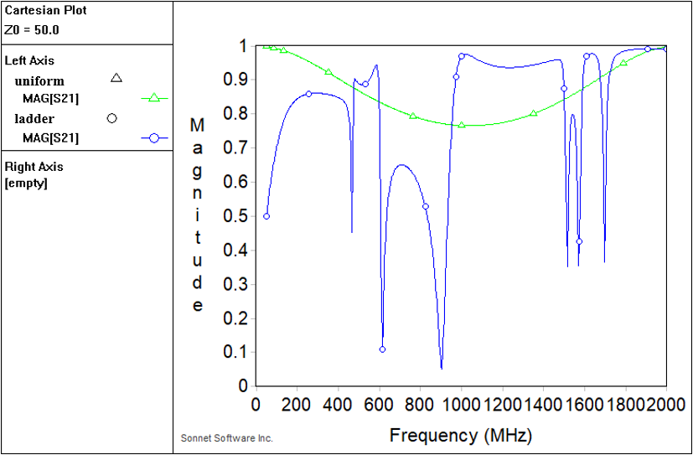
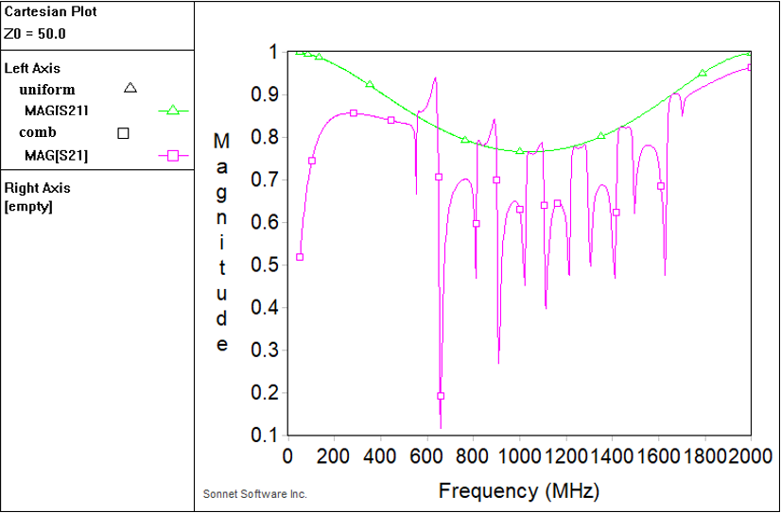
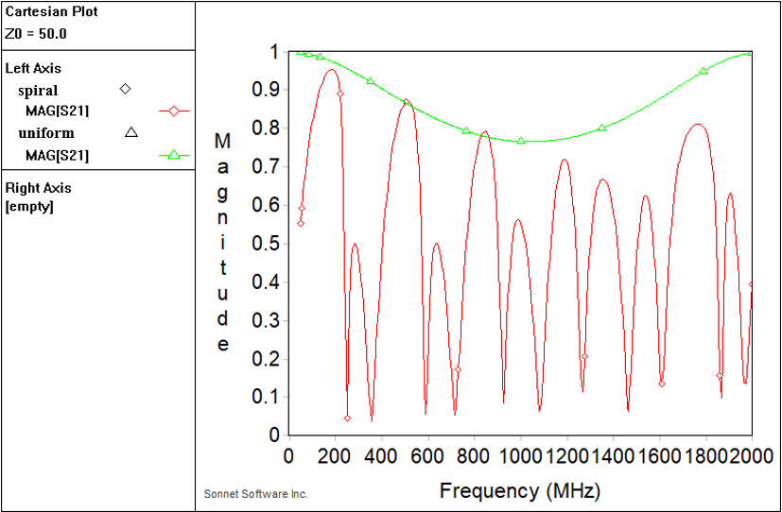
HF E-M field transmission simulations
SONNET is a kind of excellent 3D planar circuit and antenna simulation tools.
It is used to study the HF transmission characteristic of the metallic film on Al₂O₃ base with different patterns.
The simulation result of S21 shows that the metallic film with different pattern can transfer most HF signals from 50-2000MHz.
air
Metallic film
Box boundary
Comb film
Al₂O₃ base
SONNET model
S21
S21
S21
Ladder film
Comb film
Spiral film

Slide 24
Summary
In CEPC accelerator complex，there are 9 inj. and ext. sub-systems. The types of all inj./ext. components are determined. The hardware designs towards TDR are being carried out.
One team is in charge of both HEPS and CEPC inj. & ext. system. A part of hardware R&D for 2 projects are overlapping. The experience of R&D could be shared.
In-air ferrite core kicker system R&D special for the CEPC is carrying out, including the lumped and distributed parameter dipole kicker, NLK and ceramic vacuum chamber with metallic coating.

Slide 25
END
Thank you for attentions!!!

Slide 26
Backup slides

Slide 27
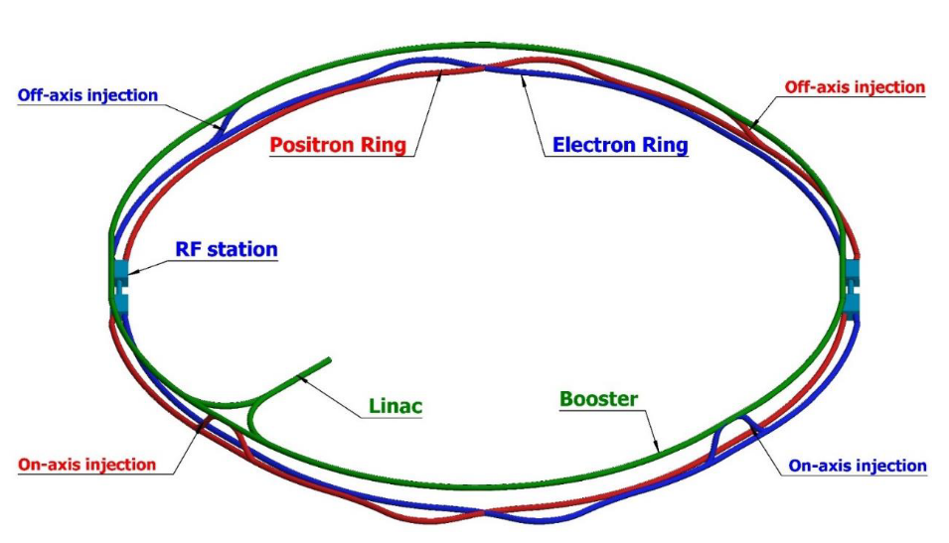
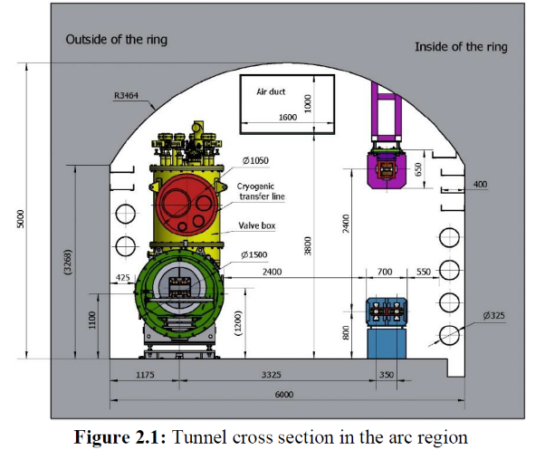
Layout of the accelerator complex
The CEPC accelerator complex consists of a Linac, which including a small damping ring for positron beams, several transport lines, a booster ring and 2 storage rings, all of which are in a single tunnel.
1.2km
120GeV
120GeV
100km
Dump
Damping ring
Dump
e+
e-
10-120GeV

Slide 28
Booster Ring
Booster operating mode | Higgs |  |  | W |  | Z
Beam energy（GeV） | 10 | 120 |  | 10 | 80 | 10 | 45.5
Function | Injection （both） | Extraction （off-axis） | Inj./Ext. （on-axis） | Injection （off-axis） | Extraction （off-axis） | Injection （off-axis） | Extraction （off-axis）
Bunch number | 242（in half ring） |  | 7（in half ring） | 1524（uniform） |  | 6000
Min. bunch spacing （ns） | 680 |  | 23800 | 220 |  | 25
Bunch number per train× train number | - |  | - | - | - | 80×75
Train spacing （ns） | - |  | - | - | - | 2460
Injection（extraction）mode | Bunch by bunch |  |  | Bunch by bunch |  | Bunch by bunch | Train by train
Kicker repetition rate (Hz) | 100 | 1000 |  | 100 | 1000 | 100 | 1000
Kicker pulse width (ns) | 1360 |  |  | 440 |  | 50 | <6900
Kicker flat top（ns） | - |  |  | - |  | - | >1980
Kicker rise（fall）time (ns) | <680 |  |  | <220 |  | <25 | <2460
Timing delay(ns) | <680 |  | <23800 | <220 |  | <2460 | <4400
injection（extraction）period (s) | 2.42 | 0.242 | 0.007 | 15.24 | 1.5 | 60 | 0.075
Kick angle (mrad) | 0.11 | 0.2 | 0.1 | 0.11 | 0.2 | 0.11 | 0.2
Kick Integral field strength (Tm) | 0.004 | 0.08 | 0.04 | 0.004 | 0.05 | 0.004 | 0.03
Beam pipe aperture Φ（mm） | 55
Considering the compatibility of three operating modes:
Function | LE-Injection （both） | HE-Extraction （off-axis） | HE-Inj./Ext. （on-axis）
Kicker repetition rate (Hz) | 100 | 1000 | 1000
Kicker pulse width (ns) | 50 | 440~2420(Adjustable) | 1360
Kicker flat top（ns） | - | 0~1980(Adjustable) | -
Kicker rise（fall）time(ns) | <25 | <220 | <680
injection（extraction）period (s) | 60 | 1.5 | 0.007
Kick angle (mrad) | 0.11 | 0.2 | 0.1
Kick Integral field strength (Tm) | 0.004 | 0.08 | 0.04
Beam pipe aperture Φ（mm） | 55 | 55 | 55
40~2000ns
1kHz
50ns,100Hz
200ns
200ns
1360ns,1kHz

Slide 29
Collider ring
Booster operating mode | Higgs |  |  | W |  | Z
Beam energy（GeV） | 120 |  |  | 80 |  | 45.5
Function | Injection （off-axis） | Injection （on-axis） | Extraction （dump） | Injection （off-axis） | Extraction （dump） | Injection （off-axis） | Extraction （dump）
Bunch number | 242（in half ring）- 7 |  |  | 1524（uniform） |  | 12000
Min. bunch spacing （ns） | 680 |  |  | 220 |  | 25
Bunch number per train× train number | - |  |  | - |  | 80×150
Train spacing （ns） | - |  |  | - |  | 245
Injection（extraction）mode | Bunch by bunch |  |  | Bunch by bunch |  | Train by train
Kicker repetition rate (Hz) | 1000 |  |  | 1000 |  | 1000
Kicker pulse width (ns) | 1360 |  |  | 440 |  | <2460
Kicker flat top（ns） | - |  |  | - |  | >1980
Kicker rise（fall）time (ns) | <680 |  |  | <220 |  | <245
Timing delay(ns) | <680 | <23800 | <680 | <220 |  | <4400
injection（extraction）period (s) | 0.242 | 0.007 | 0.242 | 1.5 |  | 0.15
Kick angle (mrad) | 0.1 | 0.2 | 0.2 | 0.1 | 0.2 | 0.1 | 0.2
Kick Integral field strength (Tm) | 0.04 | 0.08 | 0.08 | 0.027 | 0.05 | 0.015 | 0.03
Beam pipe aperture HxV（mm） | 75×56
Considering the compatibility of three operating modes:
Function | Injection （on-axis） | Injection （off-axis） | Extraction （dump）
Kicker repetition rate (Hz) | 1000 | 1000 | 1000
Kicker pulse width (ns) | 1360 | 440~2420(Adjustable) | 440~2420(Adjustable)
Kicker flat top（ns） | - | 0~1980(Adjustable) | 0~1980(Adjustable)
Kicker rise（fall）time(ns) | <680 | <220 | <220
injection（extraction）period (s) | 0.007 | 1.5 | 1.5
Kick angle (mrad) | 0.2 | 0.1 | 0.2
Kick Integral field strength (Tm) | 0.08 | 0.04 | 0.08
Beam pipe aperture HxV（mm） | 75×56 | 75×56 | 75×56
40~2000ns
1kHz
40~2000ns
1kHz
1360ns,1kHz
200ns
200ns
200ns
200ns

