Slide 1


CEPC collider ring magnets R&D
Mei Yang, Fusan Chen, Xianjing Sun
Nov. 9,2021
The 2021 International Workshop on the High Energy Circular Electron Positron Collider
Nov. 8-12, 2021, IHEP

Slide 2
Outline
Progress on CEPC dual aperture dipole magnets
  First short dipole magnet prototype
  Coil Modification of short dipole magnet prototype
  Design of long dual aperture dipole magnet
Progress on CEPC dual aperture quadrupole magnets
  Optimization of dual aperture quadrupole magnet
  Layouts of trim coils
  Modification of short DAQ prototype
Design of sextupole magnet
Summary and next plan

Slide 3
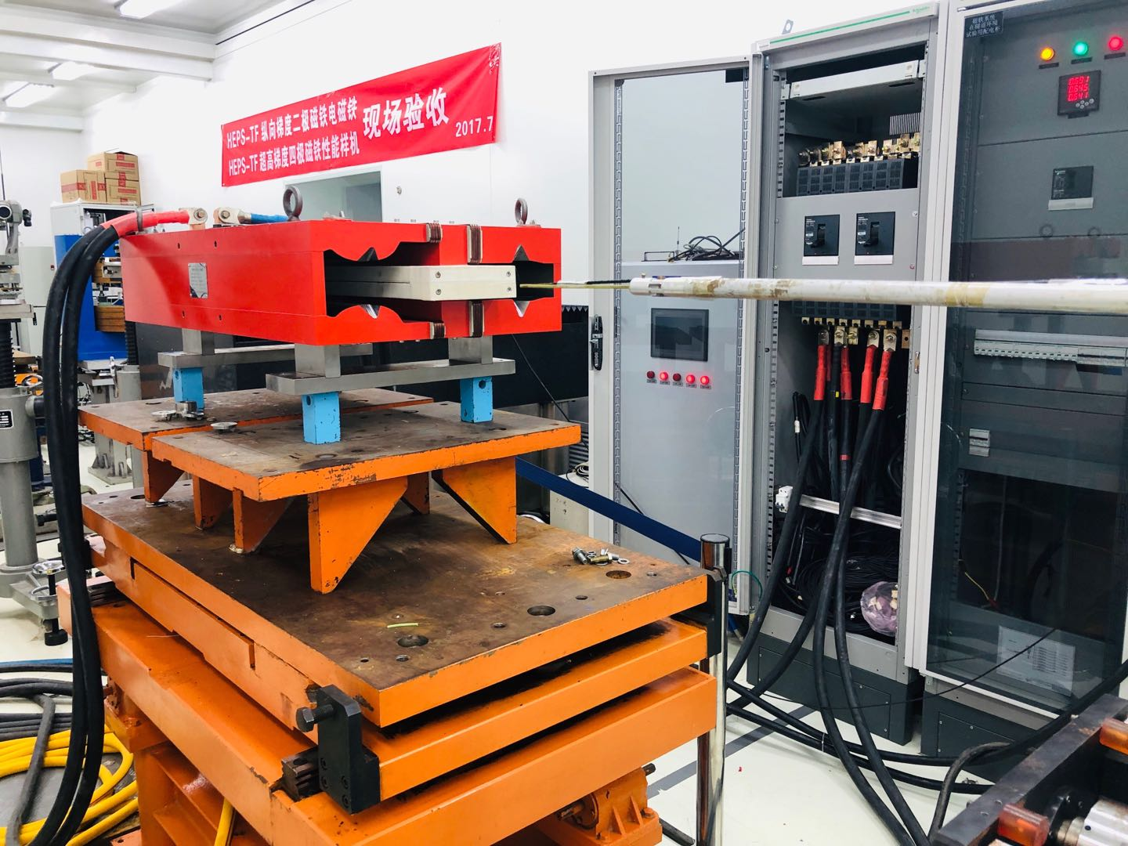
First short dipole magnet prototype
First short dual aperture dipole magnet with sextupole component was built and measured.
  The results showed good agreement with the simulation.
  Center field difference <0.3% in two apertures(residual field effect and different gaps at the two apertures).
Ap2
Ap1
Dipole measured by a hall probe system
B/I Transfer function
By along z at different energy

Slide 4
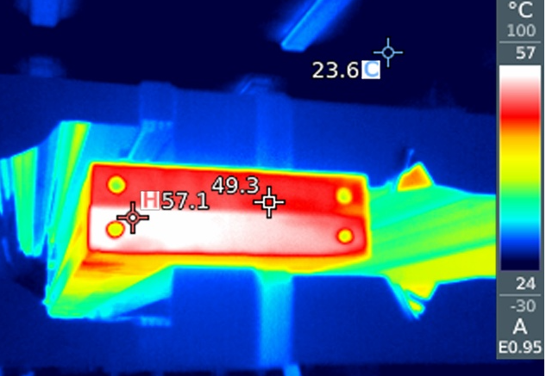
  Coil Modification of short dipole magnet prototype
Old coils:
  4 turns of aluminum busbars without cooling holes.
  Material : non pure aluminum.
  Insulated with Kapton and glass ribbon.
  Temperature rise at the end of the coil.
    Aluminum end faces are easy to oxidize and become insulated.
Modification
  Add a cooling hole in the busbars.
  Contact resistance: Silver plated surface.
  Radiation resistance: special surface treatment.
  No epoxy and organic materials.
Ap2
Ap1

Slide 5
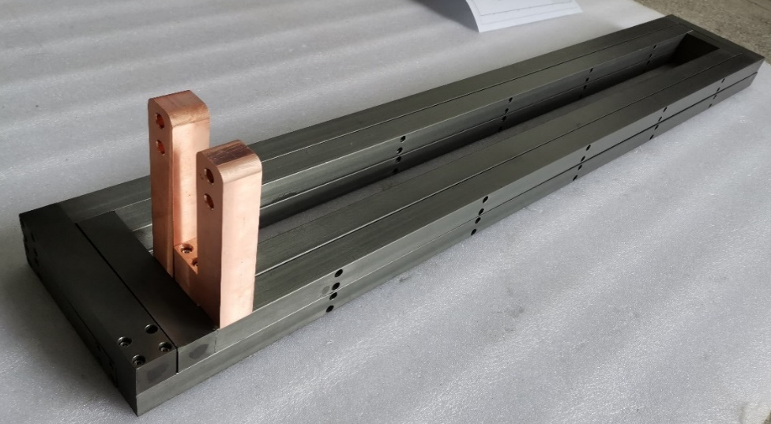
Coil Modification of short dipole magnet prototype
Coil design
  Aluminum strip: 4 turns;
  Cross section:30*27mm,D7mm;
  Water channel sealed by sealing ring;
Hard anodized insulation test results
  Thickness: 30~50μm.
  Water drop test: passed.（1Mpa-0.12Mpa，keep 30min)
  Turn by turn insulation test: failed
  High voltage test：failed (large leakage current).
By Keye.

Slide 6
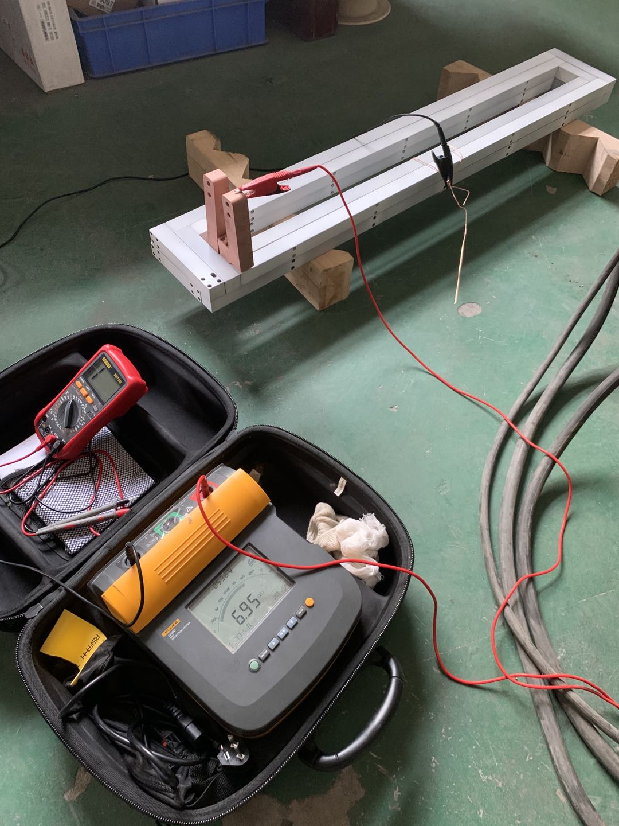
Coil Modification of short dipole magnet prototype
Ceramic coating insulation test results
  Water drop test: passed（1Mpa~0.12Mpa，keep 30min)
  Turn by turn insulation test: passed.
  High voltage test：passed.
  Resistance: much larger than design.
The insulating coating lead to poor contact of the contact surface, the oxidation corrosion of silver plating.
Surface treatment required.
By Keye.

Slide 7
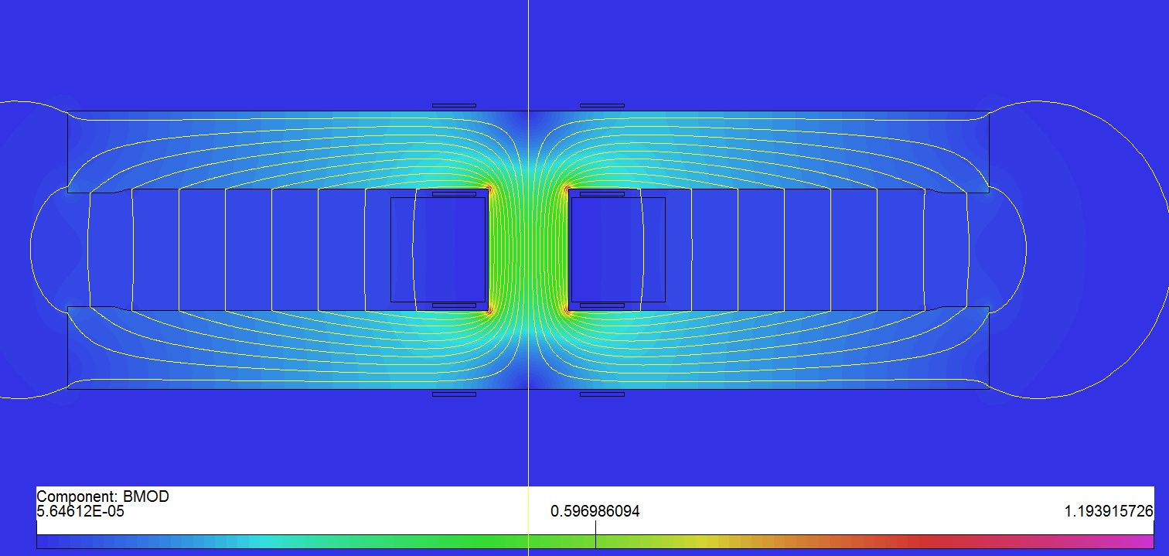
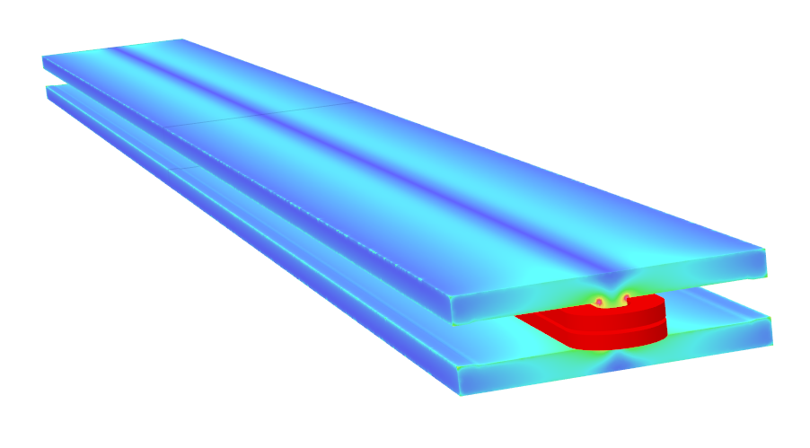
Design of long dual aperture dipole magnet
Design of long dual aperture dipole magnet (DAD)
  As the magnetic length is up to 28.7m, the 5.7m pure dipole model will be built to check the field quality, mechanical strength and deformation.
  Basic parameters
  Design considerations
    Beam center separation is 350mm;
    Solid iron with DT4;
    Two turns of aluminum busbars with cooling hole;
    Silvered contact face to reduce contact resistance.
Item | Value
Center field (Gs) | 141.6@45.5GeV，373@120GeV，568@182.5GeV
Gap (mm) | 70
Magnetic Length (m) | 5.737
Good field region (mm) | ±13.5
Field harmonics | <0.05%
Field adjustability | ±1.5%
Field difference between two apertures | <0.5%

Slide 8
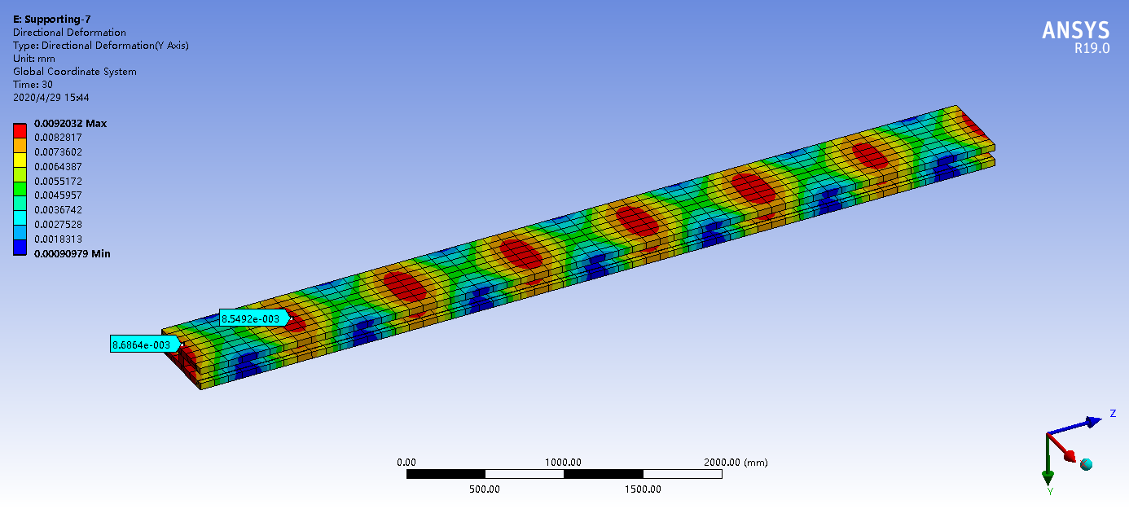
Mechanical design of DAD
By Keye.
The mechanical design of the long DAD has been completed.
  Coils with cooling hole: 2 turns to reduce the power loss in the power cables.
  Max. displacement: ~0.01mm.

Slide 9
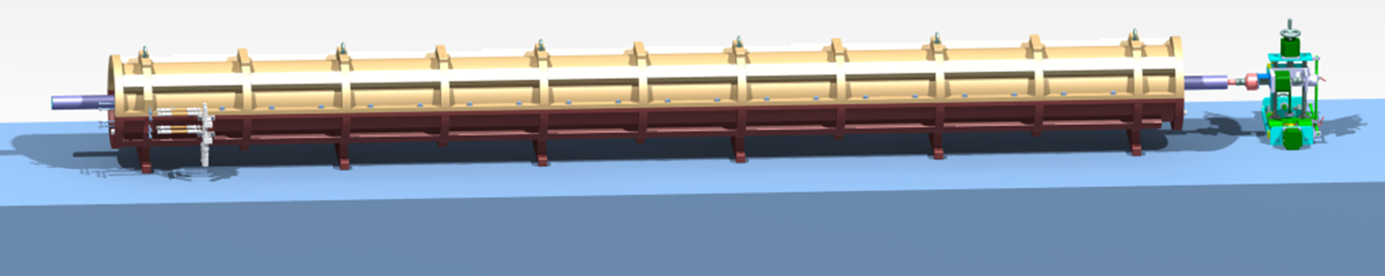
Magnetic measurement method : RCS
DAD will be measured by a rotating coil measurement system
  Shared with the booster dipole magnet (with 4 sub-coils).
  For DAD, 5 sub-coils are connected in series.

Slide 10
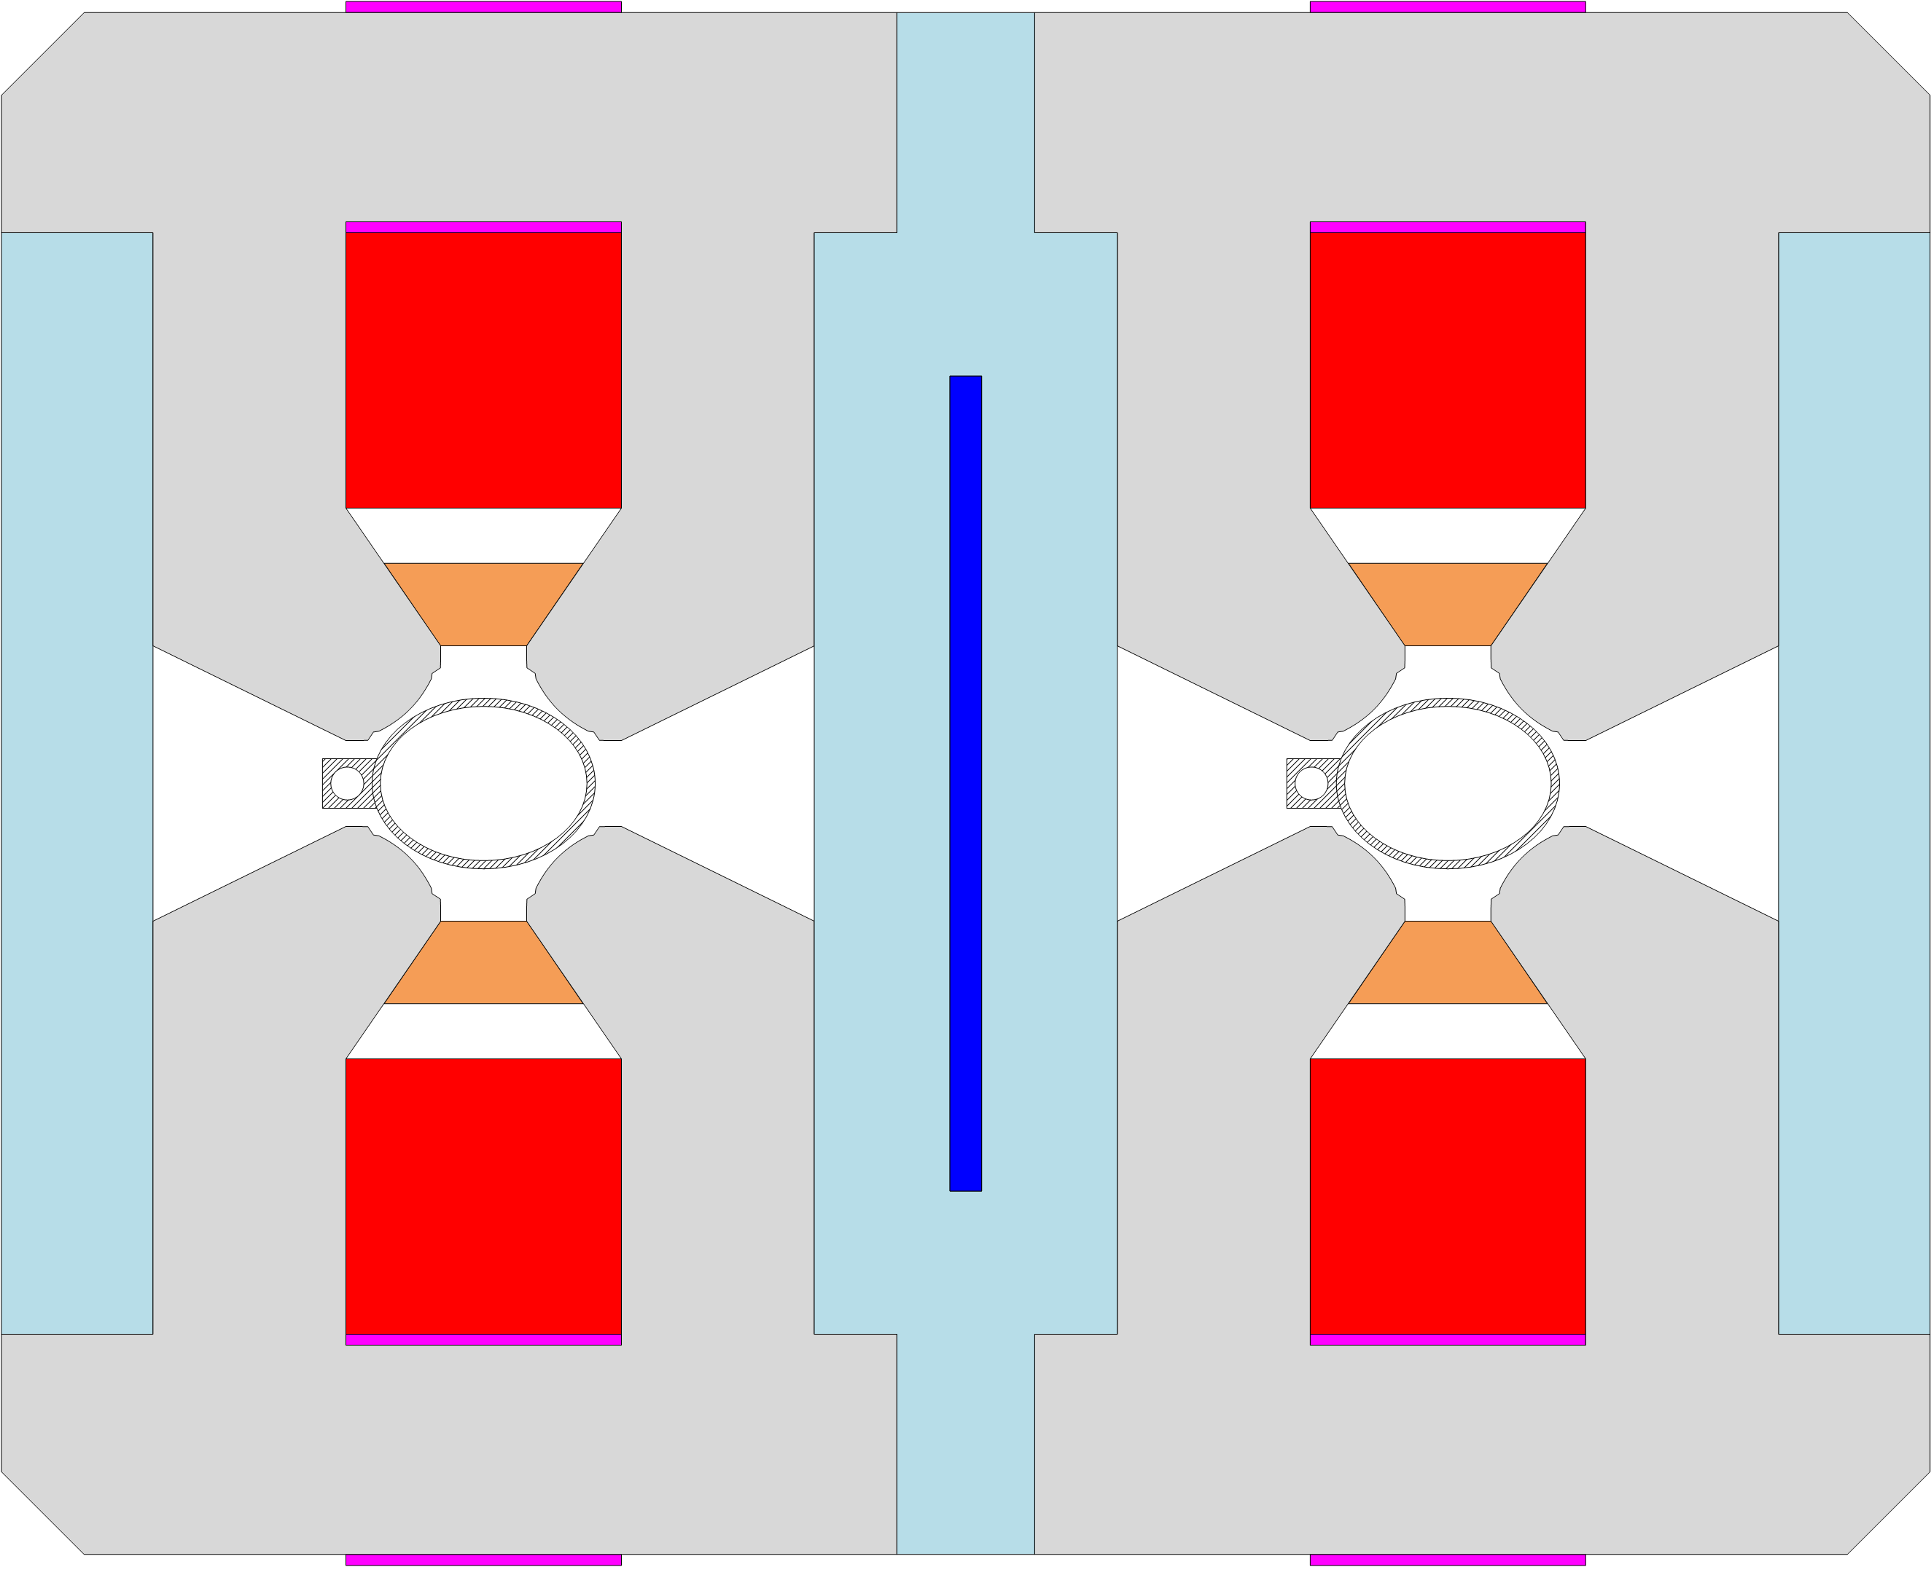
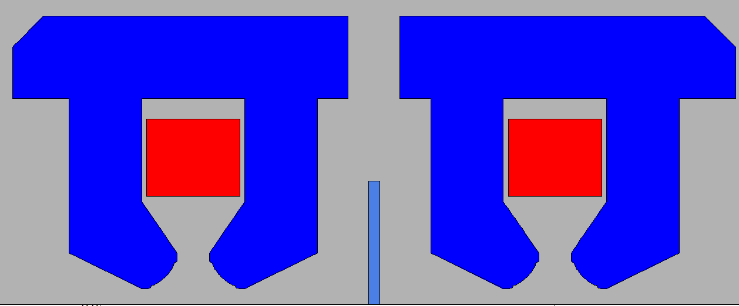
Progress on the collider dual aperture quadrupole magnet
Basic parameters of dual aperture quadrupole (DAQ)
First focus/defocus (F/D) prototype features:
  DT4 compensation sheet at yoke center.
  Trim coils are the same with main coils.
  Hollow water cooled aluminum conductor.
  The field in DT4 sheet saturation resulted harmonic changes in the b1 and b3.
Item | Value
Field gradient(T/m) | 3.2@45.5GeV，8.4@120GeV，12.8@182.5GeV
Aperture (mm) | 76
Magnetic Length (m) | 2
Good field region (mm) | ±12.2
Field harmonics | <0.05%
Field adjustability | ±1.5%
Field difference between two apertures | <0.5%
DT4 sheet
X shift as current

Slide 11
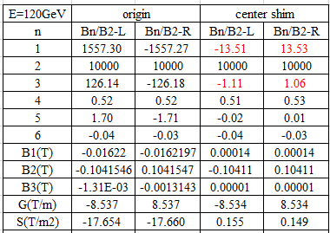
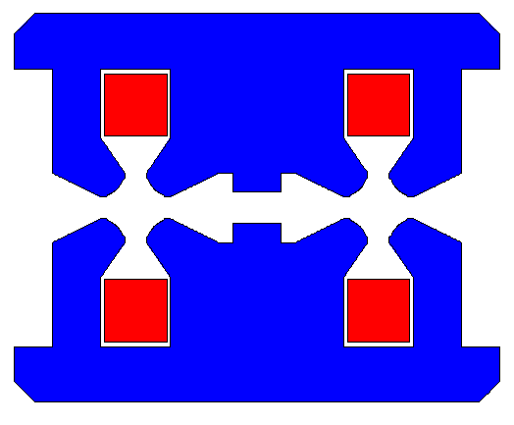
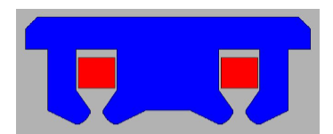
Optimization of F/D prototype
New design of F/D prototype
  Shim at yoke center
  The iron not saturated and the b1&b3 component changes along with energies can be neglected.
Center shim
Original

Slide 12
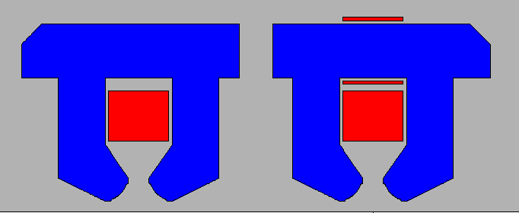
Layout of trim coils
Trim coil: adjust the field at two apertures
  Counteract energy sawtooth effect
  Eliminate the dispersion of magnetic field.
Optimization target:
  Product local field strength in one aperture and do not generate additional higher order harmonics.
  Never affect the other aperture.
Trim coil

Slide 13
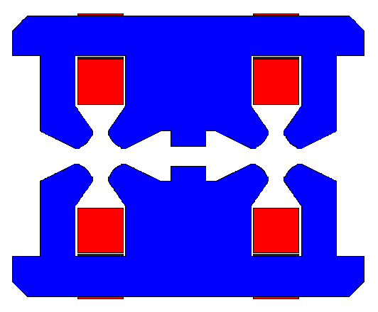
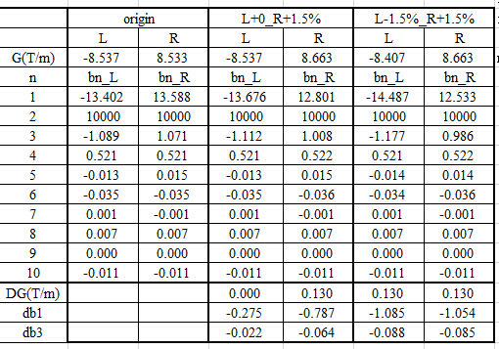
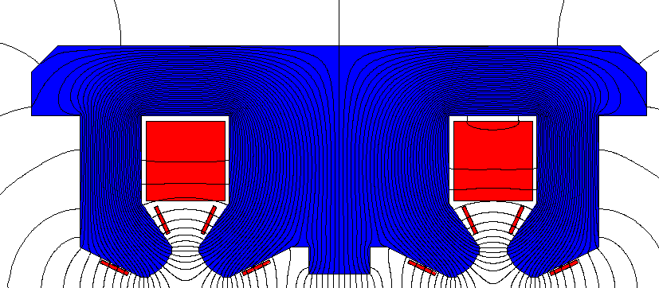
Layouts of trim coils
Layout 1: same with the main coil.
  Without trim coil, from Z to TT, b1 varies about 5 units.
  With 1.5% trim coil: b1 varies 260 units, b3 varies 20 units.
Layout 2: chosen.
  1.5% trim coil : harmonic variations are accepted at different energies.
Layout 1: trim coil
Layout 2: trim coil

Slide 14
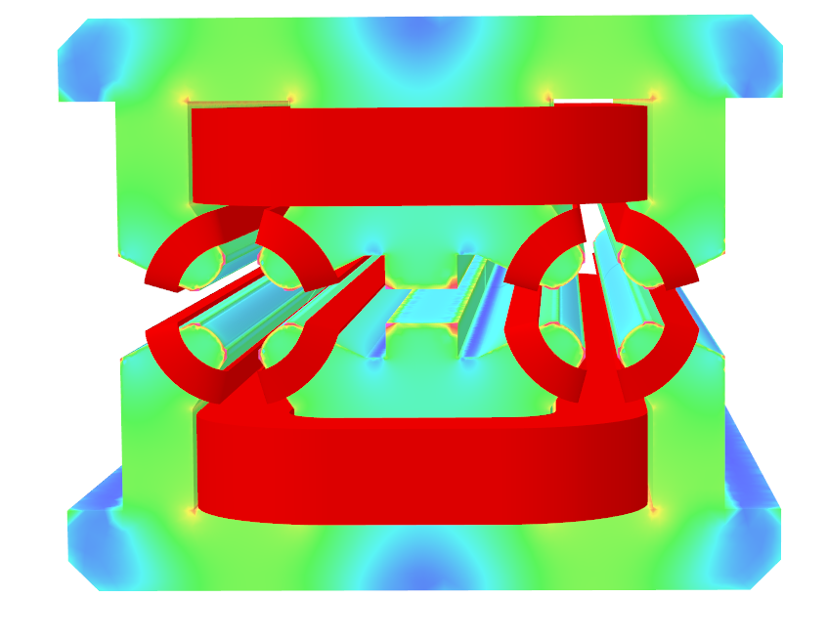
3D simulation
3D simulation with trim coils
  The harmonics change a little.
Trimcoil | 45GeV |  | 120GeV |  | 182.5GeV |  | change
 | AP_L | AP_R | AP_L | AP_R | AP_L | AP_R
G(T/m) | -3.18 | 3.28 | -8.39 | 8.64 | -12.68 | 13.05
b3 | 9.63 | -9.53 | 9.64 | -9.72 | 10.52 | -11.58 | -2.1
b4 | 0.53 | 0.41 | 0.54 | 0.42 | 0.56 | 0.43
b5 | 0.11 | -0.12 | 0.11 | -0.12 | 0.12 | -0.14
b6 | -0.34 | -0.31 | -0.35 | -0.31 | -0.36 | -0.33
x0(mm) | 0.2937 | -0.2834 | 0.2936 | -0.2807 | 0.2841 | -0.2560 | 0.03
Beam sep |  | -0.5770 |  | -0.5743 |  | -0.5401 | 0.04

Slide 15
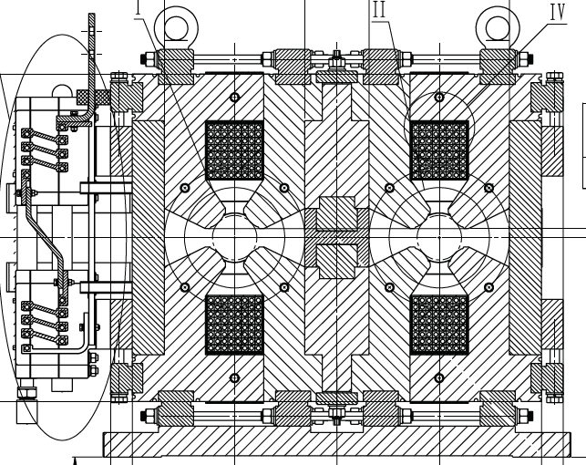
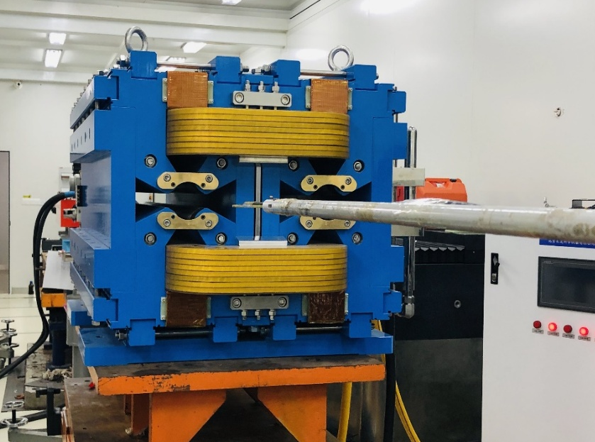
  Modification of short DAQ prototype
Modification of the dual aperture quadrupole magnet（short model: 1m)
  The new simulation of the 1m magnet is been checked. Mechanical design is done and the DT4 block will be modified.
  Machining is in progress.
  Field measurement methods: RCS and SSW.
    A new rotating coil is planned for the DAQ.
    Also a stretched wire measurement system is under development.

Slide 16
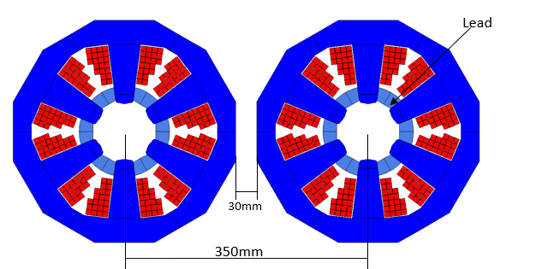
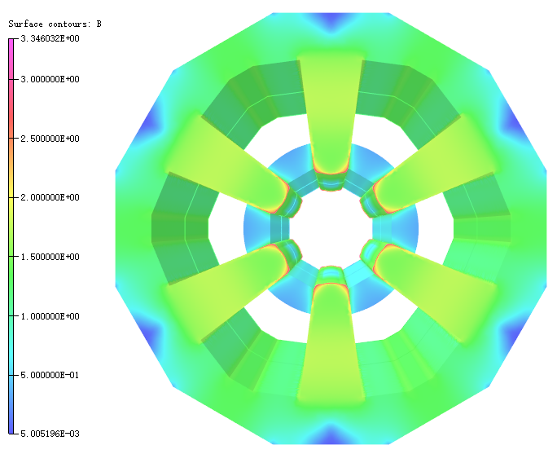
Design of sextupole magnet
Basic design
  Wedge-shaped magnetic poles are used to reduce magnetic pole saturation and improve excitation efficiency
  Further optimization to the position of the lead block and the arrangement of coil wires to reserve space for magnet assembly.
  Mechanical design is in progress.

Slide 17
Summary and next plan
For DAD:
  The long dual aperture dipole magnet is under production.
  The radiation protection and contact surface treatment experiment of the water-cooled aluminum rod is in progress.
  The RCS will be used to study field quality and remnant effect.
For DAQ:
  The new compensated scheme simulation for the F/D dual aperture quadrupole has been finished.
  The modification of the prototype is undergone and will be measured.
  New optimization will be done according to the measurement results.
The single sextupole magnet is in mechanical design.

Slide 18
Thank you for your attention!

