Slide 1
CEPC collider ring lattice design for the high luminosity scheme
Yiwei Wang
for the CEPC Accelerator Physics Group
The Institute of High Energy Physics, Chinese Academy of Sciences
The 2021 International Workshop on the High Energy Circular Electron Positron Collider
November 8-12, 2021, IHEP

Slide 2
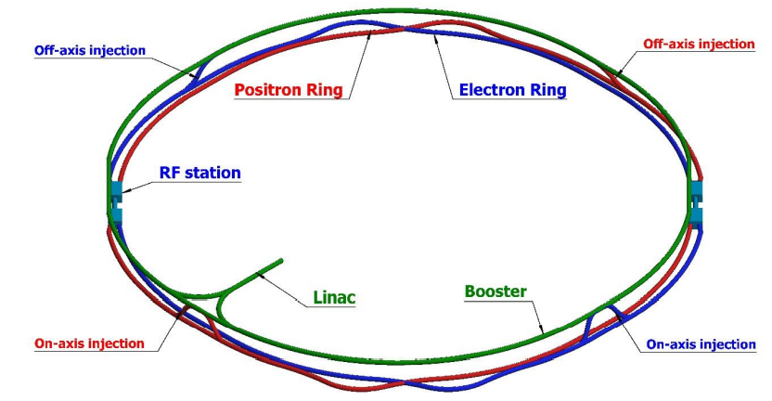
Design requirement of the CEPC collider ring
SR power 30MW (50 MW upgradable), 100km, 2 IPs
Crab waist collision
Local chromaticity correction for the interaction region
Non-interleaved sextupoles
Correction of sawtooth orbit
Shared cavities for two beam @ tt, Higgs
Dual aperture dipole and quadrupole magnets
Spin polarized beam @ Z
Asymmetric interaction region
Compatible of $t\overline{t}$/H/W/Z modes
Compatible with SPPC
*ref: K. Oide, arXiv:1610.07170; M. Zobov et al, Phys. Rev. Lett. 104, 174801(2010); A. Milanese, PRAB 19, 112401 (2016); CEPC pre-CDR; CEPC-CDR

Slide 3
Key parameters of high luminosity scheme
C. Yu, Y. W. Wang, Y. Zhang, S. Bai, Y. Zhu, D. Wang, J. Gao et al
Key parameters of CDR scheme for Higgs
L*=2.2m, θc=33mrad, βx*=0.36m, βy*=1.5mm, Emittance=1.2nm
Strength requirements of anti-solenoids B_{z}~7.2T
Two-in-one type SC quadrupole coils (Peak field 3.8T & 136T/m)
Key parameters of high luminosity scheme for Higgs
L*=1.9m, θc=33mrad, βx*=0.33m, βy*=1.0mm, Emittance=0.64nm
Strength requirements of anti-solenoids B_{z}~7.2T (6.8T with a shorter solenoid)
Two-in-one type SC quadrupole coils (Peak field 3.8T & 141T/m) with room temperature vacuum chamber & Iron yoke
Reduction of the length from IP to 1st quadrupole without changing the front-end position of the FD cryo-module
To make the lattice robust and provide good start point for DA

Slide 4
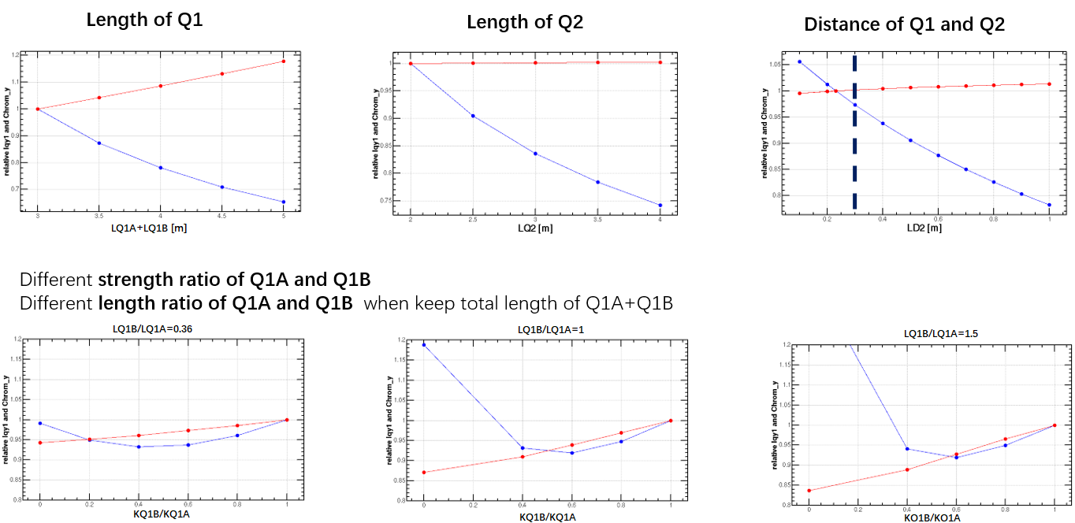
Optimization of final doublet design for Higgs
CEPC is mainly optimized at Higgs energy. The final doublet design was mainly optimized for Higgs.
Status of the FD @ Higgs：L*=1.9m, LQ1=2.5m, LQ2=1.5m, d=0.3m, KQ1A=142T/m, KQ1B=85T/m, KQ2=96T/m
Minimum of radiation power occurs at KQ1B/KQ1A≈0.6
Strength, length of Q1, Q2 and their distance are mainly constrained by superconducting, mechanical installation, vacuum technologies in the MDI.
—relative chromaticity on y plane
—relative radiation power on y plane
Minimum of radiation power occurs at KQ1B/KQ1A≈0.6
Different length of Q1A and Q1B doesn’t affect much on the minimum of the power and chromaticity. This provides more freedom of the FD technical design.

Slide 5
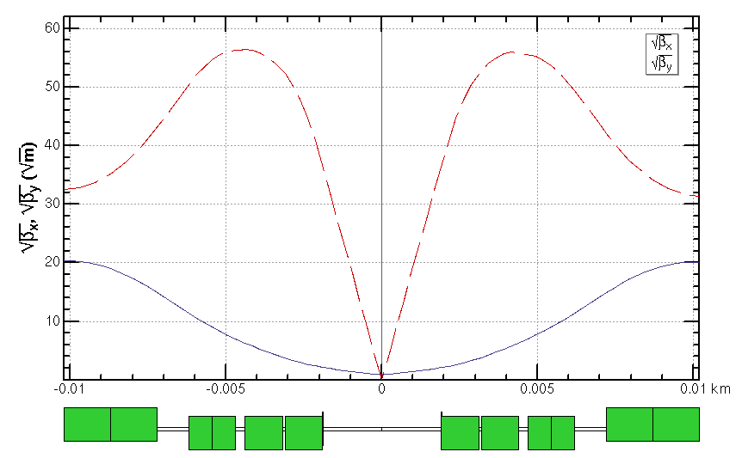
Interaction region for all modes
For the interaction region, the IP beta functions are refitted with the different combination of final doulets and the matching quadruples.
*ref: FCC-ee CDR
 | L [m] | Strength [T/m]
 |  | ttbar | Higgs | W | Z
Q1AIRU | 1.21 | -141 | -141 | -94 | -110
Q1BIRU | 1.21 | -59 | -85 | -56 | +65
Q2IRU | 1.5 | -51 | +95 | +63 | 0
Q3AIRU | 1.5 | +40 | 0 | 0 | +2
Q3BIRU | 1.5 | +40 | 0 | 0 | +2
Q1AIRD | 1.21 | -142 | -142 | -95 | -110
Q1BIRD | 1.21 | -64 | -85 | -57 | +65
Q2IRD | 1.5 | -47 | +96 | +64 | 0
Q3AIRD | 1.5 | +40 | 0 | 0 | +2
Q3BIRD | 1.5 | +40 | 0 | 0 | +2
ttbar
Q3BIRU
Q3AIRU
Q2IRU
Q1BIRU
Q1AIRU
Q1AIRD
Q1BIRD
Q2IRD
Q3AIRD
Q3BIRD
 | QD | QF
Z | Q1A | Q1B
W/H | Q1A+Q1B | Q2
ttbar | Q1A+Q1B+Q2 | add quad Q3A and Q3B
Strength of other modes doesn’t exceeded the one of Higgs mode.

Slide 6
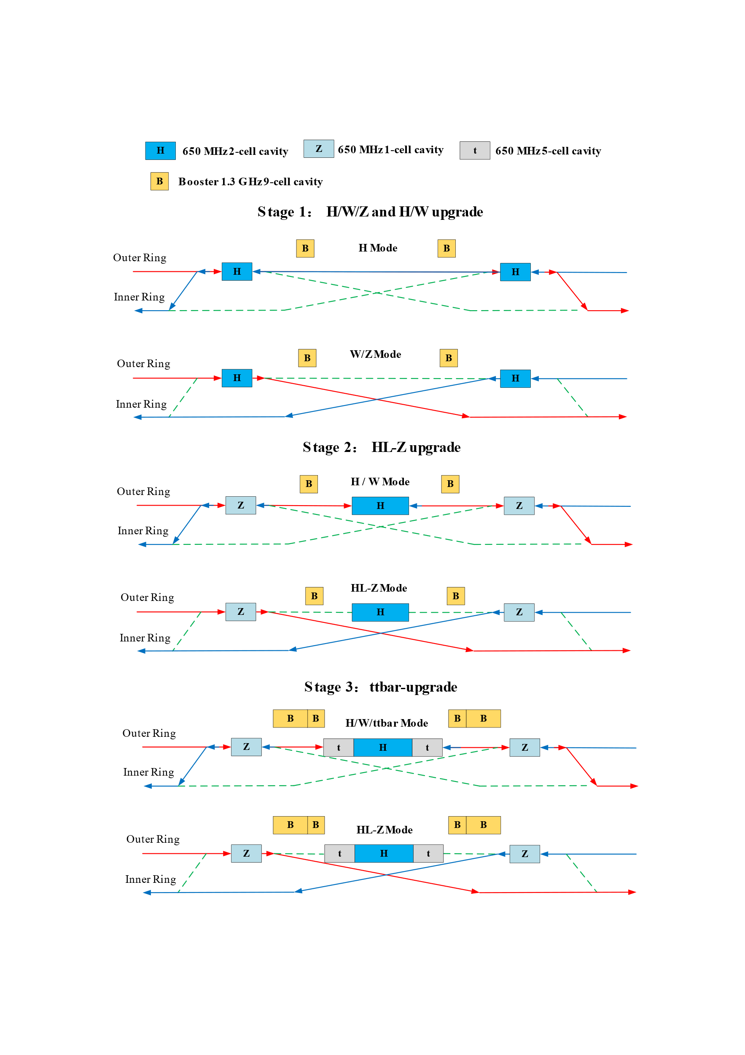
RF staging for compatible modes
1st priority of the Higgs running and flexible switching
Low cost at early stage
Get high luminosity for all modes
Stage 1 (H/W run)
Layout and parameters are same with CDR except longer central part
Medium or low luminosity at Z
Stage 2 (HL-Z upgrade)
Move Higgs cavities to center and add high current Z cavities.
By-pass low current H cavities.
Stage 3(ttbar upgrade)：
Add ttbar cavities (low current, high gradient, high Q)
Nb3Sn@4.2 K or others to significant reducing the cost of cryo-system and AC power.
by J. Y. Zhai, Yiwei Wang

Slide 7
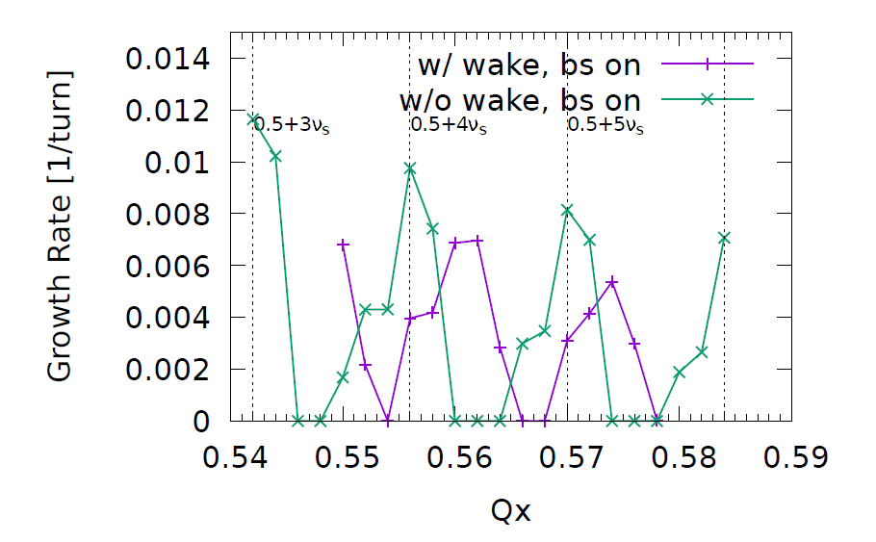
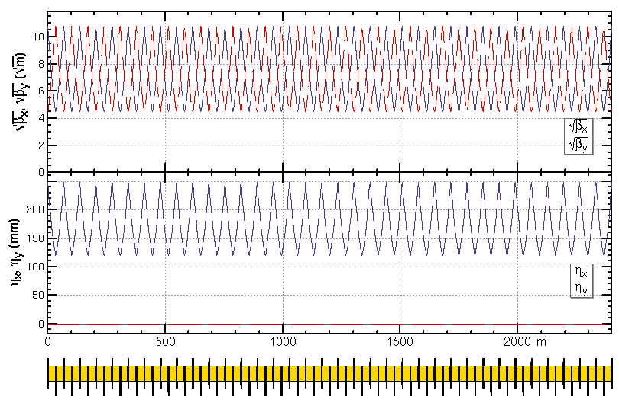
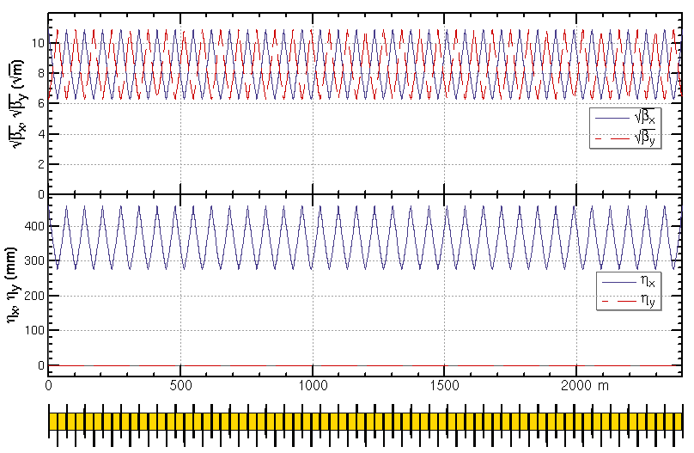
ARC region for all modes
Z and W modes need larger momentum compaction factor αp and thus larger emittance εx, Qs
To suppress the impedance induced instability at Z mode
To increase stable tune area if considering beam-beam effect and impedance consistently at W and Z modes
Microwave instability
stable tune area with both beam-beam and impedance (Z mode 90/90)
Na Wang,
CEPC Day, March 2020
Yuan Zhang
Phase advance reduced from 90° to 60° for W and Z modes
H/tt mode 90°/ 90°
W/Z mode 60°/ 60°

Slide 8
Status of beam parameters
 | ttbar | Higgs | W | Z
Number of IPs | 2
Circumference [km] | 100.0
SR power per beam [MW] | 30
Half crossing angle at IP [mrad] | 16.5
Bending radius [km] | 10.7
Energy [GeV] | 180 | 120 | 80 | 45.5
Energy loss per turn [GeV] | 9.1 | 1.8 | 0.357 | 0.037
Piwinski angle | 1.21 | 5.94 | 6.08 | 24.68
Bunch number | 35 | 249 | 1297 | 11951
Bunch spacing [ns] | 4524 | 636 | 257 | 25 (10% gap)
Bunch population [10^10] | 20 | 14 | 13.5 | 14
Beam current [mA] | 3.3 | 16.7 | 84.1 | 803.5
Momentum compaction [10^-5] | 0.71 | 0.71 | 1.43 | 1.43
Beta functions at IP (bx/by) [m/mm] | 1.04/2.7 | 0.33/1 | 0.21/1 | 0.13/0.9
Emittance (ex/ey) [nm/pm] | 1.4/4.7 | 0.64/1.3 | 0.87/1.7 | 0.27/1.4
Beam size at IP (sigx/sigy) [um/nm] | 39/113 | 15/36 | 13/42 | 6/35
Bunch length (SR/total) [mm] | 2.2/2.9 | 2.3/3.9 | 2.5/4.9 | 2.5/8.7
Energy spread (SR/total) [%] | 0.15/0.20 | 0.10/0.17 | 0.07/0.14 | 0.04/0.13
Energy acceptance (DA/RF) [%] | 2.3/2.6 | 1.7/2.2 | 1.2/2.5 | 1.3/1.7
Beam-beam parameters (ksix/ksiy) | 0.071/0.1 | 0.015/0.11 | 0.012/0.113 | 0.004/0.127
RF voltage [GV] | 10 | 2.2 | 0.7 | 0.12
RF frequency [MHz] | 650 | 650 | 650 | 650
HOM power per cavity (5/2/1cell)[kw] | 0.4/0.2/0.1 | 1/0.4/0.2 | -/1.8/0.9 | -/-/5.8
Longitudinal tune Qs | 0.078 | 0.049 | 0.062 | 0.035
Beam lifetime (bhabha/beamstrahlung)[min] | 81/23 | 39/40 | 60/700 | 80/18000
Beam lifetime [min] | 18 | 20 | 55 | 80
Hour glass Factor | 0.89 | 0.9 | 0.9 | 0.97
Luminosity per IP[1e34/cm^2/s] | 0.5 | 5.0 | 16 | 115
Y.W. Wang, D. Wang, Y. Zhang, J. Y. zhai, S.Bai, Y.D. Liu, N. Wang, C. X. Cui, C.H. Yu, J. Gao et al
*Yiwei Wang et al, IPAC21, WEPAB033

Slide 9
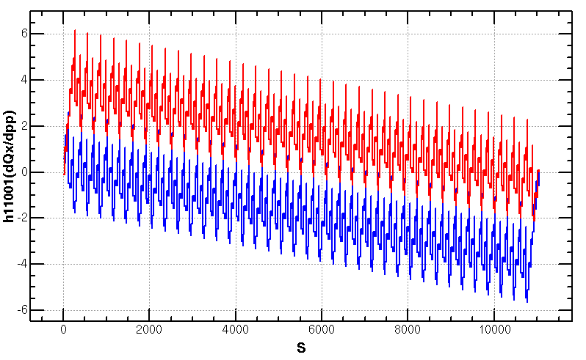
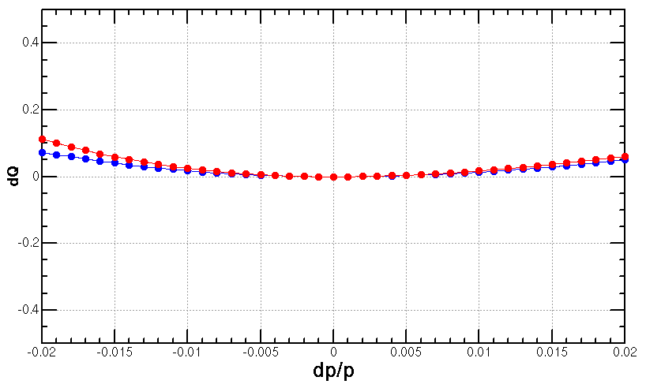
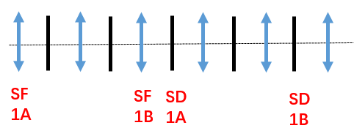
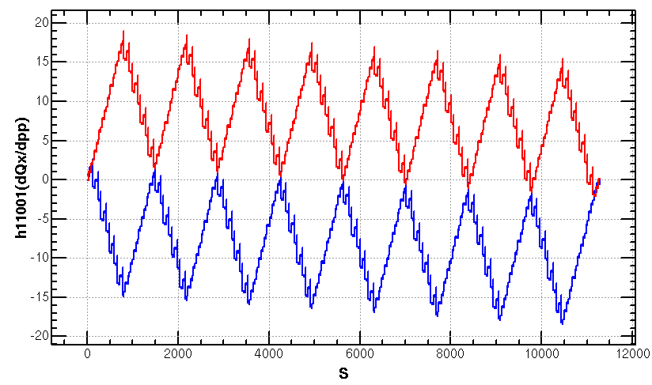
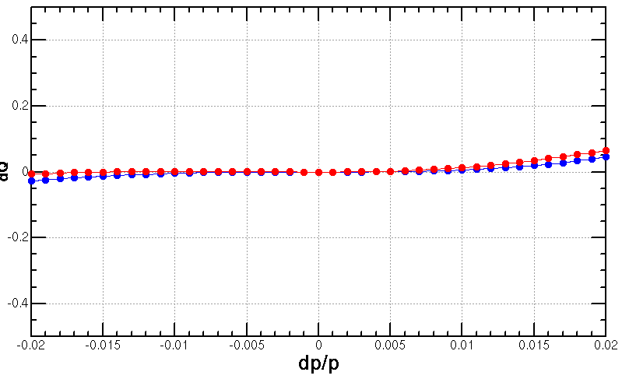
Optimization of the ARC aberration at ttbar and Higgs modes
2nd order chromaticity is a main aberration for the optimization of momentum acceptance with 2-repeated sextupole scheme.
In previous versions, 2nd order chromaticity generated in the ARC region are corrected with IR knobs (phase advance or K1).
However, the IR knobs will generate distortions at IP (beta, alfa and dispersion) especially for the horizontal plane.
A lattice with 8-repeated sextupoles scheme
much less 2nd order chromaticity for the horizontal plane
Scheme with 2 repeated sextupoles
Proposed by K. Oide
Q’’=313, 410
Q’’=9, 145
Scheme with 8 repeated sextupoles
Proposed by Tianjian Bian

Slide 10
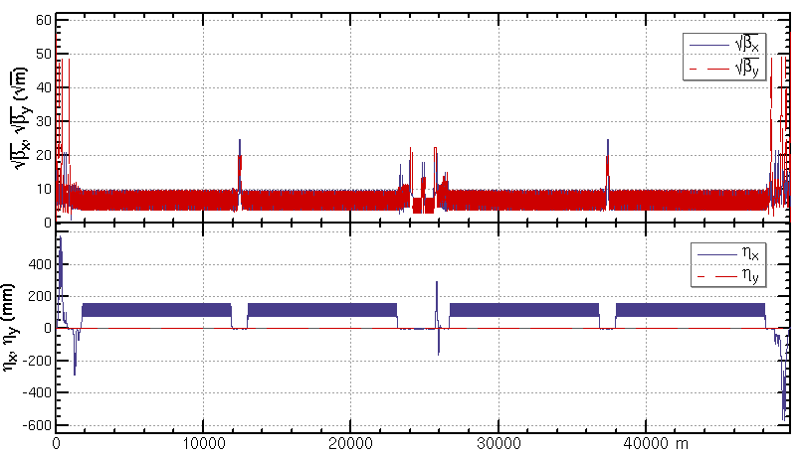
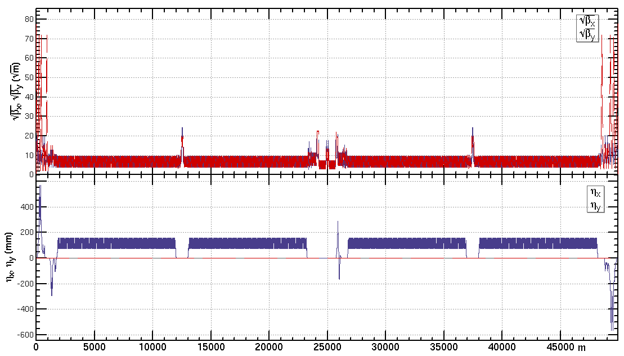
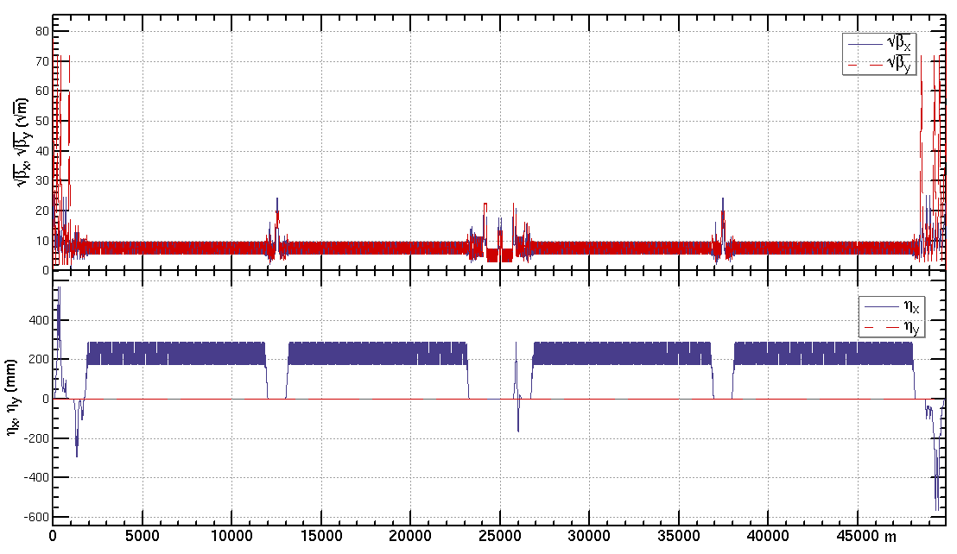
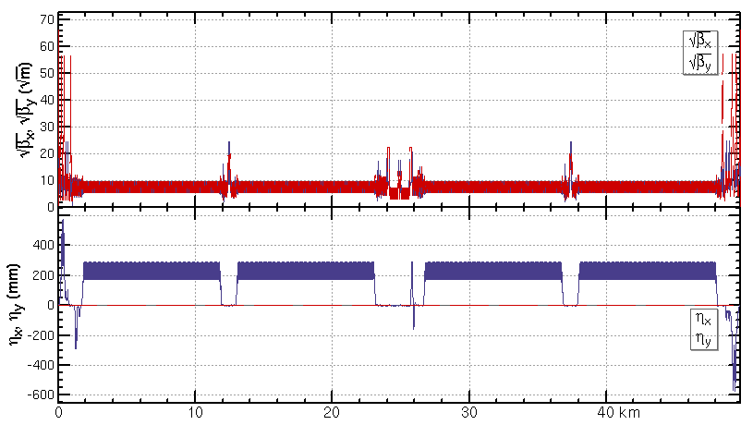
Lattice of half ring
ttbar: εx=1.4nm, β=1.04m/2.7mm
Higgs: εx=0.64nm, β=0.33m/1mm
W: εx=0.87nm, β=0.21m/1mm
Z: εx=0.27nm, β=0.13m/0.9mm
The new RF layout has not been implemented in these lattices.

Slide 11
Dynamic aperture requirement
X. H. Cui, Y. Zhang, Y. W. Wang
 | ttbar | Higgs | W | Z
Horizontal Emittance in collider/booster [nm] | $1.4$ / 2.83 | $0.64$/ 1.26 | $0.87$/ 0.56 | $0.27$ / 0.19
DA requirement from injection | $${\text{13.9} σ}_{x}×7 σ_{y}$$ off axis | $$14.4{ σ}_{x}×7{ σ}_{y}$$ off axis $$7{ σ}_{x}×7 σ_{y}$$ on axis | $${\text{10.5} σ}_{x}×5 σ_{y}$$ off axis | $${\text{11.8} σ}_{x}×5{ σ}_{y}$$ off axis
Beam lifetime (mainly bhabha and beamstrahlung) [min] | 18 | 20 | 55 | 80
Energy acceptance requirement from beam lifetime [%] | 2.3 | 1.7 | 1.2 | 1.3
DA requirement | ttbar | Higgs | W | Z
with on-axis injection | - | ${\text{7}σ}_{x}×15σ_{y}×$1.7% | - | -
with off-axis injection | ${\text{13.9}σ}_{x}×{20σ}_{y}×$2.3% | ${\text{14.4}σ}_{x}×15σ_{y}×$1.7% | ${\text{1}\text{0.5}σ}_{x}×9σ_{y}×$1.2% | ${\text{1}\text{1.8}σ}_{x}×9σ_{y}×$1.3%
* need beam-beam simulation to check for y

Slide 12
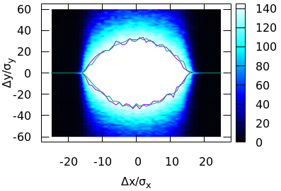
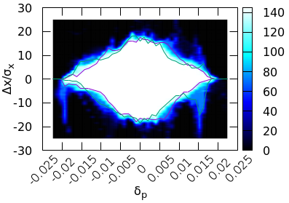
Dynamic aperture @ Higgs
Tracking to get DA without errors, with turns for one transvers damping time, with 4 initial phases
Higgs DA achieved DA requirement with 52variables (32 arc sextupoles + 8 IR sextupoles + 4 multipoles + 8 phase advance)
Effects included in tracking
Synchrotron motion
Radiation loss in all magnets
Tapering
Crab waist sextupole
Maxwellian fringes
Kinematic terms
Finite length of sextupole
with coupling 0.2%
J. Wu, Y. Zhang, Y. W. Wang
Achieved (w/o error): $16σ_{x}×32σ_{y}×1.9\%$
Goal (w/ error): $7σ_{x}×15σ_{y}×1.7\%$

Slide 13
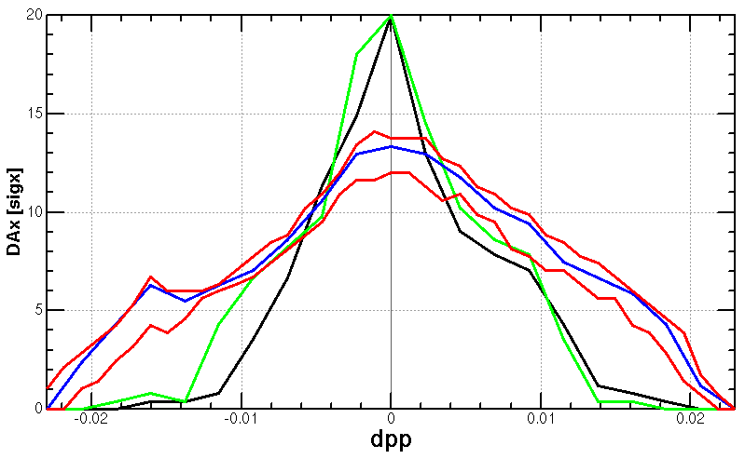
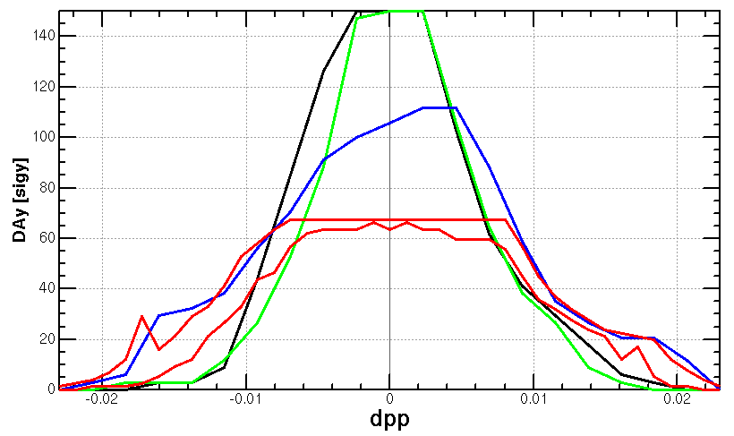
Dynamic aperture @ ttbar
Tracking to get DA without errors, with turns for one transvers damping time, with initial phase 0
ttbar DA achieved energy acceptance of 2.0% with 32 arc sextupoles
will be further optimized with other variables
Totally 256 families of arc sextupoles.
Effects included in tracking
Synchrotron motion
Radiation loss in all magnets
Tapering
Crab waist sextupole
Maxwellian fringes
Kinematic terms
Finite length of sextupole
w/o RF
w/o rad
w/ damp
w/ damp+fluc (max, min)
turns for one transvers damping time
Initial phase=0

Slide 14
Optimization of the ARC aberration at W and Z modes
The distribution of sextupoles for Higgs & ttbar mode allowed to select –I sextupole pairs for W &Z mode.
6*6=36 cases for 23 cells
There are much more combinations if choose different cases in each arc section (184 cells)
SF
1A
SF
1B
SF
2A
SF
2B
SF3A
SF
3B
SF
4A
SF
4B
SD
1A
SD
1B
SD
2A
SD
2B
SD3A
SD
3B
SD
4A
SD
4B
-I
-I
-I
-I
@ dp/p=1%
1st pair | 2nd pair
(1A, 2A) | (2B,3B) | (3A,4A) | (3B,4B)
(1B, 2B) | - | (3A,4A) | (3B,4B)
(2A, 3A) | - | - | (3B,4B)

Slide 15
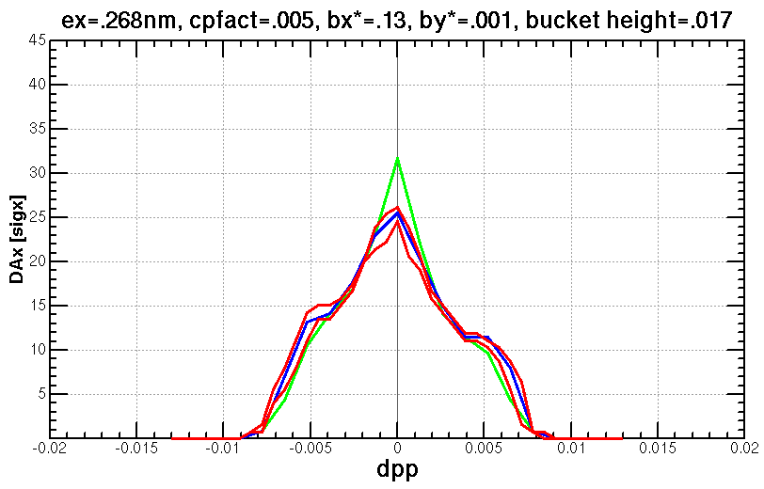
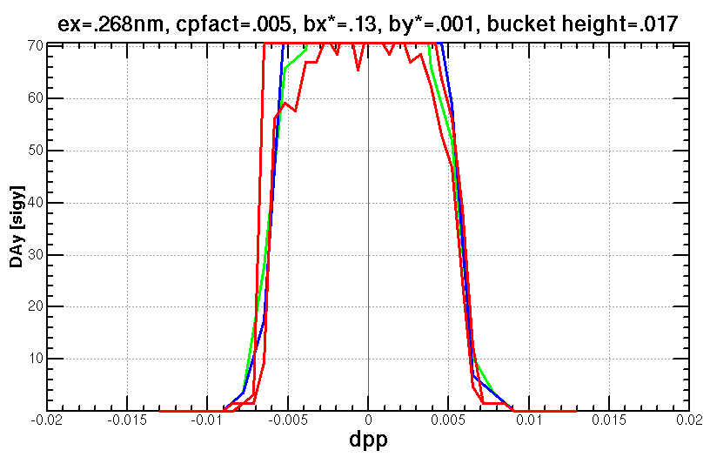
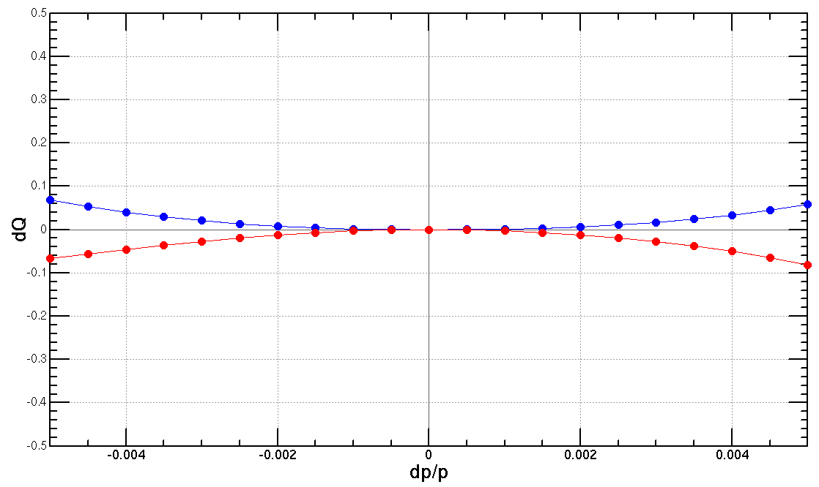
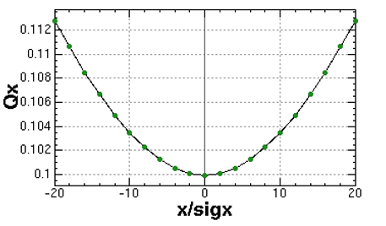
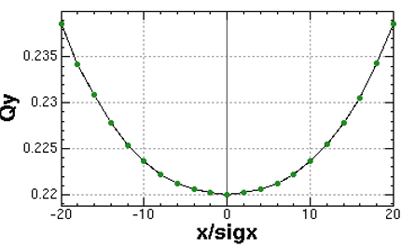
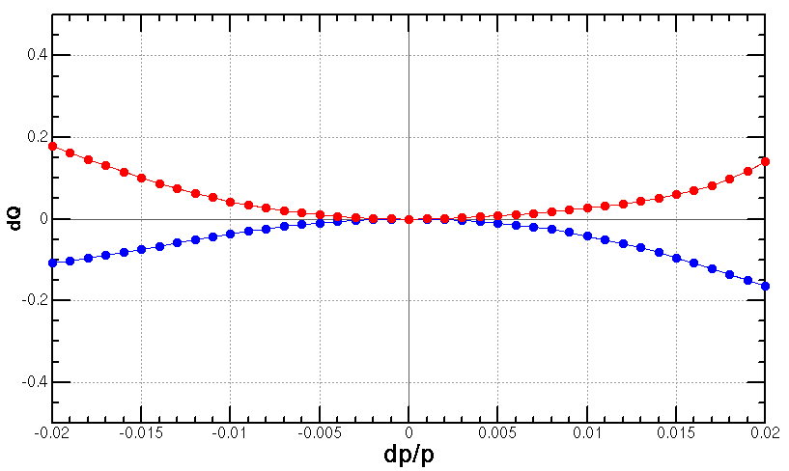
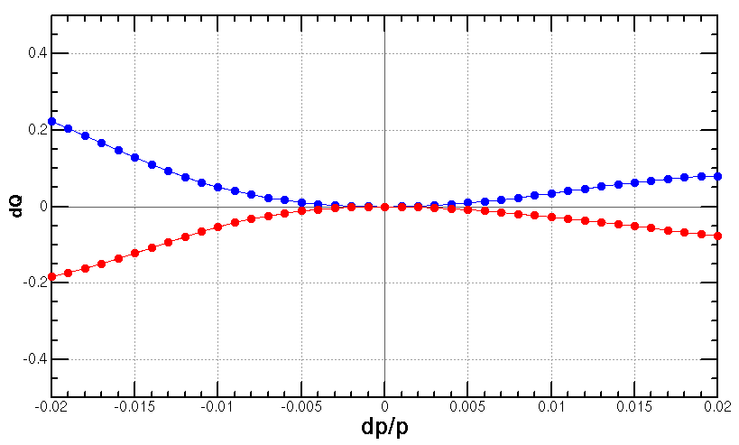
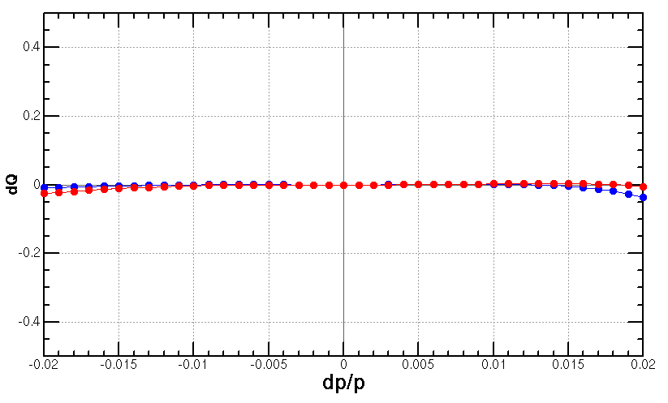
Dynamic aperture @ Z
w/o RF
w/o rad
w/ damp
w/ damp+fluc (max, min)
turns for one transvers damping time
Initial phase=0
with 2 families only
case {1,4}
case {1,4}
case {4,3}
case {3,4}
case {4,3}+{3,4}
Possible solution
case {4,3}+{3,4}
+

Slide 16
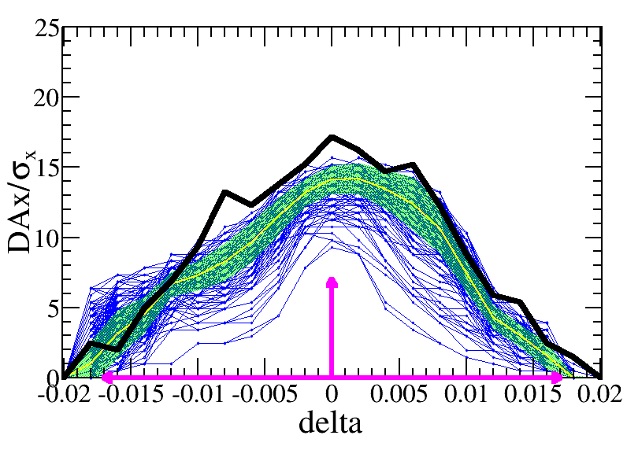
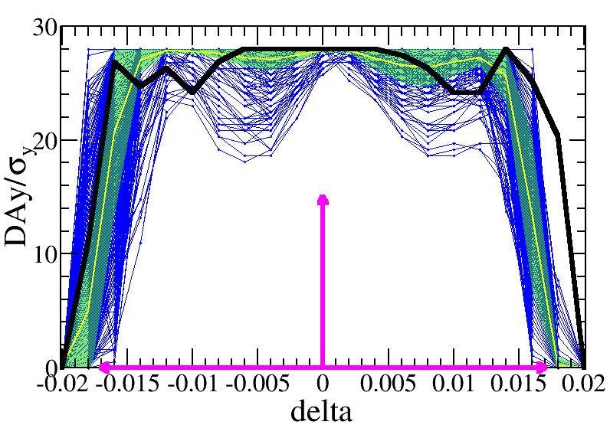
Dynamic aperture with error @ Higgs
Bin Wang,
Yuanyuan Wei,
Yiwei Wang
Error correction started with 50 um misalignment in IR quadrupoles
closed orbit distortion (COD) and dispersion free steering (DFS) correction has been done
DA with 418 (out of 1000) error seeds satisfy the on-axis injection requirements
Further optimization with 100 um misalignment in IR quadrupoles is undergoing.
Component | Δx (mm) | Δy (mm) | Δθ_{z} (mrad) | Field error
Dipole | 0.10 | 0.10 | 0.1 | 0.01%
Arc Quadrupole | 0.10 | 0.10 | 0.1 | 0.02%
IR Quadrupole | 0.05 | 0.05 | 0.05
Sextupole | 0.10 | 0.10 | 0.1
—DA w/o error
—DA of each seed
—mean value
—statistic errors
—requirement
Lattice version cepc.lat.diff.8713.346.2p used
εx=0.64nm, β=0.33m/1mm, L*=1.9m

Slide 17
Summary
The high luminosity scheme of CEPC collider ring with 30MW has been designed by mainly squeezing the βy* and emittance.
New aberration correction scheme in ARC region, compatible final quadrupoles in IR
Phase advance reduced from 90° to 60° for W/Z mode to suppress impedance instability and increase stable tune area
Dynamic aperture w/o error @ Higgs energy fulfills the requirements. Dynamic aperture @ ttbar energy will be further optimized with other variables. Tune shift will be corrected to optimize the DA @ W & Z.
The imperfection correction to the high luminosity lattice is on going.
With transverse alignment of 50um for final quadrupoles and 100um for other magnets, COD and dispersion correction were made while beta-beating was not done yet.
The dynamic aperture with errors @ Higgs fulfill the requirement.

Slide 19
Comparison of the sextupole numbers
The 8-repeated scheme saved around 31% sextupoles compared with the 2-repeated scheme.
 | 2 repeated scheme | 8 repeated scheme
ttbar/Higgs (90°/ 90°) | period=5 cells sext. num=(2 SF, 2 SD) | period=23 cells sext. num=(8 SF, 8 SD)
W/Z (60°/ 60°) | period=7 cells sext. num=(2 SF, 2 SD) | period=23 cells sext. num=(4 SF, 4 SD)
All modes | period=35 cells sext. num=(14 SF, 14 SD)+ (6 SF, 6 SD)=(20 SF, 20 SD) | period=23 cells sext. num=(8 SF, 8 SD)
Main magnets in ARC | CDR Quantity, length and field | high lumi. w/ 8 repeated scheme Quantity, length and field | high lumi. w/ 8 repeated scheme Quantity, length and field
Dipoles (dual aperture) | 2320, 28.686 m, 373 Gs | 2944, 21.7 m, 390 Gs (Quant +27%, total length -4%) | 2944, 21.7 m, 390 Gs (Quant +27%, total length -4%)
Quadpoles (dual aperture) | 2320, 2 m, 8.4 T/m | 2944, 3 m, 10.6 T/m (Quant +27%, total length +90%) | 2944, 3 m, 10.6 T/m (Quant +27%, total length +90%)
Sextupoles (single aperture) | SF: 896, 0.7 m, 506 T/m^2 SD: 896, 0.7 m*2, 506 T/m^2 | SF: 1024, 0.7 m, 1100 T/m^2 SD: 1024, 0.7 m*2, 1129 T/m^2 (Quant +14%, total length +14%) | SF: 1024, 0.7 m, 1100 T/m^2 SD: 1024, 0.7 m*2, 1129 T/m^2 (Quant +14%, total length +14%)

Slide 20
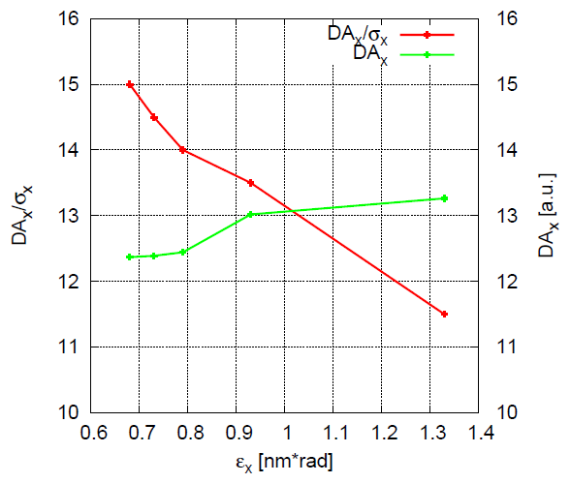
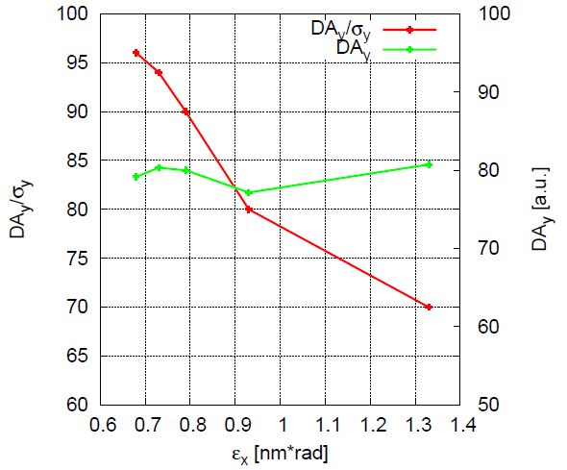
Dynamic aperture vs. emittance
Larger normalized dynamic aperture with smaller emittance ( for ex~1nm )
The nonlinearity in interaction region is much larger than the arc region
Better DA with smaller emittance benefits from smaller nonlinearity in the IR and smaller beam size though stronger nonlinearity in ARC thus stronger error correction will need
Efficient direction of dynamic aperture optimization
Just show the tendency; each dynamic aperture result can be further optimized with directly optimization
DA without fluctuation
Notes:
More slides with the explanation

