Slide 1

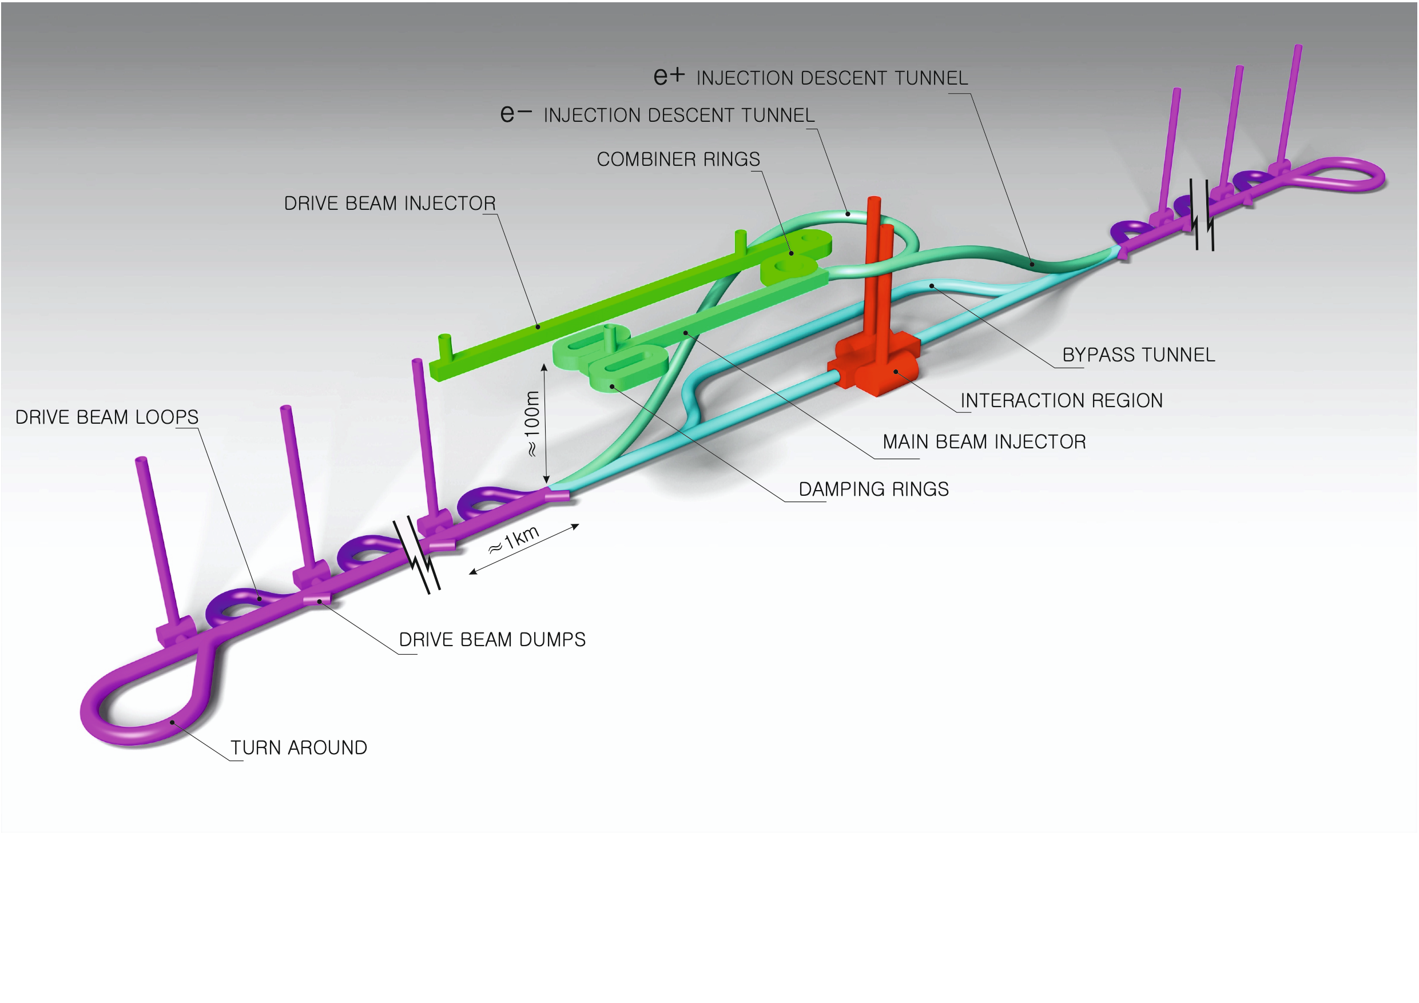
Steinar Stapnes, CERN

Slide 2
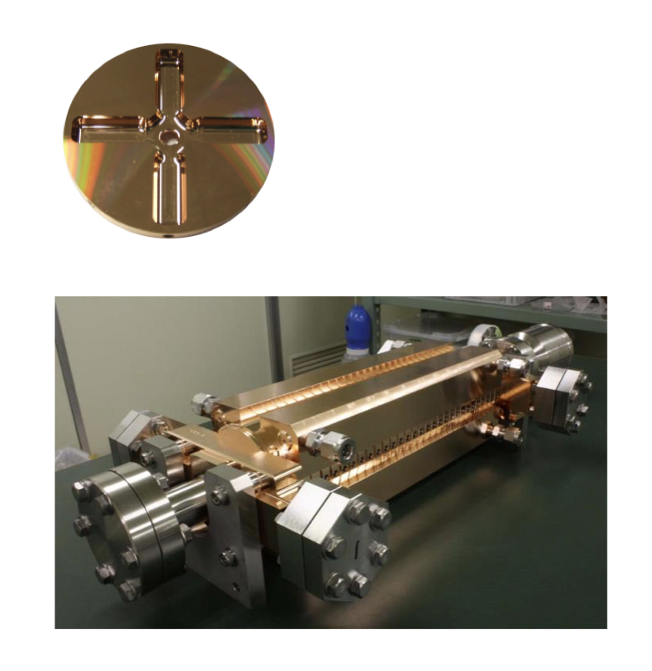
Proposed e⁺e– linear colliders – CLIC
The Compact Linear Collider (CLIC)
  Timeline: Electron-positron linear collider at CERN for the era beyond HL-LHC (~2035 Technical Schedule)
  Compact: Novel and unique two-beam accelerating technique with high-gradient room temperature RF cavities (~20’500 cavities at 380 GeV), ~11km in its initial phase
  Expandable: Staged programme with collision energies from 380 GeV (Higgs/top) up to 3 TeV (Energy Frontier)
  CDR in 2012. Updated project overview documents in 2018 (Project Implementation Plan). See resource slide.
  Cost: 5.9 BCHF for 380 GeV (stable wrt 2012)
  Power: 168 MW at 380 GeV (reduced wrt 2012),
  some further reductions possible
  Comprehensive Detector and Physics studies
Accelerating structure prototype for CLIC:
12 GHz (L~25 cm)

Slide 3
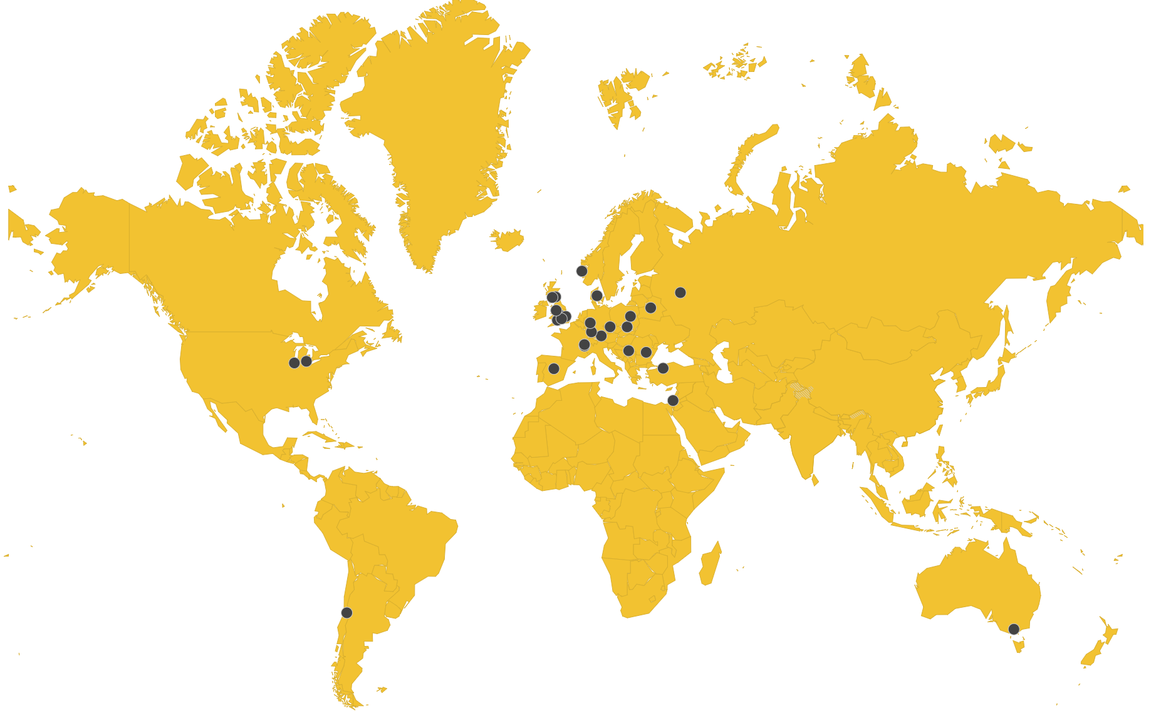
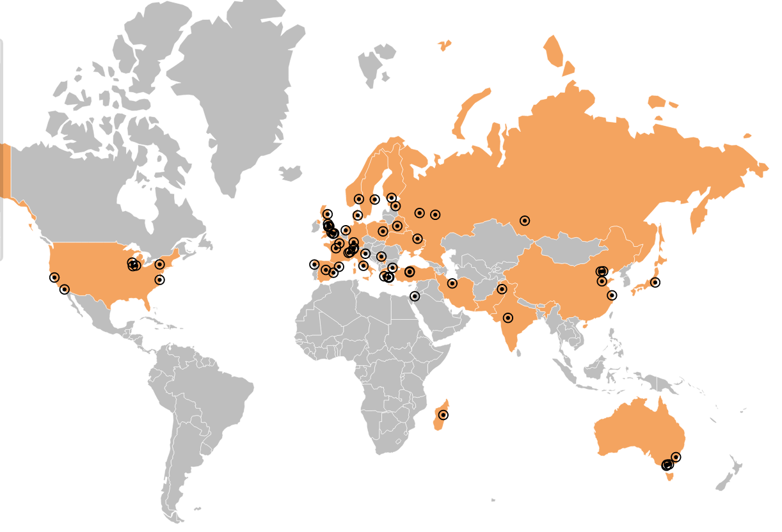
Collaborations
CLIC accelerator
  ~50 institutes from 28 countries
  CLIC accelerator studies
  CLIC accelerator design and development
  Construction and operation of CLIC Test Facility, CTF3
CLIC detector and physics (CLICdp)
  30 institutes from 18 countries
  Physics prospects & simulations studies
  Detector optimisation + R&D for CLIC
+ strong participation in the CALICE and FCAL Collaborations and in AIDA-2020

Slide 4
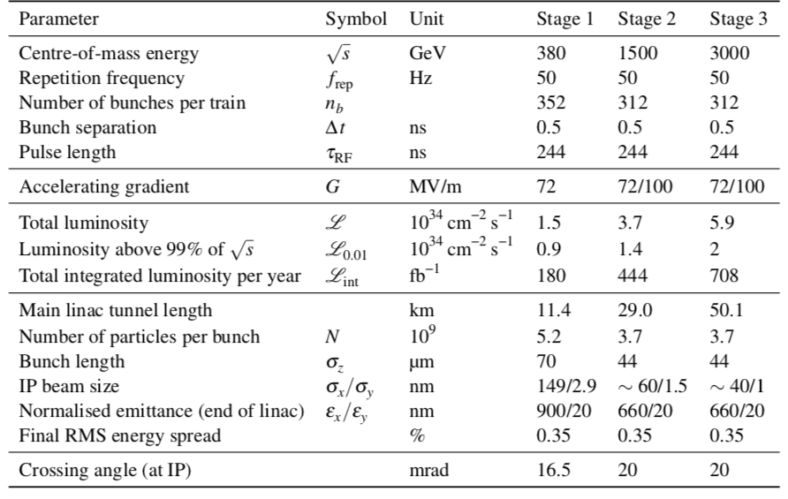
CLIC parameters

Slide 5
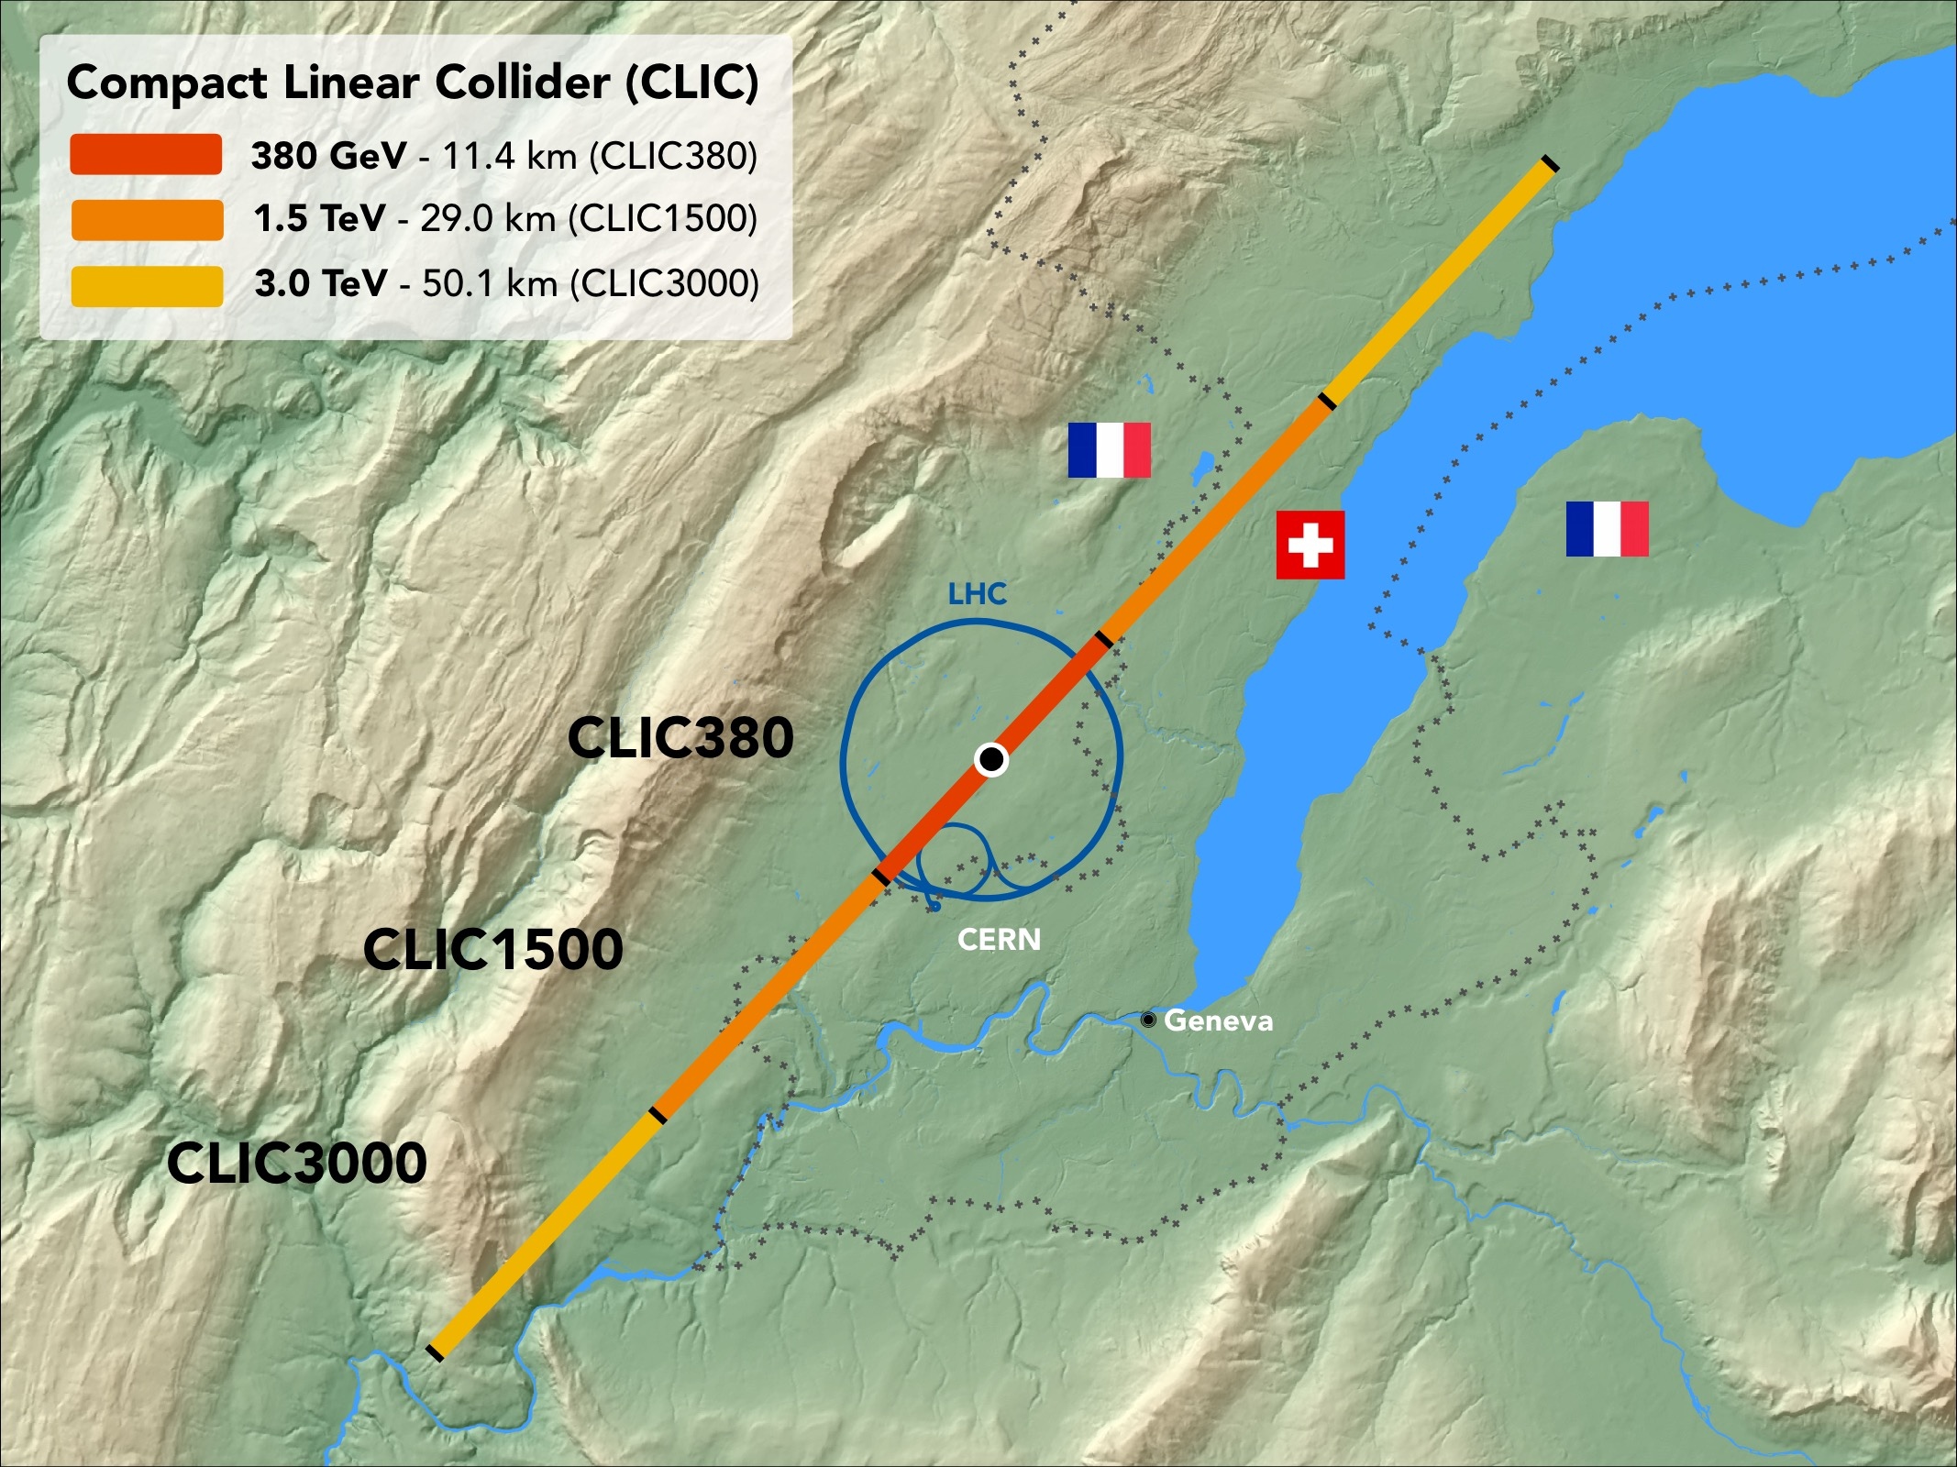
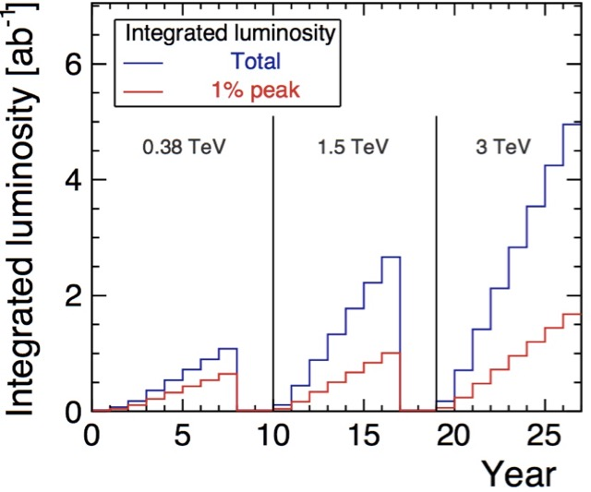
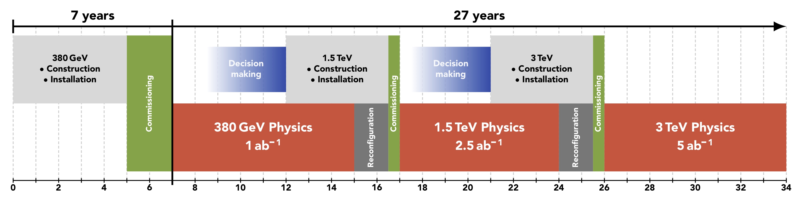
CLIC timeline
Ramp-up and up-time assumptions: arXiv:1810.13022, Bordry et al.
Technology Driven Schedule from start of construction shown above.
A preparation phase of ~5 years is needed before (estimated resource need for this phase is ~4% of overall project costs)

Slide 6
CLIC Project Readiness Report (PRR)
Project Readiness Report as a step toward a TDR – for next ESPP
Assuming ESPP in 2026, Project Approval ~ 2028, Project (tunnel) construction can start in ~ 2030.
Focusing on:
The X-band technology readiness for the 380 GeV CLIC initial phase
Optimizing the luminosity at 380 GeV
Improving the power efficiency for both the initial phase and at high energies
More details:
X-band studies: Structure manufacturability and optimized conditioning, interfaces to all connecting systems for large scale production, designs for and support of use in applications, e.g. for FEL linacs, ICS and medical linacs, possible future improvements for power/cost
Luminosity: beamdynamics studies and related hardware optimisation for nano beams from damping rings to final focus (mechanical and thermal stability, alignment, instrumentation, vacuum systems, stray field control, magnet stability, etc)
Improving damping ring and drive beam RF efficiency, study parameters and potential hardware changes to reduce power, from 380 GeV to multi-TeV energies with high luminosities

Slide 7

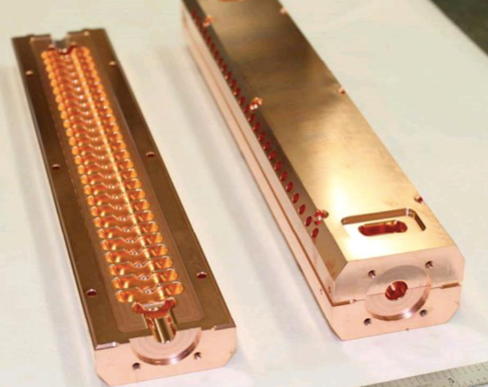
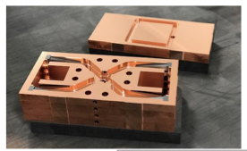
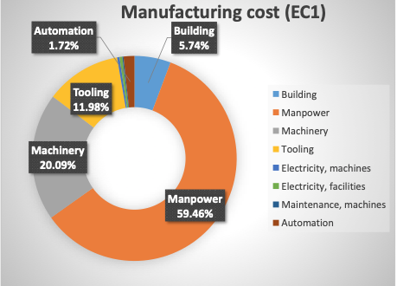
X-band
Industrial questionnaire:
Based on the companies feedback, the preparation phase to the mass production could take about five years. Capacity clearly available.
Structures and components currently in production to study designs, operation/conditioning, manufacturing, industry qualification/experience
EU projects: ARIES, I-FAST, new TNA

Slide 8
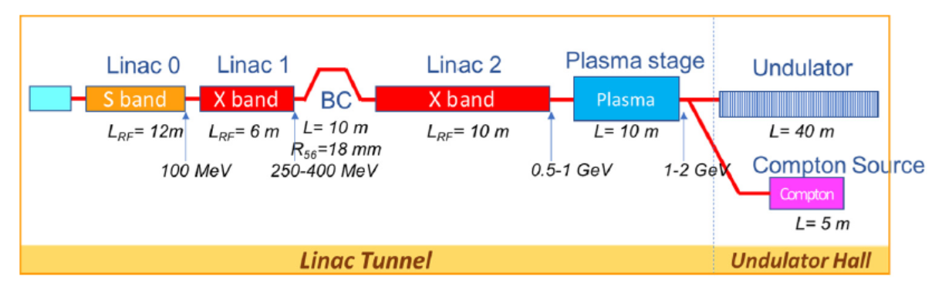
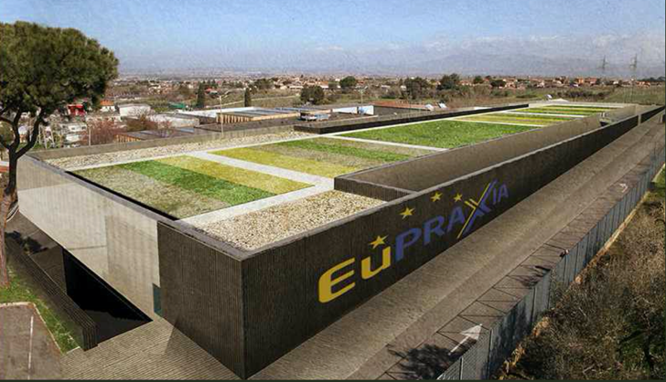
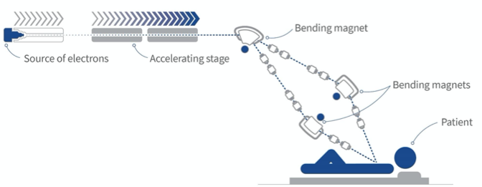
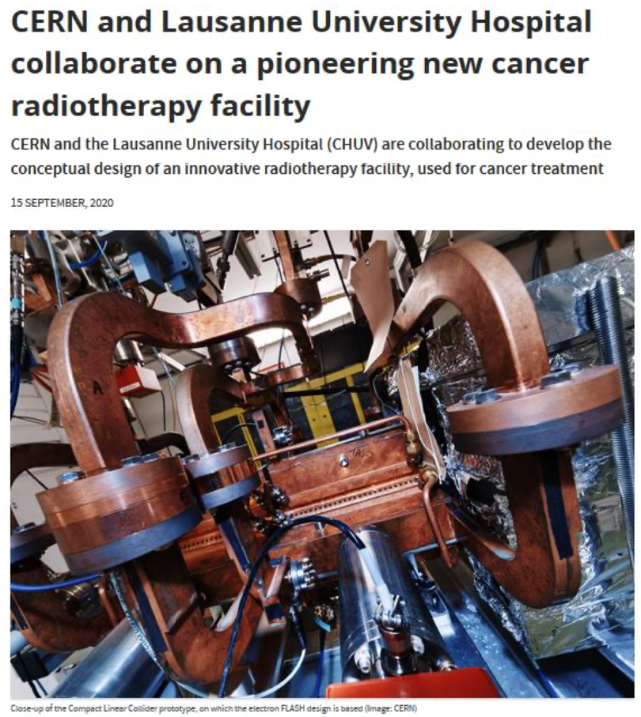
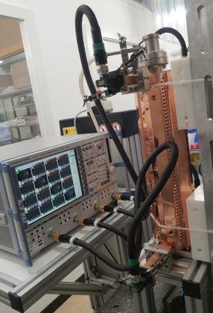
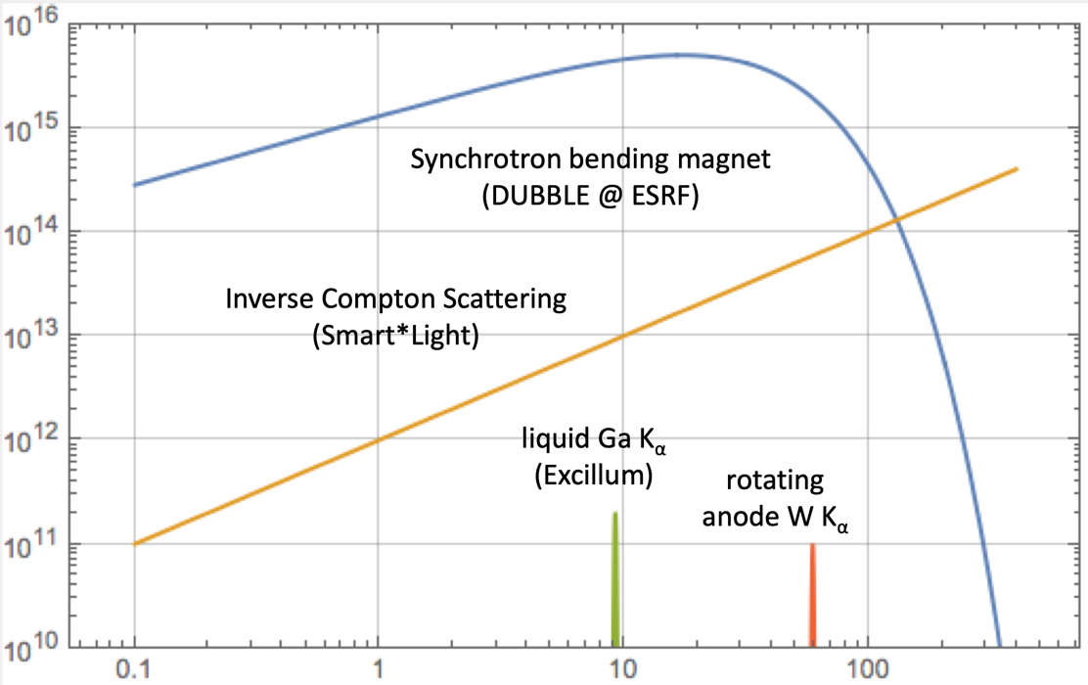
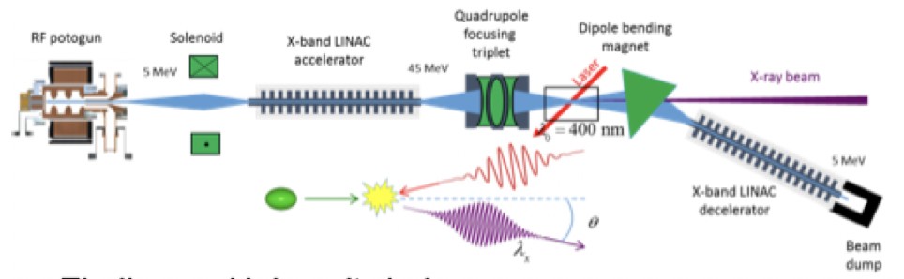
Applications – injector, X-band modules, RF
CompactLight Design Studies 2018-21 (link)
INFN 1 GeV linac
Flash RT CDR, next build it at CHUV
“Design Studies” for ICS
AERES, IFAST and TNA project
X-band accelerating modules
Notes:
Size of investments

Slide 9
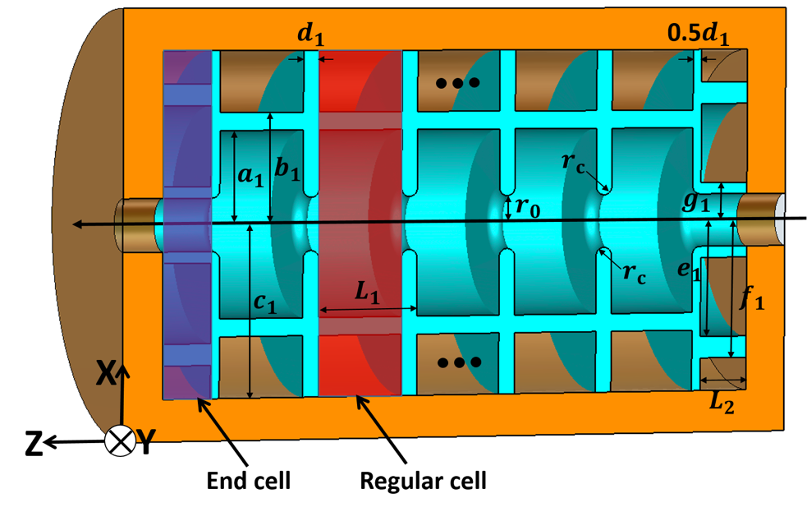
Fundamental studies of high-field phenomena – field emission, material dynamics, breakdown initiation, breakdown evolution, conditioning. Specific techniques and theoretical frameworks include dislocation dynamics, plasmons and collective phenomena, atomistic and kinetic Monte Carlo simulation, FEM simulations, plasma formation and dynamics and advanced electron microscopy (SEM, FIB, TEM).
Main collaborations – Jerusalem, Helsinki, Uppsala, Tartu
Design for high-gradient and efficiency – predictive modelling of high-field performance as a function of RF design. Materials (including di-electrics) and processes for high gradients and efficiency.
Designs for CLIC, but also RFQ, Muon collider, XFEL, ICS, etc
Experimental support XBoxes and pulsed DC system.
Cryogenic systems – Combining high-gradients in cryo-copper and high-temperature superconductors for high-efficiency and reduced peak RF power requirements.

Slide 10
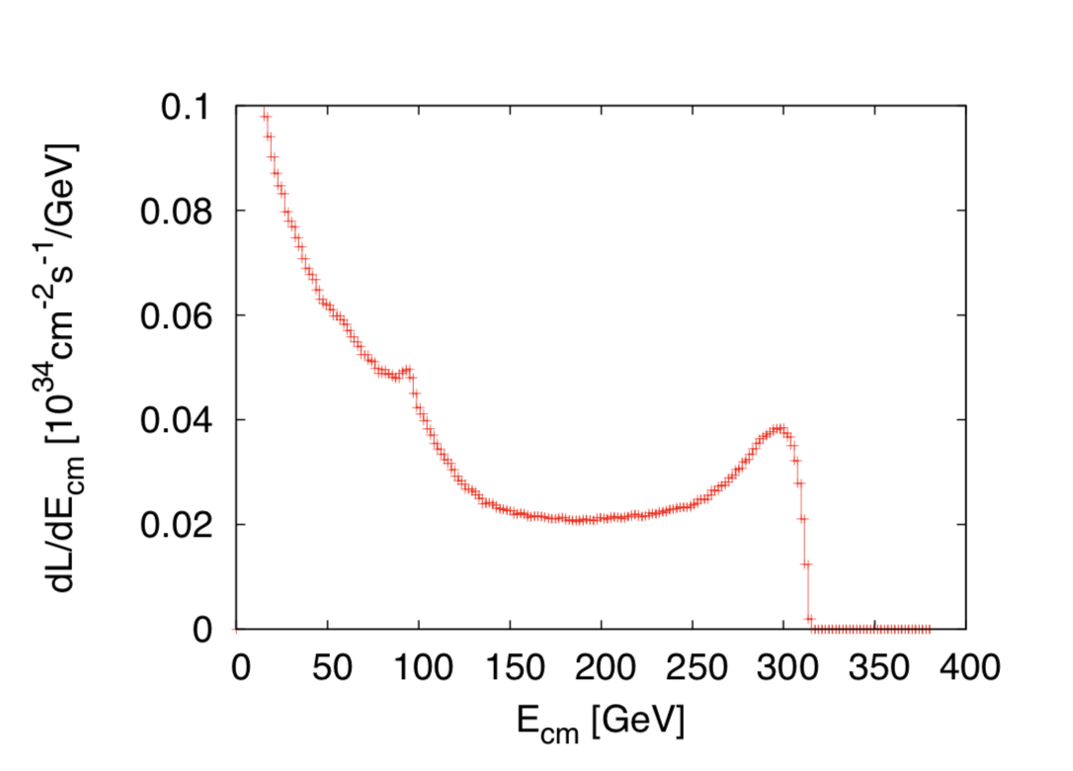
CLIC acc. studies – luminosity
Further work on luminosity performance, possible improvements and margins, operation at the Z-pole and gamma-gamma
    Z pole performance, 2.3x10³² – 0.4x10³⁴ cm⁻² s⁻¹
      The latter number when accelerator configured for Z running (e.g. early or end of first stage)
      Gamma – Gamma spectrum (example)
      Luminosity margins and increases
      Baseline includes estimates static and dynamic degradations from damping ring to IP: 1.5 x 10³⁴ cm⁻² s⁻¹, a “perfect” machine will give : 4.3 x 10³⁴ cm⁻² s⁻¹, so significant upside
      In addition: doubling the frequency (50 Hz to 100 Hz) would double the luminosity, at a cost of +50 MW and ~5% cost increase
    CLIC note about these studies
Notes:
Is this the last version of this slide, now published

Slide 11
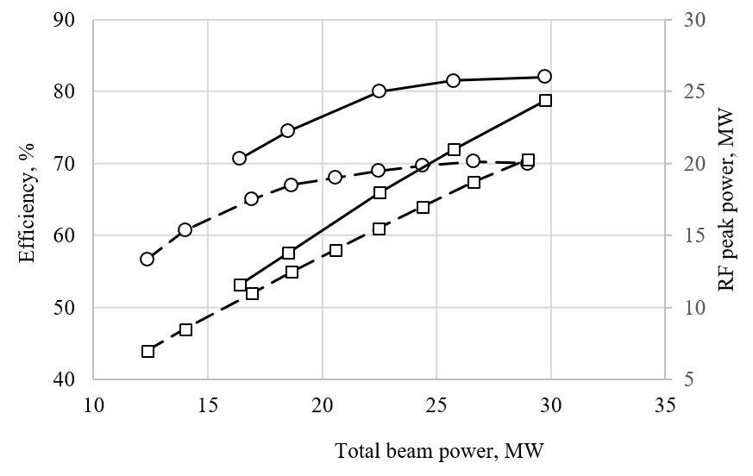
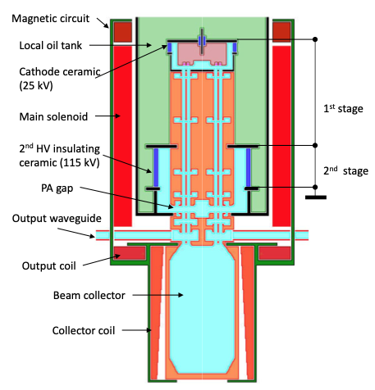
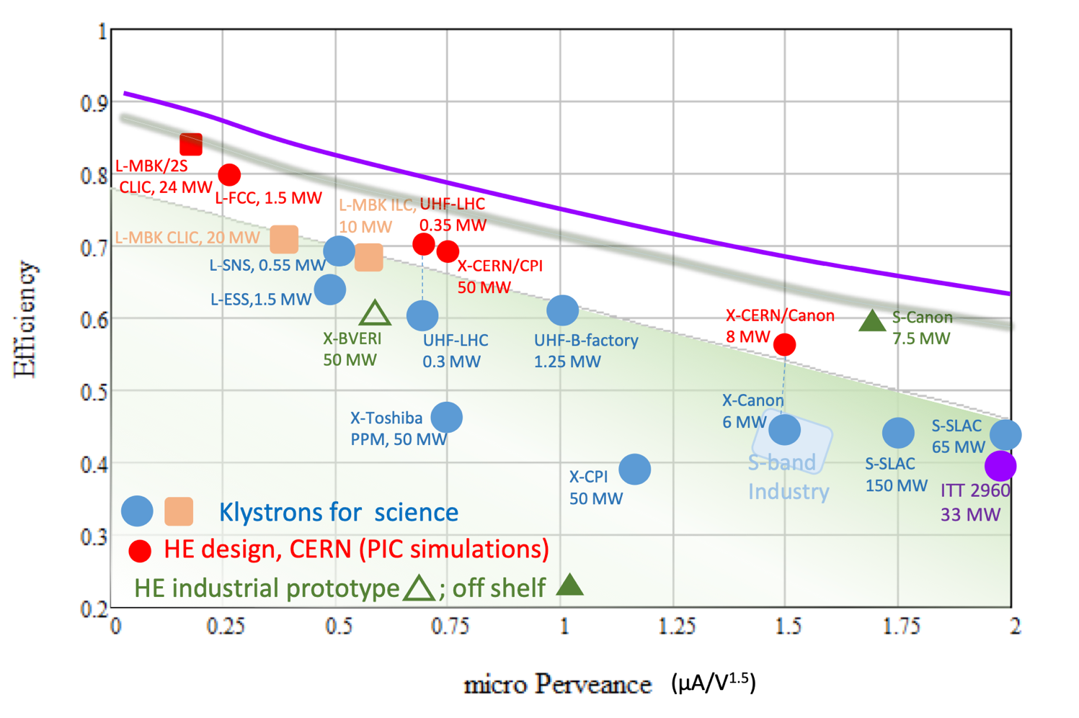
High Eff. Klystrons
L-band, X-band (for applications/collaborators and Xboxes)
Drivebeam klystron: The klystron efficiency (circles) and the peak RF power (squares) simulated for the CLIC TS MBK (solid lines) and measured for the Canon MBK E37503 (dashed lines) vs total beam power. See more later.
Publication: https://ieeexplore.ieee.org/document/9115885
HE implementations:
New small X-band klystron, ordered
Large with CPI, work with INFN
L-band two stage, design done, prototyping for FCC
Also important, redesign of damping ring RF system (well underway) – no klystron development foreseen

Slide 12
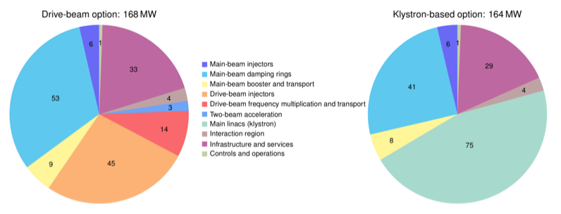
Power and Energy
Power estimate bottom up (concentrating on 380 GeV systems)
Very large reductions since CDR, better estimates of nominal settings, much more optimised drivebeam complex and more efficient klystrons, injectors more optimized, etc
Further savings possible, main target damping ring RF, L-band klystron
Topic 1 Running when energy is cheap
CLIC is normal conduction, single pass, can change off-on-off quickly, at low power when not pulsed. Specify state-change (off-standby-on) times and power uses for each – see if clever scheduling using low cost periods, can reduce the energy bill
Topic 2: Renewable energy (carbon footprint)
Is it possible to fully supply the annual electricity demand of the CLIC-380 by installing local wind and PV generators (this could be e.g. achieved by 330 MW-peak PV and 220 MW-peak wind generators, at a cost of slightly more than 10% of the CLIC 380 GeV cost)

Slide 13
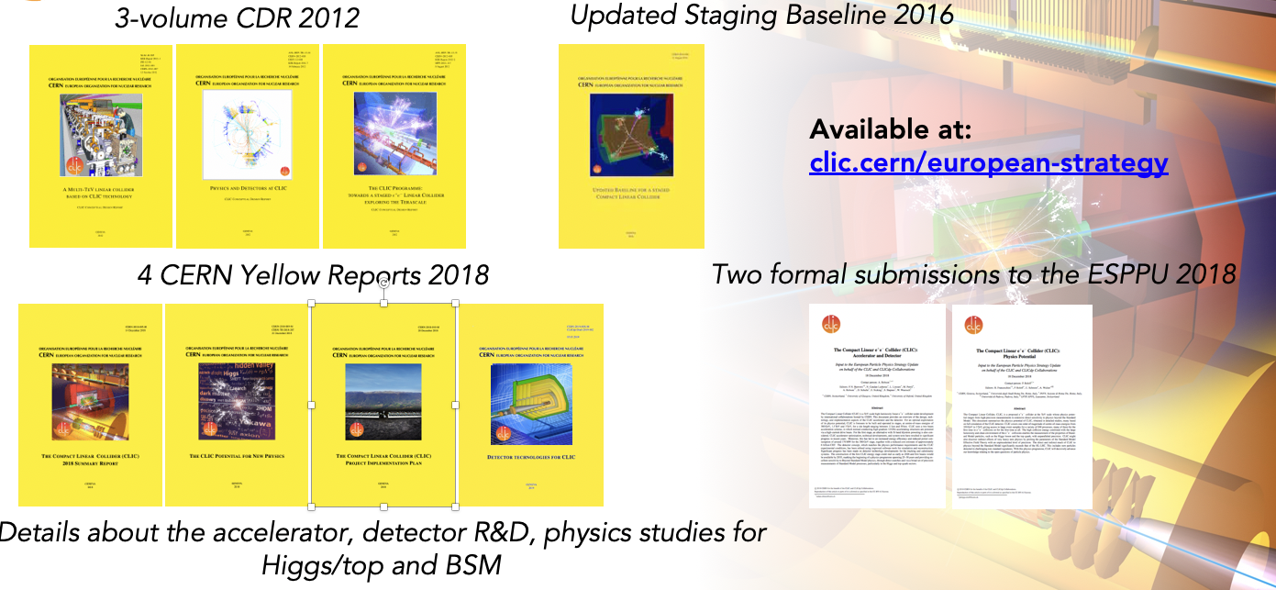
Resources
Several LoIs have been submitted on behalf of CLIC and CLICdp to the Snowmass process:
The CLIC accelerator study: Link
Beam-dynamics focused on very high energies: Link
The physics potential: Link
The detector: Link

Slide 14
Steinar Stapnes, CERN

Slide 15

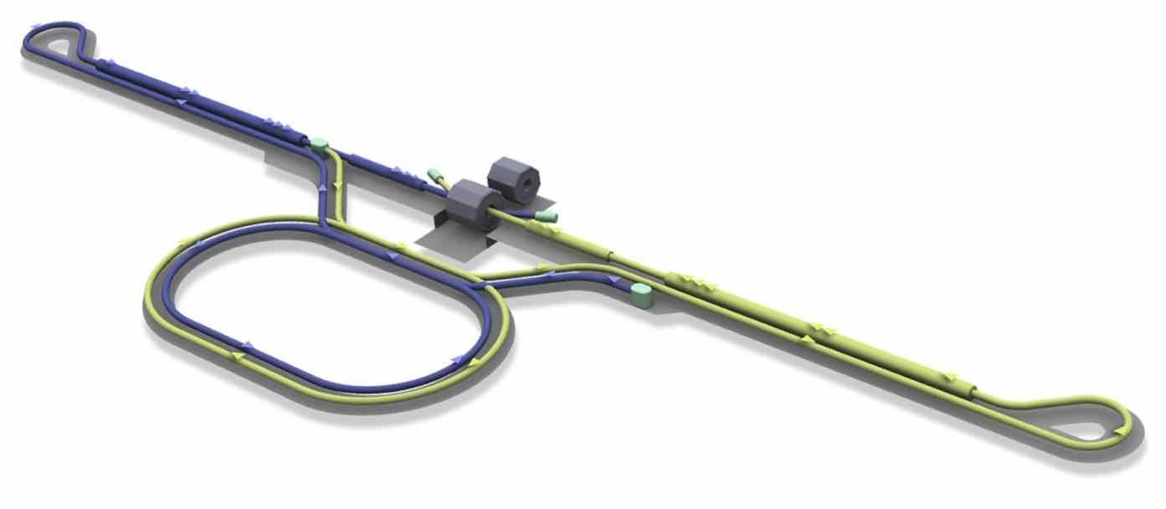
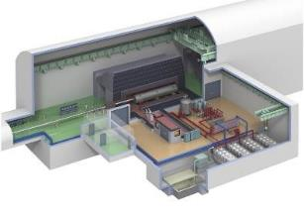
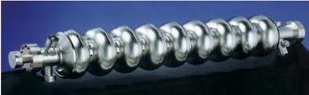
Proposed e⁺e– linear colliders – ILC
e- Main Linac
e+ Source
Beam delivery system (BDS)
e- Source
Damping Ring
Positron source
e+ Main Linac
Total 20.5 km
Item | Parameters
C.M. Energy | 250 GeV*
Length | 20km
Luminosity | 1.35 x10³⁴ cm⁻²s⁻¹
Repetition | 5 Hz
Beam Pulse Period | 0.73 ms
Beam Current | 5.8 mA (in pulse)
Beam size (y) at FF | 7.7 nm＠250GeV
SRF Cavity G. Q₀ | 31.5 MV/m (35 MV/m) Q₀ = 1x10 ¹⁰
*ILC is foreseen to be upgraded in luminosity and energy (towards ~ 1 TeV)
Key Technologies
Nano-beam Technology
SRF Accelerating Technology

Slide 16
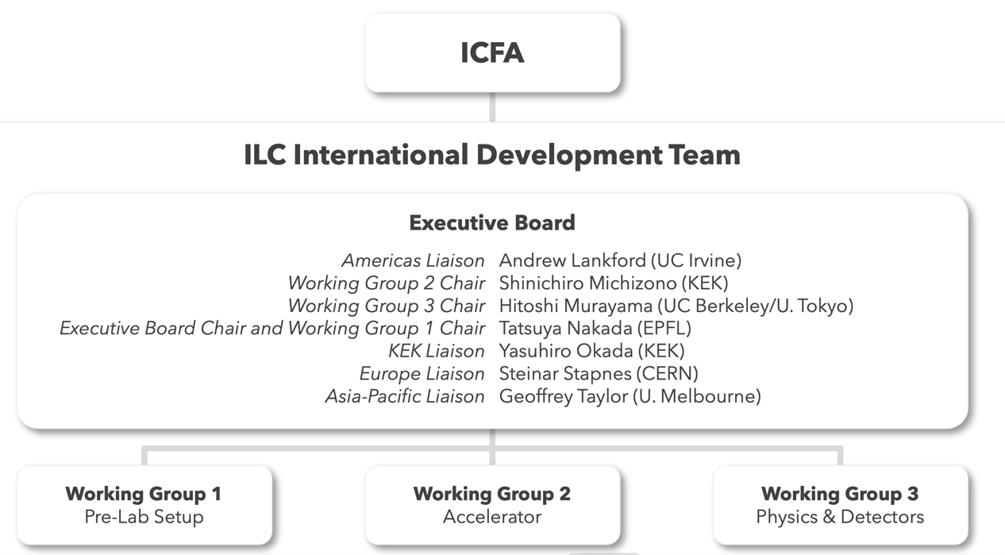
IDT structure from Summer 2020

Slide 17
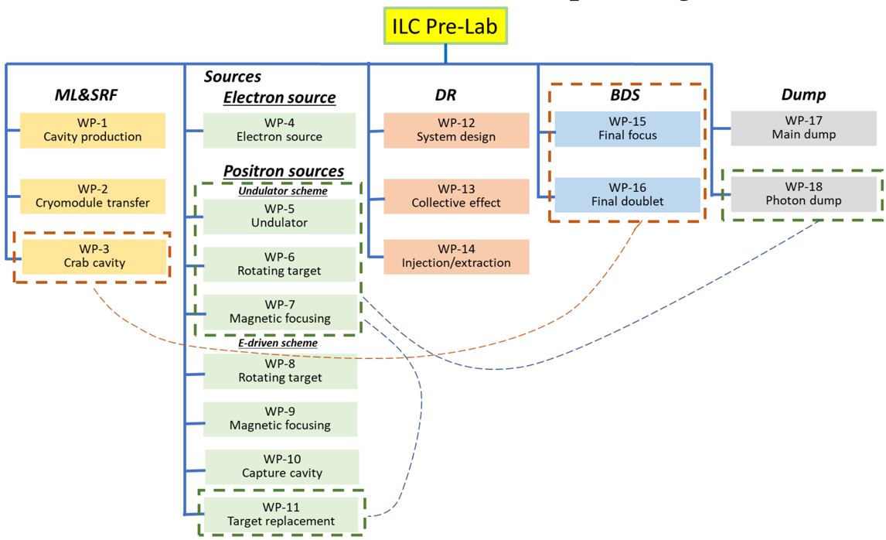
ILC overall timeline
IDT (~1.5 years)
  Prepare the work and deliverables of the ILC Pre-Laboratory and work out, with national and regional laboratories, a scenario for their contributions
  Prepare a proposal for the organisation and governance
  of the ILC Pre-Laboratory
ILC Pre-Laboratory (~4 years)
  Complete all the technical preparation necessary to start the ILC project (infrastructure, environmental impact
  and accelerator facility)
  Prepare scenarios for the regional contributions to and organisation for the ILC.
ILC laboratory
  Construction and commissioning of the ILC (~9-10 years)
  Followed by the operation of the ILC
  Managing the scientific programme of the ILC
Planning, except to start in 2022 at the earliest

Slide 18
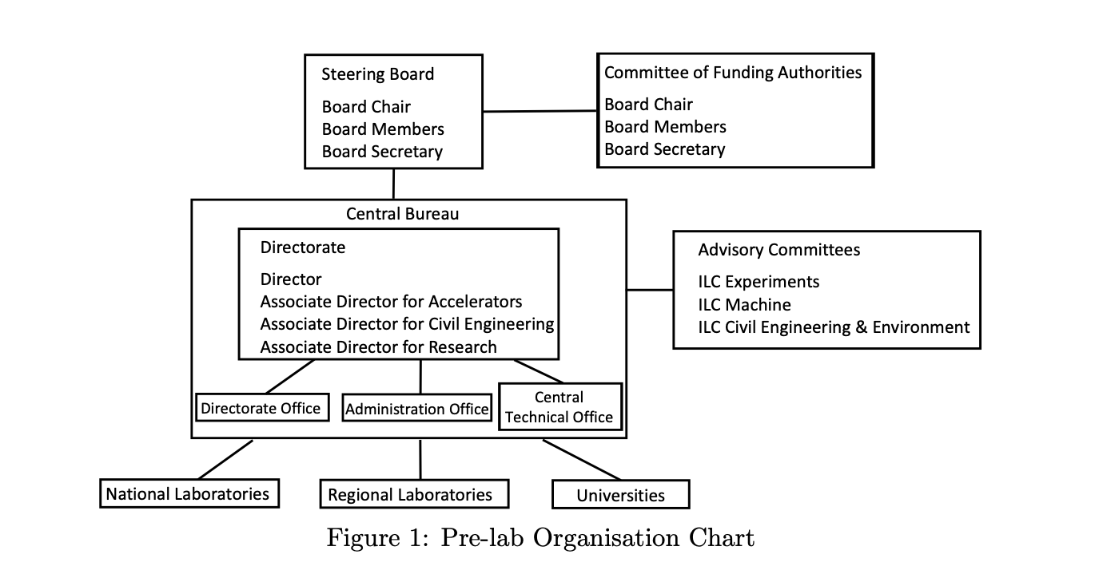
ILC Prelab planning
https://arxiv.org/abs/2106.00602

Slide 19
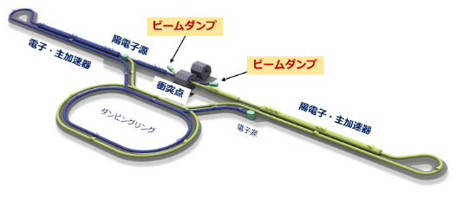
Technical preparation
IDT-WG2 summarized the technical preparation as work packages (WPs) in the technical preparation document.
ILC Pre-lab
SRF
～41MILCU
285 FTE-yr
e- source
～2.5MILCU, 6 FTE-yr
DR
～2.5MILCU, 30FTE-yr
BDS
～2MILCU, 16FTE-yr
Dump
～3MILCU, 12FTE-yr
WP-4
Electron source
WP-12
System design
WP-15
Final focus
WP-17
Main dump
Actual cavity /CM manufacturing
WP-1
Cavity production
e+ source
～6MILCU, 15FTE-yr
Undulator scheme
WP-2
Cryomodule assembly
WP-13
Collective effect
WP-16
Final doublet
WP-18
Photon dump
WP-5
Undulator
WP-14
Injection/extraction
For detail,
http://doi.org/10.5281/ zenodo.4742018
WP-3
Crab cavity
WP-6
Rotating target
WP-7
Magnetic focusing
SRF technology is energy-efficient, and its applications are increasing around the world.
These WPs will contribute to the promotion of SRF accelerators in each region.
e-Driven scheme
WP-8
Rotating target
The technical preparation document was reviewed by the international review committee (chair:Tor Raubenheimer (SLAC)).
The total global cost of the Prelab project is about 60 MILCU and about 360 FTE-year. (This does not include the cost of the infrastructure for the WPs.)
The cost will be shared internationally as in-kind contribution.
WP-9
Magnetic focusing
WP-10
Capture cavity
WP-11
Target replacement

Slide 20
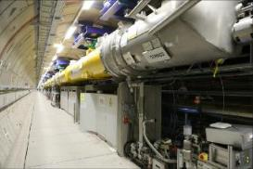

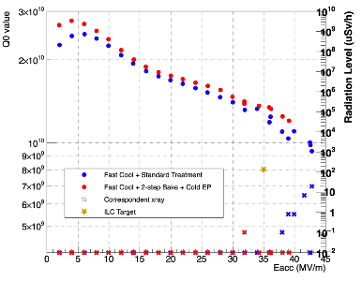

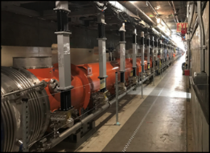
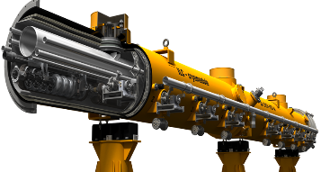
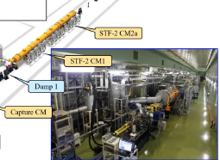
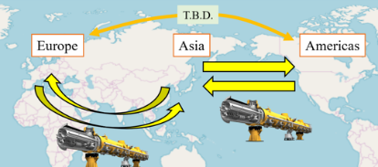

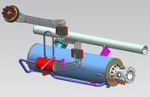
Progress in SRF
～2017
2018～2021
Pre-lab
Yield evaluation of cavities based on TDR
High performance and cost reduction
~41 M$,285 FTE-yr
Cavity
Euro-XFEL Operation (Europe)
~800 cavities/
~100 Modules
LCLS-II Construction (USA)
~280 cavities/
~35 Modules
Cavity manufacturing, performance demonstration (Yield demonstration in three areas)
Demonstration of cryomodule assembly, transfer, and performance
US-Japan: high performance with new surface treatment, etc.
The mass production of European XFEL has reached ≥ 83% of the ILC specification yield (90%).
ILC
Germany-Japan: Improving Efficiency in Cavity Manufacturing
Final design is underway to comply with "High Pressure Gas Safety".
Cryomodule
Eng. design
Module assembly
Realized through international cooperation and procurement
Accelerator performance verification at KEK-STF2
France-Japan: Automation of cavity cleaning

Slide 21
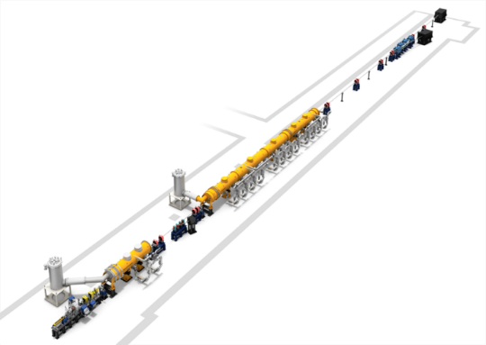

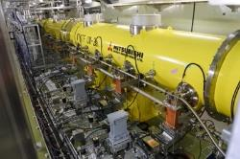
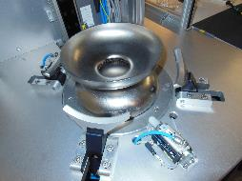
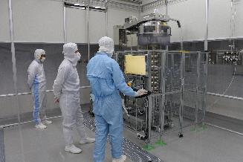
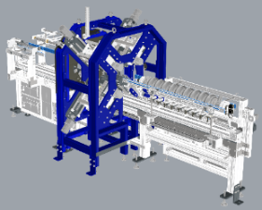
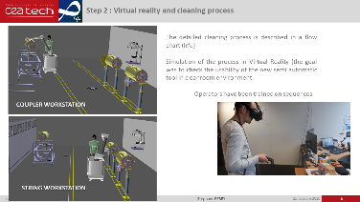
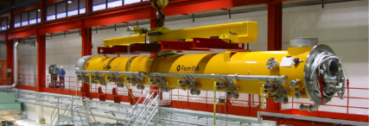
International Cooperation in SRF
2018-2021:
Achieve stable electric field E > 35 MV/m through US-Japan cooperation
  Improvement of Nb material manufacturing process and properties (FG, MG, LG)
  Improvement of surface treatment technology
    Low temperature (10-20C) EP Two-step baking (75C and 120C) Optimization of cooling speed (flux expulsion)
Cavity manufacturing efficiency improvement and dust prevention work automation Germany/France-Japan cooperation
Beam acceleration demonstration KEK-STF, 33 MV/m
High Gradient Cryomodule (HGC, FNAL) (in progress)
  Aim to demonstrate 38 MV/m
Demonstration plan at ILC Pre-Lab (2022-)
Preparation for mass production: Demonstration of international statistics in three region
US-Japan: Improving Performance through Surface Treatment
Cost reduction by direct slicing materials
From ILCX2021 (Shin MICHIZONO)
Direct slice from ingot (eliminates the rolling and mechanical polishing)
KEK-STF
Germany-Japan: Improving efficiency in cavity manufacturing
France-Japan：Automation of Dust Prevention Work
(DESY)
HGC（FNAL)
aiming for performance beyond ILC specifications (in progress)
Cavity Frequency Measurement System(Quality assurance for cavity manufacturing process)

Slide 22
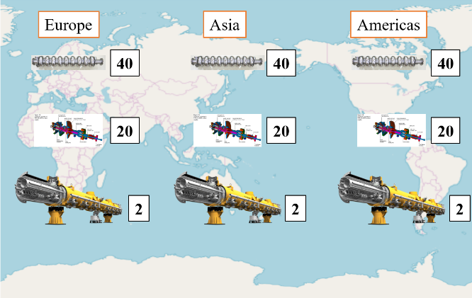
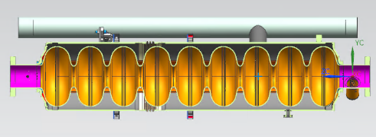
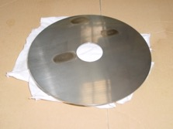
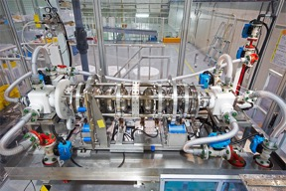

WP-1: Cavity industrial-production readiness
In recent years, U.S.-Japan/Europe-Japan cooperation is working on cavity performance improvemen and cost reduction. The yield will be evaluated.
Demonstration of mass-production, 120 cavities
    ~1% (total required number) → 40 cavities / region
  (Goal）
Cavity performance (35MV/m), success rate (yield) 90%.
(Final confirmation)
Establishment of HPGS for mass-production
Demonstration of performance/cost effective manufacturing method (results after TDR)
  Material (Nb) production: No impurity contamination (direct slicing) + cost reduction
  New surface treatment method: Improved performance due to high electric field and low loss in cavity
Reconfirmation of plug-compatibility: Final design to be confirmed
Confirmation of best surface treatment
40 cavities
Cavity production
↓
Surface treatment
↓
VT incl. success yield
↓
Installation into CM
Of the 40 cavities, about half will be used for CM assembly and the rest will be used for cost reduction evaluation
Baseline design in TDR
Nb sheet
EP
HT
Items in green frame is related to WP-2 (next page)
To be confirmed the best method for mass-production

Slide 23









WP-2: CM Assembly, Global transfer and Performance assurance
Two CMs production / region
Two CM production per region
48 cavities produced in WP-1 will be installed
Satisfied with HPGS
(Final confirmation)
Incl. ancillaries (coupler, tuner, SC-Magnet)
CM global transfer (as first case in SRF)
  CM transfer from each region
  Preparation for shock absorber, vacuum monitoring system
  To be evaluated performance assurance in Japan
Work flow of WP-2
CM production
↓
Performance test @region
↓
CM global transfer
↓
Performance assurance in Japan
cavity
Completion of CM final design
Power coupler
SC-Magnet
After the performance tests in each area, they will be transported to Japan via sea. The performance tests will be done again in Japan.
For the components that have progressed after TDR, evaluate the performance before deciding whether to use it
Tuner (TDR baseline)
Cage for transfer
Shock absorber and logger
Vacuum monitoring system
Improved tuner

Slide 24







ILC R&D facilities in KEK
In Europe and the U.S., basic facilities for the evaluation of the superconducting accelerator at the European XFEL and LCLS-II are in place, but in Japan, additional basic facilities are needed.
COI
Superconducting RF test facility
Cavity Fabrication Facility
Nano beam R&D (ATF)

Slide 25













Progress for positron source
Plan A:Undulator scheme
Plan B:e-driven scheme (same tunnel)
Plan C:e-driven scheme (extra tunnel)
～2017 tech. design
2018～2021 tech. verification
Pre-lab
1.5 M$ 10FTE-yr
Undulator scheme to obtain polarization
Ti target beam test
Optics design
Pulse solenoid design
Next Steps:
evaluate both schemes by international cooperation
Undulator prototype
Photon dump design
Practical Operation of Superconducting Helical Undulator (APS)
Technology selection
High-speed rotating positron target, Technology Design
Long undulator operation at European XFEL
Target maintenance
Conventional e-Driven
4.4 M$, 5FTE-yr
Target Prototyping
Vacuum characteristics Testing
APS cavity
Optics design
Target thermal simulation
Mag. focusing
Paricle simulation
Loading compensation
Thermal analysis
RF stability test

Slide 26






Progress for DR
～2017
2018～2021
Pre-lab
Final design
Stable op.
Eng. design
~2.5 M$,30 FTE-yr
DR
Maturing technology for beams in the latest ring accelerators such as SuperKEKB
Design based on experience with circular accelerators around the world.
Eng. Design
Equipment verification
Inj./Ext.
Beam extraction demonstrated.
LBNL
CERN-CLIC
Fast kicker technology

Slide 27






Progress for final focus
～2017
2018～2021
Pre-lab
Tech. design completed
Spec. almost achieved
Detailed design
Stable operation demonstration
Wakefield effect
~2M$, 16FTE-yr
ATF: achieved 41nm (2016)
（37nm=ILC（7.7nm)）
Wakefield effect was evaluated at ATF.
-confirm no serious problem at ILC
-demonstrate a technique to reduce the wakefield effect
ATF International Review (Committee)*
-The committee highly evaluated the achievements of ATF so far.
-The committee pointed out the importance of continuing research to contribute to the detailed design of the ILC final convergence.
High-speed beam position control technology was also demonstrated.
Modify the beam monitor system, etc. at ATF to demonstrate stable operation.
* https://agenda.linearcollider.org/event/8626/

Slide 28










Progress for beam dump
～2017
2018～2021
Pre-lab
Design revalidation and specific facility design
~3M$, 12FTE-yr
Basic design
(by researchers abroad)
Remote Maintenance
Designed with 500GeV beam
Absorber: Water(10 atm)
Specific design of radiation shield
Beam Dump Water Circulation System Design (2020)
Testing of main components of circulating water system
Beam window replacement device
Leakage countermeasures for radiating dump water
Earthquake resistant design
Detailed system design (pursuit of safety design)
Confirmation of safety by simulation
Heat and stress in beam window, heat and shock waves in water
Evaluation of activation and shielding
Design for shielding of muon particles generated by beam dump
Heat analysis
Shock wave
Consultations with beam target/dump experts from around the world beyond ILC
Civil Design of Beam Dump Cavity (2019)
(including muon shielding)
LHC beam dump
RADIATE collaboration

Slide 29

Topography and geology assumed in civil engineering design of ILC
Rock mass is generally uniform over a long distance of 50 km
Solid rock zone is less susceptible to ground vibration
No "known faults” crosses the site, which is expected to be active faults
granite zone
We evaluated candidate sites by selecting the most suitable geology for construction.
Reduces civil and cost risks due to massive water inflow, etc.
Construction of road tunnels and other projects may pass through areas with poor geology, depending on the conditions of the starting and ending points.
ILC selects candidate sites with priority given to geology, avoiding soft ground in advance.
Seismic survey (total 30 km), electromagnetic survey (13 km), and borehole survey (7 boreholes) were carried out.
In the area of the accelerator tunnel, hard and uncracked granite is considered to be widely distributed.

Slide 30




Radiation safety and community understanding
Facility design for radiation safety (radiation protection and long-term maintenance of radioactive materials)
Experiences with KEK and other large accelerators around the world
Experience with proton accelerators with more severe activation (Selection of materials for beam dump windows and positron targets)
Safety evaluation by simulation
The final design for safety, including the structure of radiation shielding, maintenance methods for activated components, measures against leakage of beam dump water, and long-term maintenance of activated materials, is being carried out with international cooperation, mainly by KEK.
Specific design of facilities and equipment through industry-academia collaboration
Studying measures for drainage, earthquake, and radiation (AAA WG)
Civil Engineering of Beam dump cavern (2019)
循環水設備室
加速器
トンネル
加速器
トンネル
Briefing sessions to promote understanding among local residents
Explanation of safety management and environmental impact measures
Briefing sessions were held at 11 venues, including the Community Exchange Center, in order to broaden the participation of local residents, and a total of 673 people attended the sessions.
Questions asked at the briefing sessions and answers to questions and concerns raised by local residents were compiled and made available on the website.
KEK, local Universities and local government
https://tipdc.org/inquiries#qa (in Japanese)

Slide 31

Environmental Initiatives
Environmental impact assessment policy
  Establishment of the "ILC Environmental Assessment Advisory Board" with external experts (2019)
    Chair: Kenichiro Yanagi (Professor Emeritus, Meiji University), Chairman of Tokyo Olympic and Paralympic Environmental Assessment Committee
  Based on the project characteristics of ILC,
    Basic guidelines for assessment, and
    Implementation structure, process, and
    Methodology and assessment targets
      (environmental impact, social and economic impact)
"Green ILC" for the environment
    (Green ILC WG, AAA)
    https://tipdc.org/assets/uploads/2020/12/guideline03.pdf (in Japanese)
    https://tipdc.org/assets/uploads/2020/12/guideline04.pdf (in Japanese)
  Energy measures: Biomass, Power-GRID, waste heat utilization
  Utilization of resources: Use of local wood for ILC-related facilities, use of high-quality granite produced during tunnel excavation
Summary of the Discussion
https://www2.kek.jp/ilc/ja/contents/docs/Strategic_Environmental_Assessment_of_the_ILC_Project_Summary_of_the_Discussion_r.pdf
Flow of environmental assessment for the ILC project (assumed)

Slide 32
Resources
The Proposal for the ILC Preparatory Laboratory is now published: https://arxiv.org/abs/2106.00602
“This proposal is intended to provide information to the laboratories and governmental authorities interested in the ILC project to allow them to consider participation”
Several announcements, e.g http://newsline.linearcollider.org/2021/06/01/ilc-preparatory-laboratory-proposal-released/
Endorsed by IFCA, (being) sent to IDT WGs, ICFA, ECFA and Lab directors
Sent to MEXT (in translated form)
The Technical Preparation Document describing the 18 WPs is at: (https://zenodo.org/record/4742019#.YLfkLi0RrqY)
And a document (in Japanese) addressing, “key issues related to the ILC project”, as identified in various reviews, is also sent
Further information about Japanese funding needs also provided

Slide 33



Deliberations of Prelab plan

Slide 34




ILCX workshop

Slide 35
Thanks
Shin Michizono in particular (his ILCX presentation)
Many other colleagues in ILC and CLIC
Over to Ivanka …

