Slide 1
CEPC Beam Instrumentation R&D
Yanfeng Sui
On behalf Beam Instrumentation Team
Accelerator Center, IHEP
The 2021 international workshop on the high energy Circular Electron-Positron Collider (CEPC)
November 8-12, 2021

Slide 2
Outline
Overview of CEPC beam instrumentation system
Beam instrumentation R&D
Summary

Slide 3
The beam instrumentation in CEPC Linac
 | Item | Method | Parameter | Amounts
Linac | Beam position | Stripline BPM | Resolution ：30um | 140
 | Beam current | ICT | 2.5%@1nC-10nC | 42
 | Beam profile | YAG/OTR | Resolution: 30um | 80
 | Beam emittance | Q+PR | 10% | 3
 | Beam energy & spread | AM+PR | 0.1% | 3
Damping ring | Average current | DCCT | Resolution :50uA@0.1mA-30mA | 1
 | Beam position | Button BPM | Resolution : 20um @ 5mA TBT | 40
 | Tune measurement | Frequency sweeping | Resolution:0.001 | 1

Slide 4
The beam instrumentation in CEPC booster
 | Item |  | Method | Parameter | Amounts
Booster | Beam position monitor | Turn by turn | Button electrode BPM | Measurement area (x × y)：±20mm×±10mm Resolution：<0.02mm Measurement time of COD：< 4 s | 1808
 |  | Bunch by bunch | Button electrode BPM | Measurement area (x × y)：±40mm×±20mm Resolution：0.1mm
 | Bunch current |  | BCM | Measurement range：10mA / per bunch Relatively precision：1/4095 | 2
 | Average current |  | DCCT | Dynamic measurement range：0.0~1.5A Resolution:50uA@0.6-8mA Linearity：0.1 % Zero drift: <0.05mA | 2
 | Beam size |  | Double slit interferometer x ray pin hole | Resolution:0.2 µm | 2
 | Bunch length |  | Streak camera Two photon intensity interferometer | Resolution:1 ps | 2
 | Tune measurement |  | Frequency sweeping method | Resolution:0.001 | 2
 |  |  | DDD | Resolution:0.001
 | Beam loss monitor |  | optical fiber | Space resolution:0.6m | 400
 | Feedback system |  | TFB | Damping time<=3ms | 2
 | Feedback system |  | LFB | Damping time<=35ms（50ms） | 2

Slide 5
The beam instrumentation in CEPC ring
 | Item |  | Method | Parameter | Amounts
Storage ring | Beam position monitor | Closed orbit | Button electrode BPM | Measurement area (x × y)：±20mm×±10mm Resolution：<0.6um Measurement time of COD：< 4 s | 2900
 |  | Bunch by bunch | Button electrode BPM | Measurement area (x × y)：±40mm×±20mm Resolution：0.1mm
 | Bunch current |  | BCM | Measurement range：10mA / per bunch Relatively precision：1/4095 | 2
 | Average current |  | DCCT | Dynamic measurement range：0.0~1.5A Linearity：0.1 % Zero drift: <0.05mA | 2
 | Beam size |  | Double slit interferometer x ray pin hole | Resolution:0.2 µm | 4
 | Bunch length |  | Streak camera Two photon intensity interferometer | Resolution:1ps@10ps | 2
 | Tune measurement |  | Frequency sweeping method | Resolution:0.001 | 2
 |  |  | DDD | Resolution:0.001
 | Beam loss monitor |  | PIN-diode | Dynamic range:120 dB Maximum counting rates≥10 MHz | 5800
 | Feedback system |  | TFB | Damping time<=47ms | 2
 |  |  | LFB | Damping time<=100ms | 2

Slide 6
Beam instrumentation R&D

Slide 7
R&D Motivation
To reduce the budget of BI system, due to a large number of monitors and the high price of commercial products. Such as BPM and beam loss monitor
Key technologies of beam diagnostics. Beam instrument at IP and beam feed back system
Easy to maintain and upgrade

Slide 8
Status of CEPC beam instrumentation R&D
System | R&D Work supported by |  |  | Work to be done
 | BEPCII | HEPS/HEPS TF | Funding
BPM electronics | √ | √ | √ | Radiation hardness Industrialization
Beam position monitor fabrication |  | √ | √ | Feed through product and detection; BPM pick-up design,
Longitudinal feedback system | √ | √ |  | Electronics development
Transverse feedback system | √ | √ |  | Electronics development Longer kicker design
Synchrotron radiation monitor |  |  |  | Cooling of SR extraction mirror; X-ray interferometer; Gas jet scanner
BI at the interaction point |  |  | √ | Special beam monitor design at IP
Bunch current monitor |  | √ |  | BBB electronics R&D based home-developed and company
Beam loss monitor |  |  | √ | beam loss detector R&D Industrialization

Slide 9
CEPC beam instrumentation R&D
Beam position monitor system
  BPM electronics
  Feed through R&D
  BPM at interaction point（IP）
Feedback systems

Slide 10
Overview of the BPM electronics R&D
The R&D of BPM electronics founded by seed money of IHEP and other funding（HEPS-TF etc.）
Kicked off in the start of 2015
The first version(V1.0) of the electronics was finished in 2018.
The second version(V2.0) was finished in middle of 2019. modification was done to improve the performance of the electronics.
The BPM electronics were installed and operating in BEPCII Linac in 2019
BEPCII SR BPMS are upgrade to home-made electronics in 2020.
8 versions have been tested in the past six years.

Slide 11
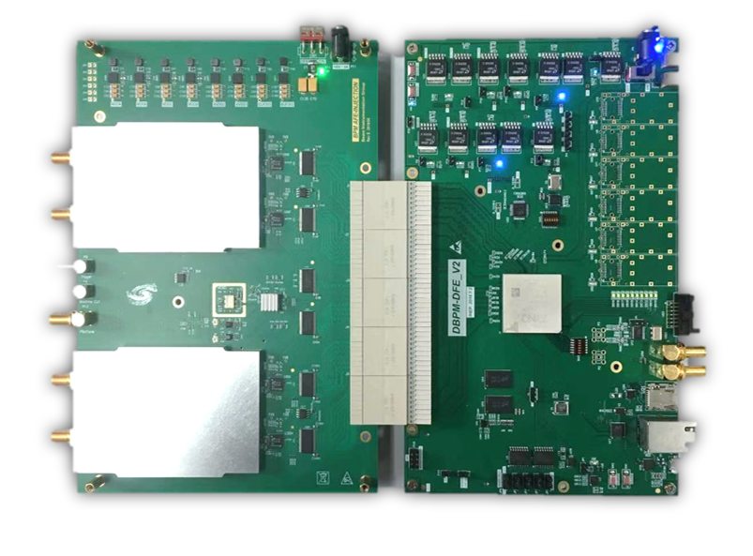
Overview of the BPM electronics
ADF
ADF
Since of ADF interface is not suitable for RF signal transmission,
so we developed new hardware, ADC&CLK in AFE board.
AFE board：RF Processing+ ADCs + Clock + Pilot tone;
DFE board：FPGA(ZYNQ) + DDR3 memory + SFPs + Ethernets;
EPICS IOC：In ZYNQ FPGA, Increase the convenience of the BPM system;

Slide 12
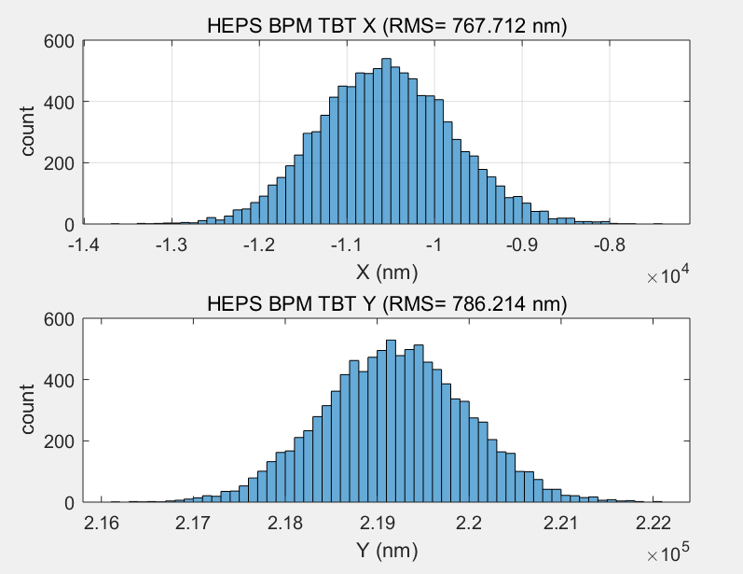
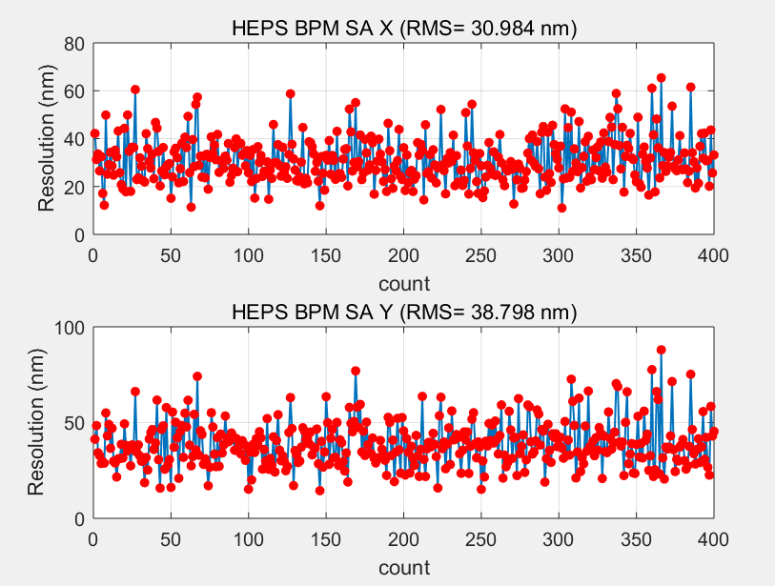
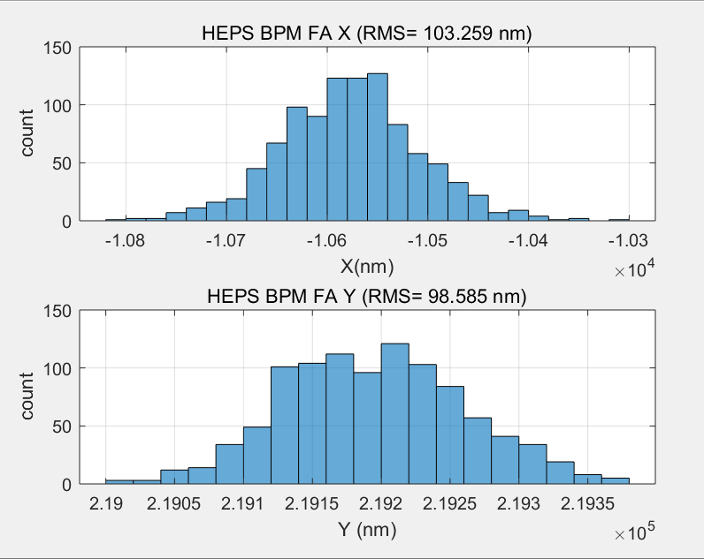
BPM TbT/FA/SA resolution test in lab
TBT RMS (X=767nm,y=786nm)
SA RMS(X=30nm,Y=38nm) 10points STD
We test the performance of DBPM in lab
RF frequency is 499.8MHz(-15dBm) from R&S SMA100
TBT data rms xpos ≈767nm, ypos ≈786nm;
FA data rms xpos ≈103nm, ypos ≈98nm;
SA data rms xpos ≈30nm, ypos ≈38nm;
Kx=Ky=8.26mm;
FA RMS (X=103nm,y=98nm)

Slide 13
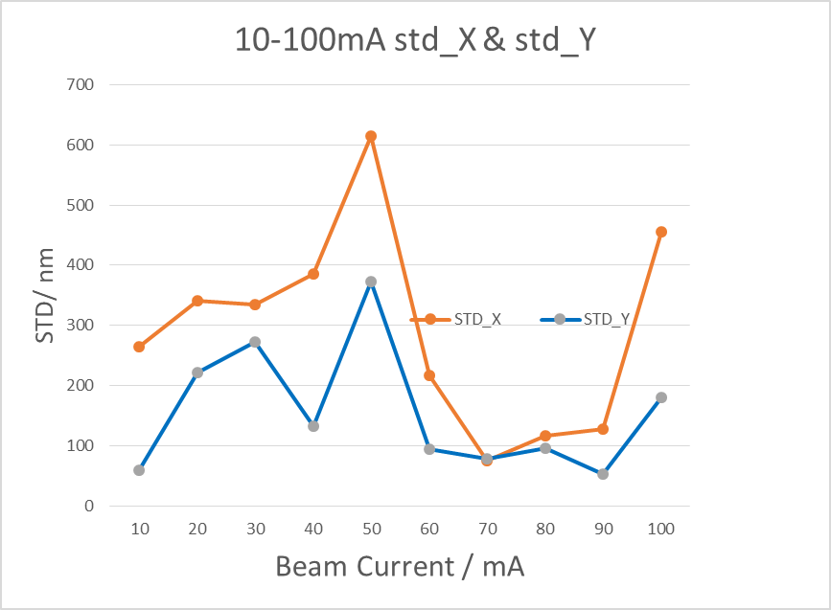
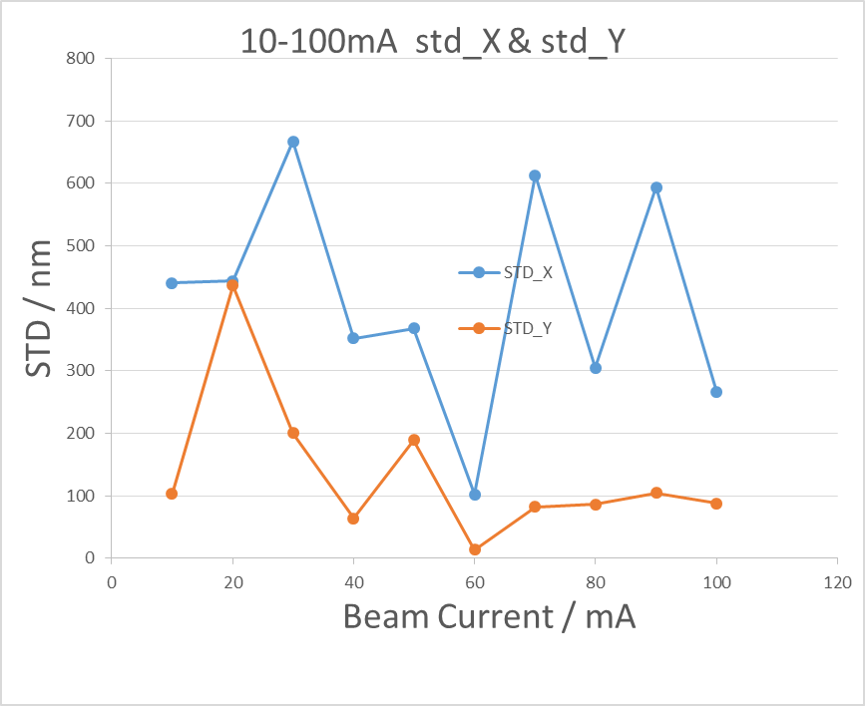
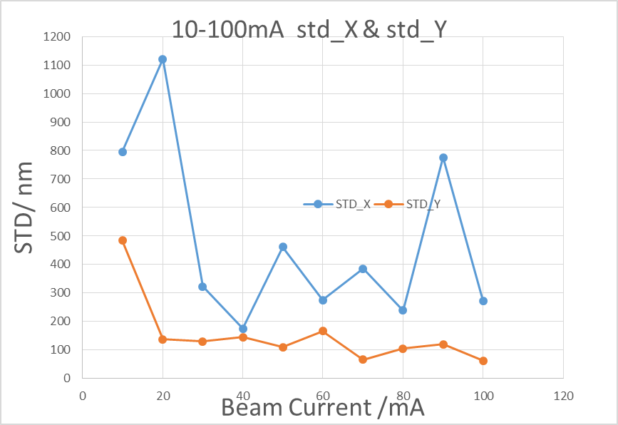
Beam test in BEPCII
Resolution of BPM electronics （110 bunches, 1/3）
BPM3
BPM4
BPM5
BPM electronics NO. | Beam current（10-20mA） |  | Beam current（20-818mA）
 | ΔX(um) | ΔY(um) | ΔX(um) | ΔY(um)
Commercial product | - | - | 6 | 7
BPM1 | - | - | 10 | 17
BPM3 | 22 | 11 | 29 | 11
BPM4 | 71 | 61 | 11 | 36
BPM5 | 5 | 17 | 4 | 31
Beam current dependence of BPM electronics

Slide 14
Home made products VS commercial products
BPM pick up
Cable
Comparative test of self-developed product and commercial product

Slide 15
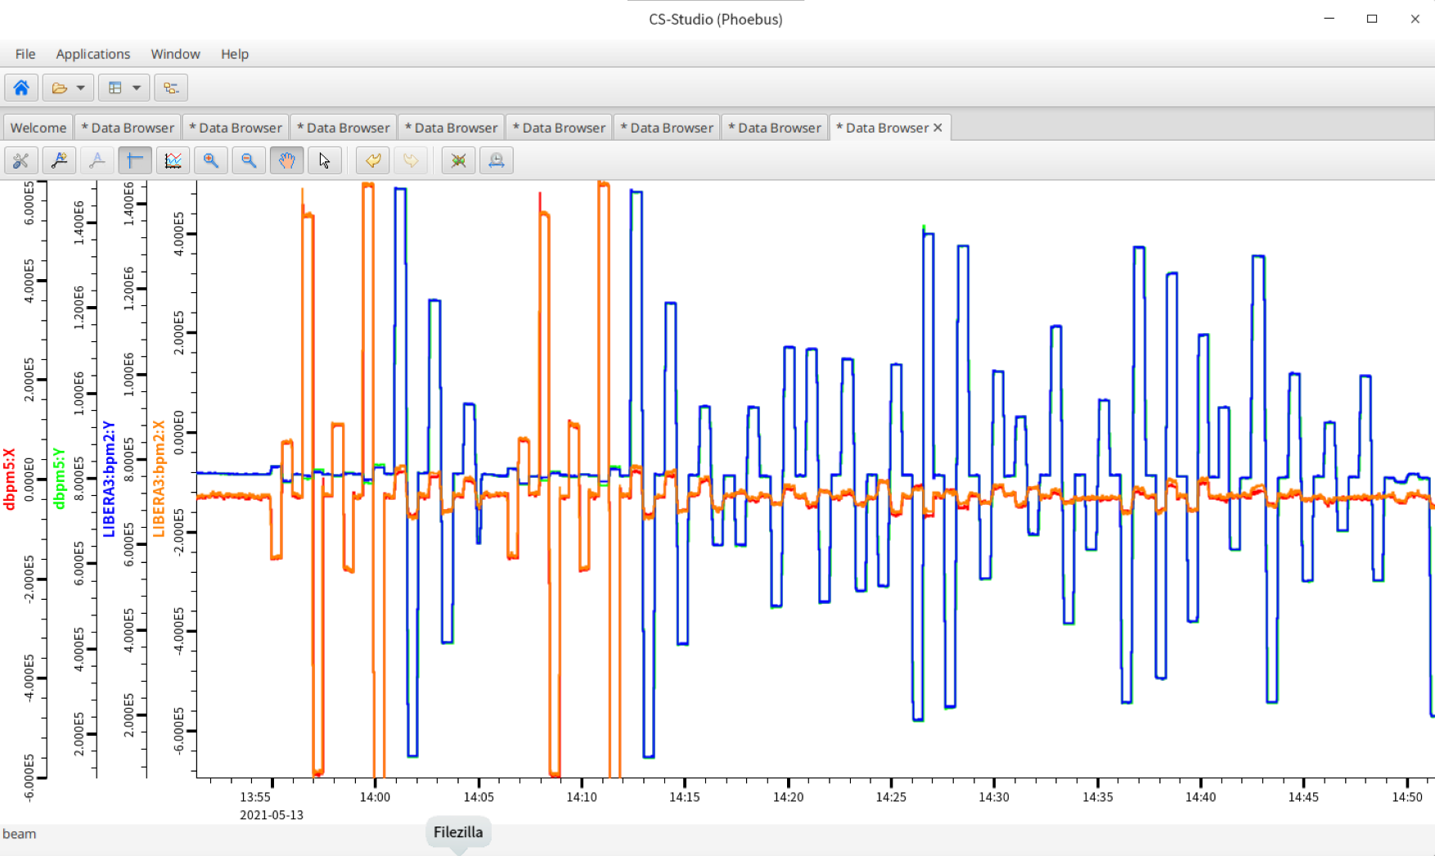
Long time stability（1 hour）

Slide 16
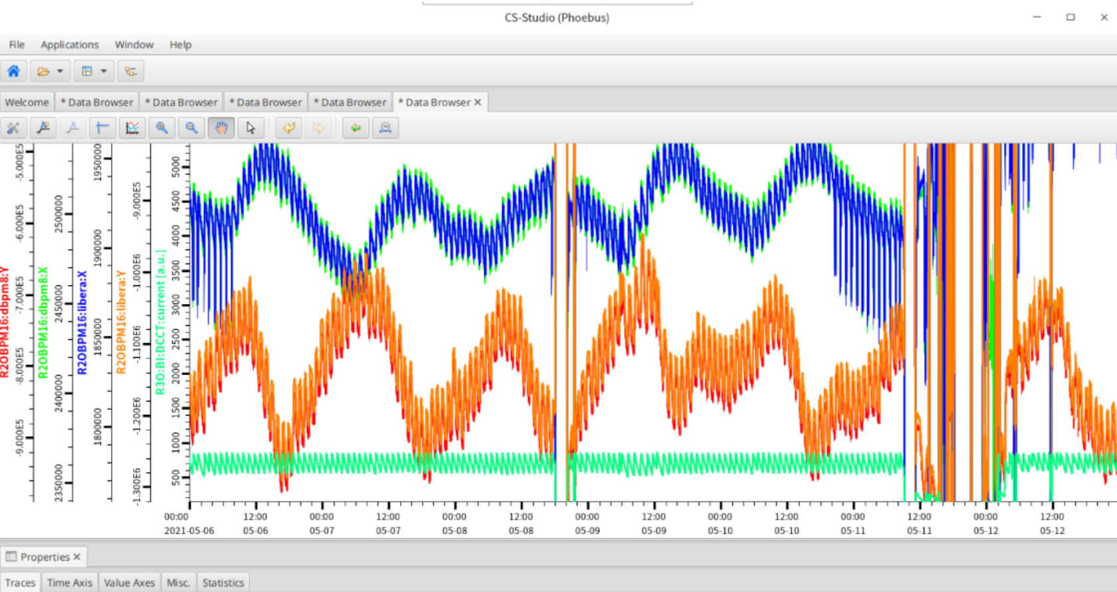
Long time stability（7 days）

Slide 17
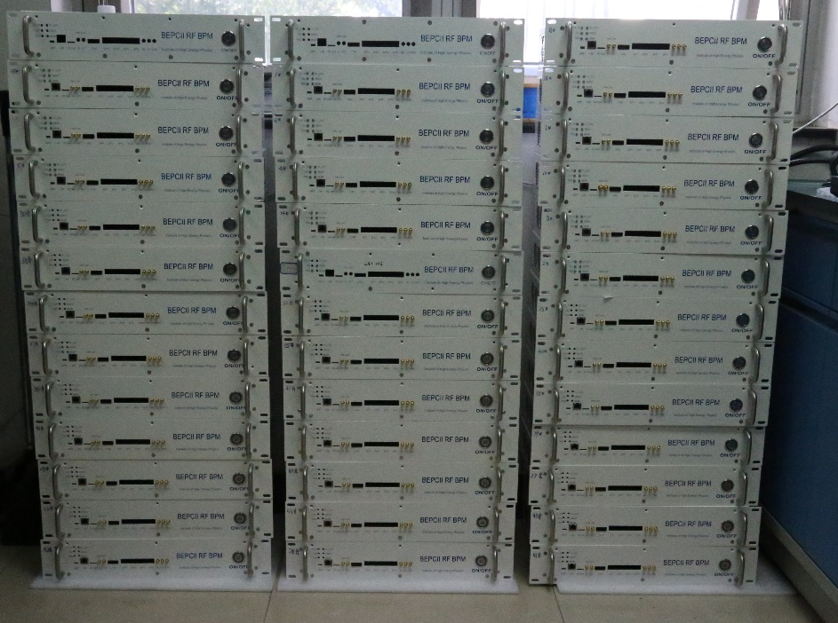
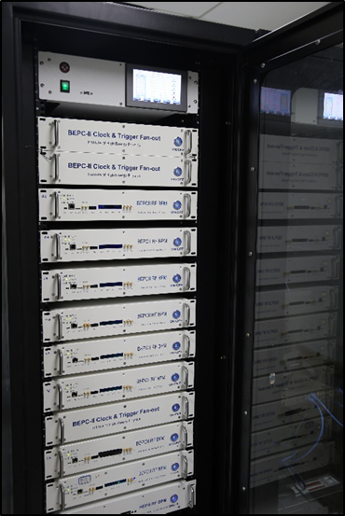
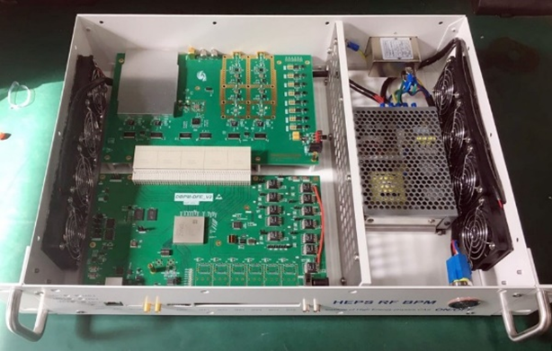
Application of BPM electronics in BEPCII
After finishing prototype test, small batch production and application has been done in BEPCII
20 sets single-pass mode BPM electronics were developed for the linac and put in operation in the middle of 2019.
Totally, 33 sets including SR mode and Collider mode BPM electronics were upgraded in BEPCII storage ring.

Slide 18
Bunch by bunch BPM electronics R&D
The beam trip is an important problem for accelerator operation. Because the accelerator system is very complicated, involves many subsystems, and various conditions are mixed together, so, it is difficult to get to the real cause for beam trip.
At present, many accelerators all over the world have established a powerful beam trip diagnostic system.
The other reason is preparing instrumentation for bunch by bunch current and beam position measurement

Slide 19
Bunch by bunch BPM electronics
Trigger
Buffer of bunch by bunch raw ADC data

Slide 20
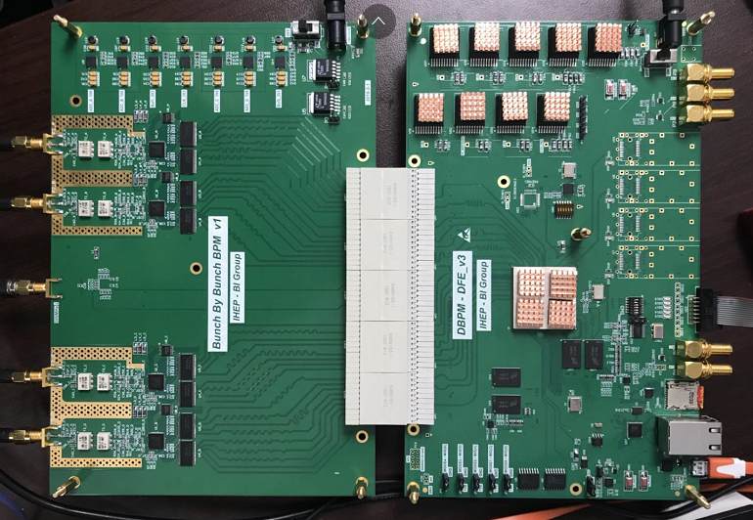
Bunch by bunch BPM electronics
Sampling clock: 500MHz,free running clock or externally clock locked with beam signal
ADC_a
ADC_b
AFE
DFE
clock
ADC_c
ADC_d

Slide 21
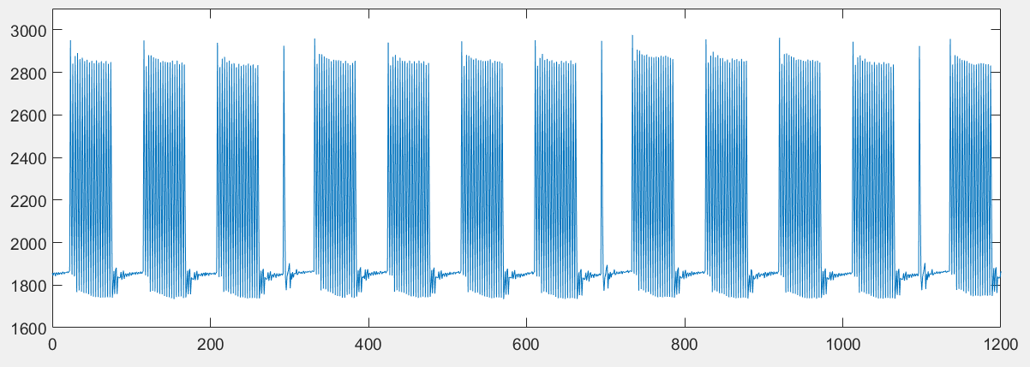
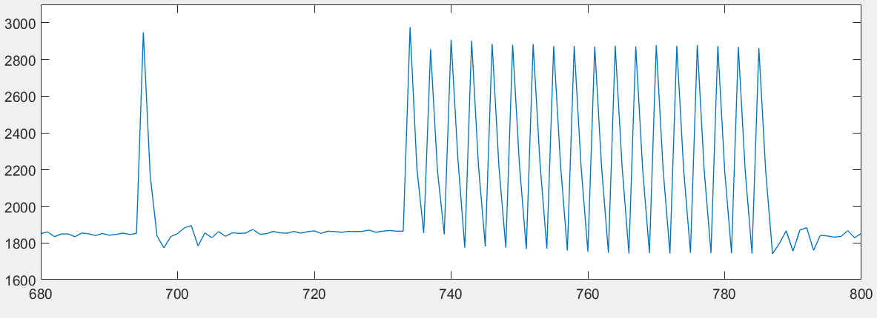
Bunch by bunch BPM electronics
Input: simulation pattern of BEPCII , repetition period 6ns

Slide 22
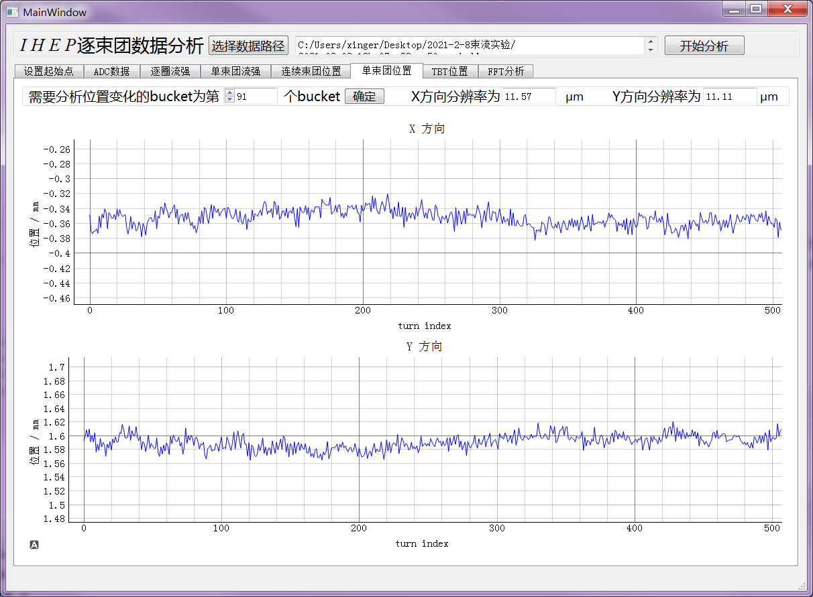
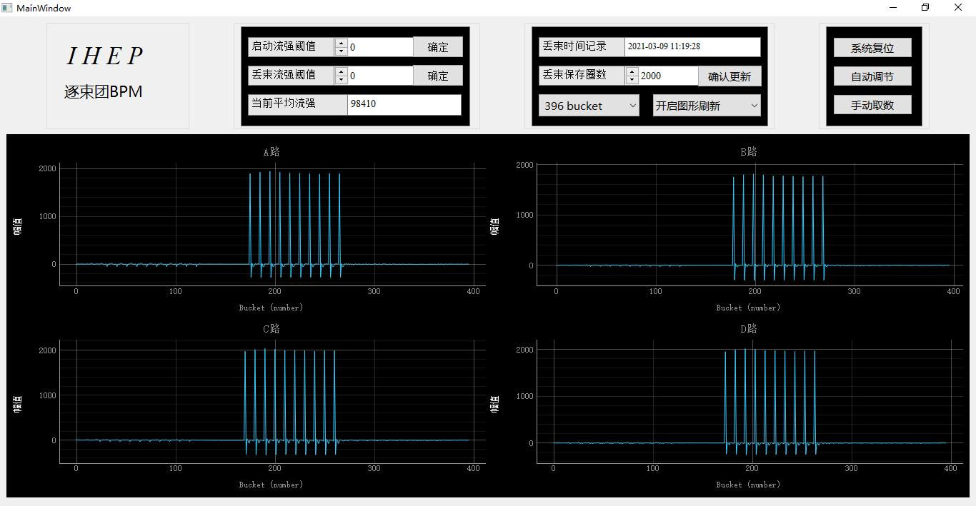
Bunch by bunch BPM electronics
The bunch by bunch BPM electronics was test in BEPCII.
The bunch current and bunch position were measured by BBB electronics
The 91st bunch position were traced in 500 turns
The bunch current were measured by electronics

Slide 23
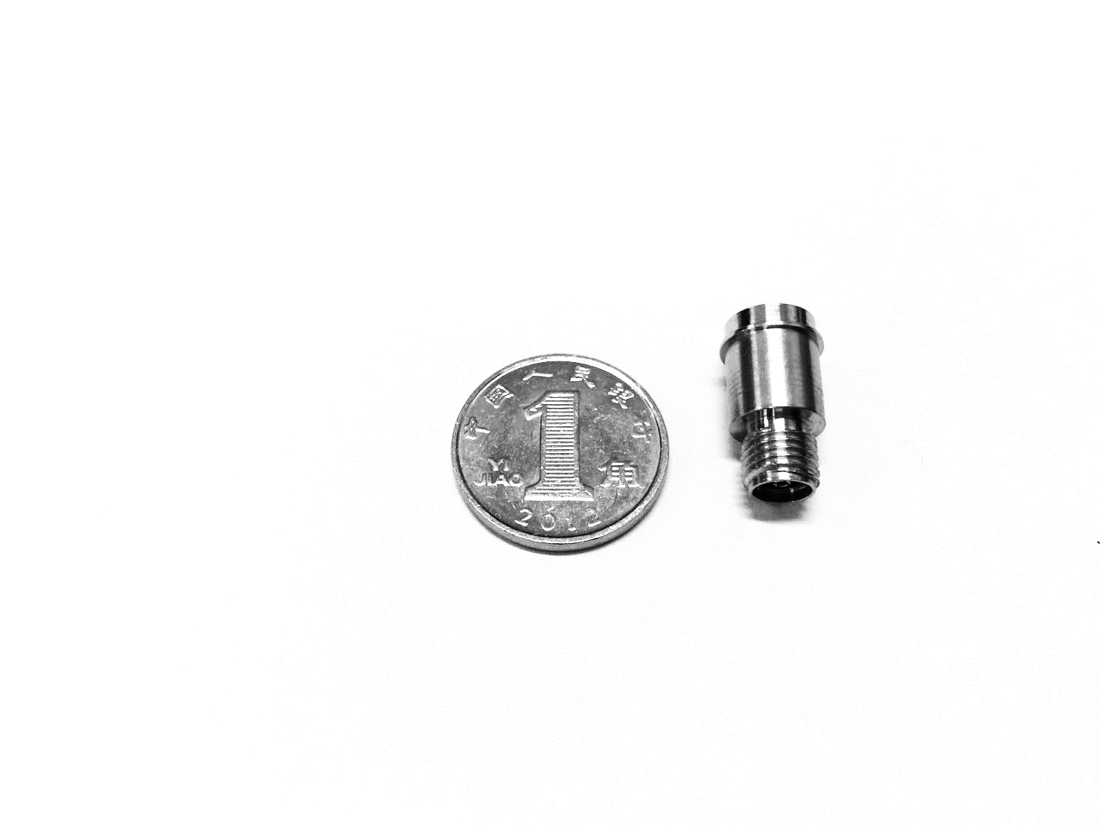
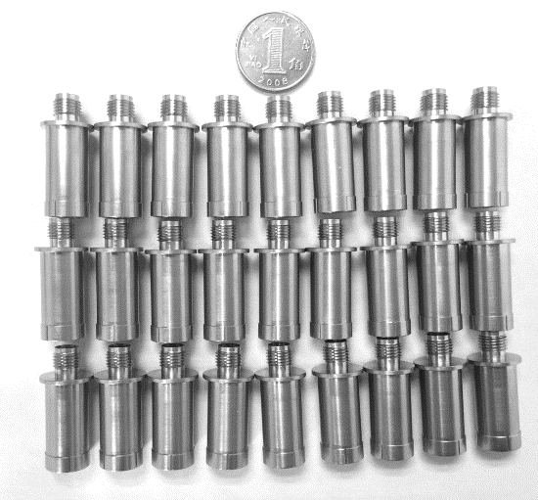
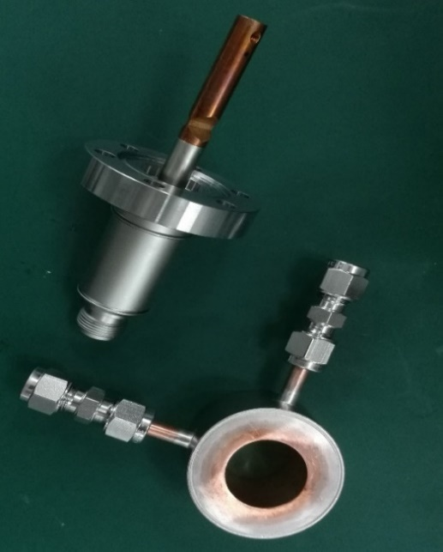
Feed-through R&D
Finished the study of feed-through in beam instrumentation.
Independent research and development of feed-through was kicked off
Two versions of feed-through have been made with the help of CIPC Member Company in the last year.
BPM feed-through V1.0
BPM feed-through V2.0
Kicker feed-through

Slide 24
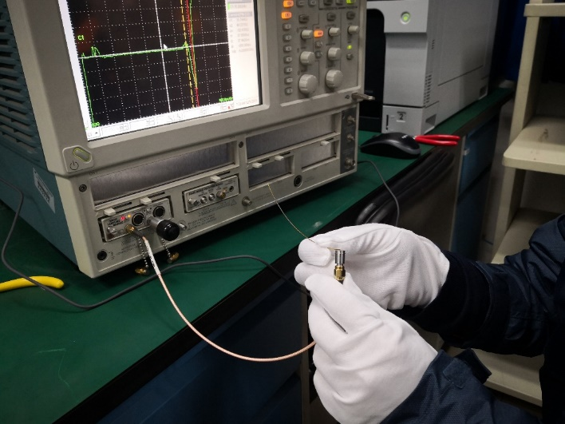
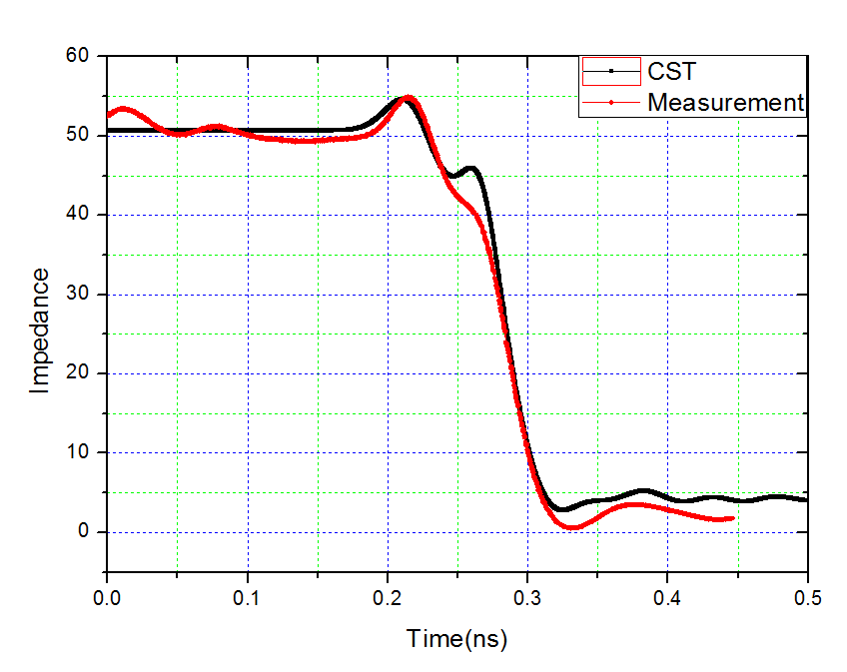
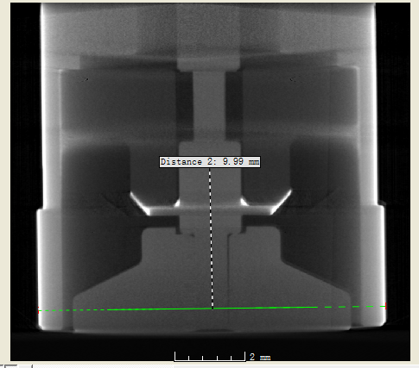
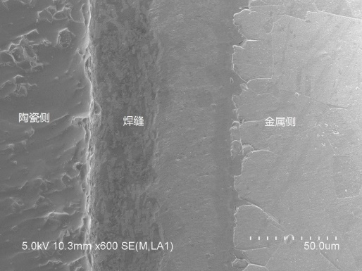
Feed-through R&D
The test result of the feedthroughs shows that the mechanical properties, high-frequency characteristics and vacuum performance can meet the demands of the CEPC BPM totally.
TDR for impedance test and X-ray tomography for inner structure check.
Morphology of solid surface by SEM.
TDR test

Slide 25
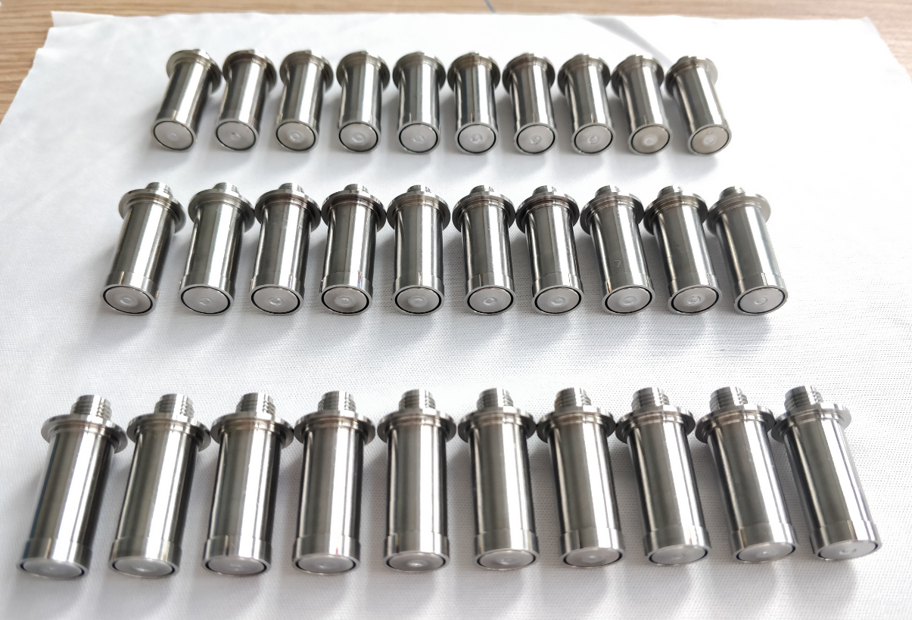
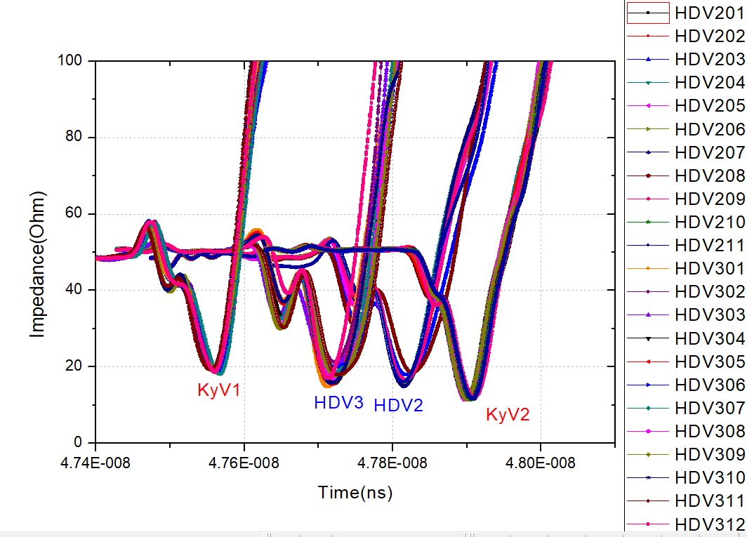
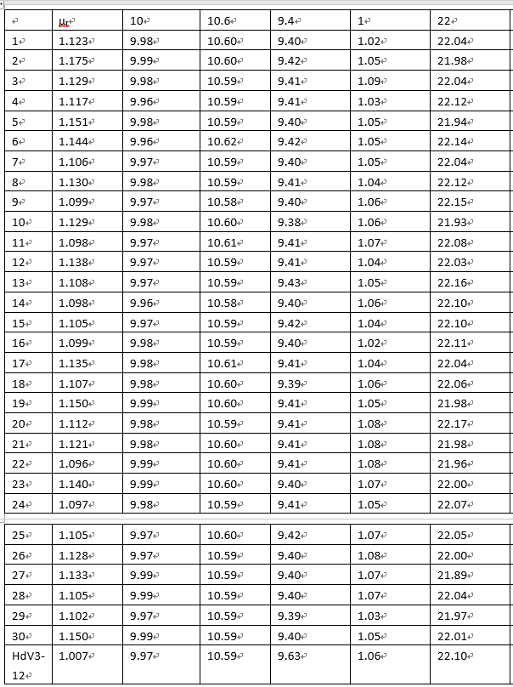
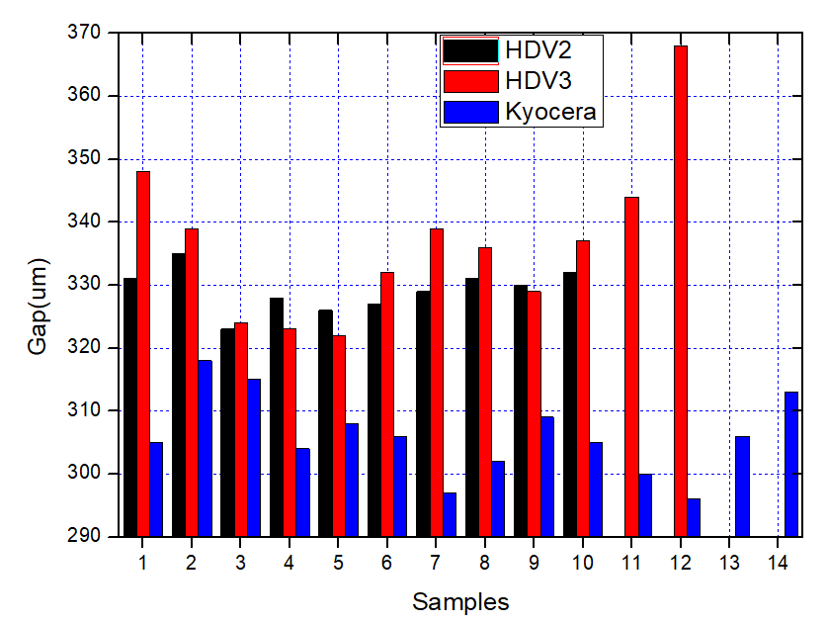
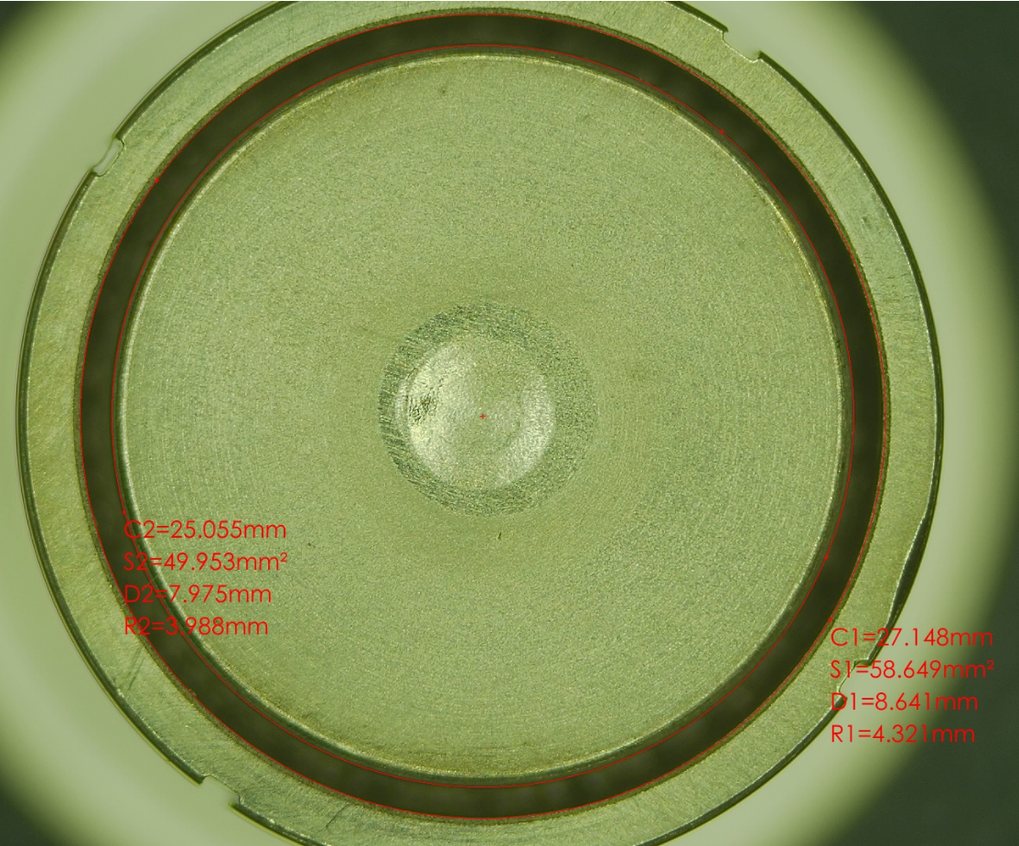
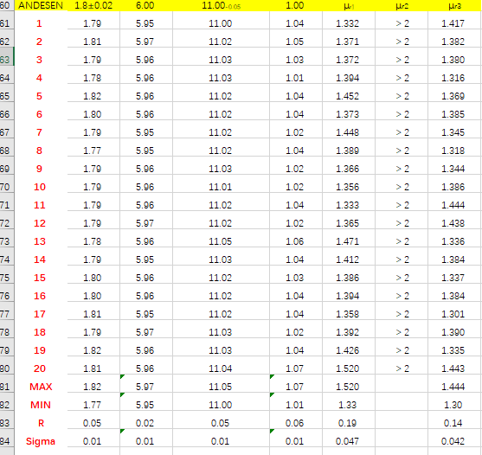
Feed-through R&D
3 Candidate manufacturers, the same design , batch products consistency test

Slide 26
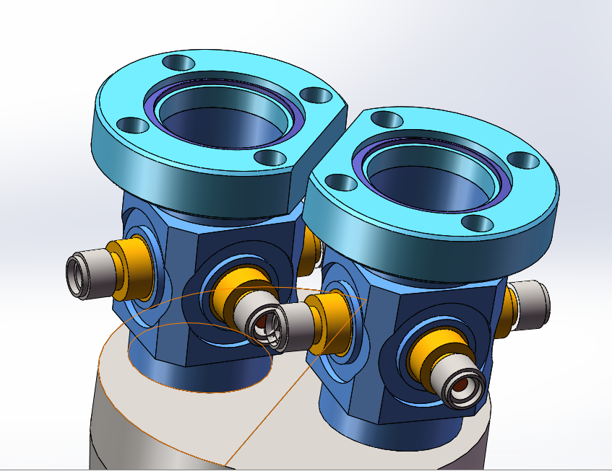
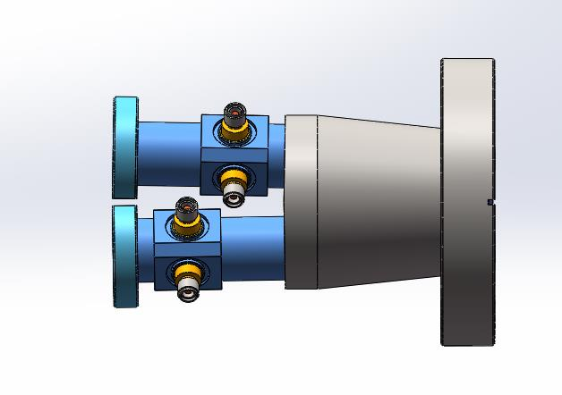
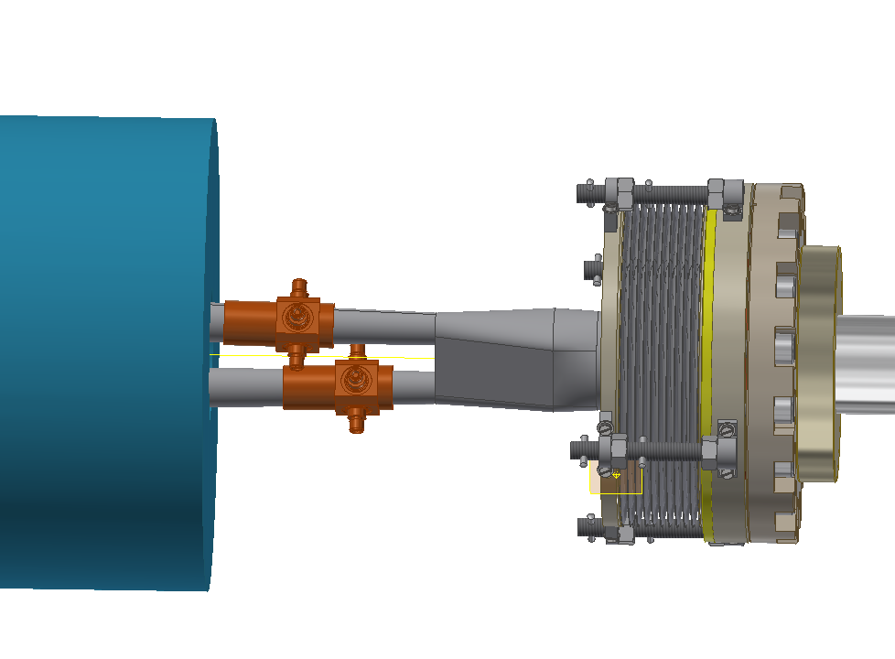
The beam instrumentation of IP
Space conflict for the inside two buttons has been solved by staggering the position ~1cm.
Monitoring the time when two beams arrive at the collision point, e+ and e- signals can be distinguished.

Slide 27
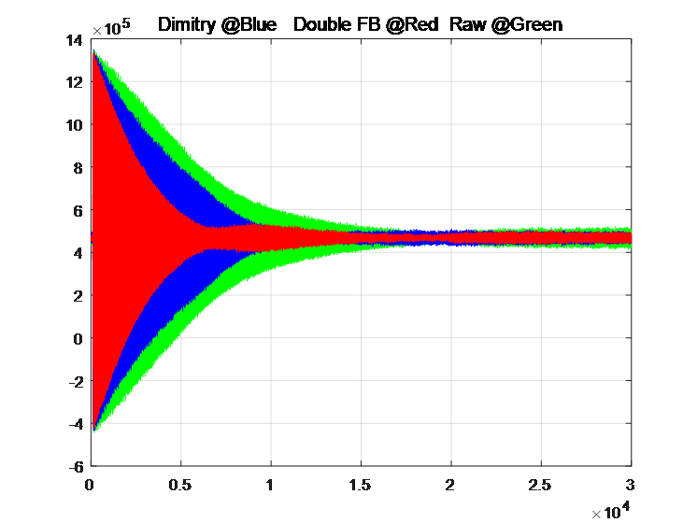
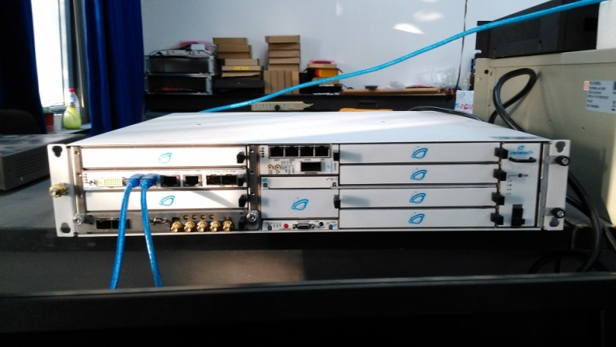
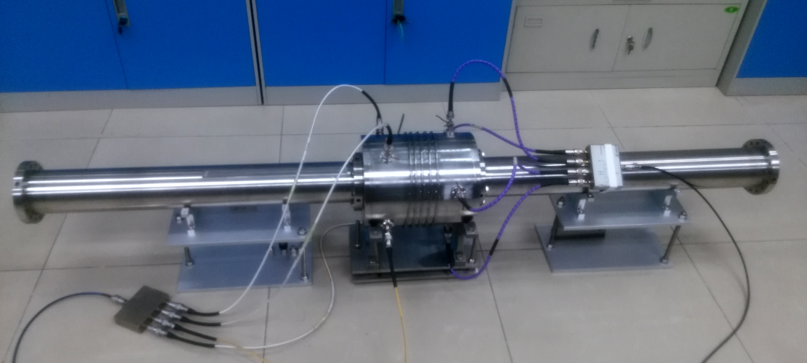
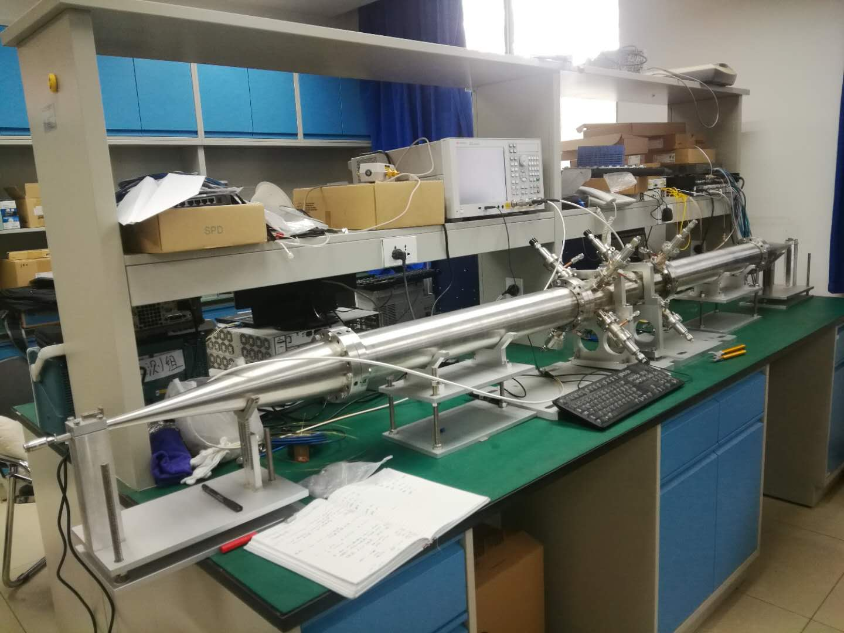
Feedback system R&D
FB electronics R&D based commercial product
The damping time of two TFBs
The kicker design and test in the lab

Slide 28
Summary
The beam position monitor, feed back system and other key technologies R&D has been carried out.
In-house developed BPMs were tested in lab and also with real beam in BEPCII. Small batch production have been used online in BEPCII linac and storage ring.
Three months of trouble-free operation of 53 units in both BEPCII storage ring and linac, more to be commissioned soon.
The feed through R&D was carried out as plan, more study will be done in consistency of batch product.

Slide 29
Thanks for your attention !

Slide 30
BACK UP

Slide 31
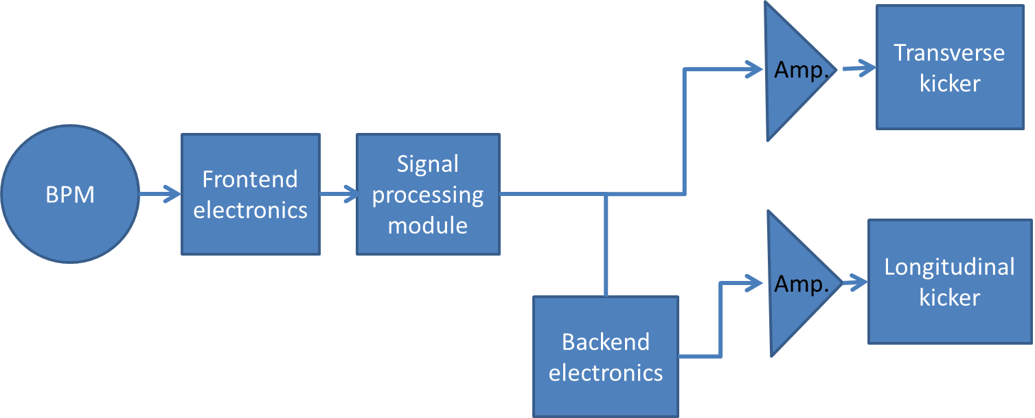
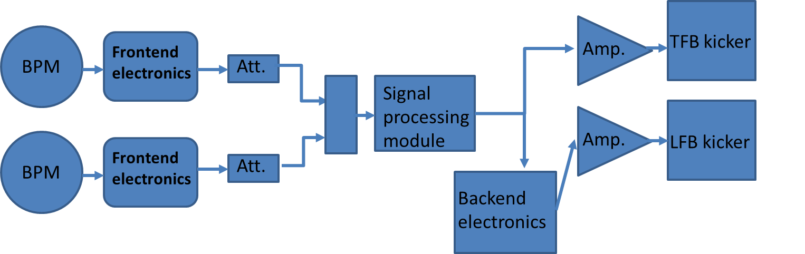
Two topologies of FB design
One BPM and One kicker, 90 degree phase shift and DC filter both are got in FPGA.
The tap number is always more than 2.
Two BPMs and One kicker, 90 degree phase shift can got by adjusting the amplitude of two BPMs signal and DC filter are got in FPGA.
The tap number is 2.

Slide 32
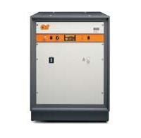
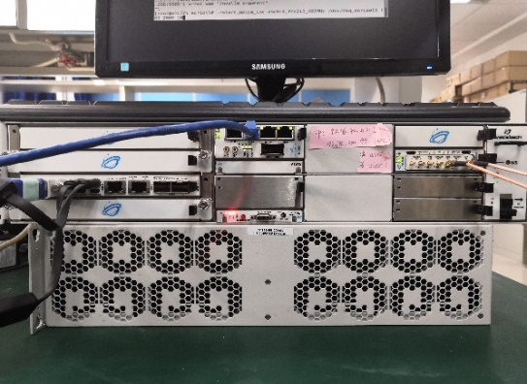
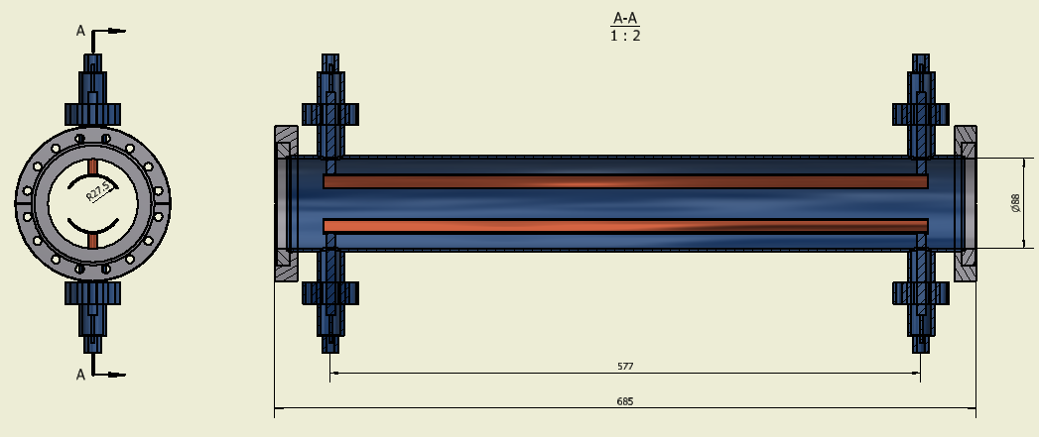
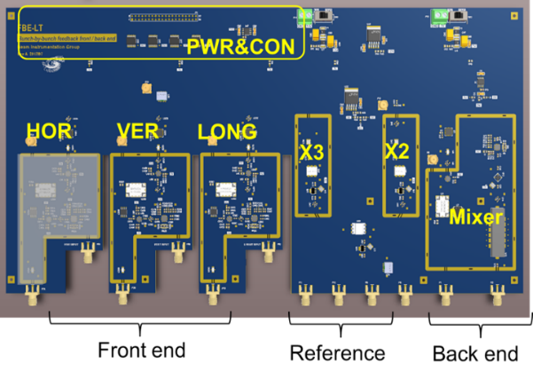
The Composition of feedback system
AR
AMP
BPM
Kicker
Front end electronics
Signal processor
AMP
AMP
AMP
Home made
Kicker
Back end
AMP
AMP

Slide 33
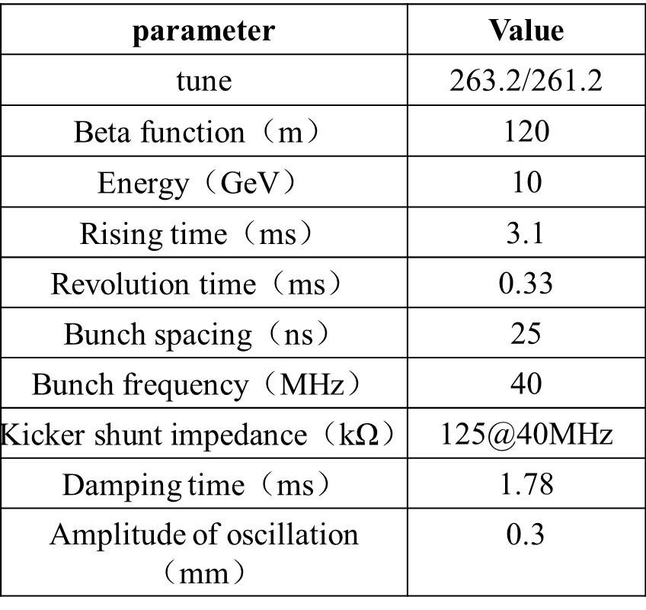
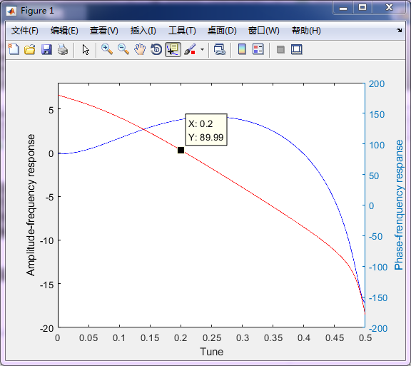
Transverse feedback on the booster
E=10GeV，β_{m}=β_{k}=120m，Δx=0.3mm, τ_{FB} =1.45 ms，so ΔV_{FB⊥}＝9.27kV, P=344w.
4-tap filter was considered
One BPM and One kicker, 90 degree phase shift and DC rejection both are got in FPGA.
2 amplifiers, 300W for each

Slide 34
Transverse feedback Kicker on the booster
※ shunt impedance Rs
Ζc :Characteristic Impedance 50Ω; g_{trans}=1; k =ω / c
a: radius; l: length of strip line

Slide 35
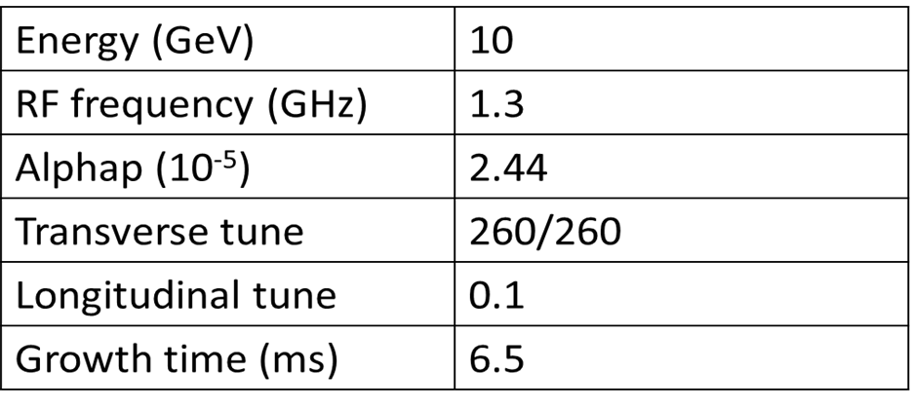
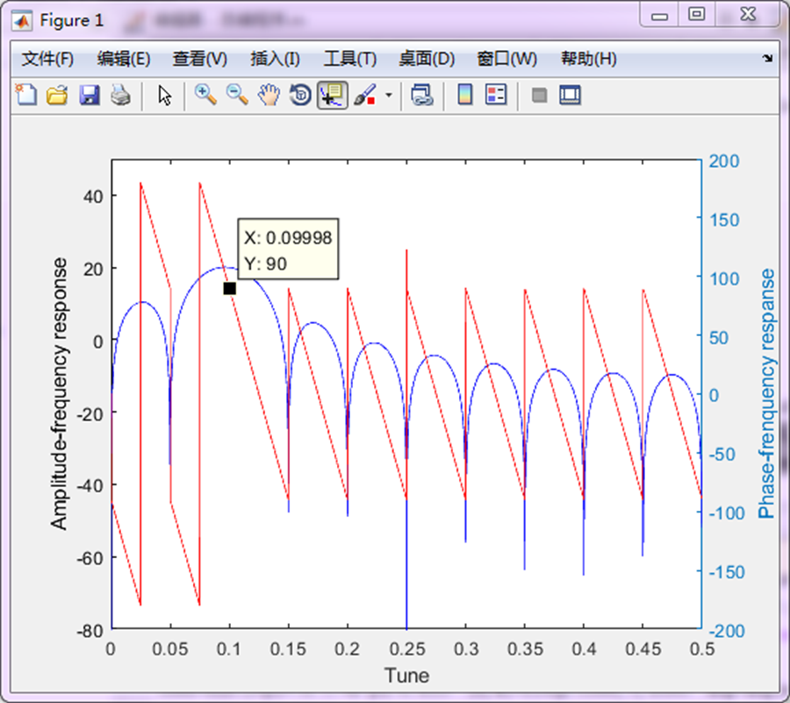
Longitudinal feedback status
E=10GeV，α=0.0000244， νs=0.1, τ_{FB} =50 ms，so ΔV_{FB||} ＝2144V，P=884W.
→ 65
20-tap filter was considered
One BPM and One kicker
90 degree phase shift and DC rejection both are got in FPGA.
4 amplifiers, 250W for each

Slide 36
Parameters of the CEPC main ring
parameter | Higgs | W | Z
nus | 0.065 | 0.04 | 0.028
Nux/nuy | 363.10 / 365.22
Energy（GeV） | 120 | 80 | 45.5
alphp | 1.11E-5
Rising time（ms） | 51.6 | 19.6 | 2.3
Natural damping time(ms） | 46.5 | 156.4 | 850
Revolution time（ms） | 0.33
Bunch number | 242 | 1524 | 12000
Bunch space（ns） | 680 | 210 | 25
current（mA） | 17.4 | 88 | 461
Z is the most dangerous mode which need feedback system.
Fast beam ion instability is dominant.
Damping time requirement for transverse feedback : <2.3ms

Slide 37
Calculation result of TFB on main ring
1，two BPMs, one kicker.
2，2-tap filter, total processing time is about 2 turn，0.66ms
3，Damping time should be smaller than 1.64ms.
For CEPC main ring Z mode，E=45.5GeV，β_{m}=225m，β_{k}=225m，Δx=0.2mm, take τ_{FB} =1.60ms，so ΔV_{FB⊥}＝16.7kV, P=898w.
AR 500A250A, the output power is 500w.
Optional choice：using multi-TFBs to shorter the damping time.

Slide 38
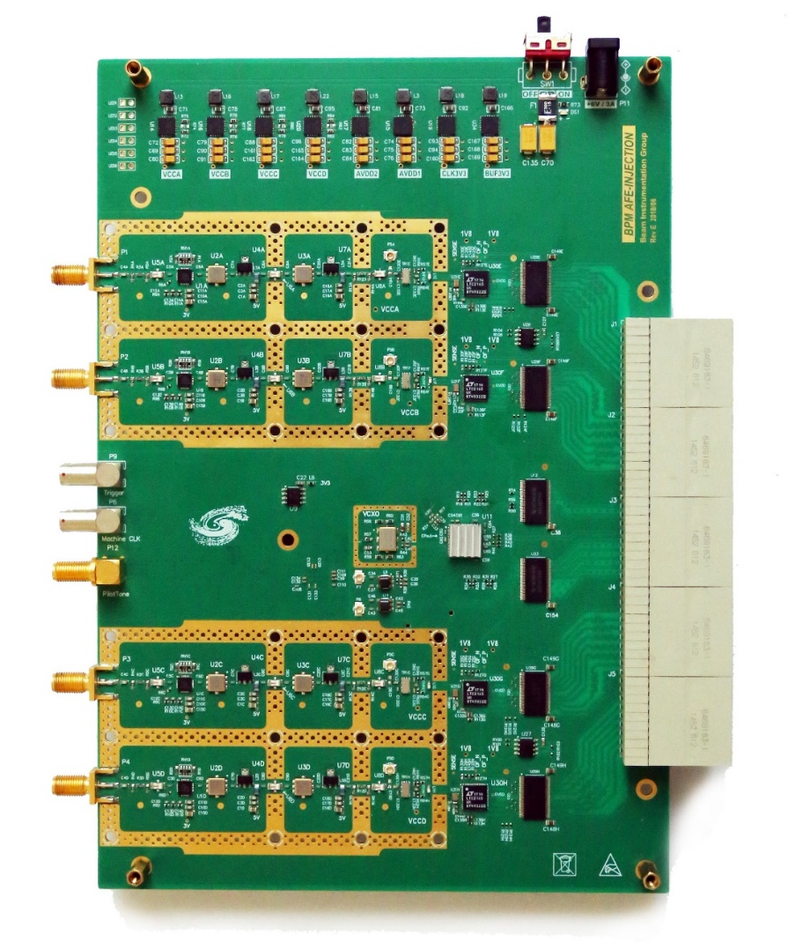
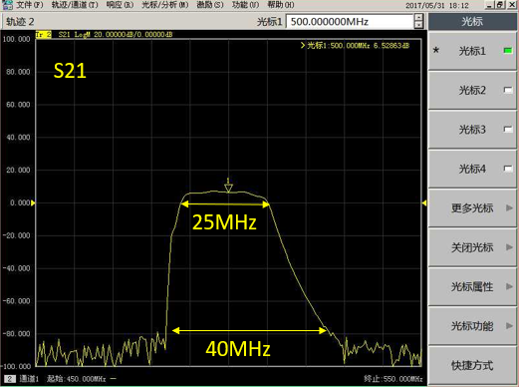
Analog Front End Board (AFE)
Performance Features
P1dB = +18.5dBm (at ADC Input)
IP3 = +39 dBm (at ADC input)
NF =6.0dB (LPF and SAW Filter)
Channel to Channel Isolation > 80dB
Phase difference < 10°
Amplitude difference < 5%
-3dB Bandwidth =25MHz
A
C
Trigger
MC
ADF
Pilot Tone
B
D
RF Circuits
Receiver S-Parameter Characterization

Slide 39
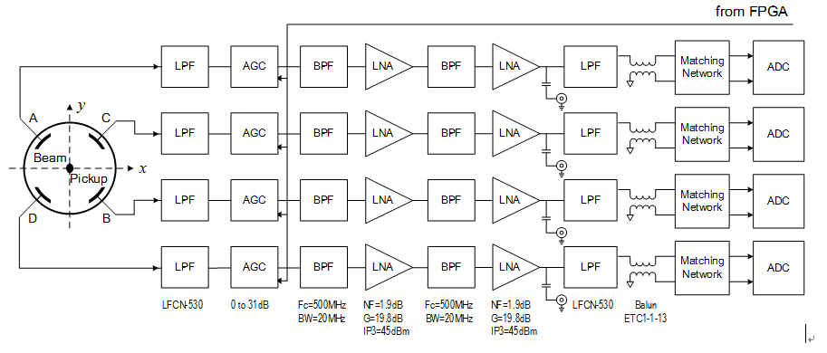



AFE RF Channel Signal Chain Design
RF 499.8MHz signals are extracted by SAW BPF(~30 MHz BW).
RF Amplifiers Gain > 40dB;
Attenuators :0~31.5dB(0.5dB step);
The signal level is adjusted by step attenuators and amplifiers.
Simulate in Advanced Design System
The performance of RF circuits is the key of excellent performance of digital BPM！
Low noise & Impedance matching
Notes:
在实际的测试中发现，microTCA的ADF接口传输射频信号隔离度较差，因此在新一版本中将ADC前置到前端板中，减小射频信号长距离传输引起的不稳定性;
这是新一版本的射频信号调理电路设计框图，射频接收链路的性能指标是数字BPM性能的保证;
因为射频链路的主要作用是功率的传输、放大和滤波等处理，因此阻抗匹配设计是其中最重要的部分;
射频链路主要包括 带通滤波电路、射频放大电路和自动增益调节电路，

Slide 40



Clock Circuit design and jitter Testing
366.7fs
Hole space: S ≈ 4D to 10D
More than 2 rows Ground Via needed;
Vias on Adjacent rows are interlaced placed;
Less λ /4 Via to Via space in one row.
Clock Power Supply factors cannot be ignored！

Slide 41


ADC Performance Analysis
ADC SNR vs Input Frequency vs Clock Jitter
A
B
Raw ADC FFT
 | SNR | ENOB | SFDR | SINAD | THD
ADC | 60.3 | 12.2 | 75.5 | 52.2 | -56.1
C
D
ADC test results
ADC histogram
Notes:
如图所示的ADC的FFT结果，最终可以得到SNR=60.3 有效位为10.2 SFDR =75.5 右图所示四路ADC的原始数据直方图;

Slide 42

The front-end electronics of BPM
8 versions of AFE electronics have been developed to improve the performance in the past six years.
The front-end electronics cross talk is better than -80dB and the dynamic range is 60dB in the latest version.

Slide 43

Digital Front End Board (DFE
Features:
Xilinx ZYNQ FPGA (XZ7100)
  Hard dual-core ARM A9 processor
  Beam signal processing with DDC+CIC+FIR
  Runs standard Debian based Linux Operating System
  Embedded IOC
Boot via 32Gbyte micro SD-Card
Gigabit Ethernet
2Gbyte DDR3 Memory (SO-DIMM Module)
  Four 6.6Gbps SFP modules
  Embedded Event Receiver
  Fast Orbit Feedback
32Mbit FLASH memory
2 Gbytes DDR3
ZYNQ 7Z100
RS-232-C
Gigabit Ethernet
SD Card
InterLock IN
InterLock OUT
JTAG
ADF Interface
4 SFP +
Machine Clk
Trigger IN
SYNC
+12V Power Input
Notes:
43

Slide 44
Digital Signal Processing Block
DDS
DDC BPM block
COD BPM block
RAW
ADC
FIR Filter
Bandpass
×
IQ Data
CIC Filter
Decimator
Compensating
FIR Filter
CORDIC
BPM Calc.
TBT Data
LFSR
CIC Filter
Decimator
Compensating
FIR Filter
Programmable
FIR Filter
BPM Calc.
FA Data
CIC Filter
Decimator
Compensating
FIR Filter
Programmable
FIR Filter
BPM Calc.
SA Data
LFSR: Linear Feed-back Shift-Register
FIR filter : Finite Impulse Response filter
CIC filter : Cascaded Integrator-Comb filter
DDS : Direct Digital Synthesis
DDC BPM Block generates IQ data with NCO&ADC
The purpose of band-pass filter is to remove the baseline of ADC;
COD BPM Block generates TbT, FA, and SA (10 Hz) data.
DSP filter = CIC+FIR for LowPass Filter and Decimator;

Slide 45
Data Acquisition Module
SA Data Acquisition function block.
  Data Acquisition control logic
  Write/Read CSV file logic
  EPICS IOC Logic
  Data base logic
  Graphical User Interface
  …
DBPM DFE Module
TCP GbE
Data Acquisition
CSV
*.
txt File
SoftIOC
Archiver Engineering
SA Data
CSS OPI
MySQL database
Measurement Display
Picture Storage

