Slide 1
CEPC collider ring orbit corrections
Bin Wang (on the behalf of the CEPC error correction team)
Institute of High Energy Physics
11.08
2021
The 2021 international workshop on the high energy Circular Electron-Positron Collider (CEPC)

Slide 2
Content
Introduction of the high luminosity
The correction scheme
The correction results
Summary and to do list

Slide 3
Beam parameters
Y. W. Wang, D. Wang, Y. Zhang, J. Y. zhai et al
 | ttbar | Higgs | W | Z
Number of IPs | 2
Circumference [km] | 100.0
SR power per beam [MW] | 30
Half crossing angle at IP [mrad] | 16.5
Bending radius [km] | 10.7
Energy [GeV] | 180 | 120 | 80 | 45.5
Energy loss per turn [GeV] | 9.1 | 1.8 | 0.357 | 0.037
Piwinski angle | 1.21 | 5.94 | 6.08 | 24.68
Bunch number | 35 | 249 | 1297 | 11951
Bunch population [10^10] | 20 | 14 | 13.5 | 14
Beam current [mA] | 3.3 | 16.7 | 84.1 | 803.5
Momentum compaction [10^-5] | 0.71 | 0.71 | 1.43 | 1.43
Beta functions at IP (bx/by) [m/mm] | 1.04/2.7 | 0.33/1 | 0.21/1 | 0.13/0.9
Emittance (ex/ey) [nm/pm] | 1.4/4.7 | 0.64/1.3 | 0.87/1.7 | 0.27/1.4
Beam size at IP (sigx/sigy) [um/nm] | 39/113 | 15/36 | 13/42 | 6/35
Bunch length (SR/total) [mm] | 2.2/2.9 | 2.3/3.9 | 2.5/4.9 | 2.5/8.7
Energy spread (SR/total) [%] | 0.15/0.20 | 0.10/0.17 | 0.07/0.14 | 0.04/0.13
Energy acceptance (DA/RF) [%] | 2.3/2.6 | 1.6/2.2 | 1.2/2.5 | 1.3/1.7
Beam-beam parameters (ksix/ksiy) | 0.071/0.1 | 0.015/0.11 | 0.012/0.113 | 0.004/0.127
RF voltage [GV] | 10 | 2.2 | 0.7 | 0.12
RF frequency [MHz] | 650 | 650 | 650 | 650
HOM power per cavity (5/2/1cell)[kw] | 0.4/0.2/0.1 | 1/0.4/0.2 | -/1.8/0.9 | -/-/5.8
Longitudinal tune Qs | 0.078 | 0.049 | 0.062 | 0.035
Beam lifetime (bhabha/beamstrahlung)[min] | 81/23 | 39/18 | 60/717 | 80/182202
Beam lifetime [min] | 18 | 12.3 | 55 | 80
Hour glass Factor | 0.89 | 0.9 | 0.9 | 0.97
Luminosity per IP[1e34/cm^2/s] | 0.5 | 5.0 | 16 | 115

Slide 4
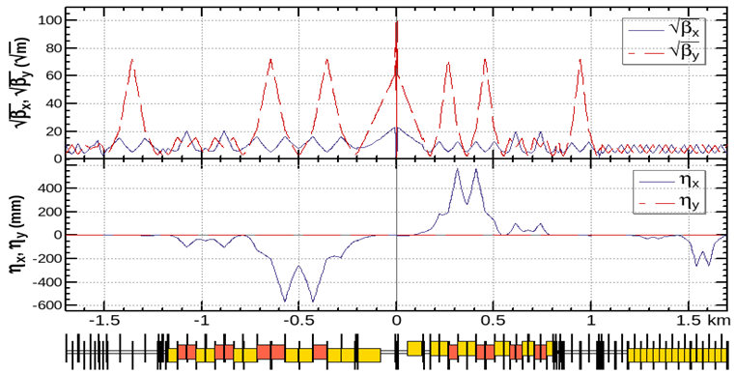
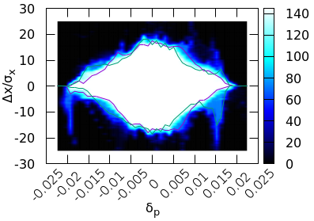
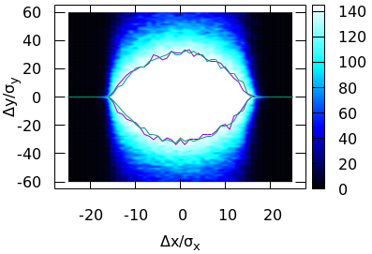
Lattice and requirements
J. Wu, Y. Zhang, Y. W. Wang
Achieved (w/o error): $16σ_{x}×32σ_{y}×1.9\%$
Goal (w/ error): $7σ_{x}×15σ_{y}×1.7\%$

Slide 5
The correction scheme
Software: SAD and AT
COD correction with sextupoles off
Turn on the sextupoles and perform COD correction again.
Dispersion correction (DFS)
Beta beating correction (LOCO)
Coupling and vertical dispersion correction (Local coupling parameter correction）

Slide 6
Errors definition and challenges
Component | Δx (mm) | Δy (mm) | Δθ_{z} (mrad) | Field error
Dipole | 0.10 | 0.10 | 0.1 | 0.01%
Arc Quadrupole | 0.10 | 0.10 | 0.1 | 0.02%
IR Quadrupole | 0.05 | 0.05 | 0.05
Sextupole | 0.10 | 0.10 | 0.1
Component | Δx (mm) | Δy (mm) | Δθ_{z} (mrad) | Field error
Dipole | 0.10 | 0.10 | 0.1 | 0.01%
Arc Quadrupole | 0.10 | 0.10 | 0.1 | 0.02%
IR Quadrupole | 0.10 | 0.10 | 0.10
Sextupole | 0.10 | 0.10 | 0.1
The high luminosity lattice is much more sensitive to imperfections, the optics correction is very challenging.
1000 lattice seeds are generated for further correction.
We study the error corrections for these two error cases.

Slide 7
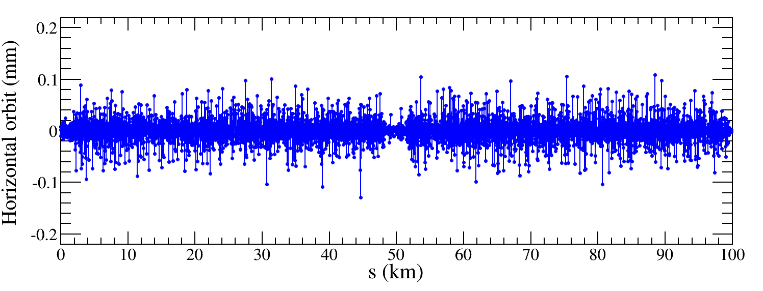
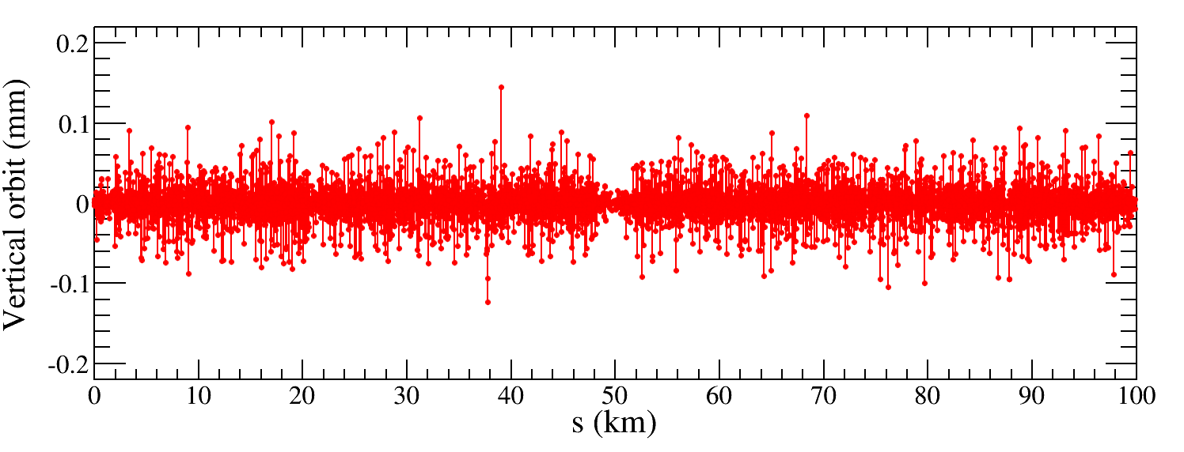
COD correction
A new corrector setting is necessary for the more limited lattice.
BPMs placed at quadrupoles (~1800, 4 per betatron wave) Horizontal correctors placed beside focusing quadrupoles（~1800）
Vertical correctors placed beside defocusing quadrupoles（~1800）
Orbit correction is applied using orbit response matrix and SVD method.
Result of one seed

Slide 8
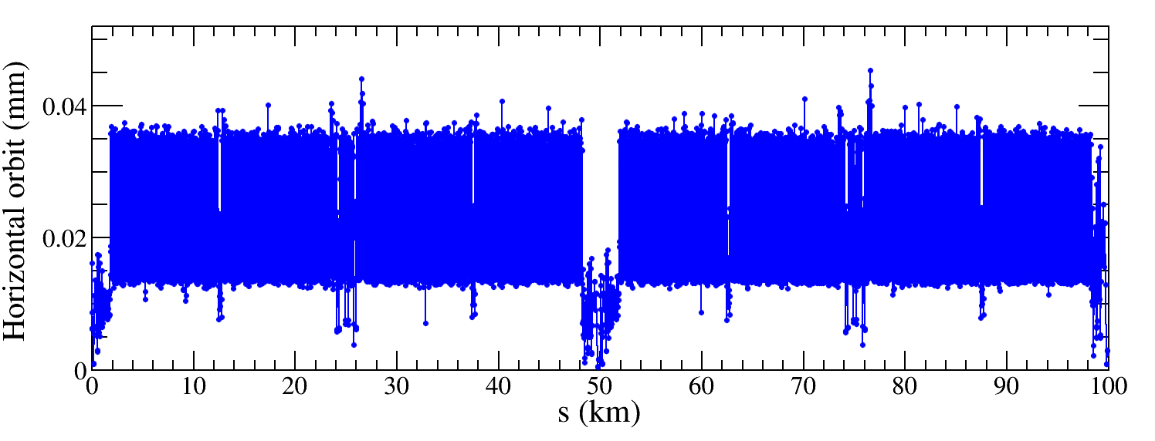
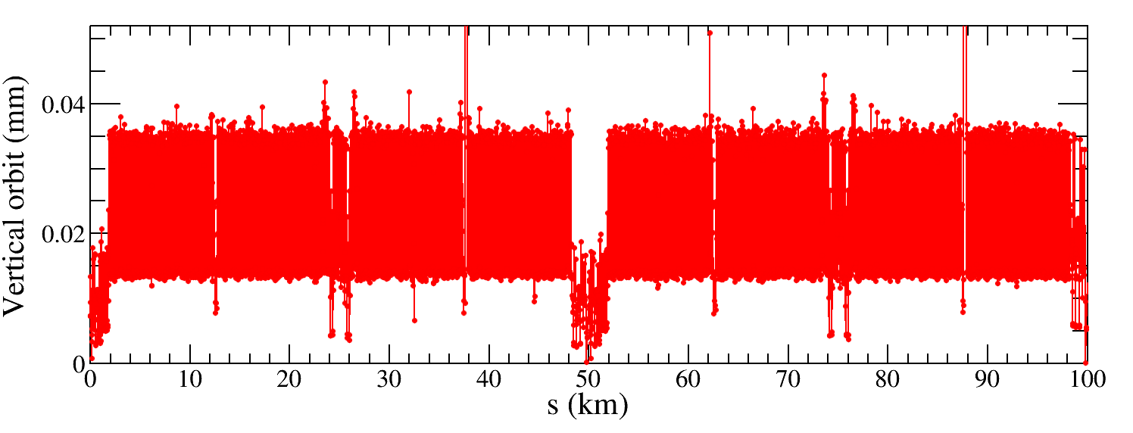
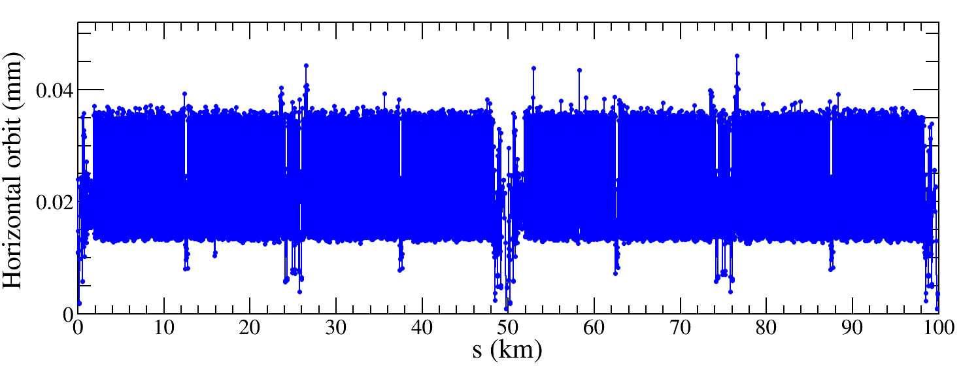
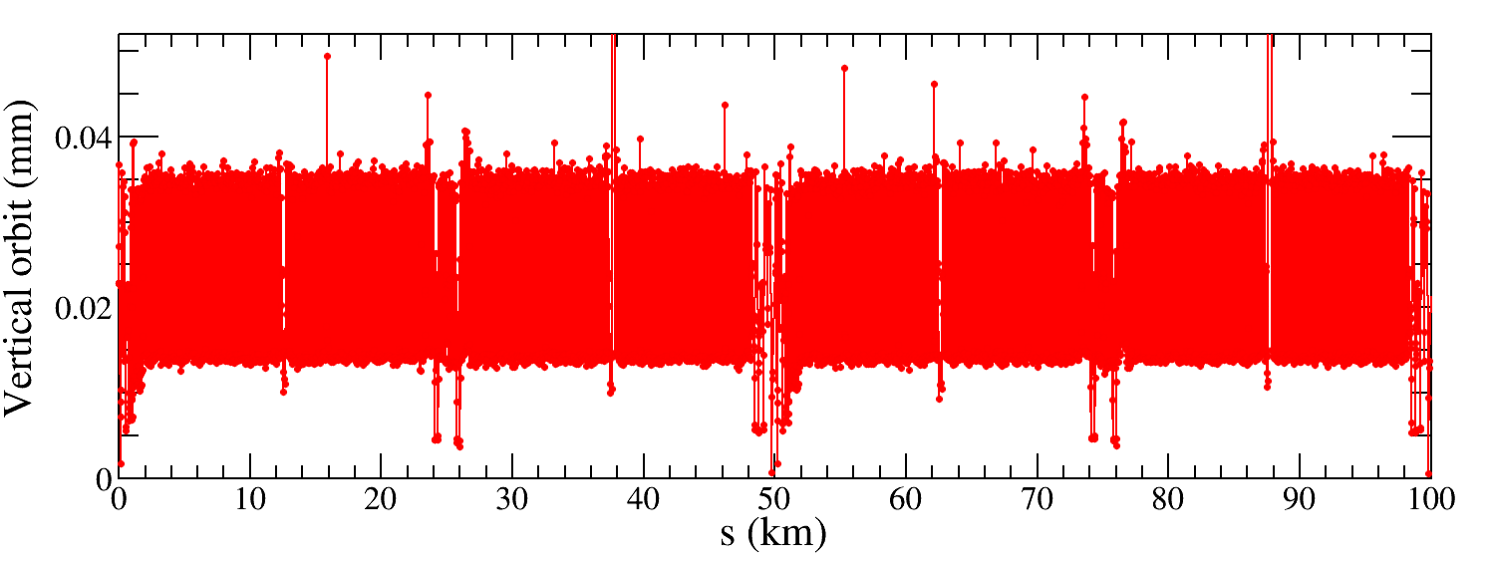
COD correction
IR=50μm 843 seeds converged
IR=100μm 678 seeds converged
$${RMS}_{COD}<0.05 mm$$
The COD correction is performed for all selected seeds;
The correction effect for this two cases are comparable with those of CDR lattice.

Slide 9
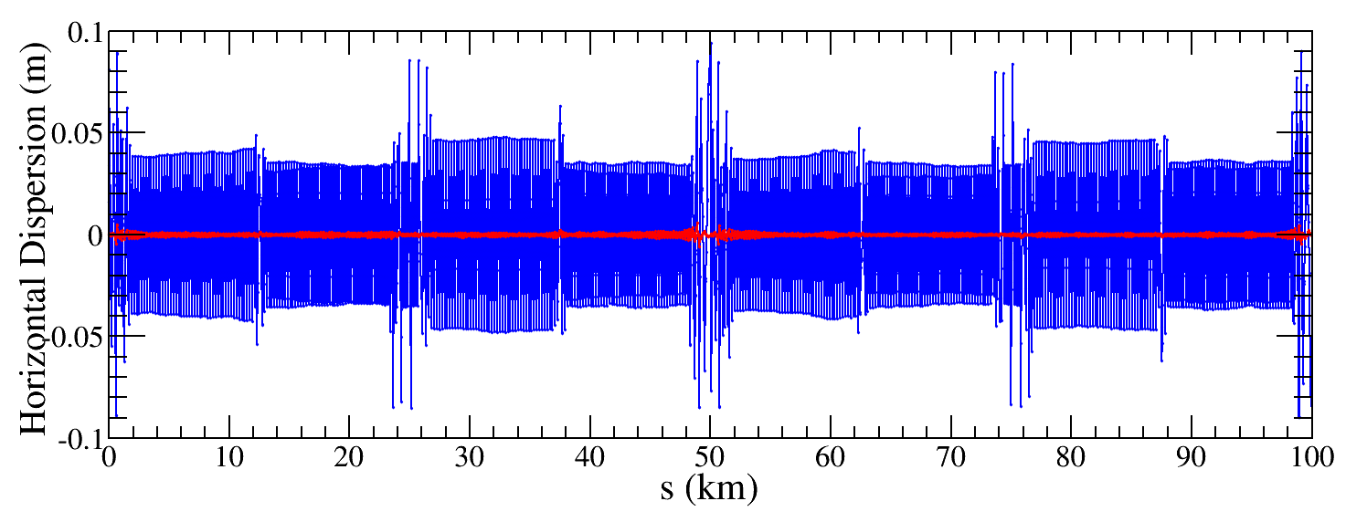
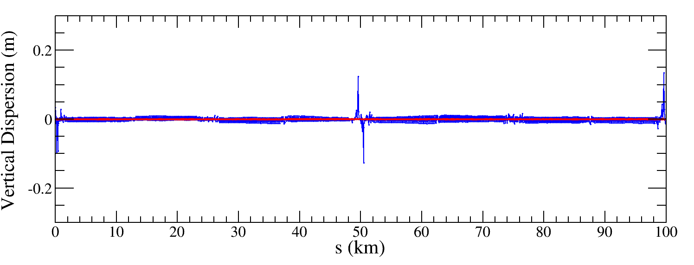
Dispersion correction
Dispersion free steering principle (DFS):$θ$_{c}
$$\vec{d}=\left(\begin{aligned}\left(1−α\right)\vec{u} \\ α\vec{D}u\end{aligned}\right)$$
M$=\left(\begin{aligned}\left(1−α\right)A \\ αB\end{aligned}\right)$
$$\vec{d}+M\vec{θ}=0$$
Result of one seed
$\vec{u}$: Orbit vector
$\vec{D}u$: Dispersion vector
$\vec{θ}$: Corrector strengths vector
$α$: Weight factor
$A$: Orbit response matrix
$B$: Dispersion response matrix

Slide 10
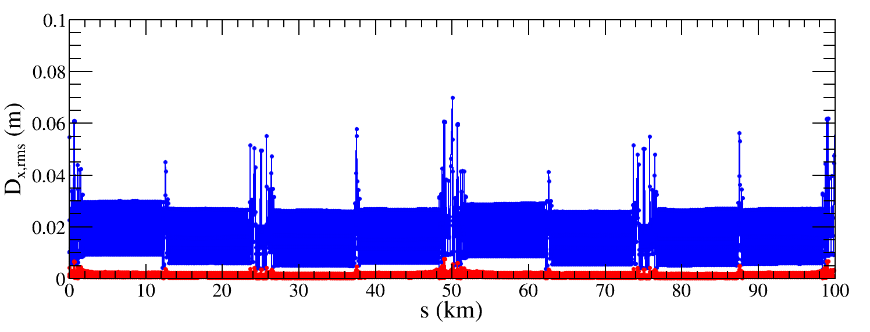
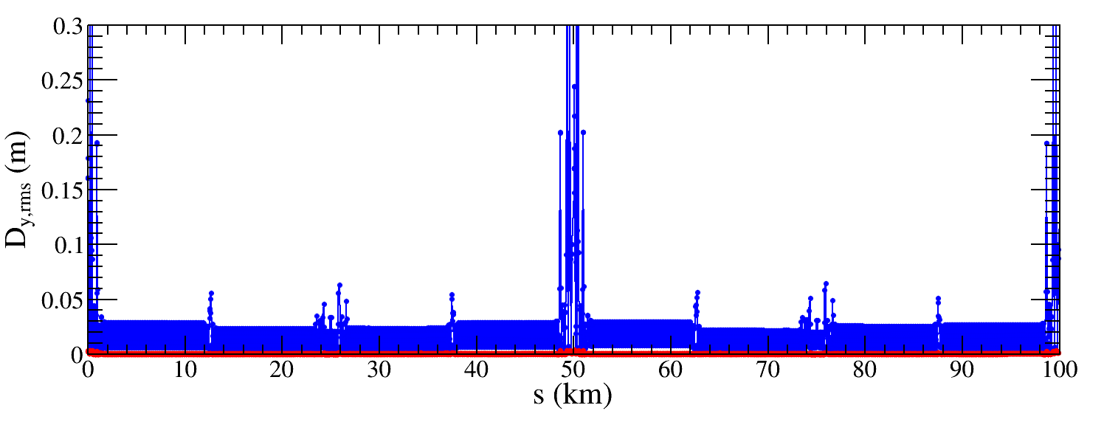
Dispersion correction
IR=50μm 674 seeds converged
${∆D}_{x,rms}$ decreased from 15.6mm to 1.3mm
Factor 12 improvement
${∆D}_{x,rms}$ decreased from 21.9mm to 0.6mm
Factor 36 improvement
The dispersion correction is performed for all selected seeds, 753 seeds are converged.
The correction effect is better than that of CDR lattice.

Slide 11
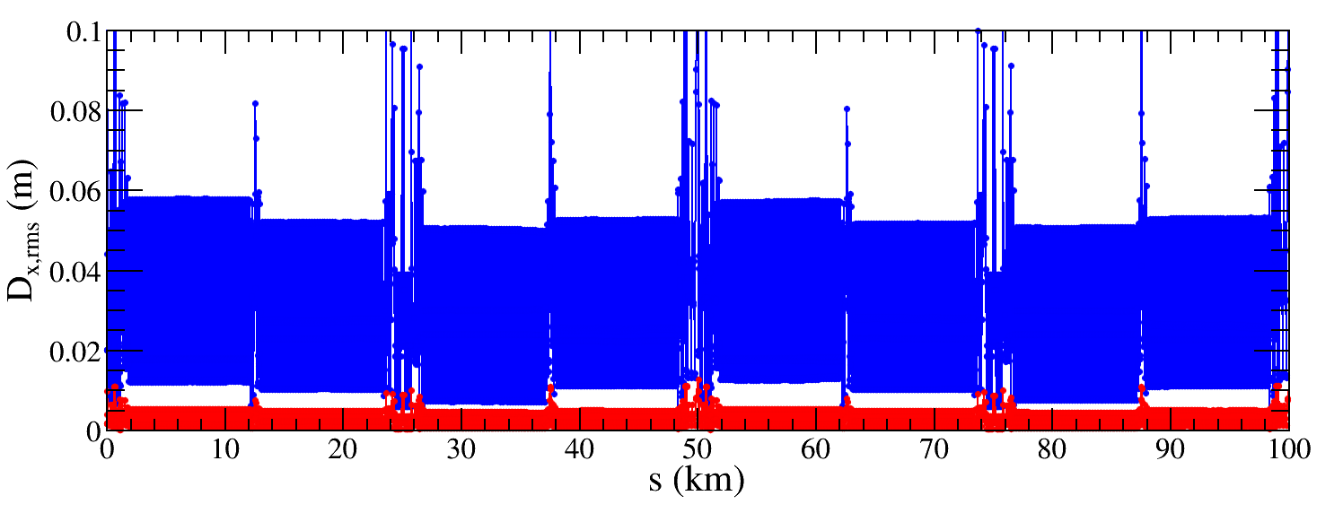
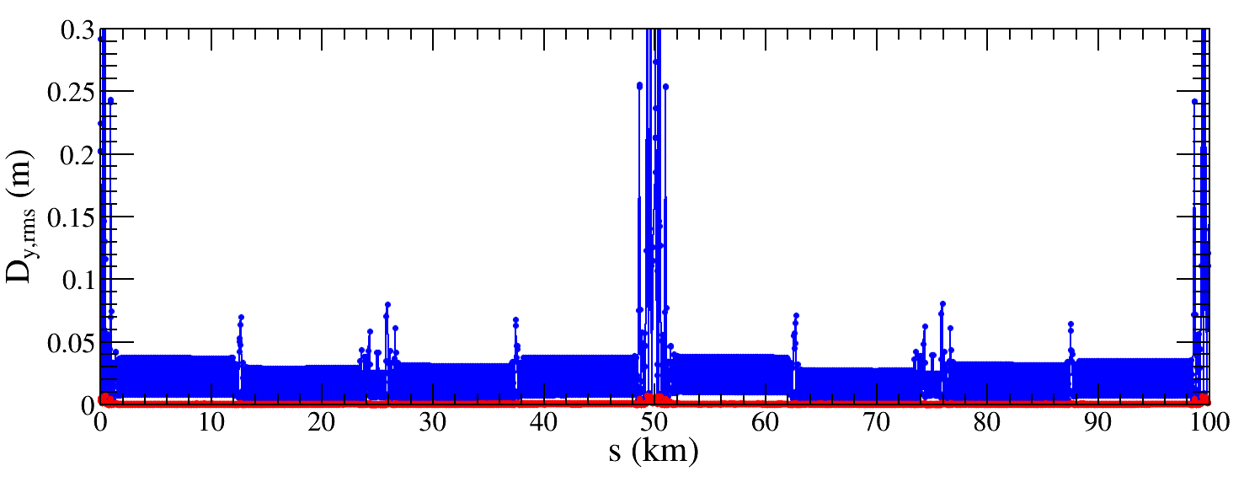
Dispersion correction
IR=50μm 674 seeds converged
${∆D}_{x,rms}$ decreased from 15.6mm to 1.3mm
Factor 12 improvement
${∆D}_{x,rms}$ decreased from 21.9mm to 0.6mm
Factor 36 improvement
IR=100μm 541 seeds converged
${∆D}_{x,rms}$ decreased from 28.8mm to 2.7mm
Factor 11 improvement
${∆D}_{x,rms}$ decreased from 23.5mm to 0.6mm
Factor 39 improvement

Slide 12
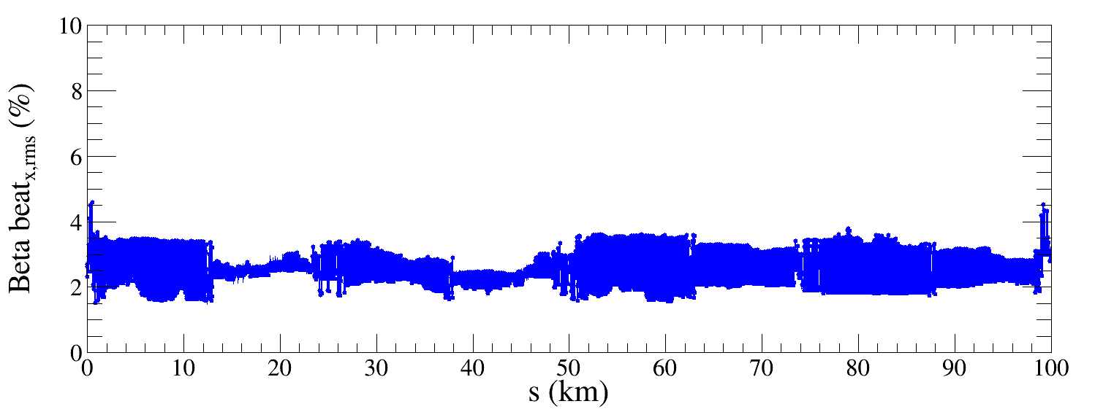
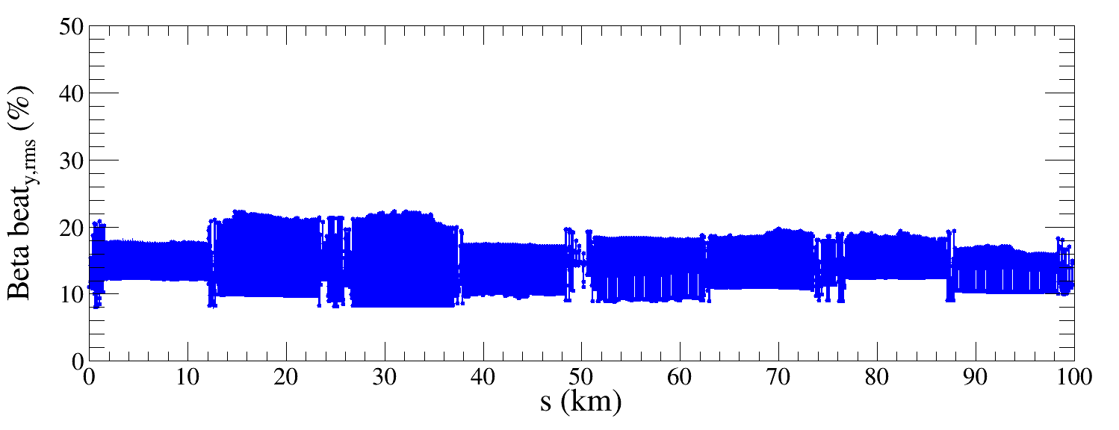
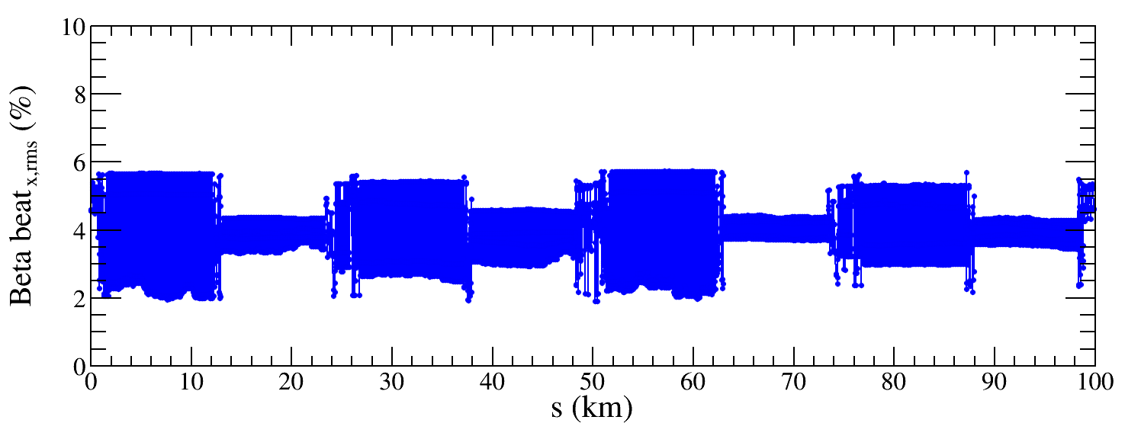
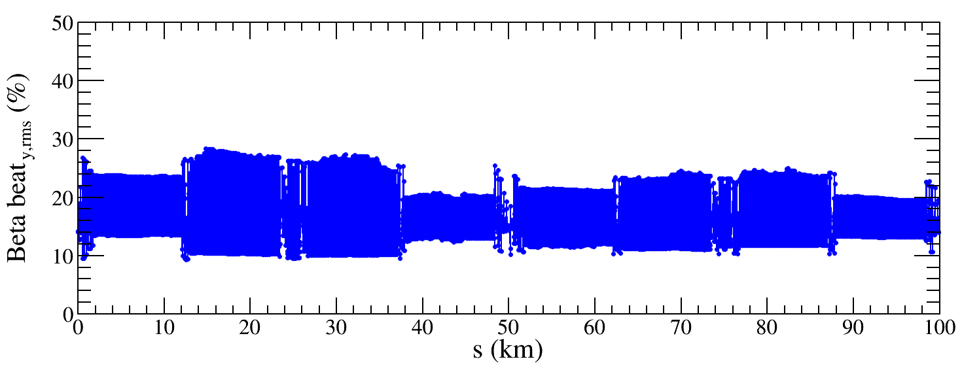
Beta-beating distribution
IR=50μm
Before correction
IR=100μm
The beta beating before LOCO correction is comparable with results based on CDR lattice.
Beta beating correction is ongoing.

Slide 13
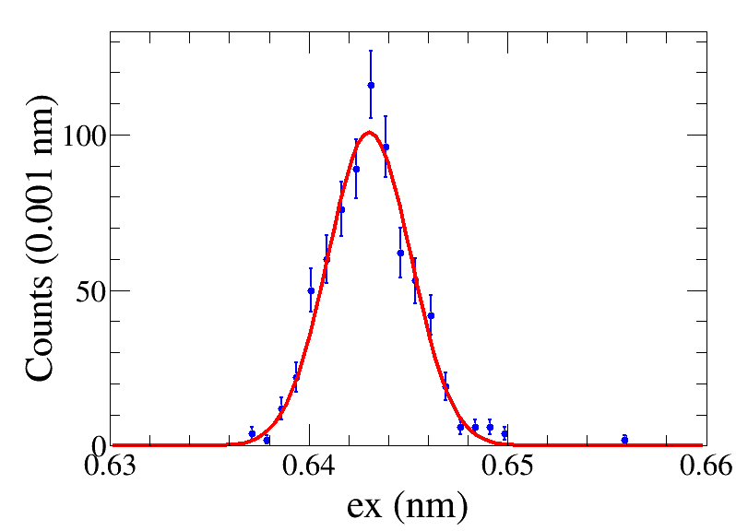
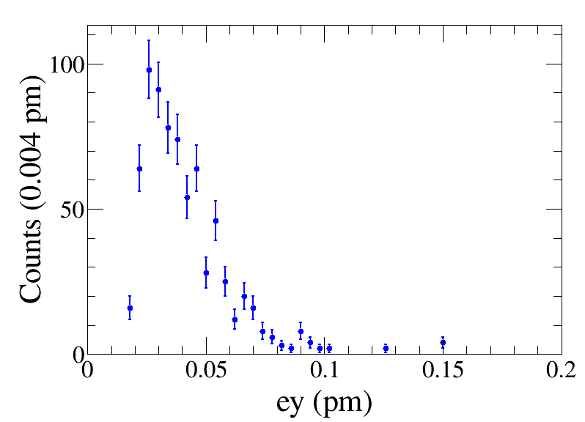
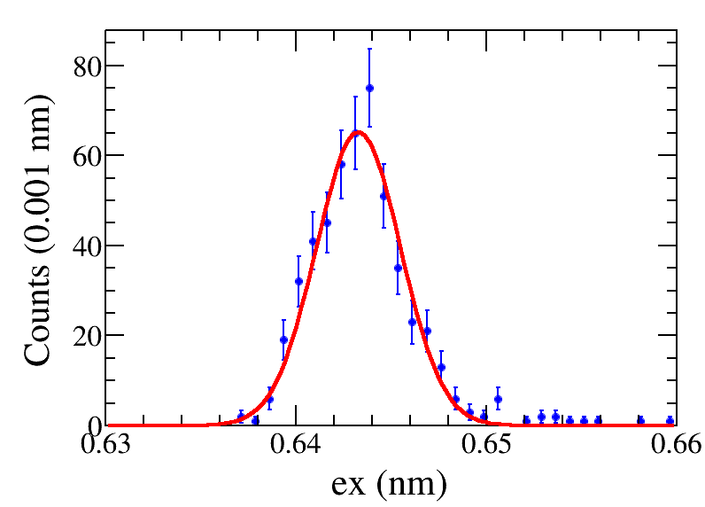
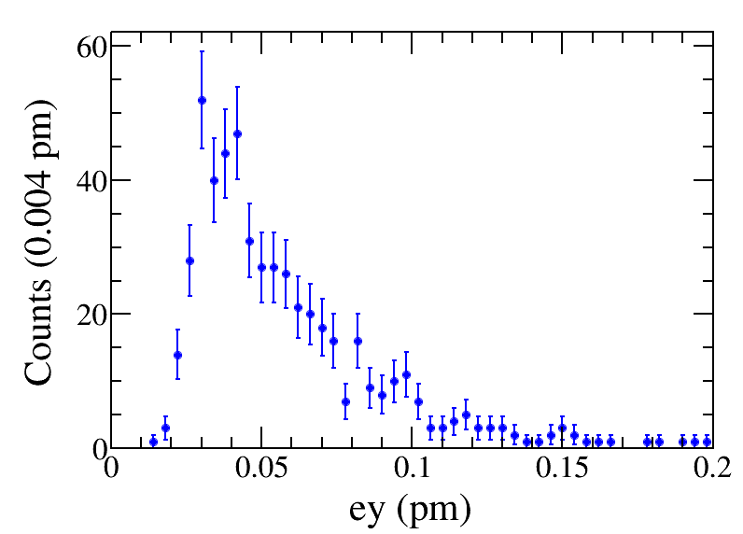
Results of emittance tuning
IR=50μm
ex = 0.6430$±0$.0021 nm,
ey = 0.0413$±$0.0005 pm
ey/ex = (0.0064$±$0.0001)%
ex = 0.6436$±0$.0026 nm,
ey = 0.0579$±$0.0010 pm
ey/ex = (0.0090$±$0.0001)%
IR=100μm
Emittance tuning results are comparable with those based on CDR lattice.

Slide 14
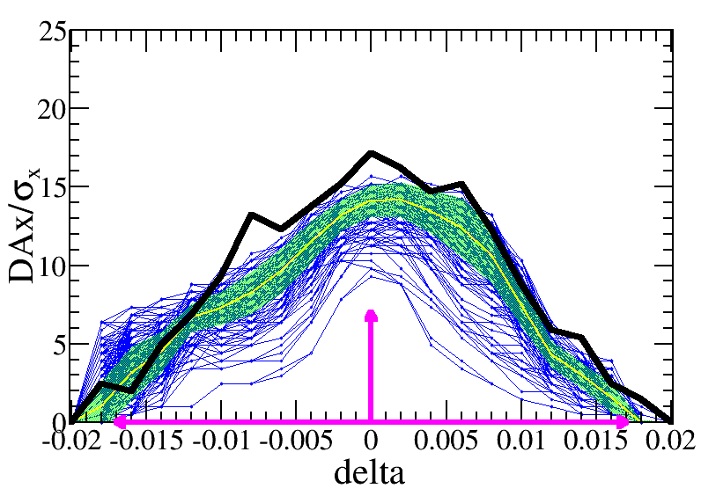
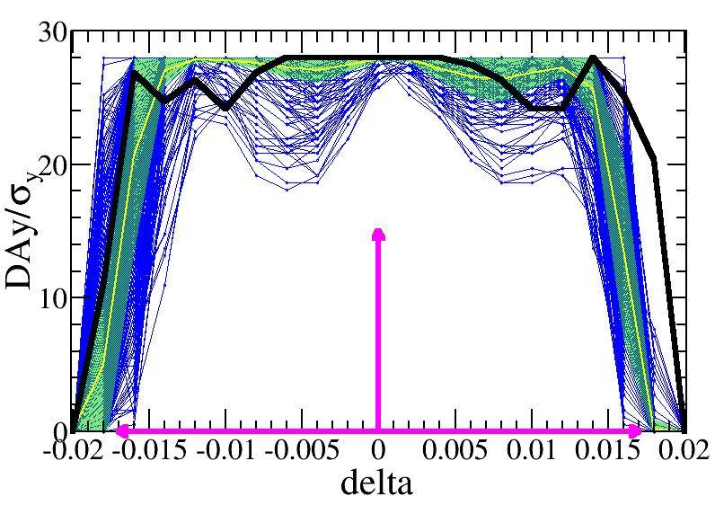
DA results
IR=50μm
The blue lines are the DA of each seed, the yellow lines and green bands are the mean value and its corresponding statistics errors, the black line is the DA of bare lattice, and the pink arrows show the DA requirement for on-axis injection, which is 7$σ_{x}×15σ_{y} \& 0.017$.
The DA of 418 error seeds with errors satisfy the on-axis injection requirements.

Slide 15
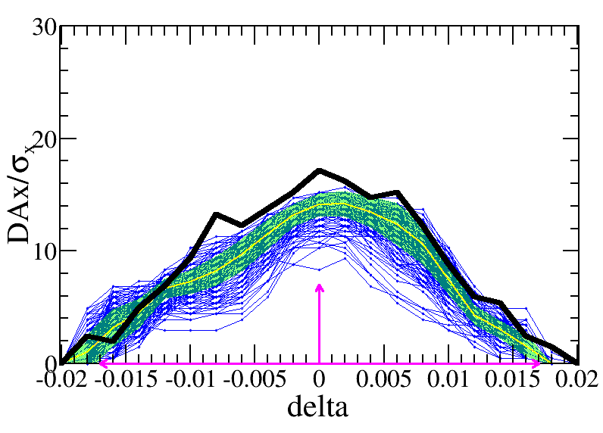
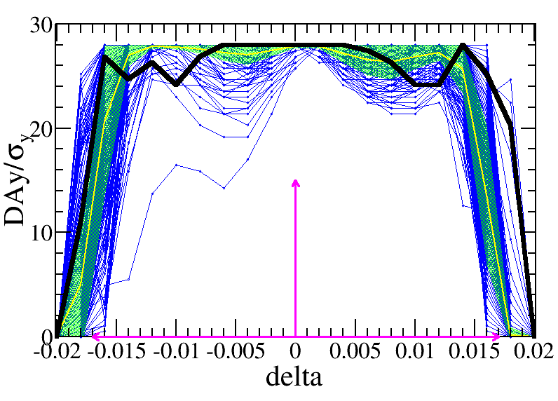
DA results
IR=50μm
IR=100μm
The DA of 270 error seeds with errors (IR=100μm) satisfy the on-axis injection requirements.

Slide 16
Summary and to do list
The imperfection correction for the high luminosity lattice is on going.
The DA of 418 lattice seeds with IR=50μm and 270 lattice seeds with IR=100μm satisfy the on-axis injection requirements.
Optimize the correction strategy to achieve finer tuning of optics.
Include more types of imperfections.

Slide 17
Thank you for your attention
E-mail:
wangbin@ihep.ac.cn

