Slide 1

Progress of CEPC SCRF System R&D
Jiyuan Zhai (IHEP)
On behalf of CEPC SRF Team
2021 International Workshop on the High Energy Circular Electron Positron Collider
November 9, 2021

Slide 2
Outline
CEPC SRF system design
CEPC SRF R&D progress
PAPS SRF infrastructure

Slide 3
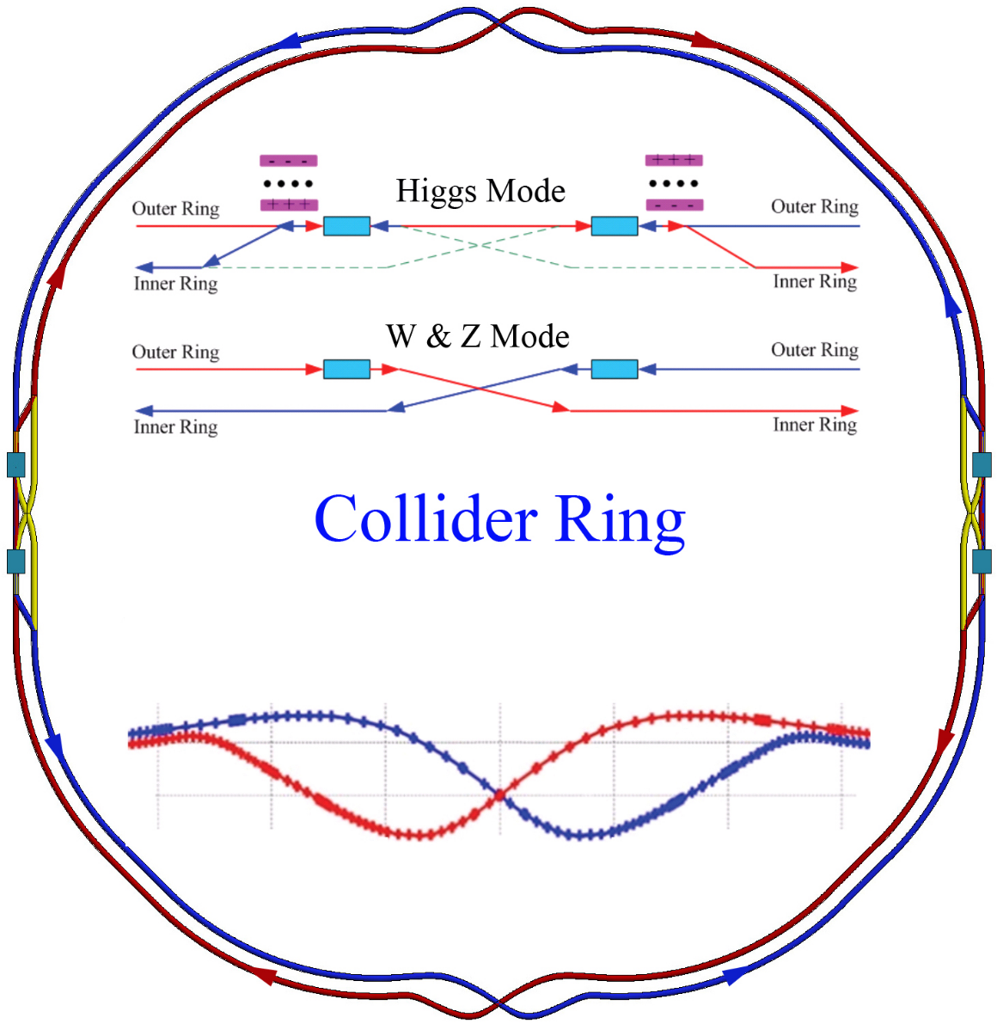
CEPC CDR SRF Layout and Parameters
 | H | W | Z
Collider Ring | 650 MHz 2-cell cavity
Lumi. / IP (10³⁴ cm⁻²s⁻¹) | 2.93 | 10.1 | 16.6 / 32.1
RF voltage (GV) | 2.17 | 0.47 | 0.1
Beam current (mA) | 17.4 x 2 | 87.7 | 460
SR power / beam (MW) | 30 | 30 | 16.5
Cavity number | 240 | 108 x 2 | 60 x 2
Q₀ at max gradient | 4E10 @ 22 MV/m (vertical test) 1.5E10 @ 20 MV/m (long term operation)
2 K cavity wall loss (kW) | 6.1 | 1.3 | 0.1
Booster Ring (extraction) | 1.3 GHz 9-cell cavity
RF voltage (GV) | 1.97 | 0.585 | 0.287
Beam current (mA) peak | 0.52 | 2.63 | 6.91
Cavity number | 96 | 64 | 32
Q₀ at max gradient | 3E10 @ 24 MV/m (vertical test) 1E10 @ 20 MV/m (long term operation)

Slide 4
CEPC SRF System TDR Status and Plan
TDR Phase 1: 2019-2021 (Components Prototyping)
SRF system TDR design and optimization (RF staging and bypass scheme proposed)
High Q, high gradient cavity, high power components and other key technology R&D
650 MHz test cryomodule integration
PAPS SRF facility construction
TDR Phase 2: 2021-2023 (System TDR Design, Cryomodule Prototyping)
SRF system TDR design optimization
650 MHz test cryomodule operation and improvement
1.3 GHz high Q full cryomodule prototyping
SRF facility (PAPS commissioning, operation and upgrade)
Industrialization (in synergy with other SRF projects in China)

Slide 5
CEPC SRF Hardware Specifications
Hardware | Qualification | Normal Operation | Max. Operation
650 MHz 2-cell Cavity | VT 4E10 @ 22 MV/m HT 2E10 @ 20 MV/m | 1.5E10 @ 20 MV/m | 2E10 @ 20 MV/m
1.3 GHz 9-cell Cavity | VT 3E10 @ 24 MV/m | 1E10 @ 20 MV/m | 2E10 @ 23 MV/m
650 MHz Input Coupler (variable) | HPT 300 kW sw | < 280 kW | 300 kW
1.3 GHz Input Coupler (variable) | HPT 20 kW peak, 4 kW avr. | < 20 kW peak | 20 kW peak
650 MHz HOM Coupler | High power test at RT and 2 K: 1 kW | < 1 kW | 1 kW
650 MHz HOM Absorber | High power test at RT: 5 kW | < 5 kW | 5 kW
650 MHz Cryomodule (six 2-cell cavities) | static loss 5 W @ 2 K | static loss 8 W @ 2 K | static loss 10 W @ 2 K
Tuner (Collider & Booster) | tuning range and resolution 400 kHz / 1 Hz | 300 kHz / 1 Hz | 400 kHz / 1 Hz

Slide 6
Outline
CEPC SRF system design
CEPC SRF R&D progress
PAPS SRF infrastructure

Slide 7
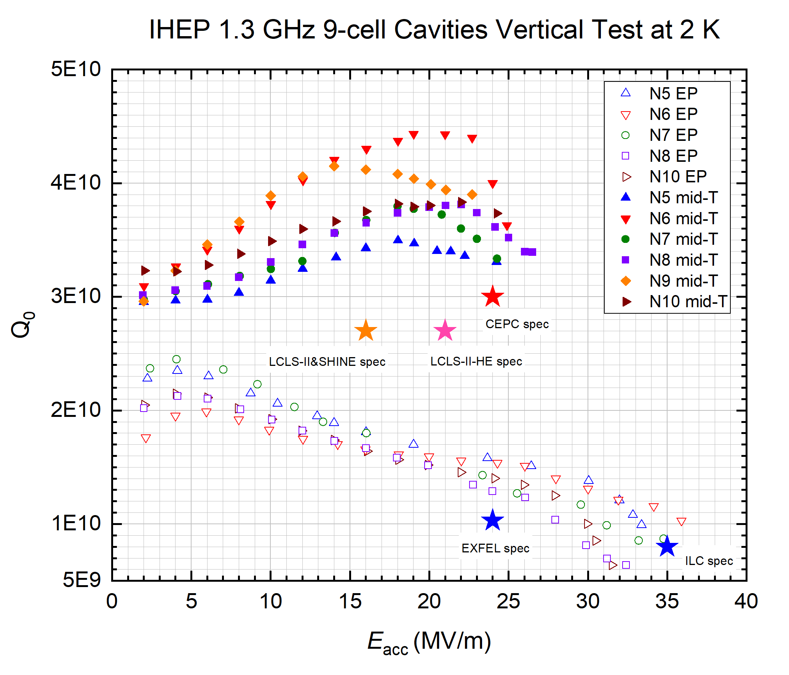
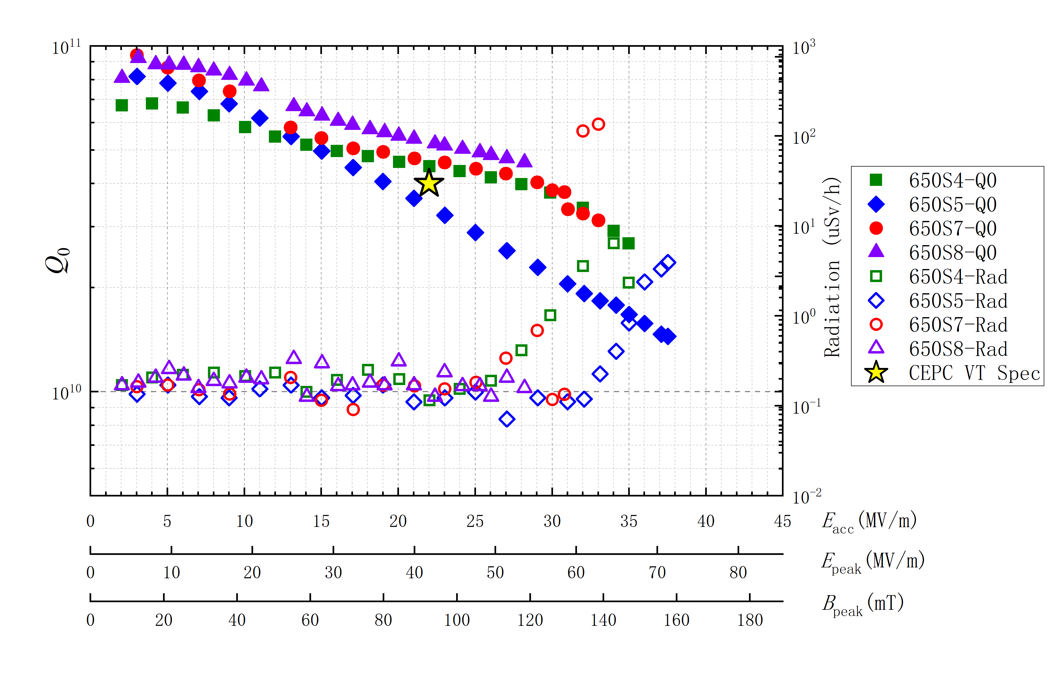
High Gradient High Q 1.3 GHz and 650 MHz Cavity
Peng Sha’s talk in this workshop
IHEP 650 MHz 1-cell Cavities Vertical Test at 2 K
EP+75C+120C, Mid-T furnace baking 1.3 GHz 9-cell cavities.
(Mid-T furnace baking recipe first reported by K. Umemori of KEK).
BCP/FP/EP FG & LG cavities. See Peng Sha’s talk for details, also for N-infusion and Mid-T treated 650 MHz cavities.

Slide 8
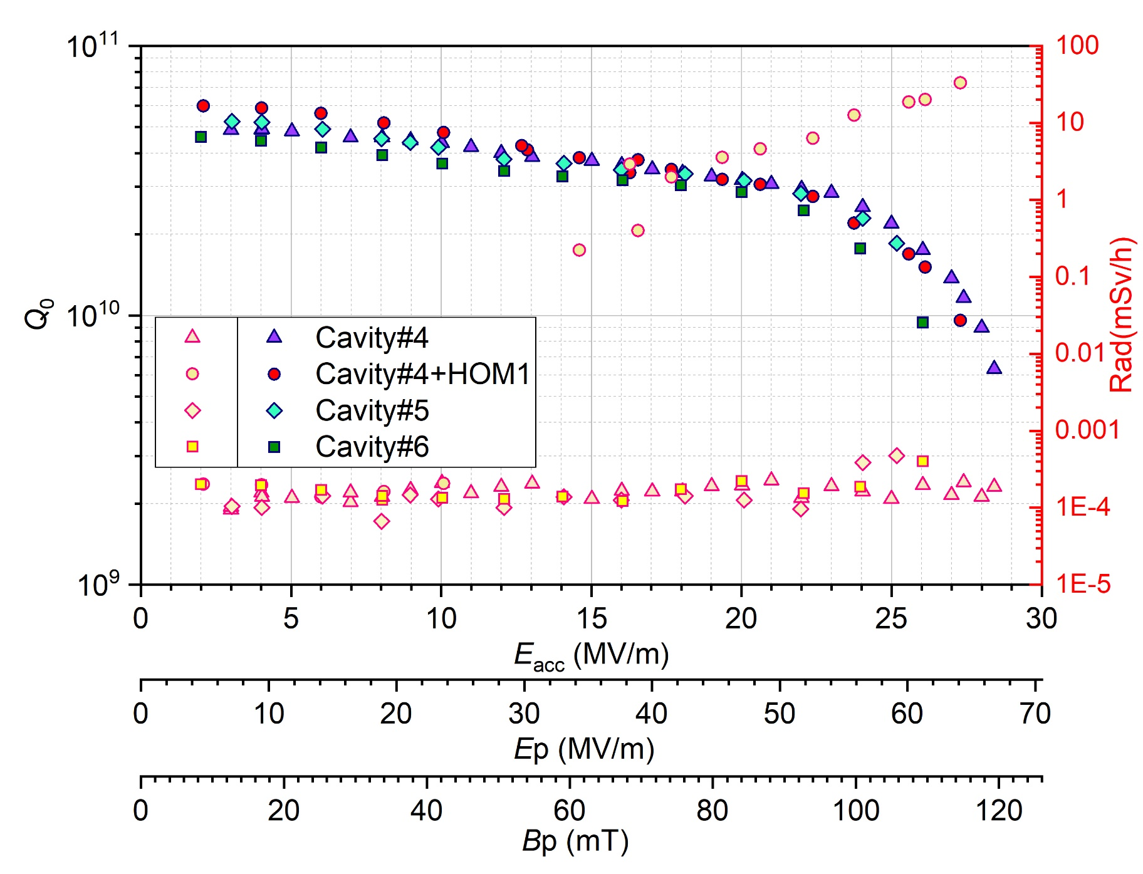
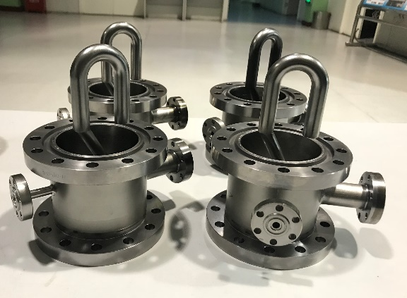
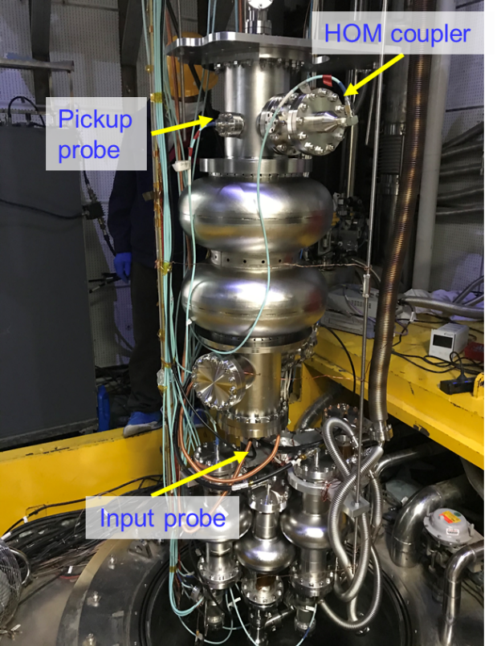
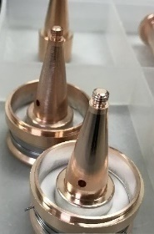
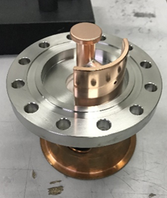
CEPC 650 MHz 2-cell Cavity Vertical Test with HOM Couplers
Peng Sha’s and Hongjuan’s talk in this workshop
BCP
Q=3E10@20 MV/m
Max Eacc = 28 MV/m
BCP 650 MHz 2-cell cavities: 2.8E10@22 MV/m (CEPC VT spec: 4E10@22 MV/m)
Performance no change after install HOM coupler
Cavity #4 and #6 installed into the 650 MHz test cryomodule

Slide 9
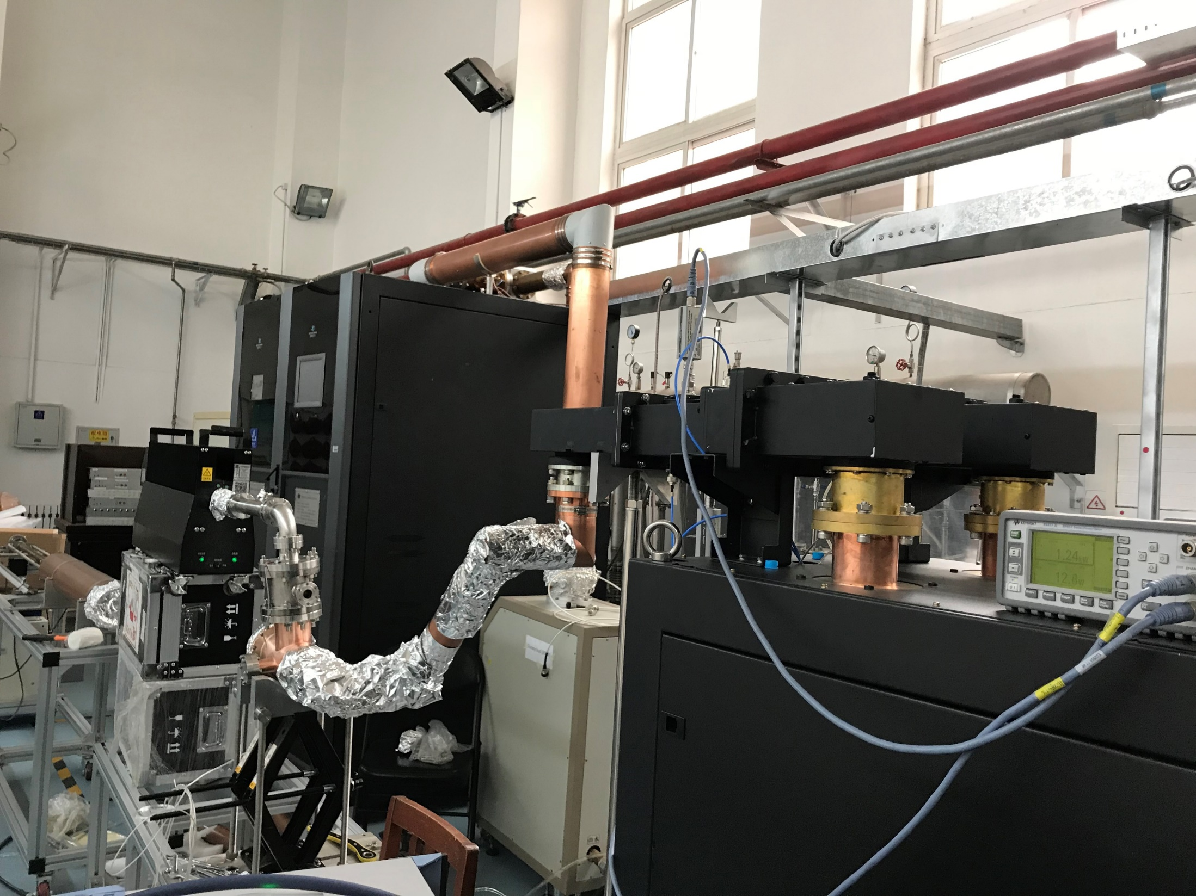
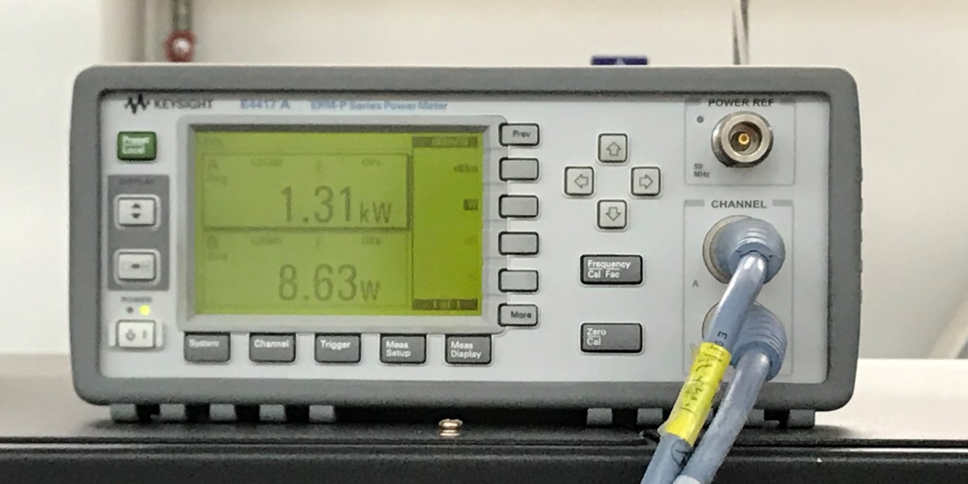
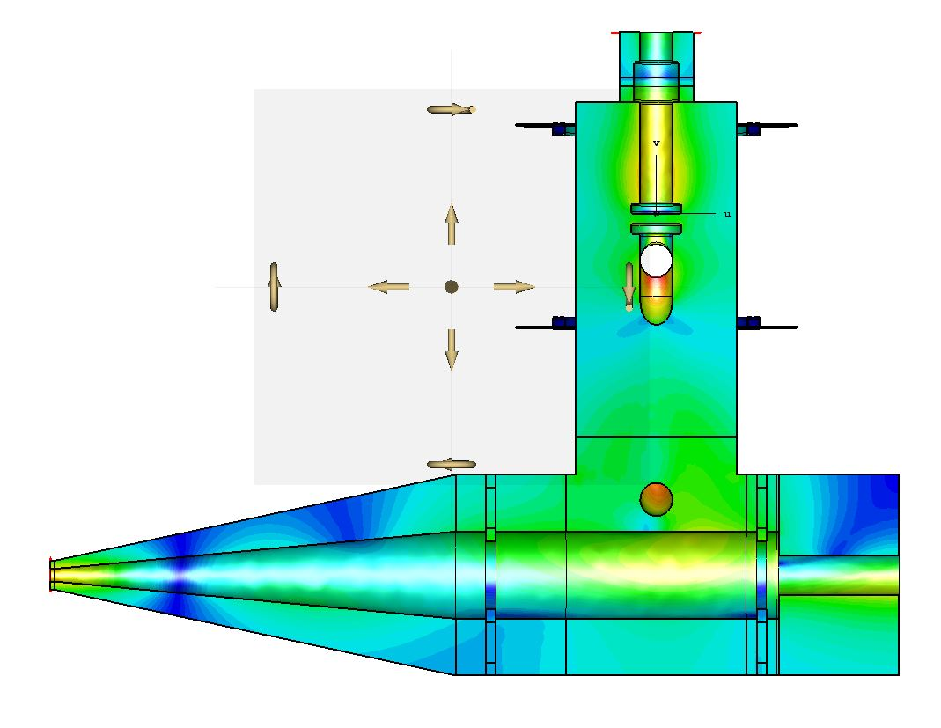
CEPC HOM Coupler High Power Test
Hongjuan Zheng’s talk in this workshop
Load
HOM coupler
Input power: 1.3 kW
Reflection power: 8.6 W
Room temperature: 20.5℃
Temperature on HOM coupler pick up: 29.4℃
Meet CEPC spec. Cold test planned.
1.3GHz solid state power source

Slide 10
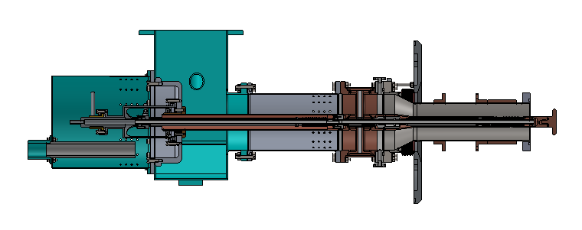
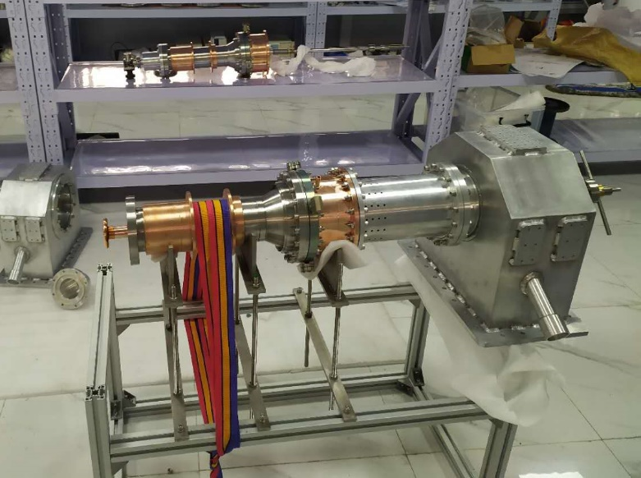
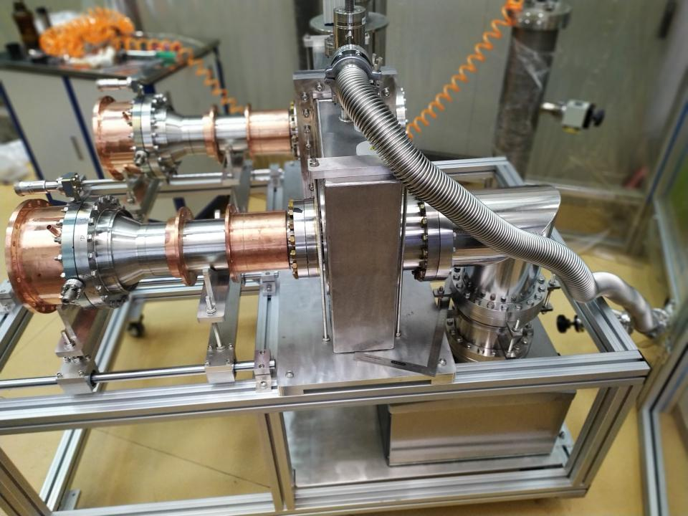
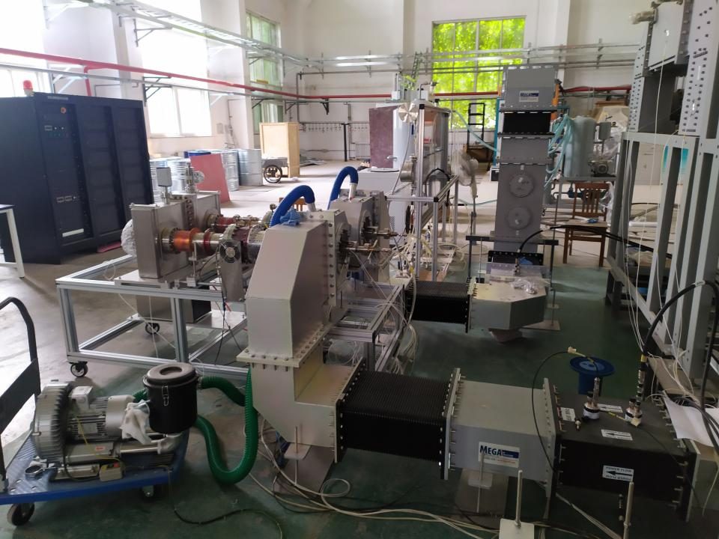
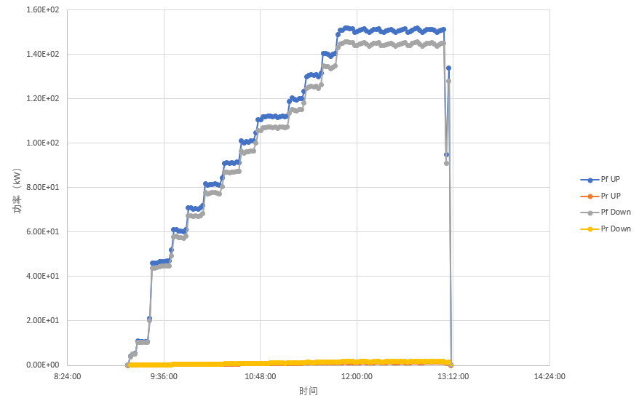
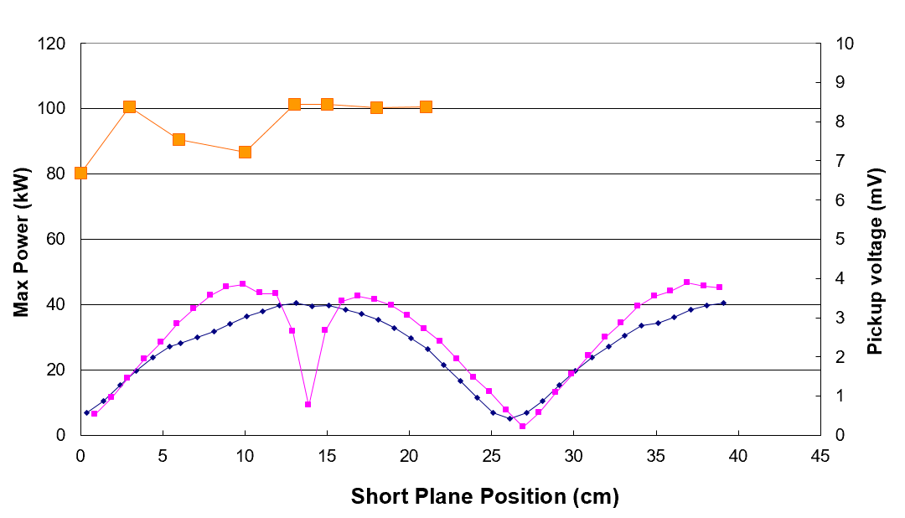
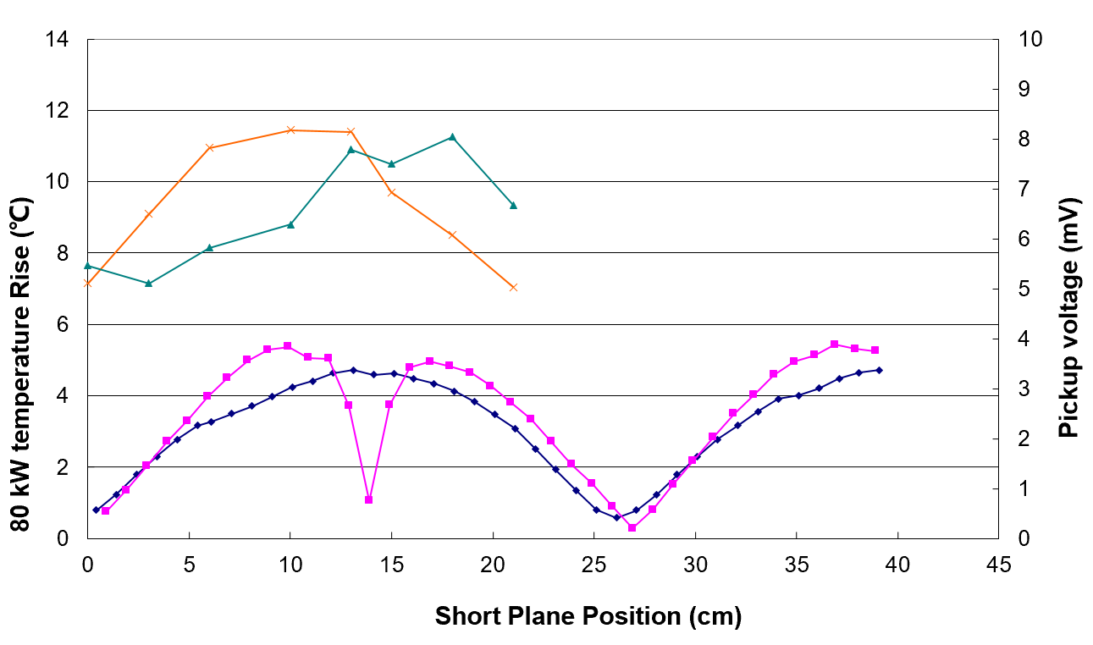
CEPC 650 MHz High Power Variable Coupler
650 MHz variable couplers tested to CW TW 150 kW (SSA power limit), SW 100 kW (corresponding to 400 kW TW power at the window, exceeds CEPC spec 300 kW). One of the world highest variable couplers.
High power test with CEPC 800 kW klystron soon (need high power circulator)
Bellow on inner conductor. Inner conductor water cooling. Outer conductor He gas cooling.
TW high power test to 150 kW
Window SW field and power
Window SW field and temperature rise

Slide 11
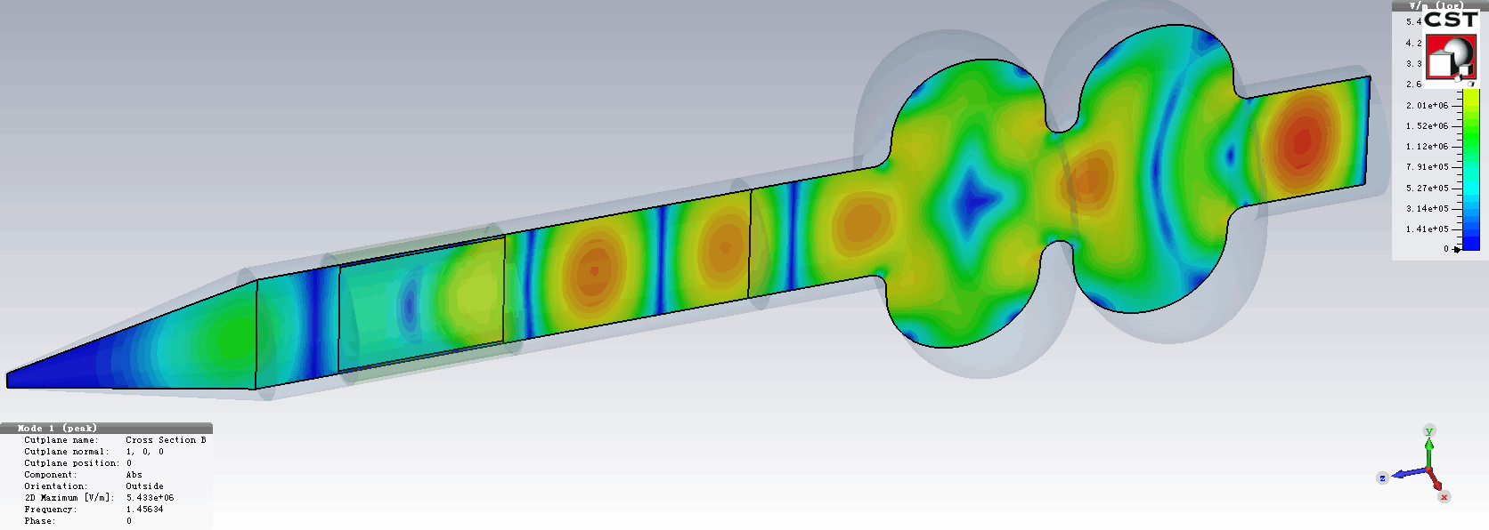
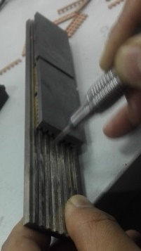
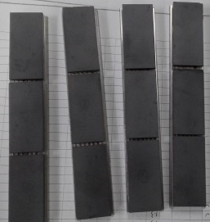
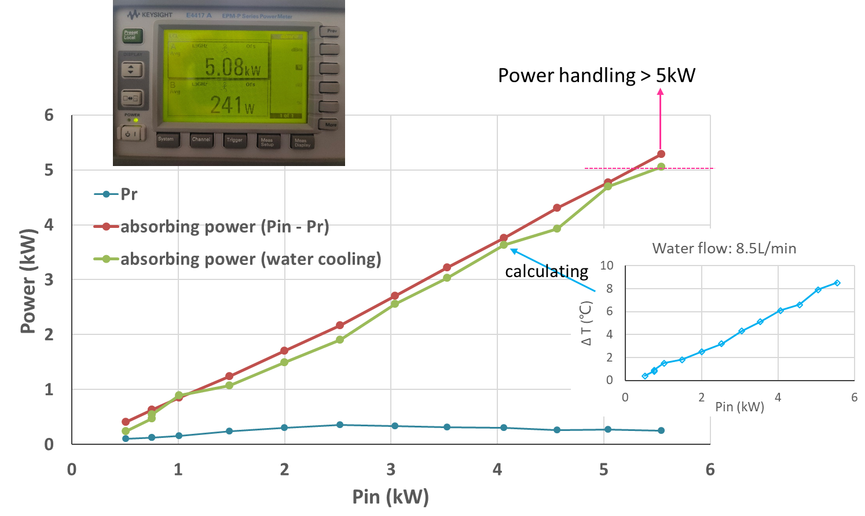

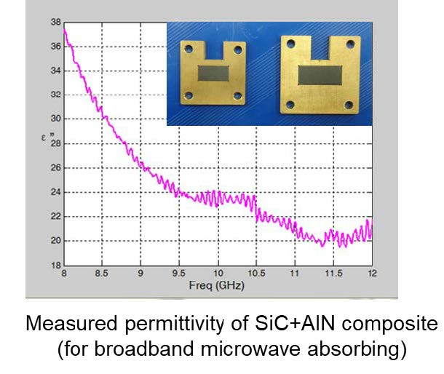
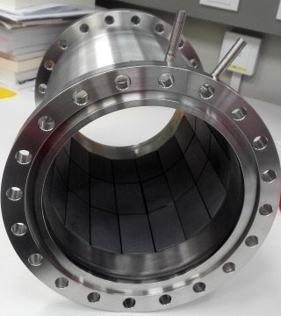
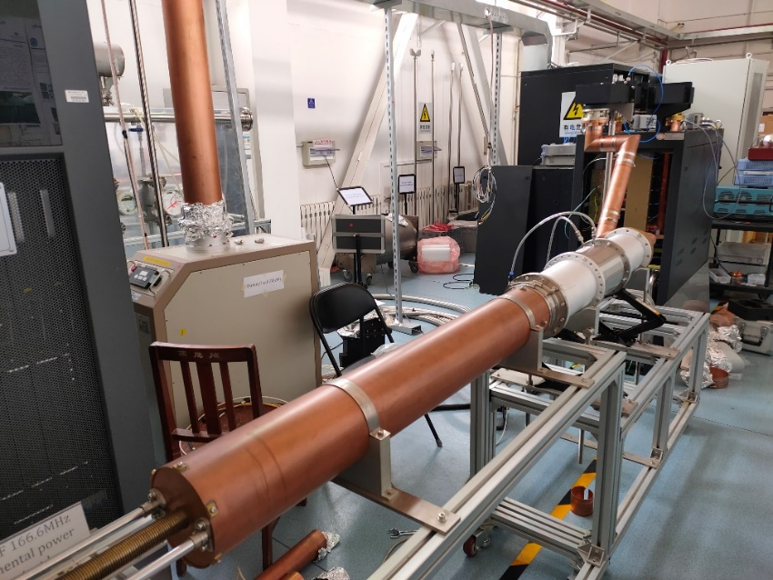
CEPC HOM Absorber High Power Test
Due to short bunch length thus wide HOM frequency range, SiC+AlN composite is chosen for cavity HOM absorbing material. 5 kW high power test show high absorbing efficiency, meet CEPC spec.
SiC+AlN composite bricks brazed on copper and then on kovar plate

Slide 12
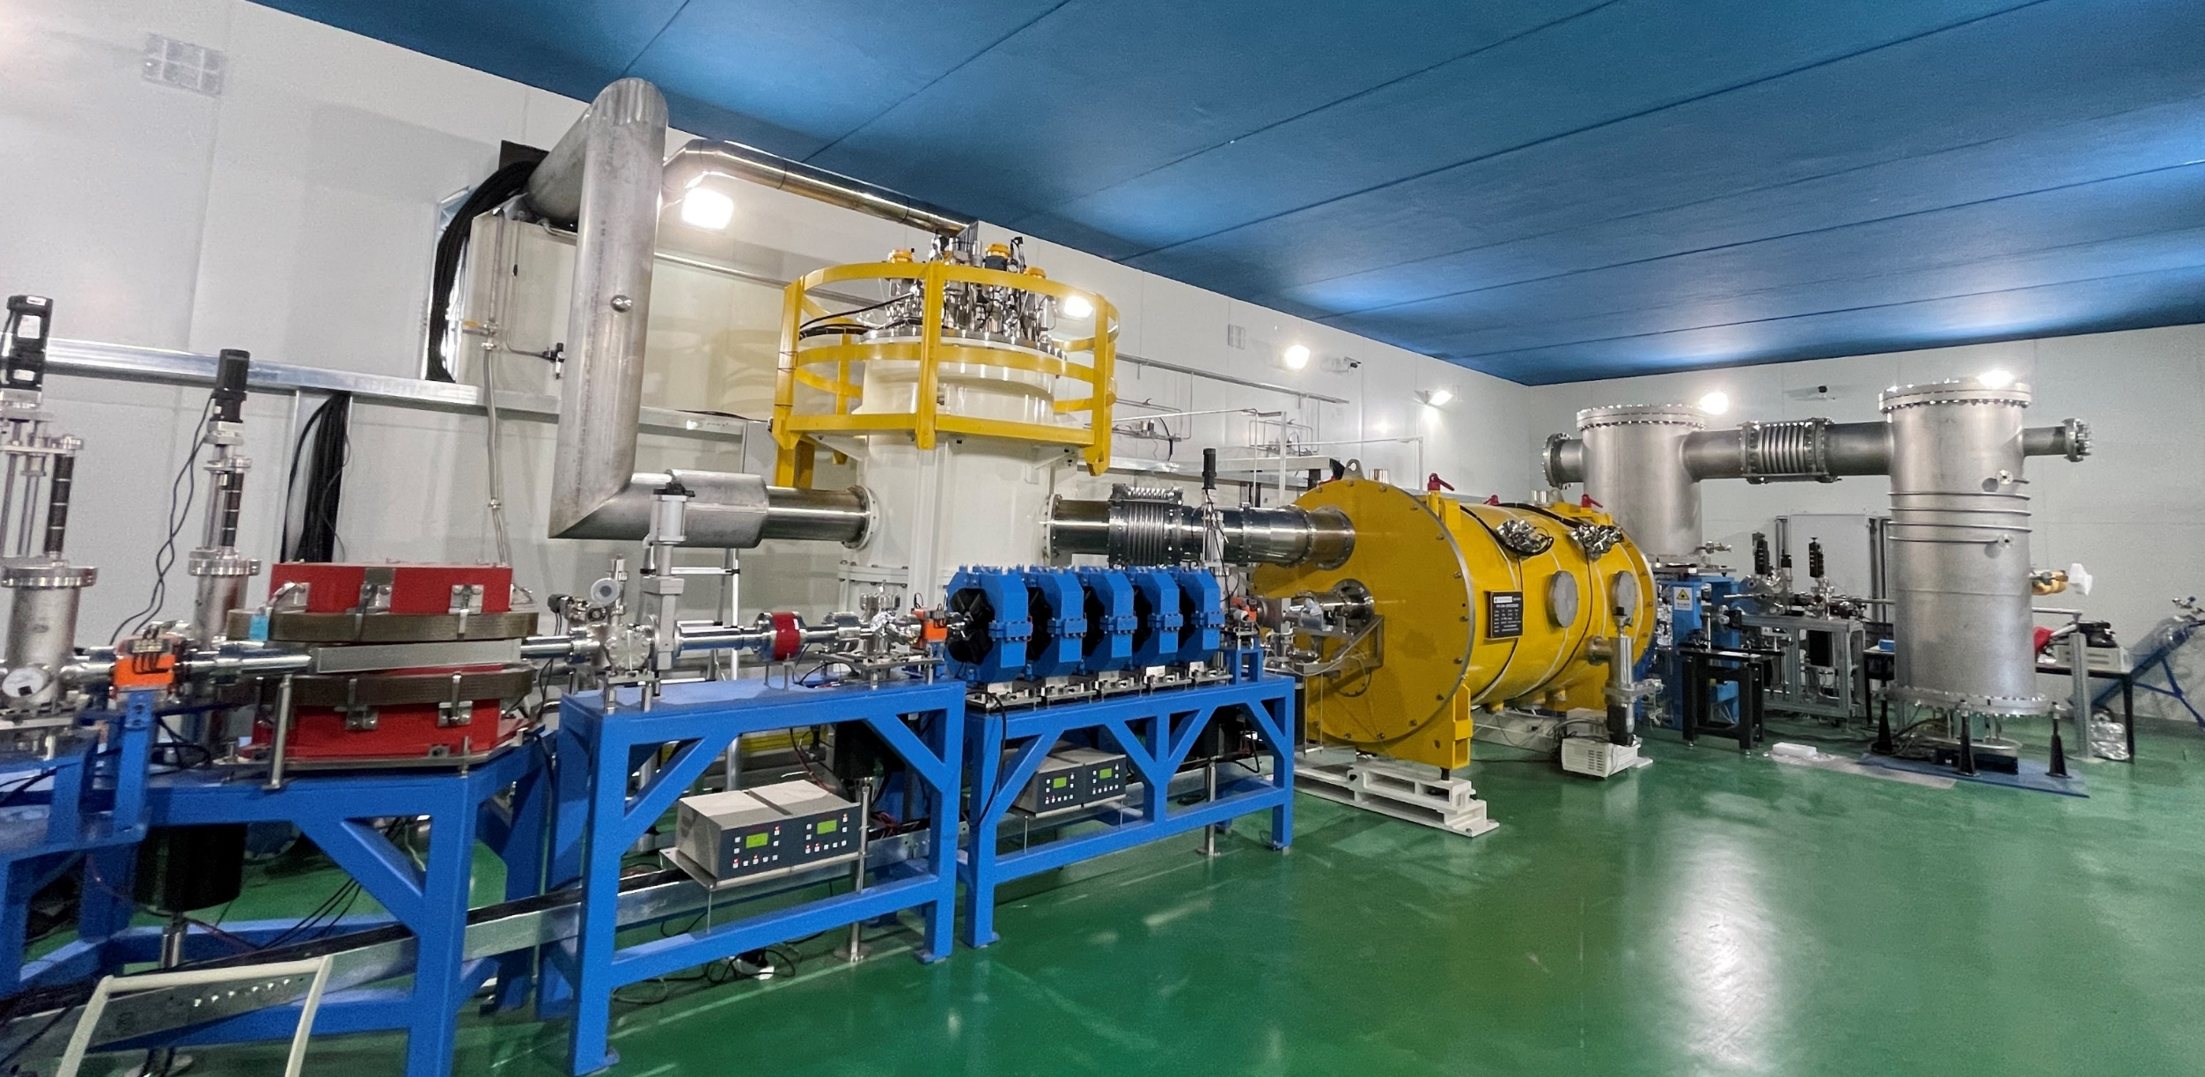
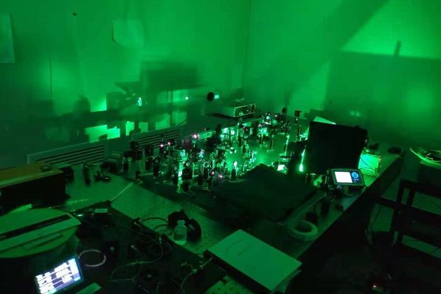
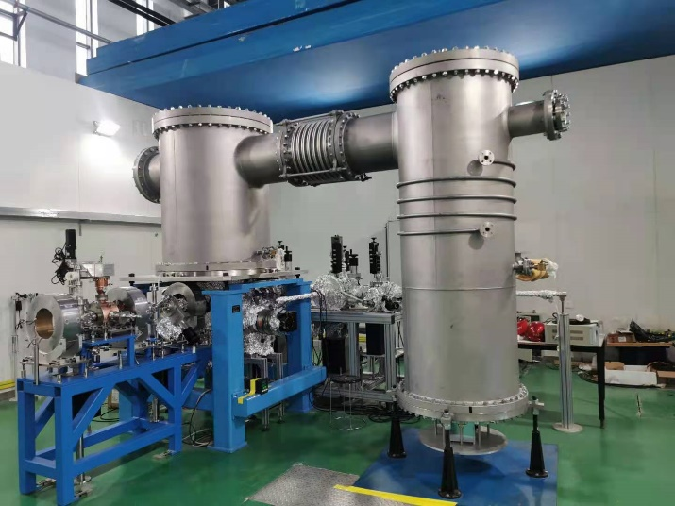
CEPC 650 MHz Test Cryomodule
Cavity string and module assembly in March to May 2021.
Modul installation in beamline, 2 K cool down test and RT coupler conditioning in May to July. Horizontal and beam test soon.
IR laser output to 116 W. Photo-cathode QE to 5 %. DC gun vacuum to 1.5E-10 Pa, voltage to 350 kV. Buncher cavity high power tested.

Slide 13
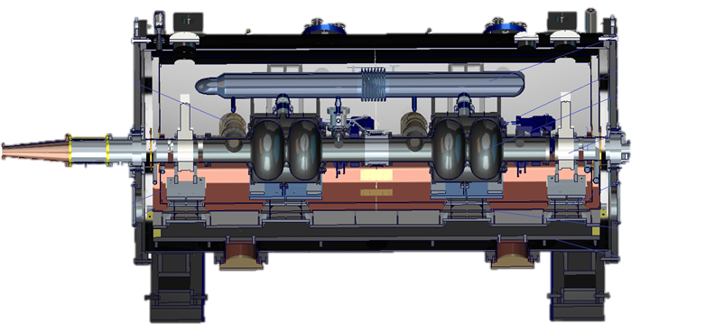
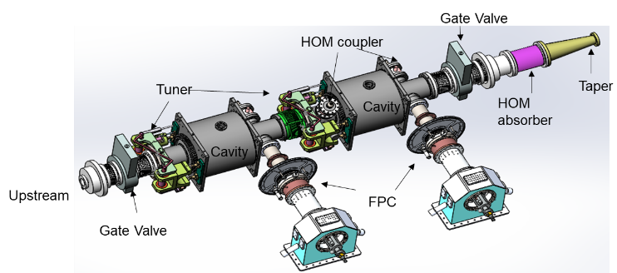
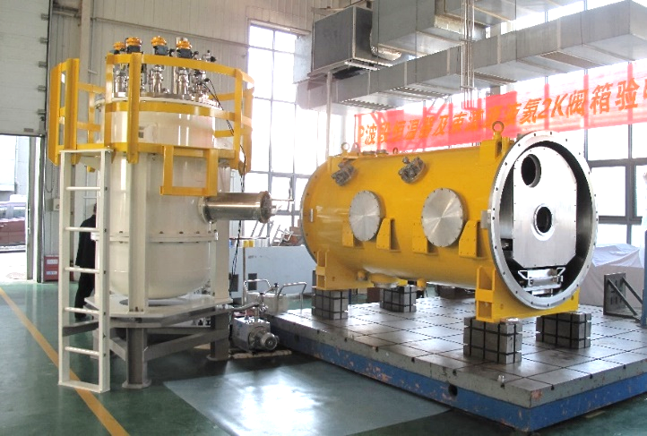
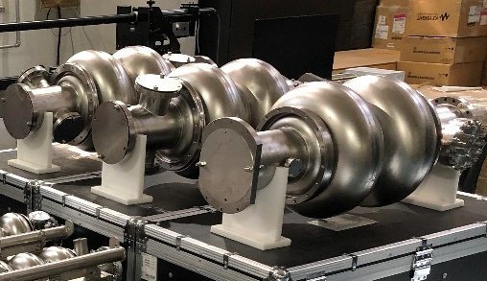
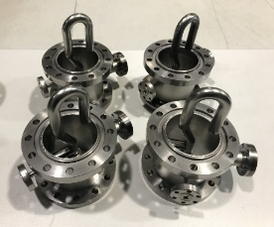
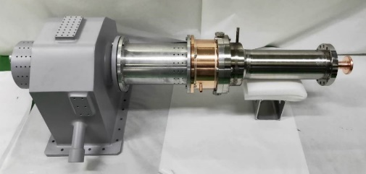
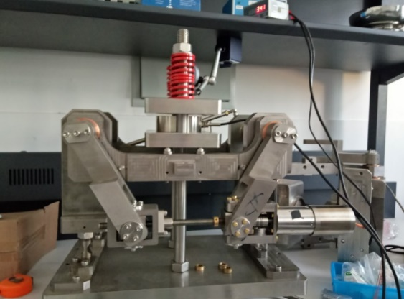
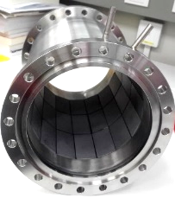
CEPC 650 MHz Test Cryomodule

Slide 14
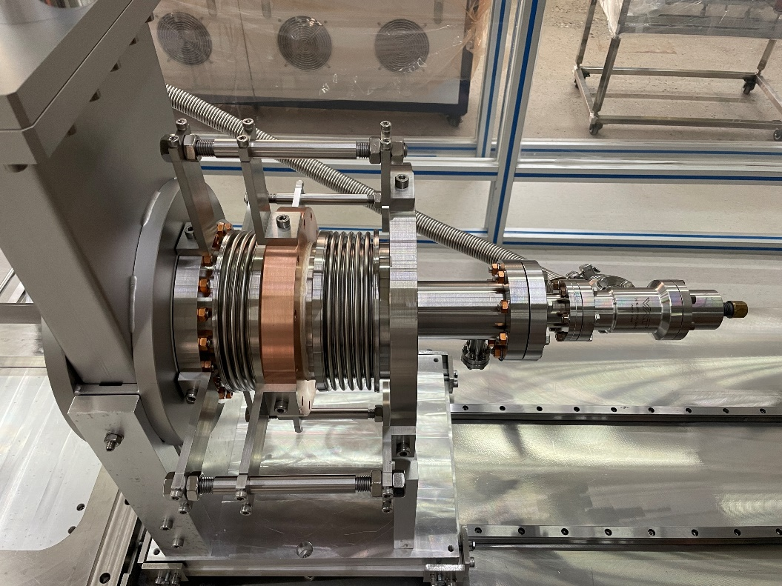
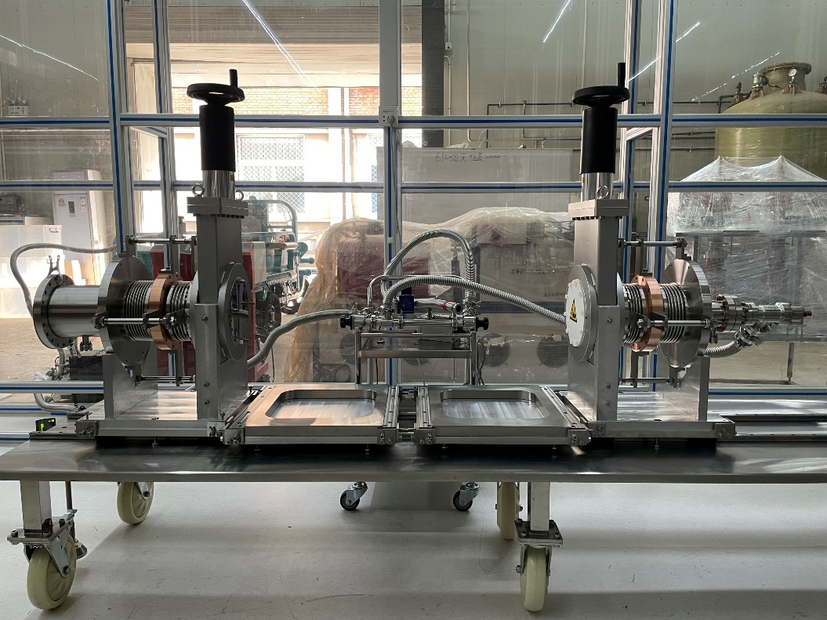
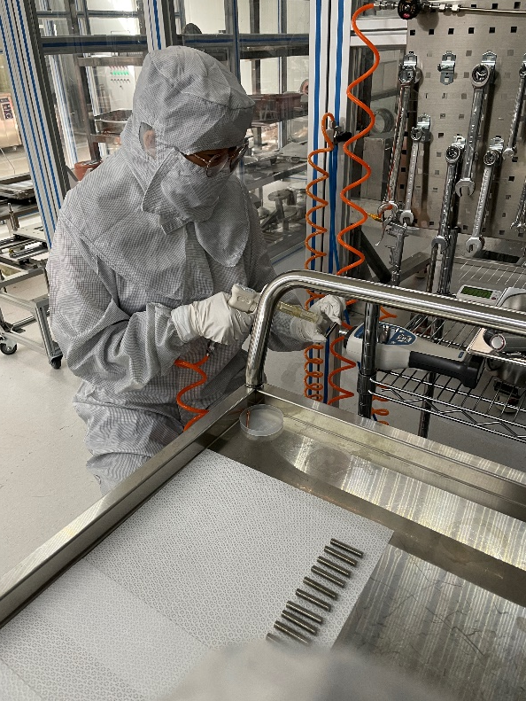
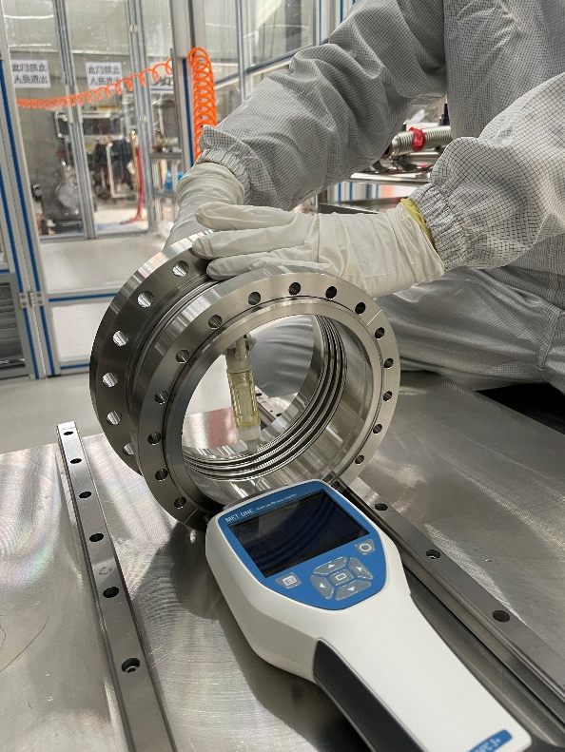
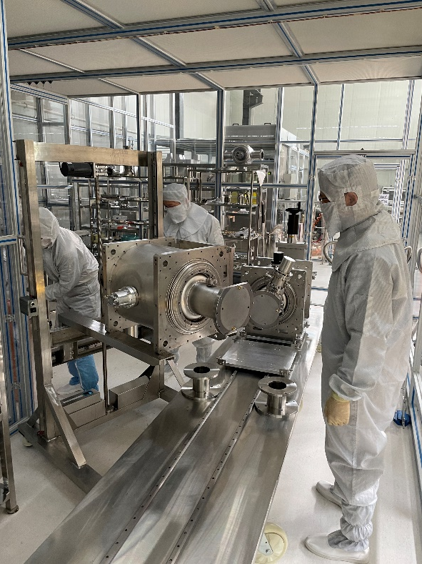
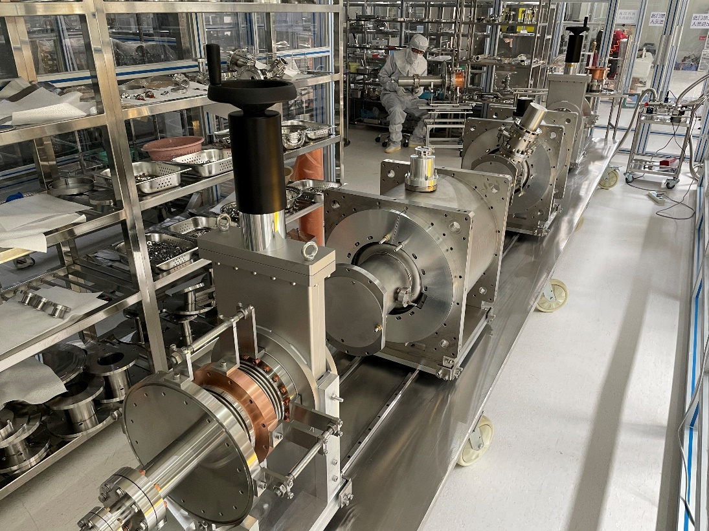
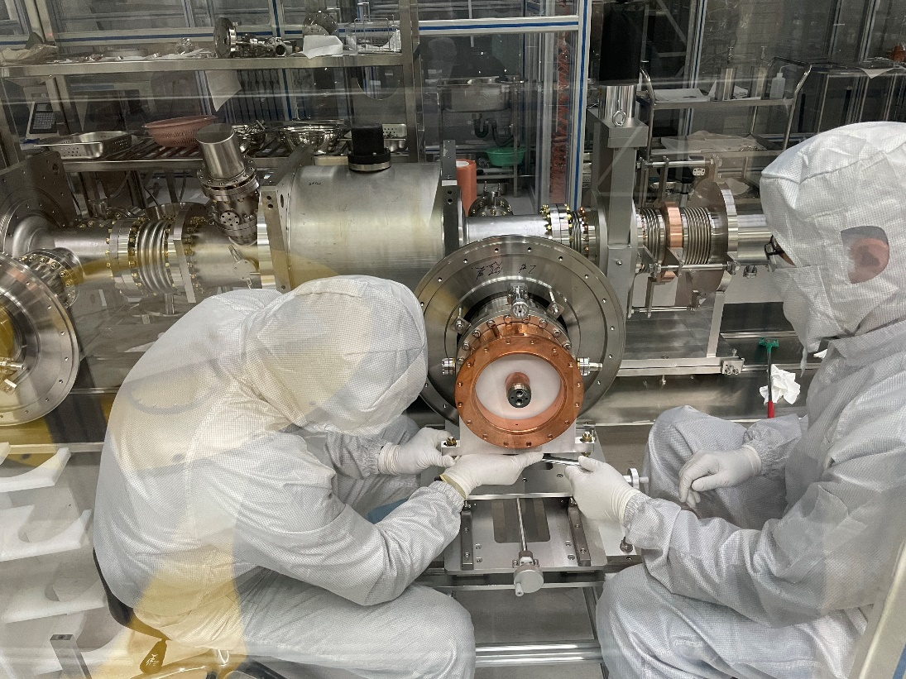
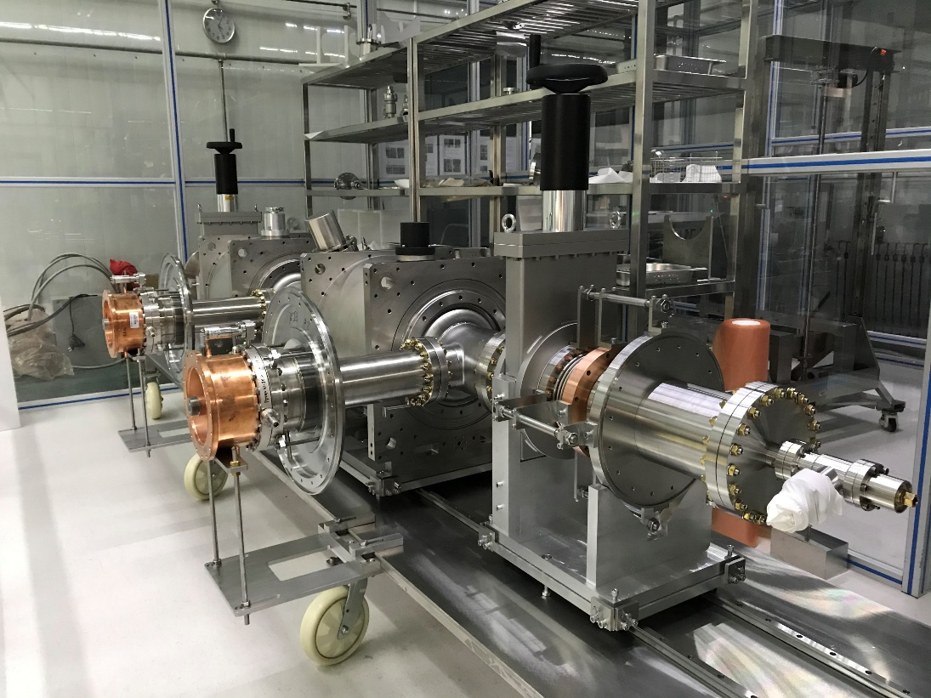
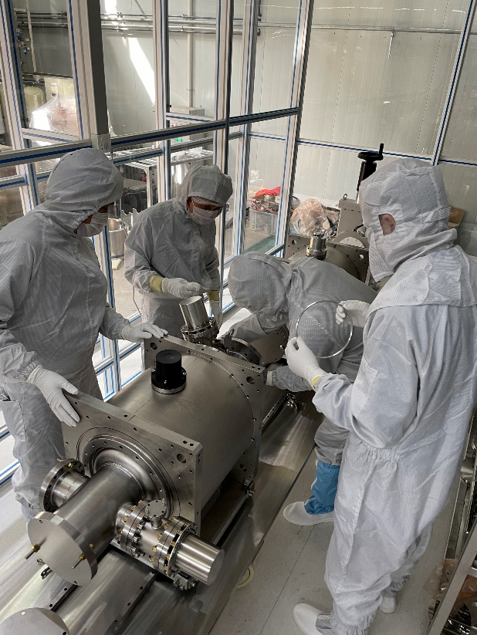
650 MHz 2 x 2-cell Cavity String Assembly

Slide 15
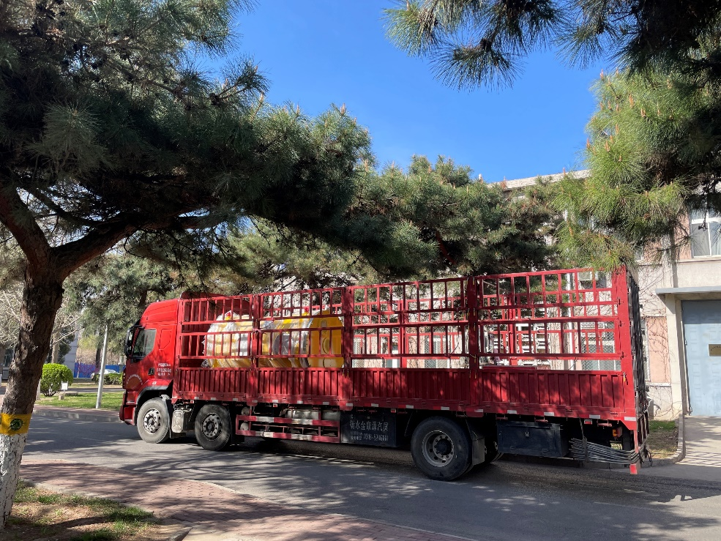
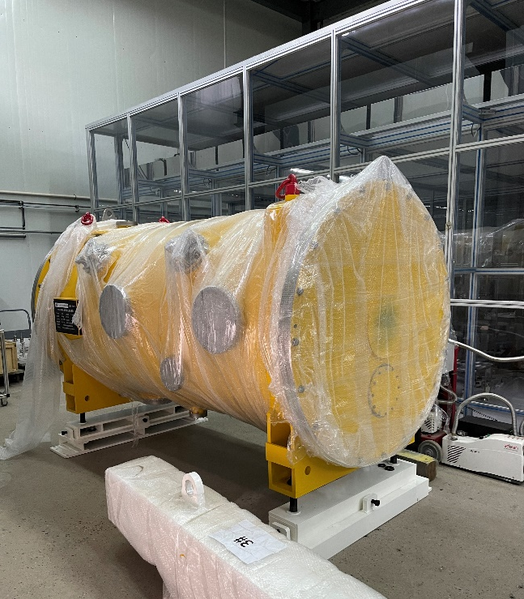
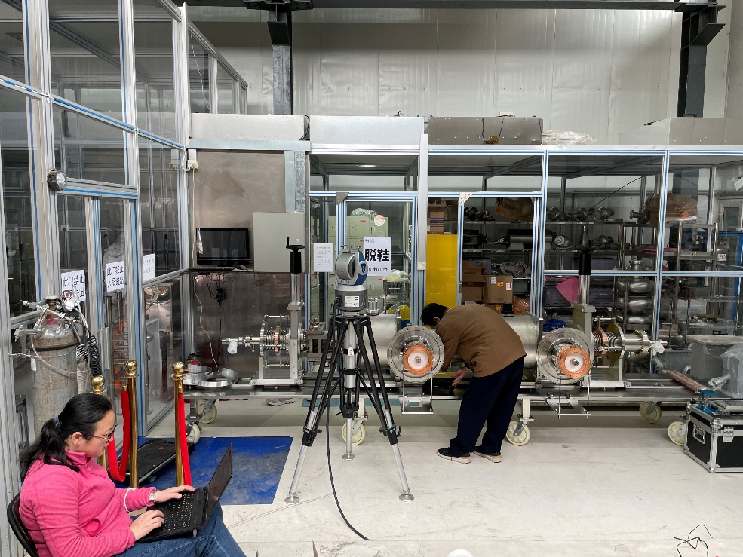
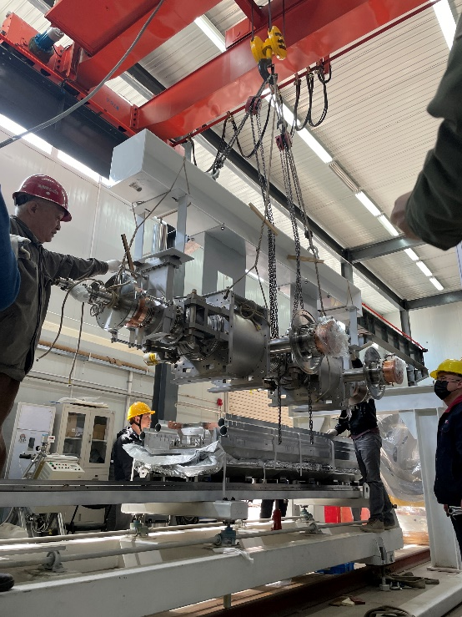
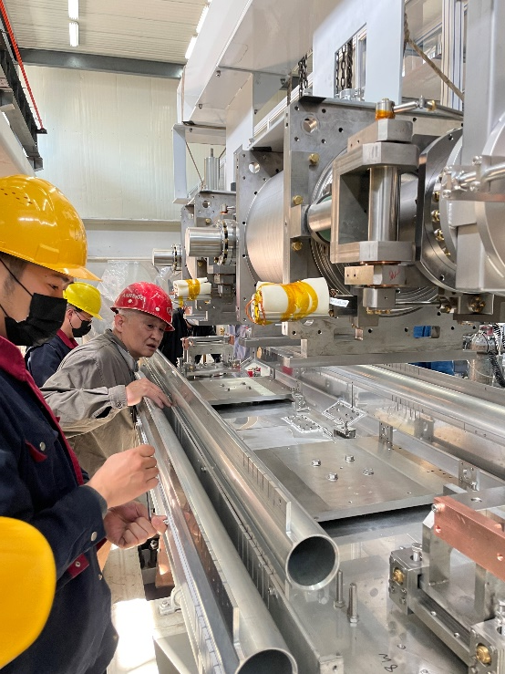





650 MHz Test Cryomodule Assembly

Slide 16








650 MHz Test Cryomodule Assembly

Slide 17






Magnetic Shielding and Compensating
North
Because of beam direction and larger beam pipe than 1.3 GHz, only two shieldings can reach the magnetic field requirement of high Q 650 MHz cavity: cavity (2 K local) shield and module (RT global) shield.
$$R_{mag}=η∙S(l)∙{(B}_{ext}{+B}_{tc})\sqrt{f}$$
Flux trapping ratio: grain size, high-T annealing, fast cold down
Magnetic sensitivity: mean free path and other
Remnant magnetic field: demagnetization, magnetic shield, magnetic compensation
Thermocurrent induced magnetic field
Magnetic compensation with coils

Slide 18





Global Magnetic Shield of the 650 MHz CM

Slide 19



650 MHz Test Cryomodule Assembly

Slide 20




650 MHz Module Transport (IHEP to PAPS 80 km)
Module transport on a frame with isolator springs. Three accelerometers attached.
Max acceleration 0.4 g (average 0.1 g) in the whole process (< 1.5 g spec)
Cavity string vacuum monitored with cold gauge (powered by UPS). No leak.

Slide 21




650 MHz Module Beamline Installation
Upstream gate valve
installation
Downstream HOM absorber, taper, ion pump, gate valve
Upstream beamline
connection
Downstream beamline and valve box connection

Slide 22


650 MHz Module Beamline Installation
Input coupler warm part, doorknob, waveguide
Module in the beamline

Slide 23


650 MHz Module 2 K Cool Down Test
Cavity vacuum @ 2 K: 6E-7 Pa
Cryogenics lines no leak. Most temperatures OK. Input coupler helium gas cooling test (need further optimize).
Frequency: CAV#1 649.856 MHz, CAV#2 649.816 MHz. Tuners stretch the cavities ~150 kHz to 650 MHz.
Input coupler Qin:
  CAV#1: 1.2E6 (HT 35 kW@13 MV/m, Beam Test 49 kW@9.7 MV/m, 10 mA)
  CAV#2: 1.8E6 (HT 35 kW@16 MV/m, Beam Test 76 kW@15 MV/m, 10 mA)
HOM couplers fundamental mode Qe (double notch, tuning not needed): #1 6.8E13, #2 1.9E13. #3 2.1E12.
Flux gates on cavity wall in the helium vessel: < 3 mG (with cavity local and vacuum vessel global shields)
Warm up for couplers RT conditioning (up to 35 kW full reflection limited by the SSA).

Slide 24




650 MHz HLRF and LLRF
150 kW (total) solid state amplifier
LLRF and timing system for 650 MHz module, laser, DC-Gun and buncher.

Slide 25

1.3 GHz High Q Cryomodule (8x9-cell)
CEPC booster 1.3 GHz SRF technology R&D and industrialization in synergy with domestic CW FEL projects.
1.3 GHz 8x9-cell high Q cryomodule prototype
Component fabrication in 2021 to mid 2022
Assemble and horizontal test in 2022
Ship to Dalian in 2023

Slide 26







1.3 GHz Cavity, Input Coupler and Tuner Production
Eight 1.3 GHz 9-cell cavities production (test at PAPS in late 2021 to early 2022).
Eight 1.3 GHz input couplers production (conditioning at PAPS in early 2022).
1.3 GHz tuner prototyping.

Slide 27



RF Measurement and Tuning Machine for Mass Production
New automatic half-cell/dumbbell frequency measurement machine
Improvement of the pre-tuning machine (ongoing)

Slide 28



1.3 GHz Input Coupler Conditioning at PAPS
Two input couplers high power conditioned in the cleanroom at PAPS. One coupler installed to the horizontal test cavity.
10 kW TW
5.8~7 kW SW at two positions (1/8 WG wave length apart)

Slide 29




1.3 GHz Cryomodule
Cryomodule from Wuxi, similar to SHINE, LCLS-II and Euro-XFEL

Slide 30
1.3 GHz High Q Mid-T Cavity Horizontal Test
Step 1a: Horizontal test with vertical test antenna (self excitation mode) at IHEP campus
  Low Q0 (unknow heat load?) , abnormal HOM notch change (HOM can thermal anchor?)
  Flux gates and thermal sensors on cavity outside wall in helium vessel, double-layer magnetic shield and foils, thermal straps (HOM coupler, beam pipe), fast cool down and flux expulsion
Step 1b: Horizontal test with vertical test antenna (self excitation mode) at PAPS
  Successful, similar Q0 as vertical test, abnormal frequency and field flatness change (bellow support, overpressure)
  Add thermal intercepts for cables, Q0 measurement comparison (mass-flow vs RF), input coupler flange heating
Step 2: Horizontal test with input coupler (self excitation mode) at PAPS
  Ongoing, got high Q0 but unstable for long time at high gradient (coupler outgassing? )
  Input coupler thermal sensors, interlocks, thermal straps, RT online conditioning, cavity active pumping
Step 3: Horizontal test with input coupler and tuner (GDR mode) at PAPS
  Tuner, LLRF, microphonics …

Slide 31






1.3 GHz High Q Mid-T Cavity Horizontal Test

Slide 32

1.3 GHz High Q Mid-T Cavity Horizontal Test
IHEP 1.3 GHz 9-cell Cavity Horizontal Test
IHEP 1.3 GHz 9-cell Cavity Vertical Test
Low power test with VT antenna
CEPC spec
High power test with input coupler
(preliminary)

Slide 33





1.3 GHz HLRF and LLRF
ΔA/A: ±0.03% (p-p)
Δφ: ±0.02° (p-p)

Slide 34
Outline
CEPC SRF system design
CEPC SRF R&D progress
PAPS SRF infrastructure

Slide 35



Slide 36






New SRF Facility

Slide 37








New SRF Facility

Slide 38











New SRF Facility
Vacuum furnace (doping & annealing) Nb3Sn furnace Nb/Cu sputtering device Cavity inspection camera and grinder 9-cell cavity pre-tuning machine
Temperature & X-ray
mapping system
Second sound cavity quench detection system
Helmholtz coil for cavity vertical test
SSA
LLRF for cavity & coupler testing

Slide 39






PAPS SRF Lab in Full Operation

Slide 40

Beam Test Facility (future extension)

Slide 41

Thank you

