Slide 1
Status of CEPCSW for tracking performance study
07/16/2021

Slide 2
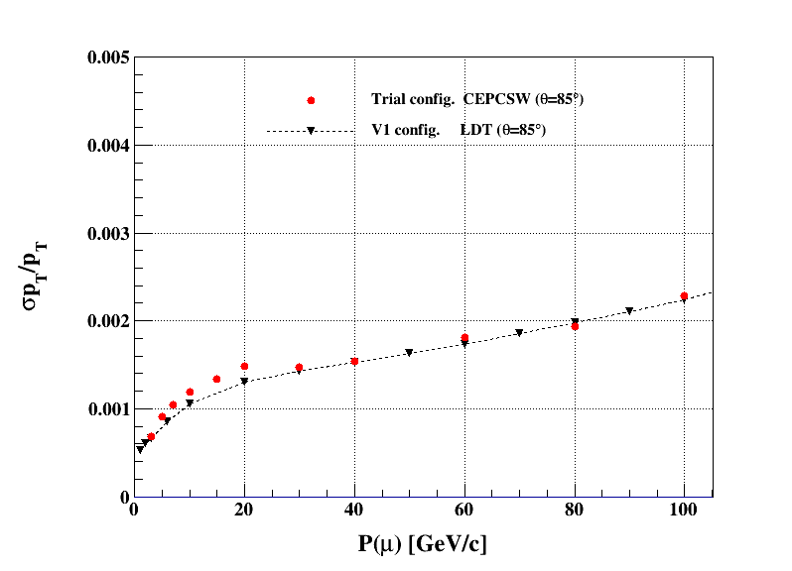
Update from previous status
・Update
# this time try to use “pocaMomKal” variable, though not so much difference.
- set the resolution of DC : 0.1mm for x and y ,
2.828mm for z
looks not so much difference from previous results, with rms_{z} = 0.11mm
- (for this figure) the wall thickness is 0.2mm (inner), 2.8mm (outer) , slightly different from the settings used in the LDT.
0.2cm (inner wall) ← check.
Carbon 0.2mm --> 0.2/213.5 = 0.09367%
Carbon 2.8mm --> 2.8/213.5 = 1.311%

Slide 3
Next Step
・ Check recent updates on the detector configuration, especially the FTD part, prepared in CEPCSW master. For the barrel, it does not affect so much, but a good timing to check the geometry.
・ Since the crash happened (like below), try to point where it comes from.
along with checking the geometry settings. (not sure how easy it is, from recent checks by myself...)

