Slide 1
工作进展
2021/08/10

Slide 2
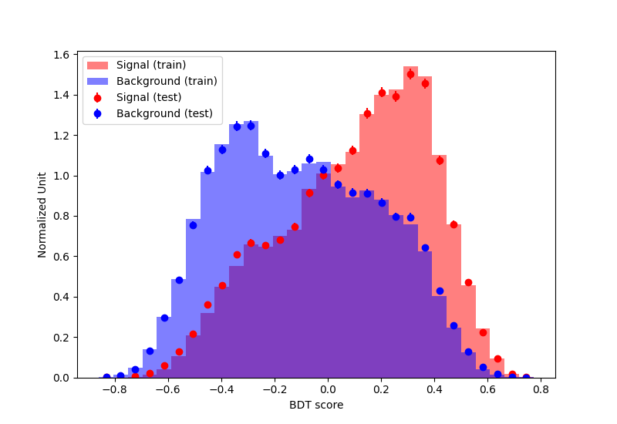
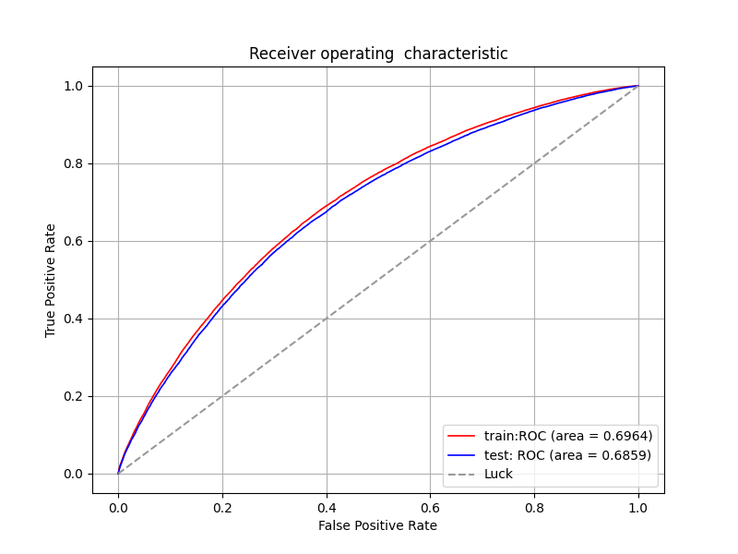
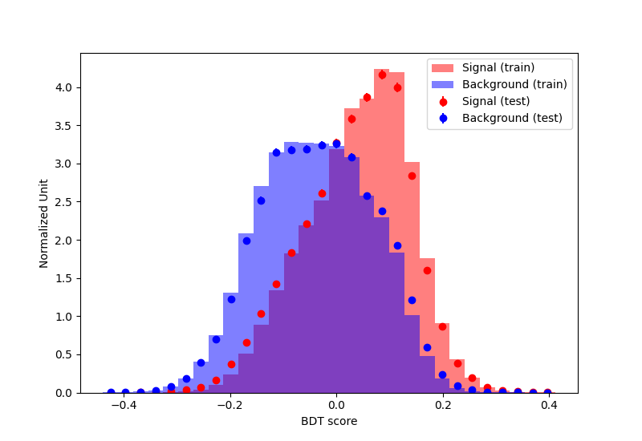
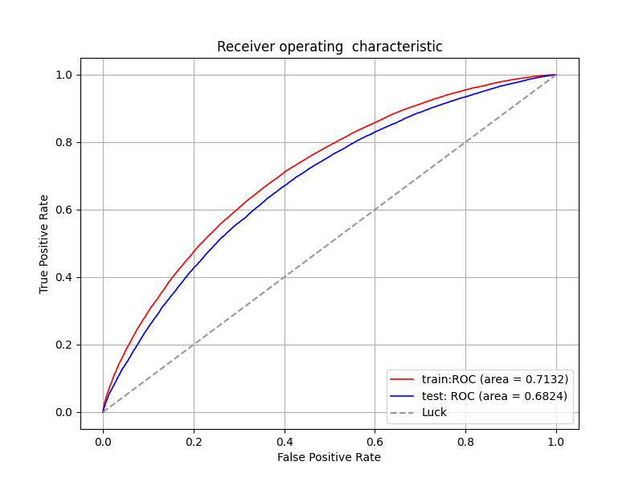
选取1. costheta1,costheta2,phi
2. P_H_Z,P_H_Zs,P_Z_Mup,P_Z_Mum
为feature
dt = DecisionTreeClassifier(max_depth=5, min_samples_leaf=200, min_samples_split=10)
bdt = AdaBoostClassifier(dt, algorithm='SAMME', n_estimators=200, learning_rate=0.5)
Area under ROC curve: 0.6964
Area under ACC curve: 0.6457
Area under ROC curve: 0.6859
Area under ACC curve: 0.6387
dt = DecisionTreeClassifier(max_depth=5, min_samples_leaf=200, min_samples_split=10)
bdt = AdaBoostClassifier(dt, algorithm='SAMME', n_estimators=300, learning_rate=1)
Area under ROC curve: 0.7132
Area under ACC curve: 0.6555
Area under ROC curve: 0.6824
Area under ACC curve: 0.6353

Slide 3
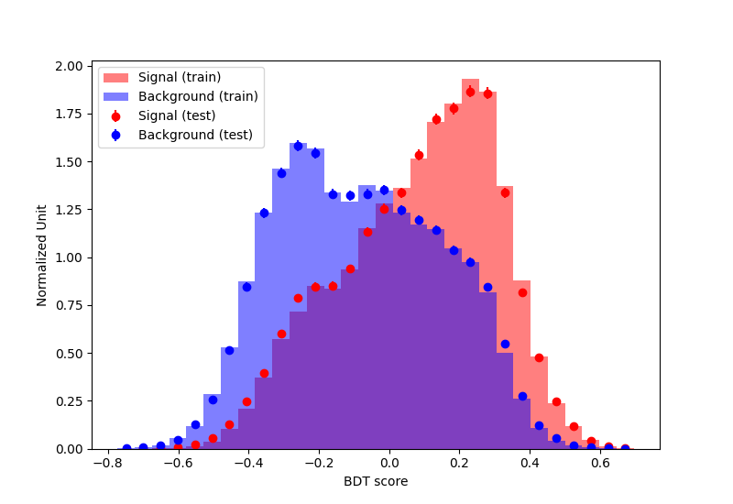
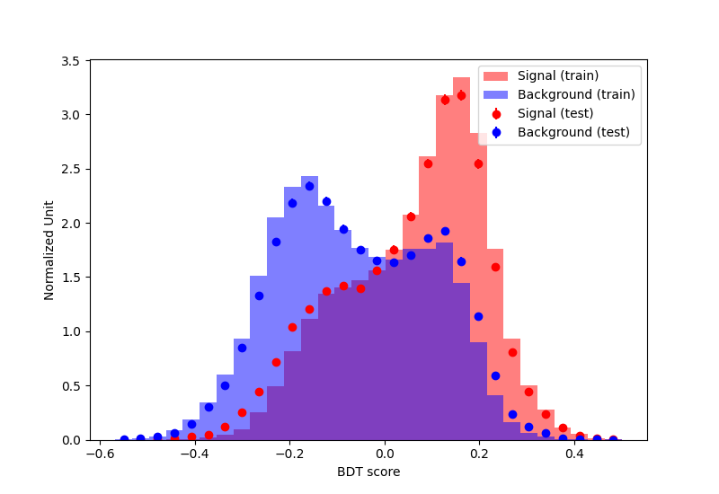
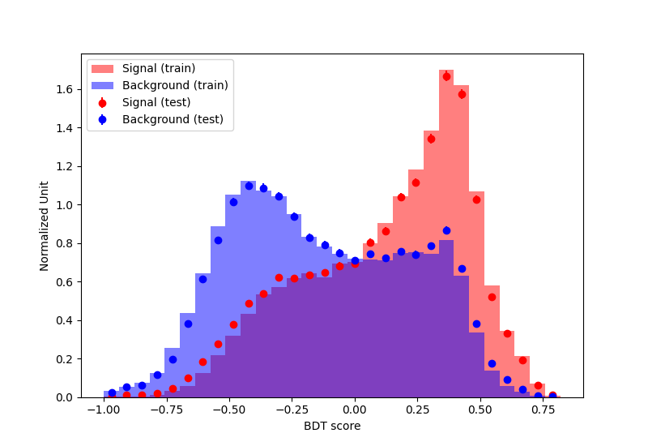
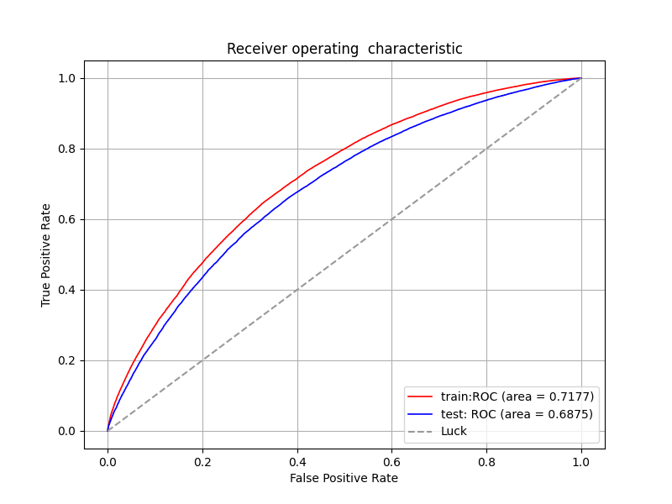
dt = DecisionTreeClassifier(max_depth=5, min_samples_leaf=200, min_samples_split=10)
bdt = AdaBoostClassifier(dt, algorithm='SAMME', n_estimators=300, learning_rate=0.5)
Area under ROC curve: 0.7002
Area under ACC curve: 0.6475
Area under ROC curve: 0.6871
Area under ACC curve: 0.6389
dt = DecisionTreeClassifier(max_depth=9, min_samples_leaf=200, min_samples_split=10)
bdt = AdaBoostClassifier(dt, algorithm='SAMME', n_estimators=300, learning_rate=0.5)
Area under ROC curve: 0.7355
Area under ACC curve: 0.6680
Area under ROC curve: 0.6808
Area under ACC curve: 0.6342
dt = DecisionTreeClassifier(max_depth=9, min_samples_leaf=200, min_samples_split=10)
bdt = AdaBoostClassifier(dt, algorithm='SAMME', n_estimators=200, learning_rate=0.2)
Area under ROC curve: 0.7177
Area under ACC curve: 0.6588
Area under ROC curve: 0.6875
Area under ACC curve: 0.6393

Slide 4
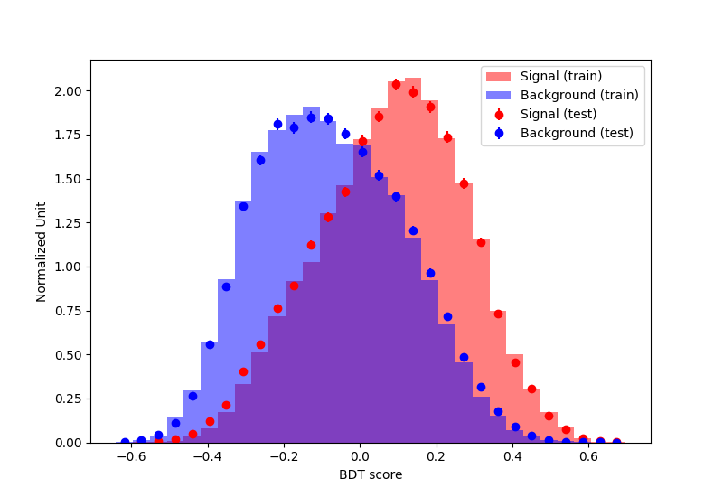
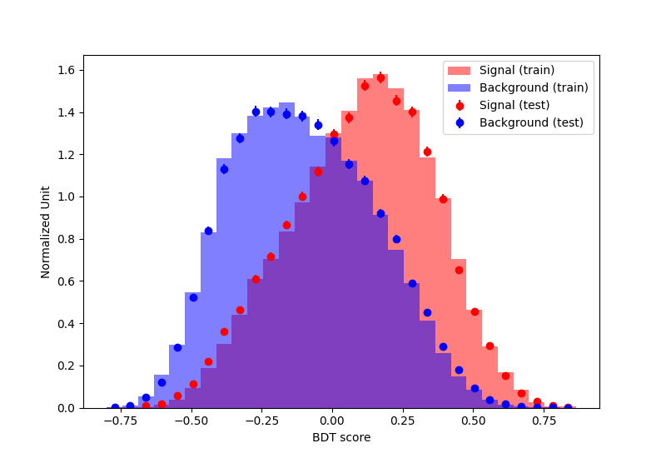
选取1. costheta1,costheta2,phi
2. P_H_Z,P_H_Zs,P_Z_Mup,P_Z_Mum
3. Px_Z,Py_Z,Pz_Z,Px_H,Py_H,Pz_H
为feature
dt = DecisionTreeClassifier(max_depth=5, min_samples_leaf=200, min_samples_split=10)
bdt = AdaBoostClassifier(dt, algorithm='SAMME', n_estimators=300, learning_rate=0.5)
Area under ROC curve: 0.7300
Area under ACC curve: 0.6679
Area under ROC curve: 0.7114
Area under ACC curve: 0.6562
dt = DecisionTreeClassifier(max_depth=5, min_samples_leaf=200, min_samples_split=10)
bdt = AdaBoostClassifier(dt, algorithm='SAMME', n_estimators=300, learning_rate=0.5)
Area under ROC curve: 0.7264
Area under ACC curve: 0.6655
Area under ROC curve: 0.7108
Area under ACC curve: 0.6559

Slide 5
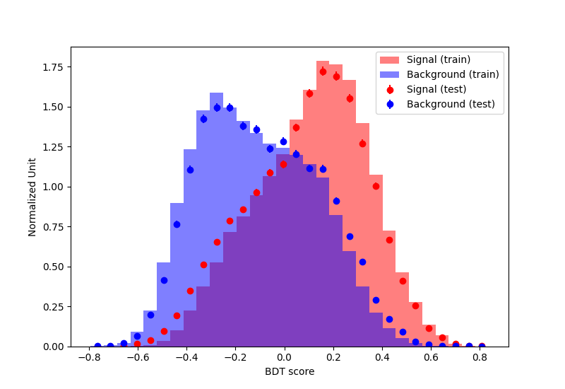
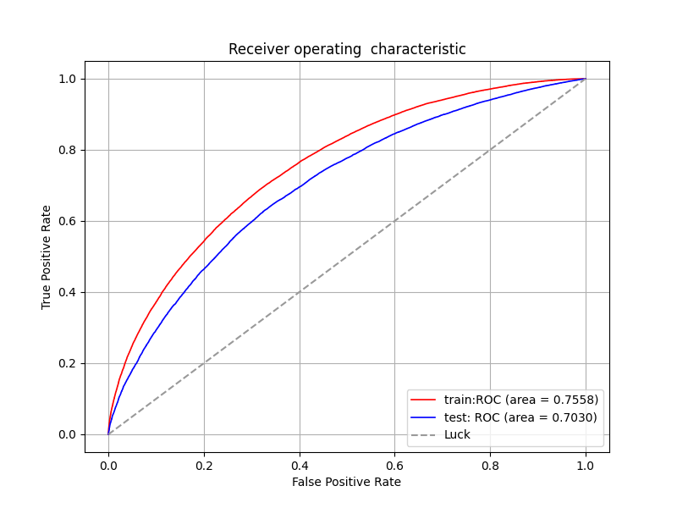
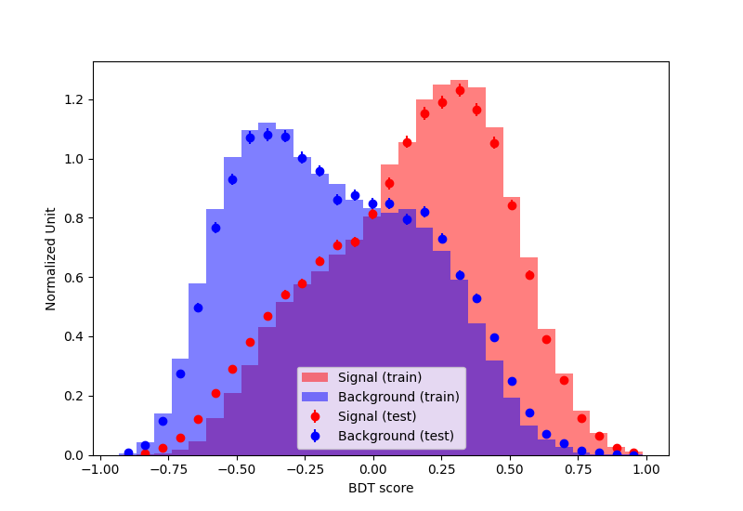
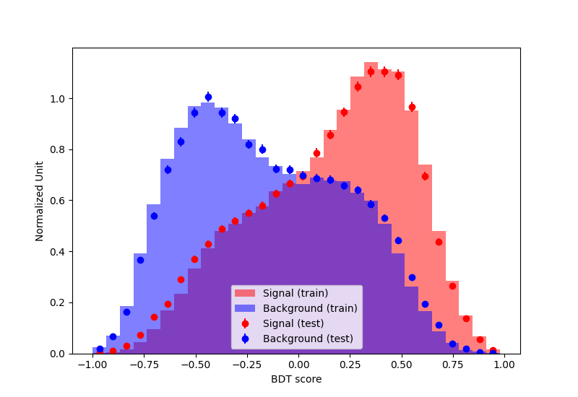
dt = DecisionTreeClassifier(max_depth=9, min_samples_leaf=200, min_samples_split=10)
bdt = AdaBoostClassifier(dt, algorithm='SAMME', n_estimators=100, learning_rate=0.5)
Area under ROC curve: 0.7558
Area under ACC curve: 0.6856
Area under ROC curve: 0.7030
Area under ACC curve: 0.6495
dt = DecisionTreeClassifier(max_depth=9, min_samples_leaf=200, min_samples_split=10)
bdt = AdaBoostClassifier(dt, algorithm='SAMME', n_estimators=100, learning_rate=0.2)
Area under ROC curve: 0.7530
Area under ACC curve: 0.6841
Area under ROC curve: 0.7100
Area under ACC curve: 0.6546
dt = DecisionTreeClassifier(max_depth=7, min_samples_leaf=200, min_samples_split=10)
bdt = AdaBoostClassifier(dt, algorithm='SAMME', n_estimators=50, learning_rate=0.3)
Area under ROC curve: 0.7294
Area under ACC curve: 0.6660
Area under ROC curve: 0.7072
Area under ACC curve: 0.6522

Slide 6
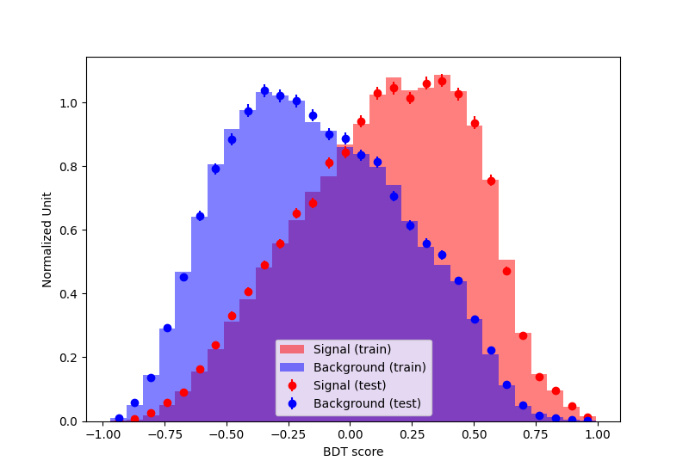
Summary:
Best:
dt = DecisionTreeClassifier(max_depth=4, min_samples_leaf=200, min_samples_split=10)
bdt = AdaBoostClassifier(dt, algorithm='SAMME', n_estimators=100, learning_rate=0.2)
train:
Area under ROC curve: 0.7147
Area under ACC curve: 0.6579
test:
Area under ROC curve: 0.7079
Area under ACC curve: 0.6535
选取1. costheta1,costheta2,phi
2. P_H_Z,P_H_Zs,P_Z_Mup,P_Z_Mum
3. Px_Z,Py_Z,Pz_Z,Px_H,Py_H,Pz_H
这三类为feature，选此页的model为贝阿特model。

Slide 7
Plan:
用cepc现在的sample，放到delphes里看一下本底的贡献，对于signal，需要产生很多其它的样本（不同的ghz1/2/4), 这样就可以得到关于这些anamolous coupling的upperlimit

