Slide 1
Compton polarimeter for CEPC
CEPC Energy Calibration Group
30 August 2021
The CEPC Day, Bejing

Slide 2
Outline
Motivation
Discussion of physical principle in Compton polarimeter
Layout for CEPC Compton polarimeter
Measurement result on Z pole
10% transverse polarization
statistical error
systematic uncertainty
Summary and outlook
2

Slide 3
Motivation of CEPC Z-pole polarized beam program
Transversely polarized beams in the ARC
beam energy calibration via the resonant depolarization technique(Accuracy ${10}^{−6}$)
Essential for precision measurements of Z mass
Obtain momentum compaction factor
Monitor machine stability
CP violation
study extra dimensions in indirect searches for massive gravitons
At least 5% ~ 10% transverse polarization
Zhe Duan, CEPC Z-pole Polarization Study Status, CEPC Day Feb 25, 2021. https://indico.ihep.ac.cn/event/13810/

Slide 4
Electron Polarimetry Techniques
Some techniques for measuring electron beam polarization
Touscheck lifetime measurement
Based on measuring the lifetime of polarized electron beams and non-polarized electron beams
The Touschek effect is not the most paramount contribution to the lifetime in CEPC
Large than 300 hours on Z pole, the increase of beam lifetime based on beam polarization is too slow to measure
Mott scattering: $\vec{e}+Z→e$
The system is relatively simple but operate restricted below 10MeV beam energy
only for transverse polarization measurement
Moller scattering: $\vec{e}+\vec{e}→e+e$
Transverse polarization and longitudinal polarization of electron/positron beams can be measured
Invasive measurements by using the solid target
Low current electron are limited to avoid depolarization effect due to the target heat.
Compton scattering: : $\vec{e}+\vec{γ}→e+γ$
applied for polarimetry at high-energy colliders involves HERA, LEP, ILC, FCC and so on
determine polarization of electron beam are mainly measuring the asymmetry of scattering particles

Slide 5
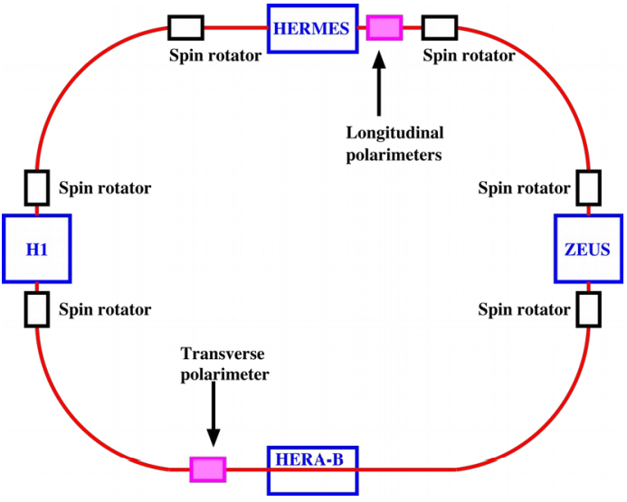
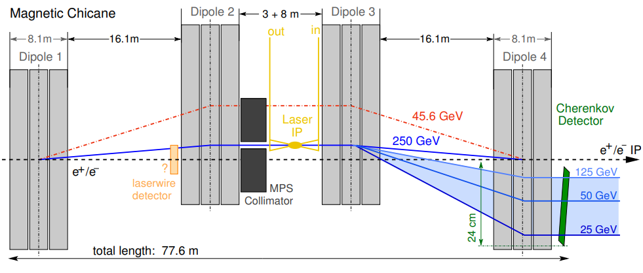
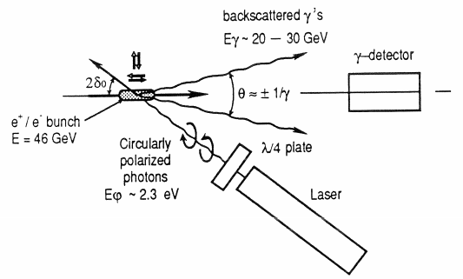
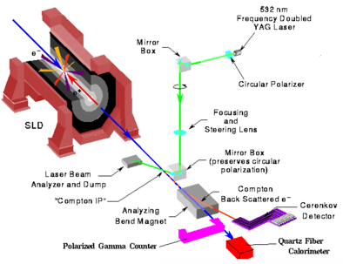
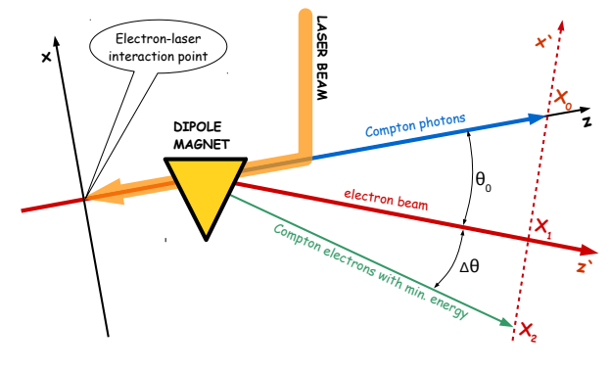
Compton polarimeter
Polarization is measured by the position/energy asymmetry of the scattered electrons or scattered photons
HERA 27GeV
ILC 45.6GeV
CERN LEP 46GeV
R.Schmidt. CERN SL/91-51(BI), 1991.
S.Schmitt, HERA polarimeter review
Jenny List, ILC Polarimetry,2020
SLD at SLAC 45.6GeV
FCC-ee 45.6GeV
单发成像
JLab Hall C 1.16GeV
Donald Jones, Hall C Compton Polarimetry, PSTP 2013.
M.Wood. SLAC, 2003.
Nickolai Muchnoi, 2018

Slide 6
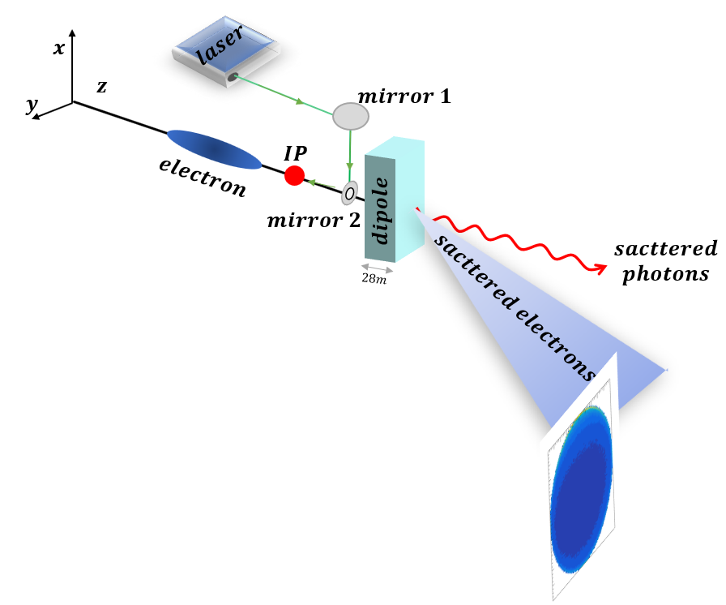
Compton Polarimeter for CEPC(Z pole)
Compton Polarimeter
Prospects for the Compton polarimeter system:
Our device is in straight sections on the ring.
The last dipole in the ARC can be used as our bending magnet of Compton polarimeter.
CEPC ARC
CEPC straight sections
CEPC Z pole: | $$E=45.5 GeV$$
Laser : | $$ω=1.24eV; E_{laser}=2.8mJ; \\ pulse length=28ps$$
Dipole parameter(CDR) | $$\left\{\begin{matrix}B=70.7904Gs \\ l=28.686m\end{matrix}\right.$$
Beam vacuum tube | 31mm(Outer radius)
Drift distance | $L_{1}=60m ; L_{2}=40m$
Beam angle (at IP of laser and electron beam)(王毅伟) | $$σ_{x}^{′}=1.2197 [μrad]$$ $$σ_{y}^{′}=0.5164 [μrad]$$
$$θ_{0}=0.0013389rad$$
$$L_{2}$$
$$L_{1}$$

Slide 7
Physics of Compton Polarimeter
The differential cross section depends on electron polarization(ζ) and laser polarization(ξ)
unpolarized
$$\frac{dσ_{0}}{dxdy}=\frac{r_{e}^{2}}{{\left(1+u\right)}^{3}\sqrt{1−x^{2}−y^{2}}}\left(1+{(1+u)}^{2}−4\frac{u}{κ}\left(1+u\right)\right)$$
Longitudinal polarization
$$\frac{dσ_{∥}}{dxdy}=\frac{{ξ_{↻}ζ_{↻}r}_{e}^{2}}{{κ\left(1+u\right)}^{3}\sqrt{1−x^{2}−y^{2}}}u\left(u+2\right)\left(1−2\frac{u}{κ}\right)$$
Transverse polarization
$$\frac{dσ_{⊥}}{dxdy}=−\frac{{ξ_{↻}ζ_{⊥}r}_{e}^{2}}{{\left(1+u\right)}^{3}\sqrt{1−x^{2}−y^{2}}}uy$$
Ref: Nickolai Muchnoi, “FCC-ee polarimeter,” arXiv e-prints , arXiv:1803.09595 (2018).
7

Slide 8
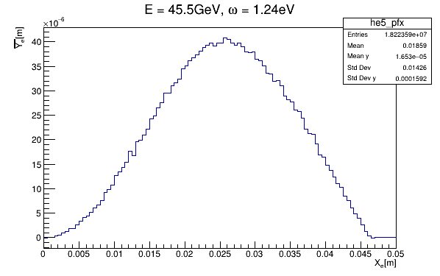
The measurement method
The MC samples
2D distribution of scattered electrons
The distribution of Y mean($\overline{Y})$vs $X$
Per X bin
Y mean
The design of detector:
X*Y = 5cm*2cm;
Pixel size: 50μm*25μm
resolution:14.434μm*7.217μm

Slide 9
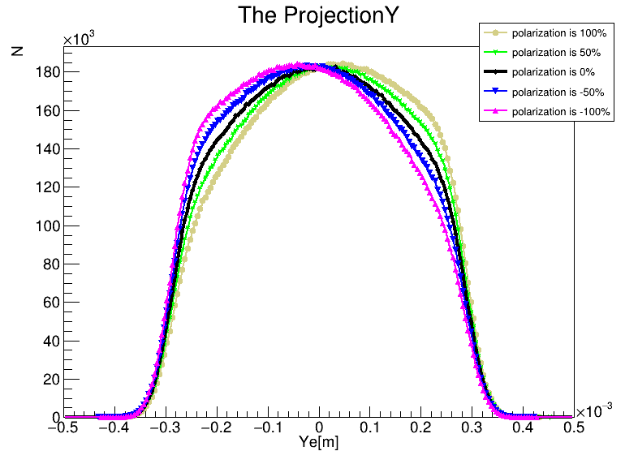
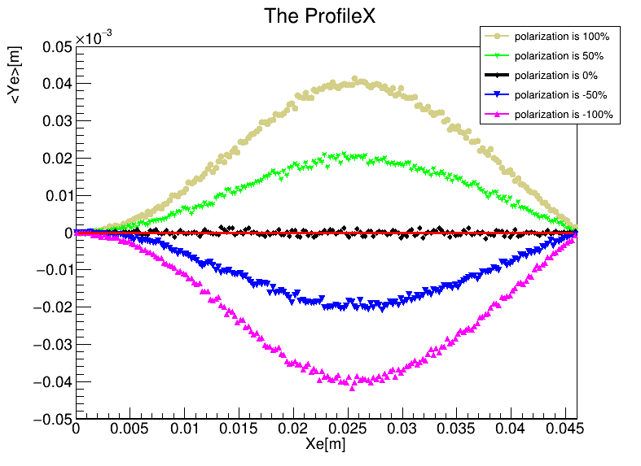
The distribution of scattered electrons
Analyzing power:
The asymmetry for 100% beam polarization.
Projection Y of 2D distribution of scattered electrons
The Y mean shift per X bin
The transverse polarization is sensitive to the distribution of scattered electrons, especially in the Y axis.

Slide 10
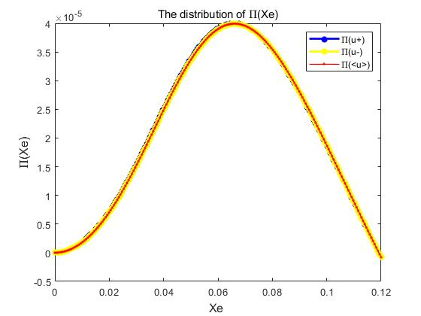
The measurement method
The fit method
$${{\overline{Y_{e}|}}_{X_{e}}=P}_{⊥}П(X_{e})$$
$\text{analyzing} \text{power}: П(X_{e})$
$P_{⊥}=ξ_{⌒}ζ_{⊥}$
$ξ_{⌒}$ is laser circular polarization
$ζ_{⊥}$ is electron beam transverse polarization
${\overline{Y_{e}|}}_{X_{e}}$ is 1d distribution of scattered electrons the mean of Y per X bin
$П(X_{e})$ is analyzing power: its value for 100% polarization
$$\left\{\begin{matrix}П\left(X_{e}\right),u=u^{+} (物理解) \\ П\left(X_{e}\right),u=u^{−} (物理解) \\ П\left(X_{e}\right),u=\overline{u}=\frac{u^{+}+u^{−}}{2}\end{matrix}\right.$$

Slide 11
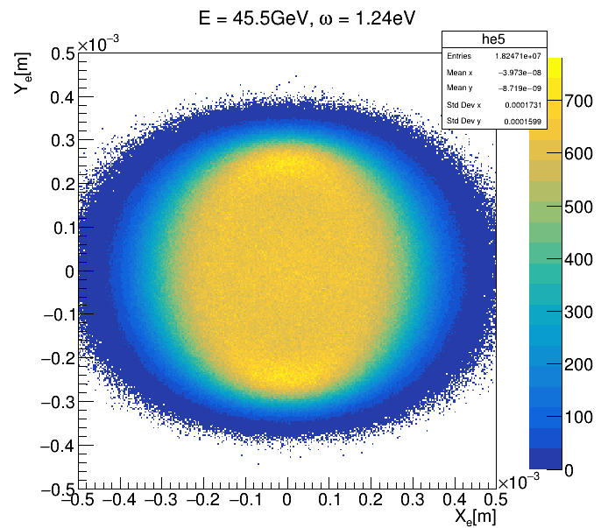
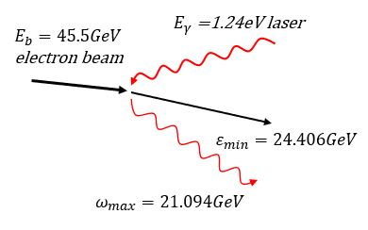
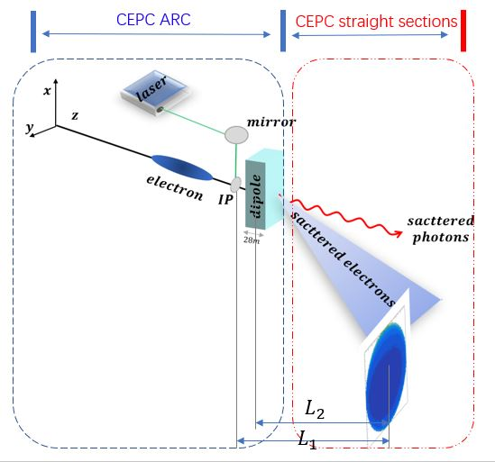
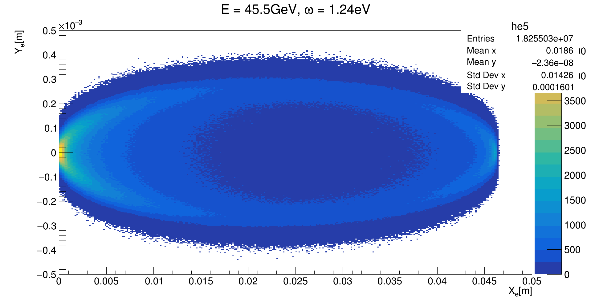
Physics of Compton Polarimeter
Summary of the relationship between (u,ψ) and ($X_{e},Y_{e}$)
$$u=\frac{energy of scattered photons}{energy of scattered electrons}$$
ψ is azimuthal in the detector; ($X_{e},Y_{e}$) is the position of scattered electrons in the detector
Case 1:Compton scattering process
 | $$uε[0,\frac{κ}{2}]$$ | $φε[0,2π$]
 | $$uε[\frac{κ}{2},κ]$$
 | $$uε[0,κ]$$ | $$φε[−\frac{π}{2},\frac{π}{2}]$$
 |  | $$φε[\frac{π}{2},\frac{3π}{2}]$$
$$κ$$
$$uε[\frac{κ}{2},κ]$$
$$u$$
$$uε[0,\frac{κ}{2}]$$
$$2π$$
$$0$$
$$φ$$
Case 2: Compton scattering &Magnetic process
$$κ$$
$$φε[\frac{π}{2},\frac{3π}{2}]$$
$$φε[−\frac{π}{2},\frac{π}{2}]$$
$$u$$
$$2π$$
$$0$$
$$φ$$
The 2d distribution of scattered electrons in detector ($X_{e},Y_{e}$) correspond to ${(u}^{+},φ^{+})$ or ${(u}^{−},φ^{−})$

Slide 12
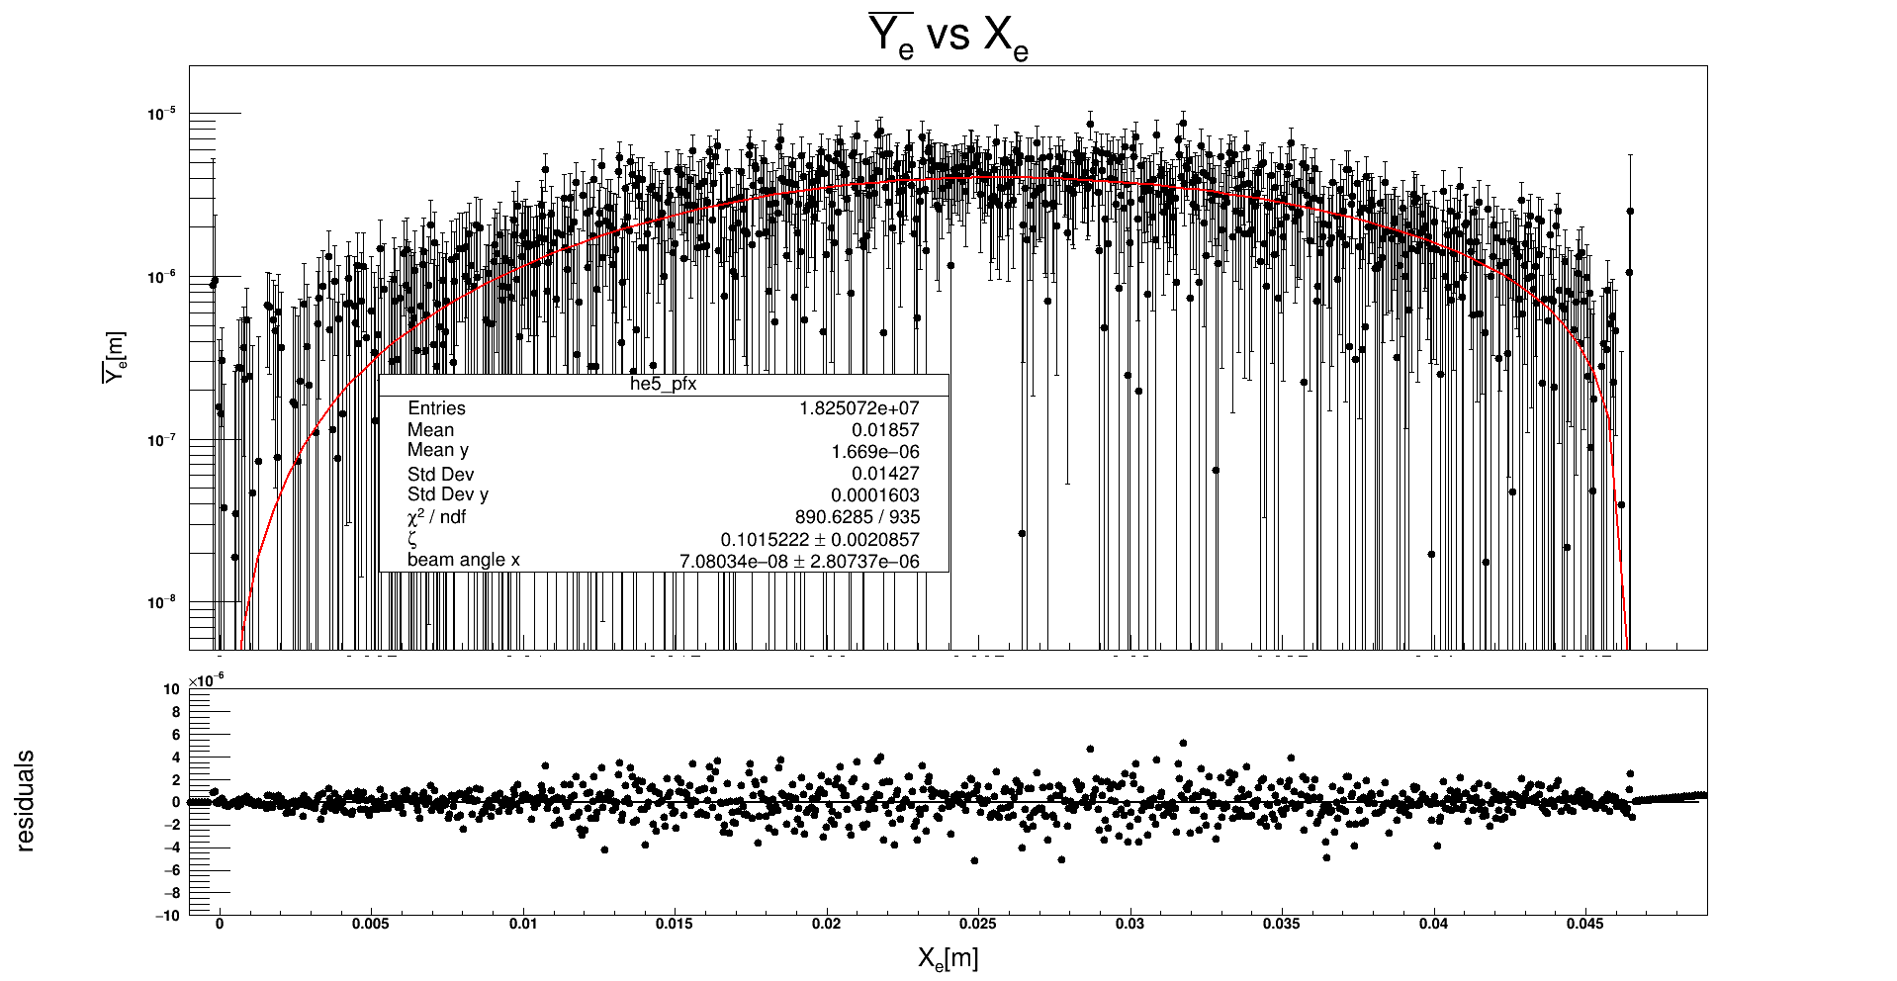
The fit result(polarization is 10%)
$$u=\overline{u}$$
$$\frac{∆P}{P}≈2\%$$

Slide 13
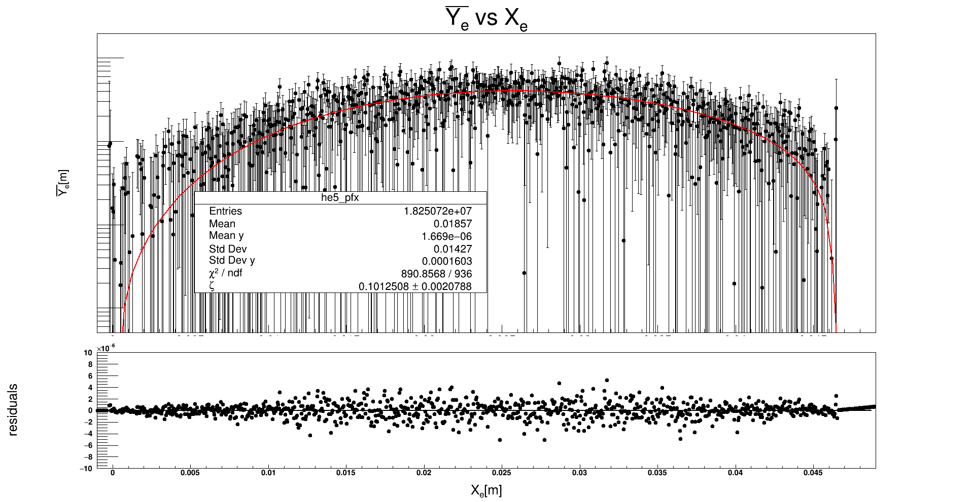
The fit result(polarization is 10%)
$$u=u^{+}$$
$$\frac{∆P}{P}≈2\%$$

Slide 14
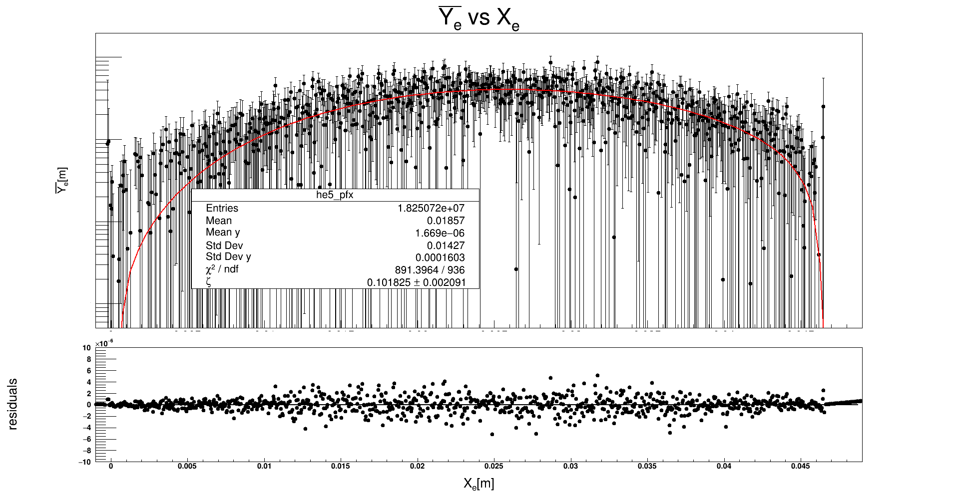
The fit result(polarization is 10%)
$$u=u^{−}$$
$$\frac{∆P}{P}≈2\%$$

Slide 15
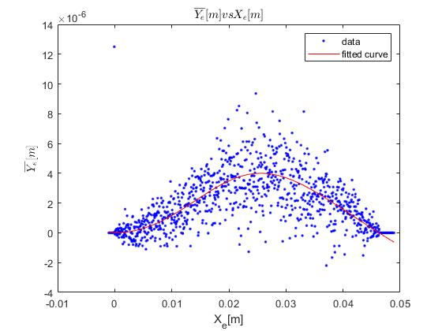
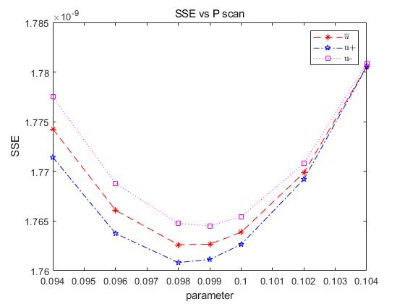
The fit result(polarization is 10%)

Slide 16
The fit result(polarization is 10%)
 | Fit function | Fit result
Pol6-fit | $$П\left(X_{e}\right),u=u^{+}$$ | $$P_{⊥}=0.101508±0.0020788$$
 | $$П\left(X_{e}\right),u=u^{−}$$ | $$P_{⊥}=0.101825±0.002091$$
 | $$П\left(X_{e}\right),u=\overline{u}$$ | $$P_{⊥}=0.1015222±0.002057$$
ROOT fit result
$$\frac{∆P}{P}≈2\%$$
Fit function | Fit result
$$П\left(X_{e}\right),u=u^{+}$$ | $$P_{⊥}=0.0980±0.0017$$
$$П\left(X_{e}\right),u=u^{−}$$ | $$P_{⊥}=0.0990±0. 0017$$
$$П\left(X_{e}\right),u=\overline{u}$$ | $$P_{⊥}=0.0980±0.0017$$
MATLAB fit result
$$\frac{∆P}{P}≈1.7\%$$

Slide 17
The statistical error
$$𝕿=\frac{f_{b}N_{e}N_{γ}}{2πσ_{xγ}σ_{yγ}\sqrt{1+{(\frac{1}{2}θ_{0}\frac{σ_{zγ}}{σ_{yγ}})}^{2}}}$$
The luminosity of Compton polarimeter
The luminosity for pulsed lasers
Par. | Unit | Physics meaning | CEPC(Z pole)
$$f_{b}$$ |  | Number of bunch crossing per second | 1(12000)
$$N_{e}$$ |  | Number of electrons per bunch | $$8×{10}^{10}$$
$$P_{L}$$ | W=J/s | power of the laser | 0.1GW
$$λ$$ | m | Wavelength of laser | 1.002$μm$(1.24eV)
$$E_{laser}$$ |  | Laser energy | 2.8mJ
Bunch length |  |  | 28ps
$$N_{γ}$$ |  | Number of photons per laser pulse | $$1.4×{10}^{16}$$
$σ_{xγ}$/$σ_{yγ}$ | m | Rms beam size | $$σ_{γ}=160μm$$
$$𝕿$$ | $${cm}^{−2}s^{−1}$$ | luminosity | $$6.9676×{10}^{33}m^{−2}∙s^{−1}$$
σ | barn | Cross section | $$393.5mb$$
Max. rate | $$s^{−1}$$ | Compton scattering event rate | $$2.742×{10}^{5}{pulse}^{−1}$$
The laser is 1HZ. Compton rate$= 2.742×{10}^{5}s^{−1}$

Slide 18
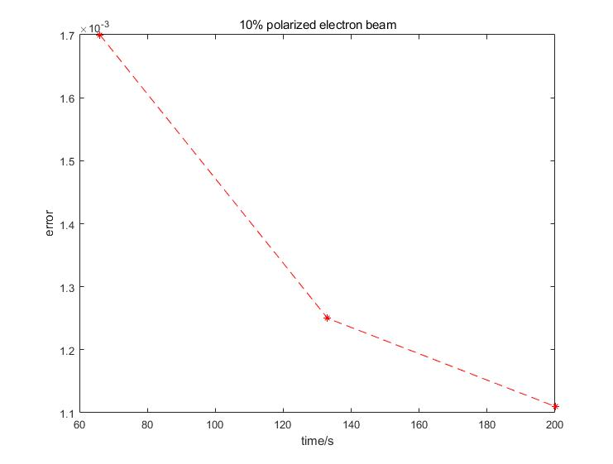
The statistic error
The statistical error vs measurement time
entries | time | error
18255630 | 66s | 0.0017
36510648 | 133s | 0.00125
54762225 | 200s | 0.00111

Slide 19
The systematic uncertainty
$${(\frac{{∆P}_{⊥}}{P_{⊥}})}^{2}={(\frac{∆\overline{Y_{e}}}{\overline{Y_{e}}})}^{2}+{(\frac{∆П}{П})}^{2}$$
Systematic
$$\frac{{∆P}_{⊥}}{P_{⊥}}=\frac{∆П}{П}=\frac{\sum{\frac{∂П\left(X_{e}\right)}{∂θ_{0}}\sum{\frac{n_{xi}}{N}}δθ_{0}}}{П}+\frac{\sum{\frac{∂П\left(X_{e}\right)}{∂L_{1}}\sum{\frac{n_{xi}}{N}}δL_{1}}}{П}+\frac{\sum{\frac{∂П\left(X_{e}\right)}{∂L_{2}}\sum{\frac{n_{xi}}{N}}δL_{2}}}{П}$$
Nbinsx 按照权重加权，即per X bin 里面的数目 $\sum{\frac{n_{xi}}{N}}$
Sources of systematic uncertainties | $$∆$$ | $$\left|\frac{∆P}{P}\right|\%$$
Dipole strength($B=70.7904Gs$) | $$7.07904×{10}^{−7}T$$ | 0.00239%
L1=60m (Ip to detector) | 1mm | 0.01653%
L2=40m (Dipole to detector) | 1mm | 0.017929%
Total |  | 0.036849%

Slide 20
The systematic uncertainty
Table 2: The systematic uncertainty of Compton polarimeter
Sources of systematic uncertainties | $$∆$$ | $$\left|\frac{∆P}{P}\right|\%$$
Dipole strength($B=70.7904Gs$) | $$7.07904×{10}^{−7}T$$ | 0.00239%
L1=60m (Ip to detector) | 1mm | 0.01653%
L2=40m (Dipole to detector) | 1mm | 0.017929%
∆α deviation of the detector | 1μrad | ignored
∆β deviation of the detector | 1μrad | ignored
Detector placement |  | ignored
Total |  | 0.036849%

Slide 21
Summary & Outlook
Summary
Transverse polarization play an important role in beam energy calibration by RDP.
Compton Polarimeter is the clear technique of choice for electron polarization at CEPC
measure the position asymmetry of scattered electrons
2% statistical error has been achieved in 66s time
0.036849% systematic uncertainty are obtained
Detector linear effect or electronic noise are not considered
Outlook
longitudinal polarized beam is a powerful ingredient of determining the anomalous couplings in the electroweak physics and suppressing background in new physics searches.
The measurement of longitudinal is essential.
21

Slide 23
Additional slides

Slide 24
Physics
Compton Polarimeter involves two physics process: Compton scattering and magnetic deflection
Case 2:
Compton scattering process
&
Magnetic deflection
Case 1:
Compton scattering process
The relationship between scattered energy & detector azimuthal angle (u,ψ)
and the position distribution of scattered electrons ${(X}_{e},$ $Y_{e})$
${(X}_{e},$ $Y_{e})$
${(u}^{+},φ^{+})$ and ${(u}^{−},φ^{−})$

Slide 25
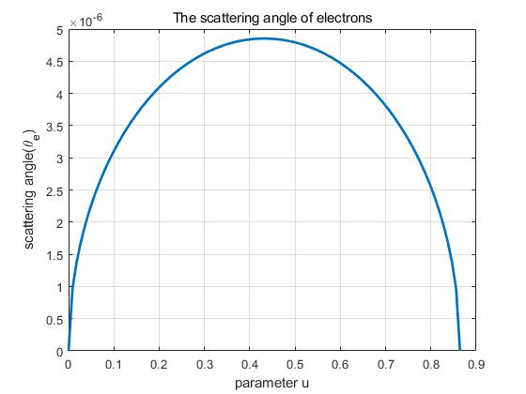
Physics
Case 1: Compton scattering process
Scattering angle of electron $θ_{e} θ_{e}=\frac{1}{γ}\sqrt{u(κ−u)}$
$E_{γ}$=1.24eV laser
When $u=\frac{κ}{2}: θ_{e}=θ_{e_max}=\frac{1}{γ}\frac{κ}{2}$
$E_{b}=45.5GeV$ electron beam
Detector is perpendicular to the beam
($φ$is the detector’s azimuthal angle):
$$\left\{\begin{matrix}uε[0,\frac{κ}{2}]，φε[0,2π] \\ uε[\frac{κ}{2},κ] ，φε[0,2π] \end{matrix}\right.$$
$$\left\{\begin{matrix}X_{e}=L_{1}θ_{e}cosφ \\ Y_{e}=L_{1}θ_{e}sinφ\end{matrix}\right.$$
$$ε_{min}=24.406GeV$$
$$ω_{max}=21.094GeV$$
$$u=\frac{ω}{ε}; u∈\left[0,κ\right]$$
$$κ=\frac{4E_{γ}E_{b}}{m^{2}}$$
$u$is ratio of scattered energy of photons to electrons
$$u=\frac{κ}{2}$$

Slide 26
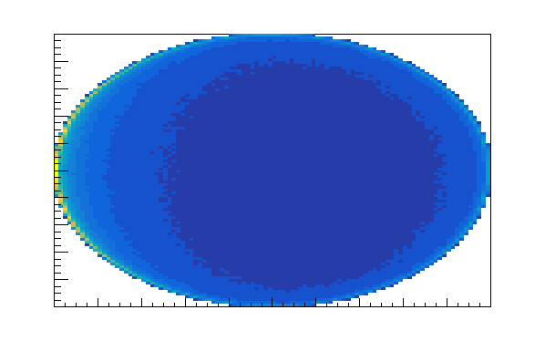
laser
Physics
Case 2: Compton scattering process + Magnetic deflection
dipole
IP
Gathering two physical process together:
γ
θ₀
$$28m$$
electron beam
γ detector
$$\left\{\begin{matrix}θ_{x}=θ_{e}cosφ+uθ_{0} \\ θ_{y}=θ_{e}sinφ\end{matrix}\right.$$
scattered electrons with minimum energy
detector
x
$uθ_{0}$ is the magnetic deflection angle caused by energy loss in Compton back-scattering process.
$$L_{2}$$
y
φ
$$L_{1}$$
The position of scattered electrons in detector plane is:
$$\left\{\begin{matrix}φε[−\frac{π}{2},\frac{π}{2}] ，uε[0,κ] \\ φε[\frac{π}{2},\frac{3π}{2}] ，uε[0,κ] \end{matrix}\right.$$
$$\left\{\begin{matrix}X_{e}=L_{1}θ_{e}cosφ+uθ_{0}L_{2} \\ Y_{e}=L_{1}θ_{e}sinφ\end{matrix}\right.$$

Slide 27
About bending angle
推导偏转角和偏移量
Higgs mode
The magnetic strength of the dipole located in last is $\frac{1}{2}B=\frac{373.4Gs}{2}=0.01867T$
Z pole
$$\frac{120GeV}{45.5GeV}=\frac{373.4Gs}{B_{z_center}}$$
L
偏转角等于圆心角
$$bending angle:θ1=θ2= \frac{l}{R}$$
x
θ1
$$B_{z_end}=\frac{1}{2}B_{z_center}=70.7904Gs$$
$偏移量x:R^{2}=L^{2}+{\left(R−x\right)}^{2}$
$Bqv=mv^{2}/R$
R-x
$$E=mc^{2}→mc=E/c$$
R
$$R=\frac{mv^{2}}{Bqv}=\frac{mv}{Be}=\frac{E}{Bec}$$
$θ=\frac{l}{R}=\text{0.0013389}rad$
θ2

Slide 28
luminosity
The luminosity of pulsed laser and electron bunch
1 pulse laser with 1 electron bunch
$$𝕿=\frac{N_{e}N_{γ}}{2πσ_{xγ}σ_{yγ}}$$
$N_{e}$(Number of electrons per bunch) = $8×{10}^{10}$
About $N_{γ}$
$N_{γ}=\frac{E_{laser}}{ω_{photon}}$
electron bunch length =8.5mm;
Pulse electron bunch = electron bunch length /c = $\frac{8.5mm}{3×{10}^{8}m/s}=28ps$
Considering the not destroy the mirrow: the laser power is 0.1GW
$$E_{laser}=P∗t=0.1GW∗28ps=2.8×{10}^{−3}J=2.8mJ$$
The number of 1 pulsed laser is:
$$N_{γ}=\frac{E_{laser}}{ω_{photon}}=\frac{2.8×{10}^{−3}J}{1.24×{1.6×10}^{−19}J}=1.4×{10}^{16}$$
The luminosity of 1 pulse laser with 1 electron bunch:
$$𝕿=\frac{N_{e}N_{γ}}{2πσ_{xγ}σ_{yγ}}=\frac{8×{10}^{10}×1.4×{10}^{16}}{2π×(160μm×160μm)}=6.967×{10}^{33}m^{−2}∙s^{−1}$$

Slide 29
luminosity
The maximum rate of pulsed laser and electron bunch
The luminosity of 1 pulse laser with 1 electron bunch:
$$𝕿=\frac{N_{e}N_{γ}}{2πσ_{xγ}σ_{yγ}}=\frac{8×{10}^{10}×1.4×{10}^{16}}{2π×(160μm×160μm)}=6.967×{10}^{33}m^{−2}∙s^{−1}$$
The ICS cross section is :
$$σ\left(κ\right)=\frac{2πr_{e}^{2}}{κ}\left[\left(1−\frac{4}{κ}−\frac{8}{κ^{2}}\right)\log\left(1+κ\right)+\frac{1}{2}\left(1−\frac{1}{{\left(1+κ\right)}^{2}}\right)+\frac{8}{κ}\right]=393.5mb$$
Compton scattering event rate:
$$N=𝕿σ=6.967×{10}^{33}m^{−2}∙s^{−1}×393.5mb=2.742{×10}^{5}{pulse}^{−1}$$
Note that: The laser is 1HZ.
IP： 1 bunch 1 second $v=\frac{3×{10}^{8}m/s}{100km}=3000次$
1s内 electron 共有12000(CEPC CDR bunch nember)*3000个束团经过IP点，但是Laser无法匹配那么高的频率，设置 laser 的频率为1Hz, 则 1s内 仅仅发生一次 pulsed laser collider with 1 electron bunch
timing system 可以给laser一个合适的trigger，保证laser同指定的一个bunch相互作用, timing system 里面有每个bunch的时间戳
正常情况下，polarization 演化的时间尺度在小时以上，甚至到几十小时，1min内的变化可以忽略。 如果是进行共振退极化实验，可以对一个指定束团，扫描一次depolarizer的频率，即进行一次resonant depolarization run，然后测量一下该束团极化度的情况，主要是看扫描depolarizer频率前后，该束团极化度有没有变化，不关心测量过程中的极化度变化

Slide 30
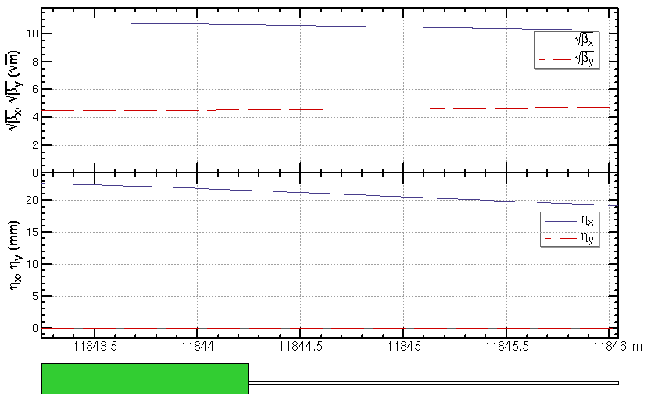
β function
$$β_{x}=121m$$
$$β_{y}=25m$$
Yiwei WANG

Slide 31
$$П(Xe)$$
$$П(x)=\frac{\int{y\frac{dσ_{⊥}}{dxdy}dy}}{\int{\frac{dσ_{0}}{dxdy}dy}}$$
$$we use the y= \sqrt{1−x^{2}}sinθ,θ∈[−\frac{π}{2},\frac{π}{2}]$$
$$\int{y\frac{dσ_{⊥}}{dxdy}dy=\int_{−\sqrt{1−x^{2}}}^{\sqrt{1−x^{2}}}{\frac{r_{e}^{2}}{{\left(1+u\right)}^{3}\sqrt{1−x^{2}−y^{2}}}uy^{2}dy=\frac{{ur}_{e}^{2}}{{\left(1+u\right)}^{3}}\int_{−\sqrt{1−x^{2}}}^{\sqrt{1−x^{2}}}{\frac{y^{2}}{\sqrt{1−x^{2}−y^{2}}}dy=\frac{(1−x^{2}){ur}_{e}^{2}}{{\left(1+u\right)}^{3}}\int_{−\frac{π}{2}}^{\frac{π}{2}}{{sinθ}^{2}dy=\frac{π{(1−x^{2})ur}_{e}^{2}}{2{\left(1+u\right)}^{3}}}}}}$$
$$\int{\frac{dσ_{0}}{dxdy}dy=\int_{−\sqrt{1−x^{2}}}^{\sqrt{1−x^{2}}}{\frac{r_{e}^{2}}{{\left(1+u\right)}^{3}\sqrt{1−x^{2}−y^{2}}}\left(1+{(1+u)}^{2}−4\frac{u}{κ}\left(1+u\right)(1−\frac{u}{κ})\right)dy}=}\frac{{πr}_{e}^{2}\left(1+{(1+u)}^{2}−4\frac{u}{κ}\left(1+u\right)(1−\frac{u}{κ})\right)}{{\left(1+u\right)}^{3}}$$
$П(x)=\frac{\left(1−x^{2}\right)u}{2\left(1+{(1+u)}^{2}−4\frac{u}{κ}\left(1+u\right)(1−\frac{u}{κ})\right)}$
$x=\frac{(X_{e}−σ_{x}^{′}L_{1})−\frac{κ}{2}θ_{0}L_{2}}{\frac{κ}{2}\sqrt{{(\frac{L_{1}}{γ})}^{2}+{(θ_{0}L_{2})}^{2}}}$
$y=\frac{Y_{e}−σ_{y}^{′}L_{1}}{\frac{L_{1}}{γ}\frac{κ}{2}}$
$u\left(Xe\right)=\frac{2\left(X_{e}−σ_{x}^{′}L_{1}\right)θ_{0}L_{2}+{κ(\frac{L_{1}}{γ})}^{2}}{2({(\frac{L_{1}}{γ})}^{2}+{(θ_{0}L_{2})}^{2})}$
$$П(Xe)=\frac{L_{1}}{γ}\frac{κ}{2}\frac{\left(1−{(\frac{(X_{e}−σ_{x}^{′}L_{1})−\frac{κ}{2}θ_{0}L_{2}}{\frac{κ}{2}\sqrt{{(\frac{L_{1}}{γ})}^{2}+{(θ_{0}L_{2})}^{2}}})}^{2}\right)u(Xe)}{2\left(1+{(1+u)}^{2}−4\frac{u}{κ}\left(1+u\right)(1−\frac{u}{κ})\right)}$$

Slide 32
$$x$$
$$laser$$
$$z$$
$$mirror 1$$
$$y$$
$$IP$$
$$electron$$
$$mirror 2$$
$$dipole$$
$$sacttered$$
$$photons$$
$$28m$$
$$sacttered electrons$$

Slide 33
Polarization = 10%
MATLAB fit result
 | Original | 0.094 | 0.096 | 0.098 | 0.099 | 0.100 | 0.102 | 0.104
$$u^{+}$$ | fit value | 0.094 (0.09061, 0.09739) | 0.096 (0.09262, 0.09938) | 0.098 (0.09462, 0.1014) | 0.099 (0.09562, 0.1024) | 0.1 (0.09662, 0.1034) | 0.102 (0.09861, 0.1054) | 0.104 (0.1006, 0.1074)
 | $${SSE}_{min}$$ | 1.771422866716164e-09 | 1.763747313661280e-09 | 1.760820089152675e-09 | 1.761137100103227e-09 | 1.762641193190349e-09 | 1.769210625774302e-09 | 1.780528386904534e-09
$$u^{−}$$ | fit value | 0.094 (0.09058, 0.09742) | 0.096 (0.09259, 0.09941) | 0.098 (0.0946, 0.1014) | 0.099 (0.0956, 0.1024) | 0.1 (0.0966, 0.1034) | 0.102 (0.09859, 0.1054) | 0.104 (0.1006, 0.1074)
 | $${SSE}_{min}$$ | 1.777505906254044e-09 | 1.768784347898592e-09 | 1.764762141769681e-09 | 1.764513295790178e-09 | 1.765439287867310e-09 | 1.770815786191480e-09 | 1.780891636742190e-09
$$\overline{u}$$ | fit value | 0.094 (0.0906, 0.0974) | 0.096 (0.0926, 0.0994) | 0.098 (0.09461, 0.1014) | 0.099 (0.09561, 0.1024) | 0.1 (0.09661, 0.1034) | 0.102 (0.0986, 0.1054) | 0.104 (0.1006, 0.1074)
 | $${SSE}_{min}$$ | 1.774281698874271e-09 | 1.766089452127655e-09 | 1.762621470597824e-09 | 1.762659079289202e-09 | 1.763877754284777e-09 | 1.769858303188516e-09 | 1.780563117309038e-09
Coefficients (with 95% confidence bounds) $SSE=\sum{w_{i}{(y_{i}−\hat{y_{i}})}^{2}}$

Slide 34
The systematic uncertainty(1)
$${(\frac{{∆P}_{⊥}}{P_{⊥}})}^{2}={(\frac{∆\overline{Y_{e}}}{\overline{Y_{e}}})}^{2}+{(\frac{∆П}{П})}^{2}$$
Systematic
$$\frac{{∆P}_{⊥}}{P_{⊥}}=\frac{∆П}{П}=\frac{\sum{\frac{∂П\left(X_{e}\right)}{∂θ_{0}}\sum{\frac{n_{xi}}{N}}δθ_{0}}}{П}+\frac{\sum{\frac{∂П\left(X_{e}\right)}{∂L_{1}}\sum{\frac{n_{xi}}{N}}δL_{1}}}{П}+\frac{\sum{\frac{∂П\left(X_{e}\right)}{∂L_{2}}\sum{\frac{n_{xi}}{N}}δL_{2}}}{П}$$
Nbinsx 按照权重加权，即per X bin 里面的数目 $\sum{\frac{n_{xi}}{N}}$
Sources of systematic uncertainties | $$∆$$ | $$\left|\frac{∆P}{P}\right|\%$$
Dipole strength | $$7.07904×{10}^{−7}T$$ | 0.00239%
L1 (Ip to detector) | 1mm | 0.01653%
L2 (Dipole to detector) | 1mm | 0.017929%
all |  | 0.036849%

Slide 35
The systematic uncertainty(2)
Detector deviation
$$\left\{\begin{matrix}X_{e}=L_{1}θ_{e}cosφ+uθ_{0}L_{2} \\ Y_{e}=L_{1}θ_{e}sinφ\end{matrix}\right.$$
$$α(β)$$
The design of detector
X*Y = 5cm*2cm;
Pixel size: 50μm*25μm
resolution:14.434μm*7.217μm
$$X_{e}(Y_{e})$$
$${X_{e}}^{′}({Y_{e}}^{′})$$
$$\left\{\begin{matrix}{X_{e}}^{′}=X_{e}/cosα \\ {Y_{e}}^{′}=Y_{e}/cosβ\end{matrix}\right.$$
∆α deviation of the detector | ∆α=0.1° | $$∆X_{e}={X_{e}}^{′}−X_{e}=1.5215×{10}^{−6}X_{e}$$ | Detector resolution x = 50/$\sqrt{12}=$14.43μm
∆β deviation of the detector | ∆β=0.1° | $$∆Y_{e}={Y_{e}}^{′}−Y_{e}=1.5215×{10}^{−6}Y_{e}$$ | Detector resolution y = 25/$\sqrt{12}=$7.22μm
The systematic error by deviation of detector can be ignored.

Slide 36
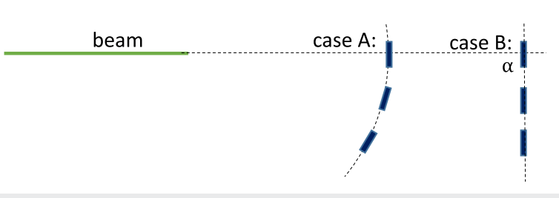
The systematic uncertainty(3)
Detector placement
$${θ_{e}}_{max}=\frac{2ω_{0}}{m_{e}}=4.853×{10}^{−6}rad$$
$$X_{A}=L_{1}θ_{e}cosφ+uθ_{0}L_{2}$$
$$X_{B}=L_{1}tanθcosφ+uL_{2}tanθ$$
$${θ_{0}}_{max}=κθ_{0}=0.00116rad$$
$$\tan\left(0.00116\right)=0.001160000520299$$
The systematic error by detector placement can be ignored.

Slide 37
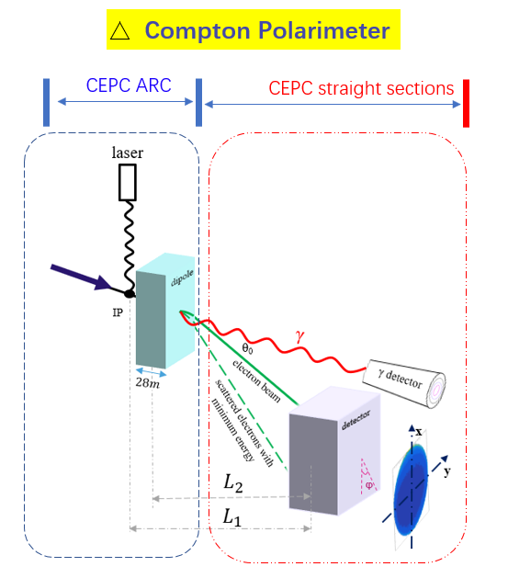
discussion
CEPC 束流管 外半径 = 31mm
由B铁参数计算 $θ_{0}=0.0013389rad$
$$∆x=L∗θ_{0}$$
$$L>\frac{\text{31}mm}{0.0013389rad}=23.15m$$
问题1：L从那里算起？B铁的中心？还是B铁的右边界？
B铁的中心
问题2： 散射电子在探测器上的分布：
不用减去 radius of tube吧？
不用
$$\left\{\begin{matrix}X_{e}=L_{1}θ_{e}cosφ+uθ_{0}L_{2} \\ Y_{e}=L_{1}θ_{e}sinφ\end{matrix}\right.$$

