Slide 1
CEPC timing detector R & D
--AC-coupled LGAD for 4D tracking
Zhijun Liang
on behalf on IHEP-HGTD team
(IHEP, Chinese Academy of Sciences)

Slide 2
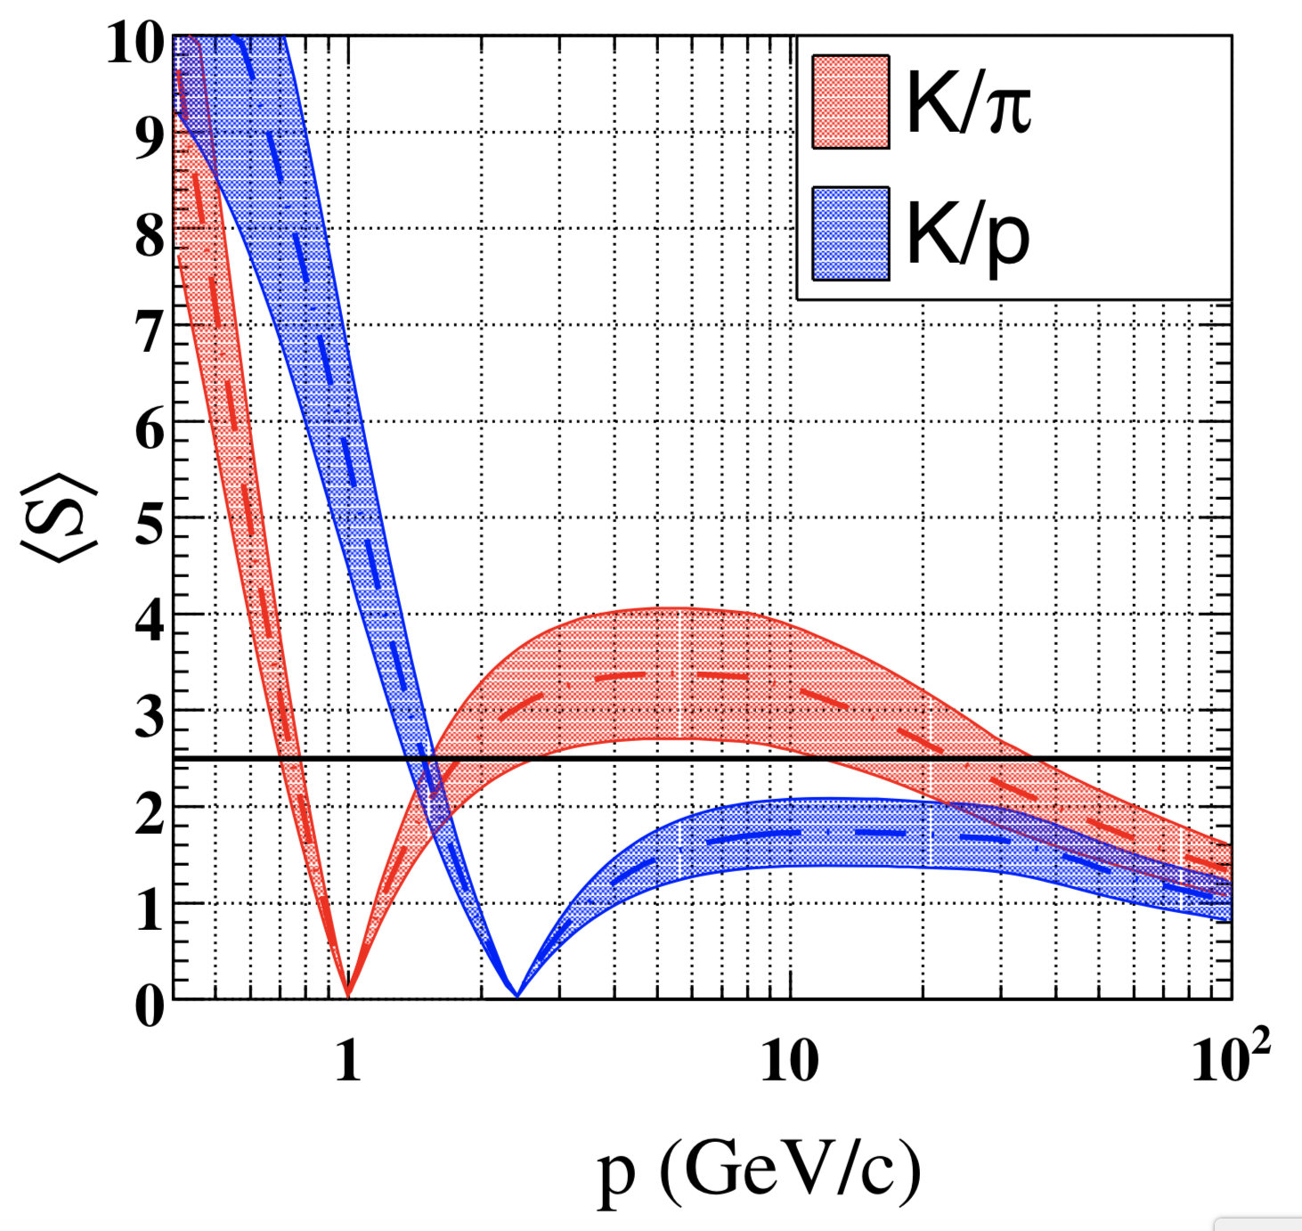
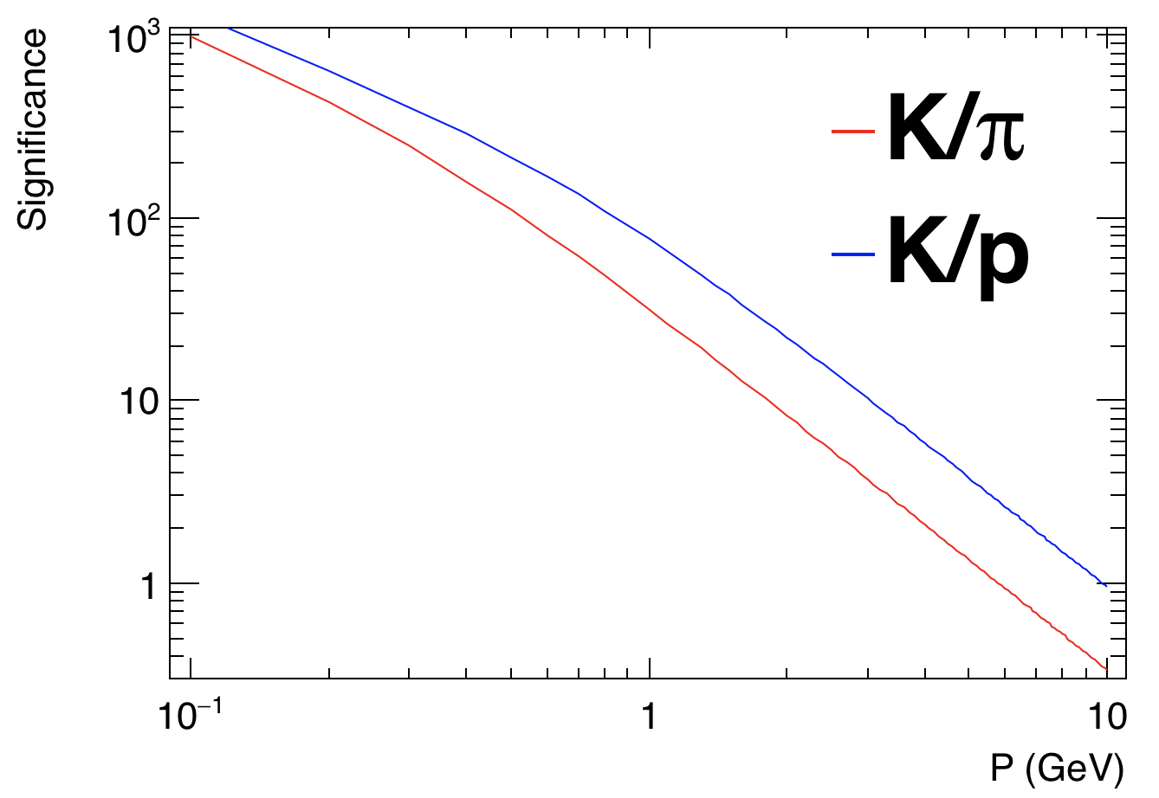
CEPC timing detector : motivation
CEPC will produce 10¹² Z boson at Z pole → Rich flavor physics program
CEPC International Advisory Committee: one of the key recommendations
→ Precision timing detector should be determined as a matter of urgency
Gas detector is responsible for particle identification in flavor (dE/dx)
→ Challenge: 0.5-2GeV for K/pi separation, >1.5GeV for K/p separation
Timing detector is complementary to gas detector
→ 0-4GeV for K/pi separation, 0-8GeV for K/p separation
timing detector
TPC
Assuming
20ps resolution
2σ

Slide 3
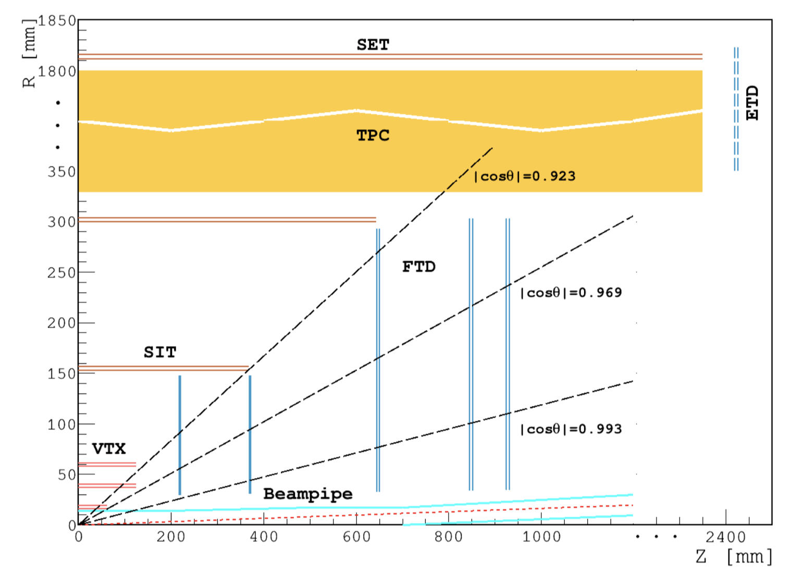
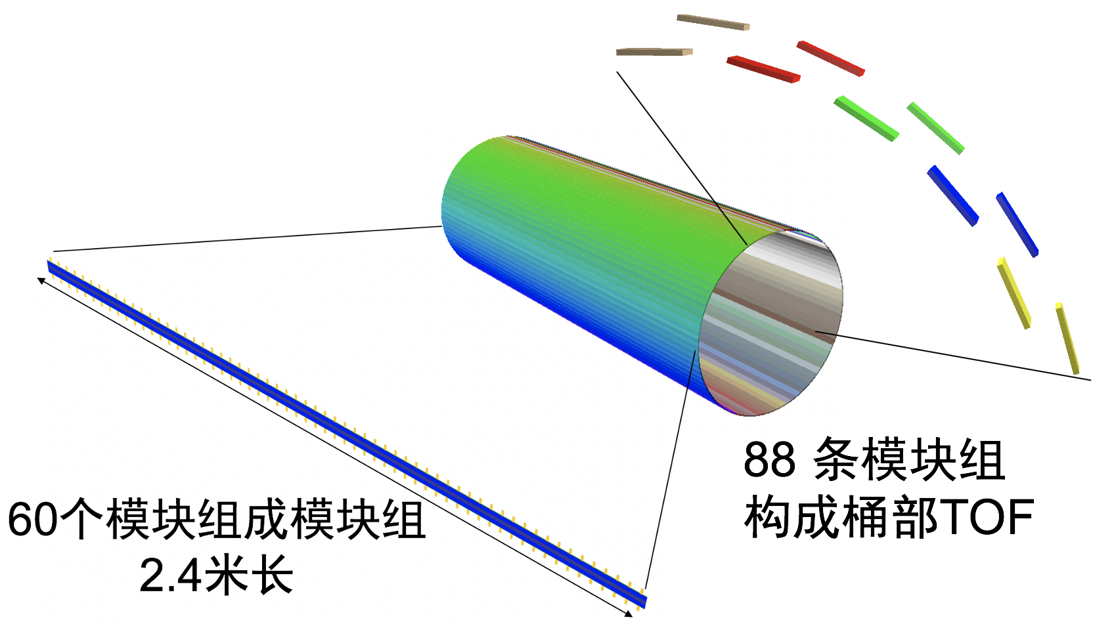
CEPC timing detector : Concept
Timing detector: Between tracker and calorimeter
→ TOF Close to SET tracker, Radius ~1.8m
Target time resolution: 50 pico-second(ps)
Area of detector ( Barrel : ~50m² , Endcap: ~20m² )
Baseline detector concept in CDR
Timing detector in Barrel region
88 stave
Timing

Slide 4
Introduction of Low-Gain Avalanche Detectors (LGAD)
DC-LGAD
CEPC application: TOF
The DC readout
Time resolution ~ 30ps
Position resolution: ~1mm
Dead zone : ~ 0.1mm

Slide 5
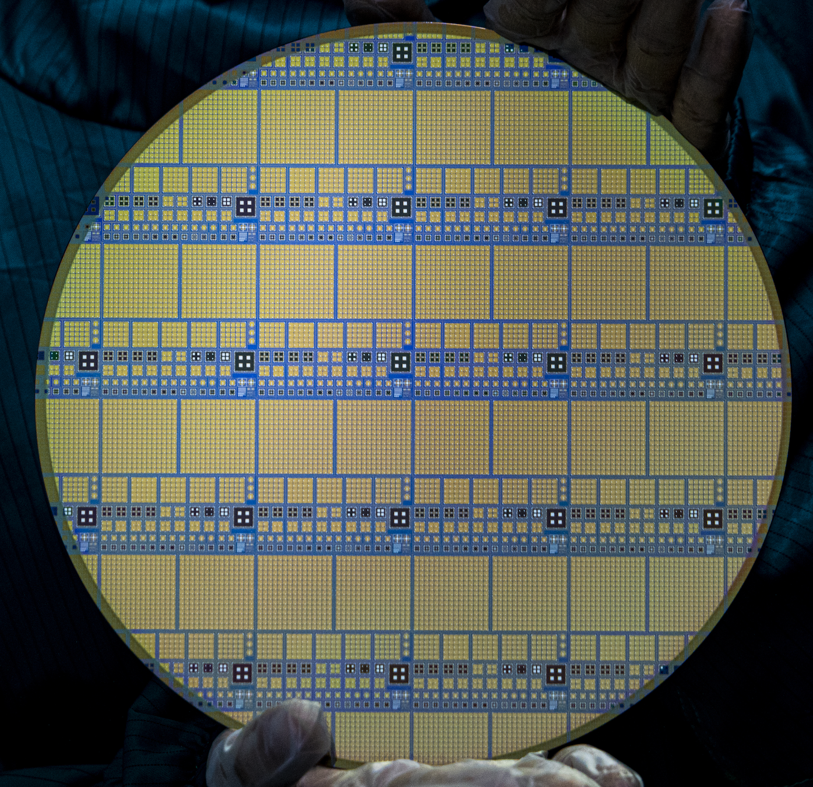
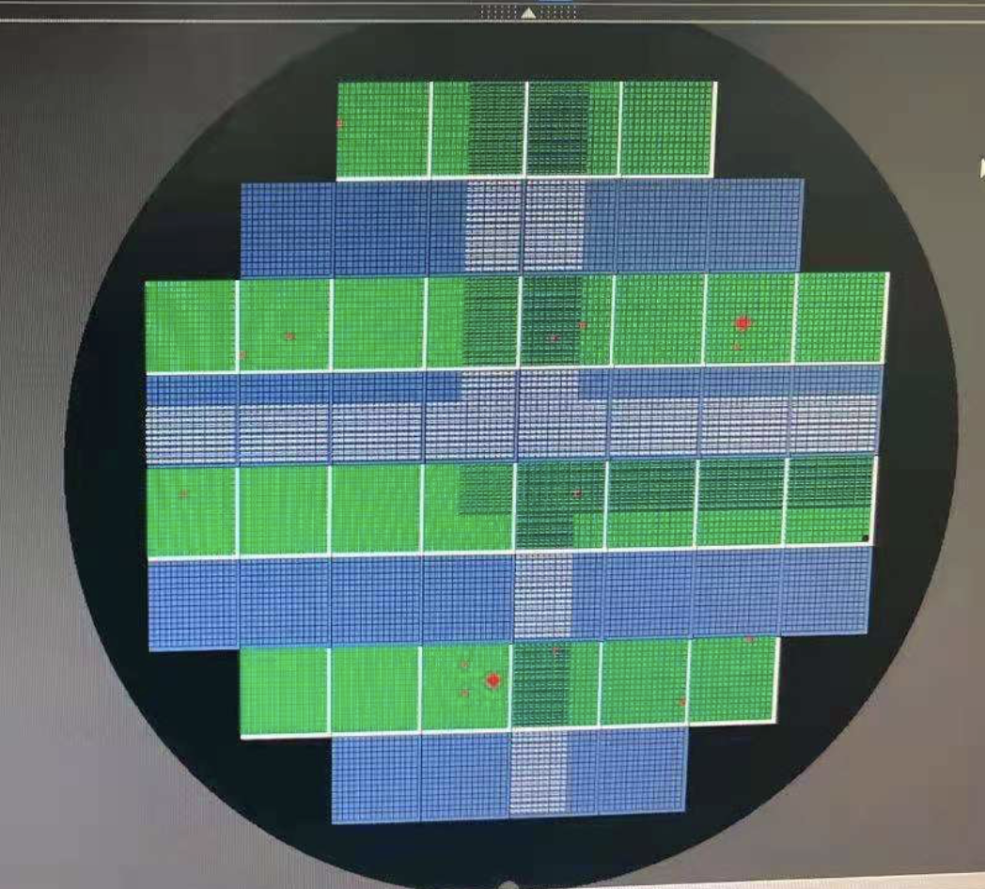
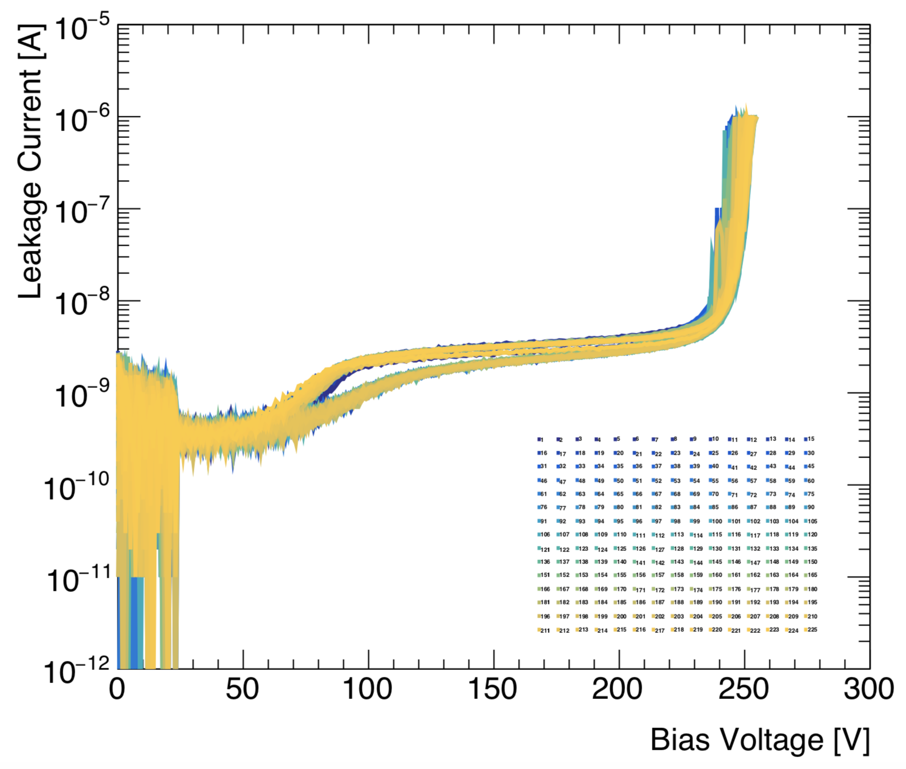
Progress in DC-LGAD for CEPC
IHEP team collaborated with Institute of micro-electronics (IME)
IHEP team designed and IME fabricated
Managed to fabricated 8-inch LGAD prototype wafer with good yield
>99.3% yield for single pad
>50% yield for 15 × 15 channels LGAD (2 × 2 cm)
I-V curve for 15*15 LGAD
Good uniformity
IHEP-IME LGAD wafer
IHEP-IME LGAD wafer
Good yield

Slide 6
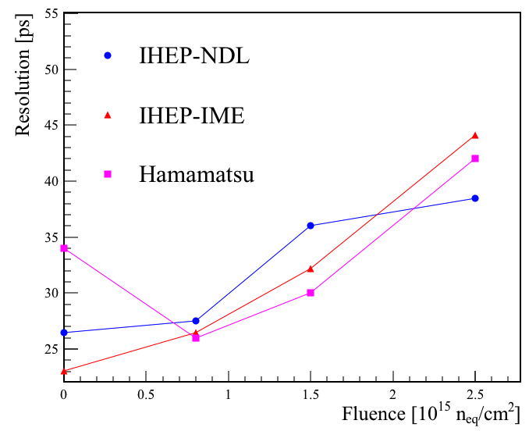
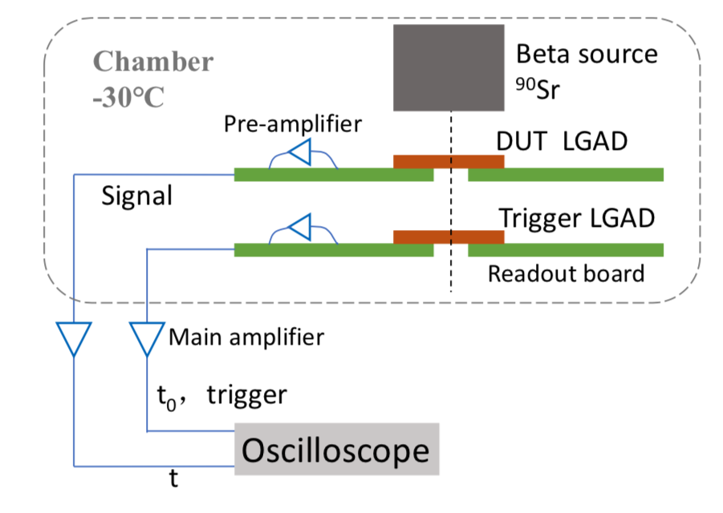
Performance of DC-LGAD developed by IHEP
Two type of LGAD developed by IHEP (joint R & D for CEPC and ATLAS)
Can reach 30 ps timing resolution in beta tests before irradiation
Below 50ps after irradiation after 2.5 × 10¹⁵ fluence (HL-LHC requirement)

Slide 7
Introduction of Low-Gain Avalanche Detectors (LGAD)
DC-LGAD
aAplication: LHC, CEPC TOF
The DC readout
Time resolution ~ 30ps
Position resolution: ~1mm
Dead zone : ~ 0.1mm
AC-LGAD
Application: CEPC TOF +SET ( 4D tracker)
AC coupled readout
Time resolution ~ 30ps
Position resolution: 10-50 um
Dead zone : 0 mm (no dead zone)

Slide 8
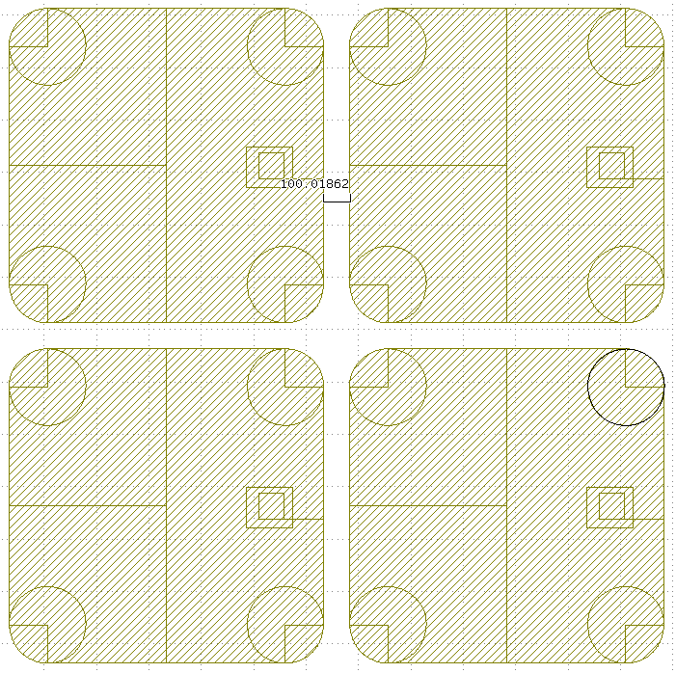
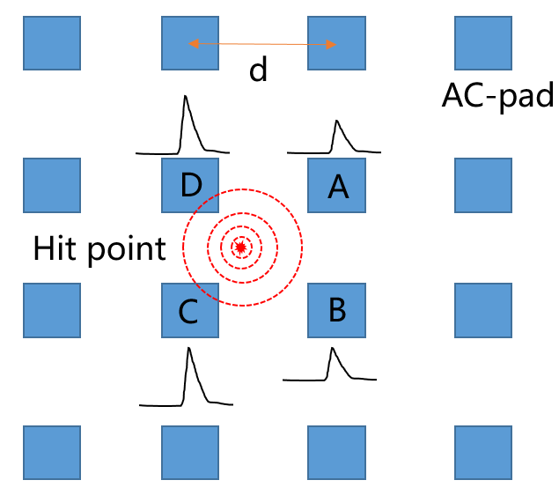
Introduction of AC-LGAD (2)
AC-LGAD
CEPC application: TOF +SET ( 4D tracker)
Cross-talk: can be adjusted
Dead zone : 0 mm (no dead zone)
DC-LGAD
CEPC application: TOF
Cross-talk: no
Dead zone : ~0.1mm

Slide 9
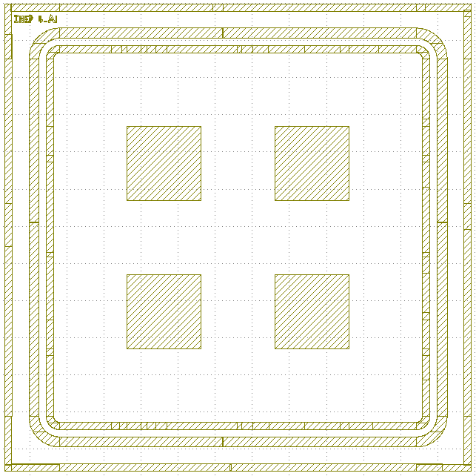
AC-LGAD prototype for CEPC
AC-LGAD first proposed by INFN in RD50, and first fabricated by FBK.
First AC-LGAD prototype in China by IHEP-IME in 2021.
Try different sensor geometry
Sensors | Sensor size [μm] | AC-pad size [μm] | Picth size [μm]
1-A7 | 1000 | 100 | 450
2-A2 | 2000 | 300 | 1200
2-A1 | 2000 | 600 | 1200
2-A3 | 2000 | 750 | 1000
4-A1 | 4000 | 1000 | 2000
4-A1
AC-pad size
2-A1
2-A2
2-A3
1-A7
Pitch size
Sensor size

Slide 10
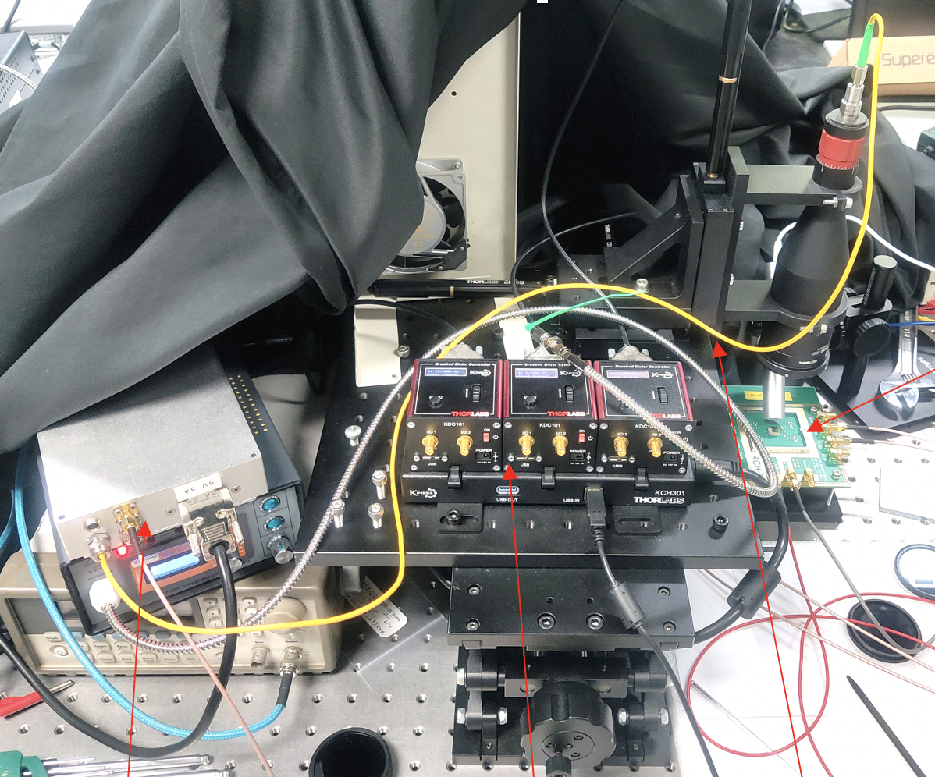
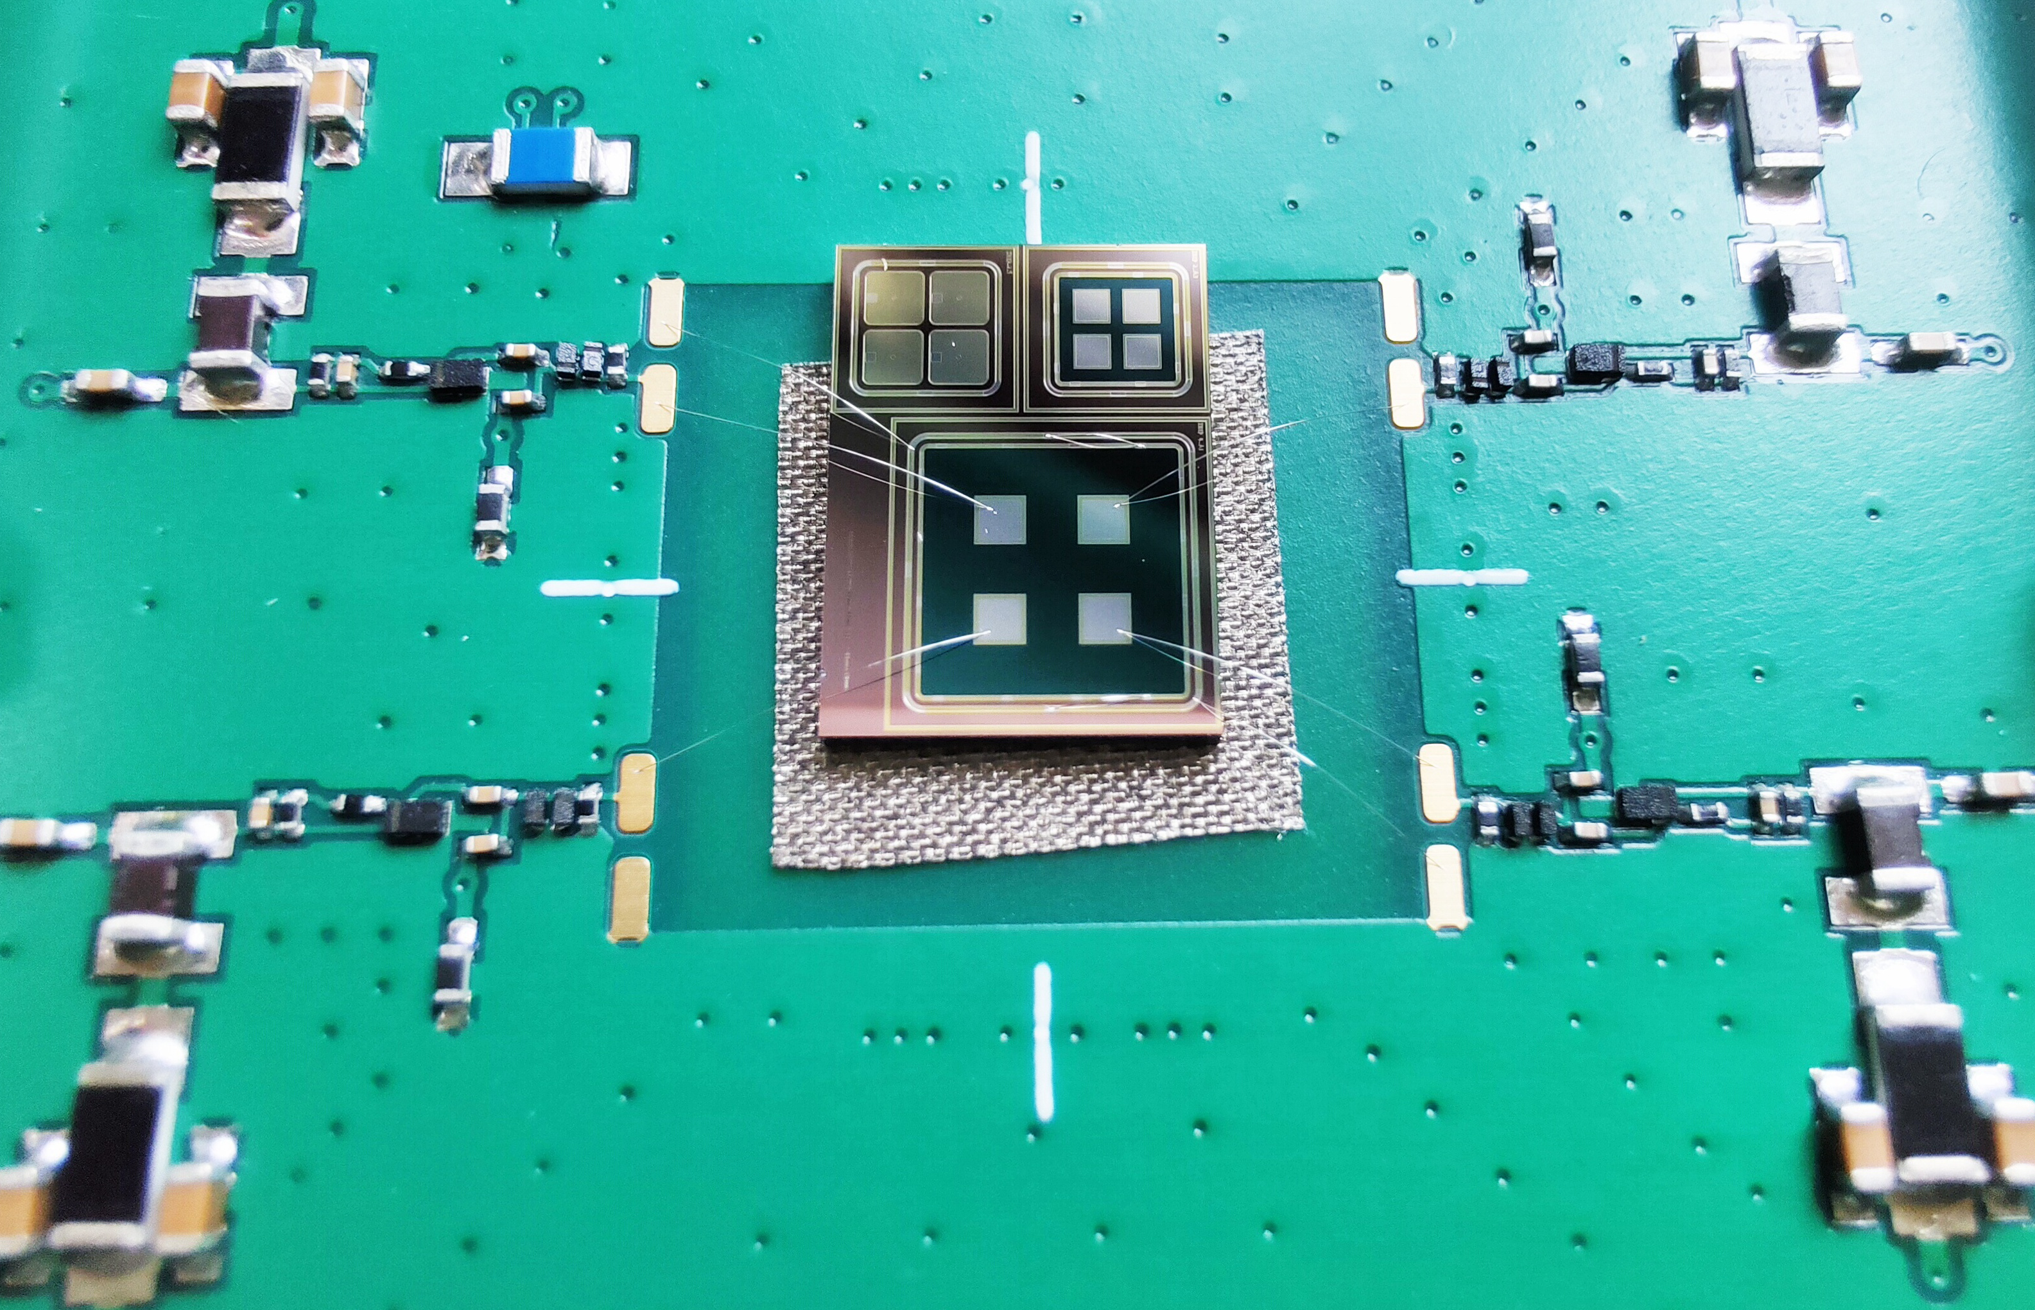
Laser testing for AC-LGAD
Pico-second laser testing for AC-LGAD
4 channels readout board with fast amplifiers (~2GHz)
3D X-Y-Z stage platform (precision : ~1um)
Pico-second laser setup
Laser beam spot
4 channels fast readout board
X-Y-Z platform

Slide 11
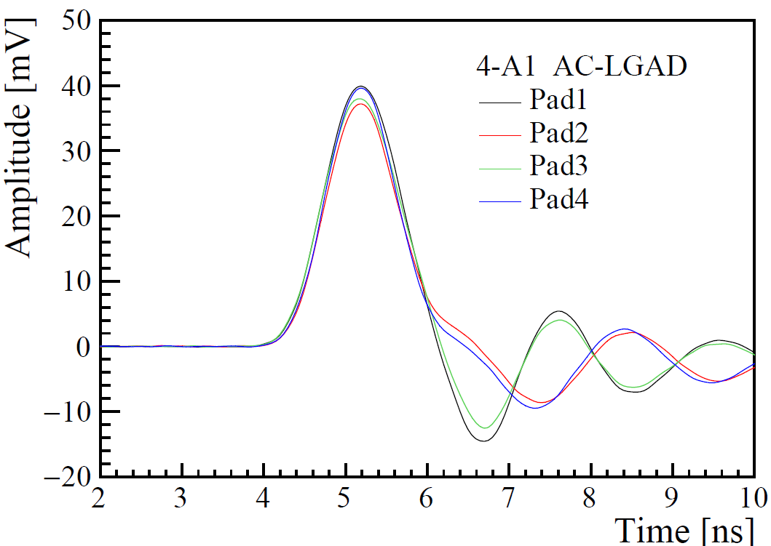
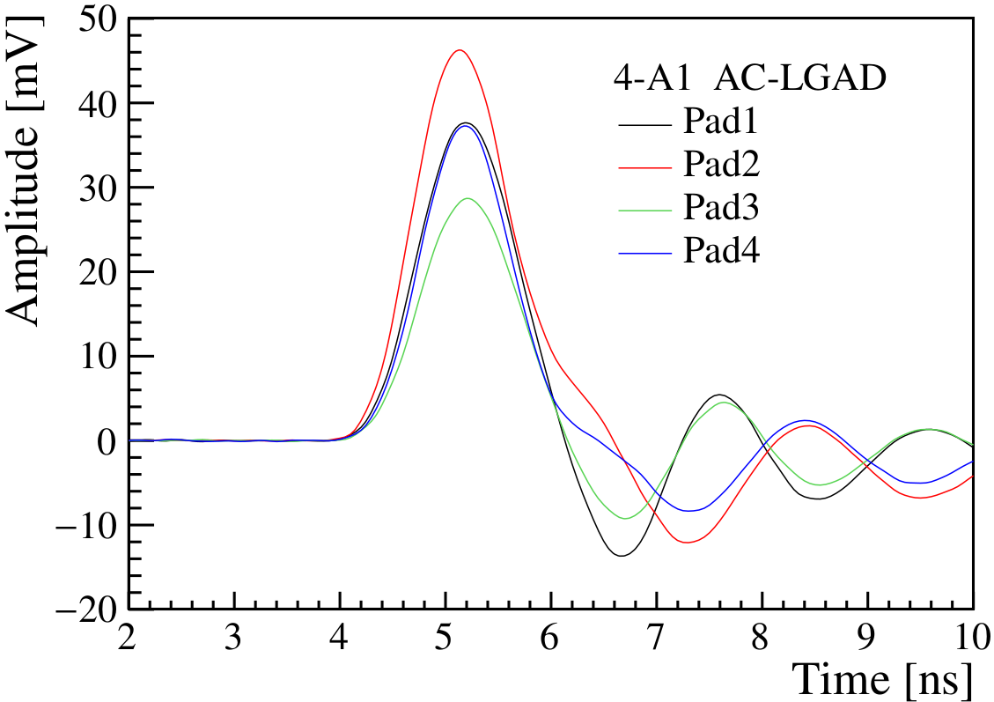
Laser testing for AC-LGAD
Pico-second laser testing for AC-LGAD
4 channels readout board with fast amplifiers (~2GHz)
3D X-Y-Z stage platform (precision : ~1um)
the ballistic deficit of the signal is smaller in large AC pads
Laser shooting in the middle
4 channels has similar signal amplitude
Laser shooting in the upper right
Upper right channel has larger amplitude
1
2
b
3
4

Slide 12
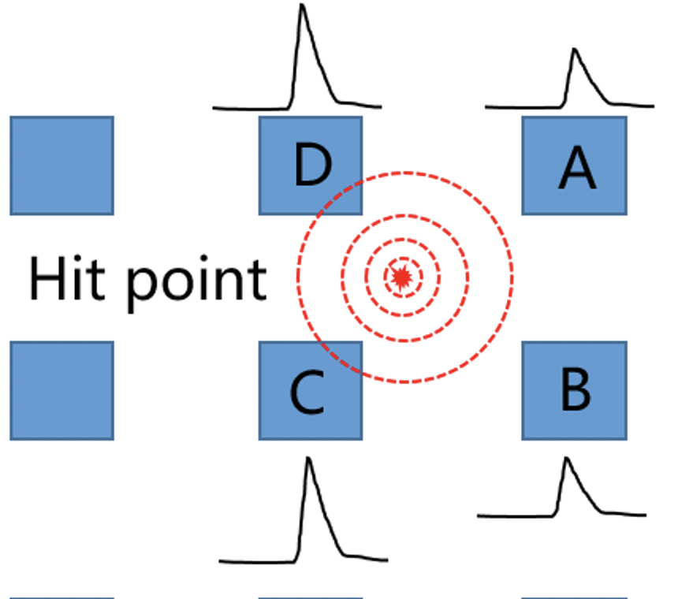
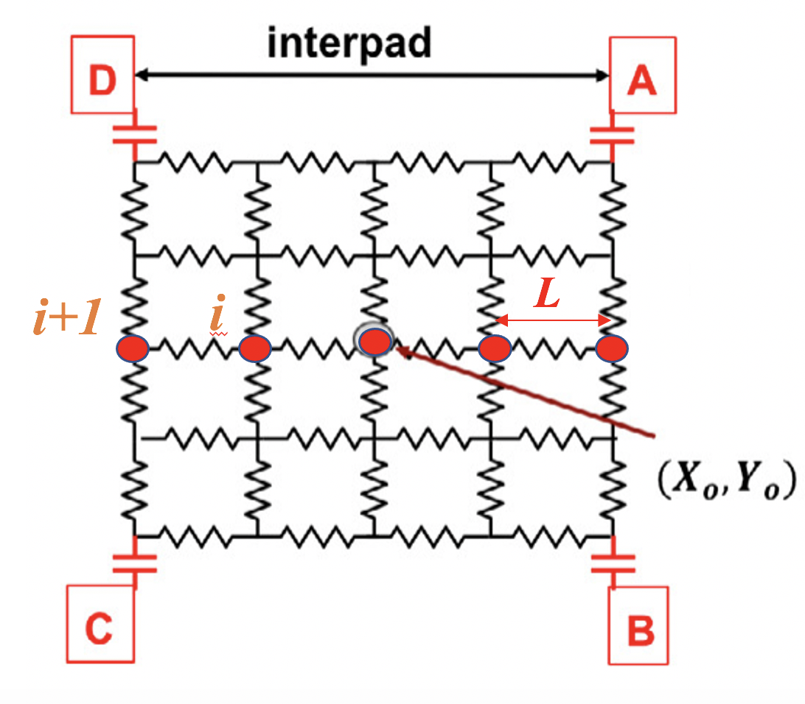
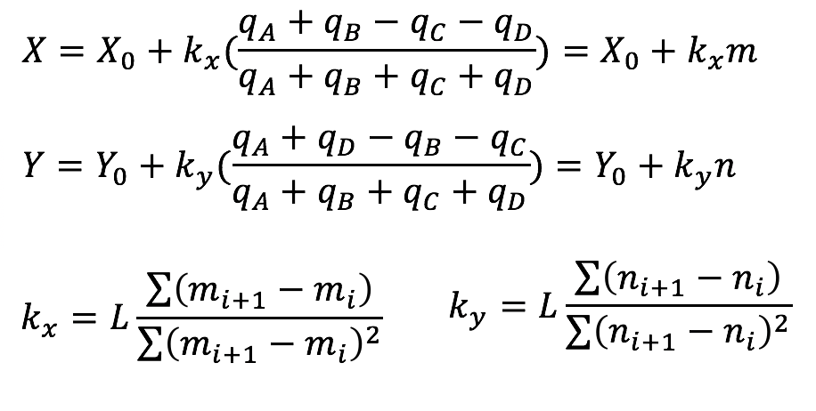
Laser testing for AC-LGAD： Readout and spatial reconstruction
Position reconstruction by Discretized Positioning Circuit model (DPC)
Input is 4 channels signal amplitude

Slide 13
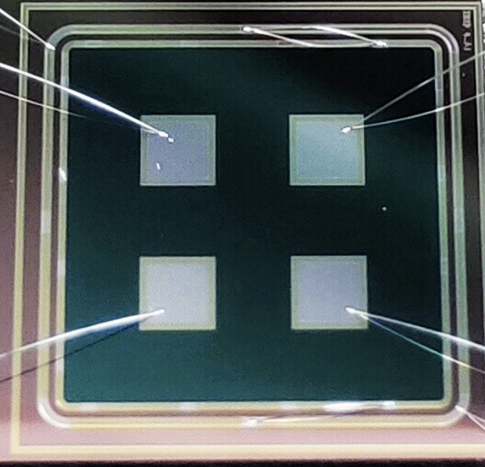
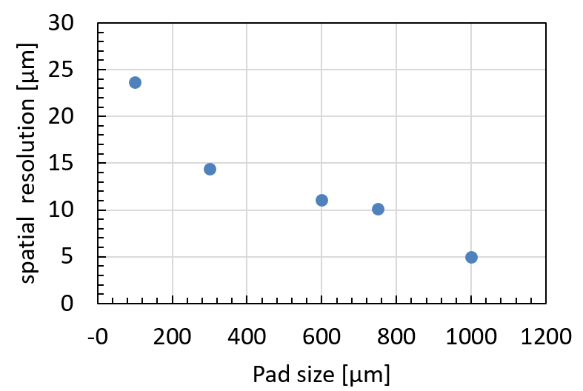
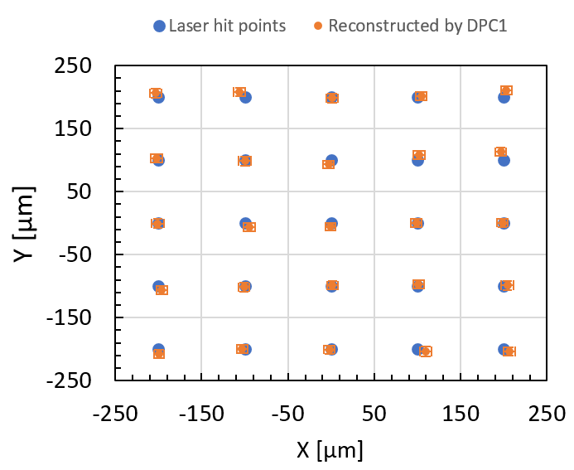
Laser testing for AC-LGAD: spatial resolution
The larger the AC-pad, the better the position resolution.
the ballistic deficit of the signal is small in large AC pads
The best resolution can reach 5μm （4-A1）
Sensors | Sensor size [μm] | AC-pad size [μm] | Picth size [μm]
4-A1 | 4000 | 1000 | 2000
hit position vs Reconstructed position

Slide 14
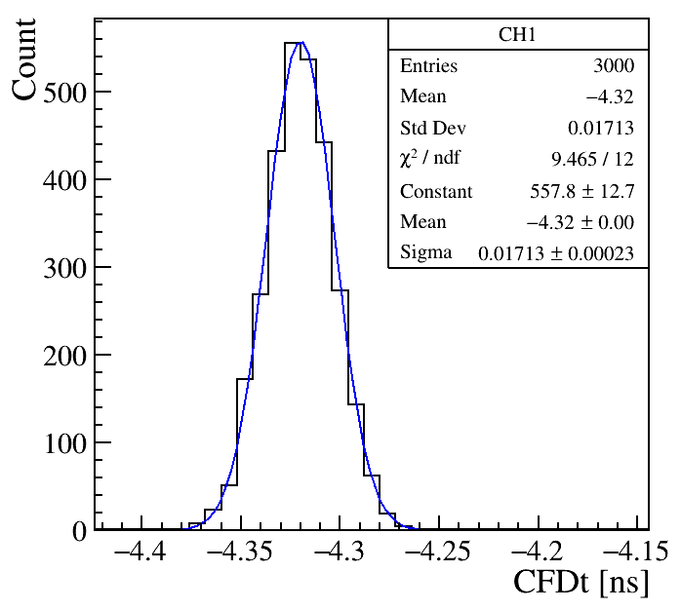
Laser testing for AC-LGAD: timing resolution
The timing resolution is about 15-17 ps
Almost no difference for different size of the pads
Arrival time distribution
Sensors | Timing resolution (ps)
1-A7 | 15
2-A2 | 16
2-A1 | 17
2-A3 | 17
4-A1 | 17

Slide 15
Summary
DC-LGAD is joint CEPC TOF+ ATLAS HGTD R & D
First full wafer prototyping runs (IHEP-IME)
Full-size LGAD sensors (2 × 2 cm) with reasonable yield
AC-LGAD is a new 4D detector （position + time）
First AC-LGAD prototype by IHEP is successful
Picosecond laser test and reconstructed by DPC model
The best spatial resolution ~5μm
Timing resolution ~17ps （Laser test）

Slide 16
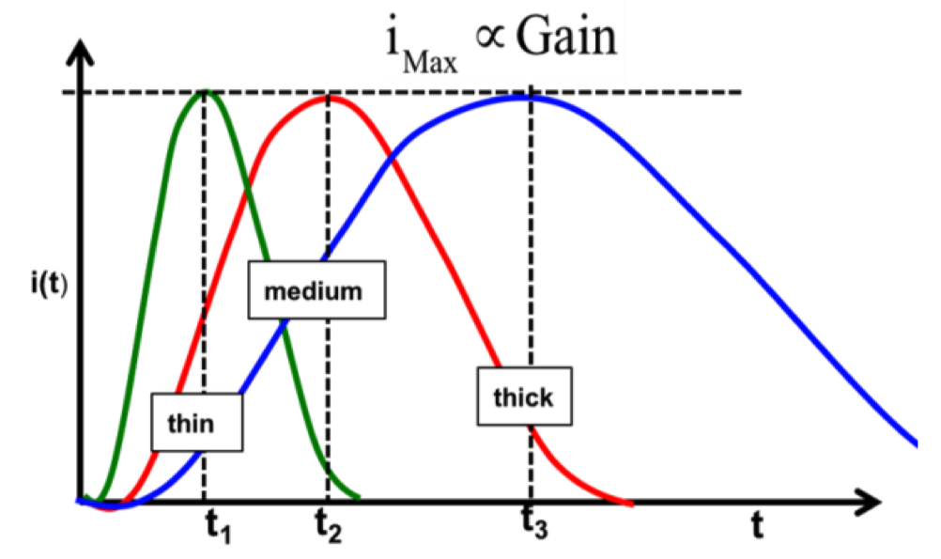
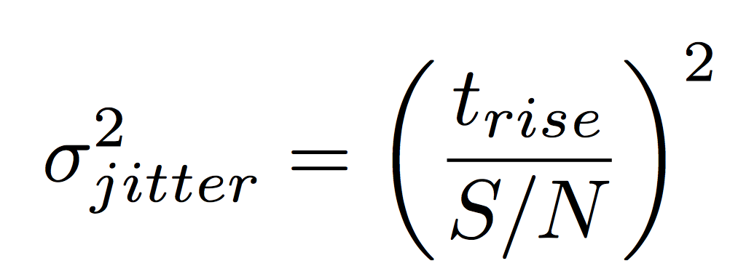
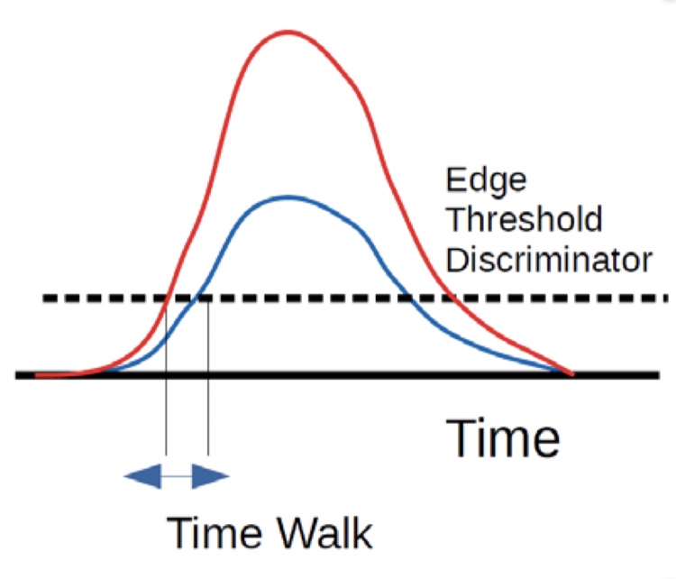
Low-Gain-Avalanche-detector
Landau Noise term:
Signal fluctuation due to non-uniform charge deposition
Minimized by reducing thickness of the sensor (50um)
Jitter
Need gain to increase S/N
Need thin detector to decrease t_{rise}
Time walk
corrected using the amplitude
estimate with the time over threshold (TOT).
fixed threshold
[1] G. Pellegrini et al., NIM A765 (2014) 12
[2] H.-W. Sadrozinski et al., arXiv: 1704.08666
[3] F. Cenna et al, NIM A796 (2015) 149-153

Slide 17
Low-Gain-Avalanche-detector
Landau Noise term:
Signal fluctuation due to non-uniform charge deposition
Minimized by reducing thickness of the sensor (50um)
Jitter
Need gain to increase S/N
Need thin detector to decrease t_{rise}
Time walk
corrected using the amplitude
estimate with the time over threshold (TOT).
fixed threshold
[1] G. Pellegrini et al., NIM A765 (2014) 12
[2] H.-W. Sadrozinski et al., arXiv: 1704.08666
[3] F. Cenna et al, NIM A796 (2015) 149-153

Slide 18
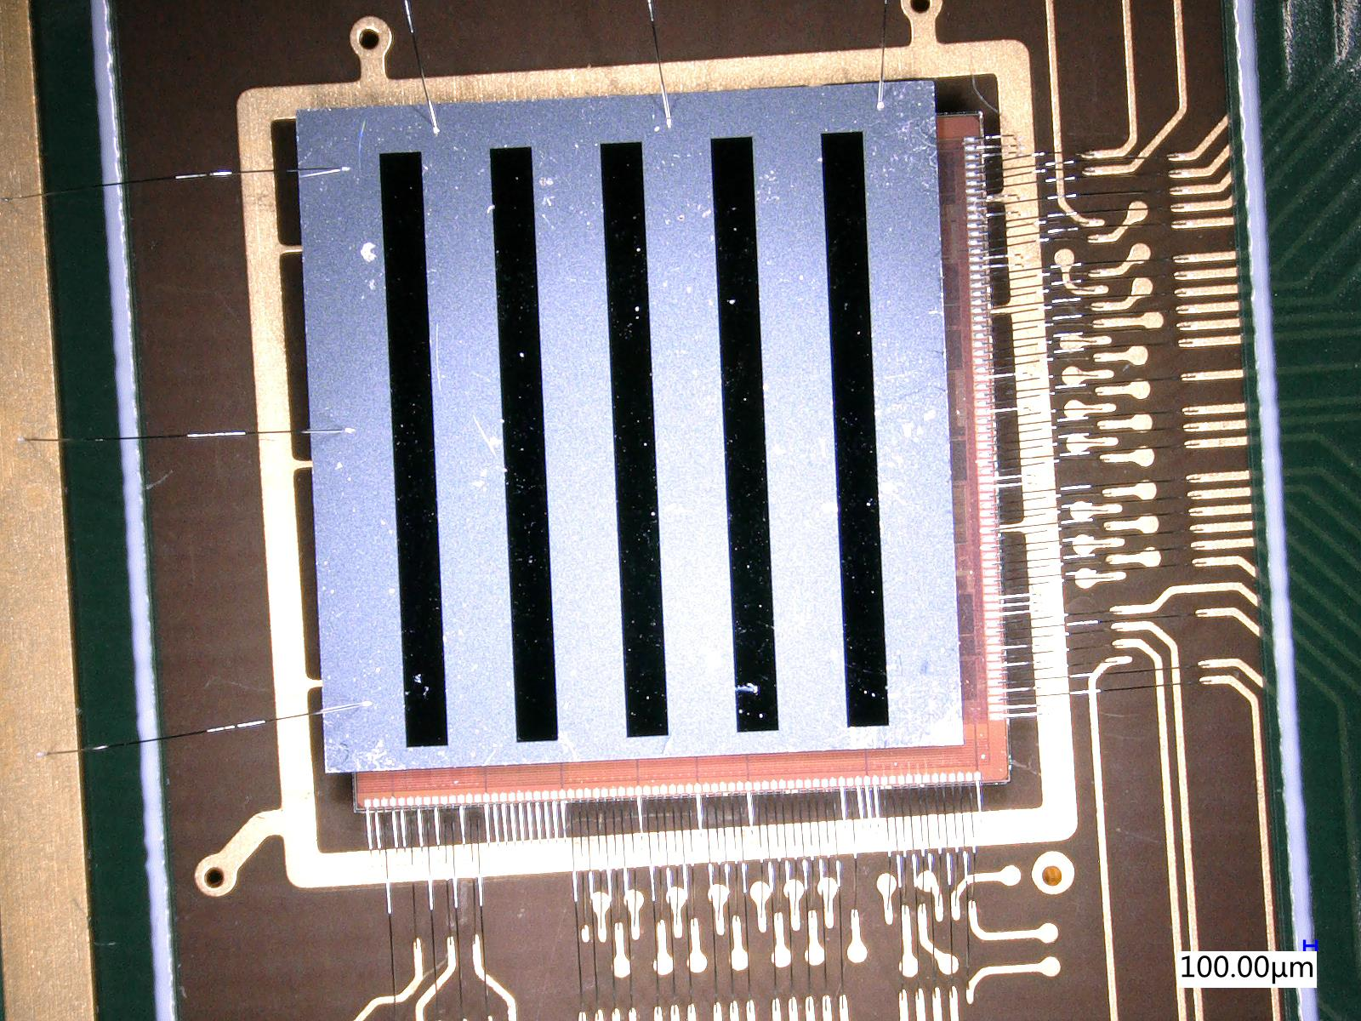
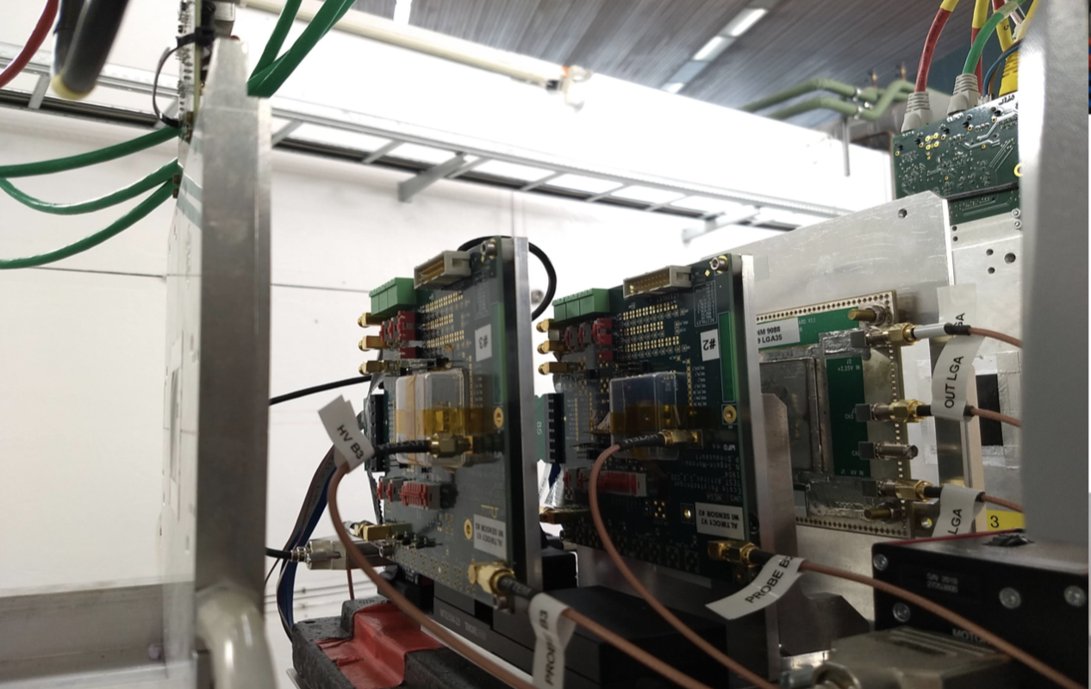
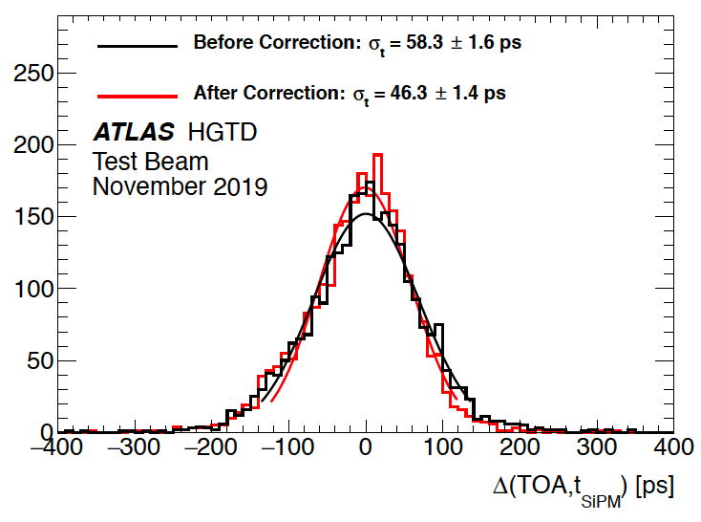
Outlook: Testbeam with ATLAS HGTD module
Time resolution: 45ps
Position resolution: ~1mm
Area : 6.5mm*6.5mm --> (2cm*4cm)

Slide 19
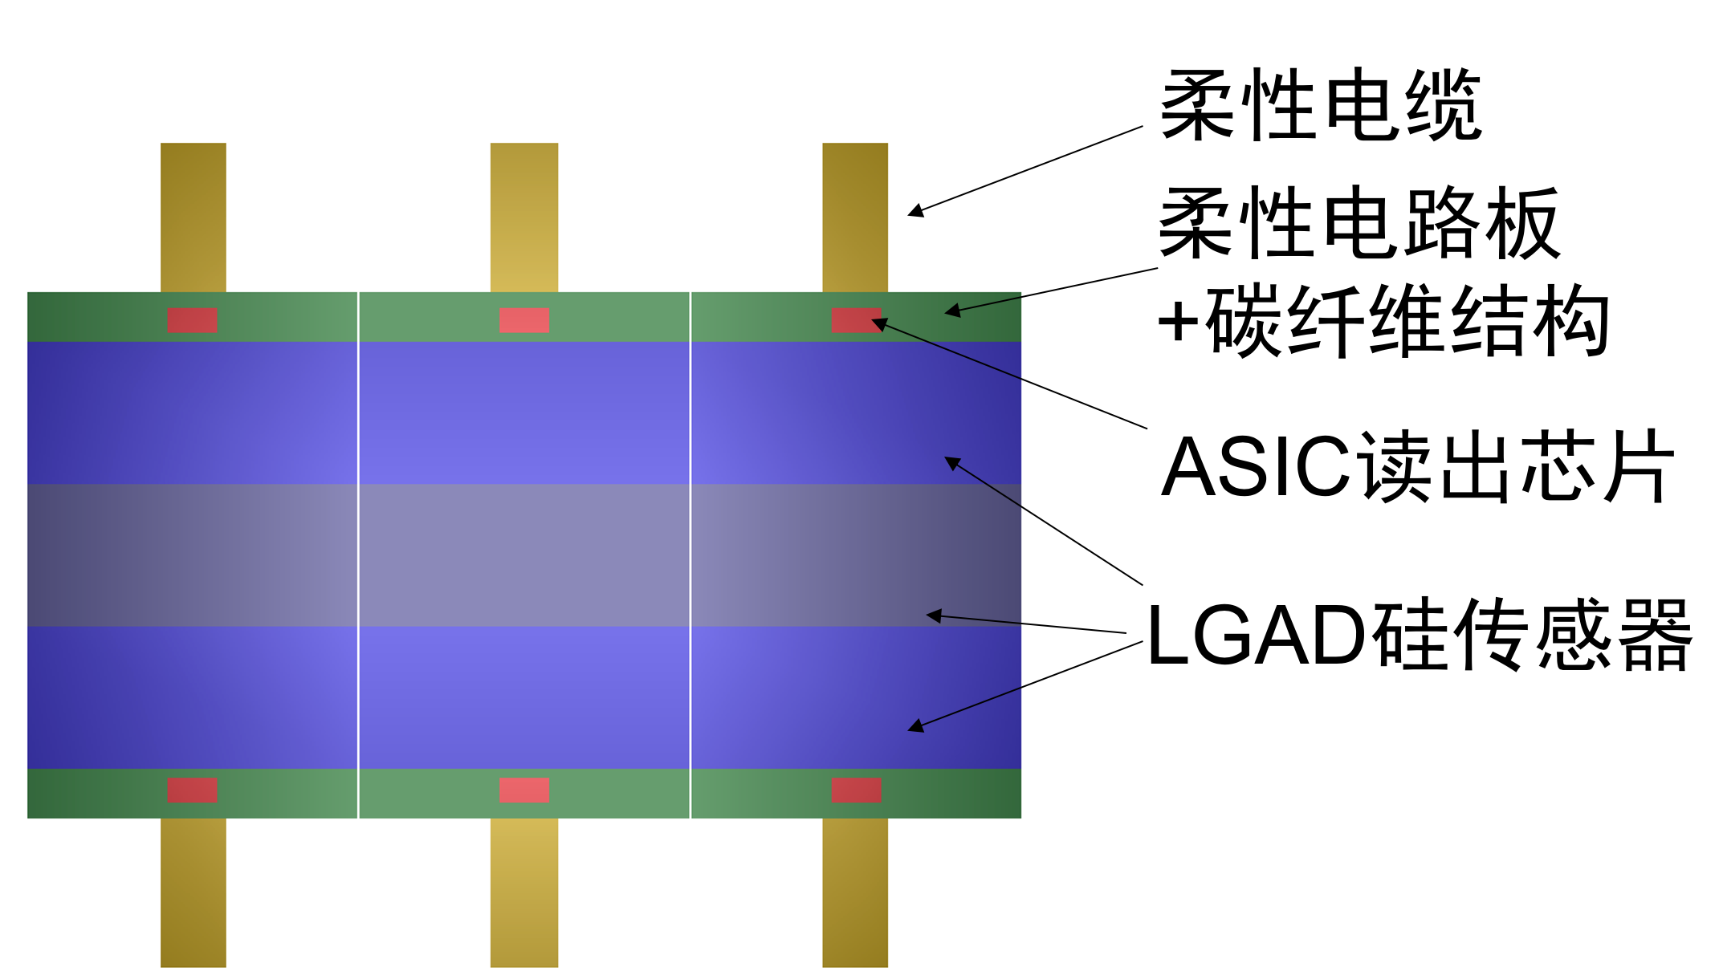
CEPC timing detector : Concept
Each module size : ~5cm * 15cm
Further optimization is on going
Flexible cable
Flexible cable
+carbon fiber structure
ASIC Readout chip
LGAD sensors

