Slide 1

Linac design as the new baseline
环形正负电子对撞机
Circular Electron Positron Collider
CEPC DAY 2021-8
C. Meng, Jingru Zhang, Xiaoping Li
on behalf of CEPC AP group, IHEP

Slide 2
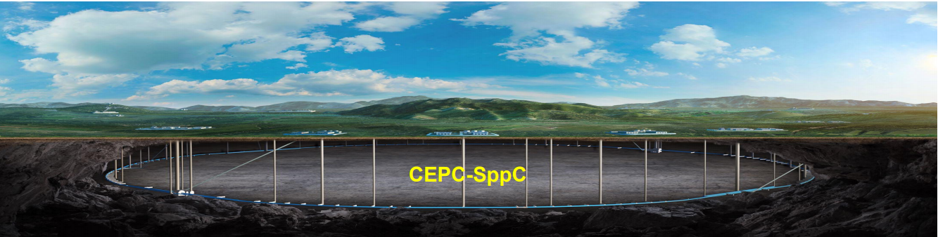
Outline
Introduction
Progress on CEPC Linac design
Summary

Slide 3
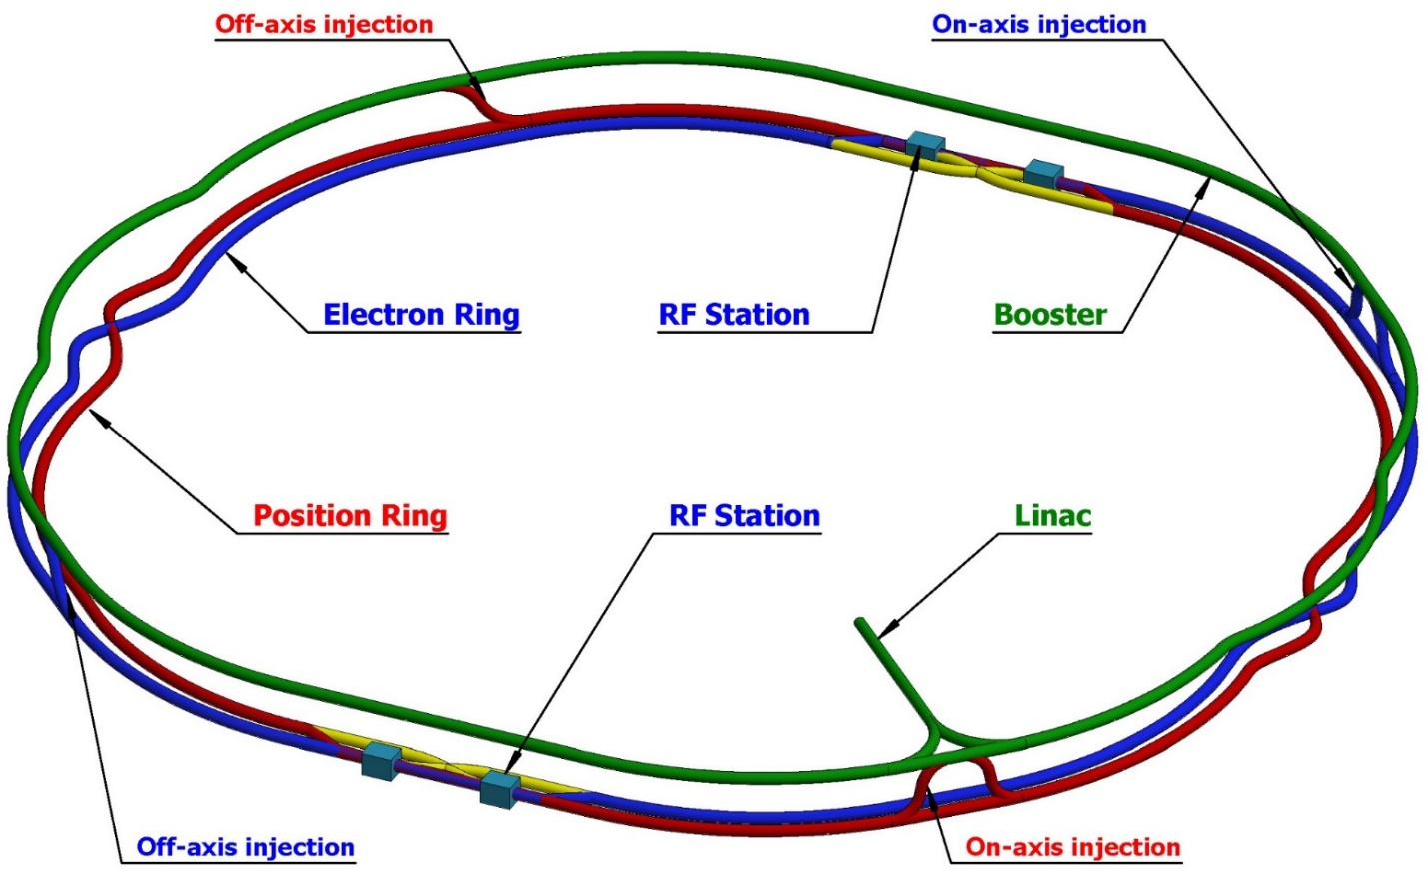
Introduction
CEPC layout
CEPC as a Higgs (W, Z) Factory
  ~100 km
CEPC layout
  20 GeV injector - Linac
  Full energy Booster
  Collider
  Transport lines
Linac design
  Many versions from 2016.4 to 2021.8
  High Availability and Reliability

Slide 4
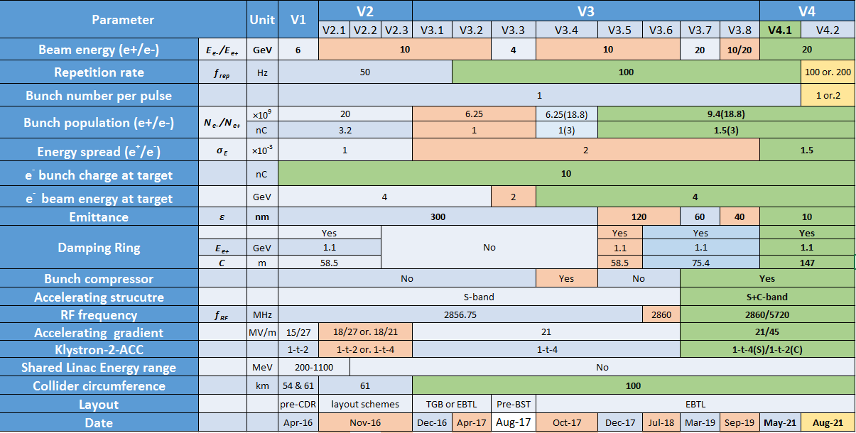
Introduction
Linac evolution
Meet the design requirements of Booster: Energy/Emittance
Pre-CDR
CDR
TDR

Slide 5
Introduction
Baseline scheme
Baseline scheme
  20 GeV
    Low magnetic field & large magnetic field range
    C-band
      Higher gradient → Shorter linac tunnel length
      Small aperture & Strong wakefield
  10 nm
    High luminosity
  100 Hz
    Injection efficiency
    High luminosity Z need faster injection process
      200 Hz
      100 Hz & two-bunch-per-pulse
      200 Hz & two-bunch-per-pulse (?)
Parameter | Symbol | Unit | Baseline
e⁻ /e⁺ beam energy | E_{e-}/E_{e+} | GeV | 20
Repetition rate | f_{rep} | Hz | 100
e⁻ /e⁺ bunch population | Ne-/Ne+ | ×10¹⁰ | 0.94(1.88)
 |  | nC | 1.5 (3)
Energy spread (e⁻ /e⁺ ) | σ_{E} |  | 1.5×10⁻³
Emittance (e⁻ /e⁺ ) | ε_{r} | nm | 10
Parameter | Unit | S-band | C-band
Frequency | MHz | 2860 | 5720
Length | m | 3.1 | 1.8
Cavity mode |  | 2π/3 | 3π/4
Aperture diameter | mm | 20~24 | 11.8~16
Gradient | MV/m | 21 | 45
D. Wang ,Problems and considerations about the timing & bunch pattern

Slide 6
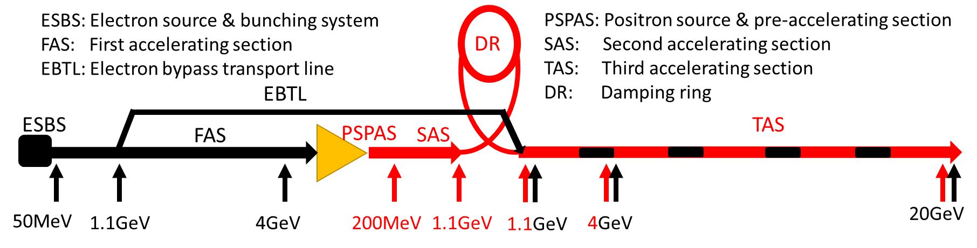
Introduction
Linac layout
EBTL is in vertical plane with 1.2 m separation
  Avoid interference with energy analyzing station, transport lines between the Linac and damping ring, waveguide and positron source
  Reduce the tunnel width
Accelerating structure
  S-band: FAS/PSPAS/SAS
  C-band: TAS

Slide 7
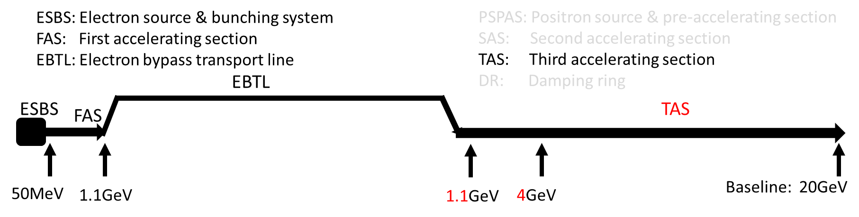
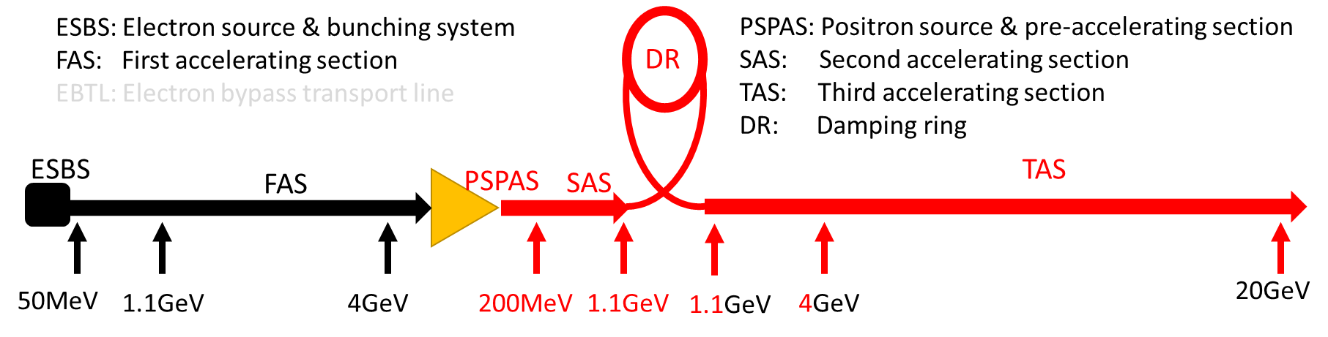
Linac design
Layout
Electron Linac
  EBTL
Positron Linac
  ESBS
  FAS
  PSPAS
  SAS
  TAS

Slide 8
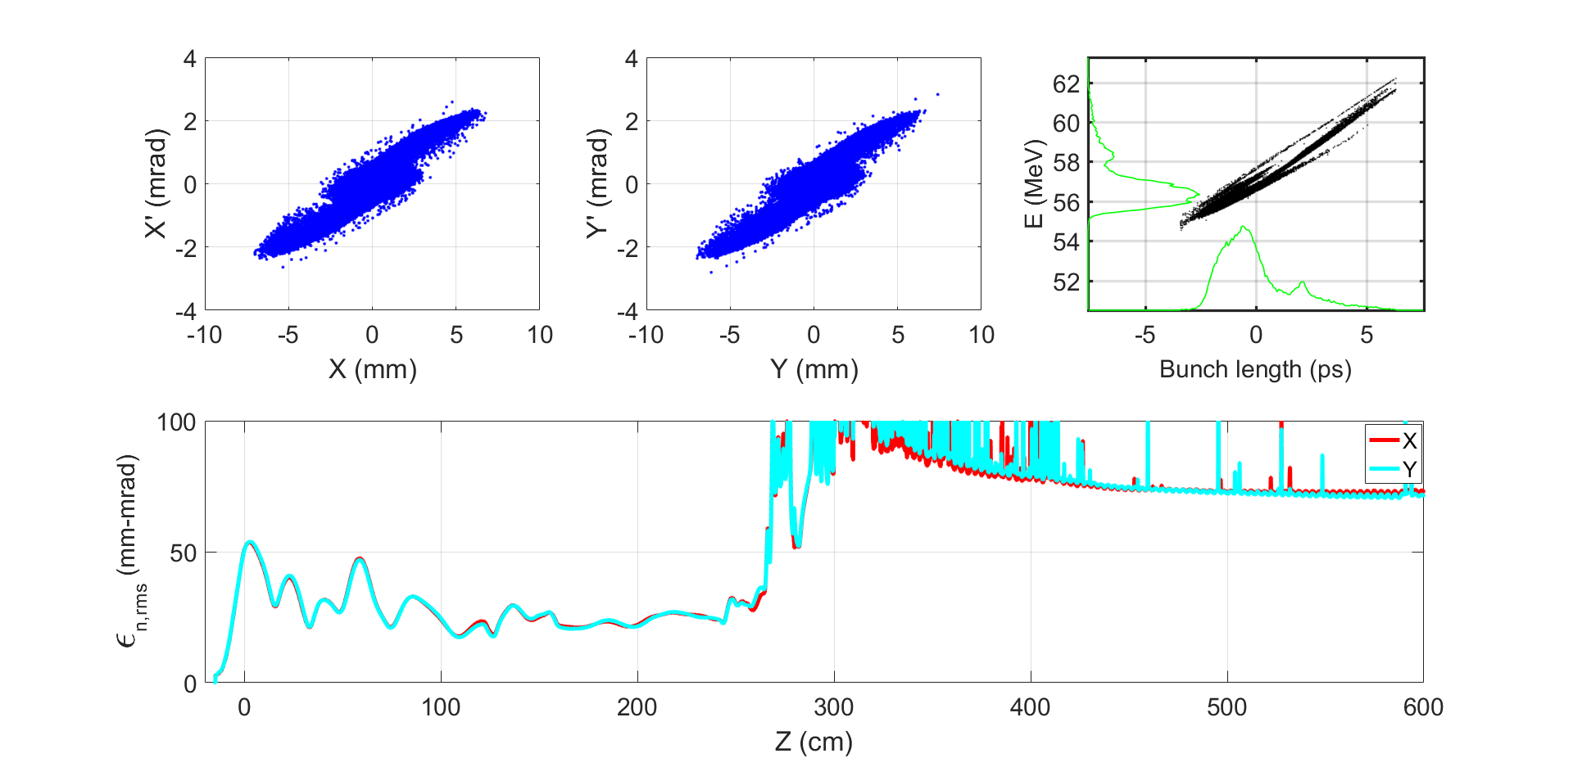
Linac design
Electron source & Bunching system
Thermionic electron gun
  Bunch charge: 11nC
  Bunch length(FWHM): 1ns
Sub-harmonic pre-buncher
  143 MHz
  572 MHz
Buncher & A0
  2860 MHz
Focusing structure
  Solenoid
Emittance
  <100 mm-mrad (Norm.Rms)
Transmission
  >90%

Slide 9
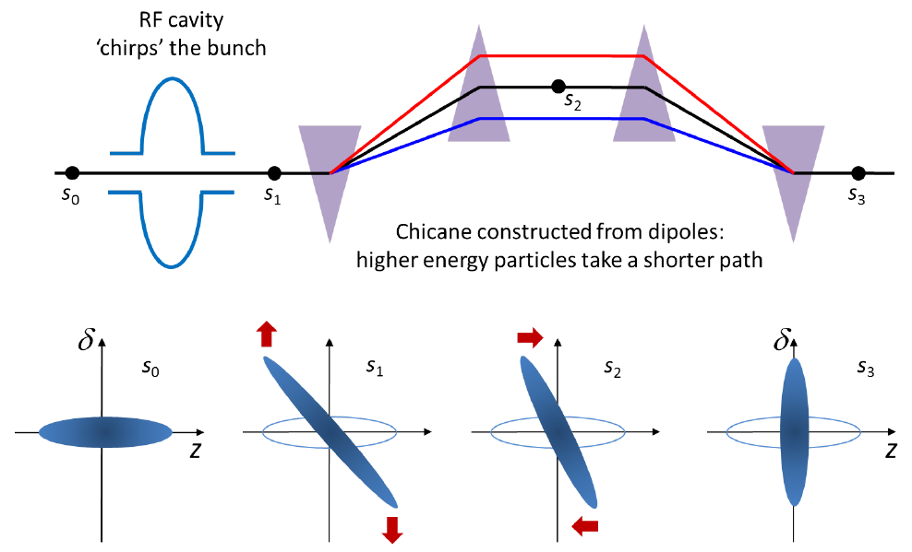
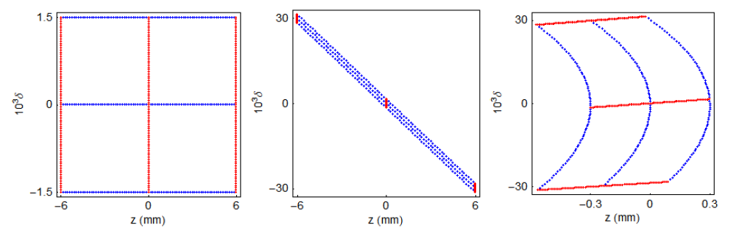
Linac design
Bunch compressor
C-band accelerating structure is introduced in the TAS
  RF frequency: 5720 MHz
  Bunch length: 1mm → 0.5mm
Bunch compressor
  First order
  Second order
@Andy Wolski

Slide 10
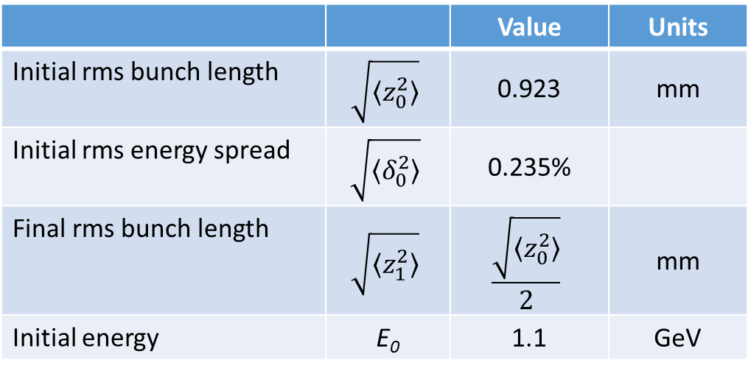
Linac design
Bunch compressor
 |  | Value | Units
Initial rms bunch length | $$\sqrt{〈z_{0}^{2}〉}$$ | 0.923 | mm
Initial rms energy spread | $$\sqrt{〈δ_{0}^{2}〉}$$ | 0.235%
Final rms bunch length | $$\sqrt{〈z_{1}^{2}〉}$$ | $$\frac{\sqrt{〈z_{0}^{2}〉}}{2}$$ | mm
Initial energy | E₀ | 1.1 | GeV
Bunch compressor

Slide 11
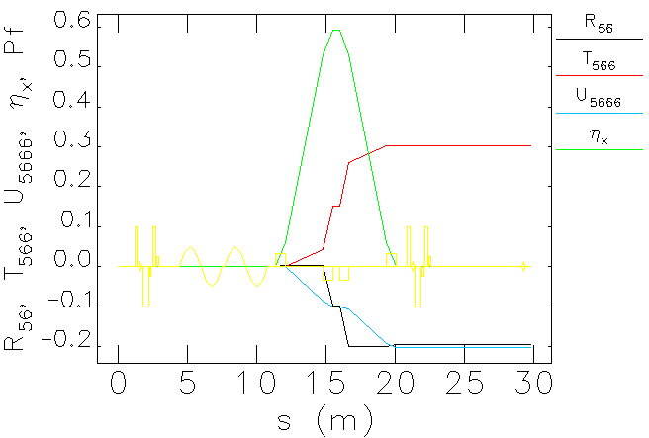
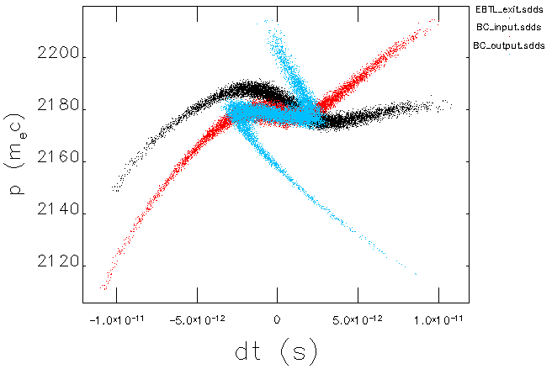
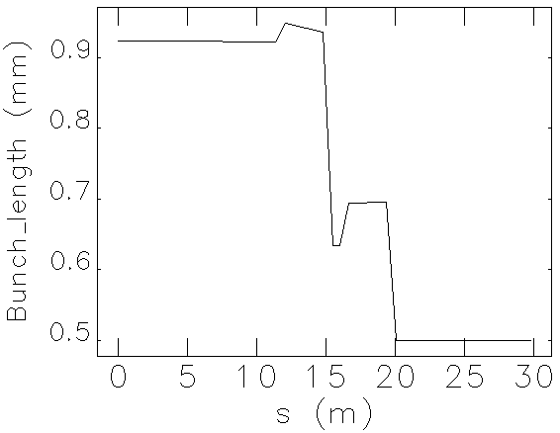
Linac design
Bunch compressor
Bunch compressor
  Accelerating structure
    Voltage=72MV→100MV
    Phase=-10.8°→0 °
  Chicane
    Angle: 10°
    a= 2.65m

Slide 12
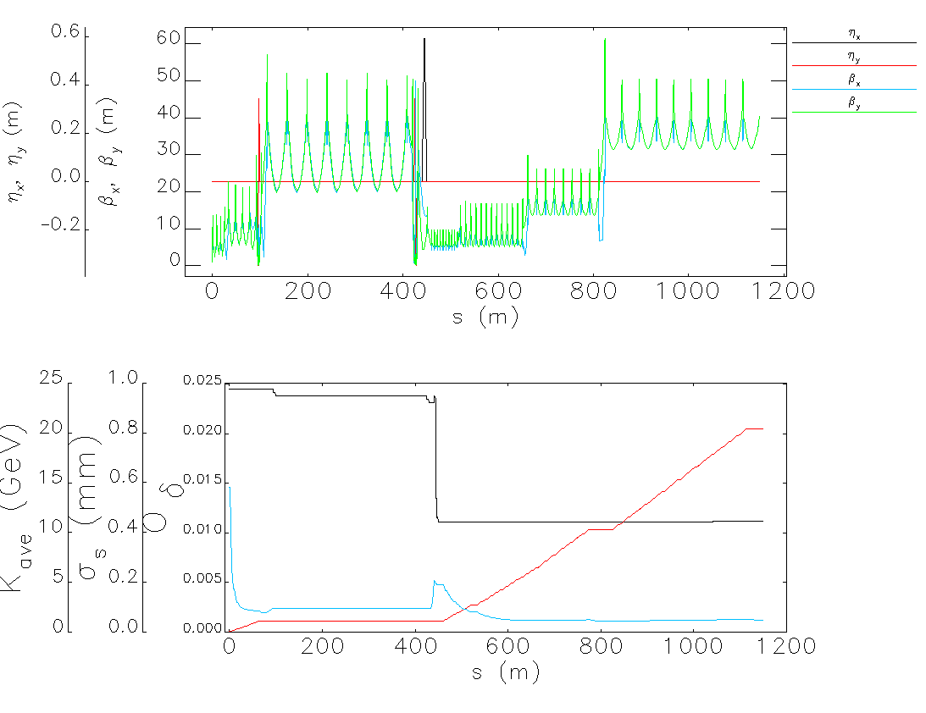
Linac design
Electron linac
Lattice design
  FAS
    4*(Triplet+2 S-band)
    (2+1+1) * (Triplet+4 S-band)
    Triplet for matching
    (13+2) *(Triplet + 4 S-band)
    Triplet for matching on Target
  ETBL
    B+3Q+B
    10* Triplet
    B+3Q+B
  TAS
    Triplet+2 S-band acc for chirp
    Chicane type bunch compressor
    Triplet for matching
    10*(Triplet + 2 C-band)
    Triplet for matching (AM)
    12*(Triplet + 4 C-band)
    6+2 *(Triplet + 8 C-band)
    Triplet for matching
    8+1 **(Triplet + 8 C-band)

Slide 13
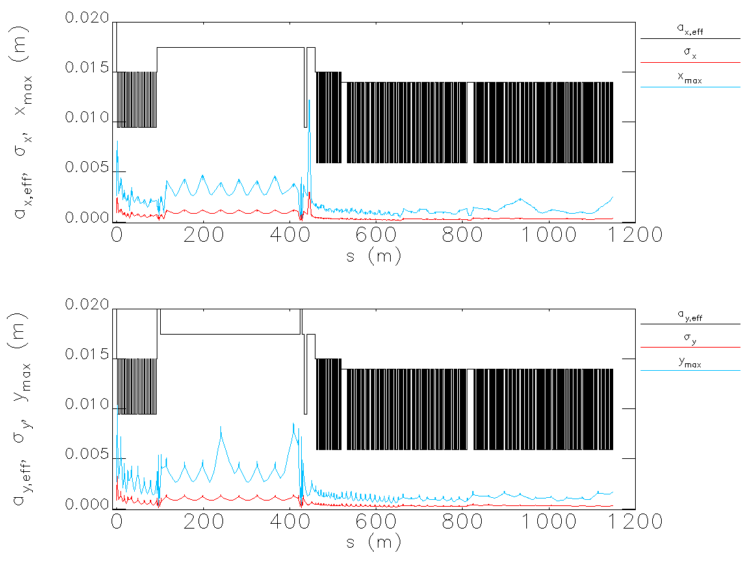
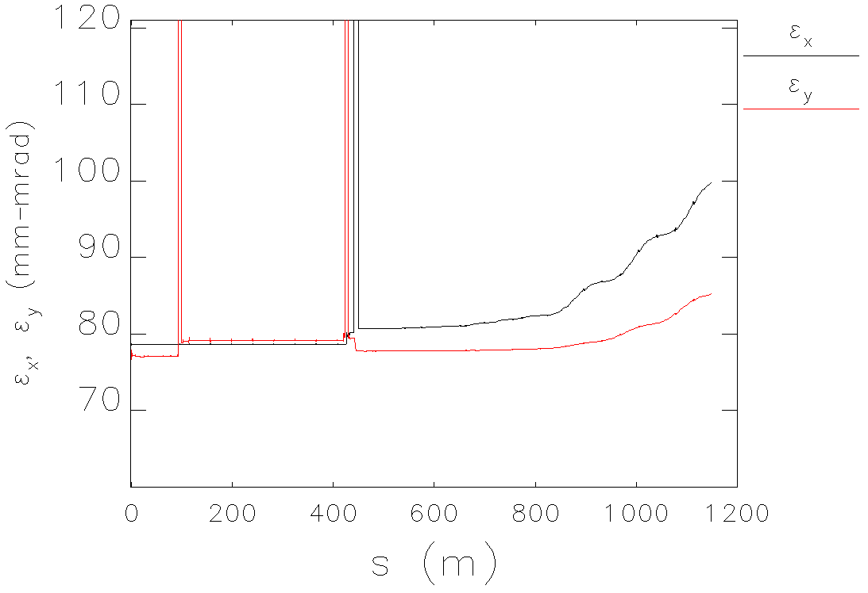
Linac design
Electron linac
Simulation results( including Wakefield & CSR)
Parameter | Unit | Baseline | Electron
e⁻ /e⁺ beam energy | GeV | 20 | 20.38
Repetition rate | Hz | 100 | 100
e⁻ /e⁺ bunch population | ×10¹⁰ | 0.94(1.88) | 1.88
 | nC | 1.5 (3) | 3
Energy spread (e⁻ /e⁺ ) |  | 1.5×10⁻³ | 1.3×10⁻³
Emittance (e⁻ /e⁺ ) | nm | 10 | 2.5

Slide 14
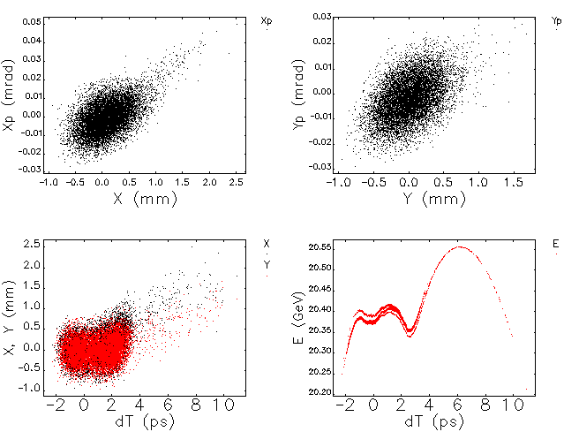
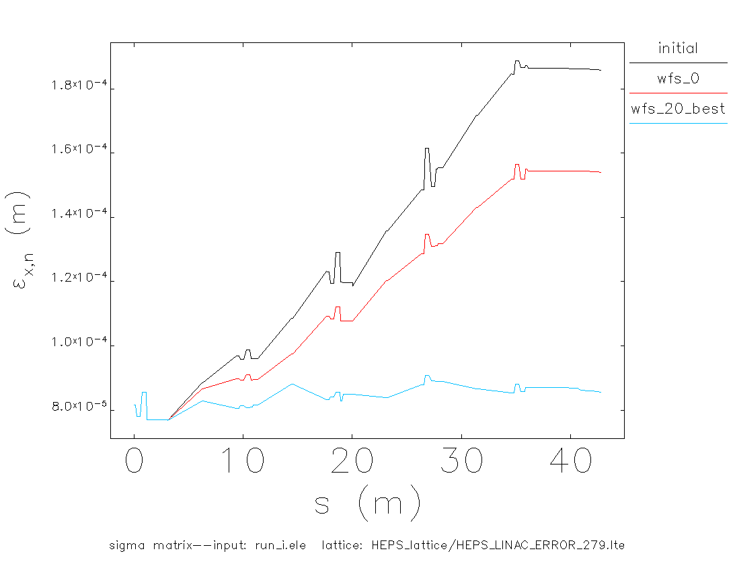
Linac design
Electron linac
Emittance growth
  Wakefield
  Error study is still in progress
    BPM resolution ~ 10µm
    Wakefield free steering(WFS)

Slide 15
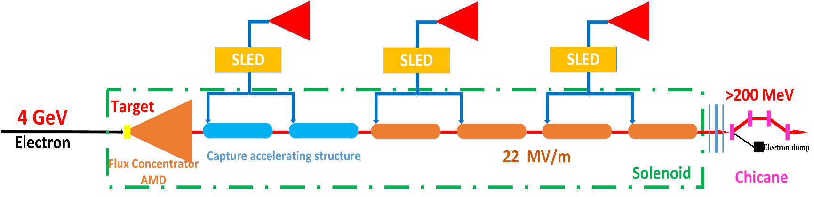
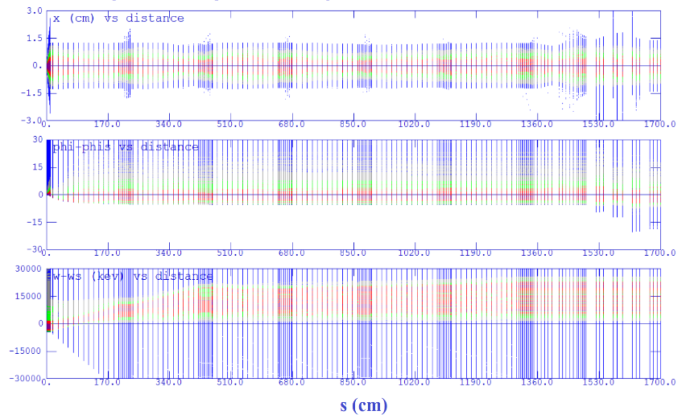
Linac design
PSPAS
Positron source
  Target (Conventional)
    tungsten@15 mm
    Beam size: 0.5 mm
AMD (Adiabatic Matching Device)
  Length: 100mm
  Aperture: 8mm→26mm
  Magnetic field: (5.5T→0T) + 0.5T
Capture & Pre-accelerating structure
  Length:2 m
  Aperture: 25 mm
  Gradient: 22 MV/m
Chicane
  Wasted electron separation
Positron source | Unit | Requirement | Simulation results
e⁻ beam energy on the target | GeV | 4
e⁻ bunch charge on the target | nC | 10
e⁺ bunch charge | nC | ≥3 | ~5.5
e⁺ Energy | MeV | ≥200 | 250
e⁺ Norm. RMS emittance | mm-mrad | ≤2400 | 2370

Slide 16
Linac design
Positron Linac
Damping Ring
  Norm. Rms. Emittance: 200 mm-mrad
  Energy: 1.1 GeV
  Energy spread: 0.5% (chirped)
  Bunch length: 0.7mm
@ D. Wang

Slide 17
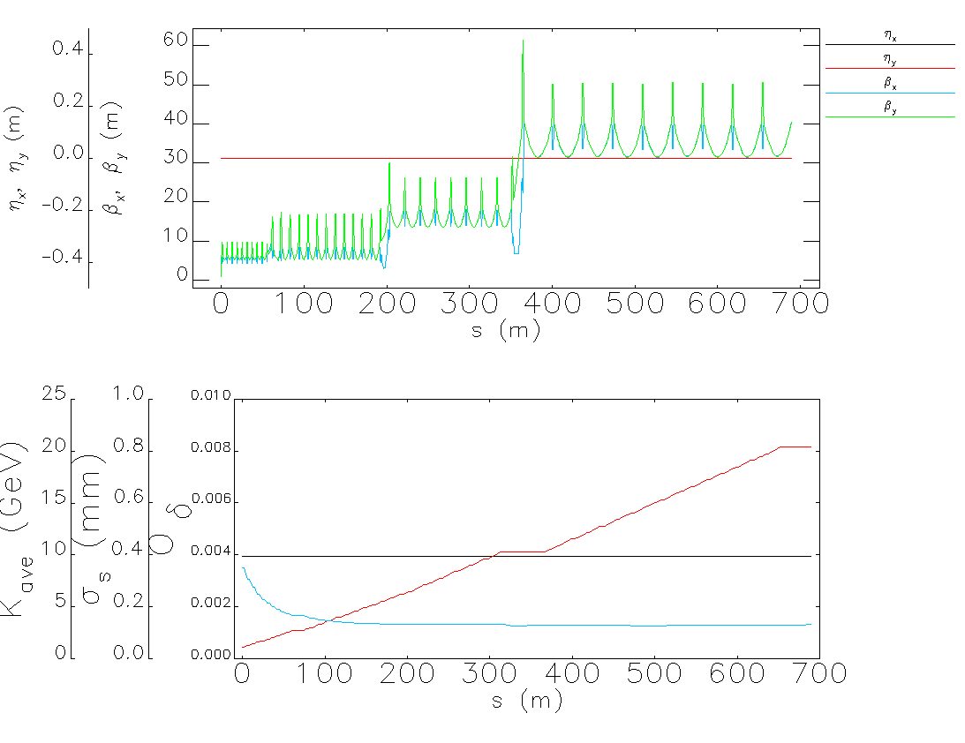
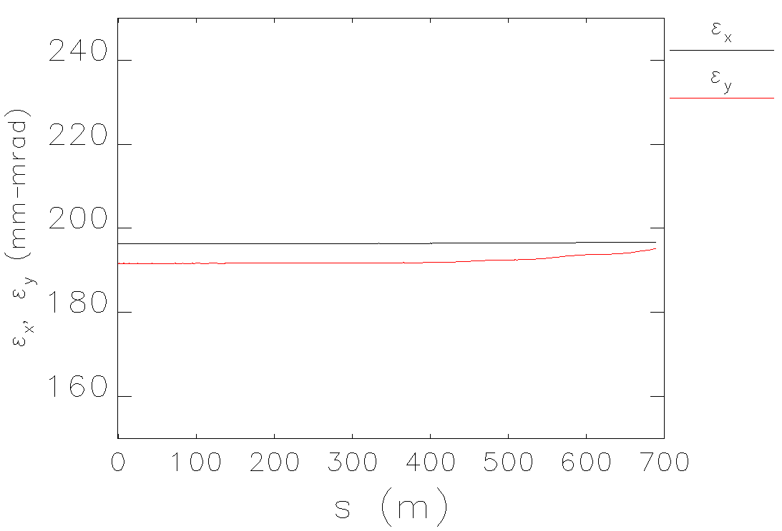
Linac design
Positron Linac
Simulation results( including Wakefield & CSR)
Parameter | Unit | Baseline | Electron | Positron
e⁻ /e⁺ beam energy | GeV | 20 | 20.38 | 20.37
Repetition rate | Hz | 100 | 100 | 100
e⁻ /e⁺ bunch population | ×10¹⁰ | 0.94(1.88) | 1.88 | 1.88
 | nC | 1.5 (3) | 3 | 3
Energy spread (e⁻ /e⁺ ) |  | 1.5×10⁻³ | 1.3×10⁻³ | 1.3×10⁻³
Emittance (e⁻ /e⁺ ) | nm | 10 | 2.5 | 5.2

Slide 18
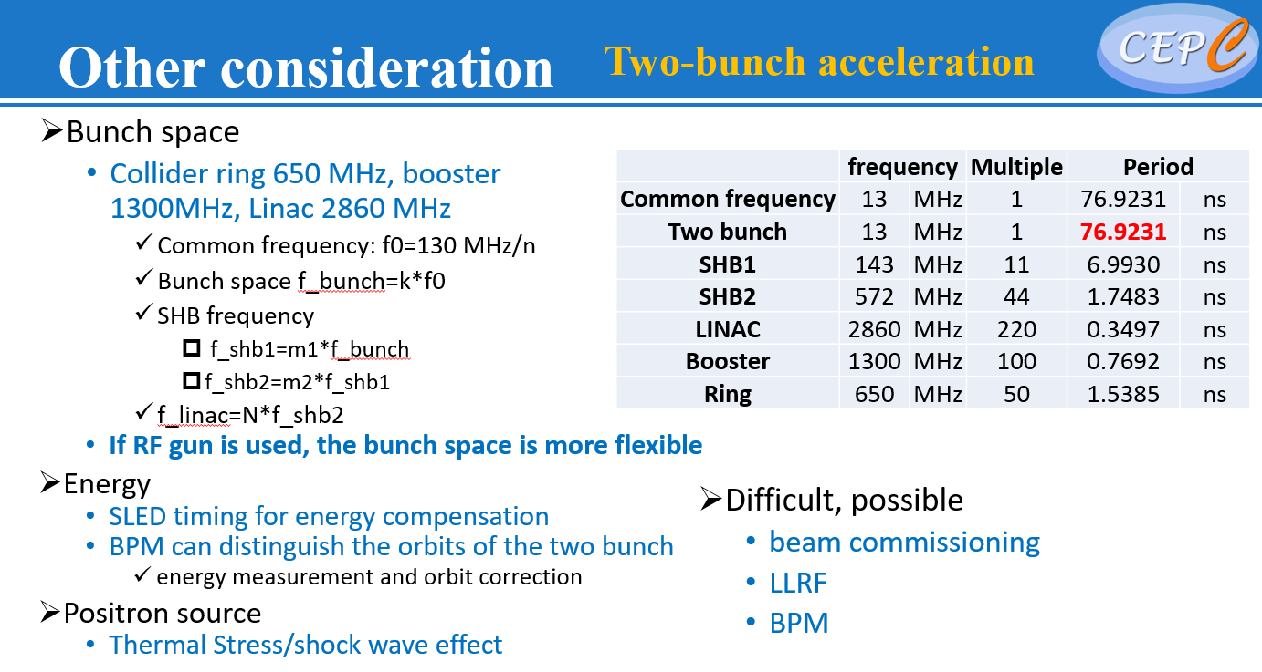
Linac design
High luminosity Z
Linac
  200 Hz
  100 Hz & two-bunch-per-pulse
    ESBS(electron source and bunching system)
    RF gun system (L-band, high bunch charge for positron production)
      Electron gun cathode material Vs. Laser system
  200 Hz & two-bunch-per-pulse (?)
Two bunch acceleration
  SLED
    Top-flat type
  Two bunch orbit correction
  Energy spread
    Energy spread compressor at Linac exit

Slide 19
Summary
The new baseline scheme of the Linac was determined at May 2021
The Linac energy is increased to 20 GeV to ease the booster magnet design difficulties (low field at injection energy and large magnetic field range) and the emittance is decreased to 10 nm for high luminosity Higgs scheme.
The C-band accelerating structure is used from 1.1 GeV to 20 GeV to save cost, however more difficulties in design need to be solved.
The lattice design and dynamic simulation have been finished, until now, the design can meet the requirements of booster.
Error study is still in progress, which requires careful consideration and simulation, need smaller alignment error and BPM resolution.
Thank you for your attention!

Slide 20
Wakefield

