Slide 1
About SPPC Study
TANG, Jingyu
for the SPPC study group
CEPC Day, Aug. 30, 2021, IHEP

Slide 2
Outline
Summary of ongoing SPPC study
Discussion about SPPC using 24-T magnets

Slide 3
Ongoing SPPC Study
Ongoing studies
  A very limited resource working on the accelerator physics studies
  Strong R&D efforts on high-field magnets which is integrated in the national effort for HT superconducting technology
  Following the CEPC study in the TDR stage

Slide 4
SPPC main parameters (as for 2017)
Parameter | Unit | Value
 |  | PreCDR | CDR | Ultimate
Circumference | km | 54.4 | 100 | 100
C.M. energy | TeV | 70.6 | 75 | 125-150
Dipole field | T | 20 | 12 | 20-24
Injection energy | TeV | 2.1 | 2.1 | 4.2
Number of IPs |  | 2 | 2 | 2
Nominal luminosity per IP | cm⁻²s⁻¹ | 1.2e35 | 1.0e35 | -
Beta function at collision | m | 0.75 | 0.75 | -
Circulating beam current | A | 1.0 | 0.7 | -
Bunch separation | ns | 25 | 25 | -
Bunch population |  | 2.0e11 | 1.5e11 | -
SR power per beam | MW | 2.1 | 1.1 | -
SR heat load per aperture @arc | W/m | 45 | 13 | -

Slide 5
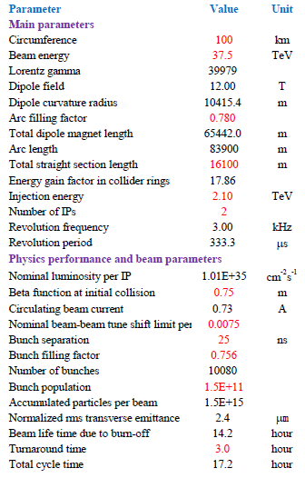
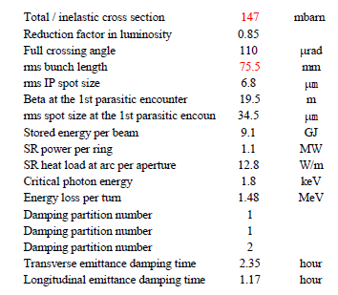
Collider Accelerator Physics
-Parameter list (no update since 2017.5)

Slide 6
Accelerator Physics
Still active:
  Longitudinal dynamics (collider and injector chain): Zhang Linhao, Tang Jingyu
  Instabilities: Zhang Linhao, Wang Lijiao, Tang Jingyu
  Beam-beam and Luminosity leveling: Wang Lijiao, Tang Jingyu
  Lattice, layout, dynamics aperture: Chen Yukai, Wang Yiwei
  Injector chain AP - MSS: Zhang Linhao
Several papers under preparation

Slide 7
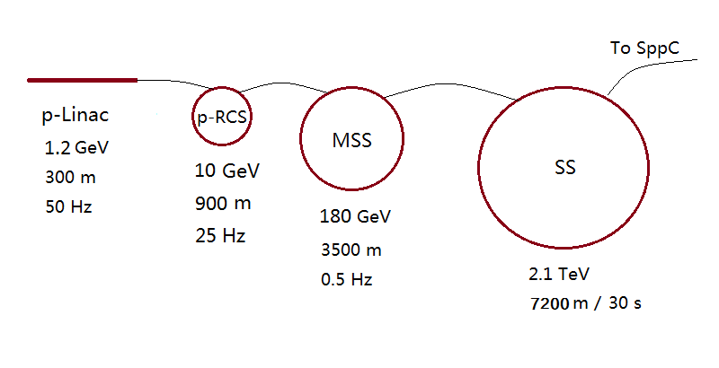
Injector chain
(for proton beam)
p-Linac: proton superconducting linac
p-RCS: proton rapid cycling synchrotron
MSS: Medium-Stage Synchrotron
SS: Super Synchrotron
Ion beams have dedicated linac (I-Linac) and RCS (I-RCS)

Slide 8
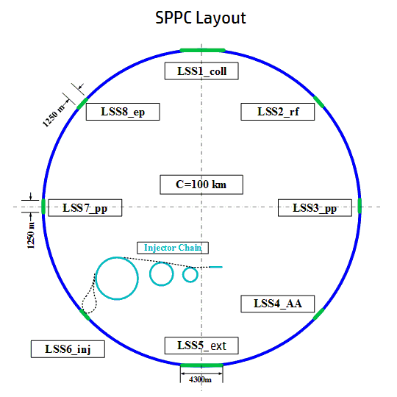
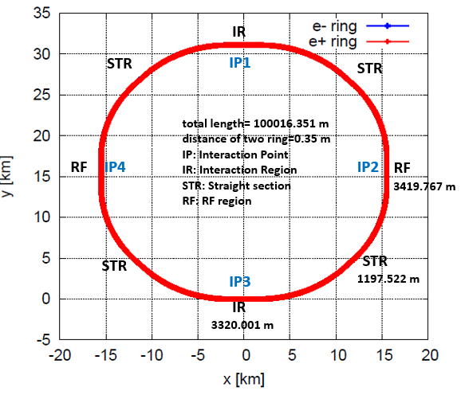
Lattice design
Wang Yiwei, Chen Yukai
Bypass issue with CEPC
  Bypass scheme study to be compatible with the CEPC, in order to accommodate CEPC and SPPC simultaneously in a same tunnel
  Very challenging, following the CEPC study evolution
CEPC Layout

Slide 9
Longitudinal beam dynamics
Zhang Linhao, Tang Jingyu
The work concerning long. Dynamics in both Collider and injector chain (five accelerators in series)
Concerns:
  Bunch filling schemes
  Luminosity leveling schemes
  Instabilities
  Requirement to the RF systems
  Global study with the injector accelerators
Study focusing on:
  Instabilities suppression in the collider
  Longitudinal dynamics in the injector chain, especially bunch splitting in the MSS
JINST 16, P03035 (2021)

Slide 10
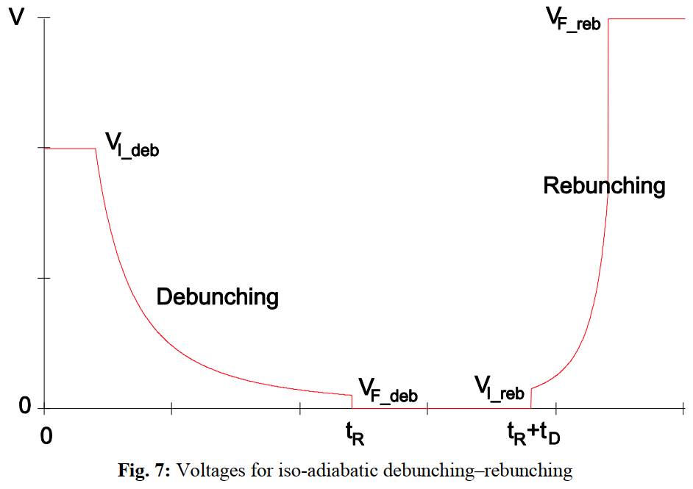
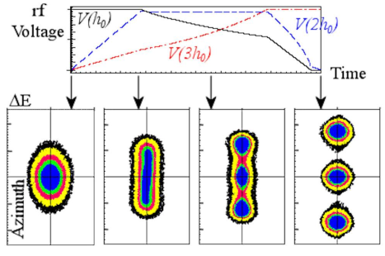
Bunch splitting in MSS
Motivation
  Mitigate the pileup effects and collective instabilities of a single bunch in the SPPC
  Bunch spacing: 25 ns → 5 ns (five-splitting of single bunch)
Bunch splitting methods in proton synchrotrons
(1) Debunching and rebunching
(2) Multi-harmonic RF bunch splitting
Triple-splitting in LHC/PS

Slide 11
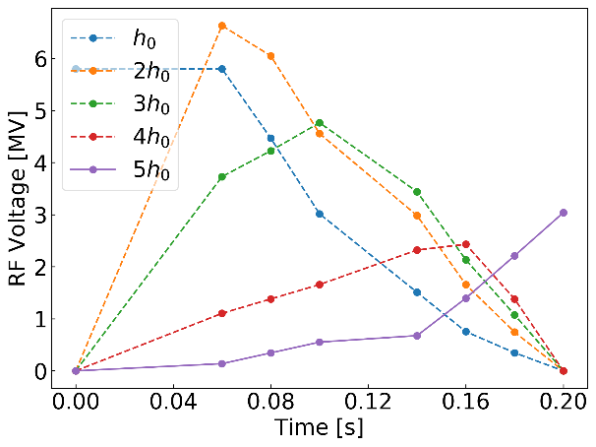
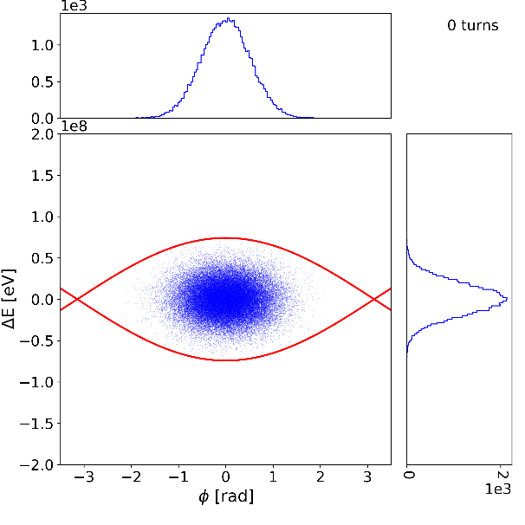
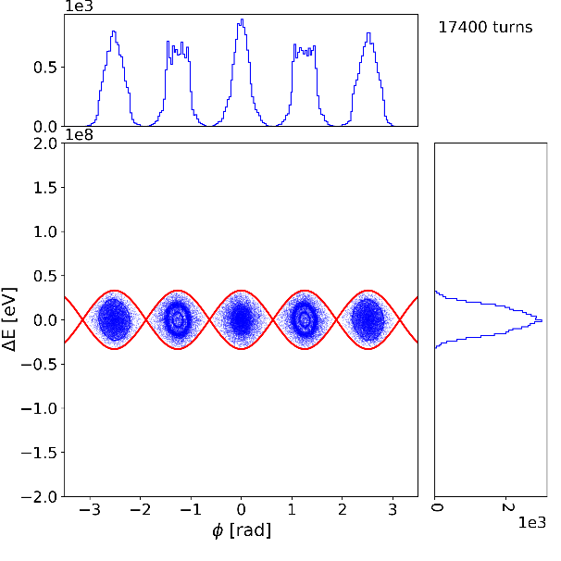
Bunch splitting at the MSS injection energy
Beam loss rate:
0.094%
Journal to be submitted

Slide 12
Luminosity optimization
Wang Lijiao , Tang Jingyu, R.Palmer (BNL)
Luminosity optimization and leveling schemes
  Goal: 30 ab⁻¹ in 10–15 years
  Flat beam optics instead of round ones when no crab cavities
RDTM 5, 245–254 (2021)

Slide 13
Beam-beam effects and compensations
Wang Lijiao , Tang Jingyu, collab. with Tanaji Sen (FNAL)
Effects and compensation of head-on interactions
  Reduction on dynamic aperture
  Large tune shift causing resonances
  Compensation by electric lens
Effects and mitigation of long range interactions
  Dynamic aperture limited mainly by the long-range B-B effects
  Balance between the B-B effect and luminosity loss with a large crossing angle
  Compensation method: current wires
B-B effects with a realistic operation scenario
  Emittance damping and bunch particles burning-off
  Combined influence on the B-B effects and luminosity leveling
To be submitted to NIM-A

Slide 14
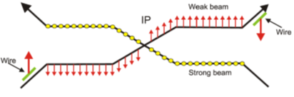
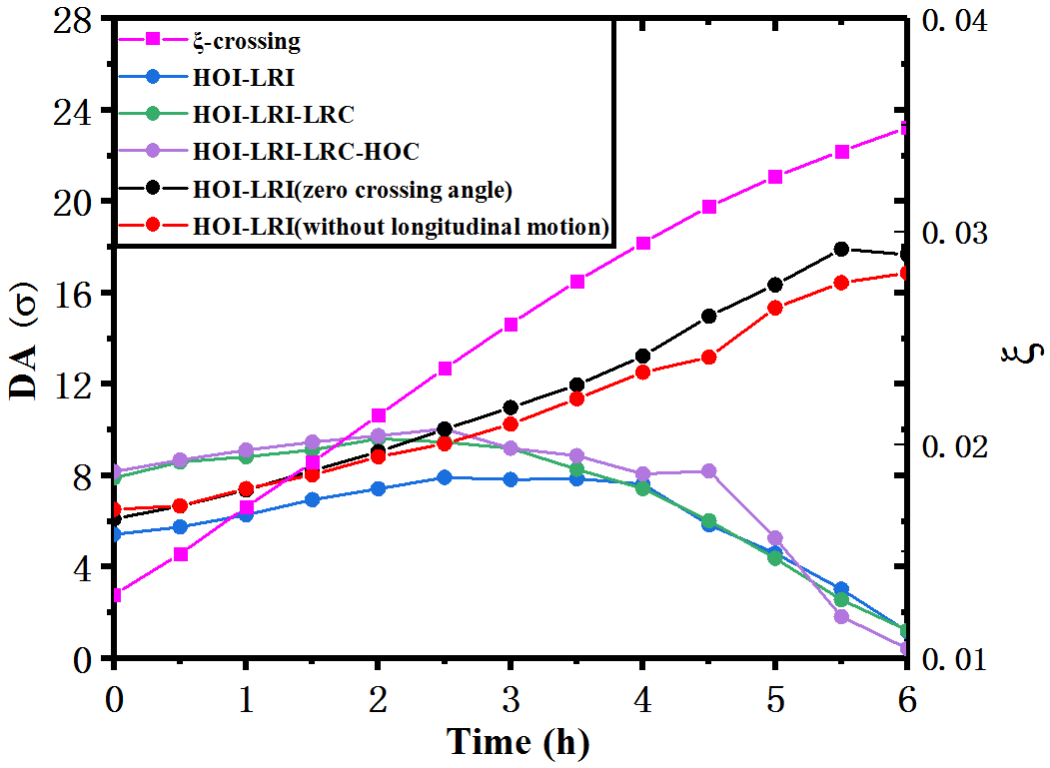
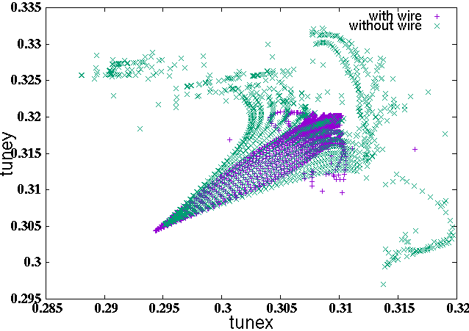
DA evolution with time for natural emittance damping and particle burning-off
Tune footprint with wire compens. (violet points) and without compens. (green points)

Slide 15
SPPC采用24-T磁铁的讨论
SPPC拟采用铁基超导磁铁，现在看来可行性很高；铁基超导体本身受到磁场的限制较小，有机会SPPC直接采用20-24 T（125-150 TeV），而不是等到未来升级时再采用。
Bypass问题(与CEPC兼容)：最高磁场提高到24 T，质子环不能有bypass设计，否则达不到150 TeV。
  能否考虑不保留CEPC探测器？
  也可以考虑适当降低对撞能量目标的方案
同步辐射问题（束流屏）：降低SPPC循环流强约15倍（同步辐射功率相对于SPPC-cdr略有增加）
  单粒子辐射功率增加16倍（∝ γ⁴）
  束团粒子数不变，减少束团数（束团串数），环的填充率大大降低
  减少SPPC注入次数，每环单次SS注入，每次SS注入分为6次（每次1个RCS束团串）
  弧区同步辐射功率线密度略有增加，达到13.5 W/m（原为12.8 W/m）

Slide 16
亮度问题：减少束团数的同时减小对撞点束流尺寸（几何发射度减小），尽量减小对撞亮度的损失
  保留高束团粒子数有利
  提高Nominal B-B参数1倍（0.0075➔0.015）
  初始亮度约为SPPC-cdr的1/4 (2.67*10^34)，但积分亮度相差小一些
注入器链问题：SPPC：75 TeV，SS: 3.75 TeV， MSS：180 GeV，p-RCS：10 GeV，p-Linac：1.2 GeV；
  维持原有的4级加速架构
  SS能量大幅提高（1.8倍，周长大幅增加），其余基本上不变
环布局问题：
  对撞区布局可以维持不变
  准直段长度要保证（4.2 km），5级准直，且不能再采用常温磁铁
  束流储能有所减小(9.1 GJ➔1.2 GJ)
ep问题：
  可以保留CEPC 单环，但需要在SPPC对撞点采用Bypass设计。
  将CEPC电子环与SS束流对撞机，可以保证两个环周长有整数倍关系

Slide 17
待重点研究的问题
  原设计的Lattice是否仍然可用（弧区和对撞区，与CEPC的兼容）
  提高初始和积分亮度的可行性（基于束-束作用）
  提高同步辐射限制的可能性（束流屏和总电功率）
  原有的准直方案是否仍然可用
  注入器优化设计，SS需要重新设计

Slide 18
Summary
SPPC study continues but at a low profile to follow CEPC in the TDR stage
For SPPC to jump directly to the ultimate stage, 150 TeV with 24-T magnets
  Basically no show stopper
  More design study is needed
Question
  Should we claim this change in Snowmass2021?
Thank you for your attention!

