Slide 1
Problems and considerations about the timing & bunch pattern
Control group: Ge Lei, Gang Li
Linac group: Jingru Zhang, Cai Meng, Zusheng Zhou, Xiaoping Li
Injection group: Jinhui Chen
RF group: Jiyuan Zhai
AP group: Dou Wang, Xiaohao Cui, Meng Li, Jie Gao, Tianmu Xin, Chenghui Yu

Slide 2
CEPC high luminosity Parameters
 | tt | Higgs | W | Z
Number of IPs | 2
Energy (GeV) | 180 | 120 | 80 | 45.5
Circumference (km) | 100
SR loss/turn (GeV) | 8.53 | 1.80 | 0.34 | 0.036
Half crossing angle (mrad) | 16.5
Piwinski angle | 1.16 | 4.30 | 7.25 | 24.9
N_{e}/bunch (10¹⁰) | 20.1 | 14.5 | 15.0 | 15.2
Bunch number (bunch spacing) | 37 (4.2μs) | 240(0.64us) | 1230 (0.27μs) | 3816 (86ns) | 11520 (25ns)
Beam current (mA) | 3.5 | 16.7 | 88.6 | 278.8 | 839.9
SR power /beam (MW) | 30 | 30 | 30 | 10 | 30
Bending radius (km) | 10.7
Phase advance of arc cell | 90°/90° | 90°/90° | 60°/60° | 60°/60°
Momentum compaction (10⁻⁵) | 0.71 | 0.71 | 1.43 | 1.43
β_{IP} x/y (m) | 1.0/0.0027 | 0.33/0.001 | 0.18/0.001 | 0.15/0.001
Emittance x/y (nm) | 1.45/0.0047 | 0.64/0.0014 | 0.84/0.00187 | 0.27/0.00135
Transverse σ_{IP} (um) | 37.9/0.11 | 15.0/0.037 | 12.3/0.043 | 6.36/0.037
ξ_{x}/ξ_{y}/IP | 0.076/0.106 | 0.021/0.115 | 0.0096/0.11 | 0.0046/0.131
V_{RF} (GV) | 9.52 | 2.20 | 0.62 | 0.1
f _{RF} (MHz) (harmonic) | 650 (216816) | 650 (216816) | 650 (216816) | 650 (216816)
Nature bunch length σ_{z} (mm) | 2.23 | 2.3 | 2.7 | 2.75
Bunch length σ_{z} (mm) | 2.66 | 3.9 | 5.4 | 9.6
HOM power/cavity (kw) | 0.45 (5cell) | 0.47 (2cell) | 1.0 (2cell) | 2.0 (2cell) | 3.02 (1cell)
Energy spread (%) | 0.17 | 0.17 | 0.12 | 0.12
Energy acceptance requirement (DA) (%) | 2.0 | 1.7 | 1.3 | 1.3
Energy acceptance by RF (%) | 2.61 | 2.3 | 2.1 | 1.48
Lifetime (hour) | 0.59 | 0.33 | 1.4 | 1.7 | 1.4
L/IP (10³⁴cm⁻²s⁻¹) | 0.5 | 5.0 | 15.4 | 35.0 | 105.5

Slide 3
Requirements in collider ring
 | tt | H | W | Z
Energy (GeV) | 180 | 120 | 80 | 45.5
Beam lifetime (min) | 36 | 20 | 80 | 84
Bunch number | 37 | 240 | 1230 | 11520
Bunch population (×10¹¹) | 2.01 | 1.45 | 1.50 | 1.52
Interval for top up* (s) | 65 | 38 | 155 | 153
* Beam current in collider decays by 3%.
Both top up injection and full injection from empty for the collider ring needs to be fulfilled.
Injection & extraction hardware should be compatible for four energy modes.

Slide 4
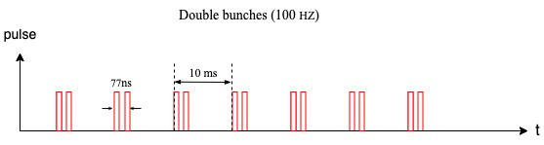
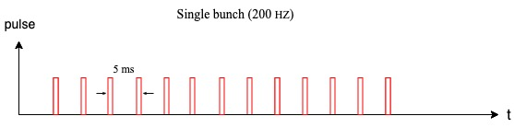
Linac
Double bunch
 | tt & H & W | Z
Repetition (Hz) | 100 | 100
Bunch number/pulse | 1 | 2
200Hz
 | tt & H & W | Z
Repetition (Hz) | 100 | 200
Bunch number/pulse | 1 | 1
Lina 200 Hz or double bunch (100Hz) scheme is only needed for Z.

Slide 5
DR
Jinhui Chen, Xiaohao Cui, Dou Wang
Double bunch
200Hz
 | tt | H | W | Z
Circumference (m) | 150
Energy(GeV) | 1.1
Store time for a train (ms) | 20
Number of trains | 2 | 2 | 2 | 2
Number of bunches/trian | 1 | 1 | 1 | 2
Bunch intensity (nC) | 1.1 | 0.9 | 0.85 | 1.0
Injection scheme | Bunch by bunch |  |  | Two by two
Kicker frequency (Hz) | 100
 | tt | H | W | Z
Circumference (m) | 150
Energy(GeV) | 1.1
Store time for a train (ms) | 20
Number of trains | 2 | 2 | 2 | 4
Number of bunches/trian | 1 | 1 | 1 | 1
Bunch intensity (nC) | 1.1 | 0.9 | 0.85 | 1.0
Injection scheme | Bunch by bunch
Kicker frequency (Hz) | 100 |  |  | 200
At each linac RF pulse a train is injected into the DR.
Z-mode is the most challenging operation in terms of charge flux delivered by the injectors.
After 4 bunches are stored, each train which cooled for 20 ms will be extracted and re-injected into the linac. At the same time, a new train will be injected into the DR.

Slide 6
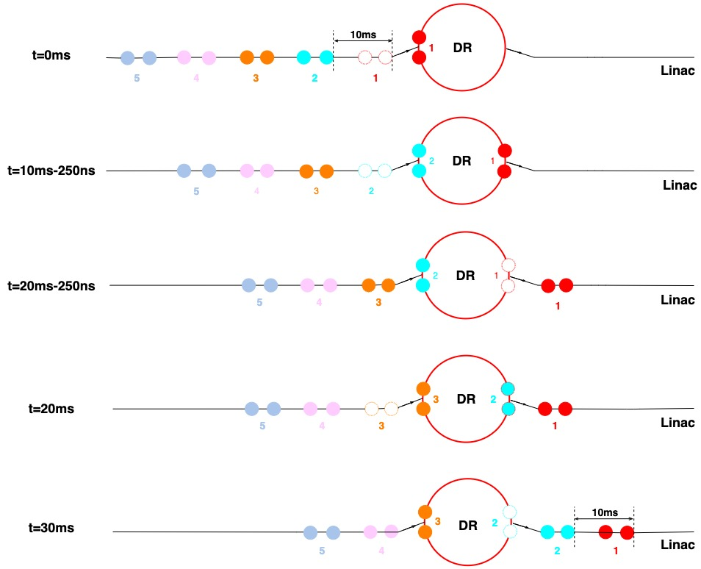
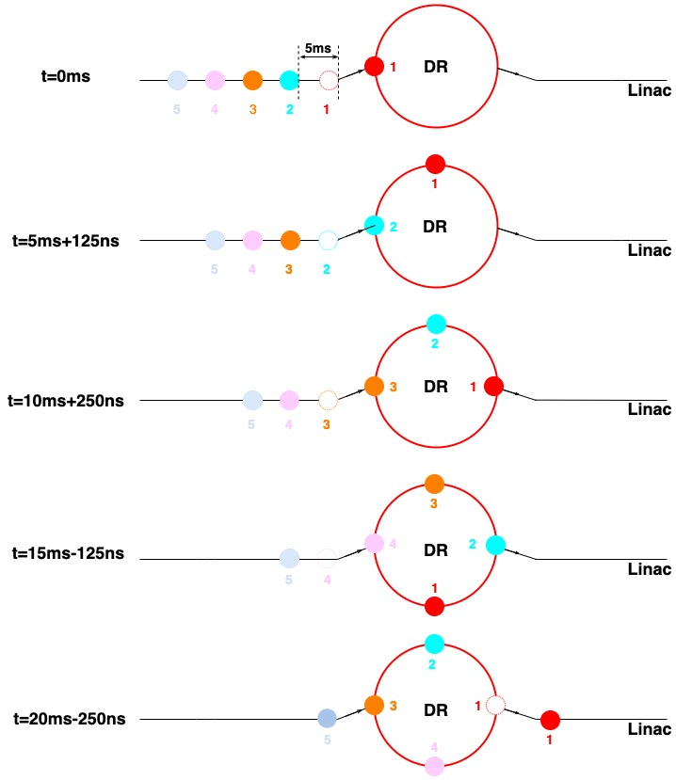
DR
Meng Li
Double bunch
200Hz

Slide 7
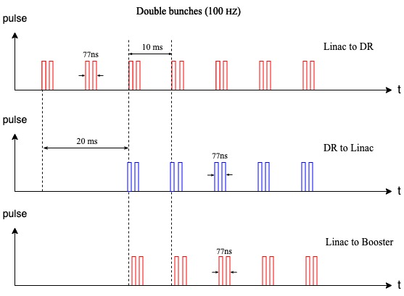
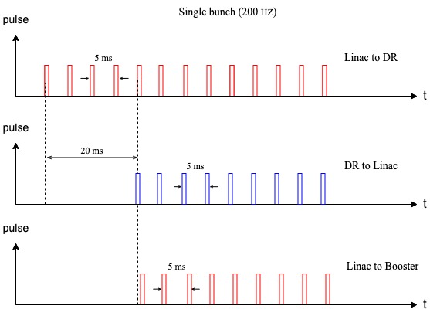
DR
Meng Li
Double bunch
200Hz

Slide 8
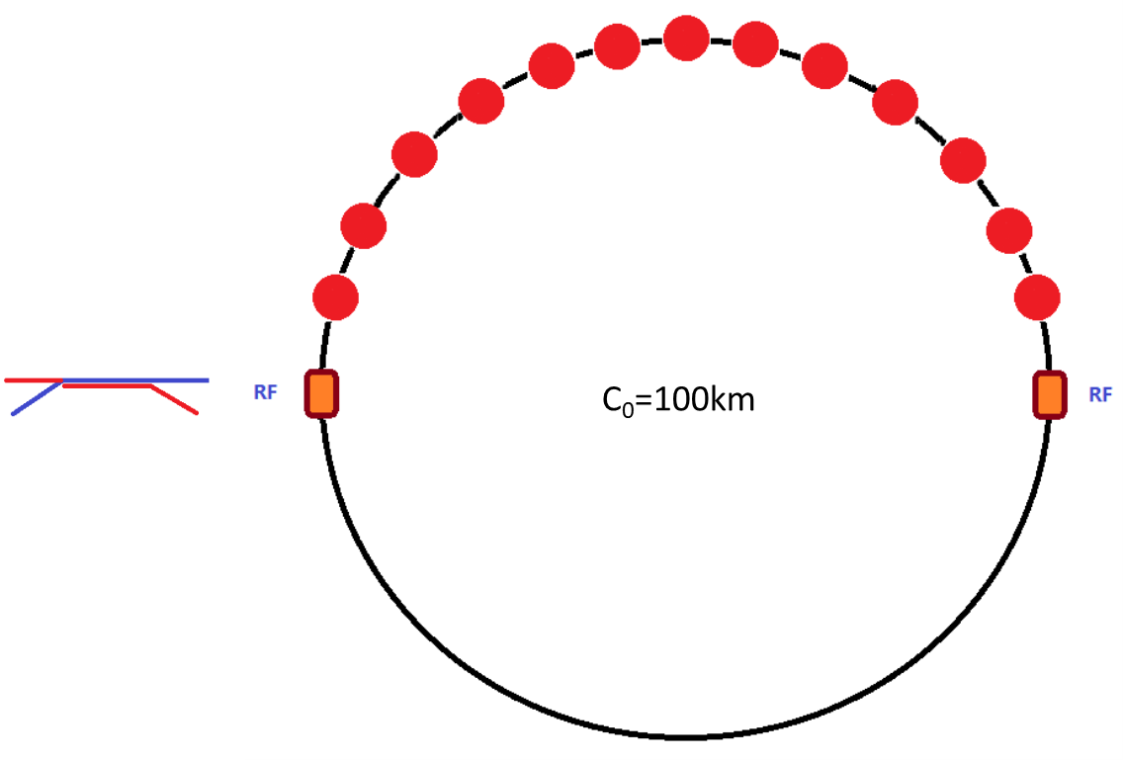
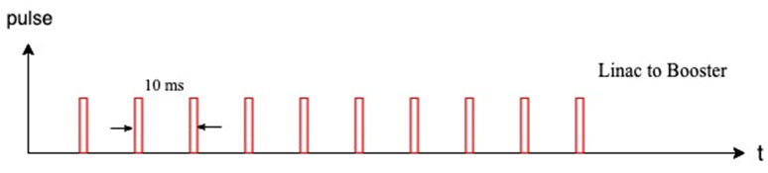
Injection to booster @20GeV ─ tt
The RF system is shared by e- and e+ beam in the collider ring.
Bunches per beam are in the half ring both for booster and collider.
 | tt
Energy（GeV） | 20
Bunch number | 37
Bunch seperation（us） | 4.2
Injection scheme | bunch by bunch
Kicker frequency(Hz) | 100
Kicker pules duration (us) | <8.4
Kicker rise up/ fall down (us) | <4.2
Timing delay(us) | 4.2
Injection duration (s) | 0.37

Slide 9
Injection to booster @20GeV ─ H
The RF system is shared by e- and e+ beam in the collider ring.
Bunches per beam are in the half ring both for booster and collider.
 | H
Energy（GeV） | 20
Bunch number | 240
Bunch seperation（us） | 0.647
Injection scheme | bunch by bunch
Kicker frequency(Hz) | 100
Kicker pules duration (us) | <1.29
Kicker rise up/ fall down (us) | <0.647
Timing delay(us) | 0.647
Injection duration (s) | 2.4

Slide 10
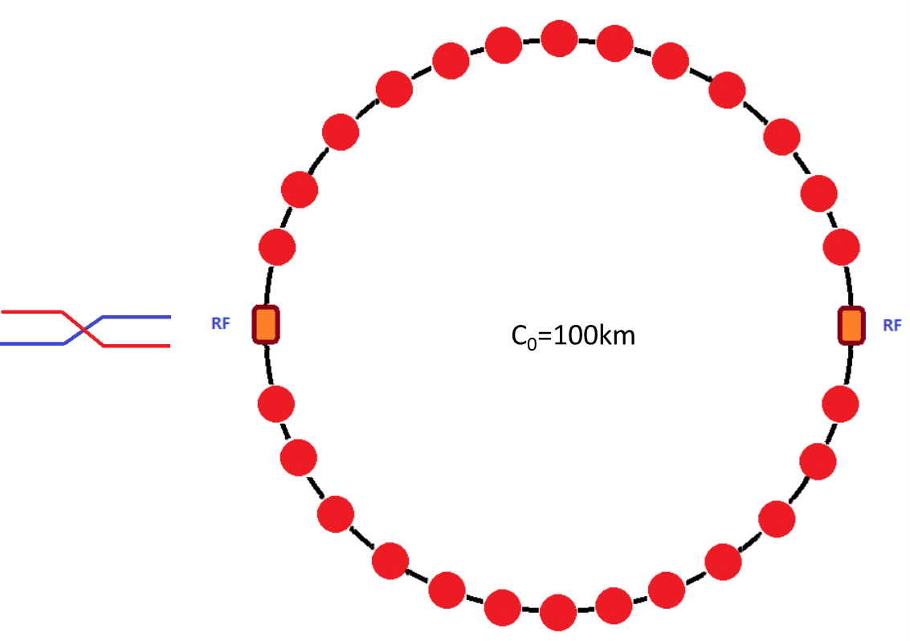
Injection to booster @20GeV ─ W
The RF system is independent for e- and e+ beam in the collider ring.
Bunches per beam are uniform in the whole ring both for booster and collider.
 | W
Energy（GeV） | 20
Bunch number | 1230
Bunch seperation（us） | 0.2677
Injection scheme | bunch by bunch
Kicker frequency(Hz) | 100
Kicker pules duration (us) | <0.535
Kicker rise up/ fall down (us) | <0.2677
Timing delay(us) | 0.2677
Injection duration (s) | 12.3

Slide 11
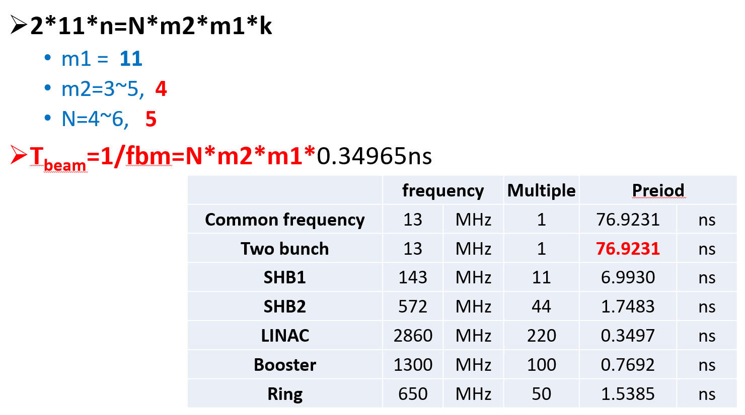
Timing problem for Z
Ge Lei, Gang Li
f (MHz) | SHB1 | SHB2 | Linac | DR | Pre-booster | booster | collider
CEPC | 143 | 572 | 2860 | 650 | ─ | 1300 | 650
FCC | ─ | ─ | 2855.98 | 400 | 400 | 400 | 400
For CEPC, the common frequency is 13MHz, so the minimum time separation= 76.92ns.
For Z, bunch separation requirement in collider: 20ns~28ns.
If the SHB1&SHB2 is cancelled, the minimum time separation=7.692ns.
@Cai Meng
2020.07.17

Slide 12
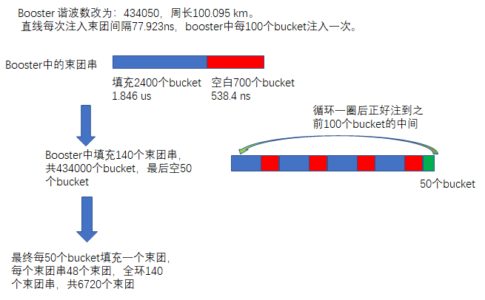
Luminosity reduction @Z due to timing issue
With current Linac design, the minimum bunch separation@Linac = 76.92ns, the minimum bunch separation@ring=38.46ns .
The max bunch number in collider is decreased. ⇒ luminosity reduction @Z (42%↓)
 | design | reality
Bunch number | 11520 | 6720 (10080?)
Bunch population (×10¹¹) | 1.52 | 1.52
Beam current (mA) | 840 | 490
SR power /beam (MW) | 30 | 17.5
L/IP (10³⁴cm⁻²s⁻¹) | 105.5 | 61.5(92.3?)
@X. H. Cui
*Bunch separation is limited by the common frequency of collider (650MHz), booster(1.3GHz) and Linac(2860MHz/572MHz/143MHz).
*Subharmonic bunchers are cancelled and the thermionic gun is replaced by RF gun.

Slide 13
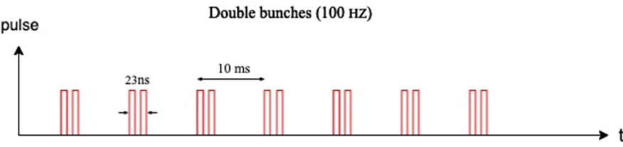
Injection to booster @20GeV ─ Z
 | Z (Linac- 200Hz) | Z (Linac- 2 bunches)
Energy（GeV） | 20
Bunch number/train | 80
Bunch separation（ns） | 23.076
Number of trains | 48
Train separation (us) | 5.11
Injection scheme | bunch by bunch | two by two
Kicker frequency(Hz) | 200 | 100
Kicker pules duration (ns) | <46.15 | <69.23
Flat top (ns) | ─ | 23.1
Kicker rise up/ fall down (ns) | <23.076 | <23.076
Timing delay(us) | 5.11 & 0.023 | 5.11 & 0.046
Injection duration (s) | 19.2
The RF system is independent for e- and e+ beam in the collider ring.
bunches per beam are distributed train by train both in booster and collider.
The number of train in booster is one third of the value in collider.

Slide 14

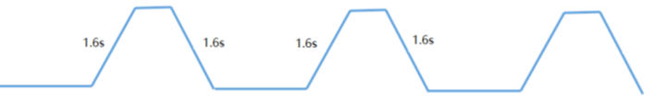
Booster ramping
Dou Wang, Xiaohao Cui
0.037s
tt
7.3s
7.3s
0.37s+7.3s+0.037s+7.3s=15.0s
1 cycles/beam
0.37s
0.24s
5s damping
Higgs
4.5s
4.5s
4.5s
4.5s
1 cycles/beam
2.4s
off-axis
2.4s
on-axis
2.4s+4.5s+5.0s+4.5s=16.4s
1.23s
W
2.7s
2.7s
1 cycles/beam
12.3s+2.7s+1.23s+2.7s=18.9s
12.3s
0.048s
Z
(19.2s+1.6s+0.048s+1.6s)*3=67.34s
19.2s
19.2s
3 cycles/beam
19.2s

Slide 15
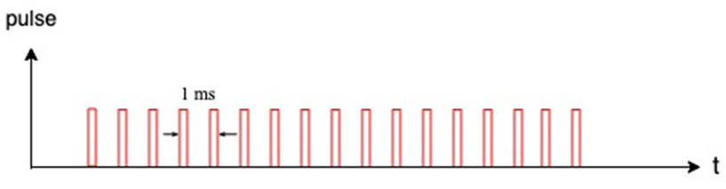
Extraction from booster @180GeV ─ tt
The RF system is shared by e- and e+ beam in the collider ring.
Bunches per beam are in the half ring both for booster and collider.
 | tt
Energy（GeV） | 180
Bunch number | 37
Bunch seperation（us） | 4.2
Extraction scheme | bunch by bunch
Kicker frequency(Hz) | 1000
Kicker pules duration (us) | <8.4
Kicker rise up/ fall down (us) | <4.2
Timing delay(us) | 4.2
Extraction duration (s) | 0.037

Slide 16
Extraction from booster @120GeV ─ H
The RF system is shared by e- and e+ beam in the collider ring.
Bunches per beam are in the half ring both for booster and collider.
 | H-off axis | H-on axis
Energy（GeV） | 120
Bunch number | 240 | 7*
Bunch seperation（us） | 0.647 | 22.1
Extraction scheme | bunch by bunch | bunch by bunch
Kicker frequency(Hz) | 1000
Kicker pules duration (us) | <1.29 | <1.29
Kicker rise up/ fall down (us) | <0.647 | <0.647
Timing delay(us) | 0.647 | 22.1
Extraction duration (s) | 0.24 | 0.007
* 7 bunches are uniform in the half ring. The bunches which are injected/extracted to/from booster each time can become more than 7 while the total current in booster is getting lower and lower.

Slide 17
Extraction from booster @80GeV ─ W
The RF system is independent for e- and e+ beam in the collider ring.
Bunches per beam are uniform in the whole ring both for booster and collider.
 | W
Energy（GeV） | 80
Bunch number | 1230
Bunch seperation（us） | 0.2677
Extraction scheme | bunch by bunch
Kicker frequency(Hz) | 1000
Kicker pules duration (us) | <0.535
Kicker rise up/ fall down (us) | <0.2677
Timing delay(us) | 0.2677
Extraction duration (s) | 1.23

Slide 18
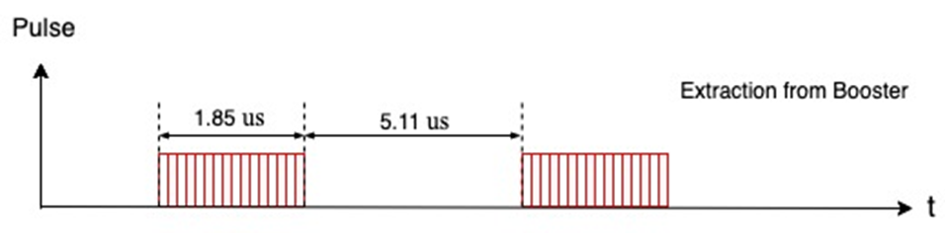
Extraction from booster @45.5GeV ─ Z
The RF system is independent for e- and e+ beam in the collider ring.
bunches per beam are distributed train by train both in booster and collider.
The number of train in booster is one third of the value in collider.
 | Z
Energy（GeV） | 45.5
Bunch number/train | 80
Bunch separation（ns） | 23.076
Number of trains | 48
Train separation (us) | 5.11
Extraction scheme | train by train
Kicker frequency(Hz) | 1000
Flat top (us) | 1.83
Kicker pules duration (us) | <12.05
Kicker rise up/ fall down (us) | <5.11
Timing delay(us) | 6.94
Extraction duration (s) | 0.048

Slide 19
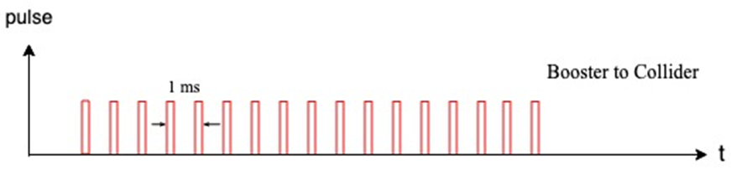
Injection to collider@180GeV ─ tt
The RF system is shared by e- and e+ beam in the collider ring.
Bunches per beam are in the half ring both for booster and collider.
 | tt
Energy（GeV） | 180
Bunch number | 37
Bunch seperation（us） | 4.2
Injection scheme | bunch by bunch
Kicker frequency(Hz) | 1000
Kicker pules duration (us) | <8.4
Kicker rise up/ fall down (us) | <4.2
Timing delay(us) | 4.2
Injection duration (s) | 0.037

Slide 20
Injection to collider@120GeV ─ H
The RF system is shared by e- and e+ beam in the collider ring.
Bunches per beam are in the half ring both for booster and collider.
 | H-off axis | H-on axis
Energy（GeV） | 120
Bunch number | 240 | 7*
Bunch seperation（us） | 0.647 | 22.1
Injection scheme | bunch by bunch | bunch by bunch
Kicker frequency(Hz) | 1000
Kicker pules duration (us) | <1.29 | <1.29
Kicker rise up/ fall down (us) | <0.647 | <0.647
Timing delay(us) | 0.647 | 22.1
Injection duration (s) | 0.24 | 0.007

Slide 21
Injection to collider@80GeV ─ W
The RF system is independent for e- and e+ beam in the collider ring.
Bunches per beam are uniform in the whole ring both for booster and collider.
 | W
Energy（GeV） | 80
Bunch number | 1230
Bunch seperation（us） | 0.2677
Injection scheme | bunch by bunch
Kicker frequency(Hz) | 1000
Kicker pules duration (us) | <0.535
Kicker rise up/ fall down (us) | <0.2677
Timing delay(us) | 0.2677
Injection duration (s) | 1.23

Slide 22
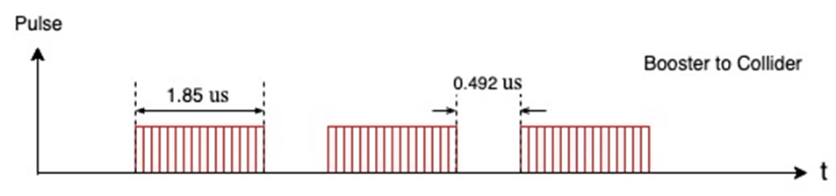
Injection to collider@45.5GeV ─ Z
The RF system is independent for e- and e+ beam in the collider ring.
bunches per beam are distributed train by train both in booster and collider.
The number of train in booster is one third of the value in collider.
 | Z
Energy（GeV） | 45.5
Bunch number/train | 80
Bunch separation（ns） | 23.076
Number of trains | 144
Train separation (us) | 0.492
Injection scheme | train by train
Kicker frequency(Hz) | 1000
Flat top (us) | 1.83
Kicker pules duration (us) | <2.81
Kicker rise up/ fall down (us) | <0.49
Timing delay(us) | 6.94 & 2.32
Injection duration (s) | 0.144

Slide 23
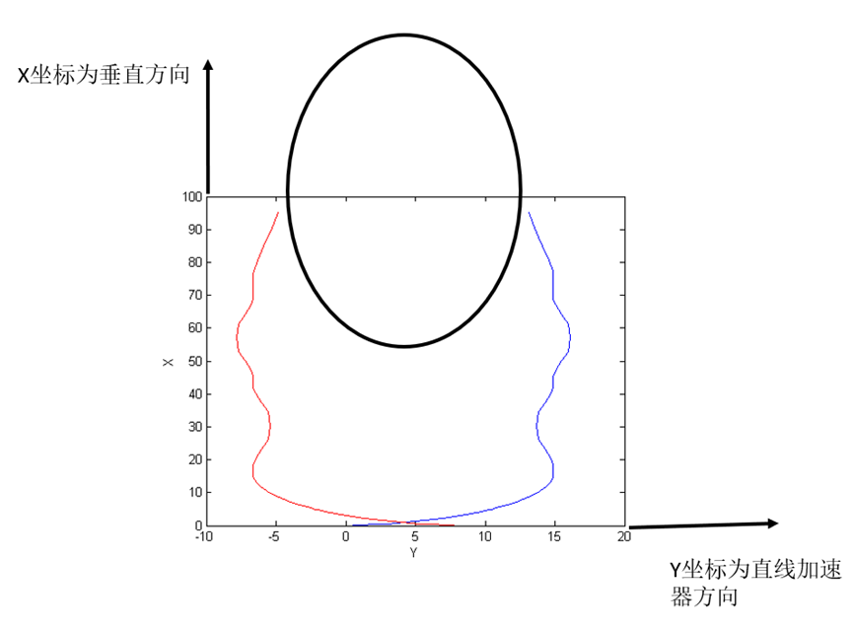
Requirement of timing system
Gang Li, Ge Lei
Choose 130MHz as clock beat → minimum time separation=7.69ns (FPGA clock &EVG/EVR transmission can be realized)
Circumference of damping ring: (L*1000*10⁹/(3*10⁸))/(1000/650)=integer
Length of transfer line between DR and Linac: （（N*150+75+104*2-8.3）10⁹/(3*10⁸))/(1000/2860)=integer
104m →101.65m
Circumference of collider/booster: (L*1000*10⁹/(3*10⁸))/(1000/650)=integer
Length of transfer line between booster and collider: (L*10⁹/(3*10⁸))/(1000/650)=integer
252m or 246m

Slide 24
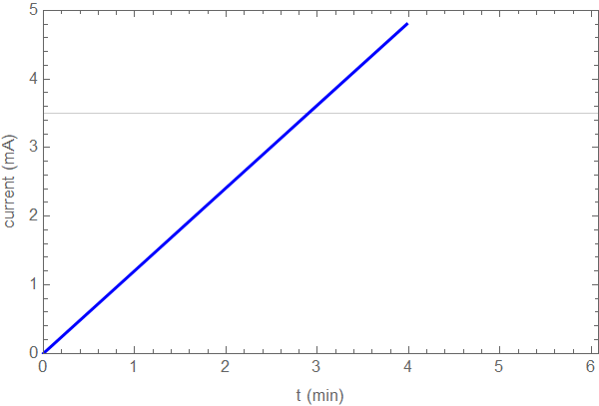
Full injection from empty-tt
Design current in collider is 3.5mA.
Total current in booster limited by RF system: < 0.3mA
Collider lifetime (non-collision): ~2600 hours ─ dominated by Toucheck lifetime
Full injection from empty for each beam → 3 min (6 min for two beams)
Collision start after each beam is injected to full current independently.

Slide 25
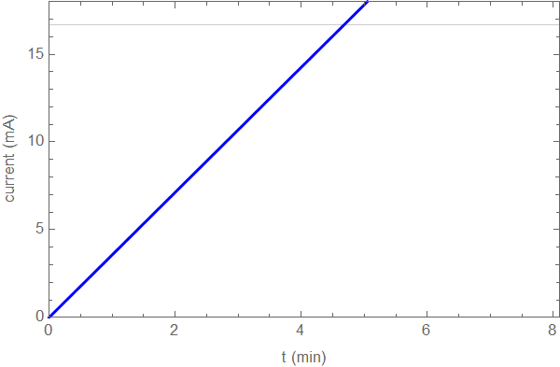
Full injection from empty-Higgs
Design current in collider is 16.7mA.
Total current in booster limited by RF system: < 1mA
Collider lifetime (non-collision): ~290 hours ─ dominated by Toucheck lifetime
Full injection from empty for each beam → 5 min (10 min for two beams)*
Collision start after each beam is injected to full current independently.
*on-axis injection for collider is assumed

Slide 26
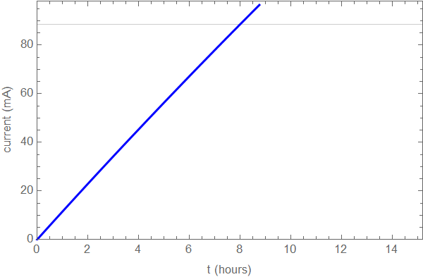
Full injection from empty-W
Design current in collider is 88.6mA.
Total current in booster limited by RF system: < 4mA
Collider lifetime (non-collision): ~150 hours ─ dominated by Toucheck lifetime
Full injection from empty for each beam → 8 min (16 min for two beams)
Collision start after each beam is injected to full current independently.

Slide 27
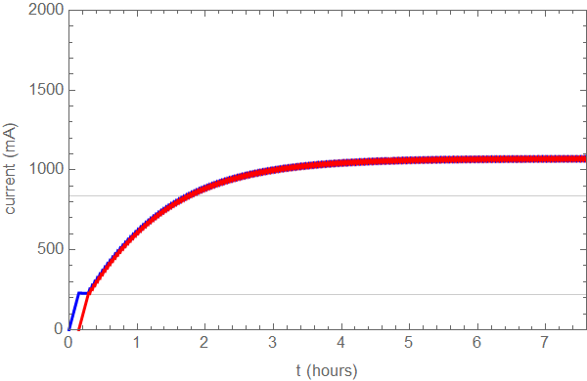
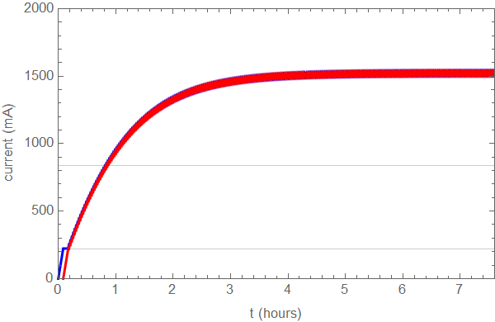
Full injection from empty-Z (bootstrapping)
Dou Wang, Xiaohao Cui, Yuan Zhang
Design current in collider is 840mA.
Total current in booster limited by RF system: < 10 mA (will be increased to 16mA)
Collider lifetime: ≥19 hours (non-collision), 1.9~1.4 hours (w. collision)*
Bootstrapping from 220mA
Full injection from empty for both beam → 2 hours (50min)
Booster threshold: 10mA
Booster threshold: 16mA
*the beam lifetime with collision is related to the current.

Slide 28
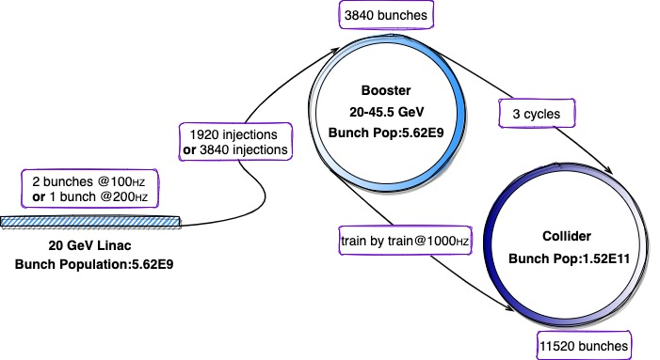
Z mode injection (top-up)
Meng Li

Slide 29
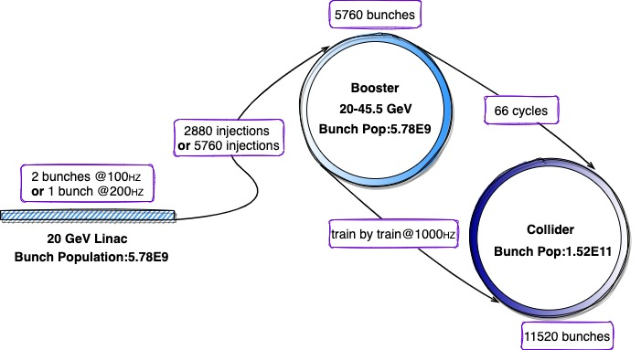
Z mode injection (full injection)
Meng Li

Slide 30
Summary
The inj./ext. chain and timing structure of CEPC for four energy modes and different injection scheme have been designed with the consideration of clock system, RF frequency choice, bunch pattern, injection hardware and so on.
The problem was found only for Z pole.
The RF frequency is not compatible for Linac and rings according to the requirement of timing system.
The minimum timing separation is relatively large due to small common frequency. ⇒ lose filling flexibility
Possible optimization
 | Common frequency | Bunch separation | Luminosity@Z | Filling flexibility
1. Keep current Linac | 13MHz | 38.46ns | 58% | No
2. Cancel SHBs, use RF gun | 130MHz | 23.07ns | 100% | No
3. f(Linac):2860→2600MHz | 130MHz | 23.07ns | 100% | No
4. New frequency for Linac and rings (hope) |  | 20.00ns,21.54ns,23.07ns,24.62ns,26.15ns, 27.69ns | 100% | Yes
Discussion about timing and filling scheme for Z is continuous.

