Slide 1
CEPC MDI progress
Sha Bai, Haoyu Shi
For CEPC MDI group
CEPC Day
2021-8-30

Slide 2
Outline
Synchrotron radiation from Final Doublet with alignment errors
Beam loss background with alignment errors
Shielding
Full detector simulation

Slide 3
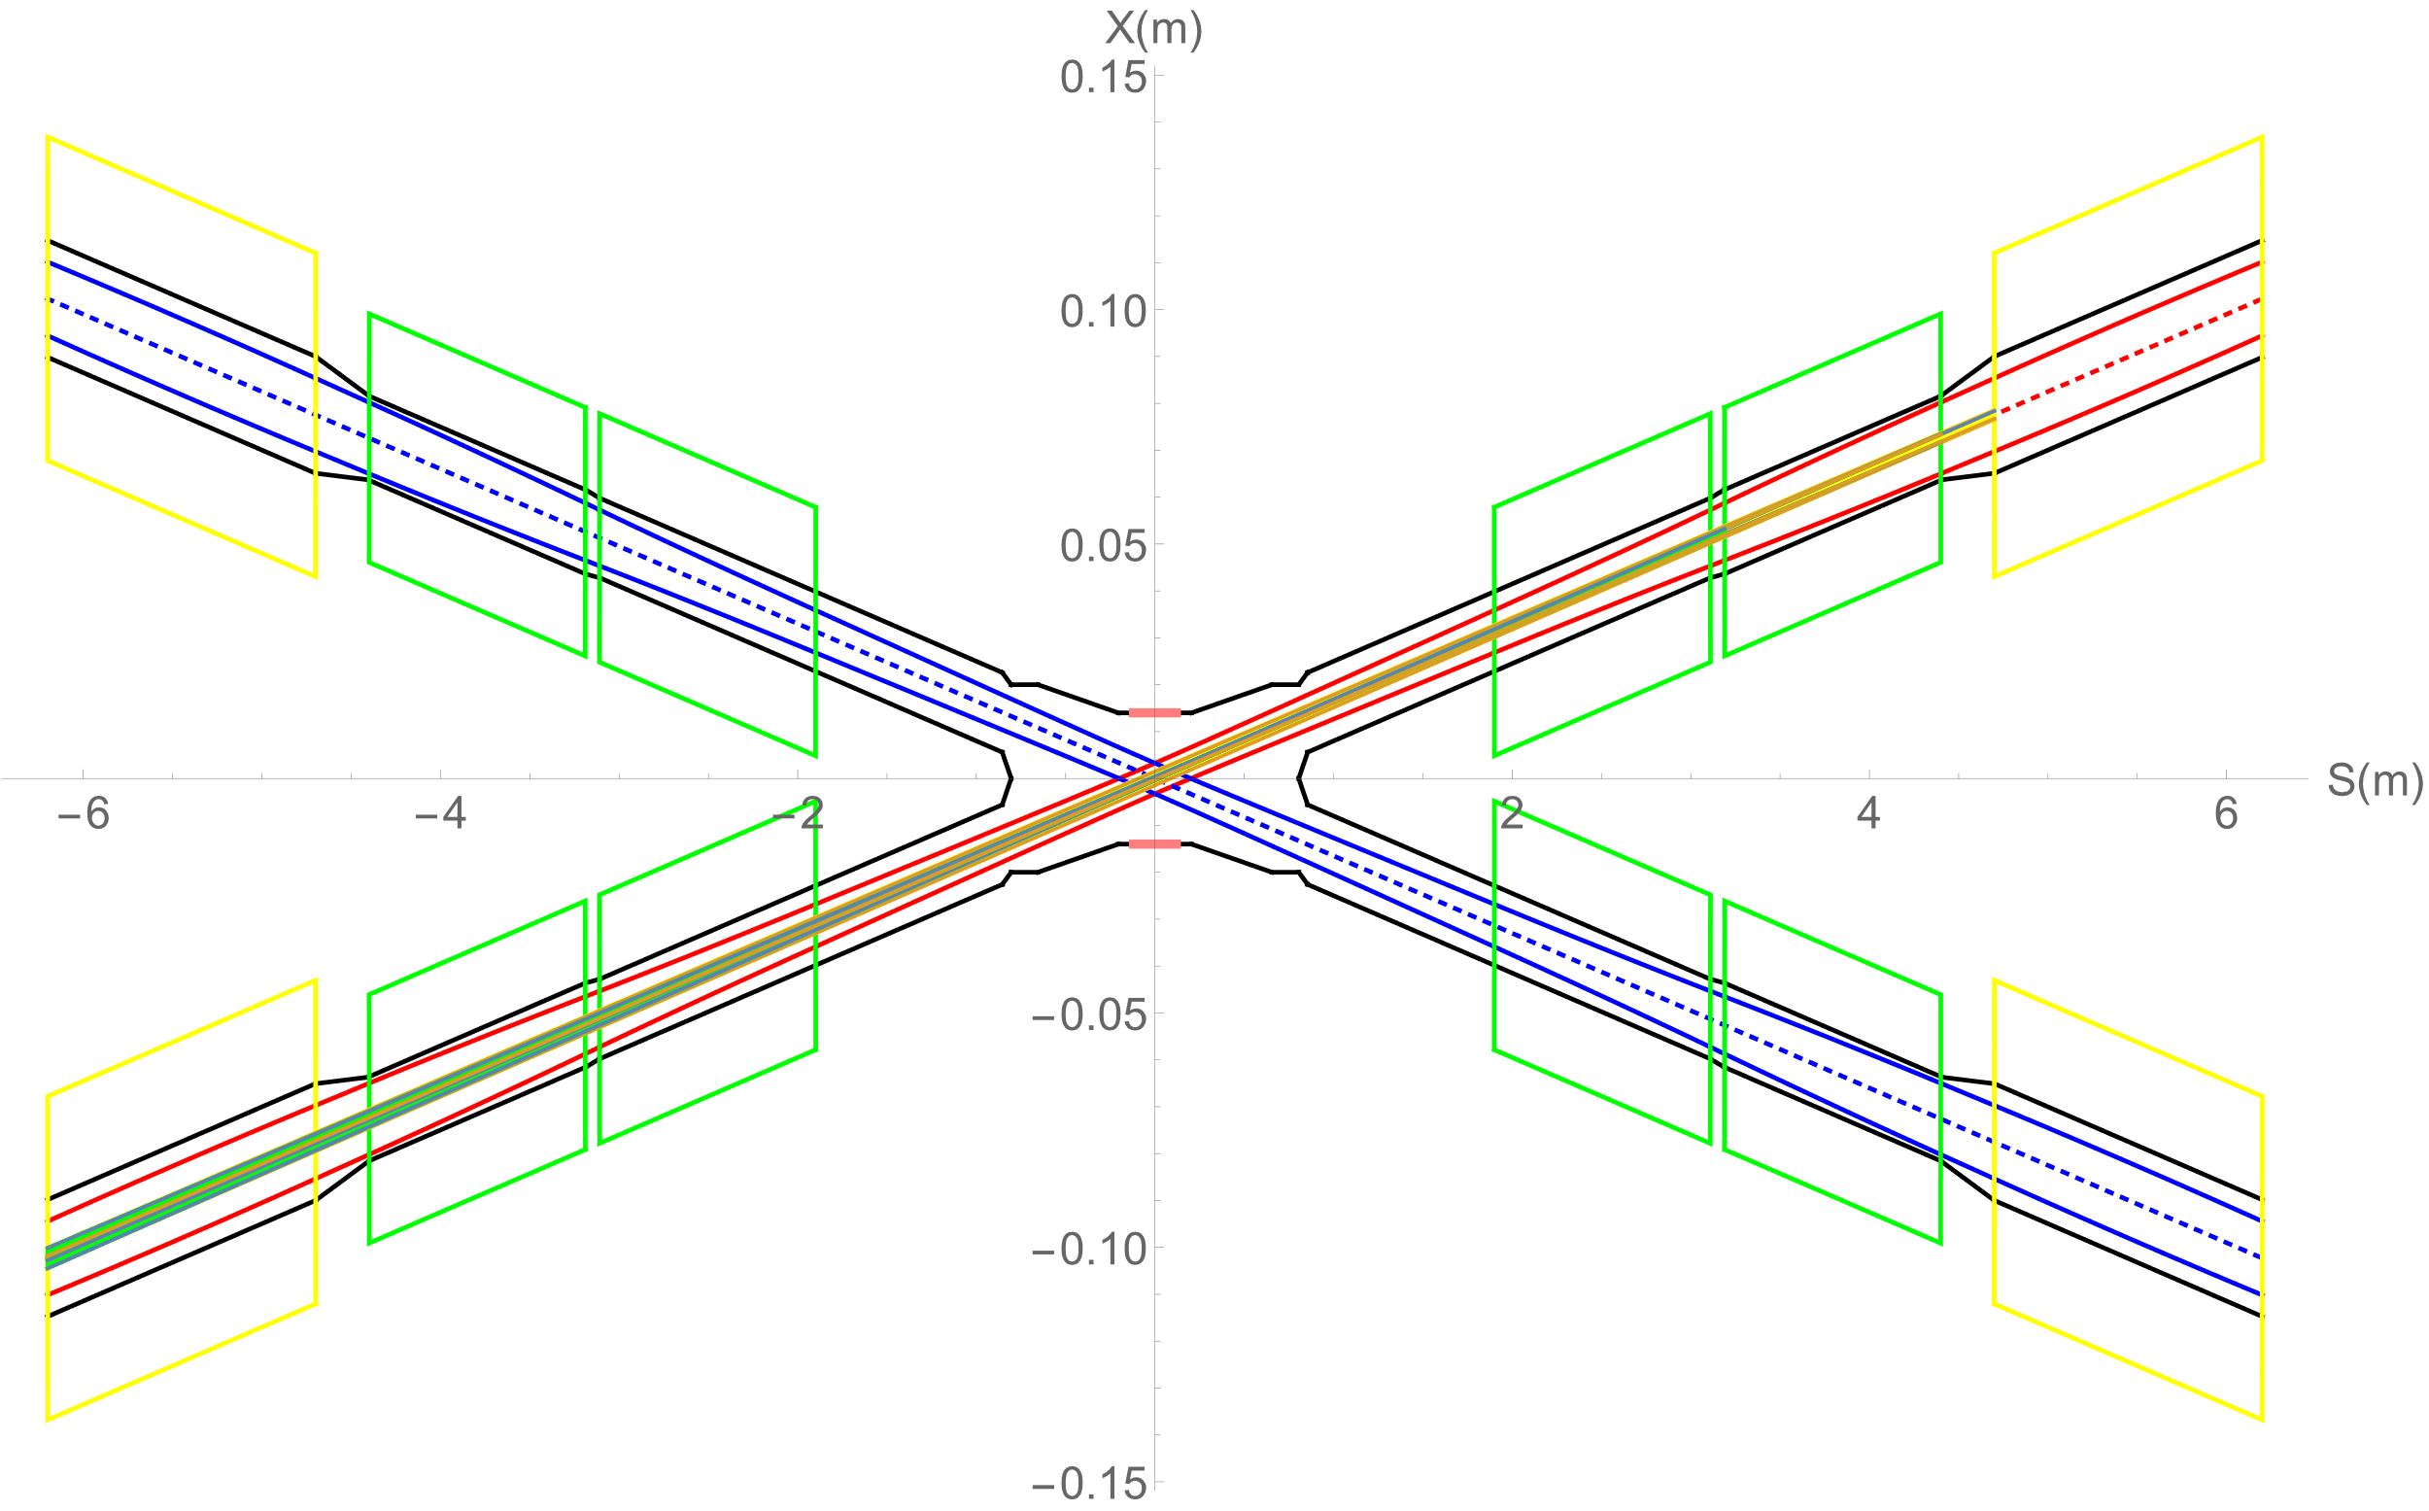
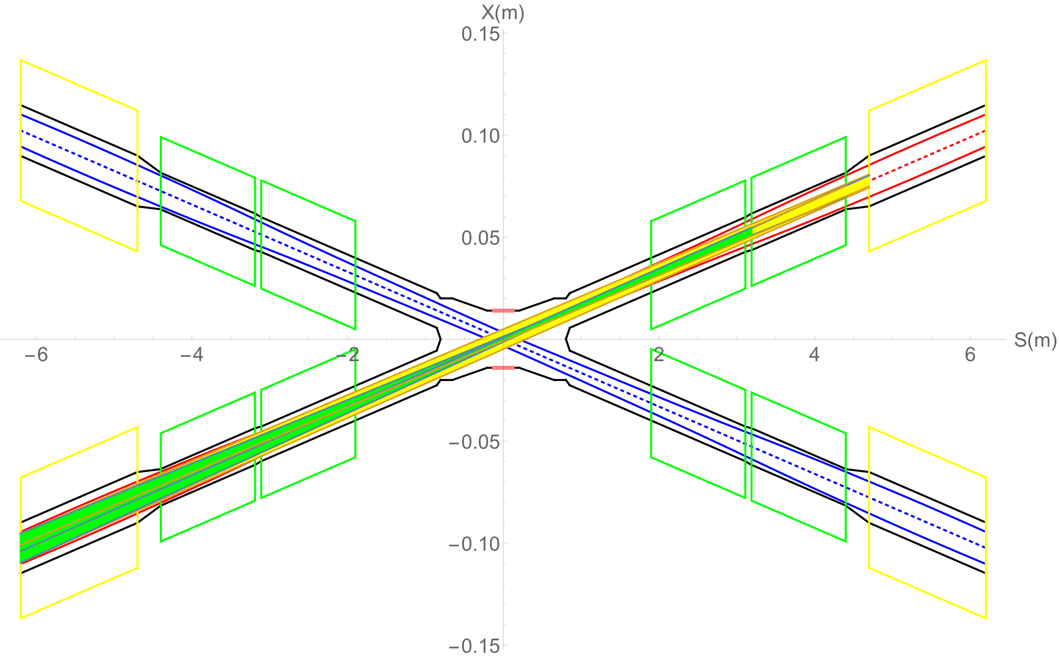
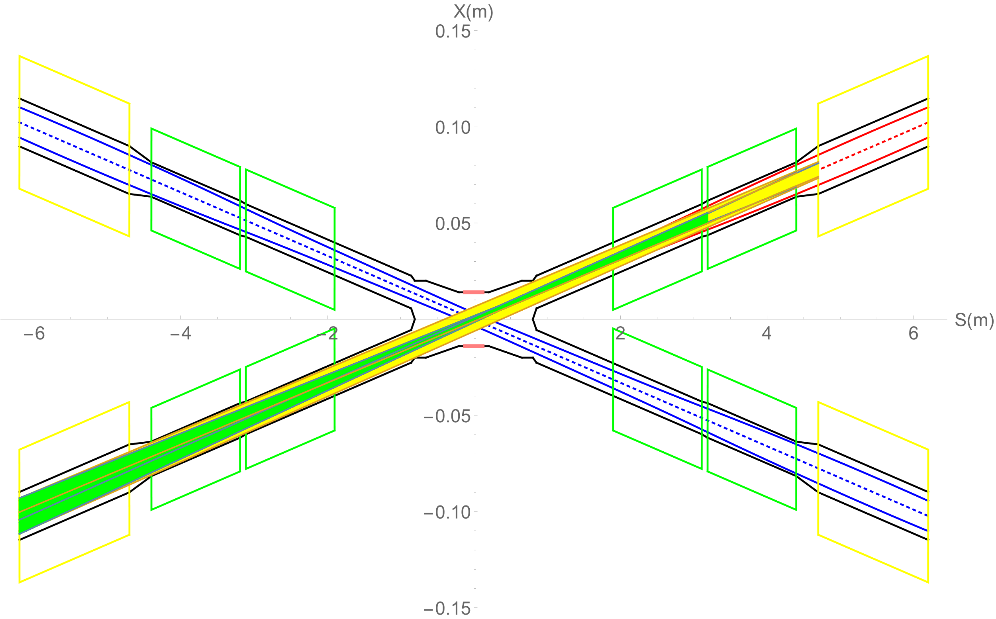
Synchrotron radiation from FD without error
SR phtons from FD within 3σx
SR phtons from FD within 10σx
SR phtons from FD within 13σx
Slices(3sigma) | QDa_SR_power_X (W) | QDa_SR_power_Y (W) | QDa_critical_energy_X(KeV) | QDa_critical_energy_Y(KeV)
3 | 212.2 | 99.9 | 724.7 | 396.3
6 | 200.2 | 94.3 | 797.2 | 435.9
9 | 198.0 | 93.2 | 821.3 | 449.1
12 | 197.2 | 92.9 | 833.4 | 455.7
18 | 196.7 | 92.6 | 845.5 | 462.3
There are no SR photons within 10σx directly hitting or once-scattering to the detector.
Collimators squeeze the beam to 13σx
SR photons generate from 10σx to 13σx will hit downstream of IR beam pipe, and once-scattering photons will not go into detector beam pipe but goes to even far away from the IP region.
SR photons from FD will not damage detector components and cause background to experiments.
Slices(3sigma) | QF1_SR_power_X (W) | QF1_SR_power_Y (W) | QF1_critical_energy_X(KeV) | QF1_critical_energy_Y(KeV)
3 | 472.9 | 135.1 | 675.2 | 499.4
6 | 446.1 | 127.4 | 742.7 | 549.4
9 | 441.2 | 126.0 | 765.2 | 566.0
12 | 439.5 | 125.5 | 776.5 | 574.3
18 | 438.3 | 125.2 | 787.7 | 582.7
Slices(3sigma) | QDb_SR_power_X (W) | QDb_SR_power_Y (W) | QDb_critical_energy_X(KeV) | QDb_critical_energy_Y(KeV)
3 | 239.2 | 42.8 | 663.1 | 263.0
6 | 225.7 | 40.4 | 729.4 | 289.3
9 | 223.2 | 39.9 | 751.5 | 298.0
12 | 222.3 | 39.8 | 762.6 | 302.4
18 | 221.7 | 39.6 | 773.6 | 306.8
 | βx (m) | βy (mm) | εx (nm) | εy (pm) | σx (um) | σy (nm)
Q1a | 11.27 | 0.23 | 0.64 | 1.3 | 85 | 17
Q1b | 46.75 | 0.49 | 0.64 | 1.3 | 172 | 25
Q2 | 212.8 | 1 | 0.64 | 1.3 | 369 | 36

Slide 4
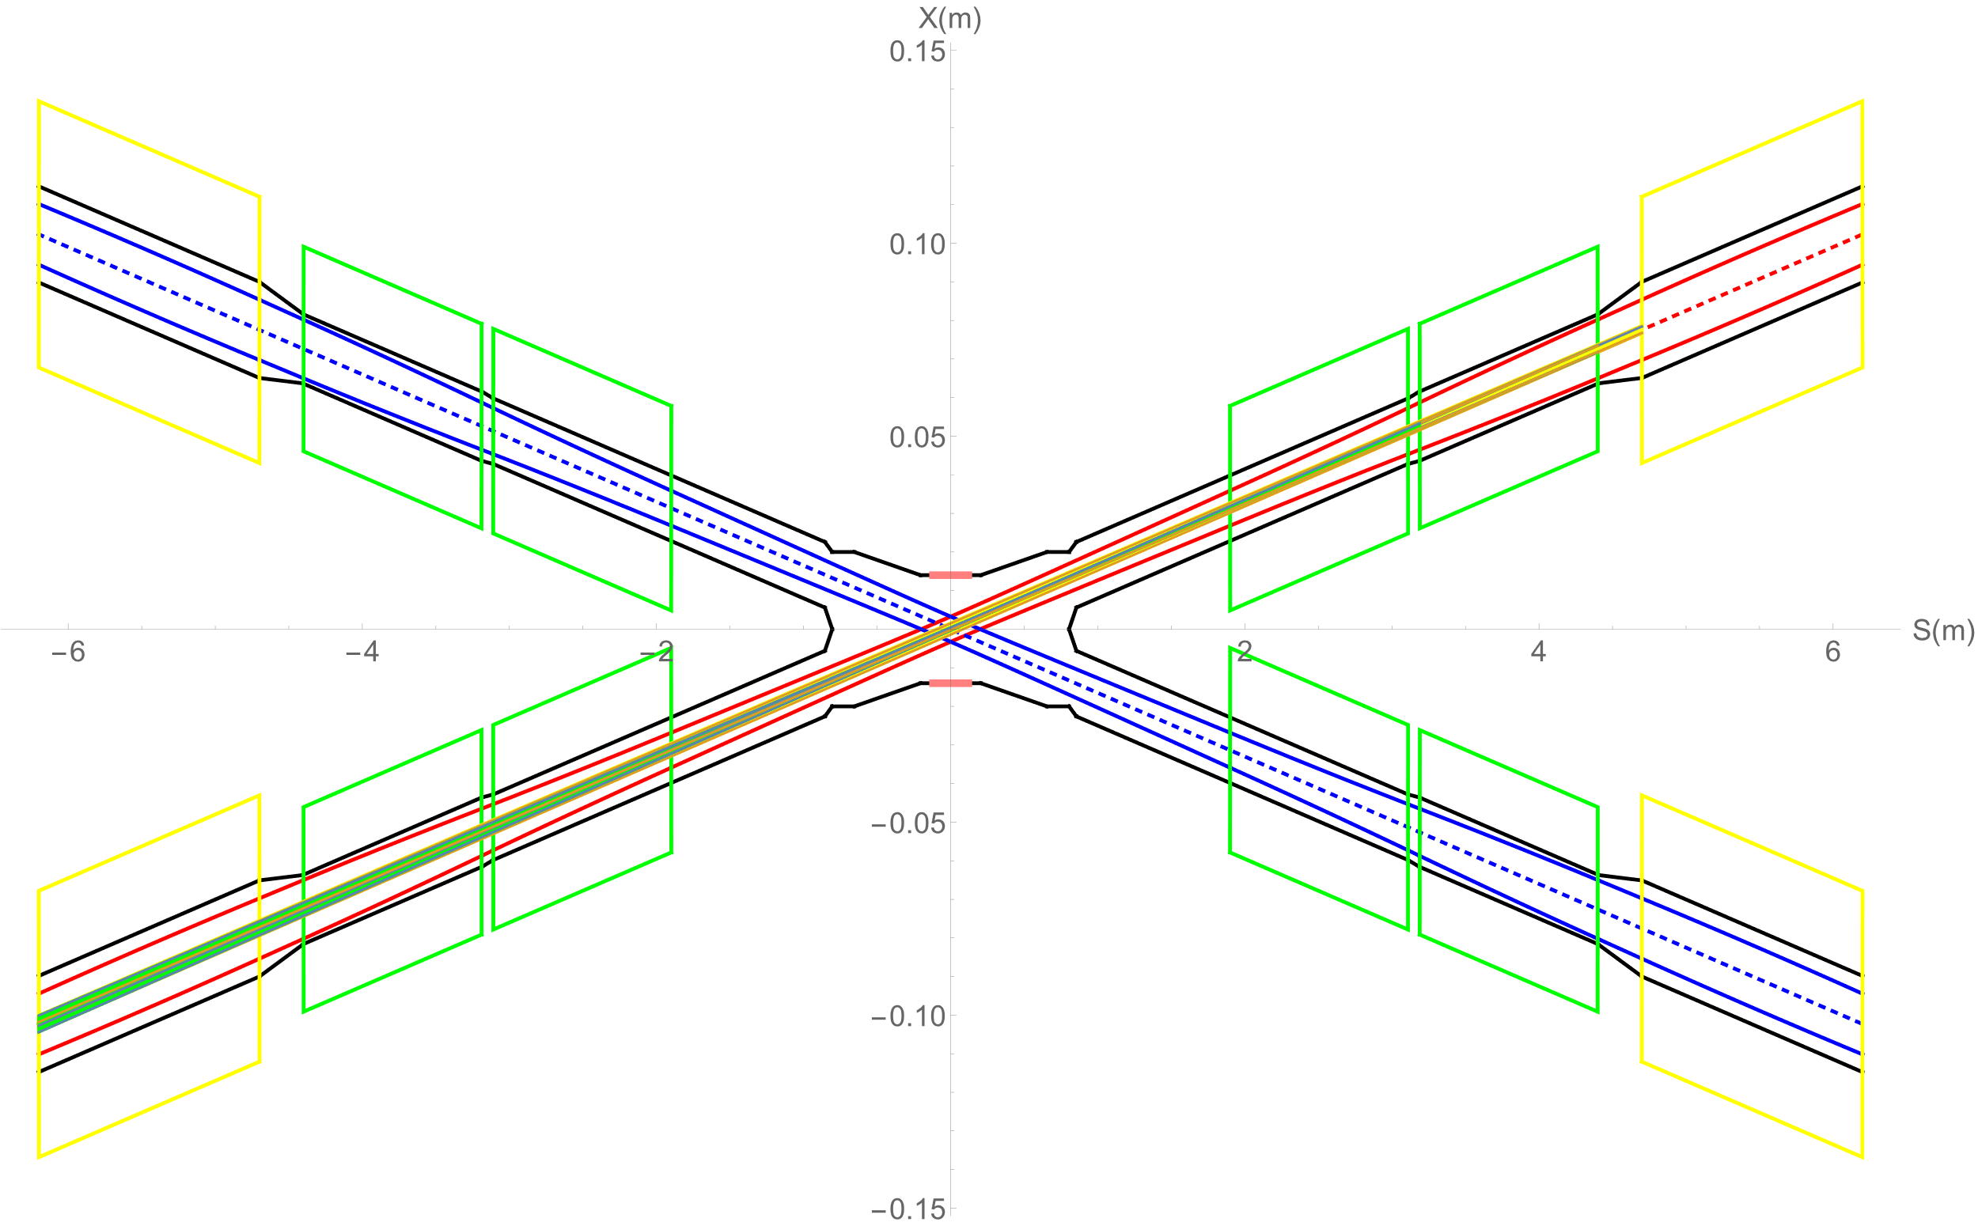
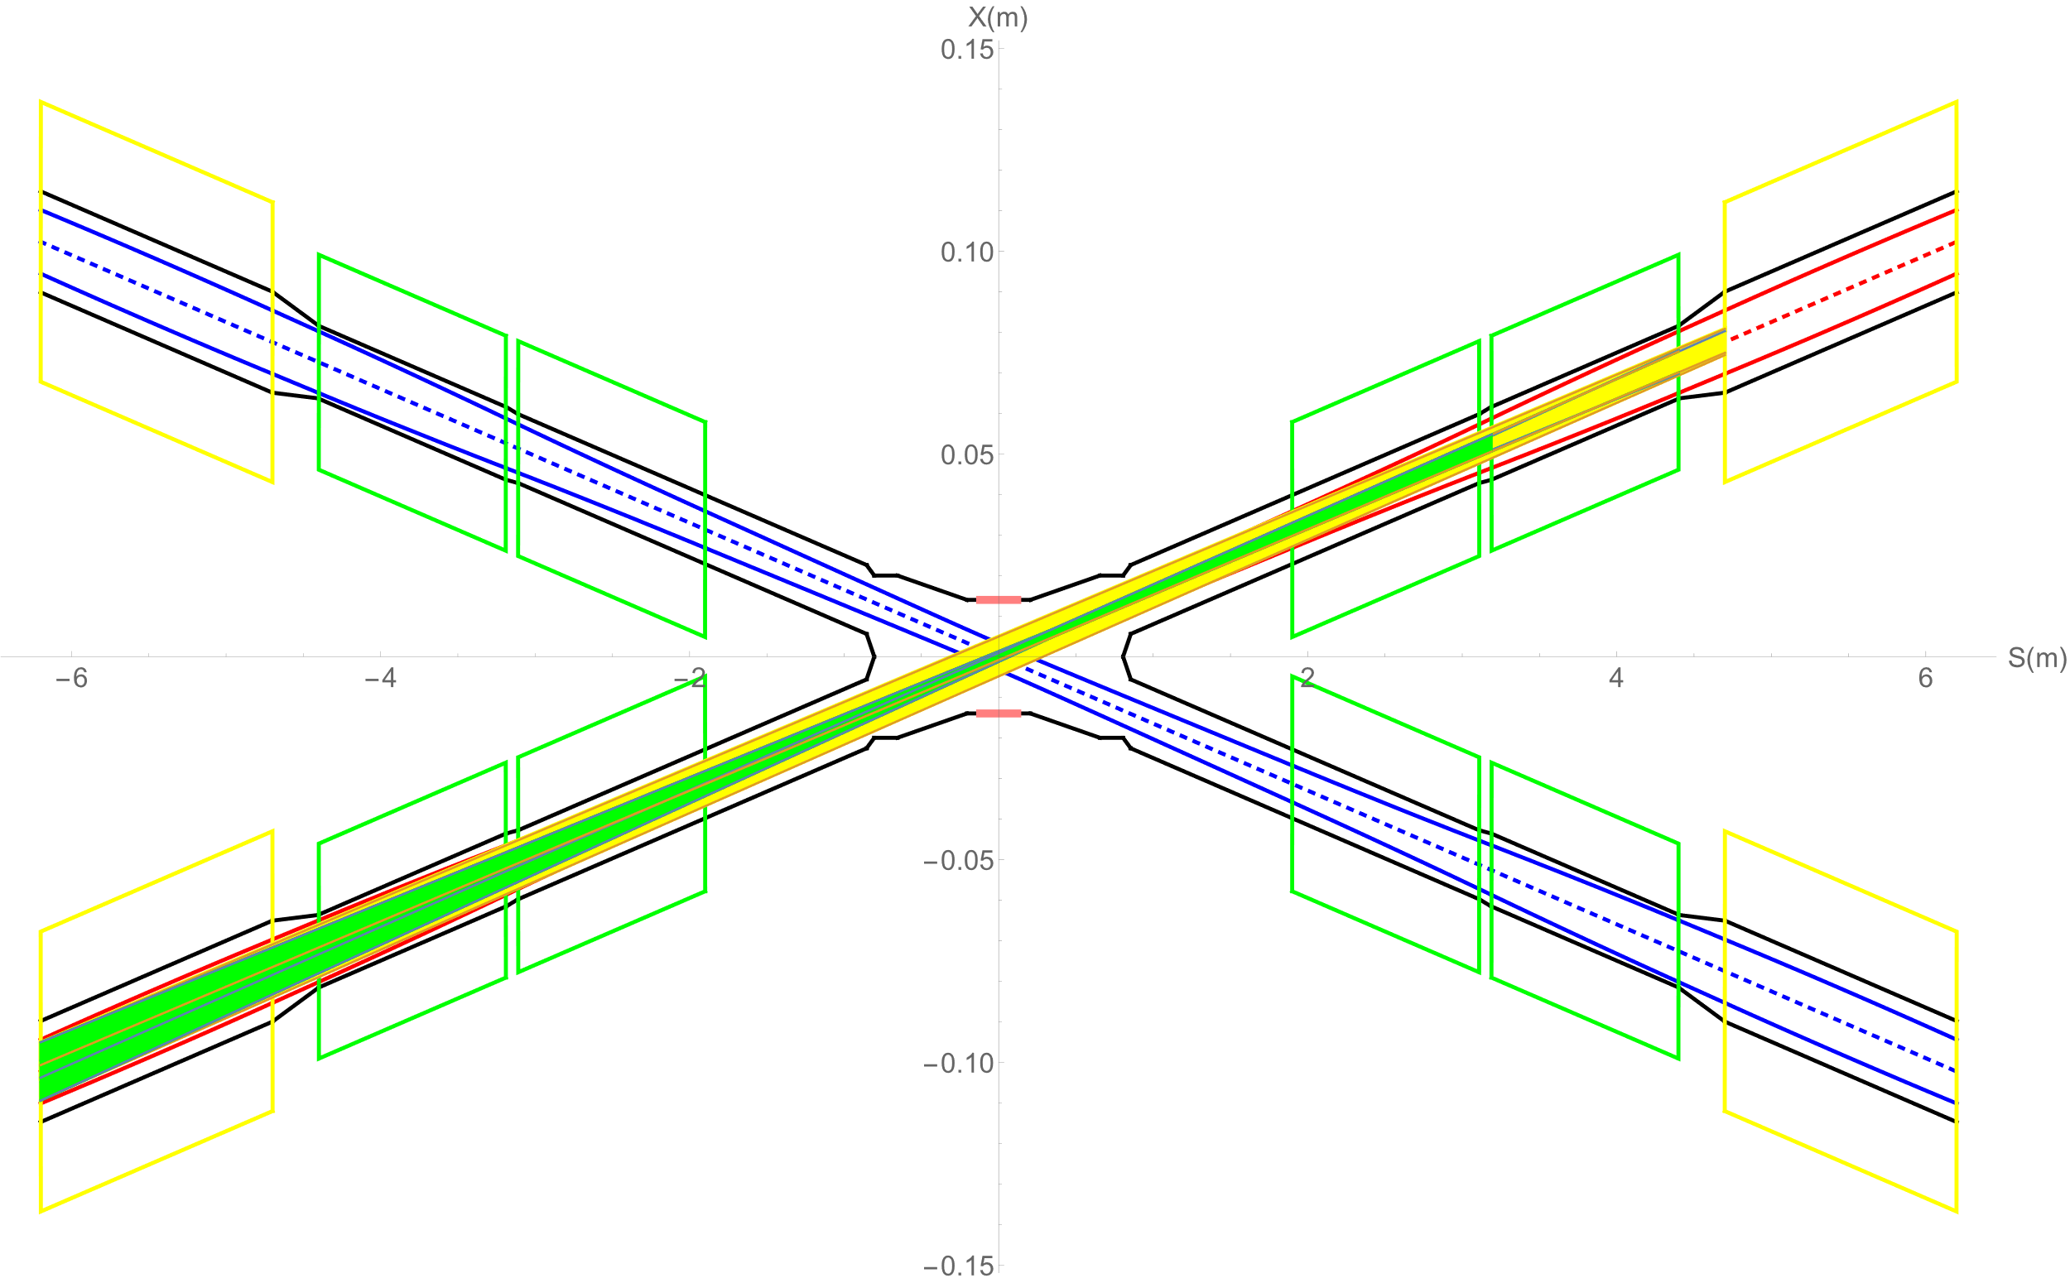
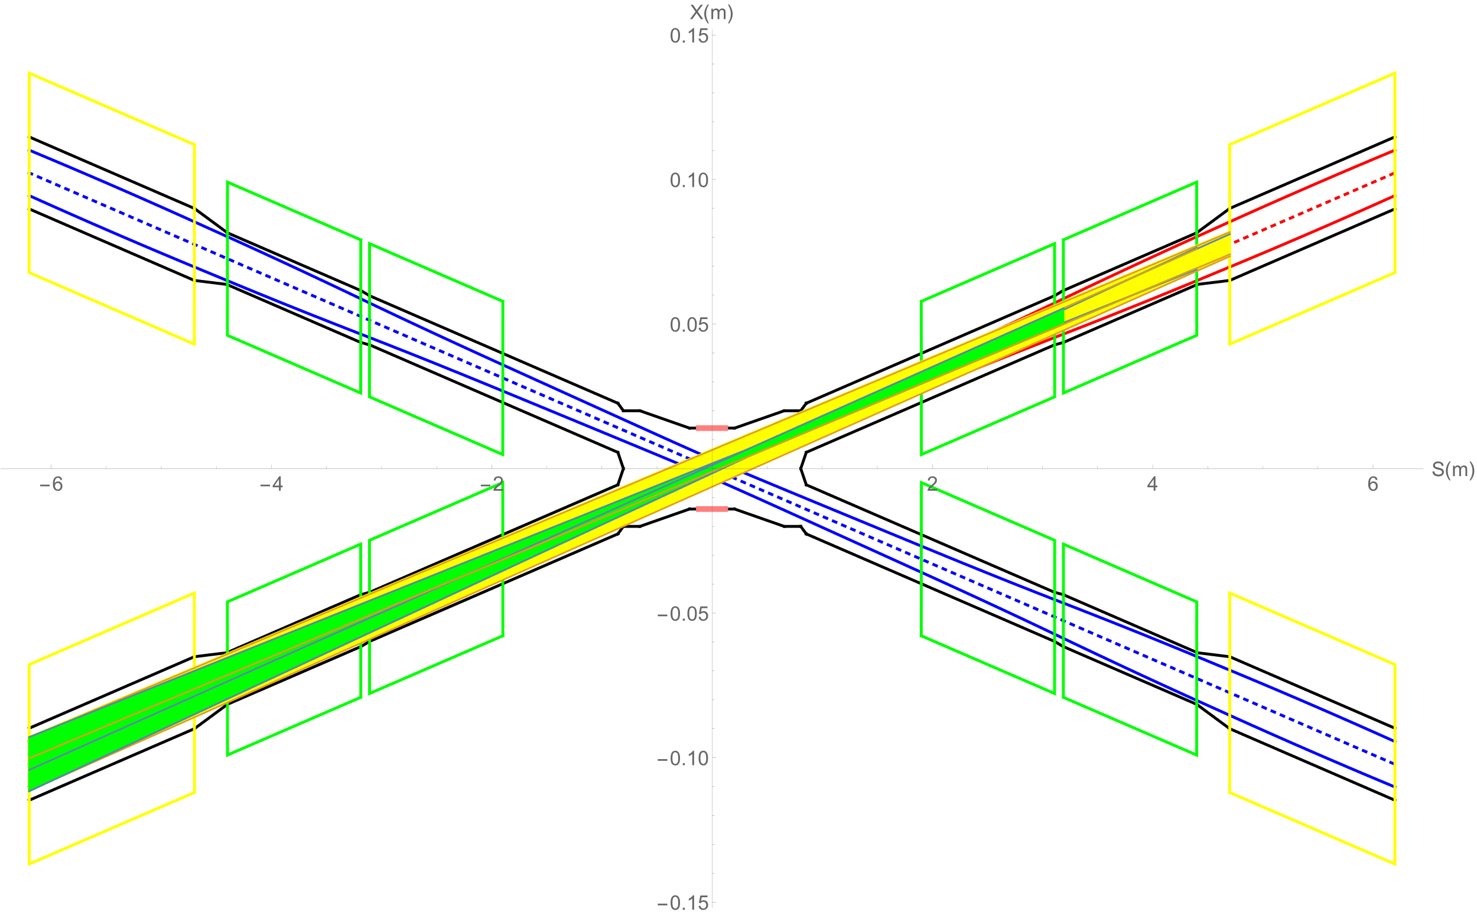
Synchrotron radiation from FD with alignment error ~50um orbit distortion
SR from FD within 3σx
SR from FD within 10σx
SR from FD within 13σx
SR photons generation within 3σx, 10σx, 13σx
~50um orbit distortion after error correction
No SR photons directly hitting or once-scattering to the detector.
Collimators squeeze the beam to 13σx
SR photons generate from 10σx to 13σx will hit downstream of IR beam pipe, and once-scattering photons will not go into detector beam pipe but goes to even far away from the IP region.
SR photons from FD will not damage detector components and cause background to experiments.

Slide 5
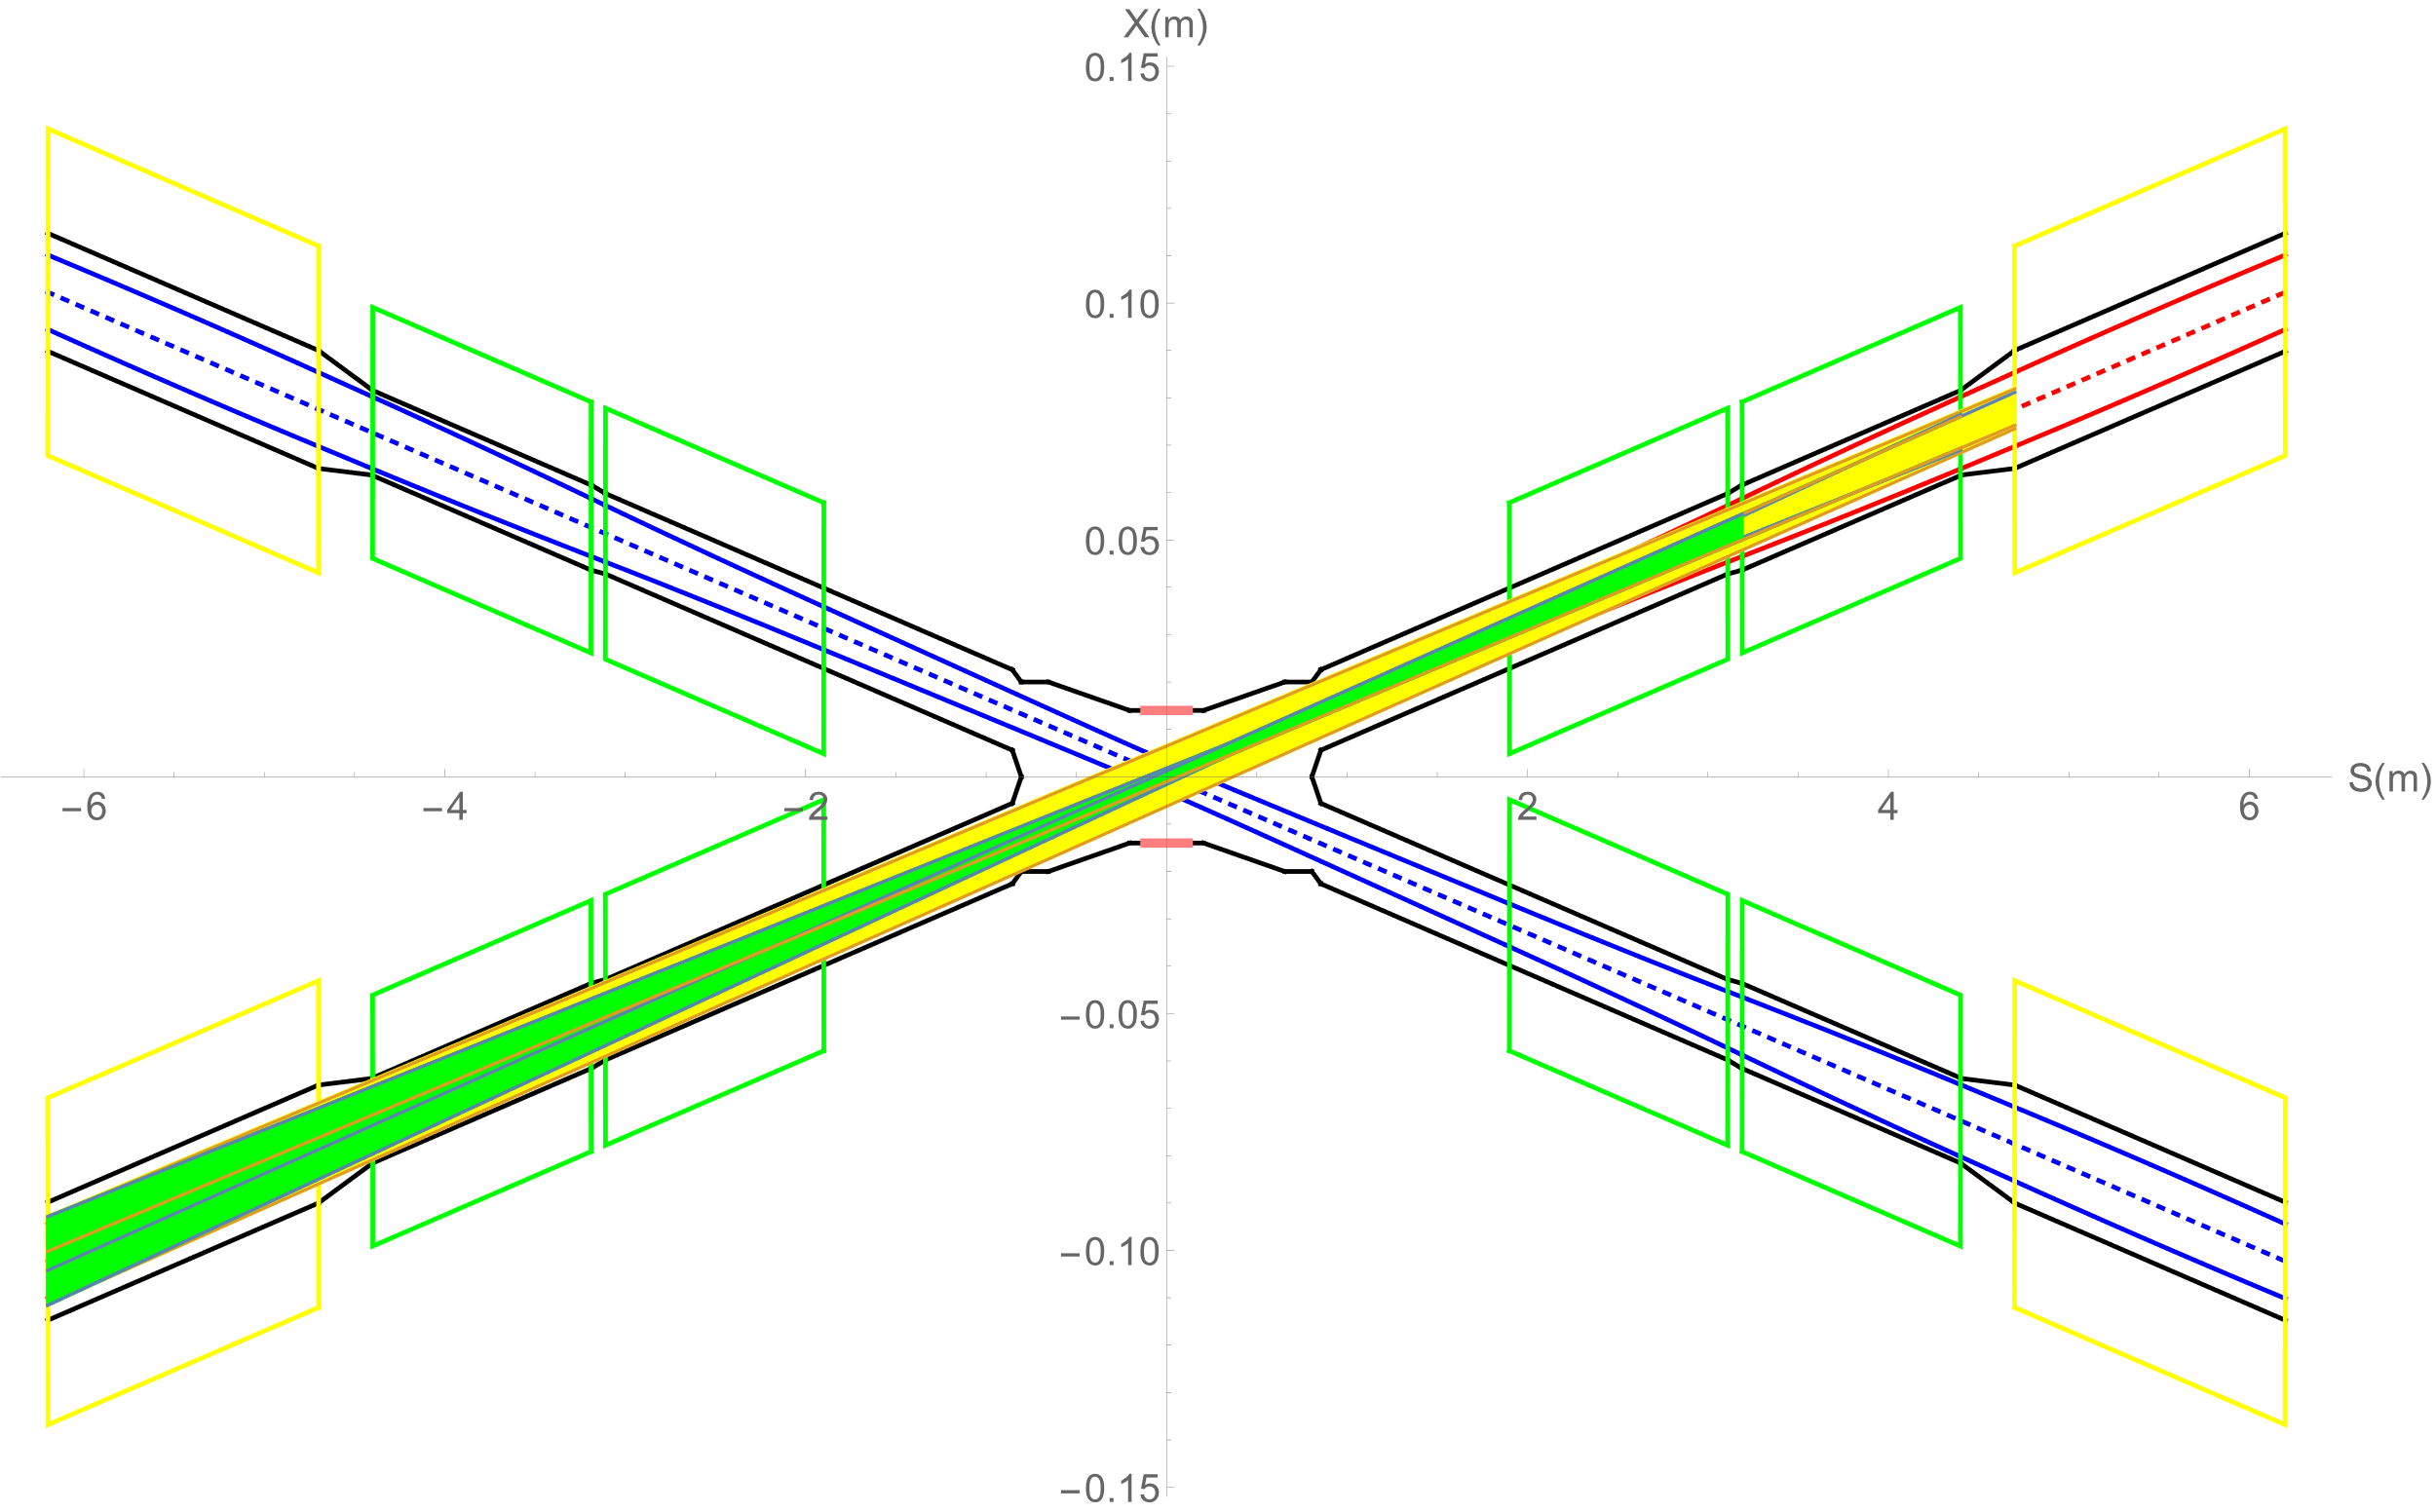
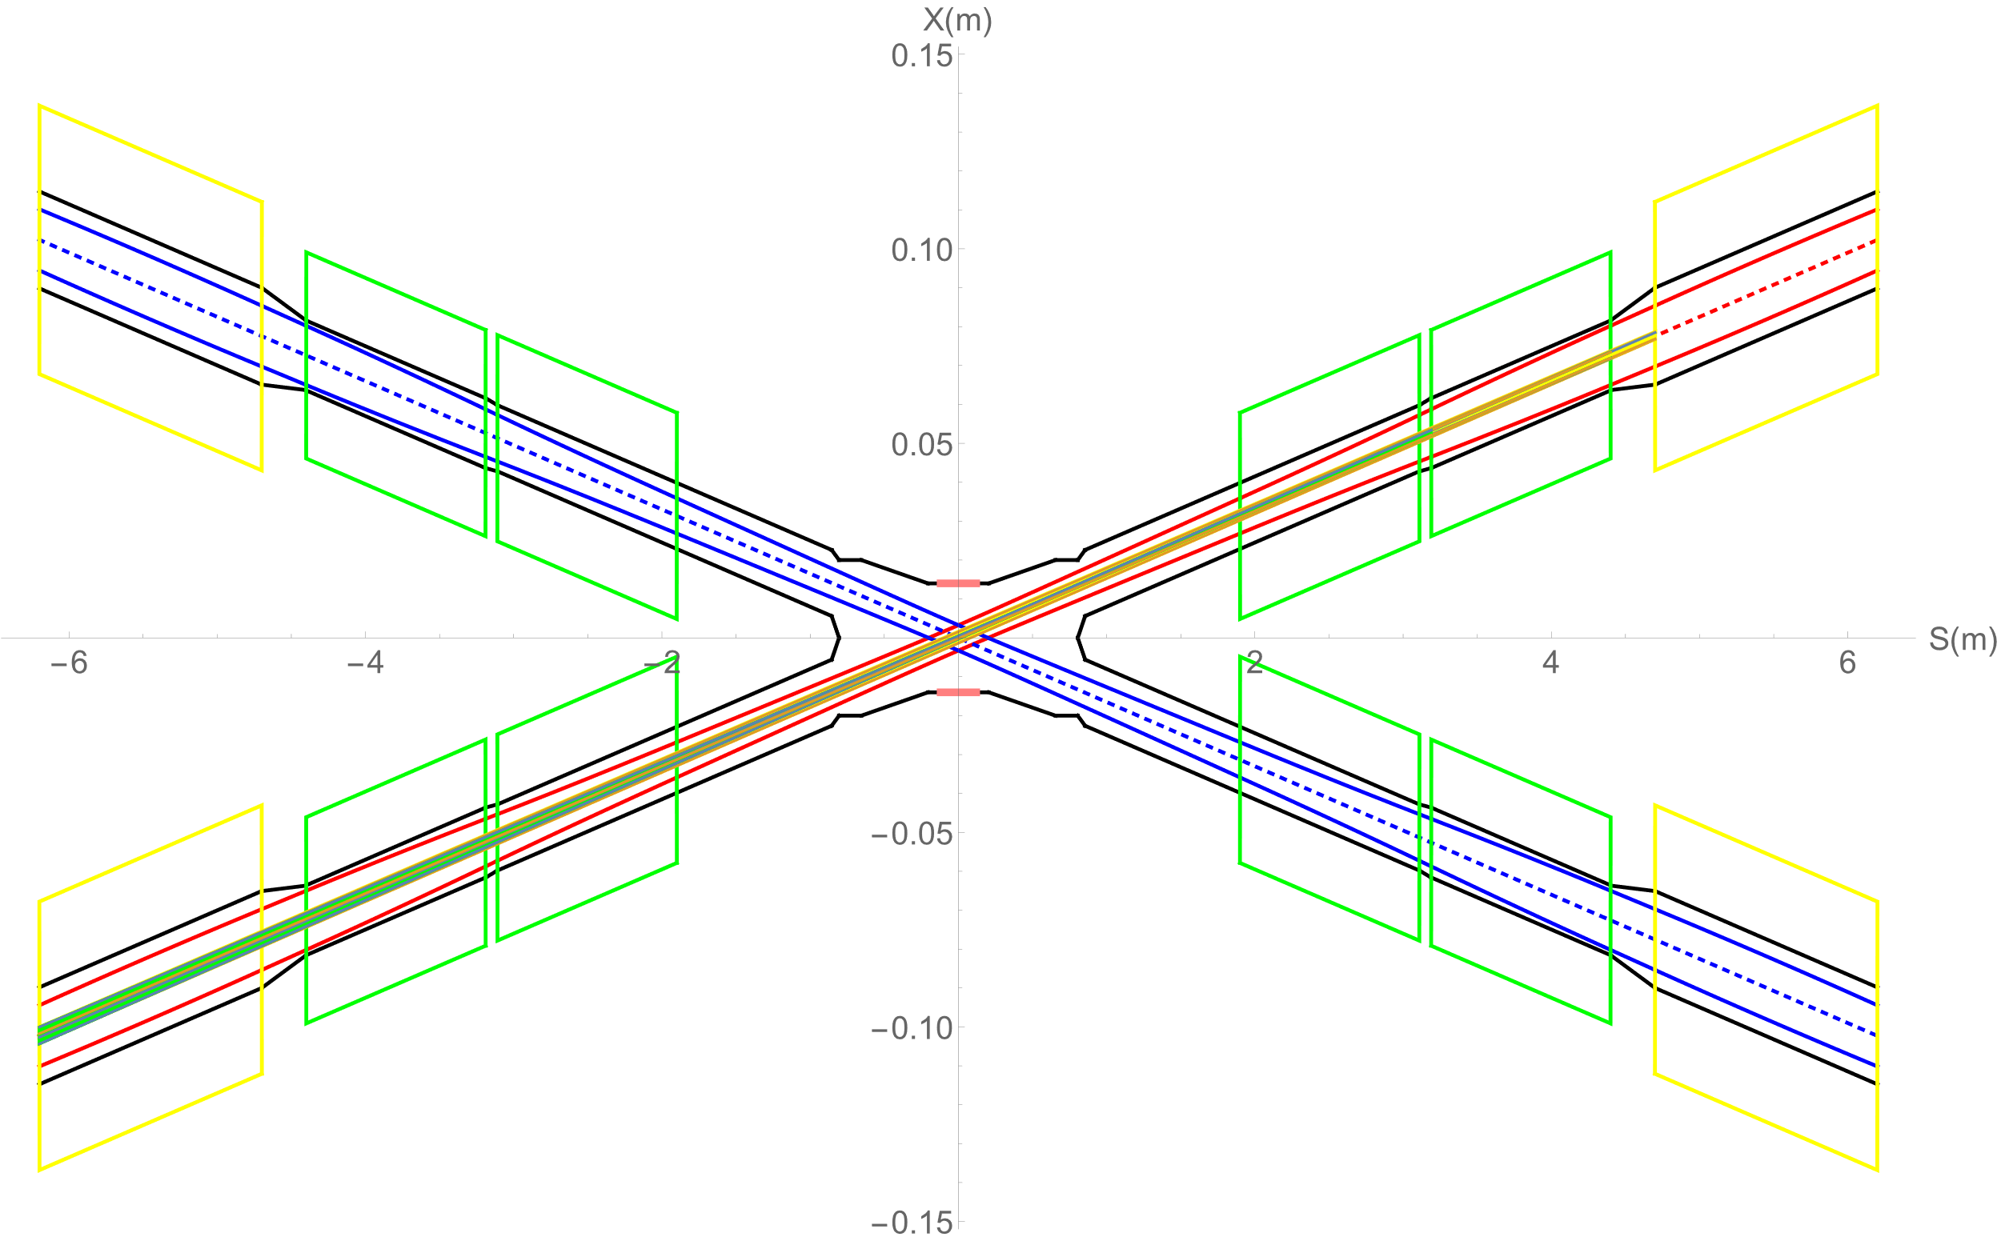
Synchrotron radiation from FD with alignment error ~100um orbit distortion
SR from FD within 3σx
SR from FD within 10σx
SR from FD within 13σx
SR photons generation within 3σx, 10σx, 13σx
~100um orbit distortion after error correction
No SR photons directly hitting or once-scattering to the detector.
Results similar with from ~50um orbit distortion
Conclusion consistent with CDR

Slide 6
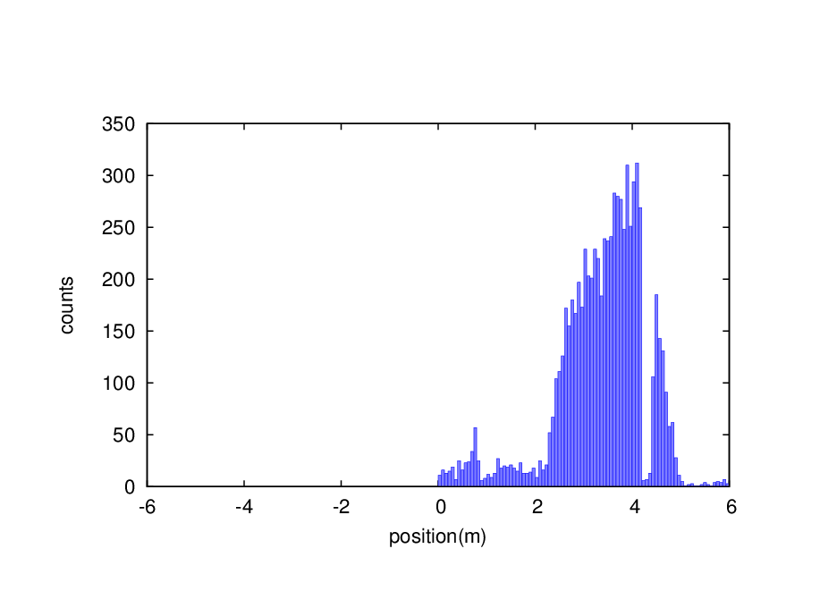
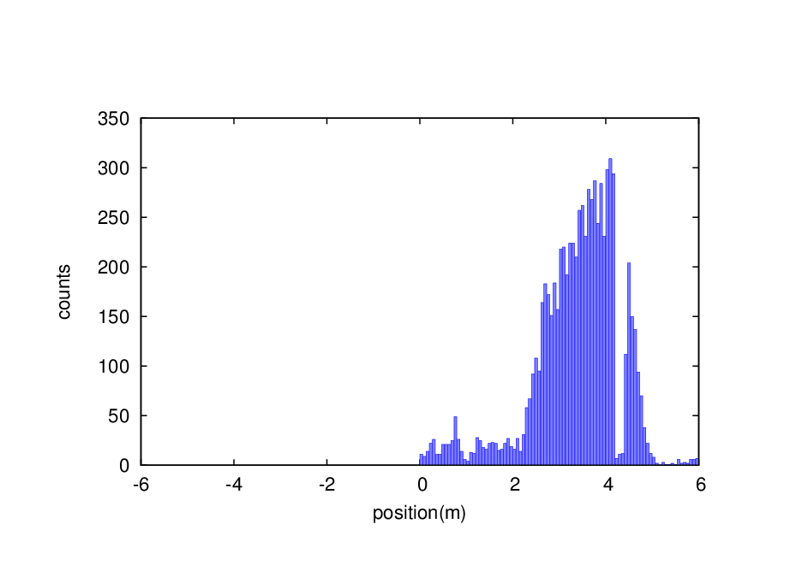
Beam loss background - RBB
Without error
With 50um orbit distortion
With 100um orbit distortion
~50um orbit distortion after correction
50um & 100um orbit distortion comparison with no error
0.23% increase of RBB beam loss particles from IR ~ ±6m
0.2% increase of RBB beam loss particles from IR ~ ±100m
No obvious evidence to improve collimators

Slide 7
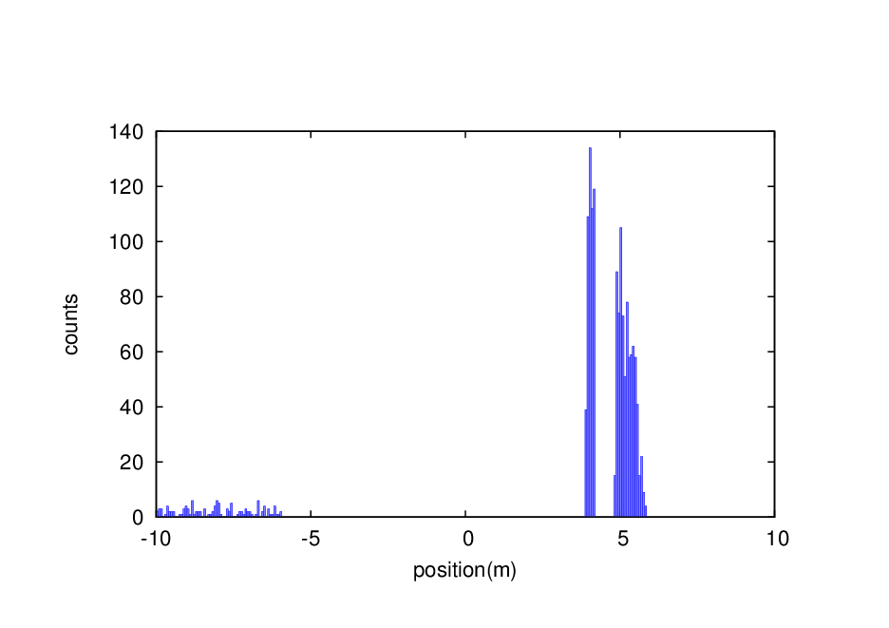
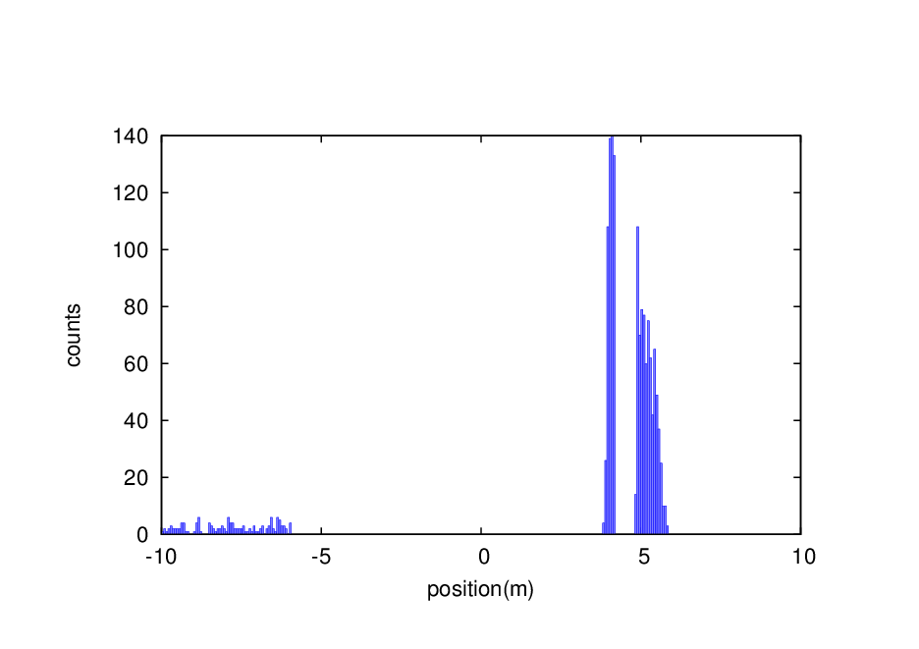
Beam loss background – Beam Gas inelastic-scattering
Without error
With 50um orbit distortion
With 100um orbit distortion
~50um orbit distortion after correction
50um & 100um orbit distortion comparison with no error
0.9% increase of BG beam loss particles from IR ~ ±6m
1.48% increase of BG beam loss particles from IR ~ ±100m
No obvious evidence to improve collimators

Slide 8
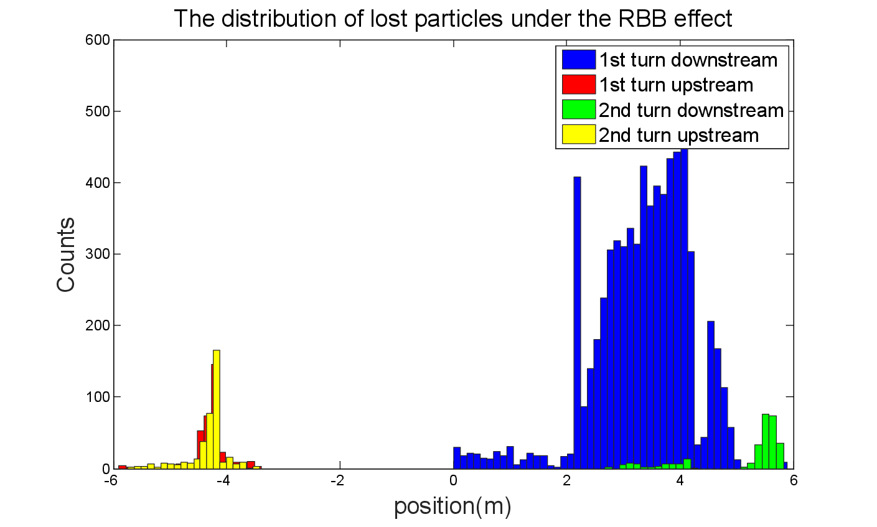
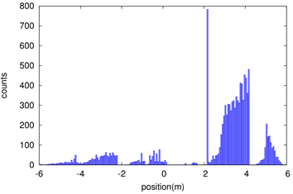
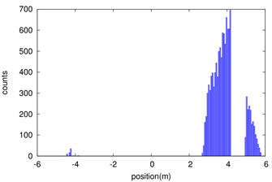
Shielding
Beam loss in the downstream IR with a large amount, due to the process of radiative bhabha scattering, beamstrahlung, beam-gas scattering, beam thermal photon scattering.
Radiation dose may damage the SC magnet coil and the detector.
solution
1. Tungsten IR beam pipe,
2. Combined iron and tungsten yoke of SC magnet
The distribution of lost particles under BG effect
The distribution of lost particles under BTH effect

Slide 9
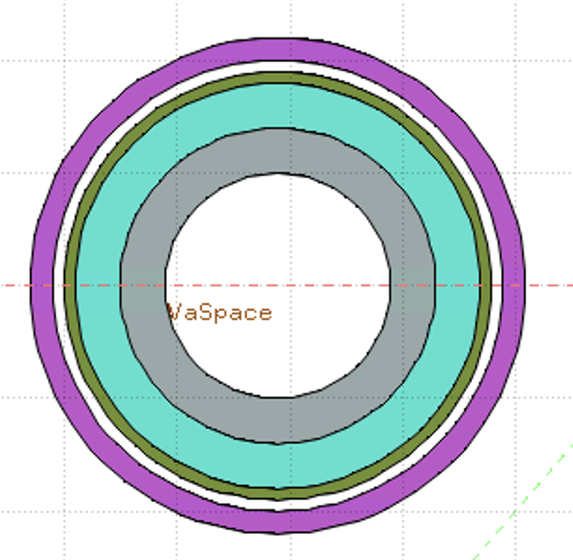
Simulation for Dose on Coil of SC
Key Issues on Calculation and Simplification of Beam pipe model
Pure tungsten IR beam pipe with 4mm thickness without cooling taken into account, simulate the Absorbed Dose on Coil (Region)
Use FLUKA Cern 4-1.1 as simulation tool
Import SAD output as source
Geometry: Pipe Only
White: Vacuum
Gray: Tungsten Pipe
Light Green: Helium
Heavy Green: Stainless Steel Vassel
Pink: Coil

Slide 10
Preliminary Result of Shielding design
Only Beam-Gas beam loss is taken into account until now
Simulate the Absorbed Dose on Coil(Region)
The result is ~0.013 GeV/g/pri
Take the loss rate calculated by SAD into account:
~0.00166 Gy/s(0.166rad/s)
~14.35 Gy/day
~36662.49 Gy/lifetime(Higgs plans to run 7 years)
Limit is 100000 Gy/lifetime

Slide 11
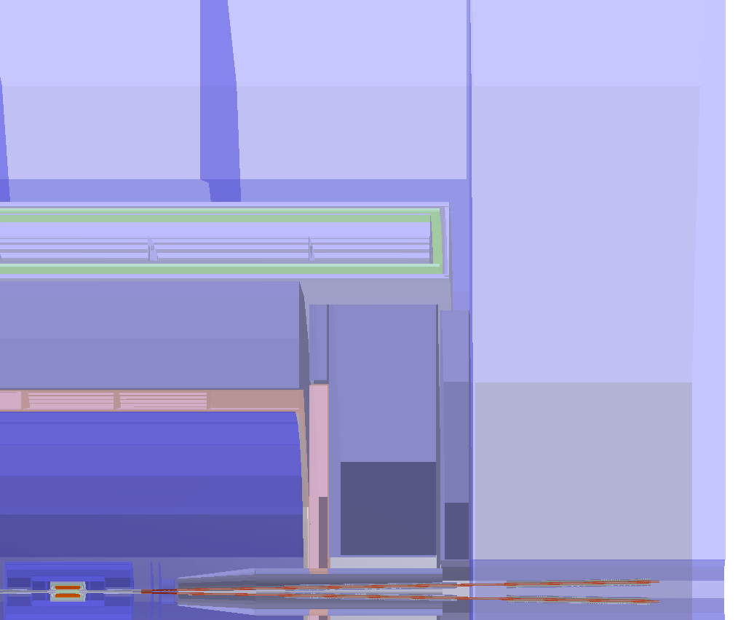
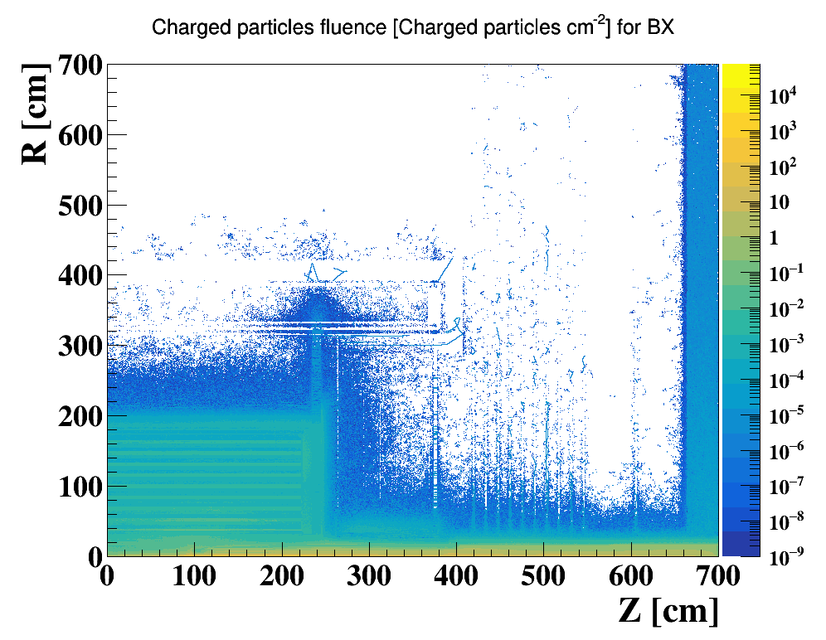
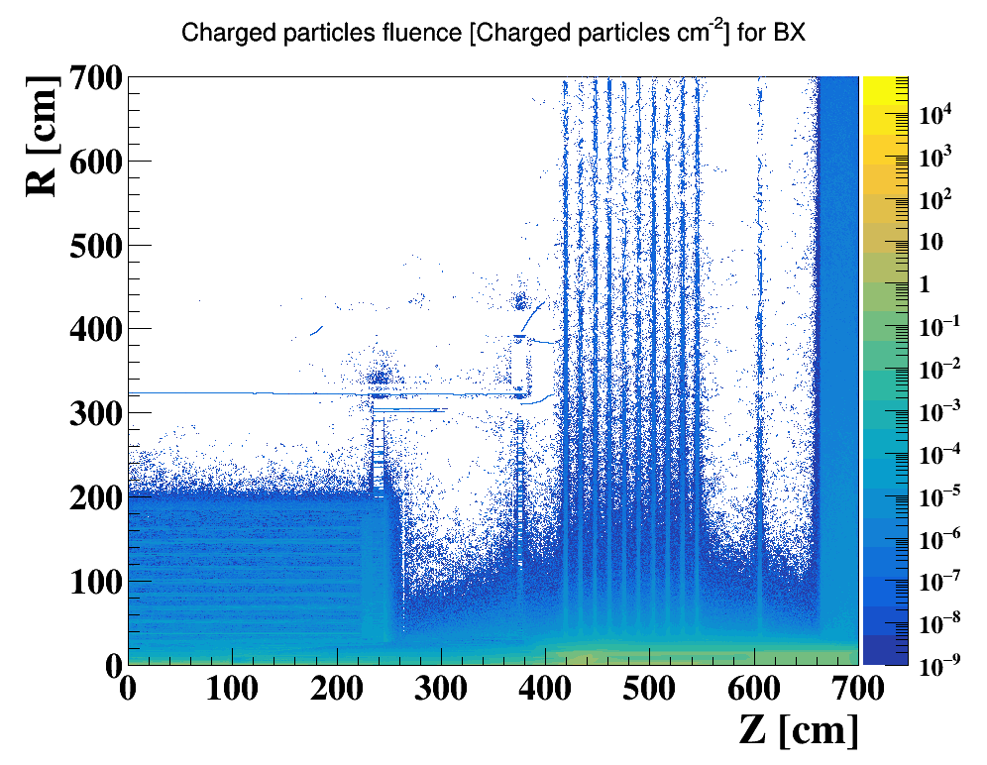
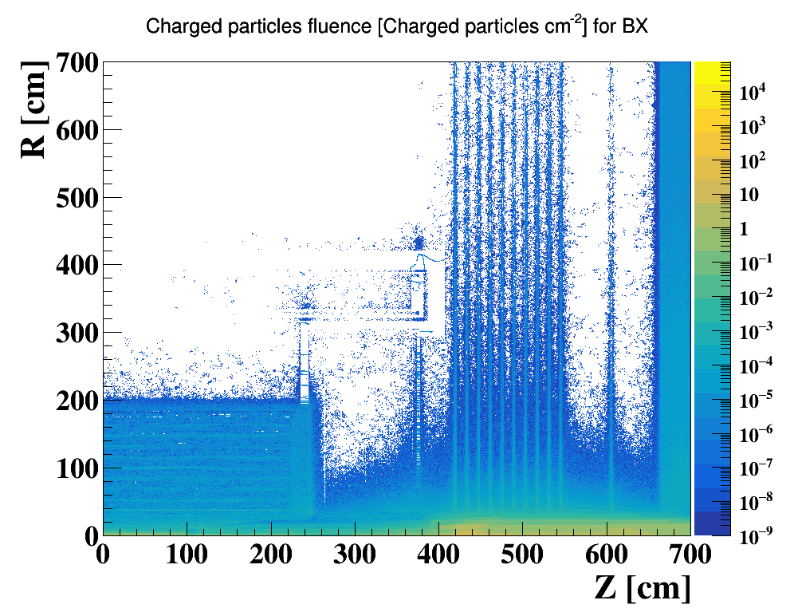
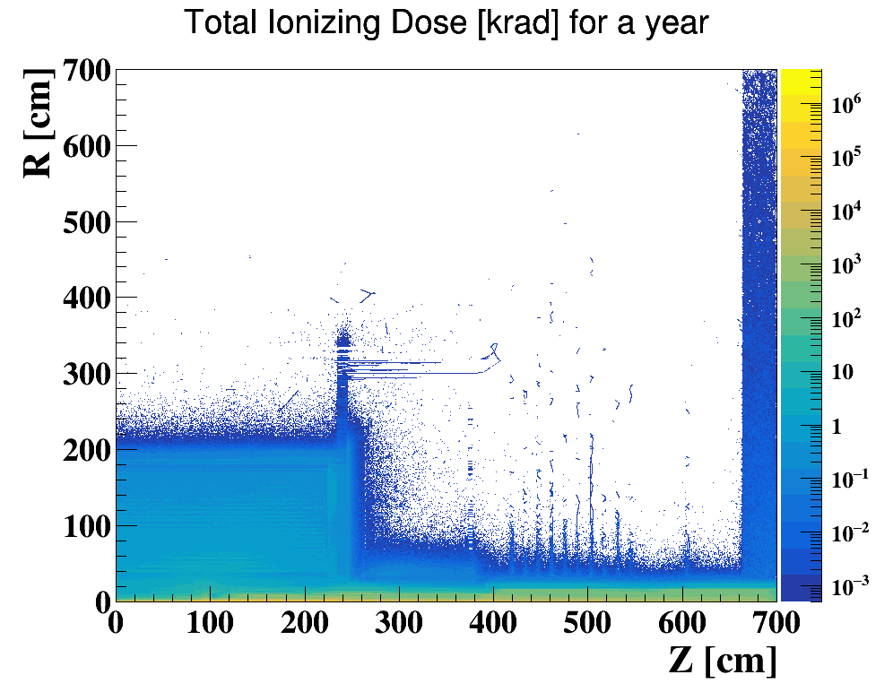
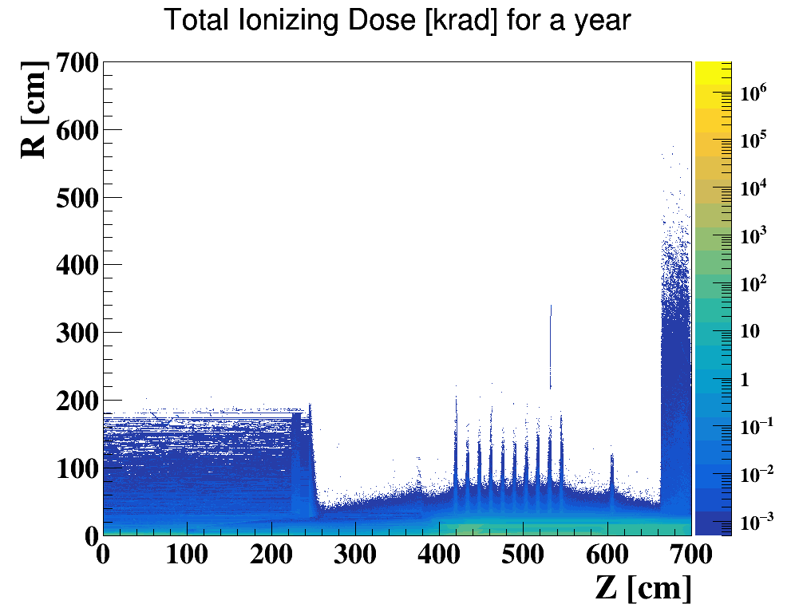
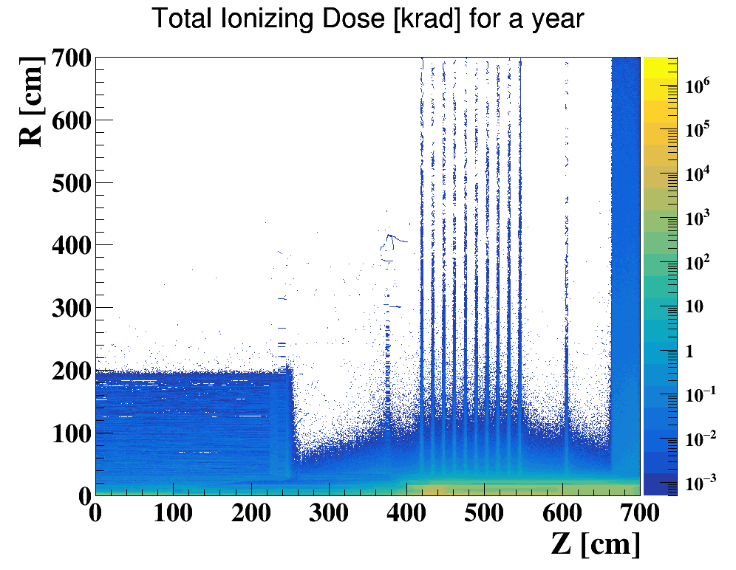
Full Detector Simulation
Pair Production
Beam Gas
Beam Th-Photon
Yoke(barrel)
300cm
Solenoid
Yoke(Endcap)
HCal
200cm
HCal
TPC
400 cm
End cap ring
EMC
Yoke plugin
The full detector simulation on Higgs Mode based on original CDR design & parameter has been performed
28mm Be beam pipe
The impact on detector due to bkg could reach EMC or more
Pair Production contributes most, bth and bgb are at same level, lower than pair production

Slide 12
Summary
SR photons from FD with alignment error will not damage detector components and cause background to experiments.
RBB and BG bkg introduce with orbit distortion, no obvious evidence to improve collimators
Tungsten IR beam pipe is preliminary designed, first results shows dose on coil of SC magnets will not cause SC quench.
The full detector simulation shows the impact on detector due to bkg could reach EMC or more. Pair Production contributes most; bth and bgb are at same level, lower than pair production

