Slide 1


The status of R&D for scintillator muon detector
Xiaolong Wang, Hongyu Zhang, Yuxin Liu, XiangYu Xu,
Xu Dong, Xiyang Wang, Weiqi Meng, Shuaichun Wang
Fudan U./Nankai U.
CEPC Day, Aug. 30, 2021

Slide 2
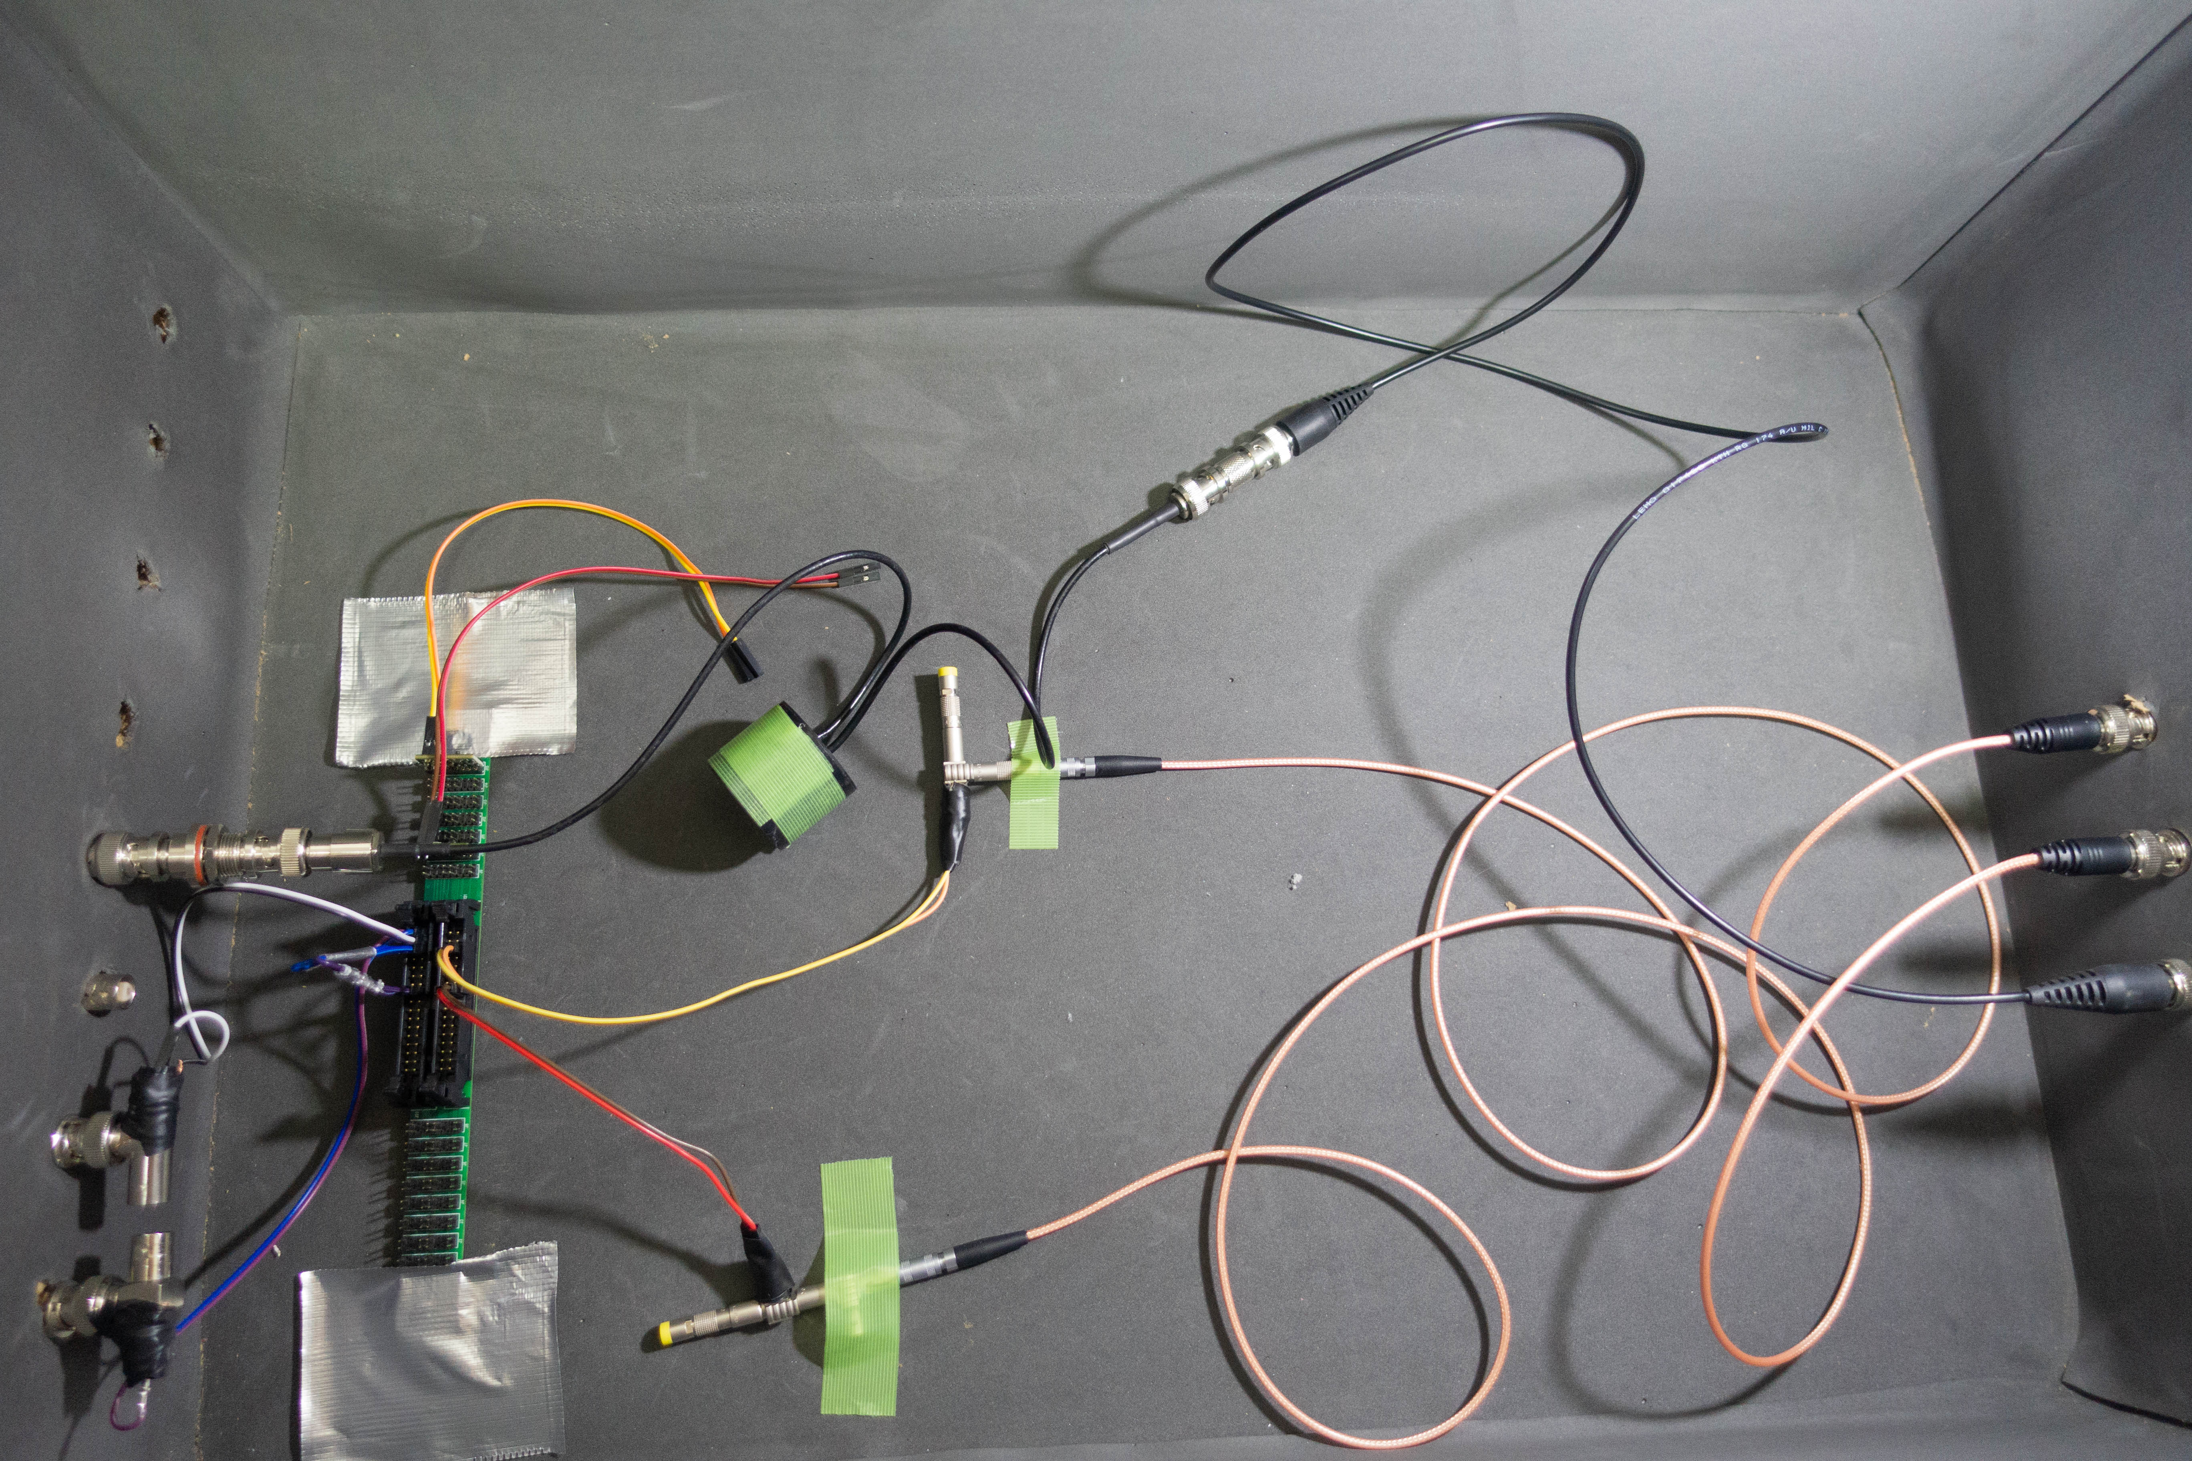
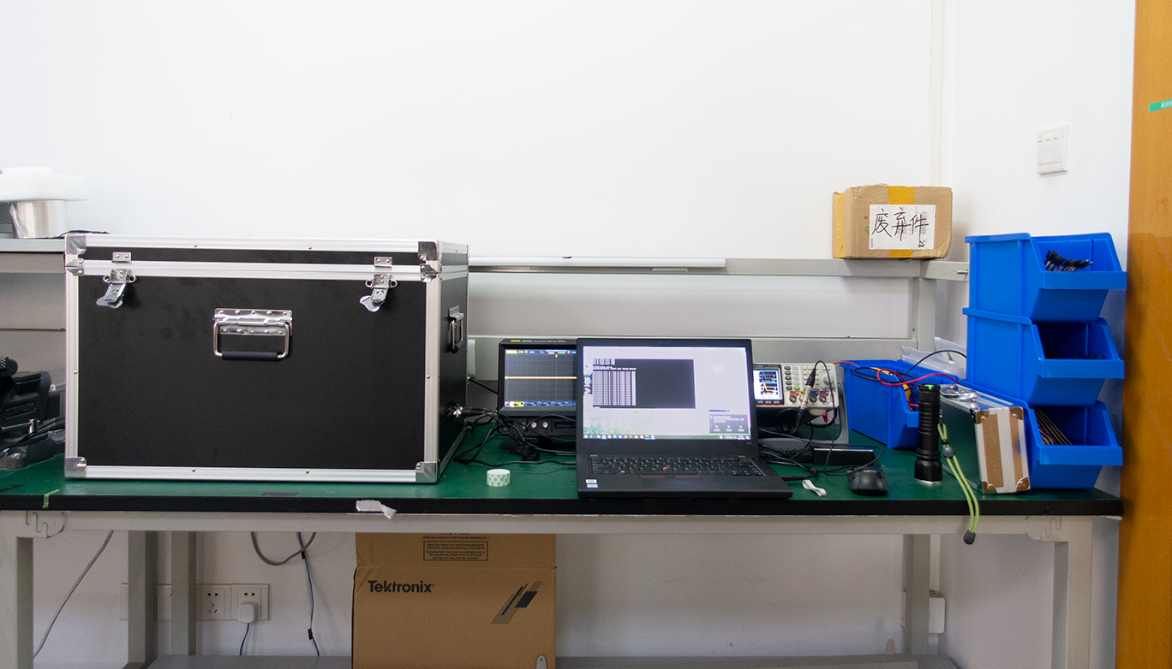
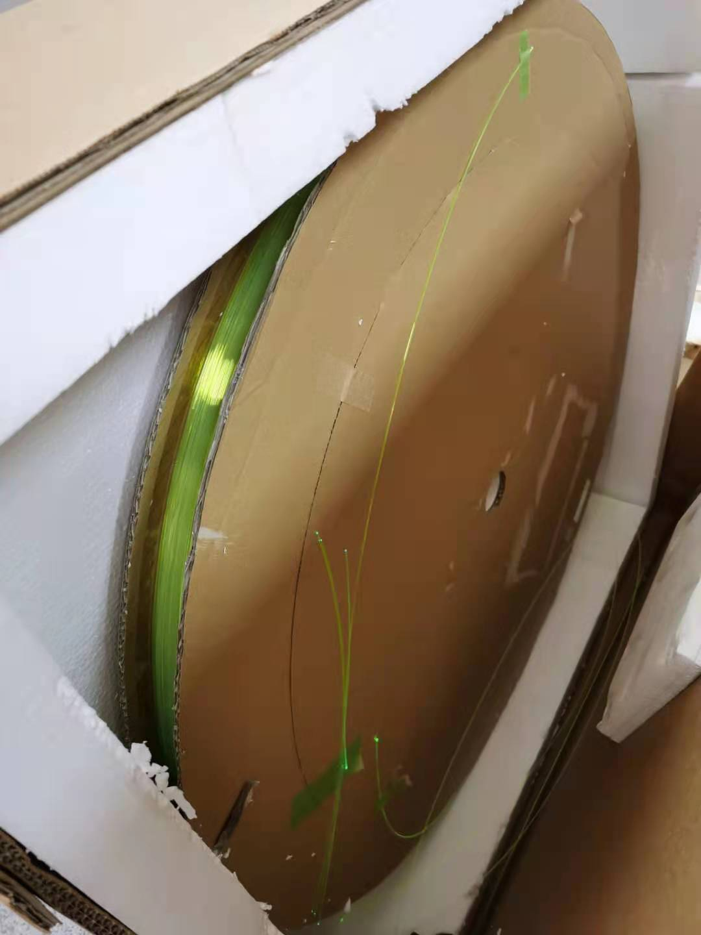
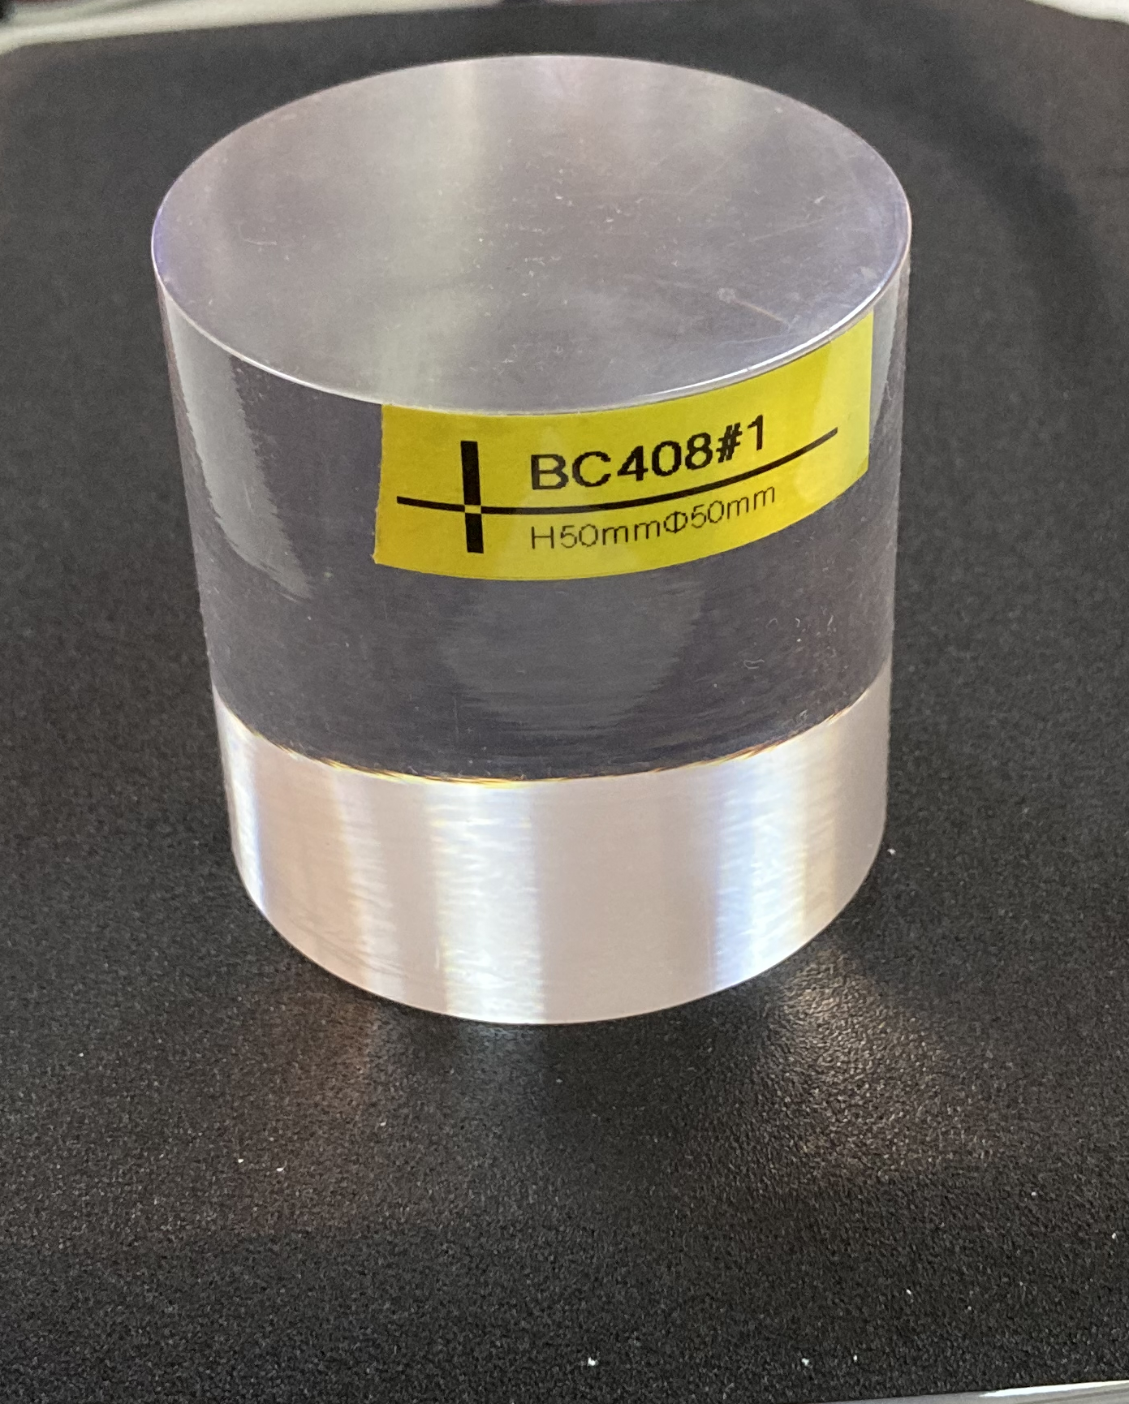
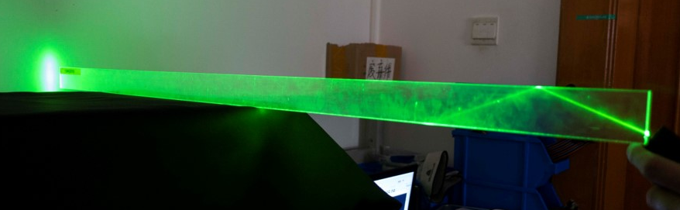
Something new
And new MPPCs from KEK.
Our last report on scintillator muon detector was in 2020…
We report something after WS at 扬州 this time.
MCP-PMT
Dark box
Kurary WLS fibre
New scintillator strip
BC400
Long attenuation length!
High time resolution!

Slide 3
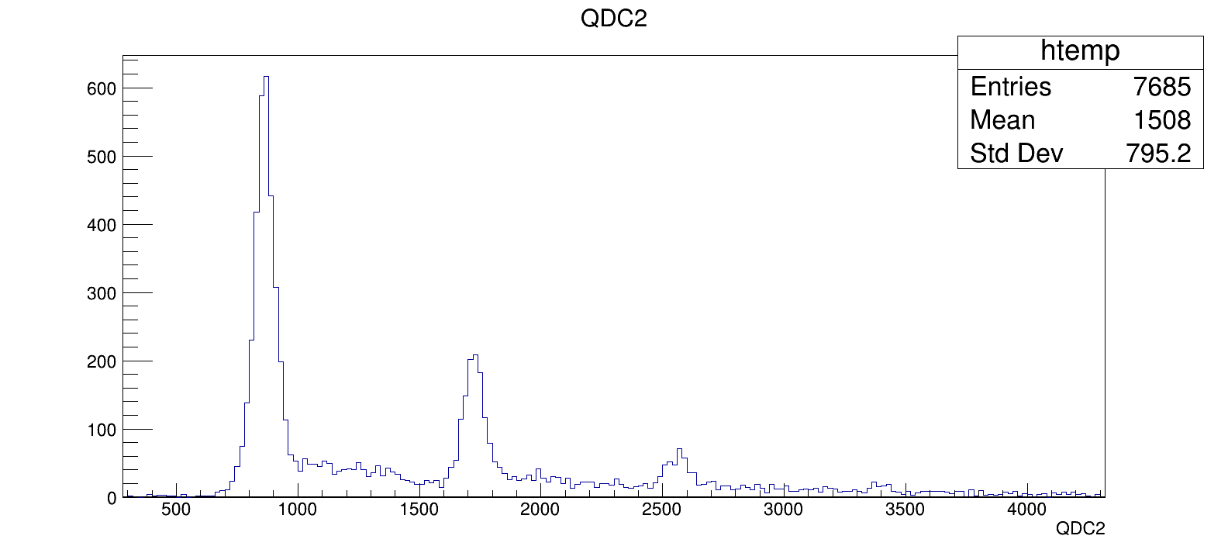
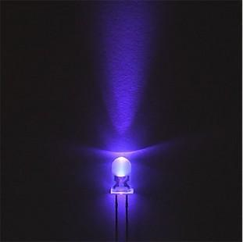
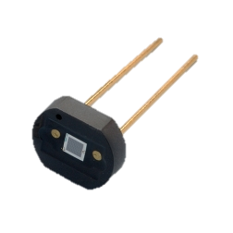
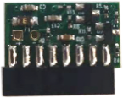
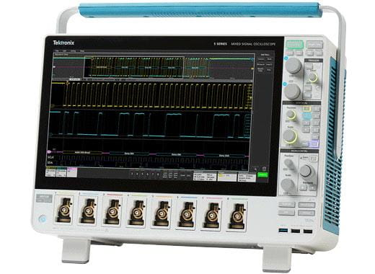
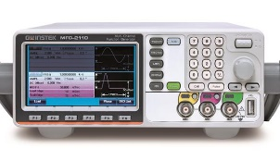
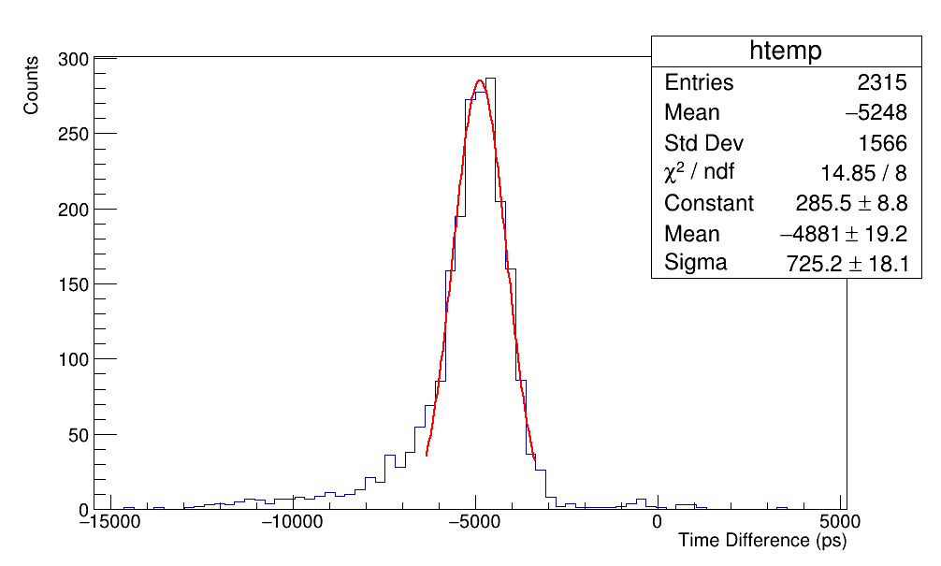
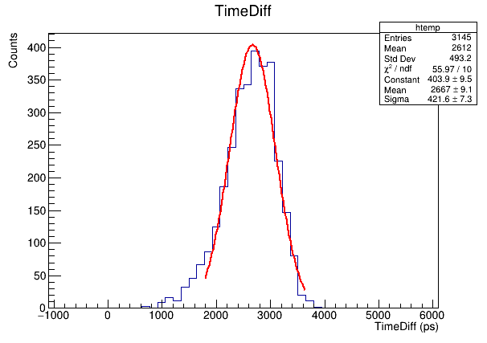
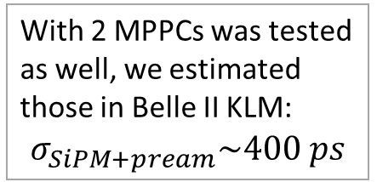

Study with MPPC only
Black Box
Differential
Amplifier
1 p.e.
LED
MPPC
13360-1350cs
Signal
QDC
Oscilloscope: 6.25 GS/s
Reference
MFG-2200
$$σ_{acq}=17.0 ps$$
MSO 56 Oscilloscope
With 2 MPPCs was tested as well, we estimated those in Belle II KLM:
$$σ_{SiPM+pream}\sim 400 ps$$
1 p.e.
12 – 15 p.e.

Slide 4
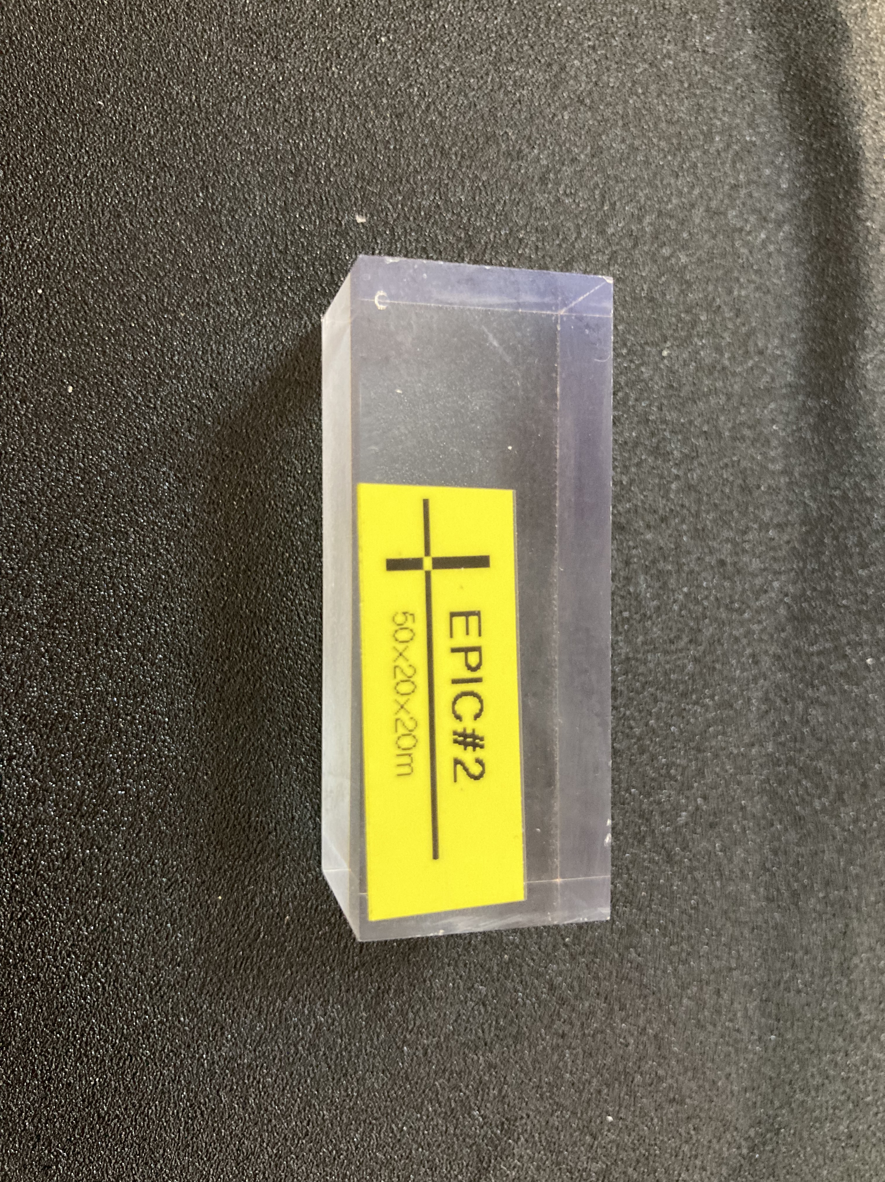
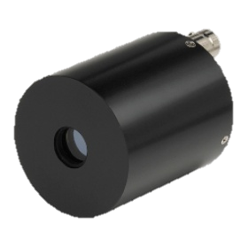

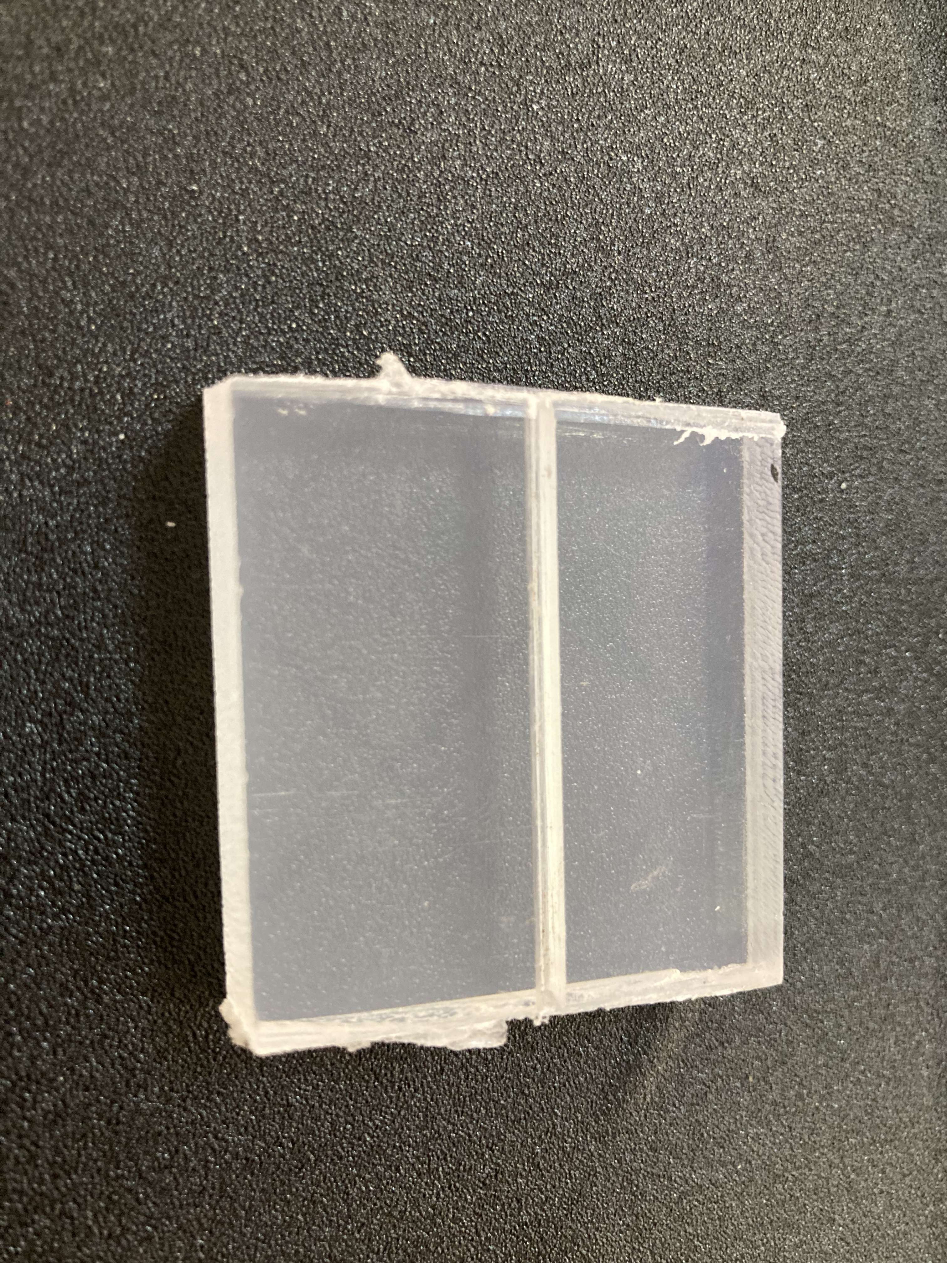

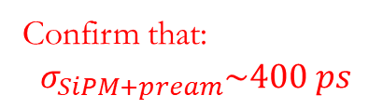

Study with MCP-PMT
#EPIC
Muon comes from cosmic ray or electron from radioactive source
Black Box
Differential
Amplifier
$$\sim 64 ps$$
MPPC
13360-1350cs
Scintillator
MCP-PMT
Signal 2
Signal 1
BC400
MSO 56 Oscilloscope
Confirm that:
$$σ_{SiPM+pream}\sim 400 ps$$
$$σ=487±21 ps$$

Slide 5


2 MCP+1 scint.
Black Box
Cosmic rays
Or radiation source
Study with a setup of high time resolution.
Uncertainty from geometry.
$$\sim 26 ps$$
MCP-PMT
$$\sim 28 ps$$
MCP-PMT
Scintillator
Signal 2
Signal 1
MSO 56 Oscilloscope

Slide 6
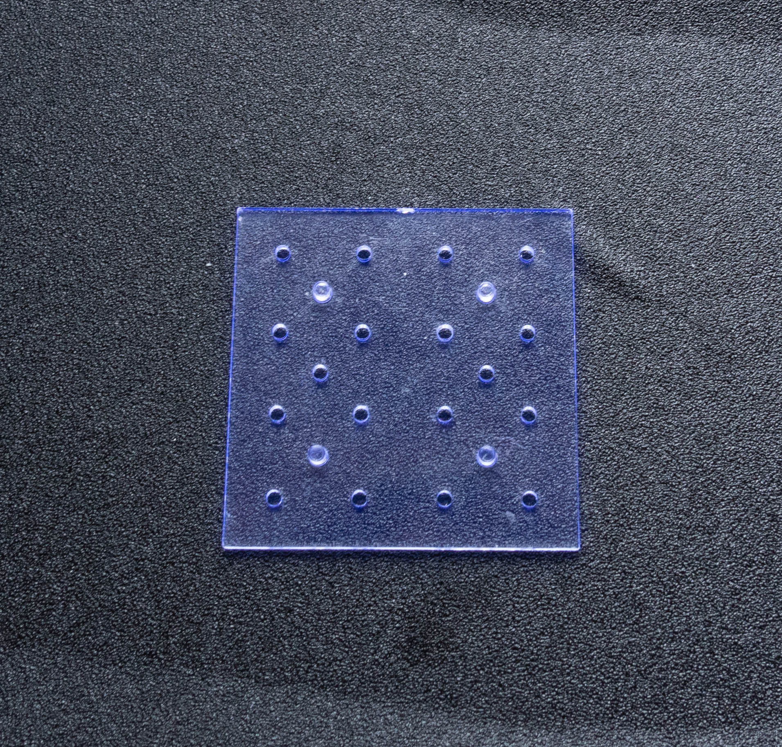

Reasonable results
Cosmic Ray
NICA
EMcal
BC400
$$H=5cm$$
But, there could be uncertainty in photon generation
Cosmic Ray
Cs¹³⁷ in the middle
2

Slide 7
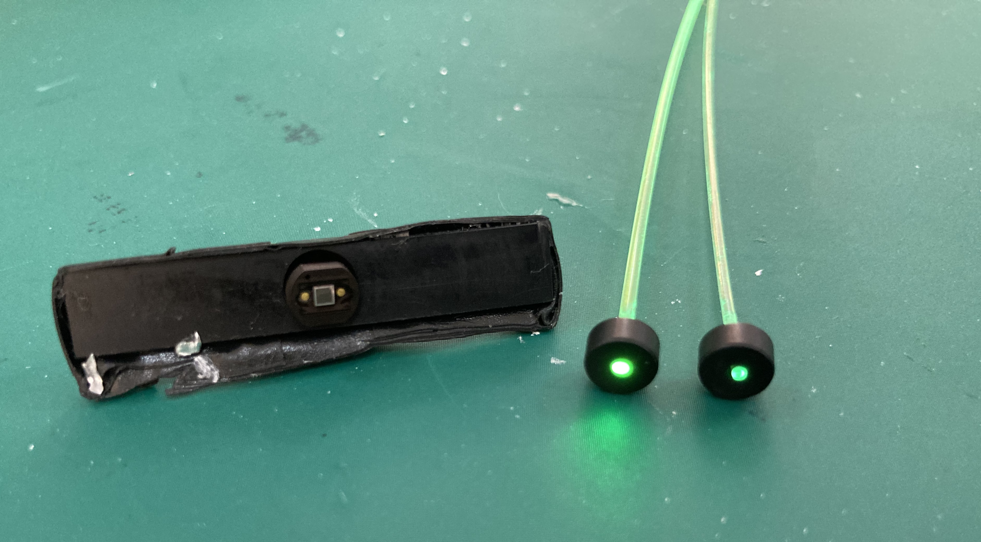
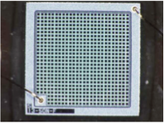
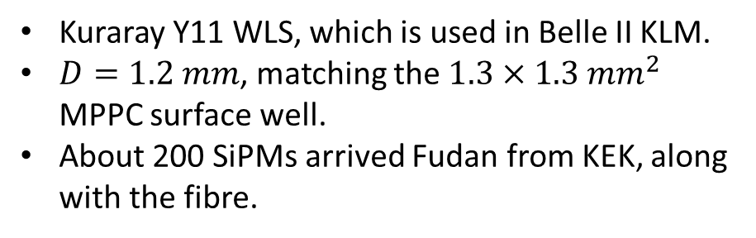

Kuraray WLS fibre
Kuraray
Saint_Gobain
$1.3×1.3 mm^{2}$
Kuraray Y11 WLS, which is used in Belle II KLM.
$D=1.2 mm$, matching the $1.3×1.3 mm^{2}$ MPPC surface well.
About 200 SiPMs arrived Fudan from KEK, along with the fibre.

Slide 8
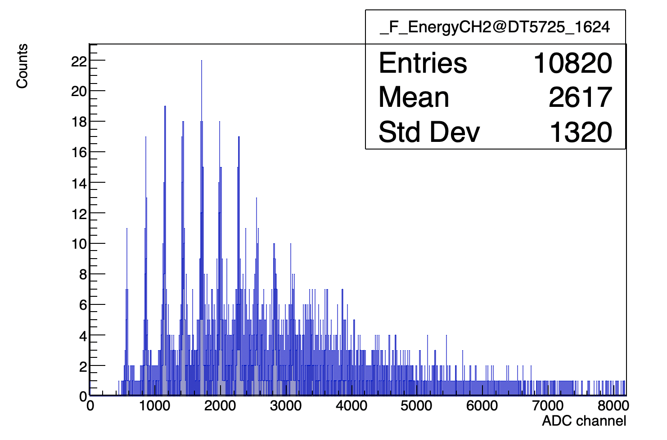
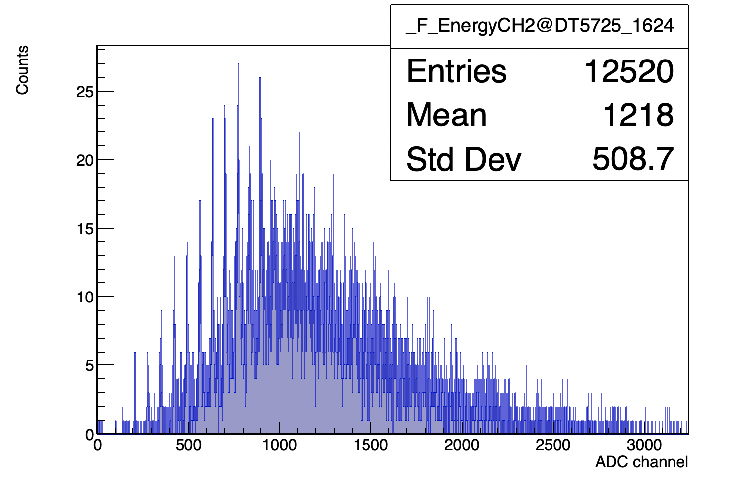
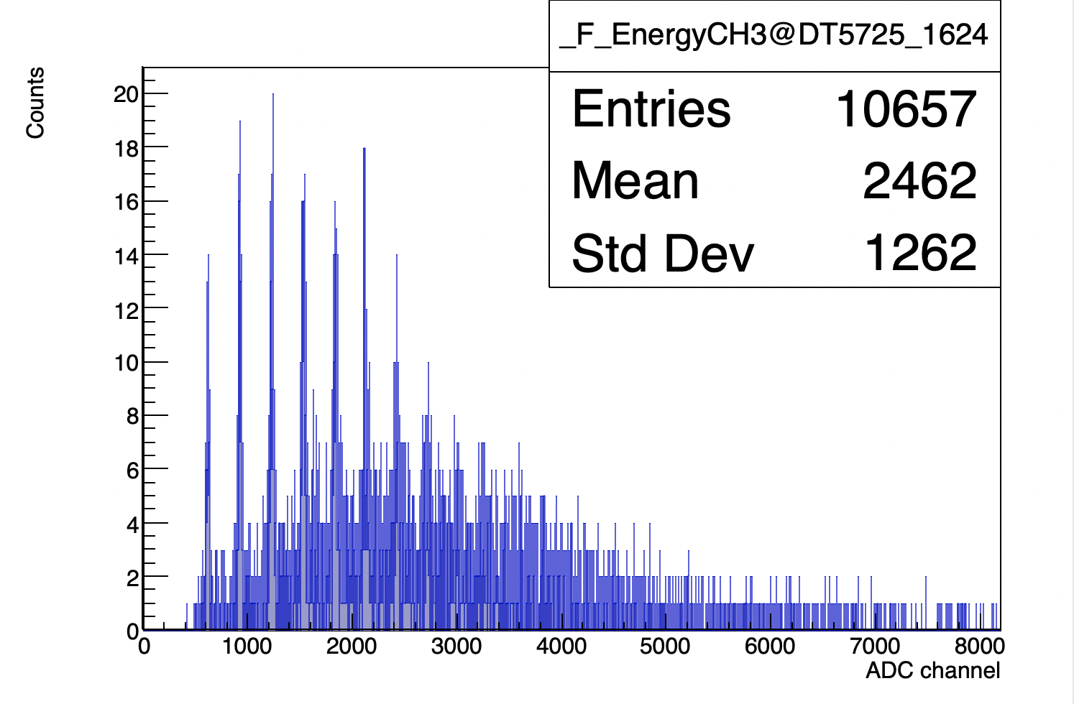
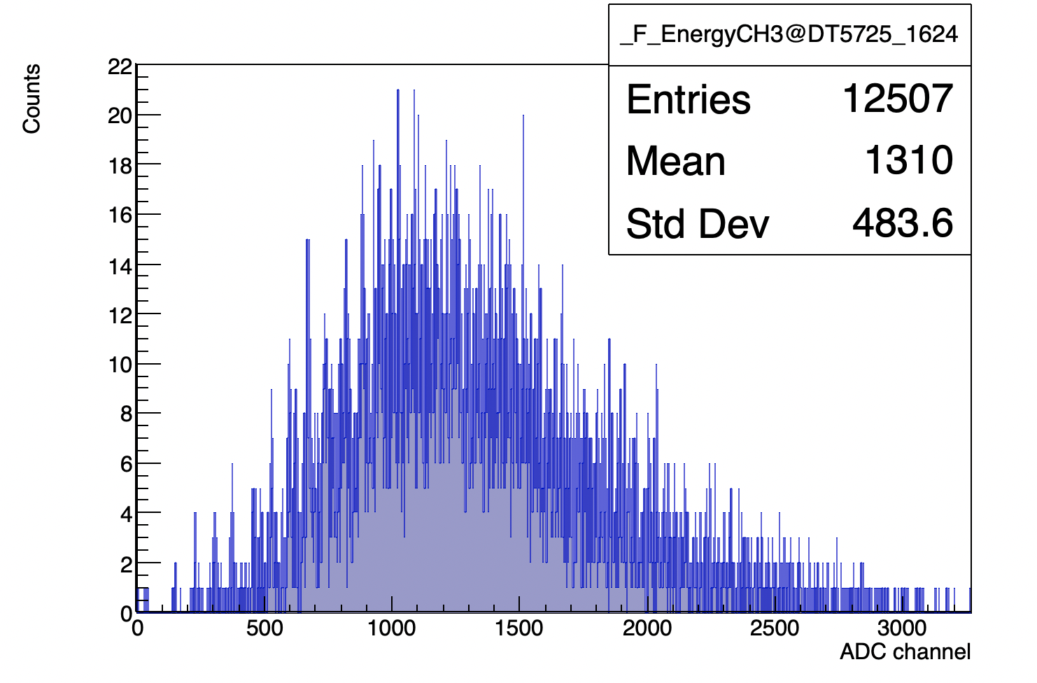
ADC measurement I
Trigger position：0-150cm
Sample#1
ADC/4
Sample#2
Saint_Gobain
Kuraray

Slide 9
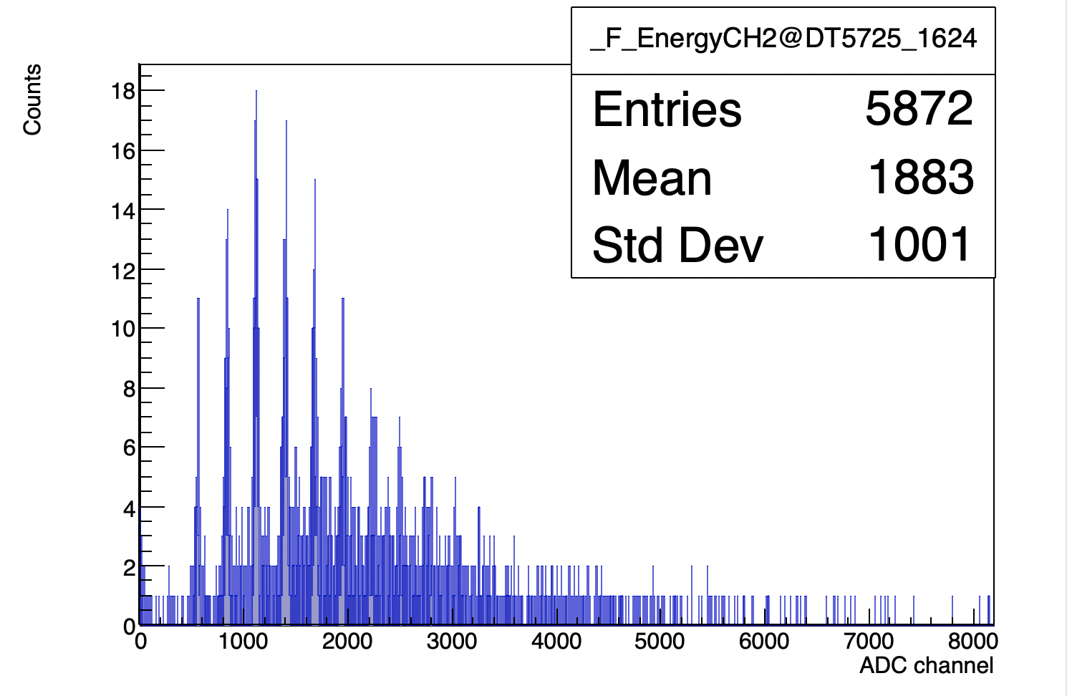
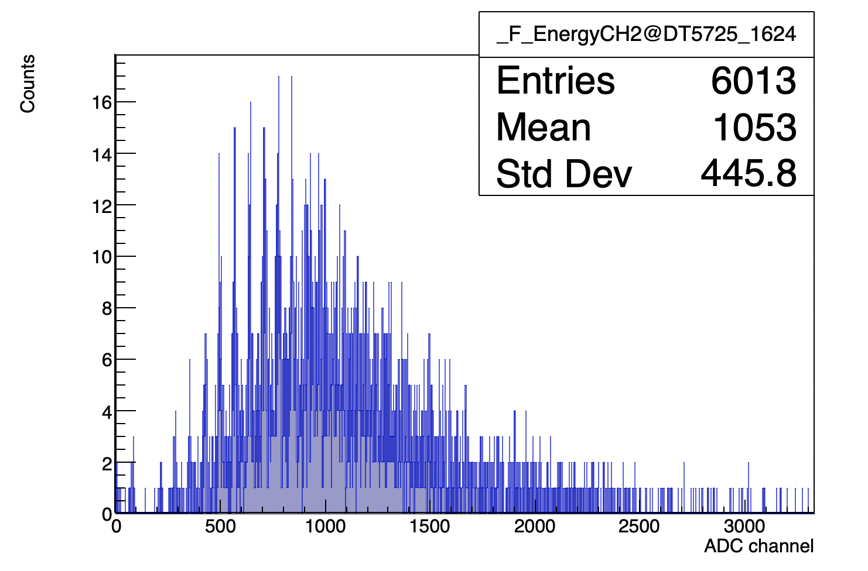
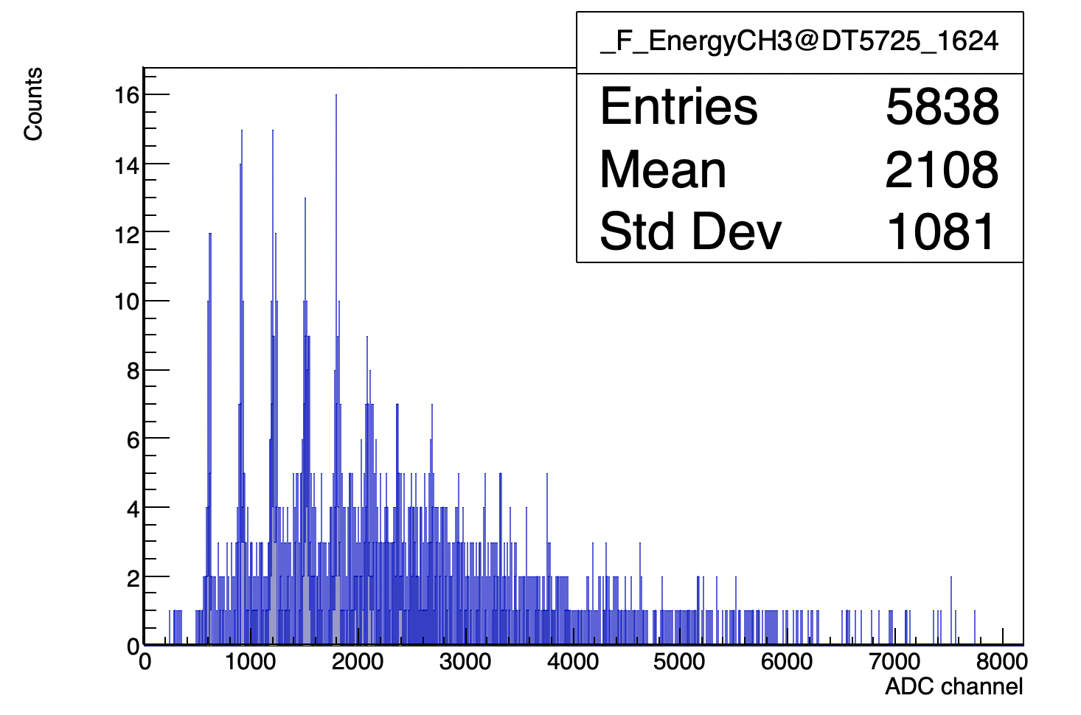
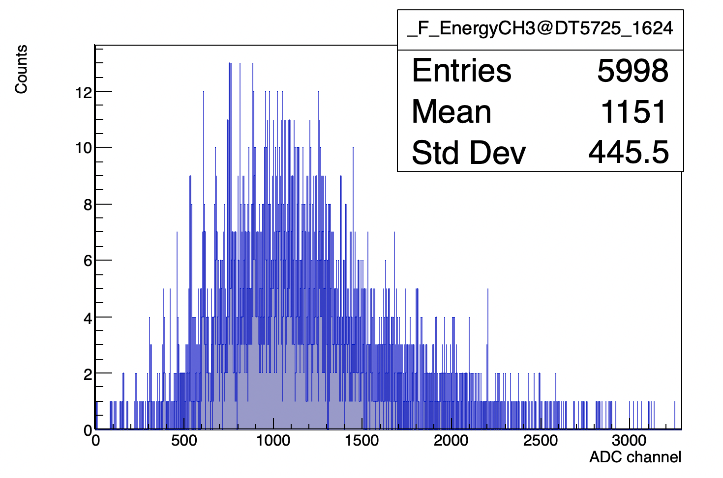

ADC measurement II
Trigger position：$70−80 cm$ (middle)
Sample#1
ADC/4
Saint_Gobain
Kuraray
Sample#2

Slide 10
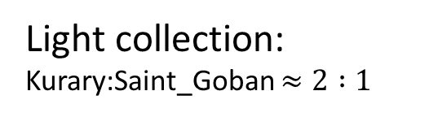
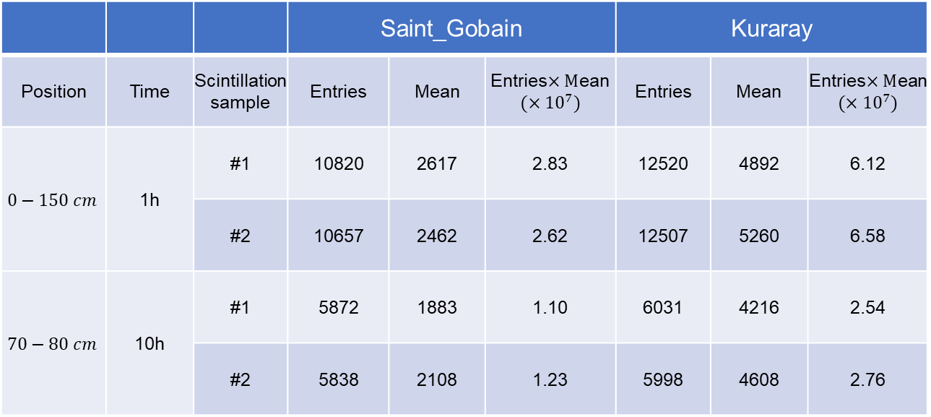
Comparison on WLS fibre
 |  |  | Saint_Gobain |  |  | Kuraray
Position | Time | Scintillation sample | Entries | Mean | Entries$×M$ean $$(×{10}^{7})$$ | Entries | Mean | Entries$×M$ean $$(×{10}^{7})$$
$$0−150 cm$$ | 1h | #1 | 10820 | 2617 | 2.83 | 12520 | 4892 | 6.12
 |  | #2 | 10657 | 2462 | 2.62 | 12507 | 5260 | 6.58
$$70−80 cm$$ | 10h | #1 | 5872 | 1883 | 1.10 | 6031 | 4216 | 2.54
 |  | #2 | 5838 | 2108 | 1.23 | 5998 | 4608 | 2.76
Ratio
Kurary/SG
2.16
2.51
2.30
2.24
Light collection: Kurary:Saint_Goban $≈2 :1$

Slide 11
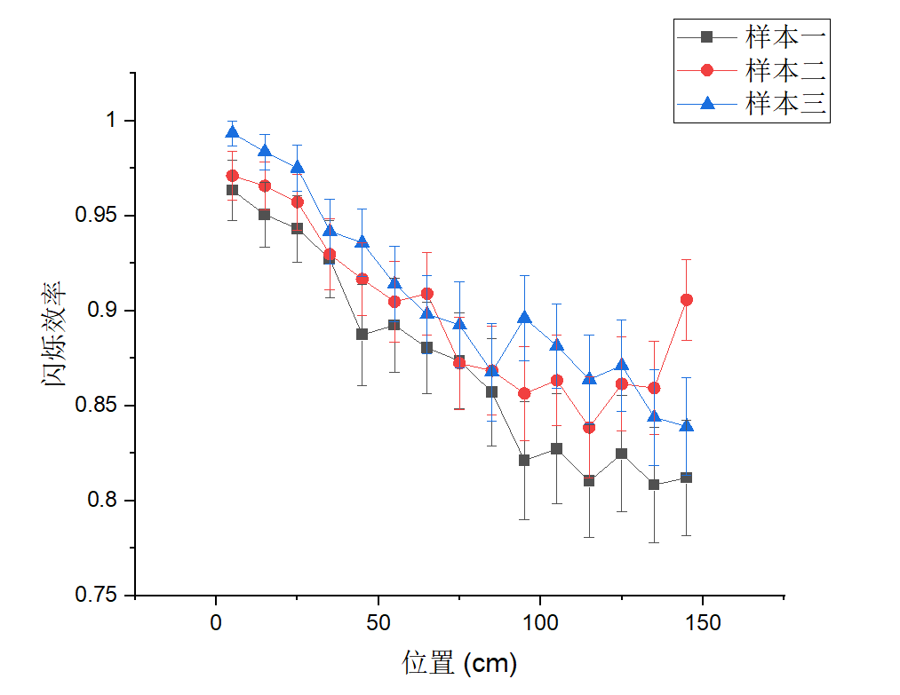
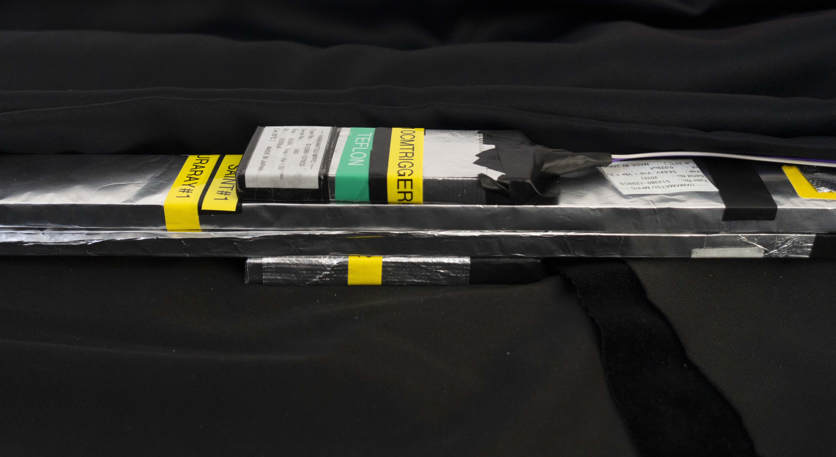
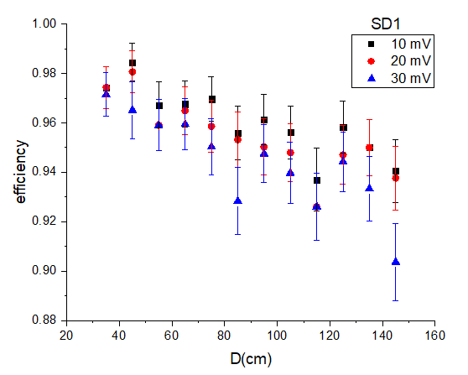
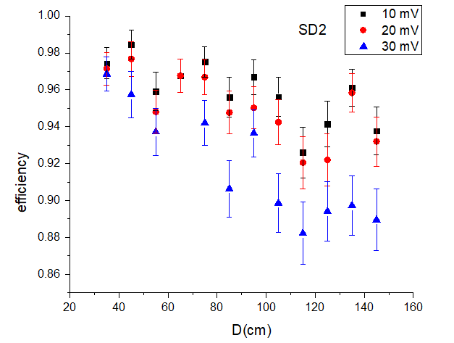
Efficiency study
Saint_Goban
Good improvement on efficiency!
Trigger Threshold：4.5 p.e.
Sample#2
Sample#1
Kurary
Kurary

Slide 12
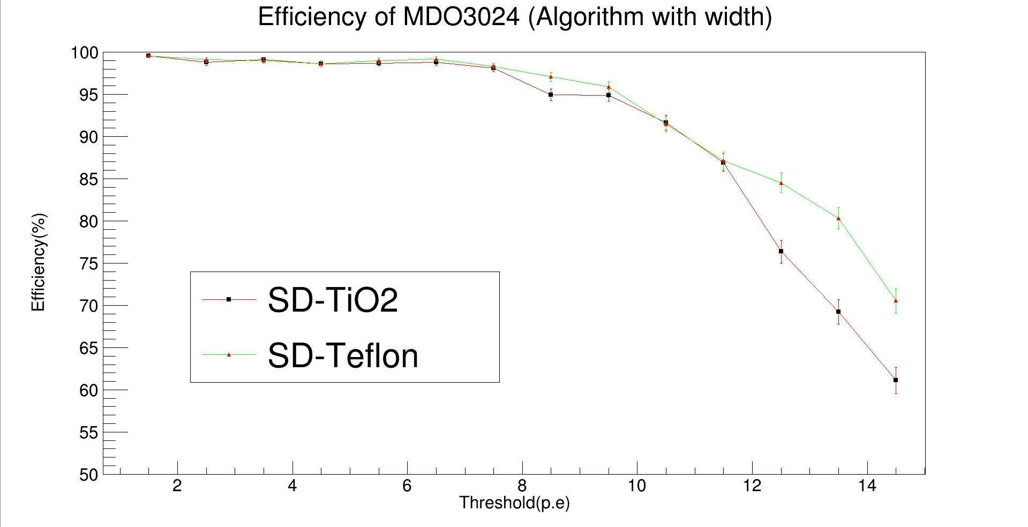
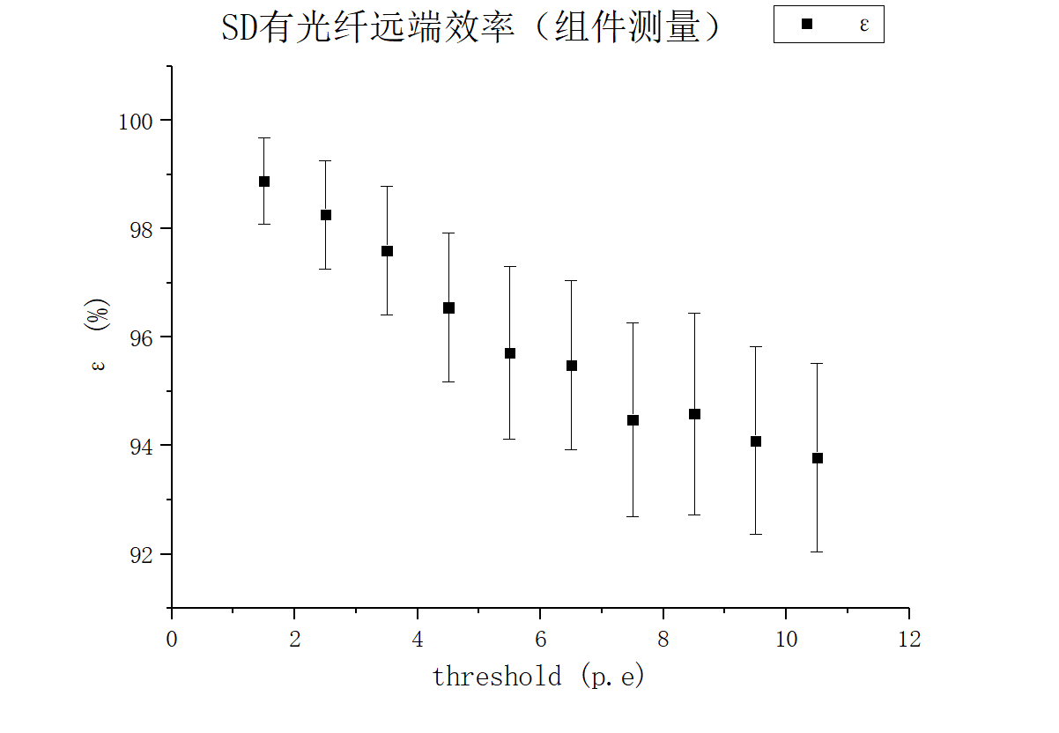
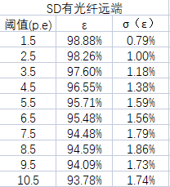
Efficiency study
Trigger at the far end of 1.5m scintillator+WLS Fibre+MPPC
Easy to collect >8 p.e.
We get similar performance of scintillator made in China.
Belle II TDR

Slide 13
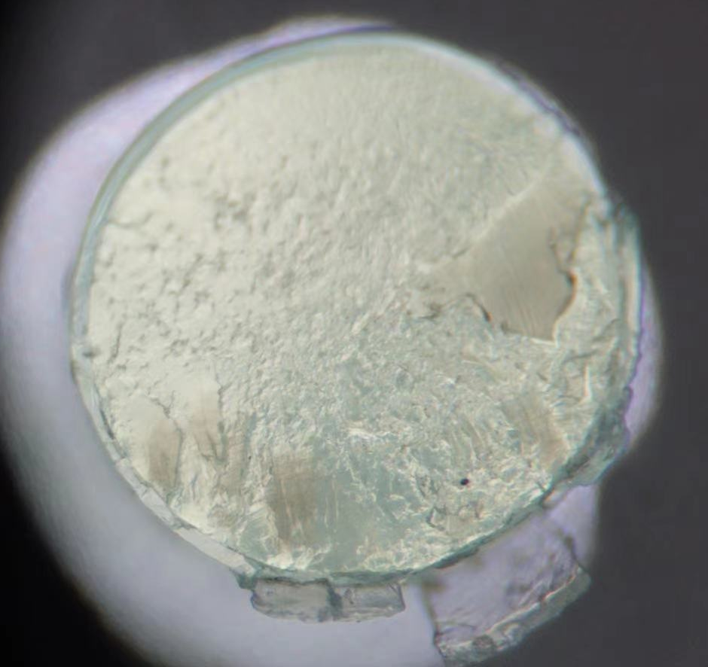
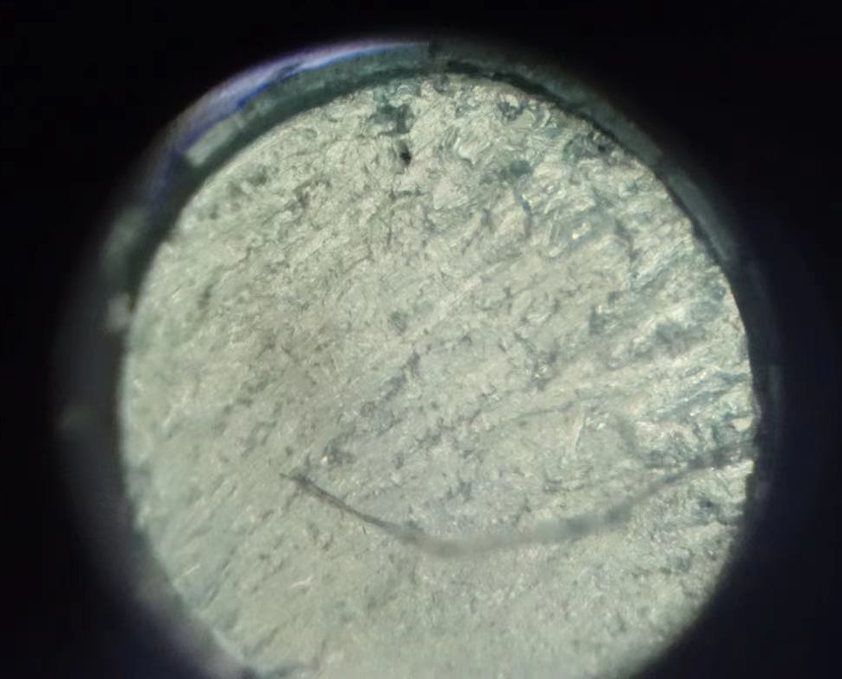
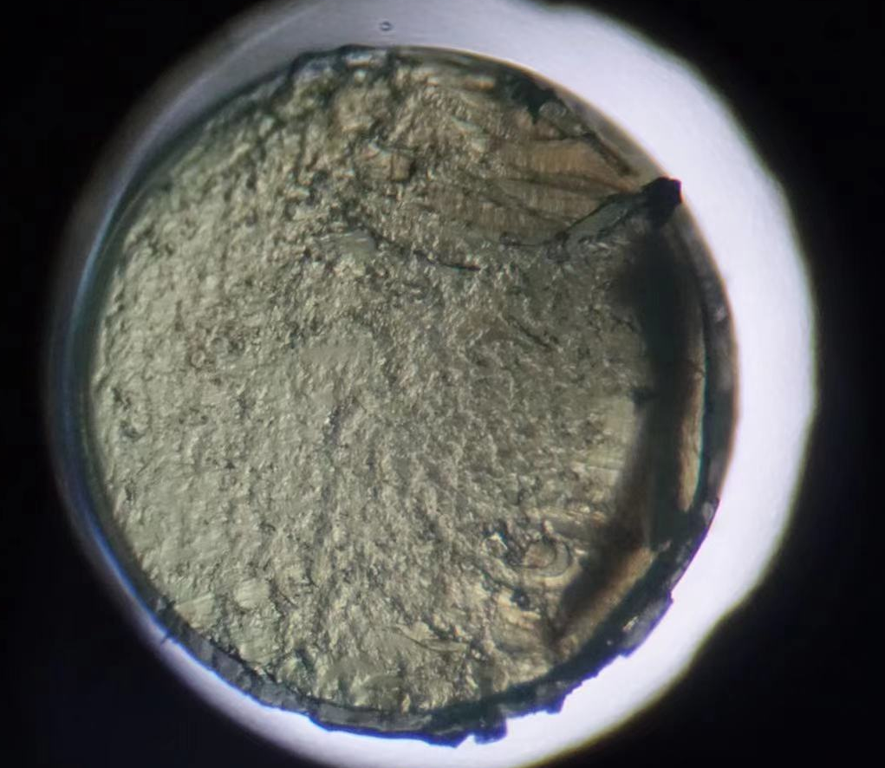
WLS fibre section
Cut with knife,
Random quality…
After surface grinding
With sandpaper
Need improvement on surface grinding for WLS fibre.

Slide 14
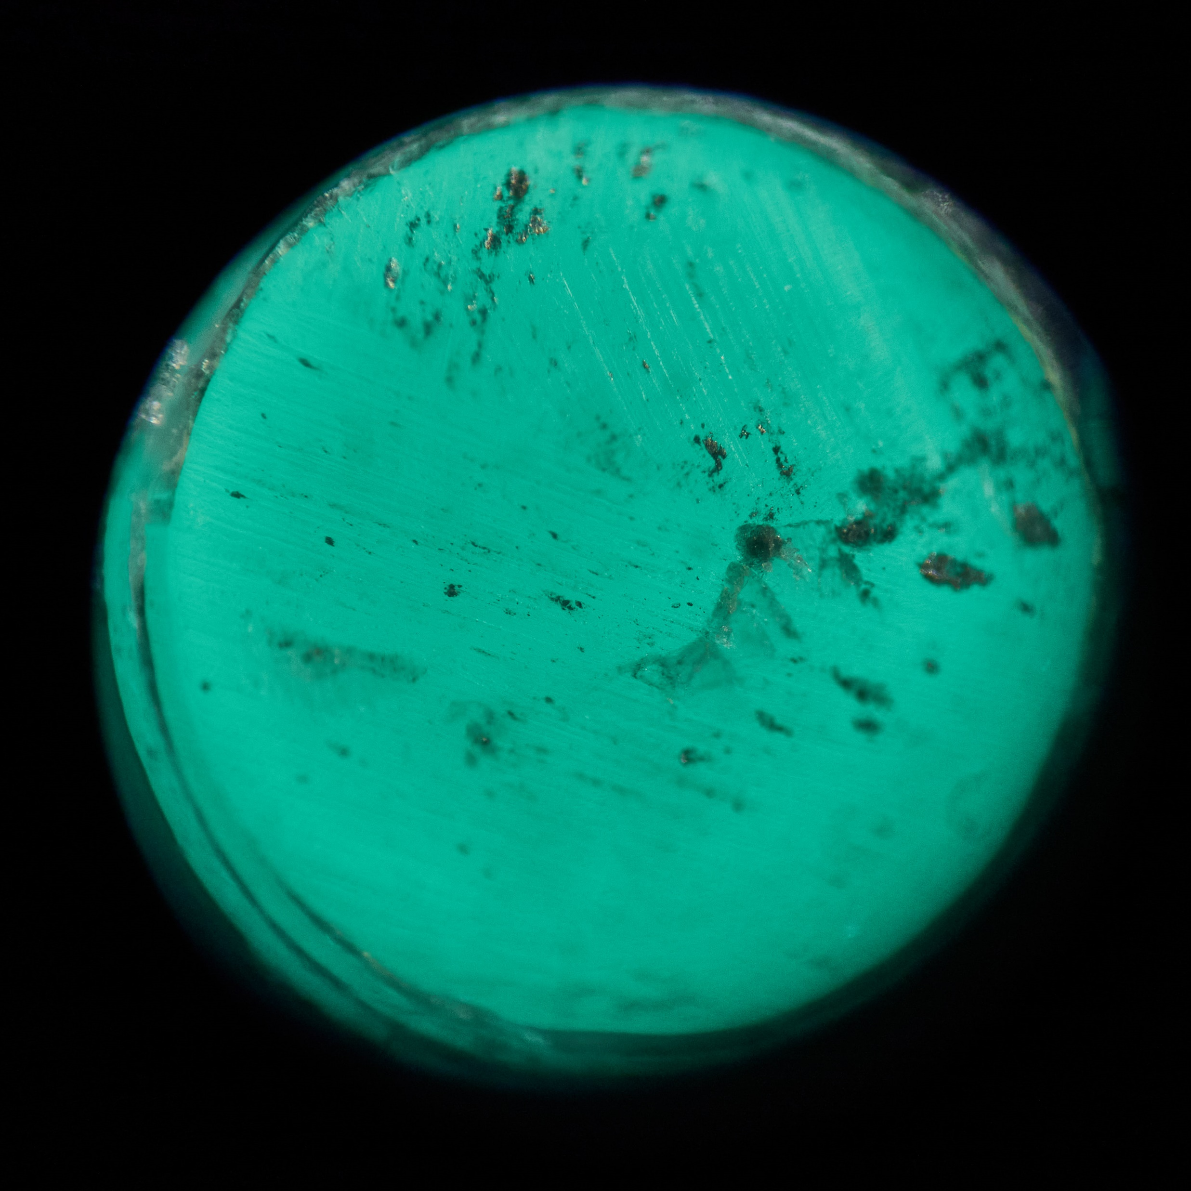
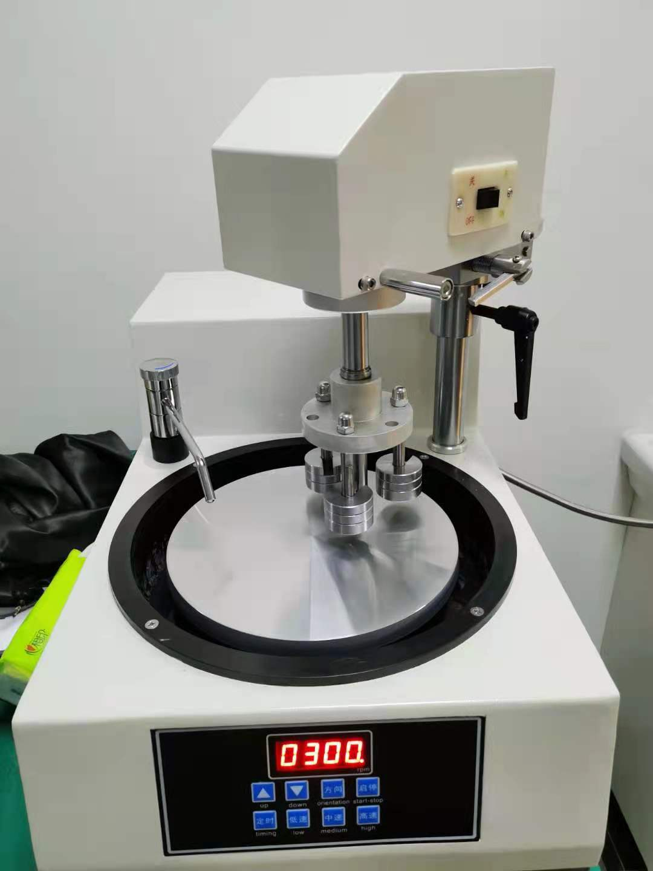
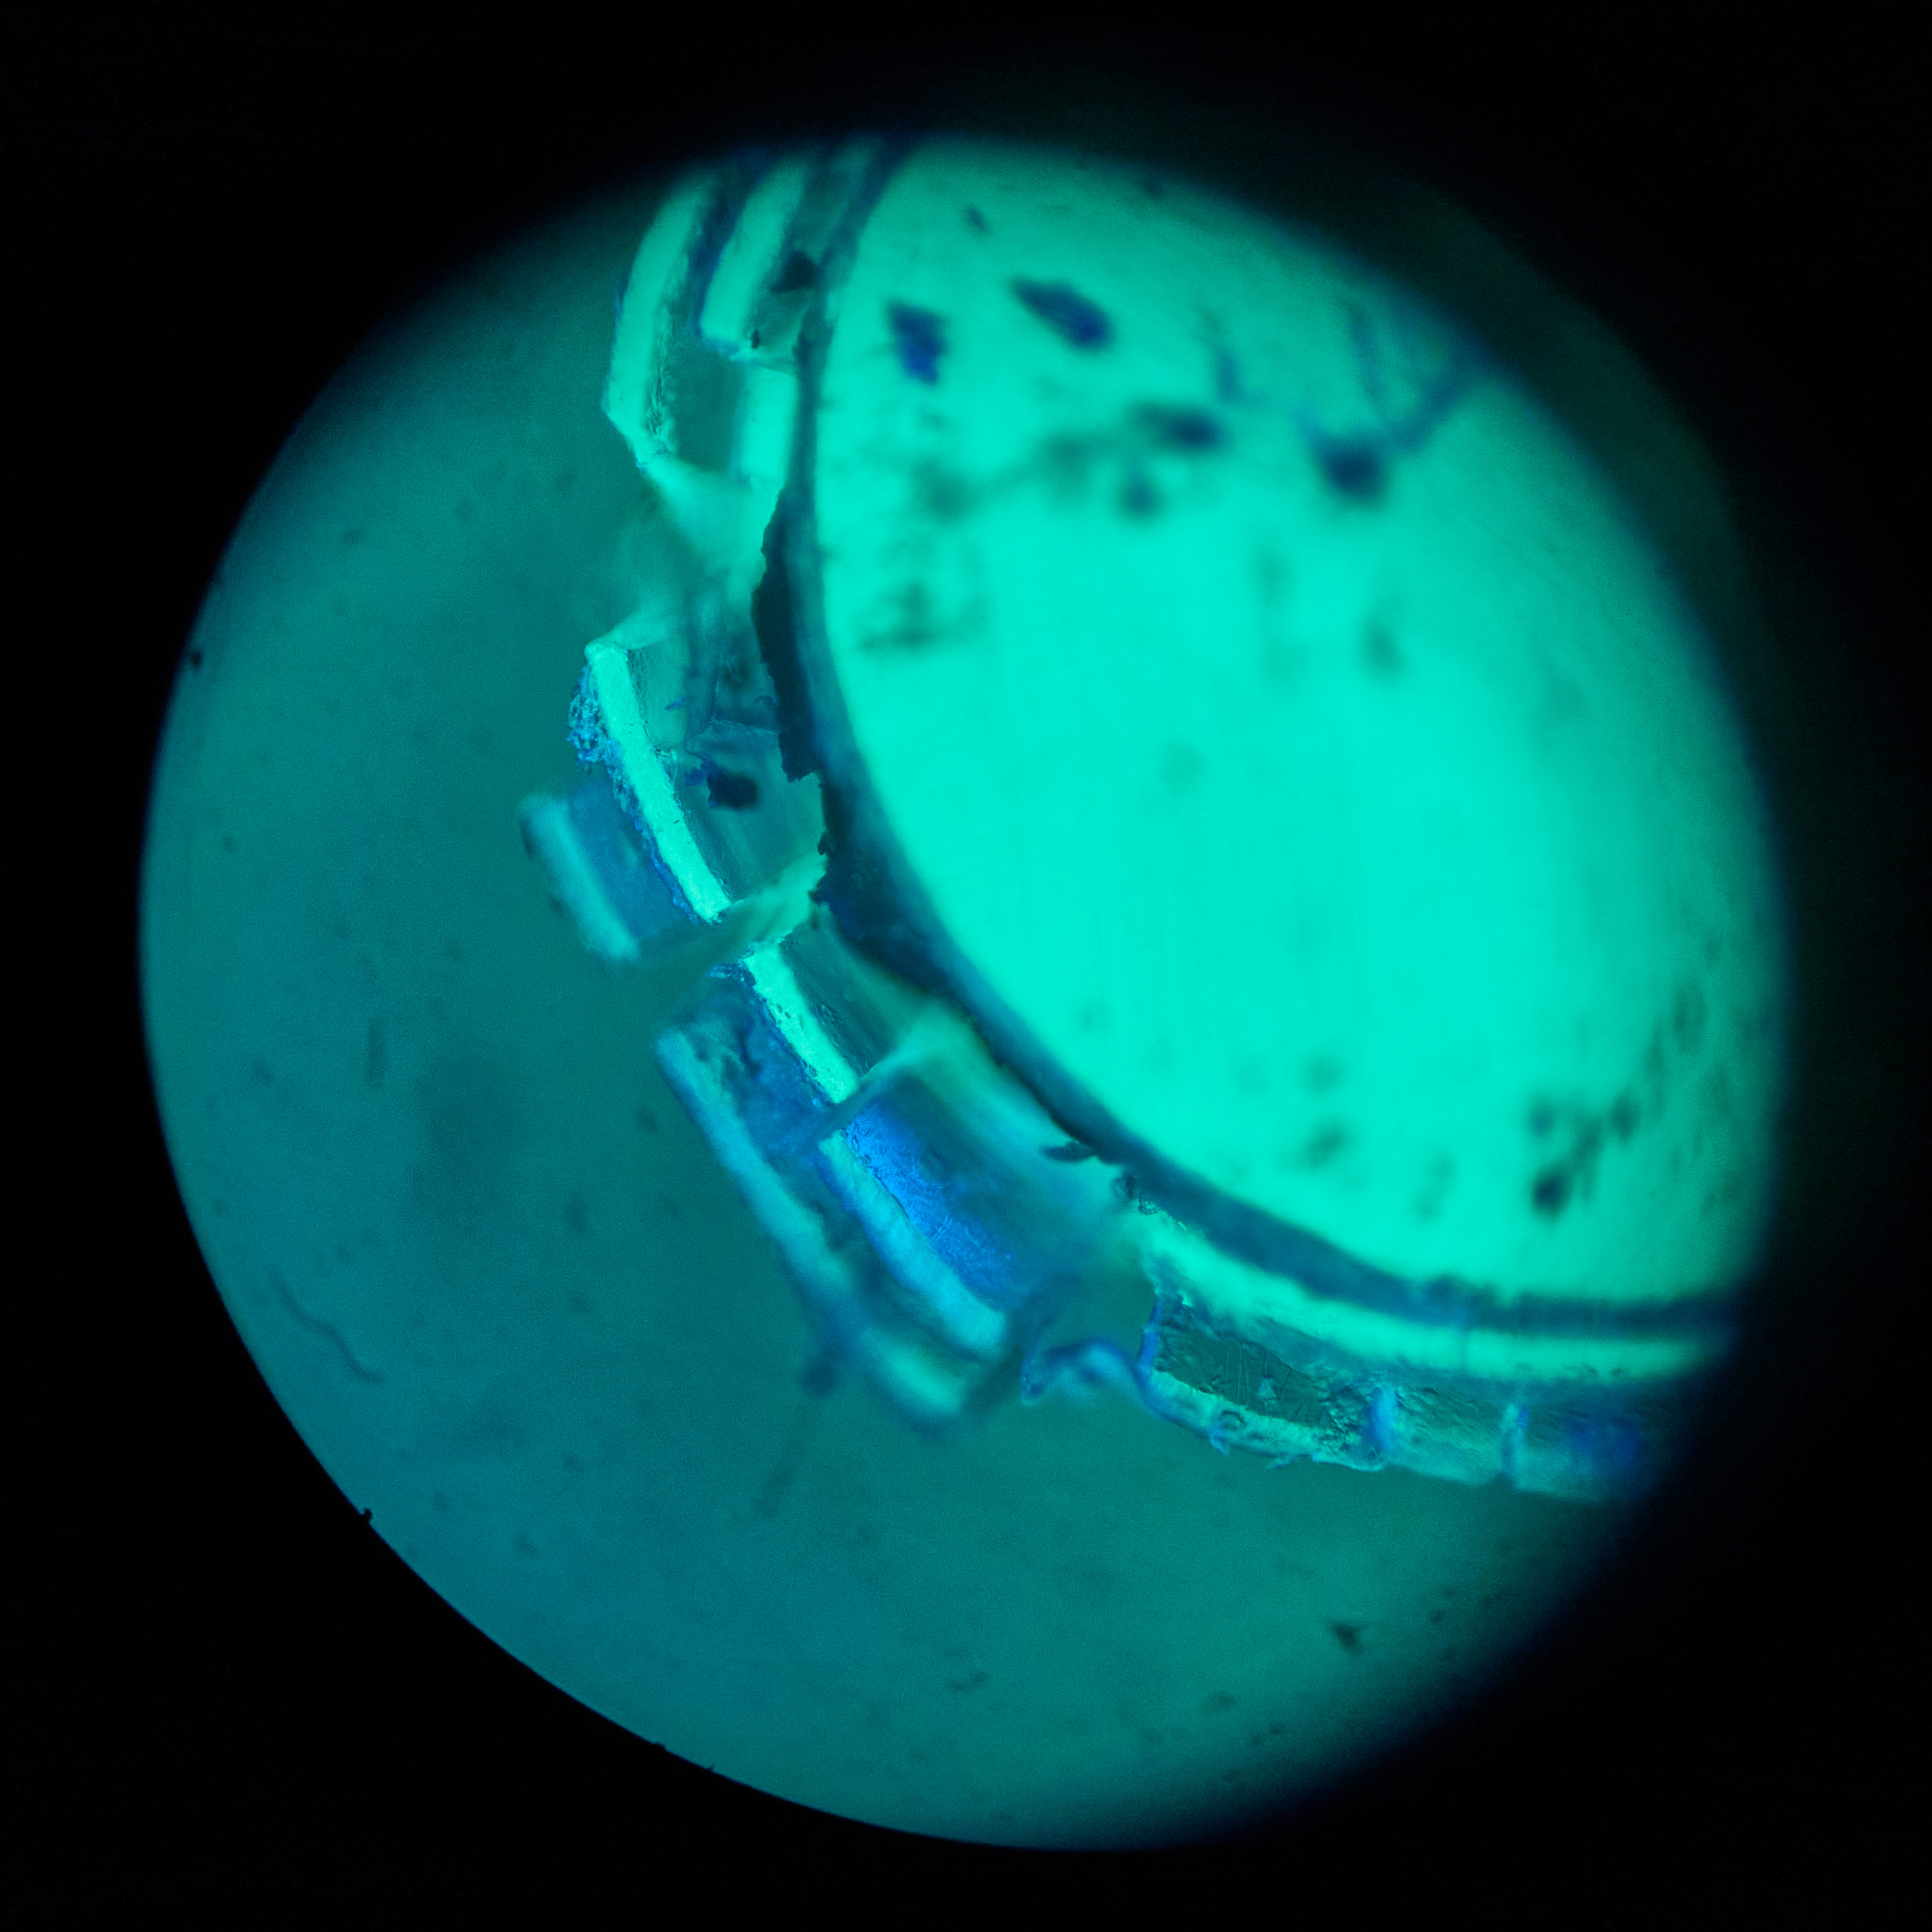
Polish for fibre
First time to use the polish machine.
Some improvement, but the surface is a bit dirty.
Damage on the out cover layer.

Slide 15
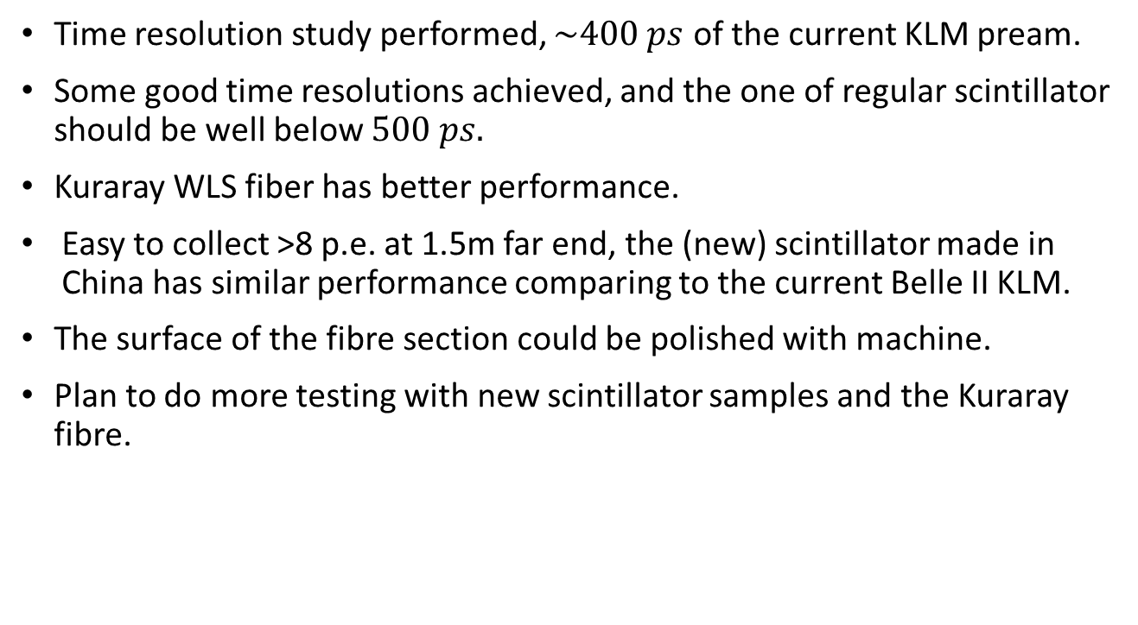
Summary and plan
Time resolution study performed, $\sim 400 ps$ of the current KLM pream.
Some good time resolutions achieved, and the one of regular scintillator should be well below $500 ps.$
Kuraray WLS fiber has better performance.
Easy to collect >8 p.e. at 1.5m far end, the (new) scintillator made in China has similar performance comparing to the current Belle II KLM.
The surface of the fibre section could be polished with machine.
Plan to do more testing with new scintillator samples and the Kuraray fibre.
Thank you!

Slide 16
backup

Slide 17
2 MCP+2 scint.
Black Box
Cosmic rays
Or radiation source
Signals from 2 scintillators.
Light block between scintillators.
Measure the time difference at photon generation.
Still have to fight against noise.
MCP-PMT
Scintillator1
Scintillator2
MCP-PMT
Signal 2
Signal 1
MSO 56 Oscilloscope

Slide 18

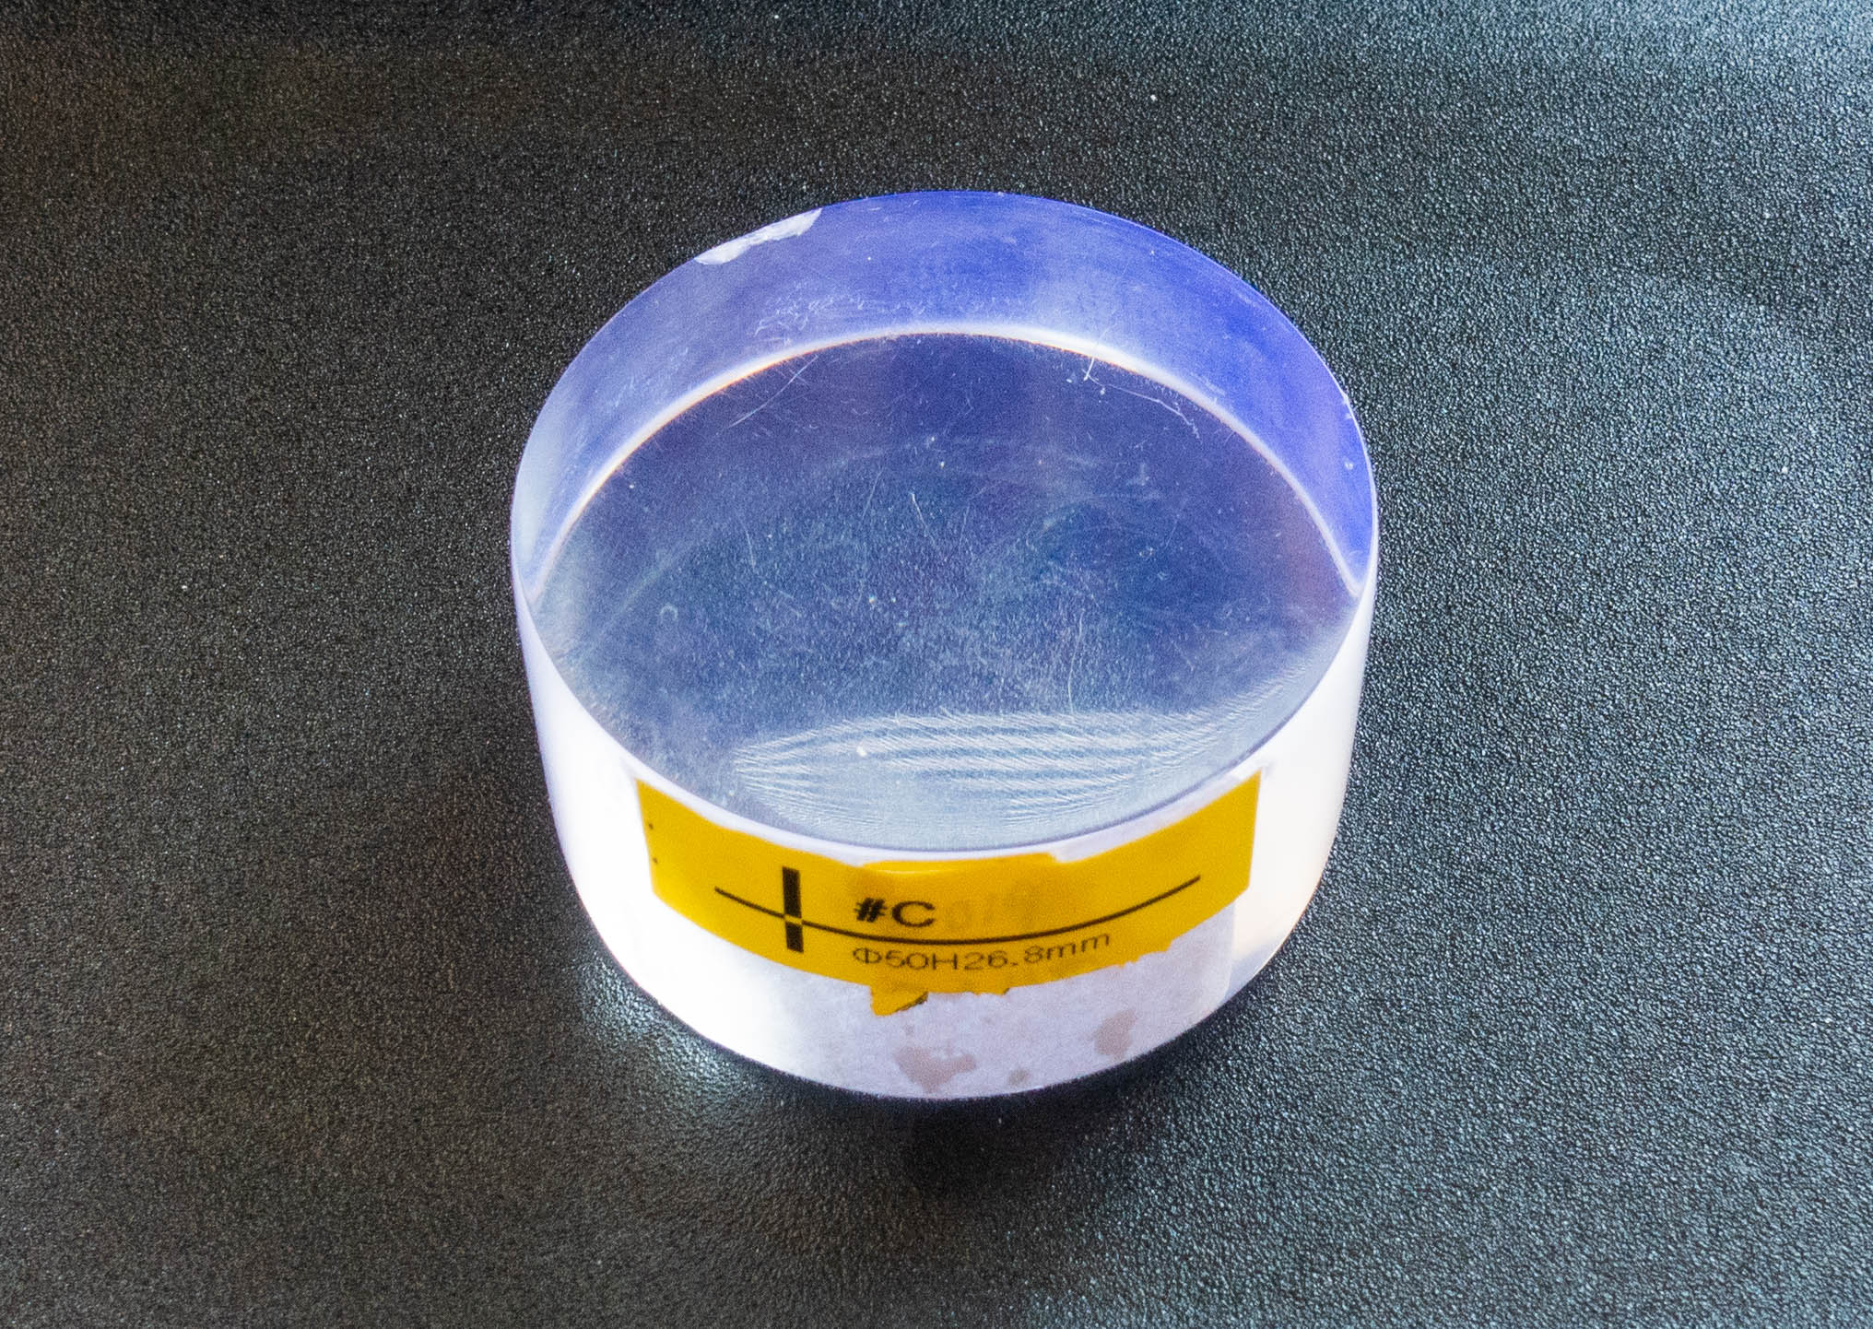




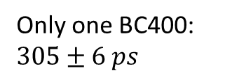
Only one BC400: $305±6 ps$
GNKD1
BC400
BC400
+
+
+
GNKD2
GNKD#C
EPIC#2
$$σ\left(GNKD\right)≈135 ps$$
$$σ\left(EPIC\right)≈97 ps$$
$$σ_{scint}\sim 270 ps$$
Some good samples!!!
We are asking companies to improve the quality of scintillator.
2

Slide 19

Time resolution
Time resolution of scintillator
Extrusion scintillator
+ Teflon + fiber coupled with MPPC
Natural growth scintillator
Without fiber coupled with PMT
Time difference caused by fiber is considerable
But we found there were some mistake in using PMT to measure the time resolution. The time resolution of pure scintillator is < 200 ps.

Slide 20
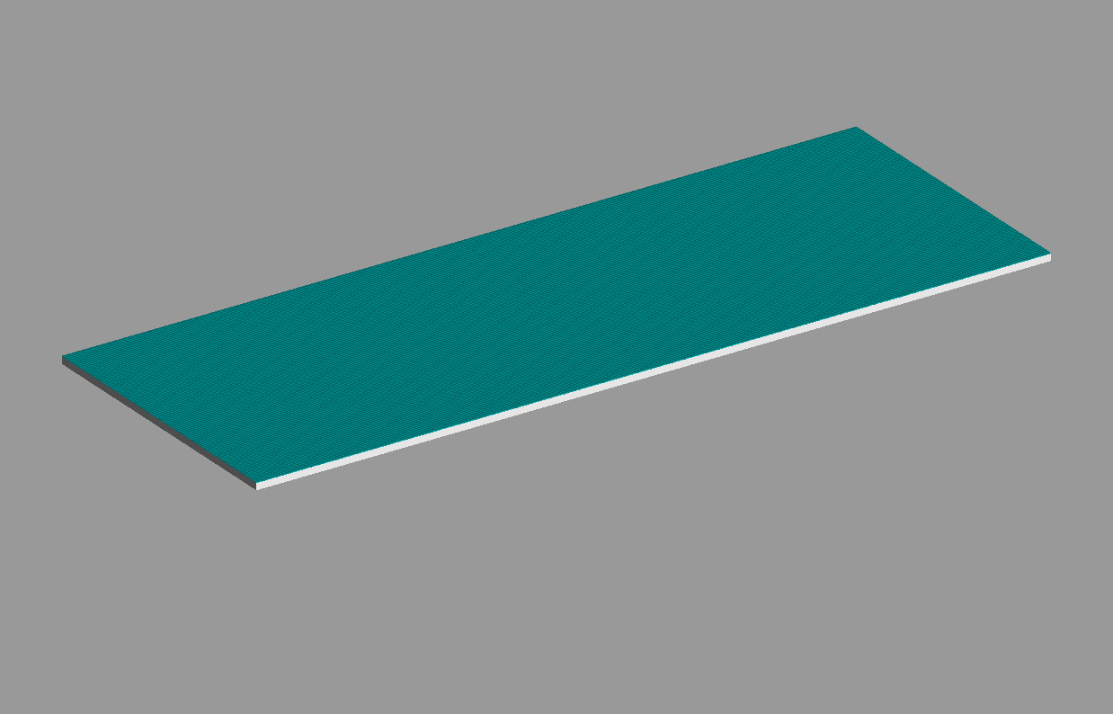
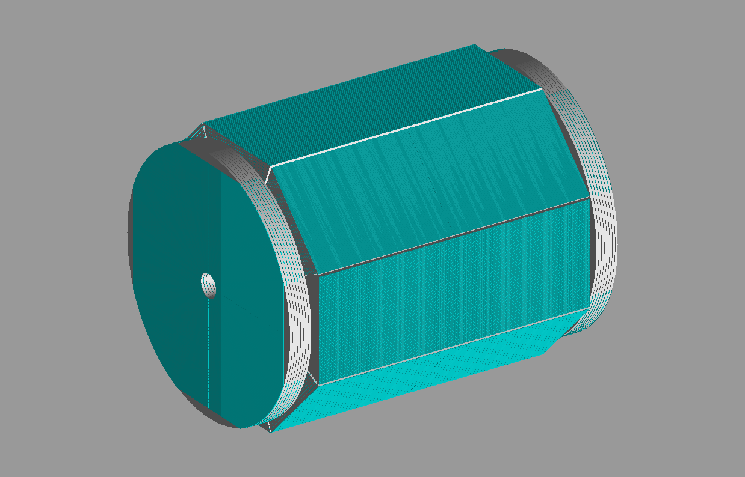





G4 simulation for muon detector
superlayer
CEPC CDR 2018
10cm
9m
12m

