Slide 1
Light Hadron Spectroscopy at BESIII
Shan JIN
Nanjing University
Workshop on Hadron Structure at High-Energy, High-Luminosity Facilities
October 25-27, 2021, Nanjing

Slide 2
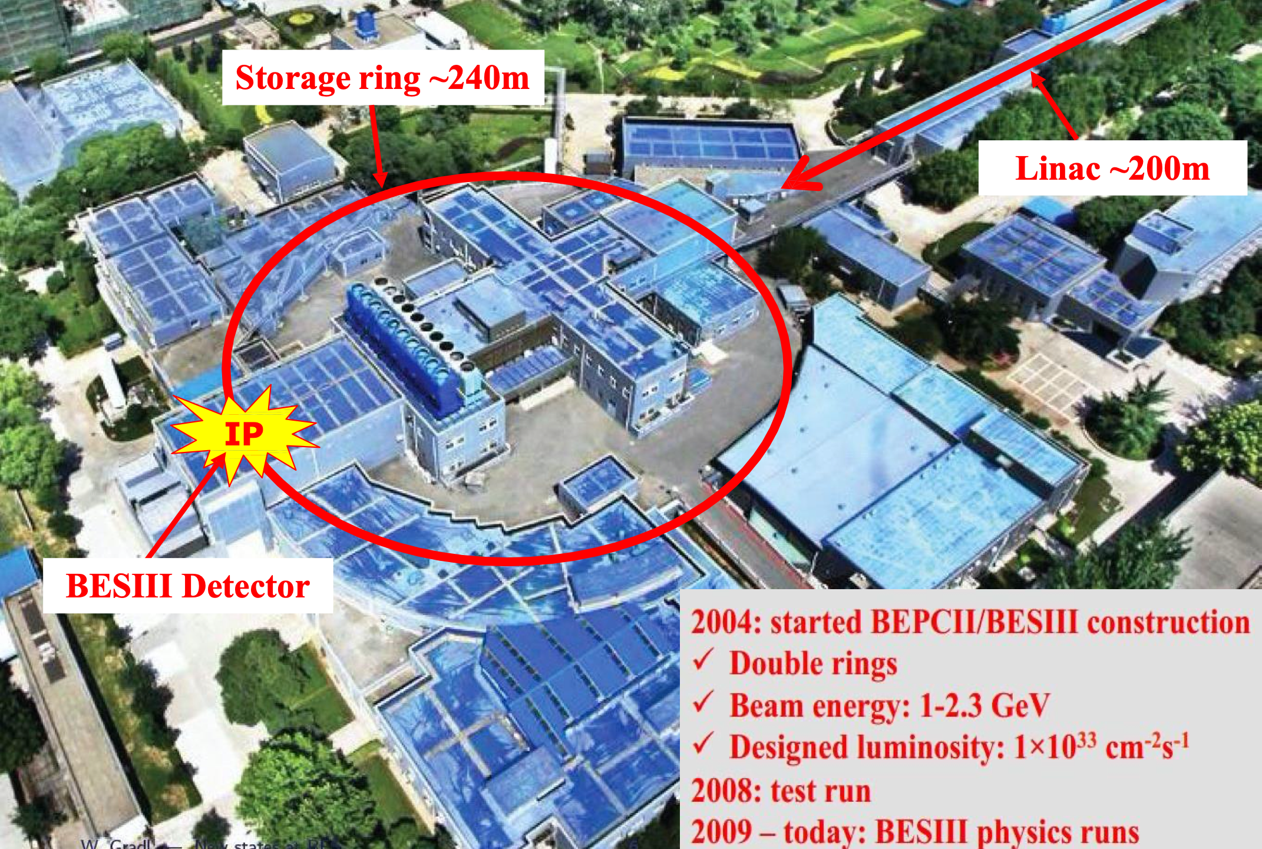
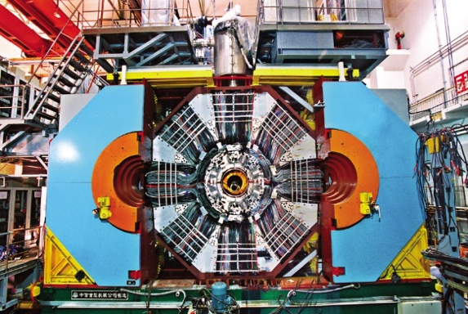
BEPCII / BESIII
MDC: σp/p ~0.5% @ 1GeV
σdE/dx ~ 6%
TOF: σT ~90 ps (barrel)
110 ps (endcap)
SCS: 1.0T (2009)
0.9T (2012)
EMC: σE/√E ~ 2.5%@1GeV

Slide 3
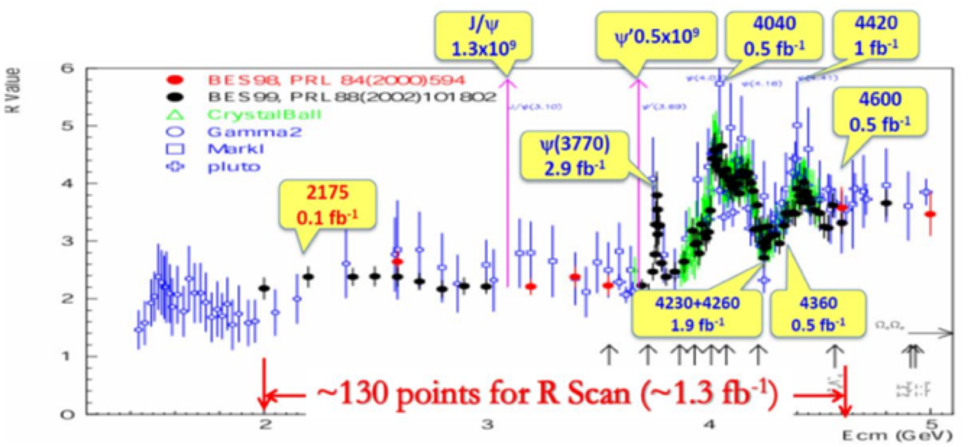
BESIII data sets
J/ψ 10¹⁰
10 Billion J/ψ events!

Slide 4
Multi-quark State, Glueball and Hybrid
Hadrons consist of 2 or 3 quarks：
Naive Quark Model：
New forms of hadrons:
  Multi-quark states ：Number of quarks >＝ 4
  Hybrids ： qqg，qqqg …
  Glueballs ： gg， ggg …
Meson（ q q ）
Baryon（q q q）
Lots of candidates, but new forms of hadrons have not been established yet!

Slide 5
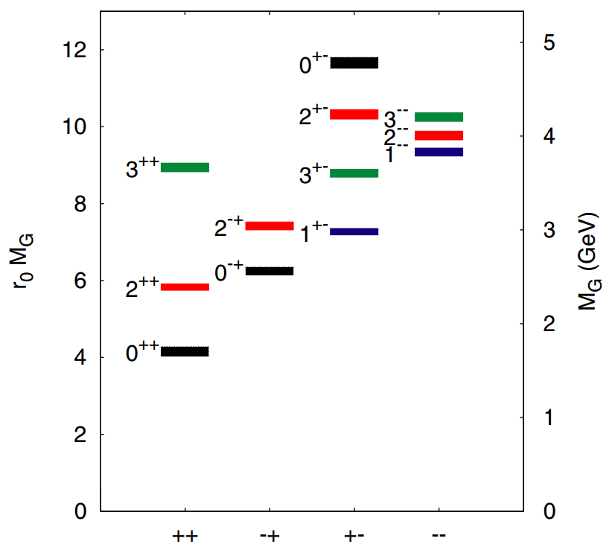
Glueballs
Unique particles formed by non-Abel Gauge
self-interactions
→ Direct test of QCD
Lattice QCD predictions
  0⁺⁺ ground state: 1~2 GeV/c²
  2⁺⁺ ground state: 2.3~2.4 GeV/c²
  0⁻⁺ ground state: 2.3~2.6 GeV/c²
J/ψ radiative decays are believed to be an ideal
place to search for above glueballs.

Slide 6
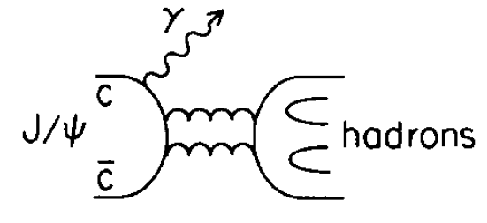
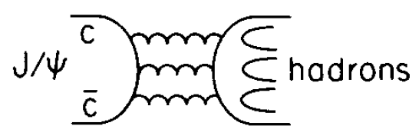
J/ψ radiative decays
Gluon rich environment
Isospin filter
  final states dominated by I=0 processes
Spin-parity filter
  C parity must be +， so J^{PC}= 0⁻⁺， 0⁺⁺，2⁺⁺，…
Clean environment
  very different from proton-antiproton collision processes
→ Ideal place to search for glueballs
>>

Slide 7
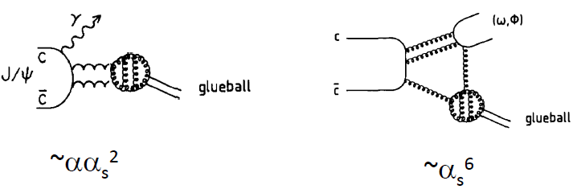
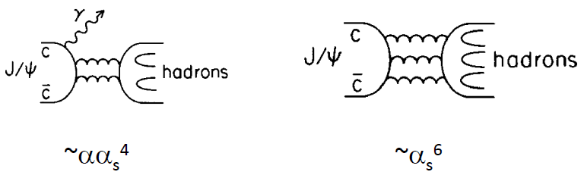
Gueball Productions
Rich production in J/ψ radiative decays — glueball production rate in J/ψ radiative decays could be higher than in J/ψ hadronic decays.
c.f. , for normal hadrons:
→ If a hadron is more richly produced in J/ψ radiative decays than in J/ψ hadronic decays, it suggests that this hadron could have large gluon content.

Slide 8
Gueball Decays
Flavor symmetric decays
No rigorous predictions on decay patterns and their branching ratios.
The glueball decays could have similar decays to the charmonium families since they all decay via gluons.
  e.g. the 0⁻⁺ glueball could have similar decays of η_{c}
  One of the largest decay modes of η_{c} is η′π+π- , so J/ψ→γη′π+π- could be the best place to search for the 0⁻⁺ glueball.

Slide 9

Highlights
X($p\overline{p}$) and X(1835)
Glueball candidates
  0⁺⁺: f₀(1500) and f₀(1710)
  2⁺⁺: f₂(2340)
  0⁻⁺: X(2370)

Slide 10
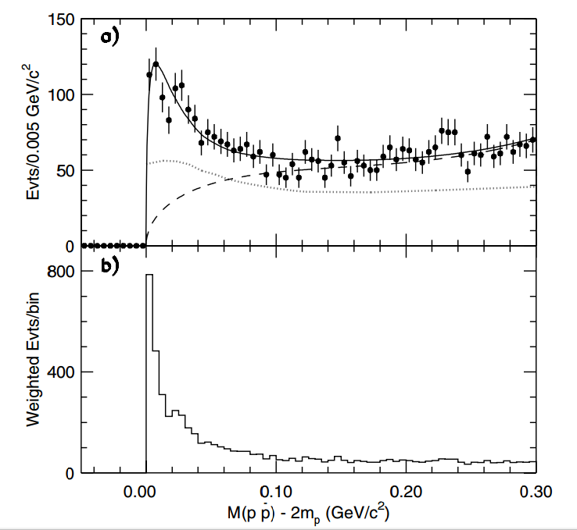
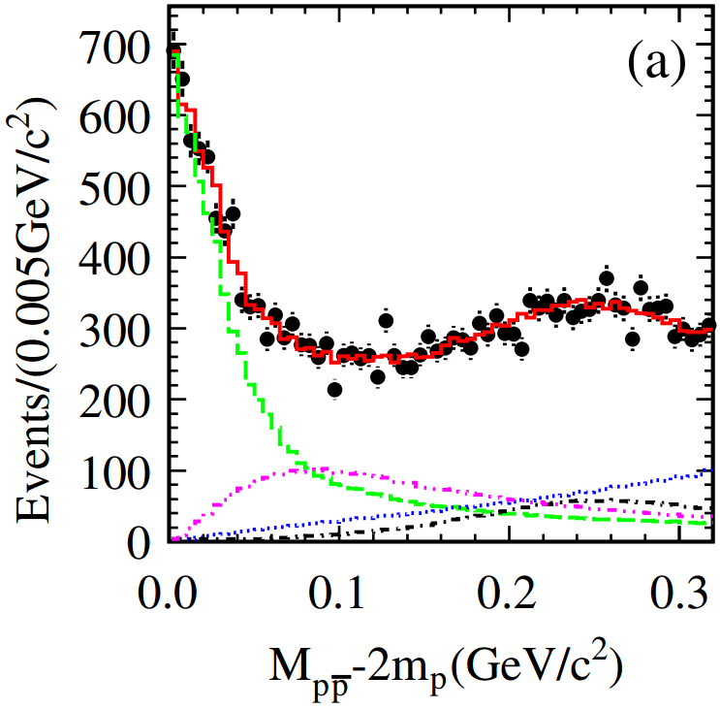
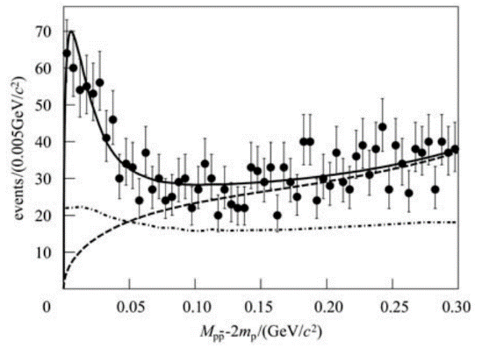
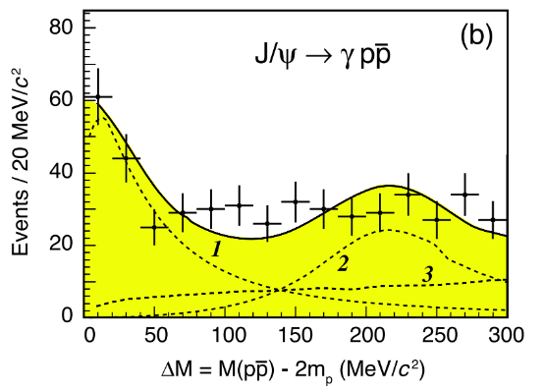




X($p\overline{p}$) — $p\overline{p}$ mass threshold enhancement
PRL 91, 022001 (2003)
Discovered by BESII in J/ψ→γ$p\overline{p}$ in 2003
Confirmed by BESIII and CLEO-c in ψ(3686)→π⁺π⁻J/ψ, J/ψ→γ$p\overline{p}$
Confirmed by BESIII in J/ψ→γ$p\overline{p}$ and its J^{PC} determined by PWA
  0⁻⁺
  $M={1832}_{−5 −17}^{+19 +18}±19 MeV/c2$
  $Γ=13±19 MeV/c2$ ($<76 MeV/c2$ @ 90% C.L.)
BESII
J/ψ→γ$p\overline{p}$
ψ(3686)→π⁺π⁻J/ψ, J/ψ→γ$p\overline{p}$
BESIII
BESIII
CLEO-c
J/ψ→γ$p\overline{p}$
Chinese Phys. C34, 421 (2010)
PRD 82, 092002 (2010)
PRL 108, 112003 (2012)

Slide 11
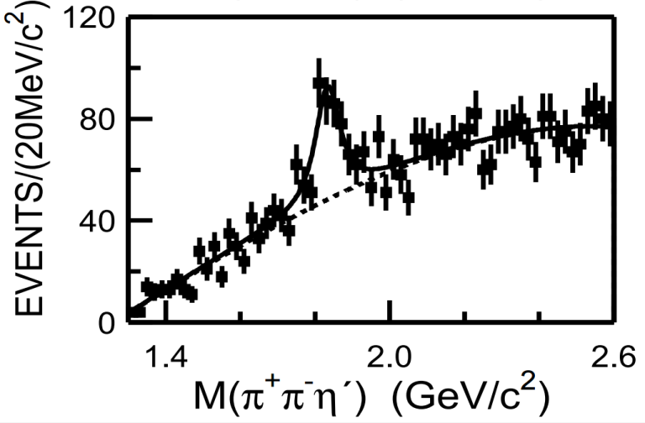
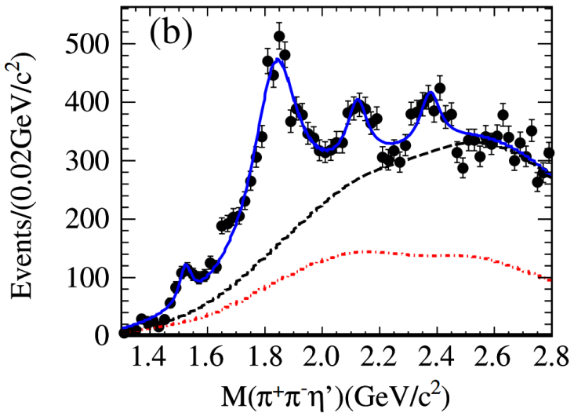
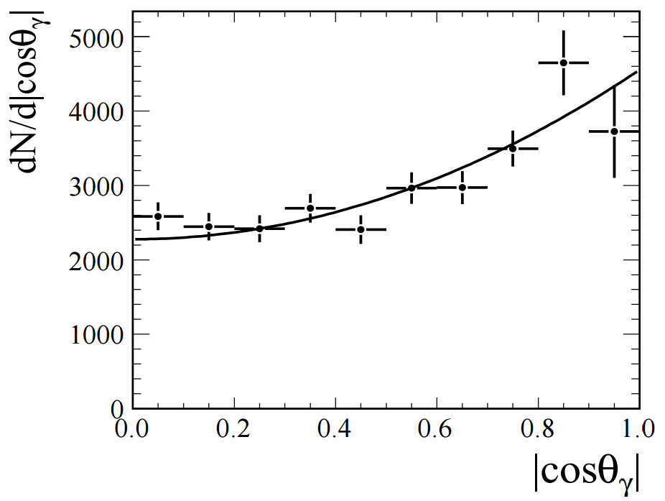

X(1835)
Phys. Rev. Lett. 95, 262001 (2005)
Discovered by BESII in J/ψ→γη′π⁺π⁻
Confirmed by BESIII in J/ψ→γη′π⁺π⁻
  $M={1836.5±3.0}_{−2.1}^{+5.6} MeV/c2$
  $Γ={190±9}_{−36}^{+38} MeV/c2$
  Angular distribution is consistent with 0⁻
BESII
BESIII
BESIII
Phys. Rev. Lett. 106, 072002 (2011)

Slide 12
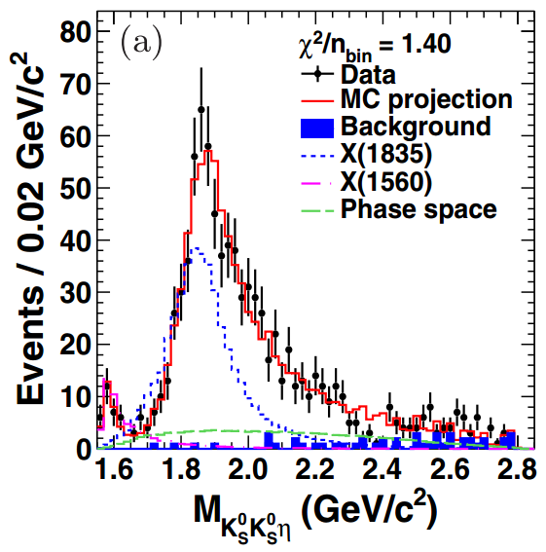
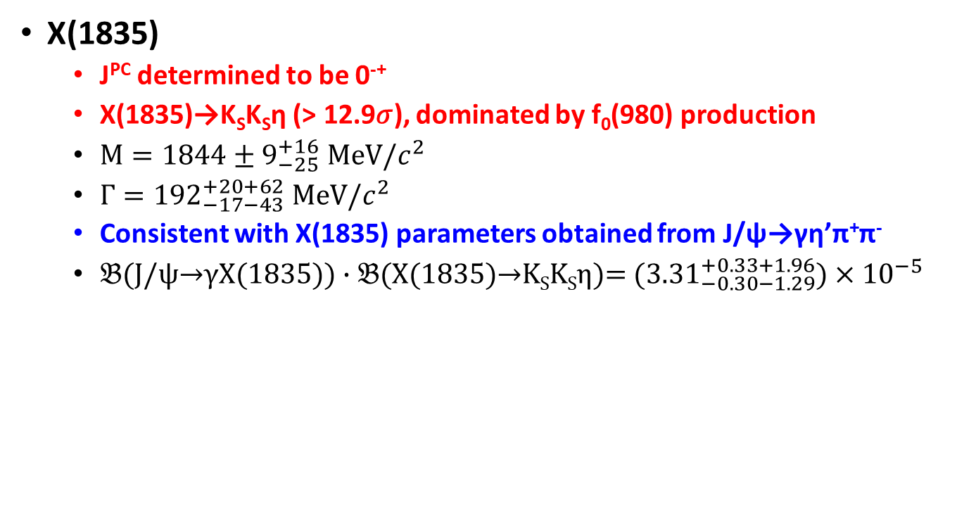
  New decay mode of X(1835) →K_{S}K_{S}η and determination J^{PC} of X(1835) in J/ψ→γK_{S}K_{S}η
PRL 115, 091803 (2015)
X(1835)
  J^{PC} determined to be 0⁻⁺
  X(1835)→K_{S}K_{S}η (> 12.9𝜎), dominated by f₀(980) production
  $\text{M}=1844±9_{−25}^{+16} MeV/c^{2}$
  $Γ={192}_{−17−43}^{+20+62} MeV/c^{2}$
  Consistent with X(1835) parameters obtained from J/ψ→γη’π⁺π⁻
  $𝔅$(J/ψ→γX(1835)) $∙𝔅$(X(1835)→K_{S}K_{S}η)=$({3.31}_{−0.30−1.29}^{+0.33+1.96})×{10}^{−5}$

Slide 13
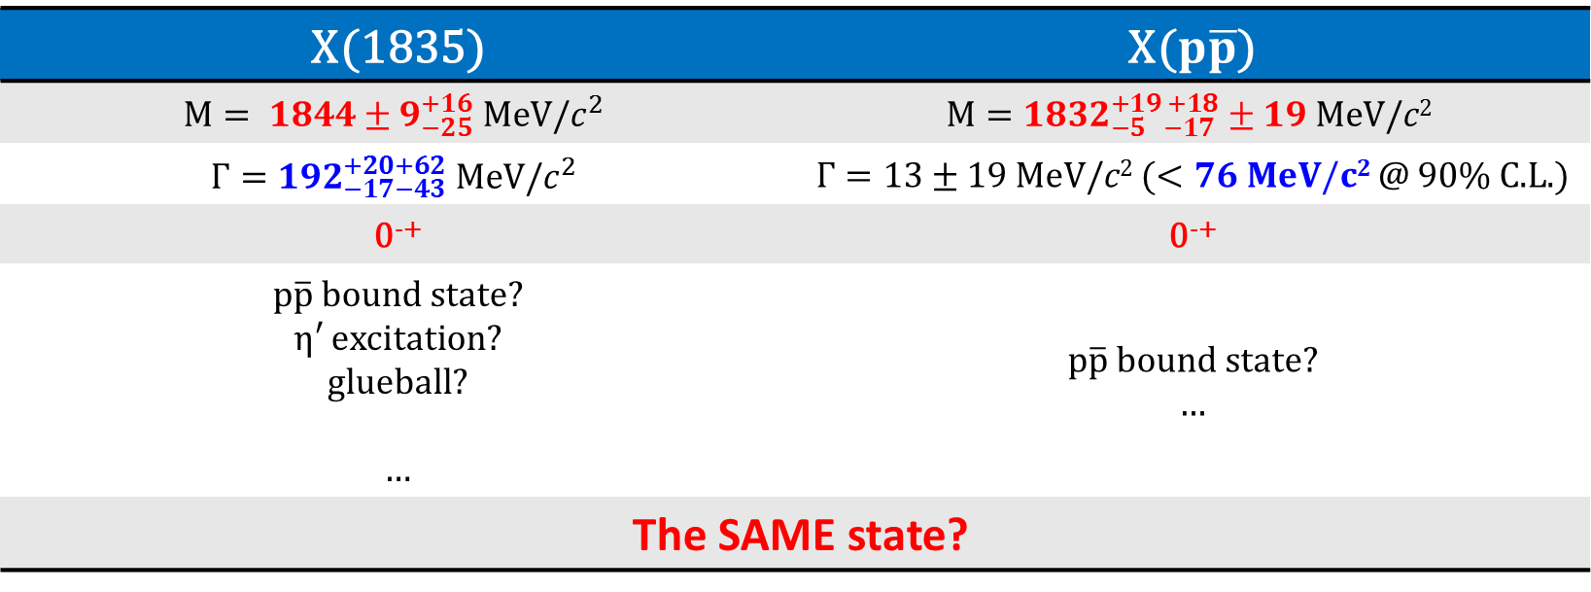
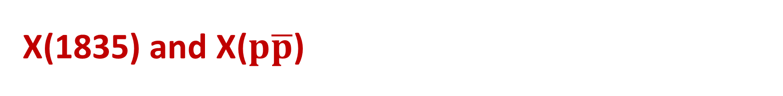
X(1835) and X($p\overline{p}$)
X(1835) | X($p\overline{p}$)
$$\text{M}= 1844±9_{−25}^{+16} MeV/c^{2}$$ | $$M={1832}_{−5 −17}^{+19 +18}±19 MeV/c2$$
$$Γ={192}_{−17−43}^{+20+62} MeV/c^{2}$$ | $Γ=13±19 MeV/c2$ ($<76 MeV/c2$ @ 90% C.L.)
0⁻⁺ | 0⁻⁺
$p\overline{p}$ bound state? η′ excitation? glueball? … | $p\overline{p}$ bound state? …
The SAME state?

Slide 14
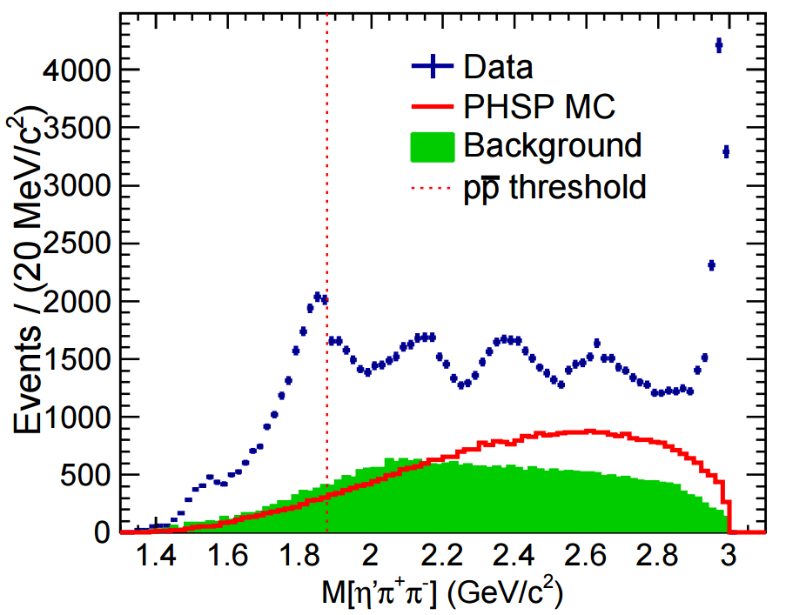
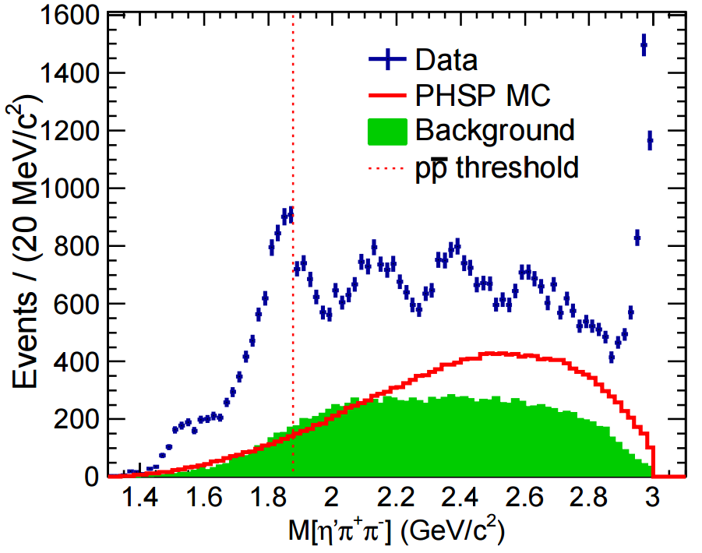
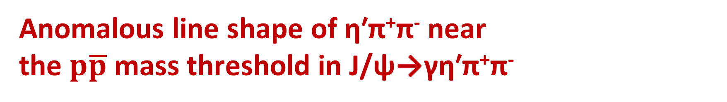
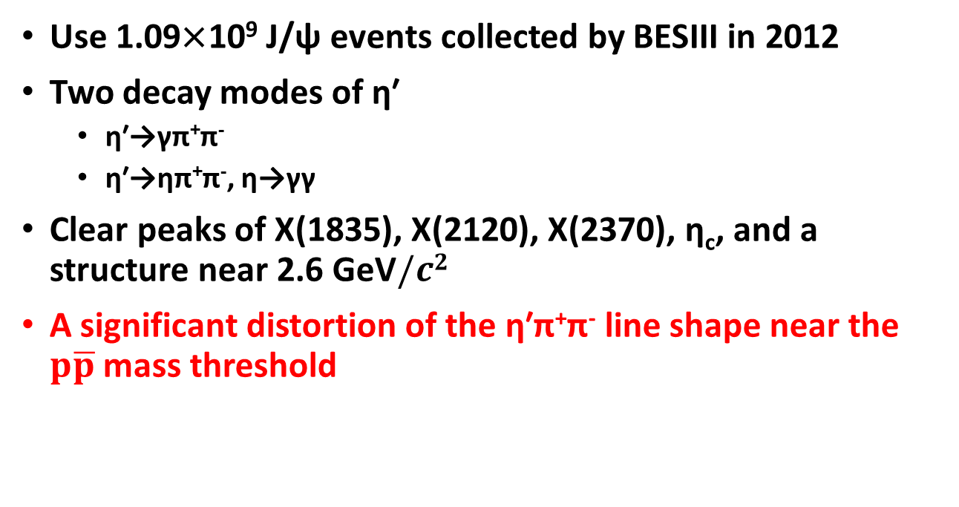
  Anomalous line shape of η′π⁺π⁻ near the $p\overline{p}$ mass threshold in J/ψ→γη′π⁺π⁻
PRL 117, 042002 (2016)
  η′→γπ⁺π⁻
Use 1.09×10⁹ J/ψ events collected by BESIII in 2012
Two decay modes of η′
  η′→γπ⁺π⁻
  η′→ηπ⁺π⁻, η→γγ
Clear peaks of X(1835), X(2120), X(2370), η_{c}, and a structure near 2.6 GeV$/c2$
A significant distortion of the η′π⁺π⁻ line shape near the $p\overline{p}$ mass threshold
  η′→ηπ⁺π⁻

Slide 15
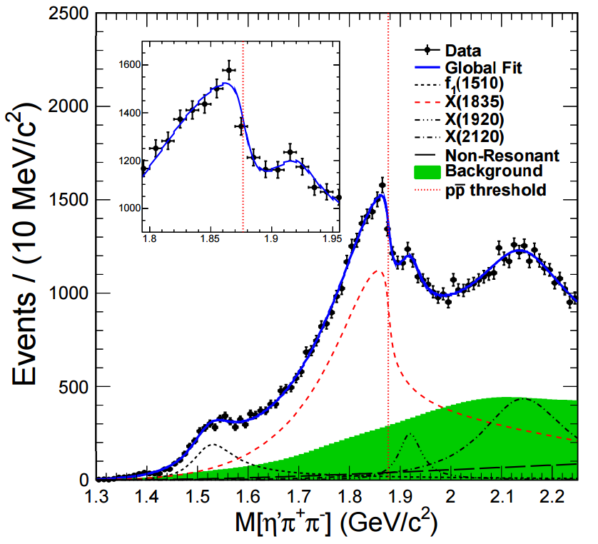
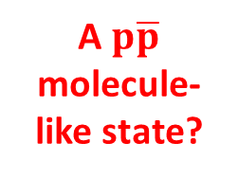




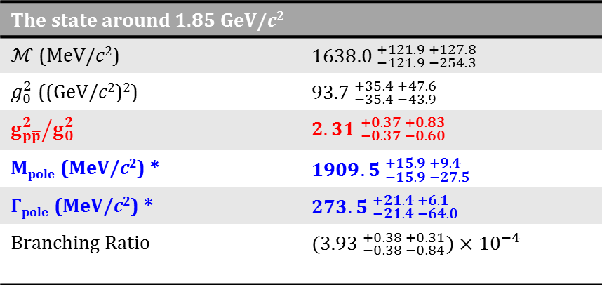
Anomalous line shape of η′π⁺π⁻ near the $p\overline{p}$ mass threshold in J/ψ→γη′π⁺π⁻ — Model I
PRL 117, 042002 (2016)
Use the Flatté formula for the line shape
  $T=\frac{\sqrt{ρ_{out}}}{ℳ^{2}−s−i\sum_{k}{g_{k}^{2}ρ_{k}}}$
    $\sum_{k}{g_{k}^{2}ρ_{k}}≃g_{0}^{2}(ρ_{0}+\frac{g_{p\overline{p}}^{2}}{g_{0}^{2}}ρ_{p\overline{p}})$
    ${g_{p\overline{p}}^{2}}/{g_{0}^{2}}$ is the ratio between the coupling strength to the $p\overline{p}$ channel and the summation of all other channels
The state around 1.85 GeV/c²
$ℳ$ (MeV/c²) | ${1638.0 }_{−121.9 −254.3}^{+121.9 +127.8}$
$g_{0}^{2}$ ((GeV/c²)²) | ${93.7 }_{−35.4 −43.9}^{+35.4 +47.6}$
${g_{p\overline{p}}^{2}}/{g_{0}^{2}}$ | ${2.31 }_{−0.37 −0.60}^{+0.37 +0.83}$
M_{pole} (MeV/c²) * | ${1909.5 }_{−15.9 −27.5}^{+15.9 +9.4}$
$Γ$_{pole} (MeV/c²) * | ${273.5 }_{−21.4 −64.0}^{+21.4 +6.1}$
Branching Ratio | ${(3.93 }_{−0.38 −0.84}^{+0.38 +0.31})×{10}^{−4}$
  log$𝓛$ = 630549.5
A $p\overline{p}$ molecule-like state?
  Significance of ${g_{p\overline{p}}^{2}}/{g_{0}^{2}}$ being non-zero is larger than 7σ
* The pole nearest to the $p\overline{p}$ mass threshold
  X(1920) is needed with 5.7σ

Slide 16
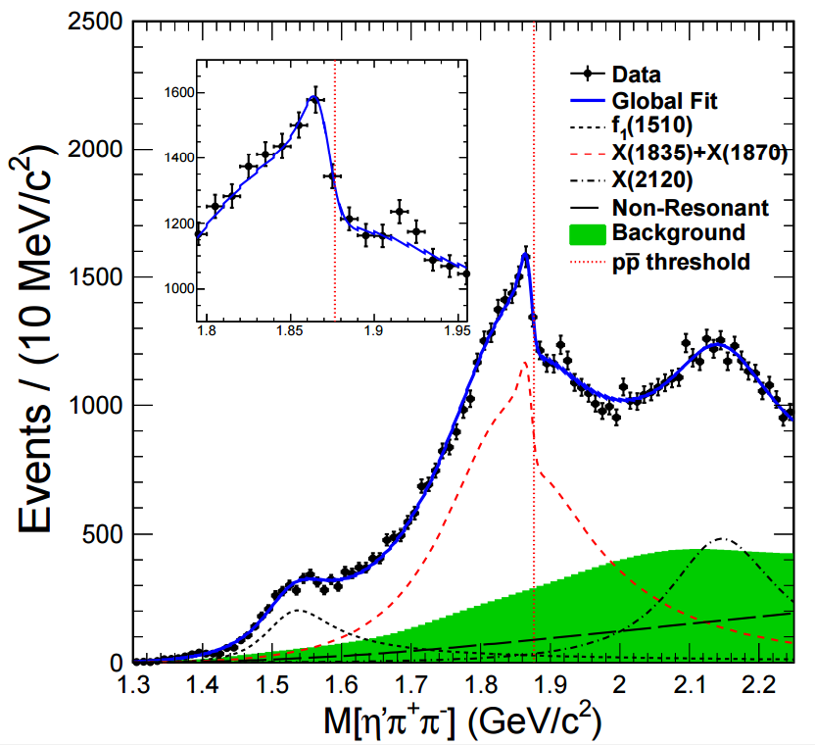




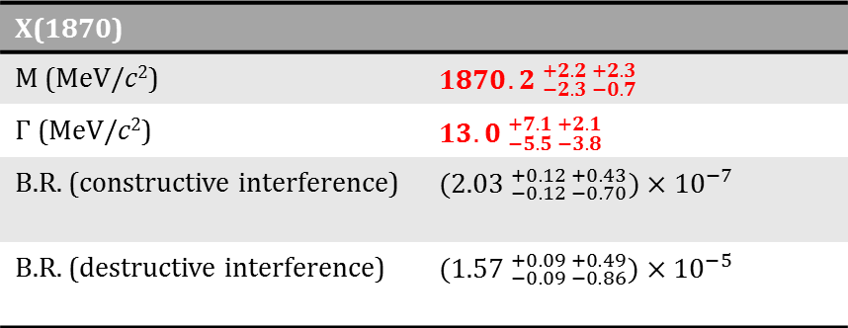
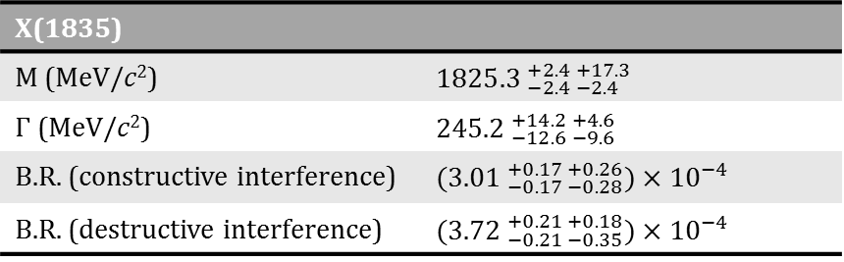
Anomalous line shape of η′π⁺π⁻ near the $p\overline{p}$ mass threshold in J/ψ→γη′π⁺π⁻ — Model II
PRL 117, 042002 (2016)
Use coherent sum of two Breit-Wigner amplitudes
  $T=\frac{\sqrt{ρ_{out}}}{M_{1}^{2}−s−iM_{1}Γ_{1}}$ + $\frac{β⋅e^{iθ}⋅\sqrt{ρ_{out}}}{M_{2}^{2}−s−iM_{2}Γ_{2}}$
X(1835)
M (MeV/c²) | ${1825.3 }_{−2.4 −2.4}^{+2.4 +17.3}$
$Γ$ (MeV/c²) | ${245.2 }_{−12.6 −9.6}^{+14.2 +4.6}$
B.R. (constructive interference) | ${(3.01 }_{−0.17 −0.28}^{+0.17 +0.26})×{10}^{−4}$
B.R. (destructive interference) | ${(3.72 }_{−0.21 −0.35}^{+0.21 +0.18})×{10}^{−4}$
X(1870)
M (MeV/c²) | ${1870.2 }_{−2.3 −0.7}^{+2.2 +2.3}$
$Γ$ (MeV/c²) | ${13.0 }_{−5.5 −3.8}^{+7.1 +2.1}$
B.R. (constructive interference) | ${(2.03 }_{−0.12 −0.70}^{+0.12 +0.43})×{10}^{−7}$
B.R. (destructive interference) | ${(1.57 }_{−0.09 −0.86}^{+0.09 +0.49})×{10}^{−5}$
  log$𝓛$ = 630540.3
A $p\overline{p}$
bound state?
  Significance of narrow X(1870)
  is larger than 7σ
  X(1920) is not significant

Slide 17
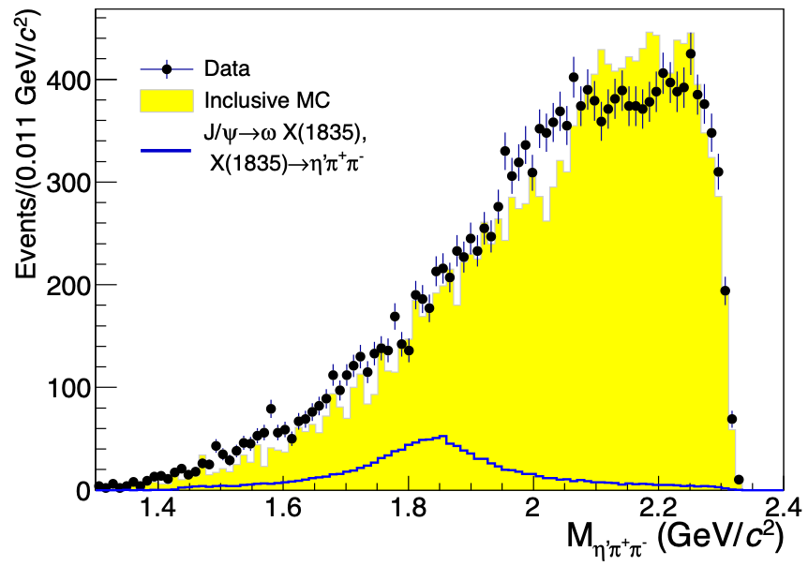
Search for the X(1835) in J/ψ→ωππη’
 | J/ψ→γX | J/ψ→𝛚X
X(1835) →η′π⁺π⁻ | 3x10⁻⁴~4x10⁻⁴ | <6.2x10⁻⁵ (90%)
X(pp ̅)→pp ̅ | 9x10⁻⁵ | <3.9x10⁻⁶ (90%)
arXiv: 1902.04862
No obvious signal of the X(1835), the corresponding upper limit is measured to be B.R. <6.2×10⁻⁵ @ 90% CL
Large gluon content?

Slide 18
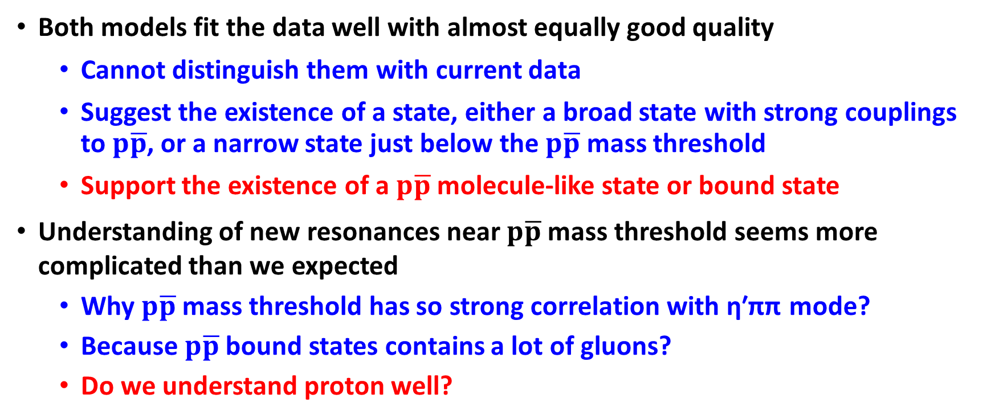

Anomalous line shape of η′π⁺π⁻ near $p\overline{p}$ mass threshold — connection between X(1835) and X($p\overline{p}$) well established
  Both models fit the data well with almost equally good quality
    Cannot distinguish them with current data
    Suggest the existence of a state, either a broad state with strong couplings to $p\overline{p}$, or a narrow state just below the $p\overline{p}$ mass threshold
    Support the existence of a $p\overline{p}$ molecule-like state or bound state
Understanding of new resonances near $p\overline{p}$ mass threshold seems more complicated than we expected
  Why $p\overline{p}$ mass threshold has so strong correlation with η′ππ mode?
  Because $p\overline{p}$ bound states contains a lot of gluons?
  Do we understand proton well?

Slide 19
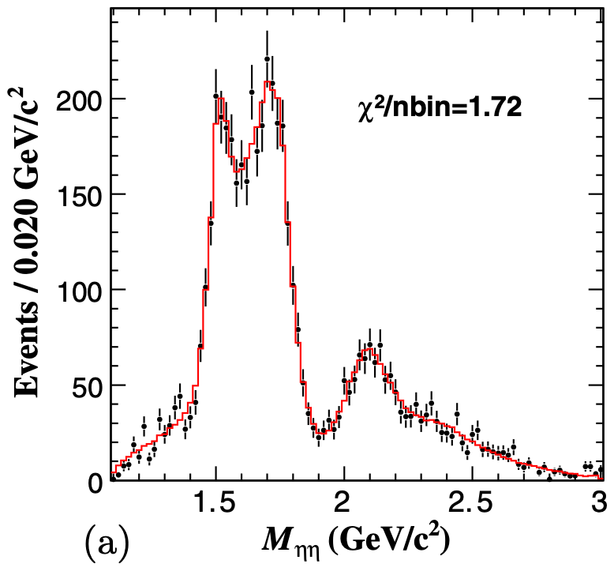
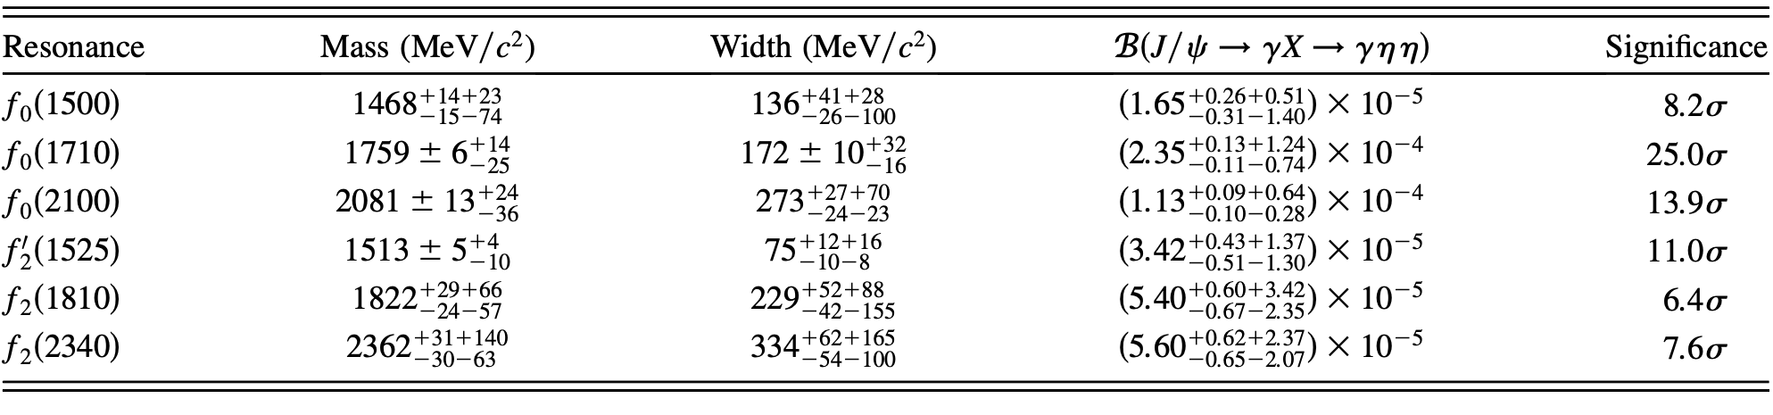
PWA of J/ψ→γηη
A good channel for the 0⁺⁺ and 2⁺⁺ glueball search
Large production rate of f0(1710)
  Comparable with the LQCD prediction
  Large overlap with other 0⁺⁺ glueball candidates [e.g. f0(1500)]
A strong contribution from f2(2340): candidate for the 2⁺⁺ glueball
PRD 87,092009

Slide 20
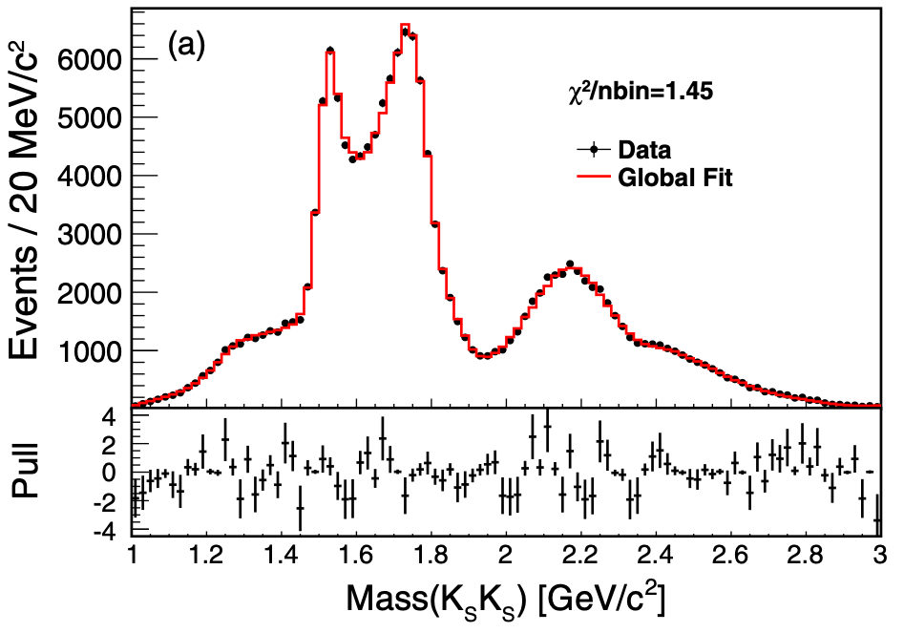
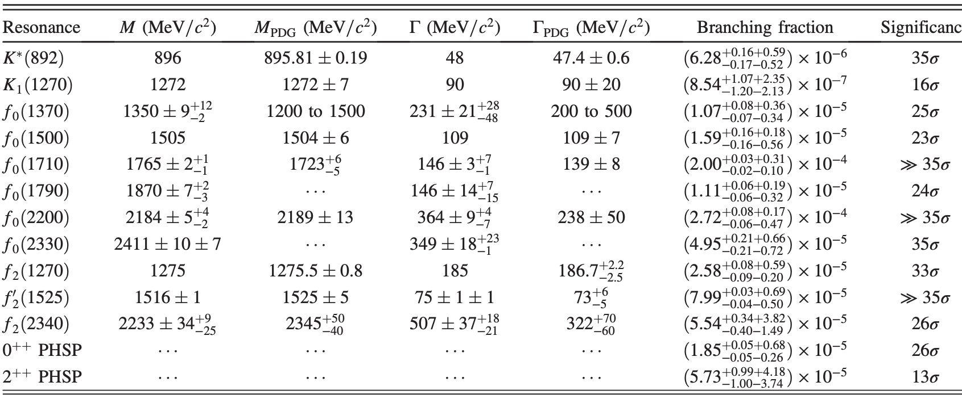
PWA of J/ψ→γKsKs
Model dependent analysis
PRD 98,072003

Slide 21
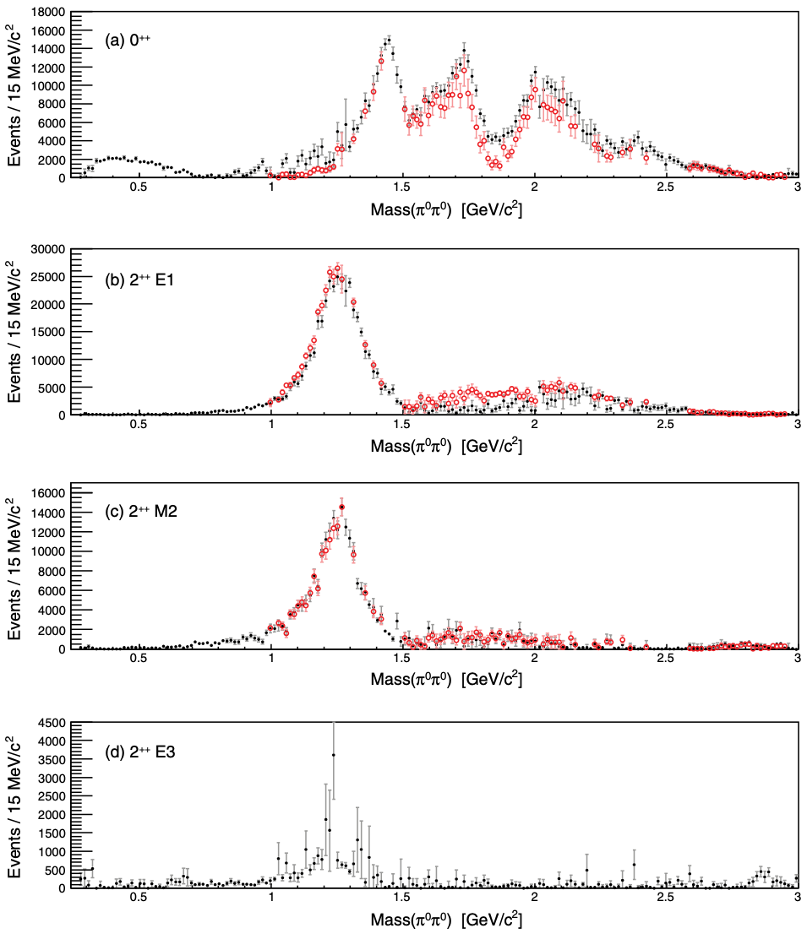
Amplitude analysis of J/ψ→γπ⁰π⁰
Model independent analysis: two distinct sets of solutions above KK threshold.
Significance structures in the scalar spectrum near 1.5GeV, 1.7GeV (f0(1500), f0(1710)).
PRD 92,052003

Slide 22
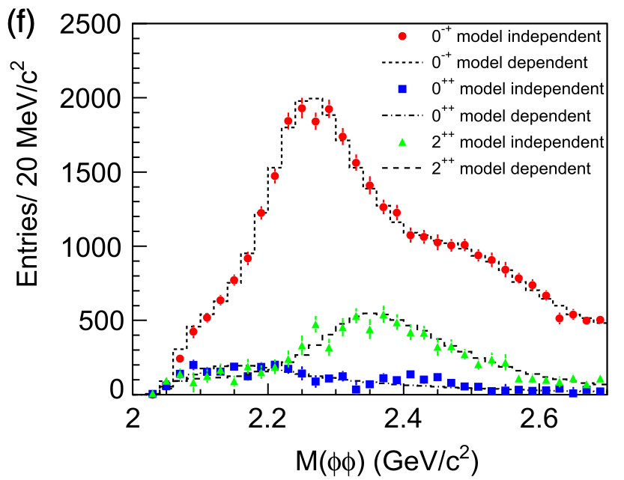
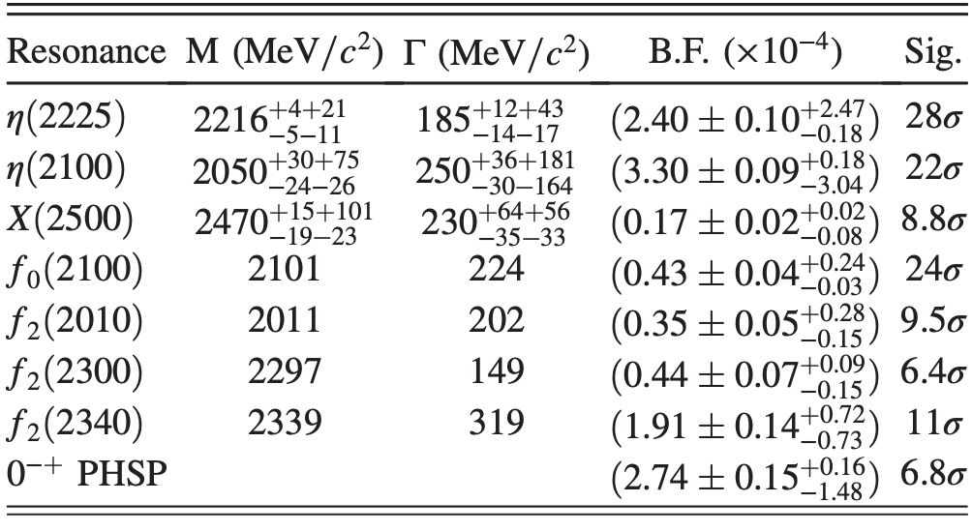
PWA of J/ψ→γΦΦ
A good channel for 0⁻⁺ and 2⁺⁺ state study above 2GeV
PRD 92, 112011
0⁻⁺ states are dominant
For f2(2340), the large production rate is compatible with the LQCD prediction for tensor glueball, similar to that in the J/ψ→γηη, γKsKs

Slide 23
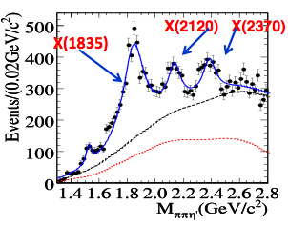
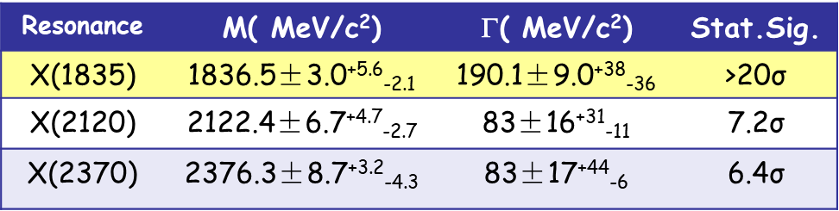

X(2370)
PRL106, 072002 (2011)
Discovered by BESIII in J/ψ→γη′π⁺π⁻
Confirmed by BESIII in J/ψ→γη′π⁺π⁻ , γη′KK
PRL 117, 042002 (2016)
BESIII Preliminary

Slide 24
X(2370) – good candidate of 0⁻⁺ glueball
Its mass is consistent with LQCD prediction on the 0⁻⁺ glueball.
Observed in the best place to search for the 0⁻⁺ glueball: J/ψ→γη′π+π-
Flavor symmetric decay – observed in both η′π+π- and η′KK decay modes.
→ Determination of its spin-parity is crucial!

Slide 25
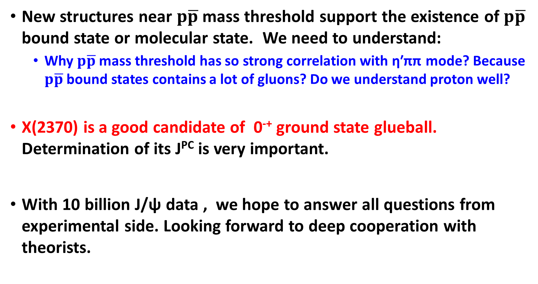
Summary
New structures near $p\overline{p}$ mass threshold support the existence of $p\overline{p}$ bound state or molecular state. We need to understand:
  Why $p\overline{p}$ mass threshold has so strong correlation with η′ππ mode? Because $p\overline{p}$ bound states contains a lot of gluons? Do we understand proton well?
X(2370) is a good candidate of 0⁻⁺ ground state glueball. Determination of its J^{PC} is very important.
With 10 billion J/ψ data , we hope to answer all questions from experimental side. Looking forward to deep cooperation with theorists.

Slide 26
backup

Slide 27
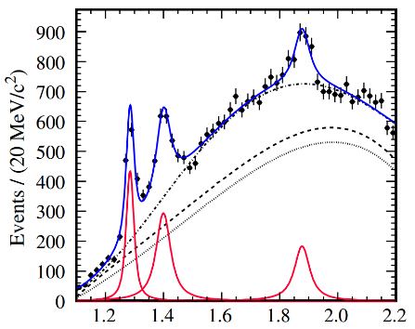
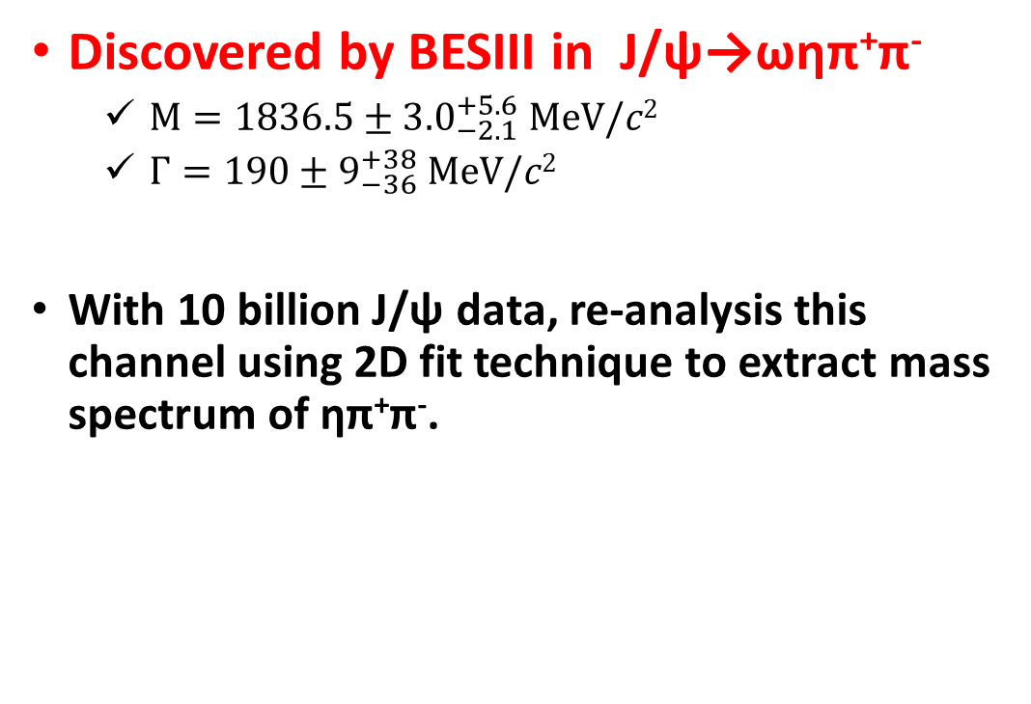
X(1870)
Phys. Rev. Lett. 107, 182001 (2011)
Discovered by BESIII in J/ψ→ωηπ⁺π⁻
  $M={1836.5±3.0}_{−2.1}^{+5.6} MeV/c2$
  $Γ={190±9}_{−36}^{+38} MeV/c2$
With 10 billion J/ψ data, re-analysis this channel using 2D fit technique to extract mass spectrum of ηπ⁺π⁻.
BESIII
M(ηπ⁺π⁻)

Slide 28
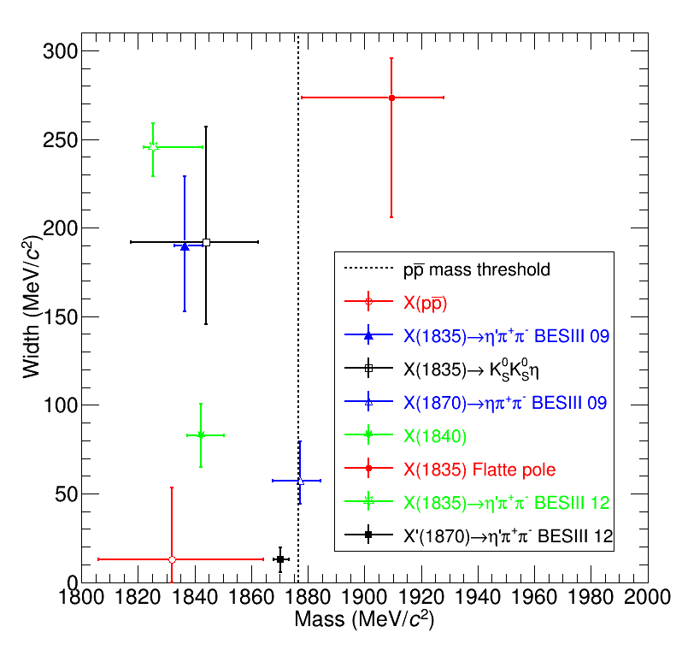


Structures around 1.8 $GeV/c2$
J/ψ→γ3(π⁺π⁻)
Phys. Rev. D 88, 091502(R) (2013)
J^{PC} of X(1840) and X(1870): need PWA
Search and study those states in more channels
J/ψ→ωηπ⁺π⁻
Phys. Rev. Lett. 107, 182001 (2011)

Slide 29


Observation of X(1835) in J/ψ→γK_{S}K_{S}η
Use 1.3×10⁹ J/ψ events collected by BESIII in 2009 and 2012
Clear structure on mass spectrum of K_{S}K_{S}η around 1.85 GeV$/c2$
Strongly correlated to f₀(980)
PWA for M(K_{S}K_{S}) < 1.1 GeV$/c2$
PRL 115, 091803 (2015)

Slide 30




Anomalous line shape of η′π⁺π⁻ near the $p\overline{p}$ mass threshold in J/ψ→γη′π⁺π⁻
Simultaneous fits to two η′ decay modes
Simple Breit-Wigner function fails in describing the η′π⁺π⁻ line shape near the $p\overline{p}$ mass threshold
Two typical circumstances where an abrupt distortion of a resonance’s line shape shows up
  Threshold structure caused by the opening of an additional $p\overline{p}$ decay mode
    Use the Flatté formula for the line shape
  Interference between two resonances with one very narrow close to threshold
    Use coherent sum of two Breit-Wigner amplitudes for the line shape
PRL 117, 042002 (2016)
  log$𝓛$ = 630503.3

Slide 31








Observation of Mppb threshold enhancement — X(ppb)
First observation of ppb mass threshold enhancement
No similar threshold structure in other channels → It can not be pure FSI effect

