Slide 1
Craig Roberts … http://inp.nju.edu.cn/
Grant no. 12135007
Welcome to Nanjing
欢迎来到南京
New Horizons for New Machines

Slide 2
1st Workshop on Hadron Structure at High-Energy, High-Luminosity Facilities
The proton is stable
It’s provided the “only” available target since Rutherford = 100 years
Haven’t we learnt enough yet?
No
And even though we haven’t nearly understood its 1D structure, we’re now looking to chart proton 3D structure.
Like children in the lolly shop
… reaching for the next big chocolate
before we’ve finished the one in our hands?
Or explorers,
always drawn to look beyond the next horizon?

Slide 3
1st Workshop on Hadron Structure at High-Energy, High-Luminosity Facilities
Today
Proton is just one of (infinitely many?) hadrons in Nature; and it’s a baryon
Pion and kaon:
predicted 80+ years ago; discovered 70+ years ago
Mesons = possibly entirely different form of hadron matter
What do we know of their structure?
Not Very Much
New Horizon in View … Modern & anticipated facilities with capacity to deliver practical pion and kaon “targets” … lift science beyond the proton → gather data to expose structure of the mesons that are critical to the existence of observable matter

Slide 4
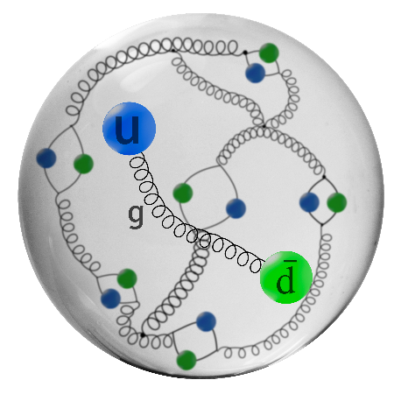
QCD Structure of Nature’s Most Fundamental Nambu Goldstone Bosons
SM Theory
Pions and kaons: bound states of valence-quark & valence-antiquark
In being bound states, they are just like all other hadrons
Formulated correctly, π and K define
the simplest bound-state problems in strong interactions
Rigorous continuum predictions are available
More are being developed
Lattice-regularised QCD is beginning to deliver
Precisions tests of strong QCD are becoming possible
No room for parameters to be varied
⇒ theorists can’t hide from null results or disagreements with data
Chapters will be closed in textbooks that will be written

Slide 5
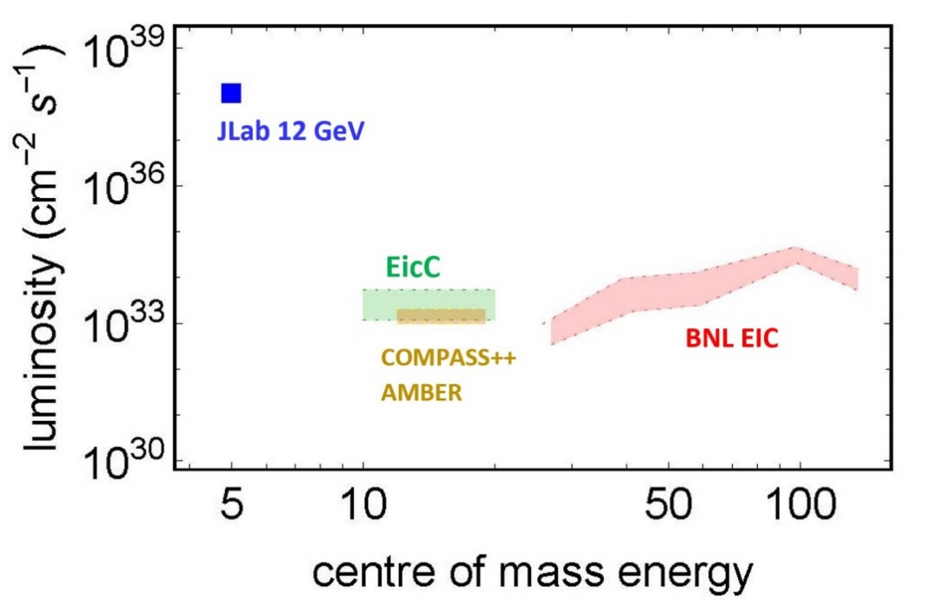
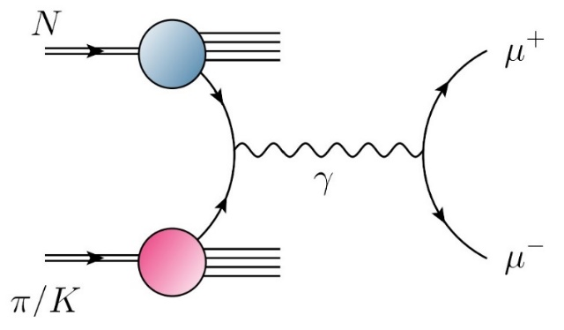
Era of Meson Targets
JLab & EIC & EicC
High luminosity electron ( + ion) beams
Access to meson targets via the Sullivan Process,
i.e., a baryon’s “meson cloud”
AMBER @ CERN SPS
High-intensity beams of pions
($\tilde{>}$ 10⁷ pions/sec in Phase-1 = approved)
and kaons (5 × 10⁶ kaons/sec Phase-2 = proposal
being prepared)
Drell-Yan, J/ψ & prompt photon production
… from proton and nuclear targets

Slide 6
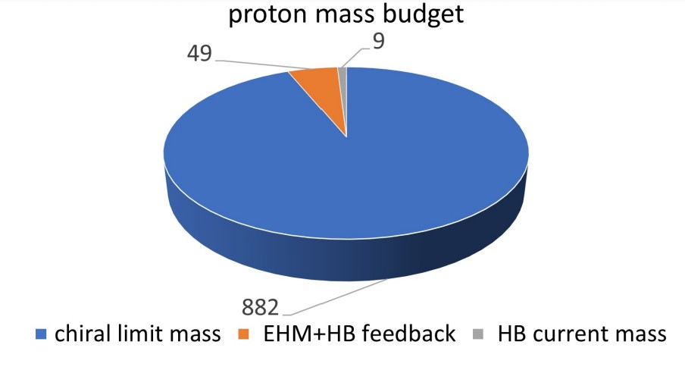
Fundamental Questions: What is; Wherefrom; Whereto mass?
Nature has two sources of mass
Higgs Boson – well understood at tree-level of SM Lagrangian
Proton mass budget
Only 9 MeV/939 MeV is directly from Higgs
Namely, just 1%
Plainly, there is another phenomenon in Nature
that is extremely effective in producing mass:
Emergent Hadron Mass (EHM)
Alone, it produces 94% of the proton’s mass
Remaining 5% is generated by
constructive interference
between EHM and Higgs-boson

Slide 7
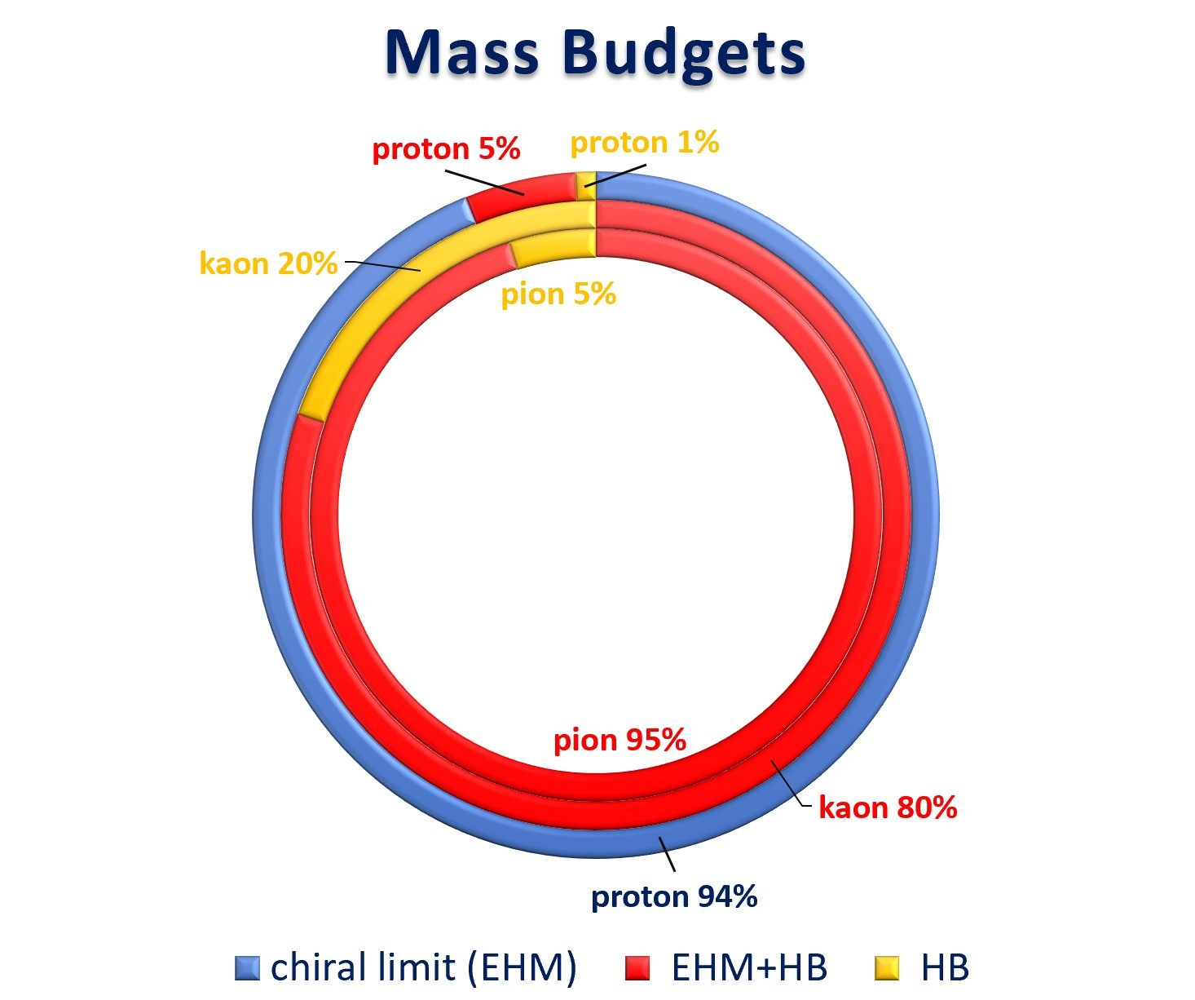
Emergence of Hadron Mass - Contrasts
Pion definitive connection to EHM
Kaon exposes Higgs-boson modulation of EHM = constructive interference between Nature’s two known sources of mass
Compare proton and pion mass budgets
Pion is a Nambu-Goldstone boson
No blue annulus
because massless in chiral-limit
EHM+HB is 95% of the total
Kaon is somewhere in between π & p
HB = 20%
EHM+HB = 80%
Critically, without Higgs mechanism of mass generation, π and K would be indistinguishable from each other
Always distinguishable from proton.
Yet, all states are supposed to be in QCD!
Proof Wanted

Slide 8
Phenomenon of Emergent Mass
SM paradigm
proton is described by QCD … 3 valence quarks
pion is also described by QCD … 1 valence quark and 1 valence antiquark
ρ-meson is also described by QCD … 1 valence quark and 1 valence antiquark
Here m_{p} ≈ 1.5 × m_{ρ}
expect m_{p} ≈ 1.5 × m_{π} … but, instead m_{p} ≈ 7 × m_{π}
Why is ≈ 1 GeV proton mass paired with ≈ ¹⁄₇ GeV pion mass in the same theory of Nature?
How is this achieved?
Does Nature fine tune?
Is there something peculiar about the pion (and by logical extension, the kaon)?
Are the answers in QCD?

Slide 9
EHM & QCD
$$L= \frac{1}{4}G_{μν}^{a}\left(x\right)G_{μν}^{a}\left(x\right)+\overline{ψ}\left[γ⋅∂_{x}+m+ig \frac{λ^{a}}{2}γ⋅A^{a}\left(x\right)\right]ψ\left(x\right)$$
$$G_{μν}^{a}\left(x\right)=∂_{μ}A_{ν}^{a}(x)−∂_{ν}A_{μ}^{a}(x)−f^{abc}A_{μ}^{b}{(x)A}_{ν}^{c}(x)$$
Can a one-line Lagrangian produce almost all visible mass in the Universe …
If so …

Slide 10
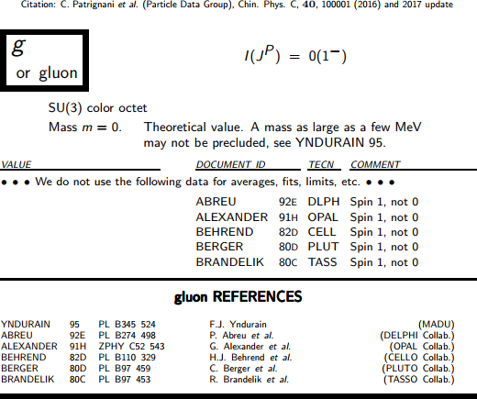
Gluons

Slide 11
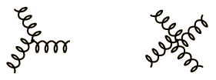
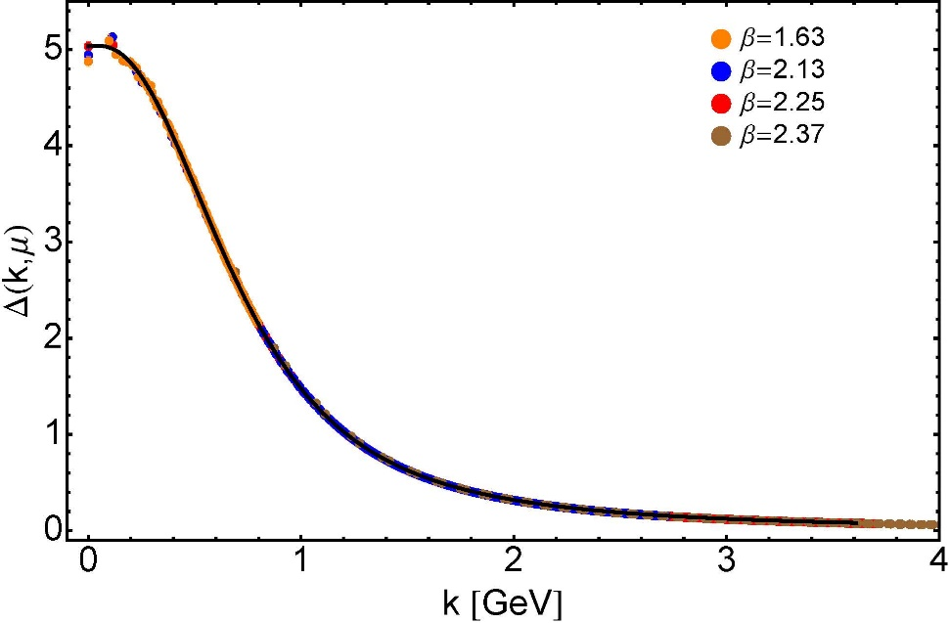
Pure gauge QCD
QCD doesn’t need quarks to be an interacting quantum field theory
Gluon self-interactions at tree-level, i.e., in the Lagrangian
Gluons are massless in perturbation theory
Not preserved non-perturbatively!
No symmetry in Nature protects four-transverse gluon modes …
$$qμ Πμν\left(q\right)≡0$$
Gluons acquire a running mass, which is large at infared momenta
⇒ Prediction: Gluon two-point function is nonzero and finite at q² = 0
3-gluon vertex
4-gluon vertex
Dynamical mass generation in continuum quantum chromodynamics
J.M. Cornwall, Phys. Rev. D 26 (1981) 1453 … ~ 1000 citations
The Gluon Mass Generation Mechanism: A Concise Primer
A.C. Aguilar, D. Binosi, J. Papavassiliou, Front. Phys. 11 (2016) 111203
Truly mass from nothing
An interacting theory, written in terms of massless gluon fields, produces dressed gluon fields that are characterised by a mass function that is large at infrared momenta
Gluon propagator … continuum and lattice QCD agree

Slide 12
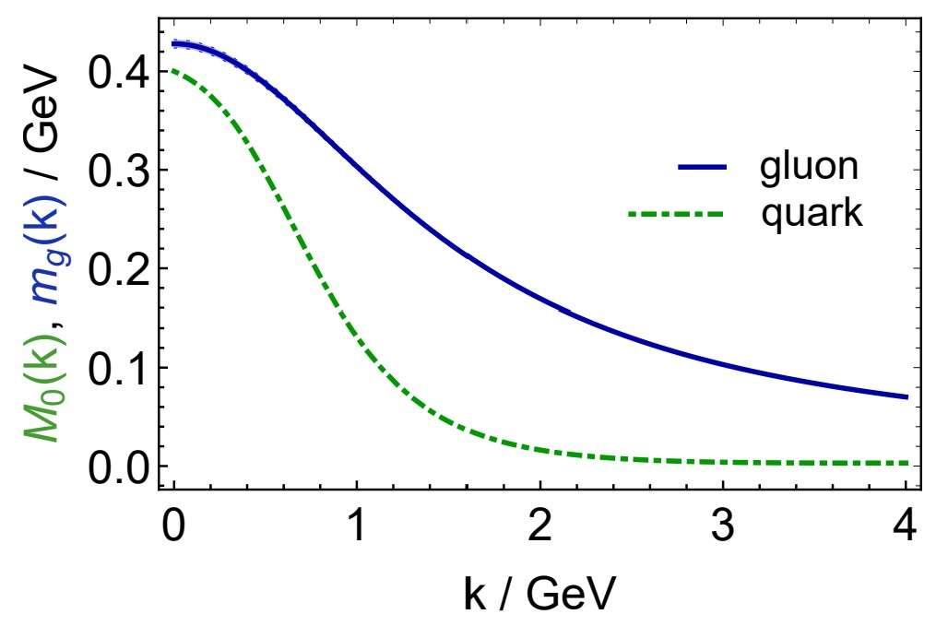
Prediction: Gluon Mass Function
Effective charge from lattice QCD, Zhu-Fang Cui, Jin-Li Zhang et al.,
NJU-INP 014/19, arXiv:1912.08232 [hep-ph], Chin. Phys. C 44 (2020) 083102/1-10 … 1682 downloads
Parameter-free predictions
In consistently combining continuum and lattice QCD,
all non-Abelian features of QCD are incorporated
Gluon mass function characterised by renormalisation group invariant IR mass
${\hat{m}}_{0}=0.43(1) GeV≈\frac{1}{2}m_{proton}$
The value is a prediction in the sense that it is $\frac{1}{2}m_{proton}$
But the value of m_{proton} is taken from experiment
The SM doesn’t “know” any of its mass scales.
Nature does.
Once these scales are given, how much predictive power does the SM deliver?
SM Theory reveals that a gluon mass scale is possible. It can then reveal all its consequences
Experiment can verify those predictions
Then the mechanism of EHM is exposed
Analogously, running mass-function for quarks also emerges: $M_{0}\left(k\right)∼B\left(k\right)=$ scalar part of quark dressing.

Slide 13
Prediction: Gluon Mass Function
Effective charge from lattice QCD, Zhu-Fang Cui, Jin-Li Zhang et al.,
NJU-INP 014/19, arXiv:1912.08232 [hep-ph], Chin. Phys. C 44 (2020) 083102/1-10 … 1621 downloads
Parameter-free predictions
In consistently combining continuum and lattice QCD,
all non-Abelian features of QCD are incorporated
Gluon mass function characterised by renormalisation group invariant IR mass
${\hat{m}}_{0}=0.43(1) GeV≈\frac{1}{2}m_{proton}$
The value is a prediction in the sense that it is $\frac{1}{2}m_{proton}$
But the value of m_{proton} is taken from experiment
As written, the SM doesn’t “know” any of its mass scales.
Nature does.
Most fundamental expressions of the QCD trace anomaly in Nature
Massless gauge bosons become massive
Massless fermions become massive
Both masses are of nuclear size
EHM
Once these scales are given, how much predictive power does the SM deliver?
SM Theory reveals that a gluon mass scale is possible. It can then reveal all its consequences
Experiment can verify those predictions
Then the mechanism of EHM is exposed
Analogously, running mass-function for quarks also emerges: $M_{0}\left(k\right)∼B\left(k\right)=$ scalar part of quark dressing.

Slide 14
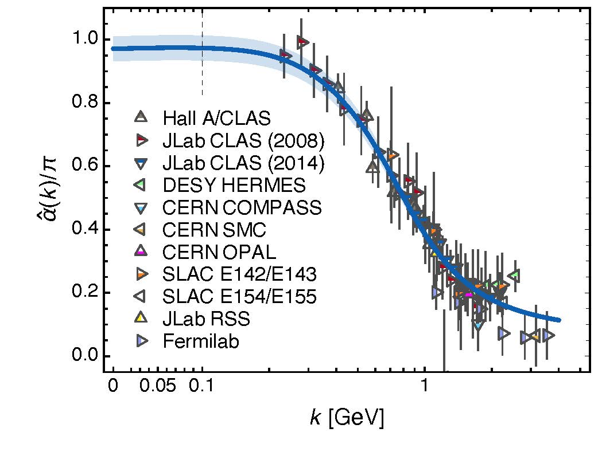
Prediction: Process-independent effective-charge in QCD
The QCD Running Coupling,
A. Deur, S. J. Brodsky and G. F. de Teramond, Prog. Part. Nucl. Phys. 90 (2016) 1-74
Process independent strong running coupling
Daniele Binosi et al., arXiv:1612.04835 [nucl-th], Phys. Rev. D 96 (2017) 054026/1-7
Effective charge from lattice QCD, Zhu-Fang Cui et al., NJU-INP 014/19, arXiv:1912.08232 [hep-ph], Chin. Phys. C 44 (2020) 083102/1-10
Continuum + lattice analyses of gauge sector enable definition and calculation of unique QCD
“Gell-Mann – Low”
running charge
Parameter-free prediction
N.B. Qualitative change in α̂_{PI}(k) at k ≈ ½ m_{p}
No Landau Pole
“Infrared Slavery”
picture of confinement is not correct
Below k ∼ m̂₀ , interactions are scale independent, just as they were in the Lagrangian; so, QCD becomes practically conformal again on the infrared domain
Data = process dependent effective charge [Grunberg:1982fw]:
α_{g1}, defined via Bjorken Sum Rule

Slide 15
Prediction Pion (Nambu-Goldstone modes) and mass
EHM demands equivalence between
one-body mass and two-body correlation strength
in Nature’s most fundamental Nambu-Goldstone bosons
Higgs boson couplings → 0
Pion exists and is massless
Pion Bethe-Salpeter amplitude
Pion wave function quark mass function
Thus, enigmatically, properties of the nearly massless pion are the cleanest expression of EHM in the Standard Model !
f_{π} E_{π}(p²) = B(p²)

Slide 16
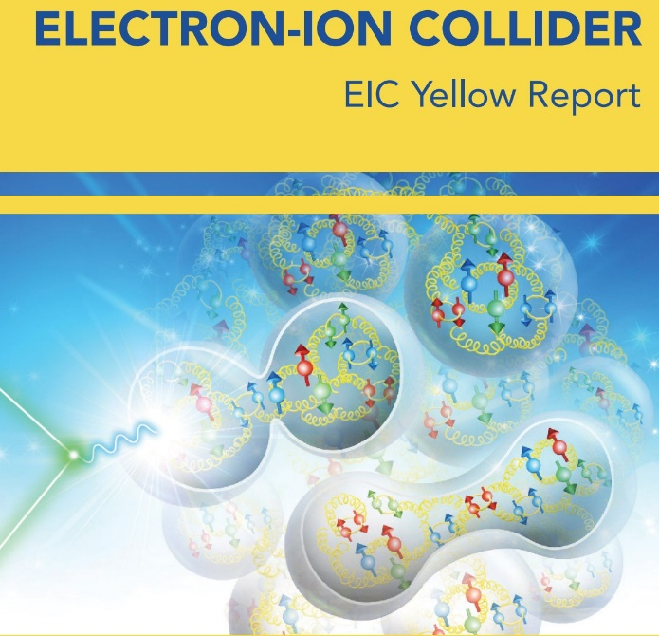
Potential of Existing and Future Facilities

Slide 17
Meson Structure Worldwide Plans and Goals
Letter of Intent: A New QCD facility at the M2 beam line of the CERN SPS. This document covers all ideas for future experiments as of January 2019.
Proposal for Phase-1: COMPASS++/AMBER: Proposal for Measurements at the M2 beam line of the CERN SPS Phase-1: 2022-2024. This document covers the three phase-1 experiments (start in 2022).
Pion and Kaon Structure at the Electron-Ion Collider, Arlene C. Aguilar et al., arXiv:1907.08218 [nucl-ex], Eur. Phys. J. A 55 (2019) 190/1-15
Strong QCD from Hadron Structure Experiments, S. J. Brodsky et al., arXiv:2006.06802 [hep-ph], Int. J. Mod. Phys. E 29 (2020) 08, 2030006/1-122
Selected Science Opportunities for the EicC, Xurong Chen, Feng-Kun Guo, Craig D. Roberts and Rong Wang, arXiv:2008.00102 [hep-ph], Few Body Syst. 61 (2020) 4, 43/1-37. Invited contribution to the Special Issue: "New Trends in Hadron Physics: a Few-Body Perspective"
Insights into the Emergence of Mass from Studies of Pion and Kaon Structure, Craig D. Roberts, David G. Richards, Tanja Horn and Lei Chang, arXiv: 2102.01765 [hep-ph], Prog. Part. Nucl. Phys. 120 (2021) 103883/1-65
Electron-Ion Collider in China, D. P. Anderle et al., arXiv:2102.09222 [nucl-ex], Front. Phys. (Beijing) 16 (2021) 6, 64701
Revealing the structure of light pseudoscalar mesons at the Electron-Ion Collider, John Arrington et al., arXiv: 2102.11788 [nucl-ex], J. Phys. G 48 (2021) 7, 075106

Slide 18
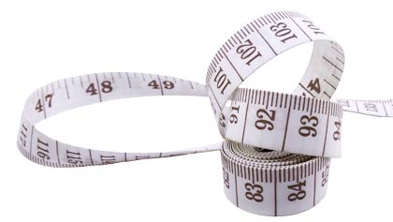
Hadron Radii

Slide 19
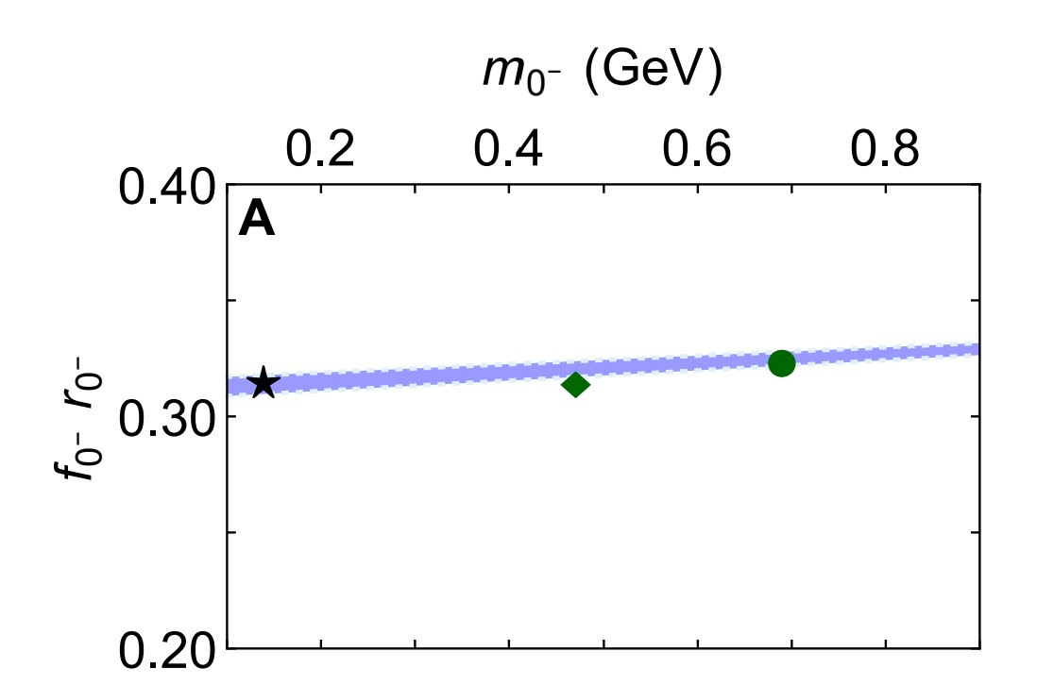
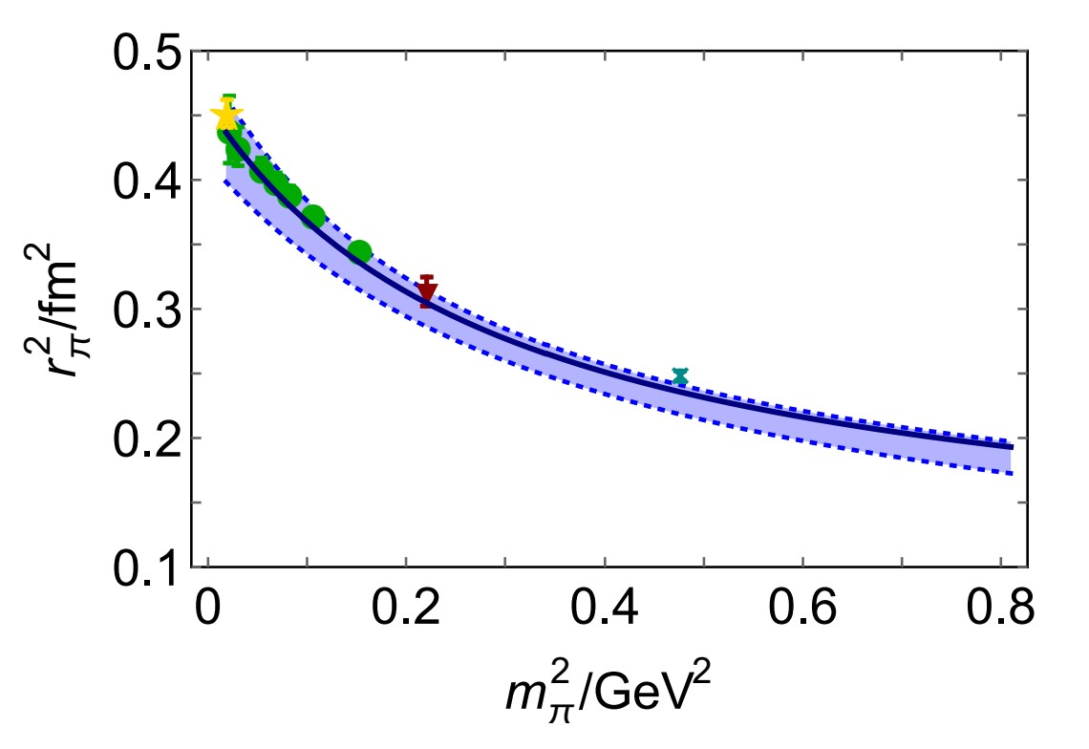
Nambu Goldstone Bosons: How Big are They?
Physics Measurements:
Pion and kaon charge radii
Scientific Context:
Hadron masses and radii are a direct expression of the links between EHM and confinement
Example: within Nambu-Goldstone boson domain of pseudoscalar-meson mass trajectory
f₀₋ r₀₋ ≈ constant
product of meson leptonic decay constant (f₀₋) and charge radius (r₀₋) is practically constant
f₀₋ is an order parameter EHM.
Equally, so is r_{π}
Precise measurements of π & K radii will reveal compositeness (confinement) scale for Nambu-Goldstone bosons
f₀₋ r₀₋ ≈ constant
Continuum & lattice
$$r_{π}∝\frac{1}{m_{π} }$$

Slide 20
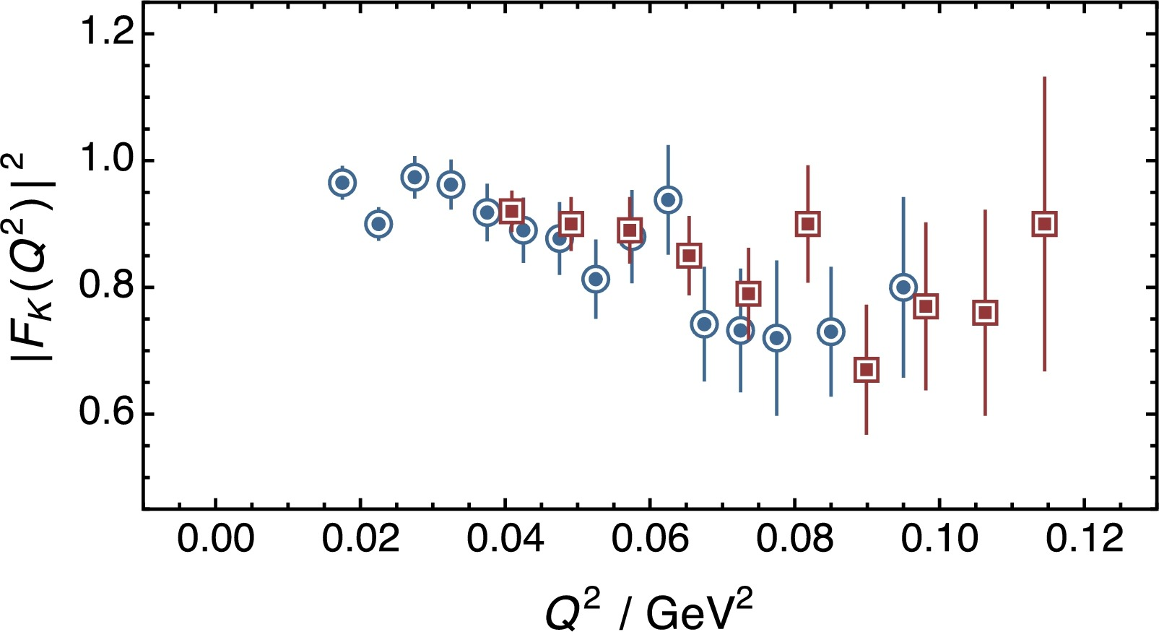
Size of Nambu Goldstone Bosons
This data is all we have … It cannot reasonably be used to claim a result for the kaon charge radius
Data – Existing:
70+ years after their discovery, knowledge of pion and kaon radii is very limited.
Pion charge radius is poorly known.
m_{π} measured to one-part in a million;
r_{π} only constrained to 1% & even this is debatable
The most precise data (charged-pion scattering at CERN) are more than 30-years-old and do not reach to very low momentum transfers
The most recent data (Selex) yield a result with errors more than 10-times larger than CERN
Pion charge radius from pion+electron elastic scattering data, Zhu-Fang Cui (崔著钫), Daniele Binosi, C.D. Roberts, S.M. Schmidt, NJU-INP 047/21, arXiv:2108.04948 [hep-ph], Phys. Lett. B 822 (2021) 136631/1-5
AMBER
Kaon radius is practically unknown
15 imprecise scattering points, on Q² > 0.015 GeV², analysed using a simple monopole fit, which is today known to be a poor approach
Recall that > 60-years of ep scattering measurements, analysed this way, led to proton radius extractions that are likely wrong by an amount in excess of 7σ.
New theory methods enable model-independent extraction of radii from precise low-Q² data
New method ⇒ r_{π} : 2.4σ tension with PDG 2021
No information beyond least-squares fit in K data
E.g. AMBER, with high-intensity π & K beams, capable of delivering precise data that are required
Enable 1st objective extraction of kaon size

Slide 21
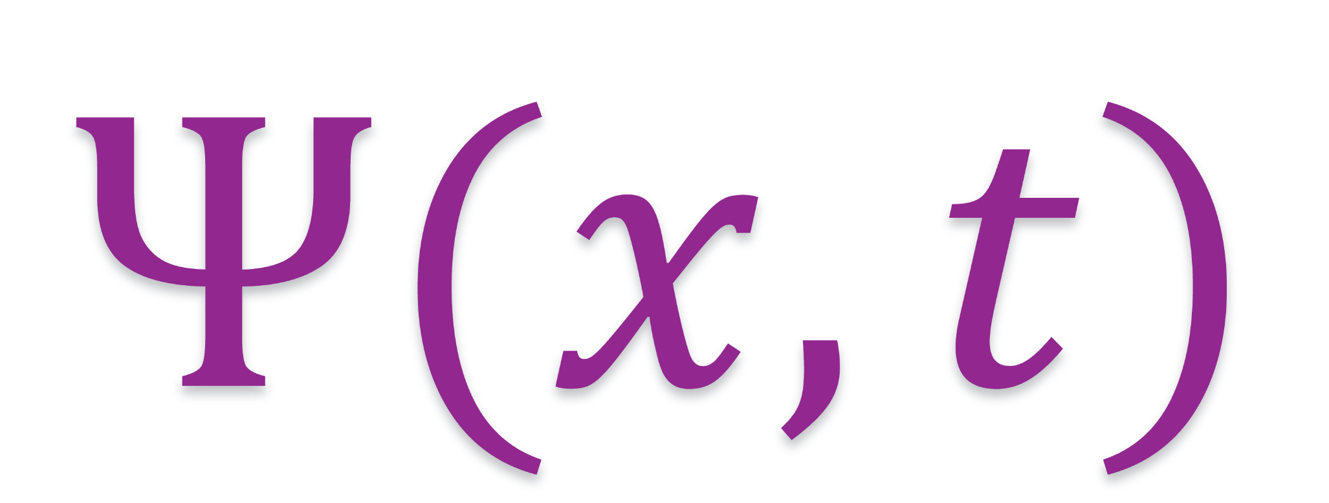
$π \& K$ DAs & Form Factors

Slide 22
Wave Functions of Nambu Goldstone Bosons
Physics Goals:
Pion and kaon distribution amplitudes (DAs – φ_{π,K})
Nearest thing in quantum field theory to a Schrödinger wave function
Consequently, fundamental to understanding π and K structure.
Scientific Context:
For 40 years, the x-dependence of the pion's dominant DA has been controversial.
Modern theory $⇒$EHM is expressed in the x-dependence of pion and kaon DAs
Pion DA is a direct measure of the dressed-quark running mass in the chiral limit.
Kaon DA is asymmetric around the midpoint of its domain of support (0<x<1)
Degree of asymmetry is signature of constructive interference between EHM and HB mass-generating mechanisms
Insights into the Emergence of Mass from Studies of Pion and Kaon Structure, Craig D. Roberts, David G. Richards, Tanja Horn and Lei Chang, NJU-INP 034/21, arXiv: 2102.01765 [hep-ph], Prog. Part. Nucl. Phys. 120 (2021) 103883/1-65

Slide 23
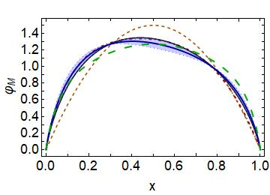
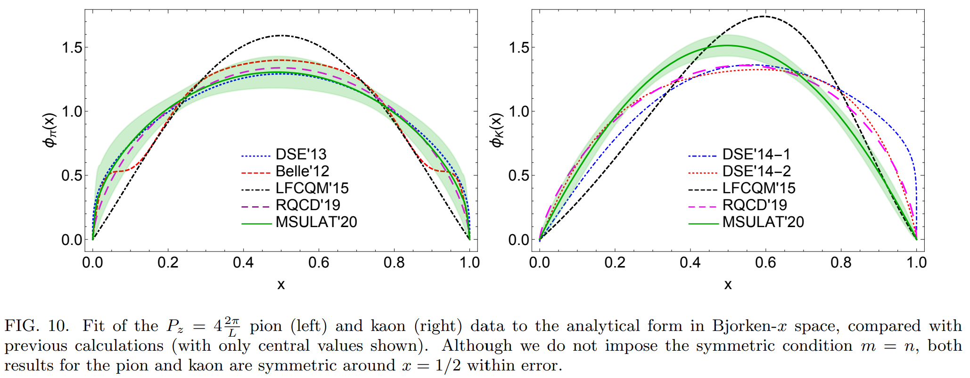
Meson leading-twist DAs
asymptotic
Continuum results exist & lQCD results arriving
Common feature = broadening
Origin = EHM
NO differences between π & K if EHM is all there is
Differences arise from Higgs-modulation of EHM mechanism
“Contrasting π & K properties reveals Higgs wave on EHM ocean”
kaon
pion
pion symmetric
kaon skewed
pion
kaon
Kaon DA vs pion DA
almost as broad
peak shifted to x=0.4(5)
〈ξ²〉 = 0.24(1), 〈ξ〉 = 0.035(5)
ERBL evolution logarithmic
Broadening & skewing persist to very large resolving scales – beyond LHC

Slide 24
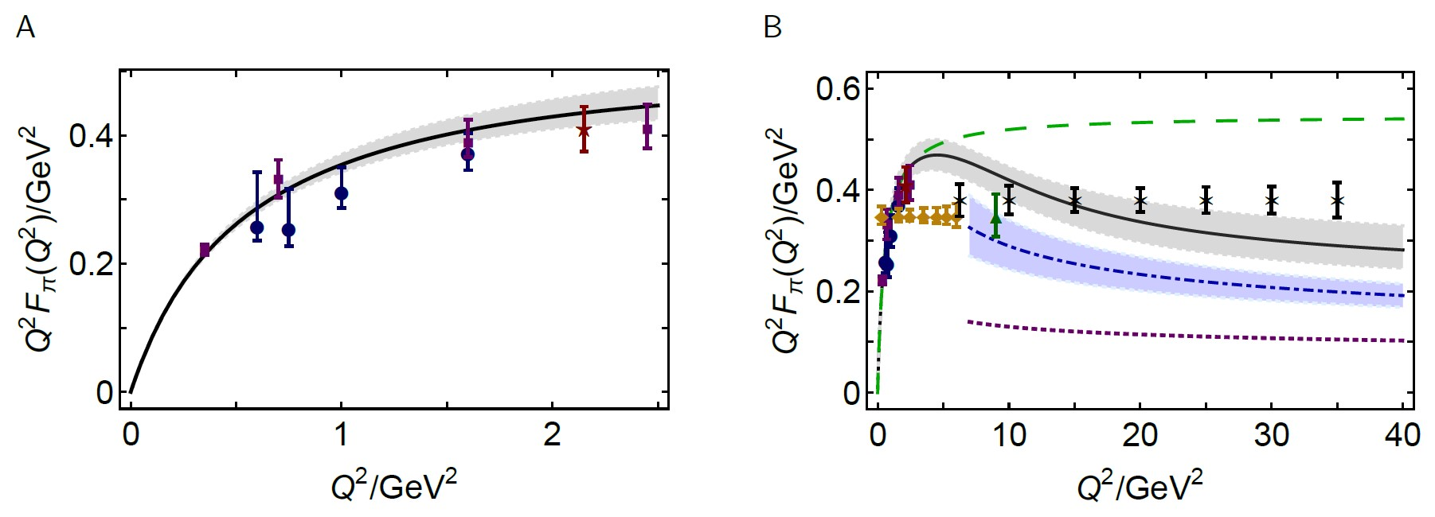
Wave Functions of Nambu Goldstone Bosons
Scientific Context:
Today, continuum and lattice are delivering consistent predictions for φ_{π,K}(x)
Can signature features of interference between EHM and HB, which are manifest in low-order Mellin moments of the DAs, be probed experimentally?
Measurement
Elastic electromagnetic form factors
Breakaway from scaling at $Q^{2}≈6 GeV^{2}$
Thereafter, $Q^{2}$ dependence
is largely described by hard-scattering formula with realistic DA
Reveal QCD scaling violations for 1st time in hard elastic scattering
CSM prediction
& existing JLab data
CSM prediction
& JLab + EIC projections

Slide 25
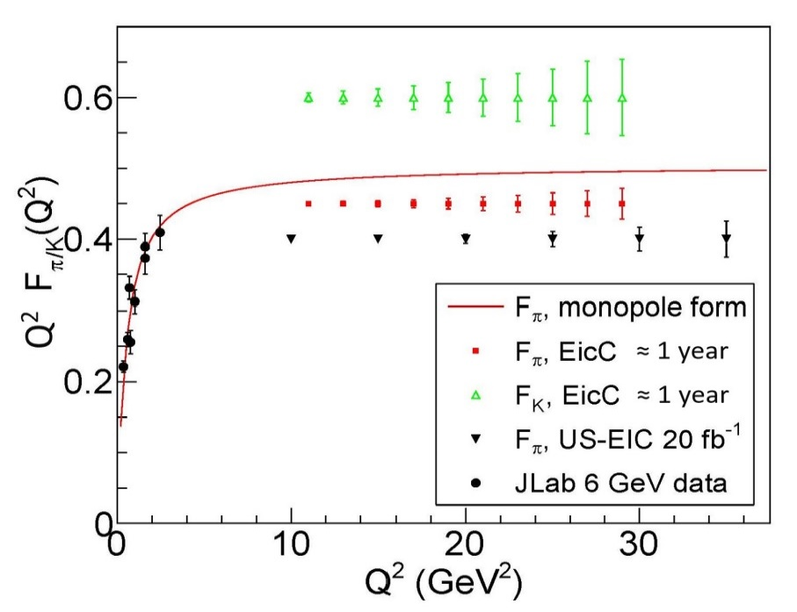
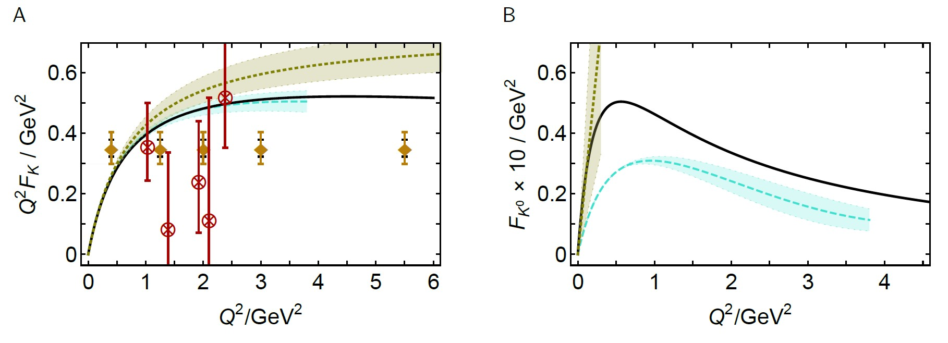
Wave Functions of Nambu Goldstone Bosons
Projections for $F_{π}\left(Q^{2}\right) \& F_{K}(Q^{2})$ at EicC
Kaon electromagnetic form factors
Charged kaon form factor
on $Q^{2 }>6 GeV^{2}⇒$ scaling violations
CSM 2017
no limit on $Q^{2 }$ reach
VMD
VMD
JLab existing
& projections
lattice 2018
limited reach in $Q^{2}$

Slide 26
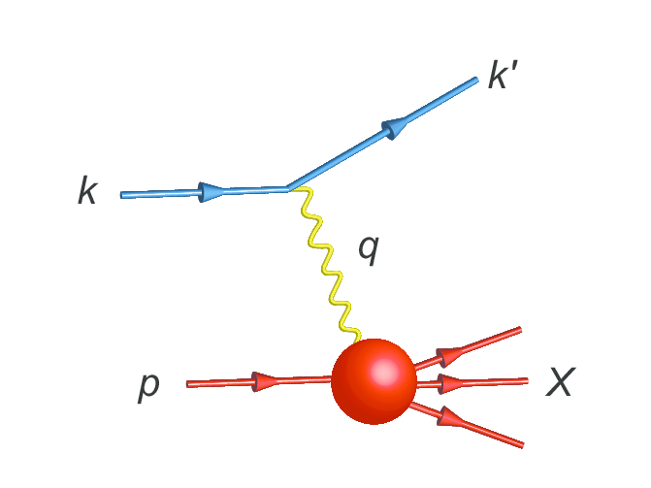
Parton Distribution Functions

Slide 27
NG Boson Distribution Functions
Insights into the Emergence of Mass from Studies of Pion and Kaon Structure, Craig D. Roberts, David G. Richards, Tanja Horn and Lei Chang, NJU-INP 034/21, arXiv: 2102.01765 [hep-ph], Prog. Part. Nucl. Phys. 120 (2021) 103883/1-65
Physics Goals:
Precise data that can be used to determine
Pion and Kaon Distribution Functions – valence, sea and glue
Provide the first complete charts of the internal structure of Nature's most fundamental Nambu-Goldstone bosons.
Today:
Existing pion data are more than 40-years-old
That data only covers the valence-quark domain
A forty-year controversy, with doubts persisting over whether the data agree with QCD predictions or challenge the truth of QCD
Regarding the kaon, worldwide, only 8 points of data exist

Slide 28
NG Boson Distribution Functions
Physics Goals:
Precise data that can be used to determine
Pion and Kaon Distribution Functions – valence, sea and glue
Provide the first complete charts of the internal structure of Nature's most fundamental Nambu-Goldstone bosons.
Future:
JLab, EIC, EicC
⇒ pion and kaon elastic electromagnetic form factors … reveal and quantify scaling
violations in hard exclusive processes … hard prediction of QCD, never seen
⇒ pion and kaon valence quark distribution functions at large $x_{B}$
AMBER
precision data to chart of π and K structure: DFs of valence, sea and glue.
Glue is particularly important … because controversial, yet prominent theory predicts that pions contain (almost) zero glue.

Slide 29
Controversy over pion valence DF
QCD-improvement of parton model leads to the following statement:
At any $ζ>ζH$ for which experiment can be interpreted through parton distributions, then
$$x≃1⇒qπ\left(x;ζ\right)∝{\left(1−x\right)}^{β=2+γ}, γ>0$$
Consequence
Any analysis of DY, DIS, etc. experiment which returns $β$<2 conflicts with QCD.
Observations
All existing internally-consistent calculations preserve connection between large-k² behaviour of interaction and large-x behaviour of DF: J=0 … (1/k²)^{n} ⇔ (1-x)^{2n}
No existing calculation with n=1 produces anything other than (1-x)²
Internally-consistent calculation that preserve RG properties of QCD,
then 2 → 2+γ, γ>0, at any factorisation-valid scale
Controversy:
Contemporary data fits yield (1-x)^{1+γ}
Is QCD wrong?
Is existing large-x data
a true measure of $qπ\left(x;ζ\right)$?
Are fitter-favoured analysis methods correct/complete?

Slide 30
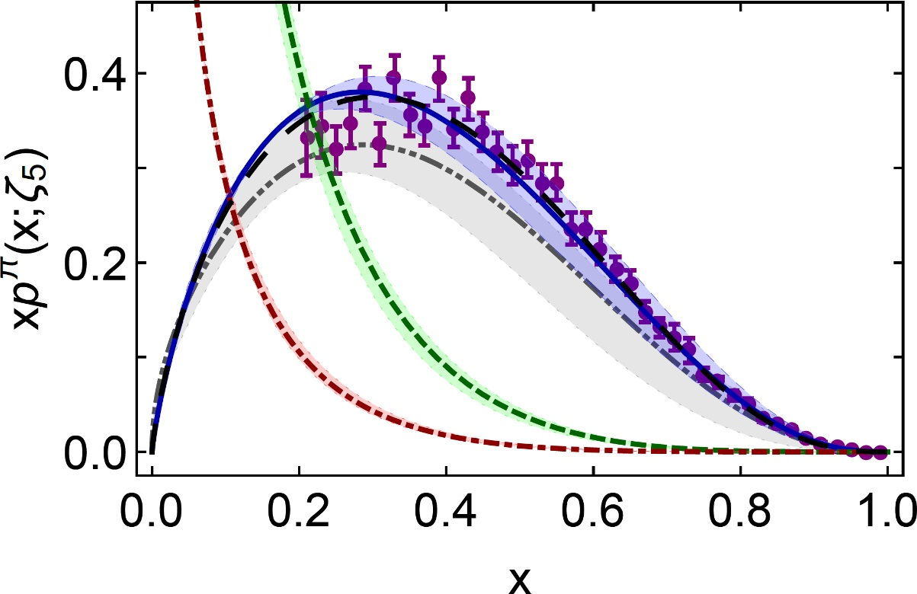
π valence-quark distributions 22 Years of Theory Evolution → 2021
Symmetry, symmetry breaking, and pion parton distributions, Minghui Ding, Khépani Raya, Daniele Binosi, Lei Chang, Craig D. Roberts and Sebastian M. Schmidt, NJU-INP 003/19, arXiv:1905.05208 [nucl-th], Phys. Rev. D 101 (2020) 054014/1-14
β^{contm}(ζ₅) = 2.66(12)
Developments in continuum-QCD enabled
1st and only
parameter-free predictions of
valence, glue and sea distributions within the pion
Reveal that $uπ(x;ζ)$is hardened by EHM
Every other continuum result available today is a practitioner-dependent fit to some body of data
Drawing insights from pion parton distributions, Minghui Ding, Khépani Raya et al.,, NJU-INP 012/19, arXiv:1912.07529 [hep-ph], Chin. Phys. C (Lett) 44 (2020) 031002/1-6
Symmetry, symmetry breaking, and pion parton distributions, Minghui Ding, Khépani Raya et al., NJU-INP 003/19, arXiv:1905.05208 [nucl-th], Phys. Rev. D 101 (2020) 054014/1-14
Higgs modulation of emergent mass as revealed in kaon and pion parton distributions, Zhu-Fang Cui, Minghui Ding, Fei Gao, Khépani Raya et al., NJU-INP 019/20, arXiv:2006.14075 [hep-ph], Eur. Phys. J. A (Lett.) 57 (2021) 5/1-8
Kaon and pion parton distributions, Zhu-Fang Cui, Minghui Ding, Fei Gao, Khépani Raya, Daniele Binosi, Lei Chang, Craig D. Roberts, Jose Rodríguez-Quintero and Sebastian M. Schmidt, NJU-INP 020/20, inSPIRE:recid 1833967, Eur. Phys. J. C 80 (2020) 1064/1-20

Slide 31
π valence-quark distributions 22 Years of Theory Evolution → 2021
Symmetry, symmetry breaking, and pion parton distributions, Minghui Ding, Khépani Raya, Daniele Binosi, Lei Chang, Craig D. Roberts and Sebastian M. Schmidt, NJU-INP 003/19, arXiv:1905.05208 [nucl-th], Phys. Rev. D 101 (2020) 054014/1-14
β^{contm}(ζ₅) = 2.66(12)
β^{lattice}(ζ₅) = 2.45(58)
Developments in continuum-QCD enabled
1st and only
parameter-free predictions of
valence, glue and sea distributions within the pion
Reveal that $uπ(x;ζ)$is hardened by EHM
Novel lattice-QCD algorithms beginning to yield results for pointwise behaviour of $uπ(x;ζ)$
Agreement between
new continuum prediction for $uπ(x;ζ)$ [Ding:2019lwe]
and recent lattice-QCD result [Sufian:2019bol]
Real strides toward understanding pion structure.
Standard Model prediction: stronger than ever before
Every other continuum result available today is a practitioner-dependent fit to some body of data
After 30 years – new era dawning in which the ultimate experimental checks can be made:
JLab12 … M2 beam-line @ CERN … EIC … EicC

Slide 32
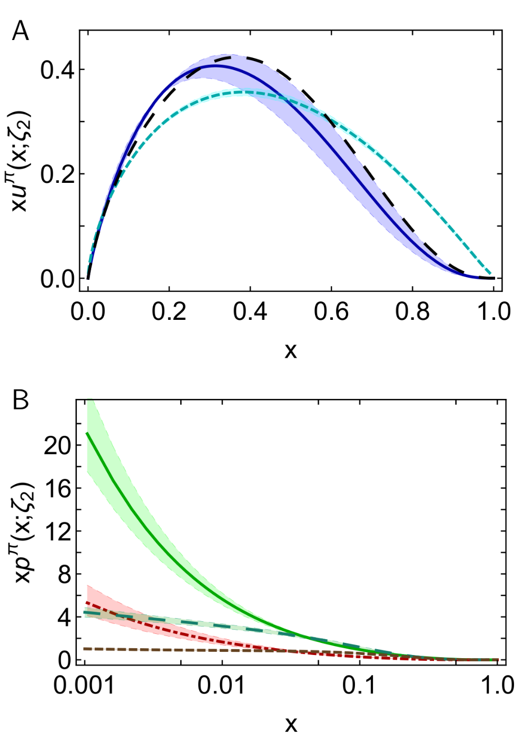
π DFs … Modern Theory Predictions vs Traditional Phenomenological Fits to Data
Valence:
momentum fraction similar
Fits … ignore NLL resummation … profile much harder
& inconsistent with QCD prediction
Glue:
Qualitative similarities on x ≥ 0.05, but marked quantitative disagreement, especially on complementary domain
Both continuum prediction and fit are very different from early phenomenology
Should be tested in new experiments that are directly sensitive to the pion’s gluon content.
E.g., prompt photon & J/Ψ production
Sea:
Prediction and fit disagree on entire x-domain
If pion’s gluon content is considered uncertain, then fair to describe sea-quark distribution as empirically unknown
Motivation for the collection and analysis of DY data with π± beams on isoscalar targets
DSE prediction
JAM valence
DSE prediction
glue & sea
JAM:
glue & sea

Slide 33
π DFs … Modern Theory Predictions vs Traditional Phenomenological Fits to Data
Valence:
momentum fraction similar
JAM … publication ignores NLL resummation … profile much harder & inconsistent with QCD prediction
Glue:
Similarities on x ≥ 0.05, but marked disagreement on important complementary domain
Both continuum prediction and JAM fit are very different from early phenomenology
Should be tested in new experiments that are directly sensitive to the pion’s gluon content.
Perhaps, prompt photon & J/Ψ production
Sea:
Prediction and fit disagree on entire x-domain
If pion’s gluon content is considered uncertain, then fair to describe sea-quark distribution as empirically unknown
Motivation for the collection and analysis of DY data with π± beams on isoscalar targets
DSE prediction
JAM valence
Breaking news …
1st exploratory lQCD results for pion’s glue DF have been released
DSE prediction
glue & sea
JAM:
glue & sea

Slide 34
Breaking news for glue in π: Continuum (Eur. Phys. J. C 80 (2020) 1064/1-20) & Lattice Predictions (arXiv:2104.06372)
Two distinct methods for solving QCD
Agree quantitatively on $g_{ }^{π}\left(x\right)$
continuum
Phenomenological analyses
exhibit qualitatively different behaviour
are disfavoured by this comparison
Highlights need for new data and improved phenomenology in order to turn that data into a real test of QCD and our understanding of Nambu-Goldstone modes.
AMBER @ CERN can provide the necessary precise data.
lattice
Regarding the distribution of glue in the pion, Lei Chang (常雷) and Craig D Roberts, e-Print: 2106.08451 [hep-ph], Chin. Phys. Lett. 38 (8) (2021) 081101/1-6 - Editors' Suggestion

Slide 35
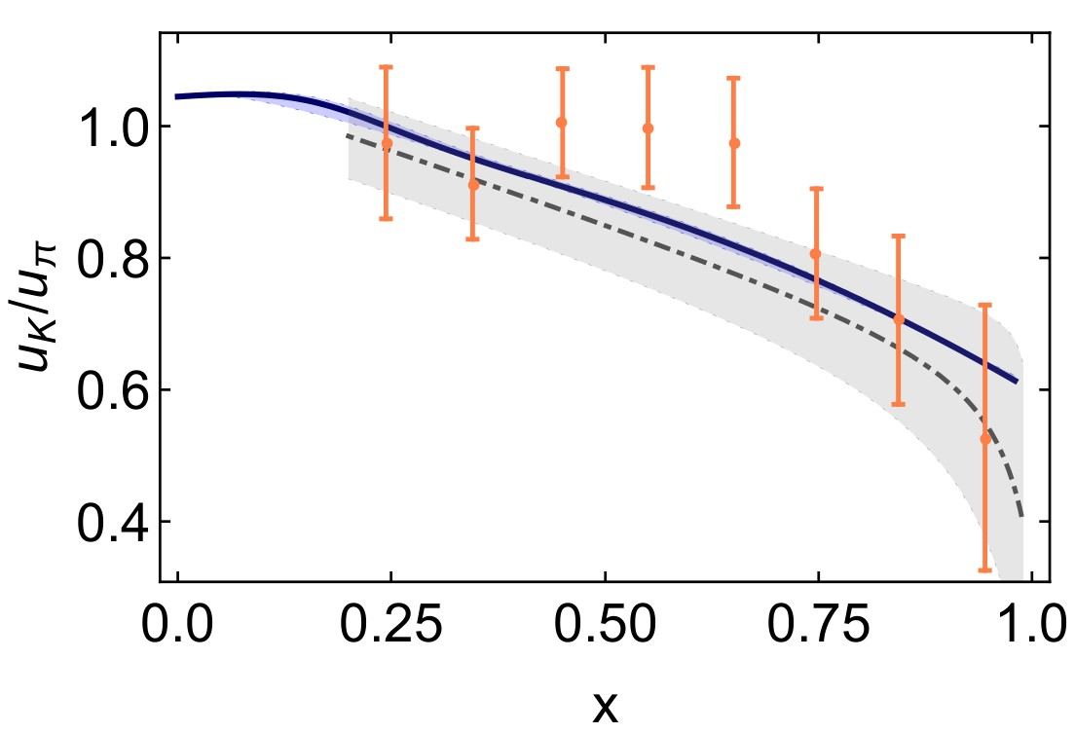
Status: Kaon
Programmes at JLab, AMBER
Proposals at EIC and EicC
Tackling the kaon structure function at EicC
Gang Xie et al. e-Print: 2109.08483 [hep-ph]
Little empirical information available on K DFs ⇒ no recent phenom. inferences.
Valence-quark distributions: results from models and a single, recent lQCD study
Kaon’s glue and sea distributions: no results
Entirety of Human history
– only 8 kaon data in existence
CERN … Phys. Lett. B 93 (1980) 354-356
One piece of available experimental information:
${u_{K}(x)}/{u_{π}\left(x\right)}$
Continuum prediction for ratio is consistent with data.
But, given large errors, this ratio is very forgiving of even large differences between various calculations of the individual DFs used to produce the ratio.
New, precise data critical if this ratio to be used as path to understanding the Standard Model’s Nambu-Goldstone modes;
Results for u_{π}(x;ζ₅), u_{K}(x;ζ₅) separately = better.
CSM
lQCD_{MSU}

Slide 36
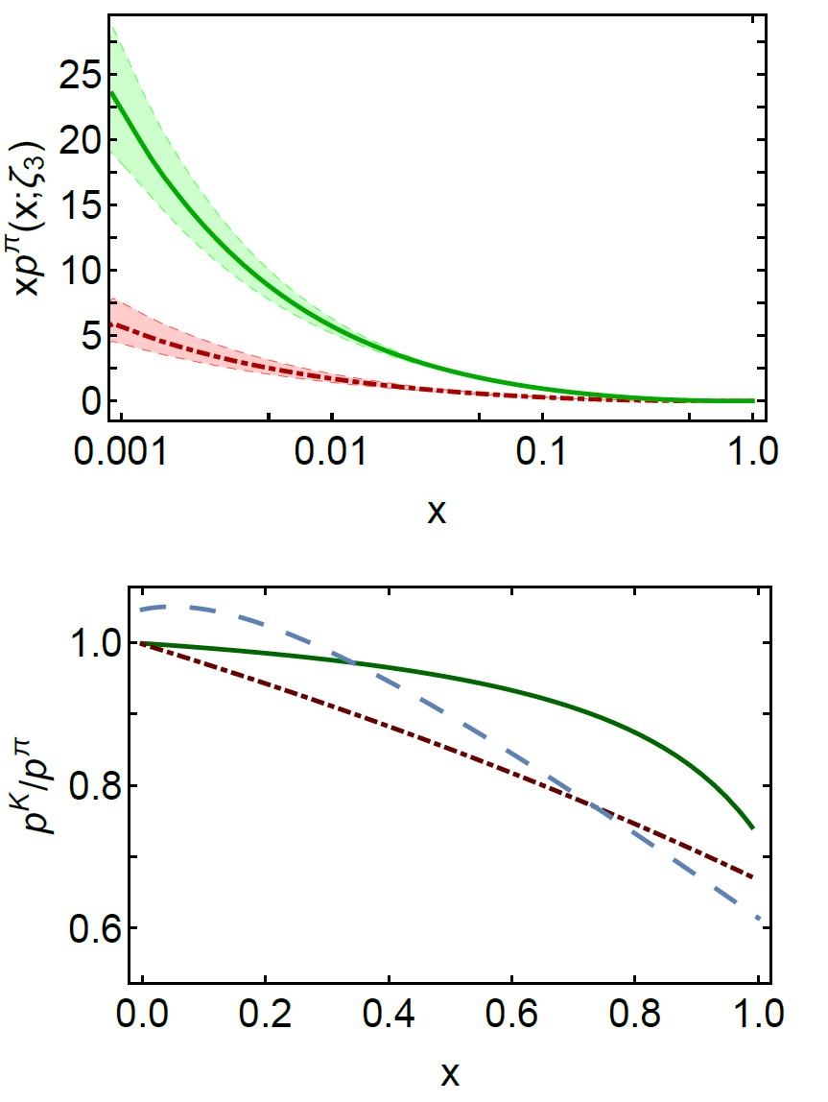
Status: Kaon
Kaon parton distributions, Z.-F. Cui et al., arXiv:2006.14075 [hep-ph], Eur. Phys. J. C 80 (2020) 1064/1-20
Little empirical information available on K DFs ⇒ no recent phenom. inferences.
Valence-quark distributions: results from models and a single, recent lQCD study
Kaon’s glue and sea distributions: no predictions … until now
Glue and Sea – Predictions:
DFs similar to those in the pion
Detailed comparison requires use of mass-dependent splitting functions.
Development underway … Preliminary conclusions:
Light-front momentum fraction carried by s-quarks in the kaon increases by ∼ 5%;
Compensated by a commensurate decrease in fractions carried by glue (−1%) and sea (−2%).
Glue
Sea
Valence
Glue
Sea

Slide 37
Epilogue
Nature has two sources of mass
Higgs mass-generating mechanism = understood
Phenomenon of Emergent Hadron Mass = much to learn
EHM (possibly/probably?) lies within the Standard Model,
i.e., in strong QCD
Basic predictions:
Gluons acquire mass ⇒ running coupling saturates on infrared domain, restoring approximate conformal behaviour
Enigmatically, the unusually light Nambu-Goldstone bosons provide the clearest windows onto the Emergence of Mass in Nature
With modern & on-the-horizon facilities having the capacity to deliver practical pion & kaon “targets”, science can finally move beyond proton, to explore & explain an entirely different form of hadron matter = the mesons without which observable Universe could not exist

Slide 38
Grant no. 12135007
Thankyou

