Slide 1
MS+UT simulation preliminary result
Zhouxk
2021.09.07

Slide 2
MS simulation
Direct read MSHits from Boole → package conflict
MS MCHits can not get directly from Boole
MS MCHits are reconstructed in Cesar’s own package：MSRecoAlgos in Brunel
Use track to propagate to MS position → match

Slide 3
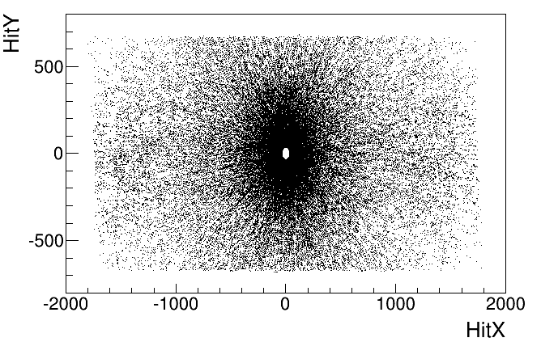
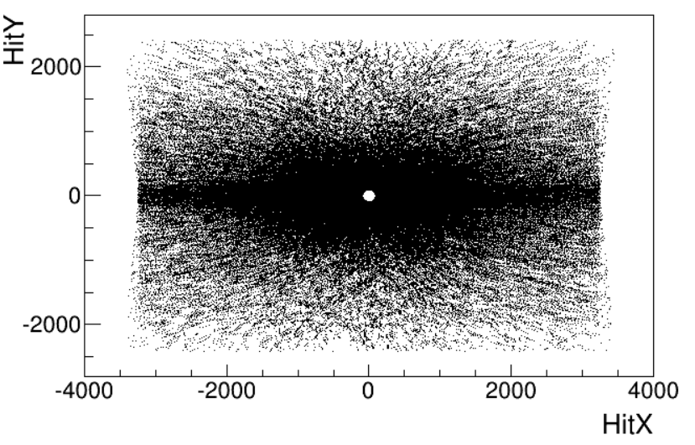
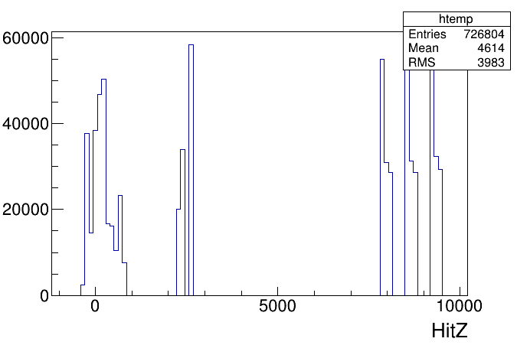
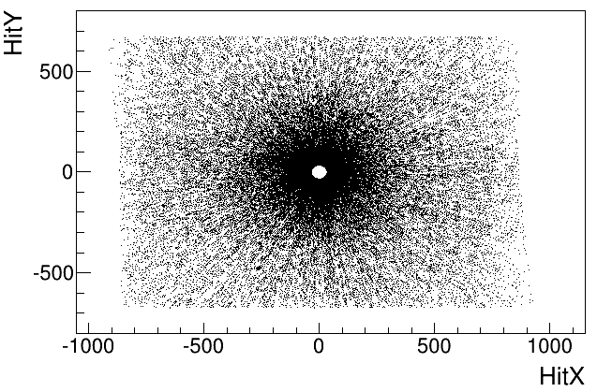
First look at Velo/UT/FT simulation
100 evts
Normal UT: 82764 charged trks
DouWidth UT: 82863 charged trks
P>200
Only charged track
DouWidth UT
FT
Normal UT

Slide 4
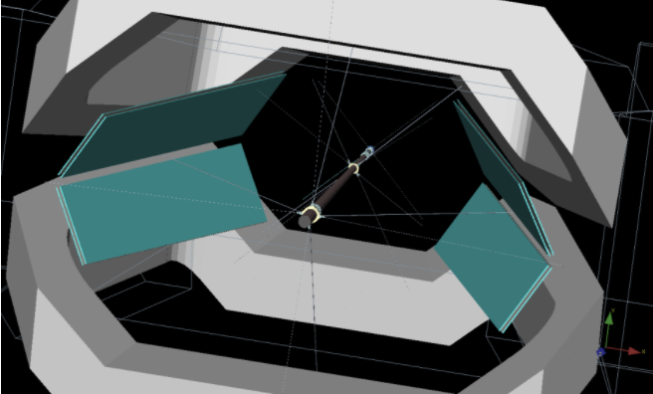
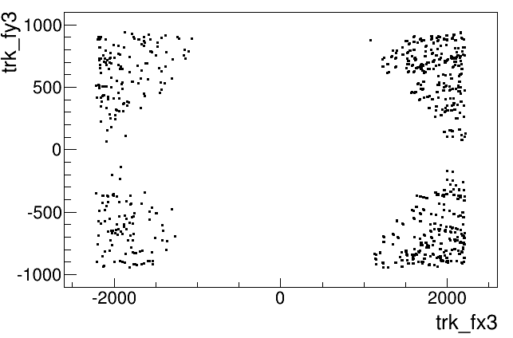
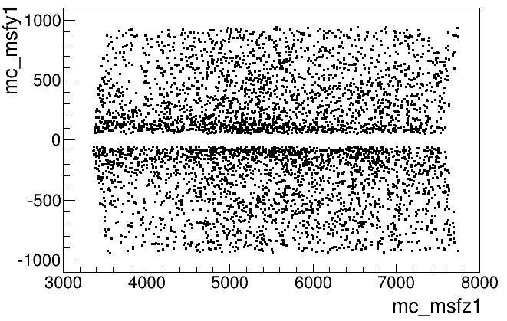
MS hit distribution
Y
Y
X
Z

Slide 5
Count
Charged tracks | UT | Velo | FT | UT+FT | UT+Velo | UT+FT+Velo
Normal UT | 14644 | 27510 | 20091 | 9557 | 11037 | 8027
DouWidth UT | 15473 | 27738 | 20561 | 9561 | 11472 | 8041

Slide 6
Add MS info
Charged tracks | MS | MS+UT | MS+Velo | MS+FT | MS+UT+FT | MS+UT+Velo | MS+Velo+UT+FT
Normal UT | 4986 | 2518 | 1616 | 219 | 108 | 1487 | 83
DouWidth UT | 4967 | 2749 | 1671 | 257 | 142 | 1638 | 111
Conclusion: double UT width will increase <5% trks
The geometry now is enough

Slide 7
