Slide 1
CEPC Auxiliary Facilities
Xiao Yu
Huang JinShu
October 13, 2021

Slide 2
Contents
Electric engineering (YREC)
Electric power demand
Power supplies and schemes
110kV Substation load distribution
110kV Substation layout
Cable passage
Electrical Equipment General Layout in Auxiliary
HVAC (YREC)
Design Parameters
Air-conditioning system in tunnel
Ventilation and smoke exhaustion system
Cooling water system (IHEP)
Subsystem division
Key requirements and parameters
Low-conductivity water system (LCW)
Cooling tower water system (CTW)
Deionized water system (DW)
Waste water collection and discharge system
Cooling water control system
Compressed air system(IHEP)
Energy saving consideration

Slide 3
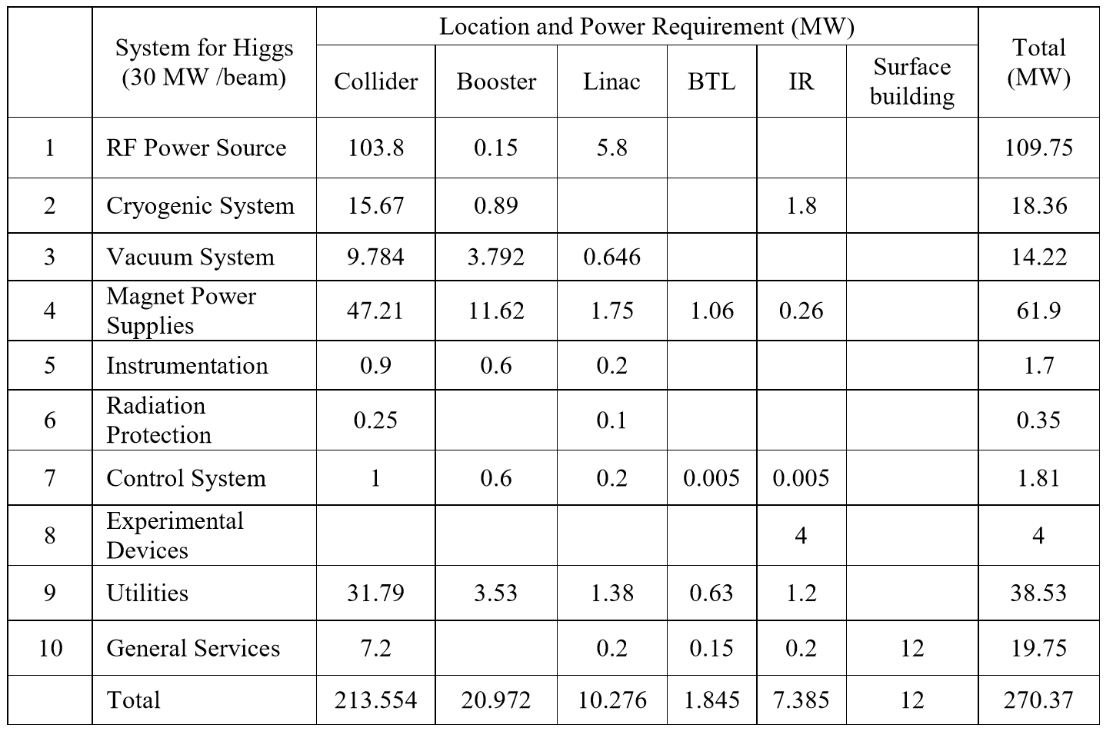
Electric engineering
Electric power demand
Total: 270.37MW

Slide 4
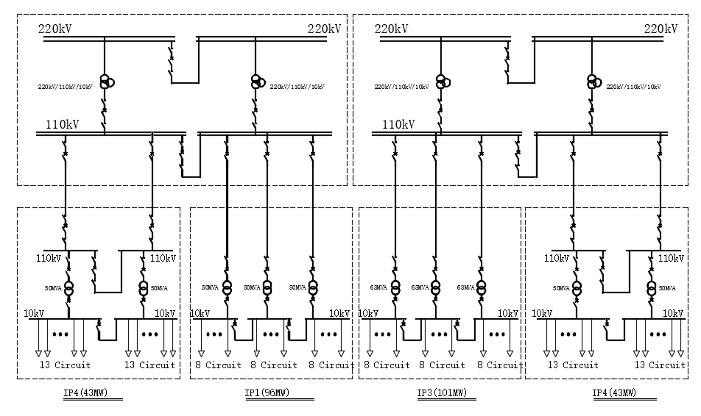
Electric engineering
Power supplies and schemes
The voltage levels on the site
220kV incomer of CEPC master substation.
110kV power distribution system.
10kV power distribution system for HV power equipment and step-down substation incomer.
0.4kV power distribution system for dedicated and general services.
220kV/110kV Master substation
2 substations
Rated capacity of transformer: 2*210MW (220/110kV/10kV).
220kV feeds connected to grid station nearby (State Grid Corporation of China).
Three-phase three-volume natural oil circulating air-cooled on-load regulating.
110kV/10kV step-down substations
4 substations(IP1~IP4)
Rated capacity of transformer: 7*50MW+3*63MW

Slide 5
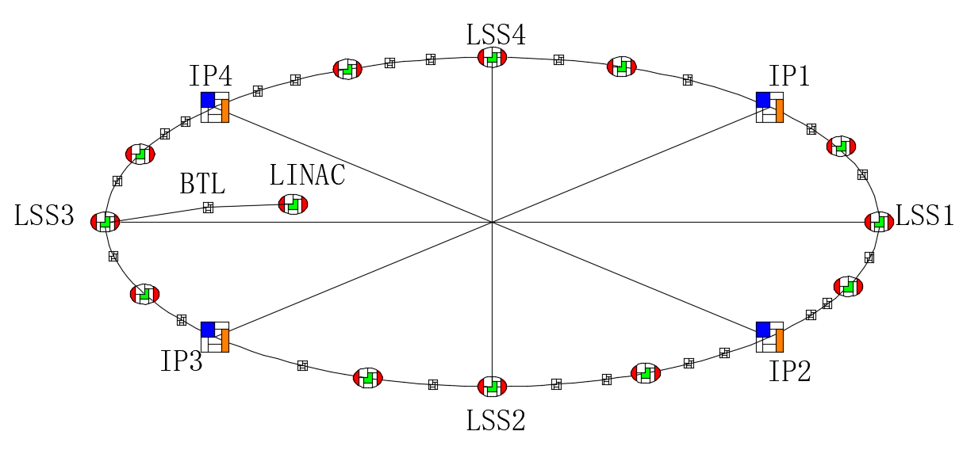
Electric engineering
10kV step-down substations
10kV feeders from 110kV/10kV substation nearby.
Surface 10kV loop : 40
Underground 10kV loop
-- 96 substations (10/0.4kV ) along the ring tunnel.
-- near the load points.
Dry-type transformers
Centralized reactive compensation
Back up diesel generator sets maybe required for personnel safety: lifts, smoke extraction etc.
Instrumentation and power converter control systems may require uninterrupted power supplies (UPS).

Slide 6
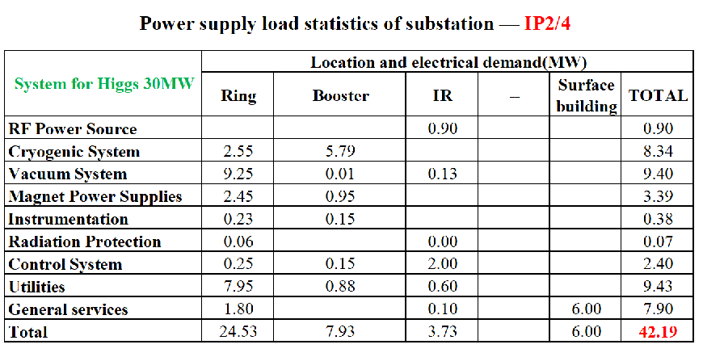
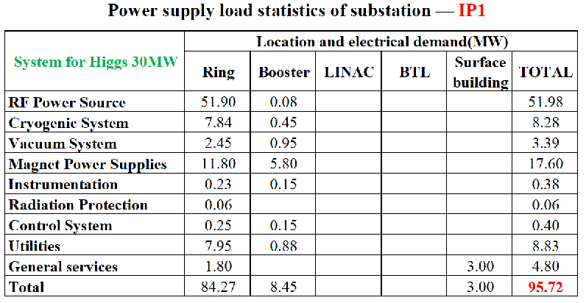
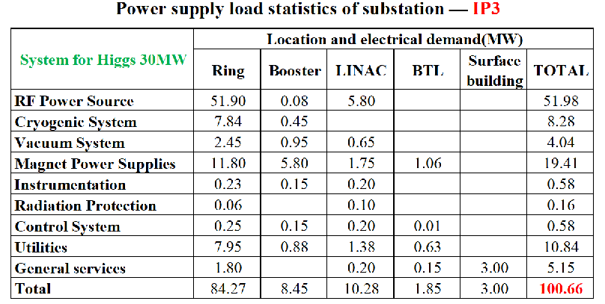
Electric engineering
110kV Substation load distribution
IP1: 96MW
IP2: 43MW
IP3: 101MW
IP4: 43MW

Slide 7
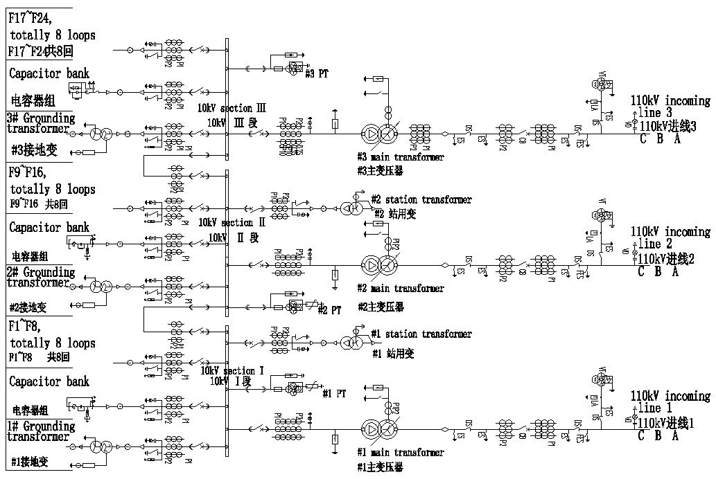
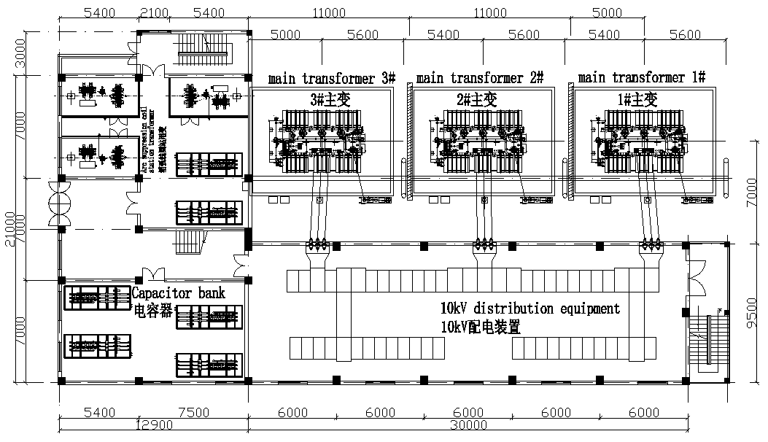
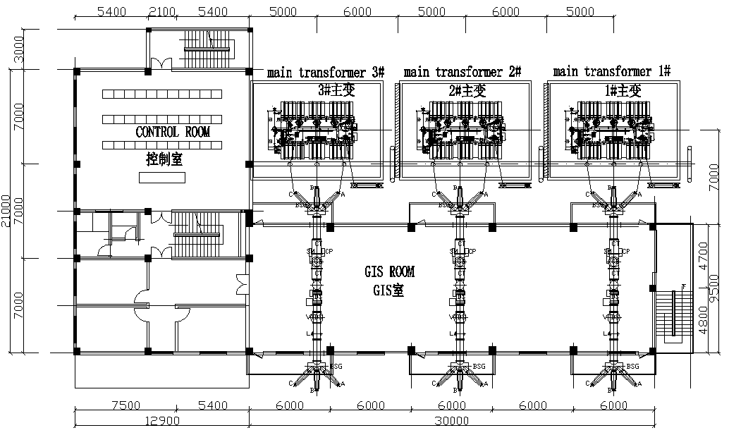
Electric engineering
110kV Substation layout
IP1/IP3
Main electrical wiring of 110kV substation
-- 110kV lines connected by the line transformer bank.
-- 10 kV lines connected by sectionalized single busbar.
Main transformer Outdoor;
10 kV Switchgear indoor
Double-row arrangement;
Outgoing line by cables.
110 kV GIS equipment in single row.

Slide 8
Electric engineering
Detailed statistics and construction scale of 10kv substations
 | Subsation Name | Num. of Substation | Diagram of 10kV | Circuit Num. | Load of 10kV Substation | Scale of Substation（0.4kV） | Location of Subsation
1 | IP1，IP3 10kV Substation | 2 | Single Bus section | 3 incoming 24 outgoing | 53.63MW(10kV） 10.17MW（0.4kV） | 2x2000kVA | Nearby 1# &2# RF Power Tunnel 1#~2# Power Hall
2 | IP2，IP4 10kV Substation | 2 | Single Bus 2 section | 2 incoming 26 outgoing | 2.73MW(10kV) 4.57MW(0.4kV) | 4x2000kVA | 1# & 2# IR Equipment Hall 3#~4# Power Hall
3 | LSS1~LSS4 10kV Substation | 4 | Single Bus 2 section | 3 incoming 10 outgoing | 2.73MW(10kV) 0.82MW(0.4kV) | 2x1250kVA | 5#~8# Power Hall
4 | LINAC 10kV Substation（31# ） | 1 | Single Bus 2 section | 2 incoming 10 outgoing | 5.8MW(10kV) 4.476MW | 2x2500kVA | LINAC
5 | BTL 10kV Substation（32# ） | 1 | Single Bus 2 section | 2 incoming 2 outgoing | 1.845MW | 2x2000kVA | BTL
6 | 1#~30# grounding 10kV Substation | 30 | Single Bus 2 section | 2 incoming 10 outgoing | 0.96MW | 2x1250kVA | Surface Substation
7 | 1#~96# Auxiliary Tunnel | 96 | Single Bus 2 section | 2 incoming 2 outgoing | 0.78MW | 2x1000kVA | Auxiliary Tunnel
 | Total Load：2xIP1 Load+2xIP2 Load+4x LSS1 Load+ 1xLINAC Load+1x BTL Load+30x Grounding Load+96x Auxilliary Load=272.2MW

Slide 9
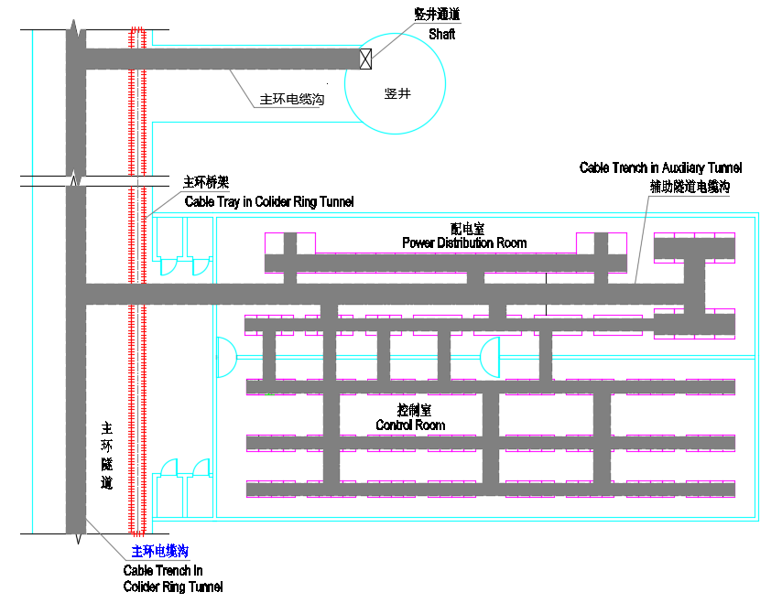
Electric engineering
Cable passage
110kV/10kV cables between substations in ground area shall be arranged in the following way: gallery, burial and overhead.
Ground cable passage
The physical experiment equipment is served by cable tray in the collider ring tunnel, while electrical appliances are served by cable trenches in the auxiliary tunnels. Cable trenches in collider ring are connected to each work area and tunnel, and access shafts are connected to ground to form a complete cable layout structure.
General layout of cables in tunnel

Slide 10
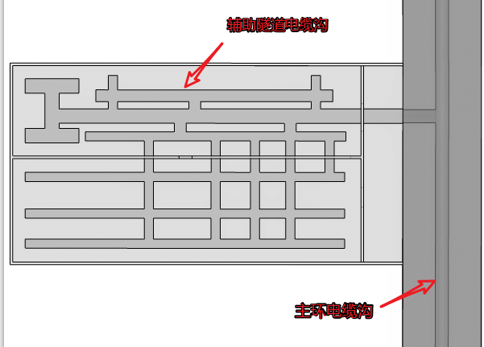
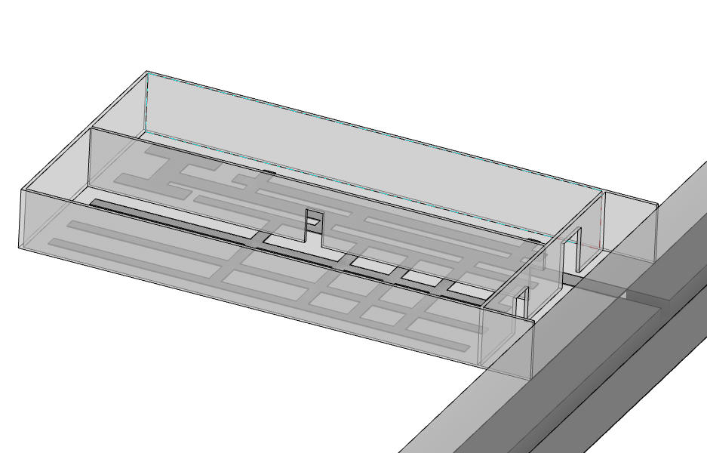
Electric engineering
Ground cable passage
Cable trenches are provided below power distribution cabinet, power cabinet and equipment cabinet (speed detection, vacuum and control) in the auxiliary stub tunnel. On one hand, the cable trenches are used for connecting cables of all kinds for physical experiment equipment in the collider ring tunnel, and on the other hand, connecting to the cable trench at the bottom plate in the middle of the collider ring tunnel.
Cable trench in auxiliary tunnel
Cable trench in collider ring tunnel
Cable layout in auxiliary stub tunnel

Slide 11
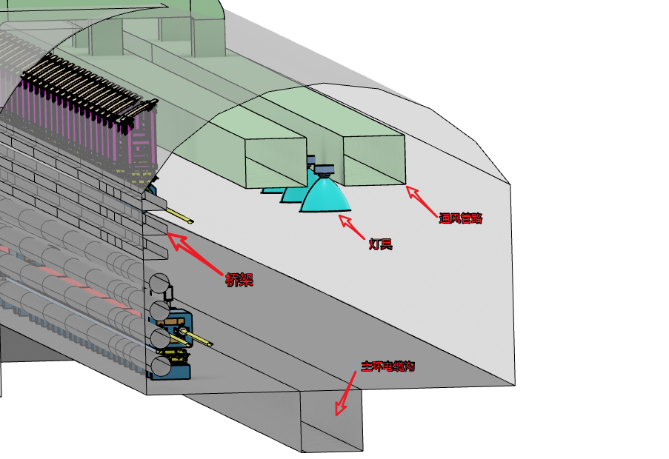
Electric engineering
Cable passage
Ground cable passage
Multi-layer cable tray is to be provided on the sidewall of the collider ring tunnel and is used mainly to accommodate cables of all kinds including power, signal and control from physical experiment equipment.
Cable trench is to be provided at the bottom plate in the middle of the collider ring tunnel and is used as a cable channel to connect each auxiliary tunnel to ground cable channel and to connect different auxiliary tunnels.
Cable layout in collider ring tunnel

Slide 12
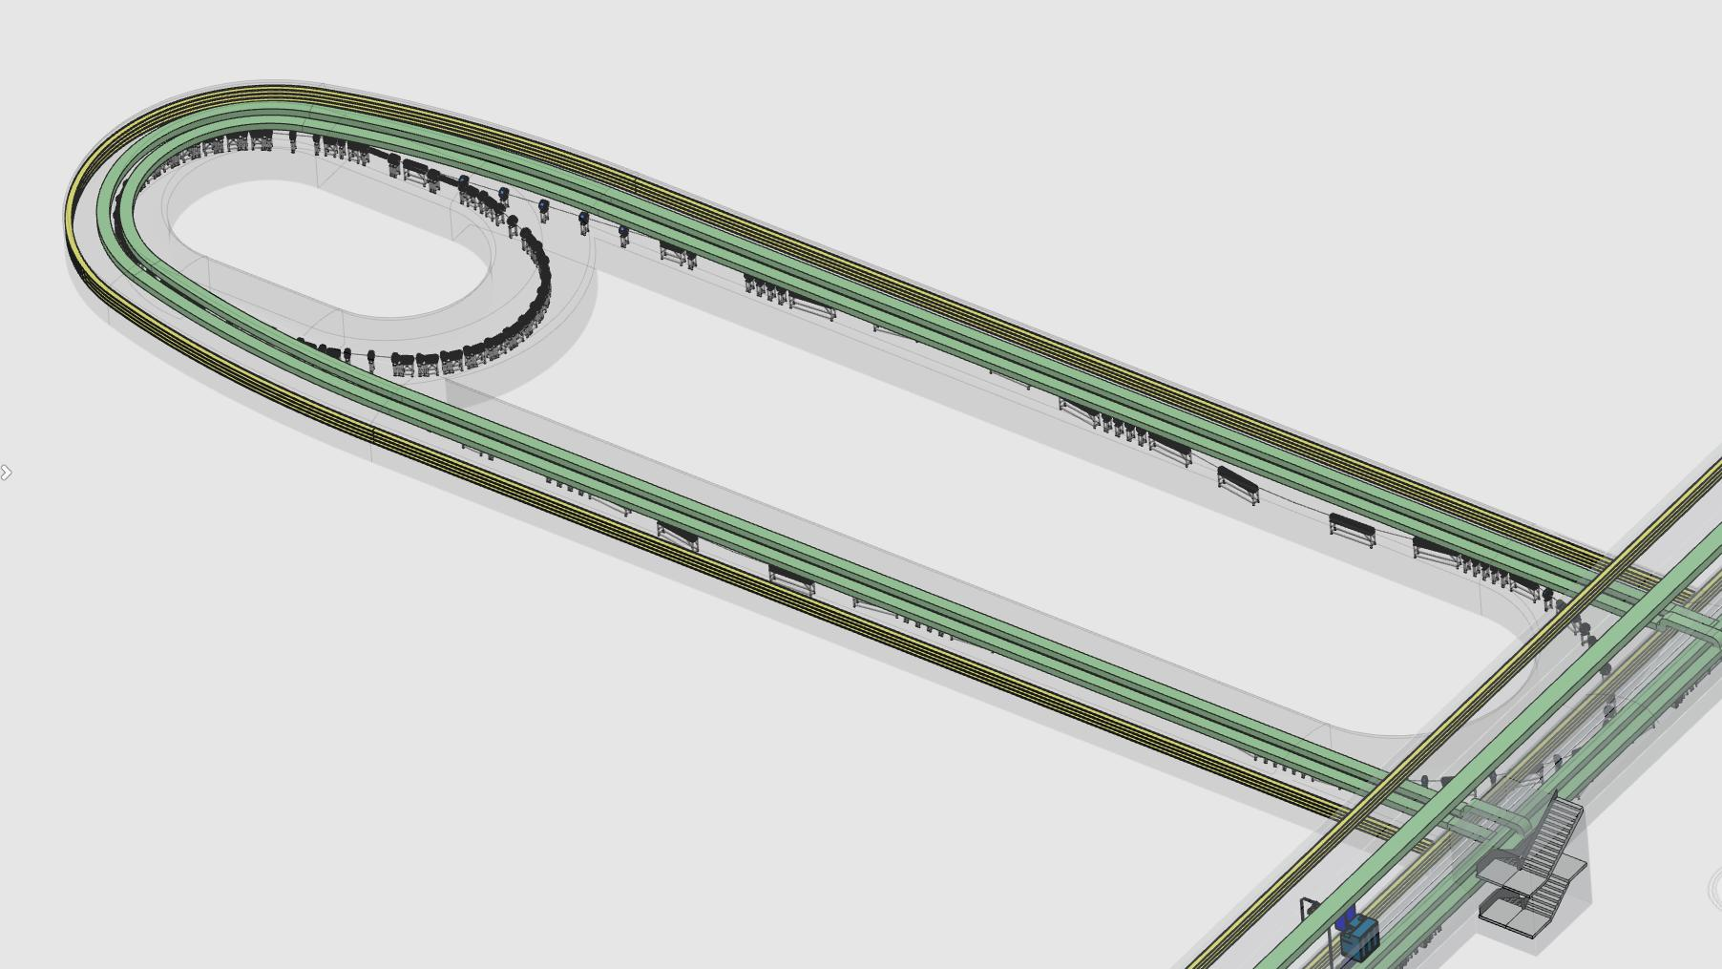
Electric engineering
Cable passage
Damping-Ring
Cable Tray
Air exhaust duct
Air exhaust duct
Cable Tray

Slide 13
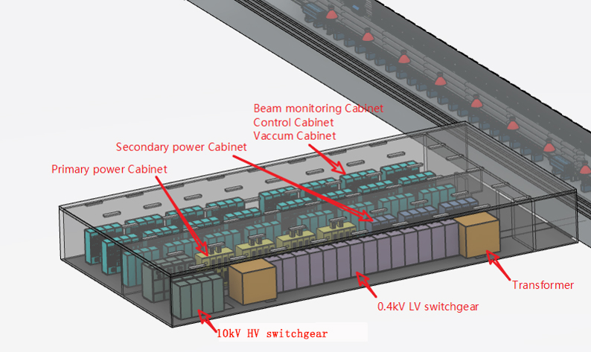
Electric engineering
Electrical equipment general layout in auxiliary
Description | Qty. | Location
Beam monitoring cabinet | 10 | Control room
Control cabinet | 44
Vacuum cabinet | 42
Primary power cabinet | 4 | Power distribution room
Secondary power cabinet | 11
10kV HV switchgear | 8
10/0.4kV transformer | 2
0.4kV LV switchgear | 12

Slide 14
HVAC
Estimated cooling loads of HVAC
Ring tunnel: 6MW
Service buildings: (200W/m²) 28MW
Total: 34MW
Coolant for air conditioning: chilled water
Heat source for heating system in winter
Heat pump -- heat recover from cooling system.
Backup boiler
Indoor Design Parameters
Tunnel
Temperature: within 30-34℃ and shall be kept below 35℃
-- Inlet: 18~20℃
-- Outlet: less than 35℃
Relative humidity: 50% ~ 60%, and shall be lower than 65%
Experimental halls
Temperature: about 26℃(summer), 20℃(winter)
Relative humidity: 50% ~ 60%, and shall be lower than 65%.
Control room (or electronics)
Temperature: about 20-25℃
Relative humidity: 45% ~ 60%
Other service building
Temperature: about 28℃(summer), 18℃(winter),
Relative humidity: lower than 65%
Design parameter | Unit | quantity
Total cooling load | MW | 34
Total chilled water flow rate | m³/h | 5850
Total cooling tower water flow rate | m³/h | 7016
Total capacity of cooling towers | MW | 41

Slide 15
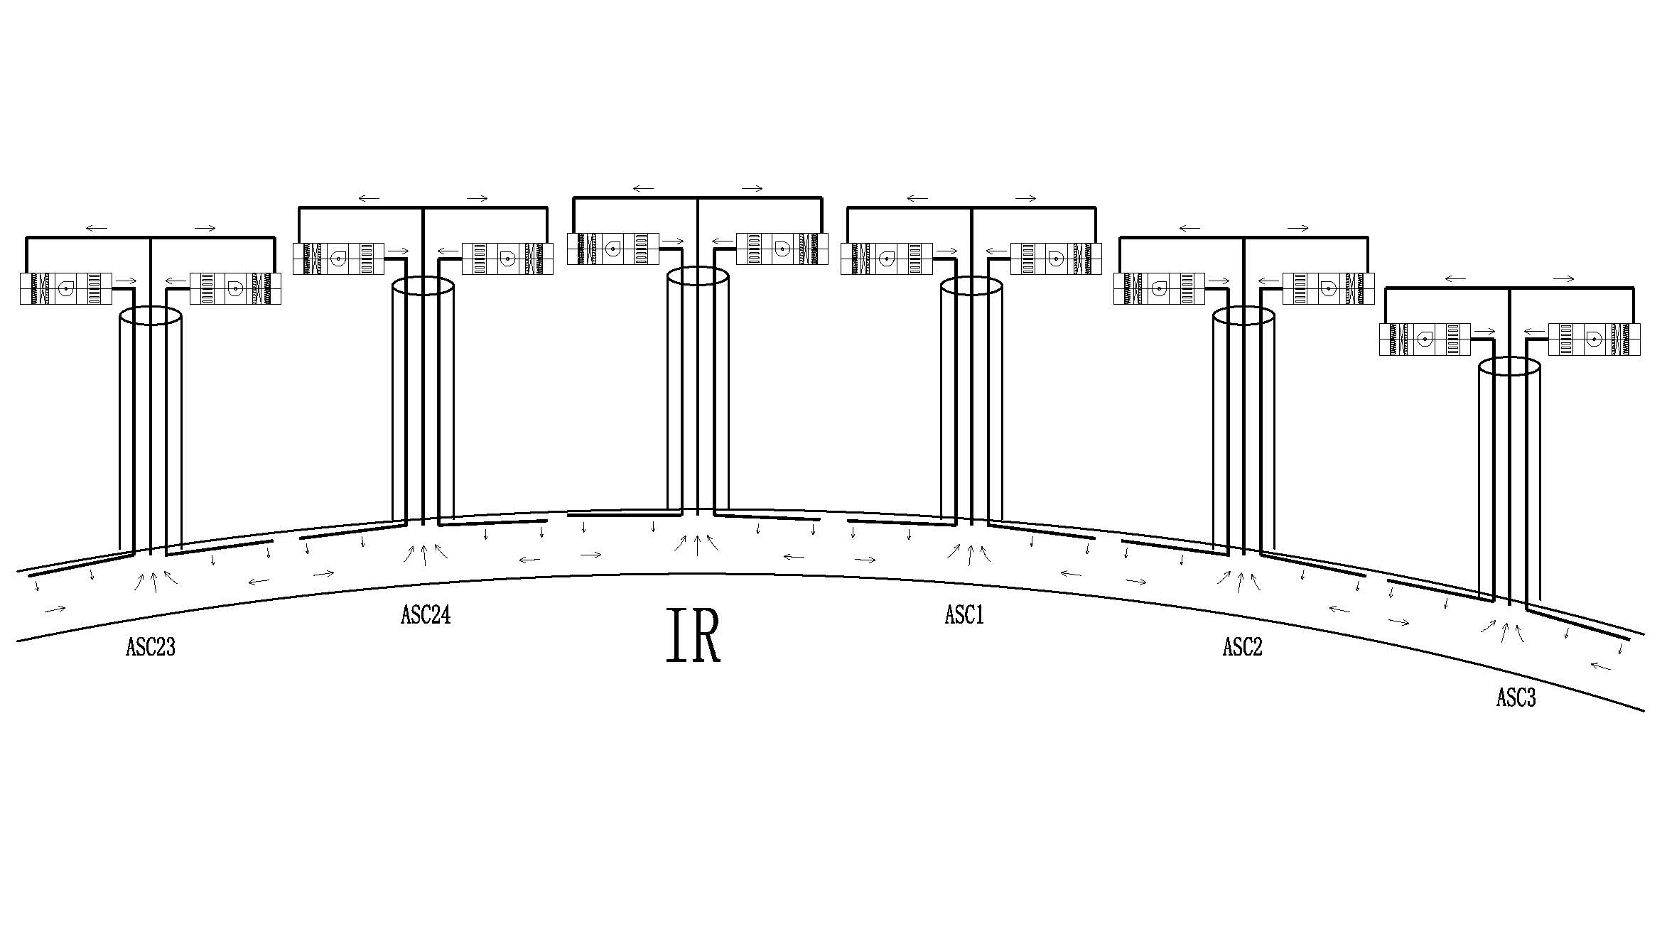
HVAC
Air-conditioning system in tunnel
Layout
The ring tunnel is divided into 32 independent sections.
Each shaft serves as a ventilation and exhaust passage for the underground main ring tunnel, and a ventilation pipe and a smoke exhaust pipe are arranged therein.
Operation scenario
Machine operation mode
-- Temperature and humidity in tunnel are maintained by inlet air.
Transitional mode
-- To purge air in the tunnel before access.
Accessible mode
-- The air flow rate could be cut down.
Emergency mode
-- In case of smoke and gas extraction.

Slide 16
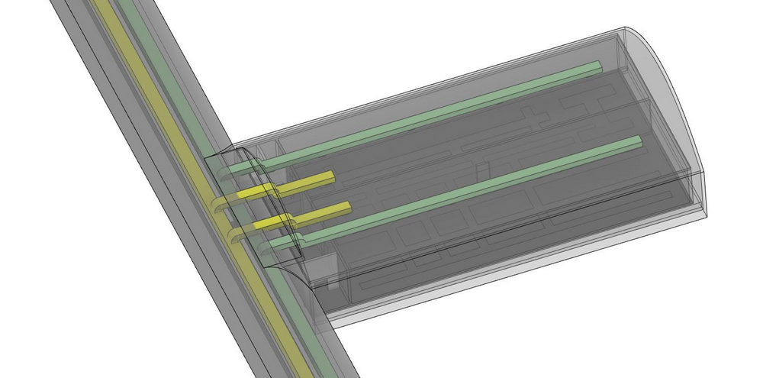
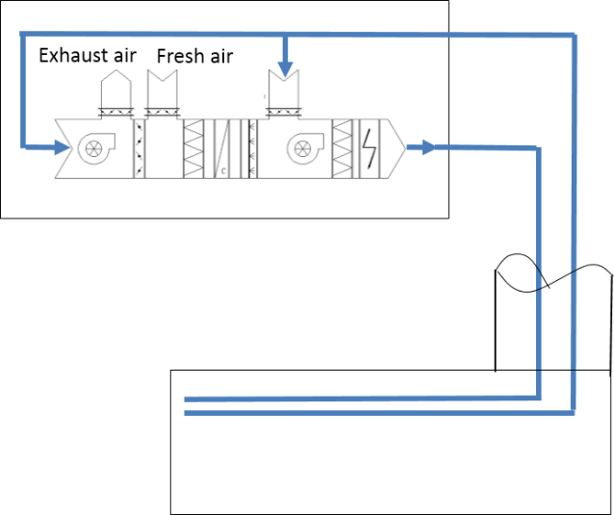
HVAC
RF auxiliary tunnels and experiment hall
Air conditioned and ventilated by mechanical supply and extraction of air via ducts in access shaft.
AHU is on ground level.
Dedicated smoke, gas extraction systems
Auxiliary stub tunnels
Air supply ducts are led out from the air supply trunk duct in the collider ring tunnel to feed cold air into the auxiliary stub tunnel, and then air exhaust ducts are connected to the air exhaust trunk duct in the collider ring tunnel for exhausting hot air from the stub tunnel.
Other service buildings
AHU
fan-coil + fresh air system
Air supply duct
Air exhaust duct
Air supply duct
Air exhaust duct

Slide 17
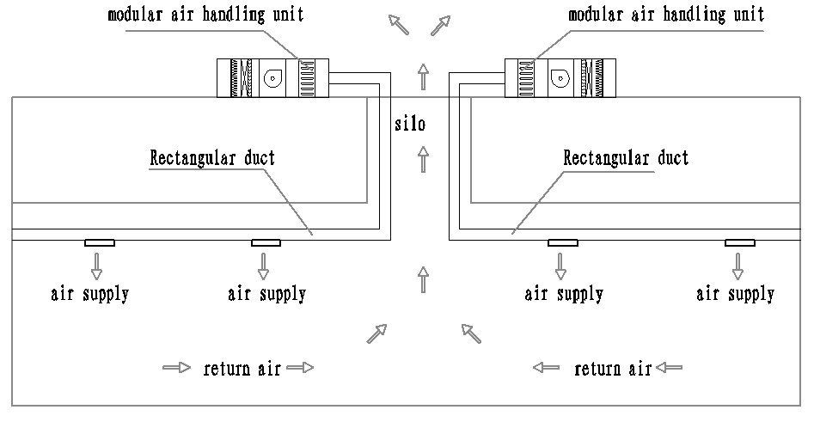
HVAC
Ventilation and smoke exhaustion system
It is proposed to combine the smoke exhaust system with the mechanical air exhaust system based on the layout features of underground caverns. Emergency smoke exhaust is applied to both the collider ring tunnel and the experiment halls.

Slide 18
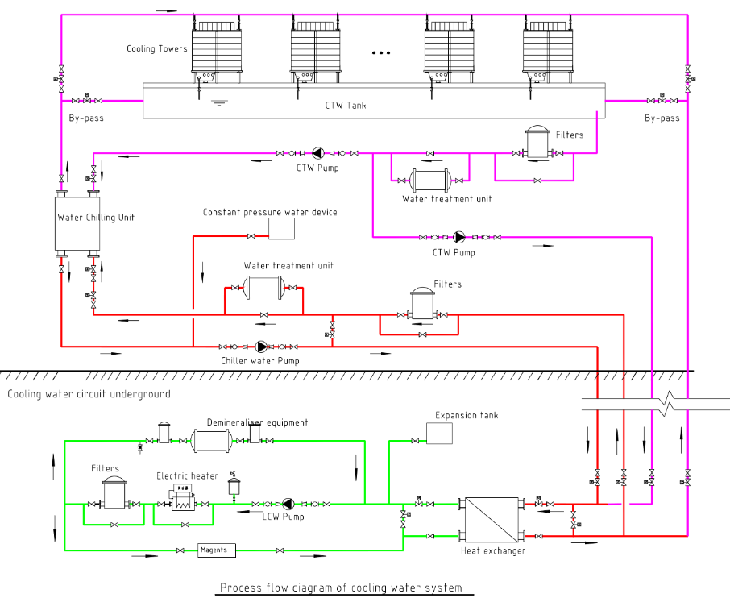
Cooling water system
Function：
Absorb heat, cooling process equipment.
Provide a constant temperature environment.
Adjusting resonant frequency.
——
Composition：
Dual circuit cooling mechanism
LCW — Direct cooling process equipment.
CTW — Provide cold source for LCW.
DW—Supply low-conductivity water for makeup.
Waste water collection and discharge system
Cooling water control system

Slide 19
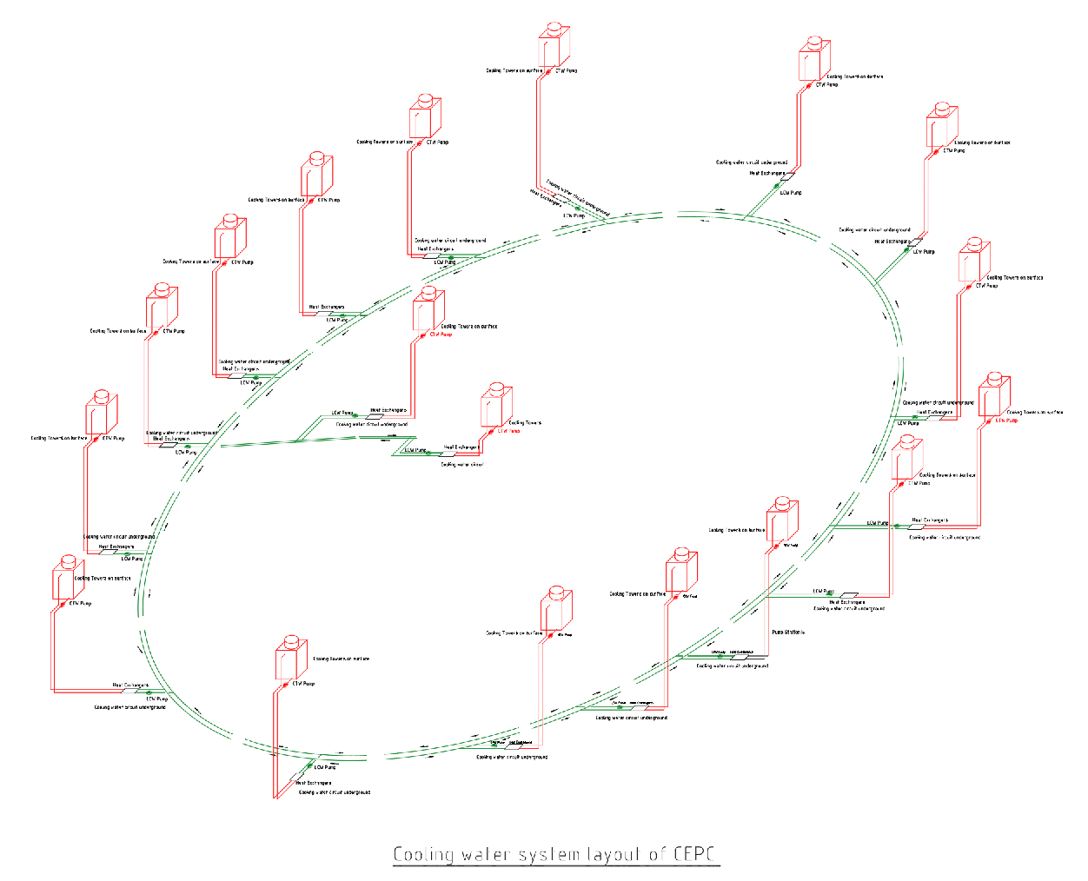
Cooling water system
Layout principle
Close to the heat load center.
Relatively concentrated.
Reasonable water supply radius.
Minimize operating pressure.
Layout scheme
Centralized water supply station:20
-- Linac—1
-- BTL—1
-- IR—2
-- Ring/Booster—16
Site
CTW and DW on surface;
LCW are underground.
LSS4
IP4
IP1
LSS3
BTL
LINAC
LSS1
IP2
IP3
LSS2

Slide 20
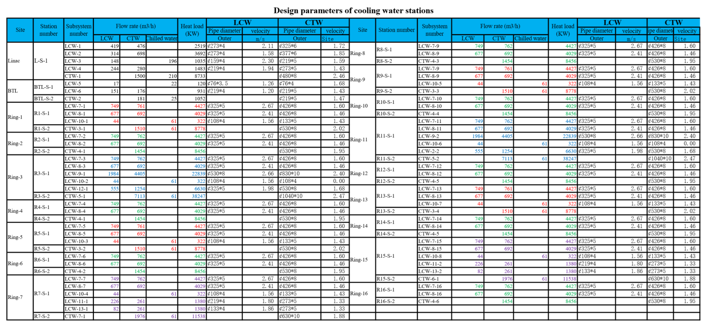
Cooling water system
Stations layout scheme

Slide 21
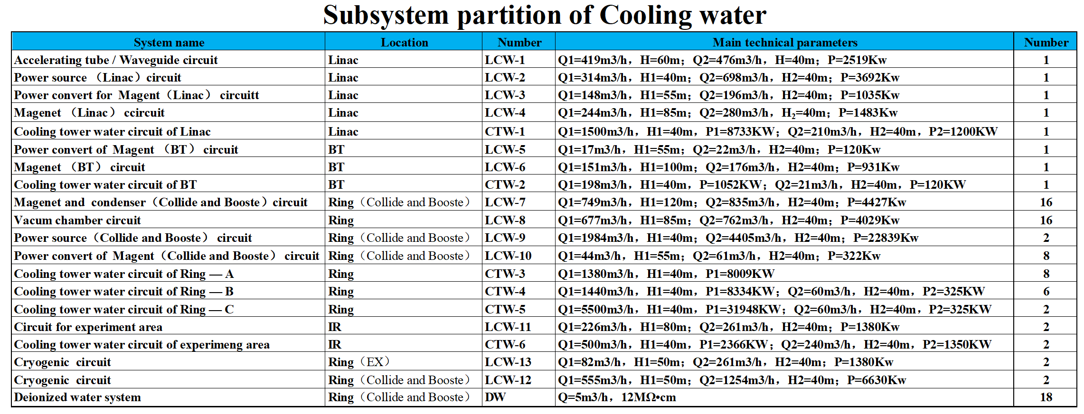
Cooling water system
Subsystem partition
There are 50 closed-loop LCW and 20 CTW subsystems in the LINAC, BTL, main ring, and experimental areas. They are defined by equipment characteristics, operational requirements ( temperature, pressure, water quality, radiation dosage), and location。

Slide 22
Cooling water system
Key requirements and parameters
Total heat load : 212.186MW
-- The heat load of 190.915MW dissipated by CEPC machine.
-- The heat load of 21.945MW dissipated by the motors of cooling water system.
Total flow rate of LCW: 30157 m³/h
Total flow rate of CTW: 40092 m³/h
Cooling water temperature
-- Cooling tower water temperature: ＜ 29℃
(Base on wet-bulb air temperature of 27℃ ambient; machine shut down in summer )
-- LCW cooling water temperature: ＜ 32 ℃
DW：Single DW unit can produce 3~5t/h deionized water with the effluent quality meets the following standards.
-- Resistivity reach 18 MΩ•cm
-- Other parameters satisfy EW-1 requirements.
Water consumption：14011m³/d（1.5% CTW）
Storage capacity of low-level radioactive wastewater ：12150m³

Slide 23
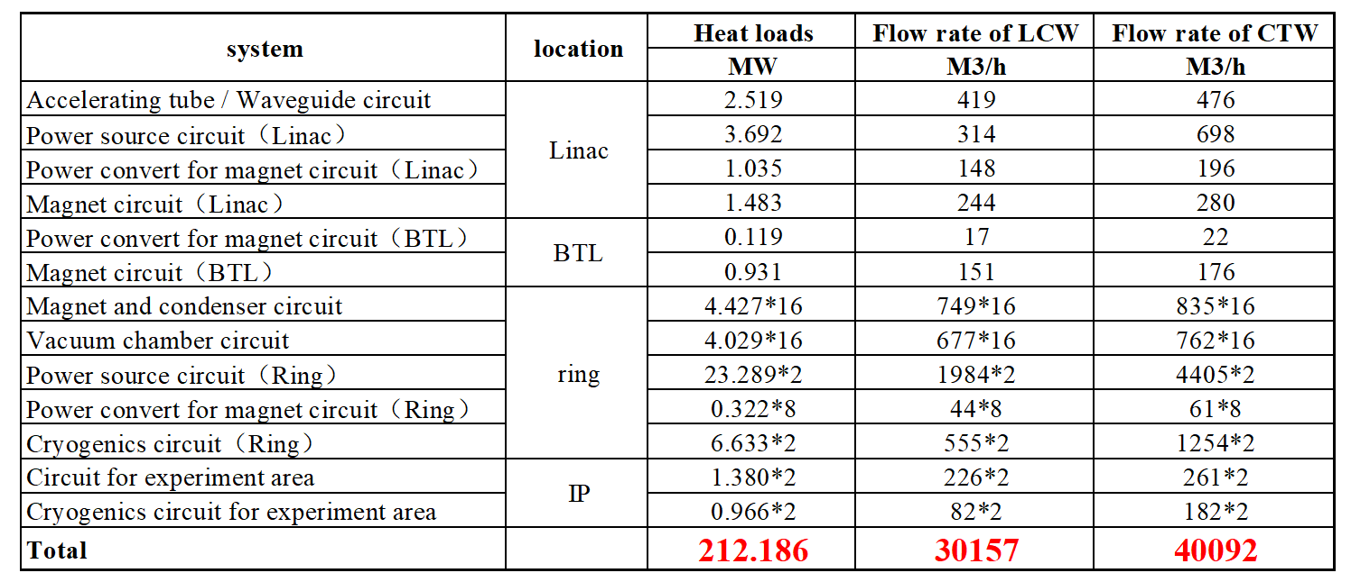
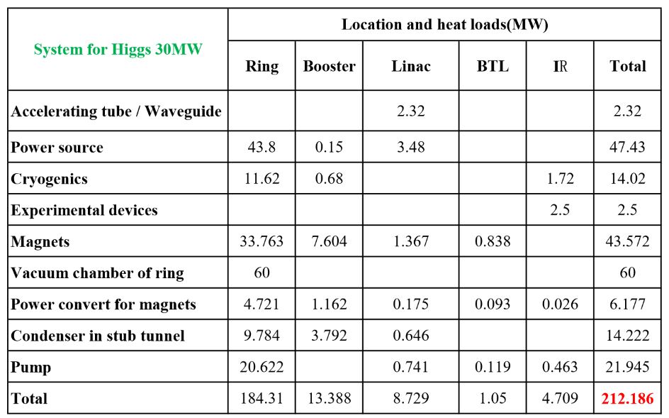
Cooling water system
Key requirements and parameters
Design parameters of cooling water system
Heat load of cooling water system

Slide 24
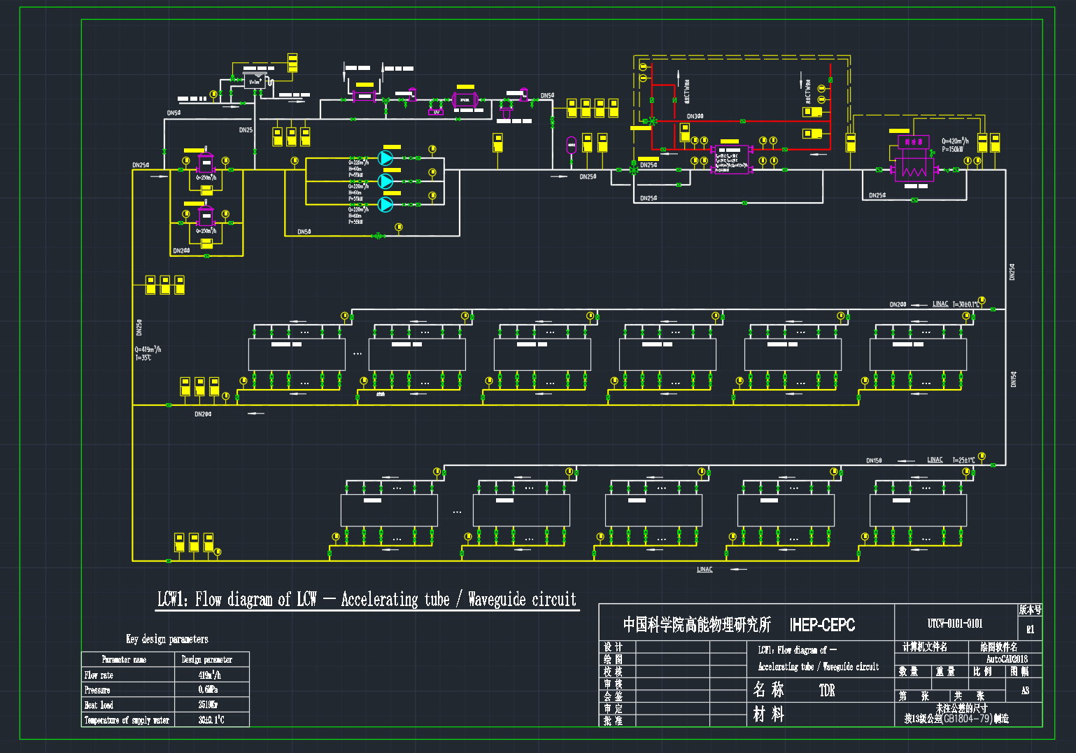
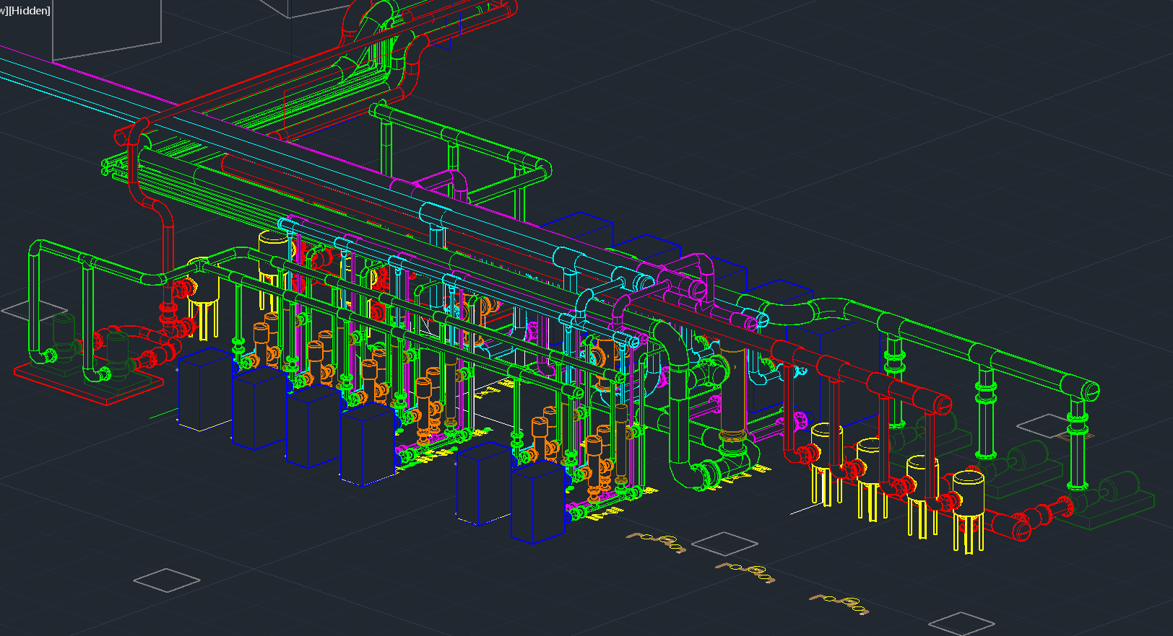
Cooling water system
LCW (Low-conductivity water system)
Flow diagram :Take Accelerating tube / Waveguide circuit for example.
-- Main loop
Various measures are set up to ensure flow distribution and pressure balance.
Trap particulate matter to prevent process equipment from blocking waterways.
Keep the system temperature stable through constant temperature control.
-- Bypass circulation
The main function of bypass system is to regulate the water quality and maintain the microenvironment of the LCW system.

Slide 25
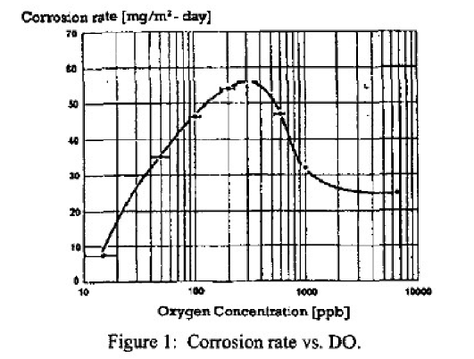
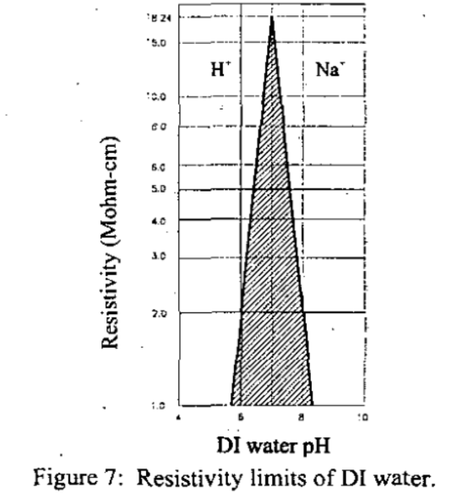
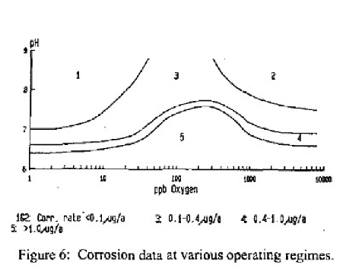
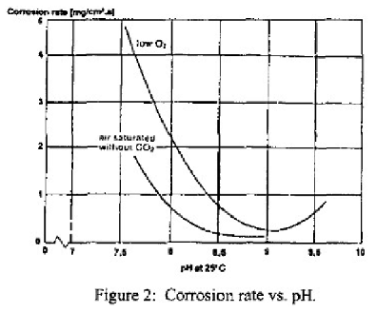
Cooling water system
LCW
In order to slow down the corrosion rate of copper, iron and other metals as much as possible, the water quality of the system needs to be stable at a certain level. Specific parameters are as follows：
-- Conductivity：0.2~1μS/cm
-- PH: 6.7~7.5
-- DO: ≤20
-- Total bacteria: ≤10 CFU/mL
-- TOC: ≤1mg/L
-- PM: ≤10/mL（>1um）

Slide 26
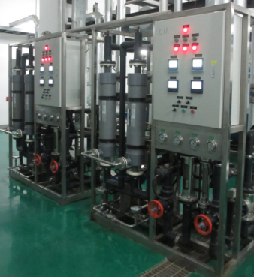
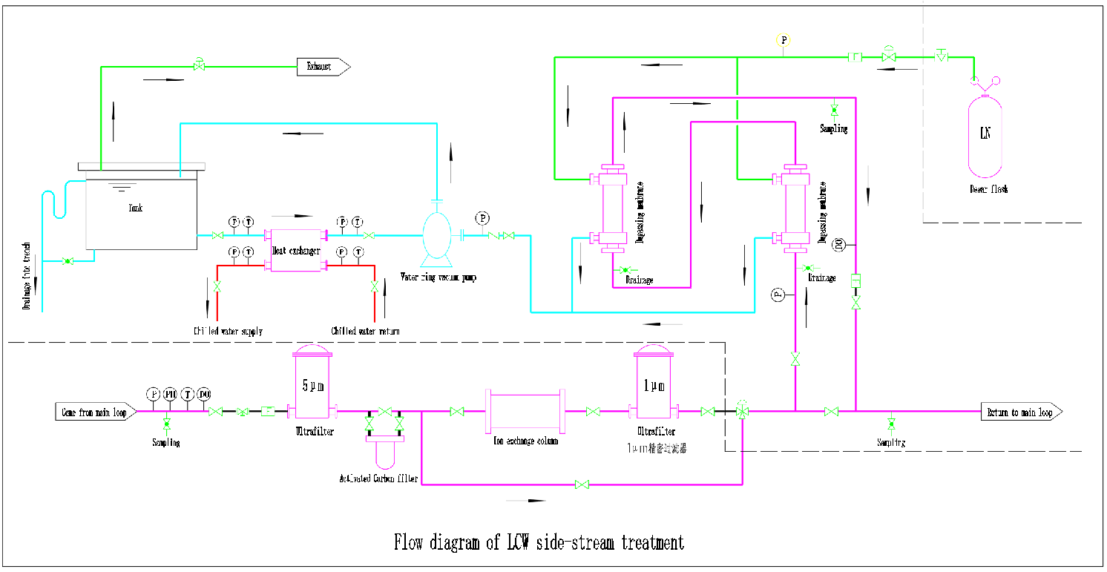
Cooling water system
LCW
A variety of measures will be adopted to achieve these water quality objectives
-- The flow rate through ion-exchange resin is about 1~5%.
-- H⁺ and Na⁺ type resin are used to adjust the PH value of the LCW system.
-- Degassing device is designed to remove dissolved oxygen in the LCW system,.
-- Nitrogen isolation is adopted to avoid LCW system contact with air.

Slide 27
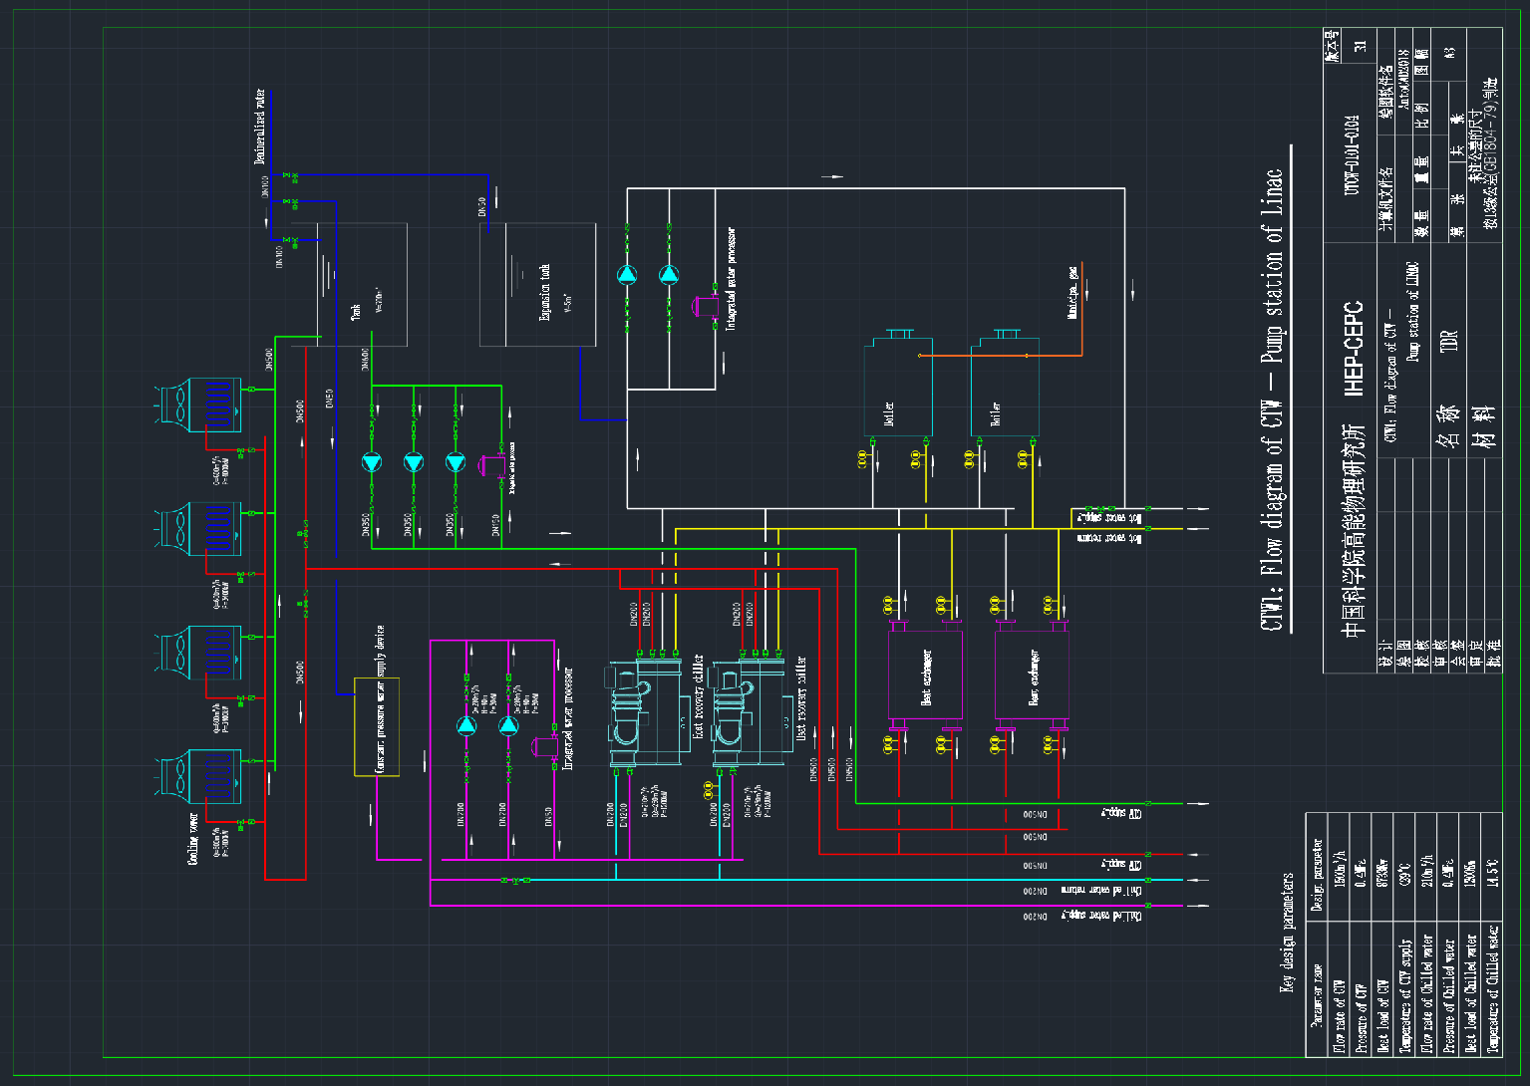
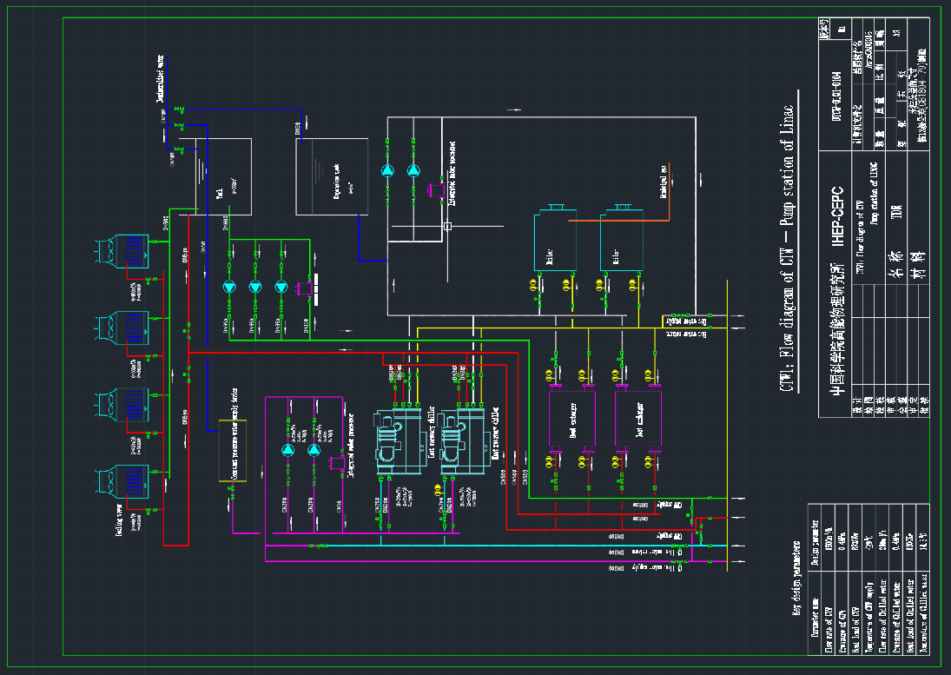
Cooling water system
CTW (Cooling tower water)
Flow diagram :Take CTW station of LINAC for example.
This process can realize different operation modes and provide cold source for LCW and hot sources for HVAC.
-- CTW≤ 29℃ (by cooling tower)
-- chilled water ≤ 14.5℃
(by Heat recovery chiller or cooling tower)
-- hot water
(by Heat recovery chiller, heat exchange and backup boil)

Slide 28
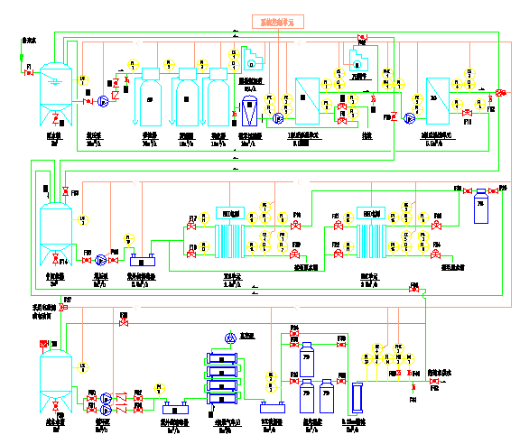
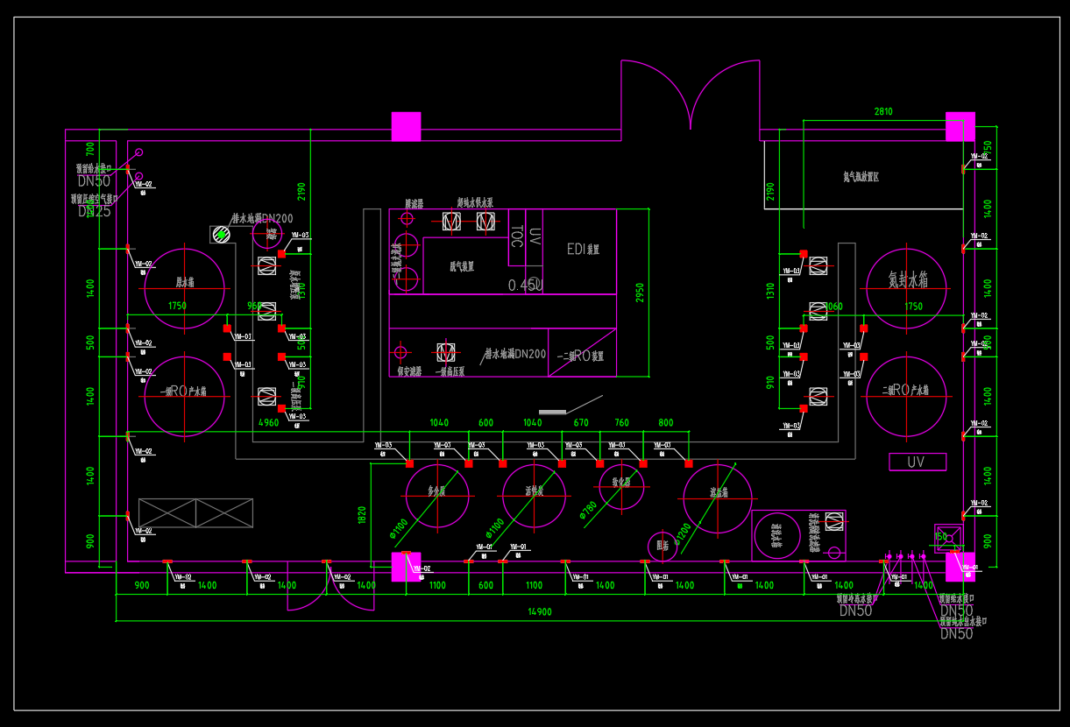
Cooling water system
DW(Deionized water )
DW system provides deionized water for LCW and laboratory. The system consists of three parts: Ultra-pure Water Treatment System, water distribution network and water terminal.
Ultra-pure Water Treatment System
-- Adopt two-stage RO(reverse osmosis) and EDI process.
-- The device can provide ultra-pure water with a resistivity of 18MΩ•cm.
Water distribution pipe network
-- CPVC, S316L or PVDF
Experimental water requirements can satisfied by adding terminal filtration and water quality lifting devices.

Slide 29
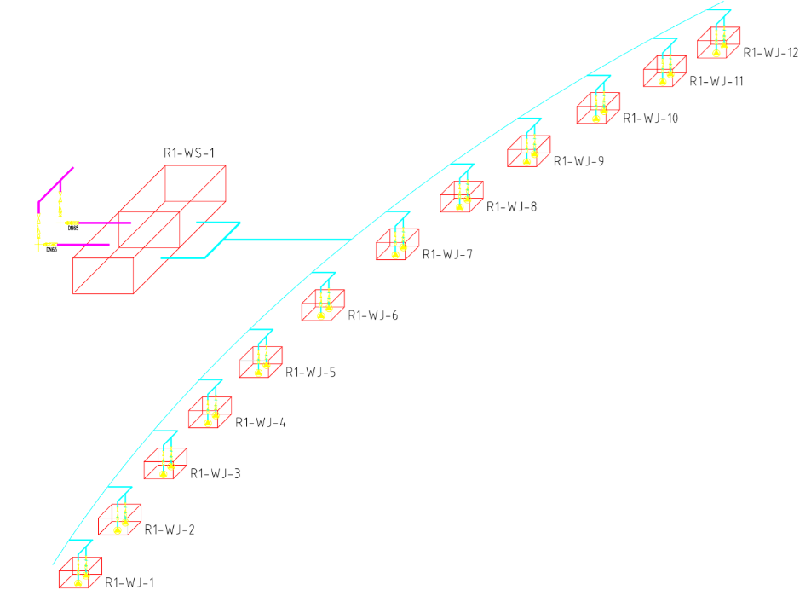
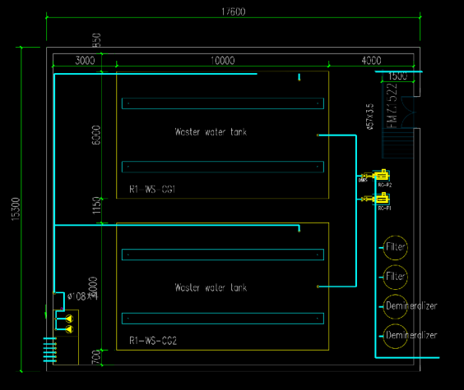
Cooling water system
WW(Waste water collection and discharge system)
Process wastewater of CEPC consists of ordinary wastewater and low-level radioactive wastewater.
-- Ordinary process wastewater is discharged directly or recycled after treatment.
-- Low-level radioactive wastewater should be collected and stored for natural attenuation, and discharged or recycled according to relevant national standards and regulations after testing.
According to the distribution of low-level radioactive wastewater discharge points and the possible discharge volume, many facilities need to be set up to collect and store.
-- Drainage ditches and catchment wells need to be set up along the tunnel , with the preliminary design of collecting well(V=2m³) is one every 500 meters, with the drainage slope is about 1‰.
-- There are 18 storage areas for low-level radioactive waste water underground. each storage volume is the maximum volume of the water cooling subsystems in the area.
（Storage volume ： 9800m³=100+100+16*600）
Discharge or reutilization.

Slide 30
Cooling water system
Cooling water control system
LCW
-- Each subsystem sets up a PLC-based field controller to collect real-time data and control the process. It records the status, performance and running time of relevant equipment, prompts maintenance time and fault in time, and sends the data to the operation station for centralized operation management through field bus.
-- According to different temperature control requirements and power consumption, different temperature control methods are adopted.
-- A special quartz crystal temperature probe is used as a high precision temperature sensor.
CTW
-- The freezing station is equipped with a local control system, which can change the number of starting and stopping chillers, cooling pumps, freezing pumps and cooling towers according to the change of the load of the primary water system to realize group control, fault detection and alarm of the main engine and its auxiliary equipment, parameter monitoring, program starting and stopping of the equipment and other functions.
-- The operation combination of cooling tower, water chiller and plate heat exchanger is adjusted according to the change of temperature and humidity in outdoor environment.
Establish a number of regional duty stations and general facility database systems.

Slide 31
Compressed Air System
System Configuration
Operating Pressure
0.6~0.8MPa
Plant Quantities
20
Single Plant Capacity
22.1 m3/min
Particle Removal Efficiency
≥99.97%
Pressure Dewpoint Temp.
-40℃
Oil Content
≤0.01ppm
Design Characteristics
High reliability（fast-switch/pressure protection/mutual standby）
Simplified specifications（pipes and pipe components, valves, instruments, etc.）
Leakage limited （easy measuring and analyzing）

Slide 32
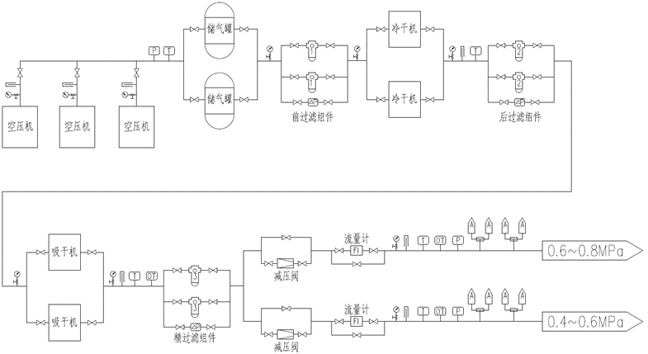
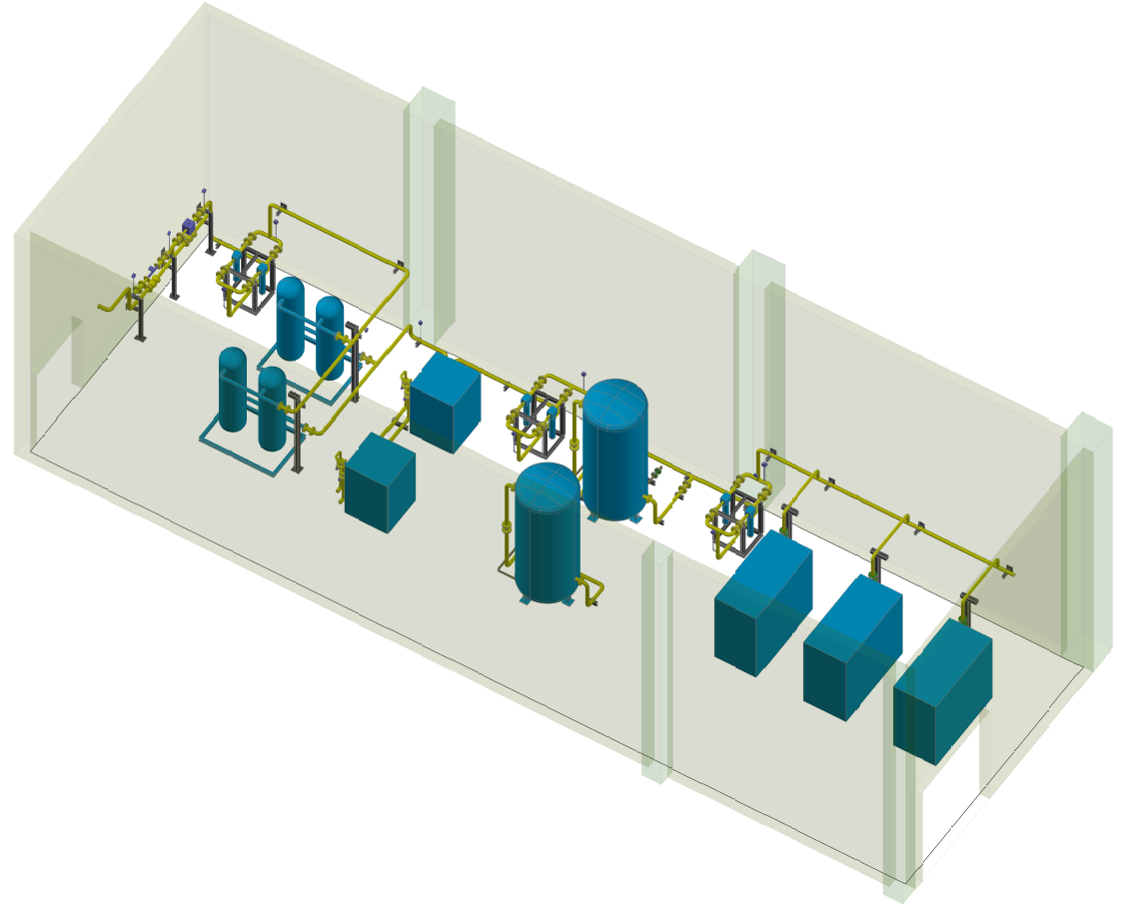
Compressed Air System
Plant Design Principle
Easy to replace any equipment
Compact procession layout
Reasonable cooling system
Distribution Design Principal
Coordinate with other pipeline and accelerator equipment
Easy to add pneumatic actuator
Field personal protection ( outlet safety design/warning sign/noise protection/etc.）
A typical compressed air plant

Slide 33
Energy saving consideration
Reduce power consumption
Auxiliary facility should be built near to the heat load center.
Minimize the operating pressure.
Electric power consumption of auxiliary facility reaches 38.53 MW. Using high efficiency motor and variable frequency motor will help to reduce energy consumption.
Adopting high temperature chiller, the cooling efficiency will increase by 2~3% for every 1℃ increase of water outlet temperature.
Thermal energy recover
Through heat recovery chiller, heat exchanger maximizes the heat absorbed by LCW as several heat sources.
Air conditioning heat source
Heating source in winter.(If possible, the heat supply could radiate to surrounding residential areas)
Other heat sources

Slide 34
Thank you for your attention !

