Slide 1
CEPC alignment technology R&D in TDR
Wang xiaolong
On behalf of Installation and Alignment team
The 2nd CEPC IARC Meeting in 2021
Oct. 11-14, 2021, On line

Slide 2
Contents
  TDR work review
  Vision instrument introduction
  Vision instrument R&D status
  Summary

Slide 3
Review
  TDR work
    An overall component installation and alignment scheme has been made based on 8 years construction period.
      Control network construction and measurement plan
      Collider ring, Booster, Linac installation schedule
      Installation efficiency estimation for per day
      Manpower requirement
      Component installation strategy in tunnel.
    Alignment observation data process method research.
      CEPC measurement reference datum analysis
      CEPC coordinate systems
      Geoid refine method
      The functions of Quaci-Geoid and Vertical model
      Elevation coordinate and horizontal coordinate calculation method.

Slide 4
  Vision instrument R&D

Slide 5
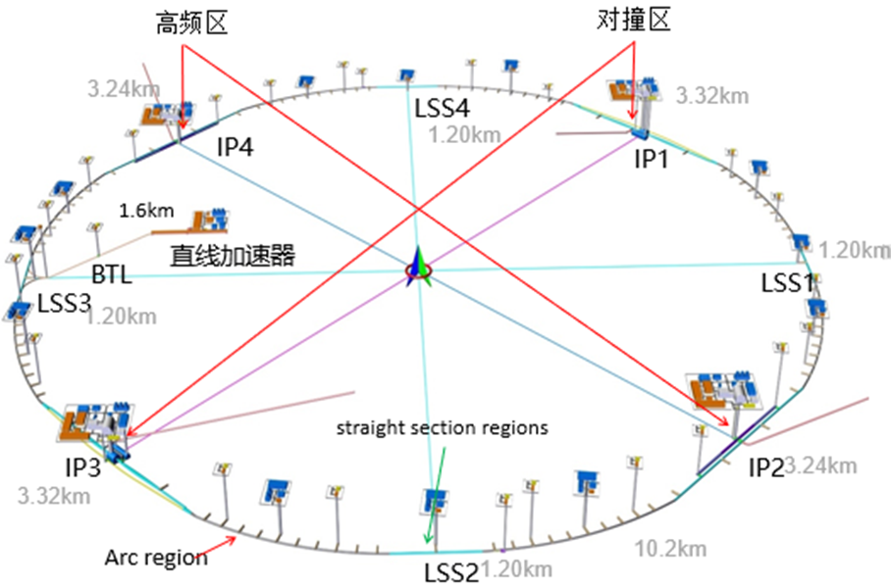
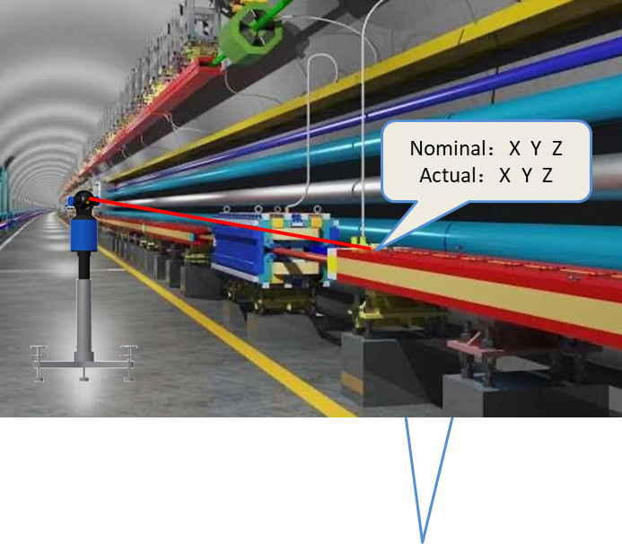
  Vision instrument introduction
  Workload of CEPC alignment
    Tunnel length 109.55km：100.034km main ring + 6.64kmIR booster tunnel + 1.21km Linac + 0.06km DR+ 1.07km BT + 2X0.268km BT
    Component quantities：41563～52155
    Use laser tracker 18259 X2=36518 stations.
    1 group 10 stations / day. 12 groups, 1 year
    Measurement workload is very heavy, need to improve measurement efficiency.
Ring tunnel

Slide 6
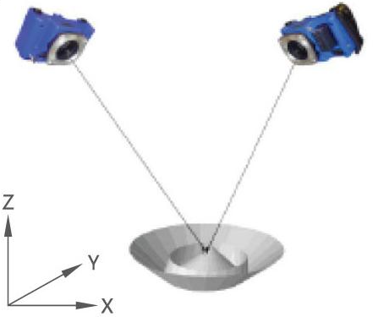
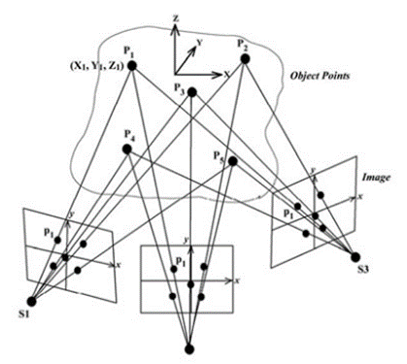
  Vision instrument introduction
Photogrammetry：
Advantages:
  High Efficiency
  Promising Precision
  Noncontact Flexible
  Cheaper
Disadvantages:
  Tunnel space: long and narrow, not conventional photogrammetric application circumstance
  Plane target can not meat measurement requirement
  Complicated tunnel environment, difficult for control point identification
  ……

Slide 7
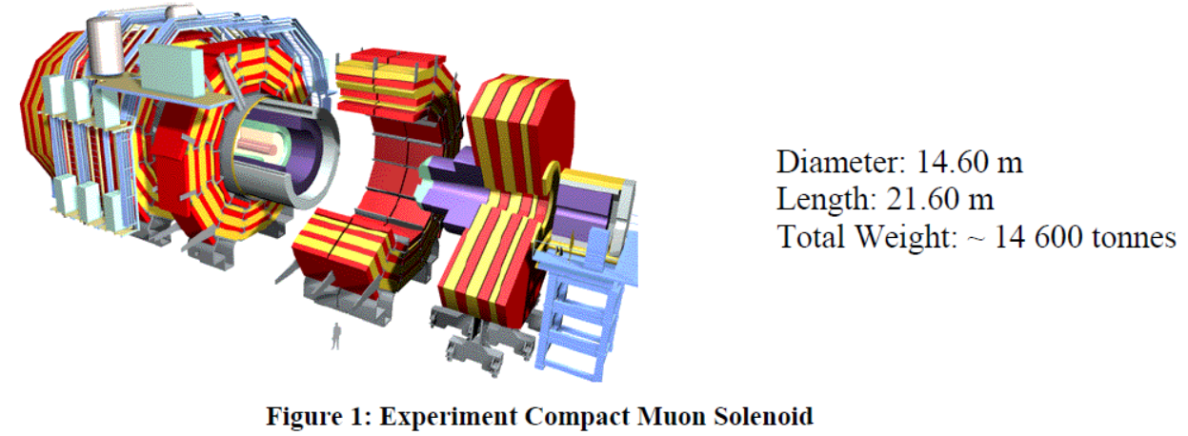
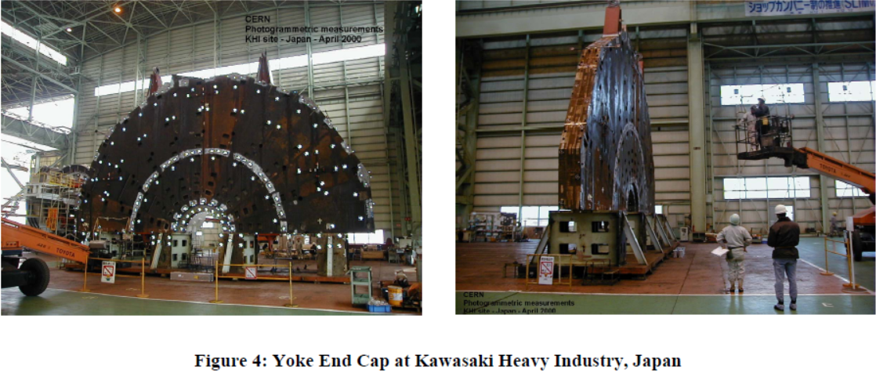
  Vision instrument introduction
  Application of photogrammetry in accelerator measurement
    CERN CMS detector end cap assembly measurement, accuracy 0.18mm
[1] Antje Behrens, Christian Lasseur, Dirk Mergelkuhl.NEW DEVELOPMENTS IN CLOSE RANGE PHOTOGRAMMETRY APPLIED TO LARGE PHYSICS DETECTORS[C]. IWAA2004, CERN, Geneva, 4-7 October 2004.

Slide 8

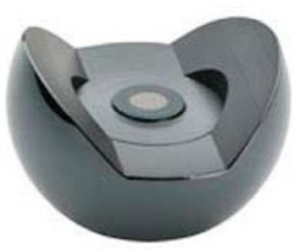
  Vision instrument introduction
    Germany GSI Facility for Antiproton and Ion Research (FAIR) , inaccessible, high radiation areas measurement,
    20m X 3.2m X 4.2m ,accuracy 0.15mm
[1] A. Marbs,F. Boochs,I. Pschorn.FINAL CONCEPT OF THE PHOTOGRAMMETRIC ALIGNMENT SYSTEM RALF FOR HIGH-RADIATION AREAS OF FAIR[C]. IWAA 2008, KEK, Tsukuba, 11-15 February 2008.

Slide 9
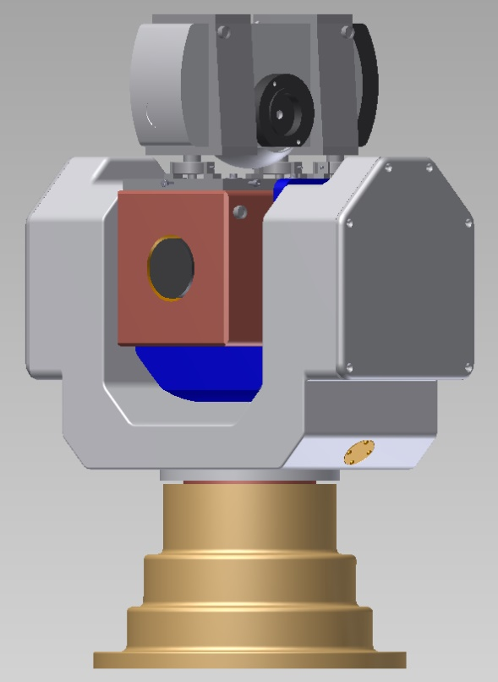
  Vision instrument introduction
  Vision instrument
    A new kind measurement instrument: photogrammetry, distance, angle measurement functions
    Objective: high precision, high efficiency
rangefinder
camera
vertical dial plate
horizontal dial plate

Slide 10
  Vision instrument introduction
  Application scene
    Improve tunnel measurement efficiency, realize multiple points high-accuracy coordinate measurement.
    Component fiducialization
    large component assembly measurement, such as the detector.
    Remote non-contact measurement in high radiation area
  Challenges
    Control point recognition in the tunnel complex environment.
    How to carry out accelerator measurement by photogrammetry .
    How to improve measurement accuracy
    How to add angle and distance information as constraints to photogrammetry to improve the adjustment accuracy.

Slide 11
  Vision instrument introduction
  R&D contents
    Photogrammetry camera
    Million capacity coded target
    Five-face target
    Photogrammetry application method research
    Two-dimensional turntable
    Vision instrument calibration research
    Adjustment software

Slide 12
  Vision instrument introduction
  Cooperation partners
    Beijing Prodetec Technology CO.,LTD: photogrammetry camera , coded target
    China Academy of Space Technology: Two-dimensional turntable
    Hanzhong Yuanhang Precision Machinery Manufacturing Co., LTD : Five-face target
    Changan university : retro-reflection coating layer research

Slide 13
  Vision instrument R&D status

Slide 14
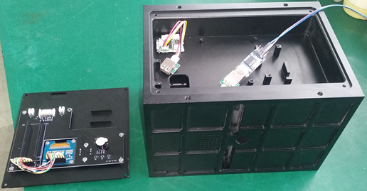
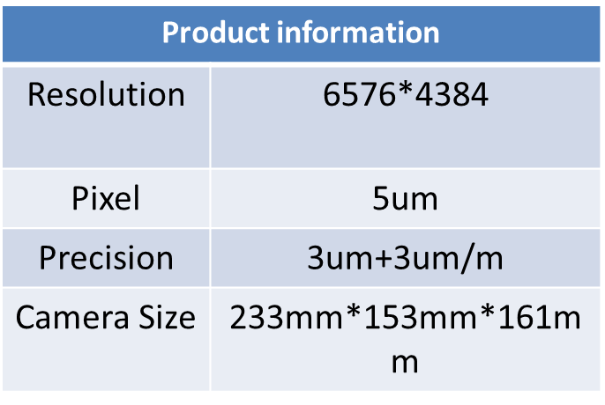
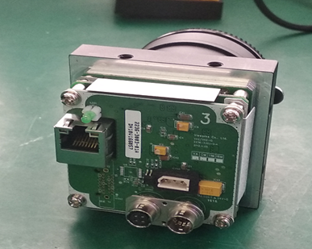
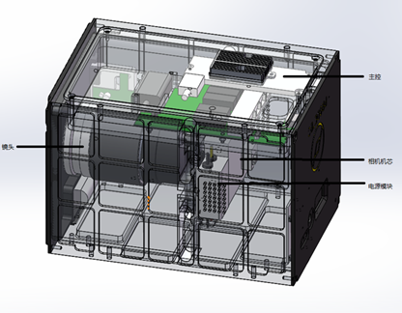
  Vision instrument R&D status
  Photogrammetry camera R&D
    Structural design
    Circuit development
    Optical system R&D
    Completed the photo pre-processing function R&D
    Completed camera test

Slide 15
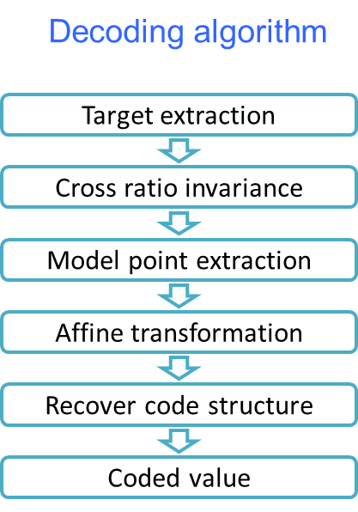
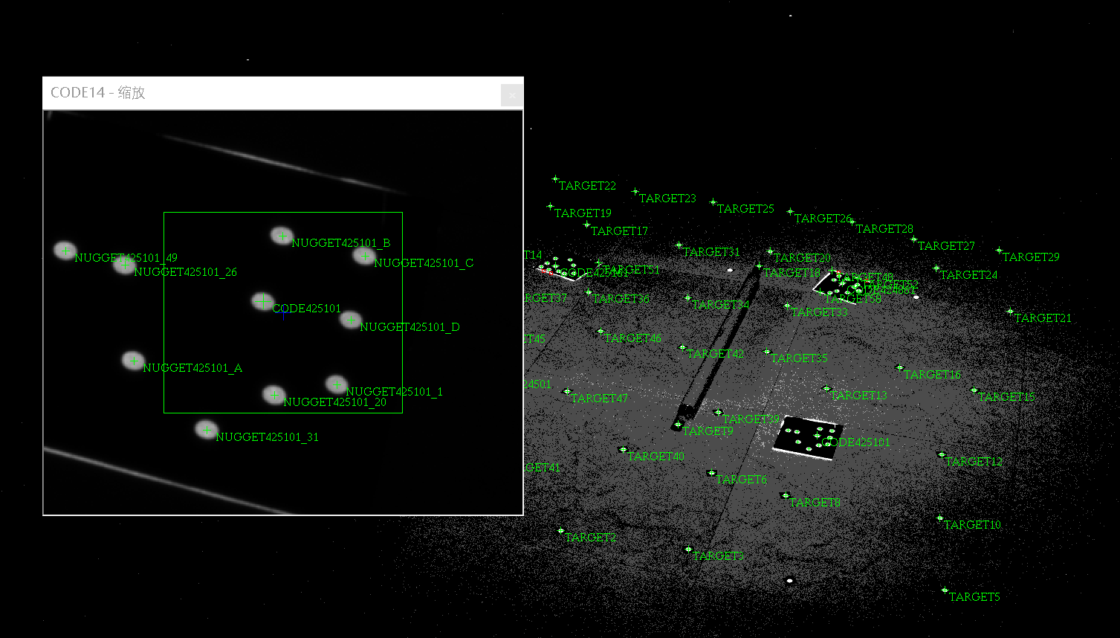
  Vision instrument R&D status
  Million capacity coded target R&D
    Function:
    Overlapping measurement , image matching
    Control point identification
    Technology index
    Coded capacity: more than 1 Million
    Recognition rate better than 95%
    Status
    Completed coded target design
    Completed recognition algorithm development
    Completed application test
Recognition rate
97%

Slide 16
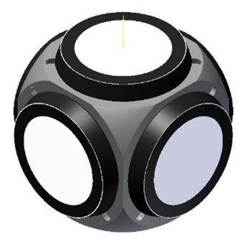
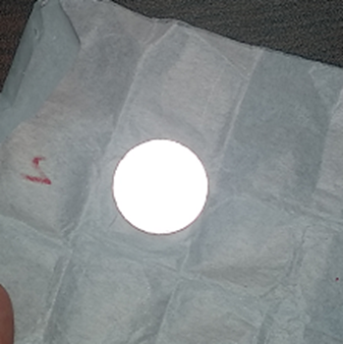
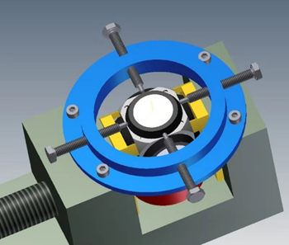
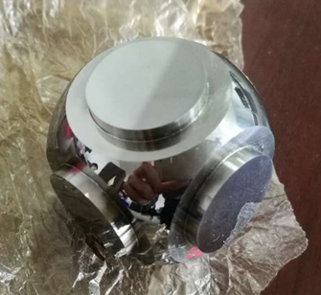
  Vision instrument R&D status
  Five-face target R&D
    Conventional photogrammetric target are plane target can not meet the requirement of shooting from different angles in tunnel circumstance.
    Five-face target, ball center coordinate can be calculated by shooting from different directions.
    Can use laser tracker target seat, Good interchangeability
    Completed target processing technology research
    Carry out retro-reflection coating layer research
    Produced 90 targets for
    measurement experiment
    Completed the target center
    calculation program

Slide 17
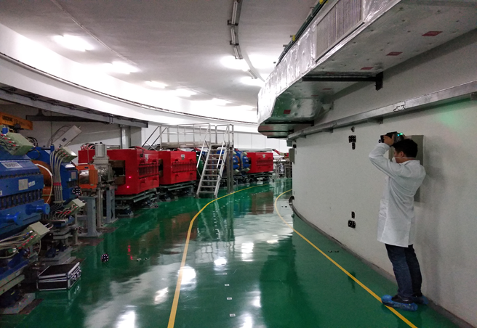
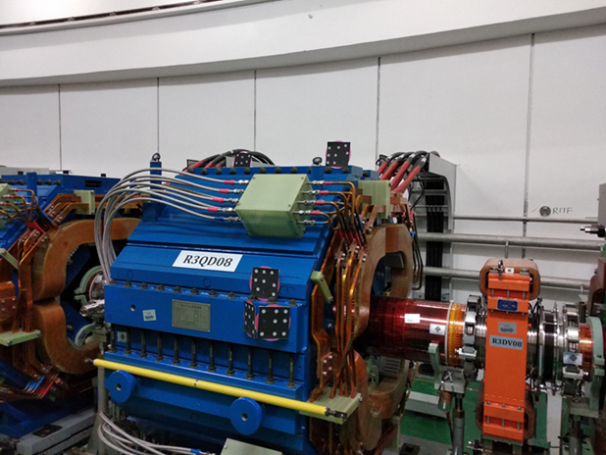
  Vision instrument R&D status
  Photogrammetry application method research
    Purpose: research how to carry out measurement by photogrammetry method in tunnel environment
    Carried out 4 times experiment
    Control point measurement method had been researched
    Verified the million capacity coded target
    Verified the Five-face target and its calculation program

Slide 18
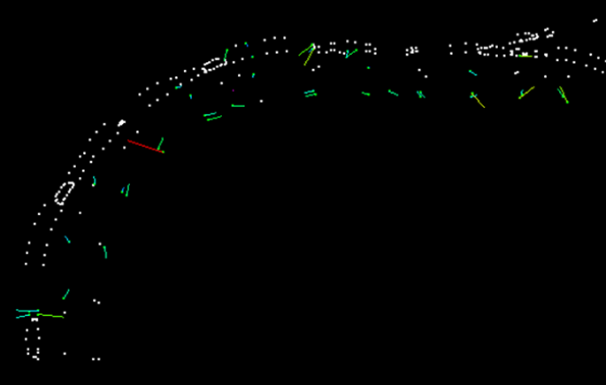
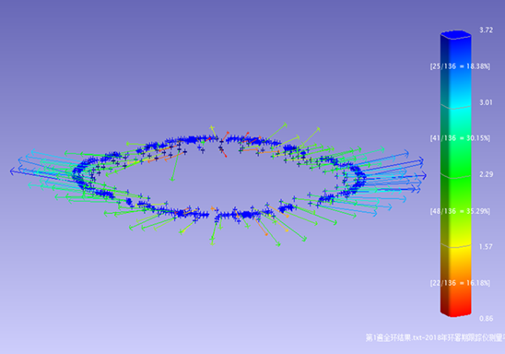
  Vision instrument R&D status
    Successfully completed the RCS ring measurement, efficiency can be increased by four times
    Problems
      In small range photogrammetry can get high accuracy, but in large range its accuracy is very instable, targets are too far apart, images overlap strength is too weak
    In order to improve the measurement accuracy, distance and angle observations should be added into photogrammetry, which is the function that the vision instrument will implement.

Slide 19
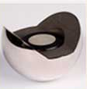
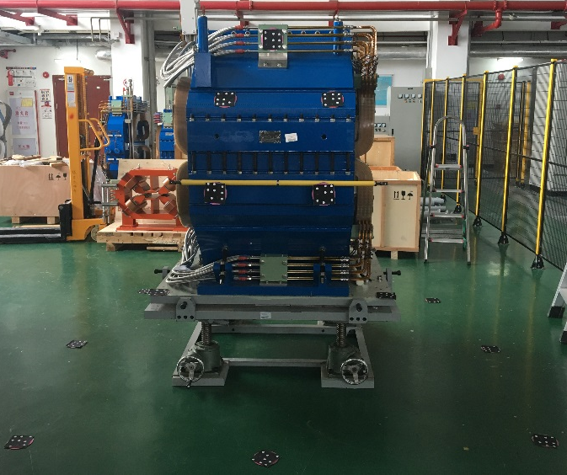
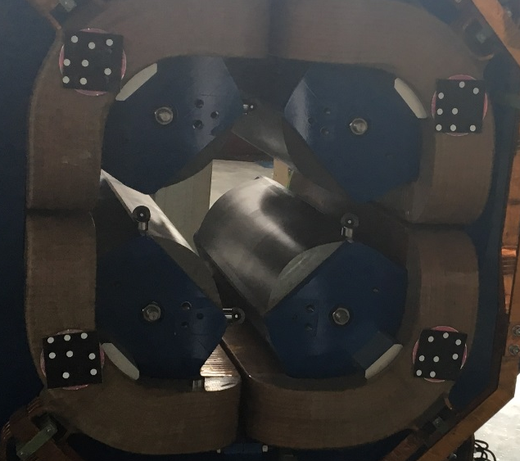
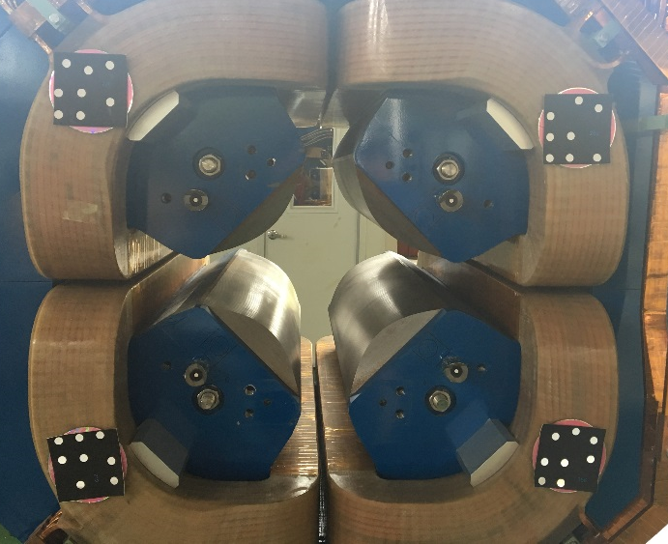
  Vision instrument R&D status
    Completed the Quadrupole fiducialization experiment by photogrammetry
    Accuracy is comparable with laser tracker
 | 激光跟踪仪结果 |  |  | 摄影测量结果 |  |  | 偏差
272QCF1 | -398.86 | 753.24 | 349.68 | -398.89 | 753.24 | 349.68 | 0.03 | 0.00 | 0.01
272QCF2 | -596.63 | 753.41 | -350.19 | -596.63 | 753.44 | -350.16 | 0.00 | -0.02 | -0.03
272QCF3 | 597.94 | 753.30 | -350.67 | 598.00 | 753.36 | -350.61 | -0.06 | -0.05 | -0.06
272QCF4 | 397.38 | 753.12 | 349.69 | 397.44 | 753.09 | 349.75 | -0.05 | 0.03 | -0.06
19

Slide 20
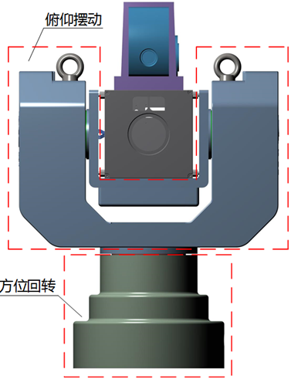
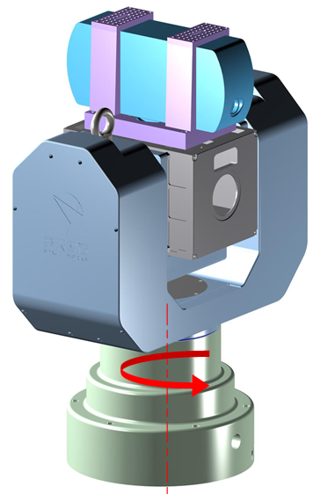
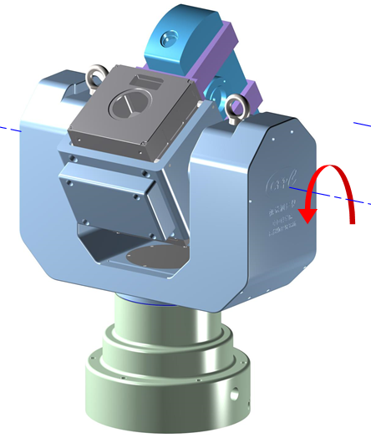
  Vision instrument R&D status
  Two-dimensional turntable R&D
    alt-azimuth shafting structure
    Camera and rangefinder are mounted on the pitching axis, easy to add counterweights, reduce the driving torque
    Azimuth axis can do 360° unlimited rotation, pitching axis rotation range is -60 ~ 90°
rangefinder
camera

Slide 21
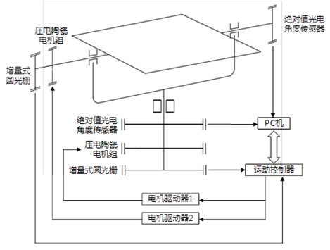
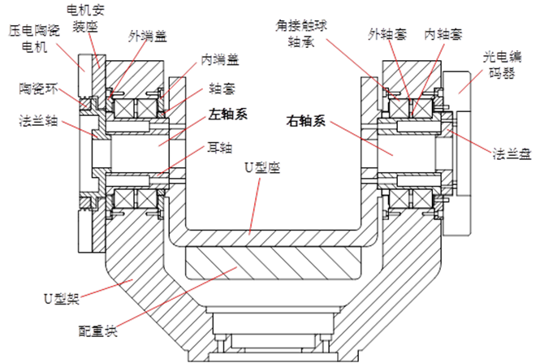
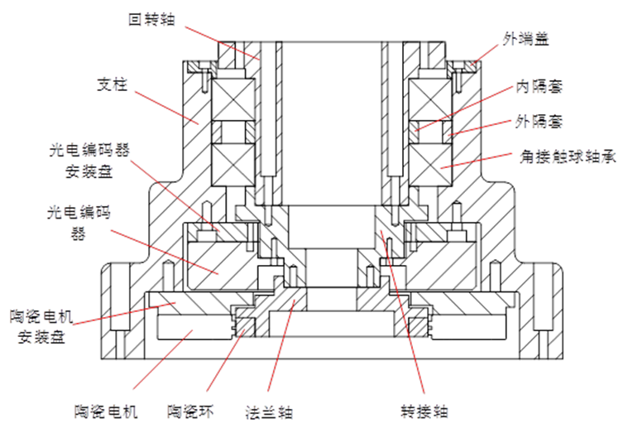
  Vision instrument R&D status
    System composition
      Mechanical shell
      Piezoelectric ceramic motor
      Incremental grating
      Absolute photoelectric Angle sensor
      motion control system
    Completed the shafting design
      load calculation
      Mechanical design
      Encoders and motors installation design

Slide 22
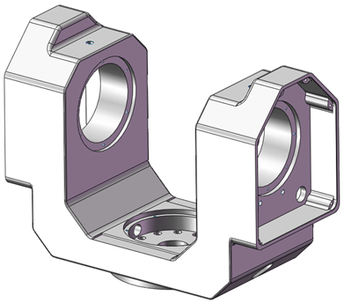
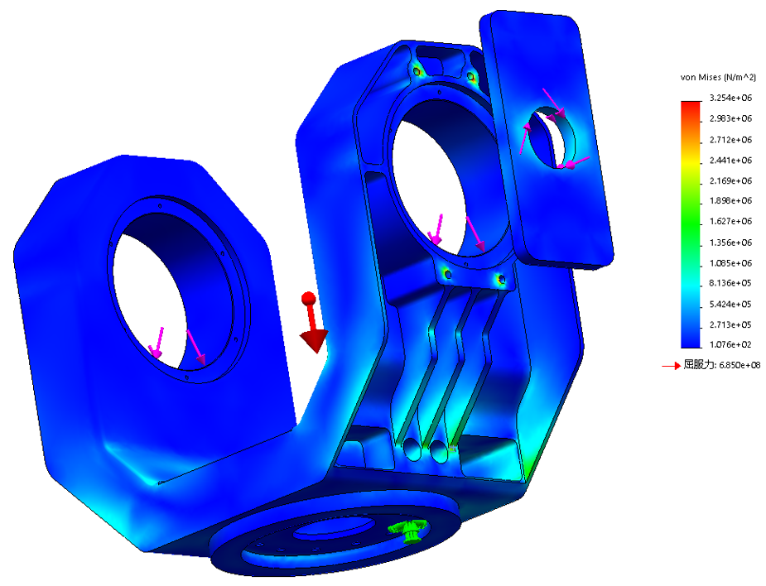
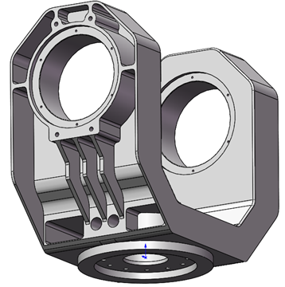
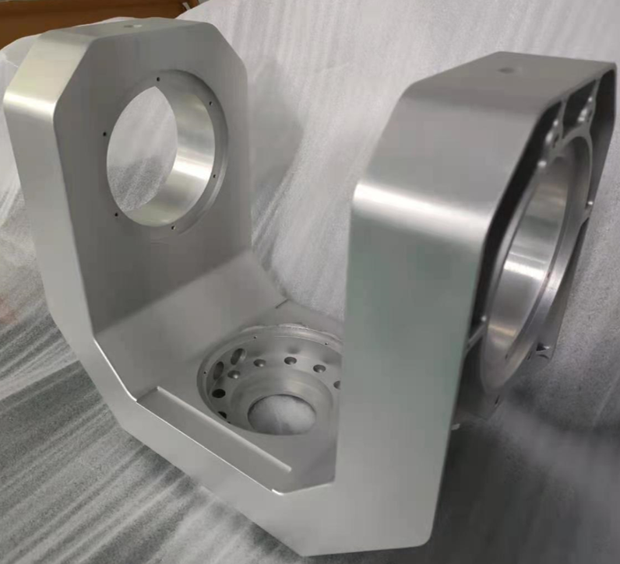
  Vision instrument R&D status
    3D modeling and finite element method to do stiffness analysis and structure optimization
    Tried the 3D printing and machining center fabrication process
    Meet the high precision, large load, light weight requirements
V1
V2
finished product

Slide 23
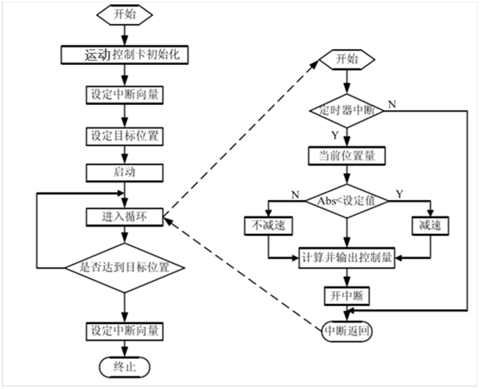
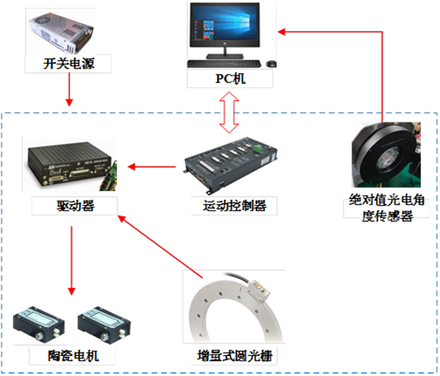
  Vision instrument R&D status
  Turntable control system
    Completed the hardware system integration
    Completed the control software development

Slide 24
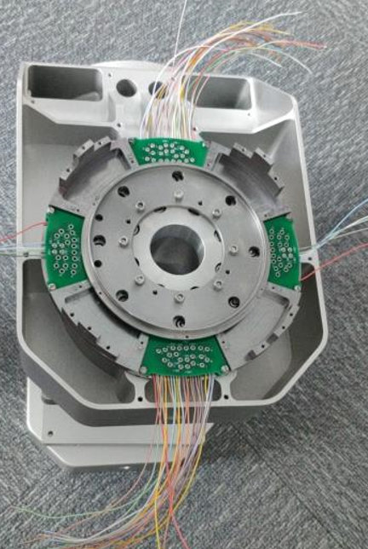
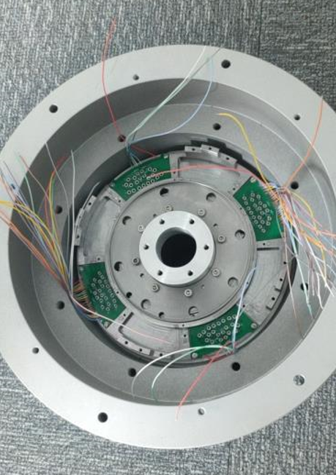
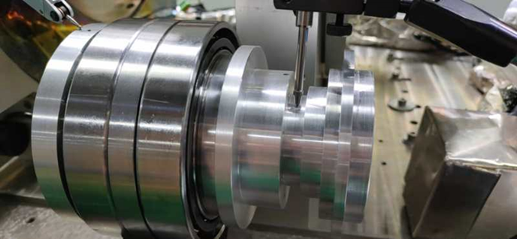
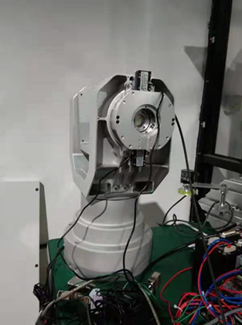
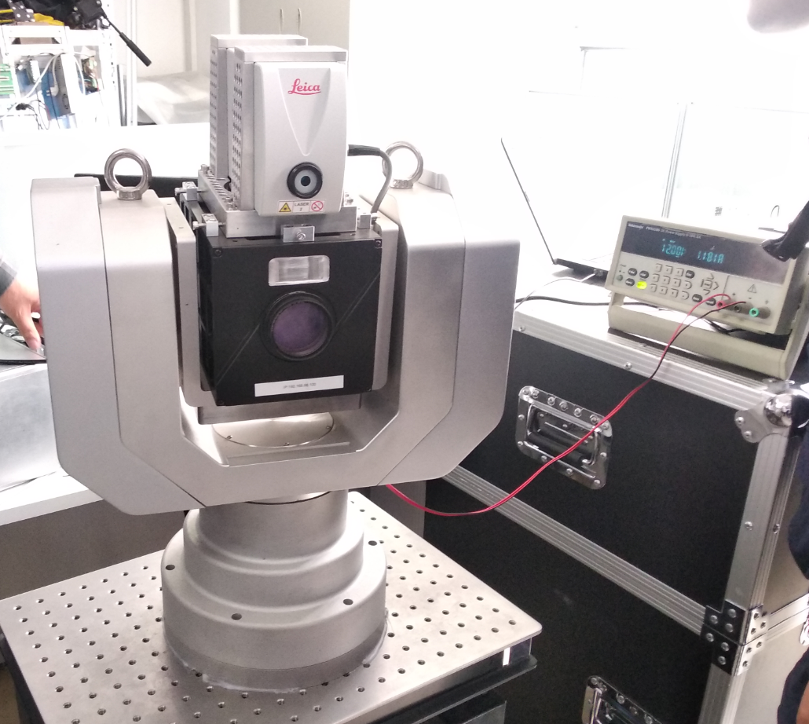
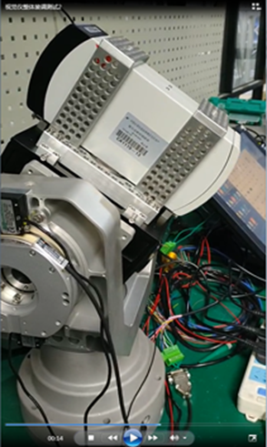
  Vision instrument R&D status
  Completed the parts processing and assembly
  Completed the motion test after installing the camera and rangefinder

Slide 25
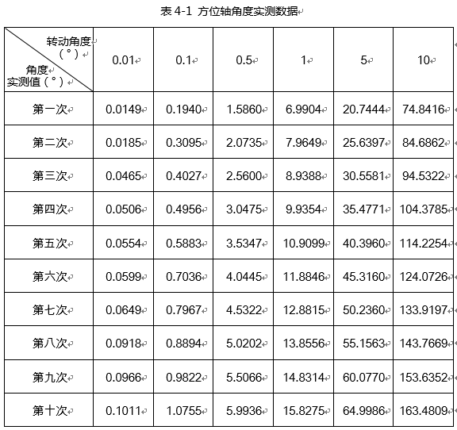
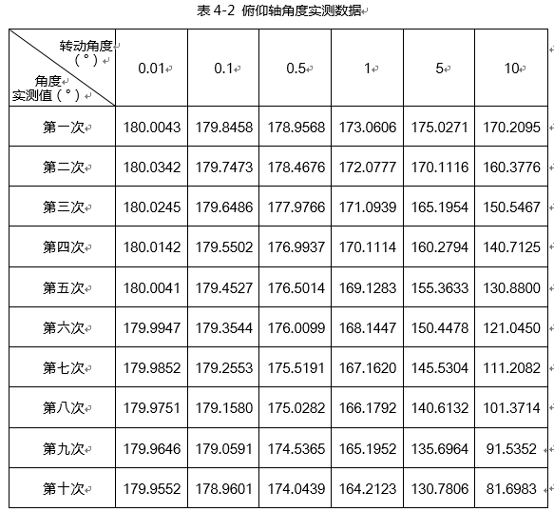
  Vision instrument R&D status
    Using incremental grating solved the running away problem caused by signal delay
    Using 10 group angle values tested the motion control system
    Test result can meet the design indexes

Slide 26
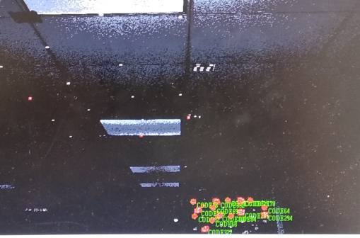
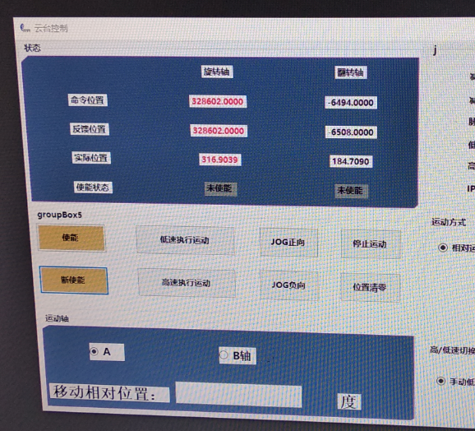
  Vision instrument R&D status
  Completed the measurement functions test
    photogrammetry, horizontal angle, vertical angle, distance
    Each image can be recorded with angles and distances

Slide 27
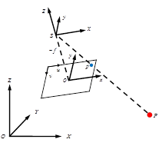
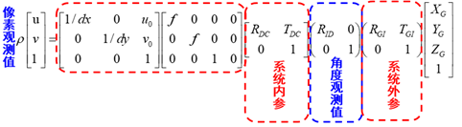
  Vision instrument R&D status
  Vision instrument calibration research
    To calculate the control point coordinate in global coordinate system by its projection point’s pixel coordinates in the image coordinate system, it needs to establish the equations
    These equations will include a series of parameters, some of the parameters reflect the position relationship between the measuring modules, so the position relationship between the measuring modules will influence the measurement result.
    Vision instrument calibration is to adjust the measuring modules to their design position, calibrate the position error and compensate the measurement result.

Slide 28
  Vision instrument R&D status
  Calibration works
    Datum fiducialiaztion
    Individual calibration
    Integral calibration
  Datum fiducialiaztion
    Turntable shafting datum fiducialization: shafting datum and the fiducials.
    Camera datum fiducialization: optical axis, principal point and fiducials.
    Rangefinder datum fiducialization:
    Use CMM measure the fiducials, adjust the camera and rangefinder according to the turntable.

Slide 29

  Vision instrument R&D status
  Individual calibration
    Encoder eccentric error: misalignment between encoder center and rotation center
    Collimation error: camera optical axis not orthogonal with turntable pitching axis .
    turntable pitching axis tilt error: pitching axis not orthogonal with azimuth axis
    Offset between pitching axis and azimuth axis
    Offset between camera optical axis and pitching axis

Slide 30


  Vision instrument R&D status
    Purchased a multi-tooth dividing table for angle calibration
    Customized a calibration field for integral calibration

Slide 31
  Vision instrument R&D status
  Adjustment software R&D
    Software R&D analysis
R&D process
problems
solutions
Observations management
Integrated adjustment
Multi observations adjustment
Constructing observation equations
Posterior variance estimation
Normal equation solution
massive observation
adjustment
Optimize algorithm
accuracy assessment

Slide 32

  Vision instrument R&D status
    Photogrammetry adjustment program has been developed
    Vision instrument adjustment model has been constructed
Global coordinate
（O_{G}-X_{G}Y_{G}Z_{G}）
Instrument
coordinate
（O_{T}-X_{I}Y_{I}Z_{I}）
Camera
coordinate
（O_{C}-X_{C}Y_{C}Z_{C}）
Image coordinate
(O_{f}-xy)
Pixel coordinate
（O_{p}-uv）
    Function relationship of image observation, angle observation distance observation and control point coordinate has been constructed

Slide 33

  Vision instrument R&D status
  Algorithm optimization
    Researched sparse matrix storage to improve image process speed .
    Tested the LLT decomposition method for normal equation calculation, calculation speed was significantly improved
  Next research
    Parallel computing.
    Multi observations adjustment weighted method

Slide 34
Summary
  To improve measurement efficiency, the vision instrument R&D is carried out.
  Apply photogrammetry to accelerator measurement is studied.
  The prototype of vision instrument has been made.
  Vision instrument calibration technique is under studying.
  Observation value processing model has been constructed.
  Photogrammetry adjustment program has been developed, algorithm optimization achieved remarkable result.
  NEXT
    Push forward the calibration work
    Data processing software development
    Carry out vision instrument measure experiment

Slide 35
  Dual aperture magnet alignment
    Magnet fiducialization.
    Calculate the coordinates of fiducials in CEPC coordinate system
fiducials
EX
Beam line
magnet
Y
X
Y
EN
CEPC coordinate system
EN
EX
Y
X
X
fiducials

Slide 36
Thank You !

