Slide 1
Start to end simulations for the linac new baseline and progress on the crucial components
Jingru Zhang
On behalf of linac group
Institute of High Energy Physics, CAS
2021.10.13

Slide 2
Outline
1
LINAC new baseline design
2
LINAC physics design
3
Progress on the crucial components
4
Summary

Slide 3
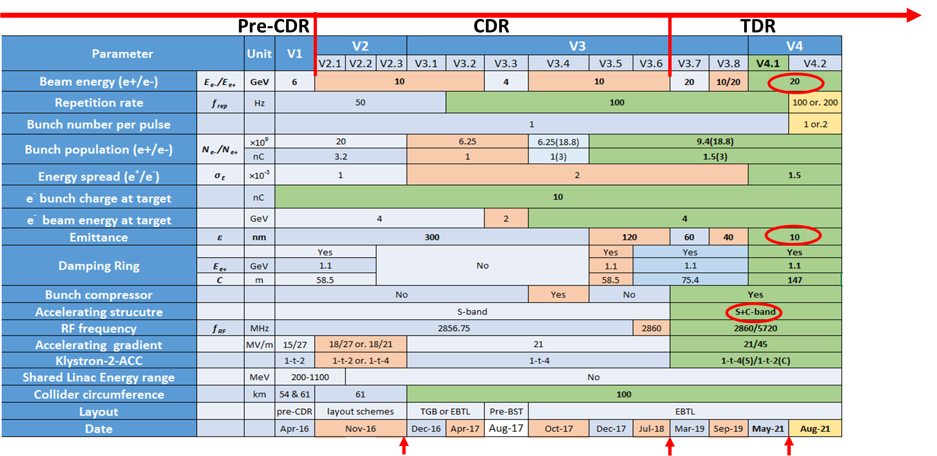
Introduction
Linac version evolution
Meet the design requirements of Booster: Energy/Emittance

Slide 4
LINAC New baseline
Increase the energy of the Linac from 10 GeV to 20GeV
  Booster magnet: Low magnetic field & large magnetic field range
  Linac：C-band accelerating structure
Decrease the emittance of the Linac from 40nm to 10nm
  Low emittance damping ring
    Nor. RMS. Emittance: 200mm-mrad
Parameter | Symbol | Unit | Baseline
e⁻ /e⁺ beam energy | E_{e-}/E_{e+} | GeV | 20
Repetition rate | f_{rep} | Hz | 100
e⁻ /e⁺ bunch population | Ne-/Ne+ | ×10¹⁰ | 0.94(1.88)
 |  | nC | 1.5 (3)
Energy spread (e⁻ /e⁺ ) | σ_{E} |  | 1.5×10⁻³
Emittance (e⁻ /e⁺ ) | ε_{r} | nm | 10
Parameter | Unit | S-band | C-band
Frequency | MHz | 2860 | 5720
Length | m | 3.1 | 1.8
Cavity mode |  | 2π/3 | 3π/4
Aperture diameter | mm | 20~24 | 11.8~16
Gradient | MV/m | 21 | 45

Slide 5
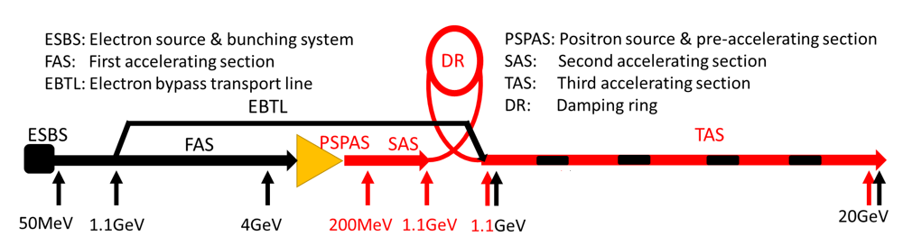
LINAC New baseline
  Layout
  Vertical electron by-pass transport line (EBTL): 1.2 m separation
S-band Linac
  FAS: 4GeV + PSPAS: 200MeV + SAS: 1.1GeV
C-band Linac
  TAS：1.1GeV→20GeV
  Because the emittance of damping ring is decreased, the C-band accelerating structure could be used from 1.1 GeV

Slide 6
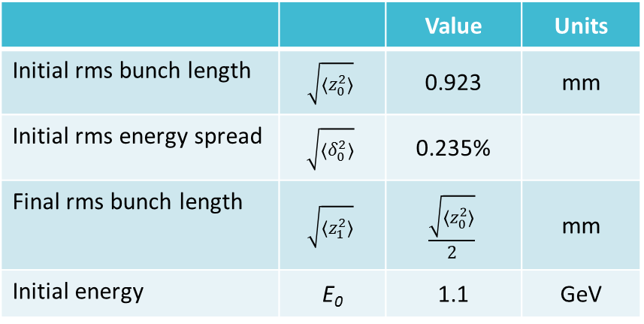
Linac physics design
Bunch compressor is needed before C-band accelerating structure
  Bunch length is from 1mm to 0.5mm
  Chicane type
    Angle: 10°
  Accelerating structure
    Voltage:100MV
 |  | Value | Units
Initial rms bunch length | $$\sqrt{〈z_{0}^{2}〉}$$ | 0.923 | mm
Initial rms energy spread | $$\sqrt{〈δ_{0}^{2}〉}$$ | 0.235%
Final rms bunch length | $$\sqrt{〈z_{1}^{2}〉}$$ | $$\frac{\sqrt{〈z_{0}^{2}〉}}{2}$$ | mm
Initial energy | E₀ | 1.1 | GeV

Slide 7
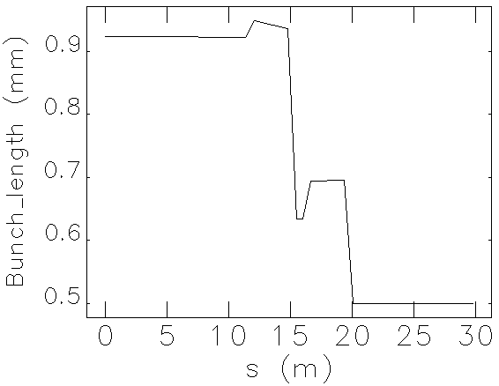
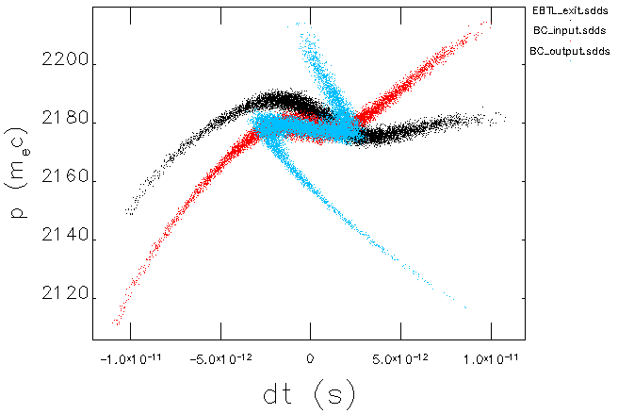
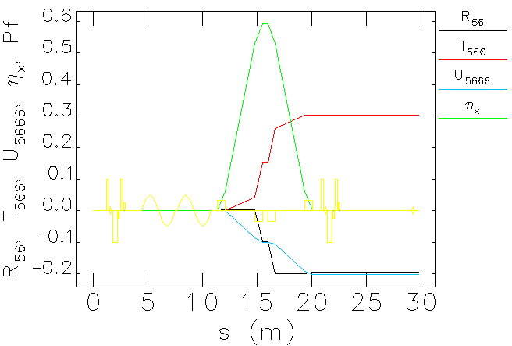
Linac physics design
Bunch compressor is needed before C-band accelerating structure
  Bunch length is from 1mm to 0.5mm
  Chicane type
    Angle: 10°
  Accelerating structure
    Voltage:100MV

Slide 8
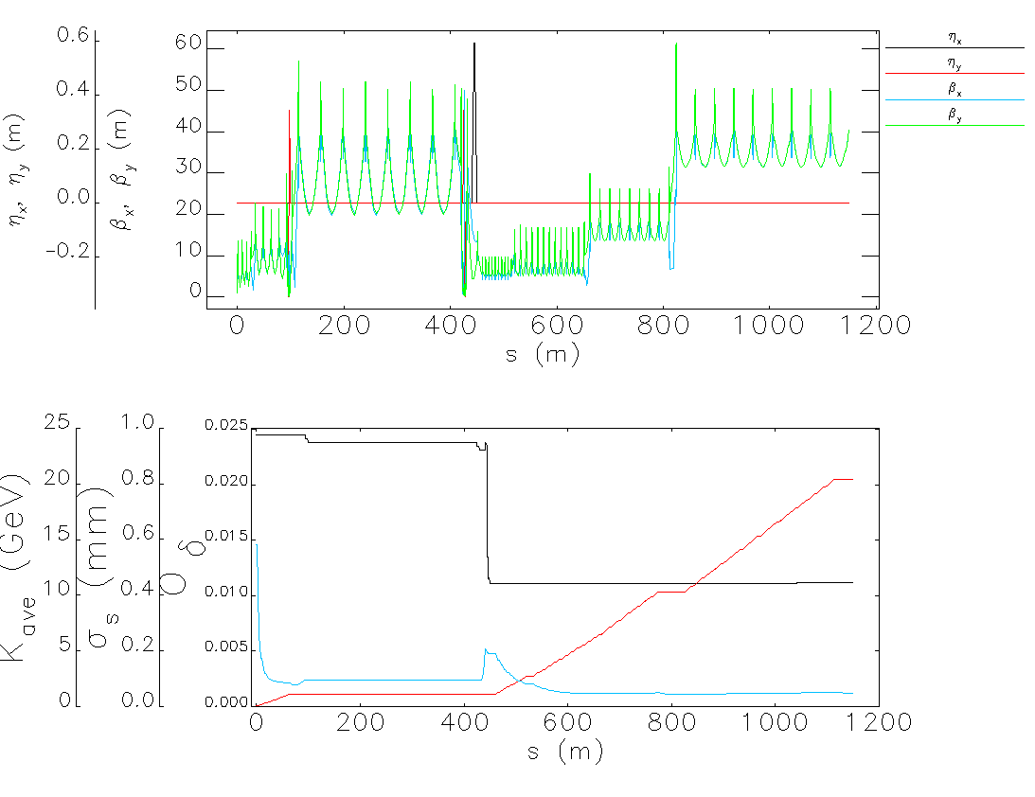
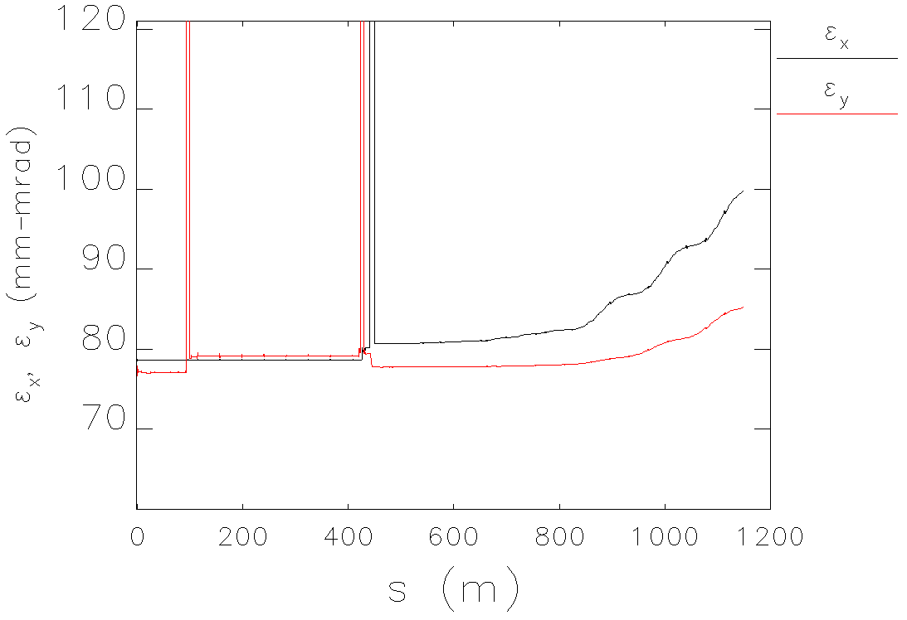
Linac physics design
Electron Linac
  Wakefield & CSR
  Emittance(w/o error)
    Growth: 25%
    2.5nm@20GeV
Parameter | Unit | Baseline | Electron
e⁻ /e⁺ beam energy | GeV | 20 | 20.38
Repetition rate | Hz | 100 | 100
e⁻ /e⁺ bunch population | ×10¹⁰ | 0.94(1.88) | 1.88
 | nC | 1.5 (3) | 3
Energy spread (e⁻ /e⁺ ) |  | 1.5×10⁻³ | 1.3×10⁻³
Emittance (e⁻ /e⁺ ) | nm | 10 | 2.5
Optics function
Emittance
Energy/bunch length/energy spread

Slide 9
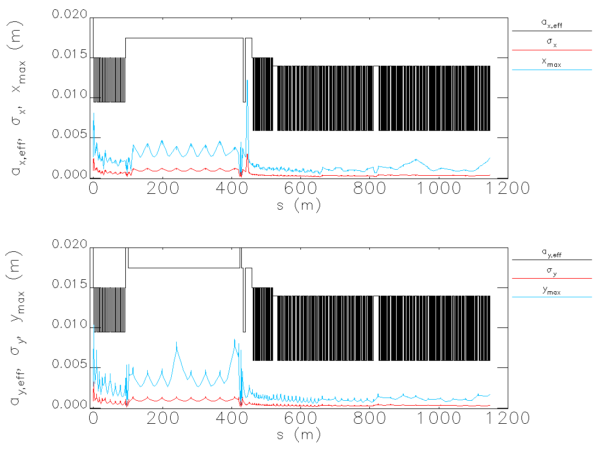
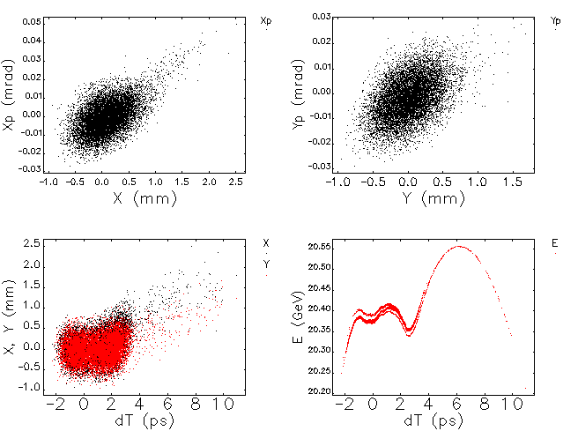
Linac physics design
Electron Linac
  Wakefield & CSR
  Emittance(w/o error)
    Growth: 25%
    2.5nm@20GeV
Parameter | Unit | Baseline | Electron
e⁻ /e⁺ beam energy | GeV | 20 | 20.38
Repetition rate | Hz | 100 | 100
e⁻ /e⁺ bunch population | ×10¹⁰ | 0.94(1.88) | 1.88
 | nC | 1.5 (3) | 3
Energy spread (e⁻ /e⁺ ) |  | 1.5×10⁻³ | 1.3×10⁻³
Emittance (e⁻ /e⁺ ) | nm | 10 | 2.5
Beam size
Distribution @ 20GeV

Slide 10
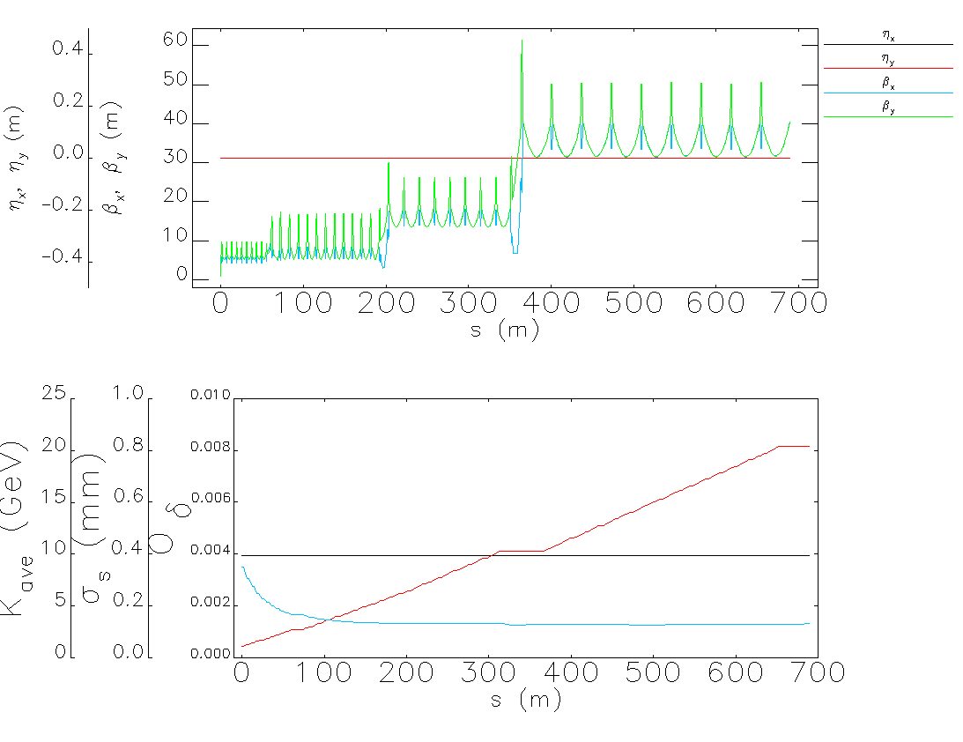
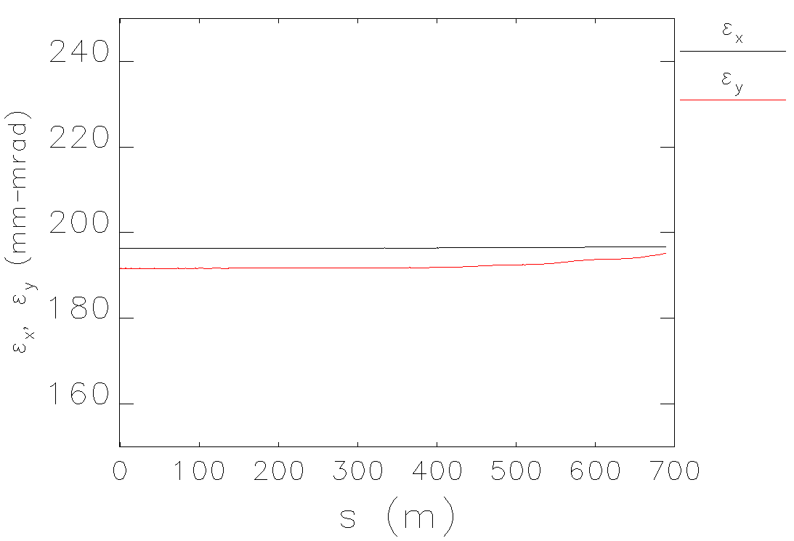
Linac physics design
Positron Linac
  Wakefield & CSR
  Emittance(w/o error)
    Growth: 5%
    5.2nm@20GeV
Parameter | Unit | Baseline | Electron | Positron
e⁻ /e⁺ beam energy | GeV | 20 | 20.38 | 20.37
Repetition rate | Hz | 100 | 100 | 100
e⁻ /e⁺ bunch population | ×10¹⁰ | 0.94(1.88) | 1.88 | 1.88
 | nC | 1.5 (3) | 3 | 3
Energy spread (e⁻ /e⁺ ) |  | 1.5×10⁻³ | 1.3×10⁻³ | 1.3×10⁻³
Emittance (e⁻ /e⁺ ) | nm | 10 | 2.5 | 5.2
Optics function
Emittance
Energy/bunch length/energy spread

Slide 11
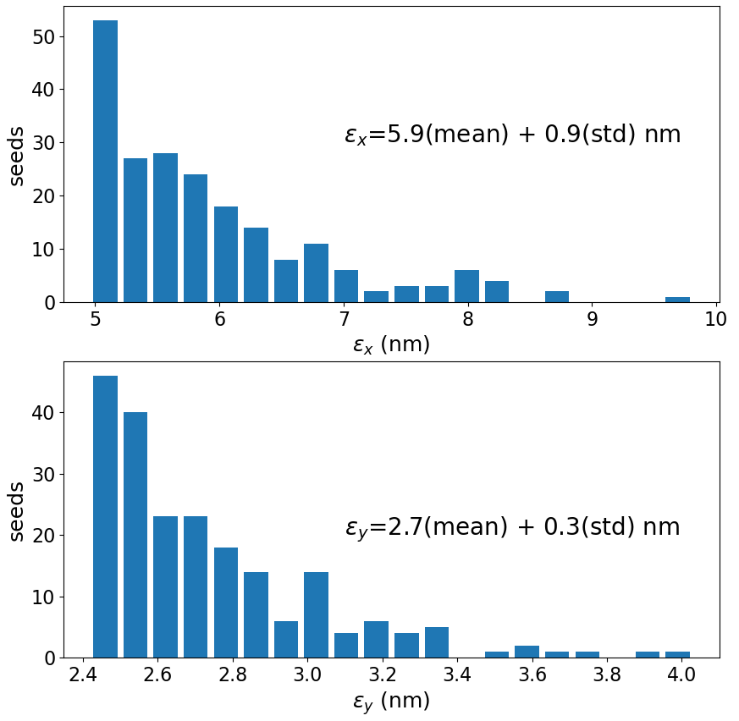
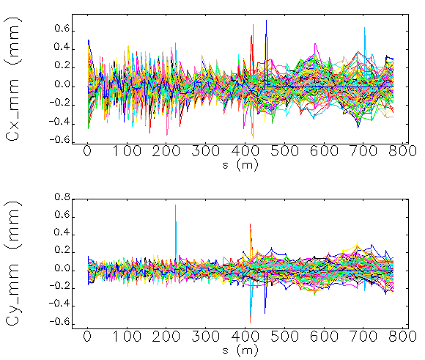
Linac physics design
Positron Linac
  errors: Magnets/Accelerating structure/BPM
  Trajectory correction: beam center<0.5mm
  Emittance growth: meet the requirement
    X: 18%(mean)+18%(std)
    Y: 10%(mean)+12%(std)
Error description | Unit | Value
Misalignment error | mm | 0.1
Rotation error | mrad | 0.2
Magnetic element field error | % | 0.1
BPM uncertainty | µm | 30

Slide 12
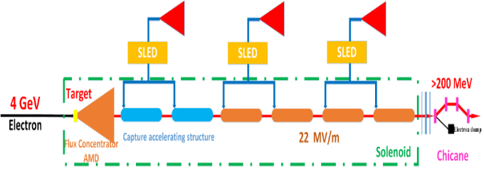
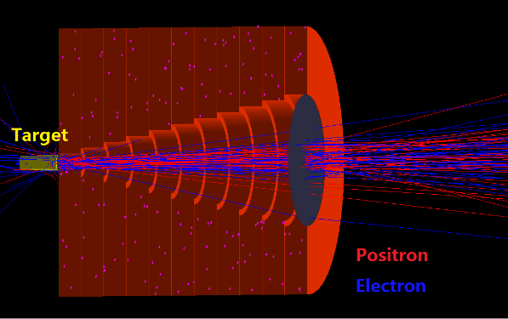
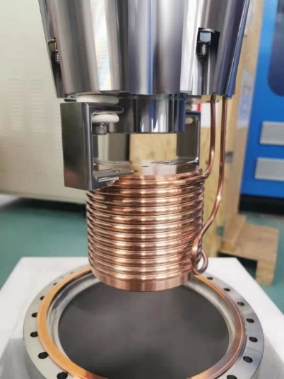
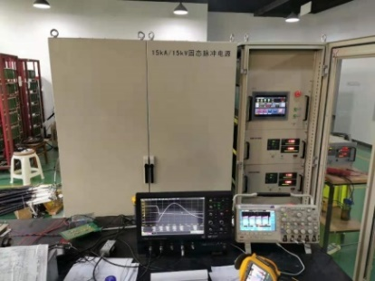
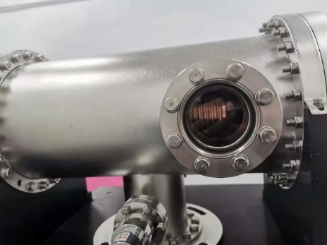
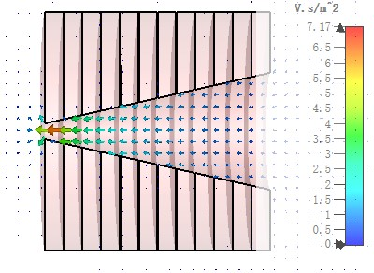
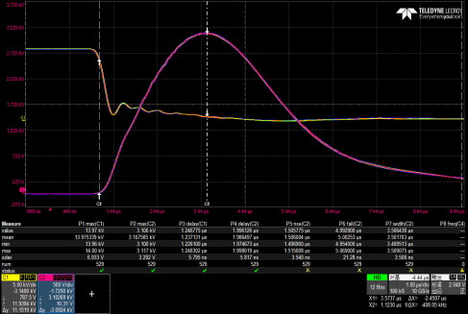
Positron Source
The FLUX concentrator is the important part of the positron source
It produces a pulsed magnetic field of 6 T to 0.5 T
Finished 15kA/15kV/50Hz solid state pulse source
FLUX concentrator has made and finished high power test
When cunrrent is 15kA , the center peak pulse magnetic field is 6.2T
R&D of the solid state pulse source
Test result of the peak pulse magnetic field
The design of the FLUX conentrator

Slide 13
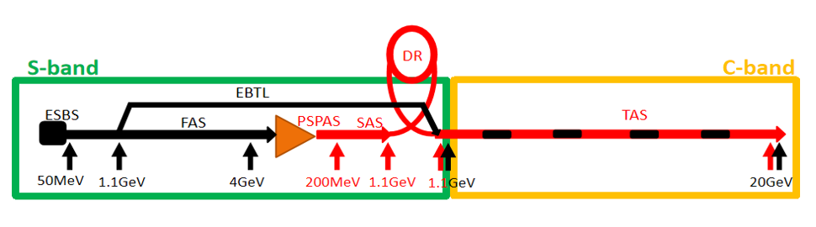
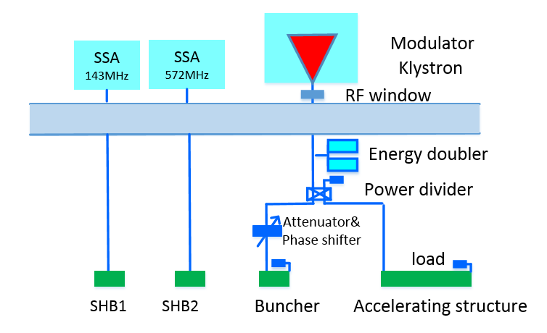
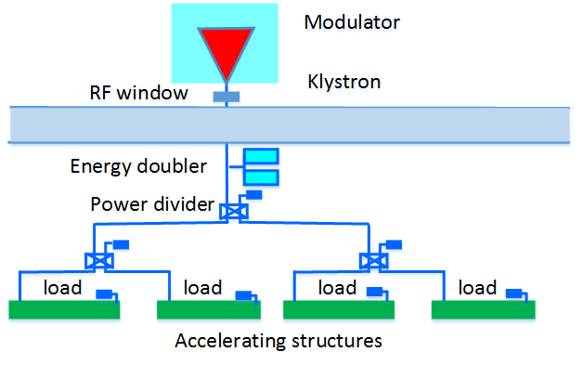
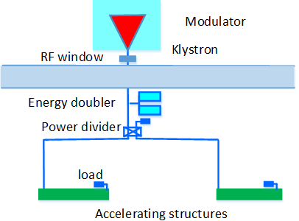
RF distribution of the linac
RF distribution of the linac
  S-band accelerating structures, 80 MW klystron
  C-band accelerating structures, 50 MW klystron
S-band
C-band

Slide 14
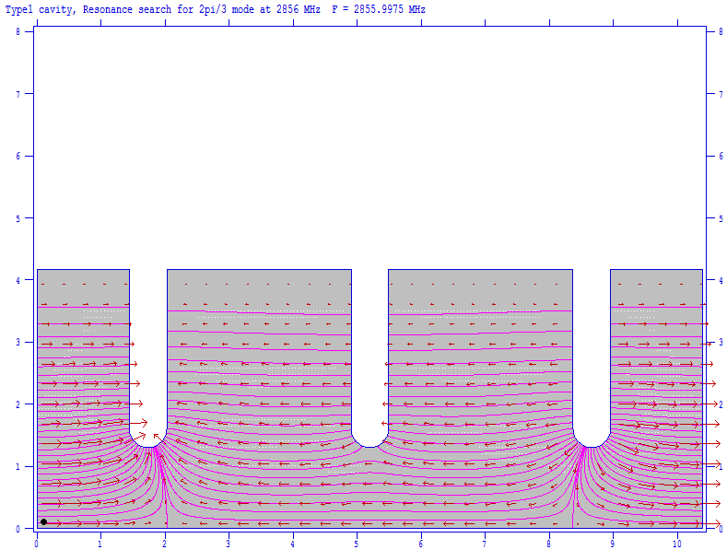
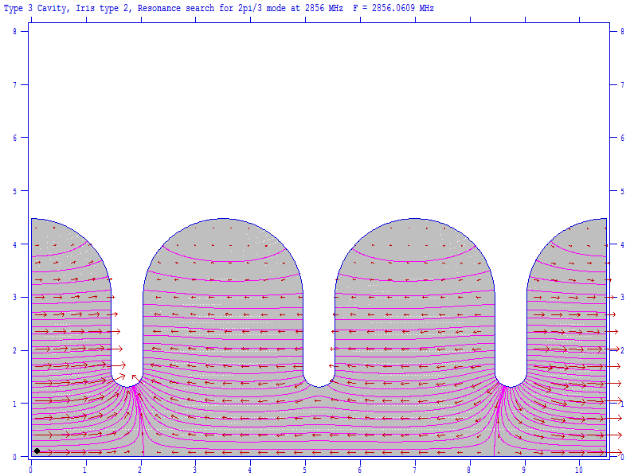
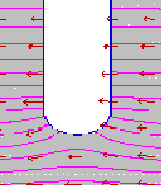
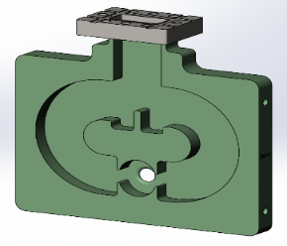
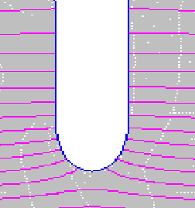
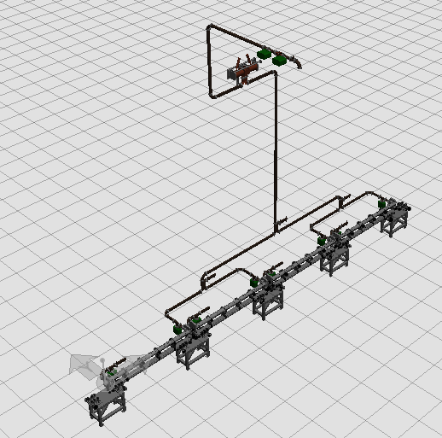
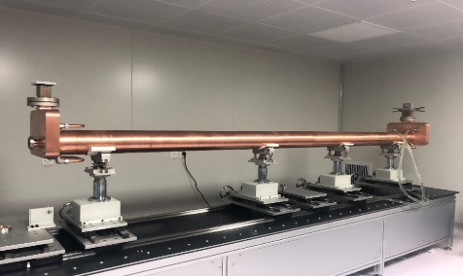
S-band accelerating structure
R&D of 3 meters long S band accelerating structure
  RF design of the cavity and coupler
  The phase shift and the cumulative phase shift are less than 1 deg
  The VSWR is 1.02 at working frequency
  Filling time is 780 nS
  The total attenuation is 4.2 dB
  Superfish is used to optimize the single cell
Windows

Slide 15
S-band accelerating structure
The main parameters of the structure
Parameters | Values | Unit
No. of Cells | 84+2*0.5 | -
Phase advance | 2π/3 | rad
Total length | 3.1 | m
Length of cell (d) | 34.988 | mm
Disk thickness (t) | 5.5 | mm
Shunt impedance (Rs) | 60.3~67.8 | MΩ/m
Quality factor | 15465~15373 | -
Group velocity: Vg/c (%) | 2% ~ 0.94% | -
Filling time (t_{f} ) | 784 | ns
Attenuation factor (τ) | 0.46 | Np
Power (@30MV/m) | 74 | MW

Slide 16
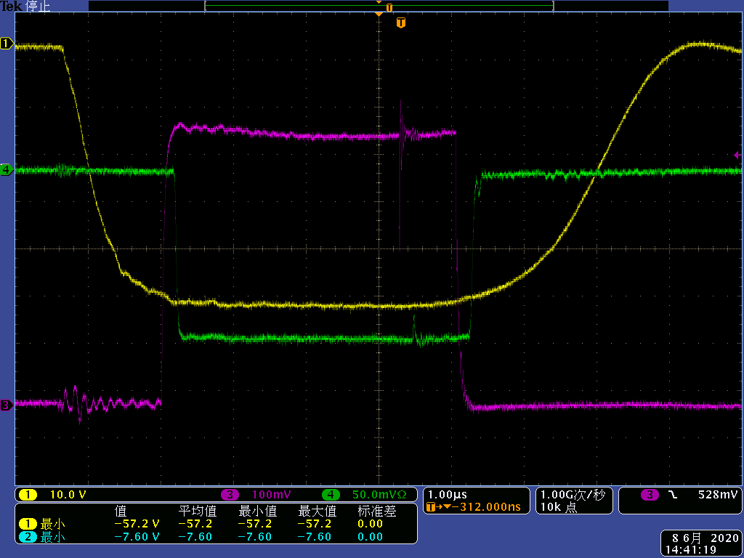
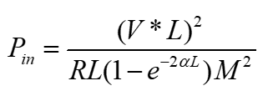
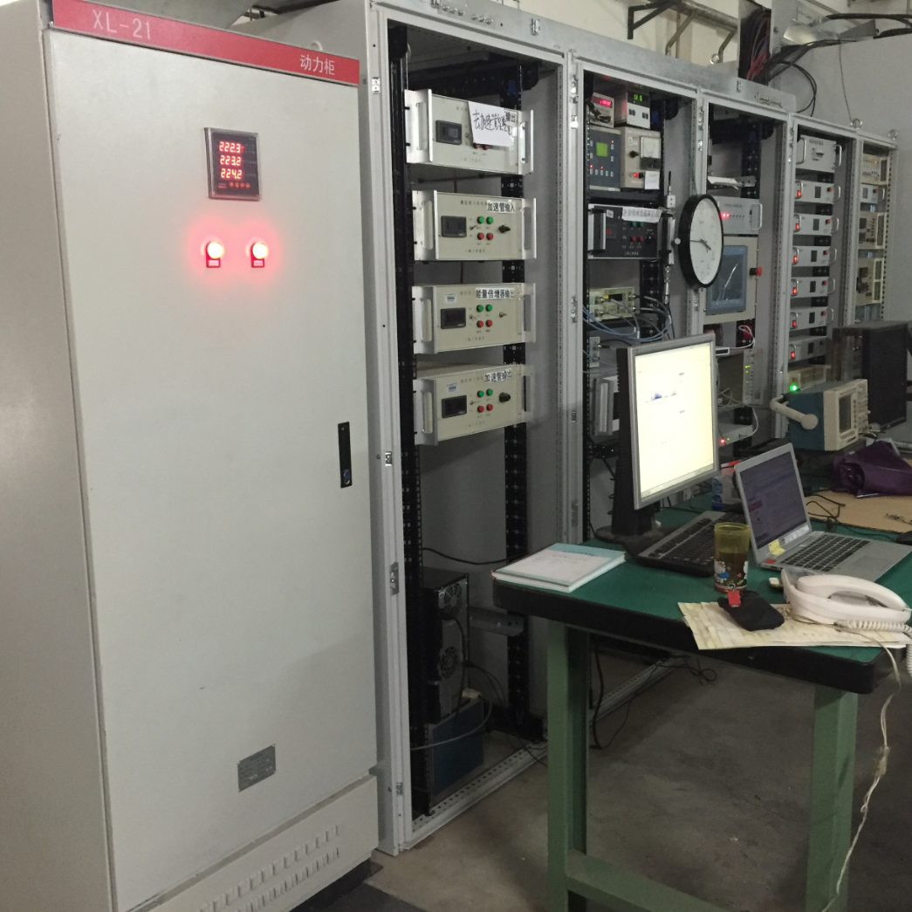
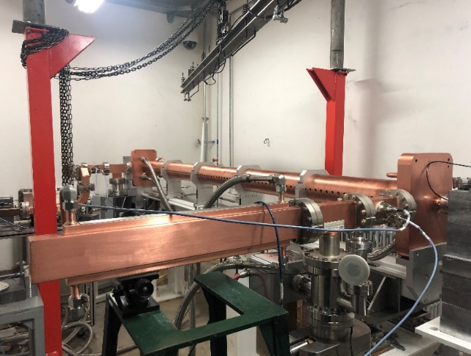
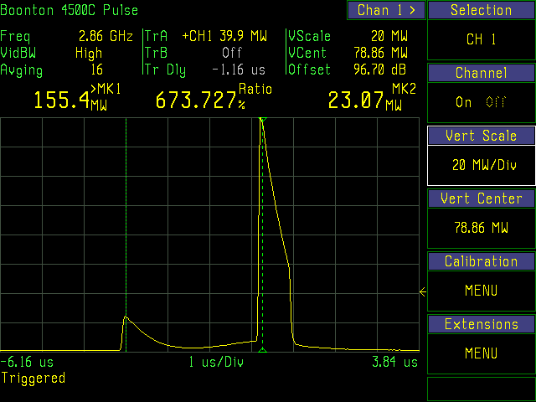
S-band accelerating structure
High power test result (with SLED)
  The modulator voltage is 37.5 kV
  the SLED energy multiplication factor：1.8
  The tested gradient has reached 33 MV/m
The waveform without SLED
The input power with SLED
Modulator and klystron
High power test bench

Slide 17

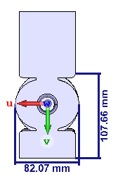
S-band accelerating structure
The coupler design（λg/4）
  The coupler is asymmetry. The cavities in the hydrogen furnace is not at the center place. That will make the welding temperature control difficult
  λg/4 short plane opposite the input port will be used
  The coupler cavity shape is racetrack shape
Windows

Slide 18
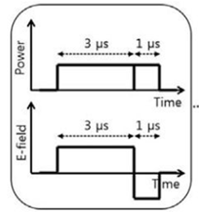
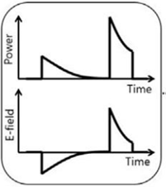
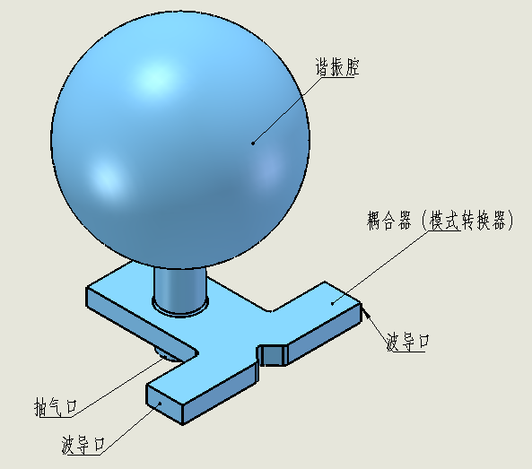
S-band pulse compressor
Improve the peak power from the klystron and saving cost
  Input power: 80 MW
  Pulse width: be compressed from 4uS→0.8uS
  Mode converter & spherical cavity
Parameter | Value
SLED water temperature | 30 ℃
Room temperature | 25 ℃
Filling time | 780 ns
Klystron output power | 80 MW
Pulse width | 4 μs
Pulse repetition rate | 100 Hz

Slide 19
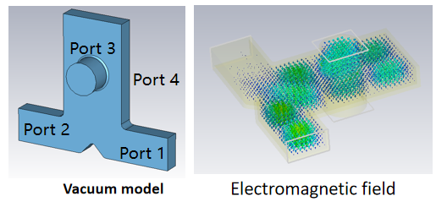
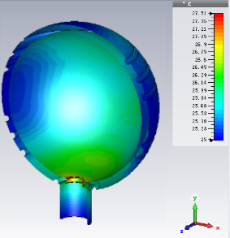
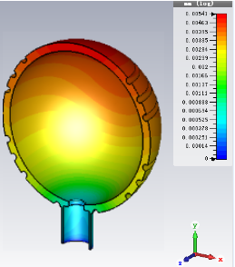
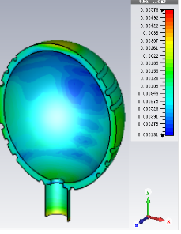
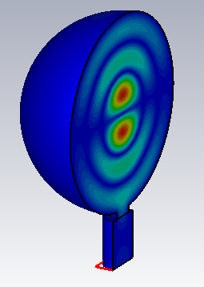
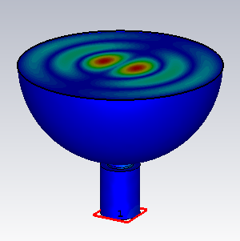
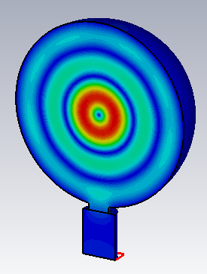
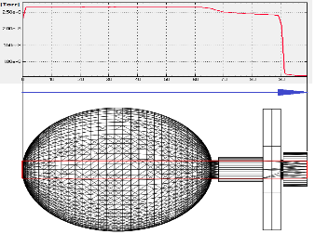
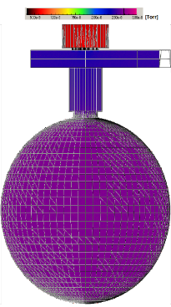




S-band pulse compressor
Pulse compressor
  Finished RF simulation (TE ₁₁₃)
    Mode converter
    Cavity diameter: 364.58mm
  Finished the thermal stress analysis
  Vacuum pumping speed and vacuum level
    The pumping speed of the ion pump is 100 L/s
  Finished the mechanical design
Mode converter design
Temperature
Deformation
Stress
Vacuum distribution
Electric field distribution of the twoTE₁₁₃ polarized degenerate mode
Simulation result

Slide 20


S-band pulse compressor
Machining in progress
  For the diameter (365 mm) is large, in order to reduce cost, Sheet Forming process has used
  Then fine machining
After fine machining

Slide 21



S-band pulse compressor
Cold test result before brazing of the prototype
  Q₀ =127934 (87% of the theoretical Value)
  β=6.5（83% of the theoretical Value）

Slide 22

C band RF system
C band RF system
  1.1 GeV→20GeV
  1 klystron to 2 accelerating structures
  50 MW Klystron (mature products)
  pulse compressor
  RF elements (Loads, power divider, waveguids)

Slide 23






C band RF system
W.C. Fang
C band RF structures at SARI (SXFEL)
6 RF units at SXFEL
Mode：4π/5
Average gradient 37.1 MV/m.
Maximum gradient 41.7 MV/m

Slide 24





C band RF system
The preliminary design of the C-band accelerating struture at IHEP
  Design goal 40 MV /m
  Constant gradient
  3π/4 mode, 1.8 meters long
  Finished cavity shape design and coupler design
    Round cavity
    Racetrack megnetic coupling
The deformation caused by temperature variation
Emax/E0 as a function of the iris ellipticity

Slide 25
C band RF system
The preliminary design of the C-band accelerating struture
Frequency: f（MHz） | 5712
No. of Cells | 85+2*0.5
Phase advance | 3π/4
Total length | 1.8m
Length of cell : d (@20°C) | 19.675mm
Disk thickness: t | 4.5mm
Average aperture: 2a (@20°C) | 14.8mm
Average diameter : 2b (@20°C) | 45.7mm
Shunt impedance : Rs (MΩ/m) | 66.0 ~ 75.7
Quality factor : Q | 11232~11359
Group velocity: Vg/c (%) | 2.8% ~ 1.4%
Filling time : t_{f} (ns) | 271
Attenuation factor : τ | 0.432

Slide 26



C band RF system
The preliminary design of the C-band accelerating struture
  No klystron and high power test facility of C-band in IHEP
  In the lab
Cavity
C-band accelerating structure

Slide 27







C band RF system
The model selection of the pulse compressor
  SLAC type (Two cavities)
  BOC type
  Spherical type
IHEP C band SLED
Test results of IHEP C band SLED
X band sphrical SLED
SACLA C band SLED
IHEP C band BOC
PSI BOC

Slide 28
Damping Ring RF cavity
D, Wang
Damping ring V3.0
  Emittance: 2500→ 166 (123) mm.mrad
  RF cavity parameters no change
 | DR V3.0
Energy (Gev) | 1.1
Circumference (m) | 147
Number of trains | 2
Number of bunches/trian | 2
Total current (mA) | 12.4
Bending radius (m) | 2.87
Dipole strength B₀ (T) | 1.28
U₀ (kev/turn) | 94.6
Damping time x/y/z (ms) | 11.4/11.4/5.7
Phase/cell (degree) | 60/60 | 75/75
Momentum compaction | 0.013 | 0.007485
Storage time (ms) | 20
δ₀ (%) | 0.056
ε₀ (mm.mrad) | 94.4 | 56.7
injection σ_{z} (mm) | 5 | 5
Extract σ_{z} (mm) | 5.6 | 4.2
ε_{inj} (mm.mrad) | 2500 | 2500
ε_{ext x/y} (mm.mrad) | 166/75 | 123/68
δ_{inj} /δ_{ext} (%) | 0.18 /0.056 | 0.18 /0.056
Energy acceptance by RF(%) | 1.4 | 1.8
f_{RF} (MHz) | 650
V_{RF} (MV) | 1.5
Longitudinal tune | 0.0299 | 0.0224

Slide 29


Damping Ring RF cavity
Y.D. Liu
Longitudinal loss factor and power(σ_{Z} &5mm)
  RF cavity model and longitudinal impedance
  The cavity diameter is 90 mm
Beta tune | 3.84/4.81
Bunch length | 5mm
Bunch number | 2
Synchtron tune | 0.062
Beam current | 10mA
k=4.12V/pC
P=51.8w&10mA

Slide 30




Damping Ring RF cavity
RF design of the 5 cell cavity
  RF cavity design
  Input coupler and doorknob design
  Coupling factor simulation
    The coupling ring is perpendicular to the direction of the magnetic field, and the coupling degree is 6.4
    Coupling degree ~ 5 at rotation angle ~ 28 degrees
 | Unit | Value
Beam tube aperture | mm | 45
Total length | mm | 1383.66
Cell length | mm | 5*230.61
Outside diameter | mm | 345
π-mode frequency | MHz | 649.993
Q0 |  | 31665
R/Q | Ω | 1316
Shunt impedance | MΩ | 20.8
Accelerating voltage | MV | 1.2 (2.0)
Accelerating gradient | MV/m | 1.04 (1.73)
Dissipated cavity power (20% margin) | kW | 45 (120)
Electromagnetic field distribution

Slide 31


Damping Ring RF cavity
B.Q.Liu
vacuum
The diameters of neck tubes of tuner and vacuum ports are 94mm
2 pump ports near the ceramic of coupler and 1 pump port for each tuner with flanges CF35 are considered. The inner diameters of these pump ports are 38mm
The aperture plates are installed near the vacuum ports
  Two 100L/s ion pump in the No.1 & N0.5 cavities, one 15L/s is in the coupler
  The vacuum pressure distribution in the cavity is uniform, 3.0e-7 ~ 3.5e-7 Pa
  The vacuum at the coupler position is about 3.4e-7 Pa
  The vacuum at the tuner position is about 5.2e-7 Pa
Ion pump distribution
Vacuum degree distribution

Slide 32





Damping Ring RF cavity
X.D. Weng
Machenical design
Cavity
Tunner
Coupler

Slide 33
Summary
In order to meet the booster requirements, the linac baseline design also change to 20 GeV
The EBTL section changed from 4GeV to 1.1 GeV
The S band structure of CEPC has finished and the gradient up to 33MV/m on the test bench with SLED
A spherical cavity compressor has developed. To reduce cost, sheet forming process is used
The FLUX concentrator has finished
The DR 5 cell cavity has designed

Slide 34
Thank you

