Slide 1

electron dump system and safety issues
Guangyi Tang, Haoyu Shi and Zhongjian Ma
2nd IARC meeting, 2021/10/14

Slide 2
outline
Introduction
Dump system
  Collider ring dumps
  Linac hot spots
Safety issues
  SR shielding
  Dose distribution
Summary and outlook

Slide 3
Radiological impact
Main consideration aspects
Impact factors | Characteristics
Synchrotron radiation | Radiation damage to magnet coil; Over heat load to ventilation system; Formation of ozone and nitrogen oxides in the air; Slightly activation to the material around;
Random beam loss | Cause secondary radiation inside the tunnel; Determine the bulk shielding thickness;
Hot spots | Collimation locations, collider/linac dumps, injection/extraction points;
Radiological impact on environment | Dose from stray radiation emitted during machine running Radionuclides in the cooling water, underground water, tunnel air, soil. Radioactivity analysis for the solid components and waste

Slide 4
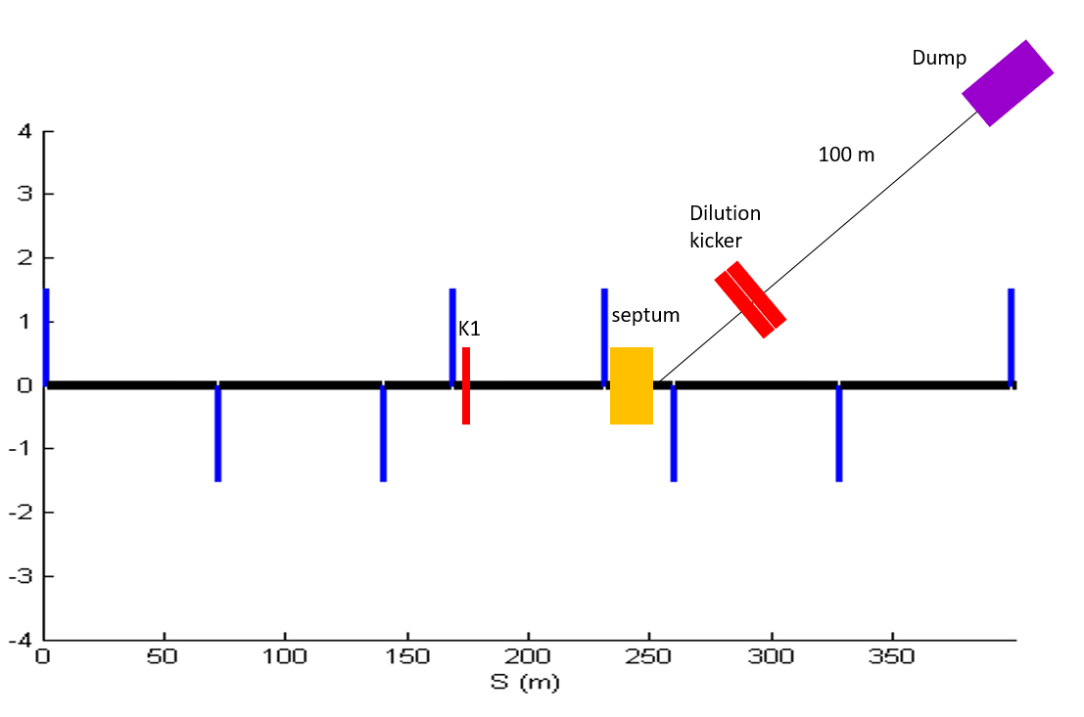
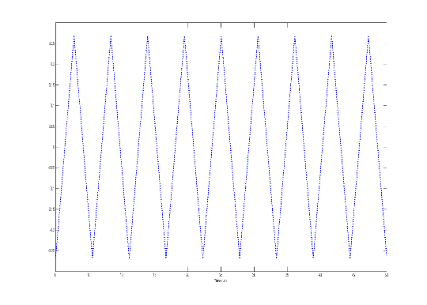
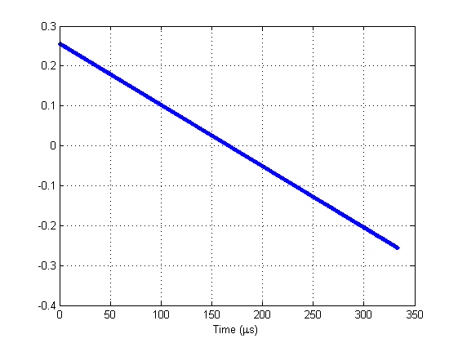
Collider Ring dump
A set of kicker magnets has been used to dilute the beam horizontally and vertically;
The area of bunch distribution on the dump is assumed to be 25cm x 25cm; The maximum temperature rise in the dump core can be obtained. The dimensions of dump haven’t been optimized yet.
The length of transfer tunnel is about 100m; the diameter is about 2m, considering the vacuum equipment, pipe installation.
Dilution kicker requirement:
Horizontal kicker should periodic oscillate 50 times in 300 us
Vertical kicker should reduce from max value to minimum in 300 us
From Xiaohao Cui

Slide 5
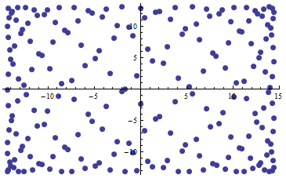
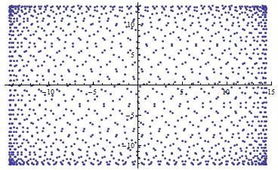
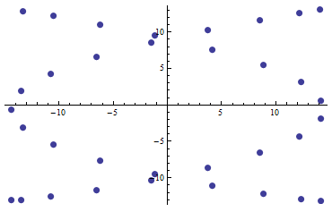
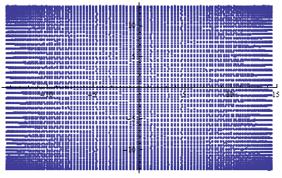
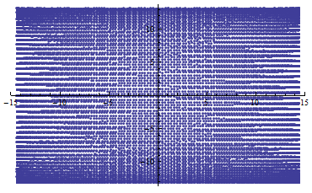

Bunch distribution
The bunch distributions on the dump surface for 5 operation models is simulated.
  Bunch size: $σ_{x}>600μm;σ_{y}>30μm;$
From Xiaohao Cui
Focus on 4 sub regions because the bunches in these regions are smaller and more concentrated than any others.
Find the maximum energy deposition. Optimize dimensions
Import to ANASYS to analyze the deformation. (going on)
Higgs
WW
ttbar
Z pole with 12k bunches
Z pole with 15k bunches

Slide 6
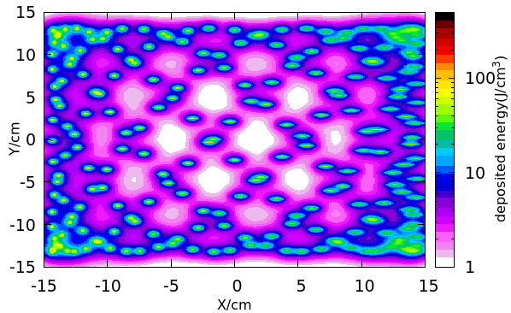
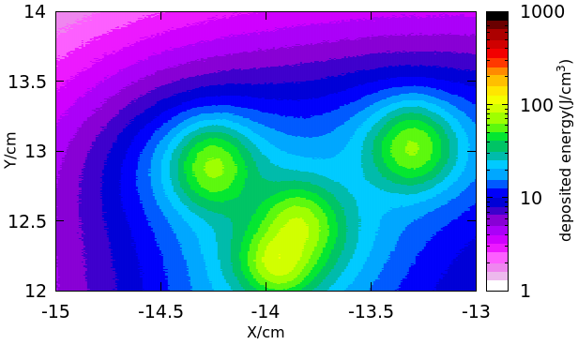
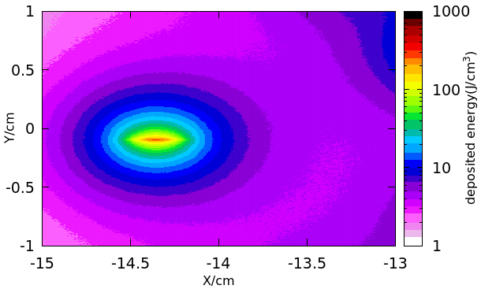
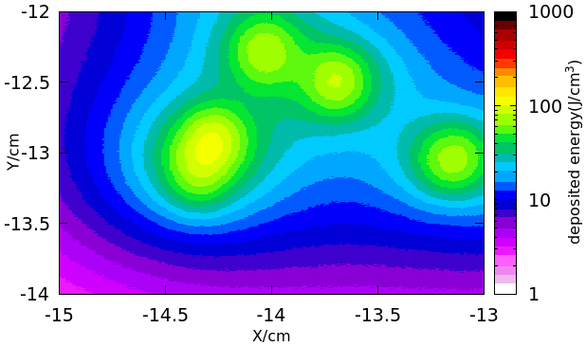
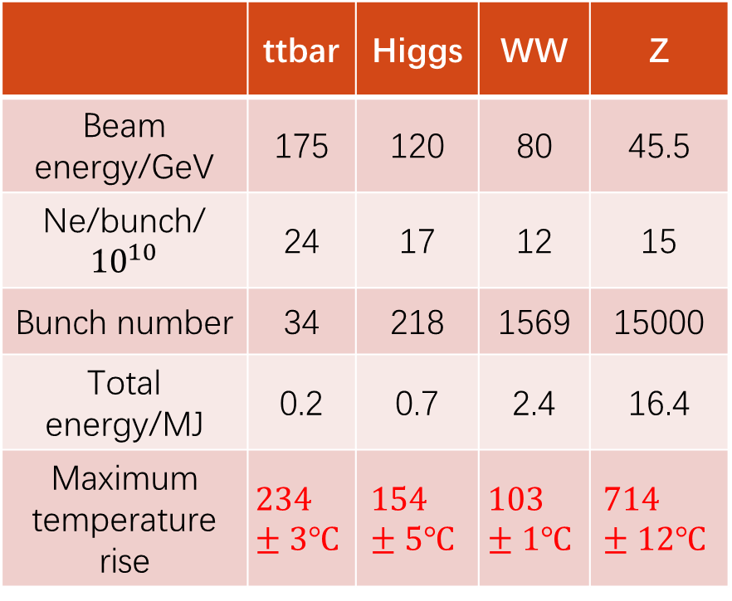
Max. temperature rise
Example: aluminum core
Max. temperature rise @Z mode can decrease by increasing the bunch distance on the dump surface.
Energy deposition @Higgs mode
 | ttbar | Higgs | WW | Z
Beam energy/GeV | 175 | 120 | 80 | 45.5
Ne/bunch/${10}^{10}$ | 24 | 17 | 12 | 15
Bunch number | 34 | 218 | 1569 | 15000
Total energy/MJ | 0.2 | 0.7 | 2.4 | 16.4
Maximum temperature rise | $$234±3℃$$ | $$154±5℃$$ | $$103±1℃$$ | $$714±12℃$$

Slide 7
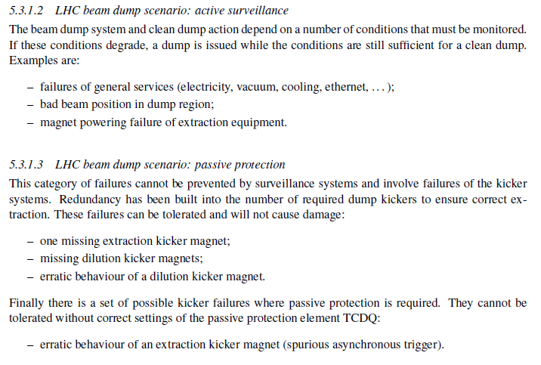
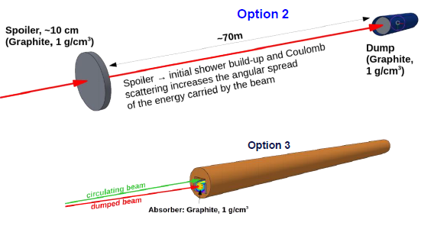
More
  Fast beam loss
External dumps with dilution systems can
be built around 4 straight sections.
Number of dumps depends on machine
requirement and reliability.
Active/passive protection is needed.
Some safety issues can be found in Haijing’s talk.
More are in our schedule.
  Passive/internal dump
  ……
Straight sections
V. Kain, Beam Transfer and Machine Protection
Alexander Krainer, talk in FCC week 2021.

Slide 8
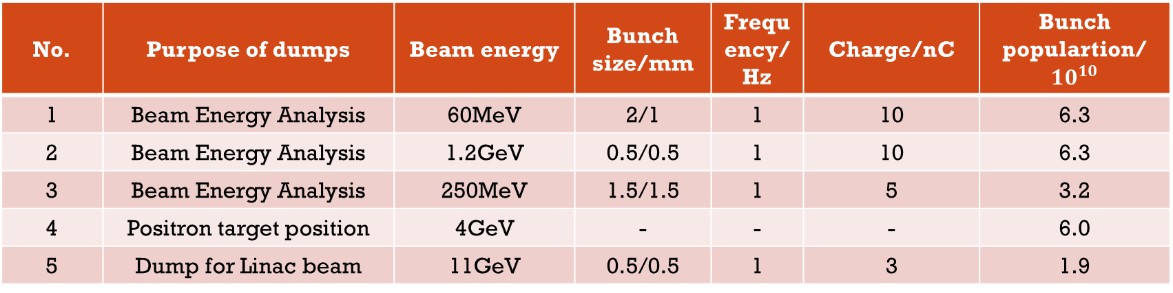
Radiation hot spots inside Linac
Radiation hot spots, such as beam energy analysis stations, collimators, positron targets, dumps, should be shielded in order to protect equipment and people and minimize the thickness of the wall of Linac tunnel.
  Two kinds of prompt radiation inside Linac tunnel: radiation from hot spots and from beam loss
  Many hot spots inside Linac are used for beam energy analysis in different locations.
For 20GeV linac, there are more hot spots and will be updated soon.
No. | Purpose of dumps | Beam energy | Bunch size/mm | Frequency/Hz | Charge/nC | Bunch populartion/$10^{10}$
1 | Beam Energy Analysis | 60MeV | 2/1 | 1 | 10 | 6.3
2 | Beam Energy Analysis | 1.2GeV | 0.5/0.5 | 1 | 10 | 6.3
3 | Beam Energy Analysis | 250MeV | 1.5/1.5 | 1 | 5 | 3.2
4 | Positron target position | 4GeV | - | - | - | 6.0
5 | Dump for Linac beam | 11GeV | 0.5/0.5 | 1 | 3 | 1.9

Slide 9
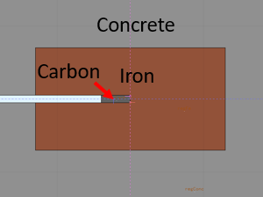
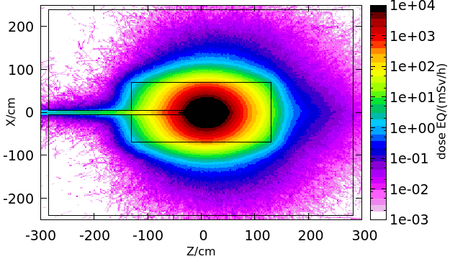
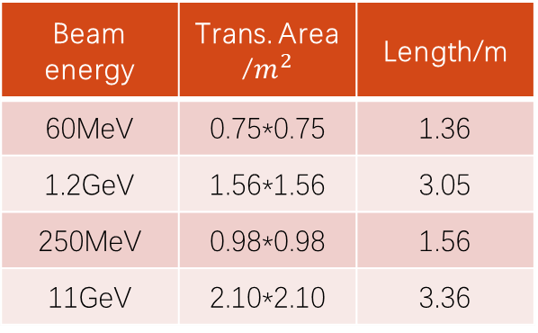
Local shield design for hot spots
Carbon and iron is selected as the absorber material, surrounded by the concrete as local shielding.
5.5mSv/h dose-eq is set as upper limit to decide the thickness of local shielding .
The thickness of shielding will be optimized so that the dose-eq out of dumps is on the order of dose-eq by beam loss in linac tunnel.
Beam energy | Trans. Area /$m^{2}$ | Length/m
60MeV | 0.75*0.75 | 1.36
1.2GeV | 1.56*1.56 | 3.05
250MeV | 0.98*0.98 | 1.56
11GeV | 2.10*2.10 | 3.36
Absorber geometry and local shielding:
Size for carbon and iron for different beam energy, adopt from other projects, is suitable but haven't been optimized.
Local size selection (11GeV dump as example):
2D map of dose distribution was simulated by FLUKA, the dose rate alone Z or X axis was averaged by 10*10cm^2 area, the shielding size can be selected by the setting dose rate limit.
Preliminary design results for different beam energy analysis station:
Radiation level nearby each energy analysis station was figured out, also specify a roughly space for the future local shielding.

Slide 10
outline
Introduction
Dump system
  Collider ring dump
  Linac dump
Safety issues
  SR shielding
  Dose distribution
Summary and outlook

Slide 11
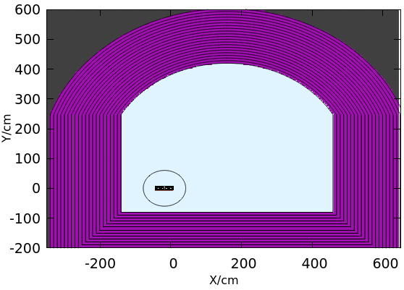
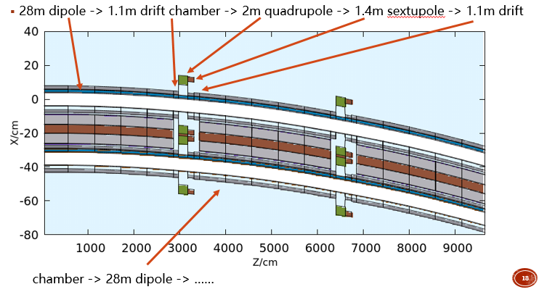
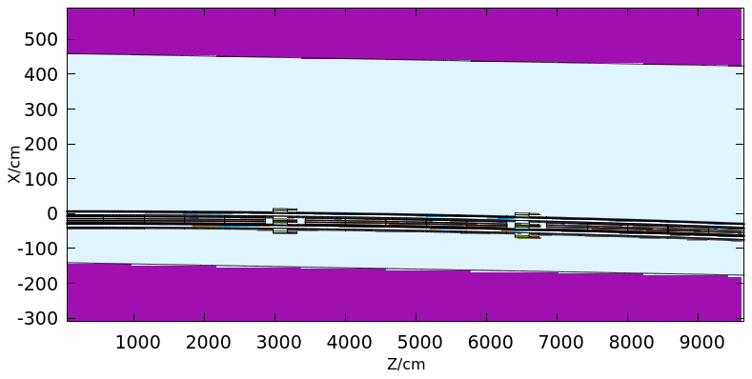
Simulation setup
Tunnel geometry
Length: 100m;
  3 dipoles;
  2 quadrupoles;
  2 sextupoles;
  Soil as wall;

Slide 12
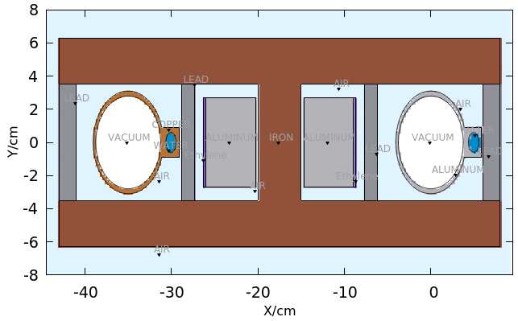
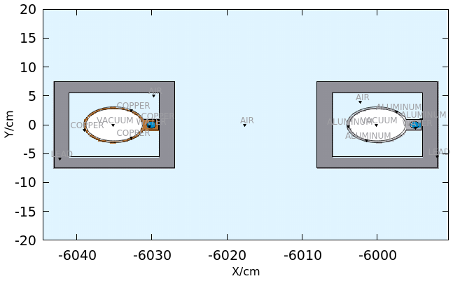


Simulation setup
Dipole
insulator, coils, lead
Insulator is added in the model.
In cross-section, area of lead: $56cm^{2}$
Drift chamber
area of lead: $216cm^{2}$

Slide 13
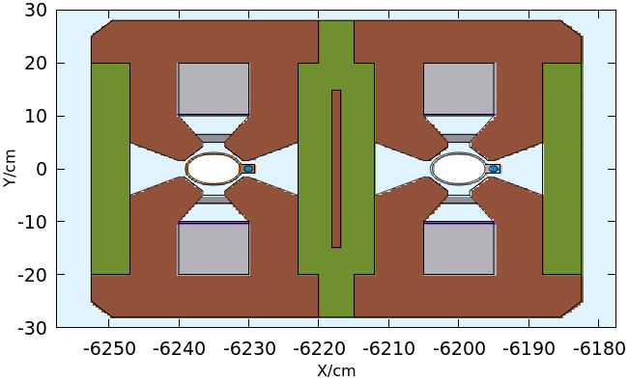
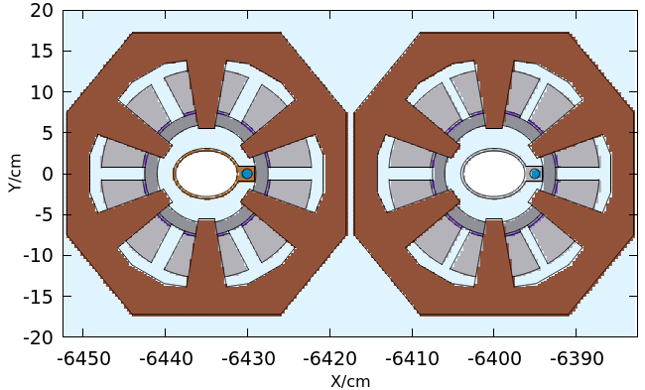
Simulation setup
Quadrupole
insulator, coils, lead
Insulator is added in the model.
area of lead : $48cm^{2}$
Sextupole
area of lead : $100cm^{2}$

Slide 14
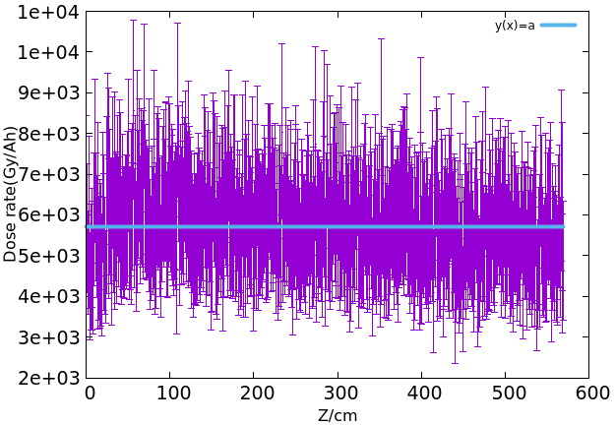
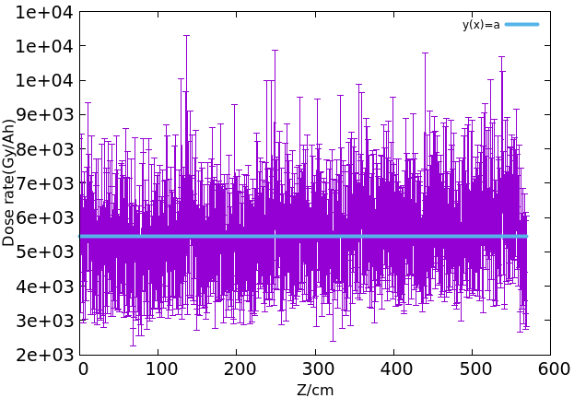
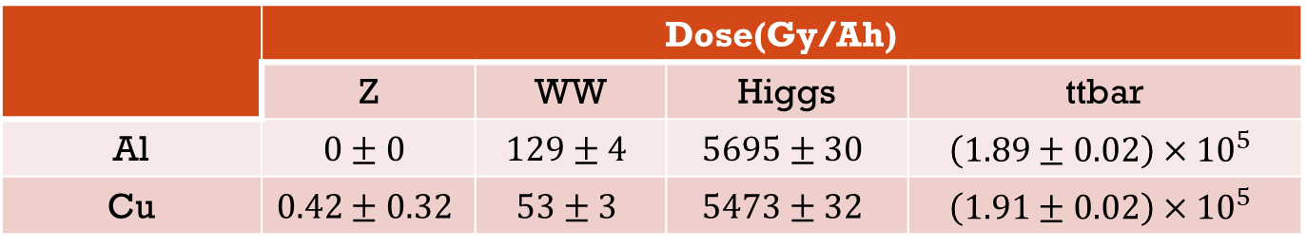
Dose around insulators (2cm lead)
For dipole:
Fit dose distribution to get values in above table, example @120GeV
 | Dose(Gy/Ah)
 | Z | WW | Higgs | ttbar
Al | $$0±0$$ | $$129±4$$ | $$5695±30$$ | $$\left(1.89±0.02\right)×{10}^{5}$$
Cu | $$0.42±0.32$$ | $$53±3$$ | $$5473±32$$ | $$\left(1.91±0.02\right)×{10}^{5}$$

Slide 15
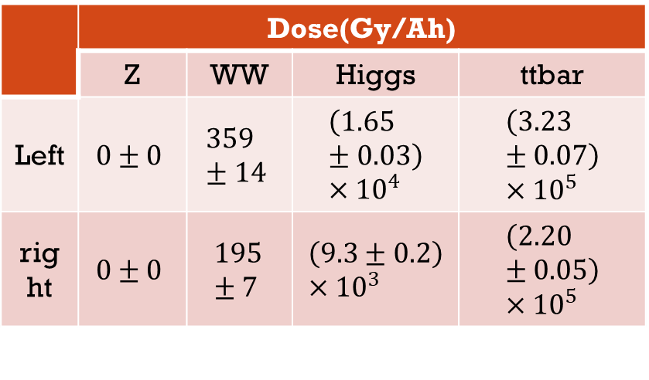
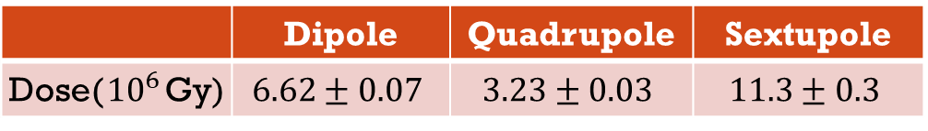
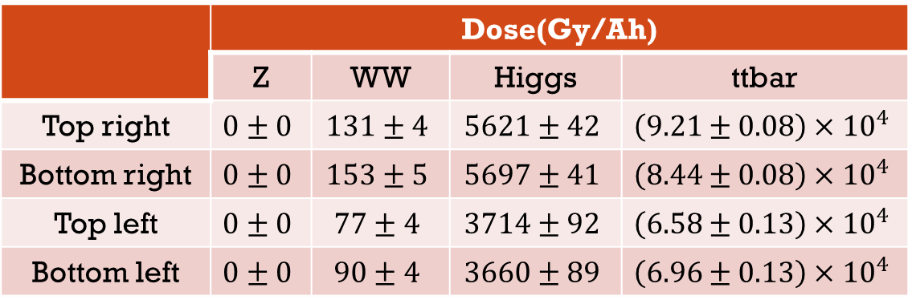
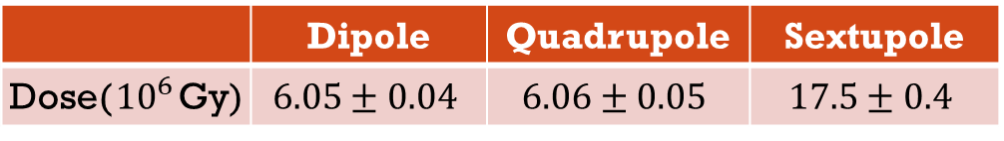
Dose around insulators (2cm lead)
Quadrupole:
Running schedule
Dose:
  10y H/Z/WW
  One year
  running ttbar
Sextupole
 | Dose(Gy/Ah)
 | Z | WW | Higgs | ttbar
Top right | $$0±0$$ | $$131±4$$ | $$5621±42$$ | $$\left(9.21±0.08\right)×{10}^{4}$$
Bottom right | $$0±0$$ | $$153±5$$ | $$5697±41$$ | $$\left(8.44±0.08\right)×{10}^{4}$$
Top left | $$0±0$$ | $$77±4$$ | $$3714±92$$ | $$\left(6.58±0.13\right)×{10}^{4}$$
Bottom left | $$0±0$$ | $$90±4$$ | $$3660±89$$ | $$\left(6.96±0.13\right)×{10}^{4}$$
 | Dose(Gy/Ah)
 | Z | WW | Higgs | ttbar
Left | $$0±0$$ | $$359±14$$ | $$\left(1.65±0.03\right)×{10}^{4}$$ | $$\left(3.23±0.07\right)×{10}^{5}$$
right | $$0±0$$ | $$195±7$$ | $$\left(9.3±0.2\right)×{10}^{3}$$ | $$\left(2.20±0.05\right)×{10}^{5}$$
 | Higgs | Z | WW
Running time (yr) | 7 | 2 | 1
 | Dipole | Quadrupole | Sextupole
Dose(${10}^{6}$Gy) | $$6.05±0.04$$ | $$6.06±0.05$$ | $$17.5±0.4$$
 | Dipole | Quadrupole | Sextupole
Dose(${10}^{6}$Gy) | $$6.62±0.07$$ | $$3.23±0.03$$ | $$11.3±0.3$$

Slide 16
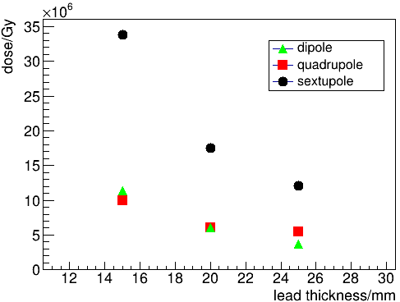
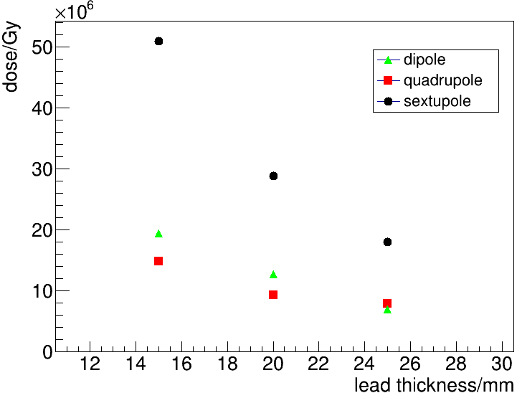
Dose vs lead thickness
While running Higgs/Z/WW (10 years),
  possible to reduce usage of lead for
  dipole and quadrupole;
  but not for sextupole;
Lead shielding works well. Will update while magnet design is updated.
While running 10+1 year,
  close to upper limit for dipole and quadrupole;
  Exceed upper limit for sextupole.

Slide 17
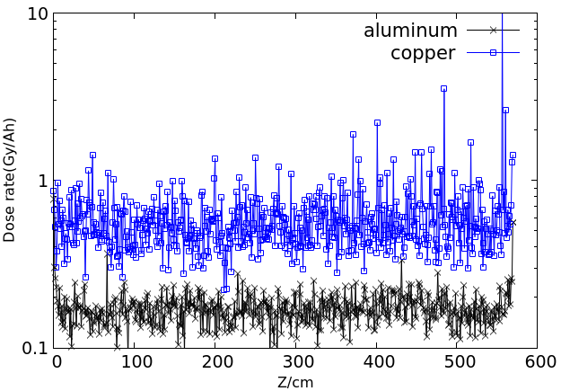
dose Around coils
In the arc section of the ring, the most important two radiation sources are from synchrotron radiation and random beam loss.
Around coils, dose caused by SR is more serious than by beam loss.
Prompt radiation dose caused by random beam loss
Prompt radiation dose caused by synchrotron radiation

Slide 18
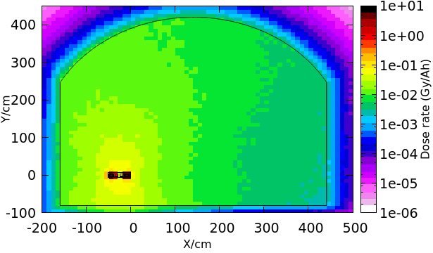
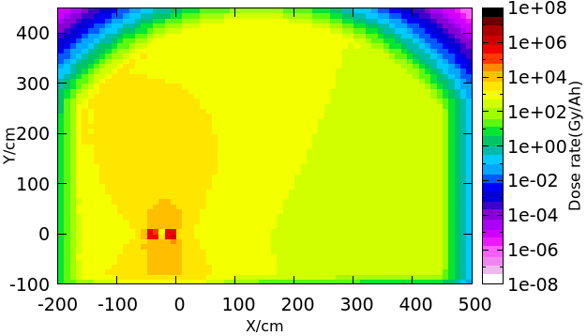
dose in the tunnel
In the arc section of the ring, the most important two radiation sources are from synchrotron radiation and random beam loss.
Radiation caused by synchrotron is more serious than another one
Secondary radiation components from random beam loss is harder and more liable to produce radioactivity in the material surrounded, Should be assessed.
Prompt radiation dose caused by random beam loss
Prompt radiation dose caused by synchrotron radiation

Slide 19
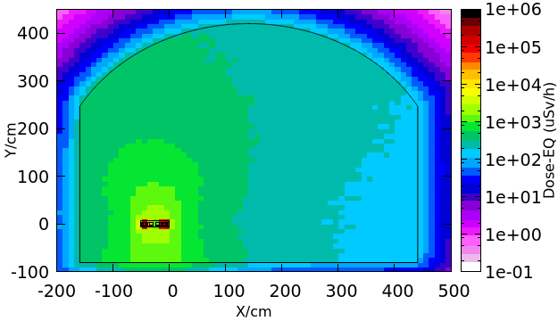
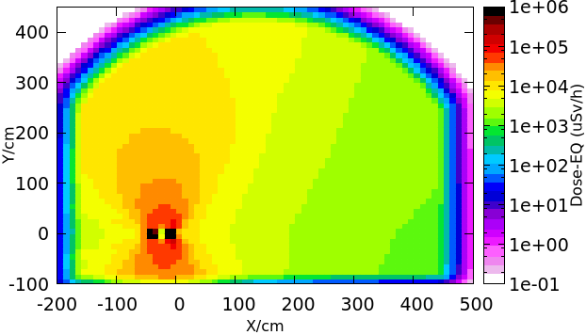
Dose-EQuivalent in the tunnel
In the arc section of the ring, the most important two radiation sources are from synchrotron radiation and random beam loss.
Radiation caused by synchrotron is more serious than another one
Secondary radiation components from random beam loss is harder and more liable to produce radioactivity in the material surrounded, Should be assessed.
Prompt radiation dose-eq caused by random beam loss
Prompt radiation dose-eq caused by synchrotron radiation

Slide 20
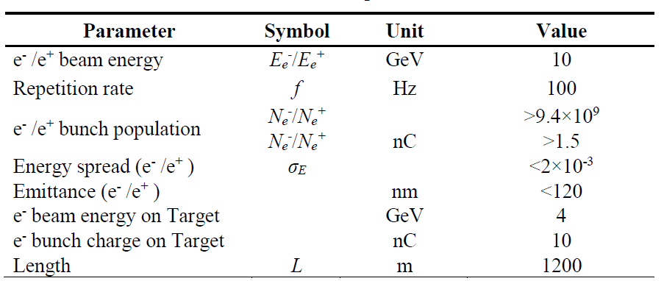
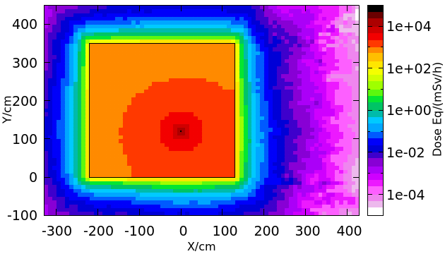
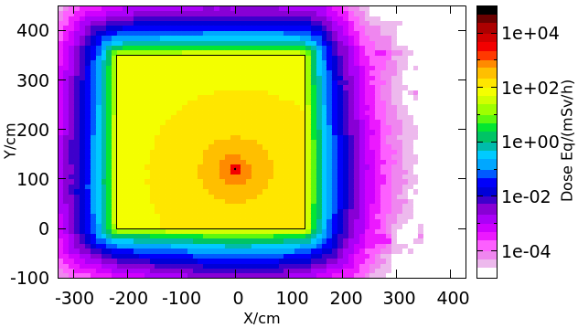
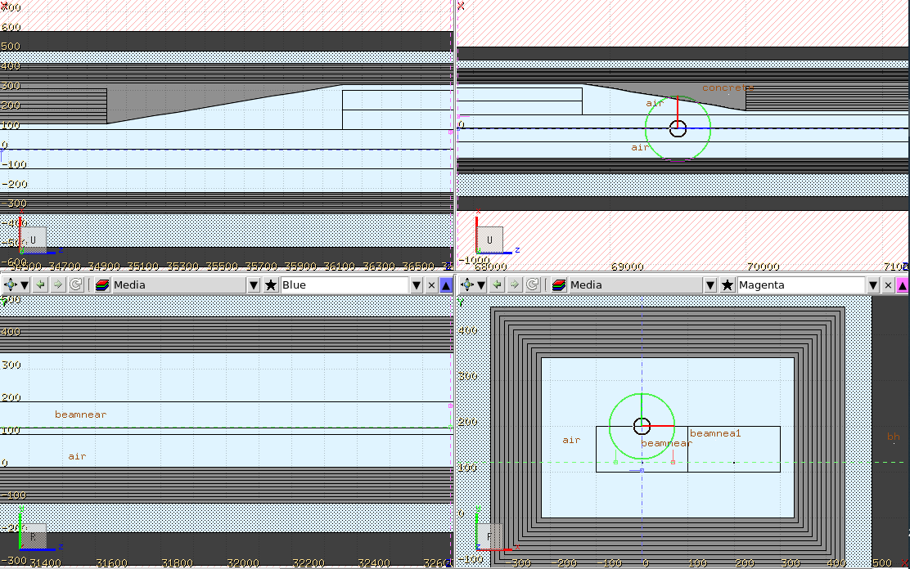
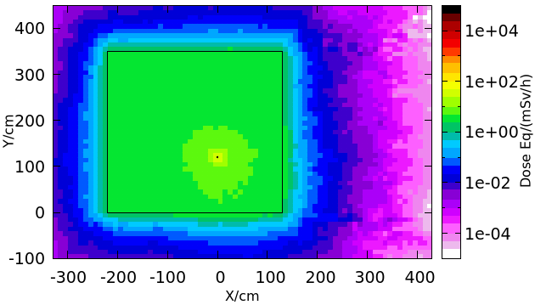
Dose-eq in Linac tunnel
Dose-eq inside Linac tunnel is important to determine the local shielding thickness.
Assume that leptons will be lost alone the beam-pipe. About 10% leptons with energy 10GeV is lost alone the beamline.
Dose-eq: total, gamma, neutron
Linac parameters
Linac simulation setup

Slide 21
Summary & outlook
Preliminary dump designs for ring and linac are done. Optimizations are going on.
SR shielding for collider ring has been checked. SR shielding for booster will be finished soon.
Dose distribution for collider and linac is obtained based on CDR paras. As linac design is updated, we will update soon.
Careful assessment of activation is needed.
2021/12
2022/04
2022/06
SR shielding for booster
Dump sizes optimization
Thank you
Assessment of activation

Slide 22
backup

Slide 23
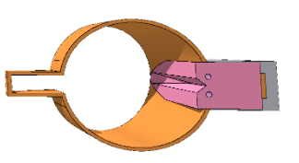
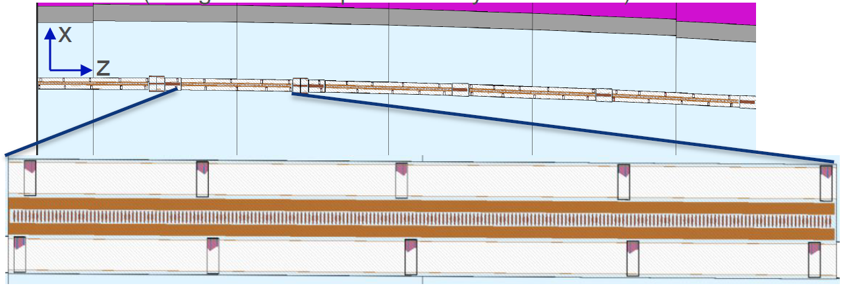

vacuum chamber: FCC-ee, two schemes
Absorbers (ABS)
Continuous shielding
CuCrZr alloy
Length: 30cm
5-6m distance
Angled surfaces for even power
Water cooled
25 ABS in each beam (MBs, MQs)
    (Design and initial placement by R. Kersevan)
Barbara Humann, FCC week 2021 talk
Equivalent to LEP layout
Continuous shielding around VC in MBs
  Due to space restrictions from yoke and coils respectively, no shielding in MQs and MSs.
Intermet180 (Tungsten alloy)
Shielding thickness:
  Top/bottom: 1cm
  Sides: 1.3cm

Slide 24
deposited Energy
The energy deposited in air and wall is less than 5%.
Energy deposited in dipole and beam-pipe is quite large.
2cm-lead shielding
 | Z | WW | Higgs | ttbar
Beam pipe (Al) | 50.0% | 45.9% | 38.5% | 36.0%
Beam pipe (Cu) | 46.7% | 27.4% | 23.0% | 26.8%
Lead | 1.1% | 9.6% | 14.9% | 14.5%
Iron of dipole | 1.9% | 14.5% | 18.7% | 16.4%
Iron of quadrupole | 0.1% | 0.9% | 1.4% | 1.4%
Iron of sextupole | 0.1% | 0.6% | 0.9% | 0.8%
Air | 0.0005% | 0.01% | 0.03% | 0.04%
Wall | 0.0004% | 0.03% | 1.8% | 3.1%

Slide 25

CEPC parameters
 | Higgs | WW | Z | Z (high lum.) | ttbar
Beam energy (GeV) | 120 | 80 | 45.5 |  | 182.5
SR loss/turn (GeV) | 1.73 | 0.34 | 0.036 |  | 9.15
Particles/bunch (${10}^{10}$) | 15 | 12 | 8 | 15 | 20
Bunch number | 242 | 1524 | 12000 | 15000 | 35
Beam current (mA) | 17.4 | 87.9 | 461.0 | 1081.4 | 3.36
SR power/beam (MW) | 30 | 30 | 16.5 | 38 | 30
Bending radius (km) | 10.72
Critical energy(keV) | 358 | 106 | 19 |  | 1258
Ave. energy/photon (keV) | 110.1 | 32.6 | 6.0 |  | 387.3
Photons/57.2m dipole | $$1.44×{10}^{18}$$ | $$4.83×{10}^{18}$$ | $$1.44×{10}^{19}$$ | $$3.38×{10}^{19}$$ | $$4.2×{10}^{17}$$

Slide 26




Hot points (2cm lead)
Quadrupole XY plane
Quadrupole : YZ plane
Dose hot points caused by particles bypassing
lead shielding.
2D dose distribution on the surface of insulator

Slide 27




Hot points (2cm lead)
Sextupole XY plane
Sextupole : YZ plane
Dose hot points caused by particles bypassing
lead shielding.
2D dose distribution on the surface of insulator

Slide 28


Dose around insulators
Lead thickness: 1.5cm
Dipole:
Quadrupole:
 | Dose(Gy/Ah)
 | Z | WW | Higgs | ttbar
Al | $$0±0$$ | $$257±4$$ | $$10673±46$$ | $$\left(2.23±0.01\right)×{10}^{5}$$
Cu | $$0.42±0.32$$ | $$201±4$$ | $$10151±47$$ | $$\left(2.30±0.01\right)×{10}^{5}$$
 | Dose(Gy/Ah)
 | Z | WW | Higgs | ttbar
Top right | $$0±0$$ | $$221±4$$ | $$9367±99$$ | $$\left(1.41±0.02\right)×{10}^{5}$$
Bottom right | $$0±0$$ | $$216±4$$ | $$9249±97$$ | $$\left(1.31±0.02\right)×{10}^{5}$$
Top left | $$0±0$$ | $$121±2$$ | $$6070±58$$ | $$\left(9.94±0.10\right)×{10}^{4}$$
Bottom left | $$0.11±0.04$$ | $$117±2$$ | $$5924±54$$ | $$\left(9.56±0.09\right)×{10}^{4}$$

Slide 29



Dose around insulators
Lead thickness: 1.5cm
Sextupole:
Running
schedule
Dose:
  10y H/Z/WW
  One year
  running ttbar
 | Dose(Gy/Ah)
 | Z | WW | Higgs | ttbar
Left | $$0±0$$ | $$651±17$$ | $$\left(3.19±0.05\right)×{10}^{4}$$ | $$\left(4.93±0.08\right)×{10}^{5}$$
right | $$0±0$$ | $$325±8$$ | $$\left(1.80±0.03\right)×{10}^{4}$$ | $$\left(2.95±0.05\right)×{10}^{5}$$
 | Higgs | Z | WW
Running time (yr) | 7 | 2 | 1
 | Dipole | Quadrupole | Sextupole
Dose(${10}^{6}$Gy) | $$11.33±0.05$$ | $$9.94±0.11$$ | $$33.76±0.6$$
 | Dipole | Quadrupole | Sextupole
Dose(${10}^{6}$Gy) | $$8.06±0.04$$ | $$4.94±0.07$$ | $$17.3±0.3$$

Slide 30


Dose around insulators
Lead thickness: 2.5cm
Dipole:
Quadrupole:
 | Dose(Gy/Ah)
 | Z | WW | Higgs | ttbar
Al | $$0±0$$ | $$12±1$$ | $$3421±23$$ | $$\left(9.26±0.06\right)×{10}^{4}$$
Cu | $$5±2$$ | $$0±0$$ | $$2914±22$$ | $$\left(8.36±0.06\right)×{10}^{4}$$
 | Dose(Gy/Ah)
 | Z | WW | Higgs | ttbar
Top right | $$0±0$$ | $$99±2$$ | $$4806±48$$ | $$\left(6.66±0.08\right)×{10}^{4}$$
Bottom right | $$0±0$$ | $$126±2$$ | $$5166±55$$ | $$\left(6.64±0.08\right)×{10}^{4}$$
Top left | $$0±0$$ | $$50±1$$ | $$2795±27$$ | $$\left(4.48±0.04\right)×{10}^{4}$$
Bottom left | $$0.29±0.07$$ | $$67±1$$ | $$3029±30$$ | $$\left(4.67±0.04\right)×{10}^{4}$$

Slide 31



Dose around insulators
Lead thickness: 2.5cm
Sextupole:
Running
schedule
Dose:
  10y H/Z/WW
  One year
  running ttbar
 | Dose(Gy/Ah)
 | Z | WW | Higgs | ttbar
Left | $$0±0$$ | $$243±9$$ | $$\left(1.13±0.02\right)×{10}^{4}$$ | $$\left(1.69±0.03\right)×{10}^{5}$$
right | $$0±0$$ | $$114±6$$ | $$\left(6.65±0.11\right)×{10}^{3}$$ | $$\left(1.09±0.02\right)×{10}^{5}$$
 | Higgs | Z | WW
Running time (yr) | 7 | 2 | 1
 | Dipole | Quadrupole | Sextupole
Dose(${10}^{6}$Gy) | $$3.62±0.03$$ | $$5.49±0.06$$ | $$12.0±0.2$$
 | Dipole | Quadrupole | Sextupole
Dose(${10}^{6}$Gy) | $$3.24±0.02$$ | $$2.33±0.03$$ | $$5.9±0.1$$

Slide 32

Temperature rise
Simulate only one bunch whose width is minimum
 |  | ttbar | Higgs | WW | Z(2T high lumi.)
Beam energy/GeV |  | 175 | 120 | 80 | 45.5
Ne/(bunch$∙{10}^{10}$) |  | 24 | 17 | 12 | 15
Bunch number |  | 34 | 218 | 1569 | 15000
Total energy/MJ |  | 0.2 | 0.7 | 2.4 | 16.4
Maximum temperature rise | Fluka | $$229±3℃$$ | $$138±4℃$$ | $$103±1℃$$ | $$714±12℃$$
 | One bunch | $$227.7±0.5℃$$ | $$140.8±0.3℃$$ | $$78.5±0.3℃$$ | $$88±29℃$$

