Slide 1
CEPC instrumentation update
Yanfeng Sui
On behalf Beam Instrumentation Team,
Accelerator Center, IHEP

Slide 2
Outline
Update of CEPC beam instrumentation system design
Progress of beam instrumentation R&D
  BPM electronics
  Feed-through
Summary

Slide 3
The beam instrumentation in CEPC Linac
 | Item | Method | Parameter | Amounts
Linac | Beam position | Stripline BPM | Resolution ：30um | 140
 | Beam current | ICT | 2.5%@1nC-10nC | 42
 | Beam profile | YAG/OTR | Resolution: 30um | 80
 | Beam emittance | Q+PR | 10% | 3
 | Beam energy & spread | AM+PR | 0.1% | 3
Damping ring | Average current | DCCT | Resolution :50uA@0.1mA-30mA | 1
 | Beam position | Button BPM | Resolution : 20um @ 5mA TBT | 40
 | Tune measurement | Frequency sweeping | Resolution:0.001 | 1

Slide 4
The beam instrumentation in CEPC booster
 | Item |  | Method | Parameter | Amounts
Booster | Beam position monitor | Turn by turn | Button electrode BPM | Measurement area (x × y)：±20mm×±10mm Resolution：<0.02mm Measurement time of COD：< 4 s | 1808
 |  | Bunch by bunch | Button electrode BPM | Measurement area (x × y)：±40mm×±20mm Resolution：0.1mm
 | Bunch current |  | BCM | Measurement range：10mA / per bunch Relatively precision：1/4095 | 2
 | Average current |  | DCCT | Dynamic measurement range：0.0~1.5A Resolution:50uA@0.6-8mA Linearity：0.1 % Zero drift: <0.05mA | 2
 | Beam size |  | Double slit interferometer x ray pin hole | Resolution:0.2 µm | 2
 | Bunch length |  | Streak camera Two photon intensity interferometer | Resolution:1 ps | 2
 | Tune measurement |  | Frequency sweeping method | Resolution:0.001 | 2
 |  |  | DDD | Resolution:0.001
 | Beam loss monitor |  | optical fiber | Space resolution:0.6m | 400
 | Feedback system |  | TFB | Damping time<=7.5ms | 2
 | Feedback system |  | LFB | Damping time<=50ms | 2

Slide 5
The beam instrumentation in CEPC ring
 | Item |  | Method | Parameter | Amounts
Storage ring | Beam position monitor | Closed orbit | Button electrode BPM | Measurement area (x × y)：±18mm×±18mm Resolution：<0.6um Measurement time of COD：< 4 s | 2900
 |  | Bunch by bunch | Button electrode BPM | Measurement area (x × y)：±18mm×±18mm Resolution：0.1mm
 | Bunch current |  | BCM | Measurement range：10mA / per bunch Relatively precision：1/4095 | 2
 | Average current |  | DCCT | Dynamic measurement range：0.0~1.5A Linearity：0.1 % Zero drift: <0.05mA | 2
 | Beam size |  | Double slit interferometer x ray pin hole | Resolution:0.2 µm | 4
 | Bunch length |  | Streak camera Two photon intensity interferometer | Resolution:1ps@10ps | 2
 | Tune measurement |  | Frequency sweeping method | Resolution:0.001 | 2
 |  |  | DDD | Resolution:0.001
 | Beam loss monitor |  | PIN-diode | Dynamic range:120 dB Maximum counting rates≥10 MHz | 5800
 | Feedback system |  | TFB | Damping time<=47ms | 2
 |  |  | LFB | Damping time<=12ms | 2

Slide 6
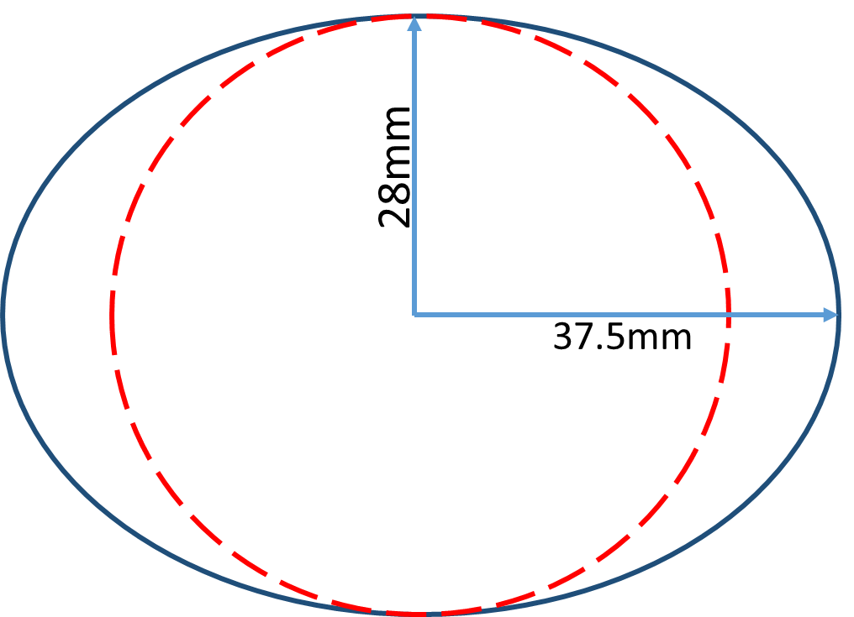
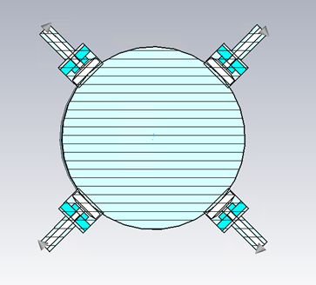
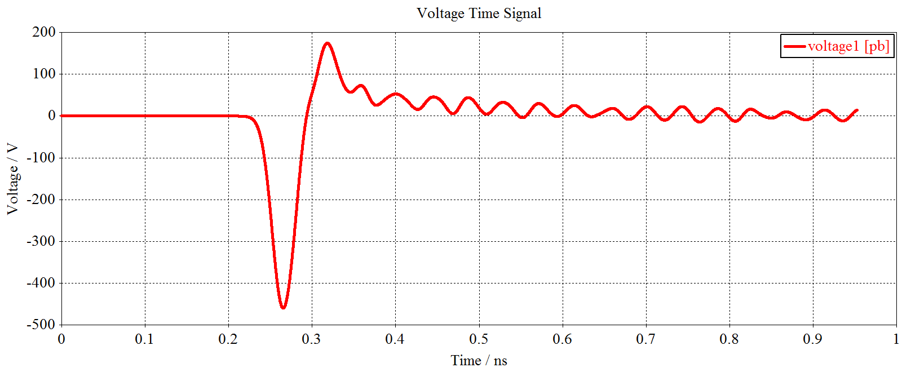
Update of BPM pick-ups
Due to modification of vacuum chamber in storage ring, the BPM pick-ups have been redesigned.
Considering the suggestions of the IARC，the diameter of the button are reduced to 5mm.
 | ttbar |  | Higgs |  | W |  | Z
 | Real | CST | Real | CST | Real | CST | Real | CST
Charge | 20e10 | 32 nC | 14e10 | 22.4 nC | 13.5e10 | 21.6 nC | 14e10 | 22.4 nC
Bunch length | 2.2/2.9 | 3 mm | 2.3/3.9 | 4 mm | 2.5/4.9 | 5 mm | 2.5/8.7 | 8.7 mm
Vpp | 507V |  | 278V |  | 216V |  | 114V
Z_500M | 0.065Ω |  | 0.065Ω |  | 0.065Ω |  | 0.065Ω
P_500M | -17.6dBm/320mA |  | -20.6dBm/224mA |  | -20.9dBm/216mA |  | -20.6dBm/224mA
Kx=Ky | 19.9 mm |  | 19.9mm |  | 19.9mm |  | 19.9mm

Slide 7
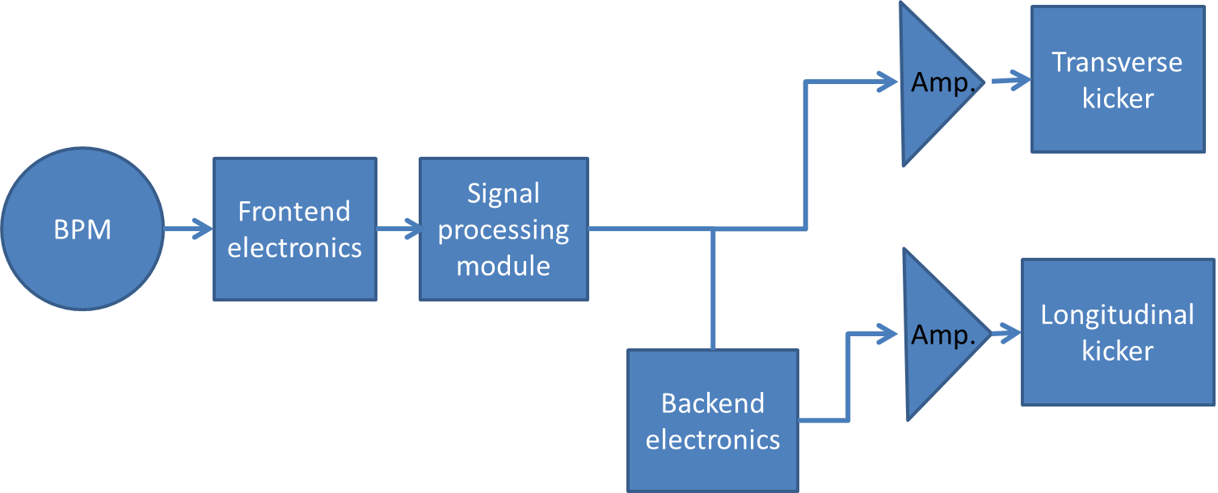
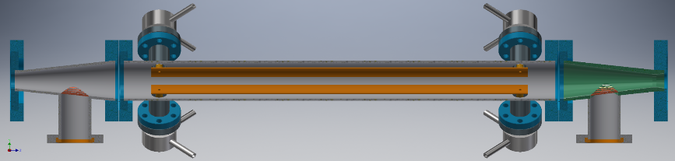
Update of feedback system
One BPM and one kicker scheme are adopted. Several bunch by bunch feedback systems will be used in the same ring.
Much longer kickers are studied to overcome the deformation of the strip line and difficulty in fabricating
As an alternative, several narrow bandwidth high-power amplifiers are studied , such as Vecta Wave, BONN and Amplifier Reasearch.

Slide 8
R&D Motivation
To reduce the budget of BI system, due to a large number of monitors and the high price of commercial products.
To grasp key technologies of beam diagnostics.
To make the whole system easy to maintain and upgrade

Slide 9
Overview of the BPM electronics R&D
The R&D of BPM electronics founded by seed money of IHEP and other funding (HEPS-TF etc.)
Kicked off in the start of 2015
The first version(V1.0) of the electronics was finished in 2018.
The second version(V2.0) was finished in middle of 2019. modification was done to improve the performance of the electronics.
The BPM electronics were installed and operating in BEPCII Linac in 2019
BEPCII SR BPMS are upgrade to home-made electronics in 2020.
8 versions have been tested in the past six years.

Slide 10
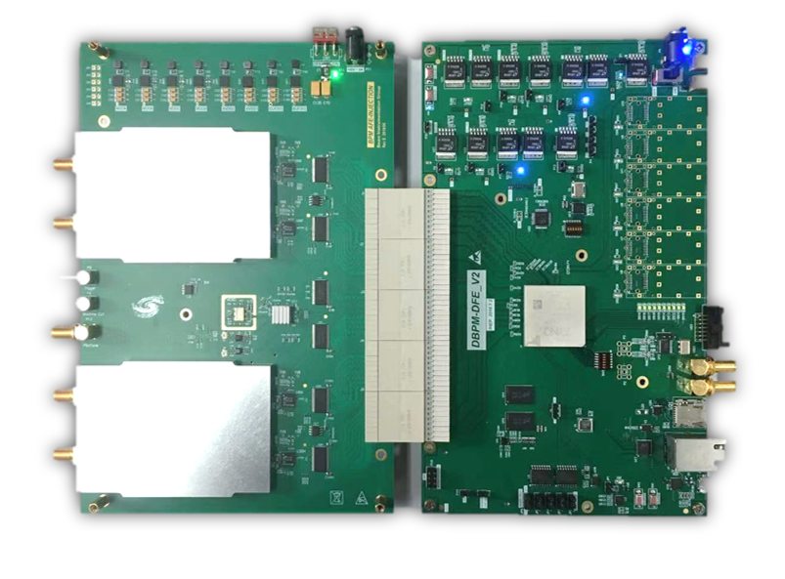
Overview of the BPM Electronics
ADF
ADF
Since of ADF interface is not suitable for RF signal transmission,
so we developed new hardware, ADC&CLK in AFE board.
AFE board：RF Processing+ ADCs + Clock + Pilot tone;
DFE board：FPGA(ZYNQ) + DDR3 memory + SFPs + Ethernets;
EPICS IOC：In ZYNQ FPGA, Increase the convenience of the BPM system;

Slide 11
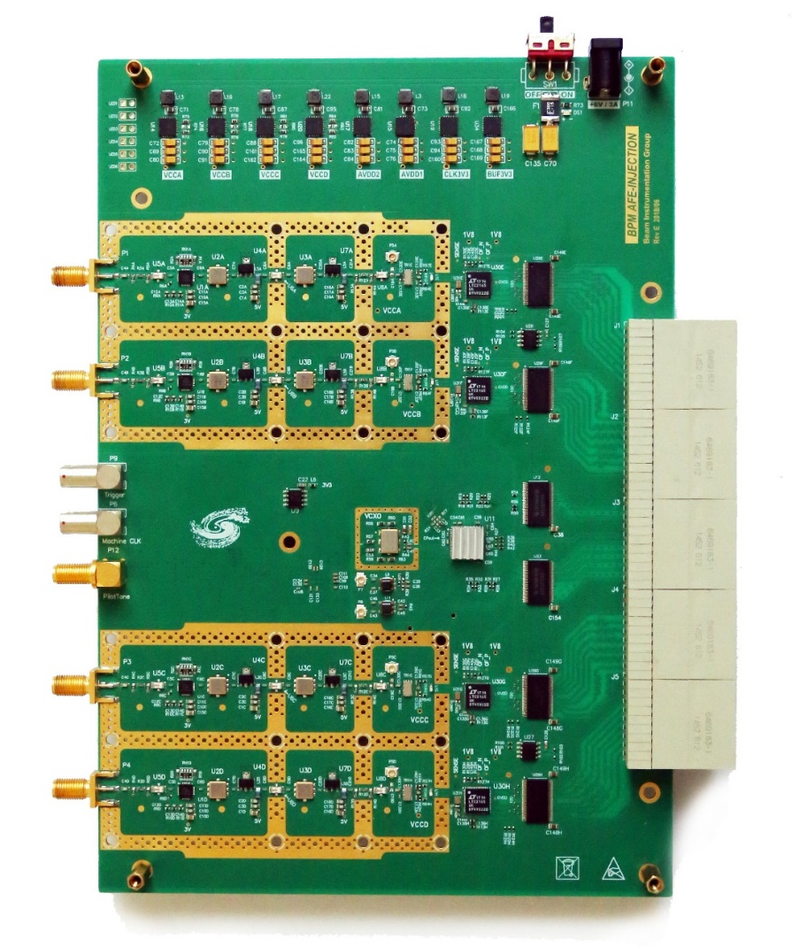
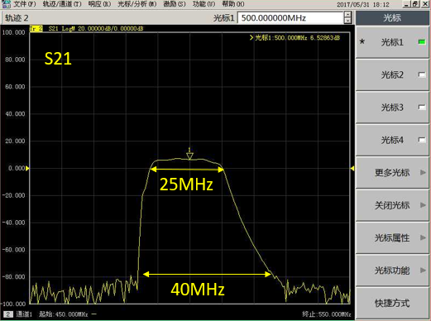
Analog Front End Board (AFE)
Performance Features
P1dB = +18.5dBm (at ADC Input)
IP3 = +39 dBm (at ADC input)
NF =6.0dB (LPF and SAW Filter)
Channel to Channel Isolation > 80dB
Phase difference < 10°
Amplitude difference < 5%
-3dB Bandwidth =25MHz
A
C
Trigger
MC
ADF
Pilot Tone
B
D
RF Circuits
Receiver S-Parameter Characterization

Slide 12
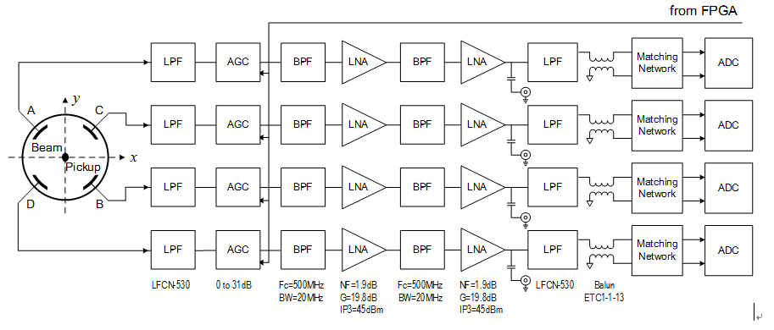
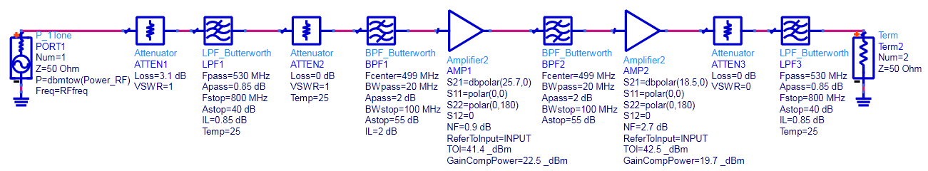


AFE RF Channel Signal Chain Design
RF 499.8MHz signals are extracted by SAW BPF(~30 MHz BW).
RF Amplifiers Gain > 40dB;
Attenuators :0~31.5dB(0.5dB step);
The signal level is adjusted by step attenuators and amplifiers.
Simulate in Advanced Design System
The performance of RF circuits is the key of excellent performance of digital BPM！
Low noise & Impedance matching
Notes:
在实际的测试中发现，microTCA的ADF接口传输射频信号隔离度较差，因此在新一版本中将ADC前置到前端板中，减小射频信号长距离传输引起的不稳定性;
这是新一版本的射频信号调理电路设计框图，射频接收链路的性能指标是数字BPM性能的保证;
因为射频链路的主要作用是功率的传输、放大和滤波等处理，因此阻抗匹配设计是其中最重要的部分;
射频链路主要包括 带通滤波电路、射频放大电路和自动增益调节电路，

Slide 13
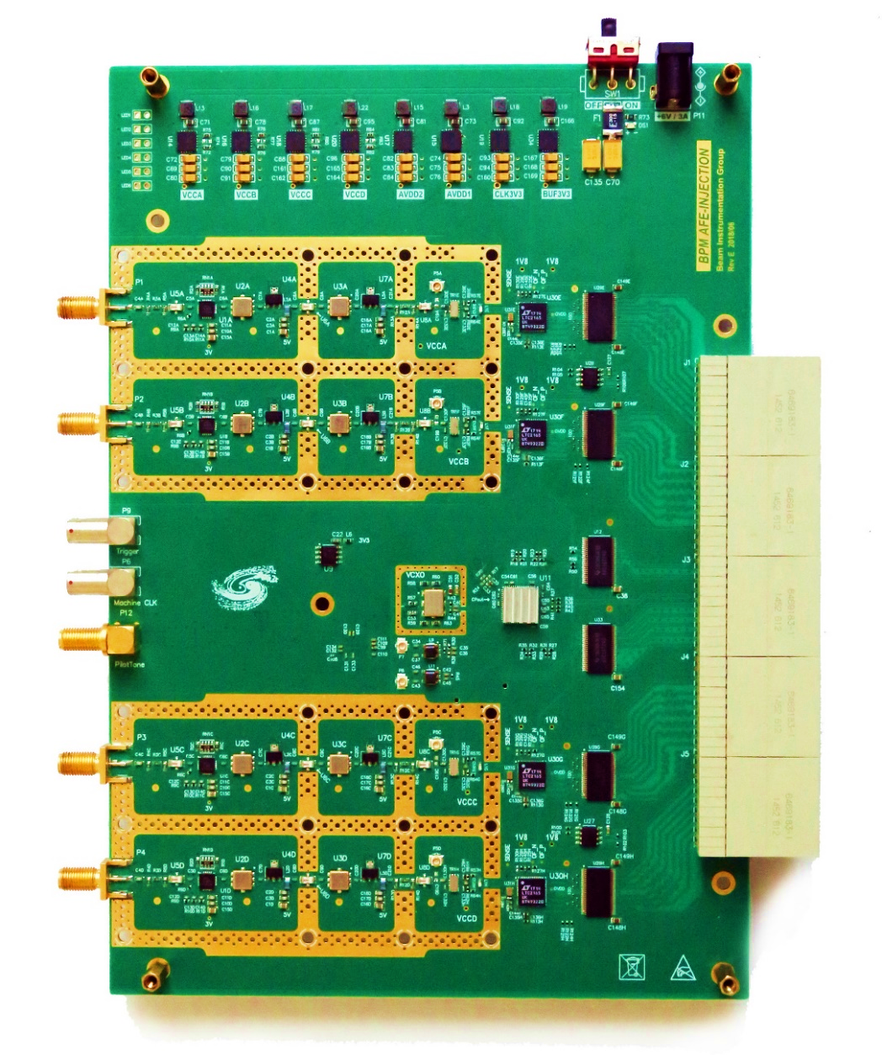
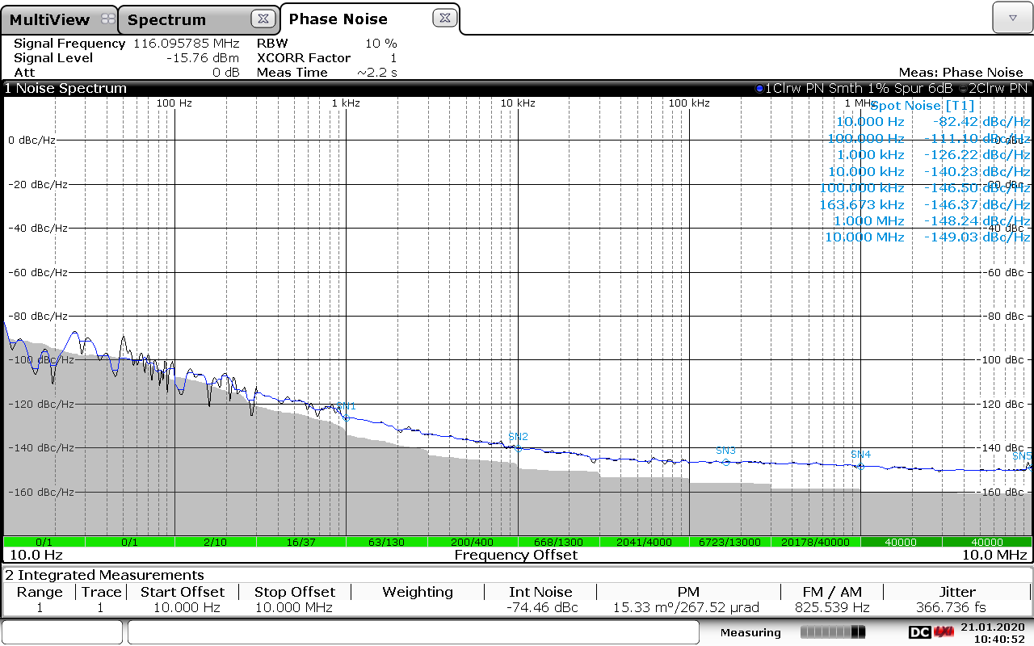
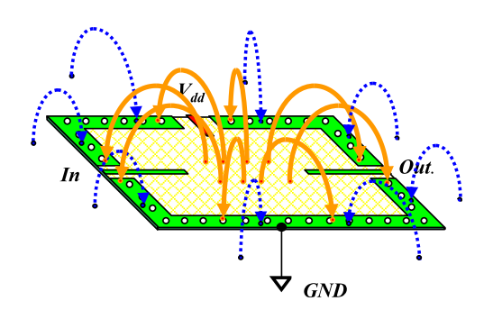
Clock Circuit design and jitter Testing
366.7fs
Hole space: S ≈ 4D to 10D
More than 2 rows Ground Via needed;
Vias on Adjacent rows are interlaced placed;
Less λ /4 Via to Via space in one row.
Clock Power Supply factors cannot be ignored！

Slide 14
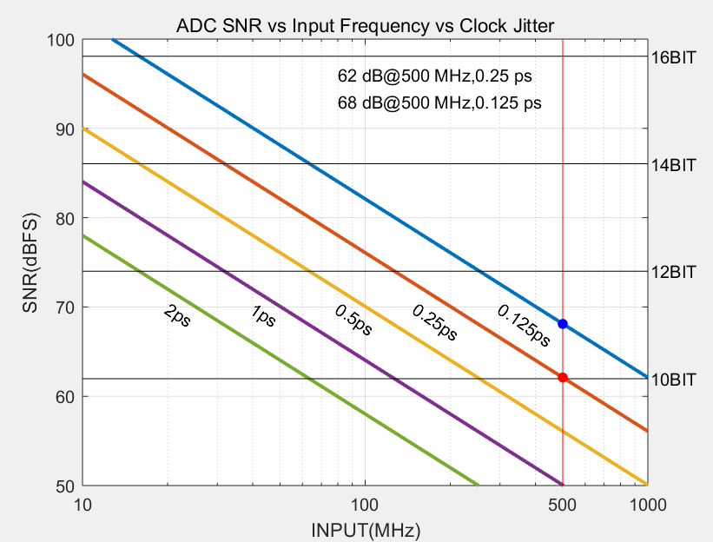
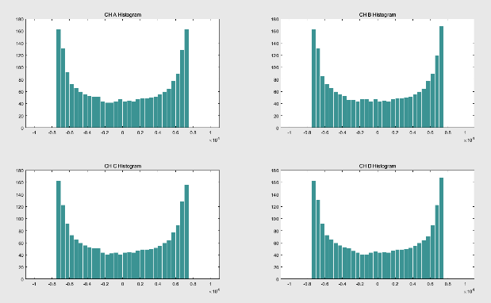
ADC Performance Analysis
ADC SNR vs Input Frequency vs Clock Jitter
A
B
Raw ADC FFT
 | SNR | ENOB | SFDR | SINAD | THD
ADC | 60.3 | 12.2 | 75.5 | 52.2 | -56.1
C
D
ADC test results
ADC histogram
Notes:
如图所示的ADC的FFT结果，最终可以得到SNR=60.3 有效位为10.2 SFDR =75.5 右图所示四路ADC的原始数据直方图;

Slide 15
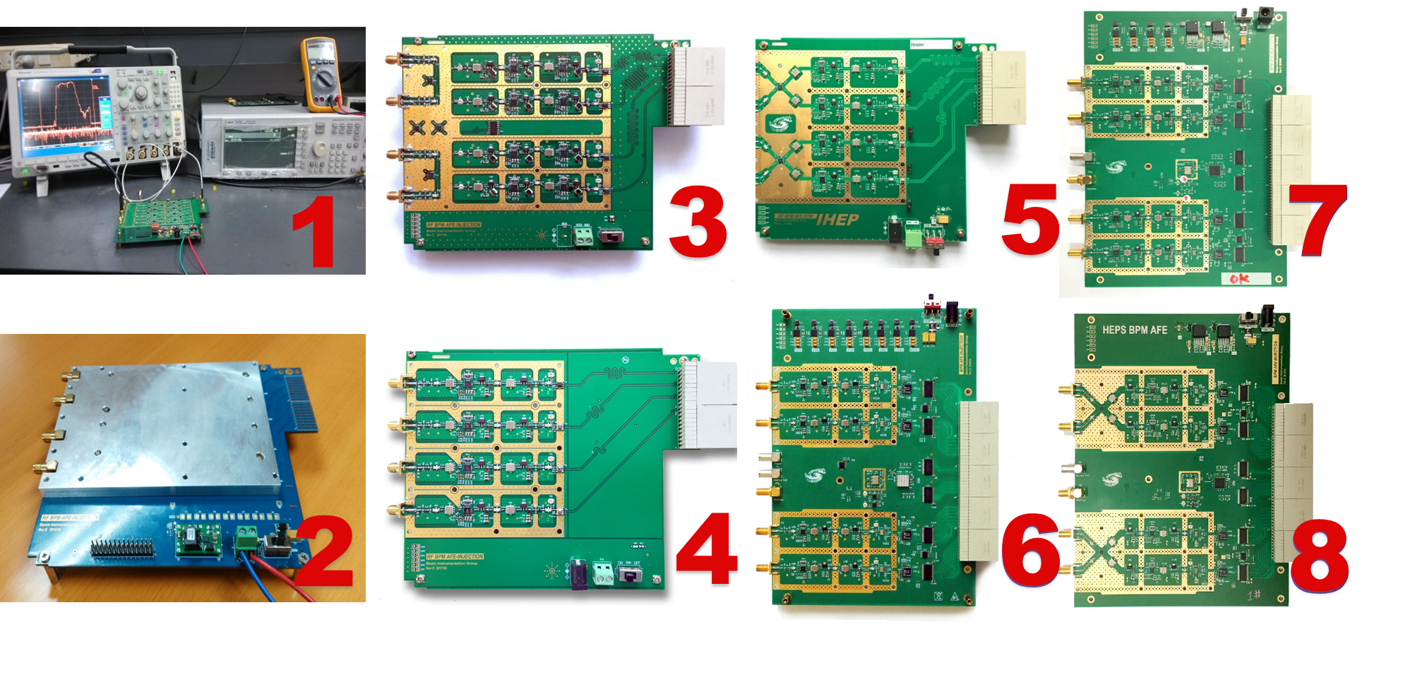
The front-end electronics of BPM
8 versions of AFE electronics have been developed to improve the performance in the past six years.
The front-end electronics cross talk is better than -80dB and the dynamic range is 60dB in the latest version.

Slide 16
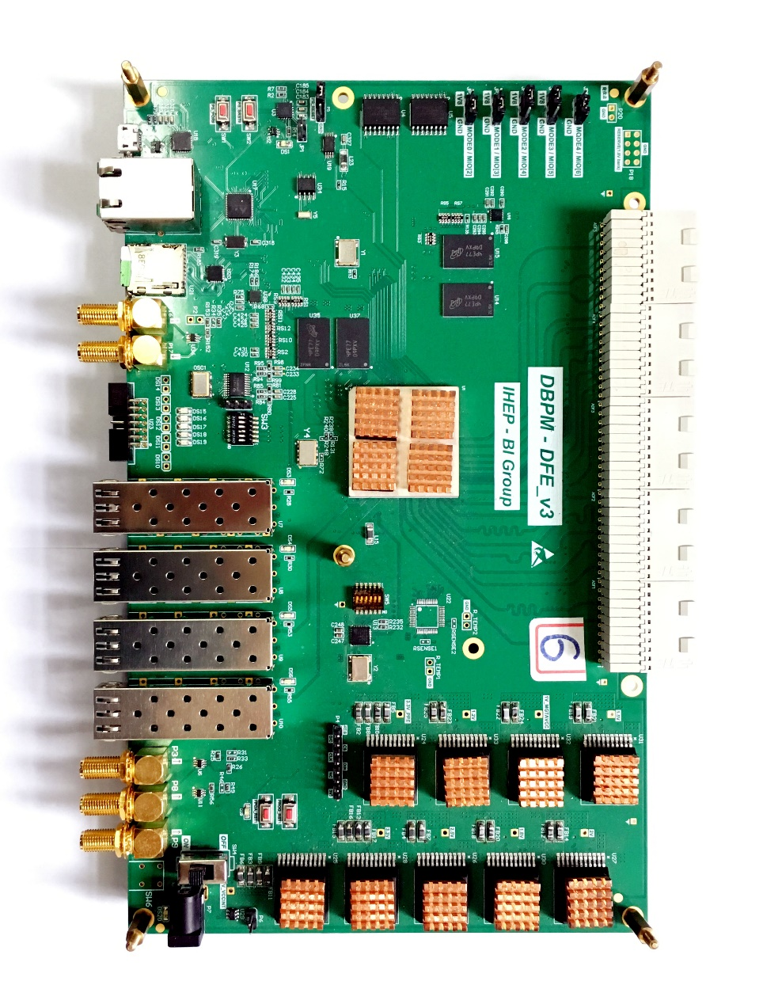
Digital Front End Board (DFE）
Features:
Xilinx ZYNQ FPGA (XZ7100)
  Hard dual-core ARM A9 processor
  Beam signal processing with DDC+CIC+FIR
  Runs standard Debian based Linux Operating System
  Embedded IOC
Boot via 32Gbyte micro SD-Card
Gigabit Ethernet
2Gbyte DDR3 Memory (SO-DIMM Module)
  Four 6.6Gbps SFP modules
  Embedded Event Receiver
32Mbit FLASH memory
2 Gbytes DDR3
ZYNQ 7Z100
RS-232-C
Gigabit Ethernet
SD Card
InterLock IN
InterLock OUT
JTAG
ADF Interface
4 SFP +
Machine Clk
Trigger IN
SYNC
+12V Power Input
Notes:
16

Slide 17
Digital Signal Processing Block
DDS
DDC BPM block
COD BPM block
RAW
ADC
FIR Filter
Bandpass
×
IQ Data
CIC Filter
Decimator
Compensating
FIR Filter
CORDIC
BPM Calc.
TBT Data
LFSR
CIC Filter
Decimator
Compensating
FIR Filter
Programmable
FIR Filter
BPM Calc.
FA Data
CIC Filter
Decimator
Compensating
FIR Filter
Programmable
FIR Filter
BPM Calc.
SA Data
LFSR: Linear Feed-back Shift-Register
FIR filter : Finite Impulse Response filter
CIC filter : Cascaded Integrator-Comb filter
DDS : Direct Digital Synthesis
DDC BPM Block generates IQ data with NCO&ADC
The purpose of band-pass filter is to remove the baseline of ADC;
COD BPM Block generates TbT, FA, and SA (10 Hz) data.
DSP filter = CIC+FIR for LowPass Filter and Decimator;

Slide 18
Data Acquisition Module
SA Data Acquisition function block.
  Data Acquisition control logic
  Write/Read CSV file logic
  EPICS IOC Logic
  Data base logic
  Graphical User Interface
  …
DBPM DFE Module
TCP GbE
Data Acquisition
CSV
*.
txt File
SoftIOC
Archiver Engineering
SA Data
CSS OPI
MySQL database
Measurement Display
Picture Storage

Slide 19
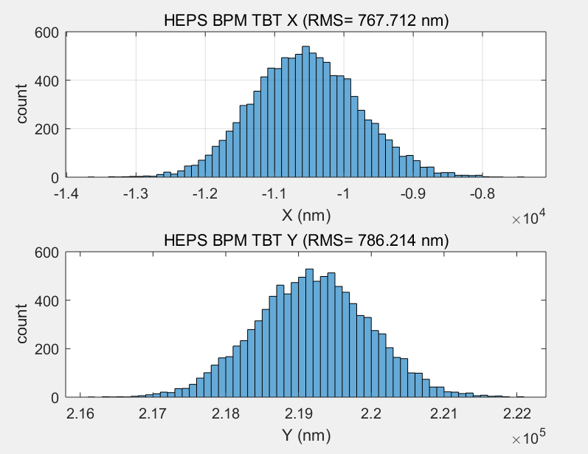
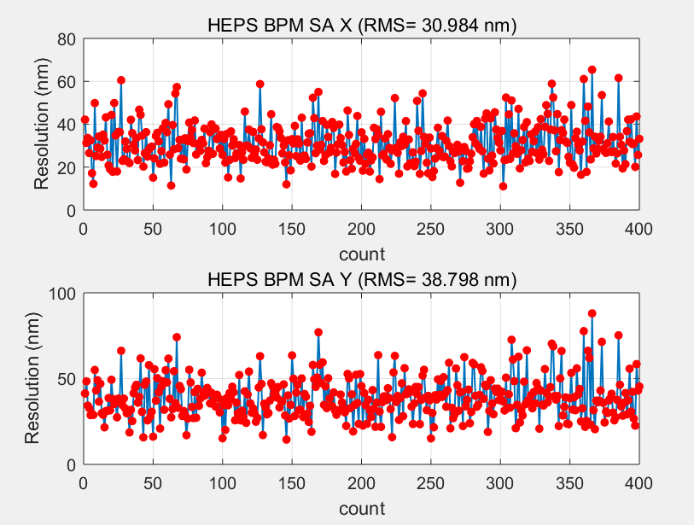
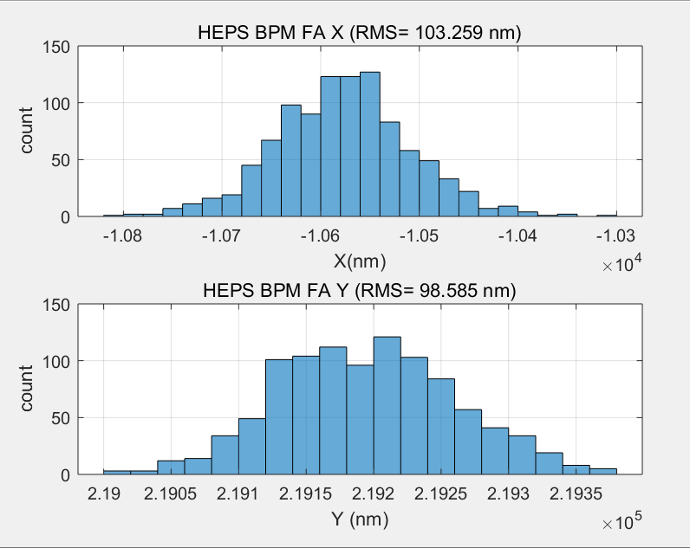
BPM TbT/FA/SA Resolution Test in Lab
TBT RMS (X=767nm,y=786nm)
SA RMS(X=30nm,Y=38nm) 10points STD
We test the performance of DBPM in house
RF frequency is 499.8MHz(-15dBm) from R&S SMA100
TBT data rms xpos ≈767nm, ypos ≈786nm;
FA data rms xpos ≈103nm, ypos ≈98nm;
SA data rms xpos ≈30nm, ypos ≈38nm;
Kx=Ky=8.26mm;
FA RMS (X=103nm,y=98nm)

Slide 20
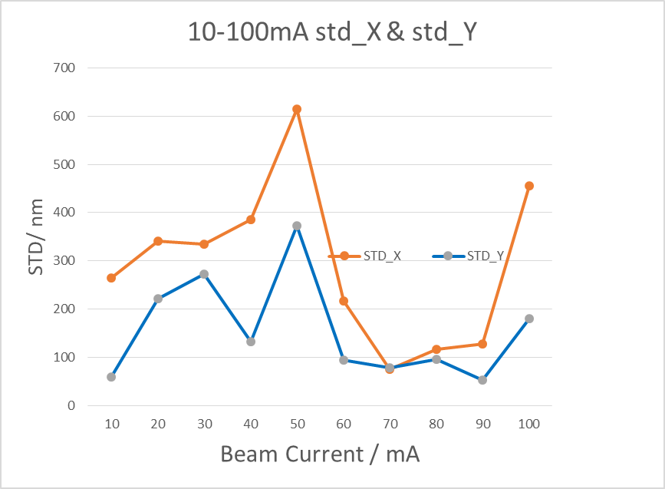
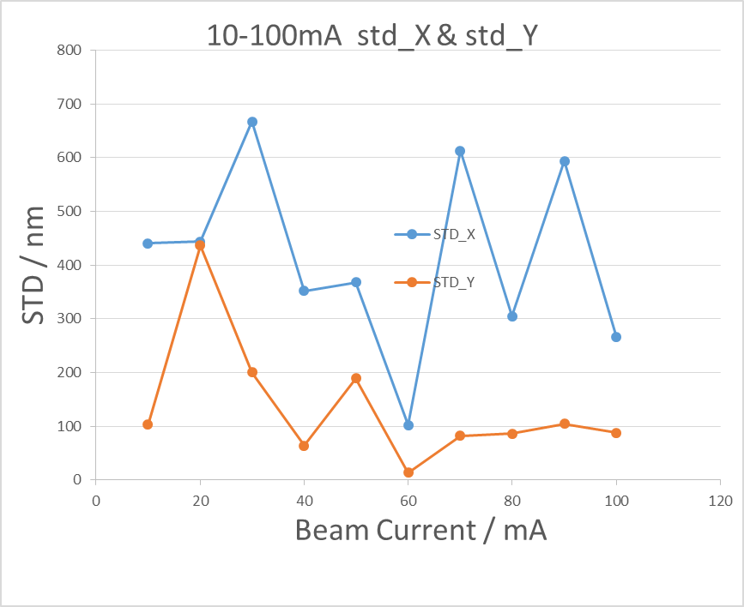
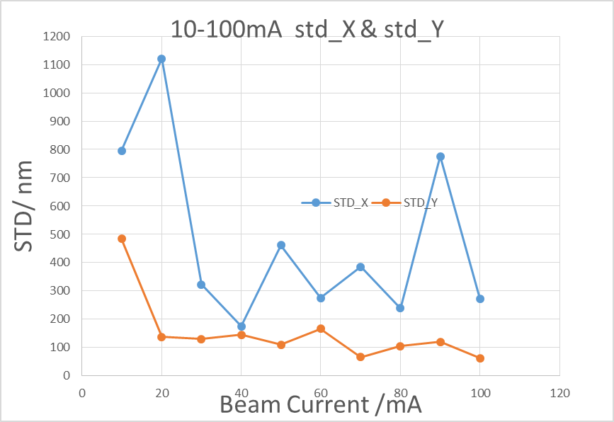
Beam test in BEPCII
Resolution of BPM electronics （110 bunches, 1/3）
BPM3
BPM4
BPM5
BPM electronics NO. | Beam current（10-20mA） |  | Beam current（20-818mA）
 | ΔX(um) | ΔY(um) | ΔX(um) | ΔY(um)
Commercial product | - | - | 6 | 7
BPM1 | - | - | 10 | 17
BPM3 | 22 | 11 | 29 | 11
BPM4 | 71 | 61 | 11 | 36
BPM5 | 5 | 17 | 4 | 31
Beam current dependence of BPM electronics in BEPCII

Slide 21
Home made products VS commercial products
BPM pick up
Cable
Comparative test of self-developed electronics and commercial product

Slide 22
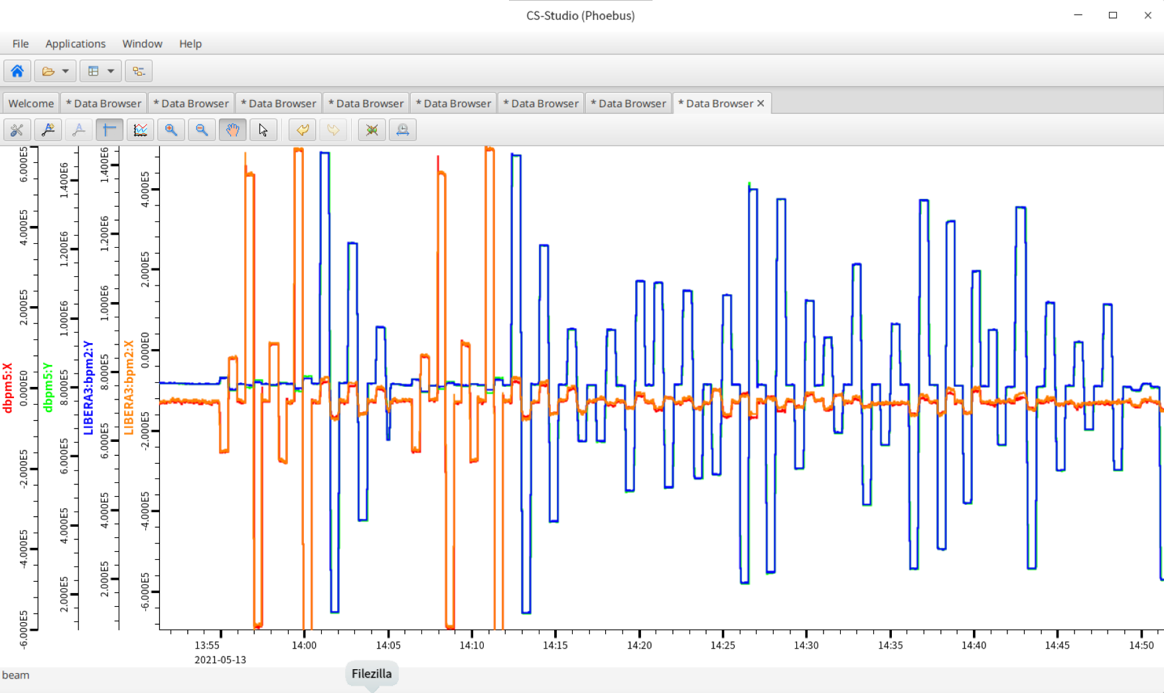
Long time stability（1 hour）

Slide 23
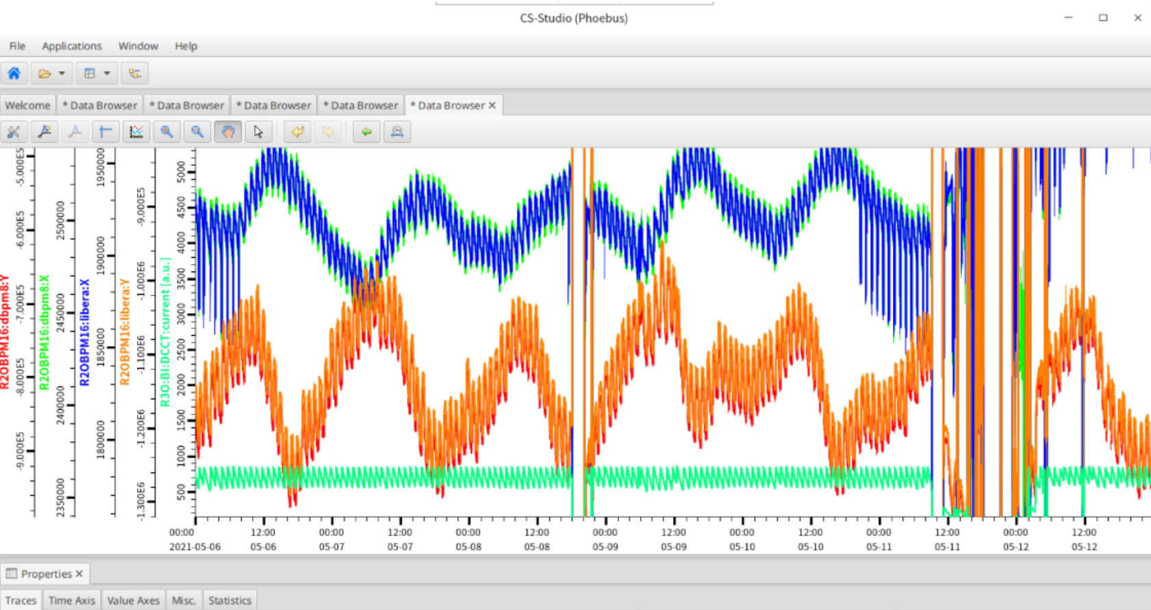
Long time stability（7 days）

Slide 24
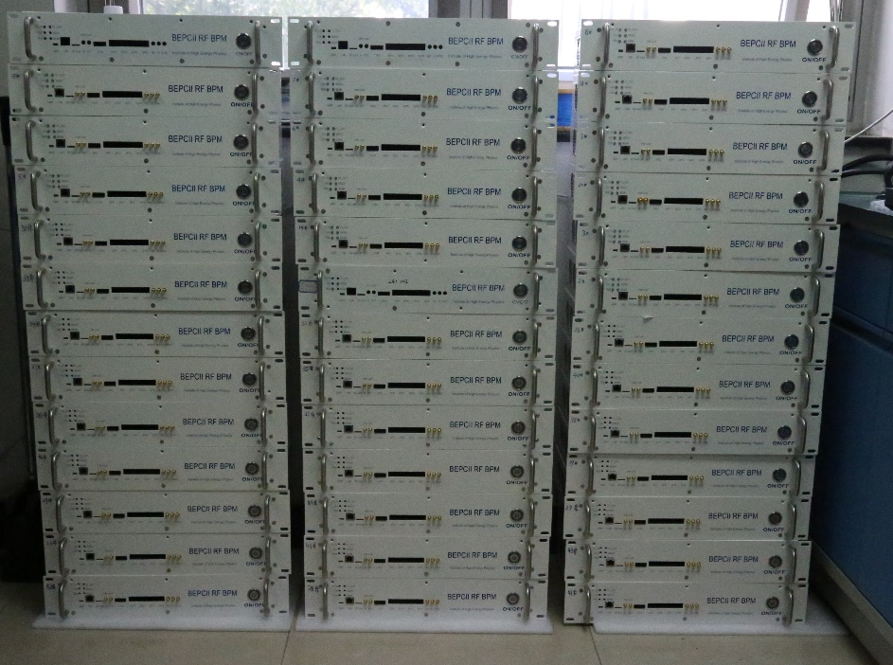
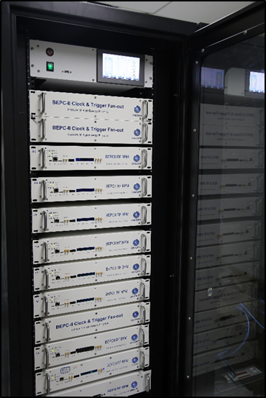
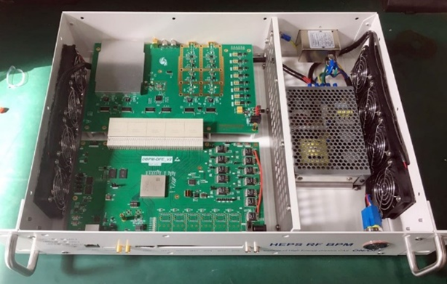
Application of BPM electronics in BEPCII
After finishing prototype test, small batch production and application has been done in BEPCII
20 sets single-pass mode BPM electronics were developed for the linac and put in operation in the middle of 2019.
Totally, 21 sets including SR mode and Collider mode BPM electronics were upgraded in 2020.

Slide 25
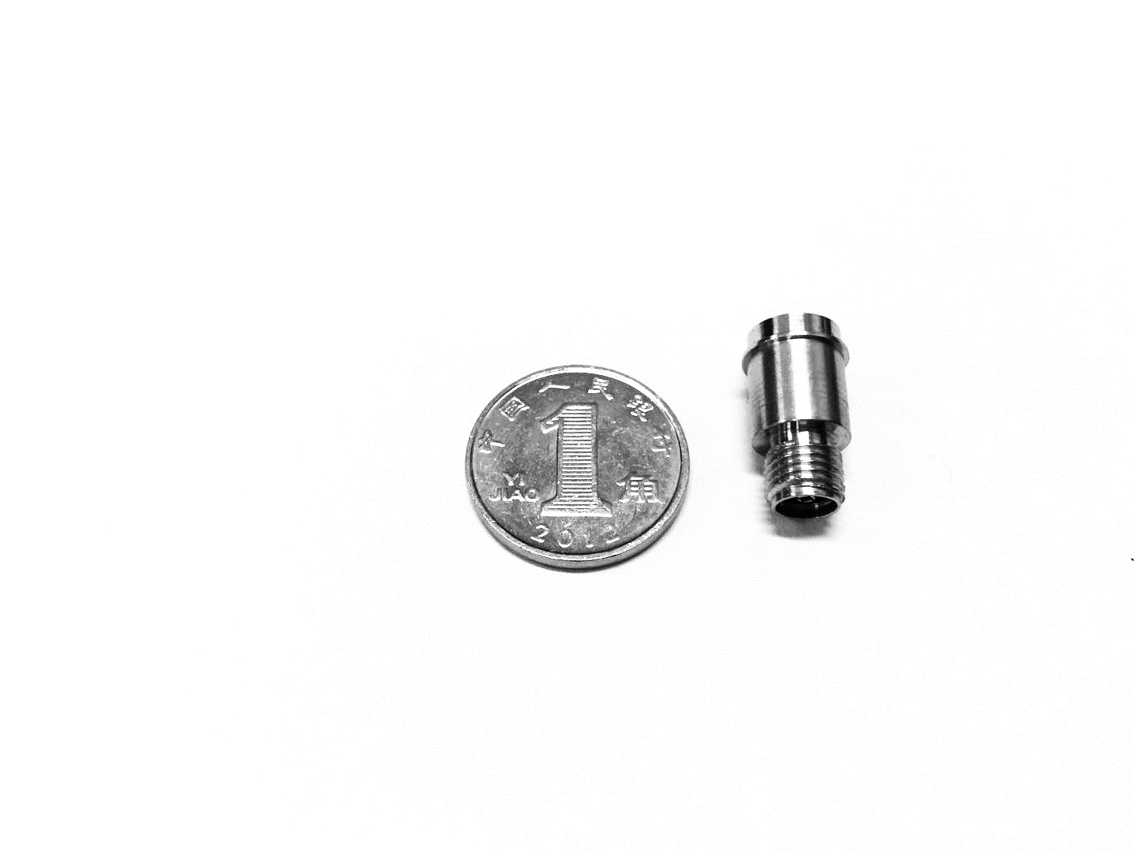
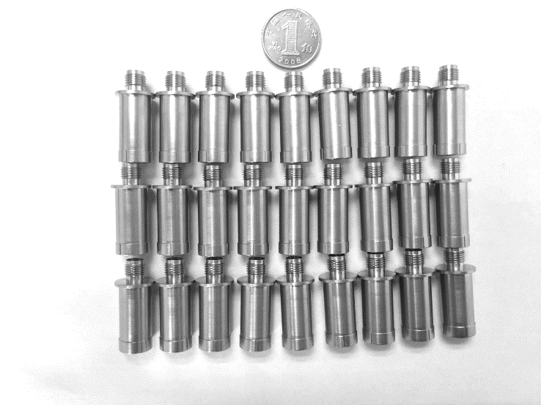
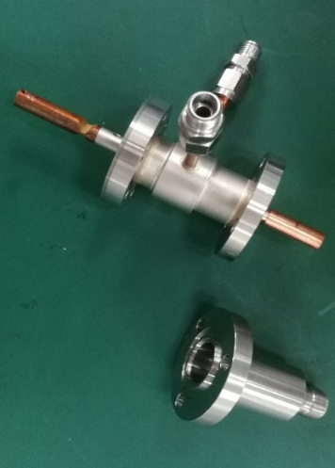
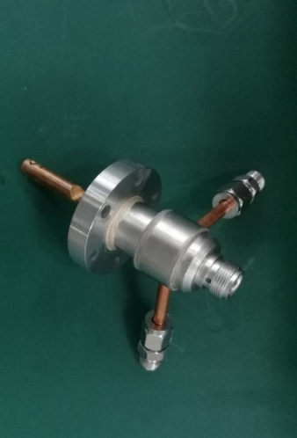
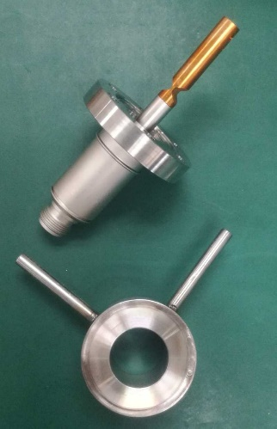
Feed-through R&D
Finished the study of feed-through in beam instrumentation.
Independent research and development of feed-through was kicked off in 2019.
Three versions of BPM feed-through have been made with the help of CIPC Member Company and other companies in the last year.
The kicker feed-through have complete multiple version evolution. The latest version is N-type feedthrough with stainless steel water jacket
BPM feed-through V1.0
BPM feed-through V2.0
Version evolution of kicker feed-through

Slide 26
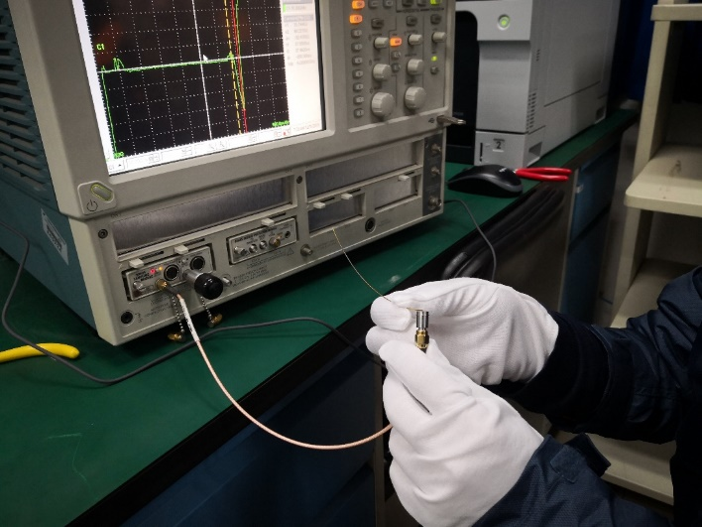
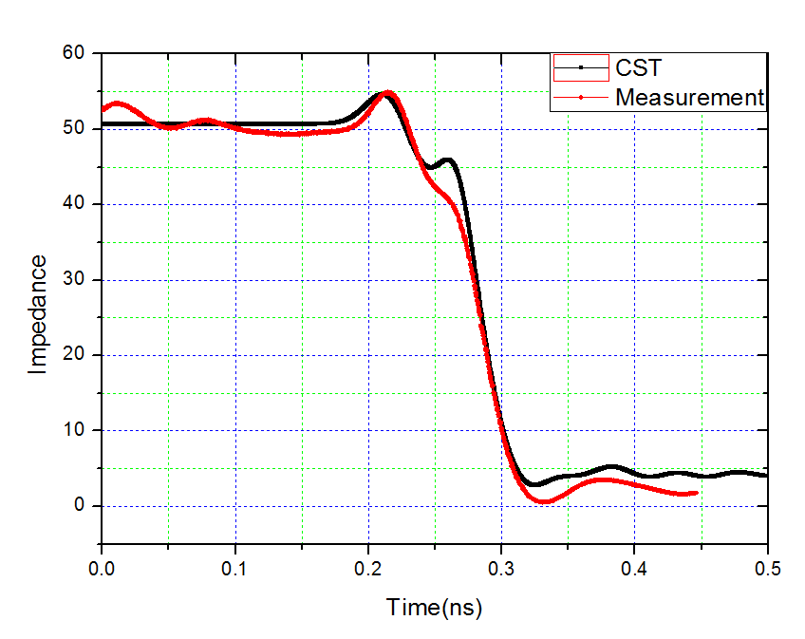
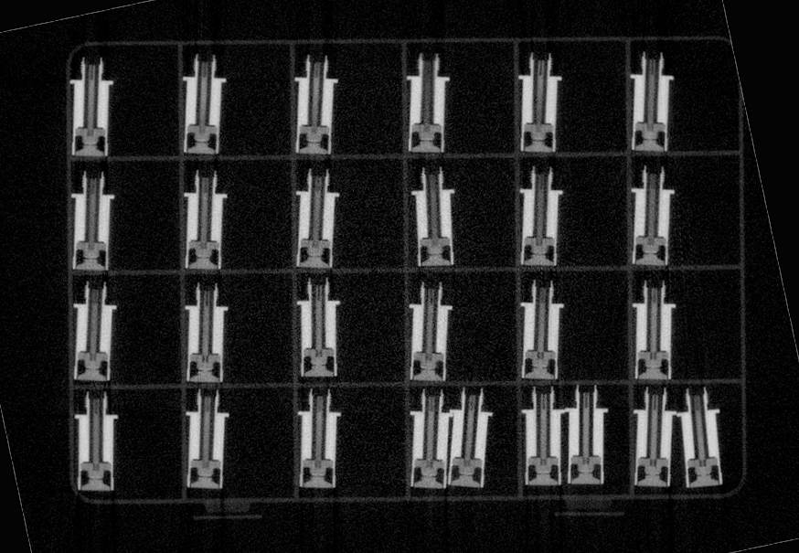
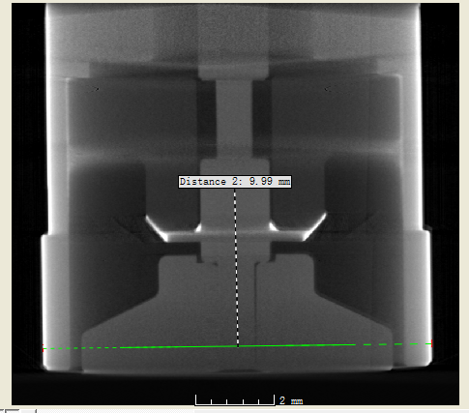
Feed-through R&D
The test result of the feedthroughs shows that the mechanical properties, high-frequency characteristics and vacuum performance can meet the demands of the CEPC BPM totally.
TDR for impedance test and X-ray tomography for inner structure check.
TDR test

Slide 27
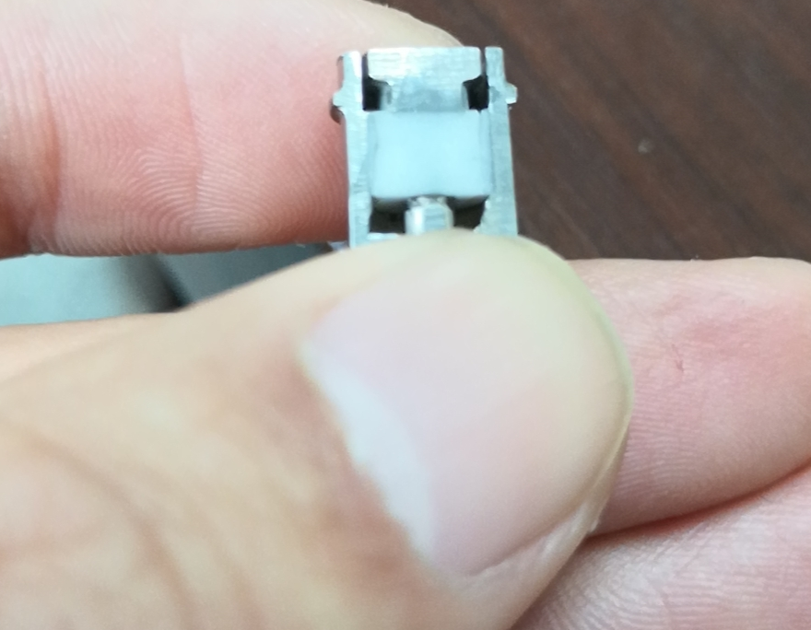
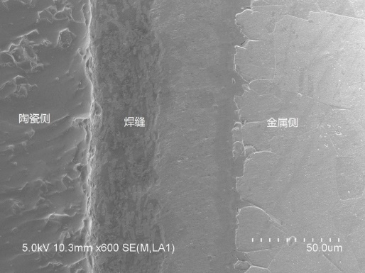
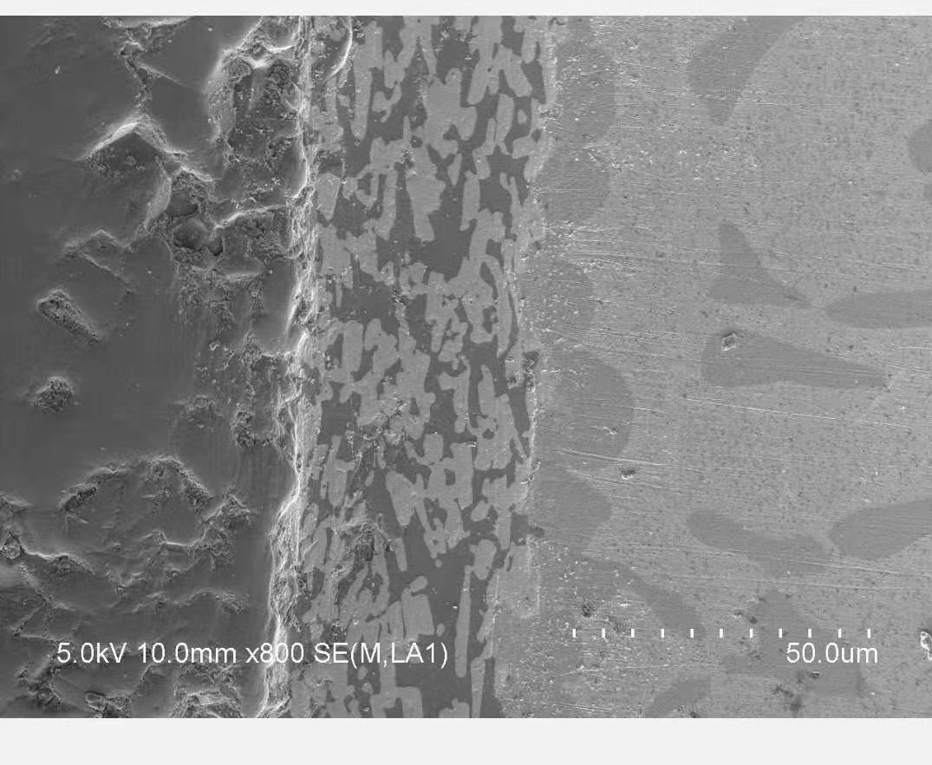
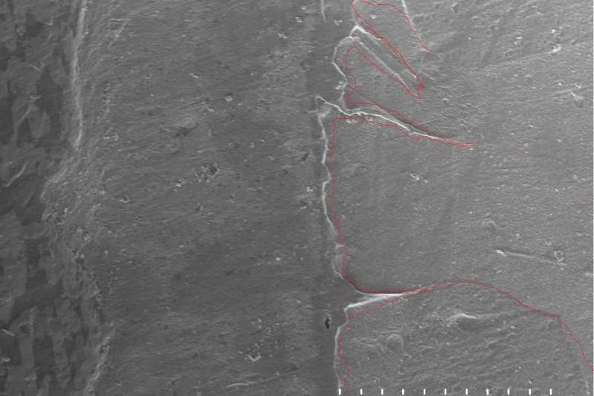
Feed-through R&D
Morphology of solid surface by SEM

Slide 28
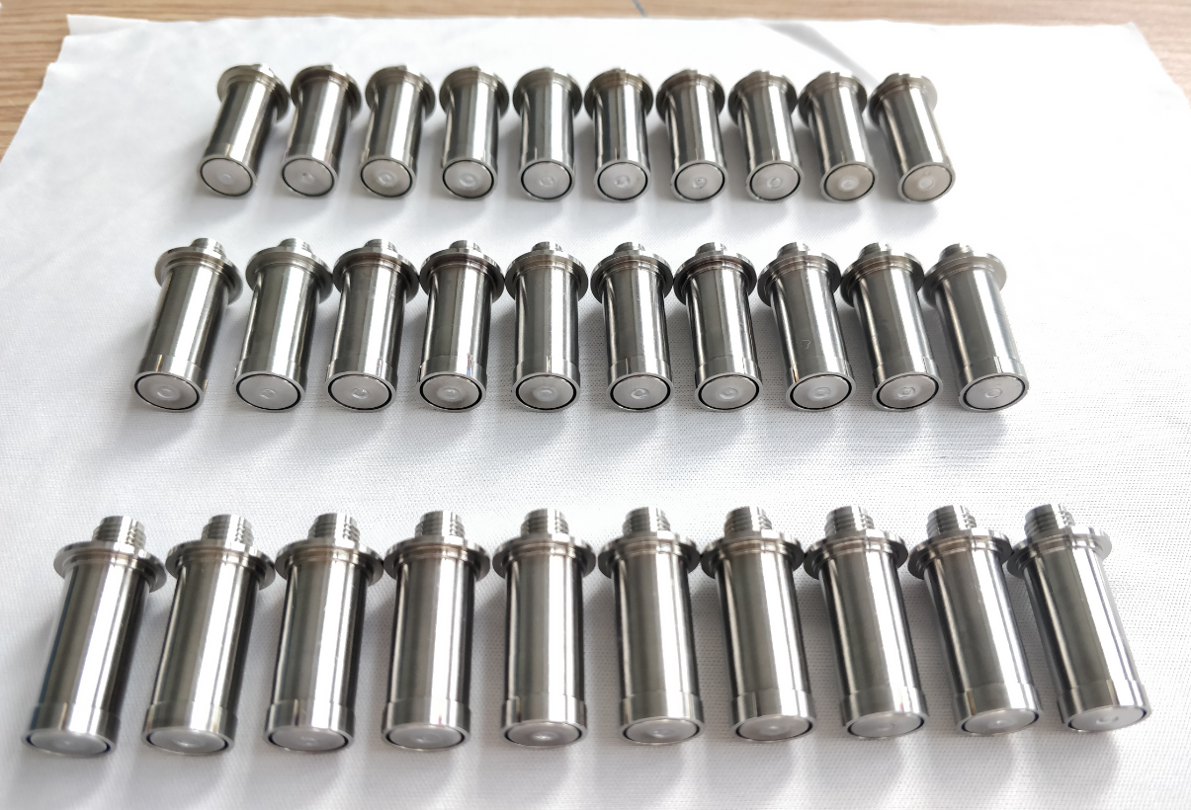
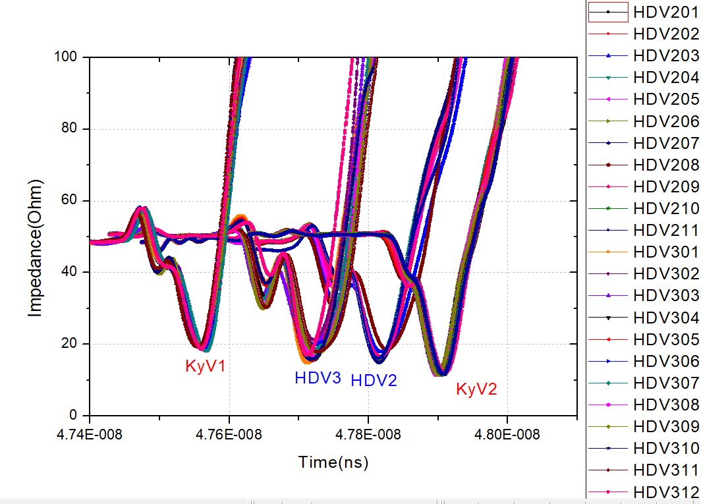
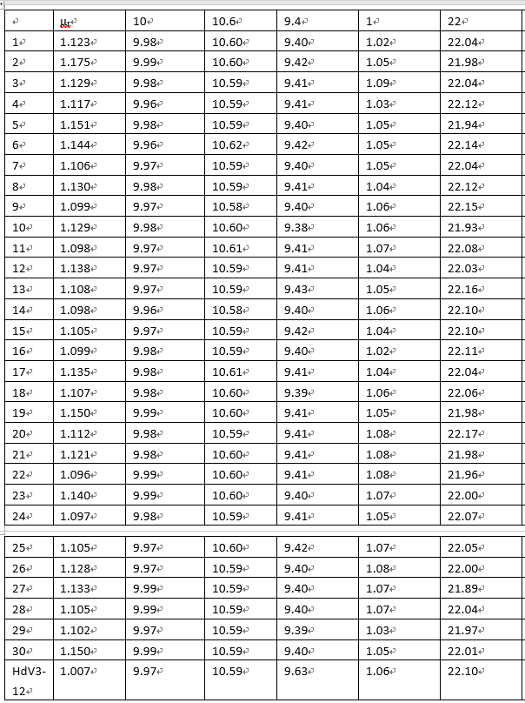
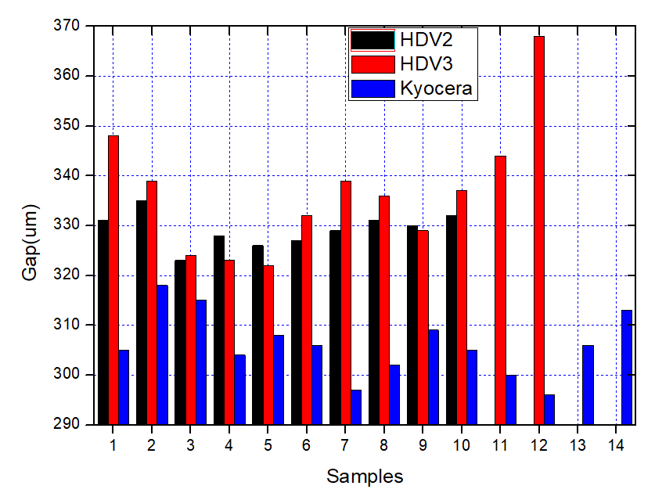
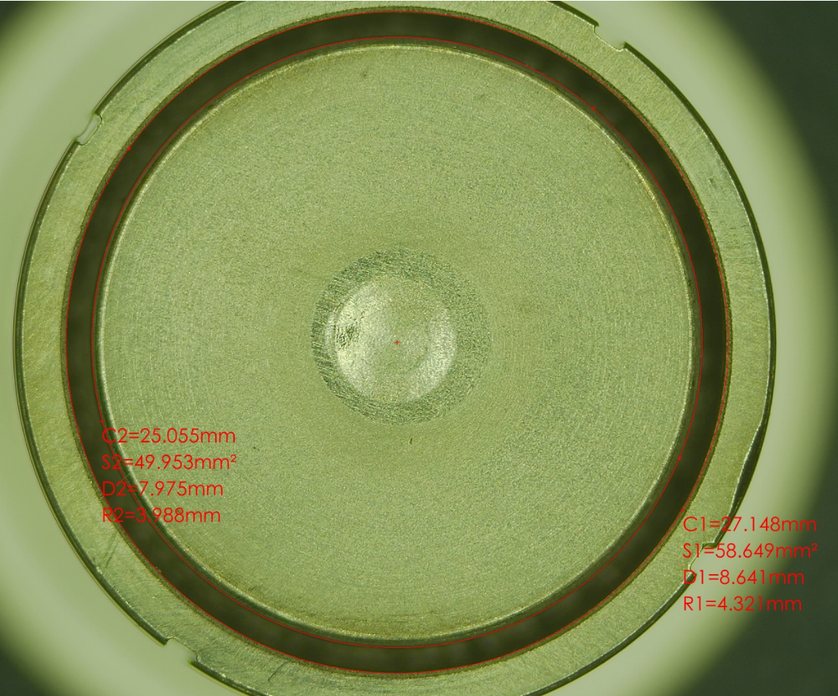
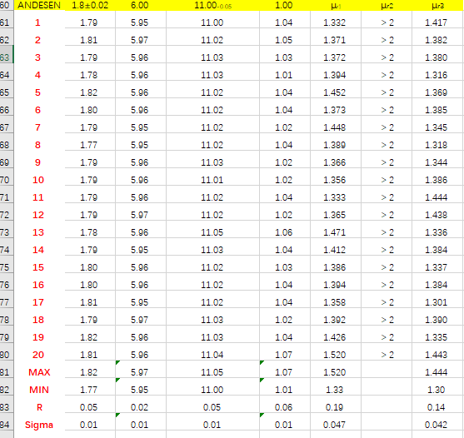
Feed-through R&D
3 Candidate manufacturers, the same design , batch products consistency test

Slide 29
Summary
The BPM pick-ups are redesigned based on the new chamber of storage ring.
Home-made BPMs were tested in lab and also with real beam in BEPCII. Small batch production have been used online in BEPCII linac and storage ring.
Three months of trouble-free operation of 21 units in BEPCII storage ring, more to be commissioned soon.
The feed through R&D was carried out as plan, more study will be done in consistency of batch product.

Slide 30
Thanks for your attention !

