Slide 1
Study of Beam-Beam Effects at CEPC
Chuntao Lin, Kazuhito Ohmi, Yuan Zhang

Slide 2
Simulation
K. Hirata et al., PA 40, 205-228 (1993)
K. Hirata, PRL, 74, 2228 (1995)
Y. Zhang et al., PRST-AB, 8, 074402 (2005)
K. Ohmi, IPAC16
Y. Zhang et al., PRAB 23, 104402, (2020)
CODE: IBB
Linear Arc Map with SR radiation
Horizontal crossing angle: Lorentz boost map
Bunch slice number is about 10 times Piwinski angle
Slice-Slice collision: Synchro-beam mapping method
Synchrotron radiation during collision
Longitudinal wake potential is calculated in frequency domain before IP each turn

Slide 3
Try to answer: if the machine parameter is reasonable
Limit of bunch population by beam-beam interaction:
Beamstrahlung lifetime (ttbar/Higgs)
If X-Z instability is suppressed (ttbar/Higgs/W/Z)
If asymmetric bunch current collision is stable
If there exist large enough stable working point space
Notes:
We do not focus on the optimization of the machine parameter

Slide 4
ttbar
Very strong SR damping (longitudinal damping time: 20 turns)
Instability may be suppressed?
Medium Piwinski Angle ~ 1, BEPCII/KEKB: 0.5， CEPC-Z> 20
Beam-beam resonance could not be well suppressed by Crab-Waist
Horizontal beam-beam parameter: 0.07, still very high
It is very different from H/W/Z

Slide 5
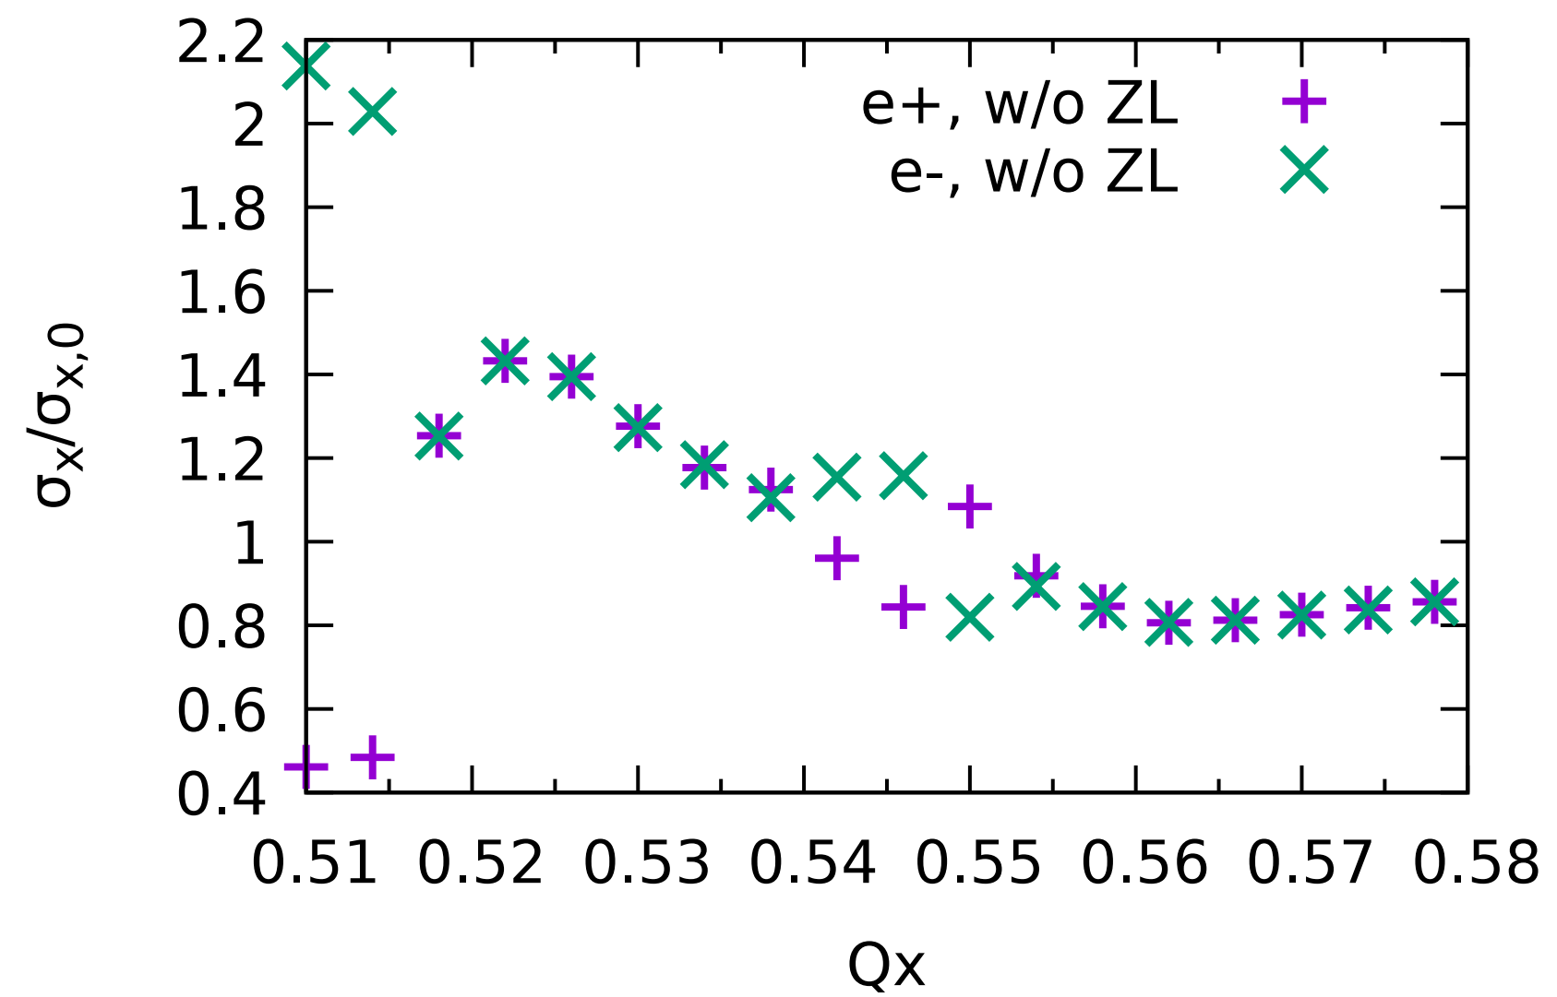
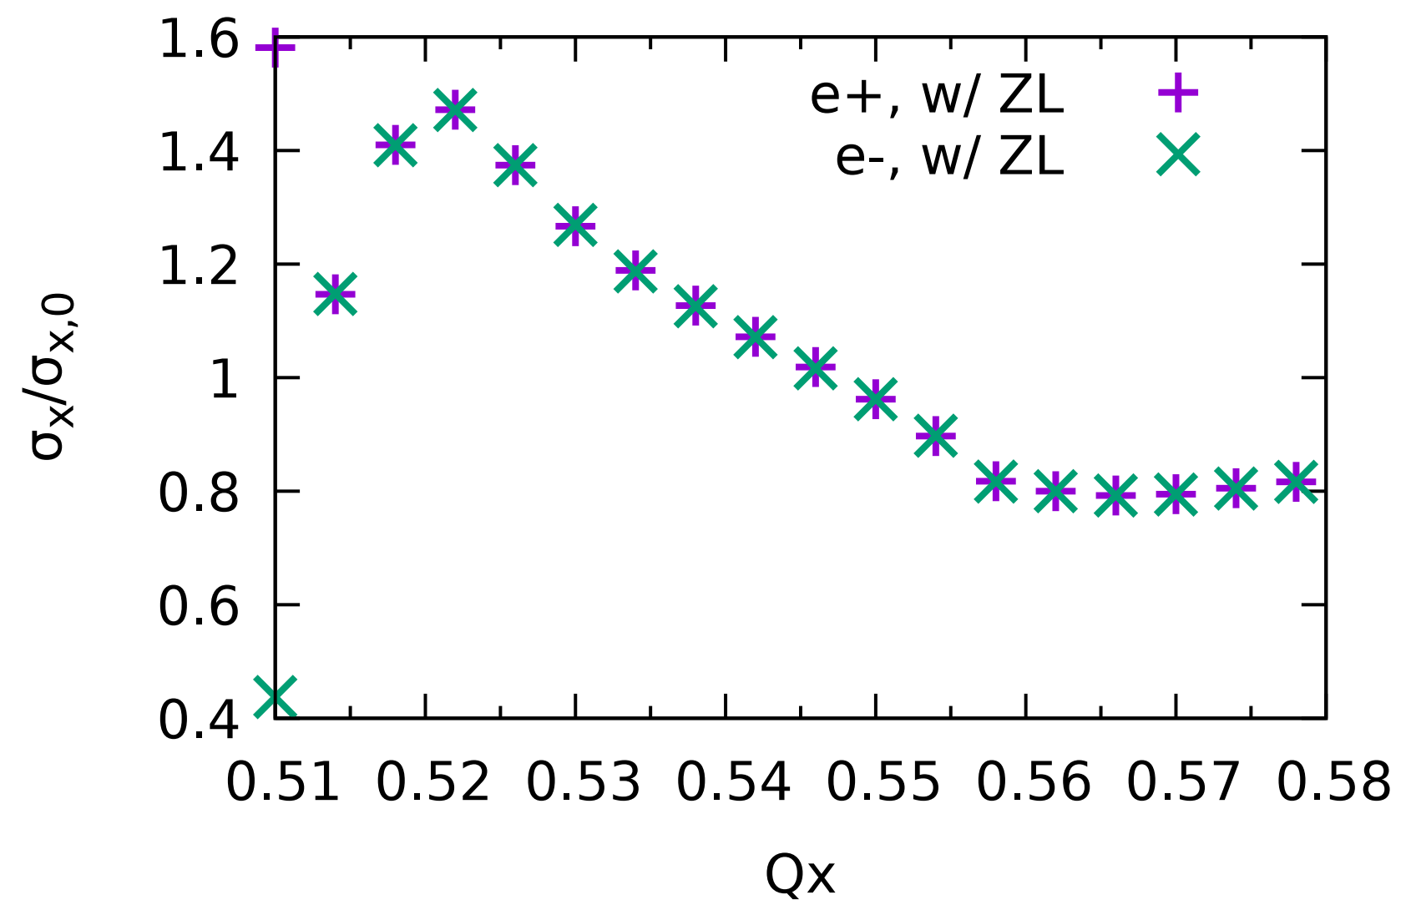
Luminosity and horizontal beam size versus Qx (ttbar,CW=0.5)
D. Shatilov, 143rd FCCee Optics Meeting
3D flip-flop is suppressed considering longitudinal impedance
Dynamic effect squeeze horizontal beam size

Slide 6
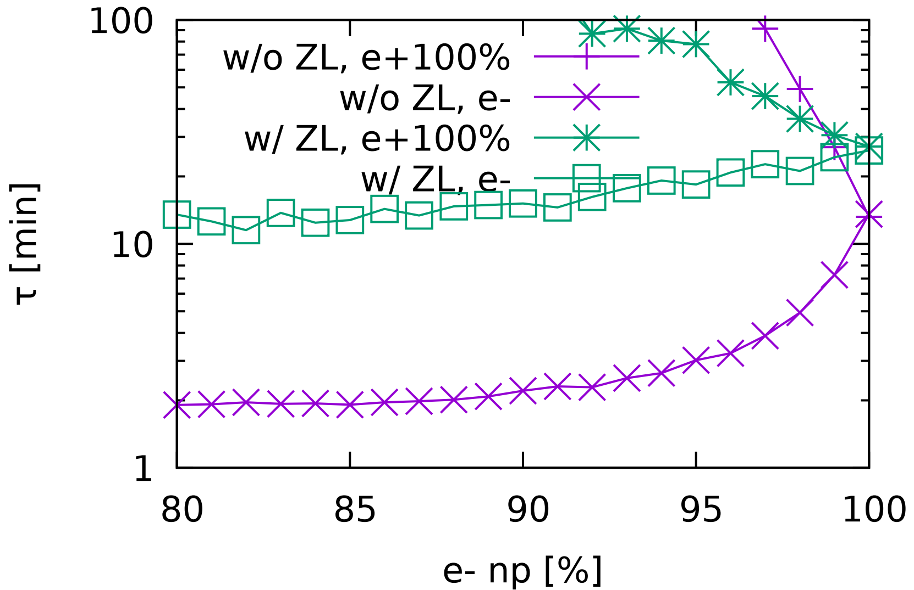
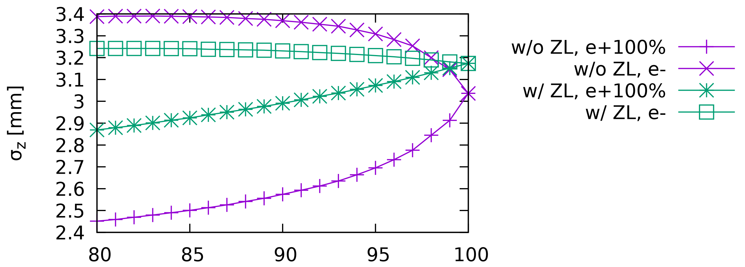
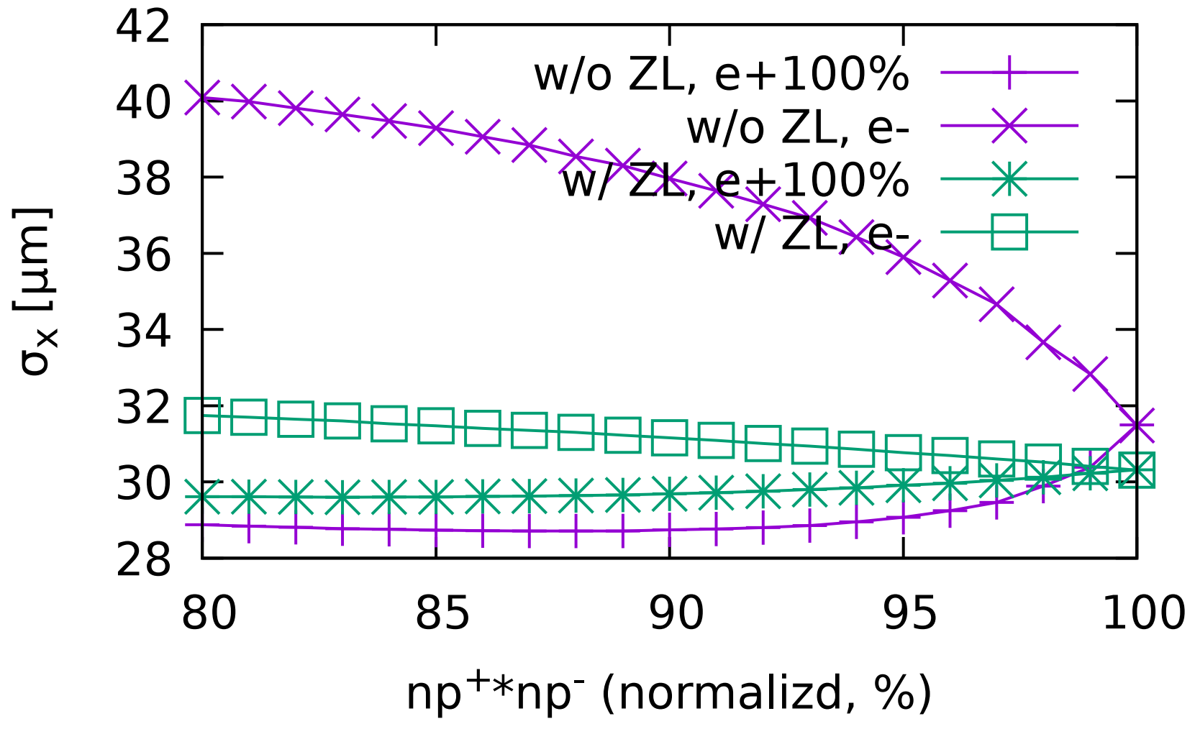
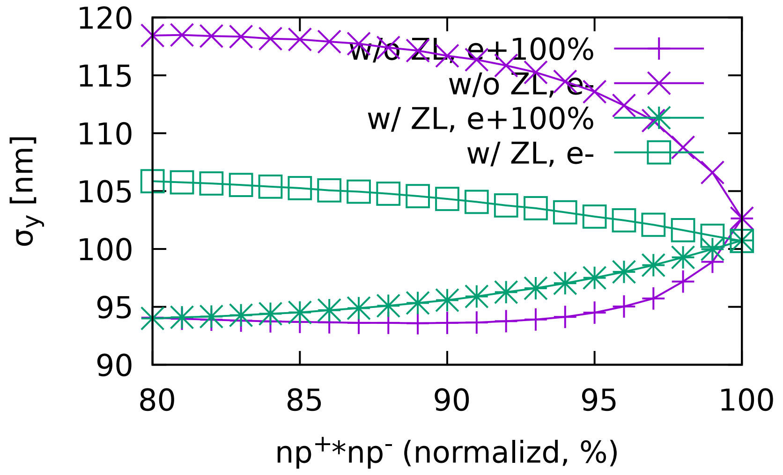
ttbar: Asymmetrical Collision
Beam lifetime is increased due to longitudinal impedance
~10% asymmetry of bunch population could be accepted for stability

Slide 7
Higgs
Large Piwinski Angle~6 (CW=0.8)
Beamstrahlung Lifetime
X-Z instability

Slide 8
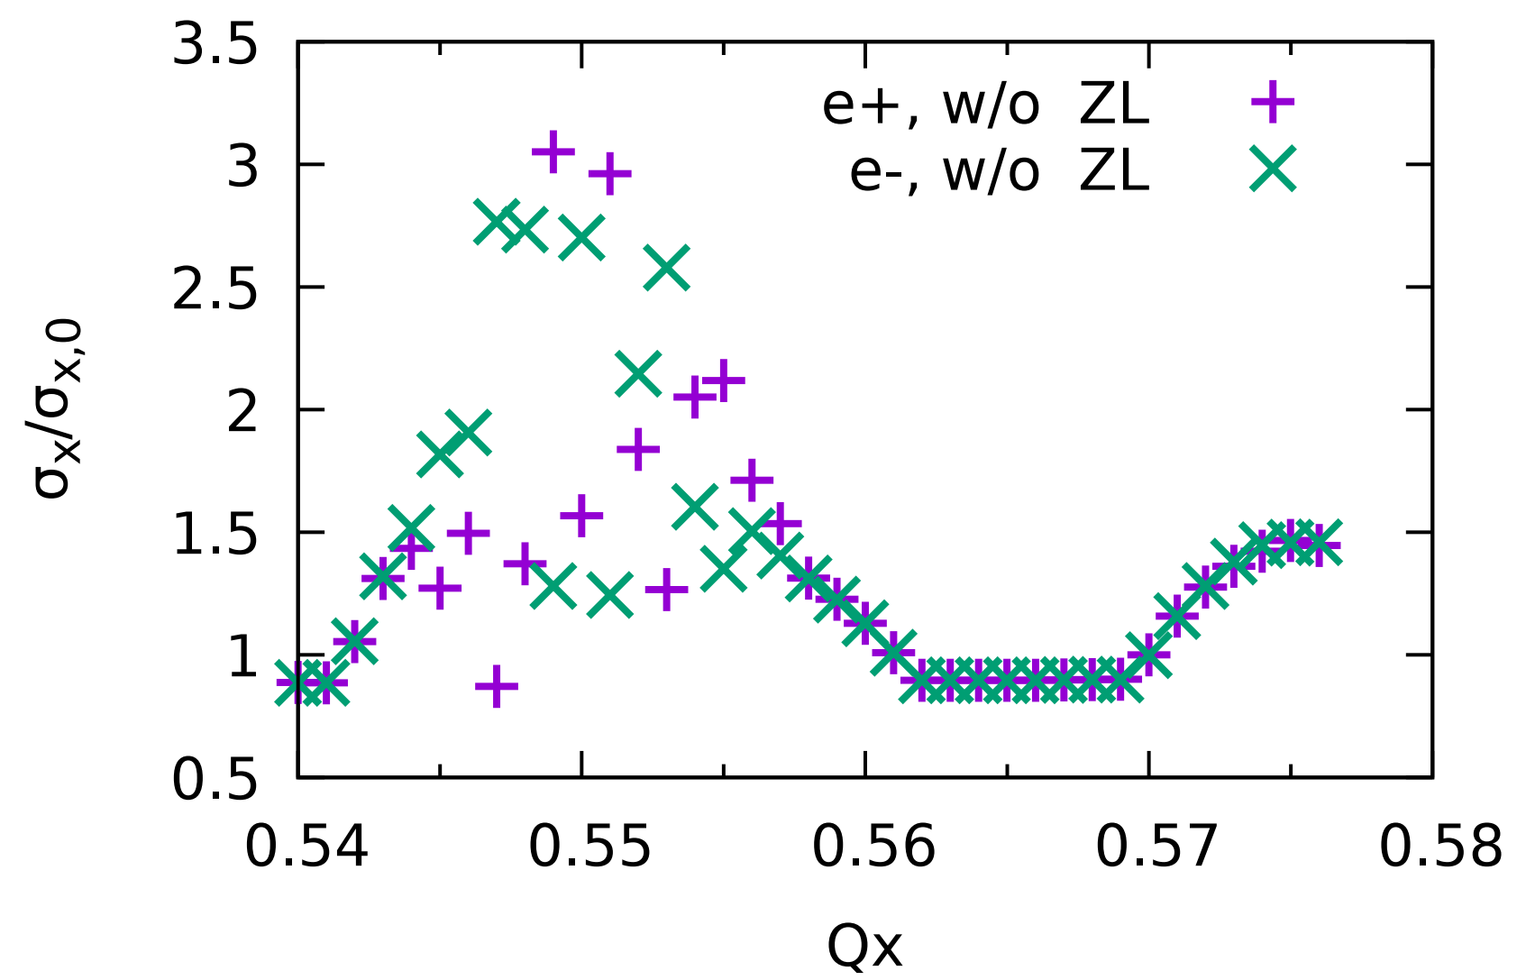
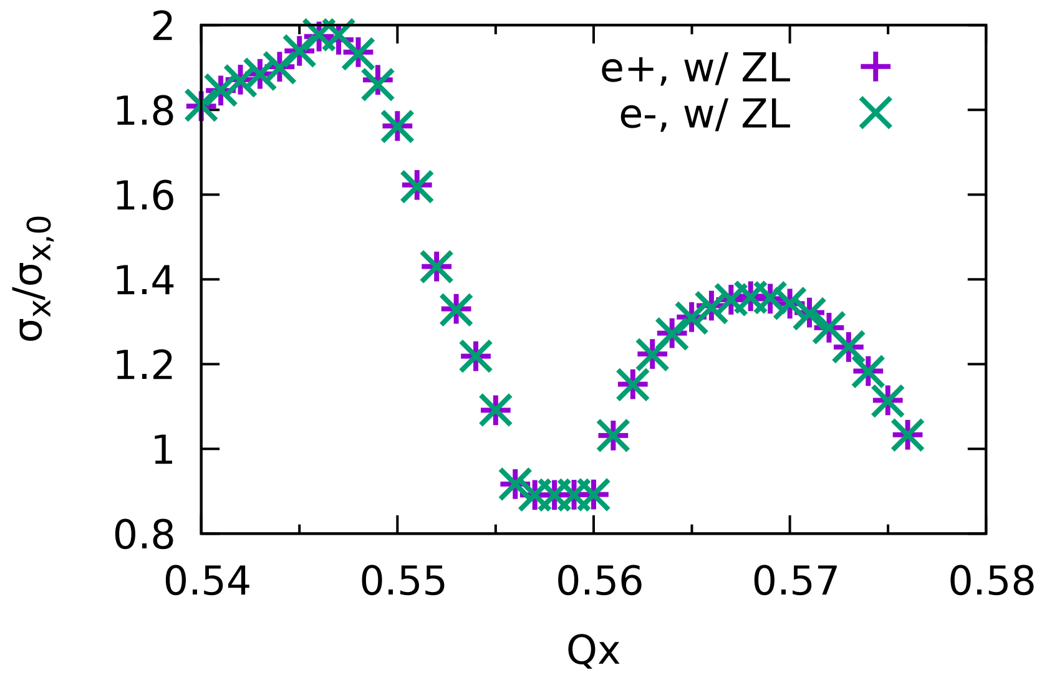
Luminosity and horizontal beam size(Higgs,CW=0.8)
Design Lum=5e34
Stable width of Qx~0.004 considering ZL, need further optimization (x-z instability)

Slide 9
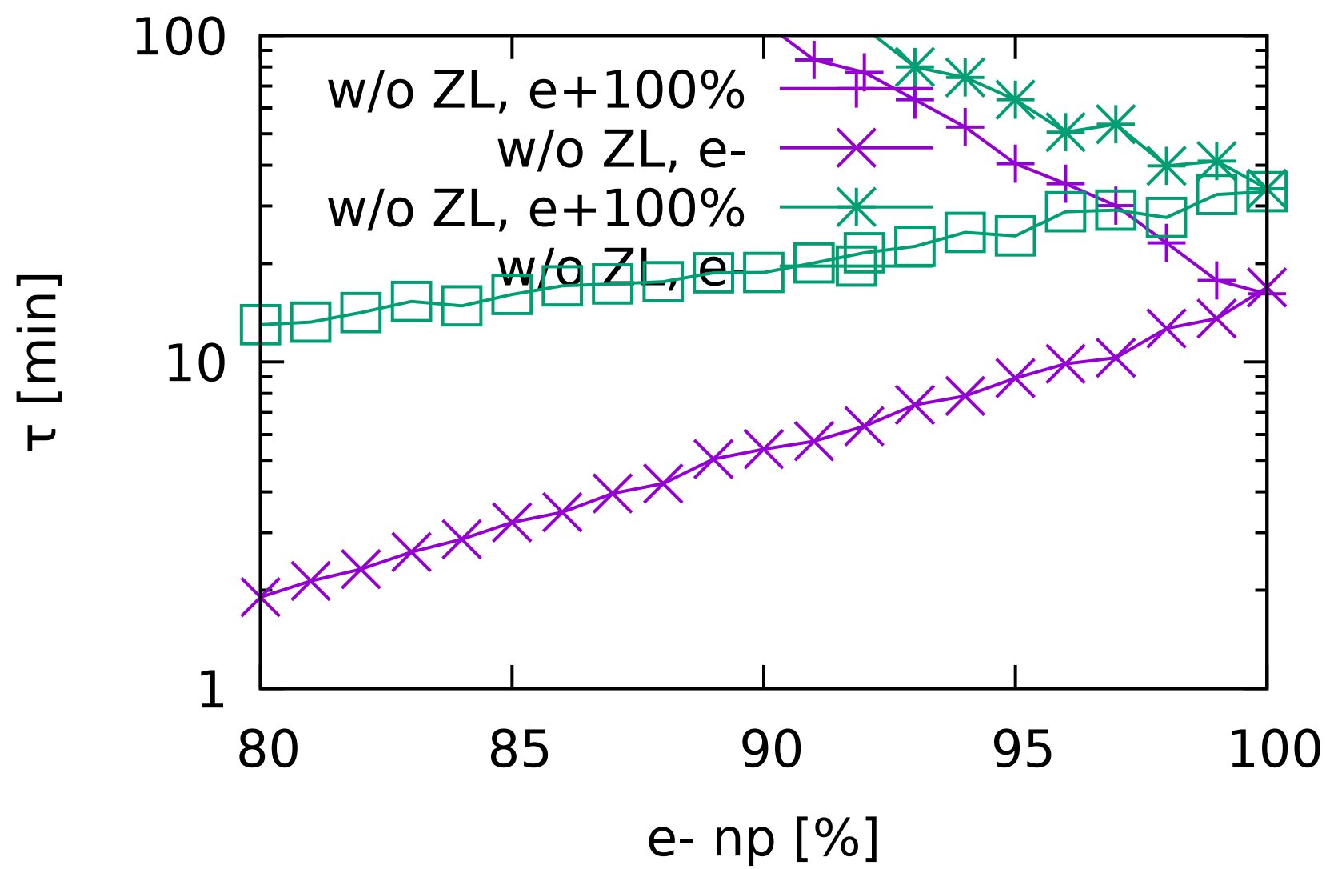
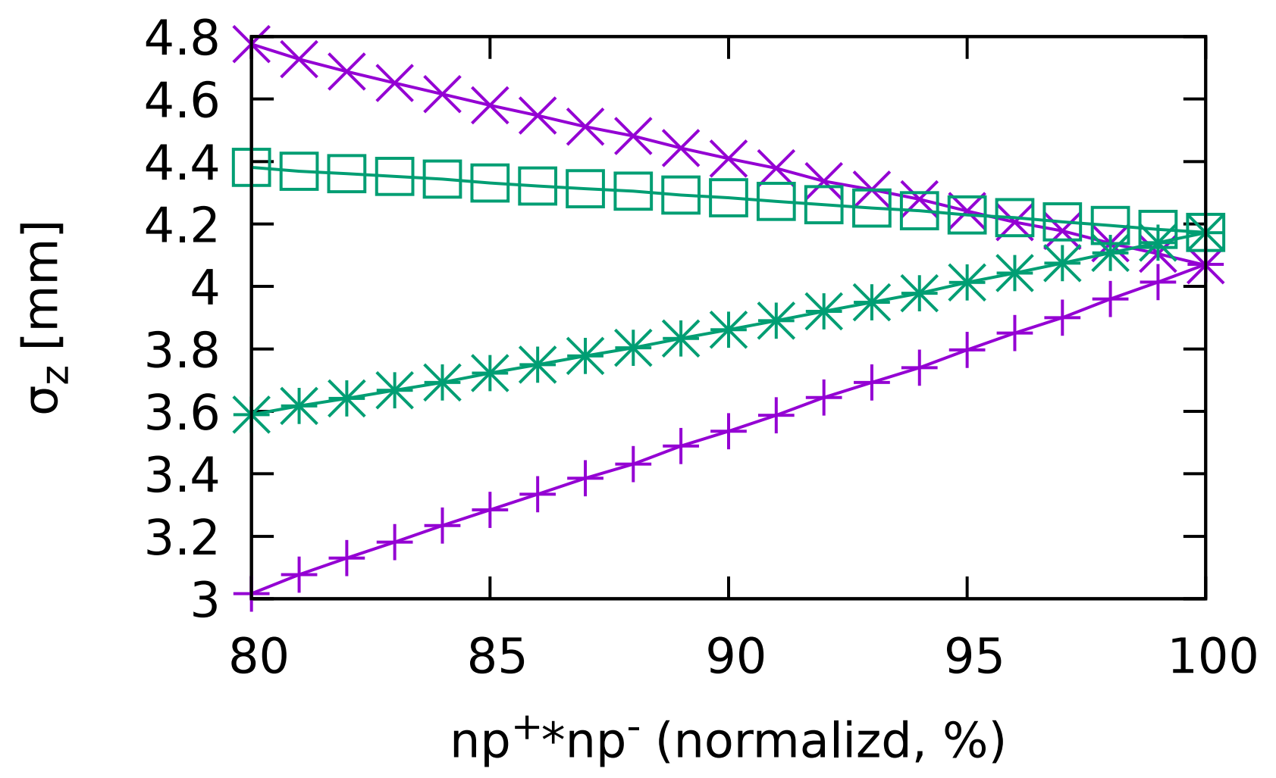
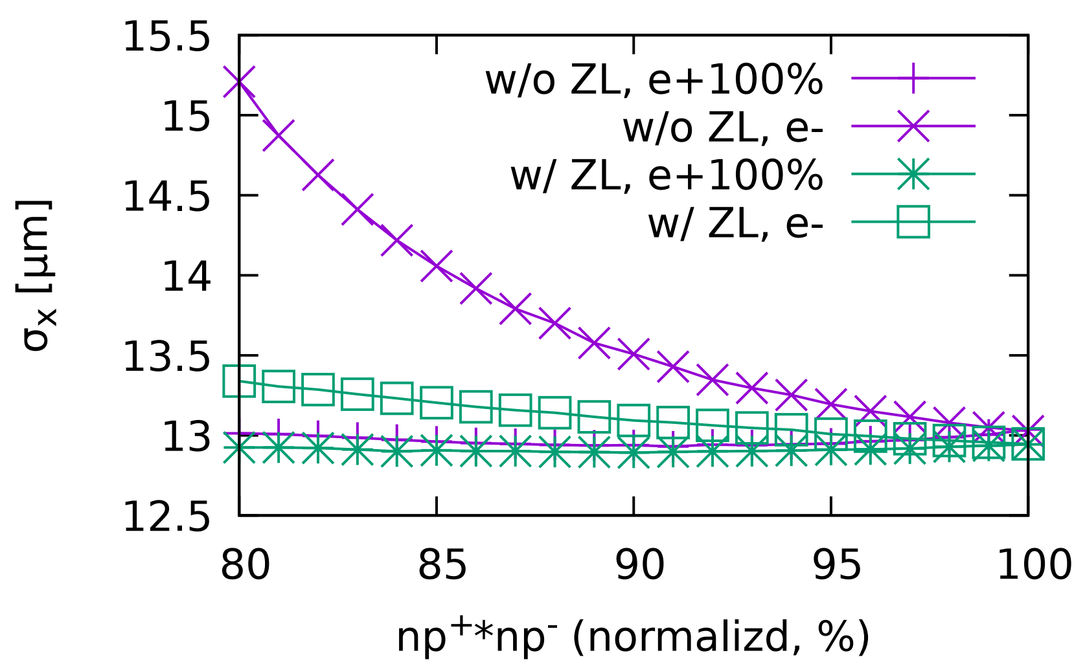
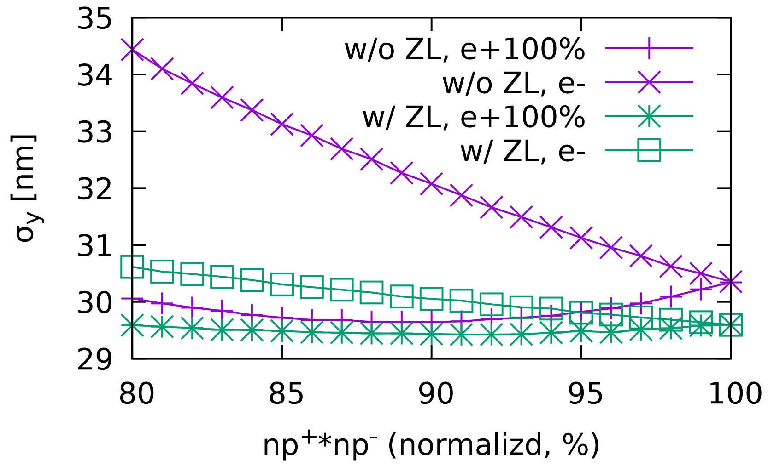
Higgs: Asymmetrical collision
Beamstrahlung lifetime
Beam lifetime is increased due to longitudinal impedance
10% asymmetry of bunch population could be accepted.

Slide 10
W
Piwinski angle is similar to that of Higgs(CW=0.8)
Beamstrahlung lifetime is not an issue
X-Z instability

Slide 11
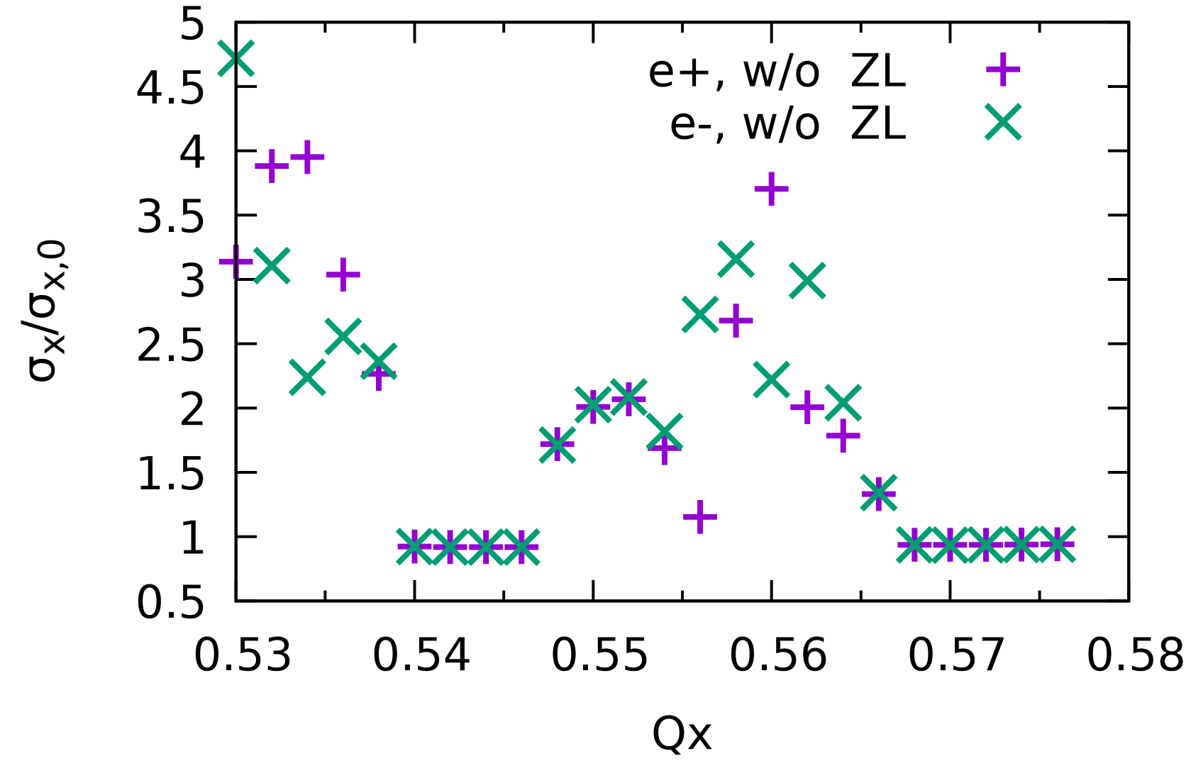
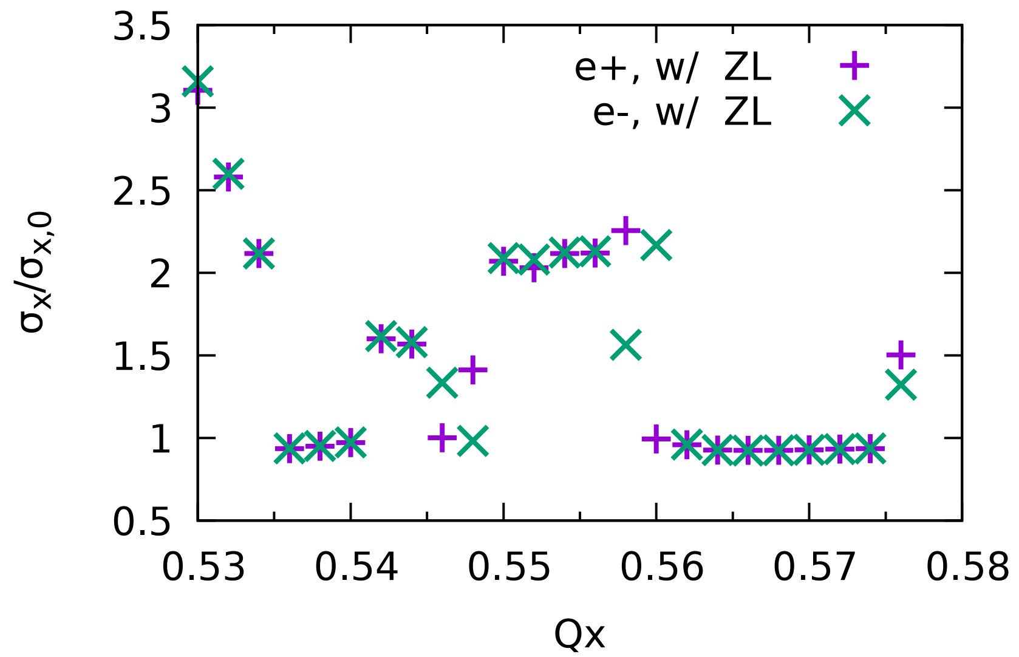
W: Luminosity and horizontal beam size
Design Lum=16e34
The optimized nux is near 0.57 w/ and w/o longitudinal impedance.
Stable tune width ~ 0.007 considering ZL

Slide 12
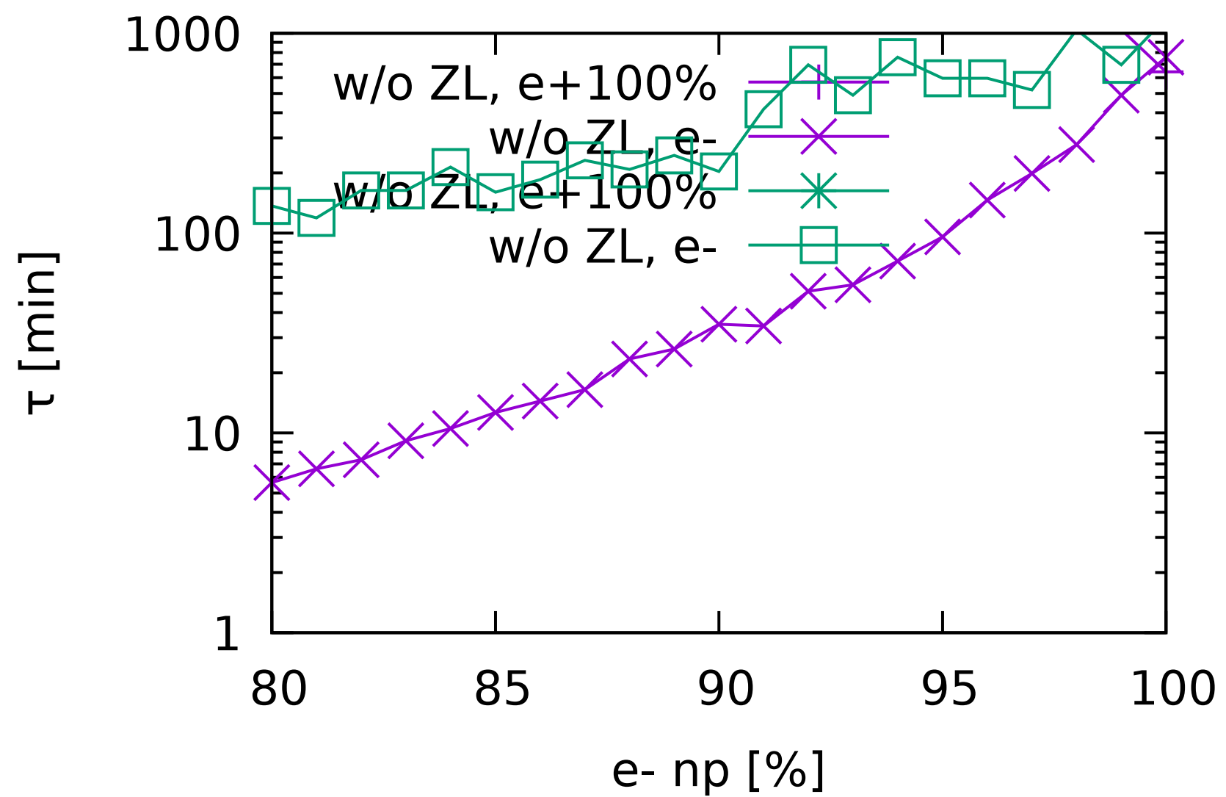
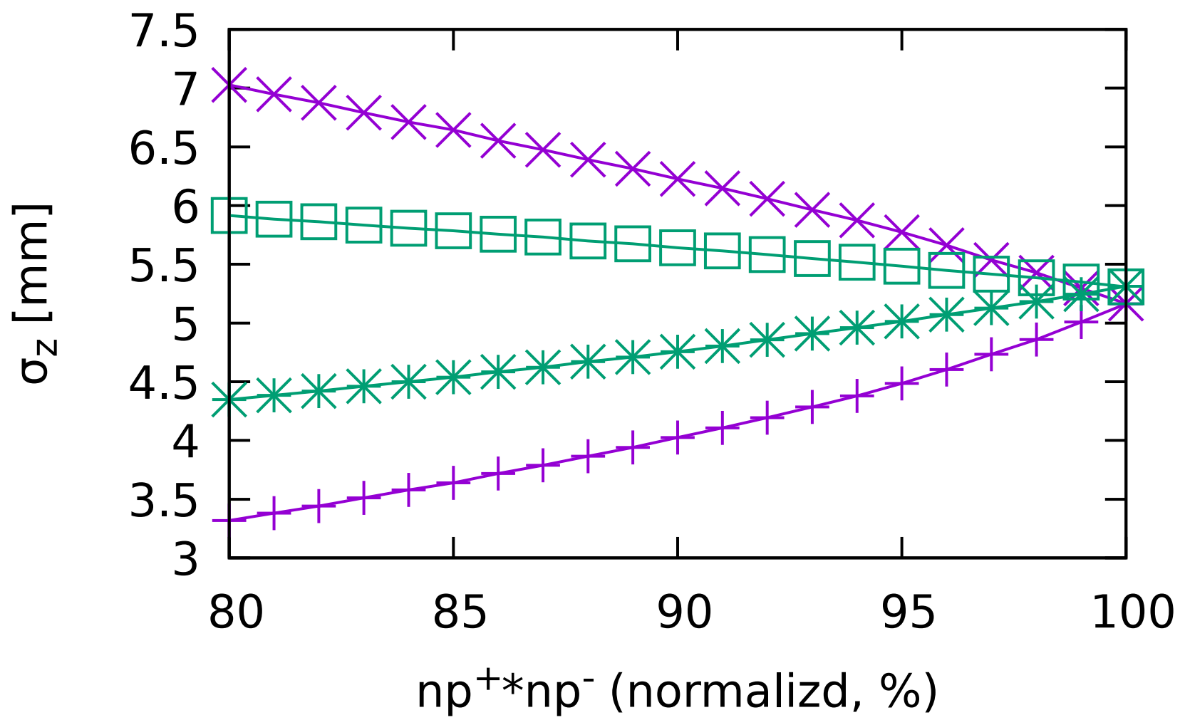
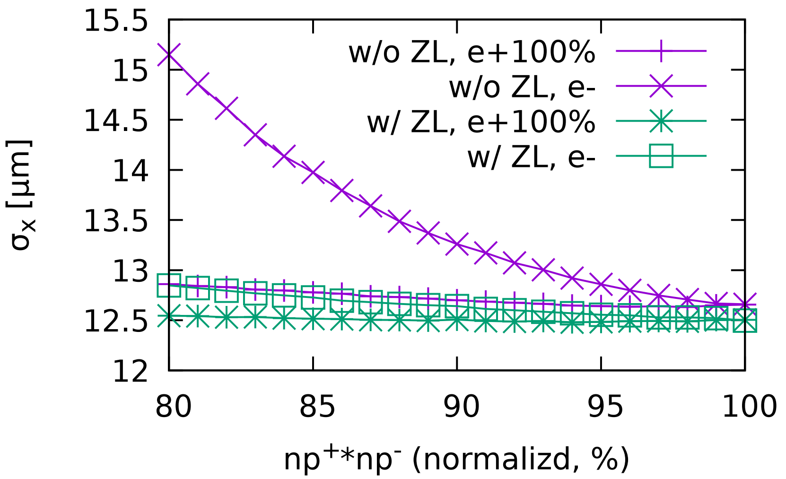
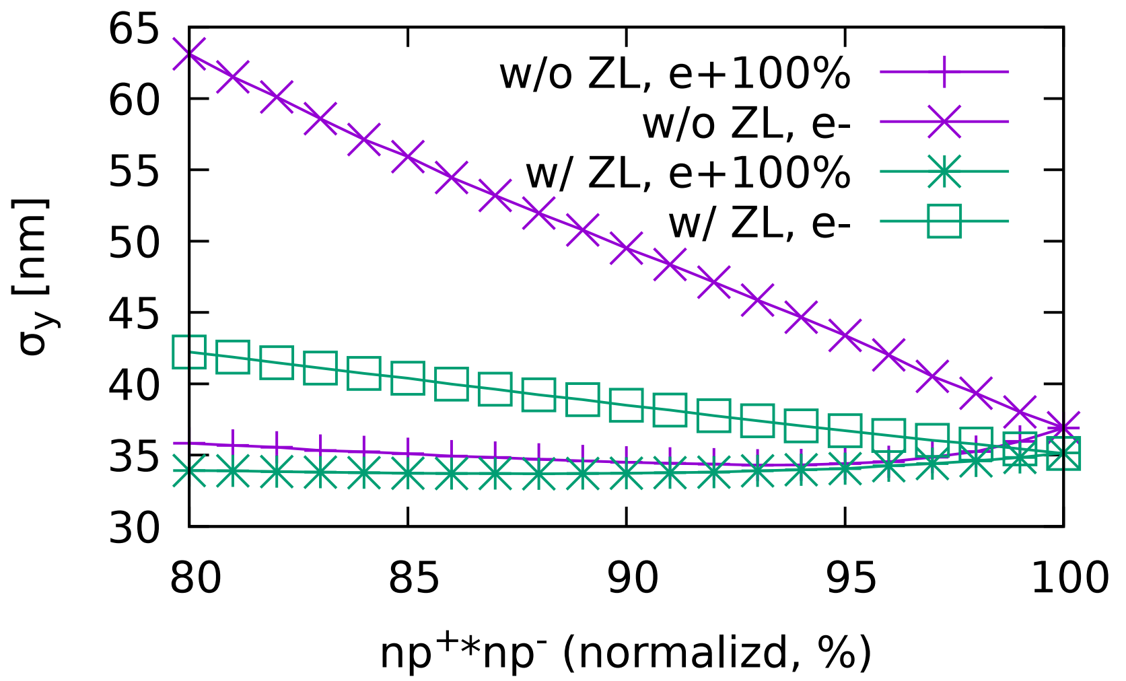
W: Asymmetrical Collision
Beamstrahlung lifetime
Beam lifetime is increased due to longitudinal impedance
10% asymmetry of bunch population could be accepted.

Slide 13
Z
Piwinski Angle: 25 (CW=1)
FODO CELL: 60/60
X-Z instability

Slide 14
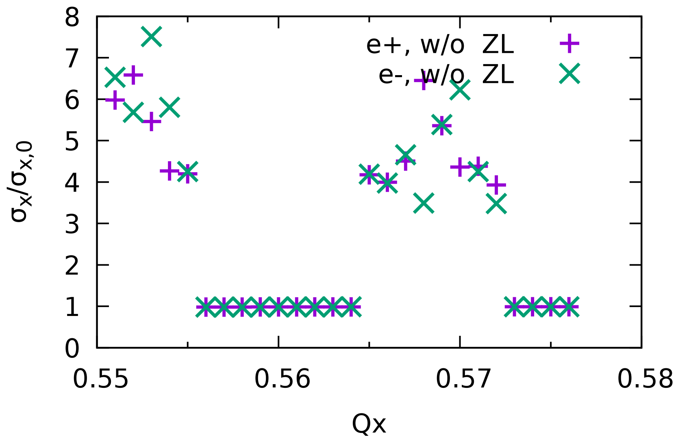
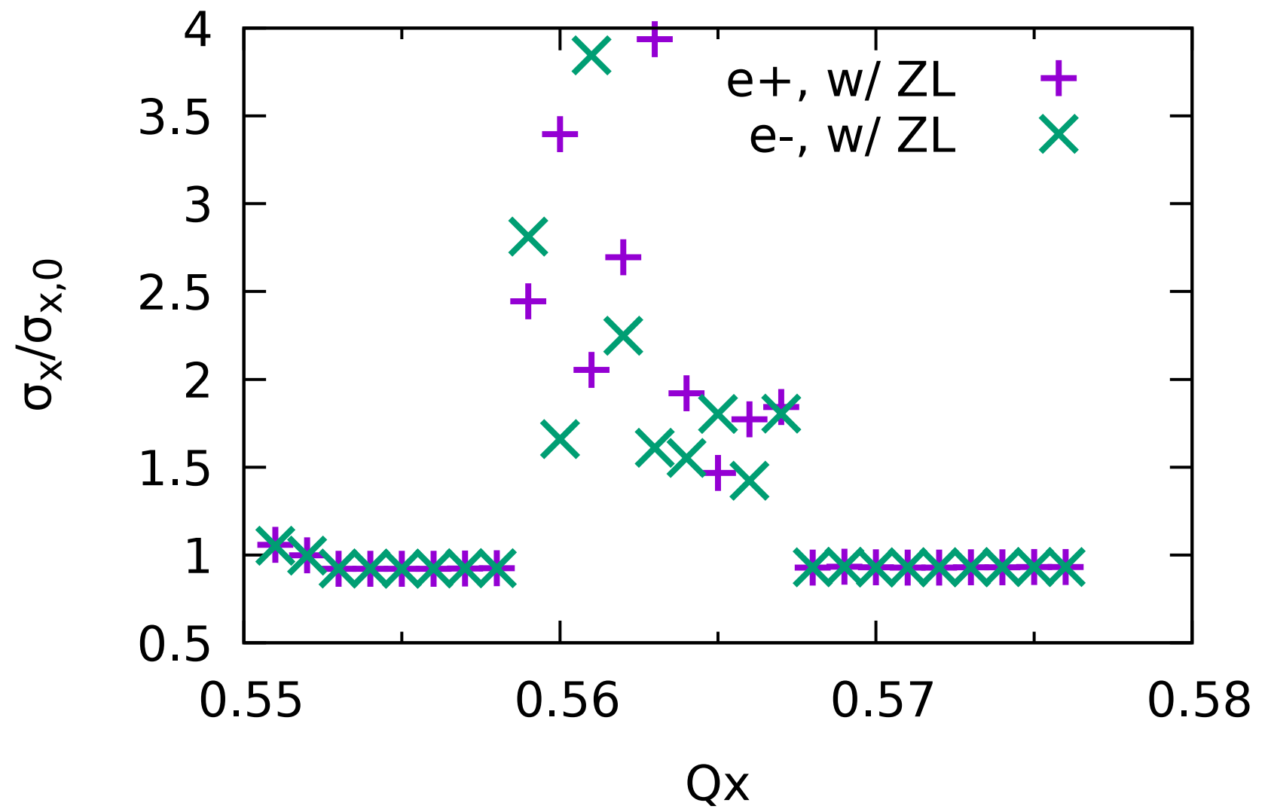
Z: Luminosity and horizontal beam size
Design Lum=115e34
Stable width of $ν_{x}$~0.01

Slide 15
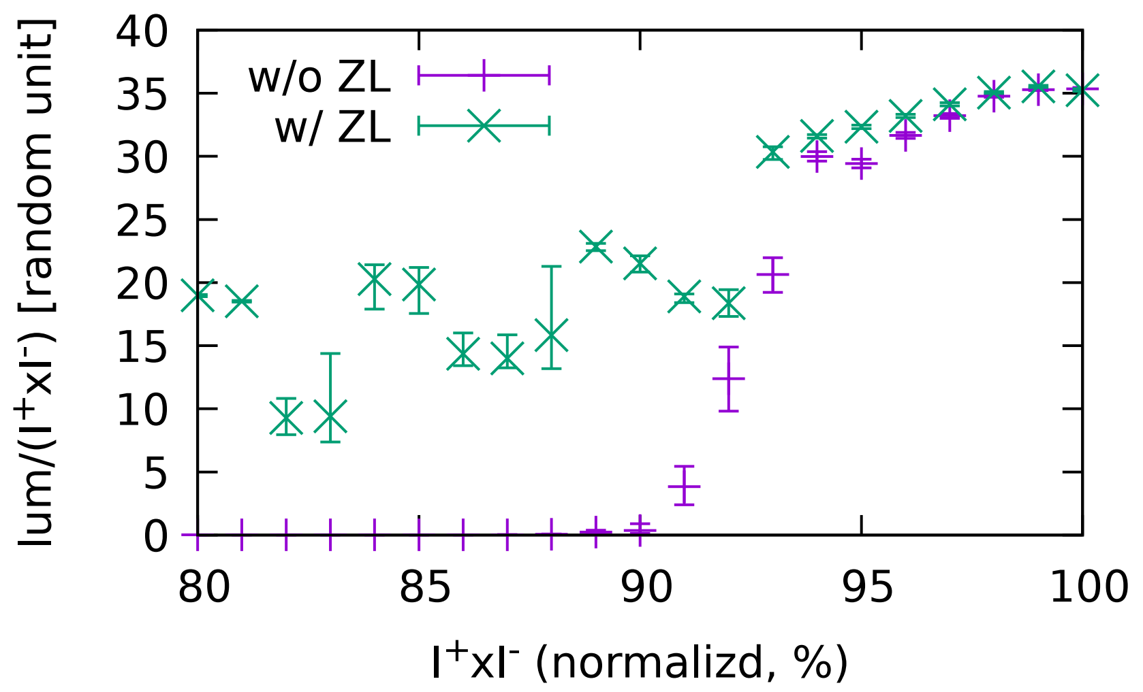
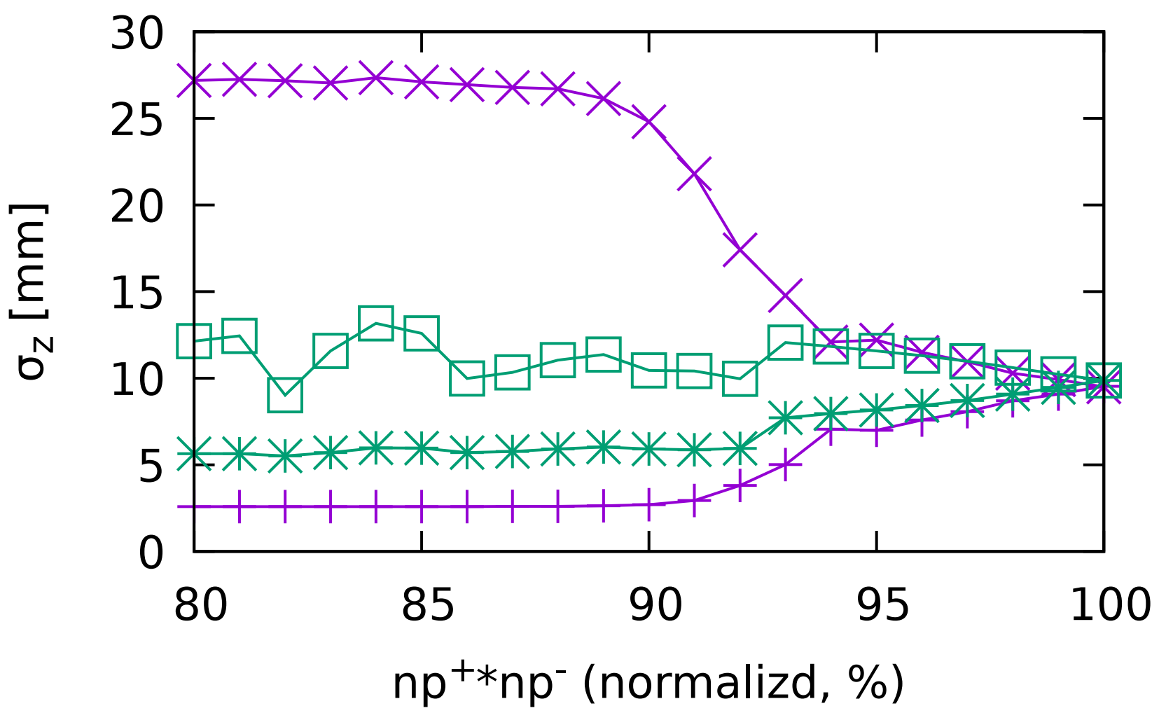
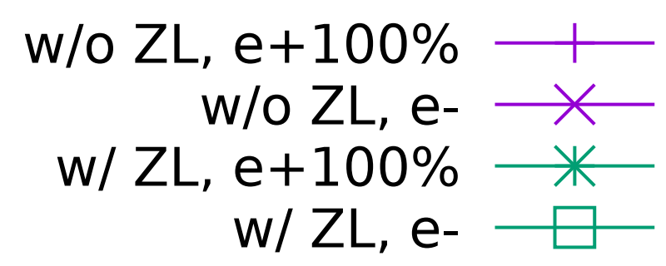
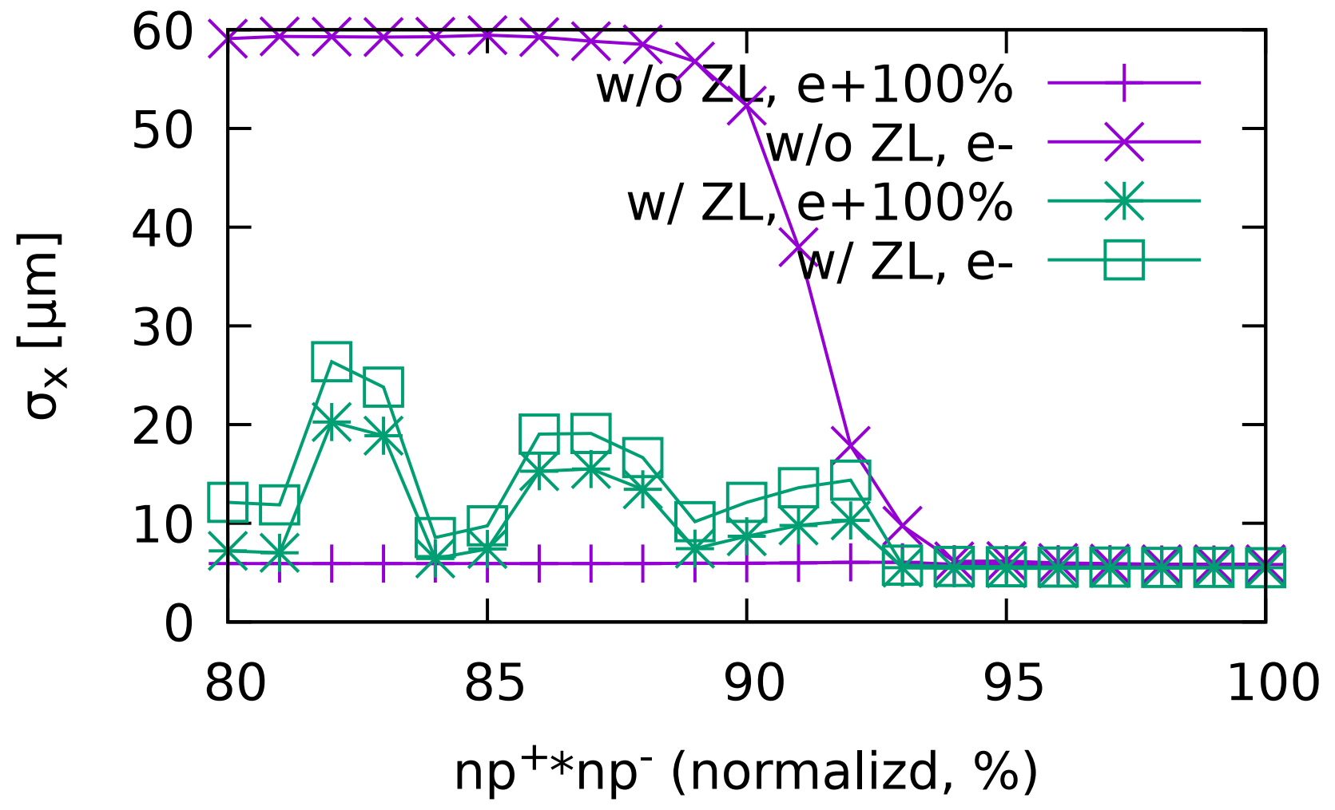
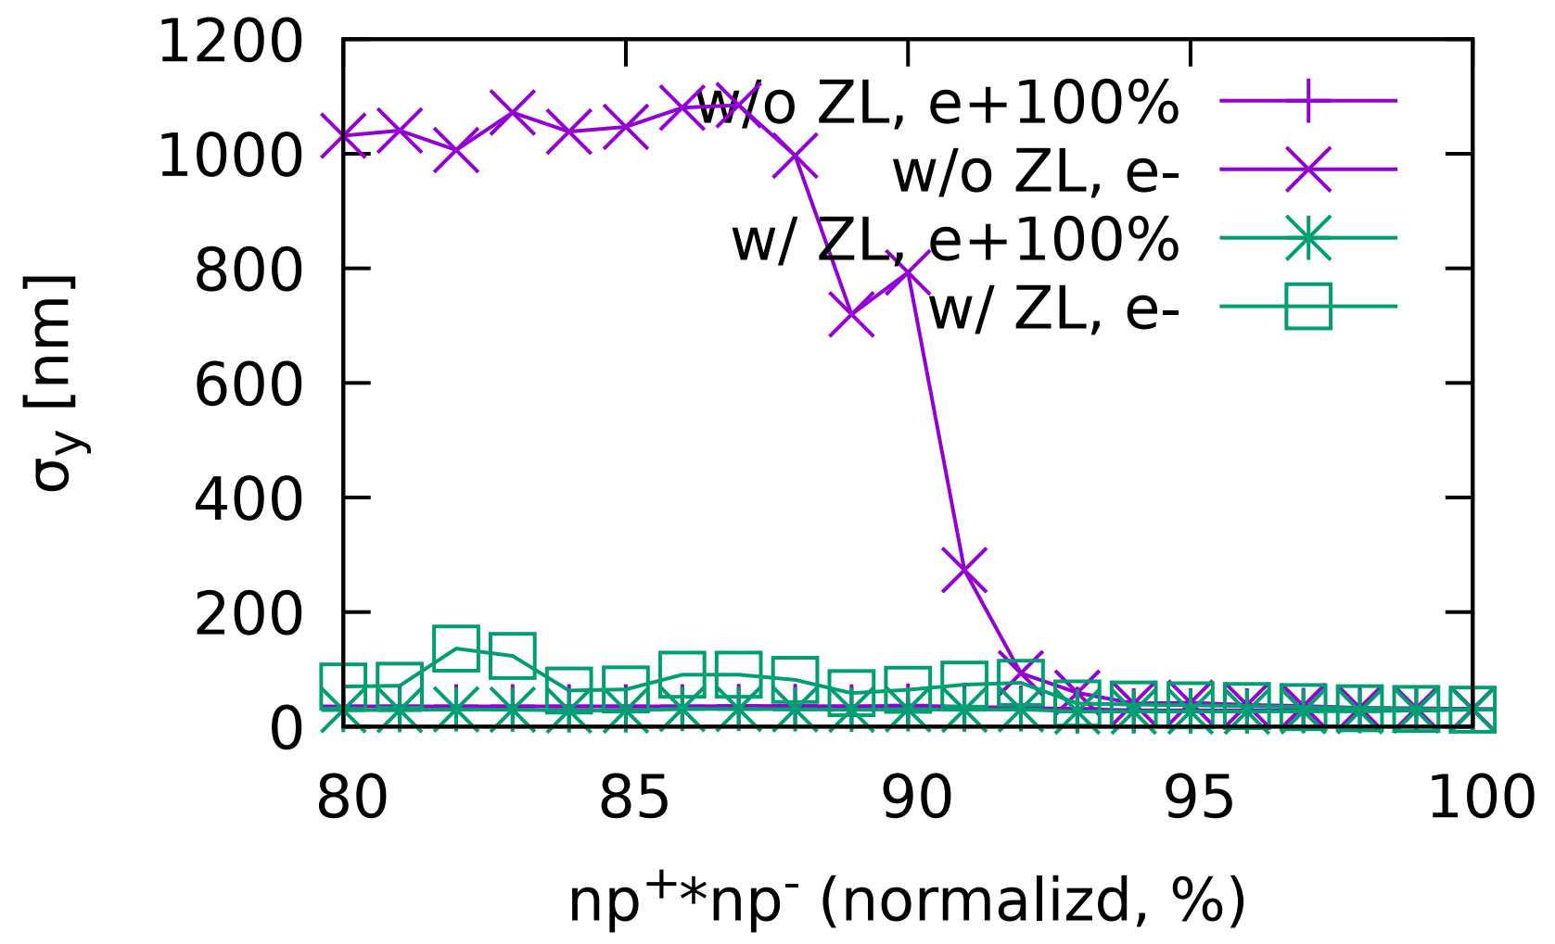
Z: asymmetrical collision
Only 5% asymmetry of bunch population could be accepted.

Slide 16
Effects of ZL
Longitudinal beam dynmics without longitudinal impedance
Longitudinal beam dynmics with longitudinal impedance
In conventional anlytical method, the longtidudinal beam parameters used in analysis are the ones which are unperturbed. It is natural to use the parameters perturbed by the longitudinal impedance.

Slide 17
Conventional method

Slide 18
New action discretization method

Slide 19
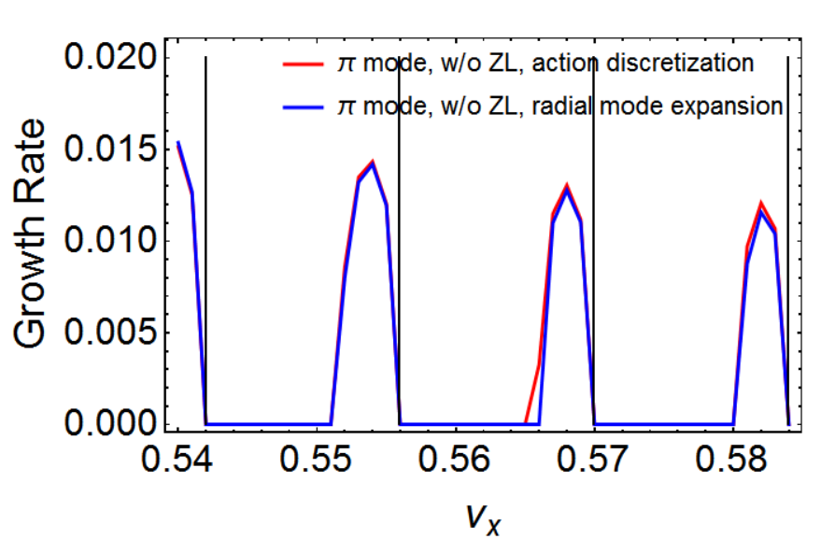
Comparison of two methods
Without ZL forбmode
Without ZL for л mode
Beam-beam interaction is replaced by a matrix form. The eigenvlaues of transformation matrix can be obtained to determine the stability of colliding bunches.

Slide 20
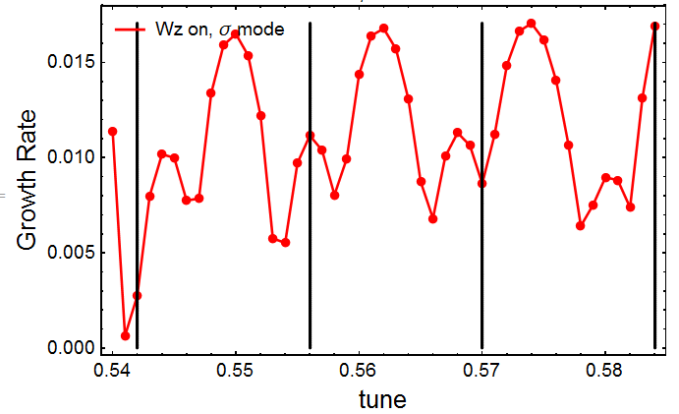
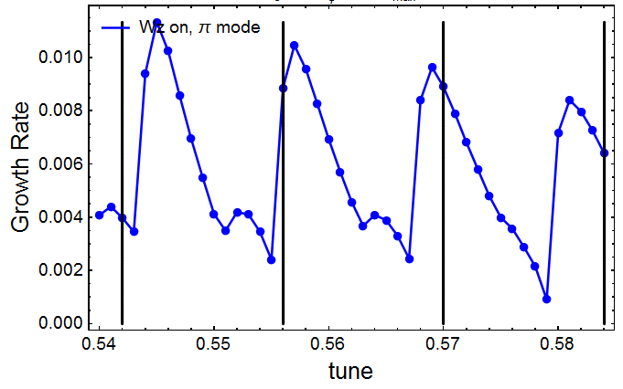
Eigenvalue problem for CEPC-Z with ZL (CEPC CDR parameters)
Growth rate versus tune with ZL forбmode
Growth rate versus tune with ZL for л mode
Comparing to the results without impedance, the original stable areas turn unstable for both бmode and л mode when we consider the influence of impedance.
Analysis work for new parameters is on-going.

Slide 21
Summary
Beamstrahlung lifetime is increased by ZL, while X-Z instability is enhanced
The X-Z instability is well suppressed at W/Z for newest machine parameters.
The stable working point space for CEPC-Higgs is about Qx~0.004 when considering ZL.
10% asymmetry of bunch population could be accepted for ttbar/Higgs/W. But only 5% asymmtry for Z.
New analysis method has been developed to understand the combined effect (BB+ZL)

