Slide 1

Collective instabilities in collider, booster and damping rings with the high luminosity
Na Wang, Yudong Liu, Yuan Zhang
IARC meeting, Oct. 12th, 2021, IHEP

Slide 2
Main beam parameters used in the calculations
Parameter [unit] | Z-High Lumi | Booster | Damping ring
Beam energy [GeV] | 45.5 | 20/45.5 | 1.1
L_{max}/IP (10³⁴cm⁻²s⁻¹) | 105.5 | / | /
Emittance (H/V) [nm] | 0.27/0.00135 | / | /
Beam current [mA] | 839.9 | 11.5/10.4 | 12.4
Bunch number | 11520 | 3833 | 4
Bunch Population [10¹⁰] | 15.2 | 0.63/0.57 | 0.95
Momentum compaction [10⁻⁵] | 1.43 | 1.12 | 0.013, 0.0075
Natural bunch length σ_{z} (mm) | 2.75 | 1.0/0.96 | 5
Natural energy spread | 3.78×10⁻⁴ | 1.6×10⁻⁴/3.7×10⁻⁴ | 0.056
Betatron tune ν_{x}/ν_{y} | 319.10/317.22 | 321.23/117.18 | 7.70/8.54, 9.28/10.11
Synchrotron tune | 0.032 | 0.069 | 0.0299, 0.0224
Radiation damping [ms] | 849.5/849.5/425.0 | 10.4×10³/879 | 11.4/11.4/5.7

Slide 3
Collective instabilities in the Collider
Impedance model is updated regarding the change of the chamber cross section (elliptical → circular), more impedance contributions included.
Instability issues for high luminosity Z are investigated
  Single bunch instabilities
  Coupled bunch instabilities
  Influence of impedance on beam-beam interaction
  Electron cloud
  Beam ion instability

Slide 4
Impedance model
Main impedance contributions are considered.
Inj./ext. elements, feedback kickers, absorbers are not included yet.
Element | Number | Element | Number
Resistive wall | / | BPMs | 1808
RF cavities | 60 | Collimators | 8
Flanges | 37714 | Electro separators | 20
Bellows | 15949 | IP chambers | 2
Gate valves | 500 | ES Transitions | 40
Vacuum pumps | 5316 | IP Transitions | 8

Slide 5
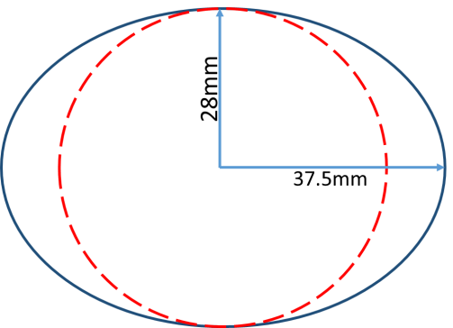
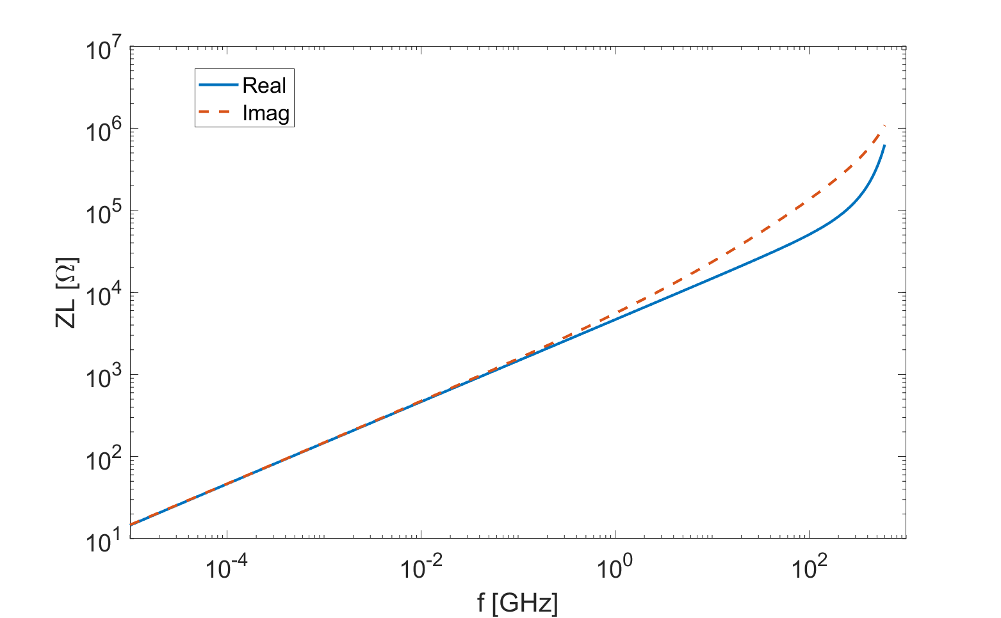
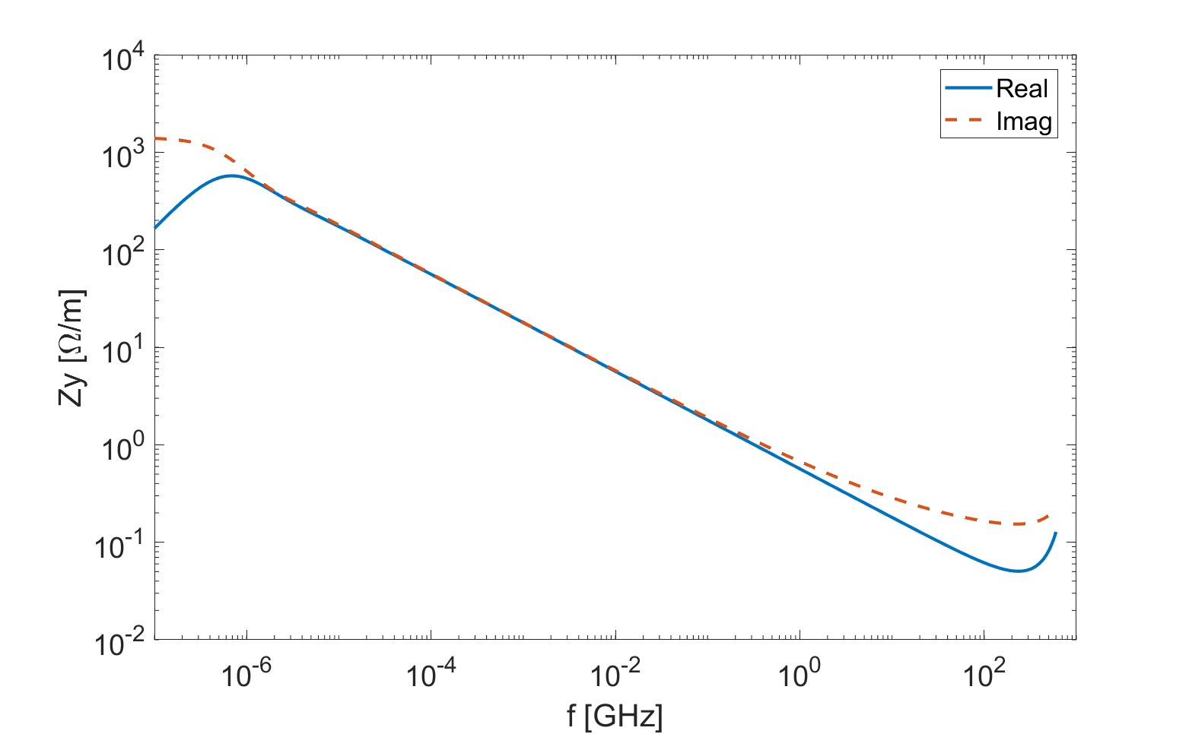
1. Resistive wall
Resistive wall impedance
  Cylindrical copper chamber: radius=28mm, thickness=3 mm
  NEG coating of 0.2 μm on the inner surface
  Multi-layer analytical formula of cylindrical pipe is used
PRST-AB 10, 111003 (2007)
σ_{cu}= 5.9E7 [S/m]
σ_{NEG}= 1.0E6 [S/m]

Slide 6
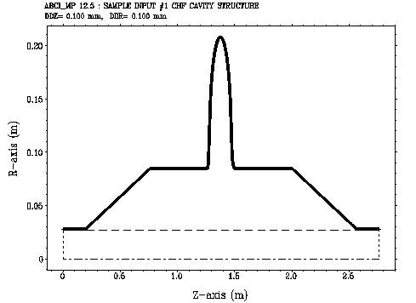
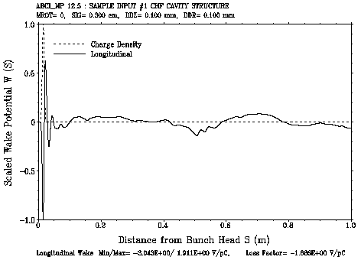
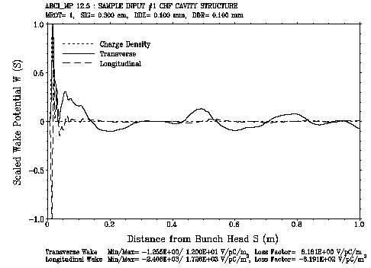
2. RF cavities
For high luminosity Z, 60 1cell superconducting RF cavities of 650MHz will be used. Taper transitions from the cavity to the ring beam pipe are considered.
The broadband impedances with exciting bunch length of 3mm are calculated and used for the study of the single bunch effects.

Slide 7
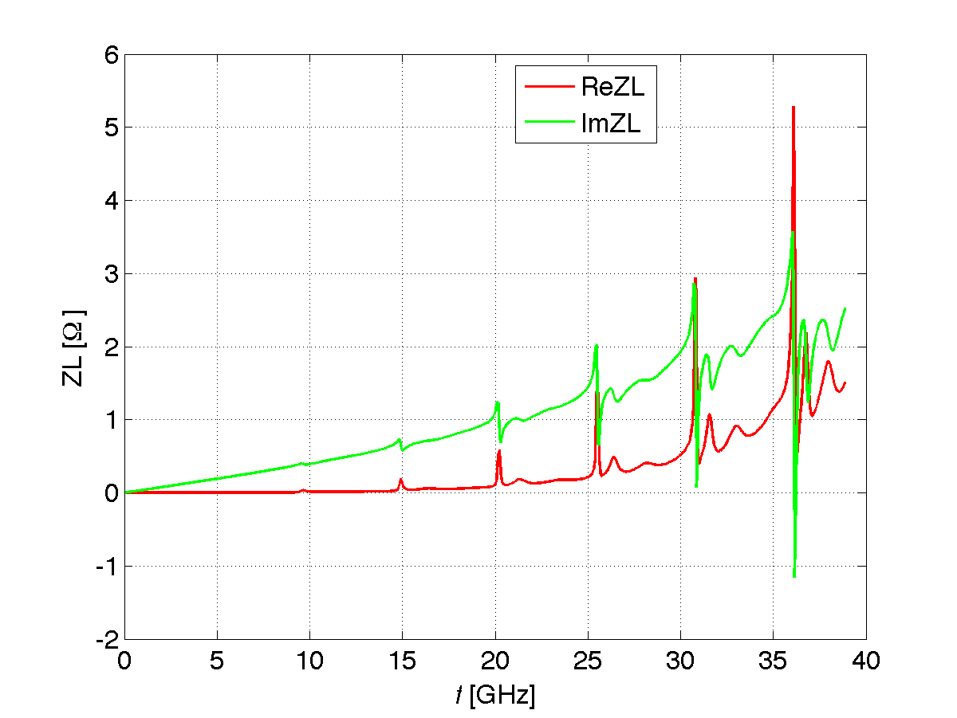
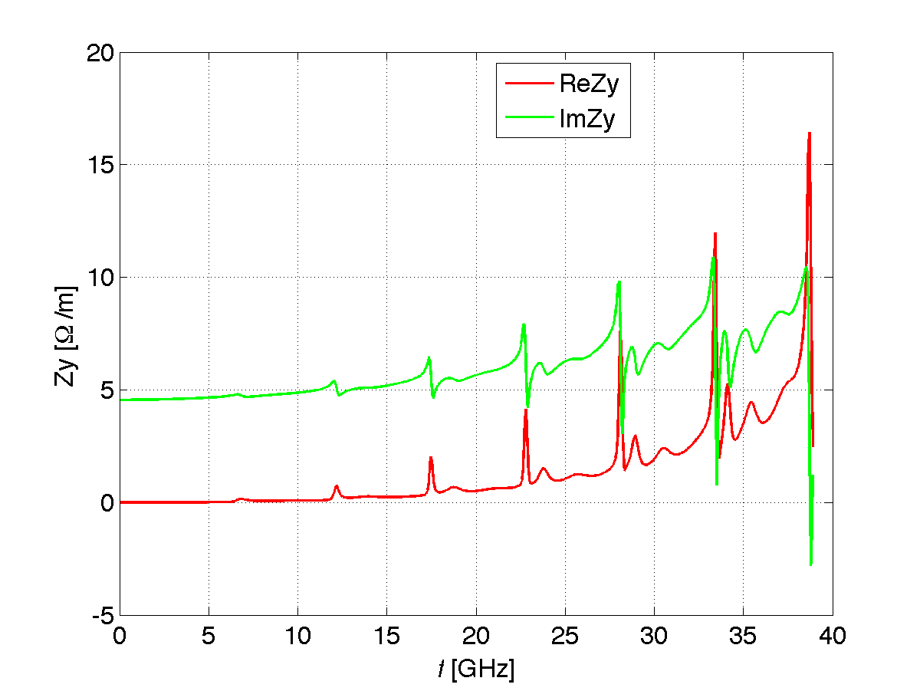
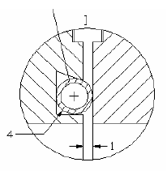
3. Flanges
RF shielding will be used to reduce the cavity structure of the flange gap.
The geometrical impedance is calculated with ABCI code.
One cylindrical cavity:
width = 1mm
depth = 1mm
SSRF or BEPCII design
The impedance is mainly broadband ⇒ one of the dominate contribution to the total broadband impedances, due to its large quantity (zero impedance flanges can be considered)
Small resonances exist above 15GHz.

Slide 8
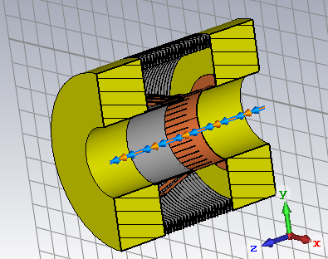
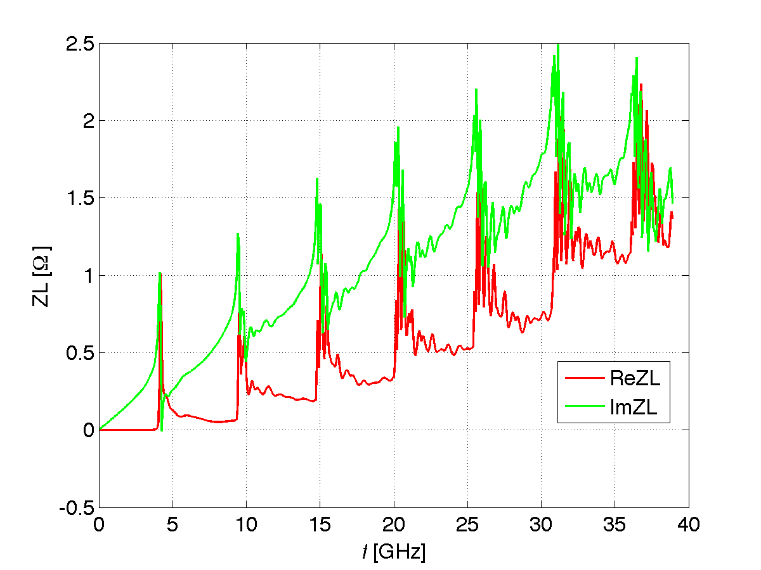
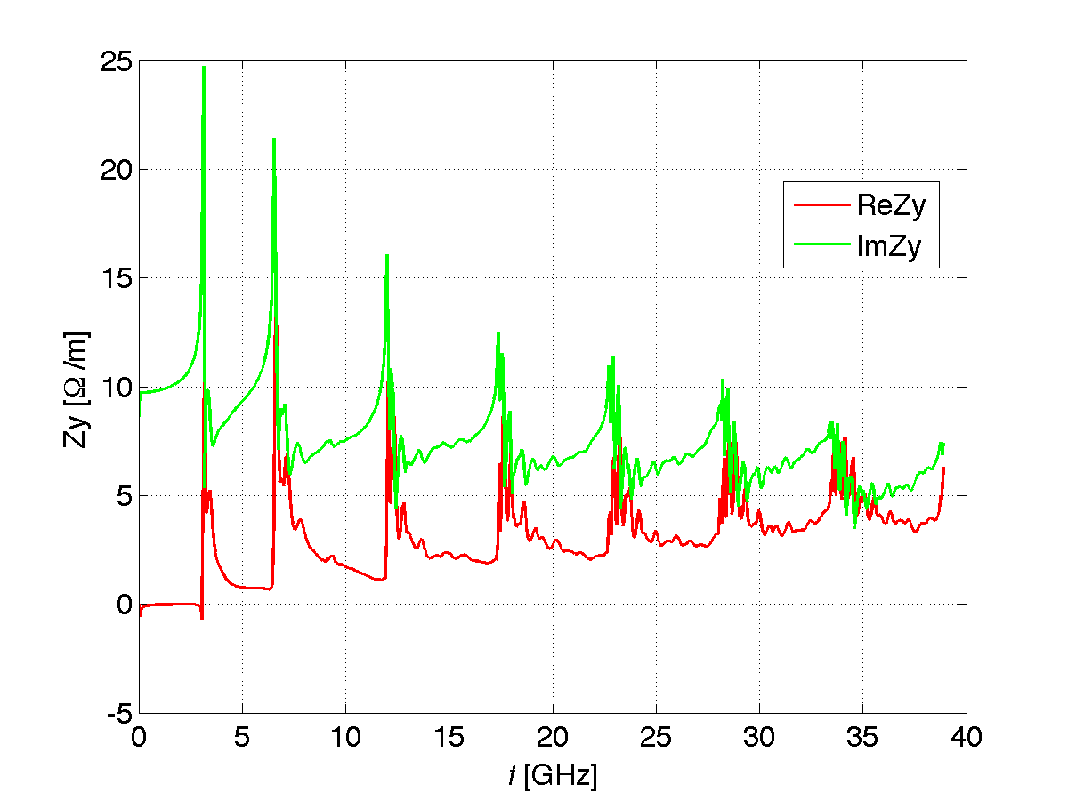
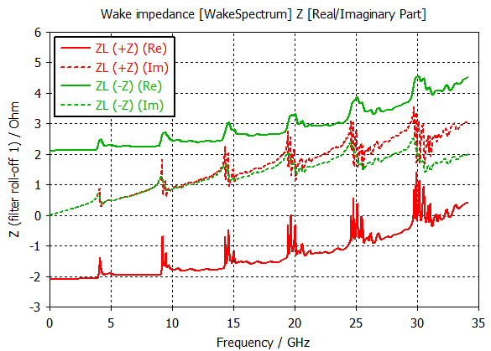
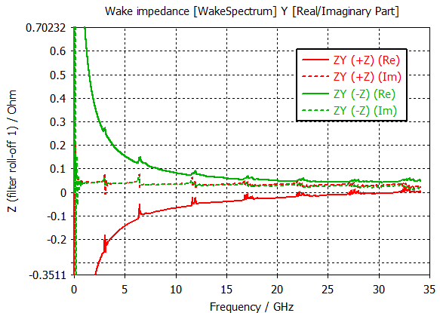
4. Bellows
The bellows are shielded by RF fingers, and the impedances are mainly contributed by the taper of the sliding fingers.
Studied with 2D simplified model and 3D model with fingers
ABCI
CST
Mainly broadband impedance, with narrow resonances at every ~5 GHz.
The imaginary part of impedances calculated by ABCI and CST are consistent, while the real part impedances given in CST depends on the beam directions.

Slide 9
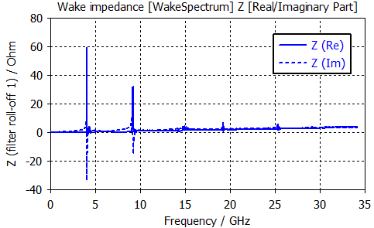
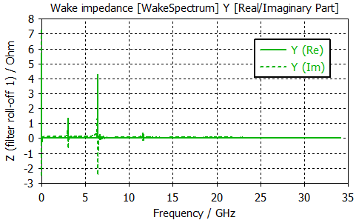
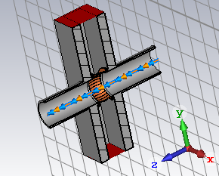
5. Gate Valves
Gate valves with RF shielding are adopted
3D model is used for the impedance calculation with CST
Narrow resonances exist both in longitudinal and transverse impedances
  Longitudinal resonances are well below the CBI threshold
  Transverse resonances close to the CBI threshold given by radiation damping

Slide 10
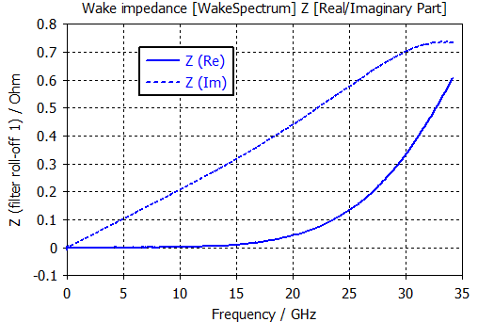
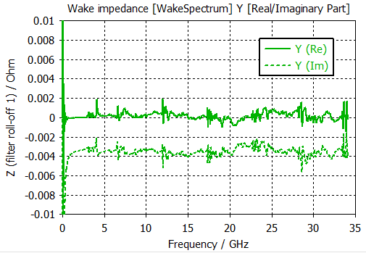
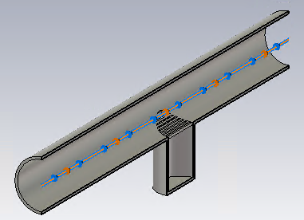
6. Vacuum pumps
The vacuum pumps will be RF shielded by the longitudinal slots
3D models are used for the impedance calculation with CST code
Contribute small broadband impedances in both planes

Slide 11
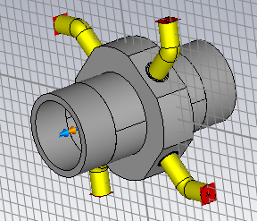
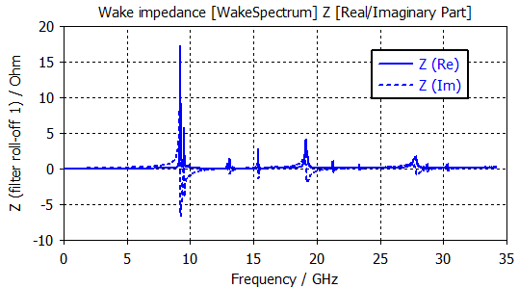
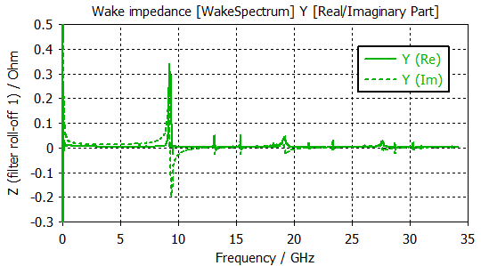
7. BPMs
3D model is used for the impedance calculation with CST
Resonances exist both in long. and trans. impedances
  All below the CBI threshold determined by radiation damping

Slide 12
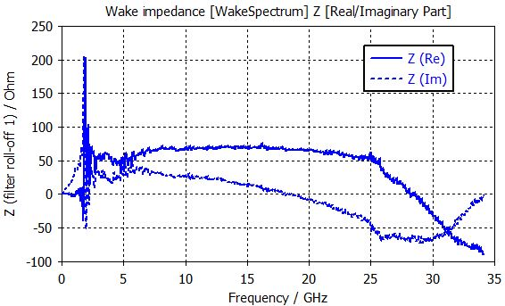
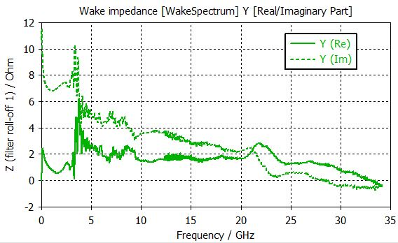
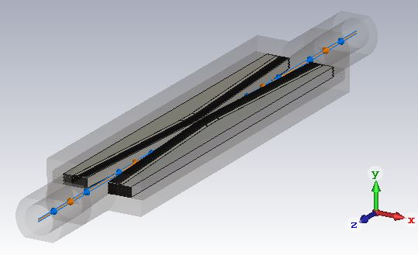
8. Collimators
Four movable horizontal collimators with minimum gap of 4.4mm are located around the interaction region.
The impedance is mainly broadband and show limited contribution to the total impedance.

Slide 13
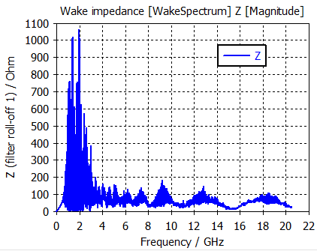
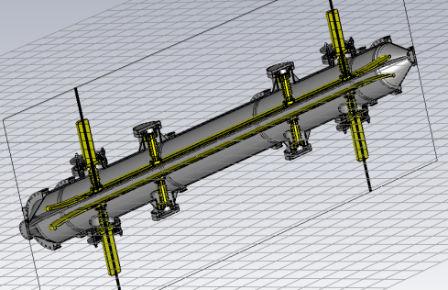
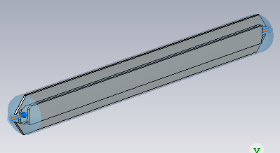
9. Electro separators
Total of 40 electro separators are used for orbit separations between the electron and positron beam orbit at the RF region.
Simplified model with PEC is used for impedance calculations.
  Rich of HOMs exist below 4GHz (wake not converged), more detailed studies are required, possible optimization maybe needed
  tapering end, HOM damper …
Simplified

Slide 14
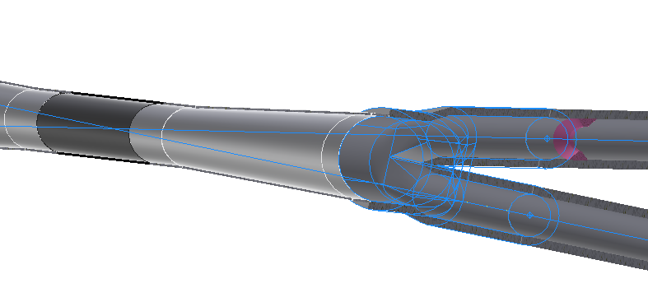
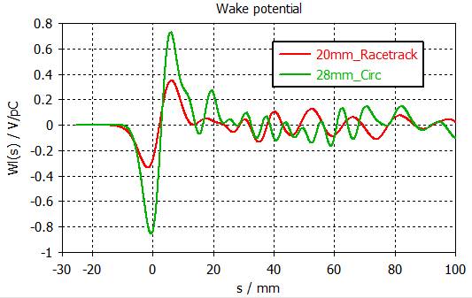
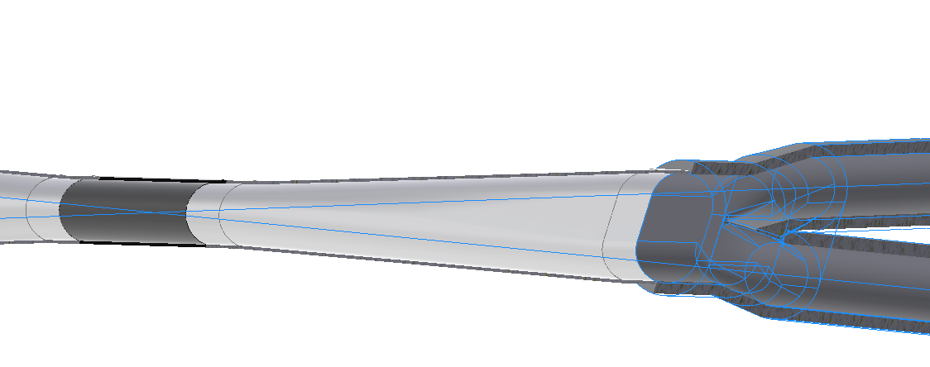
10. Interaction region
Former version
  Inner diameter at IP: 28 mm
  X: 28-40-(2-20)mm; Y: 28-40-20mm
Primary studies show that the loss factor is reduced by a factor of 3 with the new design.
More detailed studies are under going.
More details in Haijing’s talk
New version
  Inner diameter at IP: 20 mm
  X: 20-35-(2-20)mm; Y: 20-20-20mm

Slide 15
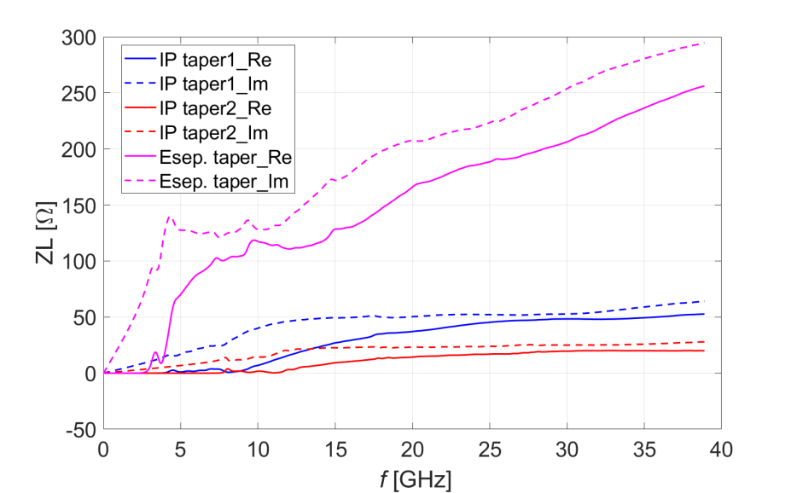
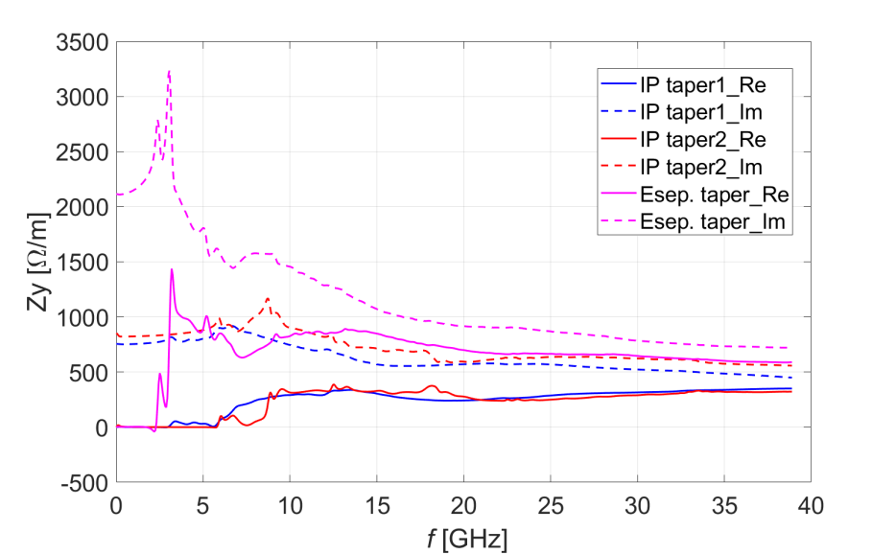
11. Transitions
Taper transitions with aspect ratio of 1/10 are used (except IP taper2 with length of 230mm).
With 2D simplified model, the impedances are calculated with ABCI.
 | Number | r1 [mm] | r2 [mm]
IP chamber taper1 | 4 | 15 | 28
IP chamber taper2 | 4 | 10 | 15
E-seperator taper | 40 | 37.5 | 28

Slide 16
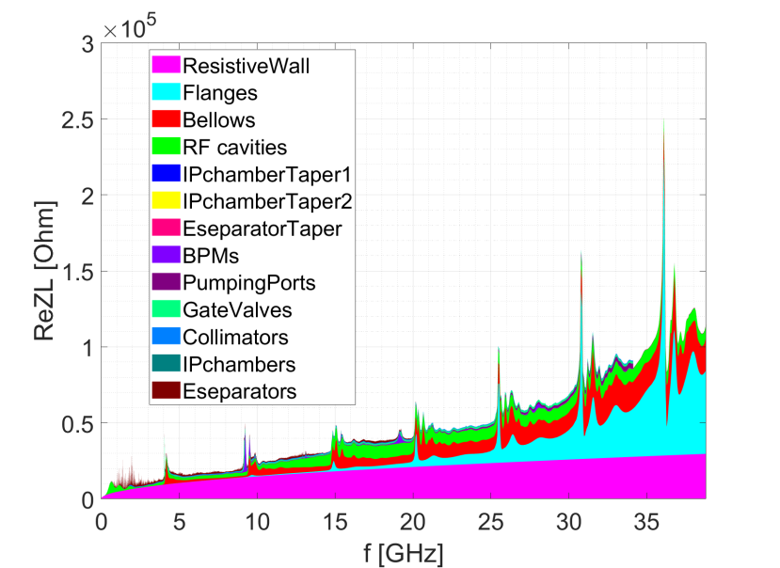
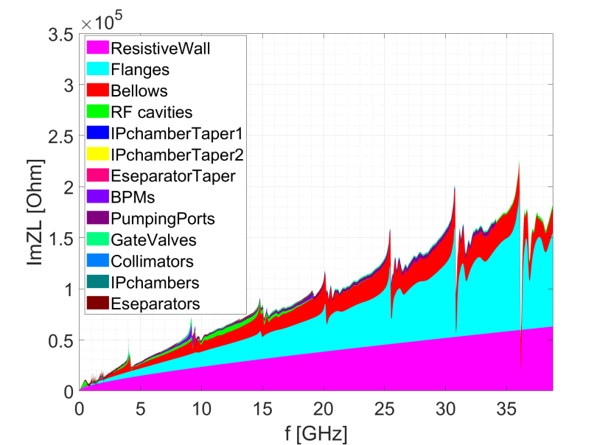
Ring longitudinal impedance
Broadband impedances are mainly contributed by: resistive wall, flanges, bellows, RF cavities.
Only broadband impedance considered for: RFs, IP chambers
Narrowband impedances need to be further checked.

Slide 17
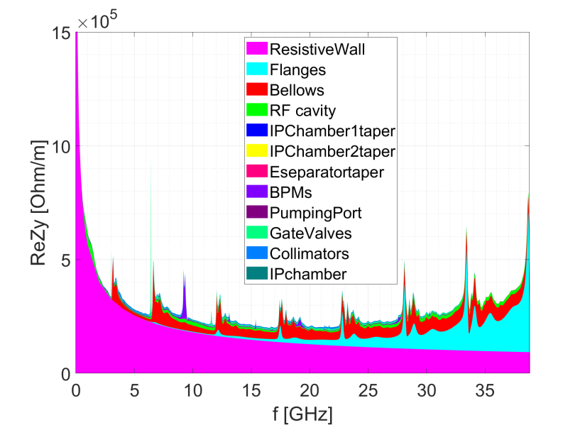
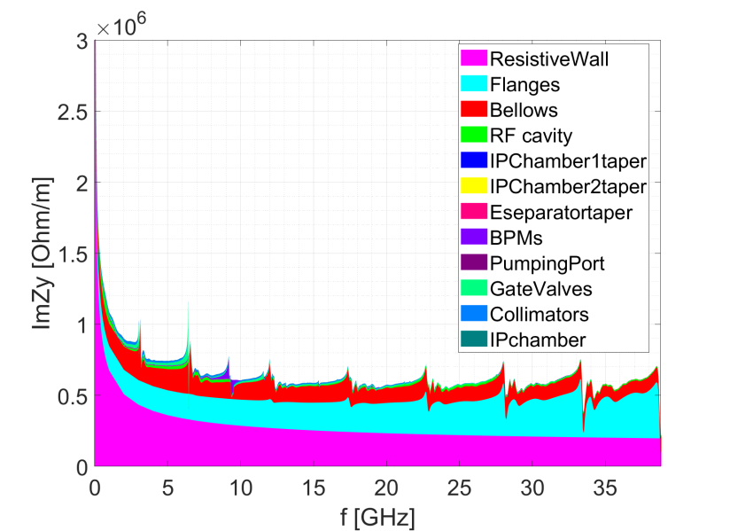
Ring transverse impedance
Broadband impedances mainly contributed by: resistive wall, flanges, bellows.
Only broadband impedance considered for: RFs, IP chambers
Narrowband impedances need to be further checked.

Slide 18
Total impedance budget @3mm
Components | Number | Z||/n, mΩ | k_{loss}, V/pC | ky, kV/pC/m
Resistive wall | - | 6.2 | 363.7 | 11.3
RF cavities | 60 | 0.5 | 101.2 | 0.5
Flanges | 37714 | 5.2 | 37.3 | 5.2
BPMs | 1808 | 0.04 | 9.5 | 0.2
Bellows | 15949 | 2.9 | 87.4 | 3.9
Gate Valves | 500 | 0.2 | 14.5 | 0.4
Pumping ports | 5316 | 0.3 | 2.3 | 0.2
Collimators | 8 | 0.02 | 11.7 | 0.3
IP chambers | 2 | 0.004 | 0.3 | 0.05
Electro-separators | 20 | -0.1 | 34.5 | 0.1
Taper transitions | 48 | 0.04 | 2.5 | 0.09
Total |  | 15.3 | 664.9 | 22.2
CDR Total |  | 11.4 | 786.8 | 20.2
Longitudinal and transverse broadband impedances are dominated by the RW, flanges and bellows.
The loss factor is mainly contributed by the resistive wall, RF cavities and bellows.
Compare to the CDR budget, we have larger Z/n and k_{y}, but smaller k_{loss}.

Slide 19
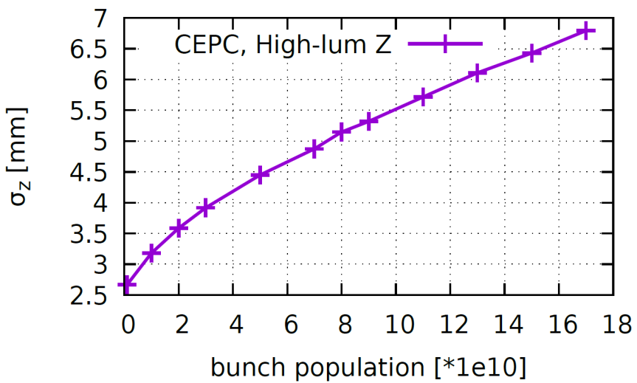
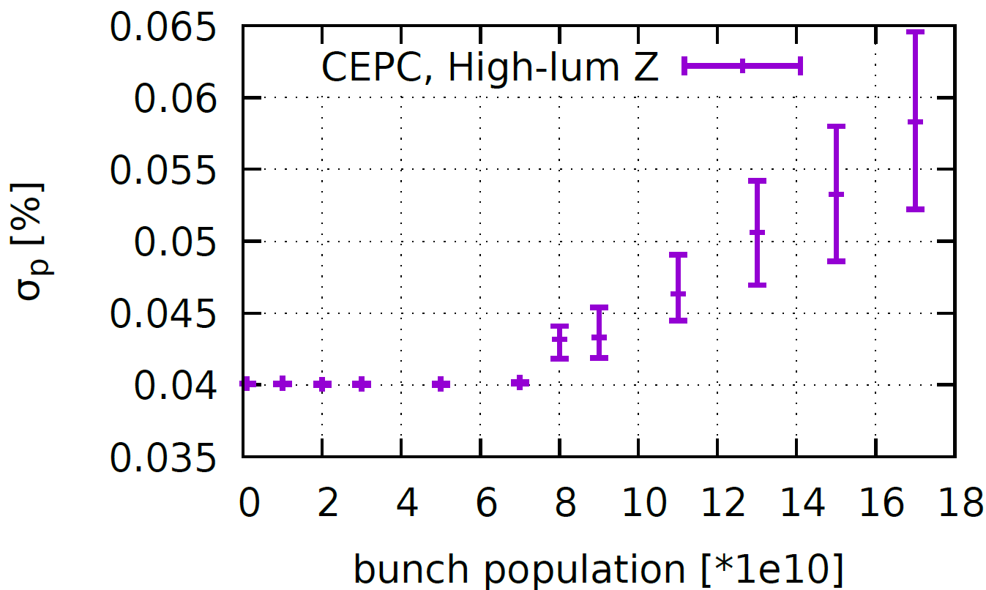
MWI instability and bunch lengthening
Rarely induce beam losses, but may reduce the luminosity due to the deformed beam distribution and increasing of the beam energy spread.
The instability threshold is about half of the design bunch intensity.
σ_{l} with ZL [mm] (σ_{l}/σ_{l0}-1) | 6.5 (140%)
σ_{e}/σ_{e0}-1 | 35%
Design
Design

Slide 20
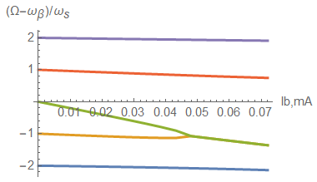
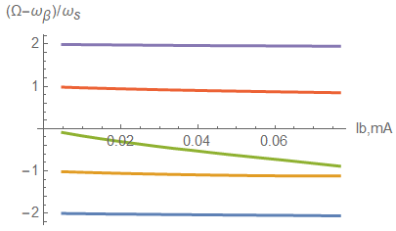
Transverse mode coupling instability
Fast instability, normally with beam losses.
The instability threshold extend from 45μA to 85uA when considering bunch lengthening due to the longitudinal impedance.
The instability will be further detuned when considering the bunch lengthening due to the beamstrahlung.
W/O ZL
W/ ZL
Design
Design

Slide 21
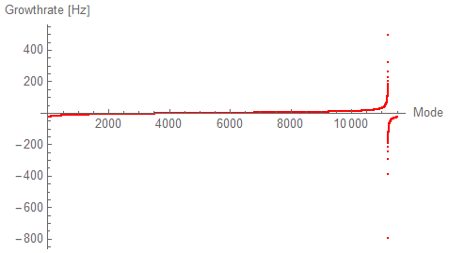
Transverse resistive wall instability
The coupled bunch instability can be driven by the resonance at zero frequency of the transverse resistive wall impedance.
An efficient bunch by bunch feedback damping of ~3 turns is required.
 | Z-High Lumi
Instability growth time [ms] | 2.0 (~6 turns)
Radiation damping [ms] | 840
Bunch by bunch feedback [ms] | 1.0 (~3 turns)
Growth time of the most dangerous mode vs. damping factors

Slide 22
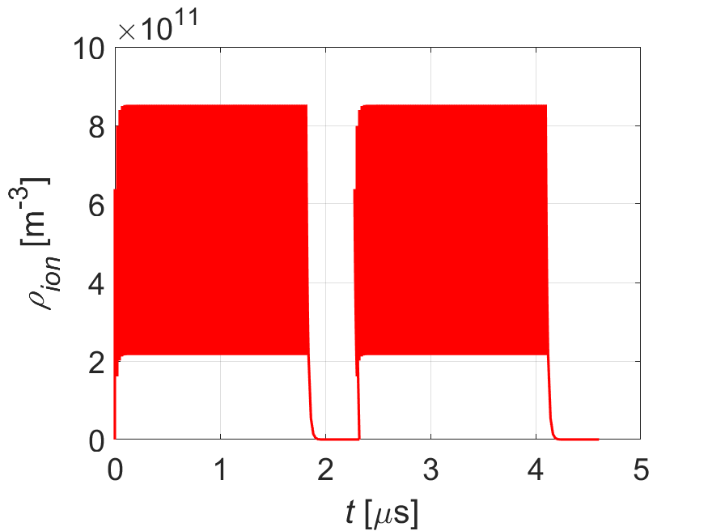
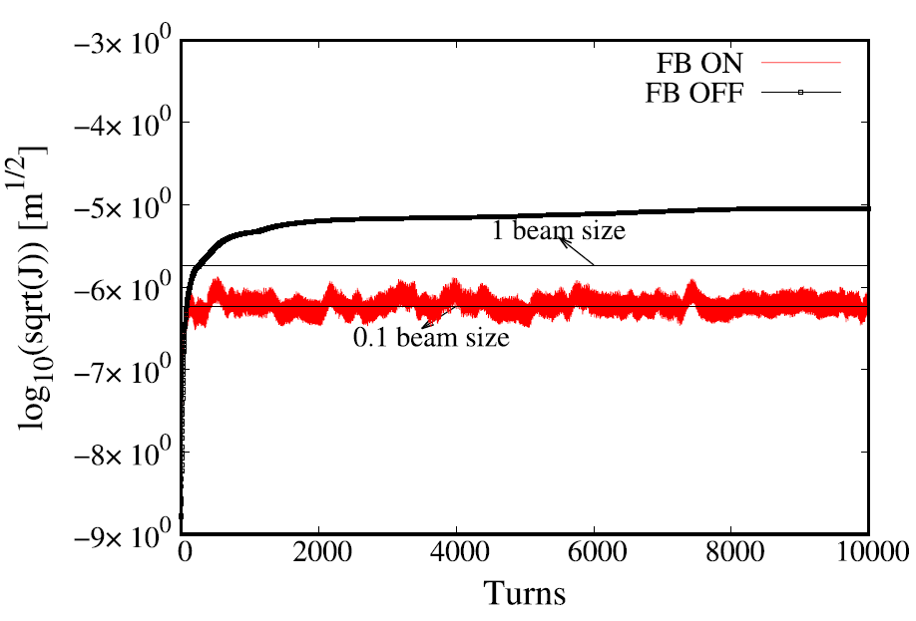
Beam ion instability
Induce emittance blow-up and a positive tune shift along the bunch train.
Filling pattern: {Ntrain=144, Bunch spacing=23ns, Gap=492ns}
Emittance growth due to the beam ion interaction are foreseen.
Parameters | Z-30MW
L_{sep}ω_{ion}/c₀ | 0.8
ρ_{ion,ave}[m⁻³] | 4.3E11
τ_{e} [ms] | 0.1
τ_{H} [ms] | 4.0
Δν_{y} | 0.016
PRAB, 23, 074401 (2020)
Build-up of ions along the bunch train
Bunch by bunch feedback can be effective on damping this effect

Slide 23
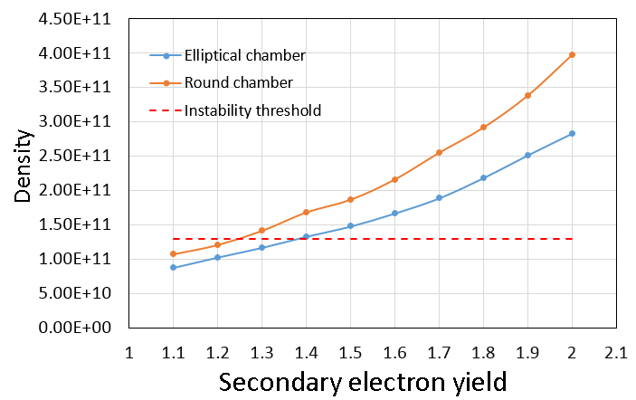
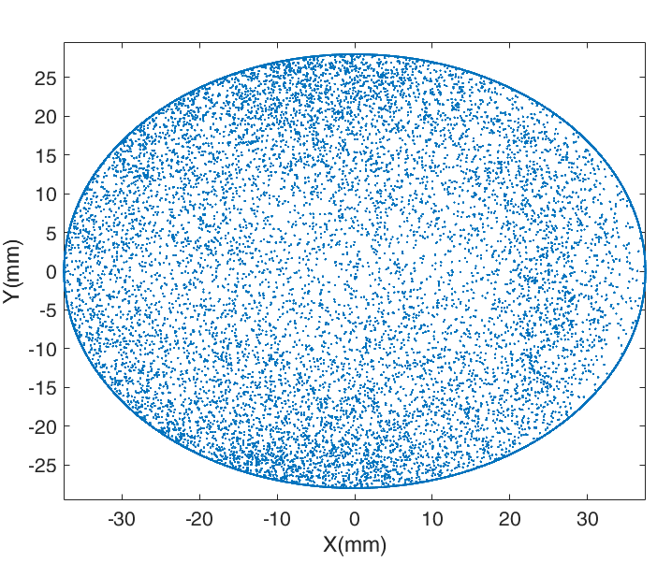
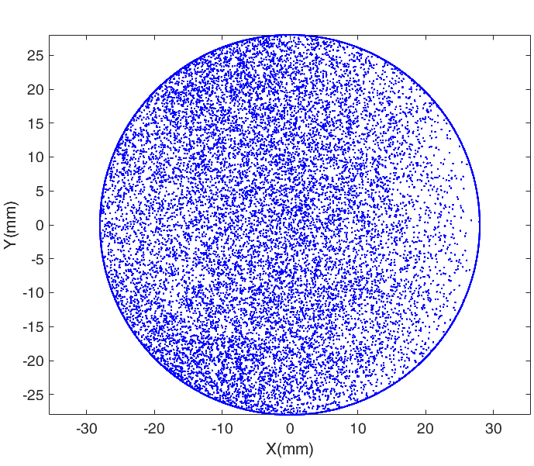
Electron cloud
The electron density is increased due to the change of the chamber cross section. The SEY needs to be reduced to <1.2 by introducing NEG coating.
More detailed simulations as well as evaluation of its induced heating are under going.
Elliptical chamber: SEY<1.3
Round chamber: SEY<1.2

Slide 24
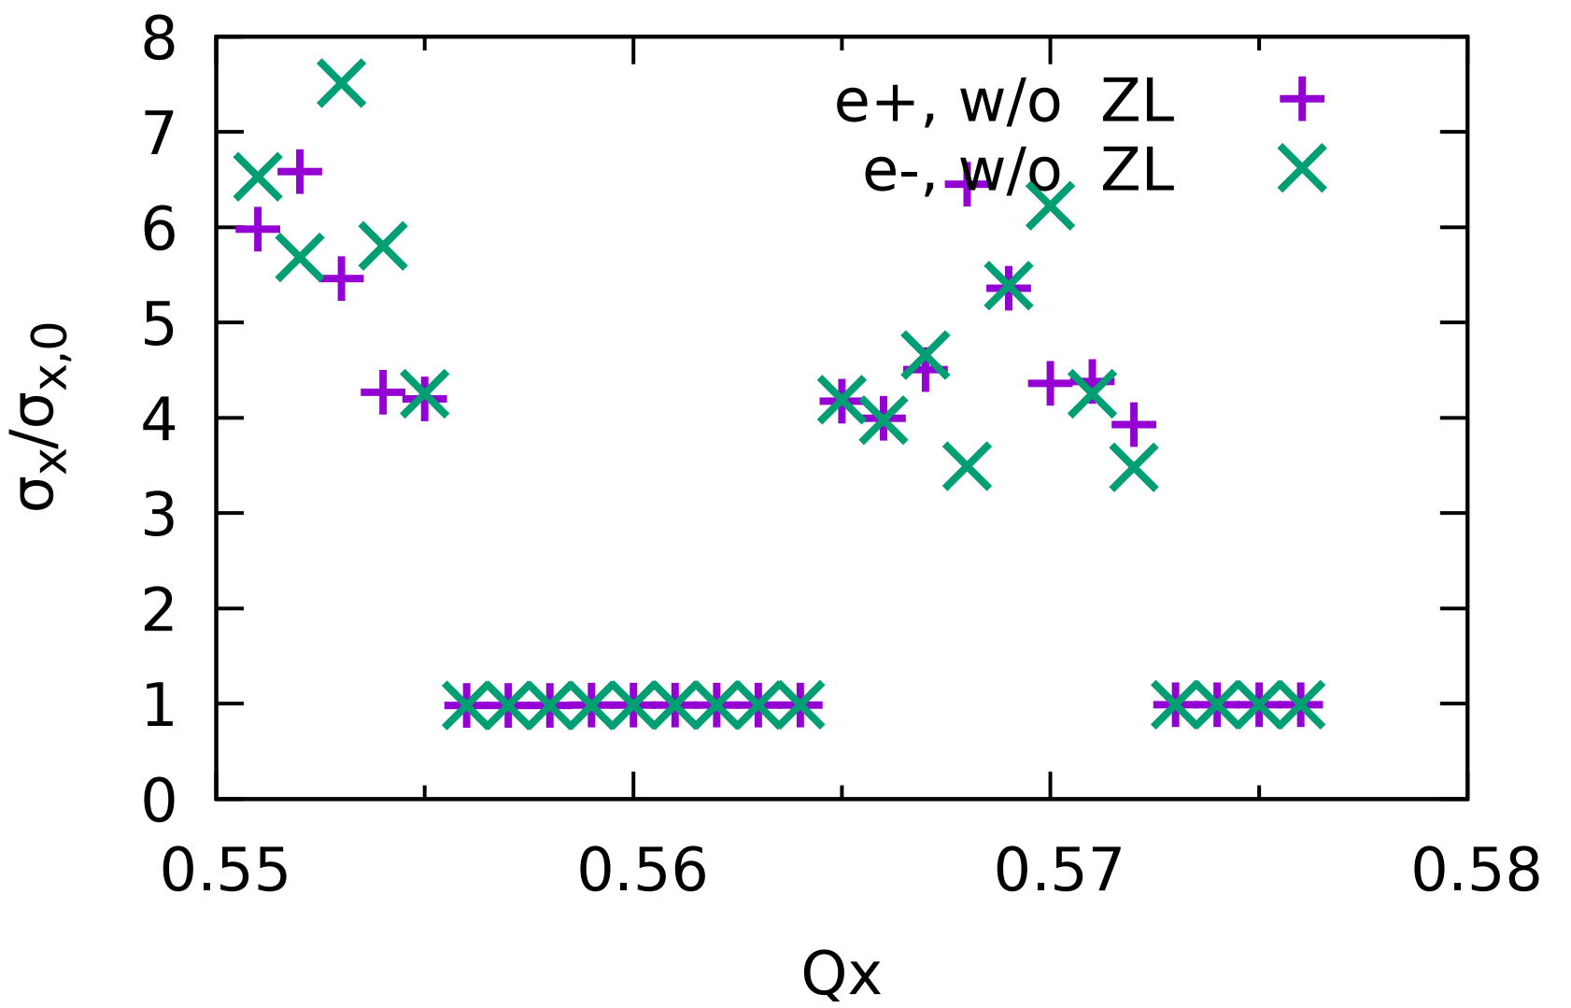
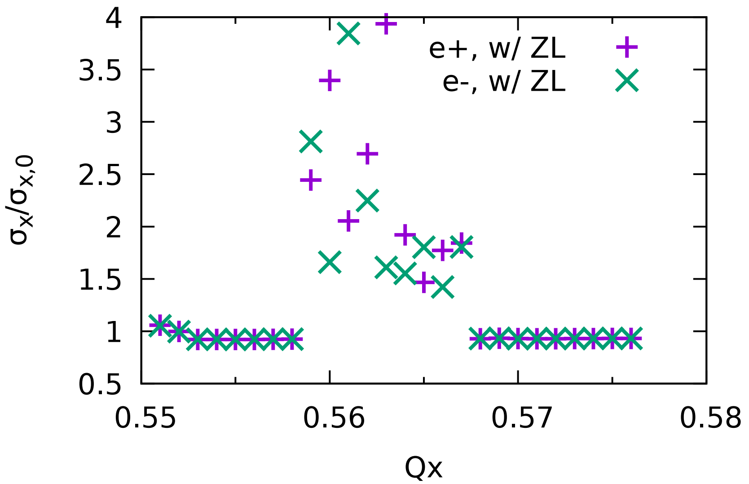
Beam beam interaction with impedance
Less stable region obtained with impedance included in the beam-beam simulation consistently.
The beam-beam interaction gets more unstable with longitudinal impedance due to the X-Z coupling.
CDR impedance is used in these plots
The stable region shrunk and shifted
Notes:
We also investigated the influence of impedance on the beam beam interaction.
It has been observed that the beam …
These two plots shows the increase of transverse beam size versus horizontal tune, without impedance and with impedance. Here we should note that the CDR impedance has been used in the studies.
We can see that the stable region of beam beam interaction will be shrunk and shifted.

Slide 25


Beam-beam interaction with impedance
With the real/imaginary longitudinal impedance roughly multiplied by a factor, the influence of the impedance on the beam-beam interaction is further investigated.
ReZL (0.5→1→2), ImZL (1)
CDR impedance is used in these plots
Distinct influence shown with the real part of the impedance increased by a factor of 2
Locations of the stable regions are mainly fixed.

Slide 26



Beam-beam interaction with impedance
ReZL (1), ImZL (0.5→1→2)
CDR impedance is used in these plots
Reasonable large stable region even with the imaginary part of the impedance increased by a factor of 2, only with shift of the stable region.
Similar impact of the real and imaginary impedance on the MWI instability threshold.

Slide 27






Beam-beam interaction with impedance
More interesting results
CDR impedance is used in these plots
To optimize the impedance to mitigate this effect, the real part of impedance should be well controlled, while the imaginary part can be more relaxed.

Slide 28
Summary on Collider
No apparent showstoppers for ttbar, Higgs, W
Main constraints for High-lumi Z include:
  Longitudinal impedance will induce bunch lengthening and beam energy spread increase, as well as reduce the stable region of beam-beam interaction.
  TMCI is OK considering bunch lengthening induced by longitudinal impedance.
  Transverse resistive wall instability needs an efficient feedback damping time of ~3 turns
  Ecloud needs an SEY of less than 1.2 or adding antechambers.
  Emittance growth due to the beam ion effect are foreseen ⇒ feedback system is needed to damp this effect.
  CBI due to HOMs needs to be further checked.

Slide 29


Collective instabilities in the Booster
Resistive wall (r=27.5mm, thick=2mm, Aluminum)
Transverse resistive wall instability growth time
Beam energy [GeV] | τ [ms]
20 | 38
45.5 | 96
ω₀
The growth times are much faster than the radiation damping (Inj./Ext.=10.4s/880ms)
⇒ Bunch by bunch feedback needed or a positive chromaticity can help
The wake field will penetrate the beam pipe at around the revolution frequency
Beam can see the material outside the chamber
Increase the chamber thickness or more detailed investigation considering the background material

Slide 30
Collective instabilities in the Booster
Single bunch instabilities
  Safety margin reserved!
Coupled bunch instability threshold
  Much more relaxed compare to the collider ring

Slide 31


Collective instabilities in the damping ring
Requirements on the beam quality
  Increase on the bunch length, beam energy spread and emittance should be less than 20%
Resistive wall (r=15mm, thick=2mm, Aluminum)

Slide 32


Collective instabilities in the damping ring
Enough safety margin for the single bunch instabilities
Bunch lengthening due to the longitudinal resistive wall impedance
Growth time for the transverse resistive wall instability is ~100 ms ⇒ can be damped by the synchrotron radiation
Requirements on the shunt impedance of the HOMs
The increase of bunch length is ~1% with only resistive wall impedance.

Slide 33
Summary on Booster and damping ring
Bunch by bunch feedback is needed for the Booster to damp the resistive wall instability. Background material needs to be considered or a thicker beam pipe should be chosen to avoid field penetration around the revolution frequency.
With only resistive wall impedance, both rings have some safety margin for the single bunch effects.
Requirements on the shunt impedance of the HOMs are given by the synchrotron radiation damping.

Slide 34
Thank you for your attention!

