Slide 1

CEPC SRF System Progress on Cavities and Modules
Jiyuan Zhai (IHEP)
On behalf of CEPC SRF R&D team
2nd CEPC International Accelerator Review Committee Meeting in 2021
October 13, 2021

Slide 2
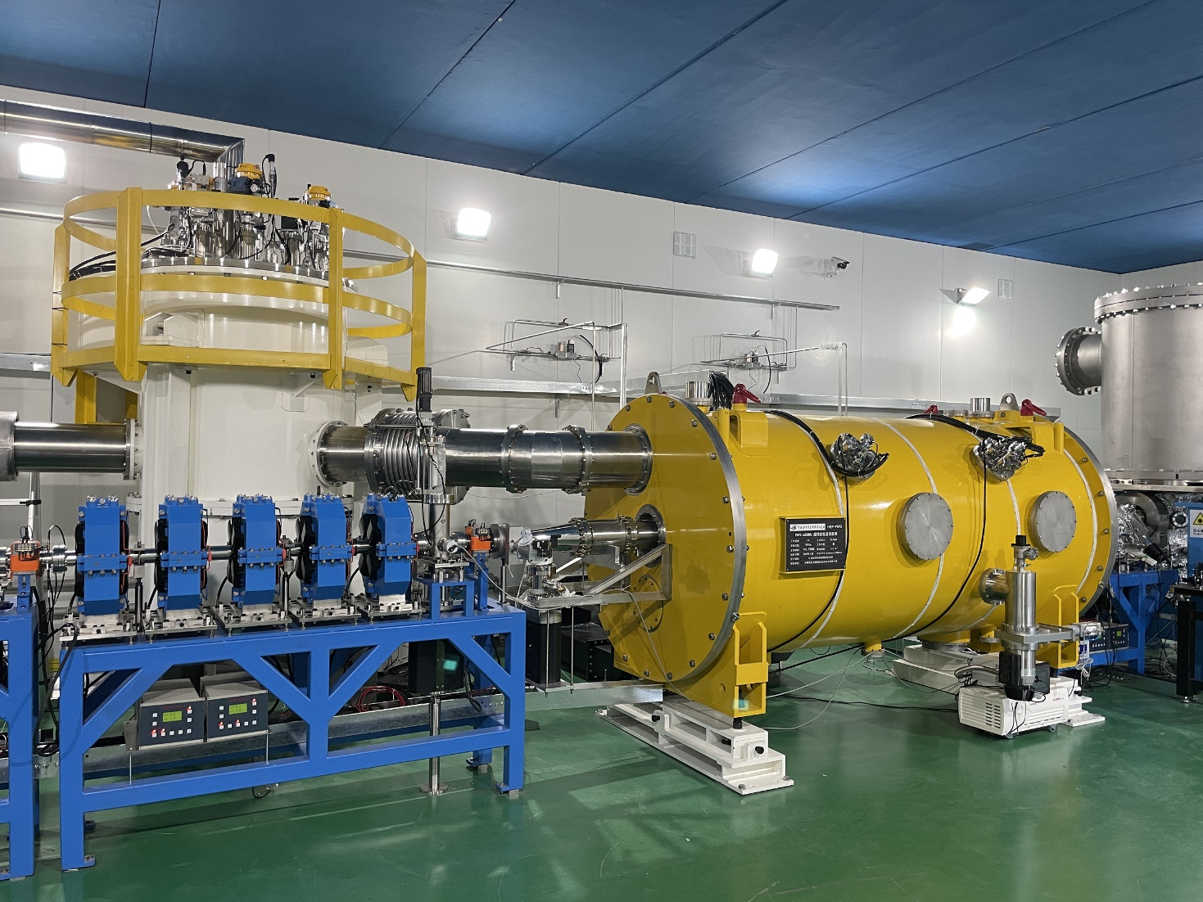
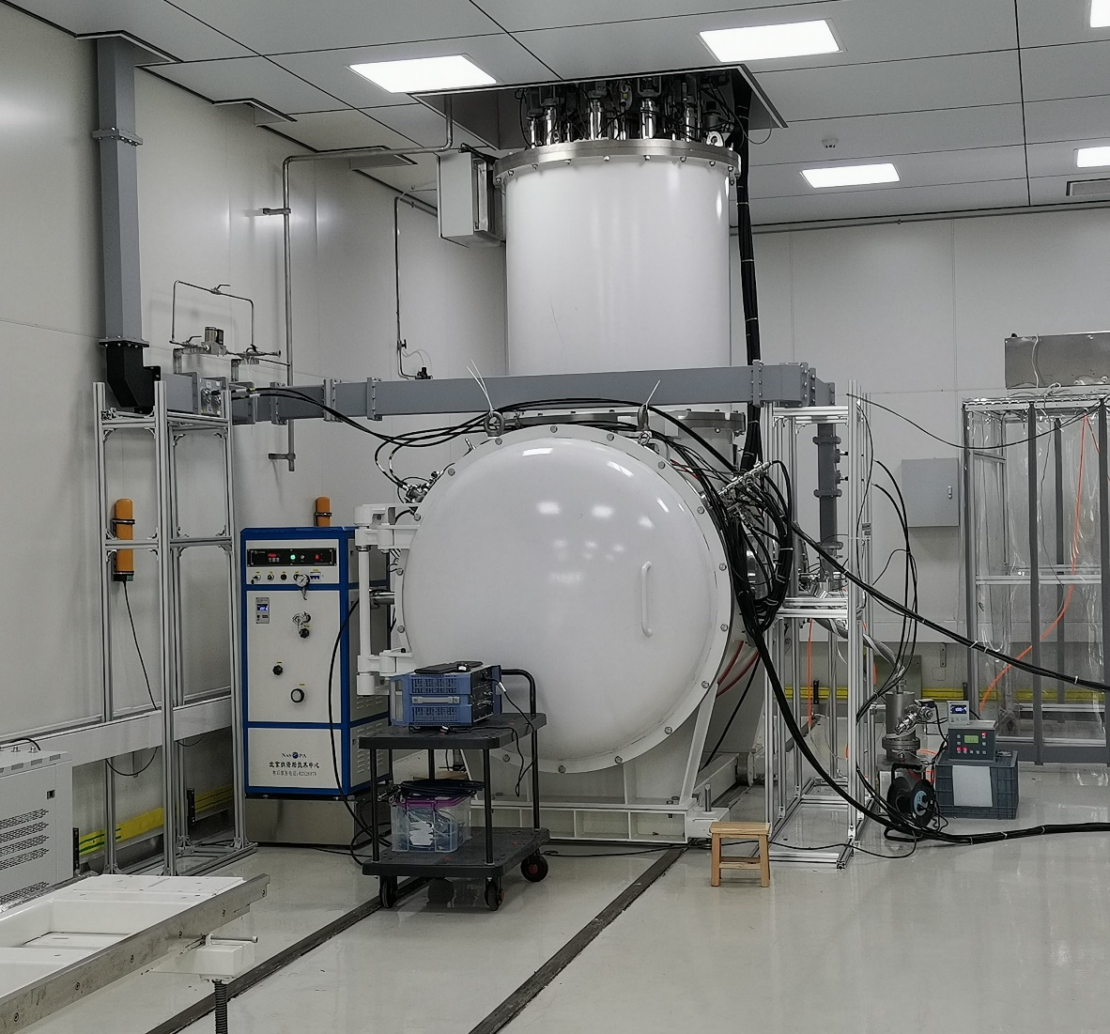
Outline
650 MHz cavity and module
1.3 GHz cavity and module

Slide 3
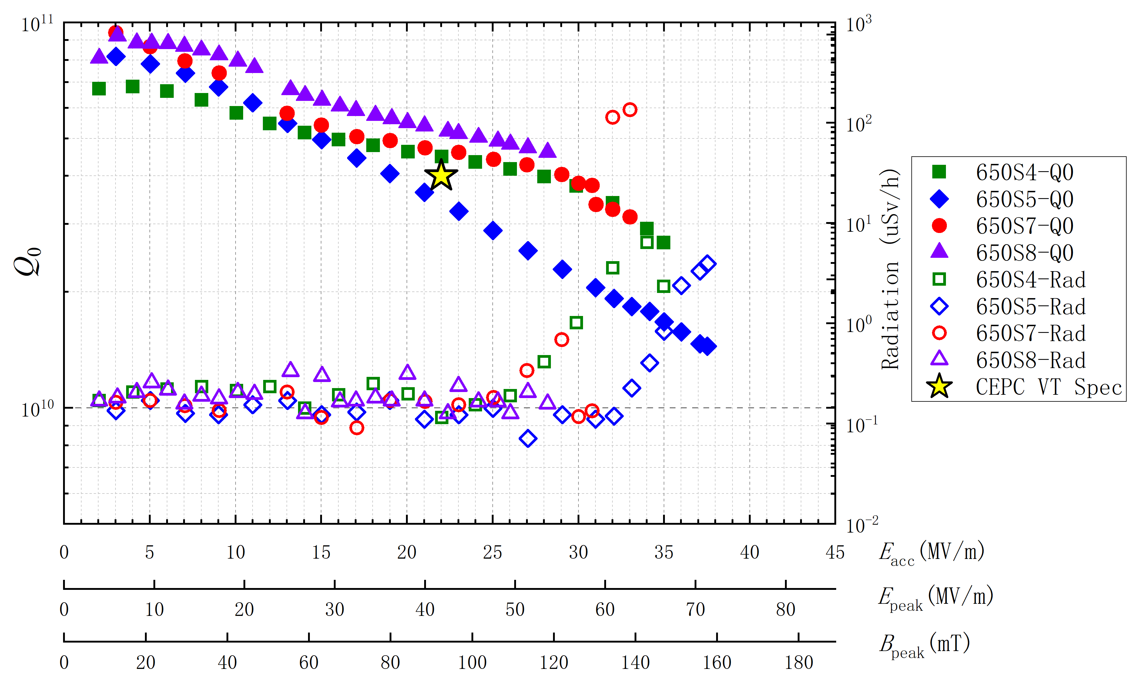
650 MHz 1-cell Cavity
Cavity | Processing | Result
650S4 (FG) | Bulk BCP 200 um + light EP 20 um + 950C 3h + light EP 20 um + 120C 48h | 2.7E10@ 35.0MV/m
650S7 (LG) | Bulk FP 200 um + 950C 3h + light EP 20 um + 900C 3h + light EP 20 um + 120C 48h | 3.1E10@ 33.0MV/m
650S5 (FG) | Bulk EP 200 um + 120C 48h | 1.5E10@ 37.5MV/m
650S8 (LG) | Bulk BCP 200 um + light EP 20 um + 950C 3h + light EP 20 um + 120C 48h | 4.6E10@ 28.2MV/m

Slide 4
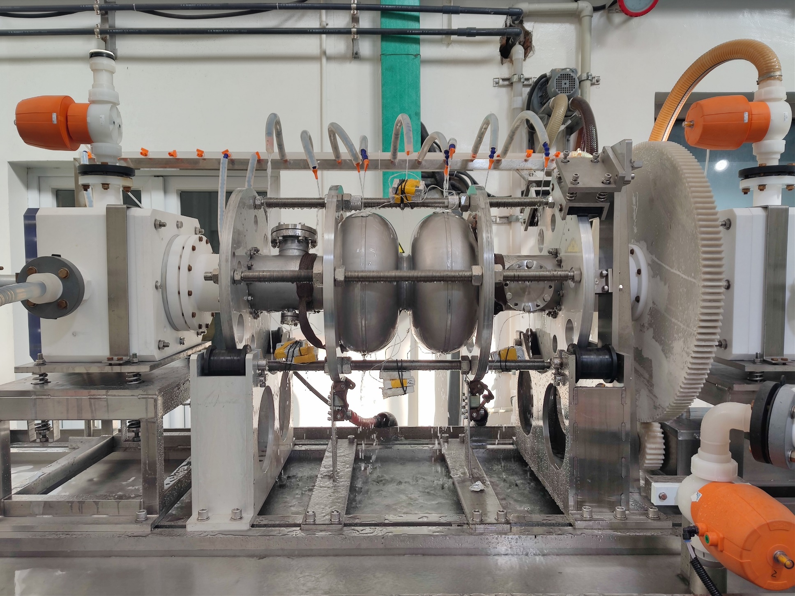
650 MHz 2-cell Cavity EP
Studies on EP process for 650 MHz 2-cell cavities were carried on.
New jigs and cathodes special for the EP on 650 MHz 2-cell cavities was made.
Parameters were scanned and optimized for the process like voltage, temperatures, flow rates and so on.
Some technological processes like on-site DI water cleaning were re-developed.
The new-treated cavities will be ready soon.

Slide 5
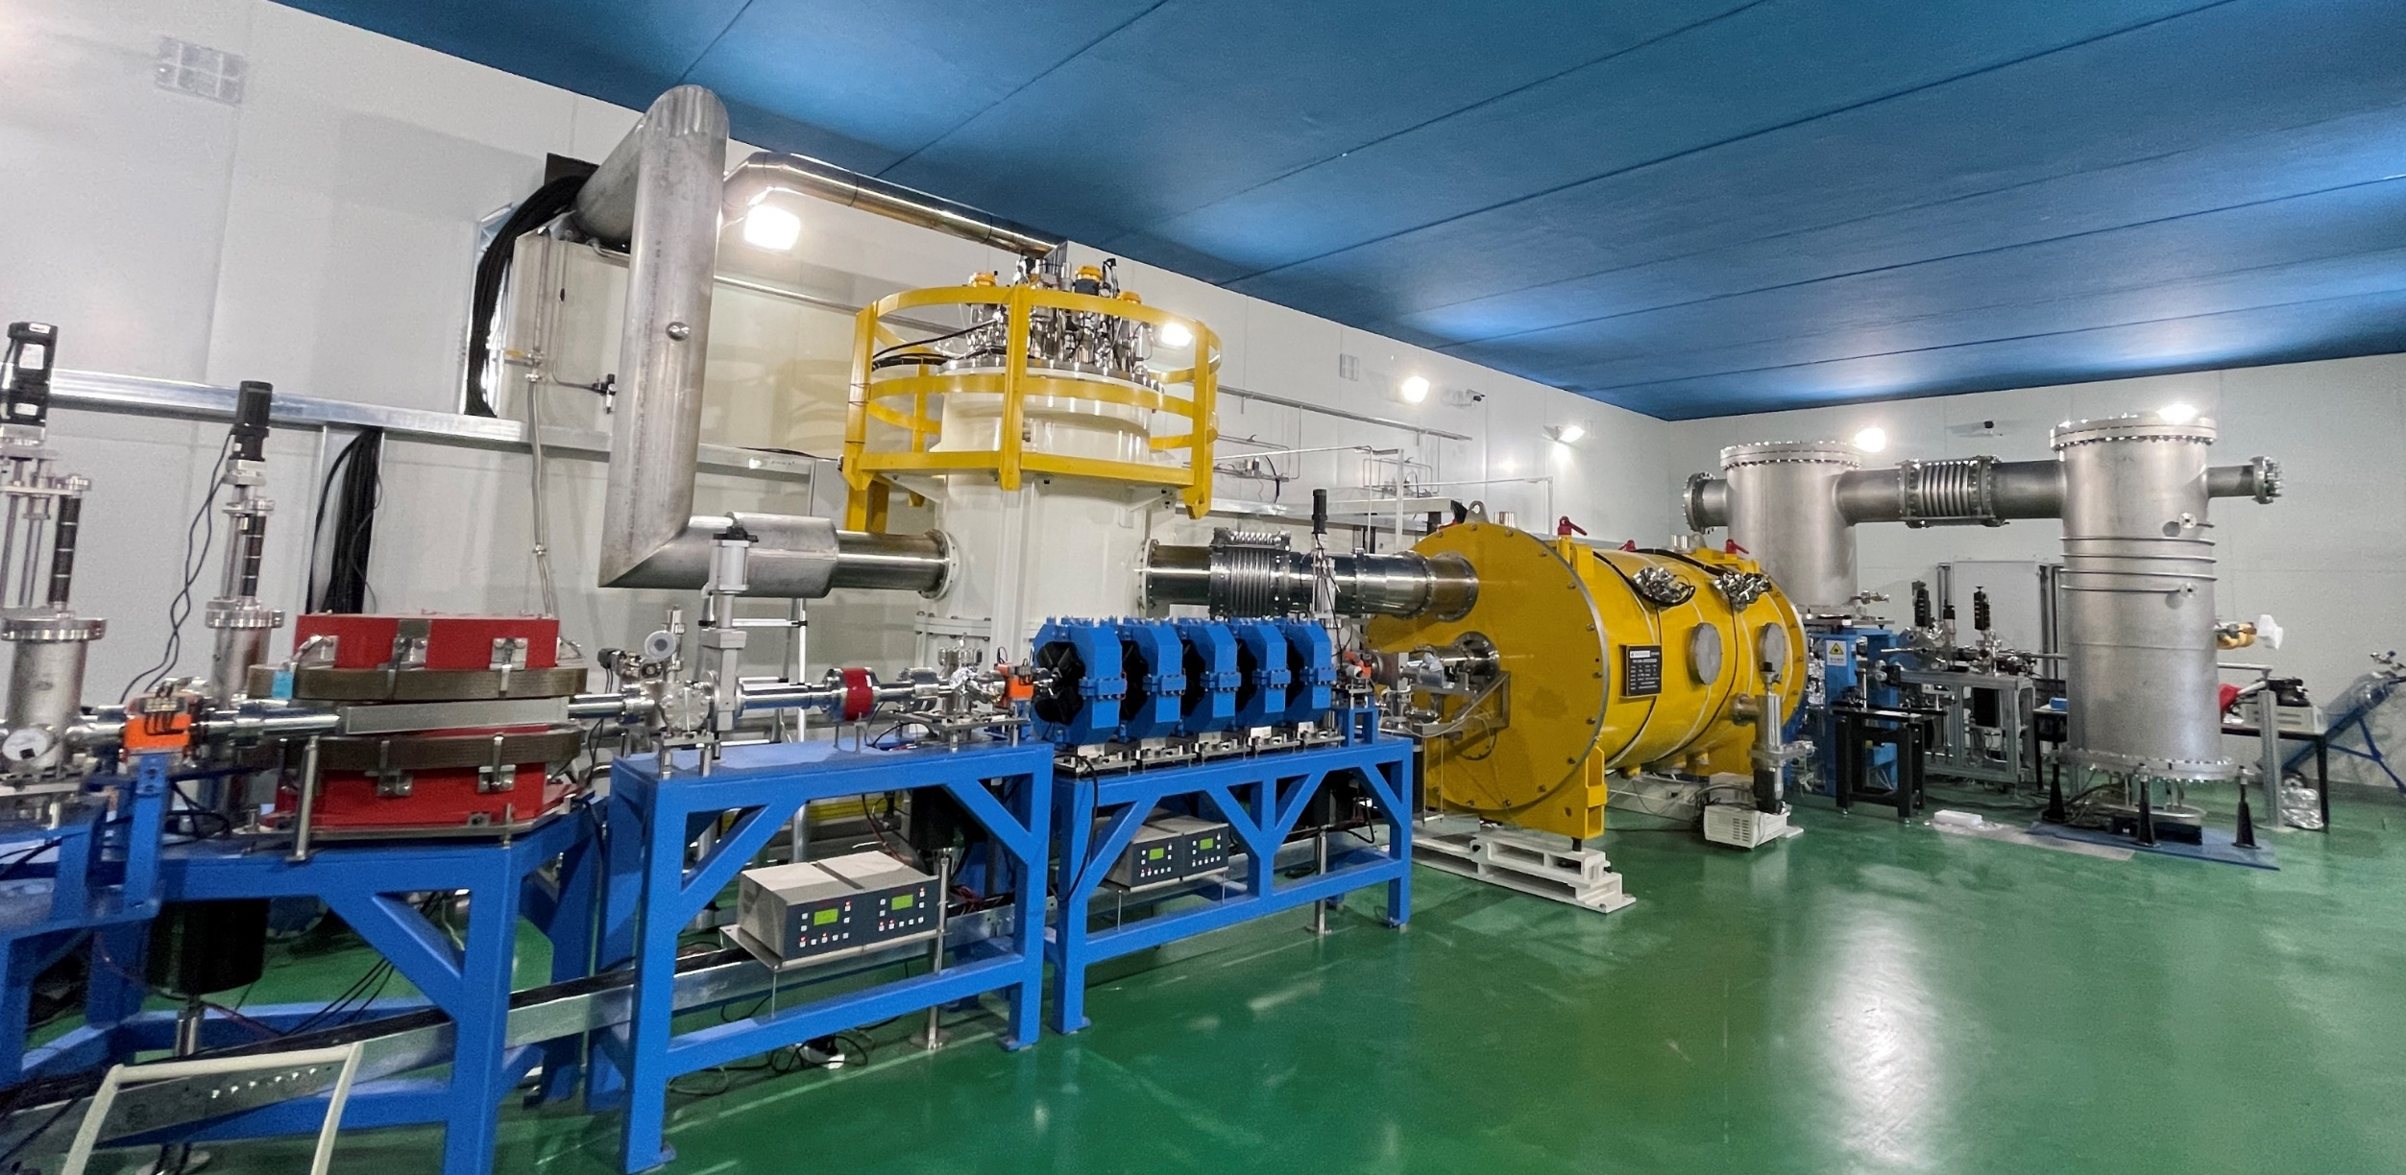
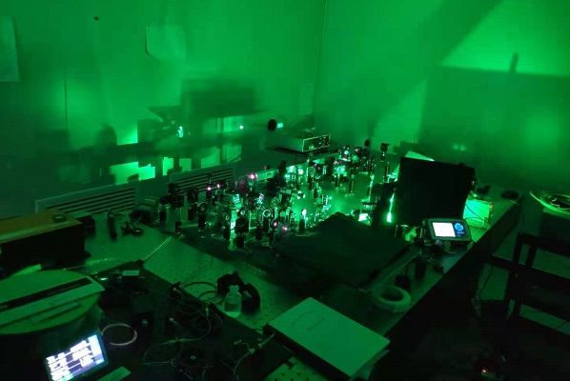
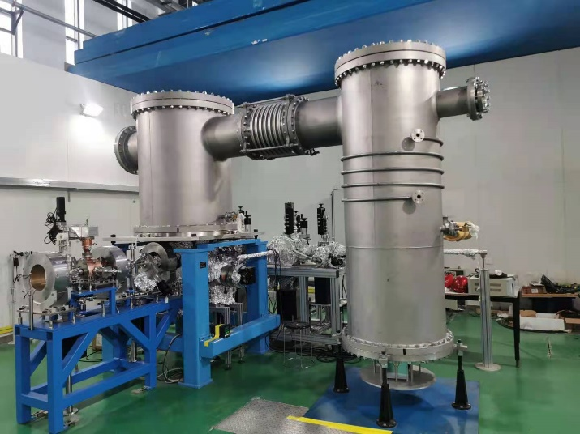
CEPC 650 MHz Test Cryomodule
Cavity string and module assembly in March to May 2021.
Modul installation in beamline, 2 K cool down test and RT coupler conditioning in May to July. Horizontal and beam test soon.
IR laser output to 116 W. Photo-cathode QE to 5 %. DC gun vacuum to 1.5E-10 Pa, voltage to 350 kV. Buncher cavity high power tested.

Slide 6
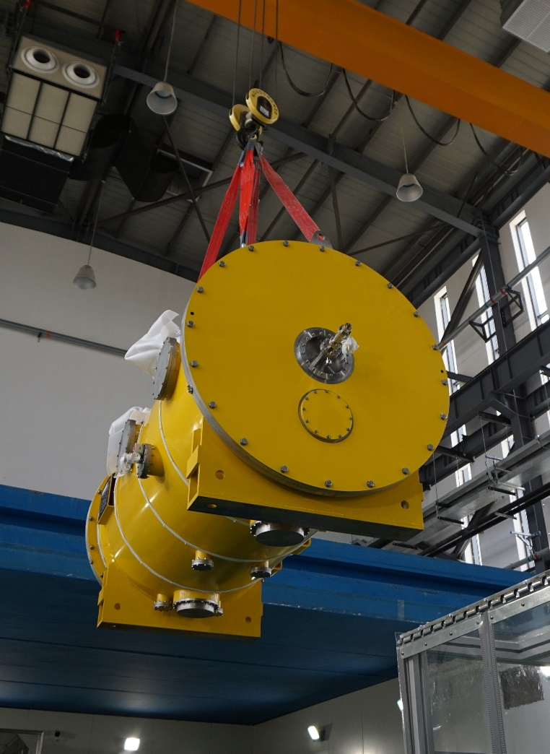
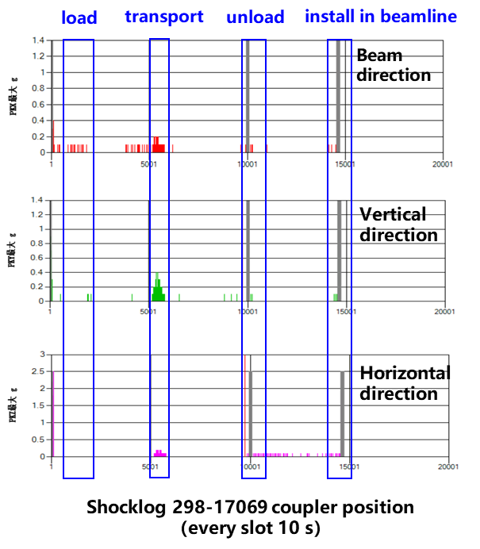
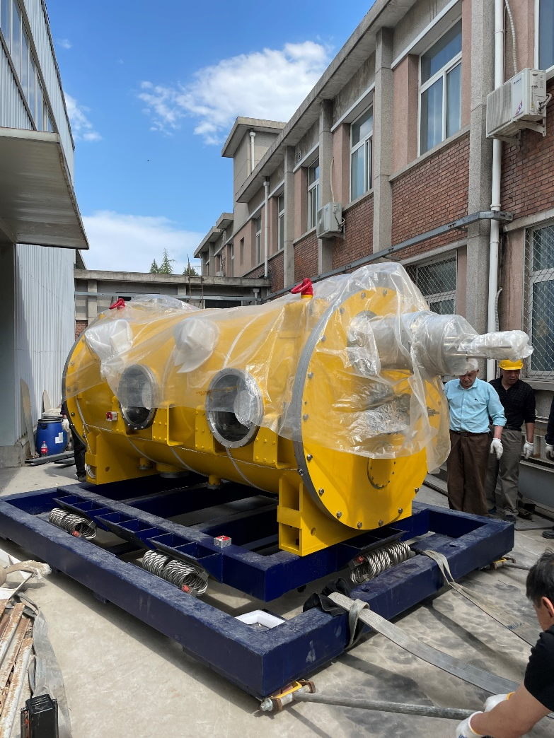
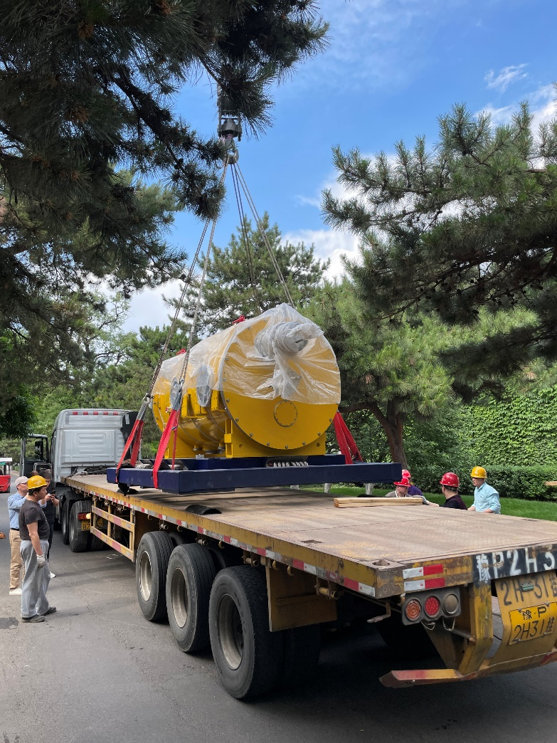
650 MHz Module Transport (IHEP to PAPS 80 km)
Module transport on a frame with isolator springs. Three accelerometers attached.
Max acceleration 0.4 g (average 0.1 g) in the whole process (< 1.5 g spec)
Cavity string vacuum monitored with cold gauge (powered by UPS). No leak.

Slide 7
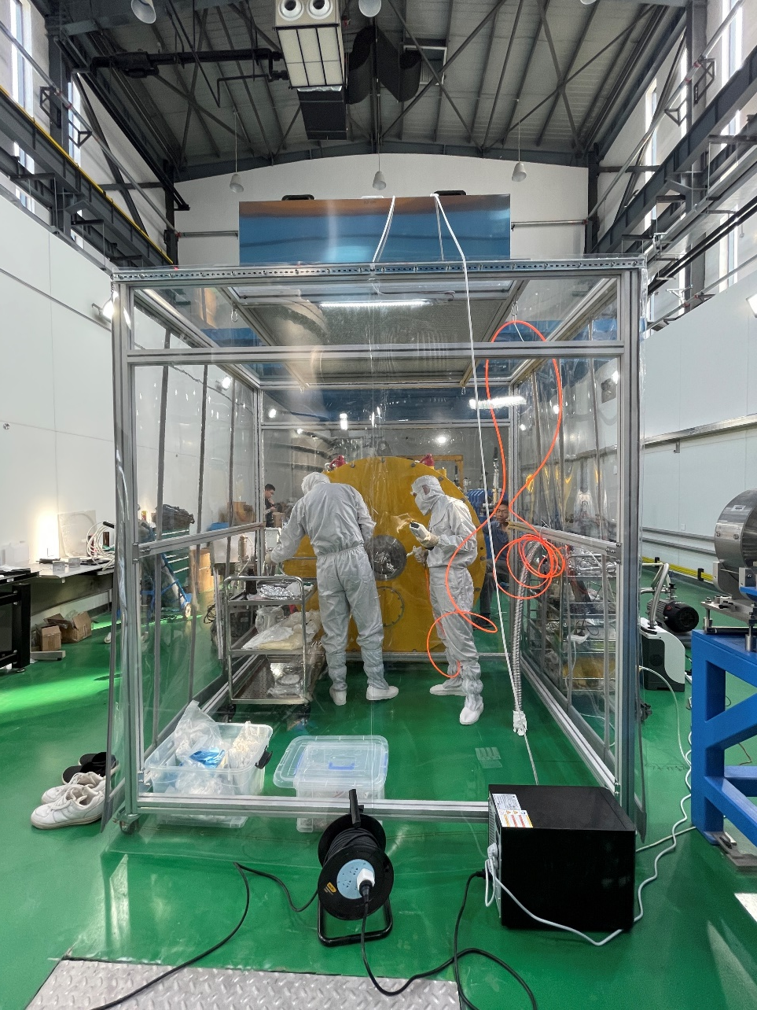
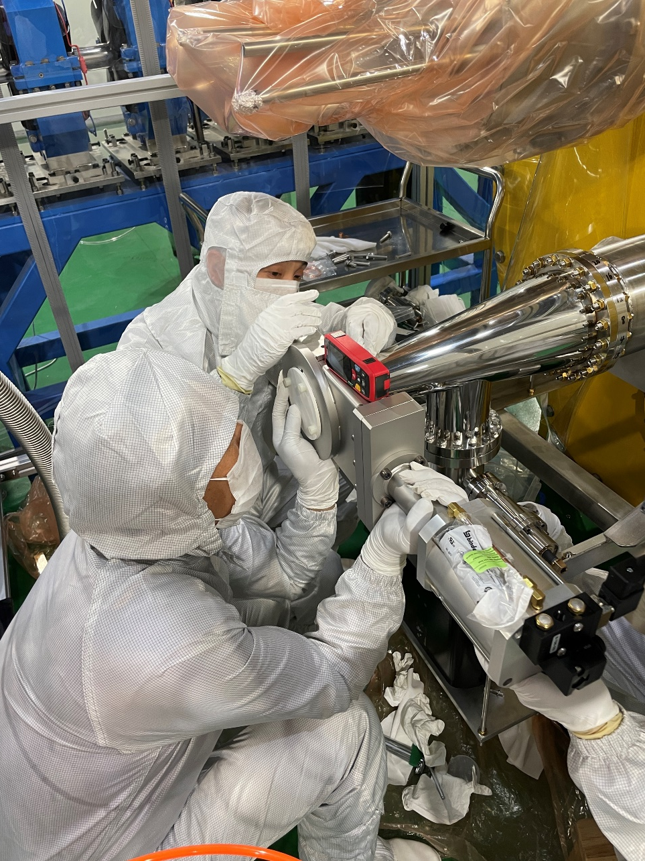
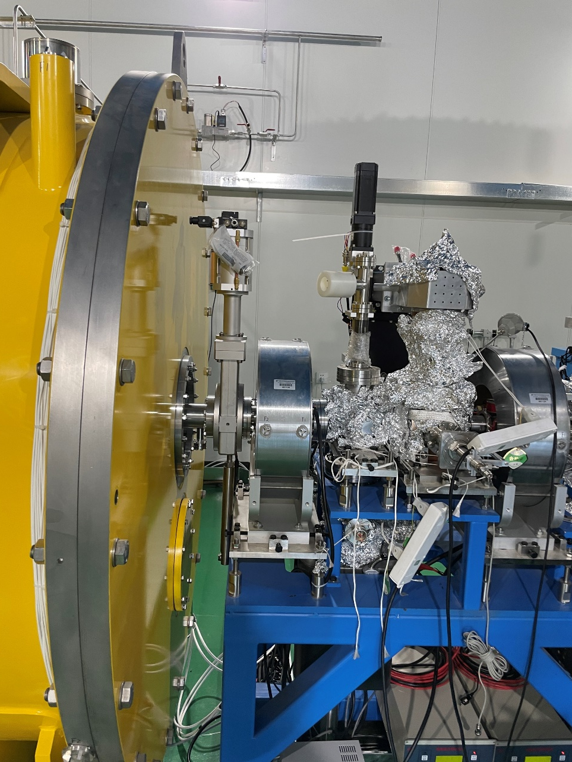
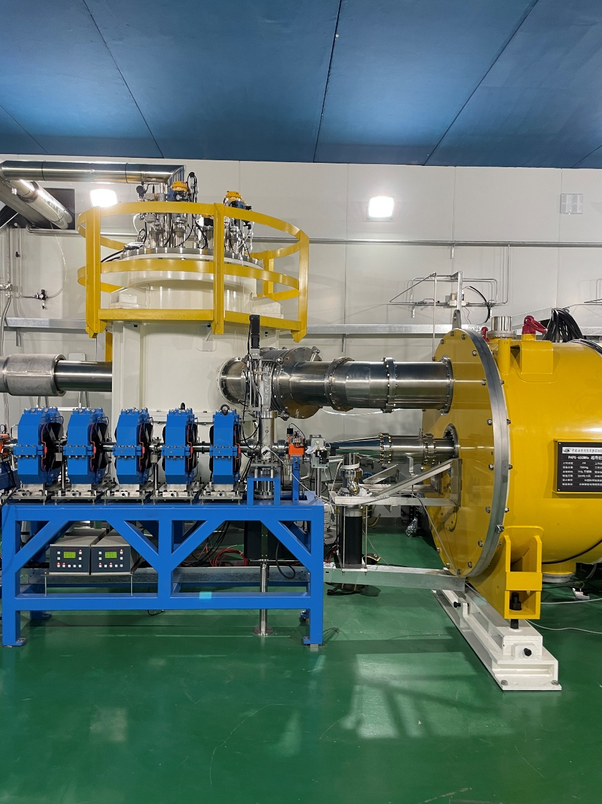
650 MHz Module Beamline Installation
Upstream gate valve
installation
Downstream HOM absorber, taper, ion pump, gate valve
Upstream beamline
connection
Downstream beamline and valve box connection

Slide 8
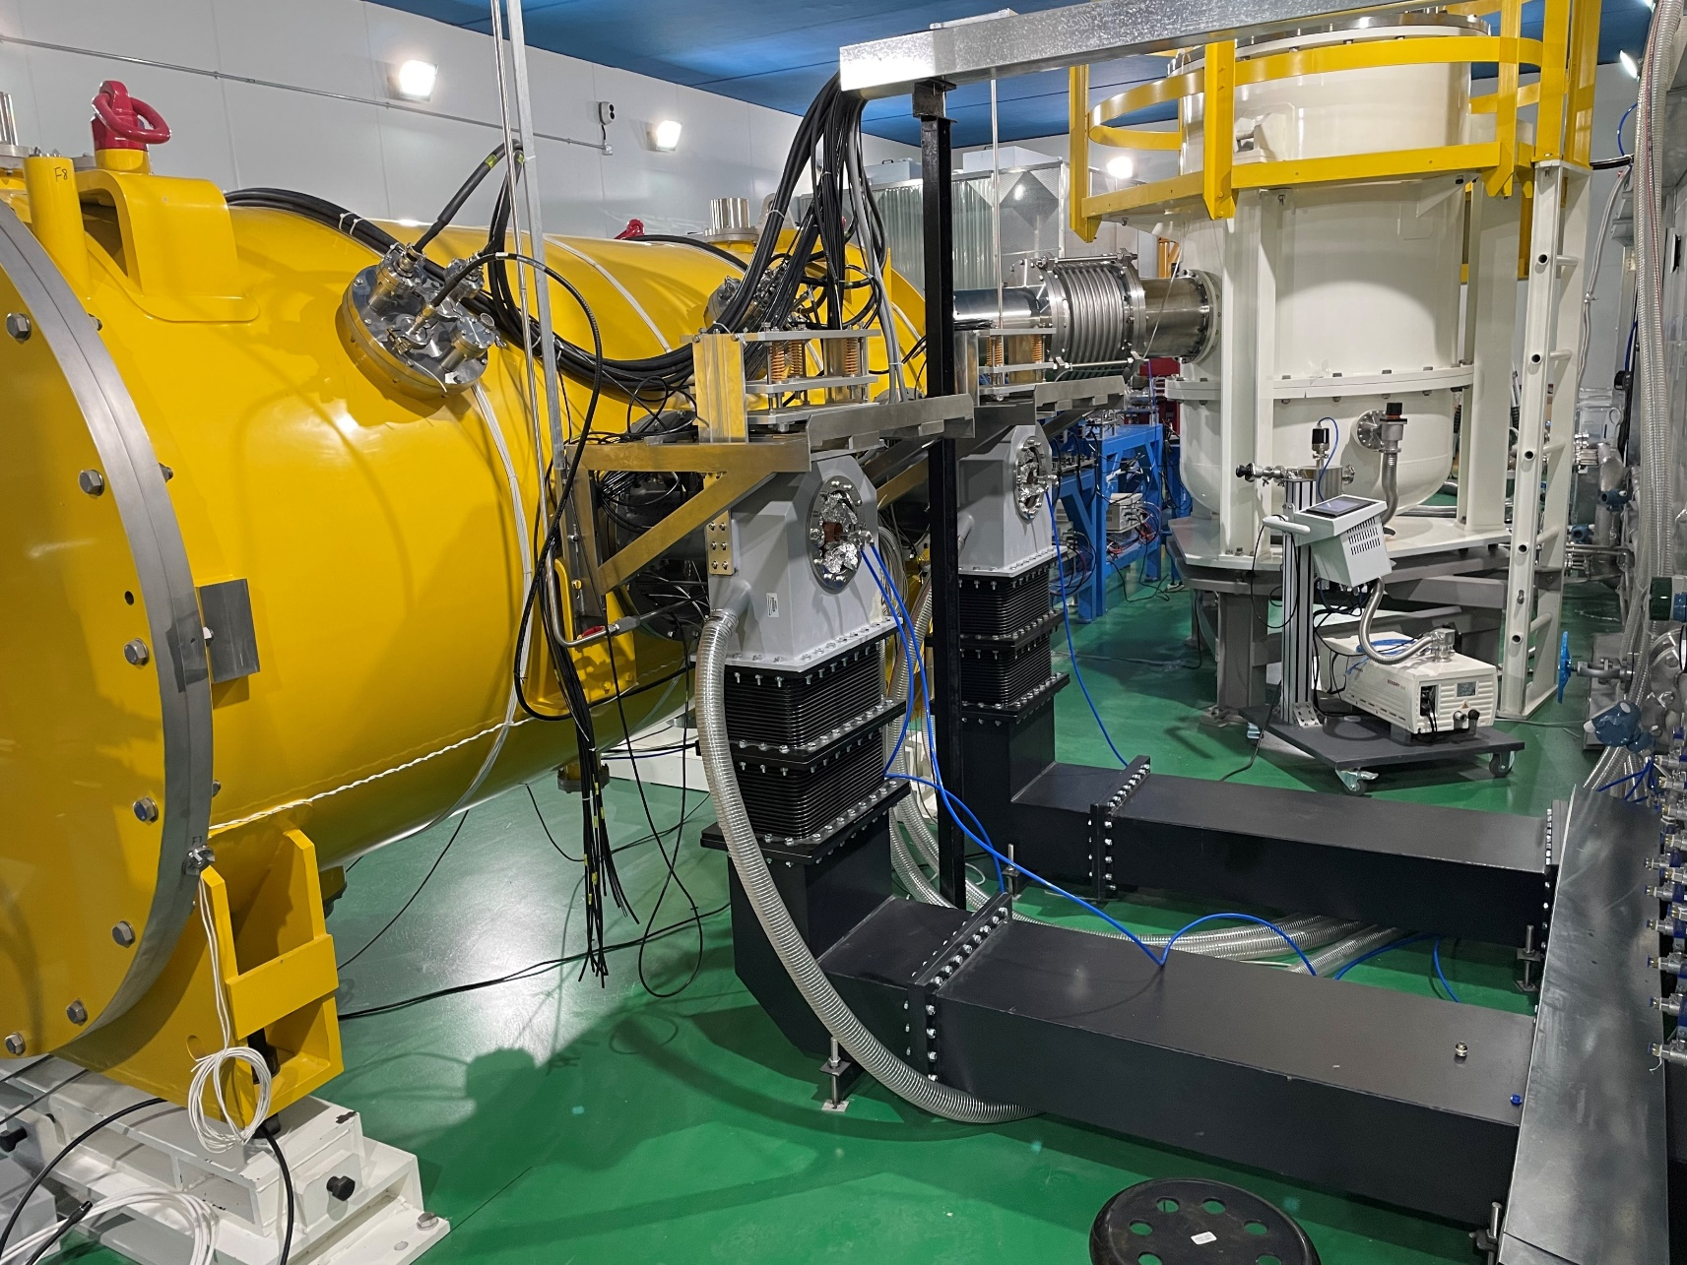
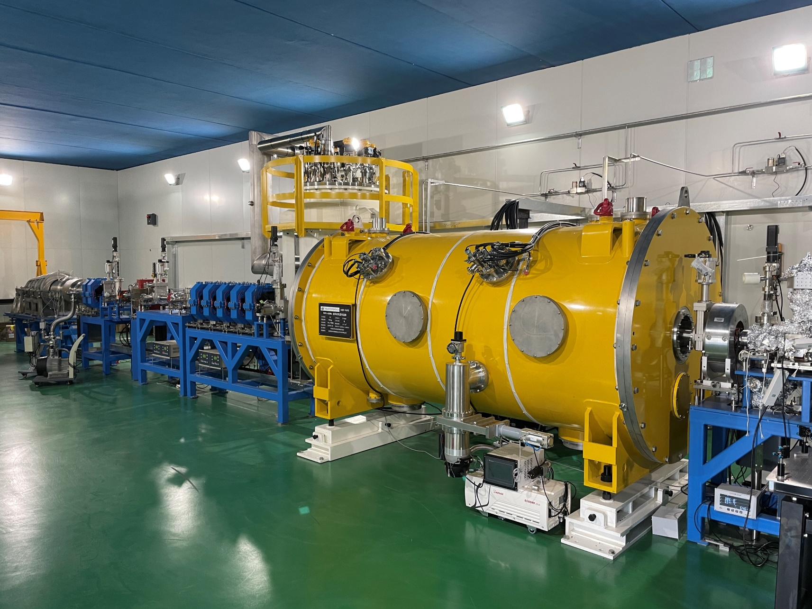
650 MHz Module Beamline Installation
Input coupler warm part, doorknob, waveguide
Module in the beamline

Slide 9
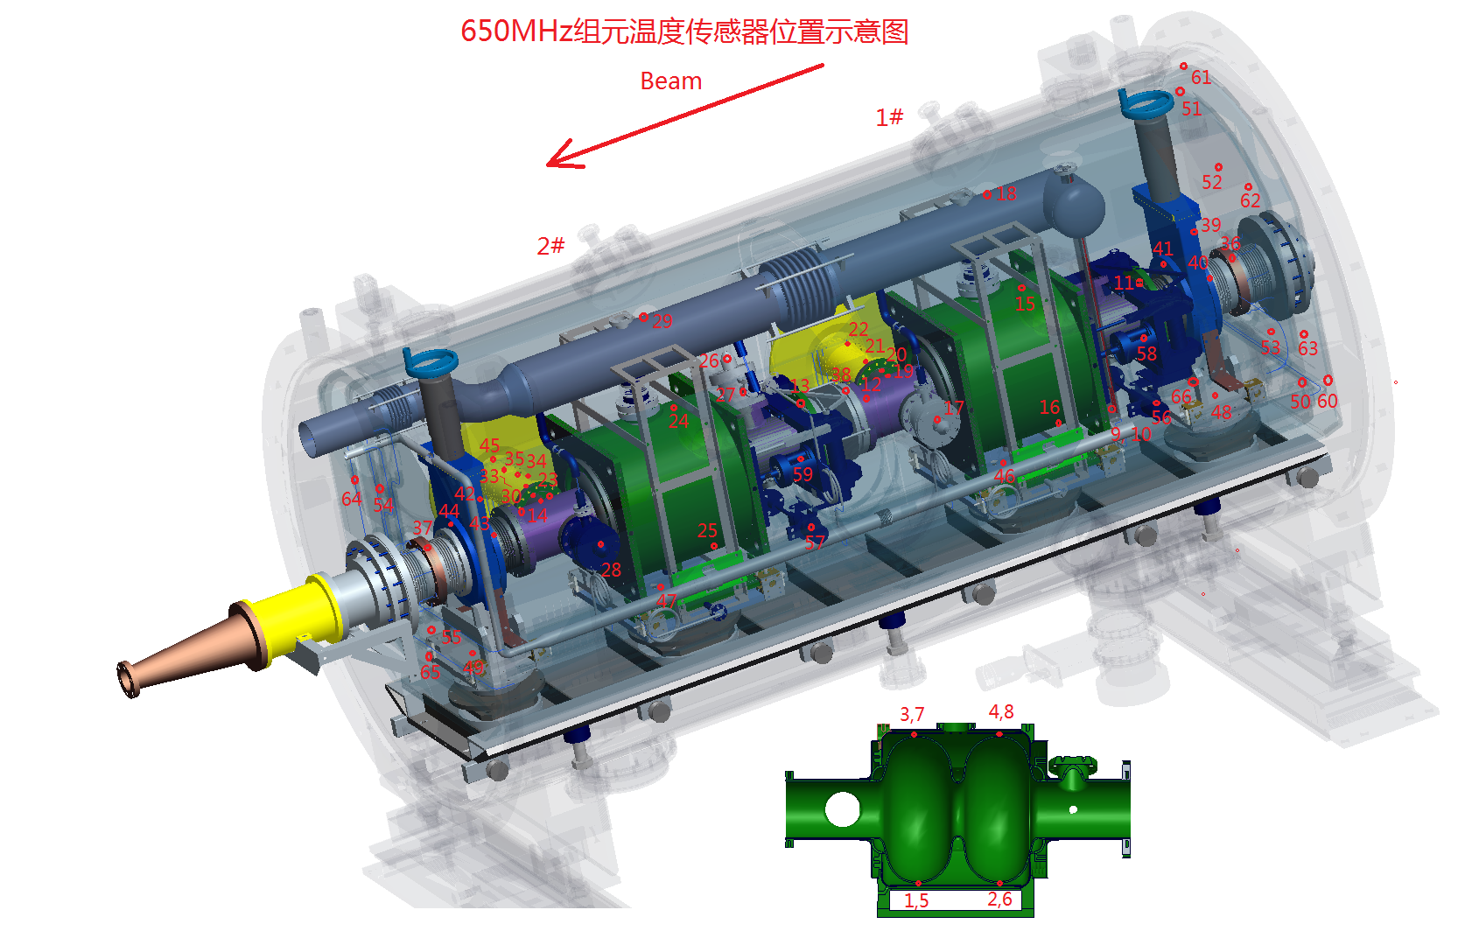
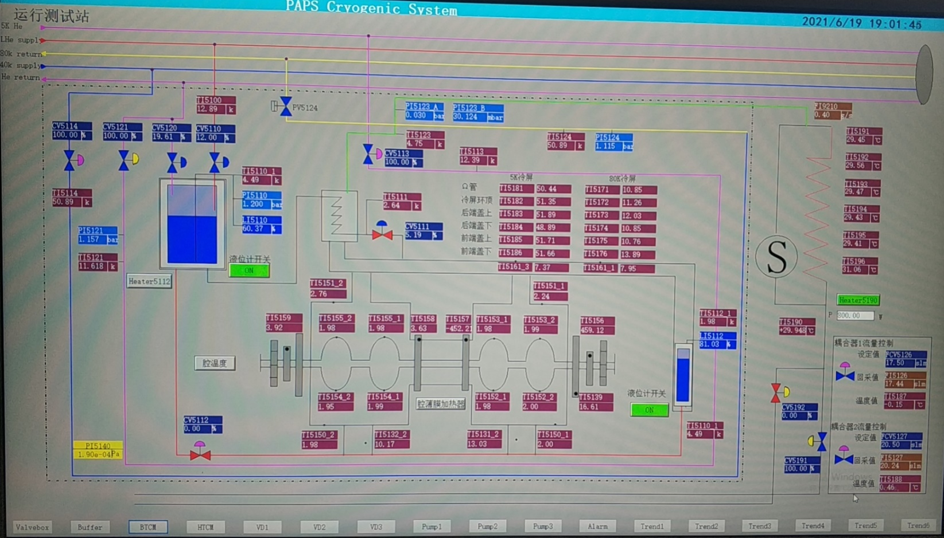
650 MHz Module 2 K Cool Down Test
Cavity vacuum @ 2 K: 6E-7 Pa
Cryogenics lines no leak. Most temperatures OK. Input coupler helium gas cooling test (need further optimize).
Frequency: CAV#1 649.856 MHz, CAV#2 649.816 MHz. Tuners stretch the cavities ~150 kHz to 650 MHz.
Input coupler Qin:
  CAV#1: 1.2E6 (HT 35 kW@13 MV/m, Beam Test 49 kW@9.7 MV/m, 10 mA)
  CAV#2: 1.8E6 (HT 35 kW@16 MV/m, Beam Test 76 kW@15 MV/m, 10 mA)
HOM couplers fundamental mode Qe (double notch, tuning not needed): #1 6.8E13, #2 1.9E13. #3 2.1E12.
Flux gates on cavity wall in the helium vessel: < 3 mG (with cavity local and vacuum vessel global shields)
Warm up for couplers RT conditioning (up to 35 kW full reflection limited by the SSA).

Slide 10
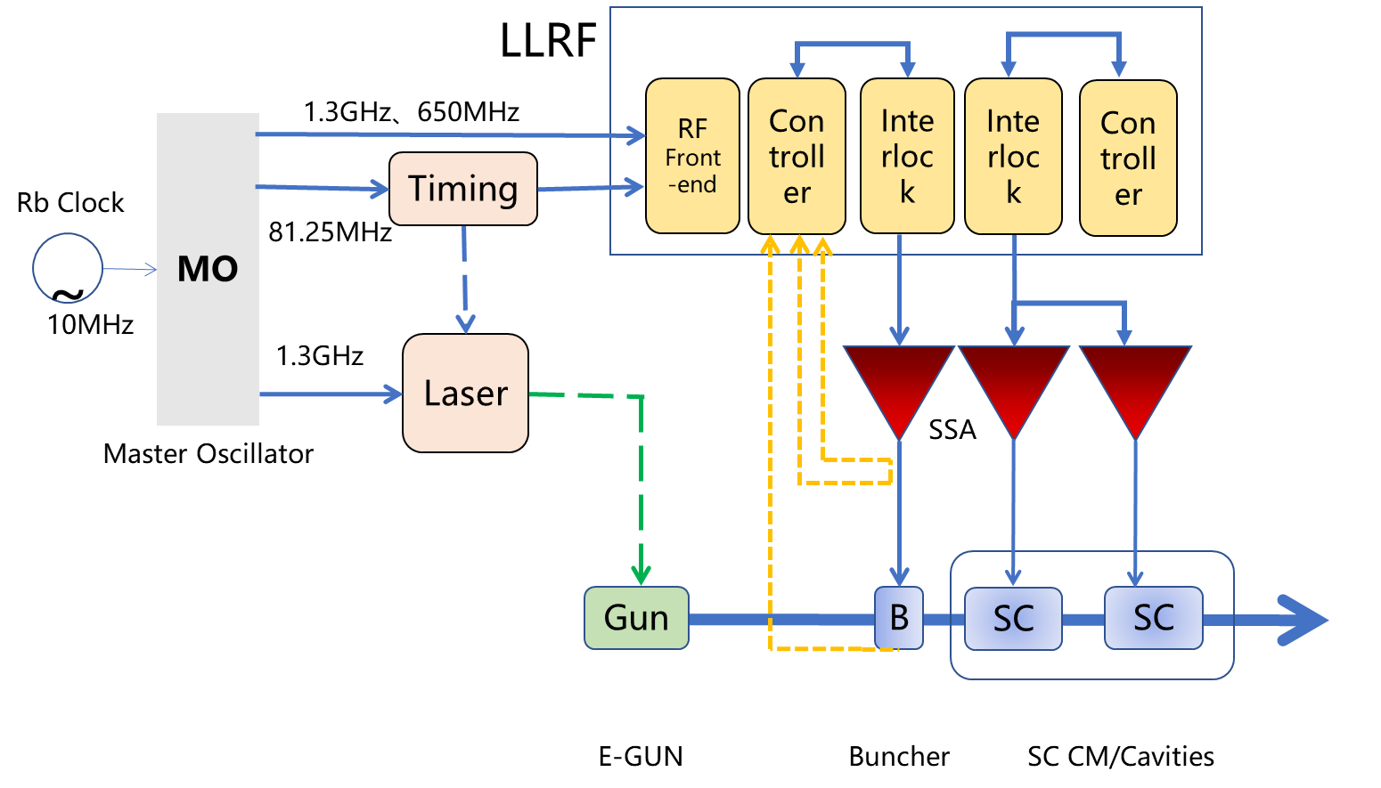
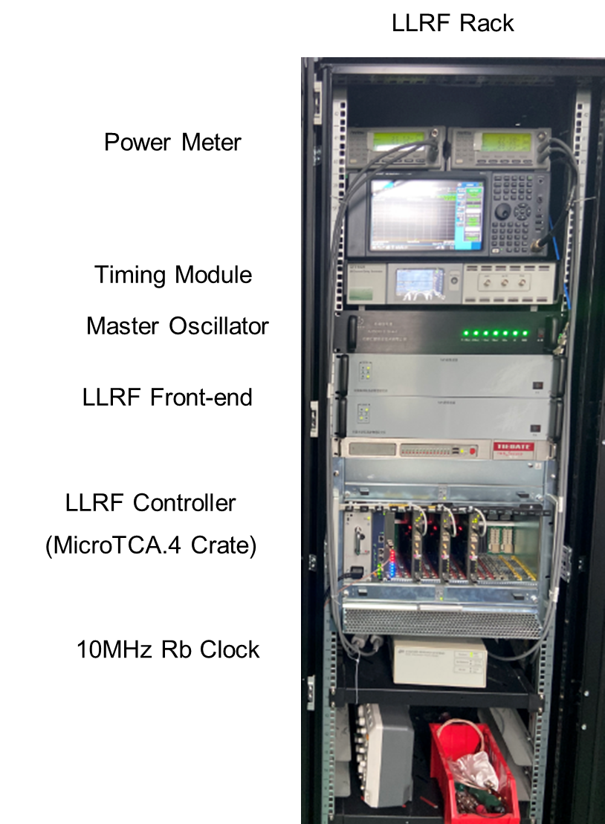
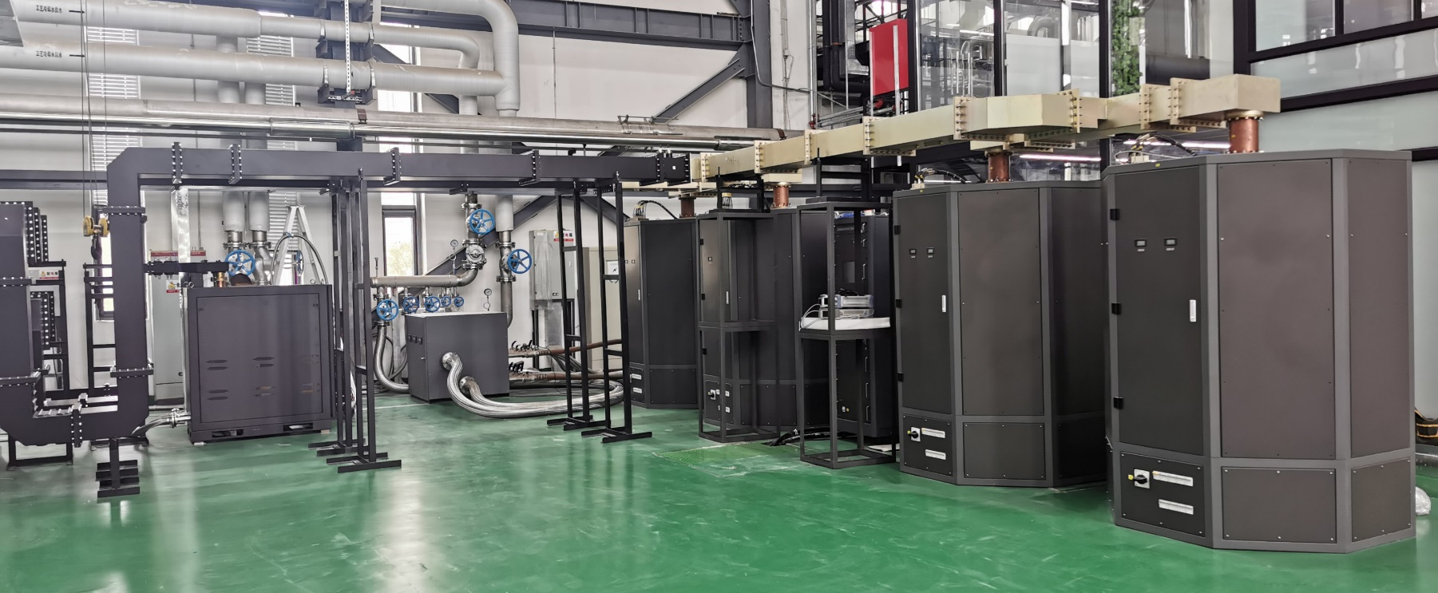
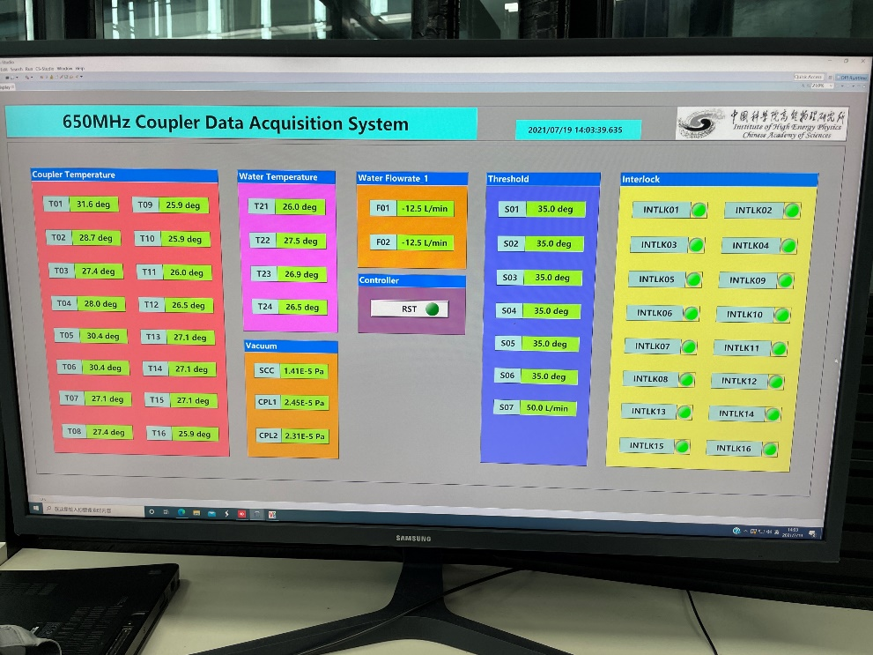
650 MHz HLRF and LLRF
150 kW (total) solid state amplifier
LLRF and timing system for 650 MHz module, laser, DC-Gun and buncher.

Slide 11
Outline
650 MHz cavity and module
1.3 GHz cavity and module

Slide 12
1.3 GHz High Q Mid-T Cavity Horizontal Test
Step 1a: Horizontal test with vertical test antenna (self excitation mode) at IHEP campus
  Low Q0 (unknow heat load?) , abnormal HOM notch change (HOM can thermal anchor?)
  Flux gates and thermal sensors on cavity outside wall in helium vessel, double-layer magnetic shield and foils, thermal straps (HOM coupler, beam pipe), fast cool down and flux expulsion
Step 1b: Horizontal test with vertical test antenna (self excitation mode) at PAPS
  Successful, similar Q0 as vertical test, abnormal frequency and field flatness change (bellow support, overpressure)
  Add thermal intercepts for cables, Q0 measurement comparison (mass-flow vs RF), input coupler flange heating
Step 2: Horizontal test with input coupler (self excitation mode) at PAPS
  Ongoing, got high Q0 but unstable for long time at high gradient (coupler outgassing? pickup cable heating?)
  Input coupler thermal sensors, interlocks, thermal straps, RT online conditioning, cavity active pumping
Step 3: Horizontal test with input coupler and tuner (GDR mode) at PAPS
  Tuner, LLRF, microphonics …

Slide 13
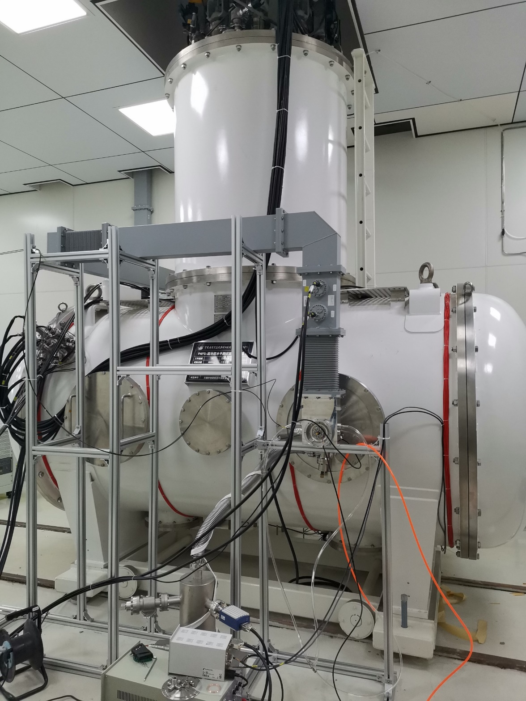
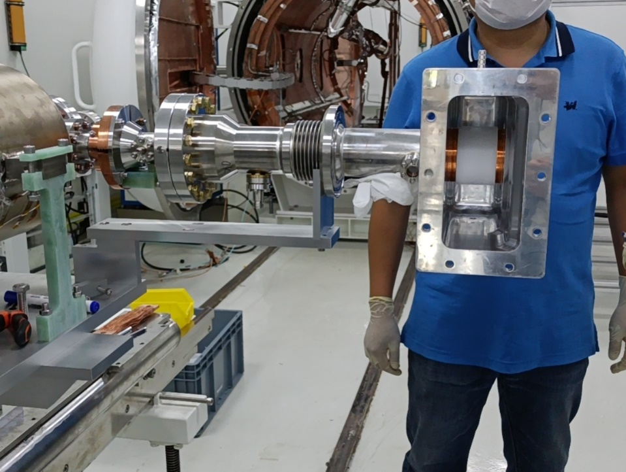
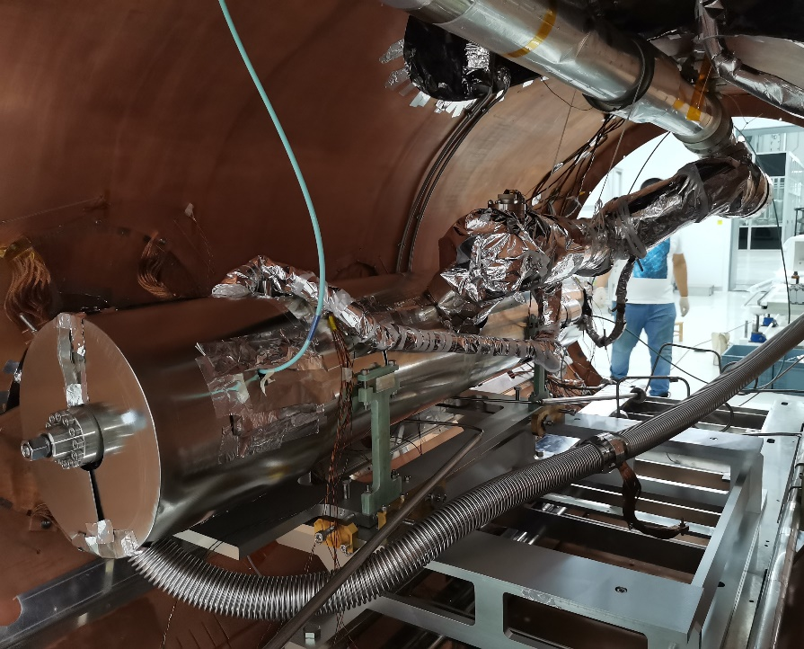
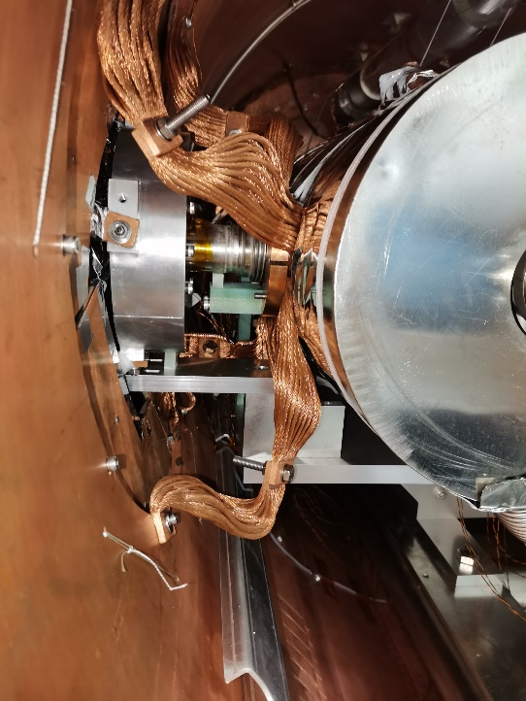
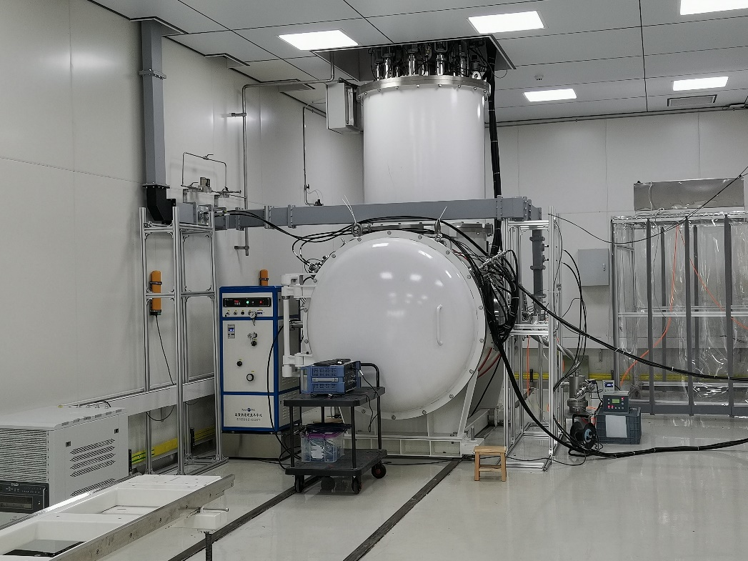
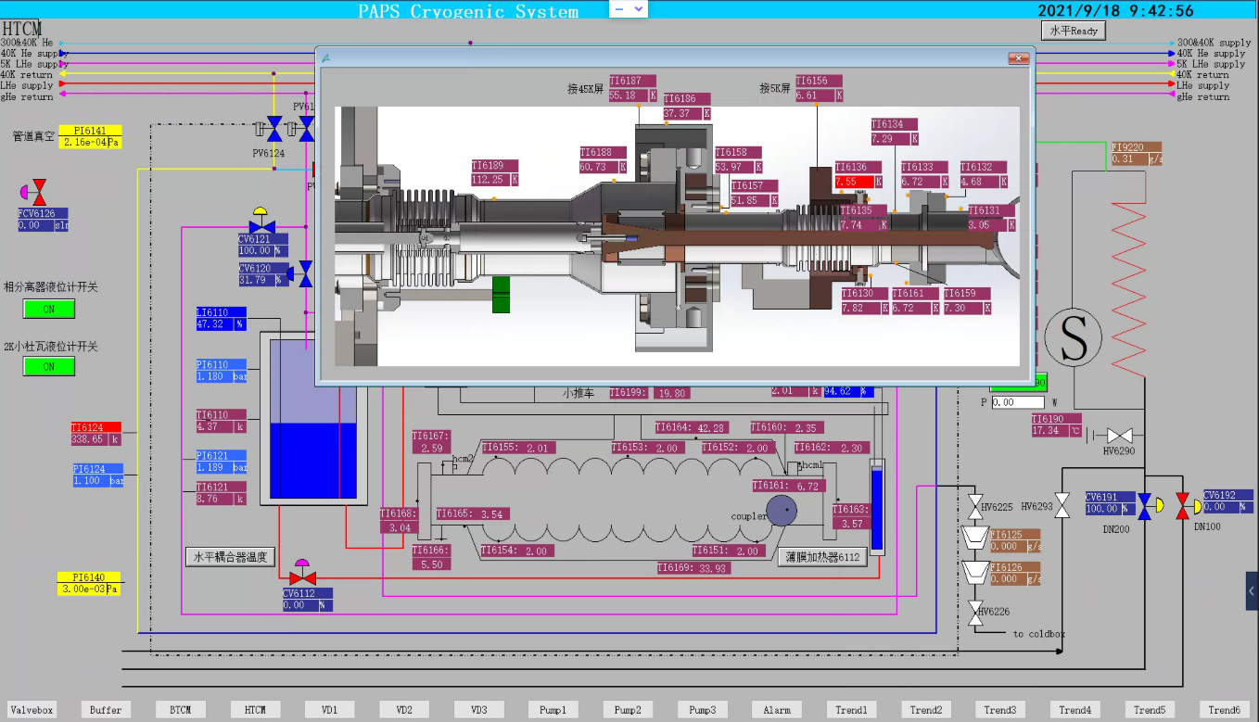
1.3 GHz High Q Mid-T Cavity Horizontal Test

Slide 14
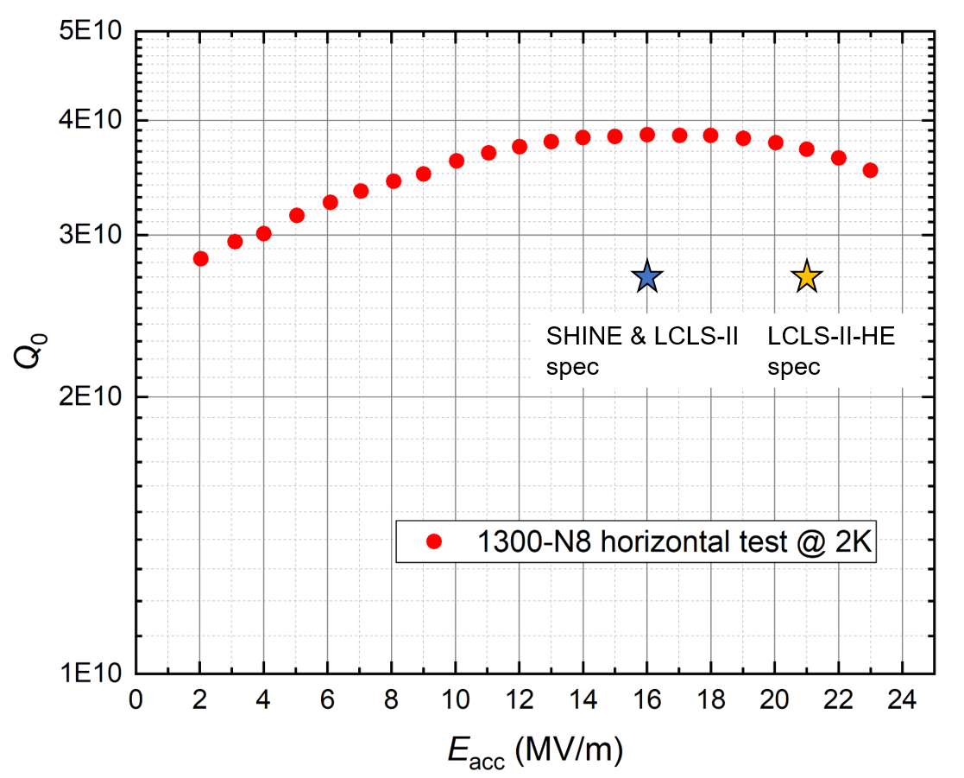
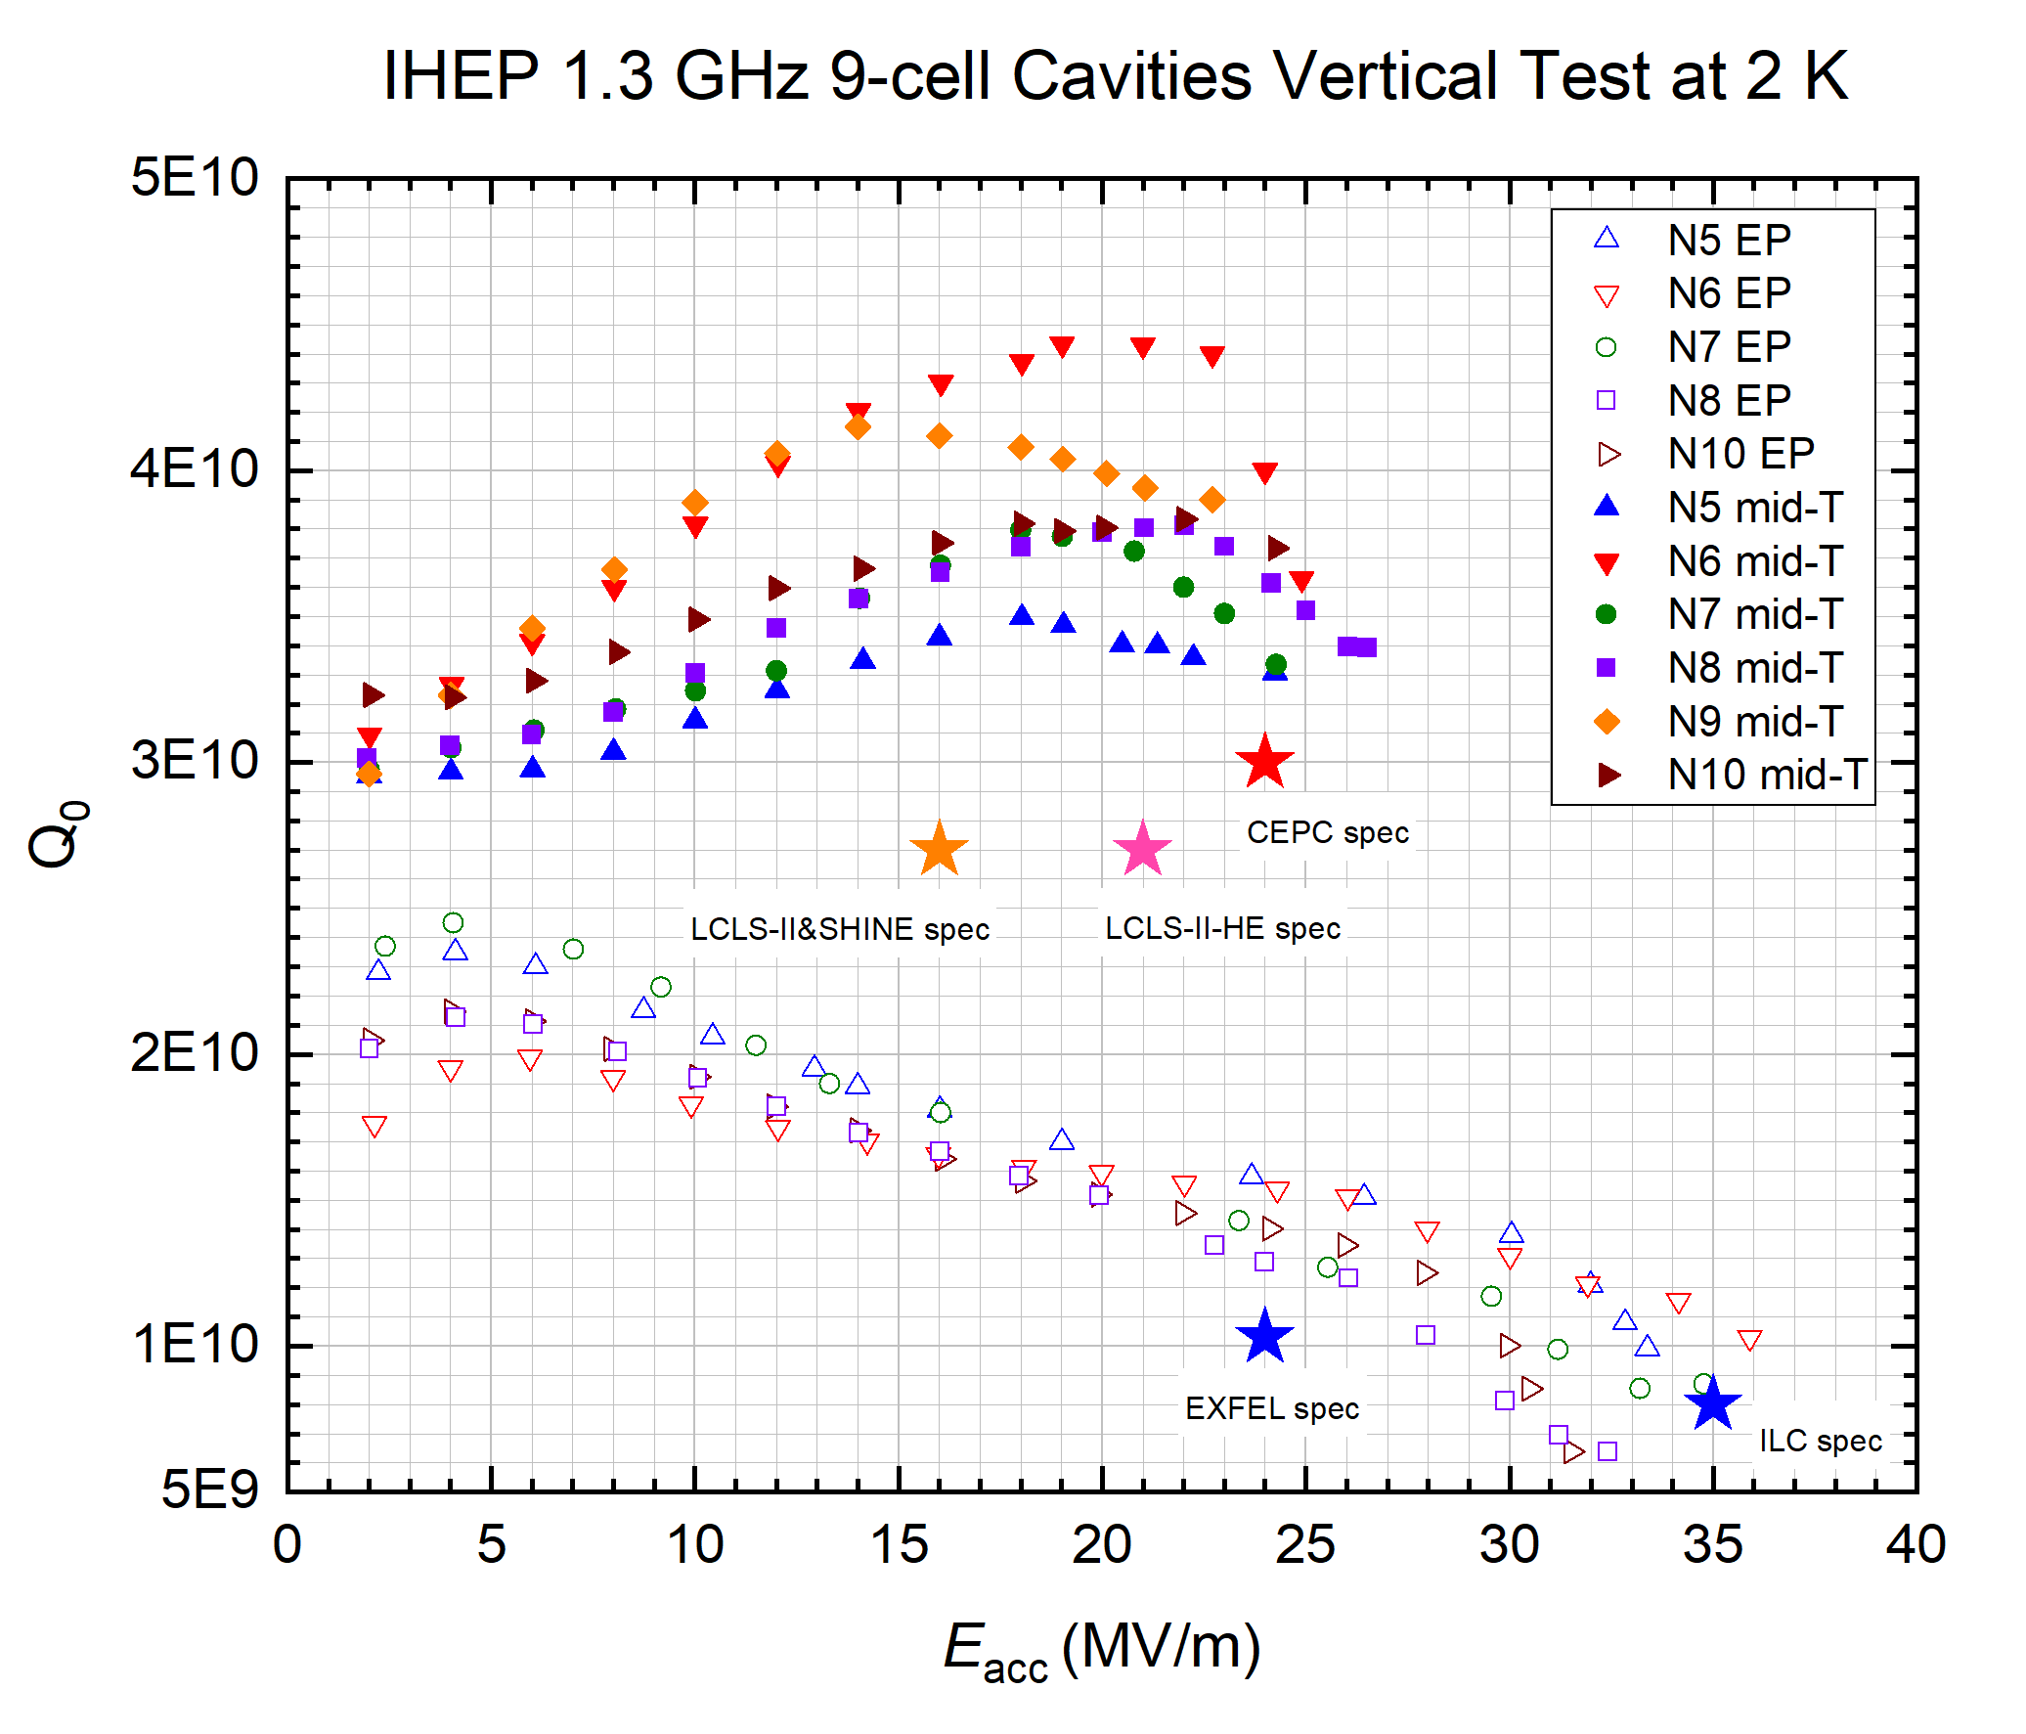
1.3 GHz High Q Mid-T Cavity Horizontal Test
IHEP 1.3 GHz 9-cell Cavity Horizontal Test
IHEP 1.3 GHz 9-cell Cavity Vertical Test
Low power test with VT antenna
CEPC spec
High power test with input coupler
(preliminary)

Slide 15
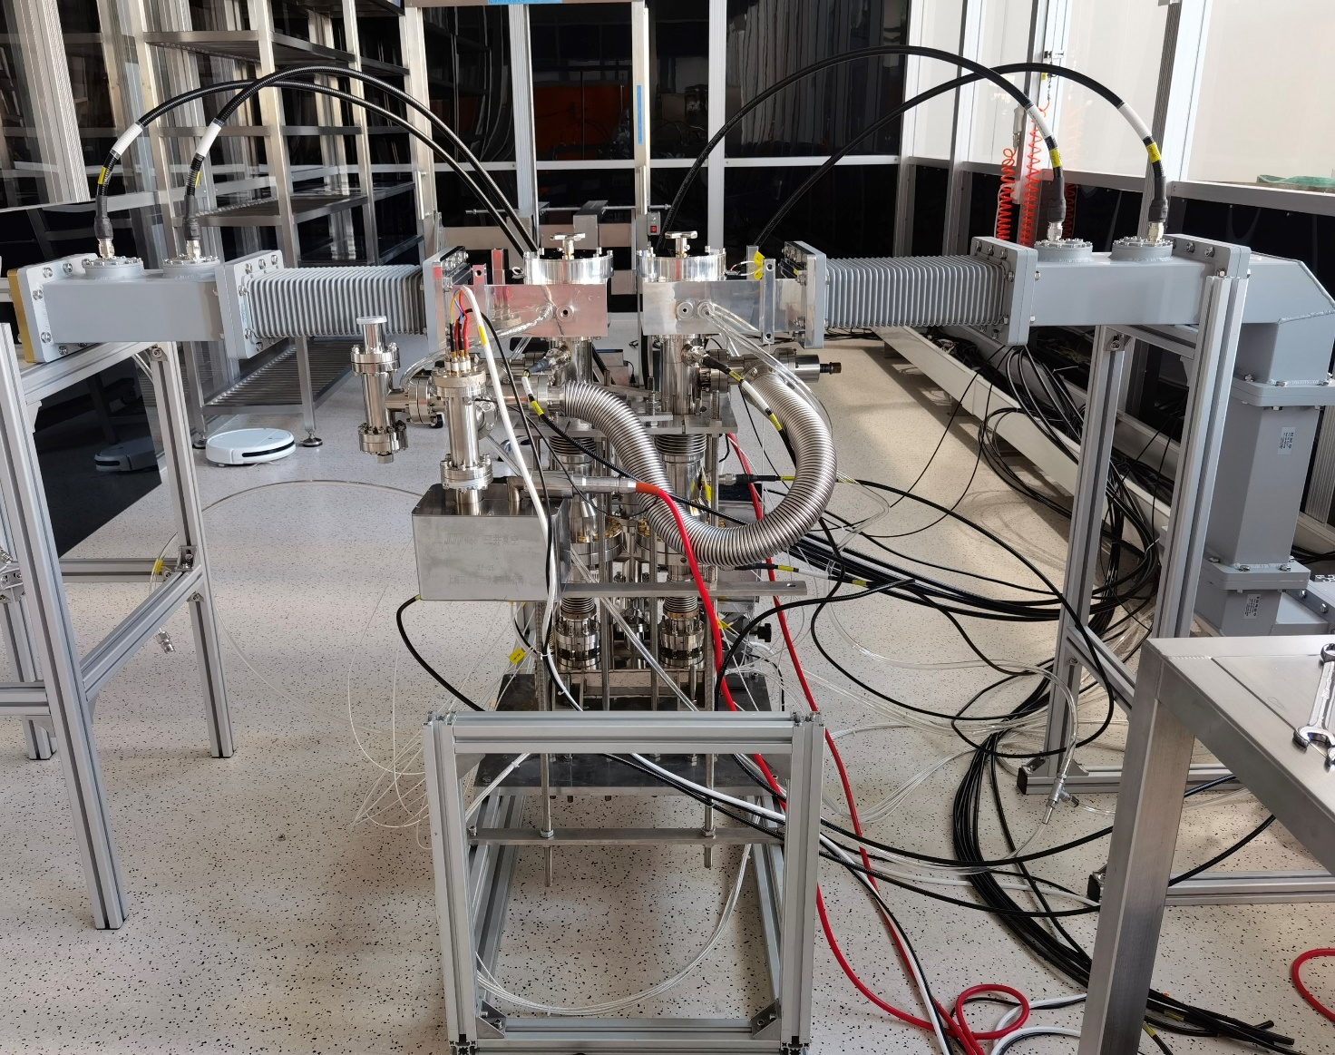
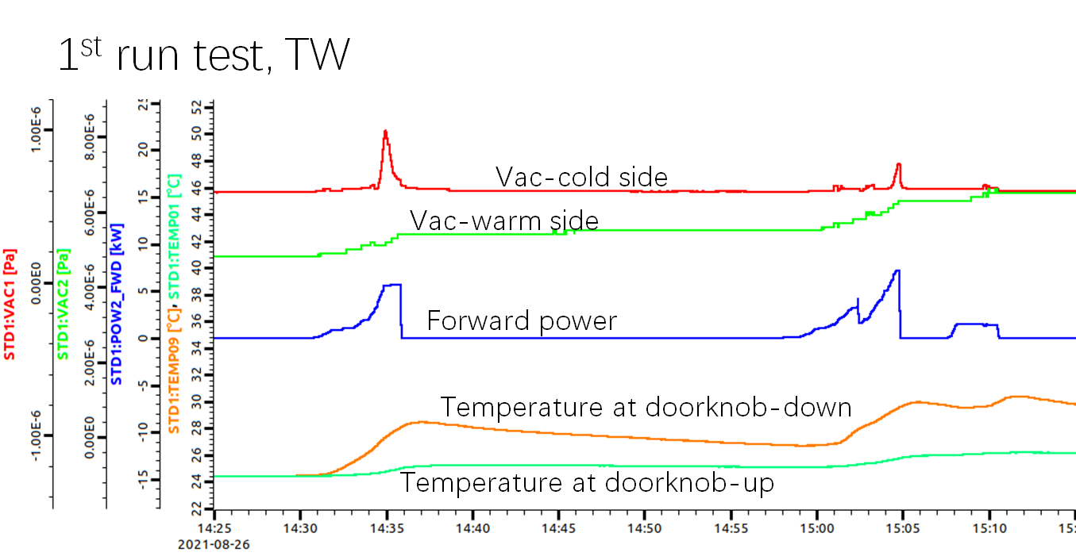
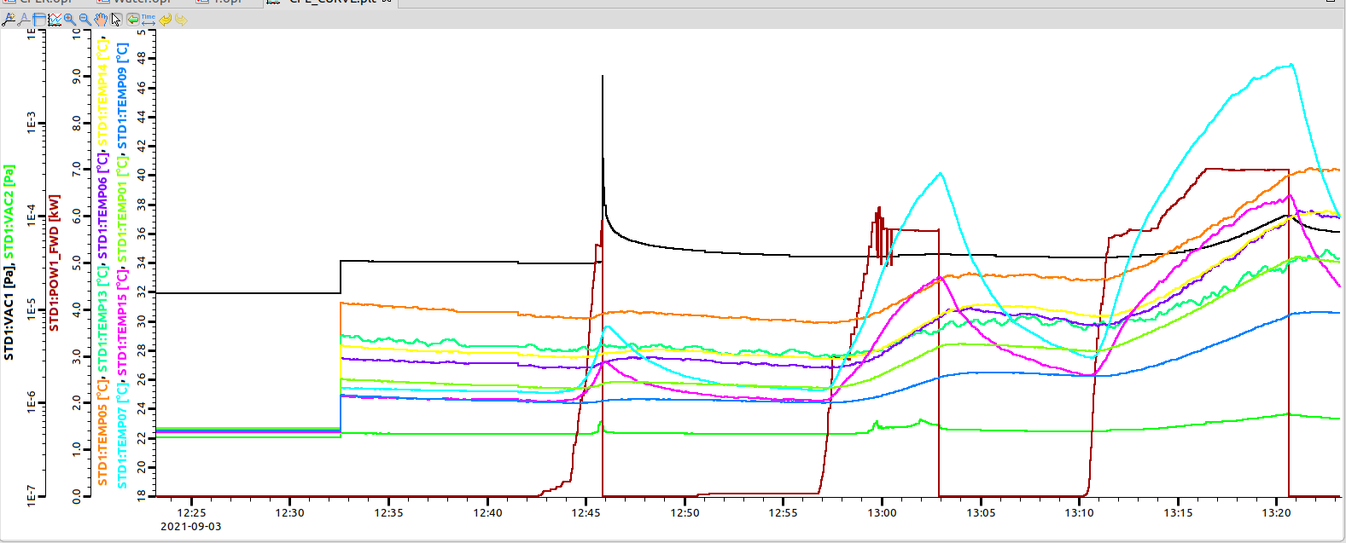
1.3 GHz Input Coupler Conditioning at PAPS
Two input couplers high power conditioned in the cleanroom at PAPS. One coupler installed to the horizontal test cavity.
10 kW TW
5.8~7 kW SW at two positions (1/8 WG wave length apart)

Slide 16
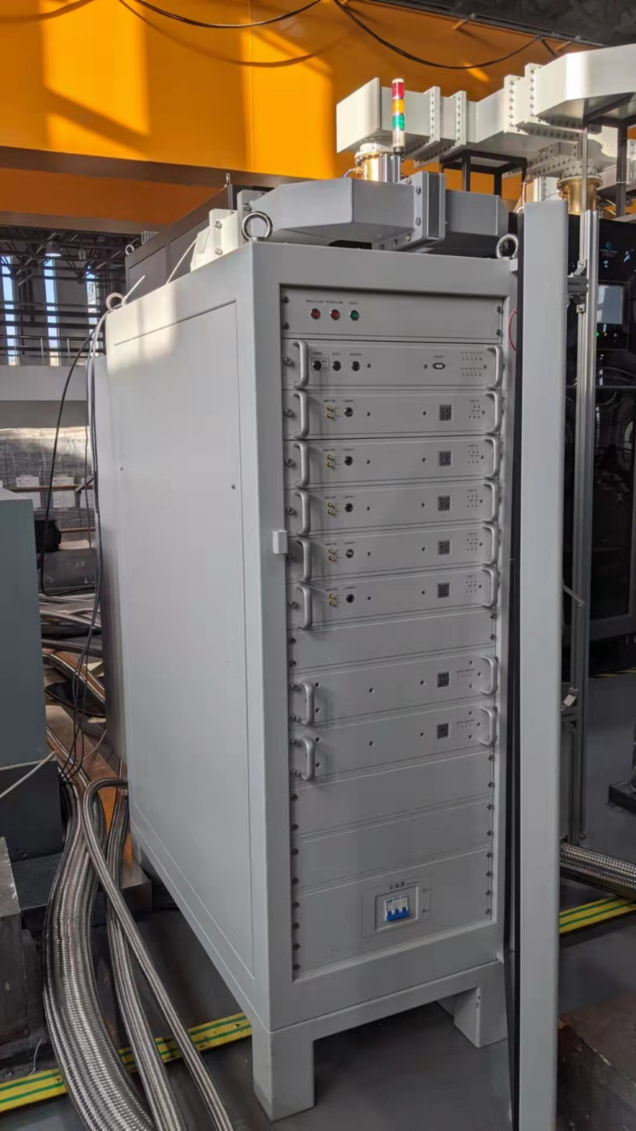
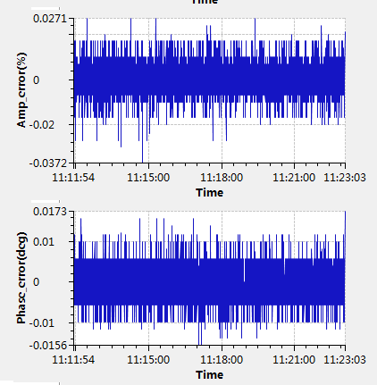
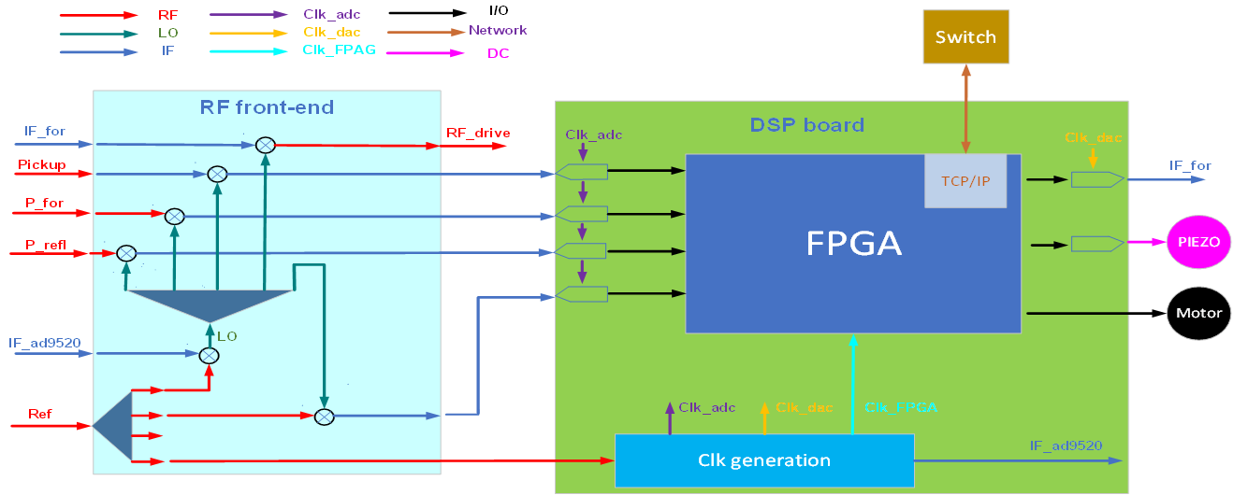
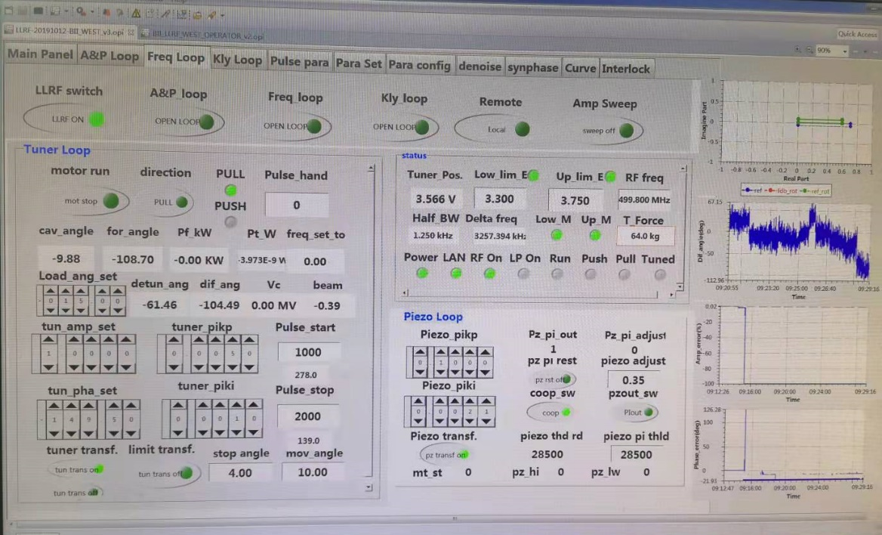
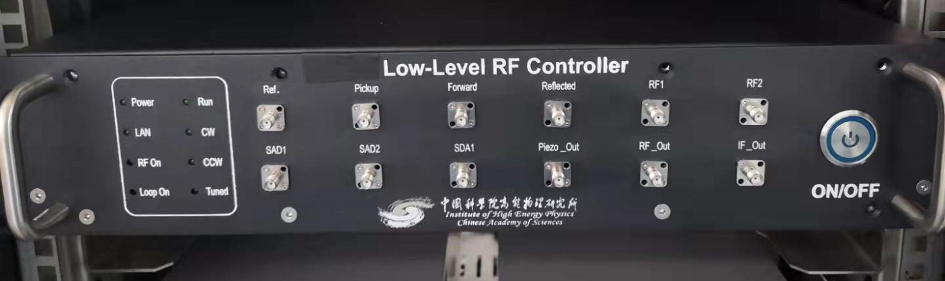
1.3 GHz HLRF and LLRF
ΔA/A: ±0.03% (p-p)
Δφ: ±0.02° (p-p)

Slide 17
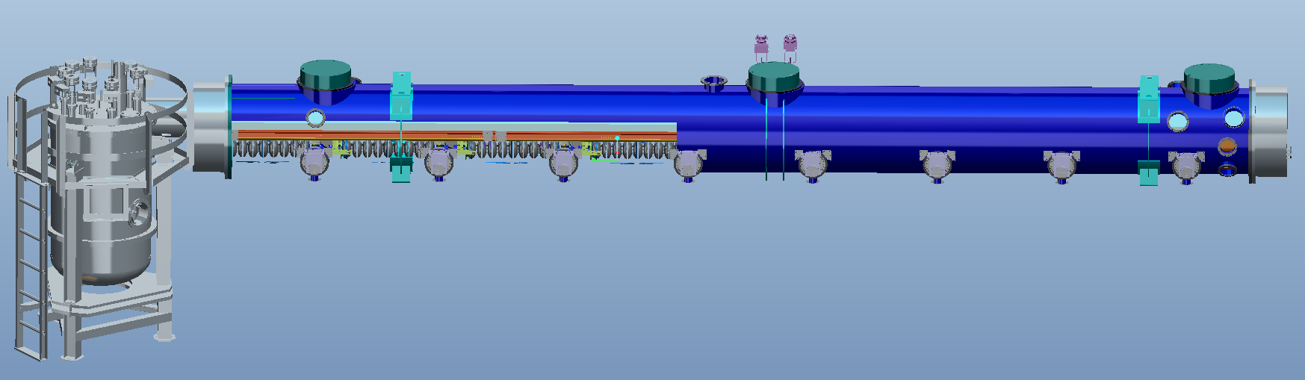
1.3 GHz High Q Cryomodule (8x9-cell)
CEPC booster 1.3 GHz SRF technology R&D and industrialization in synergy with domestic CW FEL projects.
1.3 GHz 8x9-cell high Q cryomodule prototype
Component fabrication in 2021 to mid 2022
Assemble and horizontal test in 2022
Ship to Dalian in 2023

Slide 18

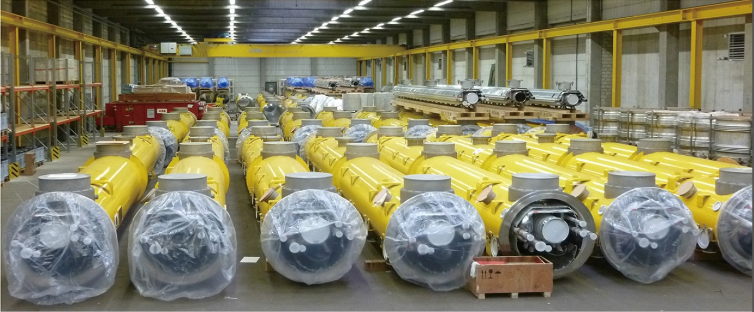
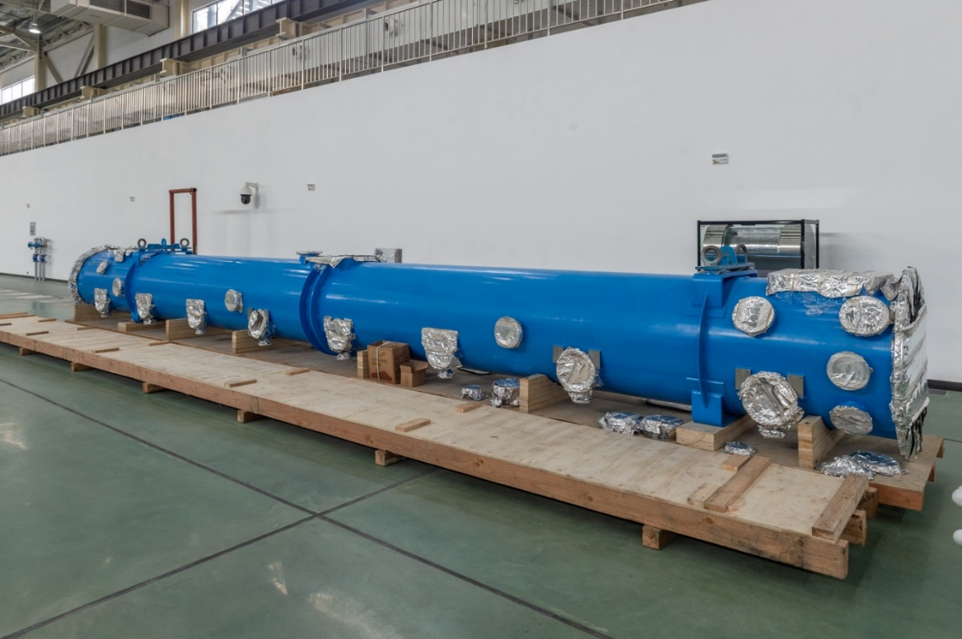
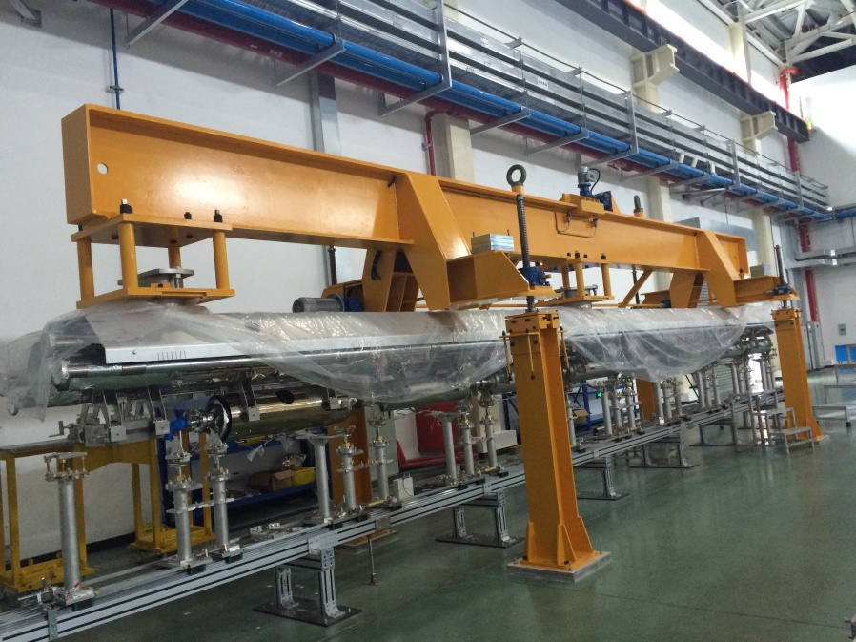
1.3 GHz Cryomodule
Cryomodule from Wuxi, similar to SHINE, LCLS-II and Euro-XFEL

Slide 19

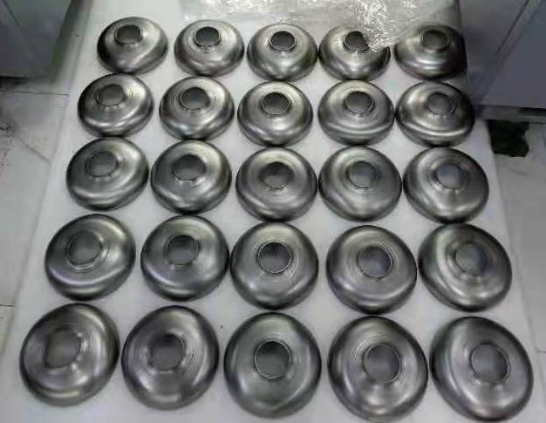
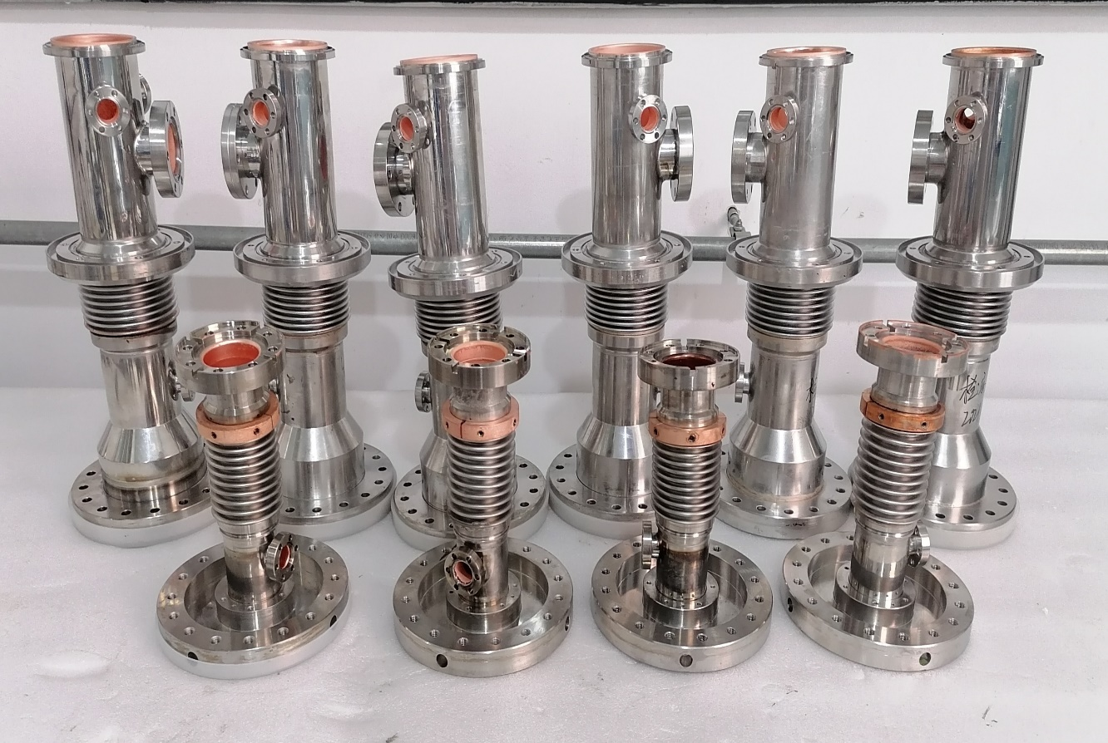
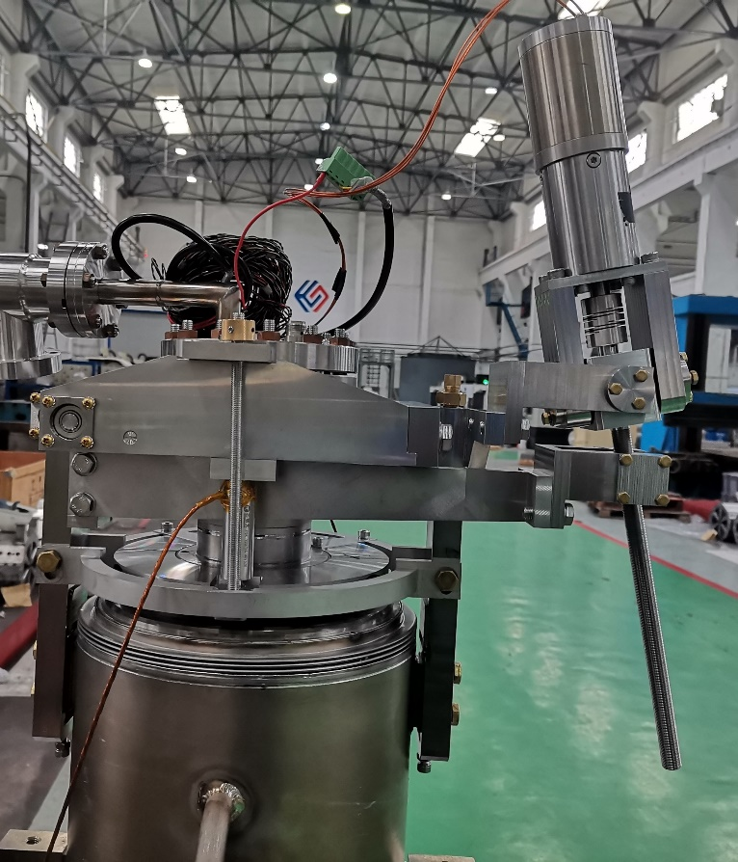
1.3 GHz Cavity, Input Coupler and Tuner Production
Eight 1.3 GHz 9-cell cavities production (test at PAPS in late 2021 to early 2022).
Eight 1.3 GHz input couplers production (conditioning at PAPS in early 2022).
1.3 GHz tuner prototyping.

Slide 20
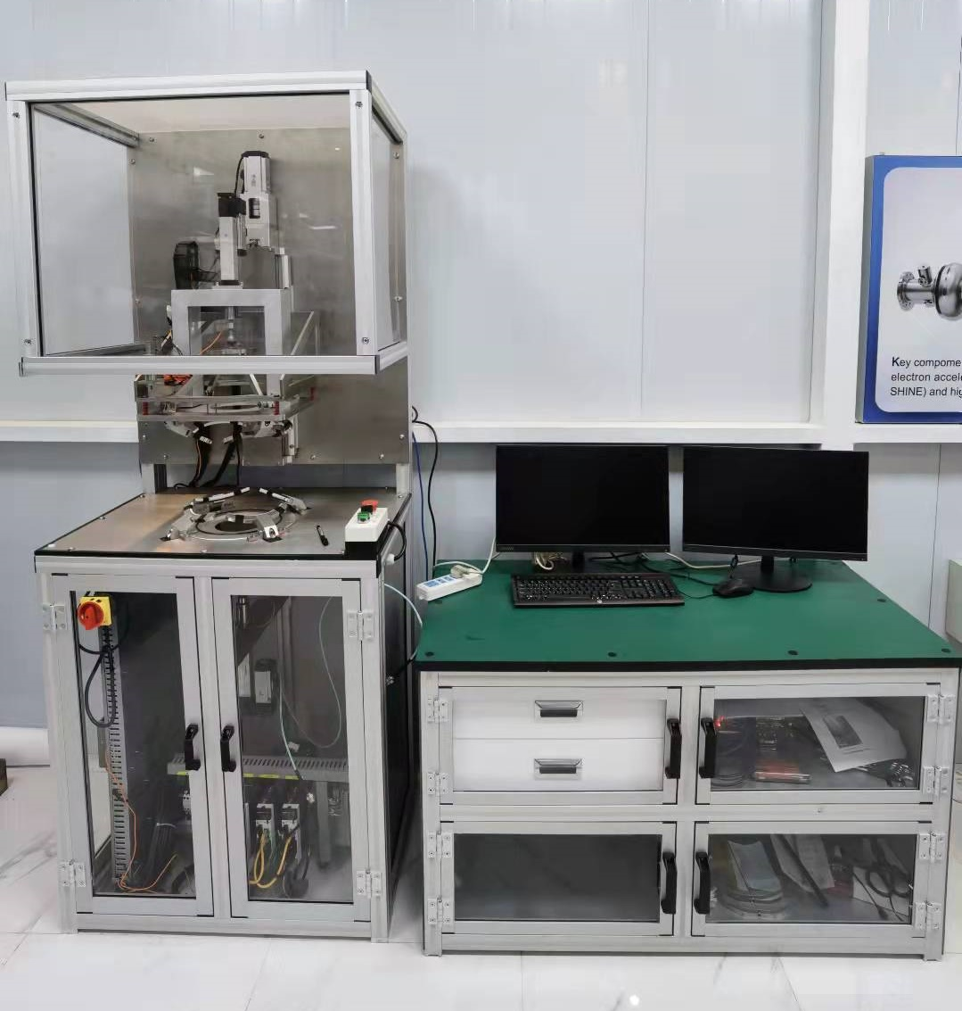
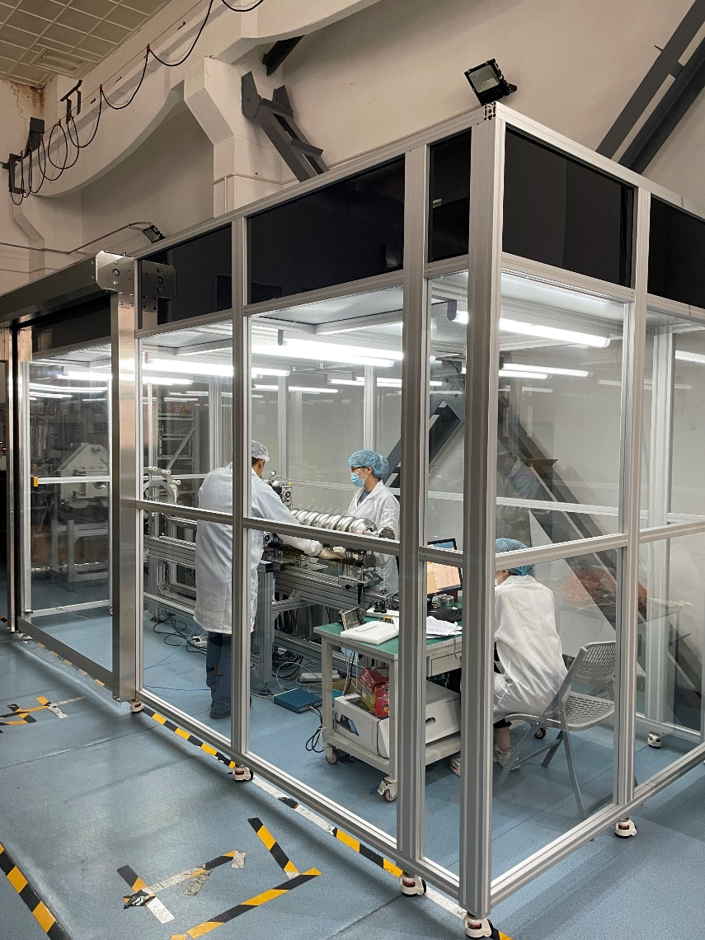
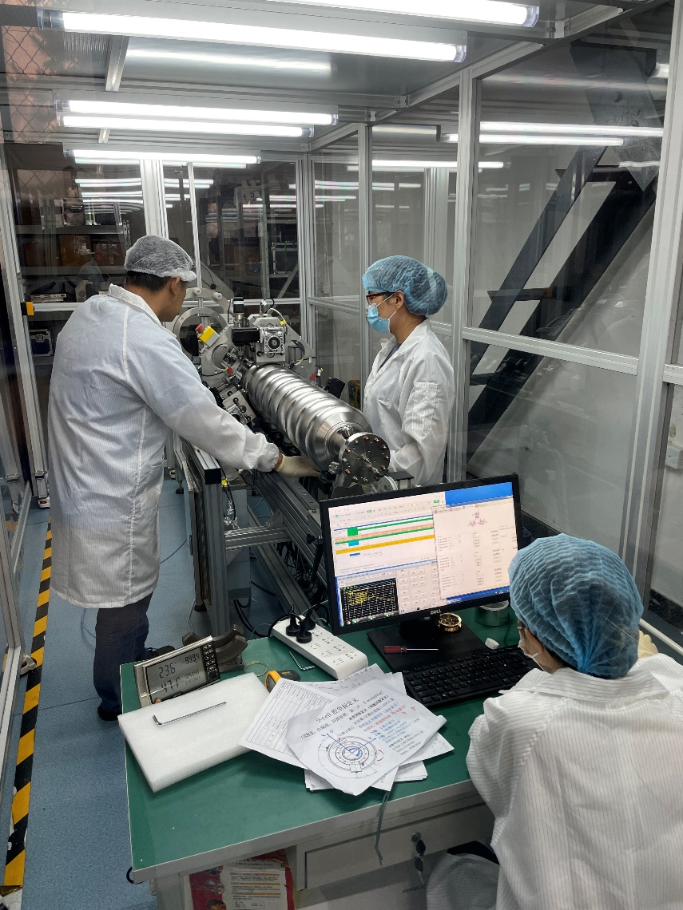
RF Measurement and Tuning Machine for Mass Production
New automatic half-cell/dumbbell frequency measurement machine
Improvement of the pre-tuning machine (ongoing)

Slide 21
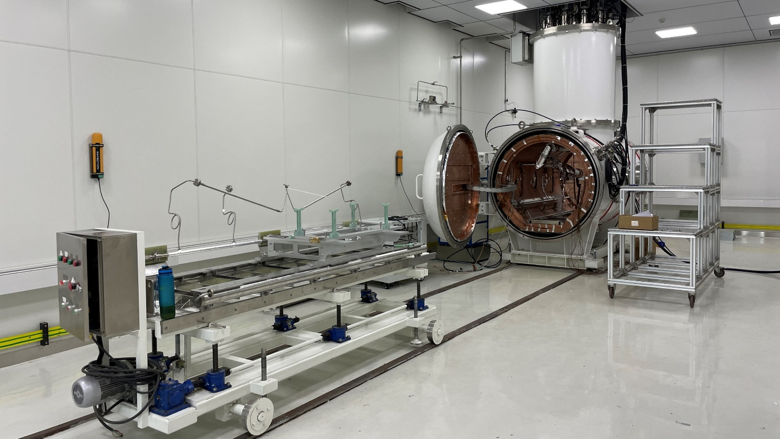





PAPS SRF Lab in Full Operation

Slide 22









PAPS SRF Lab in Full Operation
Cavities: 166 MHz QWR, 325 MHz spoke, 324 MHz double-spoke, 500 MHz, 650 MHz, 1.3 GHz elliptical…
Various input
couplers
CEPC 650 MHz module
FEL/CEPC 1.3 GHz module
HEPS 166 MHz
module
HEPS and BEPCII-U
500 MHz module
CSNS-II double
-spoke module

Slide 23
Summary
High Q SRF cavity and module technology is essential for CEPC.
650 MHz module 2 K cool down test completed, ready for horizontal test.
1.3 GHz high Q cavity horizontal test ongoing with good preliminary result.
1.3 GHz 8x9-cell cryomodule in progress.

Slide 24

Thank you

