Slide 1
MDI Studies for CEPC
Sha Bai
On behalf of CEPC MDI group
CEPC IARC meeting
2021-10-12

Slide 2
Outline
IR Superconducting magnet design
New IR beam pipe
Synchrotron radiation
Beam loss background
Shielding
Detector simulation
Summary

Slide 3
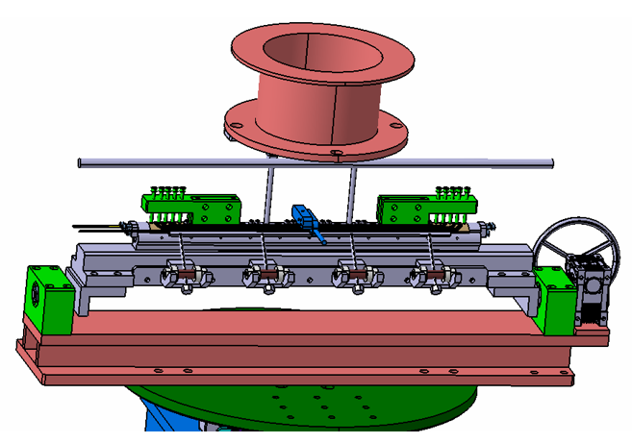
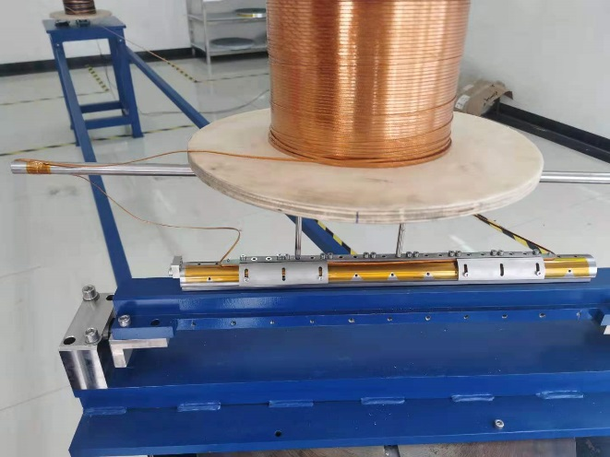
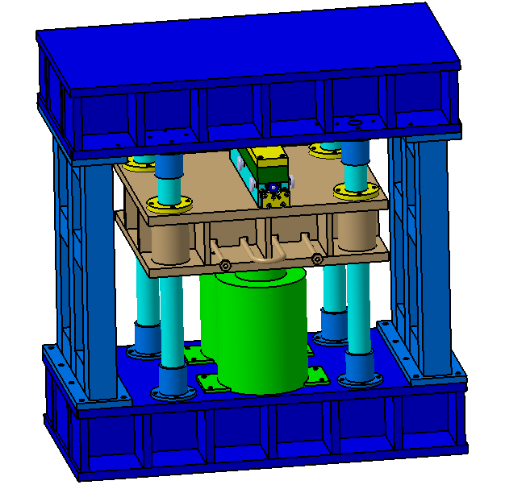
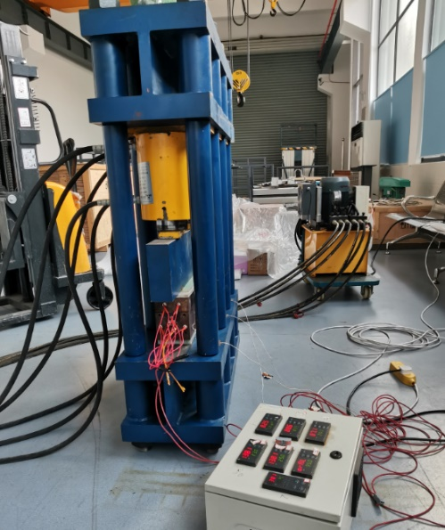
Development status of 0.5m single aperture QD0 short model magnet
Study and research on key technologies of 0.5m single aperture QD0 short model (NbTi, 136T/m) is in collaboration with KEYE Company.
Progress: fabrication of quadrupole coil winding machine, coil heating and curing system has been finished.

Slide 4
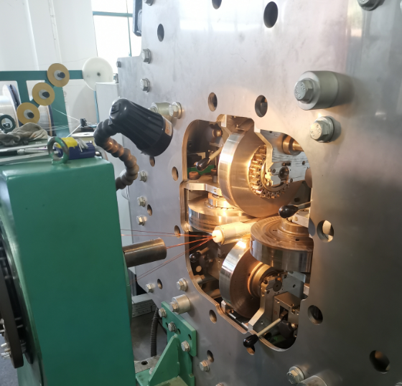
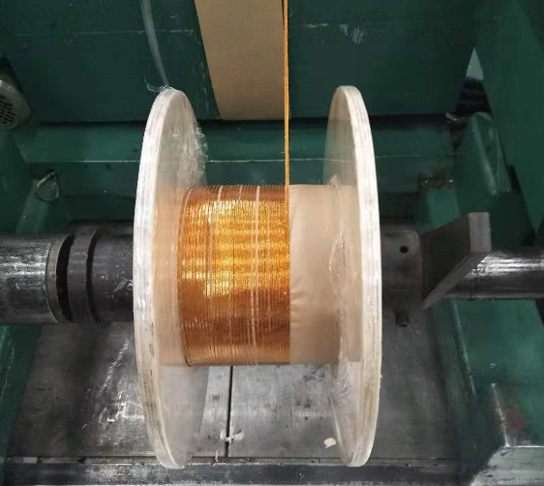
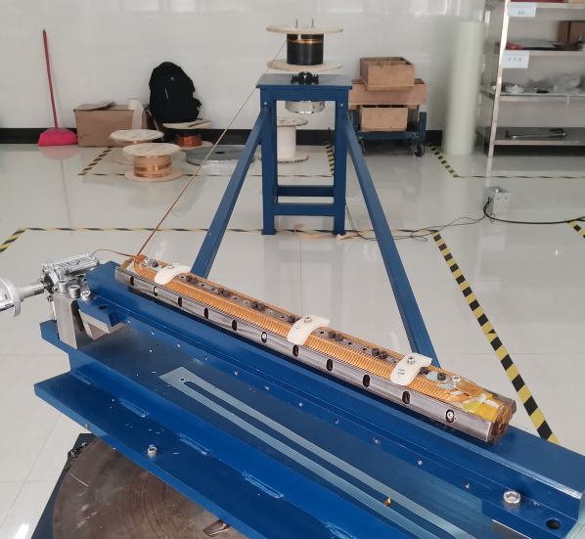
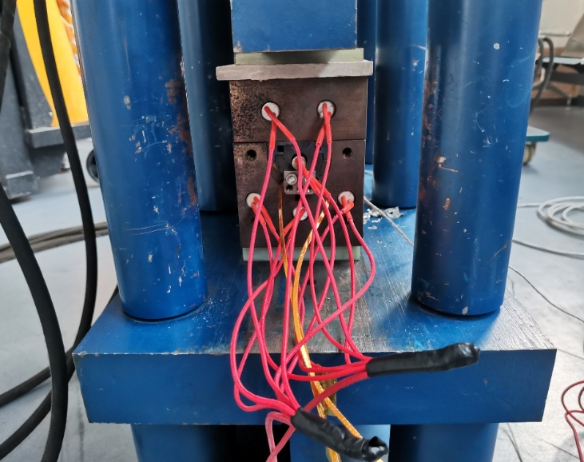
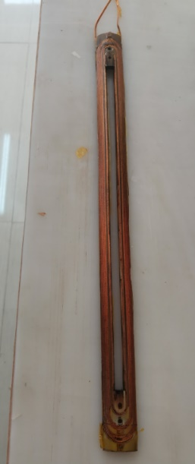
Development status of 0.5m single aperture QD0 short model magnet
Fabrication of NbTi Rutherford cable is finished (12 strands).
Fabrication of QD0 short model magnet is in progress

Slide 5
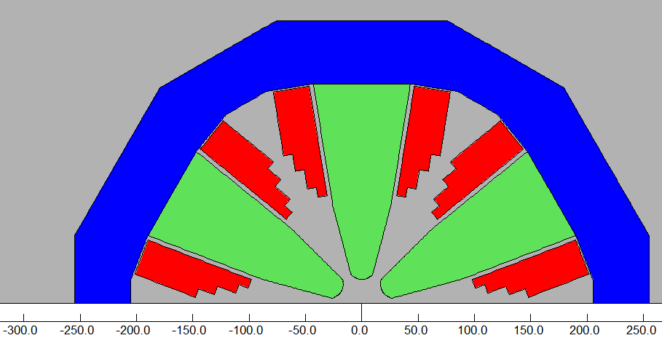
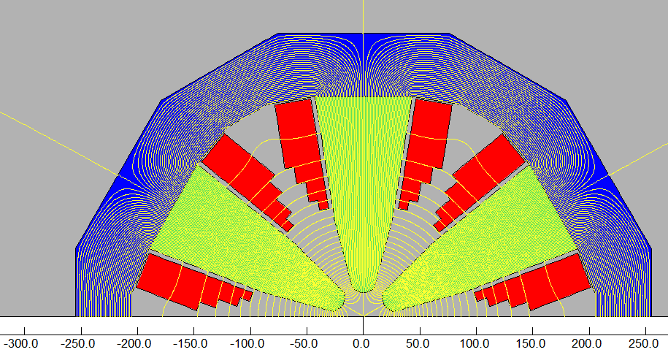
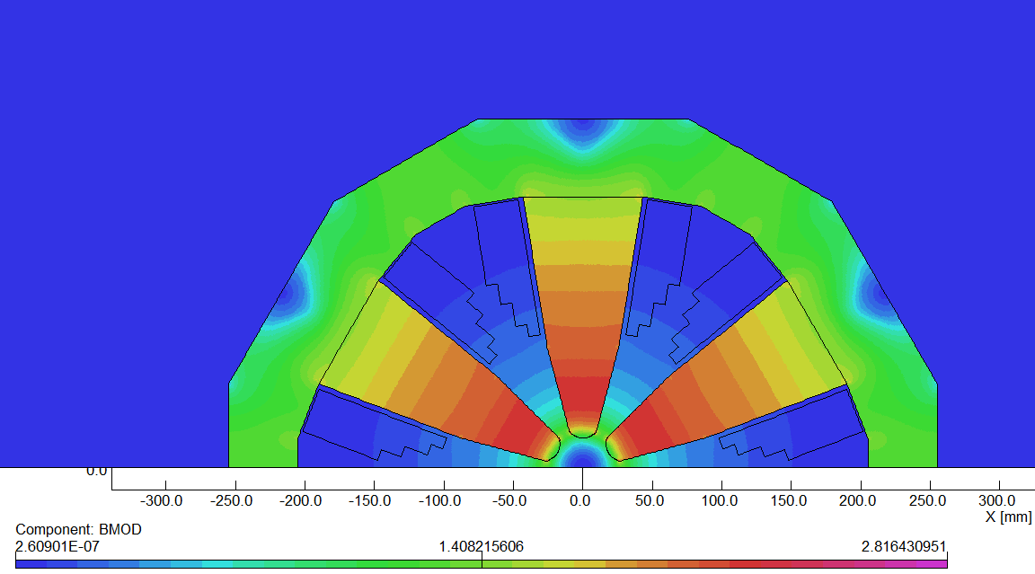
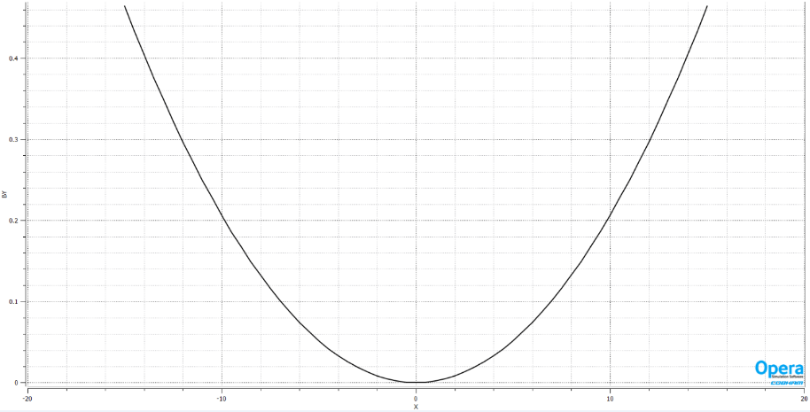
Updated design of CEPC IR sextupole magnet
Recently, the requirement for IR sextupole magnets is updated.
The magnet bore and pole field is reduced.
Conventional sextupole magnet technology can be used (FeCoV pole). Max strength 3886T/m² is achieved with bore aperture 42 mm. Max current < 200A.
2D model
B_{y} field distribution

Slide 6
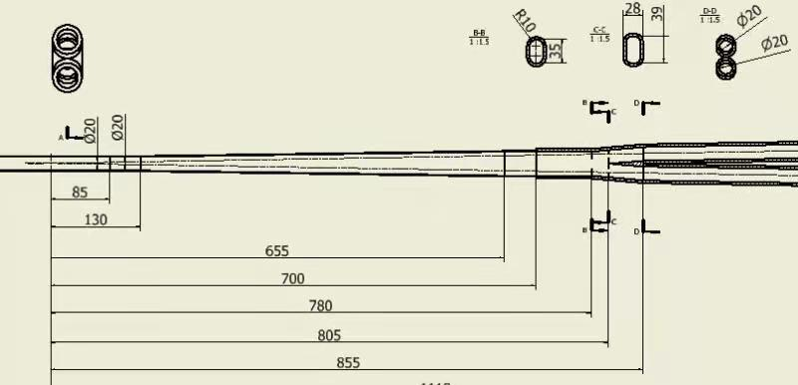
New Φ20mm IR beam pipe
From IP(mm) | Shape | Inner diameter(mm) | Material | Marker
0-85 | Circular | 20 | Be
85~130 | Circular | 20 | Al
130~655 | Cone | 20~35 | Al | Taper: 1:70
655~780 | Circular | 35 | Al
780~855 | Cone | 35~48 | Al
Berryllium (central) and Aluminum(forward) beam pipes
Central beryllium pipe inner diameter changes from 28mm(CDR) to 20mm
Smaller Be inner diameter, benefit for vertex detector experiment

Slide 7
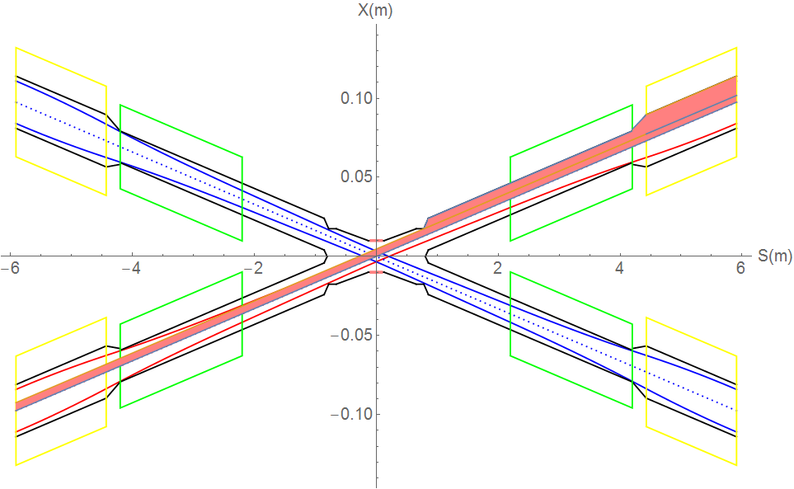
SR from last bending magnet upstream of IP
Normal condition
QF1
QD0
Region | SR heat load | SR average power density
0~780mm | 0 | 0
780mm~855mm | 48.3W | 178.9W/cm²
855mm~1.11m | 0.454W | 0.49W/cm²
1.11m~2.2m(QD0 entrance) | 1.49W | 0.38W/cm²
QD0 | 2.89W | 0.39W/cm²
QD0~QF1 | 47.9W | 57.6W/cm²
QF1 | 3.42W | 0.64W/cm²
There is no SR photons hitting the central beam pipe in normal conditions.
Single layer beam pipe with water cooling, SR heat load is not a problem.

Slide 8
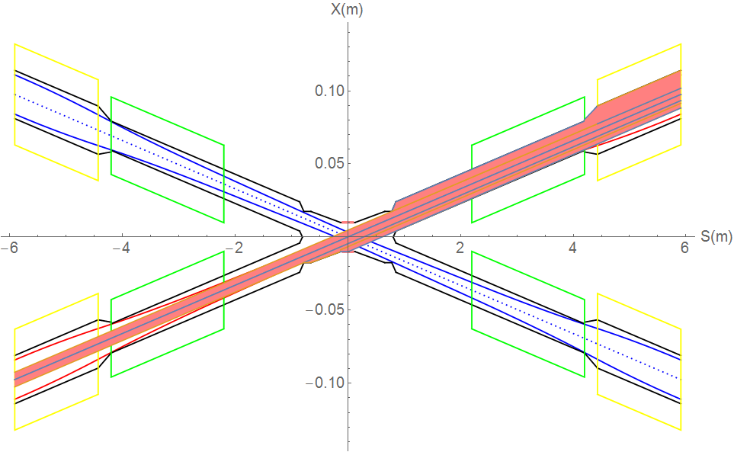
SR from last bending magnet upstream of IP
Abnormal condition
SR hitting Be pipe directly in (- 85mm ~ 11.4mm) range, but since instantaneously, heat load is not a problem.
SR photons hitting the bellows under the extreme beam conditions, temperature rise ~1⁰C
QF1
QD0
Region | Material | SR heat load | SR average power density
-85mm ~ 11.4mm | Be | 13.74W | 41W/cm²
-130mm ~ -85mm | Al | 6.66W | 41.1W/cm²
-780mm ~ -655m | Al | 18.3W | 40.7W/cm²
Extreme condition, eg, if a magnet power is lost, a large distortion will appear immediately for the whole ring orbit. The beam will be lost when exceeded.
In extreme cases ~ at least 10 times per day. The beam will be stopped within 0.5ms when abnormal.
The background of the detector should not be considered under abnormal conditions.
The beam orbit deviation will not affect detector operation, since the high background part will be removed when data analysis is carried out.

Slide 9
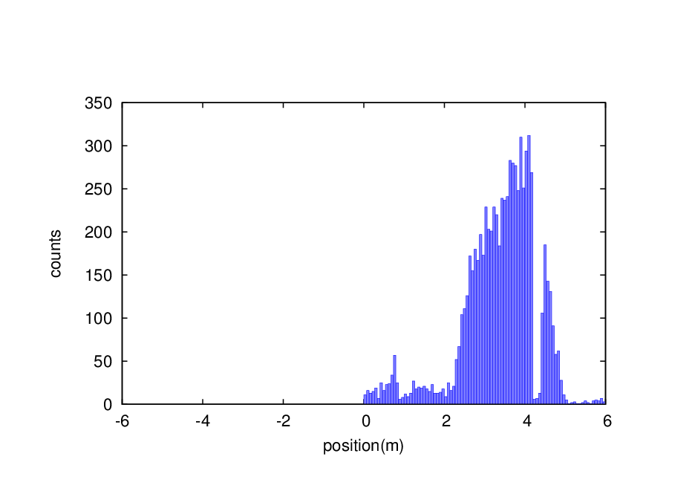
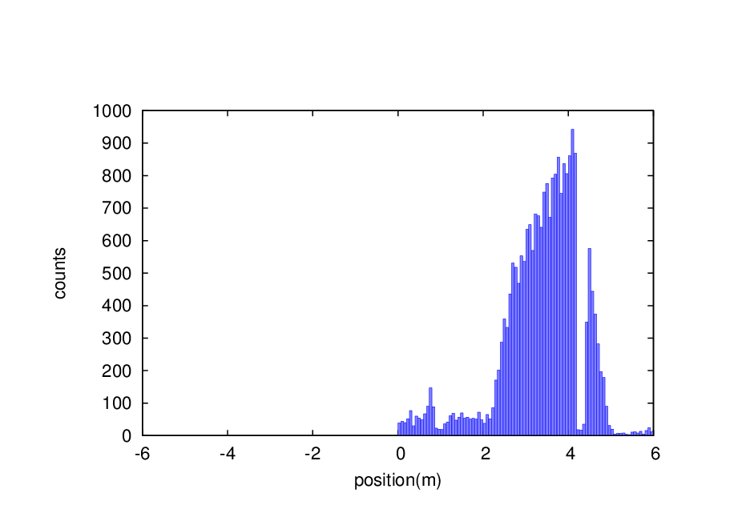
Beam loss background - RBB
With multipole errors
Only with random multiple errors, no systematic multiple errors
No extra beam loss in upstream of IP, but 3 times beam loss increase in downstream of IP
It can not solve the problem by optimize the collimators since the increase loss appears immediately after RBB in downstream of IP
Without error
With multipole field error
Multiple errors (random)
 | Q | S | O | DEC | DOC | 14 | 16 | 18 | 20 | 24
B | 0 | 4e-4 | 8e-5 | 2e-5 | 8e-5 | 2e-5 | 8e-5 | 2e-5 | 8e-5 | 2e-5
Q | 0 | 4e-4 | 4e-4 | 2e-4 | 2e-4 | 1e-4 | 1e-4 | 1e-4 | 1e-4 | 1e-4
S | 0 | 0 | 2e-3 | 3e-4 | 2e-3 | 3e-4 | 1e-3 | 3e-4 | 1e-3 | 3e-4

Slide 10
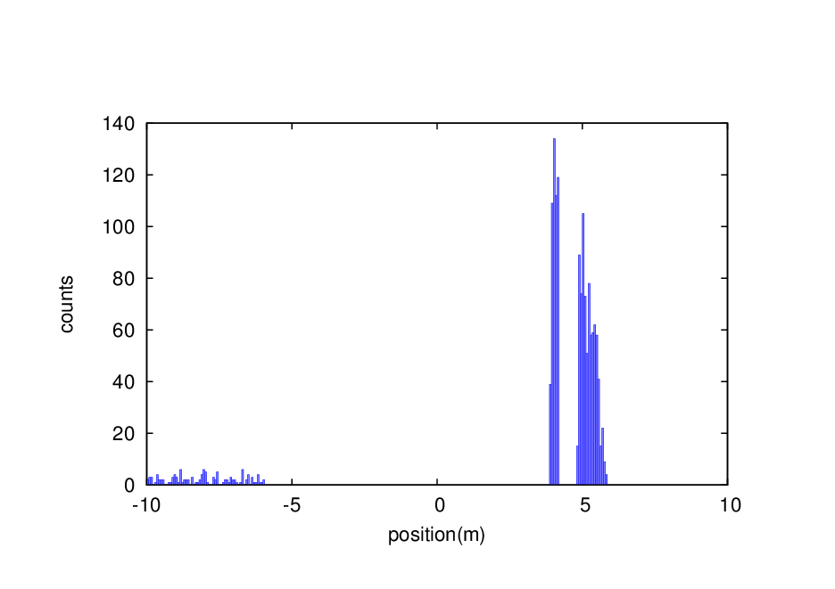
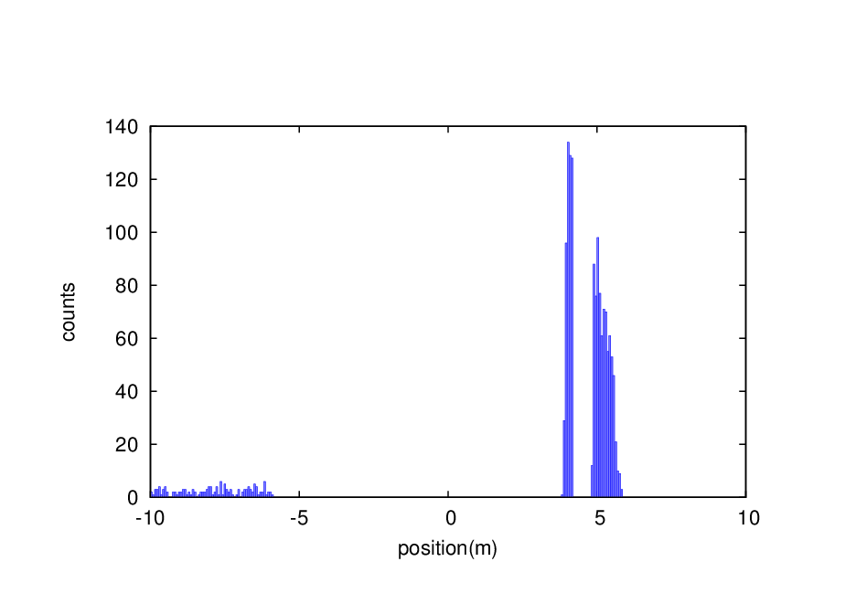
Beam loss background – Beam Gas inelastic scattering
With multipole errors
Without error
With multipole error
Only with random multiple errors, no systematic multiple errors
200000 events generated due to BG
1.73% increase of BG beam loss particles from IR ~ ±10m
Detector input events 25times, needs to improve collimators

Slide 11
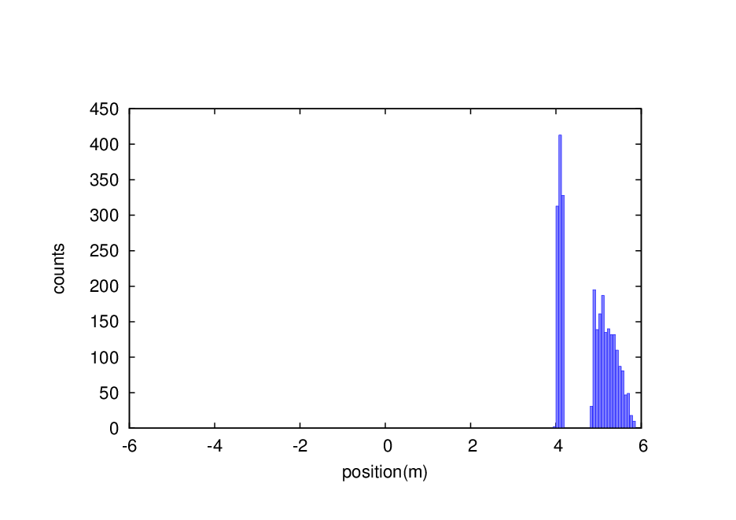
Beam loss background – Beam thermal photon scattering
With multipole errors
Without error
With multipole error
Only with random multiple errors, no systematic multiple errors
No increase of BTH beam loss particles from IR ~ ±6m
No obvious evidence to improve collimators

Slide 12
Beam loss background – RBB
With beam-beam
Without beam-beam
With beam-beam
200000 events generated due to RBB
3.2% increase of RBB beam loss particles from IR ~ 6m
It can not solve the problem by optimize the collimators since the increase loss appears immediately after RBB in downstream of IP

Slide 13
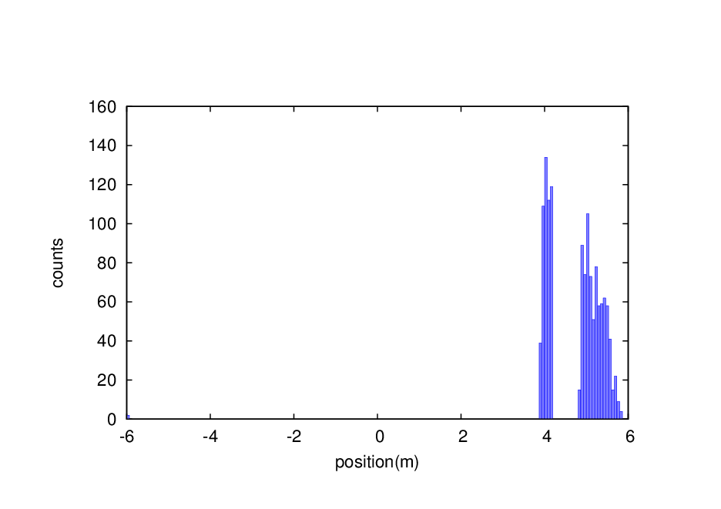
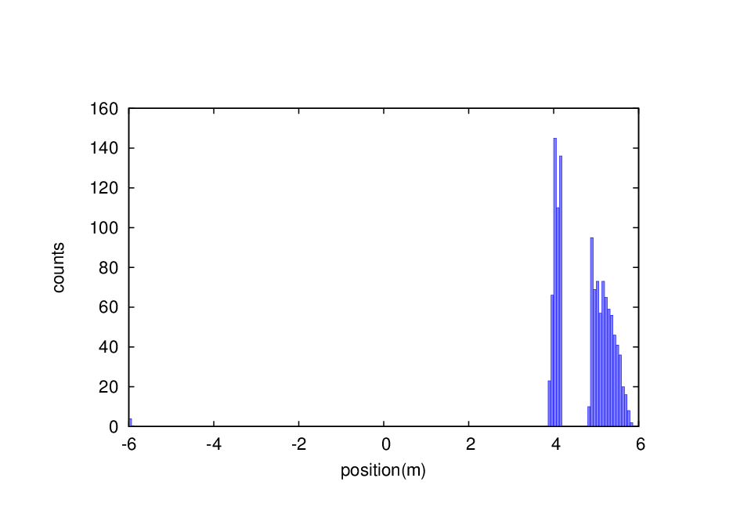
Beam loss background – Beam Gas inelastic scattering
With beam-beam
Without beam-beam
With beam-beam
0.07% increase of BG beam loss particles from IR ~ ±6m including upstream ones
Detector input events 25times, needs to improve collimators

Slide 14
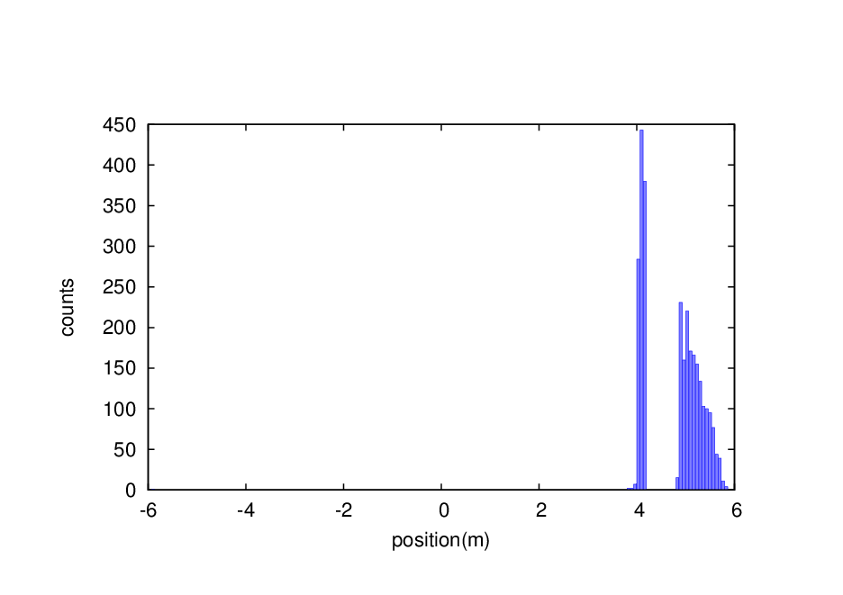
Beam loss background – Beam thermal photon scattering
With beam-beam
Without beam-beam
With beam-beam
200000 events generated due to BTH
4.9% increase of BTH beam loss particles from IR ~ ±6m
Detector input events 25times, needs to improve collimators

Slide 15
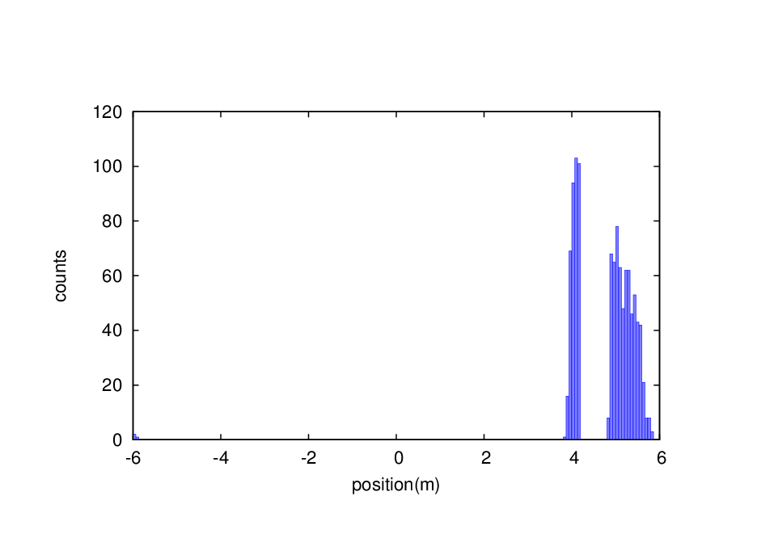
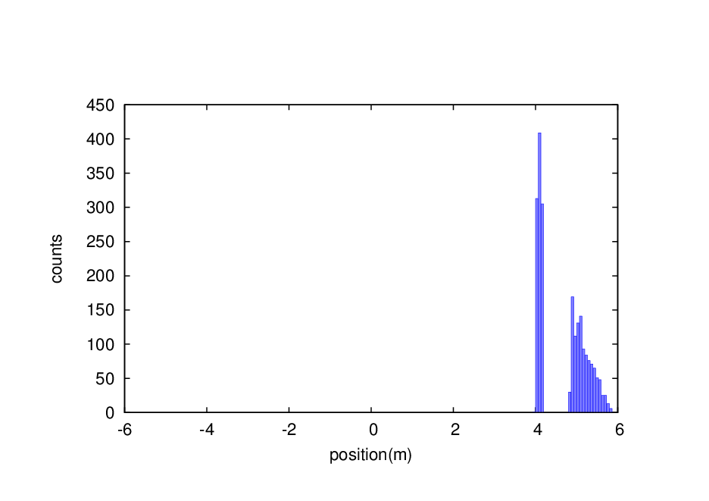
Collimator optimization
Two pairs of vertical collimators added for one IP in one ring, with which the beam loss background with multipole errors and beam-beam effects reduced 20%.
name | Position | Distance to IP/m | Beta function/m | Horizontal Dispersion/m | Phase | BSC/2/m | Range of half width allowed/mm
APTX1 | D1I.1897 | 2139.06 | 113.83 | 0.24 | 356.87 | 0.00968 | 1~10
APTX2 | D1I.1894 | 2207.63 | 113.83 | 0.24 | 356.62 | 0.00968 | 1~10
APTX3 | D1O.10 | 1832.52 | 113.83 | 0.24 | 6.65 | 0.00968 | 1~10
APTX4 | D1O.14 | 1901.09 | 113.83 | 0.24 | 6.90 | 0.00968 | 1~10
APTY1 | D1I.1904 | 2001.92 | 20.70 | 0.24 | 359.91 | 0.003348 | 1~3.3
APTY2 | D1I.1900 | 2070.49 | 20.70 | 0.24 | 359.66 | 0.003348 | 1~3.3
APTY3 | D1O.16 | 1969.67 | 20.70 | 0.24 | 7.59 | 0.003348 | 1~3.3
ATPY4 | D1O.20 | 2038.24 | 20.70 | 0.24 | 7.84 | 0.003348 | 1~3.3
BG
BTH
Beam stay clear region: 18 σ_{x}+3mm, 22 σ_{y}+3mm
Impedance requirement: slope angle of collimator < 0.1
To shield big energy spread particles, phase between pair collimators: π/2+n*π
Collimator design in large dispersion region: σ=$\sqrt{εβ+\left(Dxσe\right)2}$

Slide 16
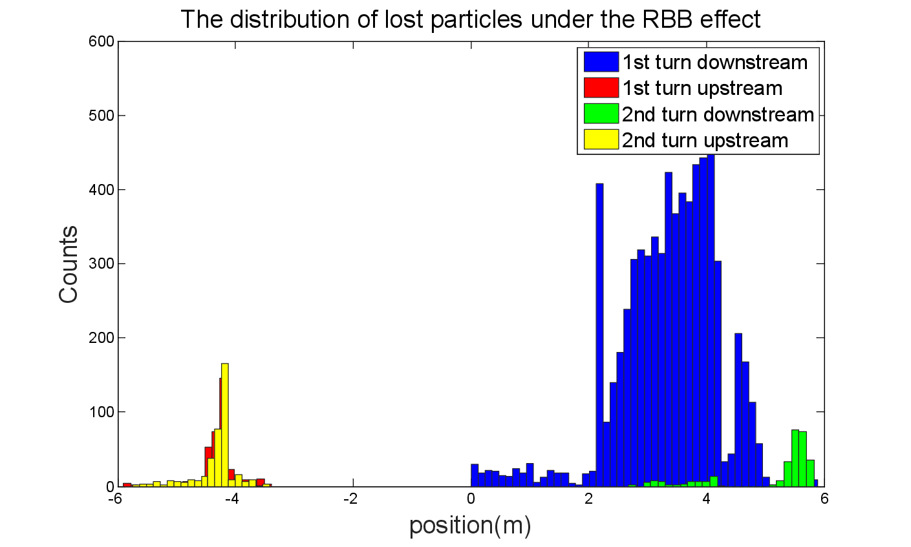
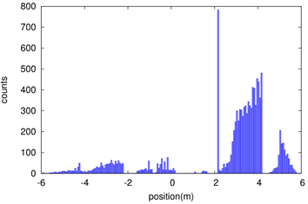
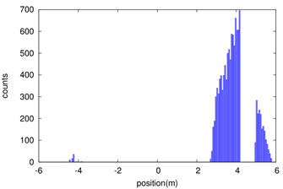
Shielding
Beam loss in the downstream IR with a large amount, due to the process of radiative bhabha scattering, beamstrahlung, beam-gas scattering, beam thermal photon scattering.
Radiation dose may damage the SC magnet coil and the detector.
solution
1. Tungsten IR beam pipe,
2. Combined iron and tungsten yoke of SC magnet
The distribution of lost particles under BG effect
The distribution of lost particles under BTH effect

Slide 17
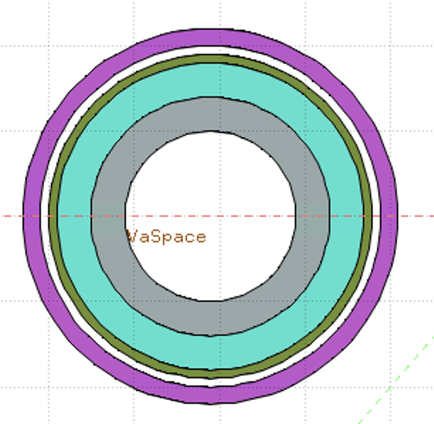
Simulation for Dose on Coil of SC
Key Issues on Calculation and Simplification of Beam pipe model
Pure tungsten IR beam pipe with 4mm thickness without cooling taken into account, simulate the Absorbed Dose on Coil (Region)
Use FLUKA Cern 4-1.1 as simulation tool
Import SAD output as source
Geometry: Pipe Only
White: Vacuum
Gray: Tungsten Pipe
Light Green: Helium
Heavy Green: Stainless Steel Vassel
Pink: Coil

Slide 18
Preliminary Result of Shielding design
Simulate the Absorbed Dose on Coil(Region)
Energy deposition per incident particle ~0.013 GeV/g/pri
Take the loss rate calculated by SAD into account:
~0.00166 Gy/s(0.166rad/s)
~14.35 Gy/day
~36662.49 Gy/lifetime(Higgs plans to run 7 years)
Limit is 100000 Gy/lifetime

Slide 19
Full Detector Simulation – detector impacts
Two Main Concern has been taken for detector impacts:
Detecting Efficiency(Occupancy): The ratio of Data/Noise
Detector Safety: Radiation Tolerance/Cooling Issues
Three quantities has been scored:
Charged Particle Fluence(Hit Density)
Total Ionizing Dose(TID)
1 MeV Silicon Equivalent Fluence(NIEL)
A Safety of 10 is always applied to all results

Slide 20
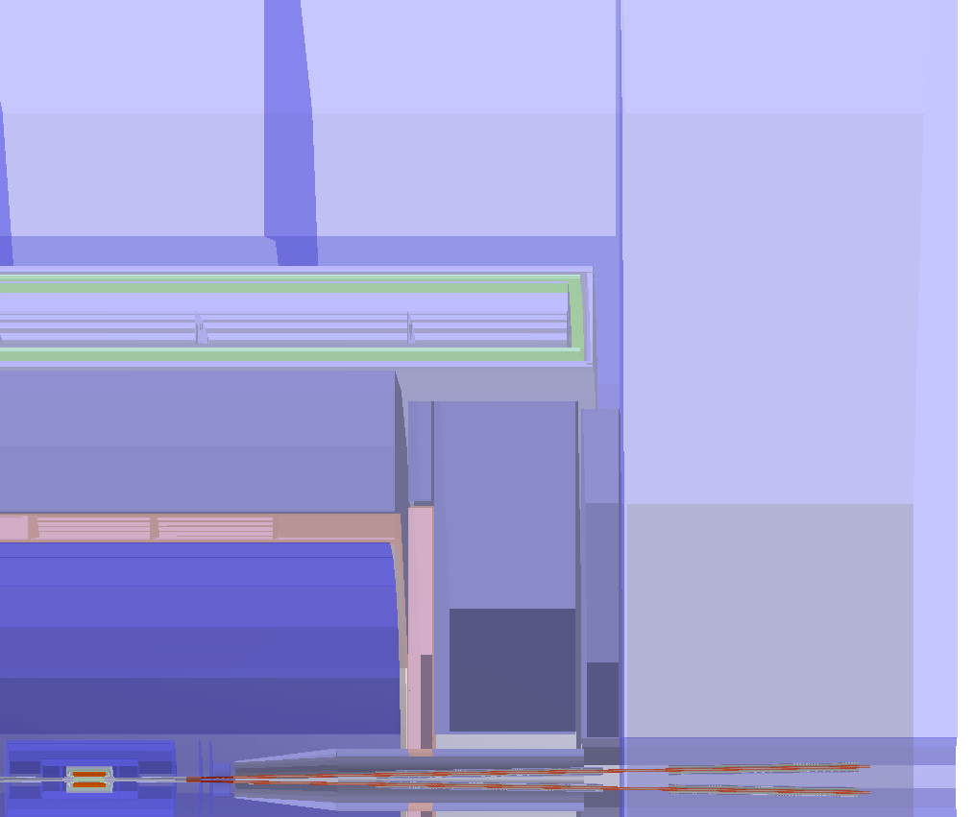
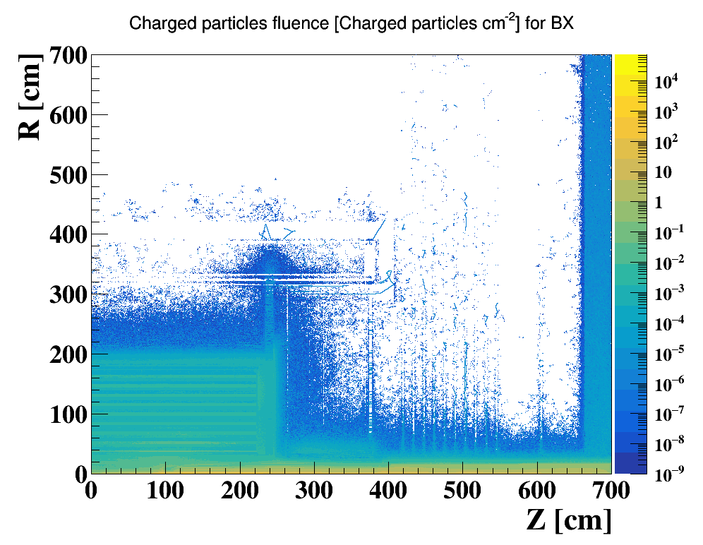
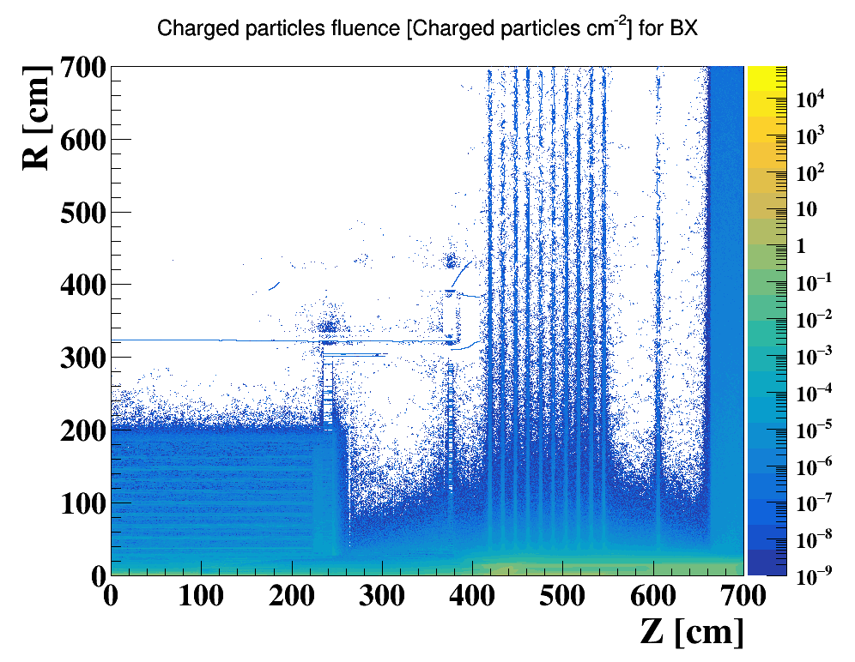
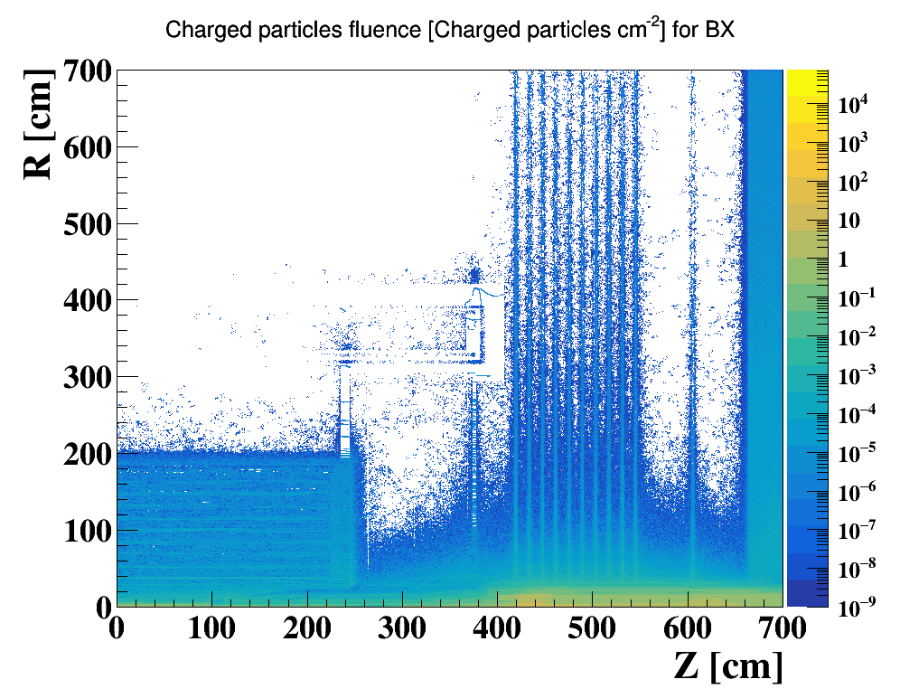
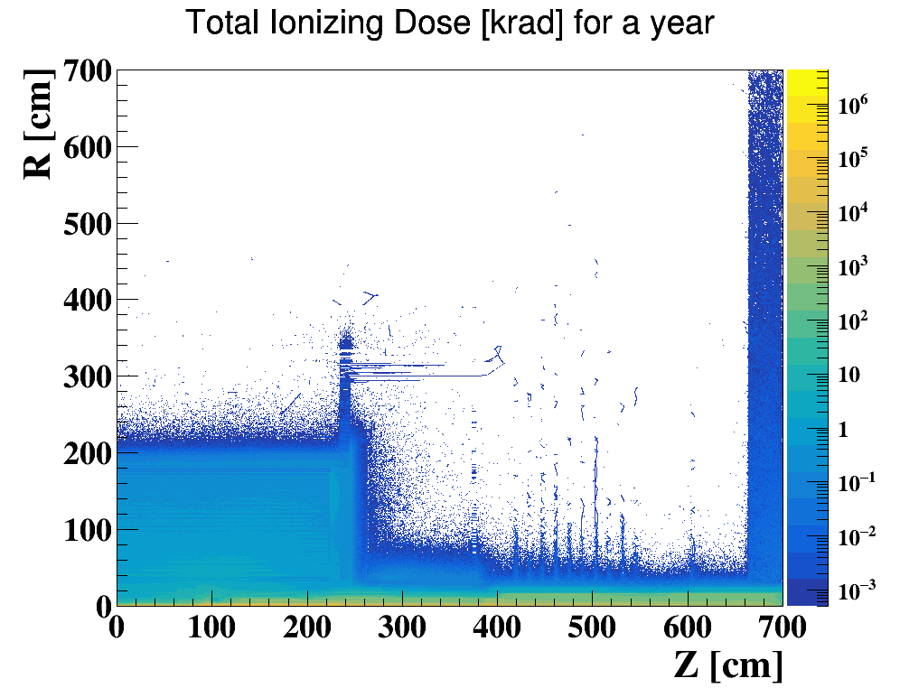
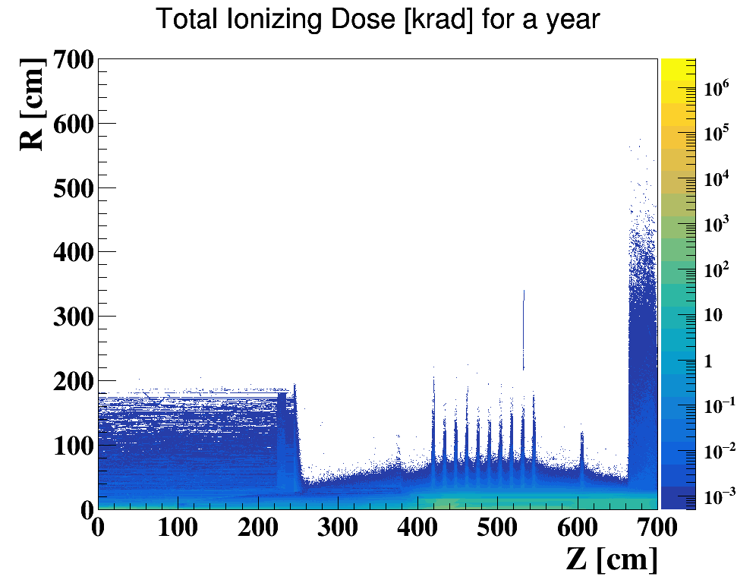
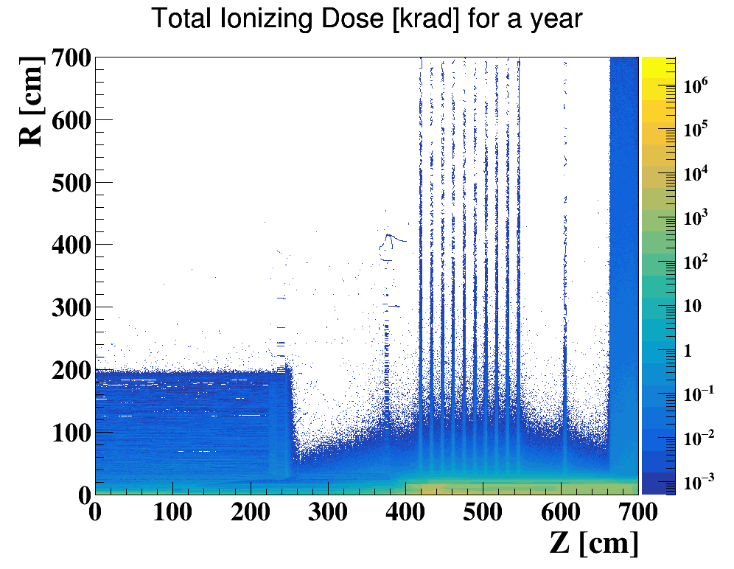
Full Detector Simulation
Pair Production
Beam Gas
Beam Th-Photon
Yoke(barrel)
300cm
Solenoid
Yoke(Endcap)
HCal
200cm
HCal
TPC
400 cm
End cap ring
EMC
Yoke plugin
The full detector simulation on Higgs Mode based on original CDR design & parameter has been performed
28mm Be beam pipe
The impact on detector due to bkg could reach EMC or more
Pair Production contributes most, bth and bgb are at same level, lower than pair production

Slide 21
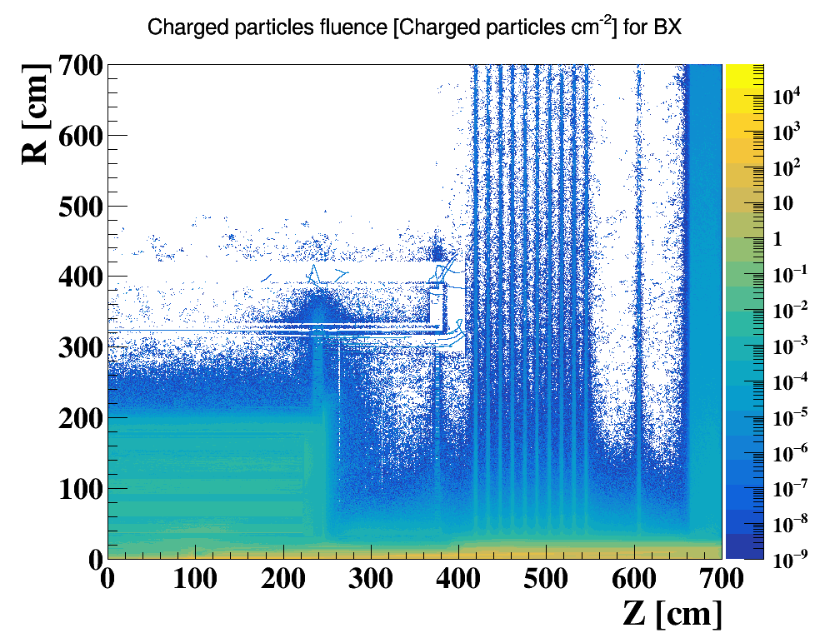
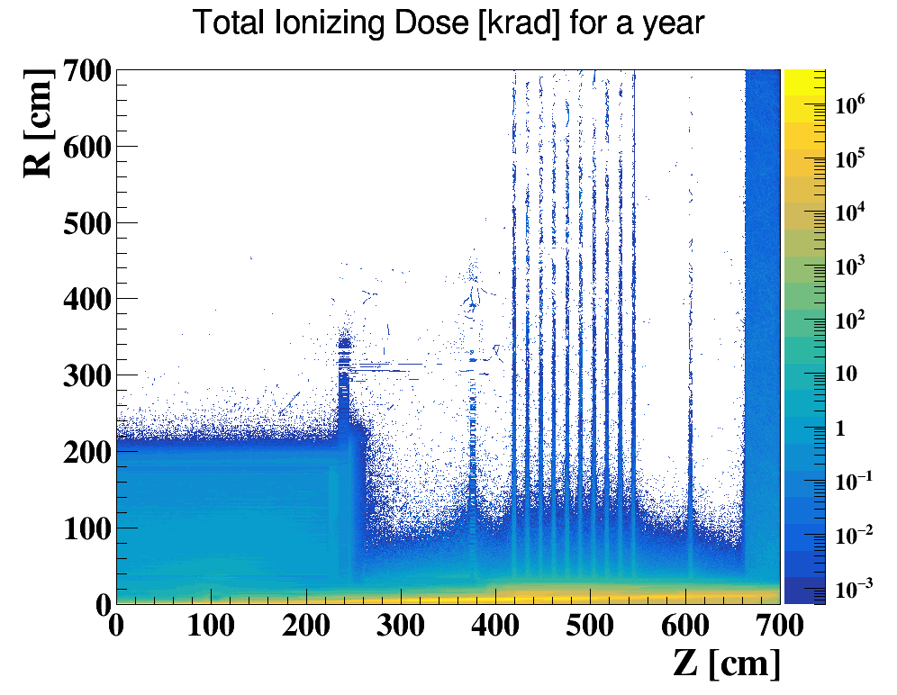
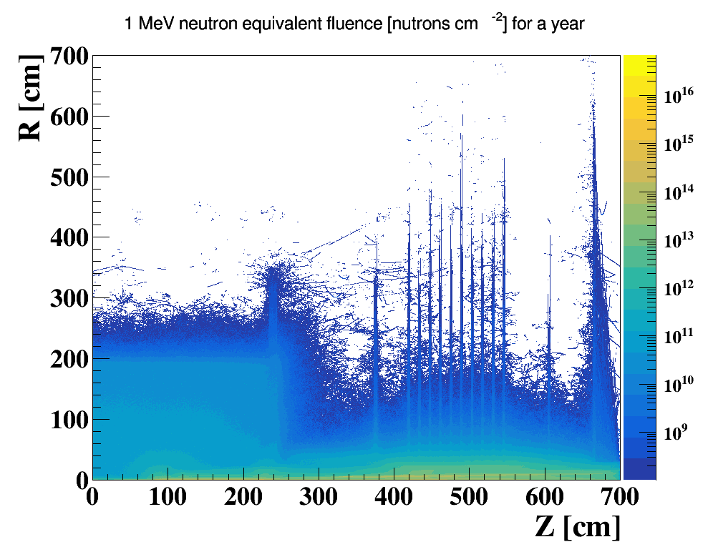
Full Detector Simulation (without Acc)
Full detector simulation performed based on CDR Higgs and baseline detector without accelerator components
Pairs Production/RBB/BGB/BTH taken into account
Preliminary feedback from detector, impacts small enough.
Needs further verification

Slide 22
Summary
For the IR Superconducting magnet design, fabrication of quadrupole coil winding machine, coil heating and curing system has been finished.
The requirement for IR sextupole magnets is updated and conventional sextupole magnet technology can be used.
New Φ20mm IR beam pipe is designed and synchrotron radiation is checked.
For the beam loss background with multipole errors and beam-beam effects, collimators are preliminary improved.
Tungsten IR beam pipe is preliminary designed, first results shows dose on coil of SC magnets will not cause SC quench.
The full detector simulation shows the impact on detector due to bkg could reach EMC or more. Pair Production contributes most; bth and bgb are at same level, lower than pair production
Preliminary feedback from detector, impacts small enough. Needs further verification.

Slide 23
Thanks

