Slide 1
Investigation on the CEPC polarization
Zhe Duan
On behalf of CEPC Beam Polarization Working Group
2021. 10. 12

Slide 2
Beam polarization working group
Physics design:
  Tao Chen, Zhe Duan, Jie Gao, Sergi Nikitin (BINP), Dou Wang, Yiwei Wang, Wenhao Xia
Polarized electron source & linac:
  Xiaoping Li, Cai Meng, Jingru Zhang
Polarimeter:
  Shanhong Chen, Yongsheng Huang, Guangyi Tang
Helpful discussions with E. Forest (KEK) & D. Sagan (Cornell) on usage of BMAD/PTC are acknowledged.

Slide 3
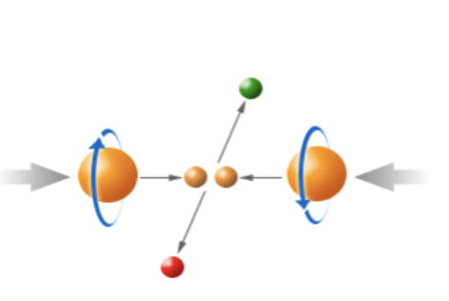
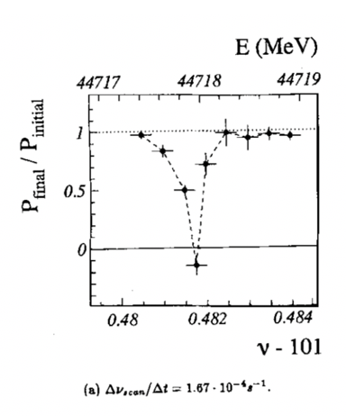
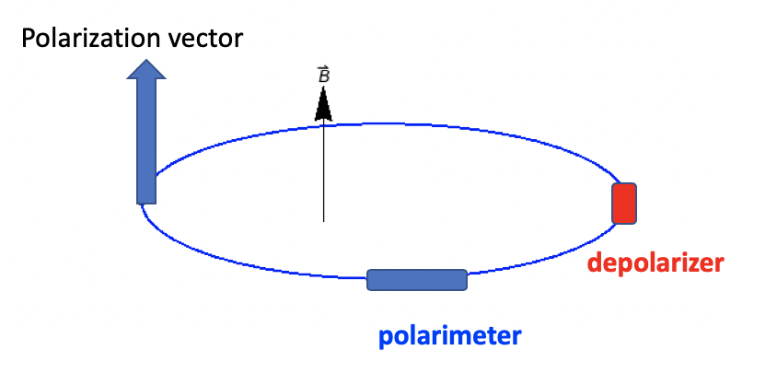
Motivation of CEPC Z-pole polarized beam program
Vertically polarized beams in the arc
  Beam energy calibration via the resonant depolarization technique
  Essential for precision measurements of Z and W properties
  At least 5% ~ 10% vertical polarization, for both e+ and e- beams
Longitudinally polarized beams at IPs
  Beneficial to colliding beam physics programs at Z, W and Higgs
  Figure of merit: Luminosity * f( Pe+, Pe- )
  ~50% or more longitudinal polarization is desired, for one beam, or both beams
L. Arnaudon, et al., Z. Phys. C 66, 45-62 (1995).
Final deliverable: a detailed design report of polarized beam operation @ Z-pole

Slide 4
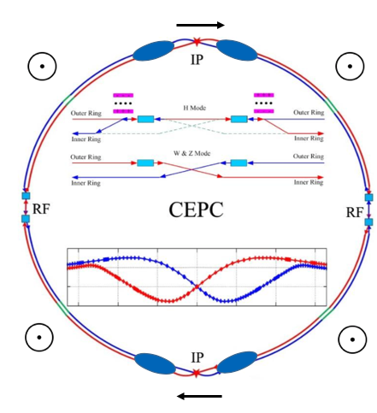
Wish list and key questions
Wish list
  A small fraction of non-colliding bunches with at least 5% vertical polarization in the arc, depolarize one-by-one to carry out resonant depolarization measurements
  All colliding bunches have > 50% time-averaged longitudinal polarization at IPs
  Luminosity is not significantly affected
  Beam lifetime is sufficient long so that top-up injection is feasible
Longitudinal polarimeter
Spin rotators
Key questions
  How to polarize the beams?
  How to adjust the polarization direction?
  How to measure the polarization?
  How to reach a high luminosity, a high polarization and a reasonable beam lifetime?
Asymmetric wigglers
depolarizer
Note: the current study is based on CEPC CDR parameters, to reach the first polarization specific design, then we’ll update according to the CEPC TDR design parameters
Transverse polarimeter

Slide 5
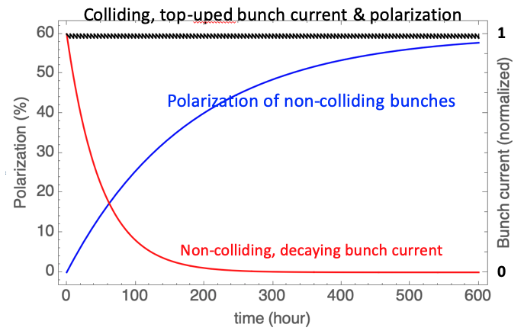
How to polarize the e+/e- beam?
 | Non-colliding bunches | Colliding bunches
Beam lifetime | 20~100 hours, a high bunch current is not necessary | ~2 hours
Injection frequency | Every 20~100 hours | Top-up injection, every ~ 10 seconds
Evolution of beam polarization | Exponential build-up Time scale ~ several hundred hours | Saw-tooth near the level of injected beam polarization
Usage | Resonant depolarization | Colliding beam experiments
Method to realize desired beam polarization | Use asymmetric wigglers to reduce self-polarization build-up time | Inject polarized beam
Note: injection of polarized beam for colliding experiments, enables resonant depolarization measurement of some colliding bunches, which could help reduce the systematic errors of RD on non-colliding bunches only.

Slide 6
Basic operation scenario
Baseline assumptions:
  The injector can supply polarized e- beam (>50%), and unpolarized e+ beam (by default)
  Resonant depolarization requires a bunch polarization > 5%
Inject ~100 unpolarized non-colliding beams
Turn-on asym. wigglers to boost self-polarization
Turn-off asym. wigglers
Replenish one decayed unpolarized non-colliding bunch ~ every hour
Resonant depolarization
Resonant depolarization measurements
~2 hours
~10 min
Time of operation
Colliding beam
experiments
Top-up injection
~10 seconds
Inject ~ 12000 polarized e- and unpolarized e+ bunches
Start colliding beam experiments
each fill could last many hours
Unless hardware failure occurs

Slide 7
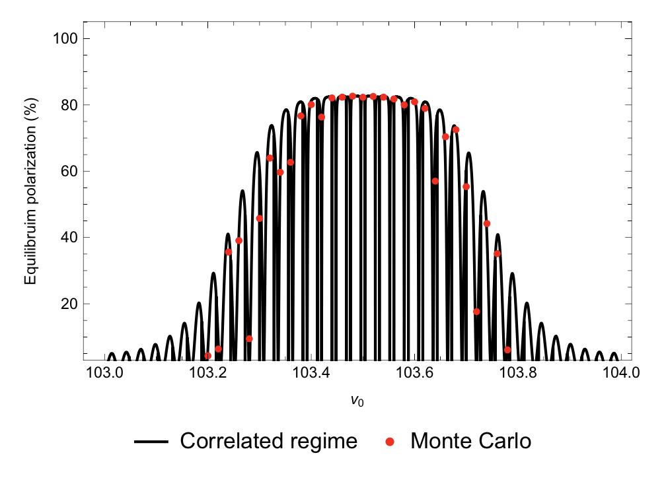
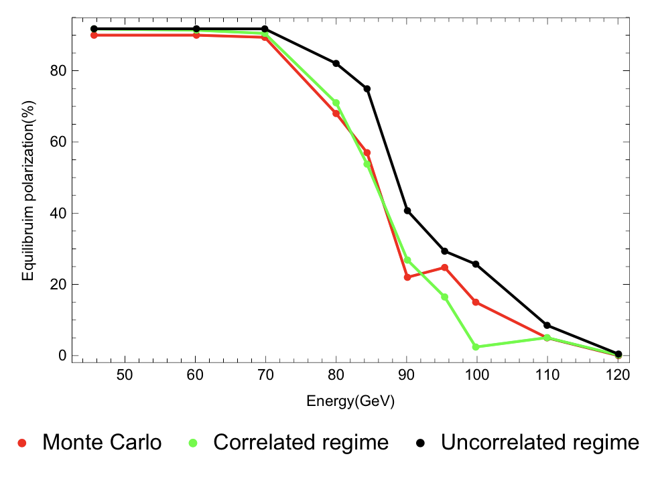
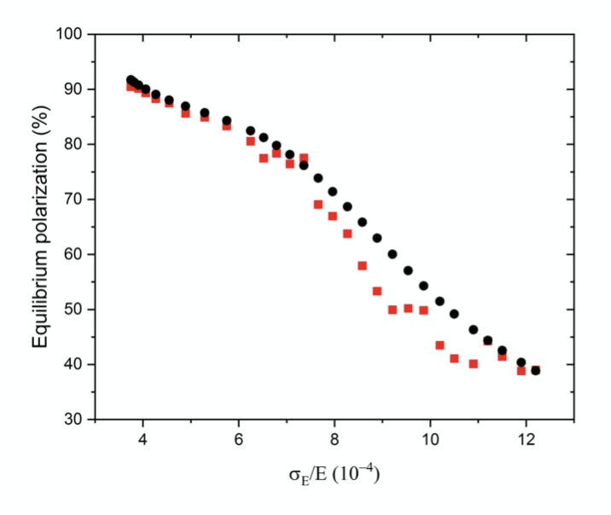
Equilibrium beam polarization in the collider ring
Wenhao Xia
CEPC CDR lattices w/ errors & corrections are converted from SAD to BMAD/PTC
Use Monte-Carlo simulations based on PTC, to evaluate the equilibrium beam polarizations.
The depolarization effects at ultra-high energies are also explored.
A journal paper is in preparation.

Slide 8
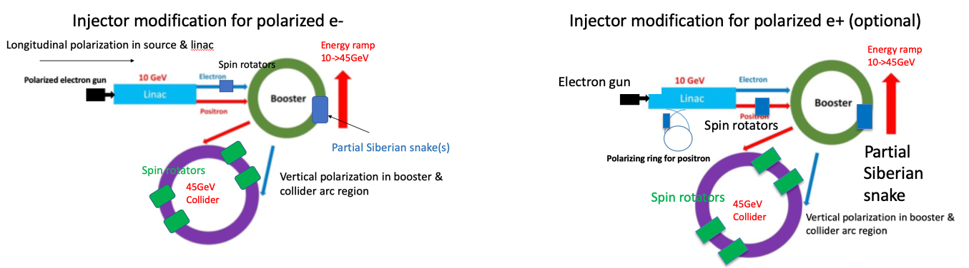
Injector chain to supply polarized e- beam
Key research topics:
Polarized electron source
e+ polarizing ring
Spin rotators in the linac-to-booster transport line
Siberian snakes in the booster

Slide 9
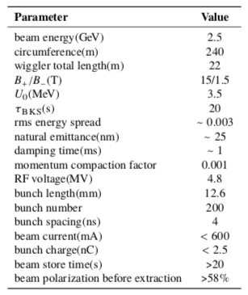
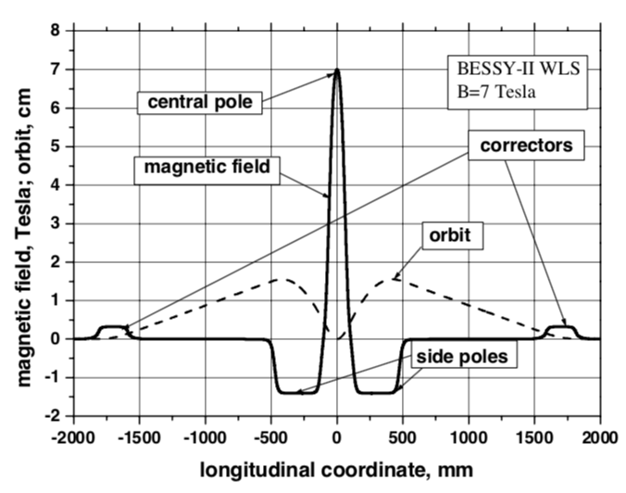
Polarized e+/e- source
Polarized e- source is matured technology
Parameters of CEPC polarized electron source
Gun type | Photocathode DC Gun
Cathode material | Super-lattice GaAs/GaAsP
HV | 150-200kV
QE | 0.5%
Polarization | ≥85%
Electrons/bunch | 2×10¹⁰
Repetition rate | 100Hz
Drive laser | 780nm (±20nm), 10μJ@1ns
Xiaoping Li
Parameter | ILC(TDR) | CLIC(3TeV) | CEPC
Electrons/microbunch | 2×10¹⁰ | 0.6×10¹⁰ | >0.94×10¹⁰
Charge / microbunch | 3.2nC | 1nC | 1.5nC
Number of microbunches | 1312 | 312 | 1
Macropulse repetition rate | 5 | 50 | 100
Average current from gun | 21μA | 15μA | 0.15μA
Polarization | >80% | >80% | >80%
A polarizing/damping ring for e+, using high-field asymmetric wigglers
  Detailed design study is under way
    Low-emittance lattice design w/ very strong wigglers
Tentative parameters
An asymmetric wiggler @BESSY-II as WLS,
A. M. Batrakov, et al., APAC 2001, pp251-253.

Slide 10
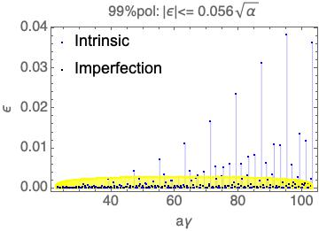
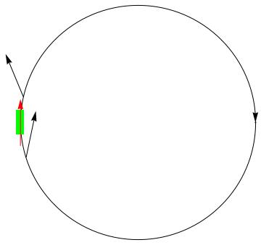
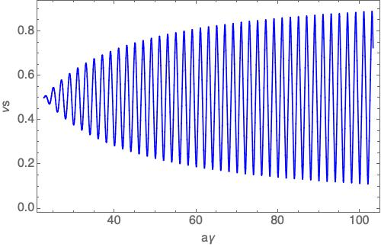
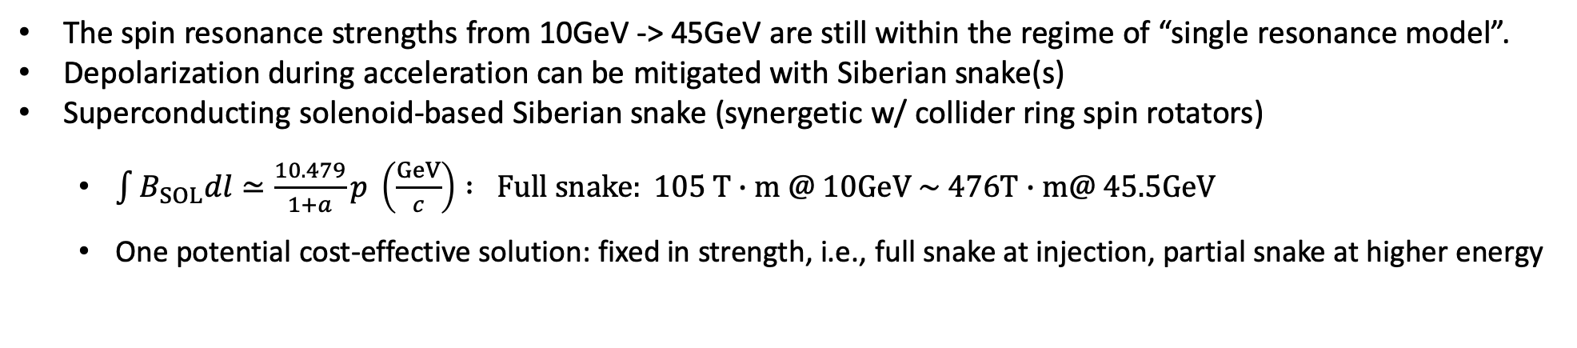
Maintenance of beam polarization in CEPC Booster
The spin resonance strengths from 10GeV -> 45GeV are still within the regime of “single resonance model”.
Depolarization during acceleration can be mitigated with Siberian snake(s)
Superconducting solenoid-based Siberian snake (synergetic w/ collider ring spin rotators)
  $\int{B_{SOL}dl}≃\frac{10.479}{1+a}p \left(\frac{GeV}{c}\right) : Full snake: 105 T∙m @ 10GeV \sim 476T∙m@ 45.5GeV$
  One potential cost-effective solution: fixed in strength, i.e., full snake at injection, partial snake at higher energy
Assume injected beam vertical normalized emittance is 10mm mrad
Siberian snake
10 GeV
45.5 GeV

Slide 11
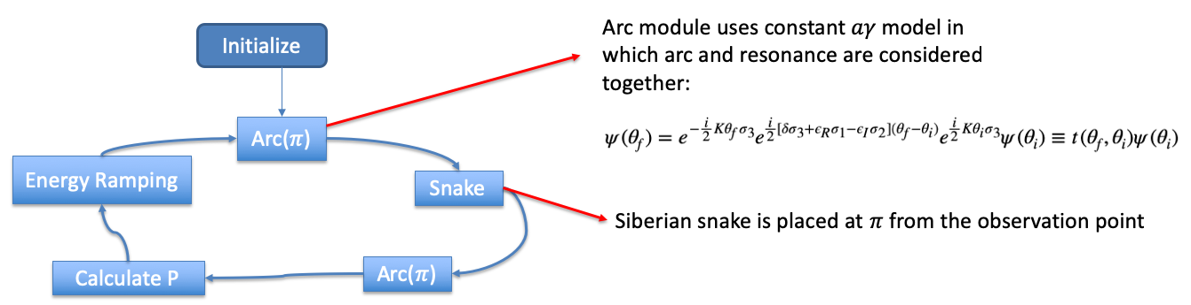
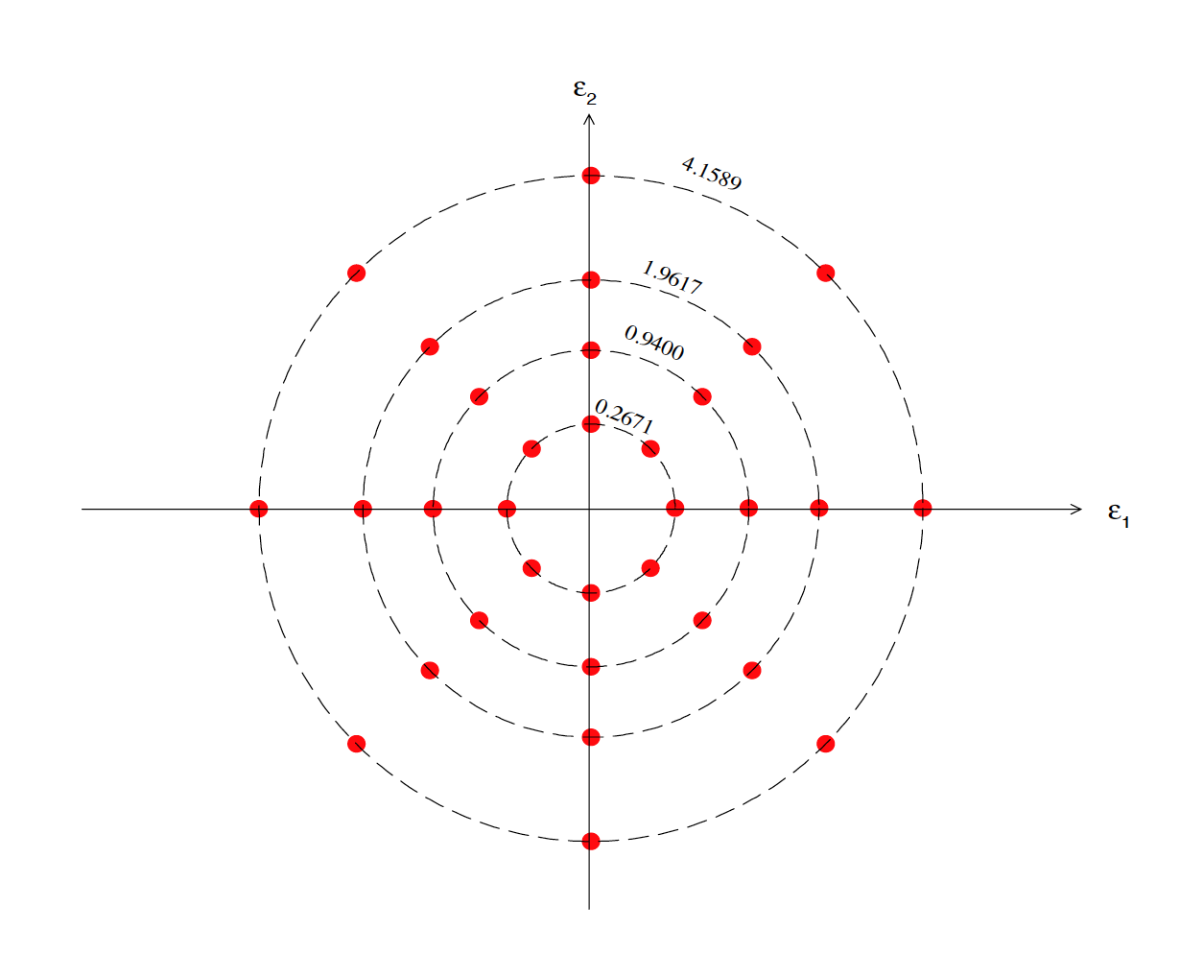
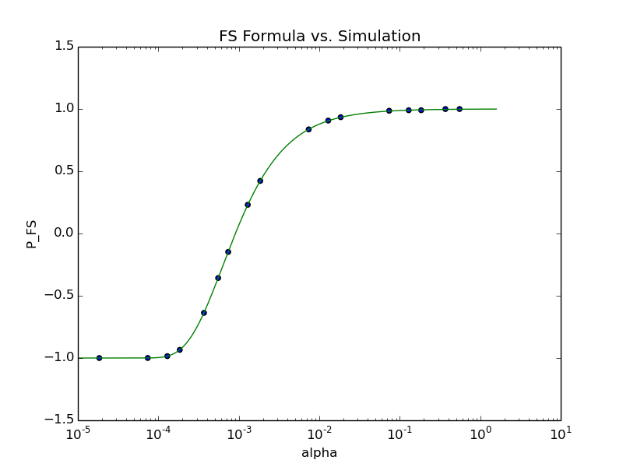
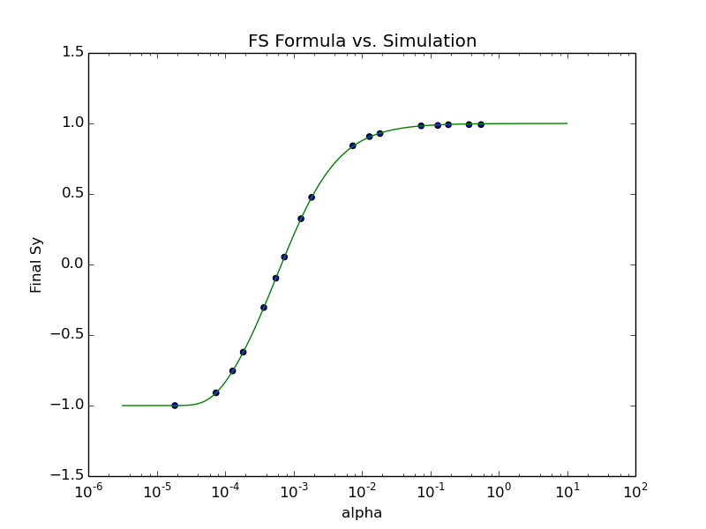
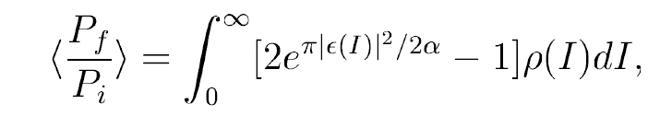

Lattice independent simulations
Diagram of the simulation algorithm
Tao Chen
Launch a beam of 32 particles to account for amplitude dependence of intrinsic resonance strength
  Benchmark: single spin resonance: $\left|ε\right|=0.02 ,K=30.$ scan ramping rate $α$
Imperfect resonance
Intrinsic resonance
$\left\langle S_{3}\right\rangle =e^{−π\frac{{\left|ε\right|}^{2}}{2α}}−1$
M.Bai, PhD thesis, 1998

Slide 12
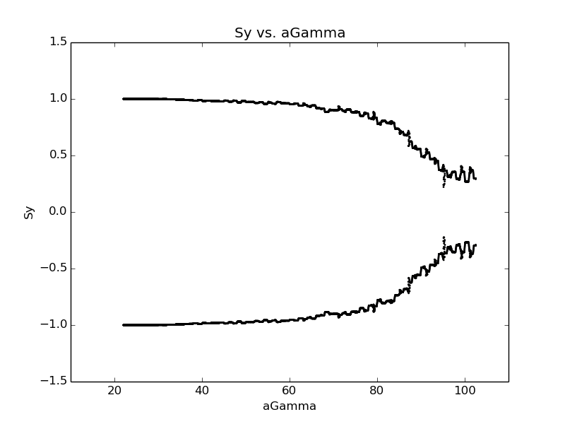
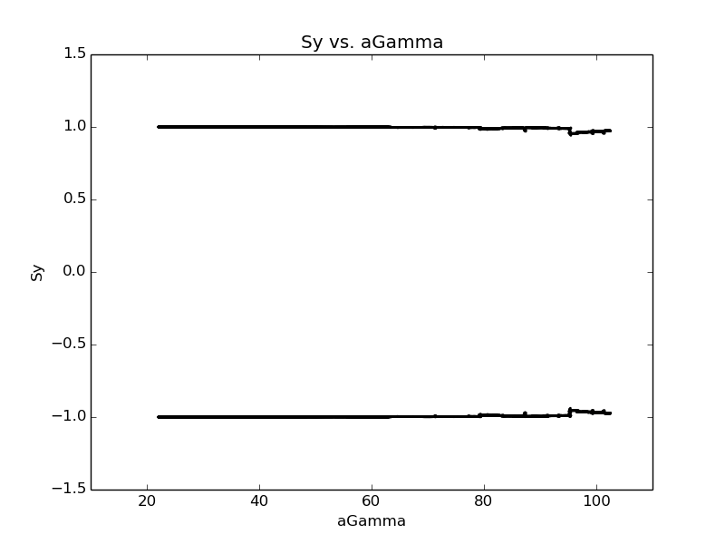
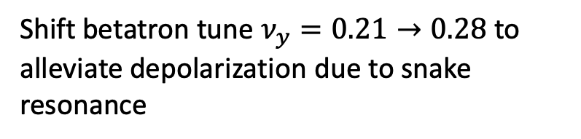
Lattice independent simulations
Tao Chen
  10GeV -> 45GeV acceleration simulation
    One constant full snake
    Constant ramping speed (10GeV->45GeV costs 2.9 second )
    Assume the injected beam particles are matched to the \vec{n} of the booster
Shift betatron tune $ν_{y}=0.21→0.28$ to alleviate depolarization due to snake resonance
The depolarization effect is due to snake resonance

Slide 13
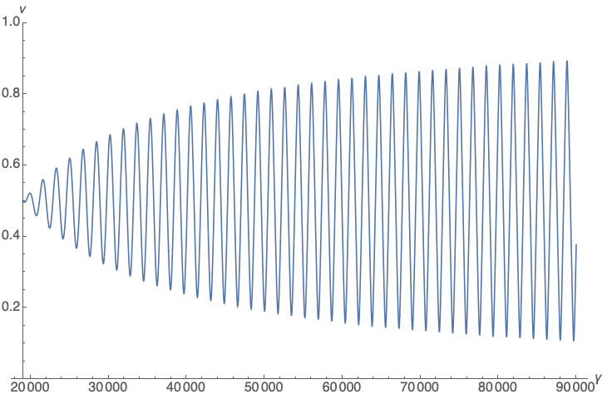
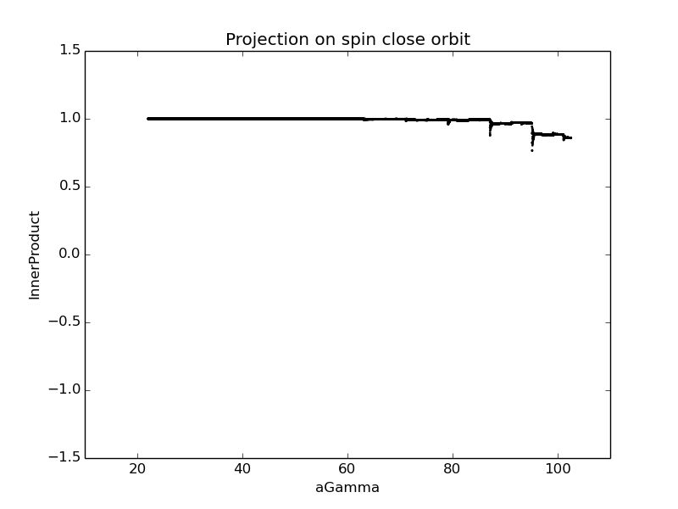
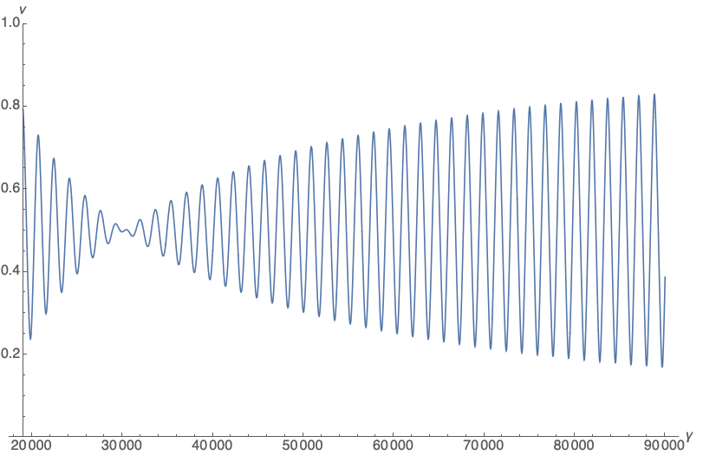
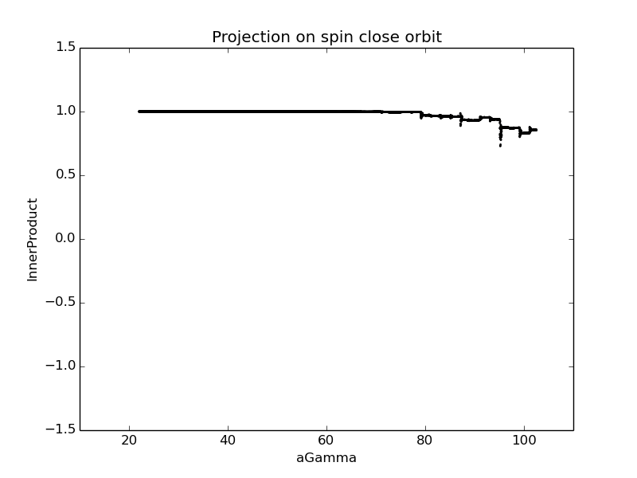
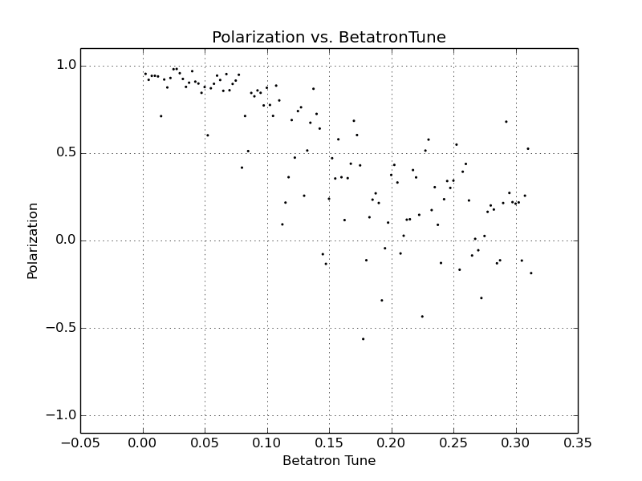
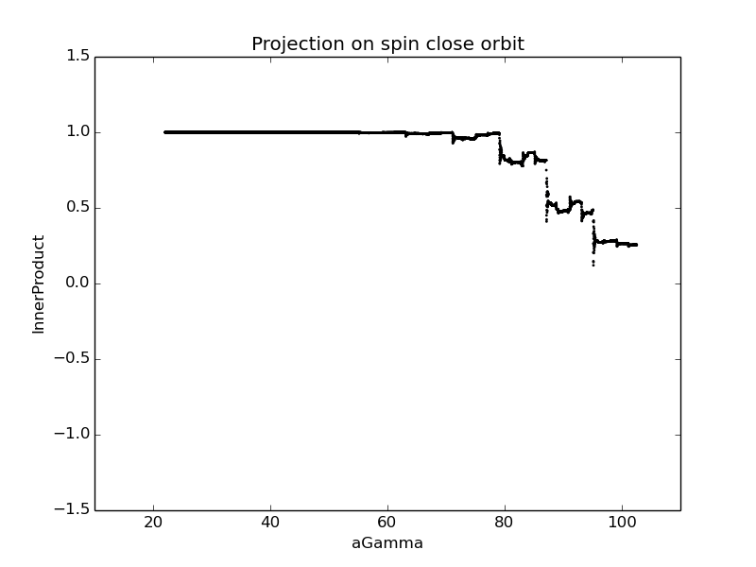
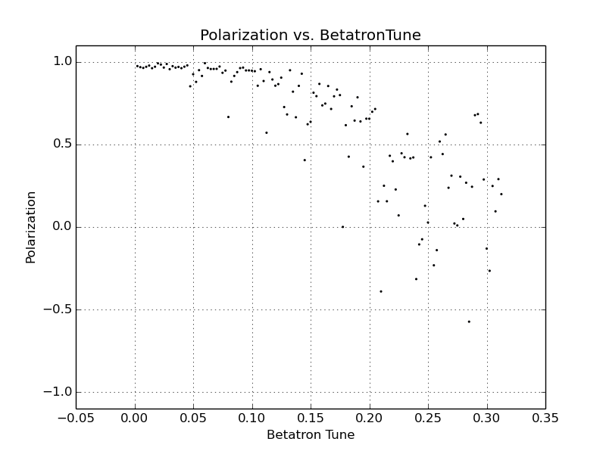
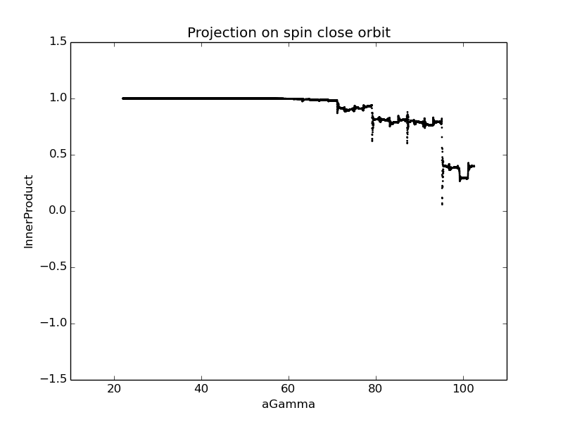


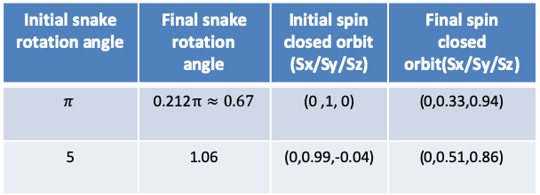


Lattice independent simulations
  10GeV -> 45GeV acceleration simulation
    Fixed strength solenoid snake
    Constant ramping speed (10GeV->45GeV costs 2.9 second )
    Assume the injected beam particles are matched to the \vec{n} of the booster
Initial snake rotation angle | Final snake rotation angle | Initial spin closed orbit (Sx/Sy/Sz) | Final spin closed orbit(Sx/Sy/Sz)
$$π$$ | 0.212$π≈0.67$ | (0 ,1, 0) | (0,0.33,0.94)
5 | 1.06 | (0,0.99,-0.04) | (0,0.51,0.86)
Tao Chen
Initial snake rotation angle = pi
Initial snake rotation angle = 5rad
$$ν=0.07$$
0.22
$$ν=0.12$$
0.17
0.13
0.12
0.10
0.07
0.07
$$ν=0.13$$
$$ν=0.22$$

Slide 14
Summary on polarization maintenance in the booster
  The polarization can be mostly preserved during the acceleration by using one full snake
  Using Solenoid-based partial snakes looks also promising in preserving polarization
  Improve the code to take into account of realistic ramping curve and other effects
  Implement the snake into the lattice, and conduct more realistic lattice-dependent simulations

Slide 15
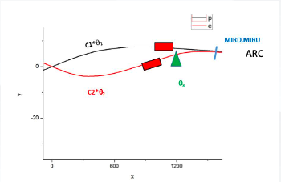
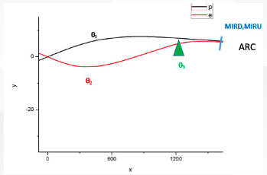
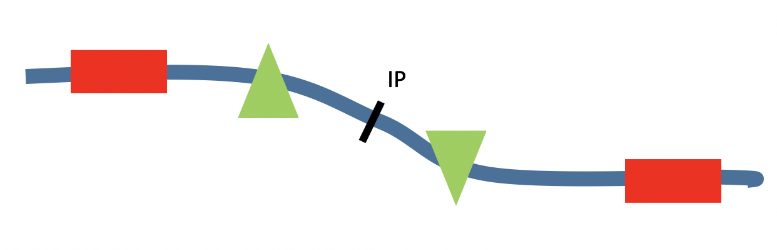

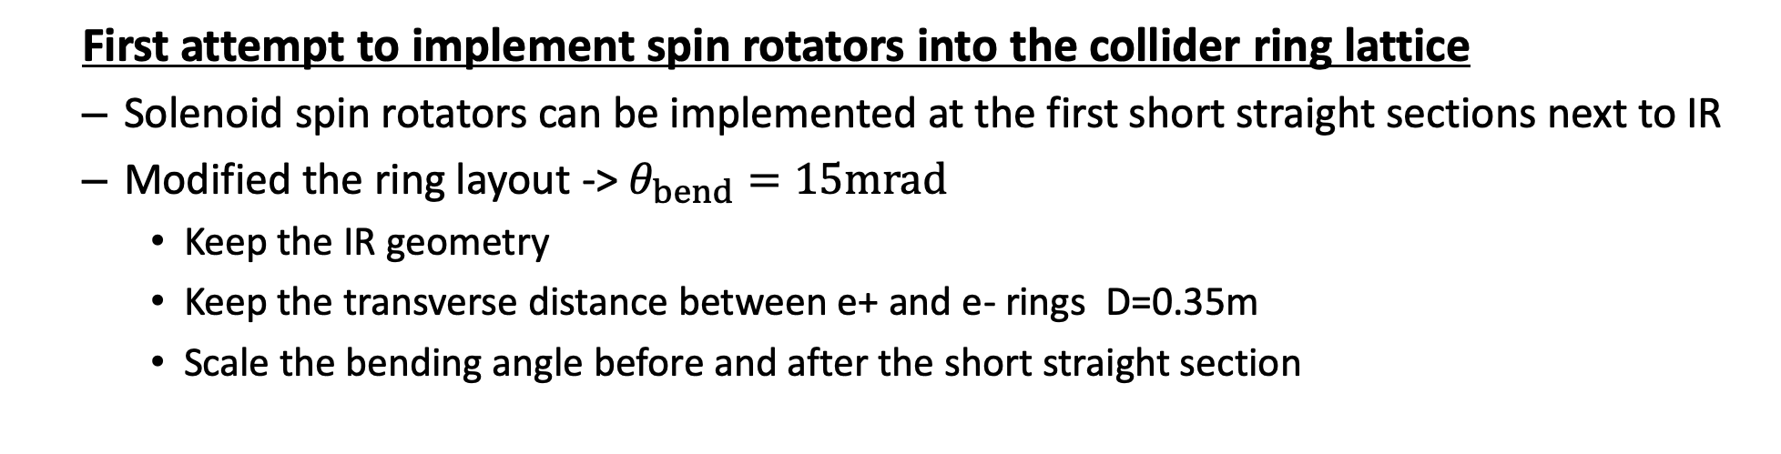
Spin rotators in the CEPC CDR lattice
  First attempt to implement spin rotators into the collider ring lattice
  Solenoid spin rotators can be implemented at the first short straight sections next to IR
  Modified the ring layout -> $θ_{bend}=15mrad$
    Keep the IR geometry
    Keep the transverse distance between e+ and e- rings D=0.35m
    Scale the bending angle before and after the short straight section
Wenhao Xia

Slide 16
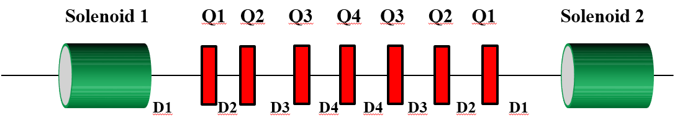
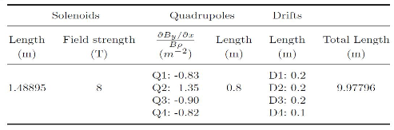
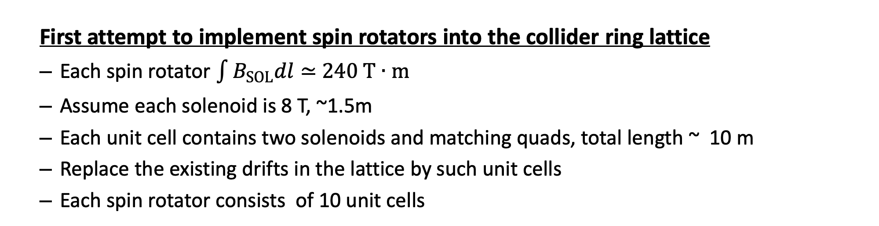
Spin rotators in the CEPC CDR lattice
  First attempt to implement spin rotators into the collider ring lattice
  Each spin rotator $\int{B_{SOL}dl}≃$ $240 T∙m$
  Assume each solenoid is 8 T, ~1.5m
  Each unit cell contains two solenoids and matching quads, total length ~ 10 m
  Replace the existing drifts in the lattice by such unit cells
  Each spin rotator consists of 10 unit cells
Wenhao Xia

Slide 17
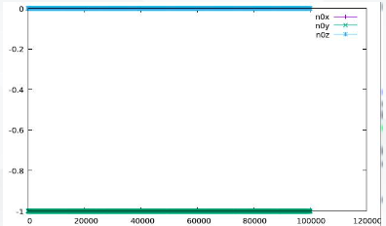
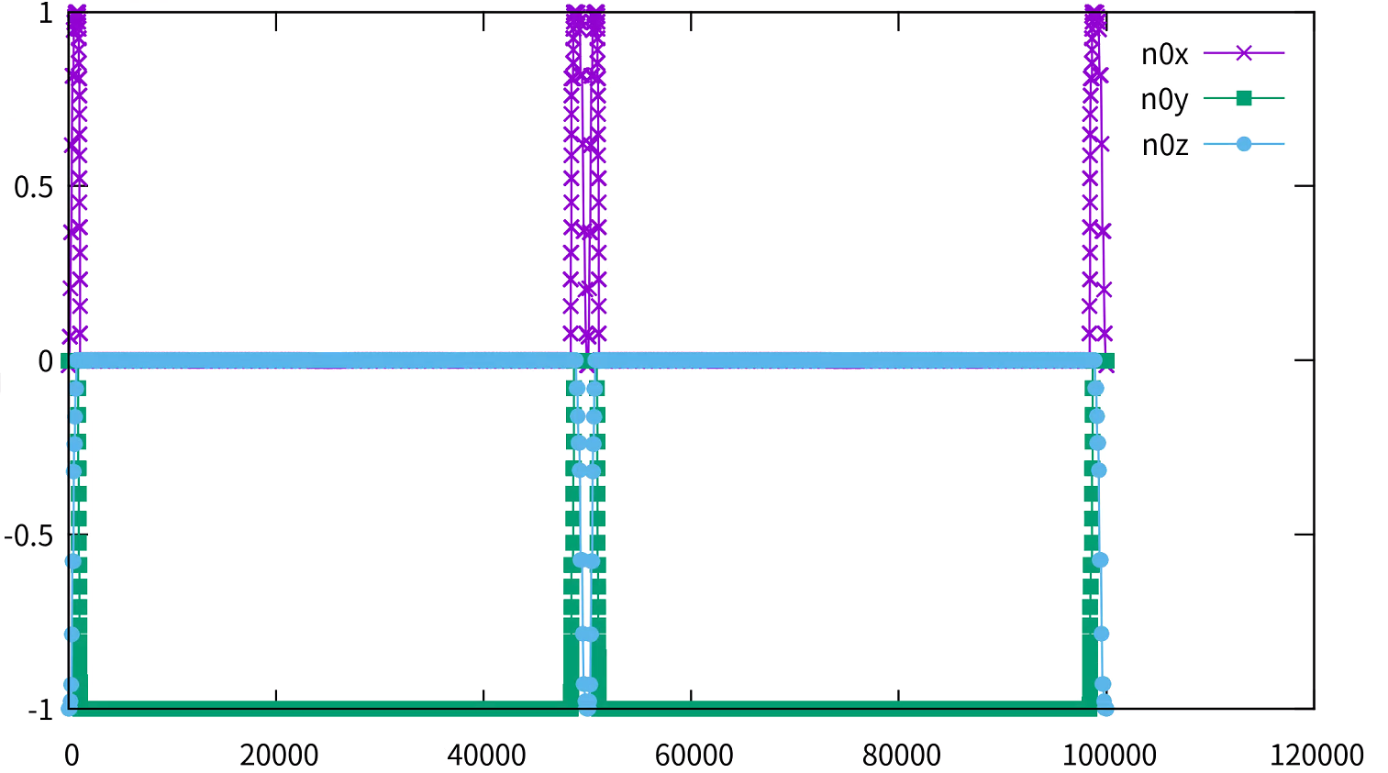
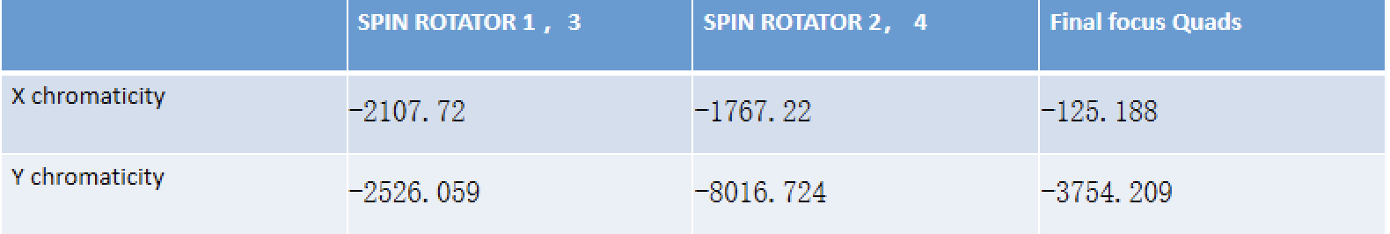
Spin rotators in the CEPC CDR lattice
  First attempt to implement spin rotators into the collider ring lattice
  The spin rotators do rotate the spin direction as expected
  But the limited space in CDR lattice requires a very compact design, superconducting quadrupole magnets are necessary
  The local chromaticity contribution from the spin rotator region is too large, and there is no dynamic aperture
Wenhao Xia
w/o spin rotators
w/ spin rotators

Slide 18
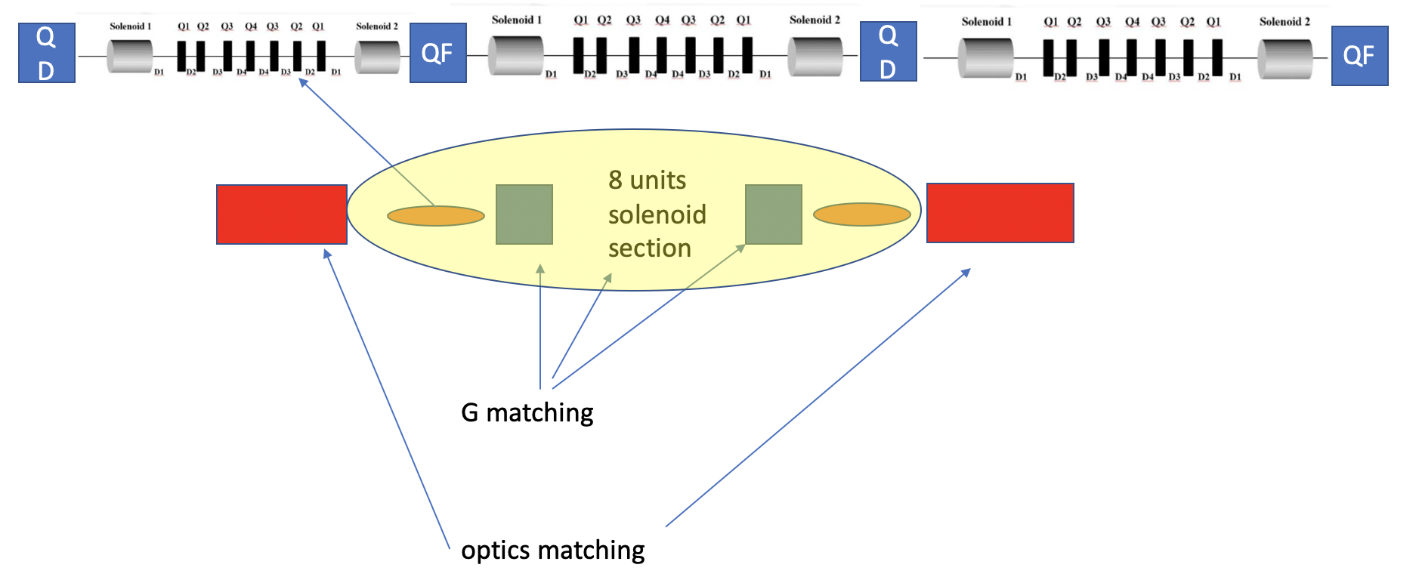
New design of spin rotators
  Redesign of the spin rotators and implementation into lattice
  A new version of CEPC lattice is under design
    The geometric requirement is built-in
    A space of ~300m is reserved for each spin rotator, in a long straight section near IR
  A new modular design of spin rotator is also under way

Slide 19
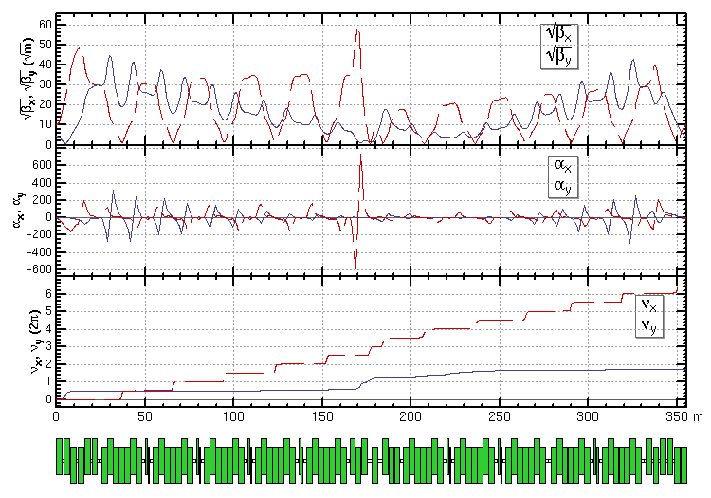

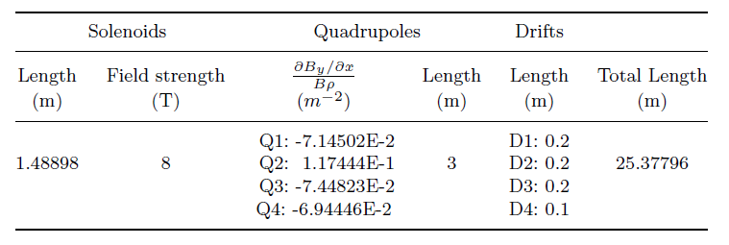
New design of spin rotators
  Redesign of the spin rotators and implementation into lattice
  Unit cell length is streched from 10 m -> 25 m
  max gradient of quads is reduced by a factor of 10
  Tuning the dedicated quads to realize spin matching
Wenhao Xia
Spin matching conditon: G_{2×6}=0

Slide 20
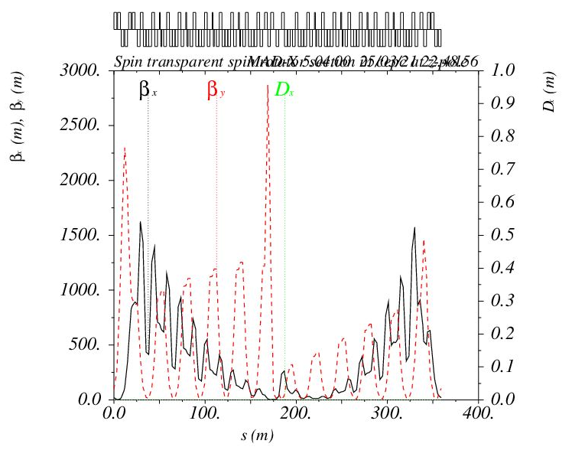
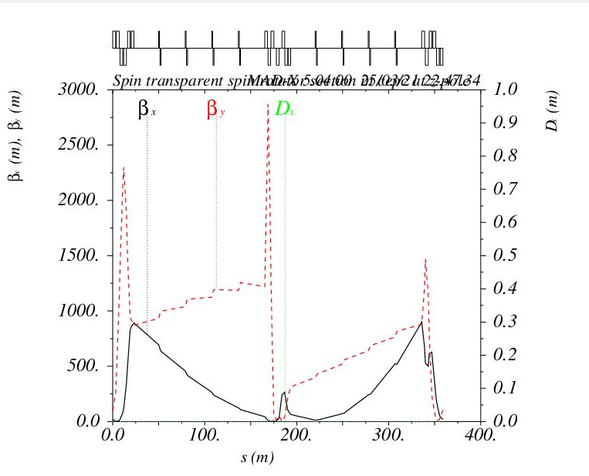
New design of spin rotators
  Redesign of the spin rotators and implementation into lattice
  Still, the local chromaticity contribution (∝ K1* β) is very large, related to large β-functions
  We are trying to optimize the variation of β-functions, perhaps the spin matching condition can be relaxed
  In addition, decoupling using skew quads (as in SuperKEKB design) could reduce the number & strengths of quads and save space, might also help reduce chromaticities.
Wenhao Xia
Optics functions in spin rotator
Soleniod unit cell is replaced by transfer matrix
 | CHROMATICITY
X | -1810.049
Y | -3238.241

Slide 21
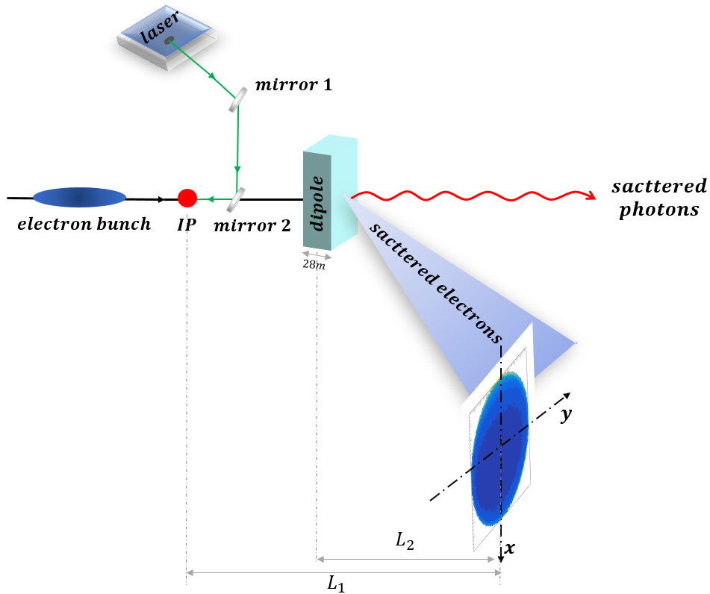
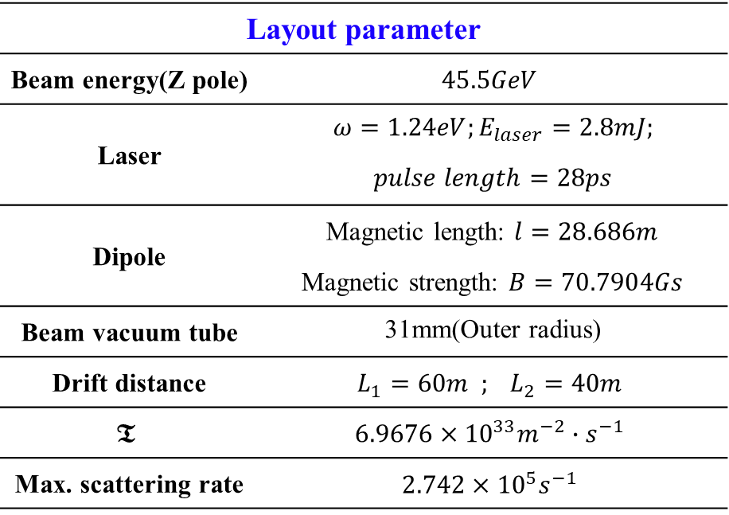
Compton Polarimeter for transverse beam polarization
Shanhong Chen
Layout of CEPC Compton polarimeter
Prospects for the Compton polarimeter system:
Arranged in previous or next straight section near the physical IP.
The last dipole in the upstream arc is used to bend electron beams.
Based on Inverse Compton scattering process
Aim to measure the distribution of scattered electrons in the detector.
Layout parameter
Beam energy(Z pole) | $$45.5GeV$$
Laser | $$ω=1.24eV;E_{laser}=2.8mJ;$$
 | $$pulse length=28ps$$
Dipole | Magnetic length: $l=28.686m$
 | Magnetic strength: $B=70.7904Gs$
Beam vacuum tube | 31mm(Outer radius)
Drift distance | $$L_{1}=60m ; L_{2}=40m$$
$$𝕿$$ | $$6.9676×{10}^{33}m^{−2}∙s^{−1}$$
Max. scattering rate | $$2.742×{10}^{5}s^{−1}$$

Slide 22
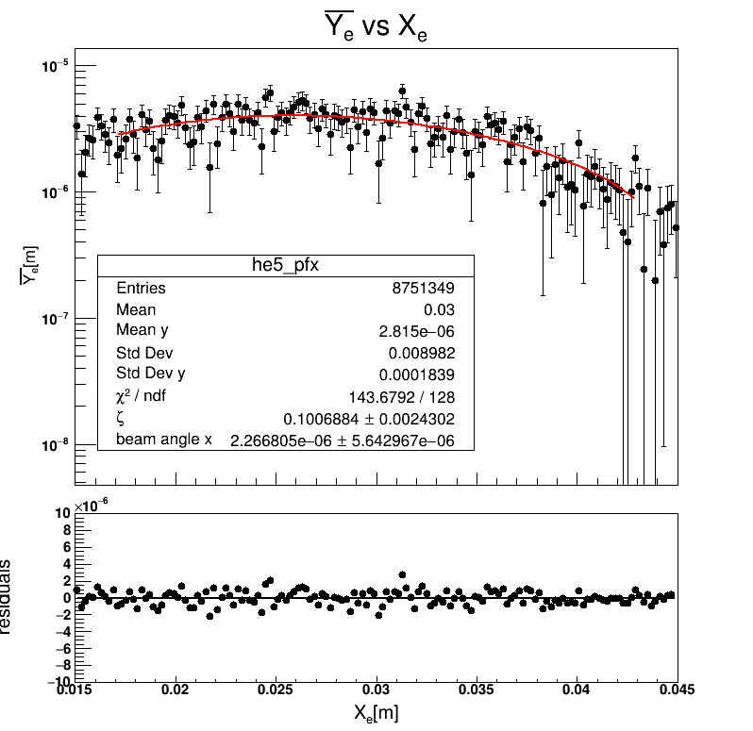



Compton Polarimeter for CEPC
Shanhong Chen
For example: 10% polarization electron beam
  Fit result: $P_{⊥}=0.1007±0.0024$
  Statistical error: $\frac{∆P}{P}≈2.43\%$ for 32s.
          $\frac{∆P}{P}≈1.63\%$ for 67s.
  Systematic uncertainty can be controlled to be 0.6%.
The measurement result
Measuring the asymmetric position distribution
of scattered electrons
Sources of systematic uncertainties | $$∆$$ | $$\left|\frac{∆P}{P}\right|$$
Dipole strength | $$7.07904×{10}^{−7}T$$ | 0.0404%
L1=60m (Ip to detector) | 1cm | 0.0168%
L2=40m (Dipole to detector) | 1cm | 0.1008%
Beam energy uncertainty | 100keV | 0.00009.3676%
Detector resolution | $$7μm×7μm$$ | $0.428$%
Total |  | 0.6%
For 5% polarization electron beam, $∆P/P$ is about 3.6% for about 1 minutes. More measurement time for small polarization.

Slide 23
Summary
The overall operation scheme of polarized beam CEPC-Z is outlined.
The injector chain of the polarized beams is being studied, in particular the maintainance of polarized beam in the booster using Siberian snakes has been simulated.
Solenoid-based spin rotators were implemented in CEPC CDR lattices, they rotate the spin direction as expected, a new modular design & optimization to reduce the chromaticity contribution is under way.
A Compton polarimeter has been designed to measure the transverse beam polarization, will be followed by a design of longitudinal beam polarimeter
Alternative subjects in the to do list
  Understand the influence of beam-beam interaction on beam polarization in the collider ring
  Spin rotators in the transport lines
  Detailed design of e+ polarizing ring

Slide 24
Backup

Slide 25



Formulas
Beam polarization evolution in an electron storage ring between injections
  $P\left(t\right)=P_{ens,DK}\left(1−e^{−t/τ_{DK}}\right)+P_{0}e^{−t/τ_{DK}}$, $\frac{1}{τ_{DK}}=\frac{1}{τ_{BKS}}+\frac{1}{τ_{dep}}$, $P_{ens,DK}≈\frac{92\%}{1+τ_{BKS}/τ_{dep}}$
Time-averaged beam polarization in an electron storage ring during top-up injection
Injected beam polarization
Self-polarization: equilibrium beam polarization in the ring
$$P_{avg}=\frac{P_{ens,DK}}{{1+τ}_{DK}/τ_{b}}+\frac{P_{0}}{{1+τ}_{b}/τ_{DK}}$$
Competition between beam decay/injection
and polarization build-up in the ring

Slide 26






Scaling with beam energy
LEP measured beam polarization
R. Assmann, et al, AIP Conference Proceeding, 570, 169 (2001).
$σ=aγσ_{ε}/Q_{s}$ becomes remarkable at higher beam energy
[1] Derbenev, Kondratenko, Skrinsky, PA 9 247, 1979. [2]S. R. Mane, arXiv:1406.0561.
$$aγ$$

Slide 27




How to adjust the polarization direction?
Devices to rotate spin around a direction in horizontal plane by a certain angle θ
Transverse magnetic field (Not favored for CEPC energies)
  $\int{B_{⊥}}dl$ independent of energy (approximately)
  Vertical orbit excursion $∝1/γ$, $∝L$
  synchrotron radiation power $∝γ^{2}$, $∝1/L$
  Examples: helical dipole, interleaved H&V bends
Longitudinal magnetic field(Under study)
  No orbit excursion, no radiation problem
  $\int{B_{⊥}}dl$ $∝1/γ$
  Need quadrupoles to decouple the beam

