Slide 1

Timing and strategies of the injection/extraction process
The 2nd CEPC International Accelerator Review Committee Meeting, Oct. 11-14, 2021. IHEP.
Speaker: Xiaohao Cui
Based on work and supports from different CEPC subsystems:
Control: Ge Lei, Gang Li
Linac: Jingru Zhang, Cai Meng, Zusheng Zhou, Xiaoping Li
Injection: Jinhui Chen
RF: Jiyuan Zhai
AP: Dou Wang, Xiaohao Cui, Meng Li, Jie Gao, Tianmu Xin, Chenghui Yu

Slide 2
Introduction
Injection and extraction from: Linac, damping ring, booster, and collider;
Energy: tt (180 GeV), Higgs (120 GeV), W (80 GeV), Z (45.5 GeV);
Top-up and injection from scratch;
Off-axis and On-axis.
Damping Ring
Positron
Linac
Booster
Electron
Collider

Slide 3
Introduction
Electron bunches are generated from the electron gun
Gun

Slide 4
Introduction
Electrons are accelerated in the Linac to 20 GeV
Gun
20 GeV

Slide 5
Introduction
Gun
20 GeV
Or the electrons can be used to generate positron bunches

Slide 6
Introduction
Gun
20 GeV
Positron bunches will be injected into a damping ring at 1.1 GeV.
Damping ring

Slide 7
Introduction
Gun
20 GeV
20 GeV
Positrons are accelerated in the Linac to 20 GeV
Damping ring

Slide 8
Introduction
After the Linac, a booster ring is needed to get the beams to full energy
Inject electrons or positrons into the booster ring
Booster Ring

Slide 9
Introduction
Ramp up to high Energy and may be stay there some time for emittance damping
Booster Ring

Slide 10
Introduction
Bunches are extracted out of the booster and inject into the collider ring
Booster Ring
Collider Ring

Slide 11
Introduction
 | tt | Higgs | W | Z
Bunch Number in collider | 37 | 240 | 1230 | 11520
Bunch Separation | 4.2μs | 0.64μs | 0.27μs | 25ns
Bunch Number in booster | 37 | 240 | 1230 | 3840
Lifetime (hour) | 0.59 | 0.33 | 1.4 | 1.4
Interval for top up* (s) | 65 | 38 | 155 | 153
* Beam current in collider decays by 3%.
Z-mode is the most challenging operation in terms of charge flux delivered by the injectors.
At Z mode, the bunch number in the booster is only 1/3 of that in the collider, so the booster need to be ramped up and down 3 times to inject into every bunch in the collider.

Slide 12
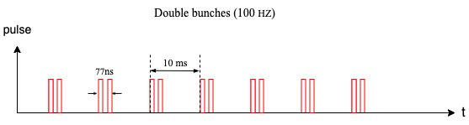
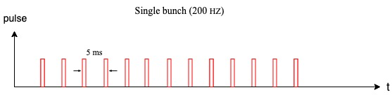
1. Linac
From the electron gun, bunches are generated in 100 Hz.
pulse
10ms
t
For High-Lum Z, more bunches are needed
It can be upgraded to double bunch (100Hz) or 200 Hz.

Slide 13
2. Damping Ring
Positron bunches will be injected into a damping ring at 1.1 GeV.
Damping ring circumference | 150 m
Store time of the bunches: | 20 ms
T=0
T=10ms
The bunches are injected into the damping ring with the same frequency as bunches in the Linac;
For 200 Hz or double-bunch mode, more bunches will be stored in the damping ring;
Each bunch which cooled for 20 ms will be extracted and re-injected into the linac.
T=20ms-250ns
T=20 ms
T=30ms-250ns

Slide 14
2. Damping Ring
Damping ring injection at Double bunch scheme
Damping ring injection at 200Hz scheme
T=0
T=0
T=5ms+125ns
T=10 ms
T=10ms+250ns
T=20ms-250ns
T=15ms+375ns
T=20ms
T=20ms+250ns
T=30ms-250ns
T=20ms+500ns

Slide 15
2. Damping Ring
0.5m
Lambertson
Kicker
Top View:
25mm
1.25m
1.25m
0.847m
1m
Injection into the damping ring is a simple on-axis injection with 1 kicker;
Extraction is similar to injection;

Slide 16
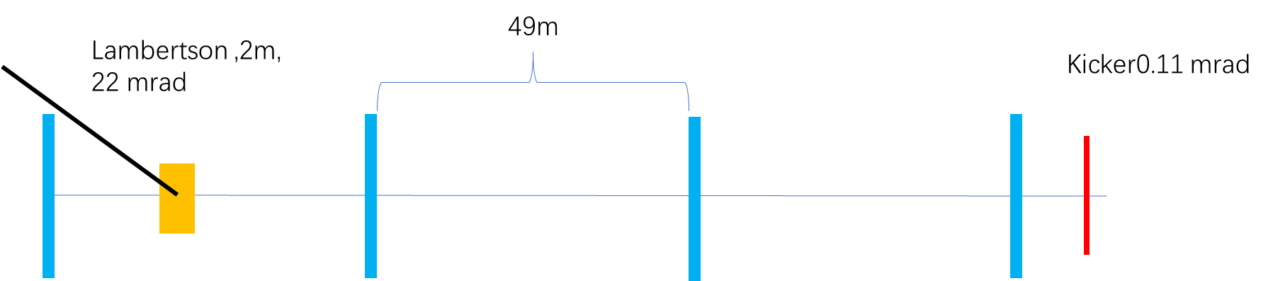
3. Injection to booster
Injection into the booster is a simple on-axis injection with 1 kicker
Bunches from the Linac will be in 100 Hz or 200 Hz
Booster Ring
T_{Linac}
T_{booster}
T_{Linac}=N*Turns+T_{booster}
Changing T_{Linac} slightly, we can fill the booster with any pattern we needed.

Slide 17
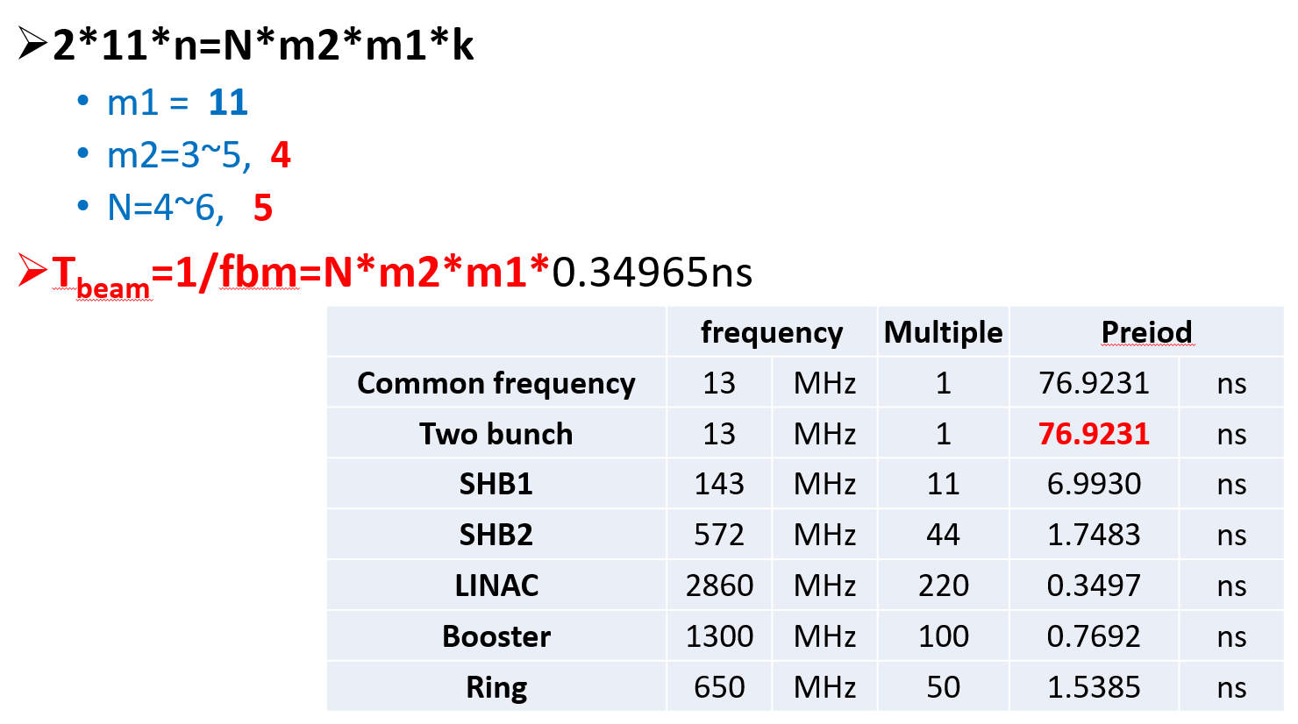
3. Injection to the Booster (Z)
Ge Lei, Gang Li
To have the flexibility of booster bunch patterns choice, some considerations on the electron gun or Linac frequencies are on going.
f (MHz) | SHB1 | SHB2 | Linac | DR | booster | collider
CEPC | 143 | 572 | 2860 | 650 | 1300 | 650
@Cai Meng
For CEPC, the common frequency is 13MHz, so the minimum time separation= 76.92ns.
Max bunch number is limited by the common frequency of collider, booster and Linac.
If the SHB1&SHB2 is cancelled, the minimum time separation=7.692ns.
2020.07.17
Subharmonic bunchers are cancelled and the thermionic gun is replaced by RF gun.
Bunch separation@Z=23.08ns

Slide 18
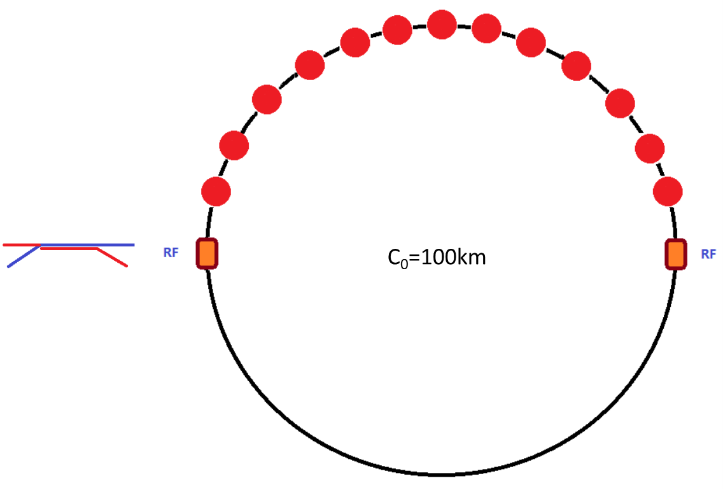
3. Injection to booster (tt and Higgs)
 | tt | H
Energy（GeV） | 20 | 20
Bunch number | 37 | 240
Bunch seperation（us） | 4.2 | 0.647
Injection scheme | bunch by bunch | bunch by bunch
Kicker frequency(Hz) | 100 | 100
Kicker pules duration (us) | <8.4 | <1.29
Kicker rise up/ fall down (us) | <4.2 | <0.647
Timing delay(us) | 4.2 | 0.647
Injection duration (s) | 0.37 | 2.4
To share the RF system, for tt and Higgs energy, bunches per beam are in the half ring both for booster and collider.

Slide 19
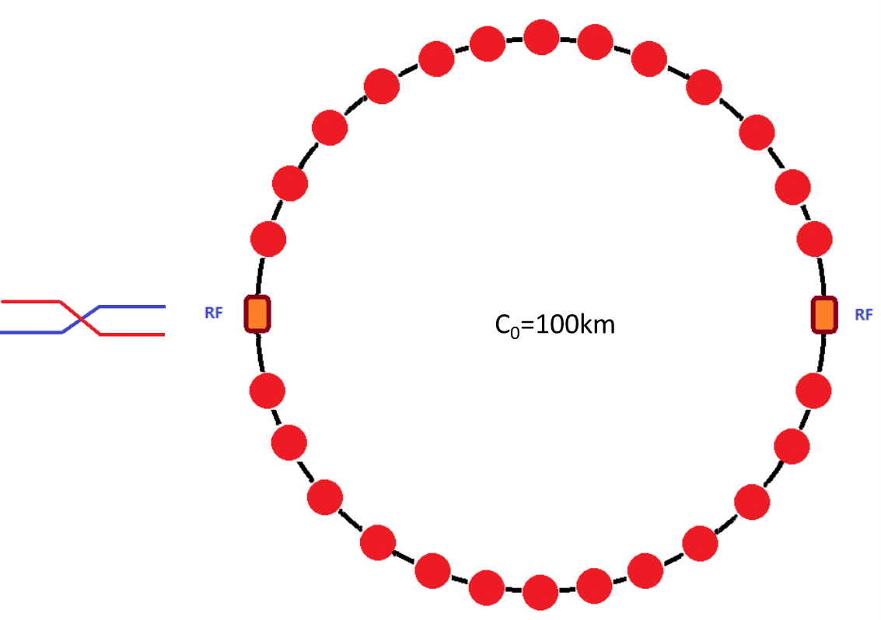
3. Injection to the Booster (W)
 | W
Energy（GeV） | 20
Bunch number | 1230
Bunch seperation（us） | 0.2677
Injection scheme | bunch by bunch
Kicker frequency(Hz) | 100
Kicker pules duration (us) | <0.535
Kicker rise up/ fall down (us) | <0.2677
Timing delay(us) | 0.2677
Injection duration (s) | 12.3
For W mode, bunches are uniform in the whole ring both for booster and collider.

Slide 20
3. Injection to the Booster (Z)
 | Z
Energy（GeV） | 20
Bunch number/train | 80
Bunch separation（ns） | 23.076
Number of trains | 48
Train separation (us) | 5.11
Kicker frequency(Hz) | 200 or 100 (double bunch)
Injection scheme | bunch by bunch or two by two
Kicker rise up/ fall down (ns) | <23.076
Flat top (ns) | 23.1 for double bunch mode
Injection duration (s) | 19.2
bunches per beam are distributed train by train both in booster and collider. (This will be talked about in detail later)
The number of train in the booster is 1/3 of that in the collider.

Slide 21
4. Extraction from the Booster
For Z energy, it becomes more complicated due to the large bunch number needed in the collider.
the separation between bunches are only 20~30 ns. Considering the rise time of the kickers, bunches are arranged train by train in the collider.
Due to the current limit in the booster, The bunch number in the booster is only 1/3 of that in the collider.
Bunch train
The bunches in the collider are arranged in bunch trains about 1.8 μs and with gaps about 500 ns. The kickers in the collider can rise and fall down in the gaps.
~ 23 ns
collider
…
…
~ 1.8 μs
~ 500 ns
Gap
Bunch train
The bunches in the booster are arranged in the same bunch train structure. But the train number is 1/3, so the gap is much longer.
…
booster
…
~ 1.8 μs
Gap ~ 5.1 μs

Slide 22
4. Extraction from the Booster
 | tt | Higgs | W
Energy（GeV） | 180 | 120 | 80
Bunch number | 37 | 240 | 1230
Bunch seperation（us） | 4.2 | 0.647 | 0.2677
Extraction scheme | bunch by bunch | bunch by bunch | bunch by bunch
Kicker frequency(Hz) | 1000 | 1000 | 1000
Kicker pules duration (us) | <8.4 | <1.29 | <0.535
Kicker rise up/ fall down (us) | <4.2 | <0.647 | <0.2677
Timing delay(us) | 4.2 | 0.647 | 0.2677
Extraction duration (s) | 0.037 | 0.24 | 1.23
 | Z
Energy（GeV） | 45.5
Bunch number/train | 80
Bunch separation（ns） | 23.076
Number of trains | 48
Train separation (us) | 5.11
Extraction scheme | train by train
Kicker frequency(Hz) | 1000
Flat top (us) | 1.83
Kicker pules duration (us) | <12.05
Kicker rise up/ fall down (us) | <5.11
Timing delay(us) | 6.94
Extraction duration (s) | 0.048

Slide 23
4. Extraction from the Booster
Some considerations on 50MW upgrade
Sub_harmonic bunchers are cancelled and the thermionic gun is replaced by RF gun.
- Min time separation=7.69ns
Uneven bunch filling
- Put more bunches in a bunch train
- Free combination of 7.69ns, 15.38ns, 23.07ns, 30.76ns…
15.38ns
7.69ns
23.07ns
Bunch train
~ 1.8 μs
~ 500 ns
Gap

Slide 24
6. Injection to the collider
Considering the robustness of the design, the injection of the main collider ring is conventional off-axis injection. (Maybe an on-axis injection is needed for Higgs)
For tt, Higgs and W energy, injection into the collider is bunch by bunch; and for Z energy, injection is train by train.
Lamberson ，26 mrad
60m
26m
66m
68m
Bunch by bunch
Train by train
Kicker:
1000 Hz
1000 Hz
The kickers rise up, inject one bunch into the collider, and fall down. This process repeated in 1000 Hz, to inject all bunches into the ring.
The kickers rise up, stay there to inject a whole train into the collider, and fall down. This process repeated in 1000 Hz, to inject all bunches into the ring.

Slide 25
6. Injection to the collider
 | tt | Higgs | W
Energy（GeV） | 180 | 120 | 80
Bunch number | 37 | 240 | 1230
Bunch seperation（us） | 4.2 | 0.647 | 0.2677
Injection scheme | bunch by bunch | bunch by bunch | bunch by bunch
Kicker frequency(Hz) | 1000 | 1000 | 1000
Kicker pules duration (us) | <8.4 | <1.29 | <0.535
Kicker rise up/ fall down (us) | <4.2 | <0.647 | <0.2677
Timing delay(us) | 4.2 | 0.647 | 0.2677
Injection duration (s) | 0.037 | 0.24 | 1.23
 | Z
Energy（GeV） | 45.5
Bunch number/train | 80
Bunch separation（ns） | 23.076
Number of trains | 144
Train separation (us) | 0.492
Injection scheme | train by train
Kicker frequency(Hz) | 1000
Flat top (us) | 1.83
Kicker pules duration (us) | <2.81
Kicker rise up/ fall down (us) | <0.49
Timing delay(us) | 6.94 & 2.32
Injection duration (s) | 0.144

Slide 26
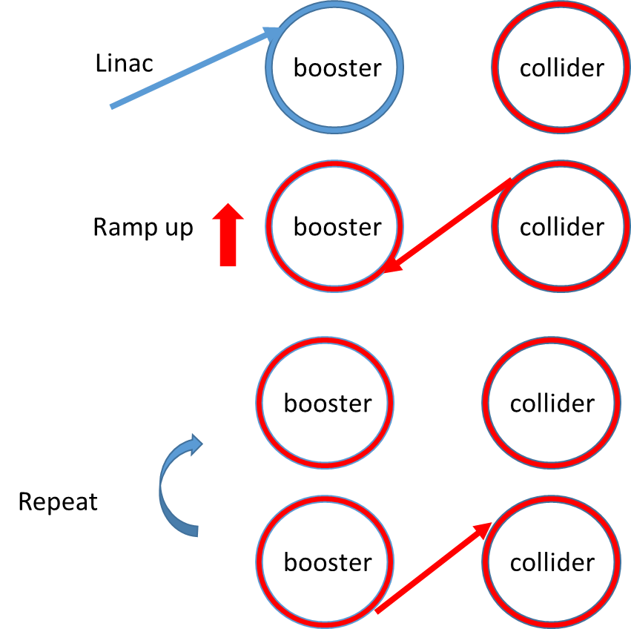
6. Injection to the collider- On-axis
1. Inject 240 small bunches into the booster.
2. Ramp the booster to high energy and inject several bunches from the collider into the booster.
3. Booster stay at 120 GeV for 4 damping time(200ms), so that the injected large bunches merge with small bunches.
4. Inject the merged large bunches back to the same empty buckets left by the last step.
5. Repeat from last step.

Slide 27
7. A diagram of the time structure
Extract from booster
0.037s
Ramp up
7.3s
Ramp down
7.3s
tt
0.37s+7.3s+0.037s+7.3s ~15s
Inject from Linac
0.37s
Extract from booster
0.24s
Ramp up
4.5s
Ramp down
4.5s
Higgs
2.4s+4.5s+5.0s+4.5s ~12s
Inject from Linac
2.4s

Slide 28
7. A diagram of the time structure
Extract from booster
1.23s
Ramp up
2.7s
Ramp down
2.7s
W
12.3s+2.7s+1.23s+2.7s ~18.9s
Inject from Linac
12.3s
Extract from booster
0.048s
Ramp up
1.6s
Ramp down
1.6s
Z
Inject from Linac
19.2
(19.2s+1.6s+0.048s+1.6s)*3=67.3s

Slide 29
7. A diagram of the time structure
On-axis injection 5s
Ramp up
4.5s
Ramp down
4.5s
2.4s+4.5s+5.0s+4.5s=16.4s
Higgs on-axis
Inject from Linac
2.4s
 | tt | Higgs | Higgs | W | Z
Interval for top up* (s) | 65 | 38 | 38 | 155 | 153
Injection time for both e⁺/e⁻ (s) | 30 | 24 | 32.8 | 37.8 | 134.6

Slide 30
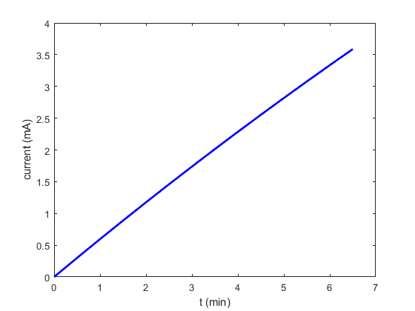
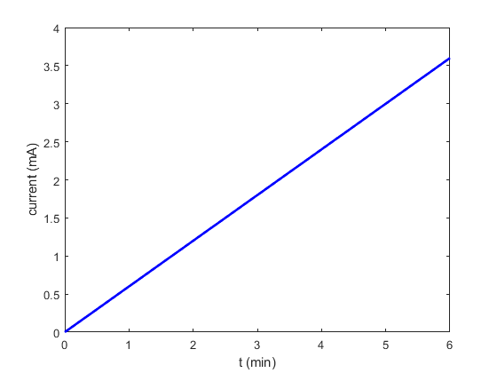
8. Injection from empty- tt
Design current in collider is 3.5mA.
Total current in booster limited by RF system: < 0.3mA
Collider lifetime (non-collision): ~2600 hours ─ dominated by Toucheck lifetime
Full injection with collision
Full injection without collision

Slide 31
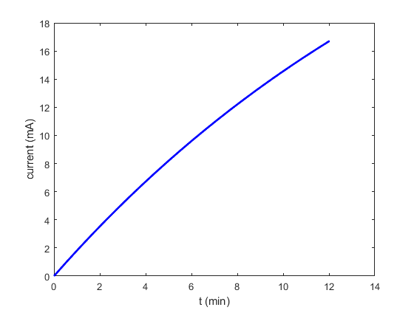
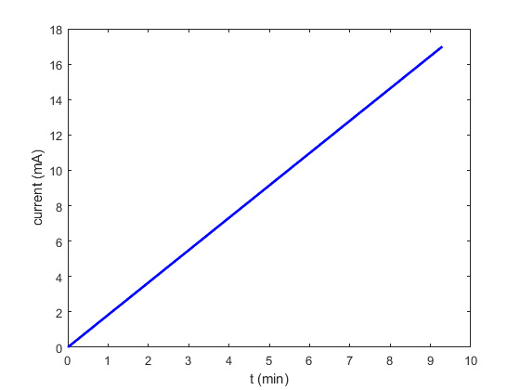
8. Injection from empty- Higgs
Design current in collider is 16.7mA.
Total current in booster limited by RF system: < 1mA
Collider lifetime (non-collision): ~290 hours ─ dominated by Toucheck lifetime
Full injection with collision
Full injection without collision
*on-axis injection for collider is assumed

Slide 32
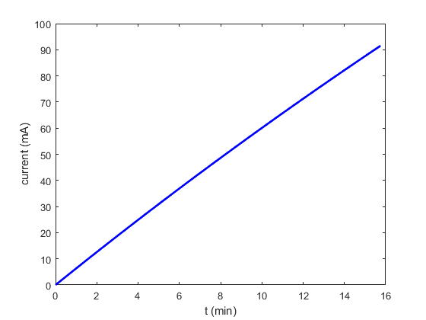
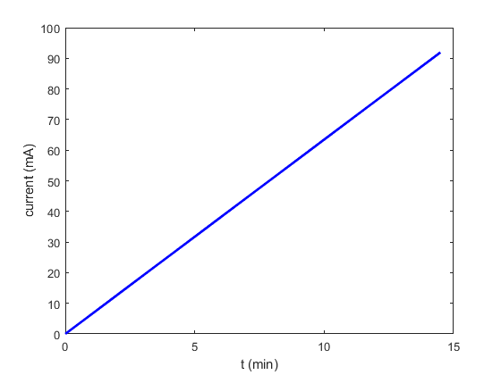
8. Injection from empty- W
Design current in collider is 88.6mA.
Total current in booster limited by RF system: < 4mA
Collider lifetime (non-collision): ~150 hours ─ dominated by Toucheck lifetime
Full injection with collision
Full injection without collision

Slide 33
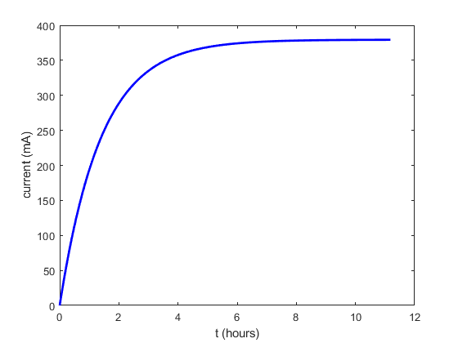
8. Injection from empty- Z
Design current in collider is 840mA.
Total current in booster limited by RF system: < 10 mA (will be increased to 16mA)
Collider lifetime: ≥19 hours (non-collision), 1.9~1.4 hours (w. collision)
The maximum current can’t be reached in a reasonable injection time.
Full injection with collision

Slide 34
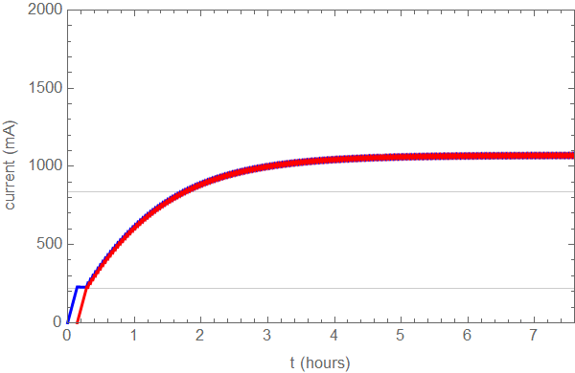
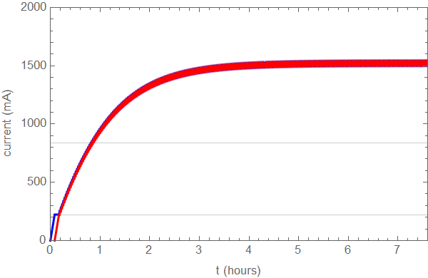
8. Injection from empty- Z
Yuan Zhang, Dou Wang
Design current in collider is 840mA.
Total current in booster limited by RF system: < 10 mA (will be increased to 16mA)
Collider lifetime: ≥19 hours (non-collision), 1.9~1.4 hours (w. collision)*
Bootstrapping from 220mA
Full injection from empty for both beam → 2 hours (50min)
Booster threshold: 10mA
Booster threshold: 16mA
*the beam lifetime with collision is related to the current.

Slide 35
Summary
1. This talk gives a general overview of the process of CEPC injection.
2. The timing structure of CEPC for different energy modes and different injection scheme are discussed.
3. Z mode is found to be the most challenging for the injection and extraction. Discussion about timing and filling scheme for Z continues.
 | Common frequency | Bunch separation | Luminosity@Z | Filling flexibility | Remark
1. Keep current Linac | 13MHz | 38.46ns | 58% | No
2. Cancel SHBs, use RF gun | 130MHz | 23.07ns | 100% | No | baseline
3. f(Linac):2860→2600MHz | 130MHz | 23.07ns | 100% | No
4. Cancel SHBs, use RF gun + uneven filling | 130MHz | 7.69ns,15.38ns,23.07ns… | 100% | Yes | Upgradable to 50MW
5. New frequency for Linac and rings (hope) |  | 20.00ns,21.54ns,23.07ns,24.62ns,26.15ns, 27.69ns | 100% | Yes

Slide 36
Thank You for Your Attention

Slide 37
Back up

Slide 38
Requirement of timing system
Gang Li, Ge Lei
Choose 130MHz as clock beat → minimum time separation=7.69ns (FPGA clock &EVG/EVR transmission can be realized)
Circumference of damping ring: (L*1000*10⁹/(3*10⁸))/(1000/650)=integer
Length of transfer line between DR and Linac: （（N*150+75+104*2-8.3）10⁹/(3*10⁸))/(1000/2860)=integer
104m →101.65m
Circumference of collider/booster: (L*1000*10⁹/(3*10⁸))/(1000/650)=integer
Length of transfer line between booster and collider: (L*10⁹/(3*10⁸))/(1000/650)=integer
252m or 246m

Slide 39
Booster TDR parameters
Injection energy: 10GeV → 20GeV
Max energy: 120GeV → 180GeV
Lower emittance ─ new lattice (TME)
Extraction
Injection
*Diameter of beam pipe is 55mm for re-injection with high single bunch current @120GeV.

Slide 40
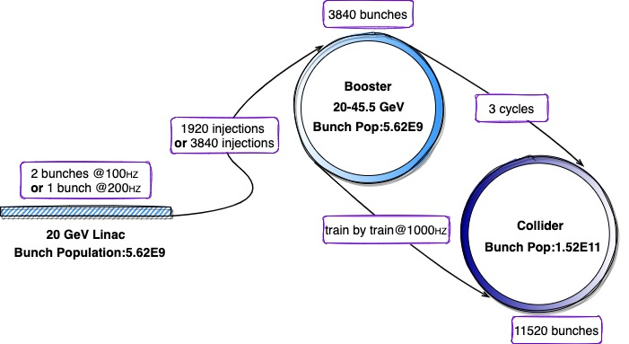
Z mode injection (top-up)
Meng Li
Booster low current operation

Slide 41
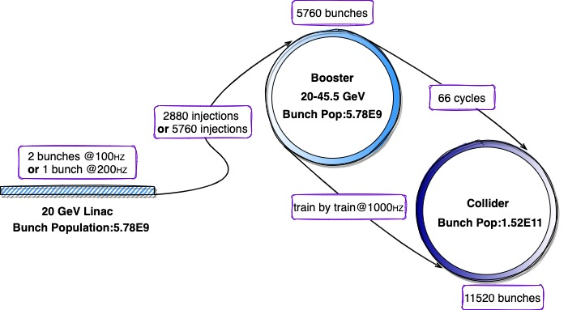
Z mode injection (full injection)
Meng Li
Booster high current operation

