Slide 1
Challenges to the CEPC control system and possible international collaborations
Presented by Gang Li
On behalf of Control Group, Accelerator Center, IHEP
2021 international workshop on CEPC

Slide 2
Outline
Performance and Scope of the CEPC control system
Requirement information of controlled devices
The challenge and characteristic of CEPC
Potential international collaborations
Summary

Slide 3
Performance of the Control System
5bility+RT
Stability
Availability
Flexibility
Scalability
Reliability
Real Time

Slide 4
Scope of the Control System
Global control
Control Platform
Center Control System: computers, servers, database, etc
Network System
Timing System
Post Mortem System
Machine Protection System
Video system
Local control
Power Supply Control System
Vacuum Control System
Temperature Monitoring System
Linac Control System
Integration of subsystems
LLRF, Cryogenic system, Injection/Extraction system etc.
Interface to other system
Detector, beamline and conventional facility

Slide 5
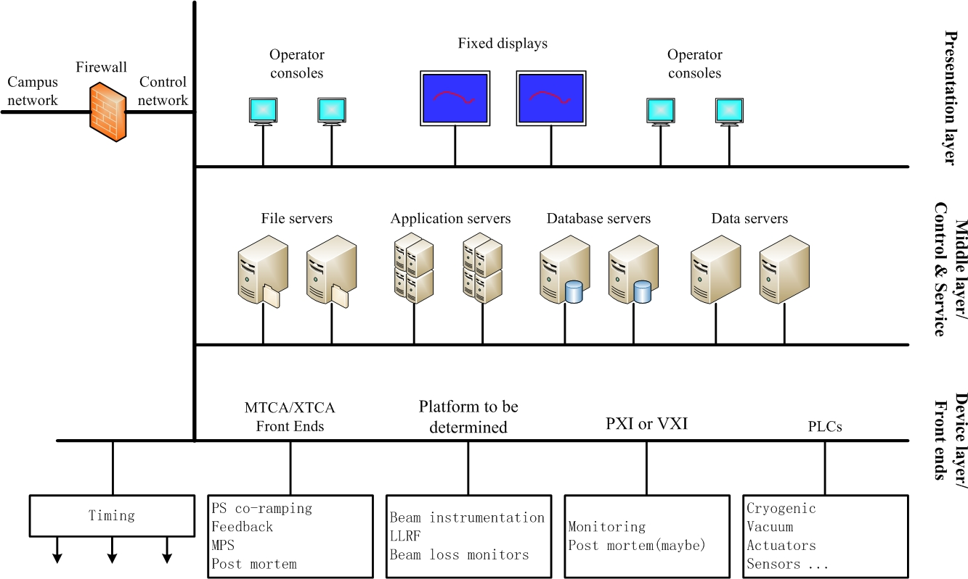
Control System and sub-system
Overall hardware architecture of the control system

Slide 6
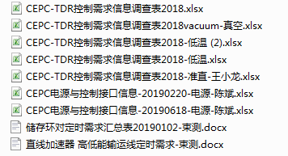
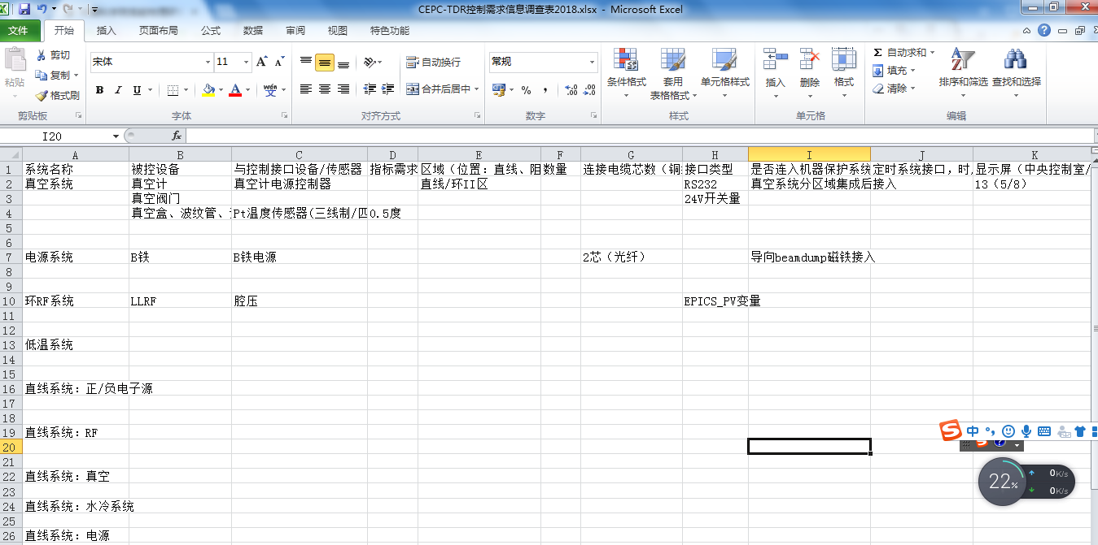
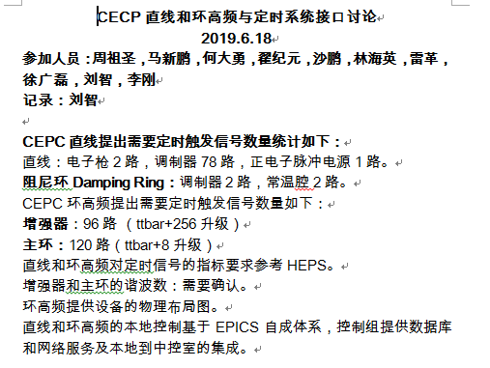
Requirement information of controlled devices

Slide 7
Control Platform
Software Platform: EPICS
Open source, free SCADA/DCS, toolkits
Hardware Platform
Standardization, Modularity and Commercial products
Workstation and servers
ATCA/uTCA (High Availability)
PLC
Fieldbus：Serial device servers and so on
Motion controller/Driver
etc.

Slide 8
The challenge and characteristic of CEPC
Super scale
Linac: 1.2/1.4km
Ring: 100km
A large number of Controlled Equipments
Discrete distributed in the Linac and Ring
Quantity of PVs
millions of PVs

Slide 9
The challenge and characteristic of CEPC
Potential bottlenecks
Data rate/traffic in the network(low latency switch)
Cut-through
Store-and-Forward
Travel time/response time(between GUI and IOCs/controlled devices)
200um(40Km, c*2/3)
Faulty recovery(Distance between stations: dozens of km)
High Availability (Redundant IOCs)
Database and Management of the control system
Database
Apps and Wechat
etc

Slide 10
Potential international collaborations
Be member of EPICS Council
EPICS Council organization was founded in 2016
Prioritize major EPICS upgrade projects for Base and Extensions to guide resource allocation decisions at investing facilities
Develop a roadmap for future EPICS Core and Extensions development to facilitate planning for all EPICS sites. The roadmap will be developed using technical input from the chairs of relevant working groups (currently EPICS Core Working Group and CS-Studio Working Group)
Provide support to control system managers in promoting EPICS development efforts to their organization leadership
Select semi-annual EPICS Collaboration Meeting sites and dates
Ensure that EPICS continues to be an open collaboration and that contributions are open-source
Join in work group(Core, CSS and Python)
GUI will be updated every 5~10 years
etc

Slide 11
Potential international collaborations
EVG/EVR Timing System
Trigger
RF reference
Precise timestamping
EVG/EVR：Broadcast
Site：APS、SLS，BEPCII，CSNS，SSRF，etc
Distance: a few Km
Support
Commercial products
EVG/EVR of SSRF
Homemade I/O and delay board
White Rabbit Timing System
Precise timestamping
Trigger
RF reference
Master/Slave: Bi-directionality
Site：CERN、GSI、ESRF、Spring-8、 SHINE、LHAASO、German Stock Exchange，etc
Distance: less than 10Km
Support
OpenHareware+Commercial products
V.S

Slide 12
Potential international collaborations
Database based on the user’s requirement
Parameter Database Naming Convention Database
Magnet Database Equipment Database
Lattice and Model Database Management of File
Log and trouble tracking Alignment Database
Management of Cable and device Alarm database
Configuration of Security database MPS and interlock database
Etc..
More and more Database will be designed with the progress of the Project

Slide 13
Potential international collaborations
Redundant IOCs

Slide 14
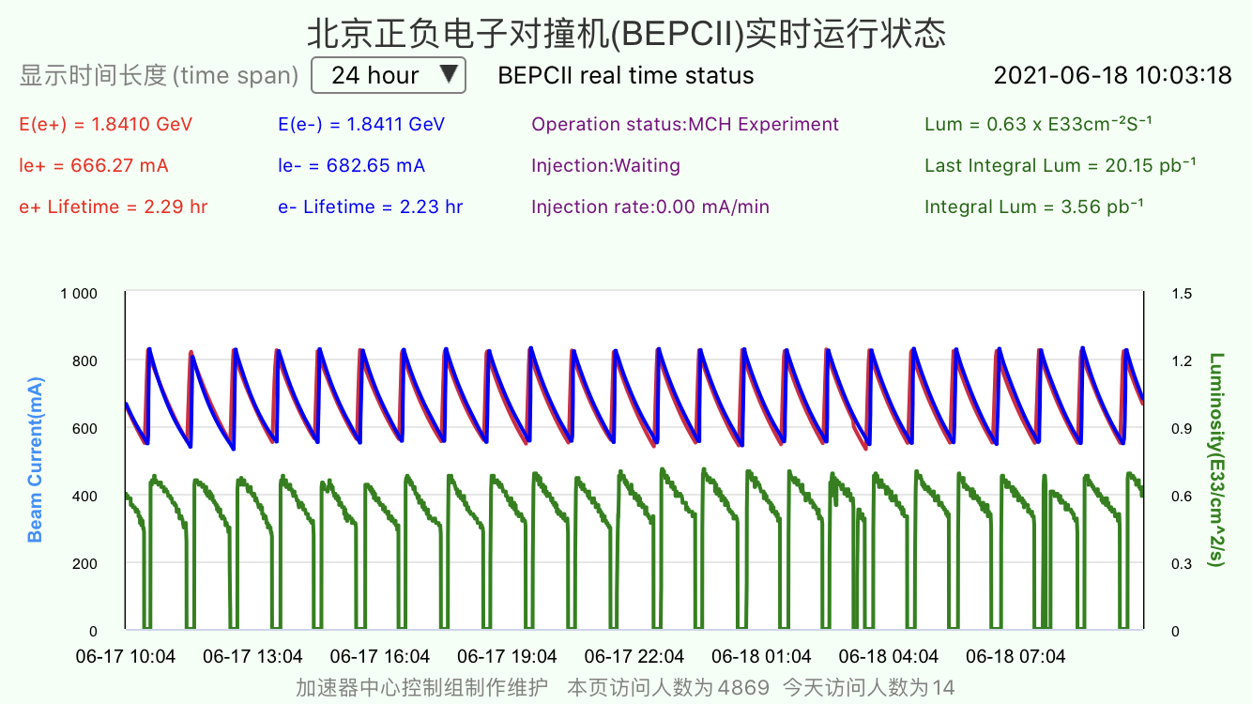
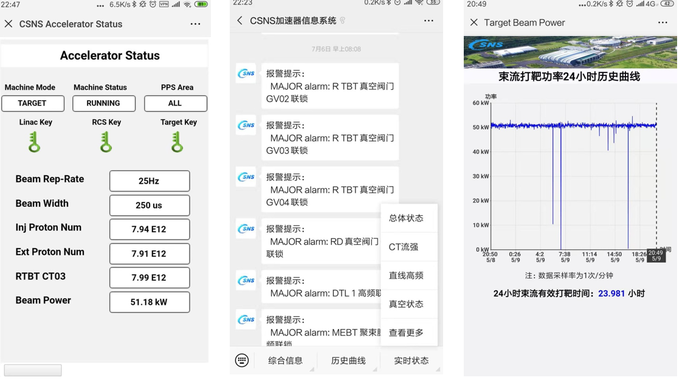
Potential international collaborations
Apps and Wechat （iOS and Android）

Slide 15
Summary
More detailed requirements should be further clarified, with the progress of CEPC TDR
EPICS：Cooperate closely with EPICS community and company
New technique: IoT/AI/machine learning in control system
Thanks a lot!

