Slide 1
Cost model for Higgs factory based on circular collider
Dou Wang, Jie Gao, Manqi Ruan, Yuhui Li, Haocheng Xu, Meng Li

Slide 2


CEPC Cost model
$$N(higgs)=N_{IP}·L·σ\left(year×month_{physics}×30×24×60×60\right)$$
$$\left(month_{physics}=6\right)$$
$$\left(month_{operation}=9\right)$$

Slide 3
Beam-beam limit
Jie Gao

Slide 4
CEPC 4IP scheme*
Haijing Wang
4 IPs
- Equal spacing between IPs
4 RFs
- RF at the midpoint of 2 IPs
- shared RFs
2×2 collision
- 2 trains/beam
IP1
RF
RF
IP4
IP2
RF
RF
* Dou Wang, et. al., “CEPC 4 IP discussions”, CEPC day, A419, IHEP, Aug. 16th 2019.
IP3

Slide 5
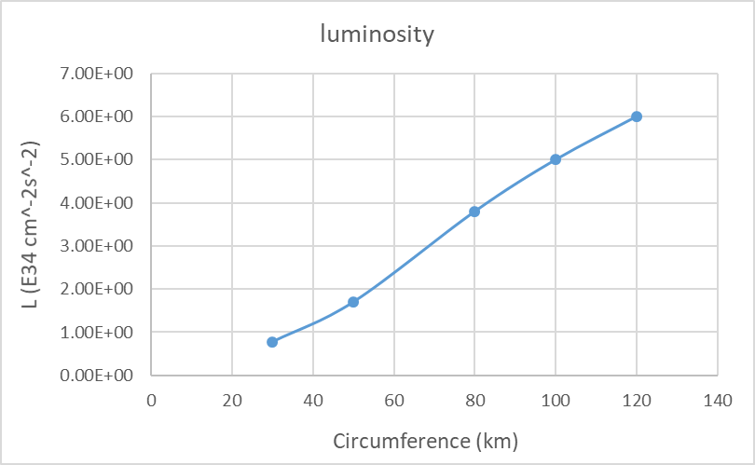

CEPC higgs luminosity vs. circumference
P_{SR}=30MW
$$L=9.35+0.40∗C−3.64∗\sqrt{C}$$

Slide 6
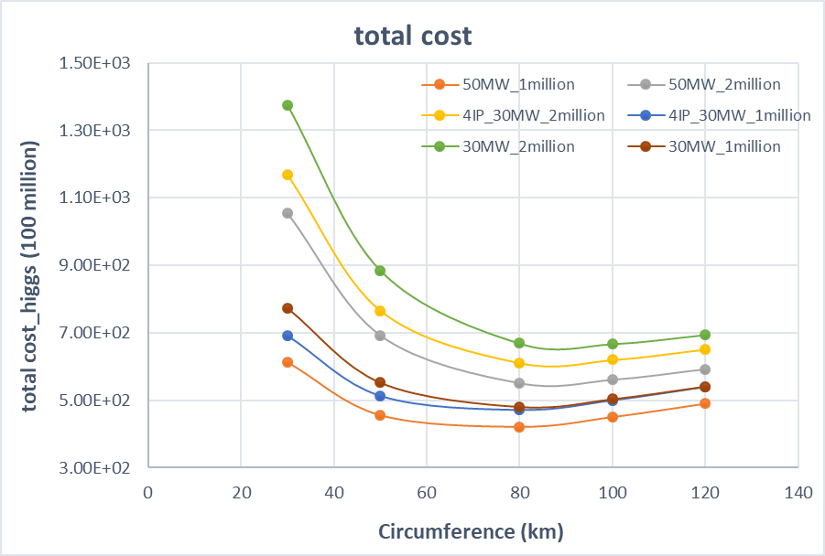
Total cost vs. circumference- higgs only
Cross section @240GeV=200fb

Slide 7
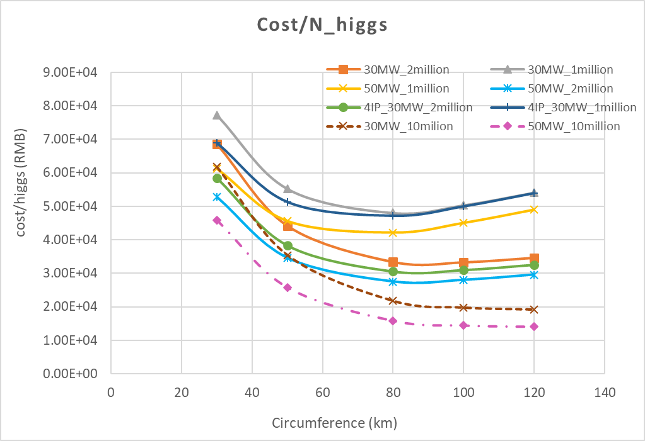
Cost per higgs vs. circumference
Higgs number↑, cost/H↓
Higgs number↑, C↑
Higgs number>1 M, cost_{4IP}↓
50MW is more efficient.

Slide 8
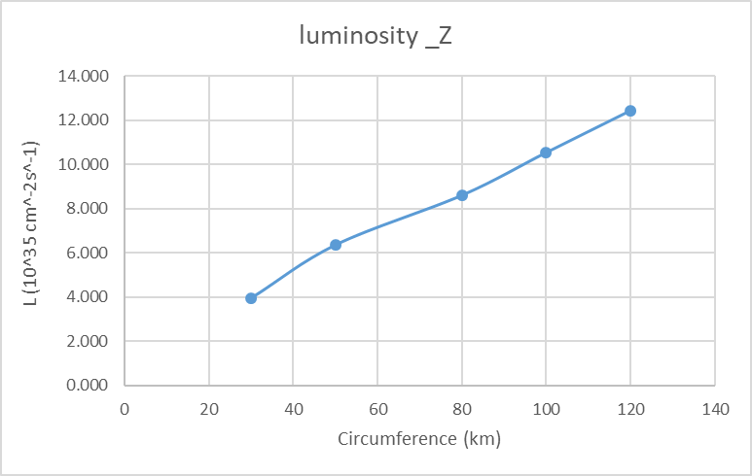
CEPC Z luminosity vs. circumference
P_{SR}=30MW

Slide 9
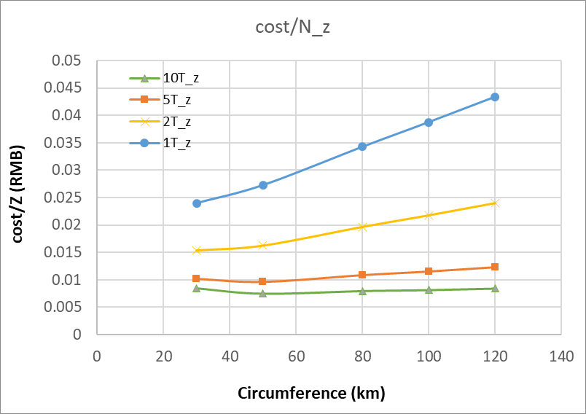
Cost per Z vs. circumference
Cross section @91GeV=30nb
6

Slide 10
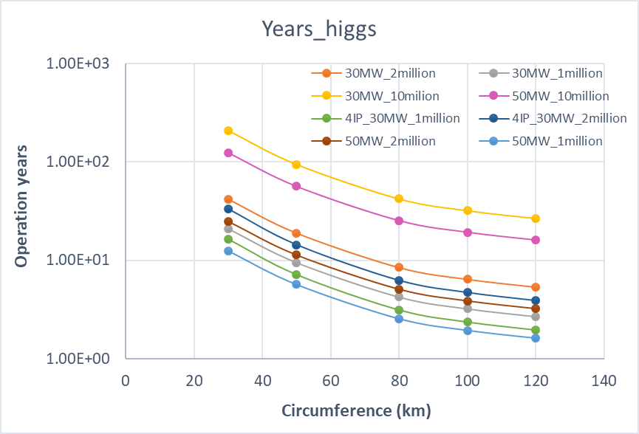
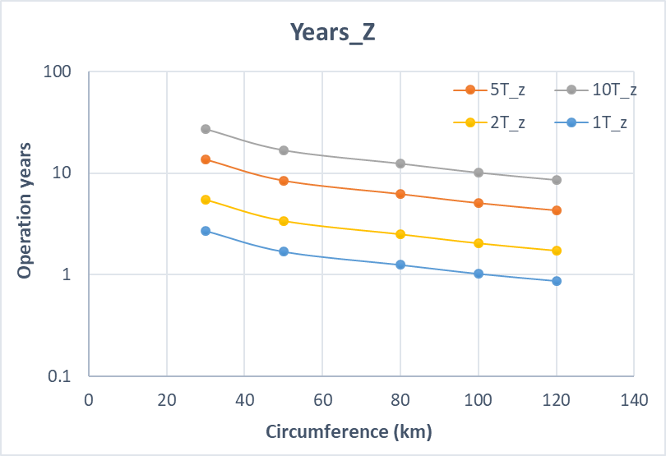
Operation years

Slide 11
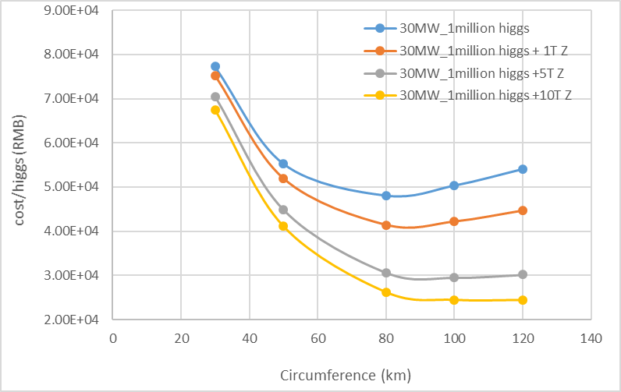
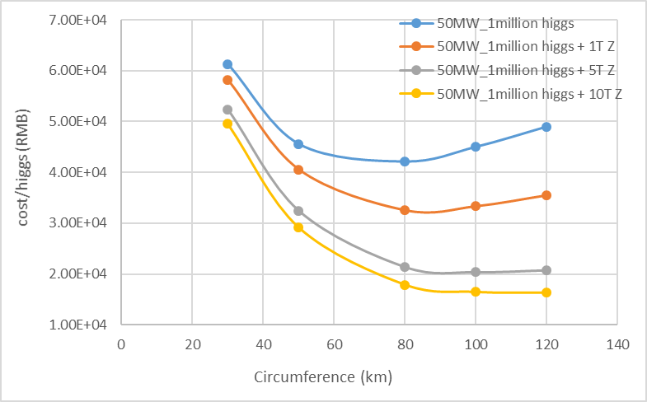
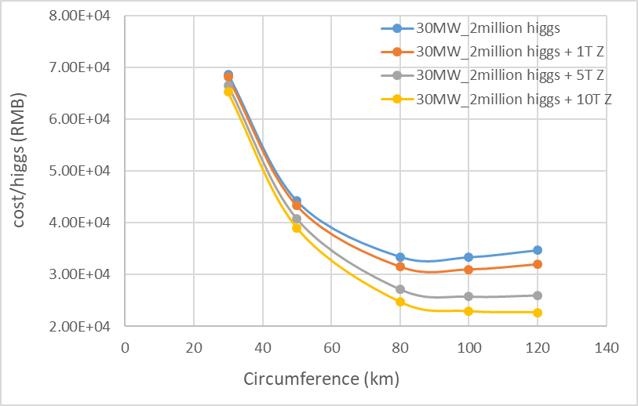
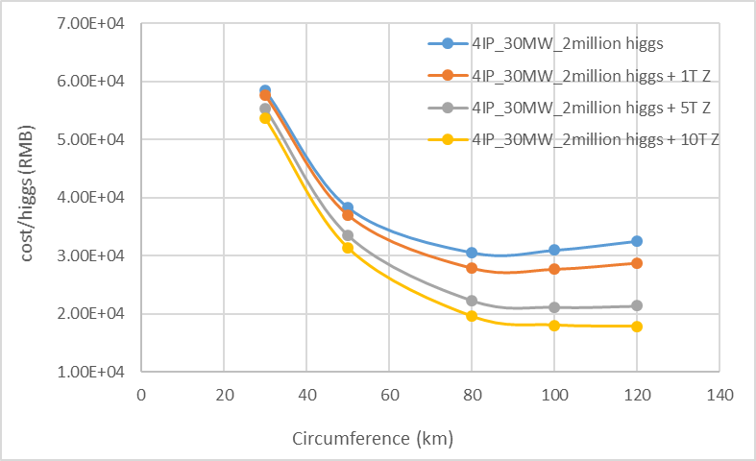
Cost per higgs vs. circumference (combining higgs & Z)

Slide 12
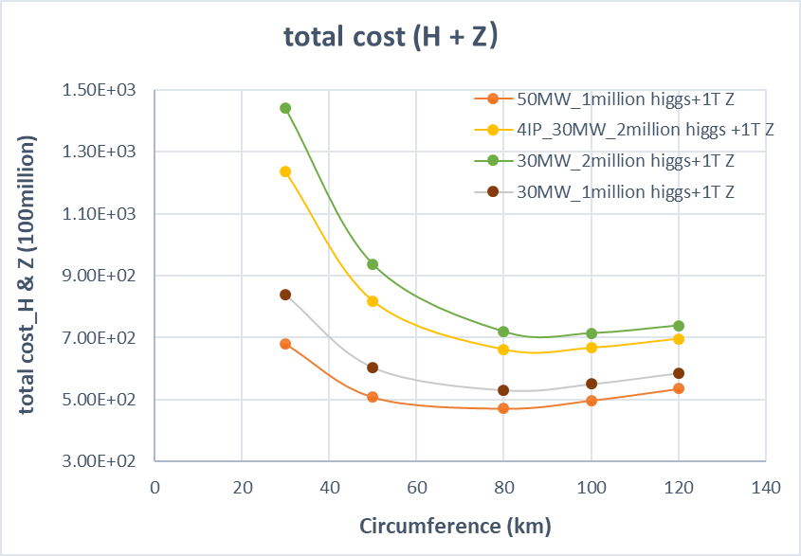
Total cost vs. circumference (combining higgs & Z)

Slide 13
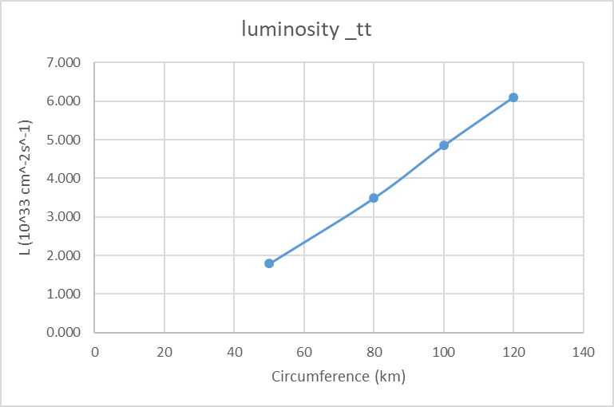
CEPC tt luminosity vs. circumference
P_{SR}=30MW

Slide 14
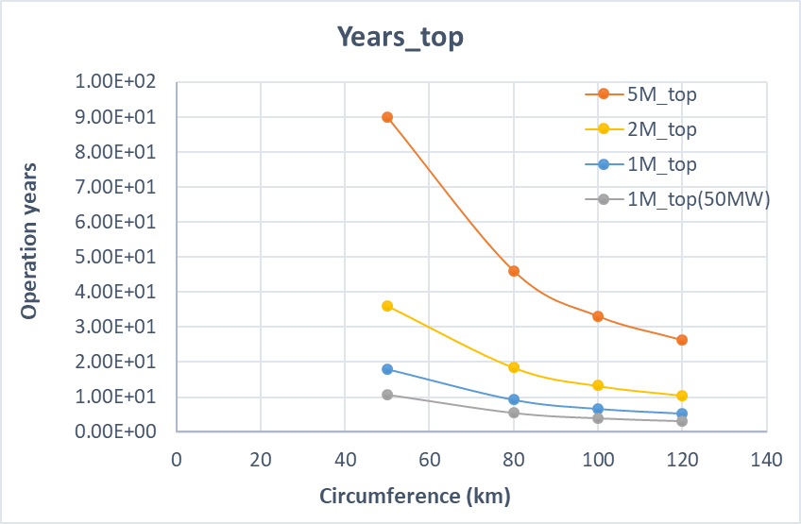
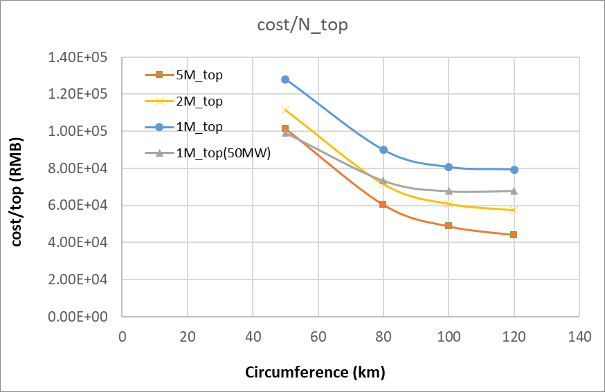
Cost per top quark vs. circumference
Cross section @360GeV=500fb
+ k×60（亿）
13

Slide 15
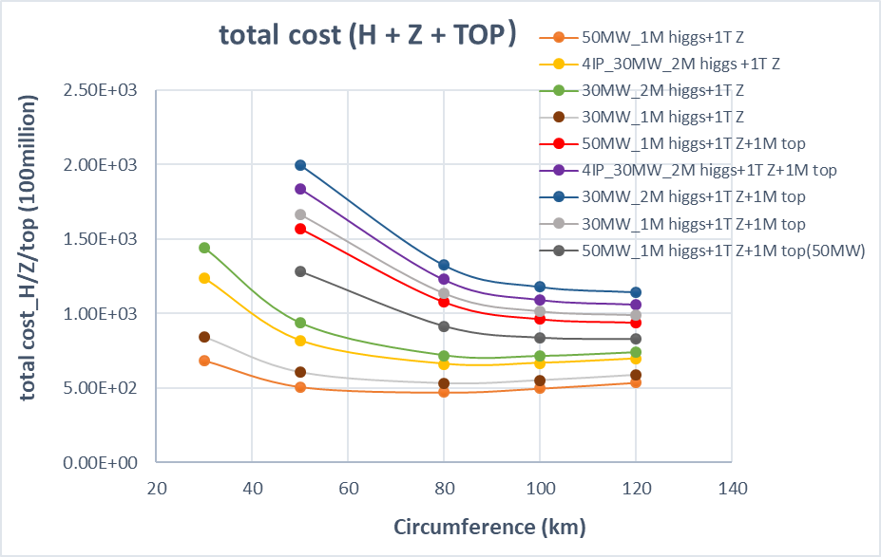
Total cost vs. circumference (combining higgs/Z/ tt)

Slide 16
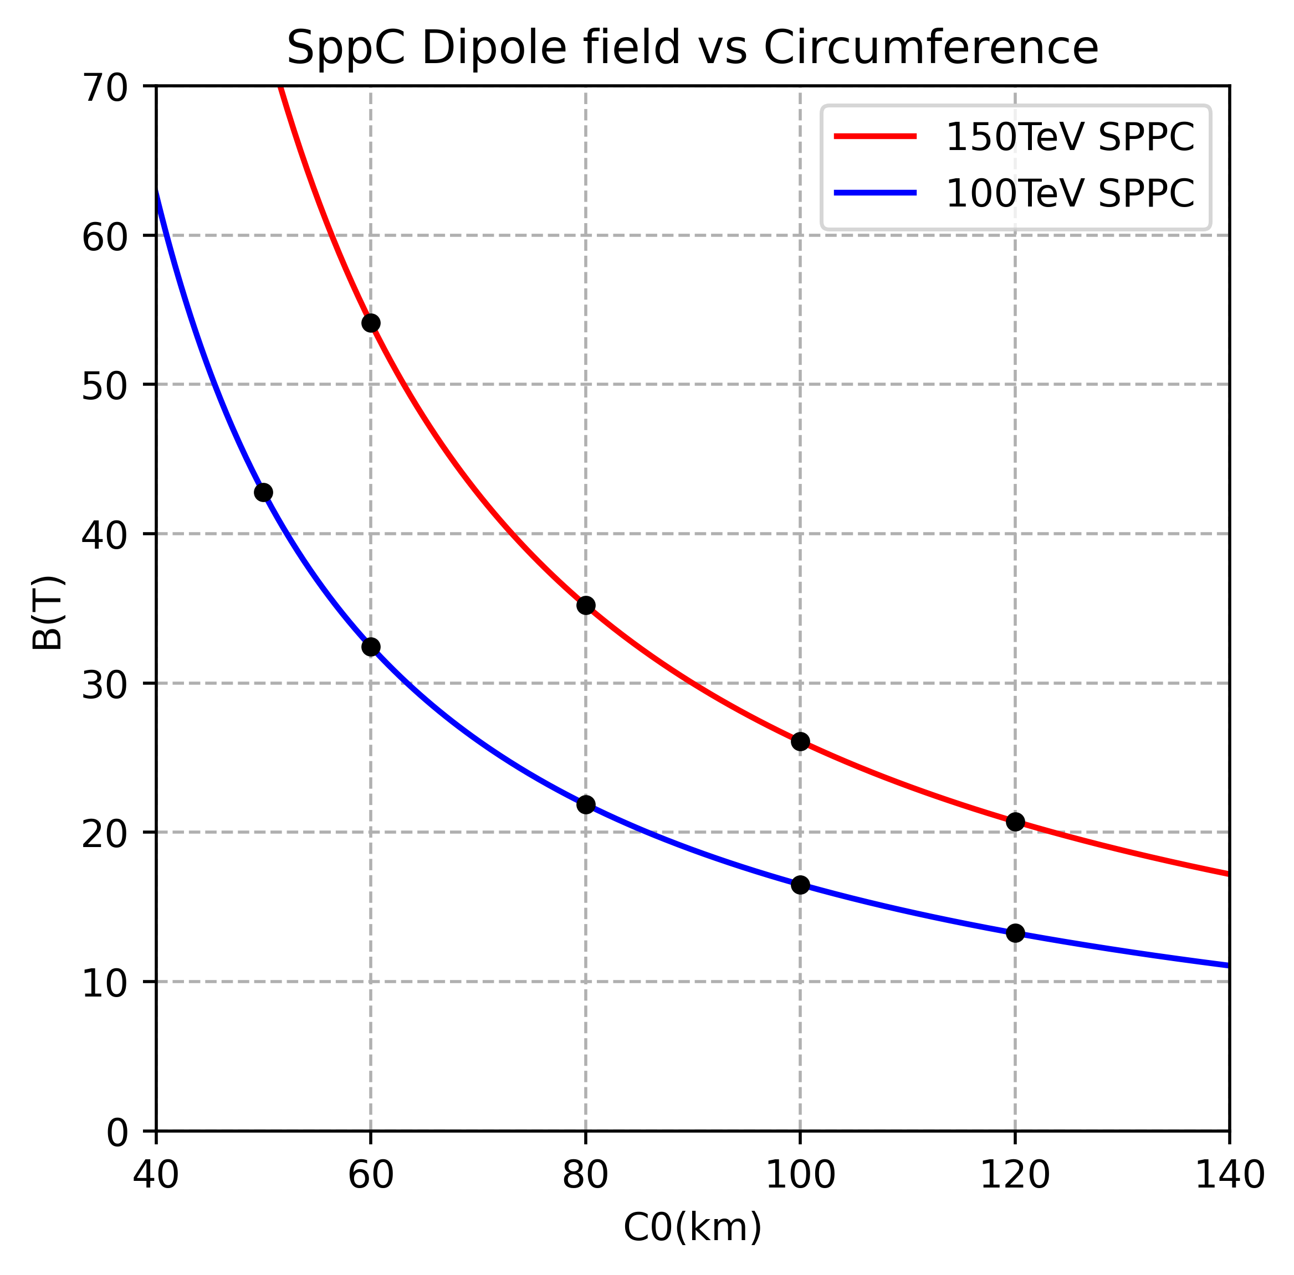
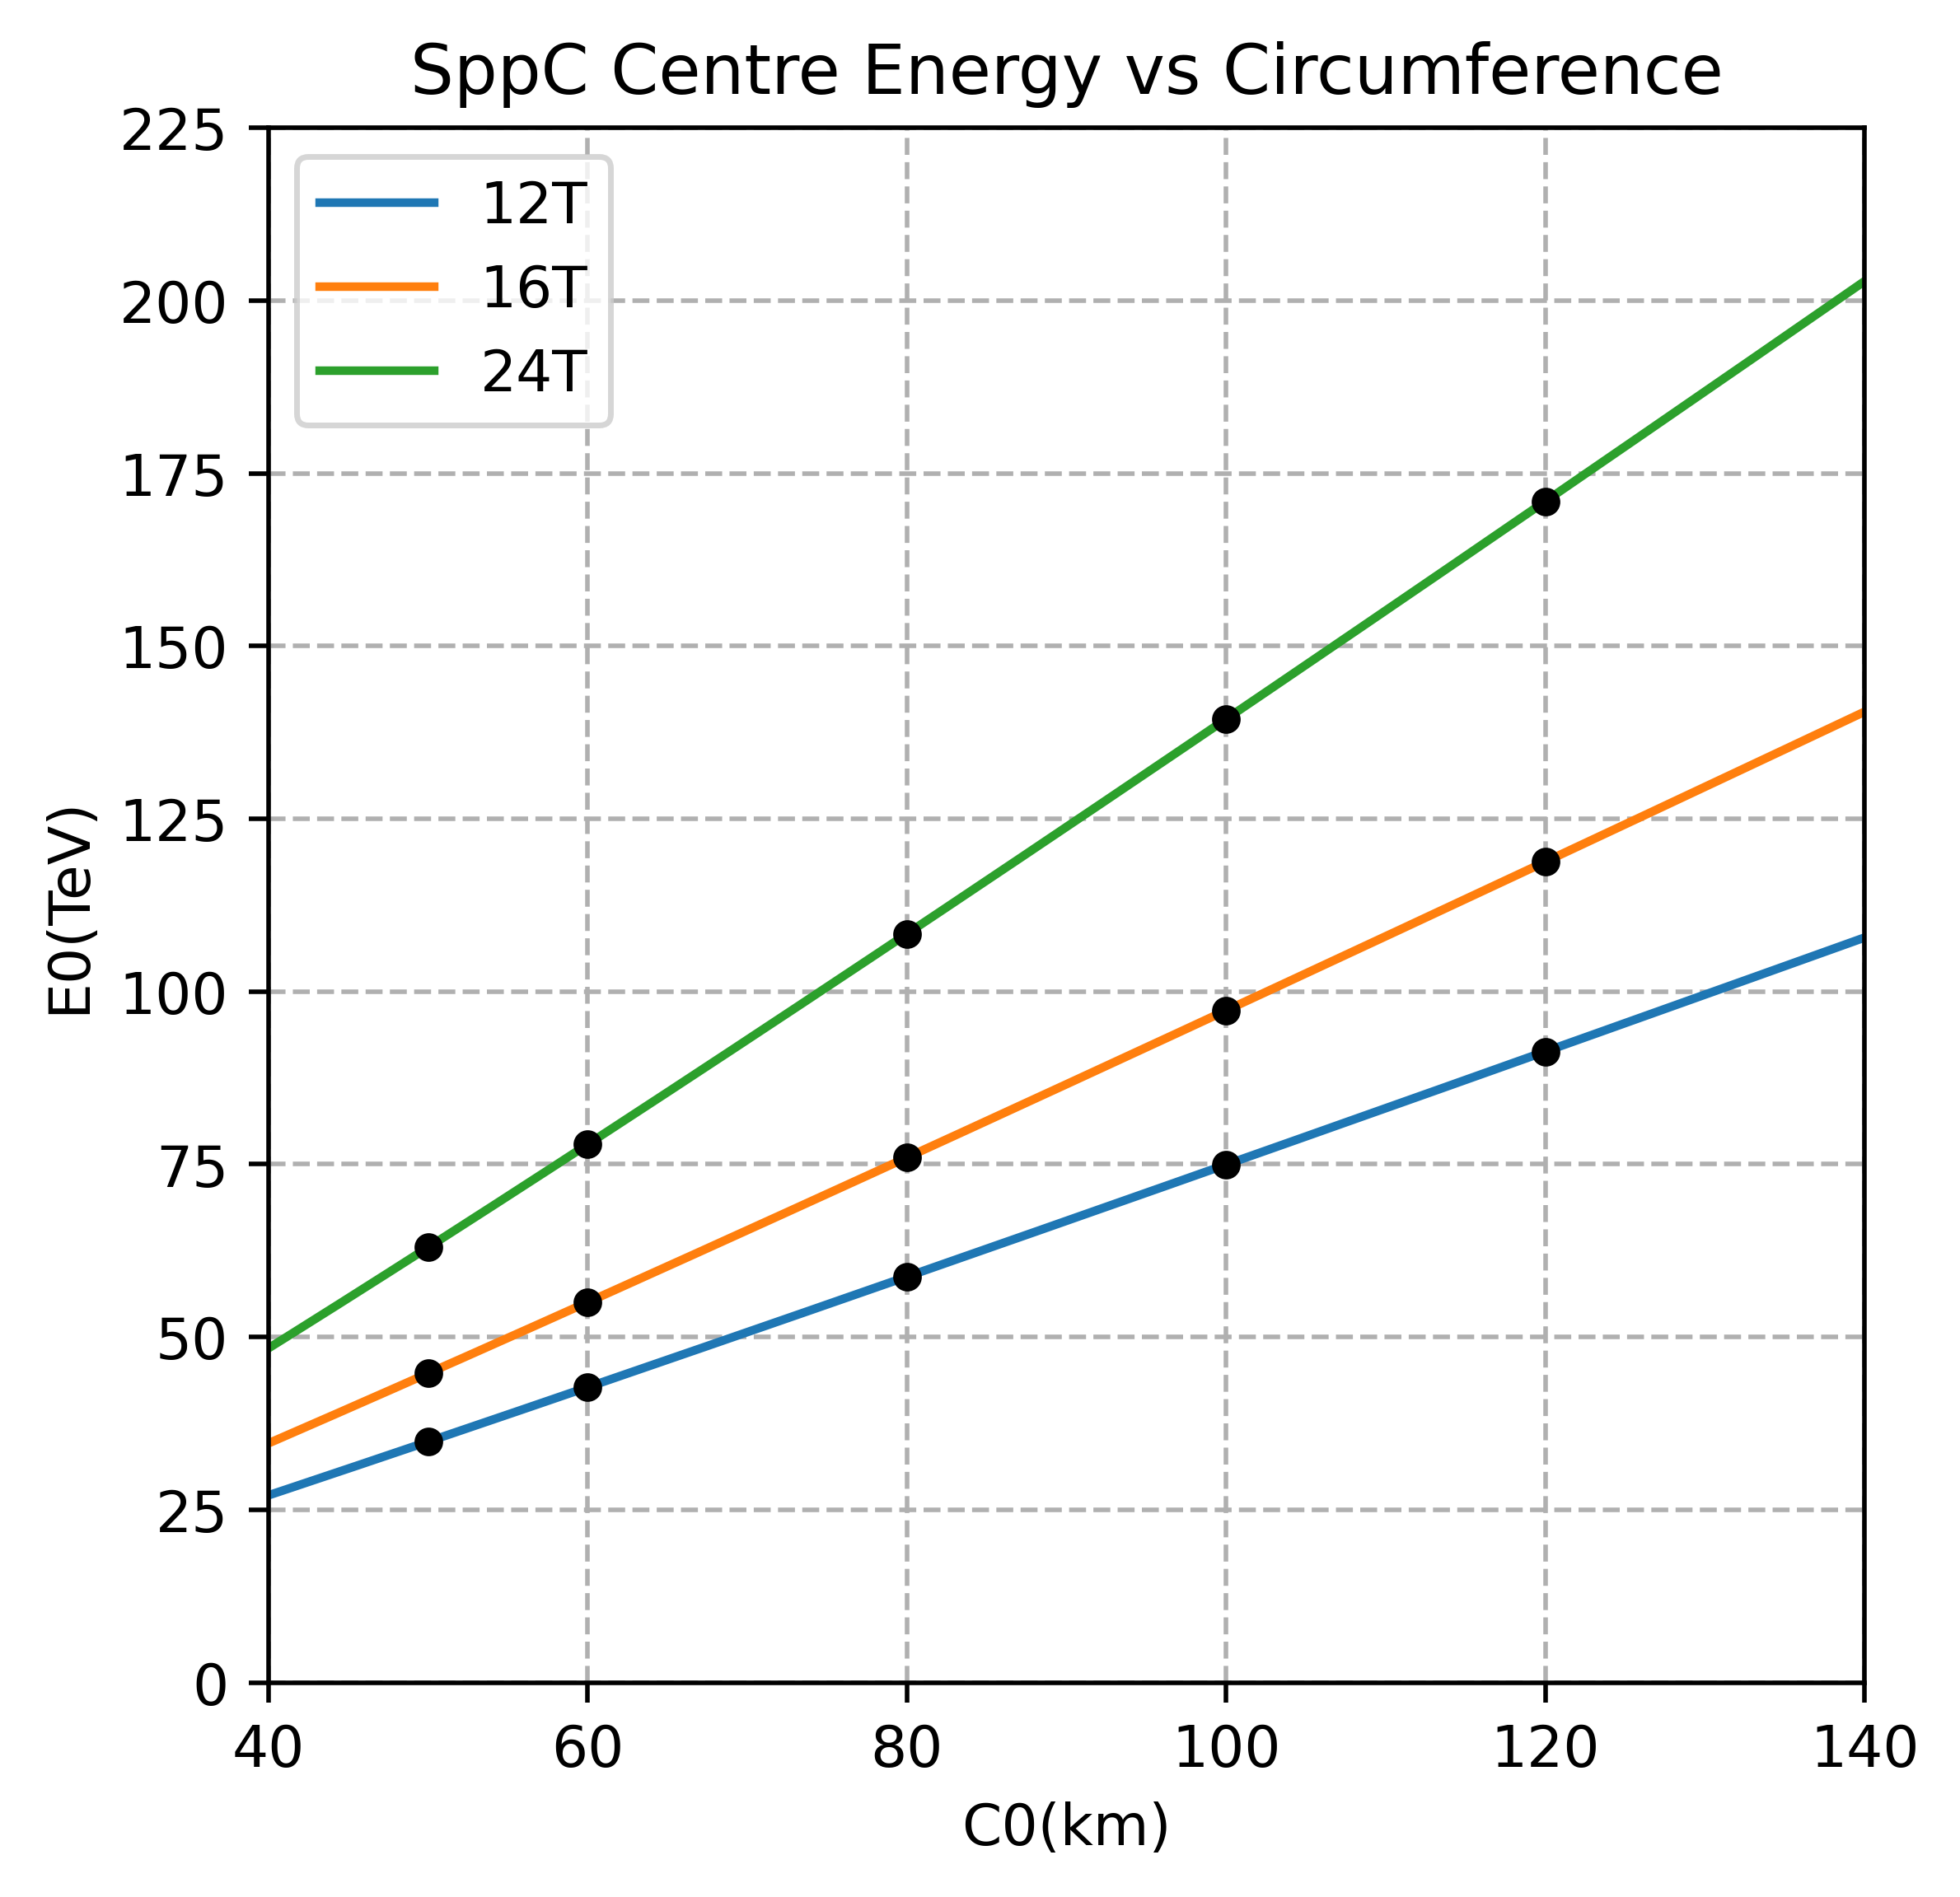
Dipole strength & energy potential of SPPC
Hao Cheng Xu

Slide 17
Summary
CEPC cost performance is studied based on a rough cost model.
Higgs physics is the first goal of CEPC
Requirement of total higgs: 1million → 80km is a good choice
Requirement of total higgs: ≥2million → 80km and 100km almost same
Combining higgs and ttbar: → 100km is the best choice
100 km circumference is a good choice for CEPC with consideration of the potential at ttbar, Z and SPPC.

Slide 18
Back up

Slide 19
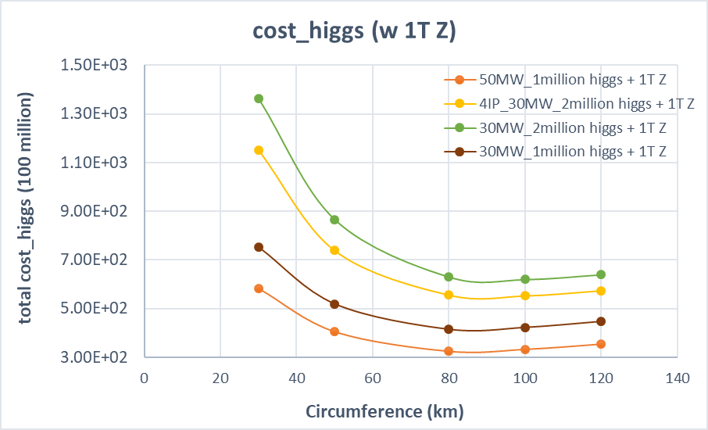
Higgs Cost vs. circumference (combining higgs & Z)

