Slide 1
Error budget analysis to the acceptable DA of the collider ring
Bin Wang (on the behalf of the CEPC error correction team)
Institute of High Energy Physics
09.22
2021
CEPC Day (Sep 25, 2021)

Slide 2
Content
The current situation of computing resources
The status of error correction of collider ring
Summary and to do list

Slide 3
Beam parameters
Y. W. Wang, D. Wang, Y. Zhang, J. Y. zhai et al
 | ttbar | Higgs | W | Z
Number of IPs | 2
Circumference [km] | 100.0
SR power per beam [MW] | 30
Half crossing angle at IP [mrad] | 16.5
Bending radius [km] | 10.7
Energy [GeV] | 180 | 120 | 80 | 45.5
Energy loss per turn [GeV] | 9.1 | 1.8 | 0.357 | 0.037
Piwinski angle | 1.21 | 5.94 | 6.08 | 24.68
Bunch number | 35 | 249 | 1297 | 11951
Bunch population [10^10] | 20 | 14 | 13.5 | 14
Beam current [mA] | 3.3 | 16.7 | 84.1 | 803.5
Momentum compaction [10^-5] | 0.71 | 0.71 | 1.43 | 1.43
Beta functions at IP (bx/by) [m/mm] | 1.04/2.7 | 0.33/1 | 0.21/1 | 0.13/0.9
Emittance (ex/ey) [nm/pm] | 1.4/4.7 | 0.64/1.3 | 0.87/1.7 | 0.27/1.4
Beam size at IP (sigx/sigy) [um/nm] | 39/113 | 15/36 | 13/42 | 6/35
Bunch length (SR/total) [mm] | 2.2/2.9 | 2.3/3.9 | 2.5/4.9 | 2.5/8.7
Energy spread (SR/total) [%] | 0.15/0.20 | 0.10/0.17 | 0.07/0.14 | 0.04/0.13
Energy acceptance (DA/RF) [%] | 2.3/2.6 | 1.6/2.2 | 1.2/2.5 | 1.3/1.7
Beam-beam parameters (ksix/ksiy) | 0.071/0.1 | 0.015/0.11 | 0.012/0.113 | 0.004/0.127
RF voltage [GV] | 10 | 2.2 | 0.7 | 0.12
RF frequency [MHz] | 650 | 650 | 650 | 650
HOM power per cavity (5/2/1cell)[kw] | 0.4/0.2/0.1 | 1/0.4/0.2 | -/1.8/0.9 | -/-/5.8
Longitudinal tune Qs | 0.078 | 0.049 | 0.062 | 0.035
Beam lifetime (bhabha/beamstrahlung)[min] | 81/23 | 39/18 | 60/717 | 80/182202
Beam lifetime [min] | 18 | 12.3 | 55 | 80
Hour glass Factor | 0.89 | 0.9 | 0.9 | 0.97
Luminosity per IP[1e34/cm^2/s] | 0.5 | 5.0 | 16 | 115

Slide 4
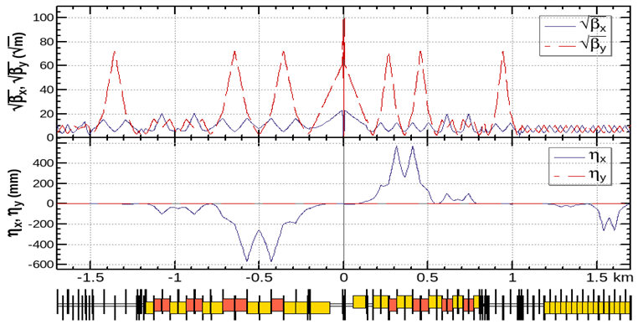
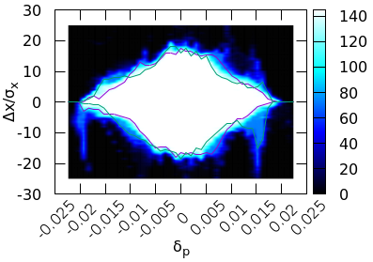
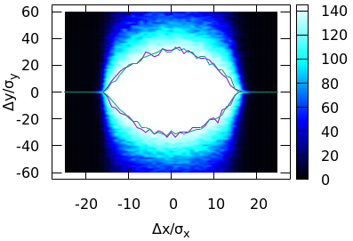
Lattice and requirements
J. Wu, Y. Zhang, Y. W. Wang
Achieved (w/o error): $16σ_{x}×32σ_{y}×1.9\%$
Goal (w/ error): $8σ_{x}×15σ_{y}×1.6\%$

Slide 5
The correction scheme
Correction steps:
Optimize the correction scheme step by step;
Optimize the correction scheme by using few lattice seeds (20 ~ 100 seeds);
Perform the correction for all 1000 seeds and calculate the passing rate;
Repeat above steps for increasing the passing rate.

Slide 6
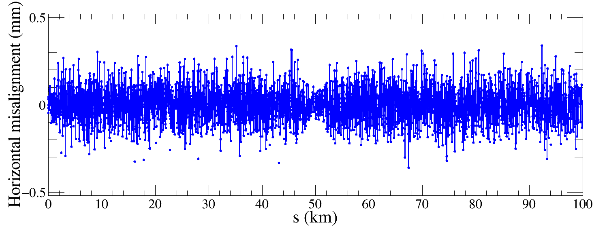
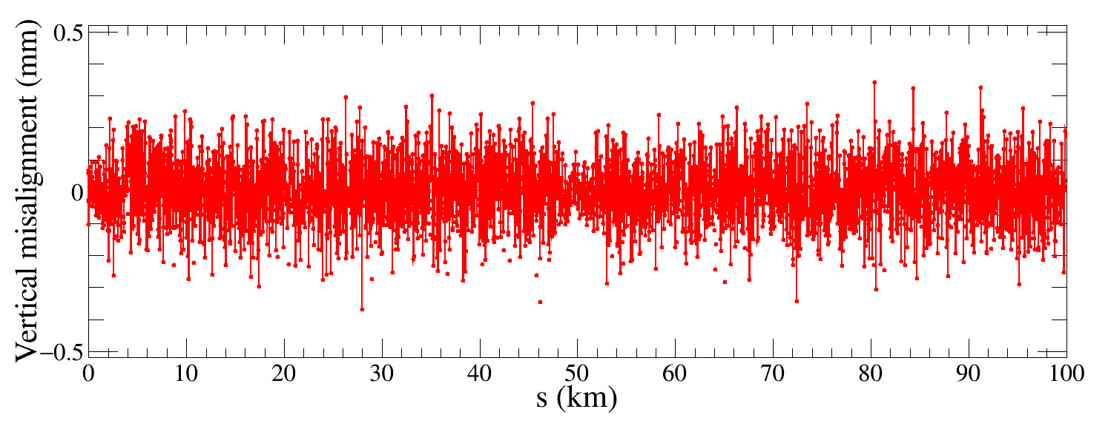
Errors definition and challenges
Component | Δx (mm) | Δy (mm) | Δθ_{z} (mrad) | Field error
Dipole | 0.10 | 0.10 | 0.1 | 0.01%
Arc Quadrupole | 0.10 | 0.10 | 0.1 | 0.02%
IR Quadrupole | 0.05 | 0.05 | 0.05
Sextupole | 0.10 | 0.10 | 0.1
The high luminosity lattice is much more sensitive to imperfections, the optics correction is very challenging.
1000 lattice seeds are generated for further correction.

Slide 7
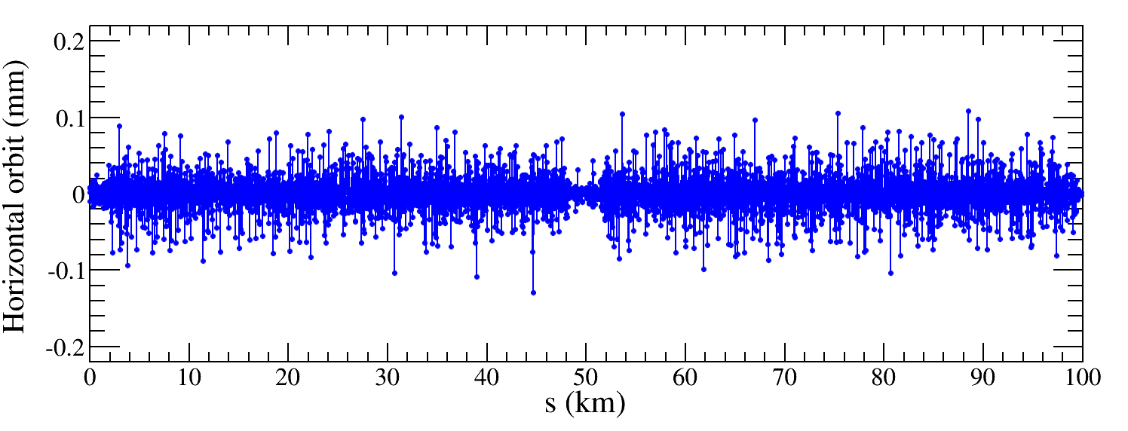
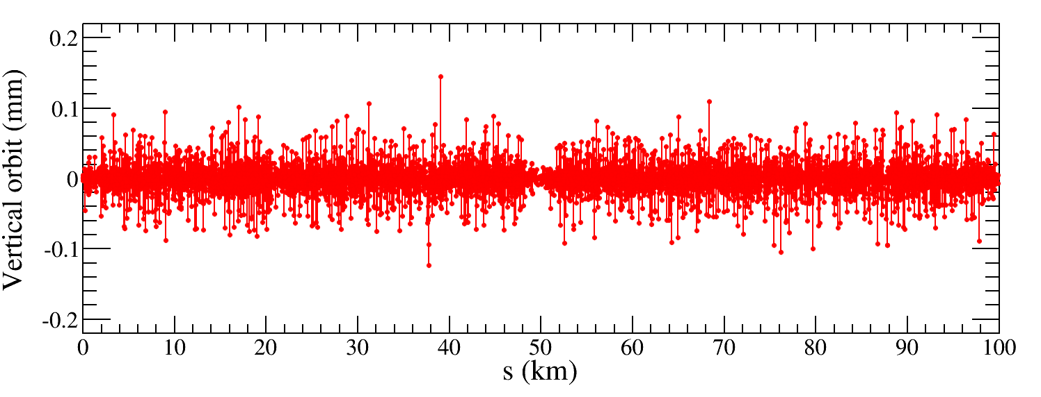
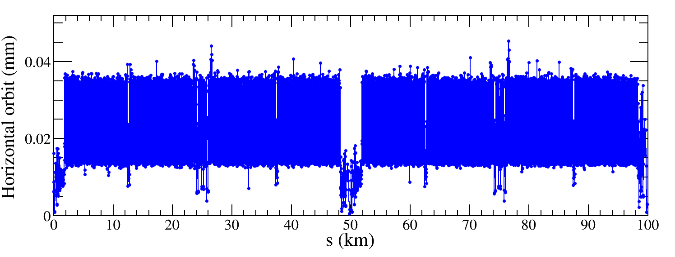
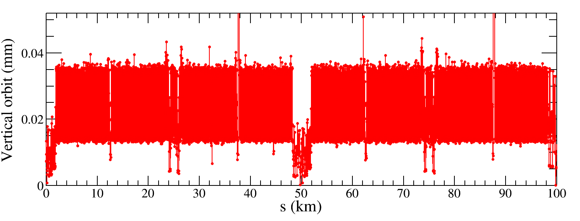
COD correction
A new corrector setting is necessary for the more limited lattice.
BPMs placed at quadrupoles (~1800, 4 per betatron wave) Horizontal correctors placed beside focusing quadrupoles（~1800）
Vertical correctors placed beside defocusing quadrupoles（~1800）
Orbit correction is applied using orbit response matrix and SVD method.
Result of one seed
765 seeds converged
$${RMS}_{COD}<0.05 mm$$

Slide 8
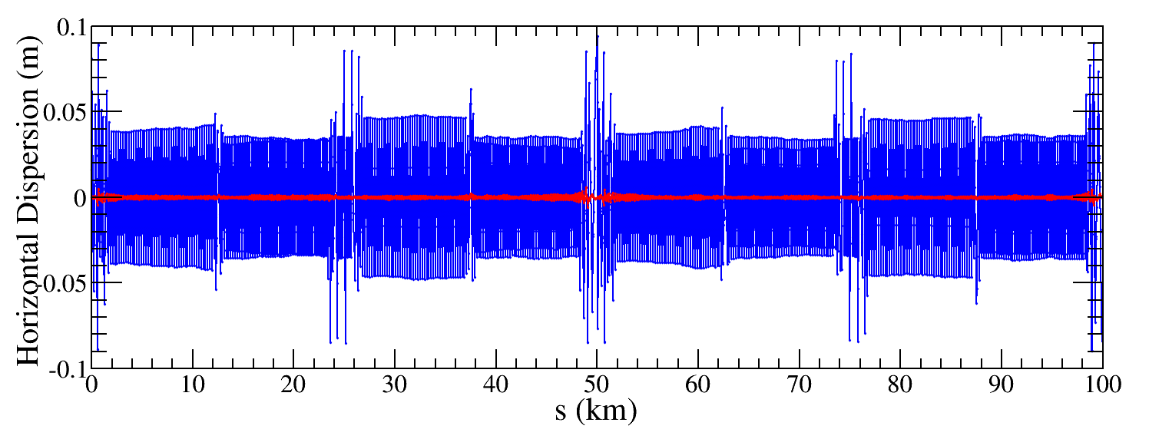
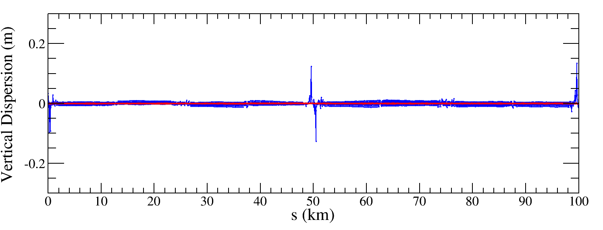
Dispersion correction
Dispersion free steering principle (DFS):$θ$_{c}
$$\vec{d}=\left(\begin{aligned}\left(1−α\right)\vec{u} \\ α\vec{D}u\end{aligned}\right)$$
M$=\left(\begin{aligned}\left(1−α\right)A \\ αB\end{aligned}\right)$
$$\vec{d}+M\vec{θ}=0$$
Result of one seed
$\vec{u}$: Orbit vector
$\vec{D}u$: Dispersion vector
$\vec{θ}$: Corrector strengths vector
$α$: Weight factor
$A$: Orbit response matrix
$B$: Dispersion response matrix

Slide 9
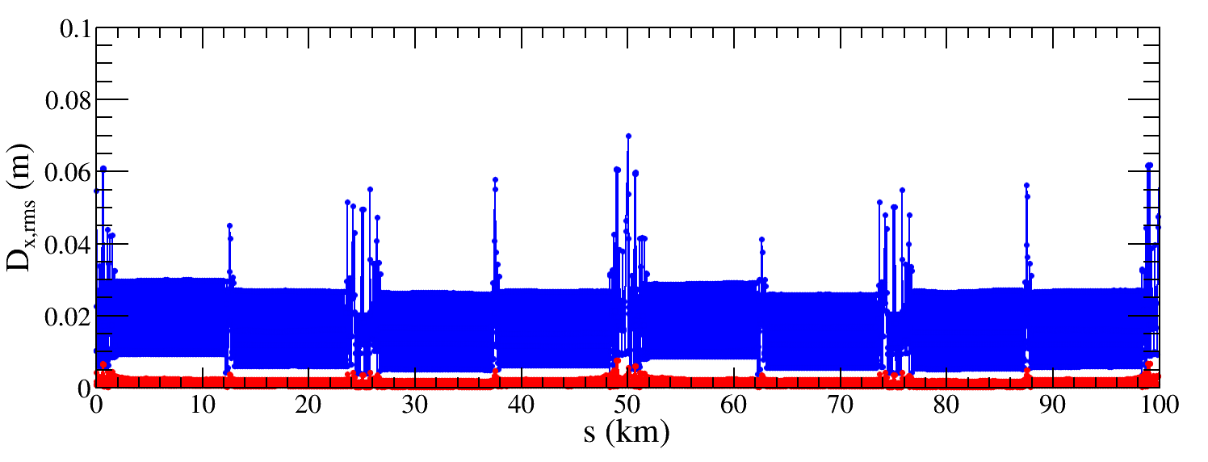
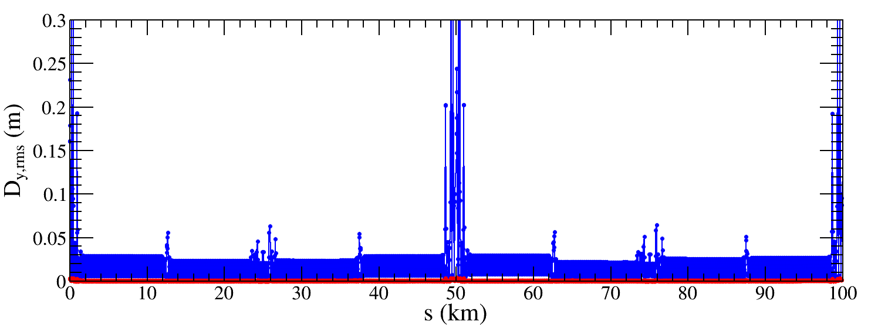
Dispersion correction
674 seeds converged
${∆D}_{x,rms}$ decreased from 15.5mm to 1.0mm
Factor 15 improvement
${∆D}_{x,rms}$ decreased from 18.4mm to 0.4mm
Factor 46 improvement
The dispersion correction is performed for all selected seeds, 674 seeds are converged.
The correction effect is better than that of CDR lattice.

Slide 10
Beta-beating correction
Correct the beta functions with sextupoles on.
Based on AT LOCO: model based correction
Establish lattice model M_{mod}, multi-parameter fit to the orbit response matrix M_{meas} to obtain calibrated model:
Parameters fitted: K, KS …
Use calibrated model to perform correction and apply to machine.
Fit the dispersion at the same time.
Application to correct beta-beating, dispersion and coupled response matrix.
More than 40h per seed (only 30 min for correction of CDR lattice)
The kernel of LOCO toolbox will be optimized for the current correction.
CDR
High-lum.

Slide 11
Summary and to do list
The imperfection correction to the high luminosity lattice is on going.
The close orbit correction and dispersion correction are finished, the passing rates and the correction effect are comparable to those for CDR lattice.
We are optimizing the kernel of LOCO toolbox.

