Slide 1
Status of CEPC Electro-magnetic Separator Bin Chen CEPC Day (Sep 22) 2021

Slide 2
Outline
Introduction
Prototype development of electrostatic separator
Factory test
Installation and commissioning at IHEP
Prototype development of dipole magnet
Summery

Slide 3
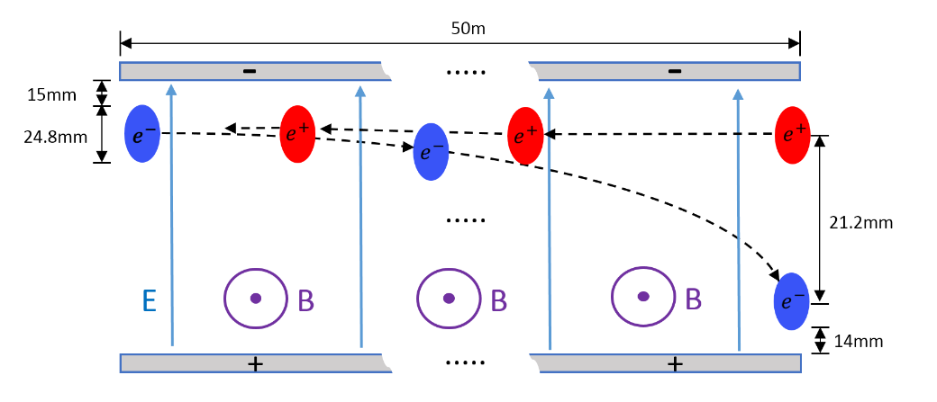
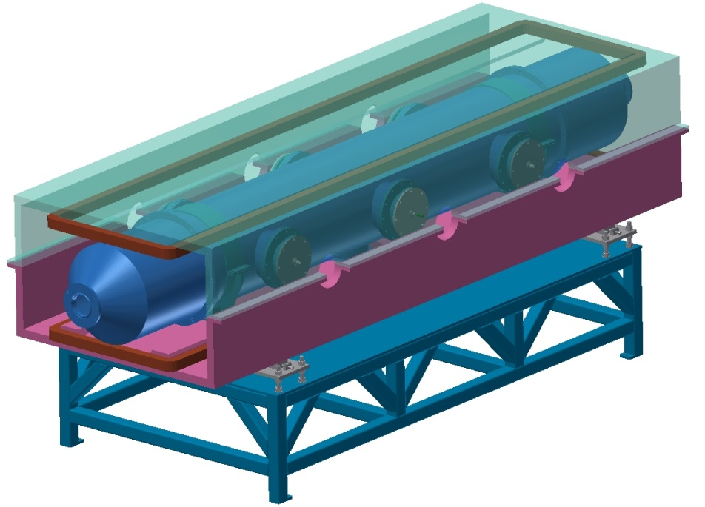
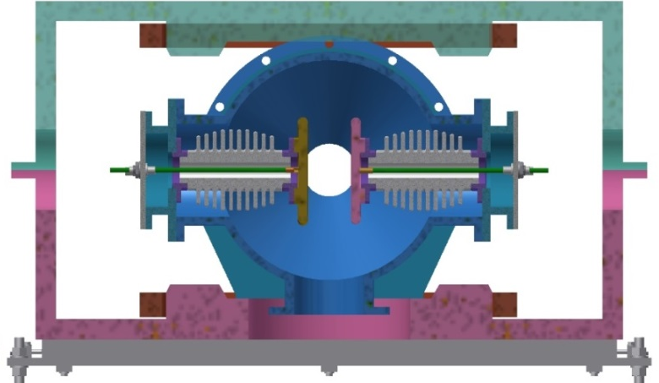
Introduction
The Electro-magnetic Separator is a device consisting of perpendicular electric and magnetic fields.
One set of Electro-magnetic Separators including 8 units, total 32 units will be need for CEPC.
 | Filed | Effective Length | Good field region | Stability
Electrostatic separator | 2.0MV/m | 4m | 46mm ⅹ11mm | 5ⅹ10⁻⁴
Dipole | 66.7Gauss | 4m | 46mm ⅹ11mm | 5ⅹ10⁻⁴
Schematic of Electrostatic-Magnetic Deflector
metal-ceramic support
high voltage feedthrough
UHV tank
Magnet
Support
structure drawing of Electro-magnetic Separator
coil
electrode

Slide 4
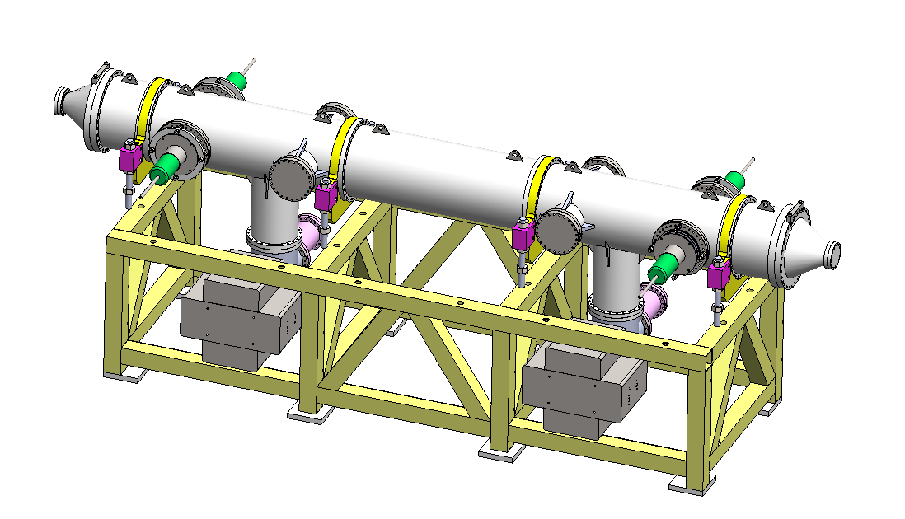
Prototype development of electrostatic separator
A separator unit including: 1. Vacuum chamber (5 straight through chambers, 2 cone tubes and 2 pump chambers); 2. a pair of electrodes; 3. 2 ground electrodes; 4. 4 groups of insulation metal-ceramic support; 5. 4 groups of high voltage feedthrough; 6. 2 sets of vacuum system (including ion pump, sublimation pump and gauge); 7. support platform.
structure drawing of Electrostatic Separator

Slide 5
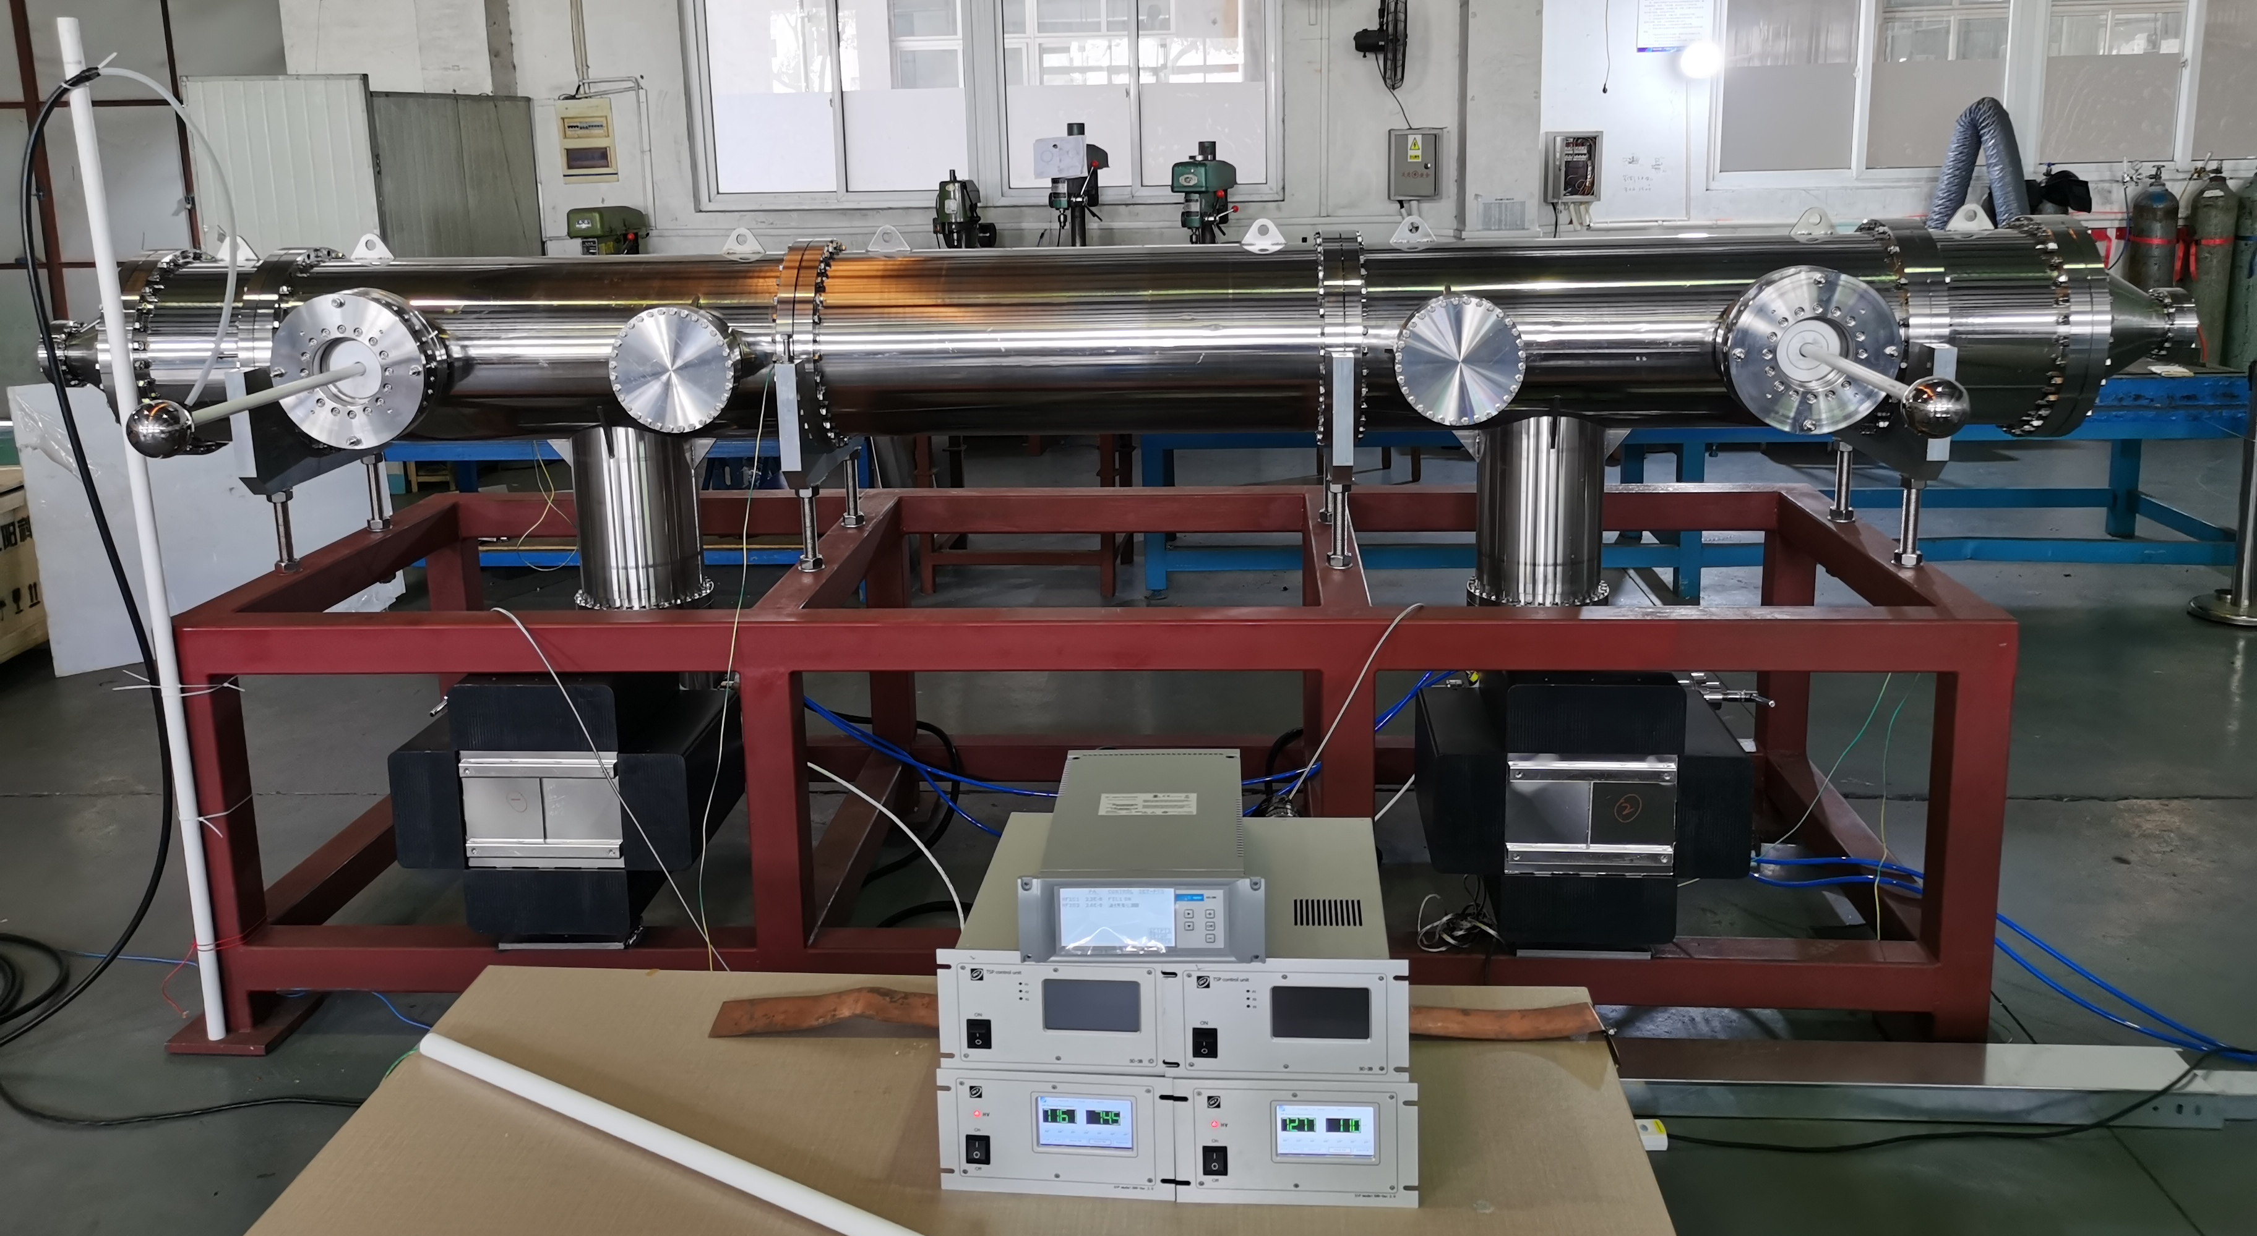
Prototype development of electrostatic separator
Factory test
Test platform
The test mainly includes: vacuum test, high voltage test, etc.

Slide 6
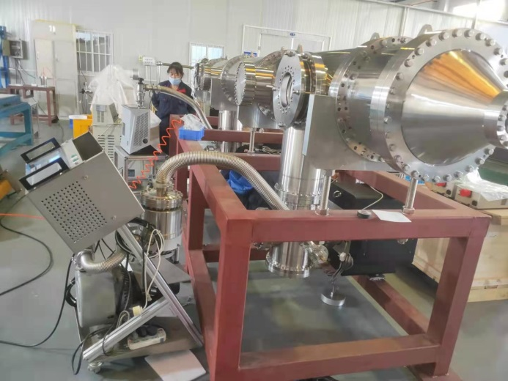
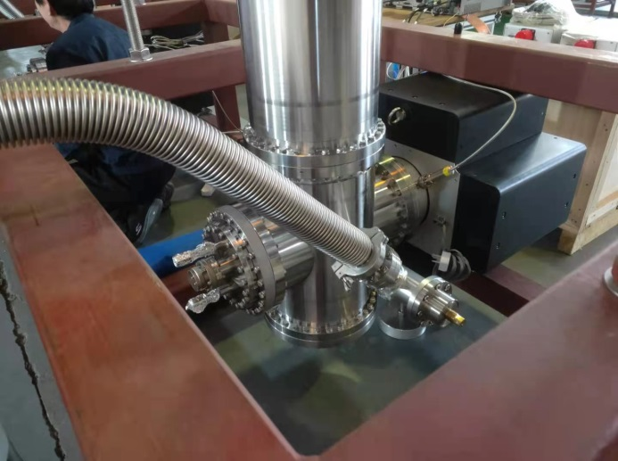
Prototype development of electrostatic separator
Factory test
Molecular pump unit for crude pumping.
Turn off the molecular pump unit and turn on the ion pump
时间 | 机组真空(Pa) | 腔室真空(Pa) | 泵1电压(V)/ 电流(mA) | 泵2电压(V)/ 电流(mA)
17:05 | 1.70E-04 | 1.70E-03 | 1150/42 | 1166/42
17.25 | 8.90E-05 | 8.00E-04 | 1647/34 | 1660/35
18:00 | 3.80E-05 | 1.70E-04 | 3053/16.6 | 3096/17.1
18:15 | 3.50E-05 | 1.40E-04 | 3179/13.7 | 3227/14.1
18:56 | 3.00E-05 | 9.80E-05 | 3417/10.1 | 3466/10.3
时间 | 腔室真空(Pa) | 泵1电压(V)/ 电流(mA) | 泵2电压(V)/电流(mA)
19:02 | 1.00E-04 | 4398/19.1 | 3432/10.7
19:21 | 5.50E-05 | 5087/10.2 | 5169/10.1
19:34 | 4.60E-05 | 5300/8.5 | 5386/8.2
7:40 | 8.20E-06 | 6379/0.900 | 6423/0.660
10:50 | 7.90E-06 | 6413/0.780 | 6534/0.743
12:15 | 7.30E-06 | 6441/0.726 | 6564/0.729
15:00 | 8.20E-06 | 4612/0.524 | 6438/0.720

Slide 7
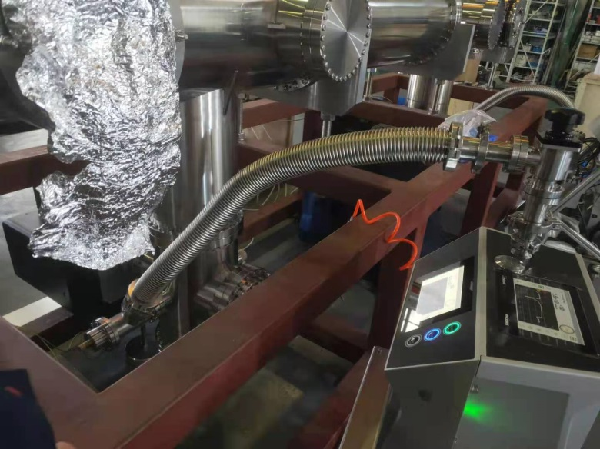
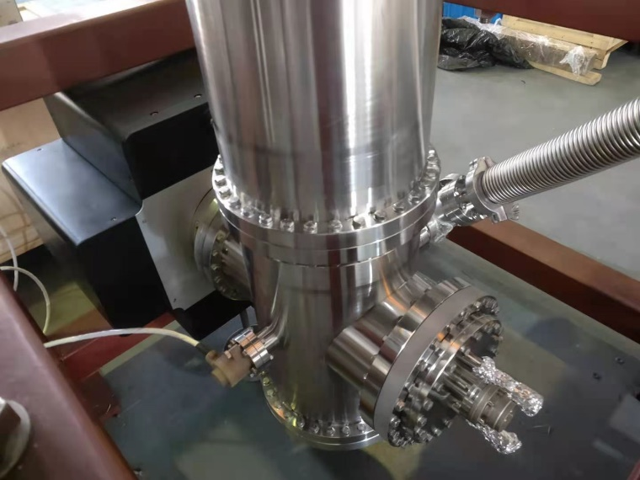
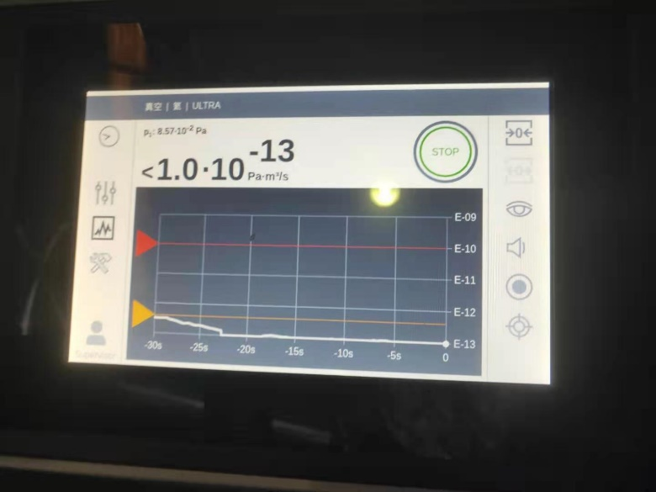
Prototype development of electrostatic separator
Factory test
System vacuum leak detection
vacuum leakage rate ≤2×10⁻¹³Pa.m3/s

Slide 8
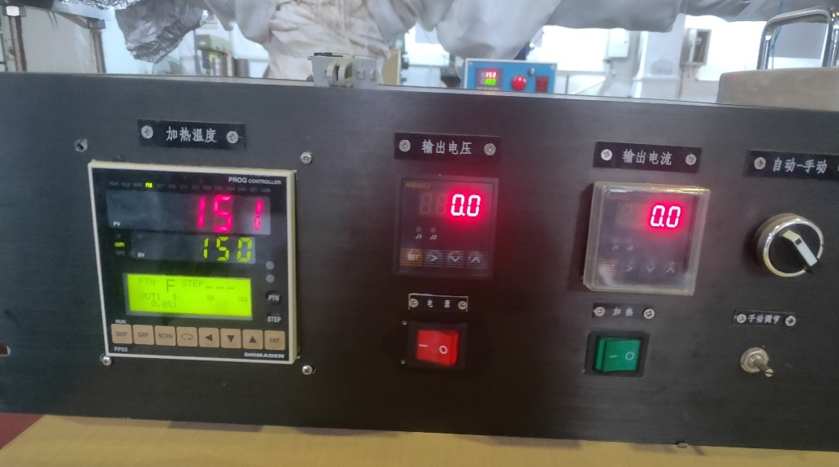
Prototype development of electrostatic separator
Factory test
The system was vacuum baked for a week (up to 150 ℃)
时间 | 温度(℃) | 真空(Pa)
11:54 | 100 | 2.70E-02
15:50 | 110 | 2.50E-02
17:10 | 110 | 3.20E-02
6:00 | 110 | 4.70E-02
8:00 | 110 | 4.10E-02
16:00 | 110 | 8.30E-03
19:15 | 115 | 1.70E-02
7:25 | 115 | 2.70E-02
8:30 | 115 | 4.60E-02
9:05 | 115 | 5.90E-02
10:30 | 115 | 6.50E-02

Slide 9
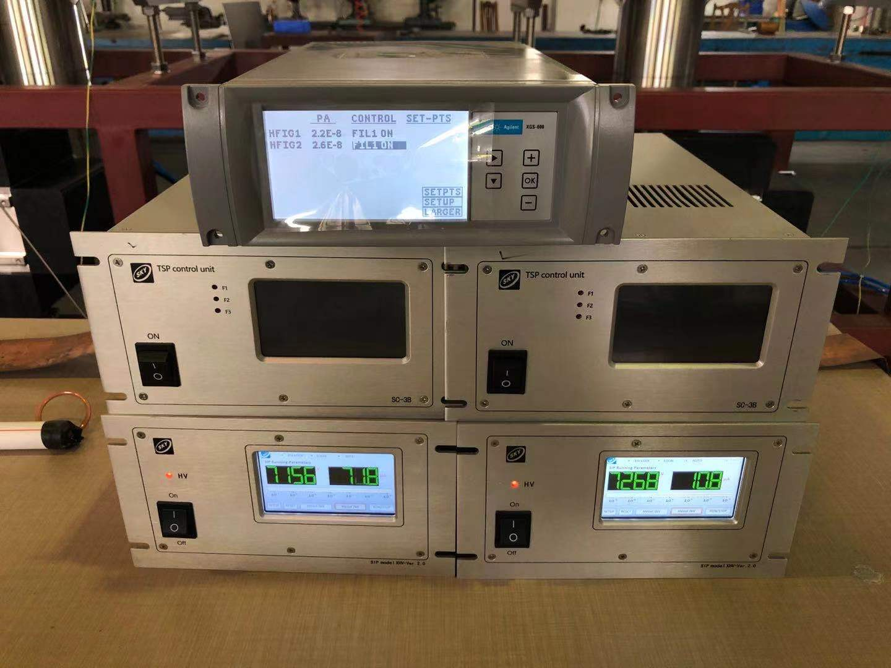
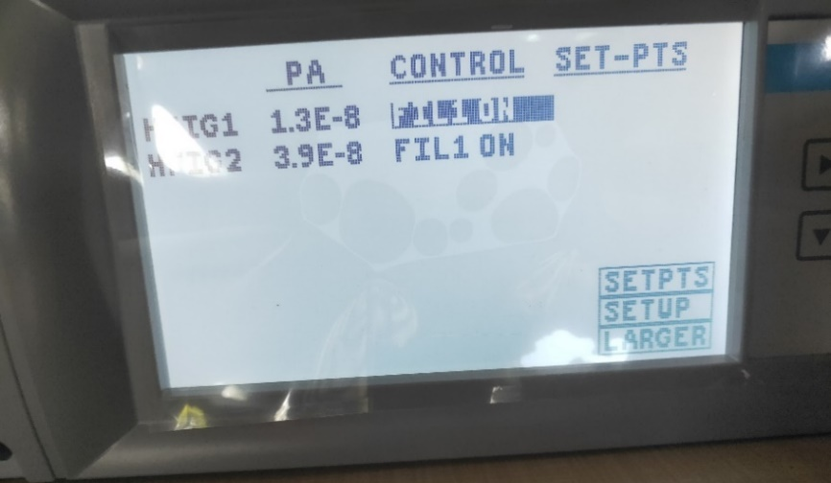
Prototype development of electrostatic separator
Factory test
The system was vacuumed after baking
vacuum pressure: 1.3×10⁻⁸Pa (1.0×10⁻¹⁰Torr)

Slide 10
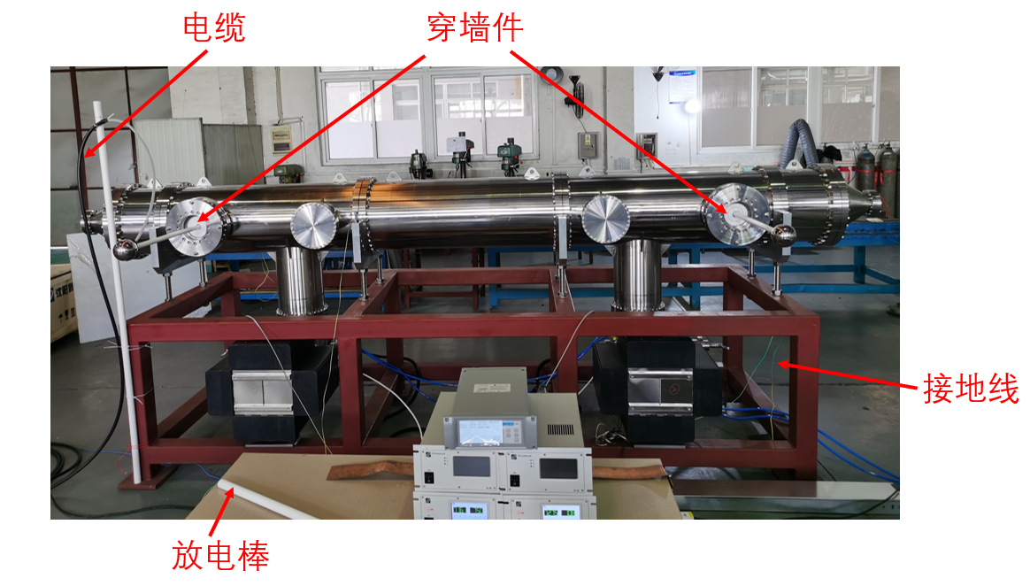
Prototype development of electrostatic separator
Factory test
High voltage test
1. The output high voltage of the power supply is connected to the feedthrough through the cable, and the cavity is connected to the ground column end of the power supply through the copper wire, which connected to the earth.
2. Open the switch of high voltage power supply, gradually increase the voltage.
3. Observe the change of vacuum degree during the process of increasing the voltage.

Slide 11
Prototype development of electrostatic separator
时间 | 高压(kv) | 真空(Pa) | 打火真空(Pa)
17:58 | 58 | 5.00E-08 | 1.20E-07
17:53 | 61.7 | 5.00E-08 | 3.00E-06
18:08 | 58 | 4.80E-08 | 3.00E-06
18:10 | 65 | 6.00E-08 | 2.00E-05
18:15 | 67 | 6.00E-08 | 8.00E-06
18:25 | 69 | 5.80E-08 | 5.00E-05
18:36 | 70 | 5.50E-08 | 4.00E-05
18:52 | 73.5 | 6.00E-08 | 6.00E-06
18:55 | 75 | 2.00E-07 | 1.70E-05
19:03 | 76 | 1.00E-07 | 2.00E-05
19:08 | 77 | 1.03E-07 | 2.00E-05
19:17 | 78 | 1.40E-07 | 6.00E-05
19:21 | 79 | 2.00E-07 | 5.00E-05
19:27 | 80 | 1.40E-07 | 4.00E-05
19:32 | 81 | 1.50E-07 | 2.00E-05
19:38 | 83 | 3.00E-07 | 4.00E-05
19:42 | 85 | 3.40E-07 | 2.00E-05
关掉规管防止因打火损坏 | 高压(kv) | 离子泵电流(uA) | 打火时离子泵电流
19:50 | 86 | 33 | 1.2 mA
19:53 | 87 | 33.6 | 1.2 mA
19:58 | 88 | 32.9 | 870 uA
20:15 | 92 | 35 | 120 uA
20:33 | 93 | 50 | 600 uA
20:37 | 95.5 | 80 | 7.8 mA
Factory test
High voltage test
When the negative power supply voltage increased to 108 kV, the power supply fails due to the arc
occurred at the air side of feedthrough
After replacing the positive polarity power supply, the aging process continued. When it increased to 95 kV, the discharge was serious.
After the vacuum was better, continued to add high voltage, and when it increased to 97 kV, the high voltage cable discharge in the air.

Slide 12
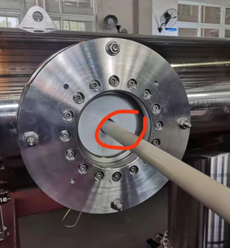
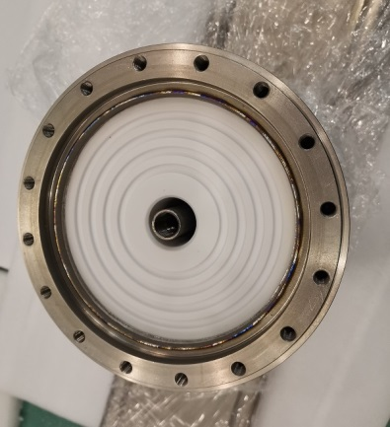
Prototype development of electrostatic separator
Factory test
Reason: 1. The insulation performance decreases due to the high air humidity (70%) of the test site; 2. The ceramic surface is polluted during assembly, resulting in a decline in insulation performance.
Improvement scheme : 1. Carry out cleaning and sandblasting of ceramic parts; 2. carve annular groove on the outer surface of ceramic parts to increase the creepage distance; 2. Electrode probe is coated with insulation bushing and sealed to block the creepage path on the air side of the HV feedthrough.
改进方案

Slide 13
Prototype development of electrostatic separator
Factory test results
Index | indicators | Factory test | Test results
Vacuum leakage rate |  | ≤1x10-10Pa.m3/s | 2×10-13Pa·m3/s
Vacuum pressure | ≤2.0×10⁻¹⁰Torr | ≤4.0×10⁻¹⁰Torr | ≤1.0×10⁻¹⁰Torr
Maximum conditioning voltage |  | ±135KV，稳定工作8小时无故障打火，真空度≤4.0×10⁻¹⁰Torr | －108KV ＋97.6KV

Slide 14
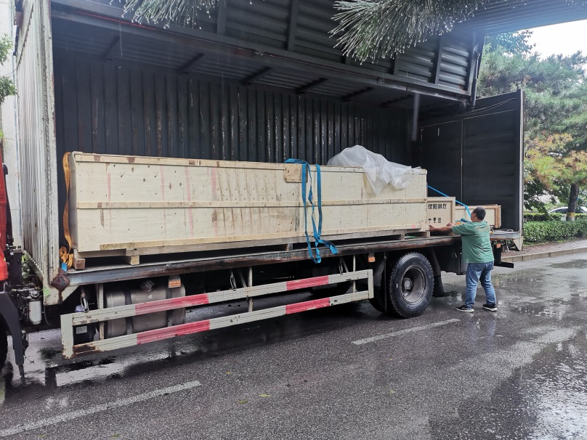
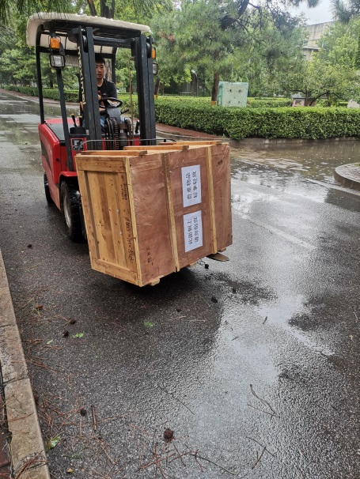
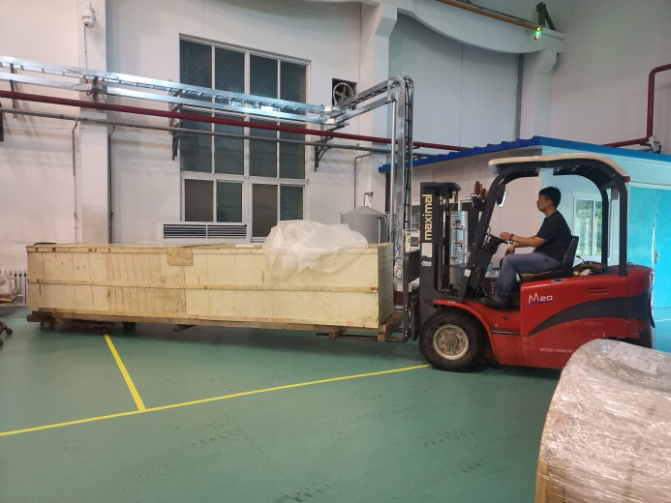
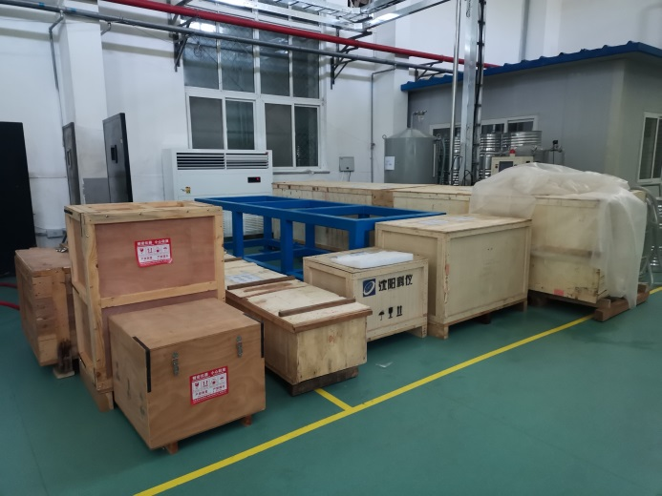
Prototype development of electrostatic separator
The separator arrived at the IHEP at the end of July 2021.

Slide 15
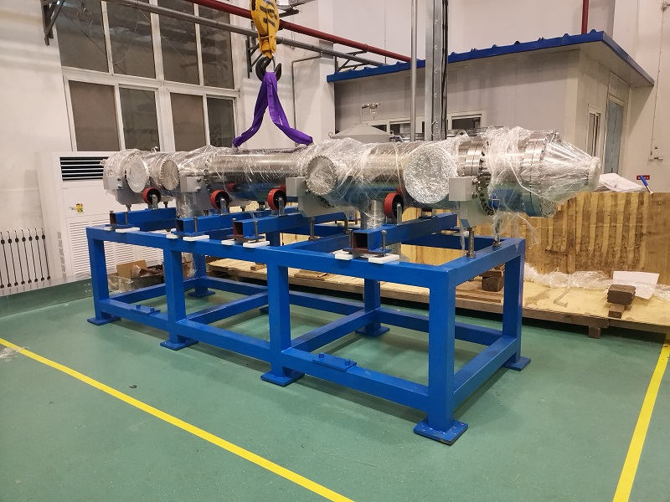
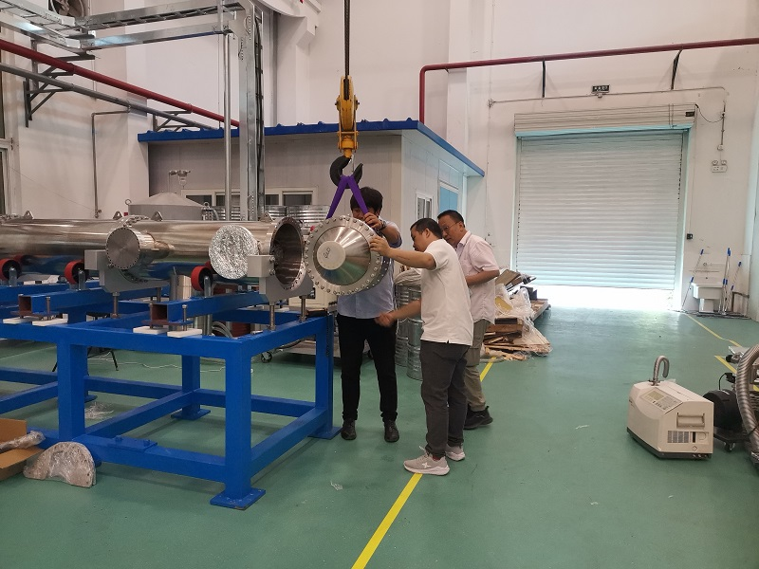
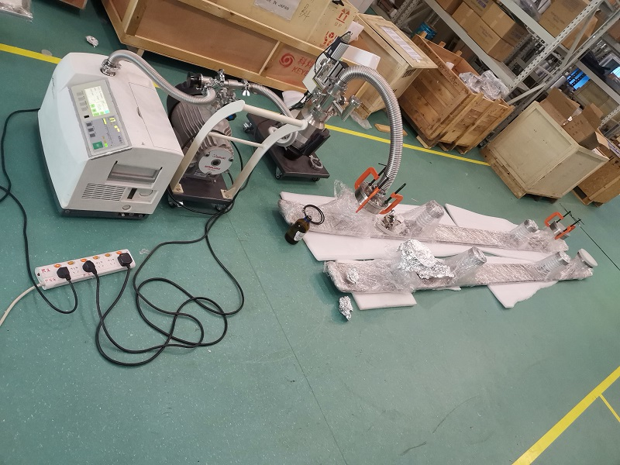
Prototype development of electrostatic separator
Install vacuum chamber and electrode plate vacuum leak detection.

Slide 16
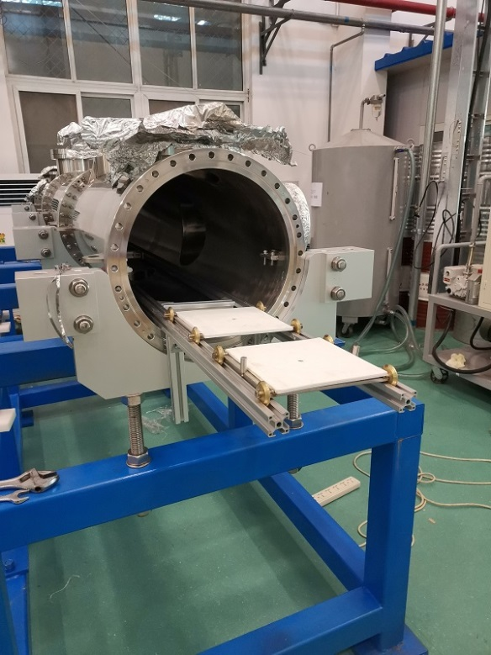
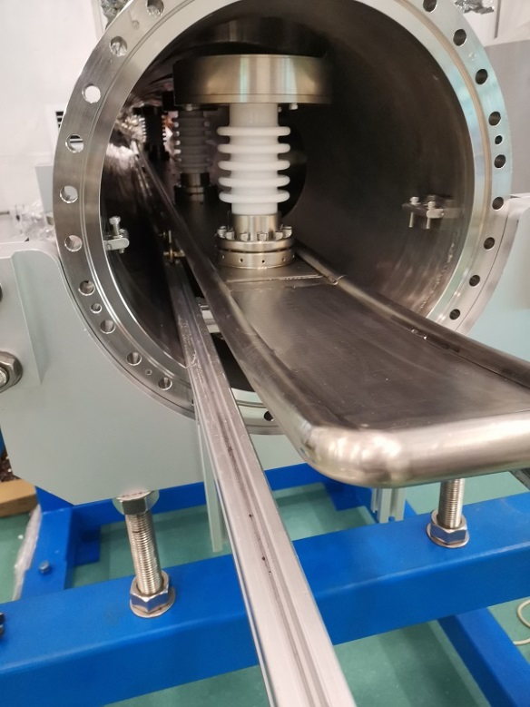
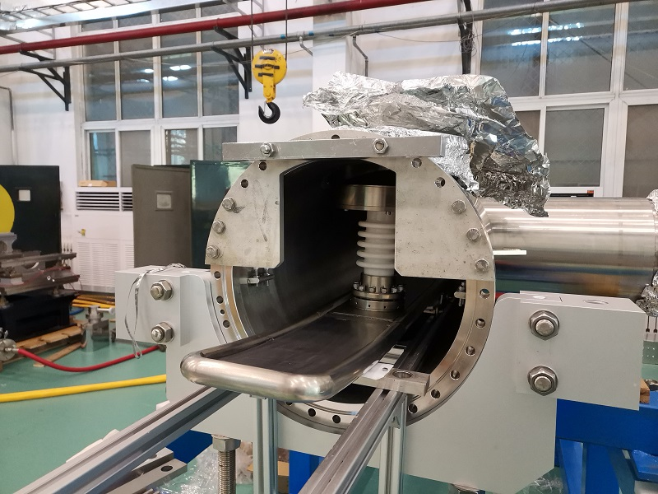
Prototype development of electrostatic separator
Installation of electrostatic separator.

Slide 17
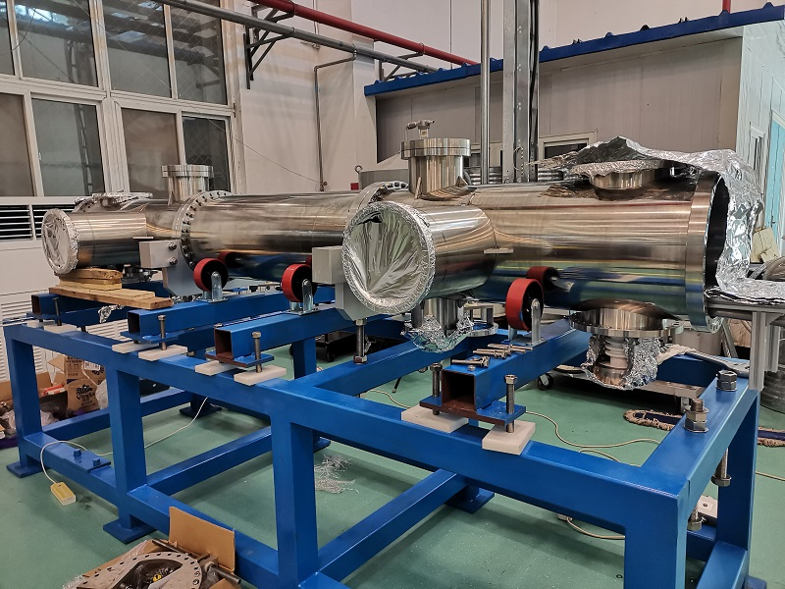
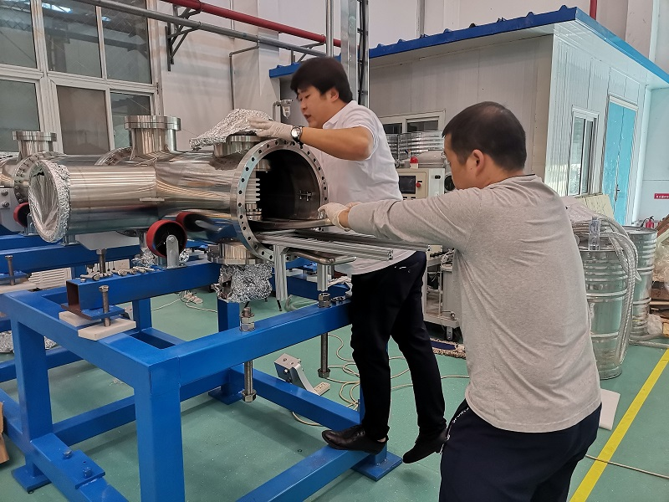
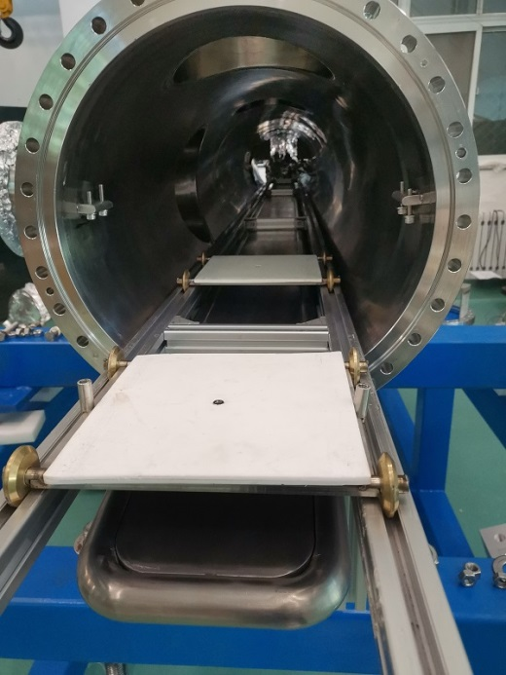
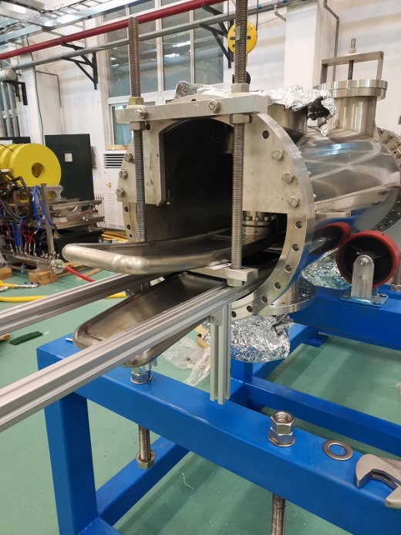
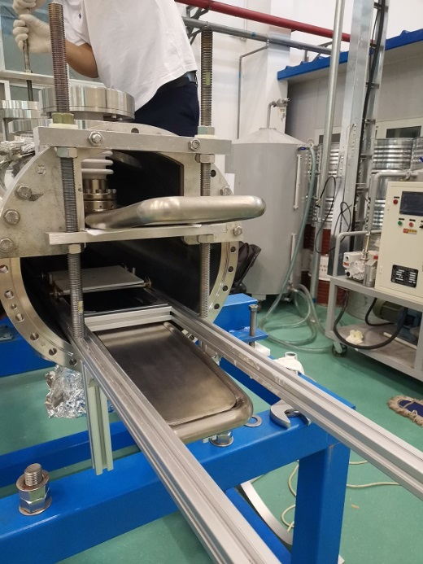
Prototype development of electrostatic separator
Installation of electrostatic separator.

Slide 18
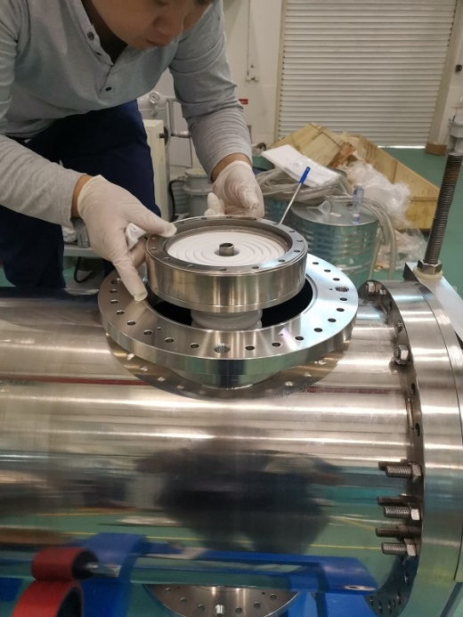
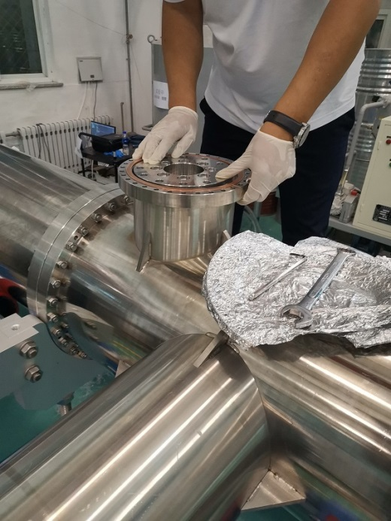
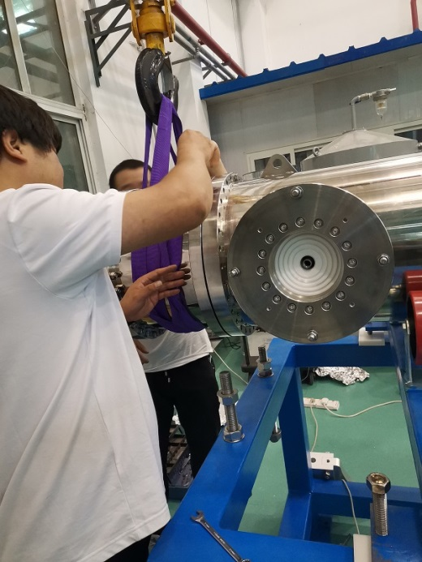
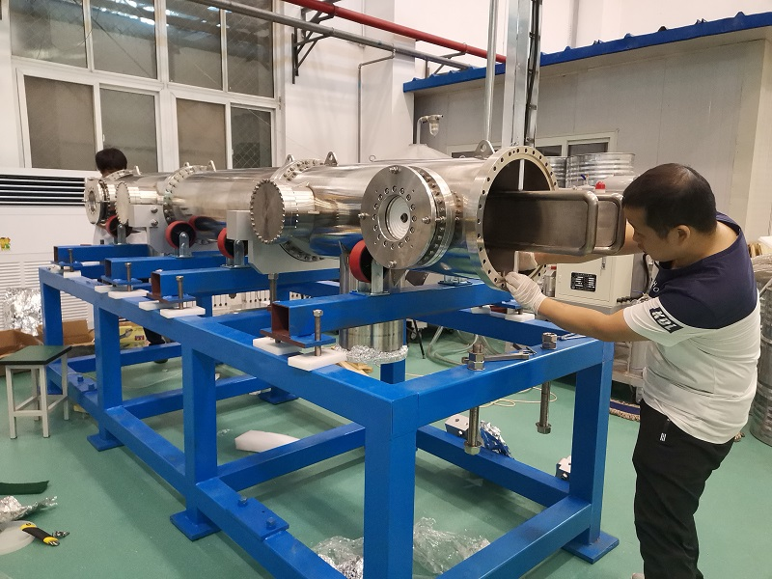
Prototype development of electrostatic separator
Installation of electrostatic separator.

Slide 19
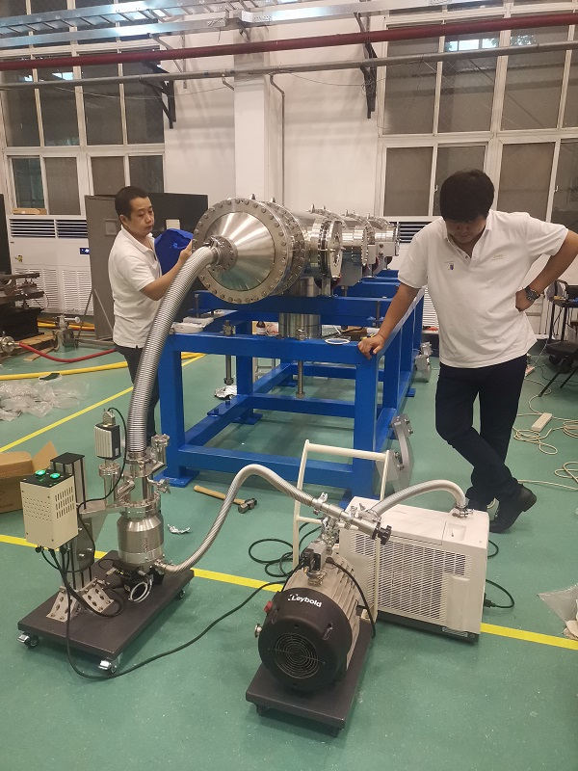
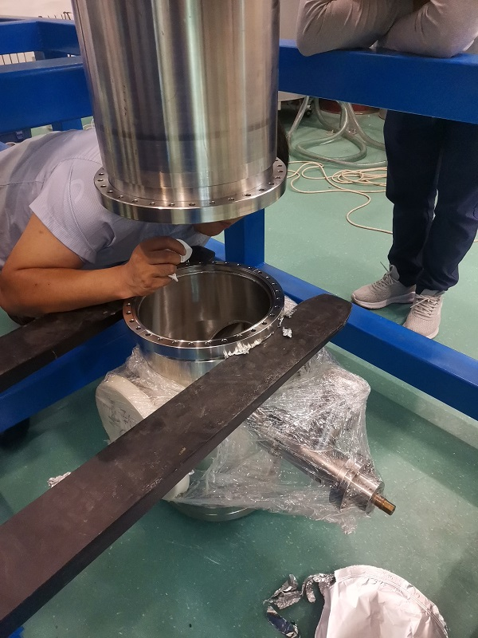
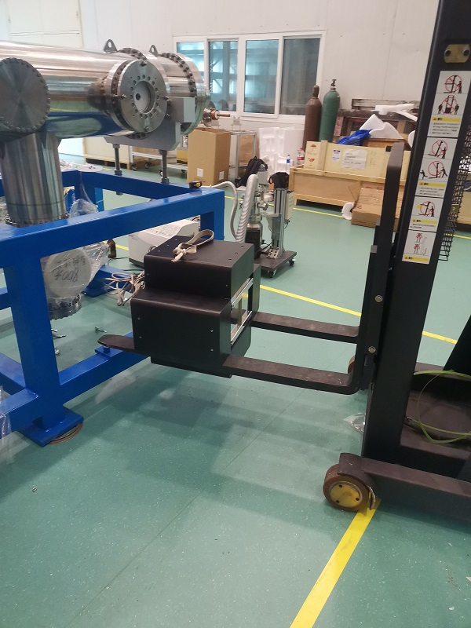
Prototype development of electrostatic separator
Installation of electrostatic separator.

Slide 20
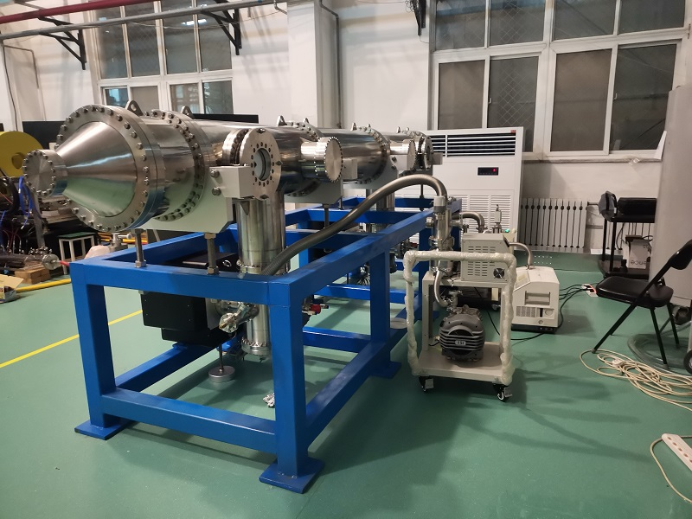
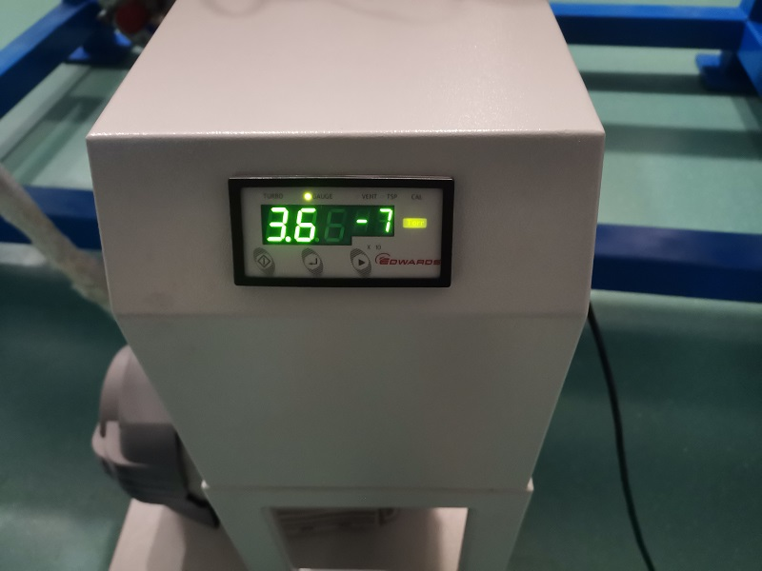
Prototype development of electrostatic separator
Molecular pump unit for crude pumping.

Slide 21
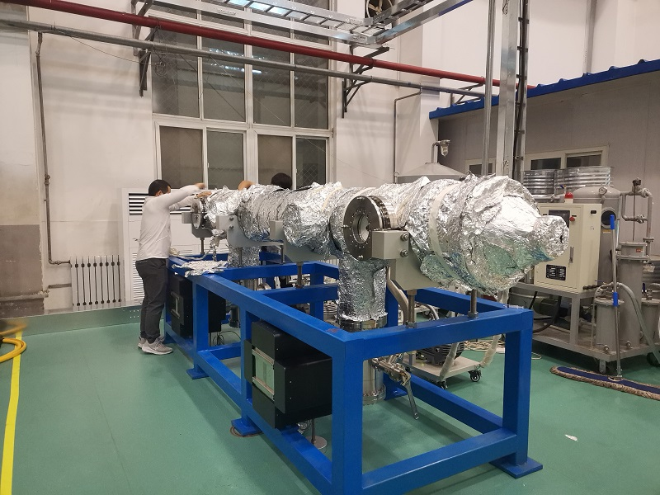
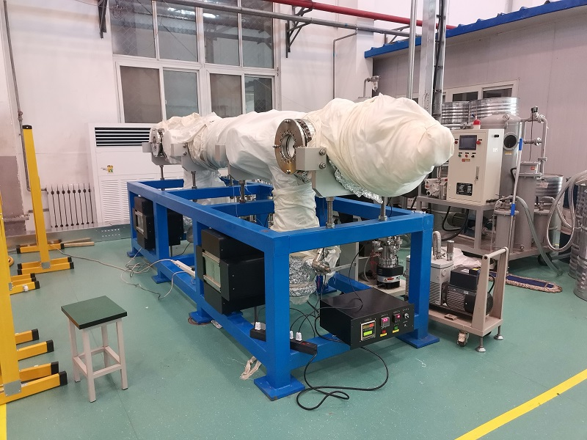
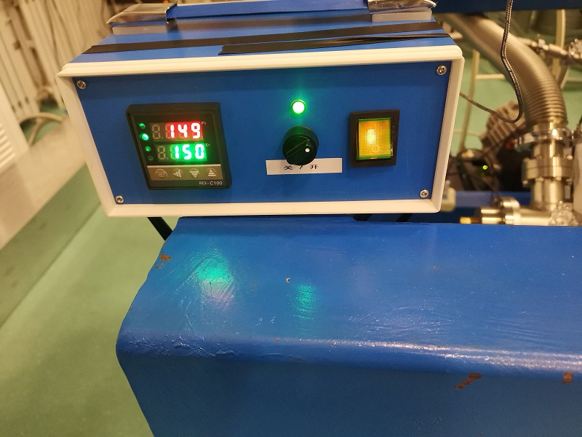
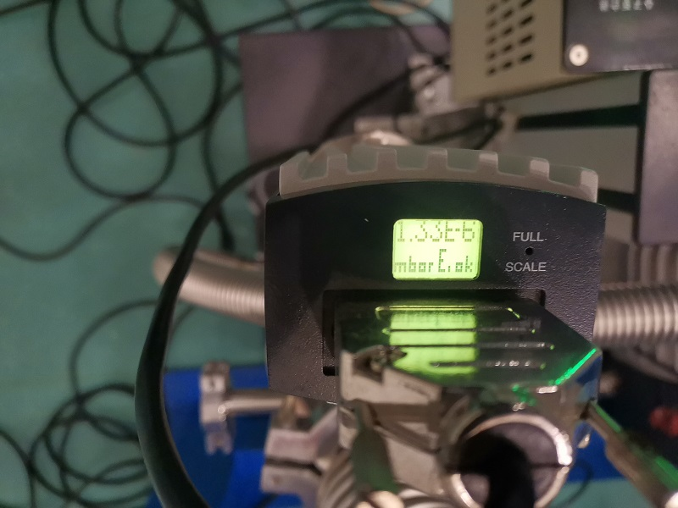
Prototype development of electrostatic separator
Vacuum baking.

Slide 22
Design of dipole magnet
Magnet Name | ESM
Center field [Guass] | 75.5
Magnet Length [m] | 4.4
Current [A/turn] | 10.8
Turns [H×V] | 12×17
Field Clamp Size [H×V, mm] | 830×610
Field Clamp Wall Thickness [mm] | 10
Field Clamp Number | 2
Coil Number | 2
Conductor Size [H×V, mm] | 3×3
Current Density [A/mm^2] | 1.2
Magnet Resistance [Ω] | 7.82
Magnet Voltage [V] | 84.4
Magnet Power [W] | 660
Magnet Inductance [H] | 2.42
Cooling Method | Air
Yoke Weight [Ton] | 11
Coil Weight [Ton] | 0.328
Magnet Weight [Ton] | 11.328
3D Model
Parameters of the magnet

Slide 23
Prototype development of dipole magnet
Completed the physical design of the magnet
Magnet Name | ESM
Center field [Guass] | 75.5
Magnet Length [m] | 4.4
Current [A/turn] | 10.8
Turns [H×V] | 12×17
Field Clamp Size [H×V, mm] | 830×610
Field Clamp Wall Thickness [mm] | 10
Field Clamp Number | 2
Coil Number | 2
Conductor Size [H×V, mm] | 3×3
Current Density [A/mm^2] | 1.2
Magnet Resistance [Ω] | 7.82
Magnet Voltage [V] | 84.4
Magnet Power [W] | 660
Magnet Inductance [H] | 2.42
Cooling Method | Air
Yoke Weight [Ton] | 11
Coil Weight [Ton] | 0.328
Magnet Weight [Ton] | 11.328
3D Model
Parameters of the magnet

Slide 24
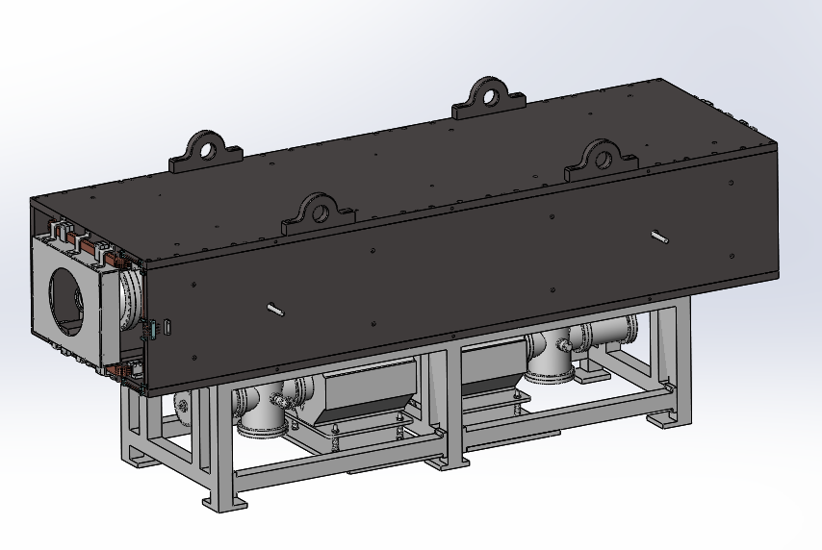
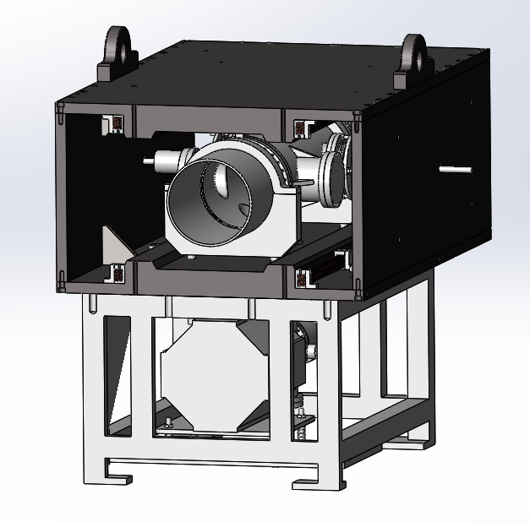
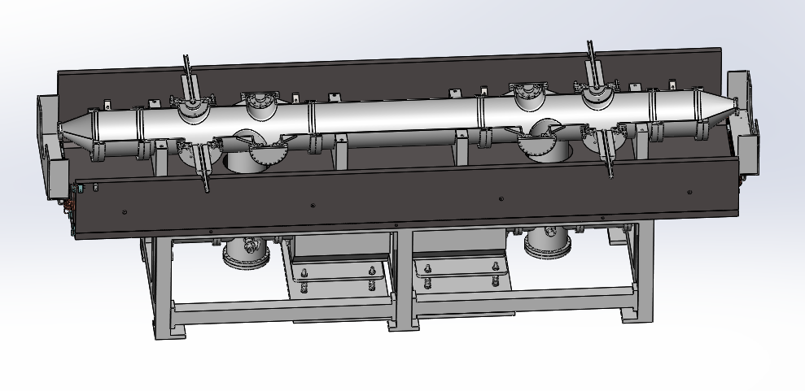
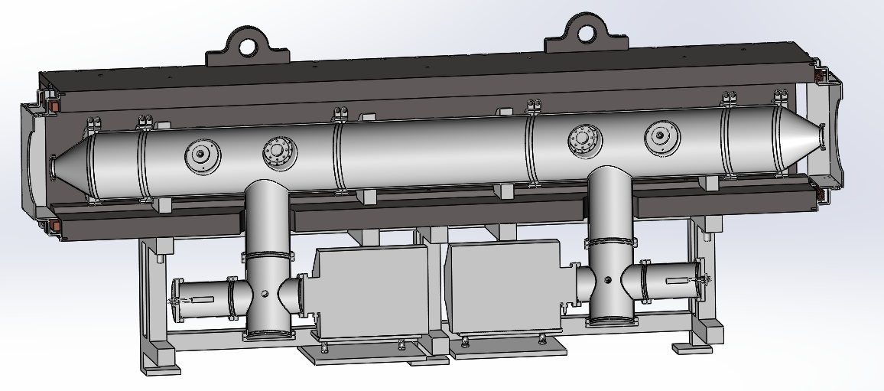
Prototype development of dipole magnet
Completed the mechanical design of the magnet

Slide 25
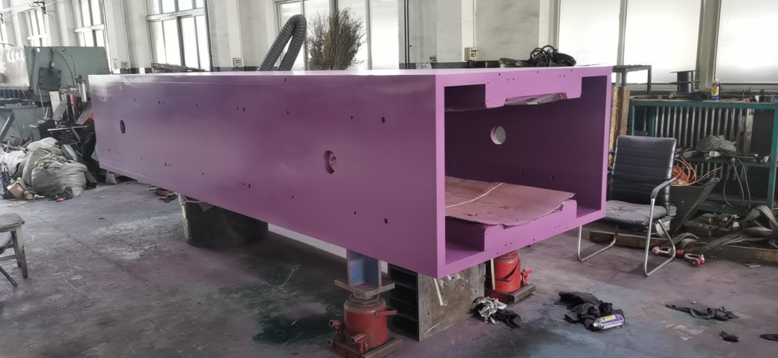
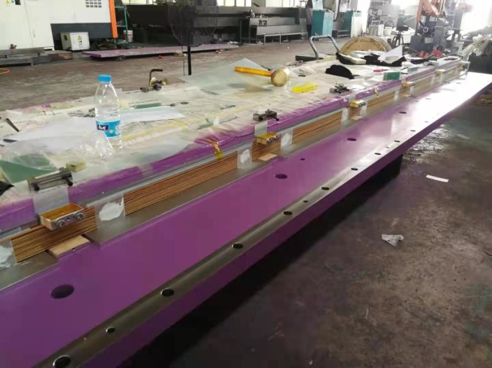
Prototype development of dipole magnet
The magnet is being manufactured in the factory
Since the length of the magnet is 4 meters, the number of turns of the coil is 12×17 ([H×V]), and the size of the wire is 3×3 (H×V, mm), the middle part of the coil is deformed during winding

Slide 26
Prototype development of dipole magnet
The magnet is being manufactured in the factory
Hold the coil with G10 epoxy plate and epoxy glue.

Slide 27
Summary
The overall installation of the separator was completed in factory and the factory test had been done.
The factory test showed that the vacuum reaches the target.
Due to the arc of the high voltage test, two power supplies failed to be used.
After the improvement by Feedthrough, the separator have been delivered to the IHEP for testing.
The overall installation of the separator was completed in IHEP.
The separator is vacuum baking.
Then the high voltage test will been done.
The magnet is being manufactured in the factory. It is planned to complete production in next month.

Slide 28
Thank You!

