Slide 1
Garfield simulation with different gas mixtures
Siman Liu, Linghui Wu, Guang Zhao, Shuiting Xin , Weimin Song
Cluster Counting Meeting
Sept 16th, 2021

Slide 2
Outline
Motivation
Ionization
Drift velocity
Longitudinal diffusion
Summary

Slide 3
Motivation
The cluster counting method has great PID capability in the future electron-positron collider experiment
The choice of the gas mixture is essential. To improve reliability of the cluster counting, some characteristics would be expected
Low cluster density to achieve high counting efficiency
Low drift velocity helps to identify clusters in time
Small longitudinal diffusion to avoid overcounting on the clusters with more than one electrons
A study with Garfield++ is performed to understand the property of different gas mixtures
He + iC₄H₁₀ (used in KLOE and Babar)
He + C₃H₈ (used in BESIII and CLEOIII/CLEO-c)
He + C₂H₆ (used in Belle/Belle-II)

Slide 4
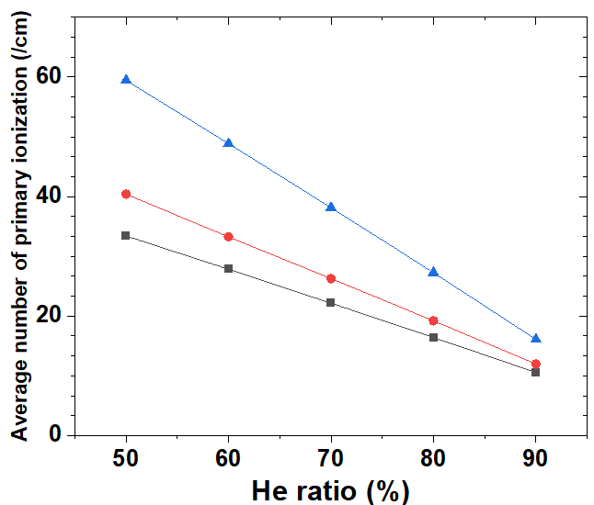
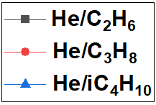
Cluster density
Incident particle: 10 GeV/c pion
Gas pressure: 1 atm
Ncl (/cm)
Cluster density : (at the same ratio of He)
iC4H10 > C3H8 > C2H6
He ratio$↑$ Cluster density$↓$
Ratio of He (%)

Slide 5
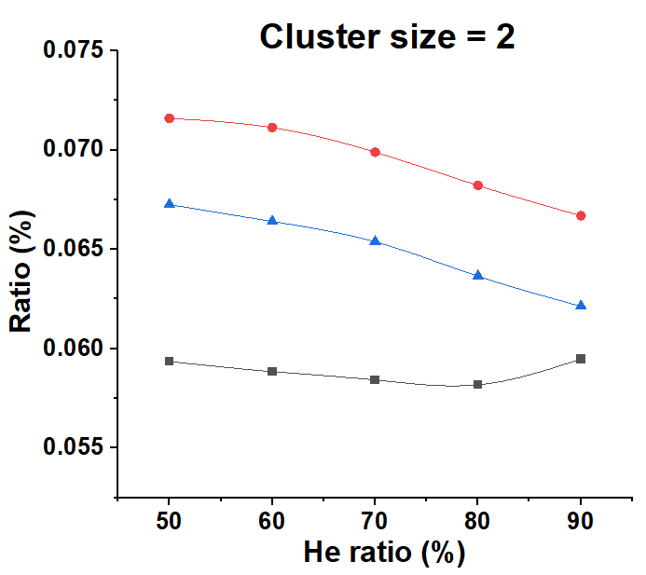
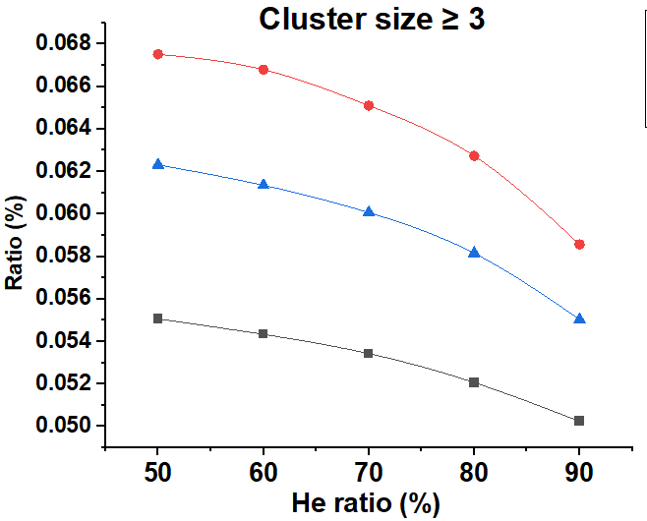
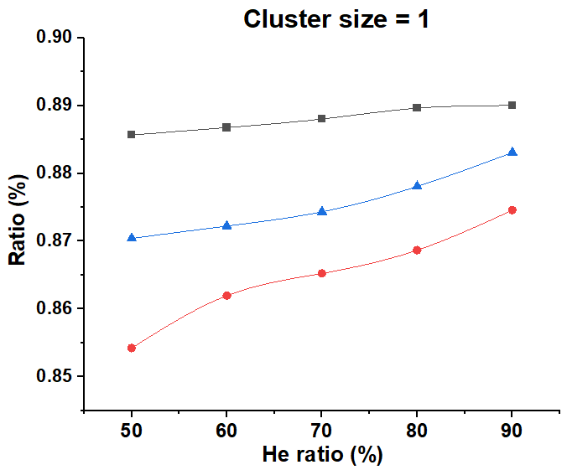
Cluster size
Cluster size = 1
Cluster size = 2
Cluster size ≥ 3
Most clusters have only one electron (85~90%)
A few percent of clusters have more than two electrons

Slide 6
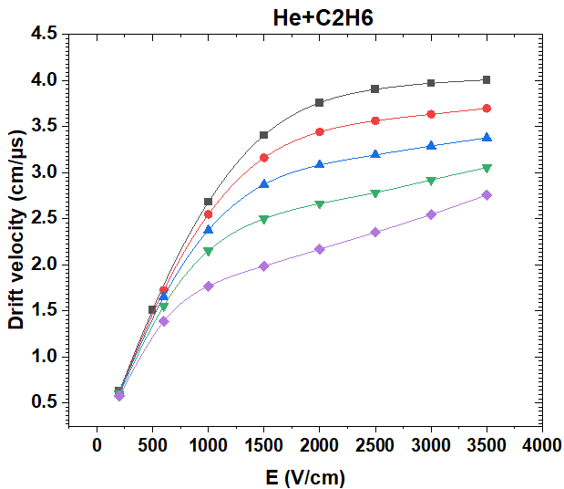
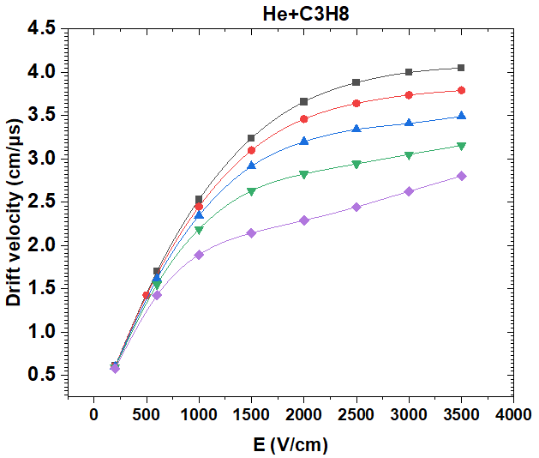
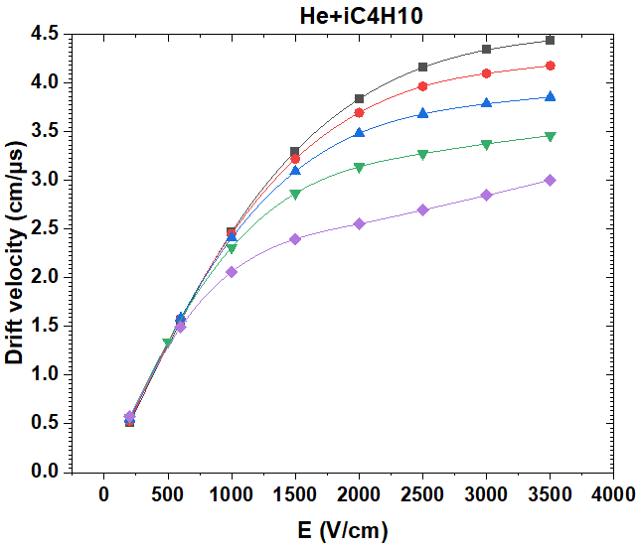
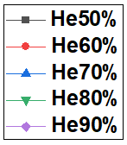
Drift velocity vs E
Gas pressure: 1 atm
Increasing ratio of He helps to reduce the drift velocity

Slide 7
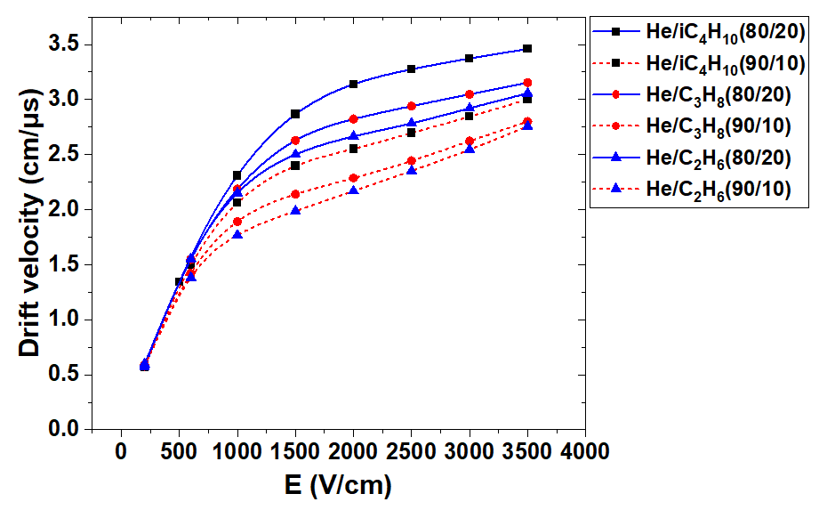
Drift velocity vs E
With the same ratio of He, He+C2H6 has the lower drift velocity

Slide 8
Simulation of drift time to distance relation and diffusion
Configurations:
Electron
Cell size: 2cm × 2cm
High voltage on sense wire: 2500V
Magnetic field : 3T
Gas pressure: 1 atm
Drift distance

Slide 9
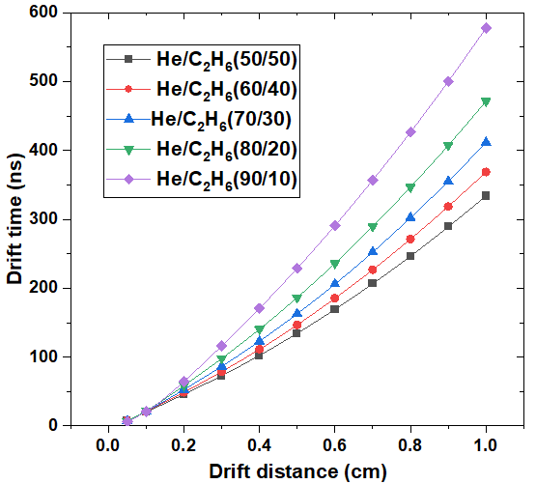
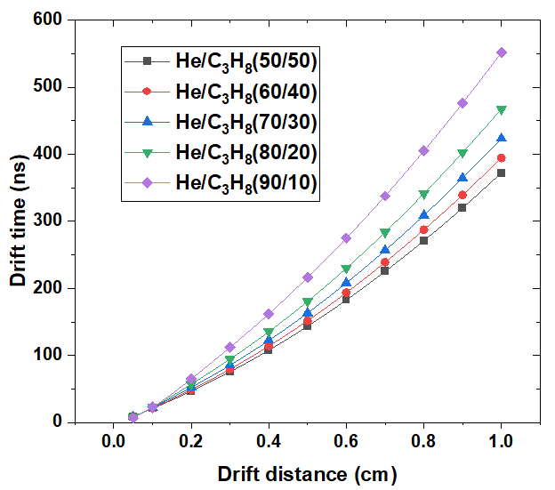
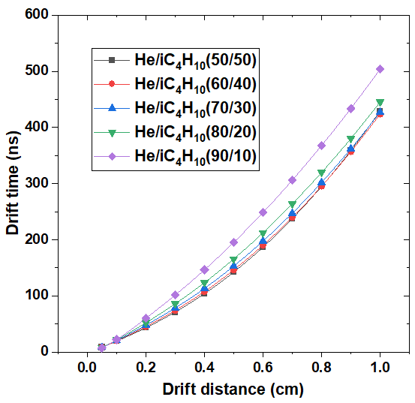
Drift time vs drift distance
Increasing ratio of He helps to reduce the drift velocity

Slide 10
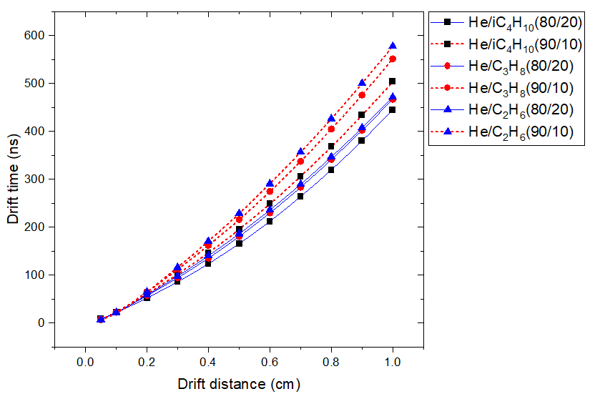
Drift time
With the same ratio of He, He+C2H6 has the longer drift time

Slide 11
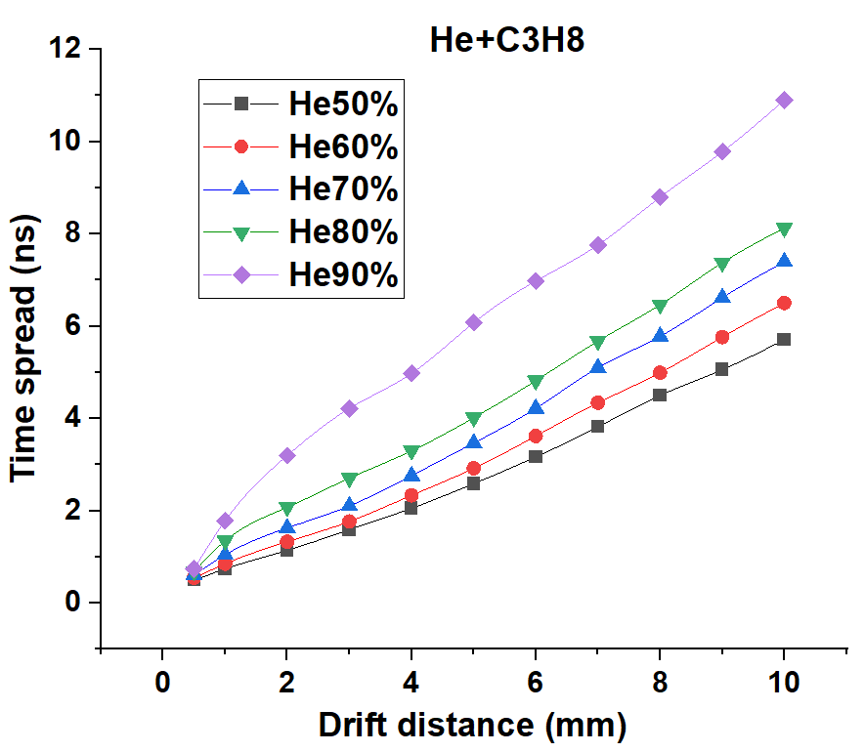
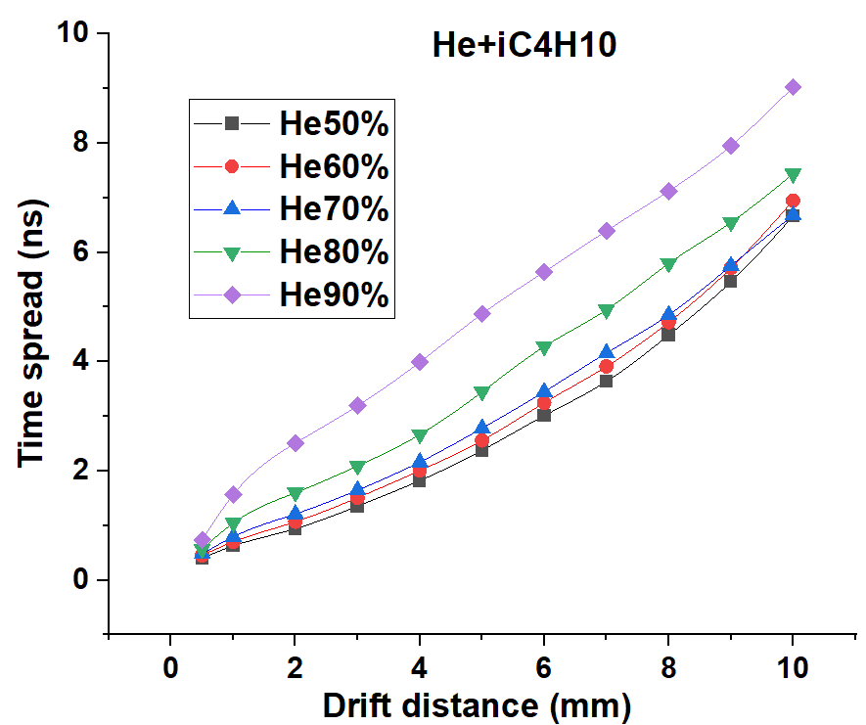
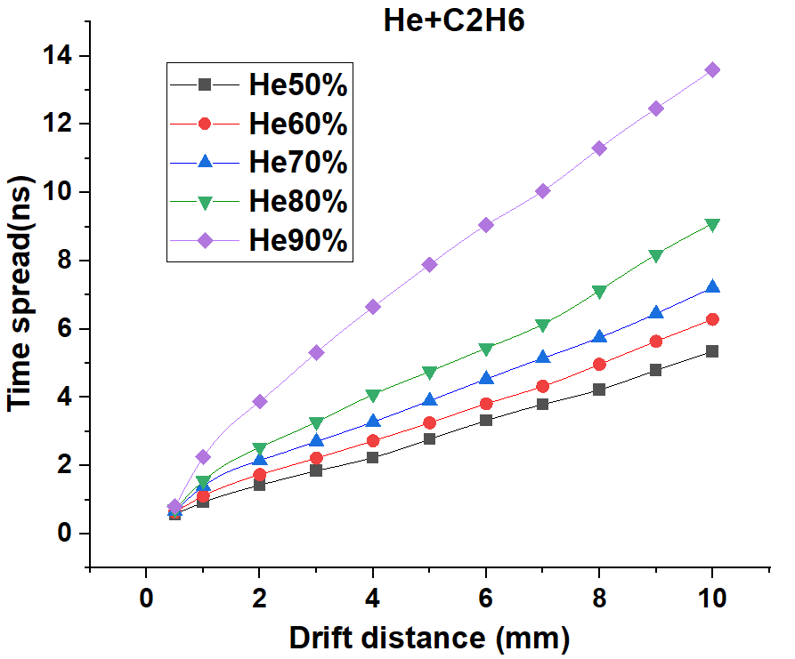
Longitudinal diffusion vs drift distance
The higher ratio of He, the larger diffusion

Slide 12
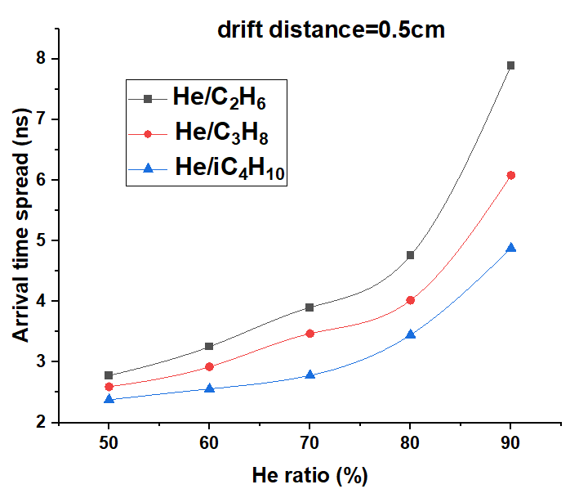
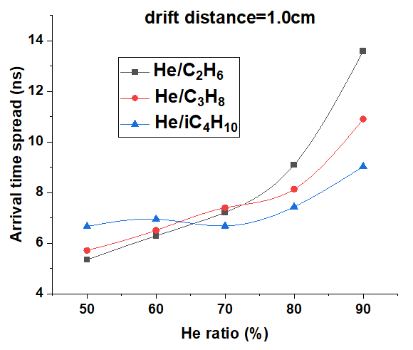
Longitudinal diffusion
With the same ratio of He, diffusion of gas with iC4H10 is smaller in most cases

Slide 13
Summary
Comparison of ionization, drift velocity and diffusion between different gas mixtures performed
Increasing the ratio of He
helps to reduce the cluster density and drift velocity
but causes the diffusion to be more serious
With the same ratio of He
diffusion of gas with iC4H10 is smaller in most cases
the gas with C2H6 has lower drift velocity

Slide 14
Thanks!

Slide 15
Back up

Slide 16
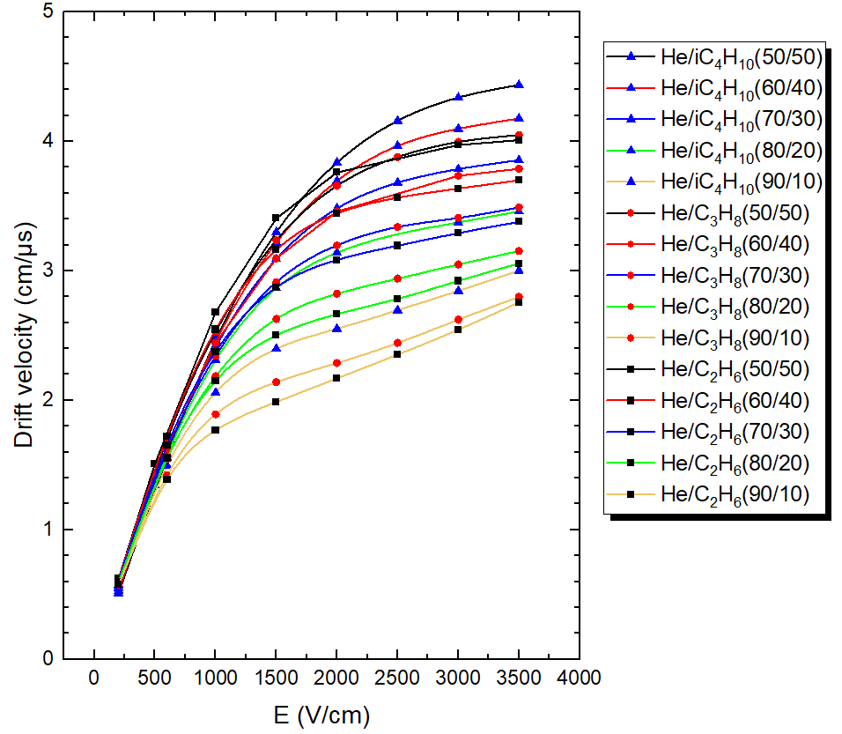
Drift velocity

Slide 17
Drift velocity
E = 2000 V/cm
gas composition | Drift velocity (cm/μs)
He/IC4H10 (50/50) | 3.835
He/IC4H10 (60/40) | 3.693
He/IC4H10 (70/30) | 3.482
He/IC4H10 (80/20) | 3.139
He/IC4H10 (90/10) | 2.552
He/C3H8 (50/50) | 3.657
He/C3H8 (60/40) | 3.457
He/C3H8 (70/30) | 3.196
He/C3H8 (80/20) | 2.823
He/C3H8 (90/10) | 2.287
He/C2H6 (50/50) | 3.760
He/C2H6 (60/40) | 3.442
He/C2H6 (70/30) | 3.084
He/C2H6 (80/20) | 2.665
He/C2H6 (90/10) | 2.169
E = 3500 V/cm
gas composition | Drift velocity (cm/μs)
He/IC4H10 (50/50) | 4.435
He/IC4H10 (60/40) | 4.176
He/IC4H10 (70/30) | 3.854
He/IC4H10 (80/20) | 3.460
He/IC4H10 (90/10) | 3.002
He/C3H8 (50/50) | 4.048
He/C3H8 (60/40) | 3.788
He/C3H8 (70/30) | 3.490
He/C3H8 (80/20) | 3.153
He/C3H8 (90/10) | 2.799
He/C2H6 (50/50) | 4.009
He/C2H6 (60/40) | 3.699
He/C2H6 (70/30) | 3.378
He/C2H6 (80/20) | 3.057
He/C2H6 (90/10) | 2.757

Slide 18
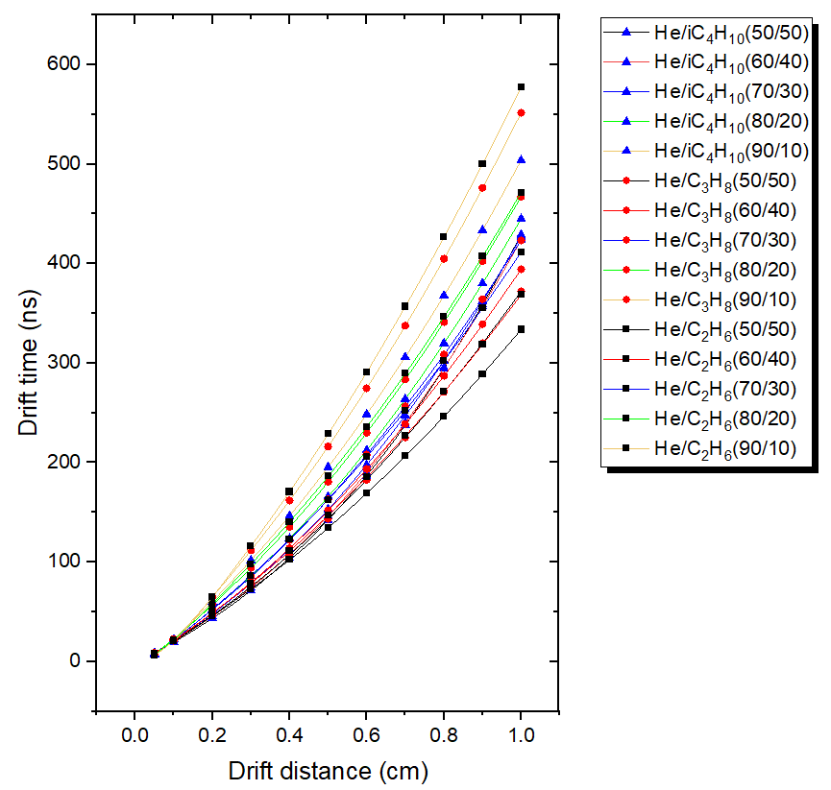
Drift time

Slide 19
Drift time
Drift distance = 0.5 cm
gas composition | Drift time (ns)
He/IC4H10 (50/50) | 142.5
He/IC4H10 (60/40) | 146.3
He/IC4H10 (70/30) | 153.1
He/IC4H10 (80/20) | 165.8
He/IC4H10 (90/10) | 195.4
He/C3H8 (50/50) | 143.4
He/C3H8 (60/40) | 151.8
He/C3H8 (70/30) | 163.1
He/C3H8 (80/20) | 180.6
He/C3H8 (90/10) | 216.1
He/C2H6 (50/50) | 134.4
He/C2H6 (60/40) | 146.6
He/C2H6 (70/30) | 162.8
He/C2H6 (80/20) | 186.3
He/C2H6 (90/10) | 228.8
Drift distance = 1.0 cm
gas composition | Drift time (ns)
He/IC4H10 (50/50) | 429.1
He/IC4H10 (60/40) | 423.9
He/IC4H10 (70/30) | 427
He/IC4H10 (80/20) | 445.2
He/IC4H10 (90/10) | 503.8
He/C3H8 (50/50) | 372.1
He/C3H8 (60/40) | 394.3
He/C3H8 (70/30) | 423.3
He/C3H8 (80/20) | 467.2
He/C3H8 (90/10) | 551.5
He/C2H6 (50/50) | 333.8
He/C2H6 (60/40) | 368.6
He/C2H6 (70/30) | 411.5
He/C2H6 (80/20) | 471.5
He/C2H6 (90/10) | 577.7

