Slide 1
Quick Check from Full Simulation
FU Chengdong
2021/08/27

Slide 2
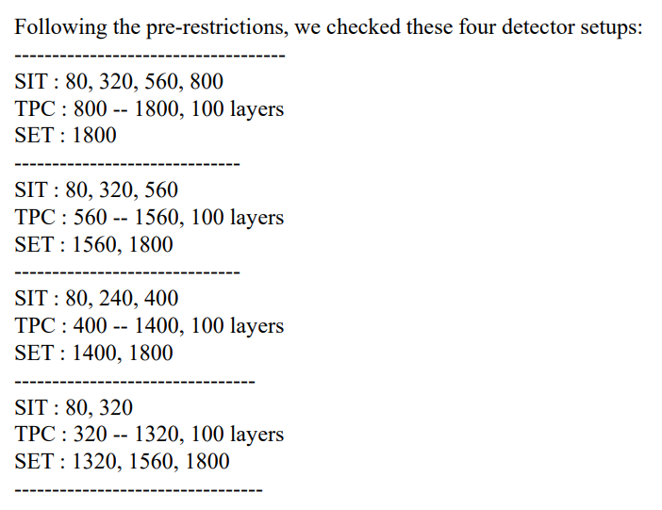
Sets
from LIANG Hao
Sets in full simulation
set1:
SIT: 80,320,560,770
DC: 800-1800
SET(SOT): 1815
set2:
SIT: 80, 320,550
DC: 560-1560
SET(SOT): 1575

Slide 3
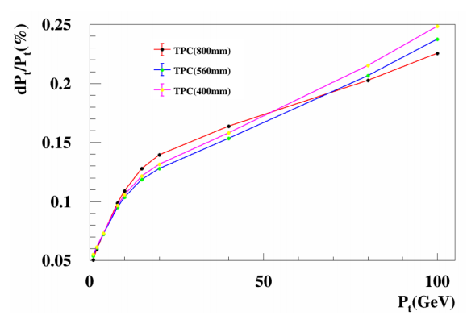
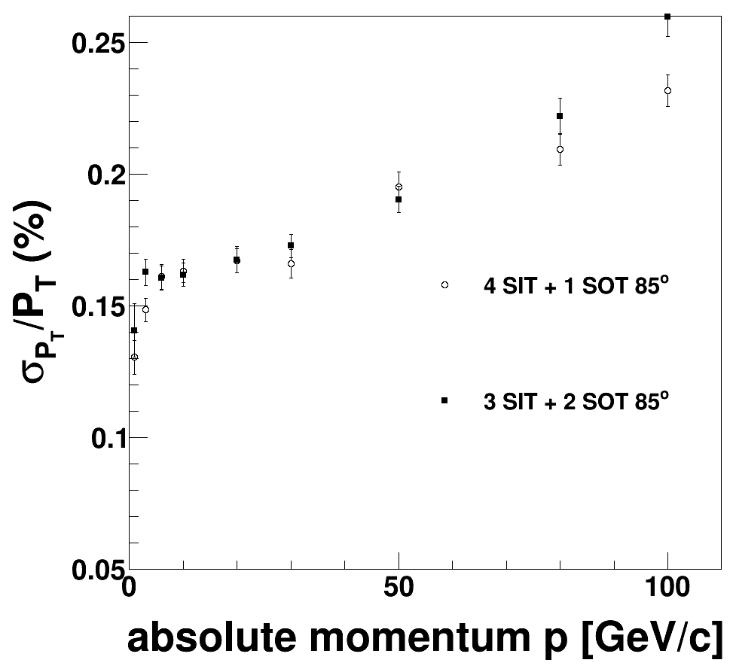
Results from full simulation
Silicon tracker hits only
TODO:
reduce statistical errors
add DC hits, DC hits will affect obviously at low momentum
from LIANG Hao

Slide 4
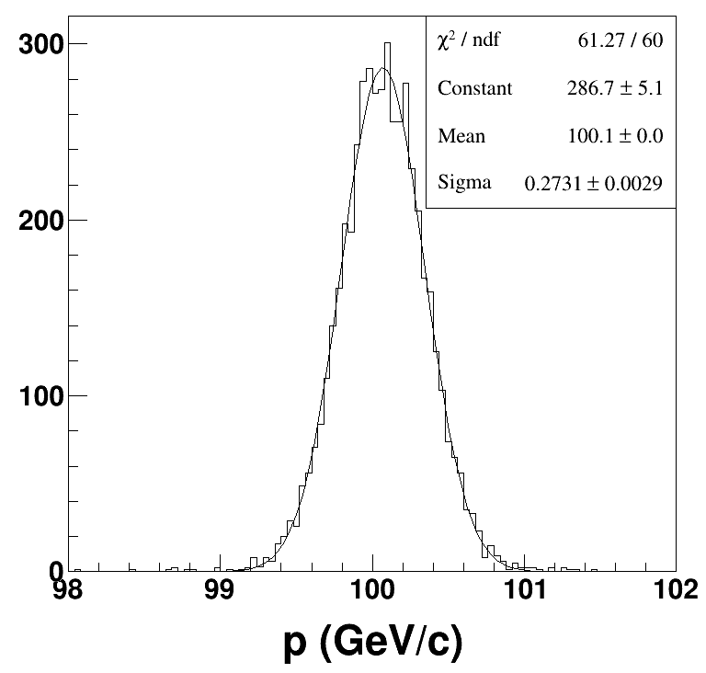
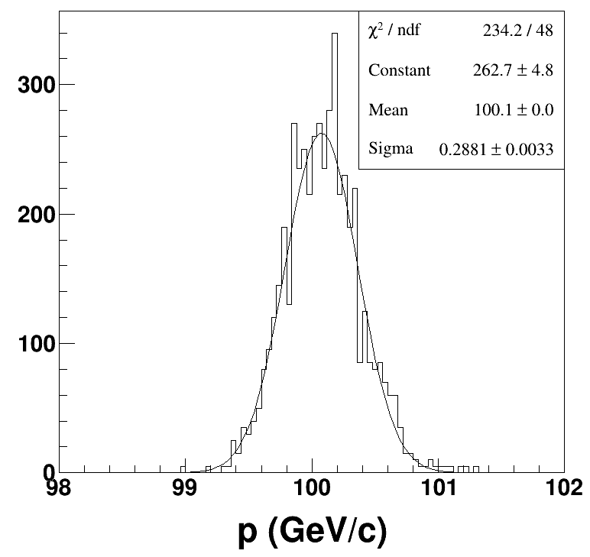
560 VS 400
Sets
80, 320, 550 + 560-1560 + 1575, 1815
80, 240, 390 + 400-1400 + 1415, 1815
560 400

