Slide 1
Fast Simulation for CEPC Tracker Optimization
Yun Youhui，Wei Zhiling，Li Zepeng
Fu Chengdong, Wu Linghui
Sep.9th ,2021

Slide 2
Baseline Design
There are 6 VXDs, 4 SITs,1 DC and 1 SET,their parameters are as follows.
Fast simulation performed using Chengdong’s software tool.

Slide 3
Scanning of number of DC layers
We change DC layers from 50 to 150 and leave the total n of DC and other parameters unchanged. The changes are as follows.
We also try to delete DC.
Both results with multiple-scattering (MSON) and without multiple-scattering (MSOFF) are presented

Slide 4
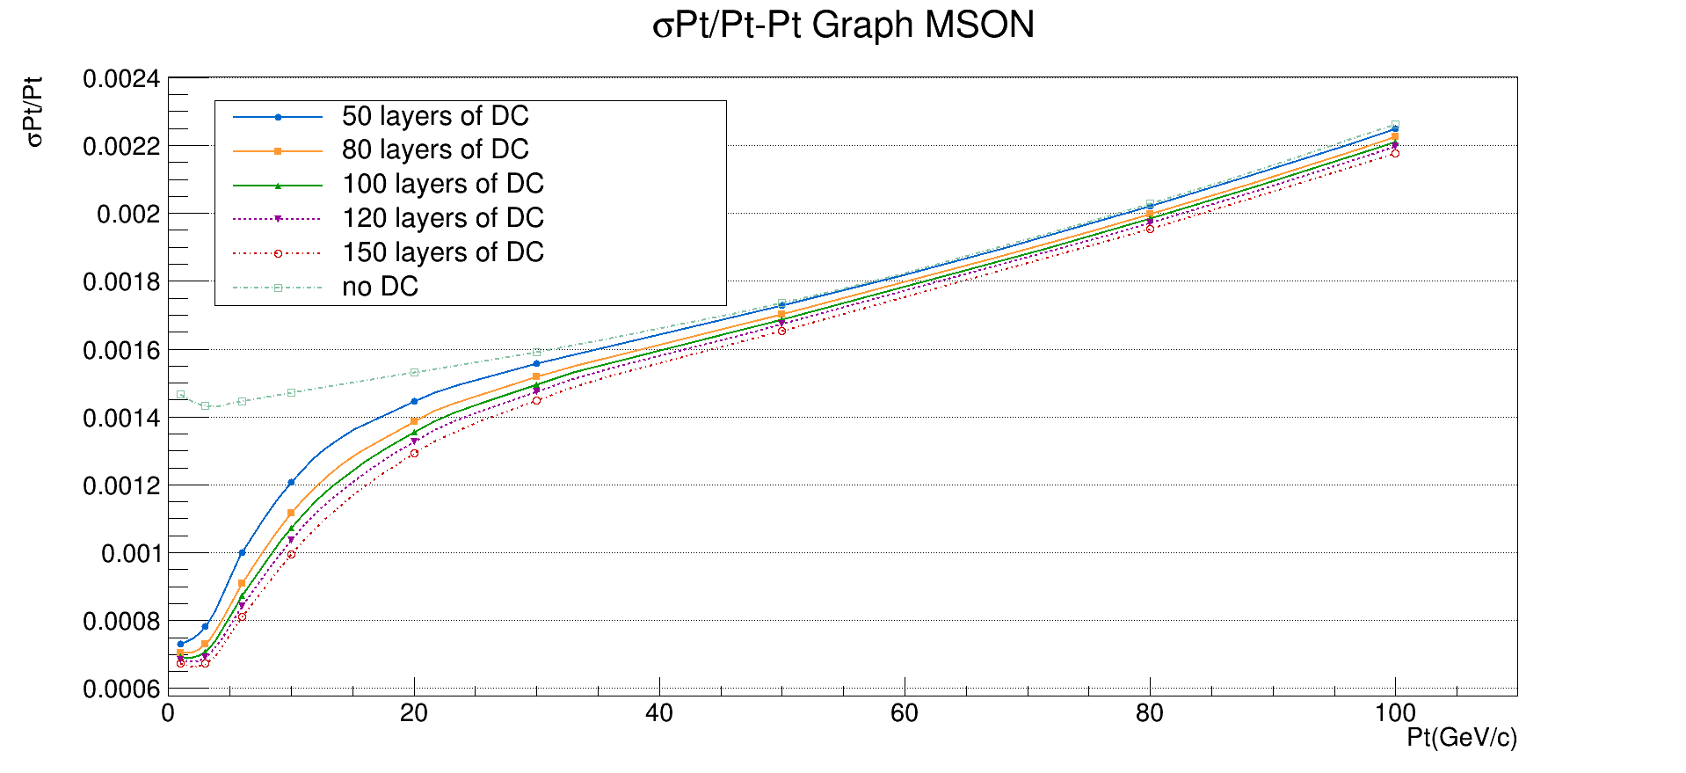
$σ$Pt/Pt vs Pt (MSON)

Slide 5
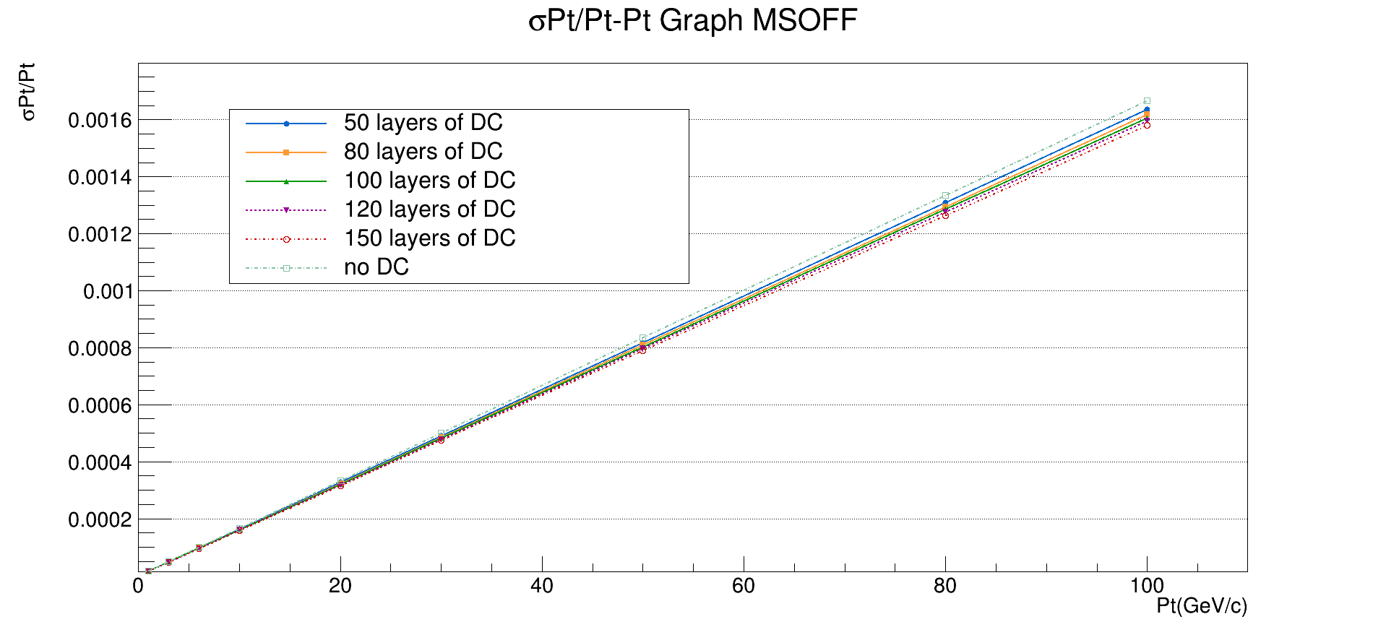
$σ$Pt/Pt vs Pt (MSOFF)

Slide 6
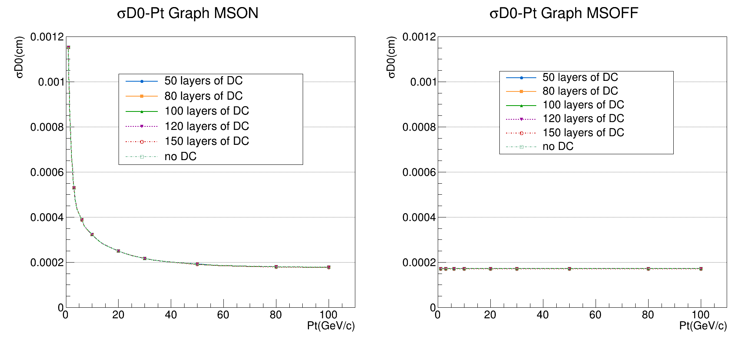
$σD_{0}$ vs Pt (MSON)
$σD_{0}$ vs Pt (MSOFF)

Slide 7
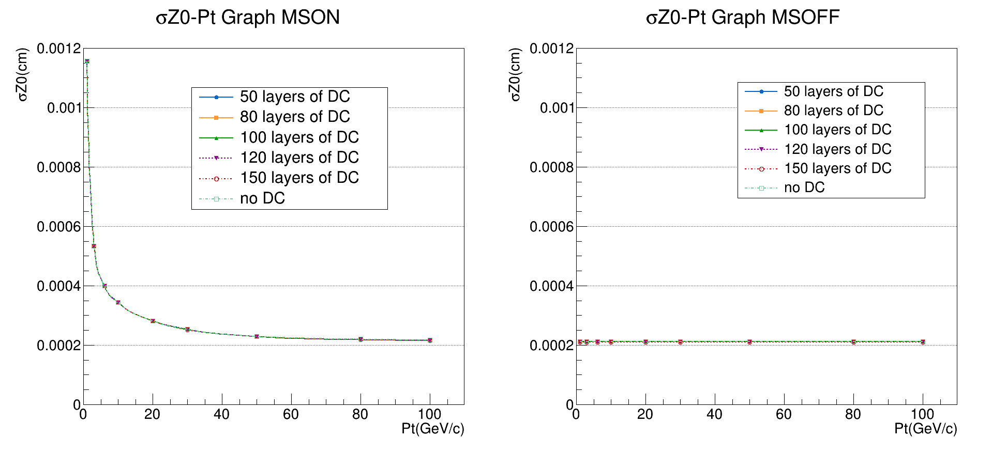
$σZ_{0}$ vs Pt (MSON)
$σZ_{0}$ vs Pt (MSON)

Slide 8
Study on the position of silicon tracker
4 SITs +1 SET $→$ 3 SITs + 2 SETs
DC is moved inward 100 mm.

Slide 9
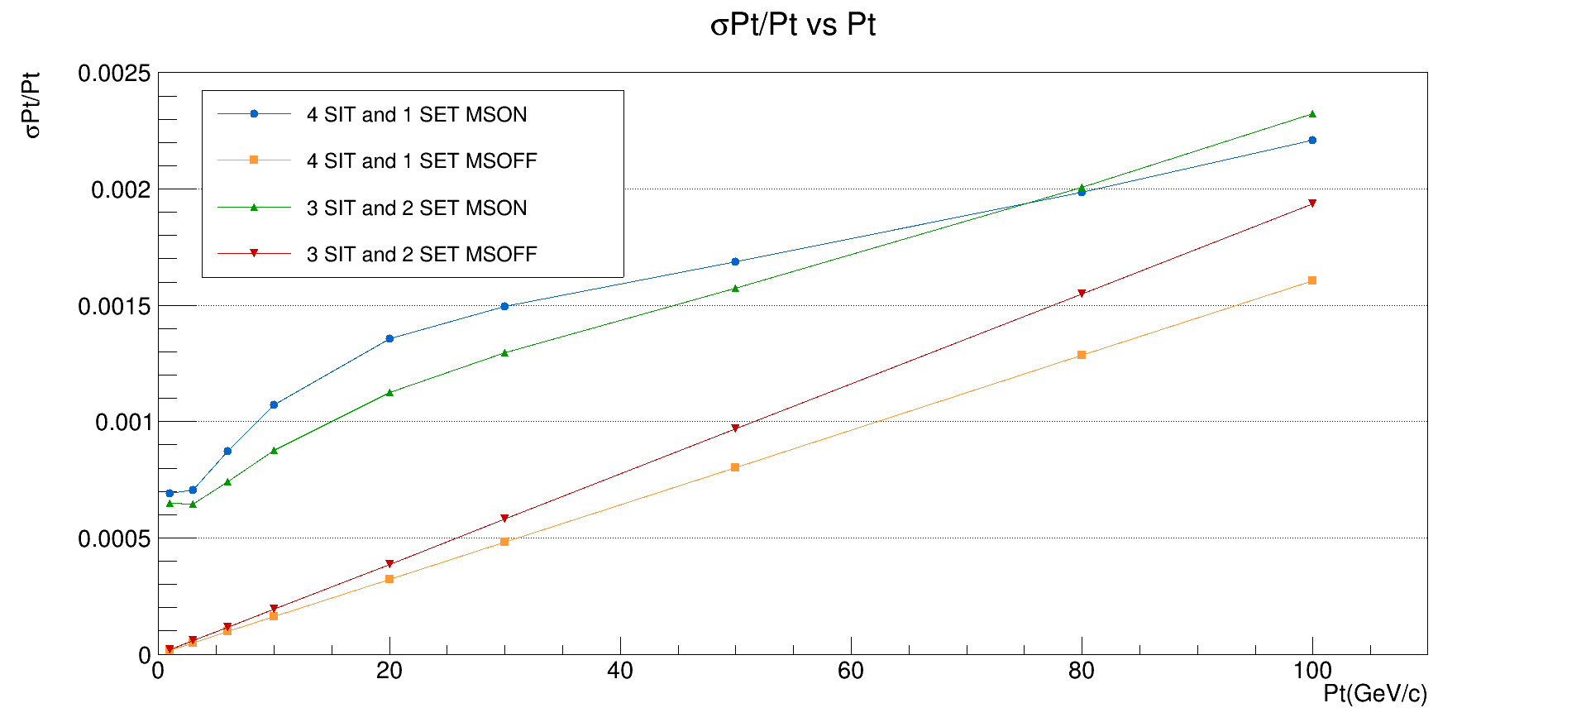
图标太小，移到空白处放大一些

Slide 10
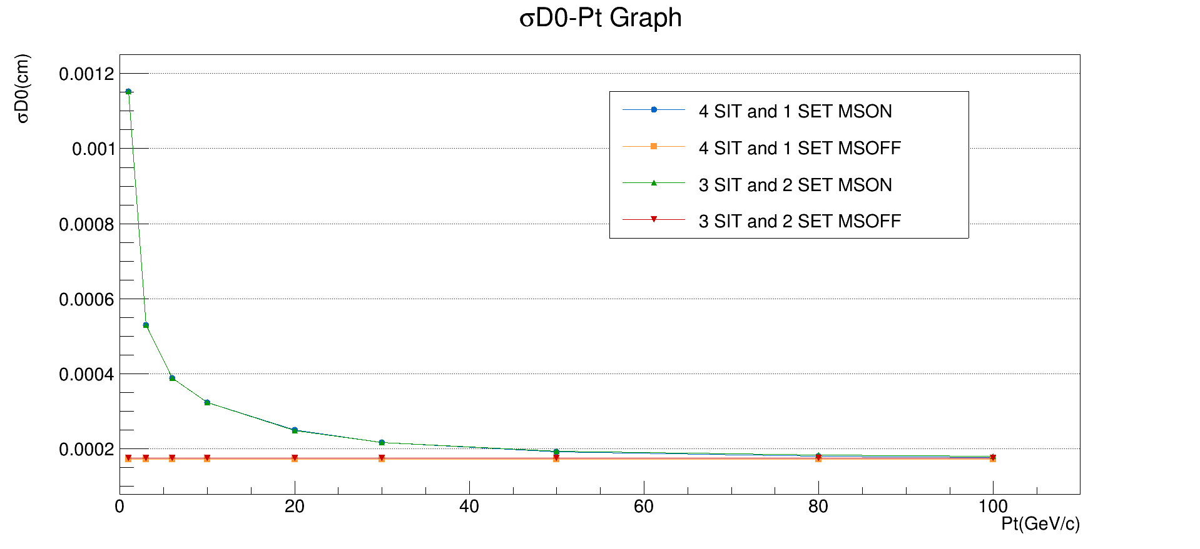
$σD_{0}$ vs Pt

Slide 11
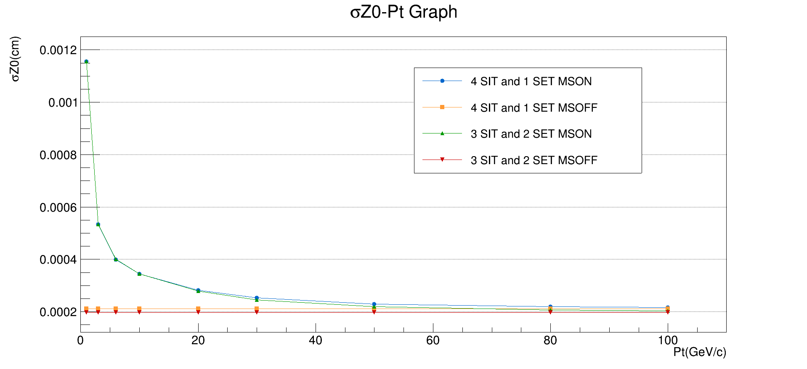
$σZ_{0}$ vs Pt

Slide 12
Summary
increasing the number of DC layers:
could improve Pt resolution(~15% for 5<Pt<20GeV/c,~5% in high Pt range)
has little impact on D0 and Z0 resolution
Move one layer of SIT to outside of DC:
Pt resolution improved below 75 GeV/c but worse above 75 GeV/c
has little impact on D0 resolution
Z0 resolution slightly improved

Slide 13
Thanks!

