Slide 1
Physics and White Papers
Manqi Ruan, Yaquan Fang
on behalf of CEPC Physics working group
Seventh Meeting of the CEPC-SppC International Advisory Committee
Nov 1-3, 5, 2021

Slide 2
Outline
Reminder: Status at CDR & IAC Recommendations
Performance progress:
  Requirements studies
  Algorithm development & quantification at full-sim
Physics:
  Higgs progresses
  Physics at 360 GeV Run
  EW
  Flavor Physics
  QCD
  BSM
Status and Plans of the white paper(s)

Slide 3
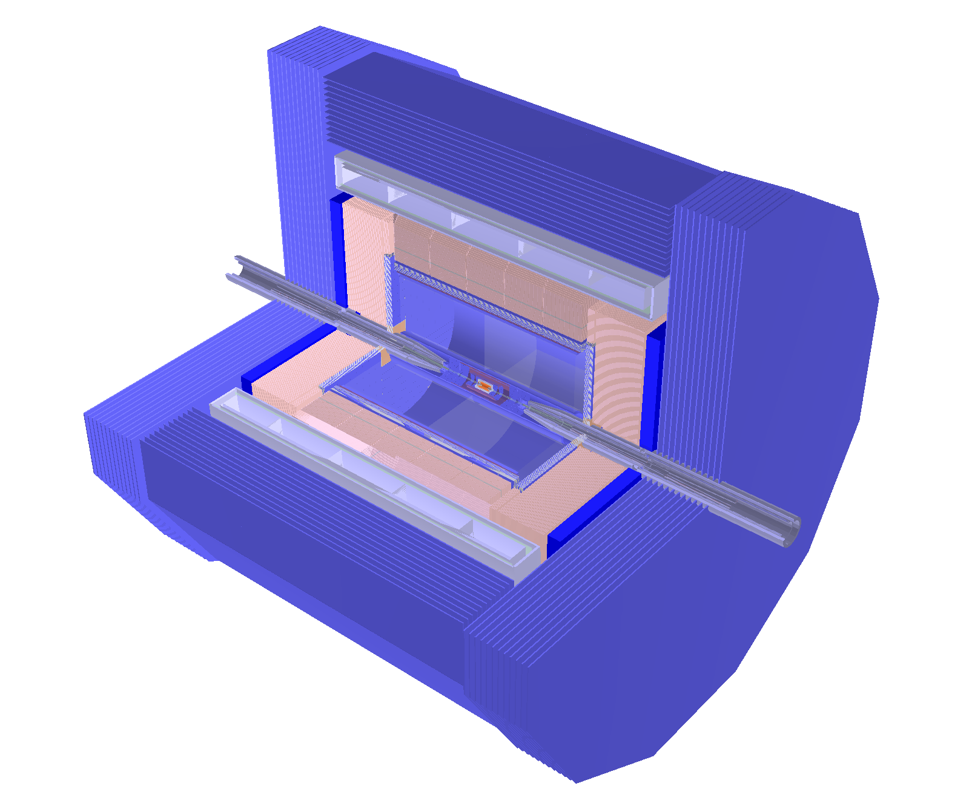
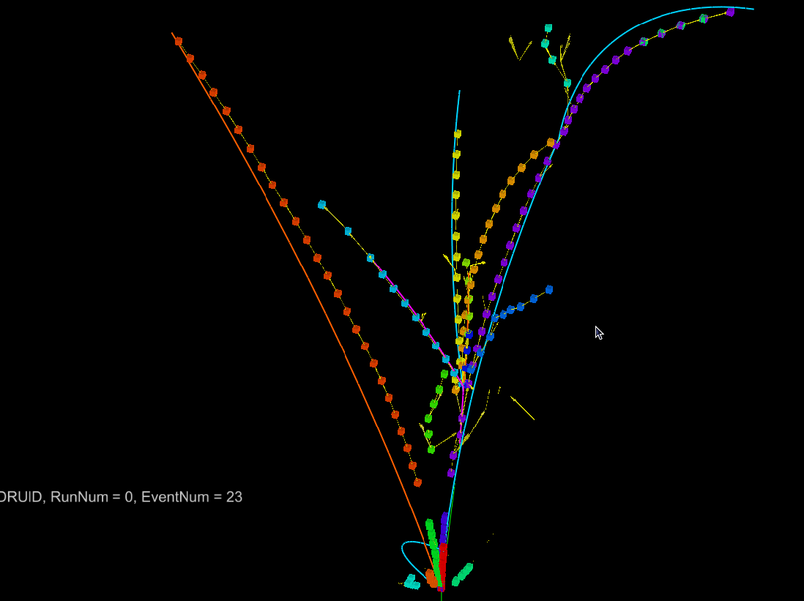
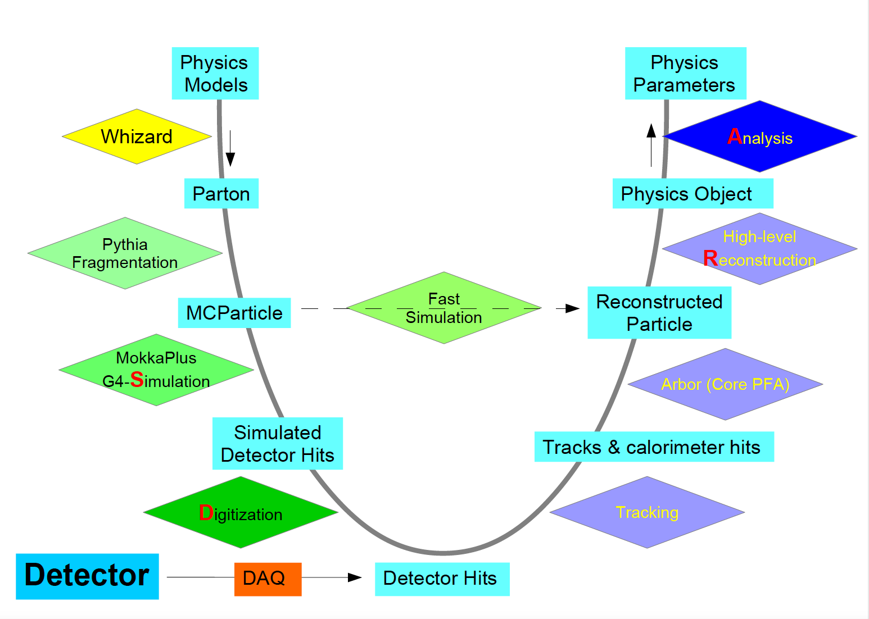
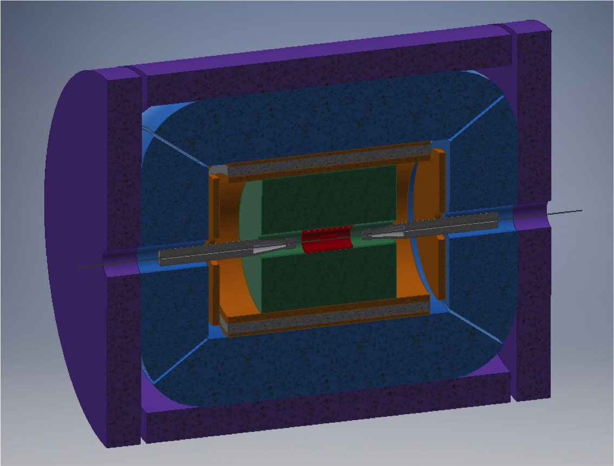
Detector & Software
Full simulation reconstruction Chain functional, iterating/validation with hardware studies

Slide 4
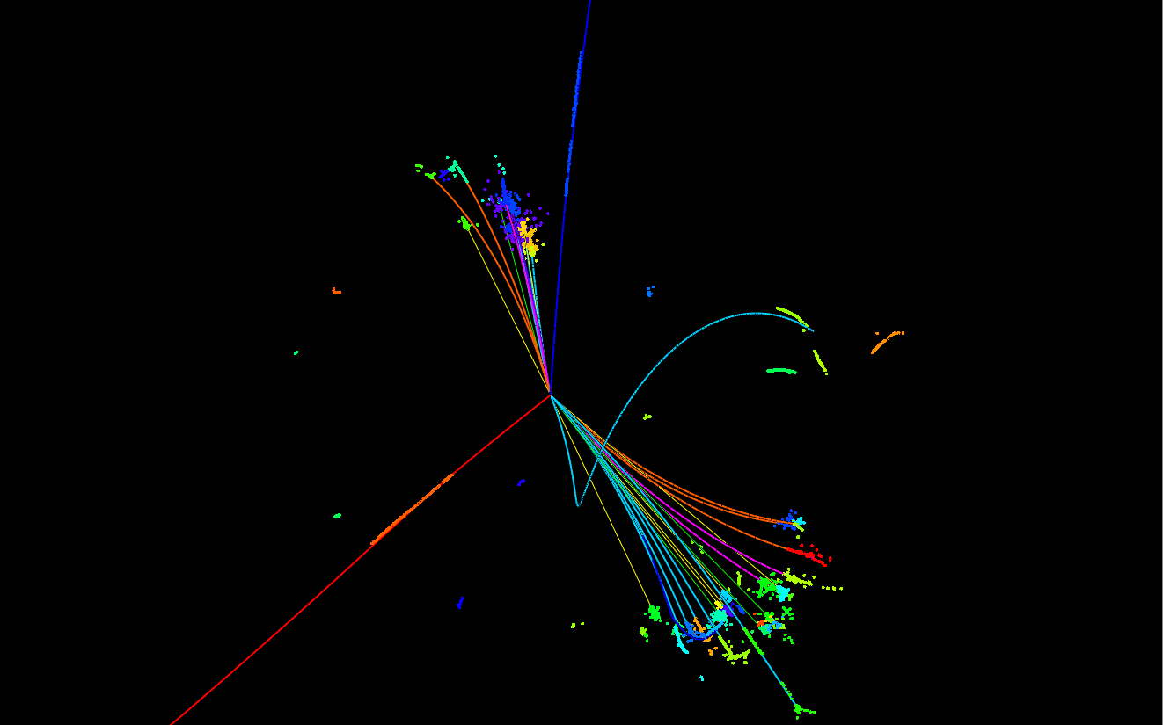
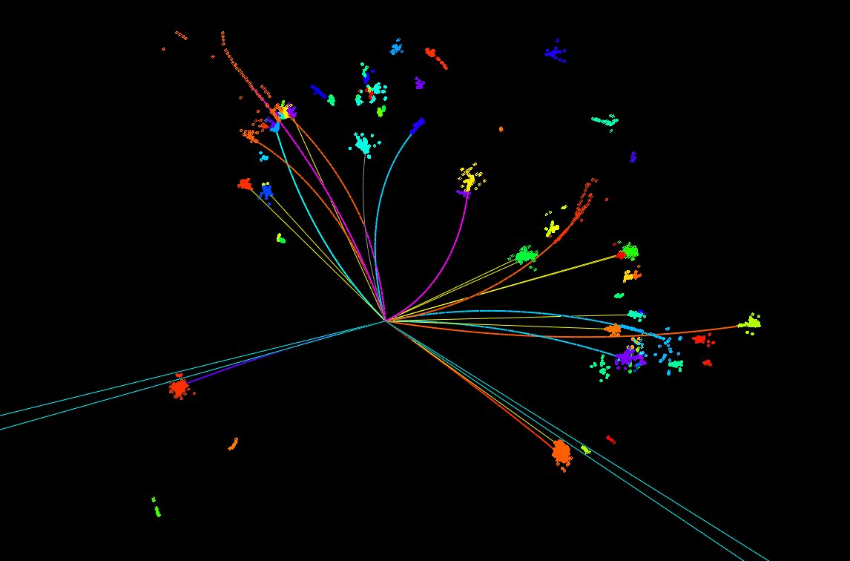
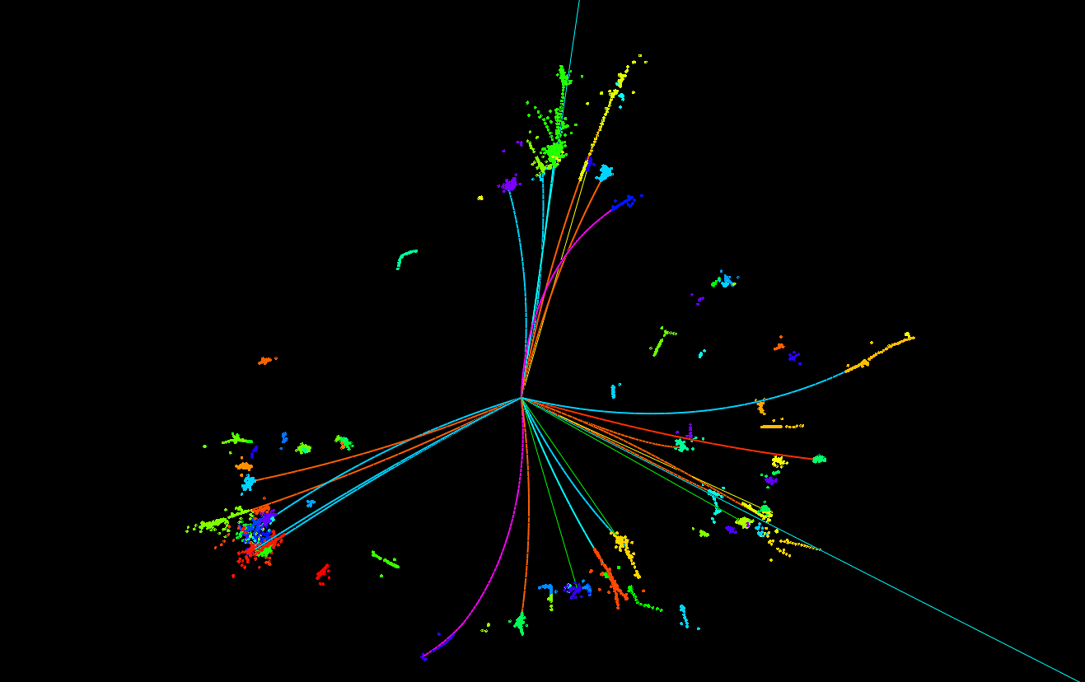
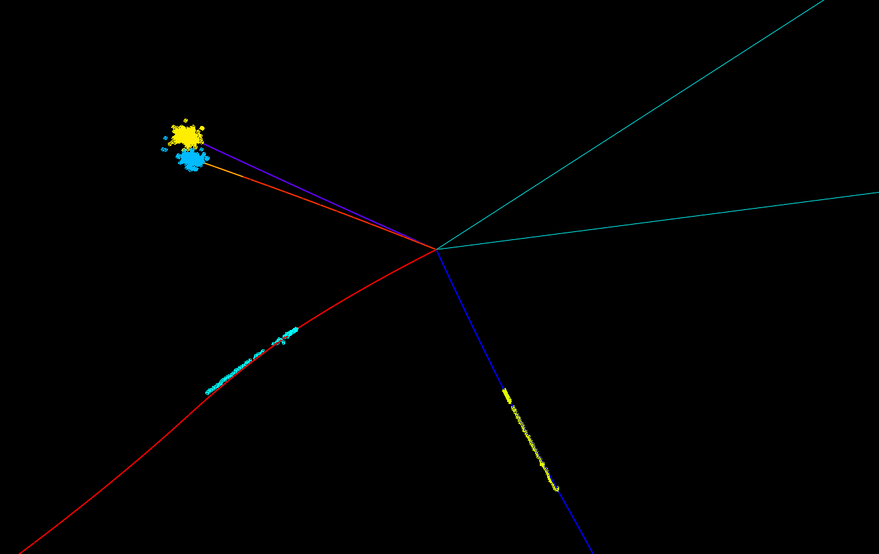
Events Display for Higgs
Z→2 muon,
H→2 b
~2%
Z→2 jet,
H→2 tau
~5%
Z→2 muon
H→WW*→eevv
~1%
ZH→4 jets
~50%

Slide 5
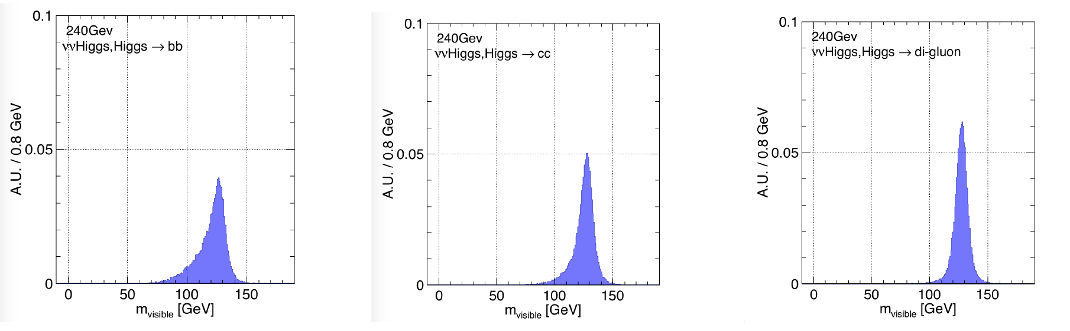
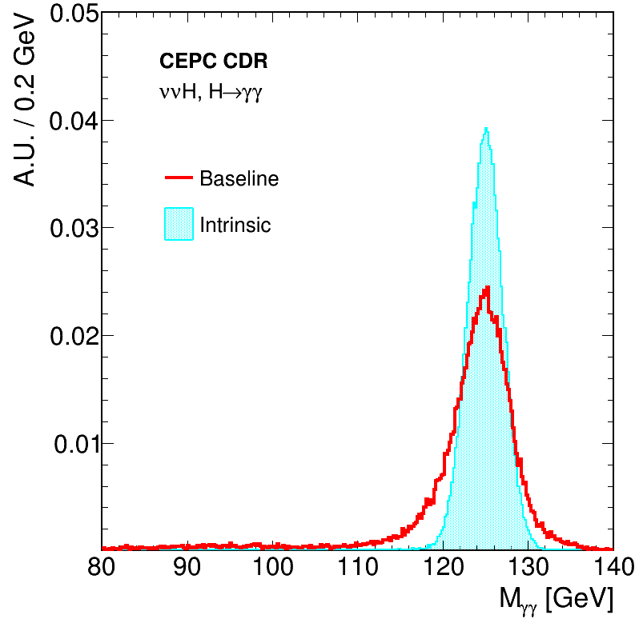
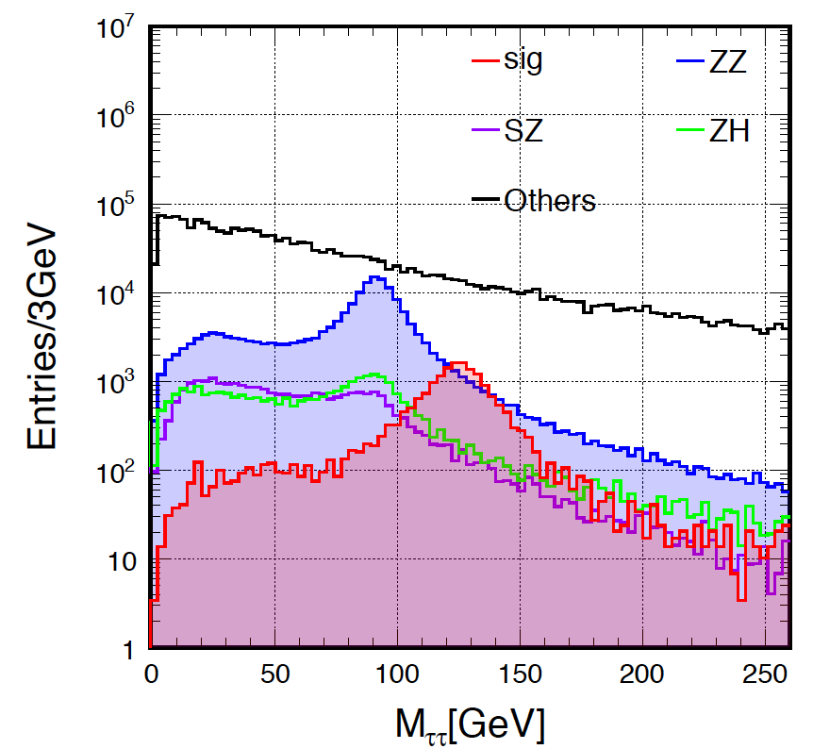
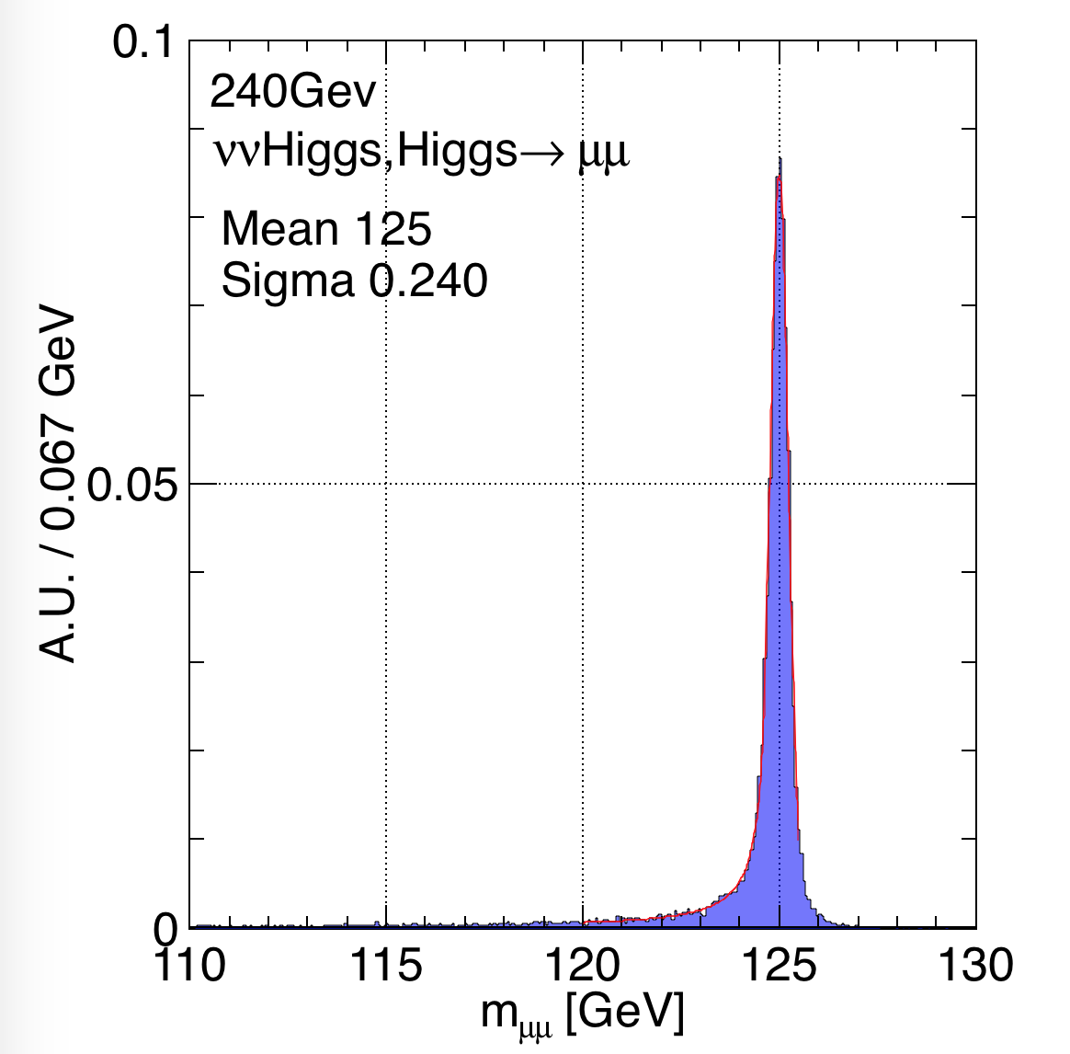
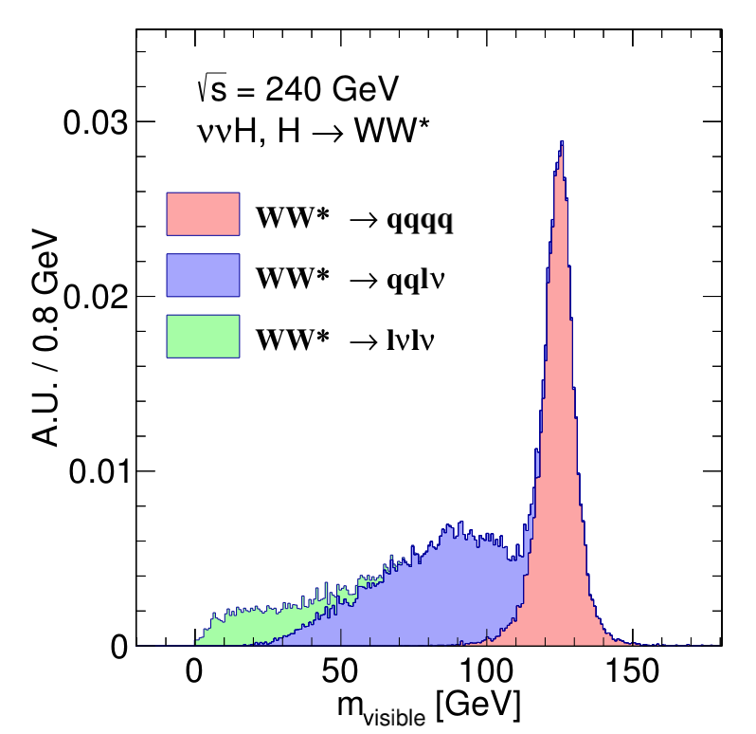
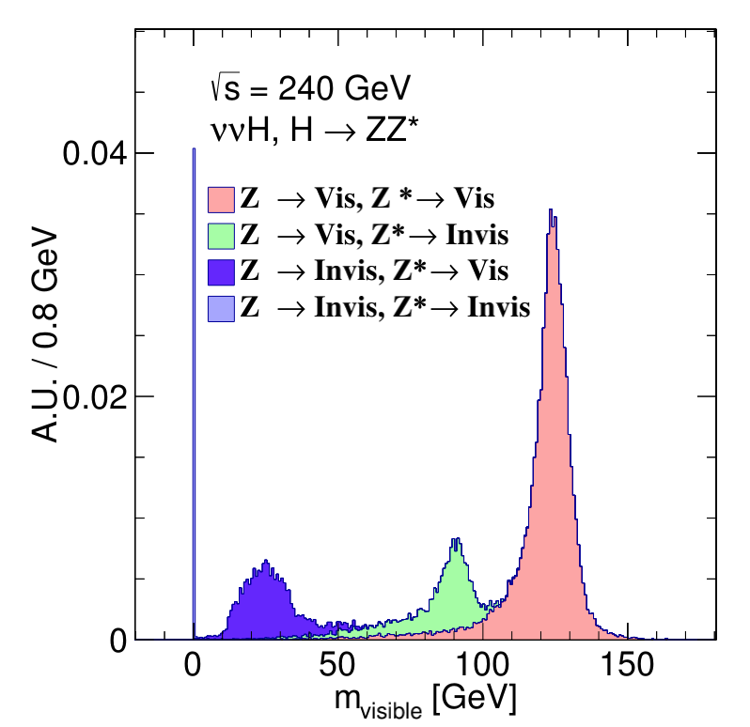
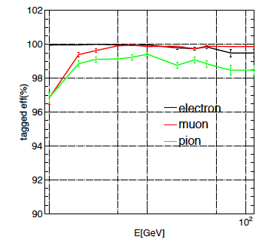
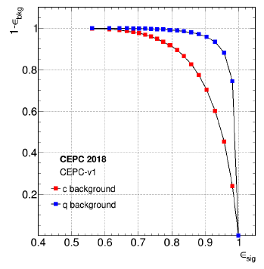








Reminder: Recon. Higgs Signatures& Detector Performance@CDR
Higgs Signals
$$H→ττ$$
$$H→bb$$
$$H→cc$$
$$H→gg$$
$$H→γγ$$
Clear Higgs Signature in all SM decay modes
Massive production of the SM background (2 fermion and 4 fermions) at the full Simulation level
Di-tau mass distribution at qqH events using collinear approximation
$$H→μμ$$
$$H→ZZ∗$$
$$H→WW∗$$
  Acceptance: |cos(θ)| < 0.99
  Tracks: Pt threshold, ~ 100 MeV
    δp/p ~ o(0.1%)
  Photons:
    Energy threshold, ~ 100 MeV
    δE/E: 3 – 15%/sqrt(E)
  BMR: 3.7%
  b-tagging: eff*purity @ Z→qq: 70%
  c-tagging: eff*purity @ Z→qq: 40%
Recon. and ID eff.

Slide 6
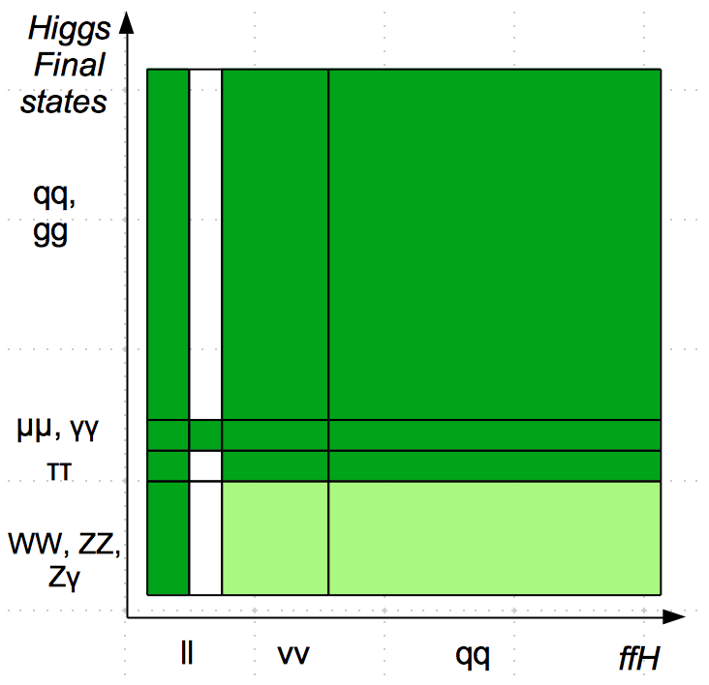
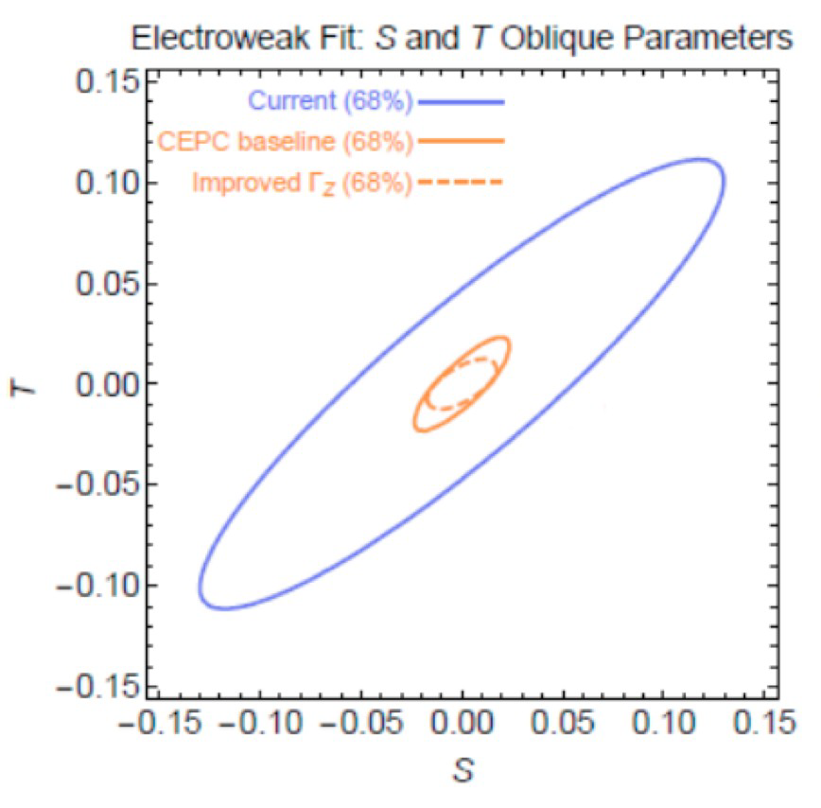
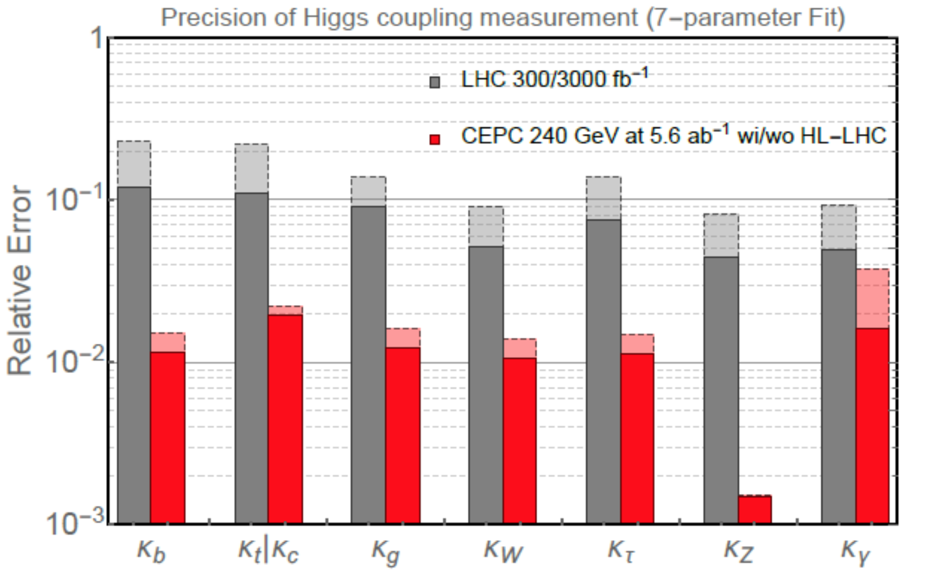
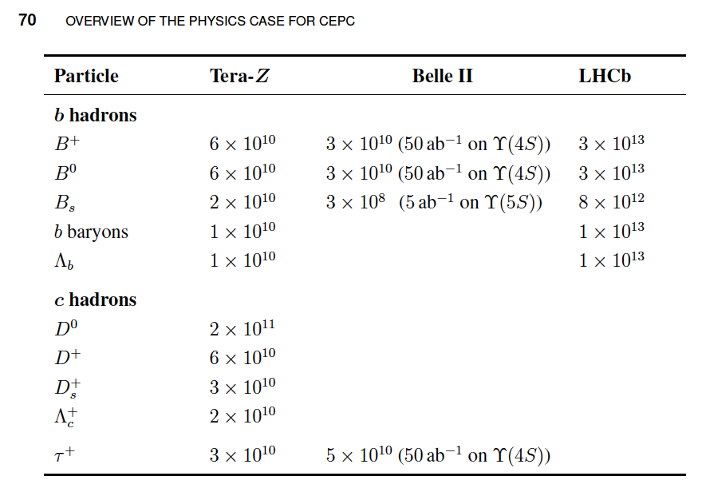
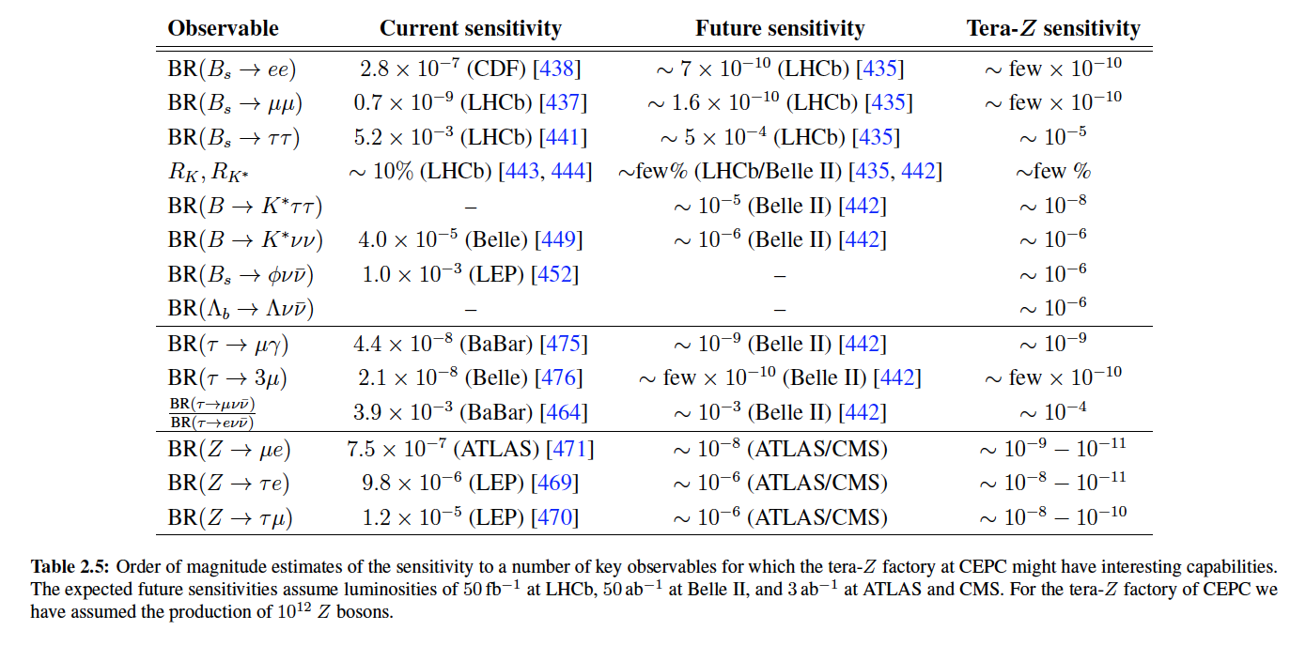
Reminder: Physics Potential@ CDR
Higgs
EW

Slide 7
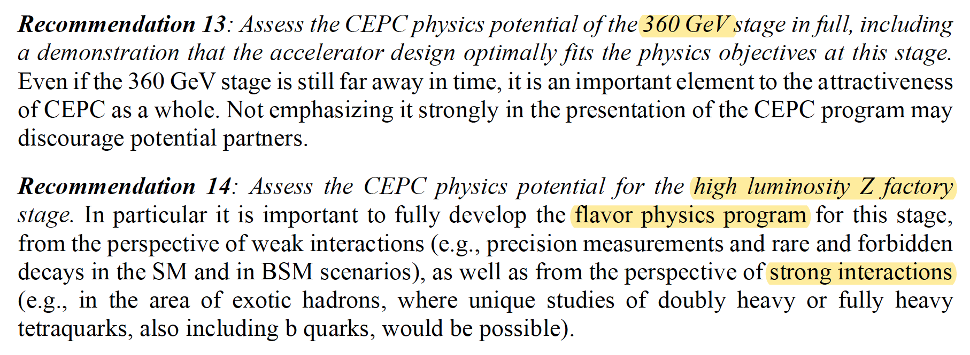
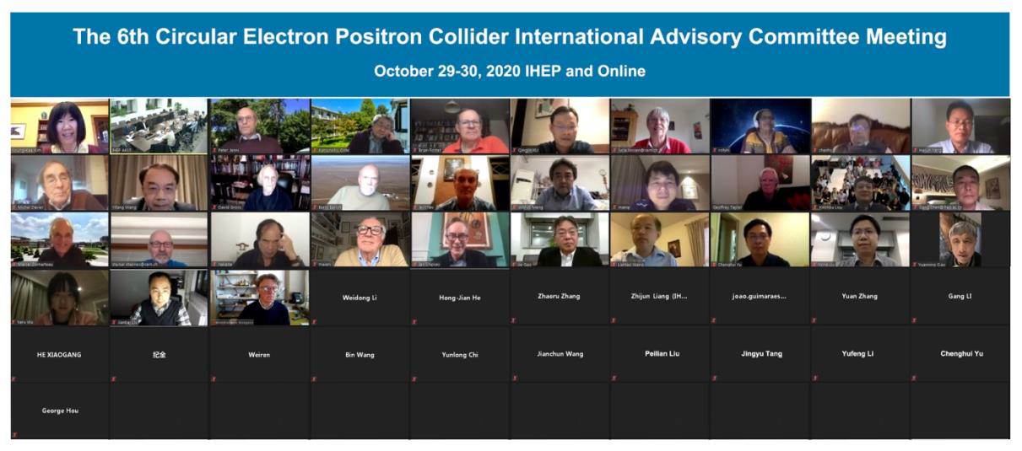
IAC Recommendation 2020

Slide 8
Physics studies post CDR
CEPC is not only for precision measurement, it is also a Discovery machine:
  Need to quantify CEPC physics potential at Higgs
  EW, Flavor, QCD & BSM
  Physics at 360 GeV Run
Guide the design/optimization of the facility & Maximize the physics output:
  Detector performances
  Simulations

Slide 9
Detector Performances

Slide 10
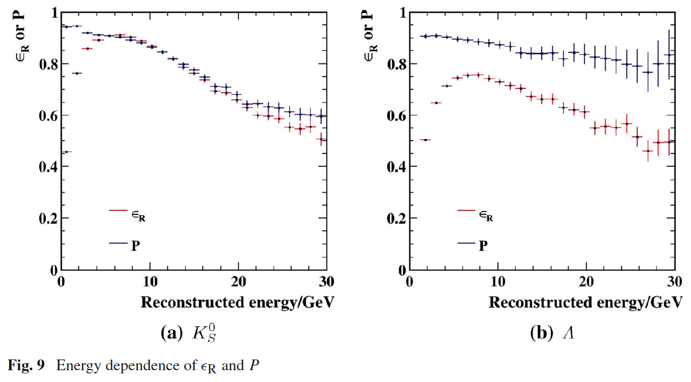
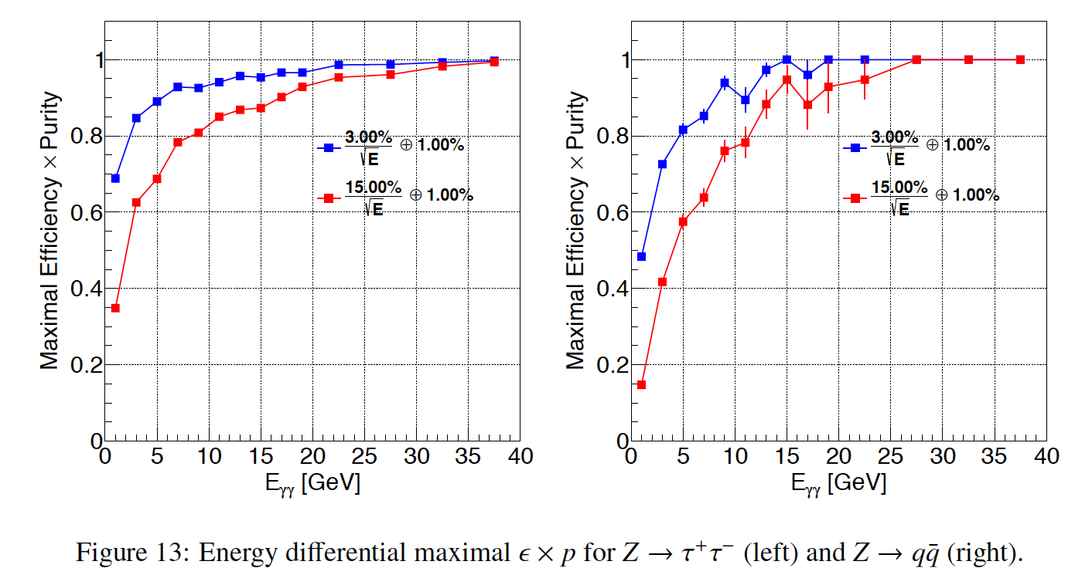
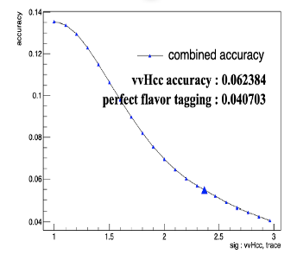
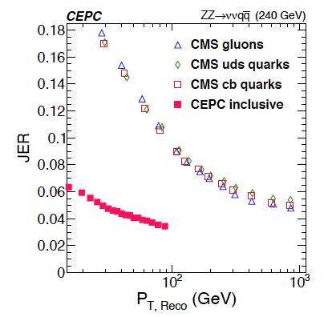
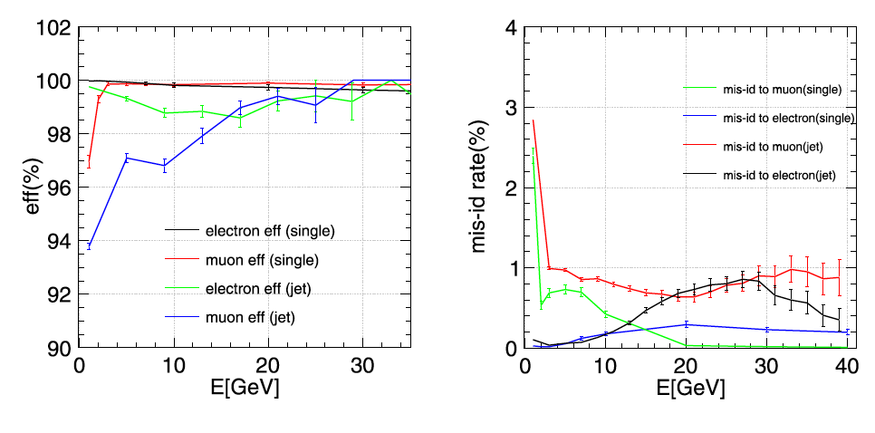
Better Understood Detector Performance
  Pi-Kaon separation: 3-sigma (requirement)
  Pi-0: eff*purity @ Z→qq > 60% @ 5GeV
  Jet charge: eff*(1-2ω)2 ~ 15%/30% @ Z→bb/cc
  Lepton inside jets:
  eff*purity @ Z→qq ~ 90% (energy > 3 GeV)
  slight degrading in jet
  Tau: eff*purity @ WW→tauvqq: 70%,
    mis id from jet fragments ~ o(1%)
  Reconstruction of simple combinations:
  Ks/Lambda/D with all tracks @ Z→qq:
  60/75 – 80/85%
  Missing Energy: Consistent with BMR.

Slide 11
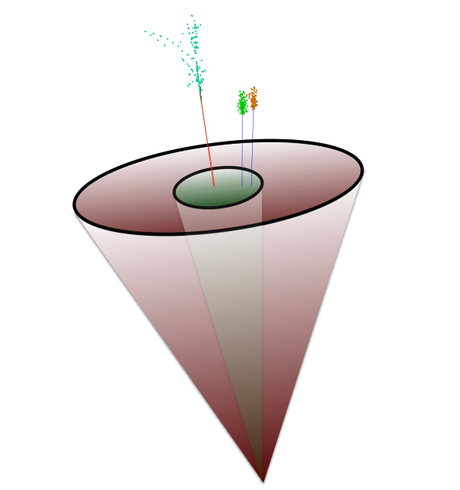
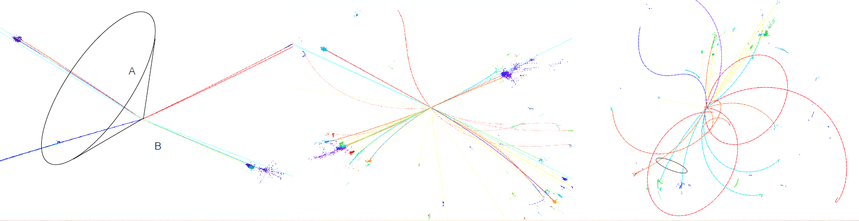
Example: Taus at the CEPC
Dan Yu
Semi-Leptonic:
ZH, Z→qq, H→ττ
WW→τvqq
Full-Hadronic:
Z→qq→τ + X
TAURUS (Tau ReconstrUction toolS):
an overall efficiency*purity higher than 70% is achieved for qqττ, and qqτv events
TAURUS/Specify Tau decay product

Slide 12
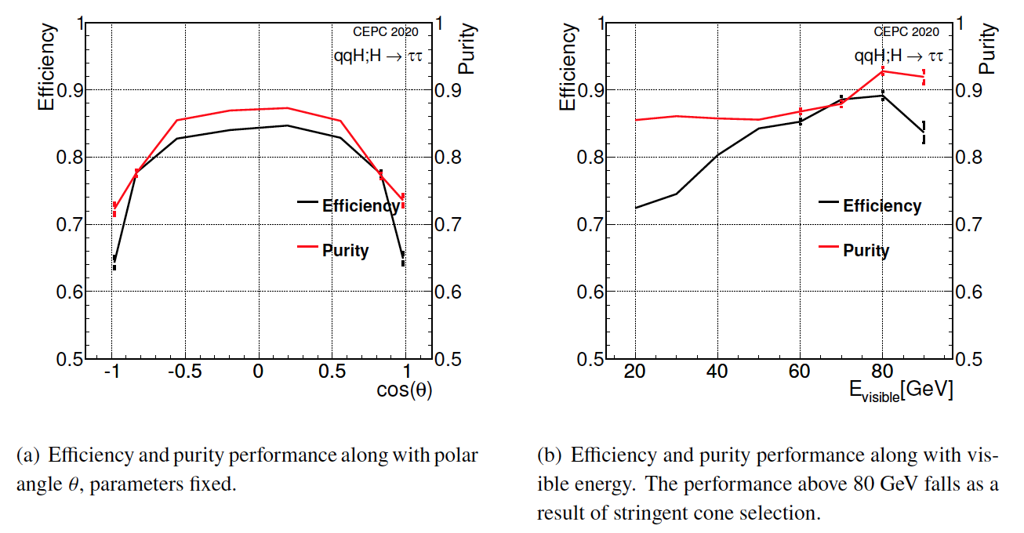
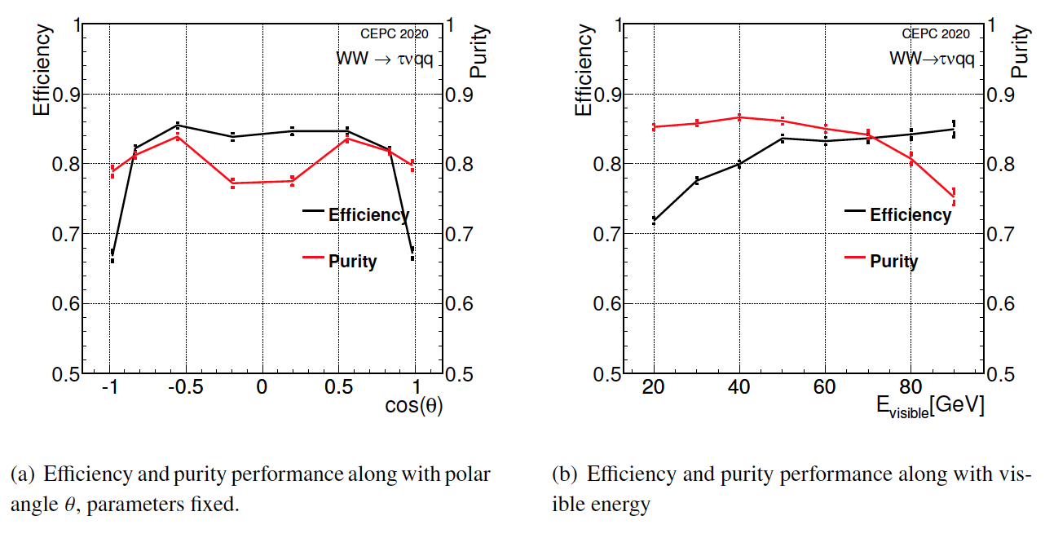
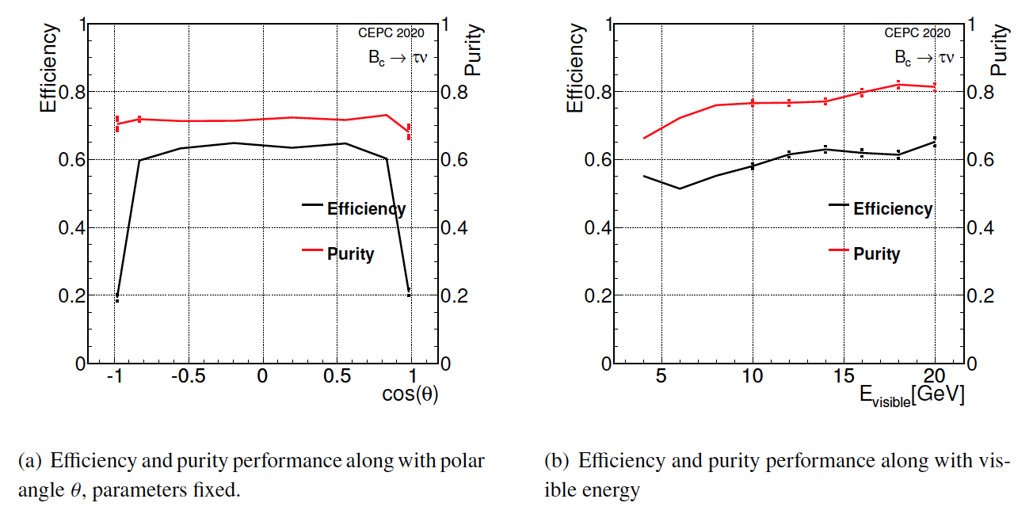
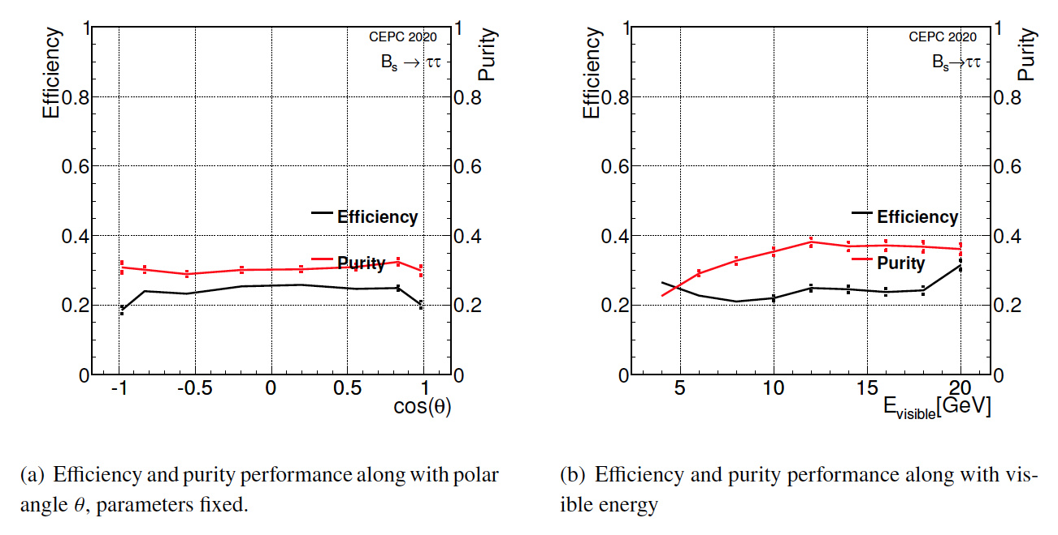
TAURUS: differential performance
Higgs
WW
Flavor leptonic
Flavor Hadronic
Notes:
Bs is hadronic decays.

Slide 13
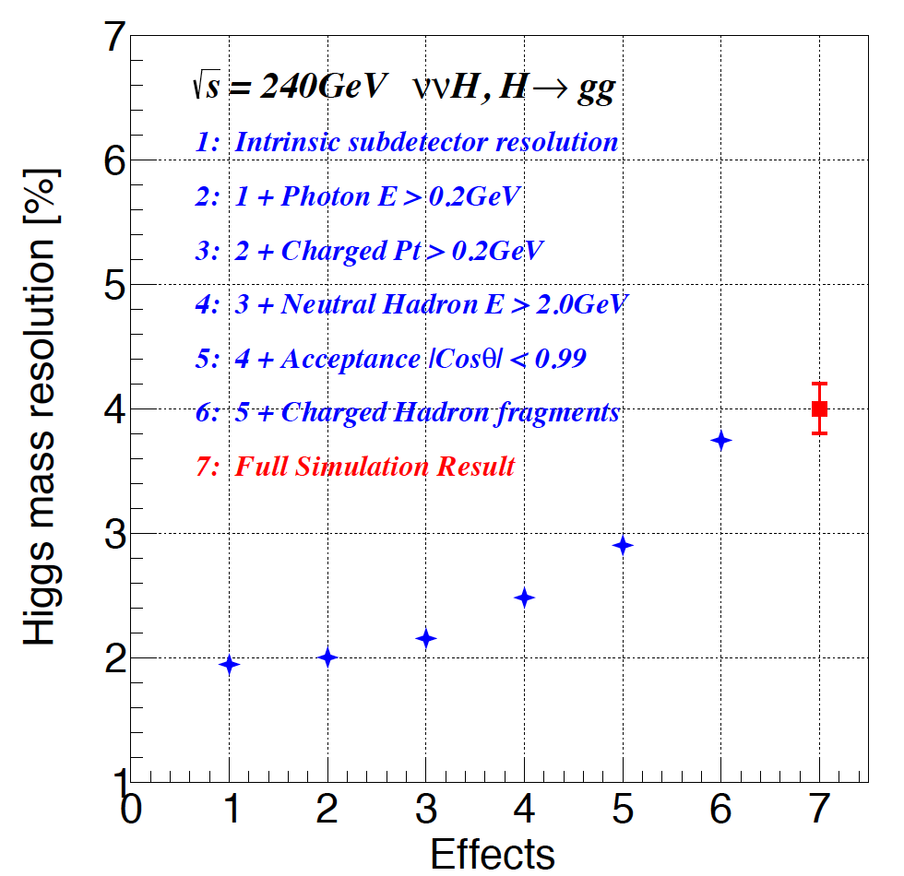
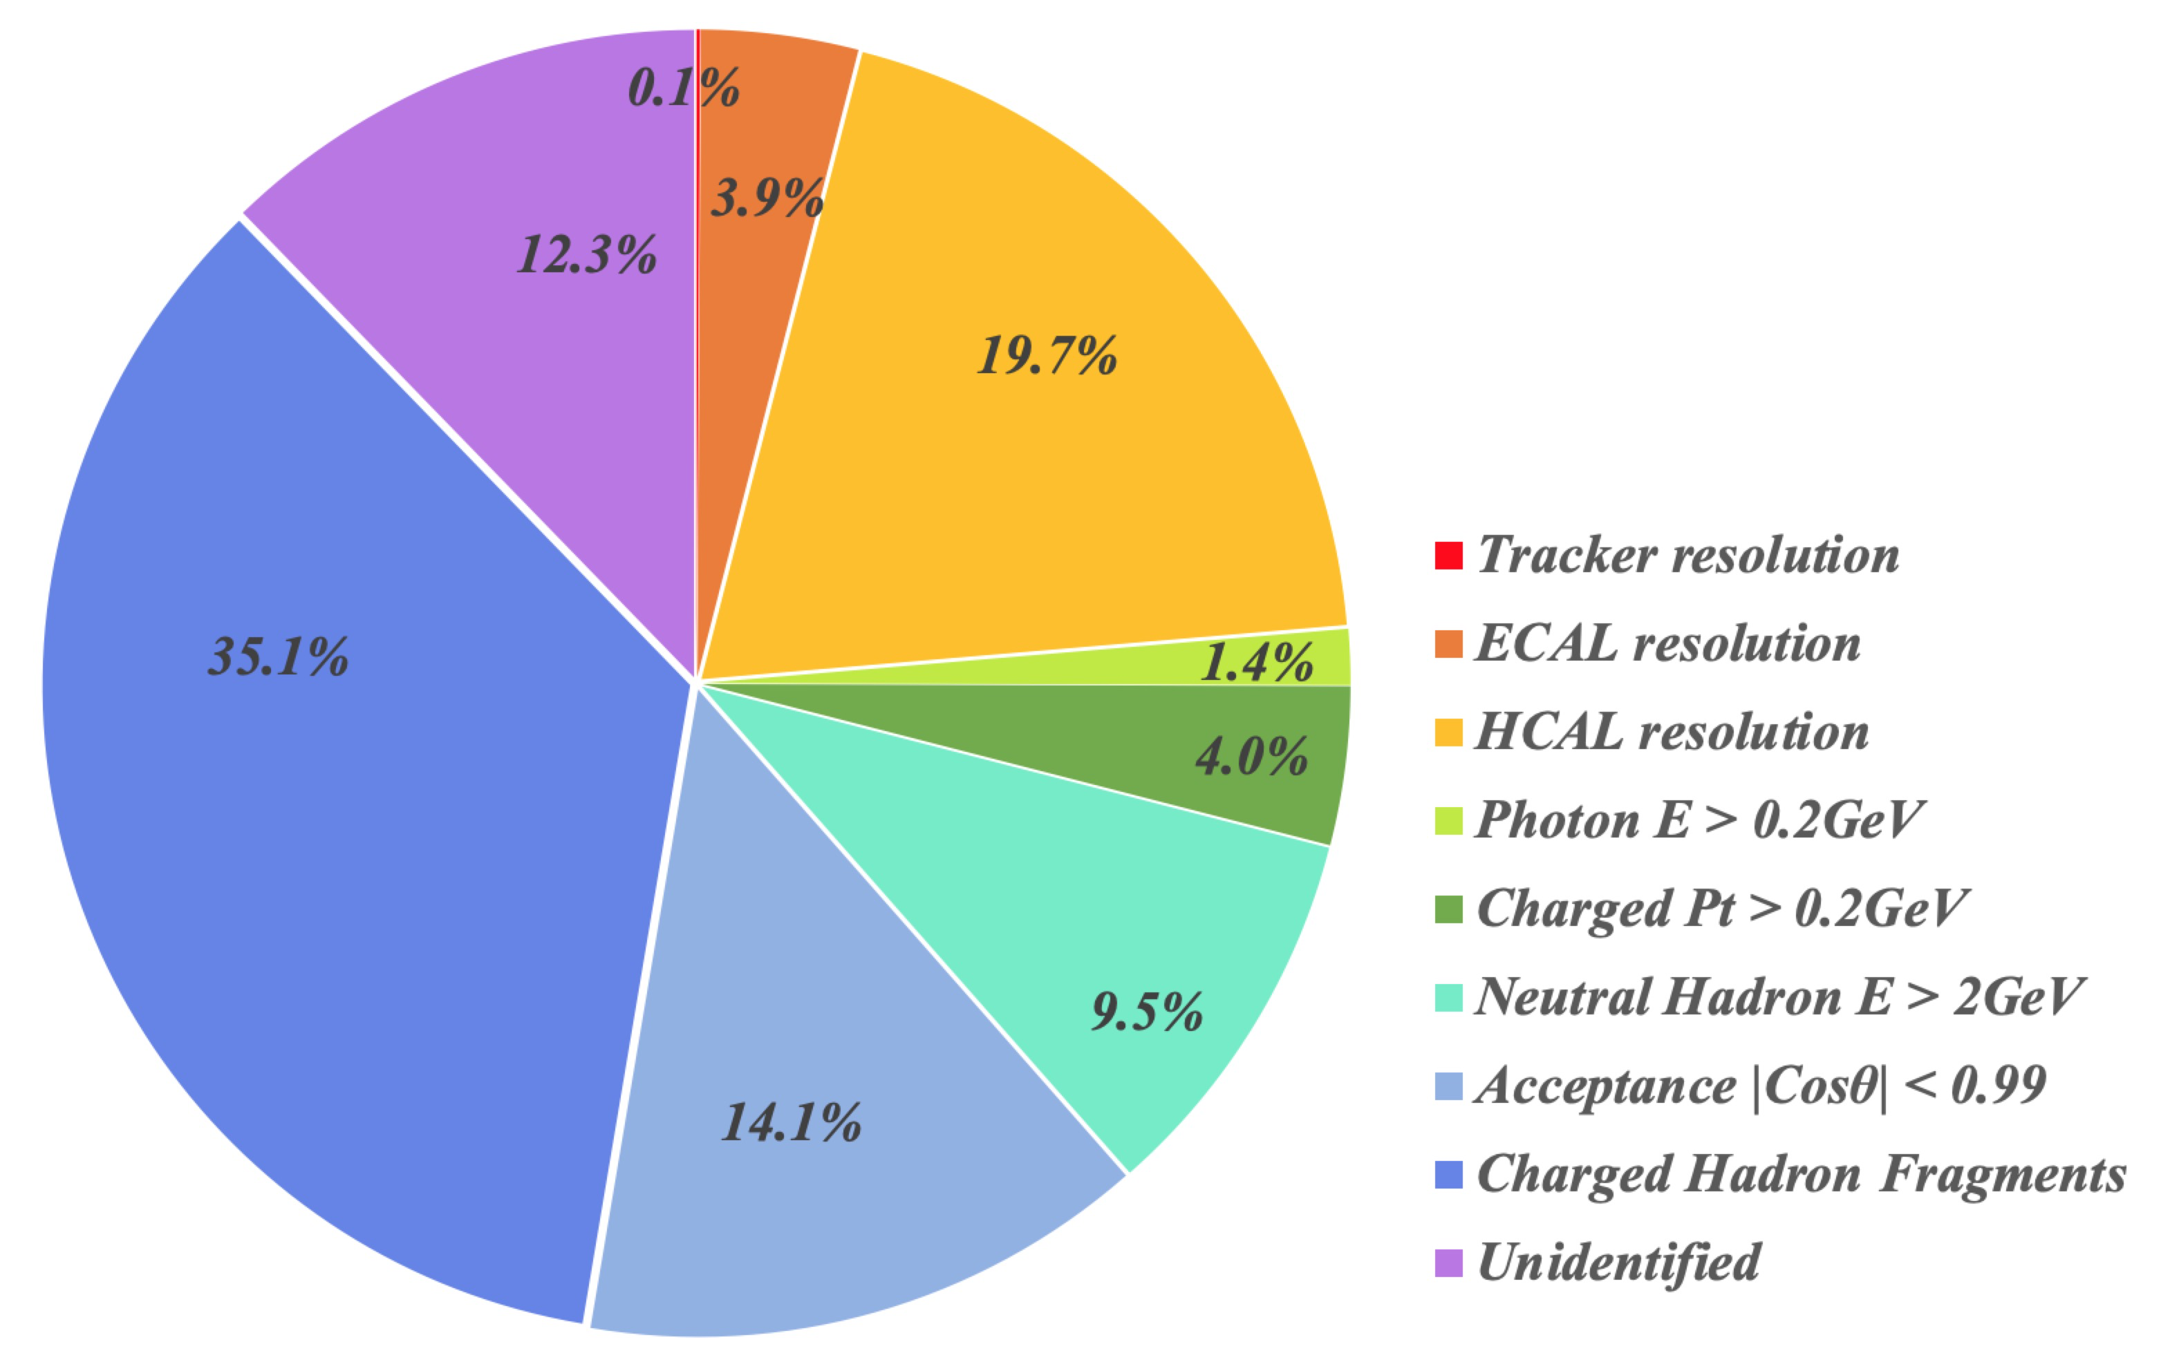
PFA Fast simulation (Preliminary)
YX. Wang
Fast simulation reproduces the full simulation results, factorize/quantifies different impacts
Remarks:
Same cleaning condition as in the Full simulation applied
Early phase of modeling/tuning

Slide 14
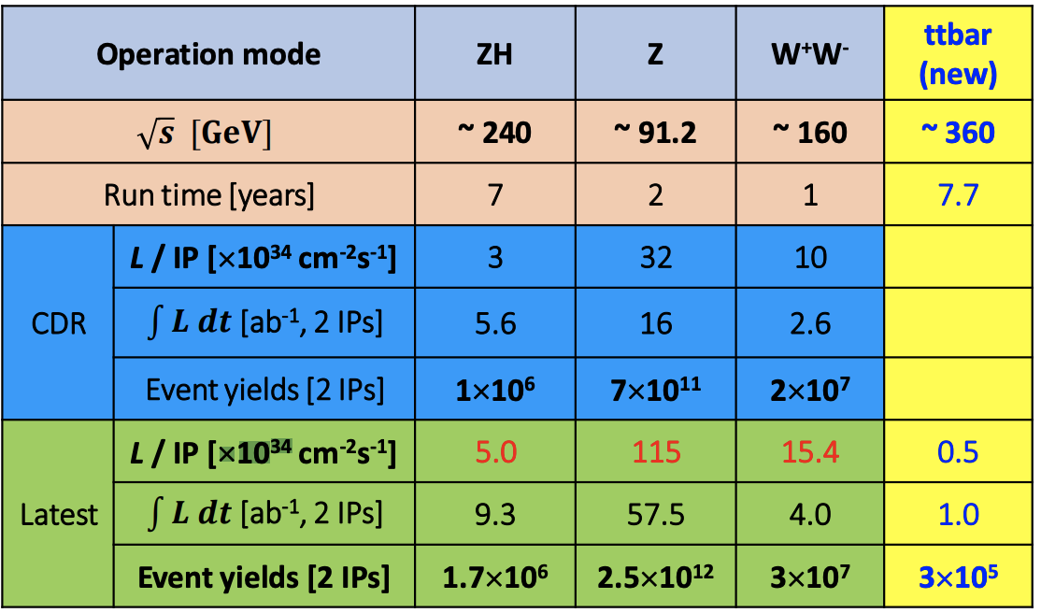
CDR/Latest Runs at CEPC
Studies are mostly based on CDR Setup.
The impacts of the latest plans will be briefly addressed in some studies.

Slide 15
Higgs Physics updates

Slide 16
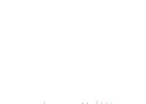
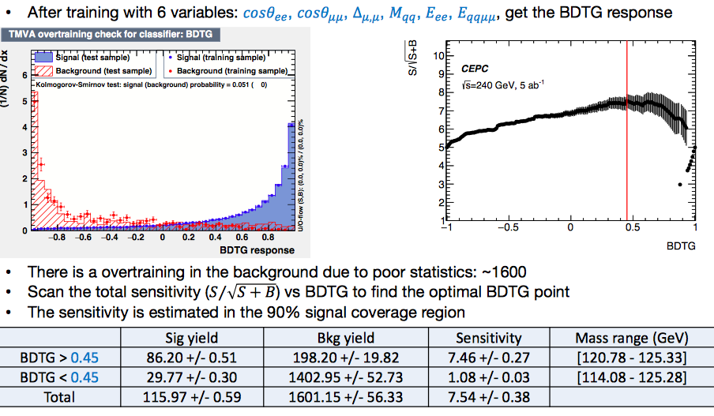
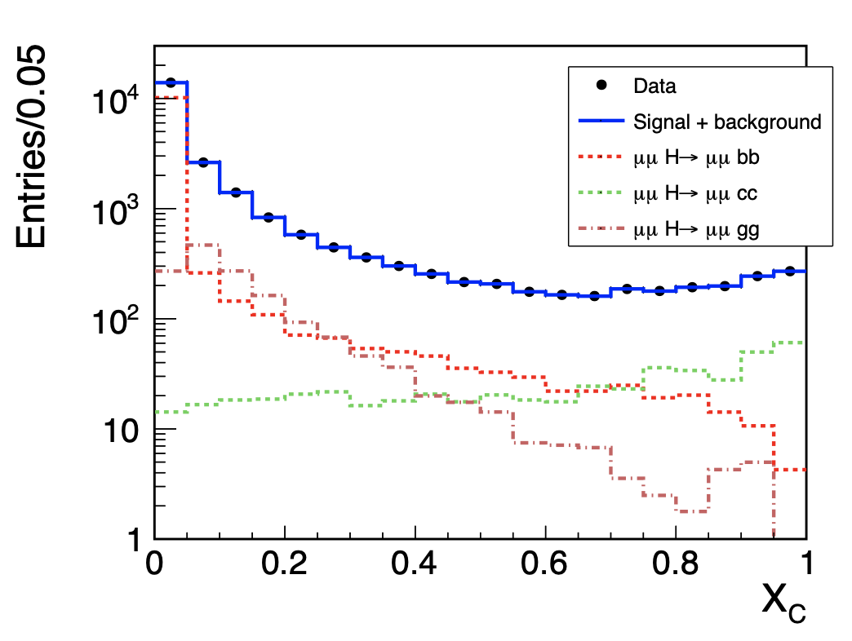
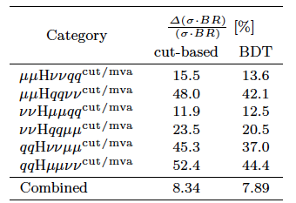
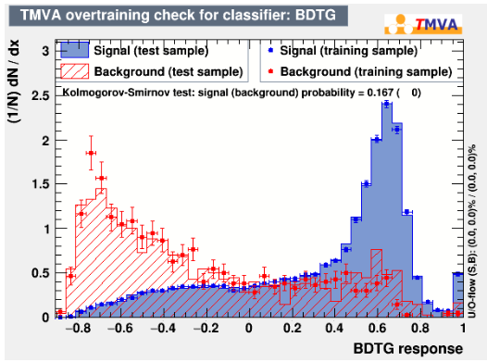




MVA methods widely used Higgs analyses
CPC Vol. 44, No.1 (2020)013001
$$H→bb,cc,gg$$
$$H→μμ$$
Yu Bai, et al.,
Kunlin Ran
For H->μμ, the improvement is ~35% w.r.t cut based one for the signal significance (improvement on precision 17%-12%).
Ryuta Kiuchi, et al.,
$$H→ZZ$$
ArXiv: 2103.09633
The overall precision has been improved from 6.8% to 5.7% with MVA as well as full simulated samples used for H->γγ.
$$H→γγ$$
Fangyi Guo

Slide 17
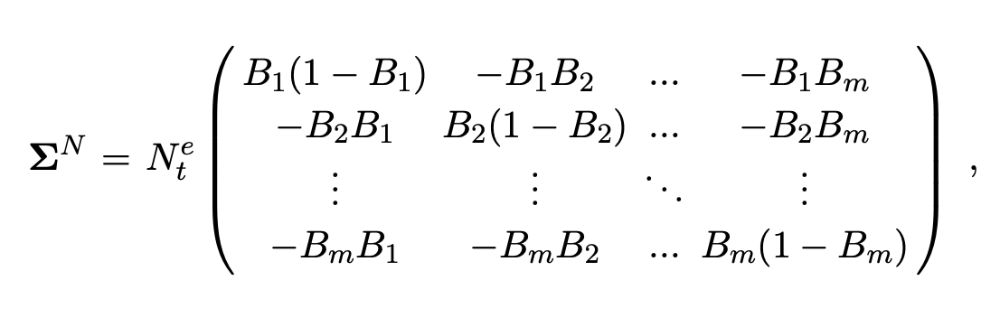
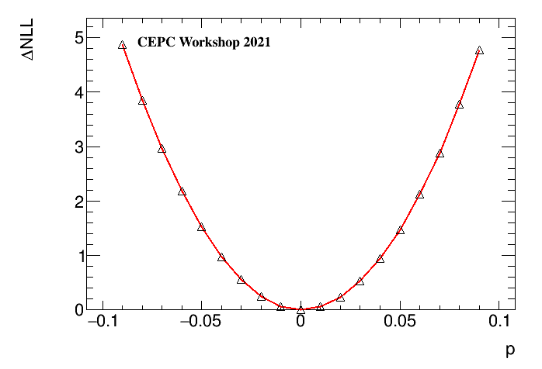
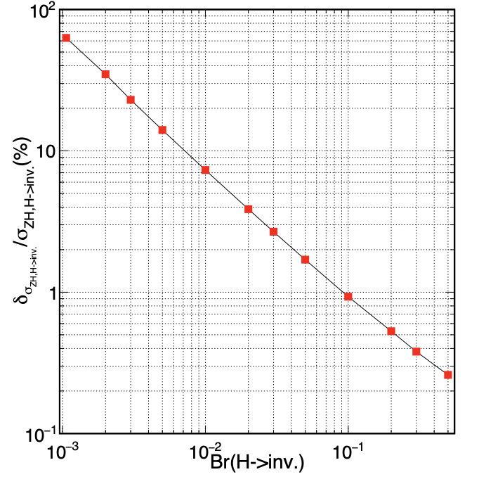
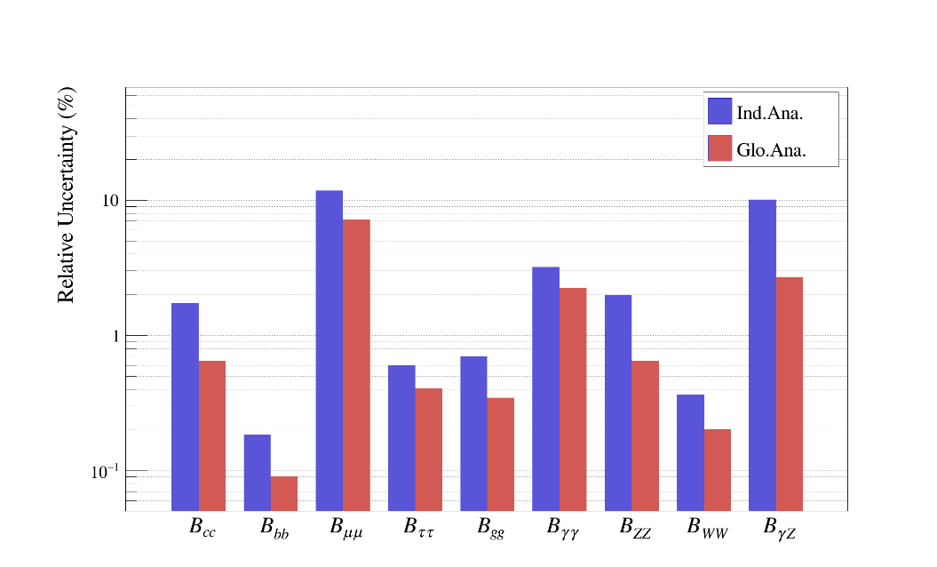
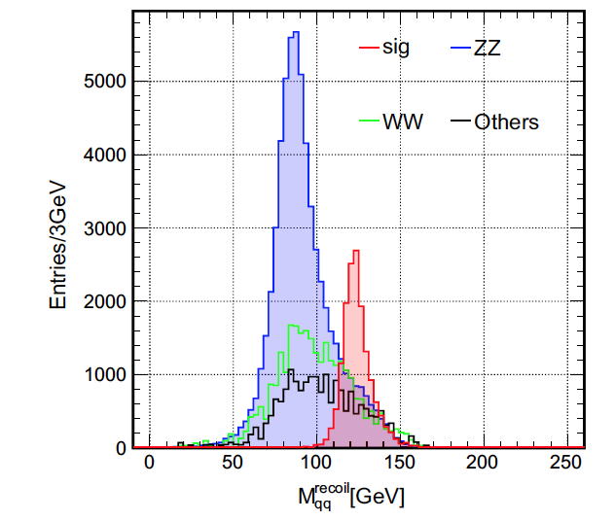
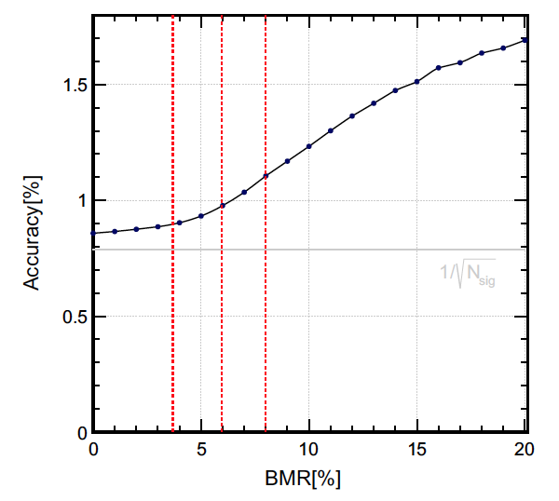

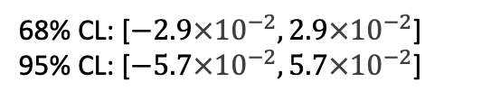
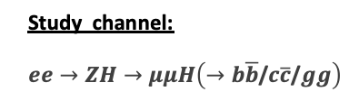

Other activities in Higgs group
Global analysis
Higgs CP Study
Higgs invisible decays
Study channel:
$ee→ZH→μμH\left(→b\overline{b}\text{/}c\overline{c}\text{/}gg\right)$
ArXiv:2103.09633
Qiyu Sha
Ryuta Kiuchi, et al.
Gang Li
ArXiv:2105.14997
Calculate the efficiency matrix
Particle level information as the
input.
Proof-of-Principle study shows precision
improved by a factor of ~2.
Full simulation study is ongoing.
$$e^{+}e^{−}→Zh→ν\overline{ν}+SS1+SS2→ν\overline{ν}q\overline{q}q\overline{q}$$
68% CL: [$−2.9{×10}^{−2}, 2.9{×10}^{−2}$]
95% CL: [$−5.7{×10}^{−2}, 5\text{.7}{×10}^{−2}$]
Higgs decays to ττ
Euro. Phys. J. C(2020) 80:7
Dan Yu
$$H→ττ$$

Slide 18
Physics @ 360 GeV Run

Slide 19


Accelerator at ttbar
Yiwei Wang
Extra Hardware:
  ttbar cavities (international sharing): Collider + 7 GV 650 MHz 5-cell cavity, Booster + 6 GV 1.3 GHz 9-cell cavity
  some septum magnets for beam separation in the RF regions
  several quadrupole magnets for final focusing
Accelerator physics design:
  With SR power limit of 30MW, current design achieved a luminosity of 0.5E34/cm^2/s/IP
  corresponding to 1ab⁻¹ for 7.7 years with 1.3 Snowmass units running/year
To achieve 2 ab⁻¹ for 7.7 years
  reducing the βy*, coupling factor and increasing the synchrotron radiation power limit.

Slide 20



Top property measurement
Zhan Li
360 GeV runs open a door to measure top properties in high precision that hadron colliders cannot reach
Currently we study the top mass and width measurements using the tt threshold method at ~360 GeV
  One order of magnitude better precision than the hadron collider is expected
  A single run at the energy where the tt xsection varies most largely in a given top mass range is found to provide the best performance : from 18 MeV to 13 MeV
  A quick energy scan with low luminosity to find the optimal energy point before data taking with the full luminosity is proposed
  More studies are ongoing for the simultaneous measurements of the top mass, width and $α_{s}$
The peak indicates the optimal sqrt{s} for the top mass
L = 100/fb
With only the optimal sqrt{s}
Top mass uncertainty = 13 MeV
Notes:
The expectation of sqr(first derivation)

Slide 21




Top quark and Higgs EFT $O_{Hq}^{(1)}, O_{Hq}^{(3)}, O_{Ht}$
Zhen Liu
At or above $t\overline{t}$ threshold at lepton colliders, one immediately again great sensitivities to the top gauge couplings.
Patrick Janot
Note that the opt. obs. Analysis is a rescaling of the study from Janot, we are working on CEPC simulation and analysis
Expect to be consistent with FCC-ee.

Slide 22


Additional sensitivity to Higgs measurements
Kaili Zhang, Jiayin Gu
2 ab⁻¹@360 GeV
30% more Higgs events
Improvement on Higgs width : 2 times better (2.9% $→$
Constraint on HH measurement.
1.4%)
21

Slide 23

Impact of the updated running plans on Higgs physics
With the Lum@ 240 GeV：5.6 ab⁻¹ $→$ 9.3 ab⁻¹ & the Lum@360 GeV Run： 2 ab⁻¹ $→$ 1 ab⁻¹:
the precision for Higgs width : 1.43% $→$ 1.36% (very stable ☺)
1.43%

Slide 24


Search for New Physics
With some 2HDM(+s) Model (X$→Sh$), it is feasible to do it at 360 GeV run.
  CMS shows some discrepancy with SM from VH$→$WW study.
  Cumulate ATLAS/CMS public results on di-photon/zγ channels show promising excesses （arix:2109.02650）, indicating. X~250-280 GeV, S~150 GeV.
Plan to perform further studies with CEPC (a bit higher colliding energy will be better ).
X
CMS-PAS-HIG-19-017
X
X

Slide 25
EW，Flavor， QCD and BSM

Slide 26


EW
With 2 years of Z pole operation (~ 1 Tera Z) and 1 year of W mass scan (~1E7 W)

Slide 27

7
26

Slide 28

EW
Lum increased with factor 3.6,
Precsion can reach ~5.3X10⁻⁵.

Slide 29

28

Slide 30

29

Slide 31

30

Slide 32

Sensitive to New Physics up to 10 TeV
31

Slide 33




CP measurement with Bs->J/psi Phi
CEPC baseline
With a decent Pid, the effective tagging power on jet Charge can be 5-6 times better than LHCb, which can compensate the statistic difference between LHCb & CEPC.
Strong motivation to higher Luminosity at Z pole （3.6 factor more events)
Preliminary
LHCb
Notes:
Γs is the average Bs decay width, and ∆Γs is the positive decay-width
difference between the heavy and light mass eigenstates in the Bs0 system
Time-dependent analyses of tree-level B0 (s) decays are sensitive to the an- (s)
gle γ ≡ arg(−VudV ∗ /VcdV ∗ ) of the unitarity triangle of the Cabibbo-Kobayashi-Maskawa ub cb
(CKM) matrix [1, 2] through CP violation in the interference of mixing and decay am- plitudes

Slide 34


QCD @ CEPC
• How to achieve the ultimate precision for alphaS at the CEPC ?
• Can we see gluon spin interference at the CEPC ??
• How to observe entanglement from non-global observables at the CEPC ???
• Can we quantitatively understand hadronization ????
+ a lot of interest/questions from Performance studies...

Slide 35






BSM
SUSY
ArXiv:2105.06135
2HDM
S. Su
J. Yuan, et al
H$→$Long Lived Particles
M.J. Ramsey-Musolf
Y. Zhang, et al
https://indico.ihep.ac.cn/event/13888/session/15
Exotic Higgs Decays

Slide 36

Toward Physics White Papers
…

Slide 37


Higgs white paper delivered
36

Slide 38


Workshops for white papers
White paper activities:
  2019.3 Higgs White Paper delivered
  2019.7 WS @ PKU: EW, Flavor, QCD working group formed
  2020.1 WS @ HKIAS: Review progress & iterate. EW Draft Ready
  2021.4 WS @ Yangzhou: BSM working group formed
CEPC Physics/Detector WS, April 2021 @ Yangzhou
  ~ 45 Physics reports
  ~ 10 Performance/Optimization study
  Significant Fresh
Higgs: Impact of 360 GeV Runs
Top physics at 360 GeV
EW: Draft ready
QCD: intensive discussions...
Flavor + BSM:
  Many Performance & Benchmark analyses
https://indico.ihep.ac.cn/event/13888/

Slide 39


White paper : Flavor Physics
Facts & interpretation...
Many Thanks to Lingfeng & HKUST

Slide 40


CEPC @ Snowmass
1/4 published
1/4 about to publish
1/2 keep on cultivating...

Slide 41
Summary
CEPC CDR provides solid basis for physics & performance study
The IAC recommendation is very helpful & implemented
  Top & Z, flavor physics with strong interactions
  Plan to cover: NP @ top, exotic hadron search at Z pole
Physics: to quantify the discovery power of CEPC, and to optimize its physics output:
  White paper in good shape and we keep moving forward.
  Enhanced community, especially from theorists
Performance:
  Much better understanding on baseline detector performance, especially those flavor physics oriented performance, etc.
  Clearer Physics requirements, that guides the detector design & optimization
Frequent & regular communications with other international projects & strategic discussion
Intensive & Health iteration with Detector.

Slide 42
backup Slides

Slide 43




H→bb, cc, gg: BMR, Color Singlet id (CSI) & Flavor tagging (Preliminary)
nnH
qqH
BMR is good enough... Huge penitential compared to Baseline FT + Naive CSI (ee-kt jet clustering & matching)
Ideal CSI improves the accuracies by up to 2 times...
Ideal Flavor tagging improves the accuracy of of Hcc by 2 times @ qqH, & 50% @ nnH

Slide 44


Slide 45


Slide 46


Slide 47

To QCD community:
What's the dependency on fragmentation method/tools?
What's the ultimate CSI?

Slide 48




Higgs CP study at CEPC
Study channel: $ee→ZH→μμH\left(→b\overline{b}\text{/}c\overline{c}\text{/}gg\right)$
Differential cross section could be represent as:
$\frac{dσ}{dcosθ_{1}dcosθ_{2}dφ}=N ×(J_{CP−even}(θ_{1}, θ_{2},φ)+p×J_{CP−odd}(θ_{1}, θ_{2},φ))$.
An Optimal Variable $ω$which combines the information from $\{θ_{1}, θ_{2}, φ\}$ defined as:
  $ω=\frac{J_{CP−odd}\left(θ_{1}, θ_{2},φ\right)}{J_{CP−even}\left(θ_{1}, θ_{2},φ\right)}$ to measure $p$
Used ML-fit in $ω$ distribution to extract $p$.
Result:
For $p$:
68% CL: [$−2.9{×10}^{−2}, 2.9{×10}^{−2}$]
95% CL: [$−5.7{×10}^{−2}, 5\text{.7}{×10}^{−2}$]

Slide 49







Image Recognition Techniques to Identify Long-Lived Particles(h->LLPs)
Mapping the raw detector information to a 2D image
Input information: image with resolution of $\left(R, φ\right)=200×200$and 1 to 2 channel(s)
  $R$ starts from 0 to 8 m, $φ$ starts from $−π$ to $π$
  Energy is the sum of Calorimeter hits.
  Time is the maximum $ΔT$ ($E>0.1 GeV$) within $\left(R, φ\right)$ pixel
Model: ResNet18 (Classification), ResNet50 (Vertex Finding)
Binary Cross Entropy Loss: $loss\left(x_{i},y_{i}\right)=−ω_{i}[y_{i}\log\left(x_{i}\right)+\left(1−y_{i}\right)log⁡(1−x_{i})]$
$$e^{+}e^{−}→Zh→ν\overline{ν}+SS1+SS2→ν\overline{ν}q\overline{q}q\overline{q}$$
Energy
Max. $ΔT$
2-channel
A LLP Event

Slide 50




Expected Search Sensitivity
Signal Efficiency of ML-based and Cut-based analysis for $Z→\overline{ν}ν$
Best branching ratio exclusion limit at decay length around a few meters: $BR(h→XX)>{～10}^{−5}$for most LLP masses
Good sensitivity for low LLP mass (as low as 1 GeV)

Slide 51



Global analysis for CEPC Higgs
Efficiency modulate N → n
Similar for their covariances
Efficiency modulate N → n
Similar for their covariances
We know the covariance of N
~ multinomial
so Σ^{n} is easy
We know the covariance of N
~ multinomial
so Σ^{n} is easy
Solve all Ni by minimizing
Solve all Ni by minimizing

Slide 52


Global analysis : Enhance Higgs coupling precision
36 classes
Global analysis + deep learning method can calculate the efficiency matrix
Particle level information as input, no dependence on jet-clustering, …
Proof-of-principle study shows precision improved by a factor of ~2
Full simulation study is ongoing …
ArXiv:2105.14997
Global analysis + deep learning method can calculate the efficiency matrix
Particle level information as input, no dependence on jet-clustering, …
Proof-of-principle study shows precision improved by a factor of ~2
Full simulation study is ongoing …

Slide 53




Higgs related physics at e⁺e⁻ collider

Slide 54

Impact on Higgs self-coupling

Slide 55

S and T in EW

Slide 56


Slide 57



Measurement of Higgs width
Method 1: Higgs width can be determined directly from the measurement of σ(ZH) and Br. of (H->ZZ*)
  But the uncertainty of Br(H->ZZ*) is relatively high due to low statistics.
Method 2: It can also be measured through:
These two orthogonal methods can be combined to reach the best precision.

Slide 58

charged current

Slide 59

LHCb LFUV results

Slide 60

59

Slide 61






$H→γγ$ precision @ CEPC conceptual detector
BGO crystal ECAL in CEPC conceptual detector:
  full BGO crystal, 24 $X_{0}$, expected energy resolution $\frac{σ_{E}}{E}\sim \frac{3\%}{\sqrt{E}}⊕\sim 1\%$.
  Simulate the detector response by smearing truth MC.
$σ\left(ZH\right)×Br(H→γγ)$ precision @ CEPC:
  Only consider the $σ_{E}$ influence in $m_{γγ}$ shape in $ννH→γγ$ and $μμH→γγ$ channels, with cut-based analysis.
  Combined statistical only precision: $δBr\left(H→γγ\right)=8.0\%$ (11% @ SiW ECAL scheme, 27% improvement. )
New Concept

Slide 62






Excesses for di-photon, zγ final states associated with leptons, missing energy, b-jets
2103.06956
1806.05996
2104.13240
Z$γ+V$
$$γγ+V$$
$$γγ+V$$
$$γγ+E_{T}^{miss}$$
$$γγ+V$$
2004.045045
ATLAS-CONF-2020-026
2003.10866
$$γγ+bjets$$
$$γγ+bjets$$

Slide 63


Excess for ATLAS/CMS di-photon/Zγ related results
arix: 2109.02650
Preliminary ICPP/IHEP
Using public ATLAS/CMS results with di-photon and Zγ results, we can extract the excess
around 151 GeV with 5.1σ and 4.8σ considering Look-Else-Where effect.
  Most contribution from di-photon.
Consistent with H →SS* hypothesis with m_{H}=270 GeV

