Slide 1



The 7th CEPC IAC meeting, 1-5 Novermber 2021
IARC meetings and Recommendations
Yuhui Li
On behalf of CEPC accelerator team

Slide 2
Contents
Introductions
Theoretical design high lights and IARC recommendations
Collider ring parameters update
Booster scheme
Linac new baseline
MDI issues
Collective instabilities
III. IARC recommendations to the key technology hardware R&D
SRF development (platform, cavities, cryomodules, …)
650M high efficiency klystrons
Normal temperature magnets (booster dipoles, dual aperture quadrupoles and sextupoles
Electrostatic-magnet deflector
Hardware for injection/extraction
Final focus Superconducting quadrupoles
Mechanics
IV. Summary

Slide 3
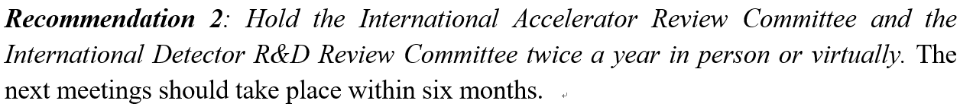
IAC request and IARC in 2021
IAC recommend the IARC meeting twice a year:
IARC Committee
Assignments
Talk No.
13 , 15
1 , 7
2 , 3
4 , 8
17 , 18
9 , 23
14 , 11
10 , 22
15 , 16
6 , 12
5 , 21
19 , 20
Principal
reviewer
Talk No.
14 , 16
4 , 17
1 , 9
2 , 3
19 , 20
7 , 21
12 , 22
6 , 19
11 , 23
13 , 15
8 , 18
5 , 10
help
reviewer
Chair:
Biagini Maria Enrica (INFN-LNF, Italy)
Members：
Bambade Philip (IJCLab, France)
Foster Brian (Oxford-DESY, England-GER)
Ko In Soo (Postech, Korea)
Levichev Eugene (BINP, Russia)
Ohuchi Norihito (KEK, Japan)
Oide Katsunobu (KEK/CERN, Japan/Swiss)
Pagani Carlo (Univ. Milan, Italy)
Sidorin Anatoly (JINR, Russia)
Stapnes Steinar (CERN, Swiss)
Tobiyama Makoto (KEK, Japan)
Zhao Zhentang (SINAP, China)
Foster Brian
Levichev Eugene
Biagini Maria Enrica
Oide Katsunobu
Sidorin Anatoly
Bambade Philip
Pagani Carlo
Ohuchi Norihito
Stapnes Steinar
Ko In Soo
Tobiyama Makoto
Zhao Zhentang

Slide 4
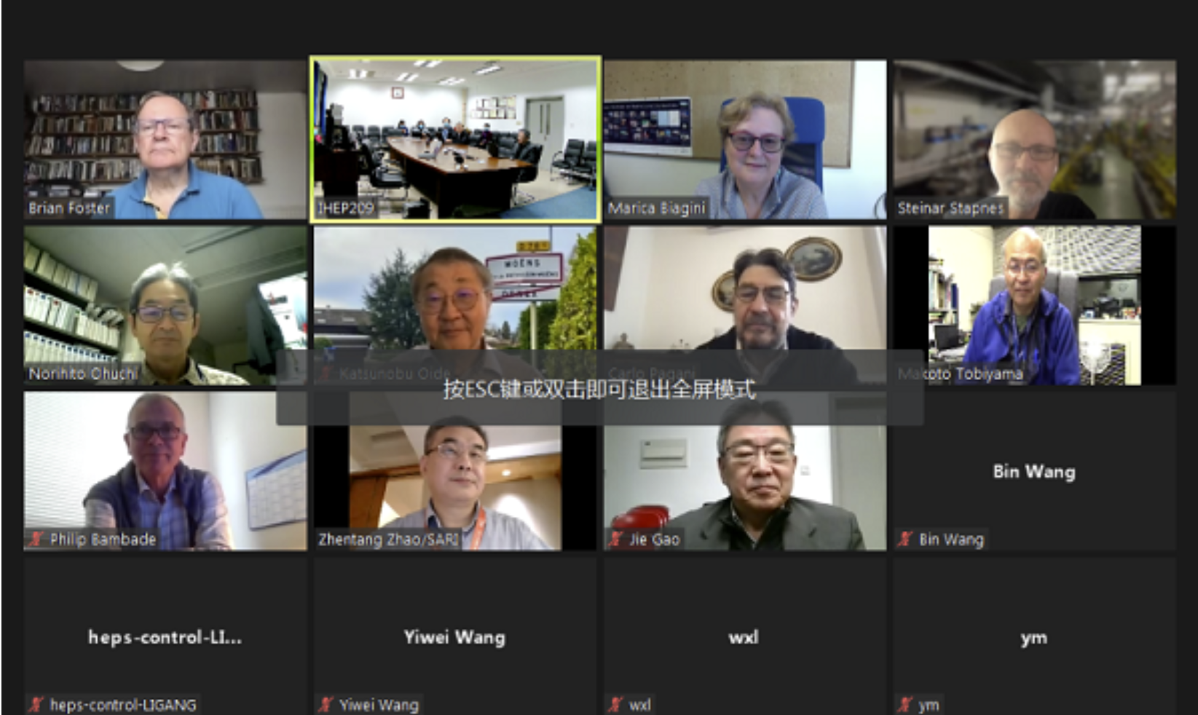
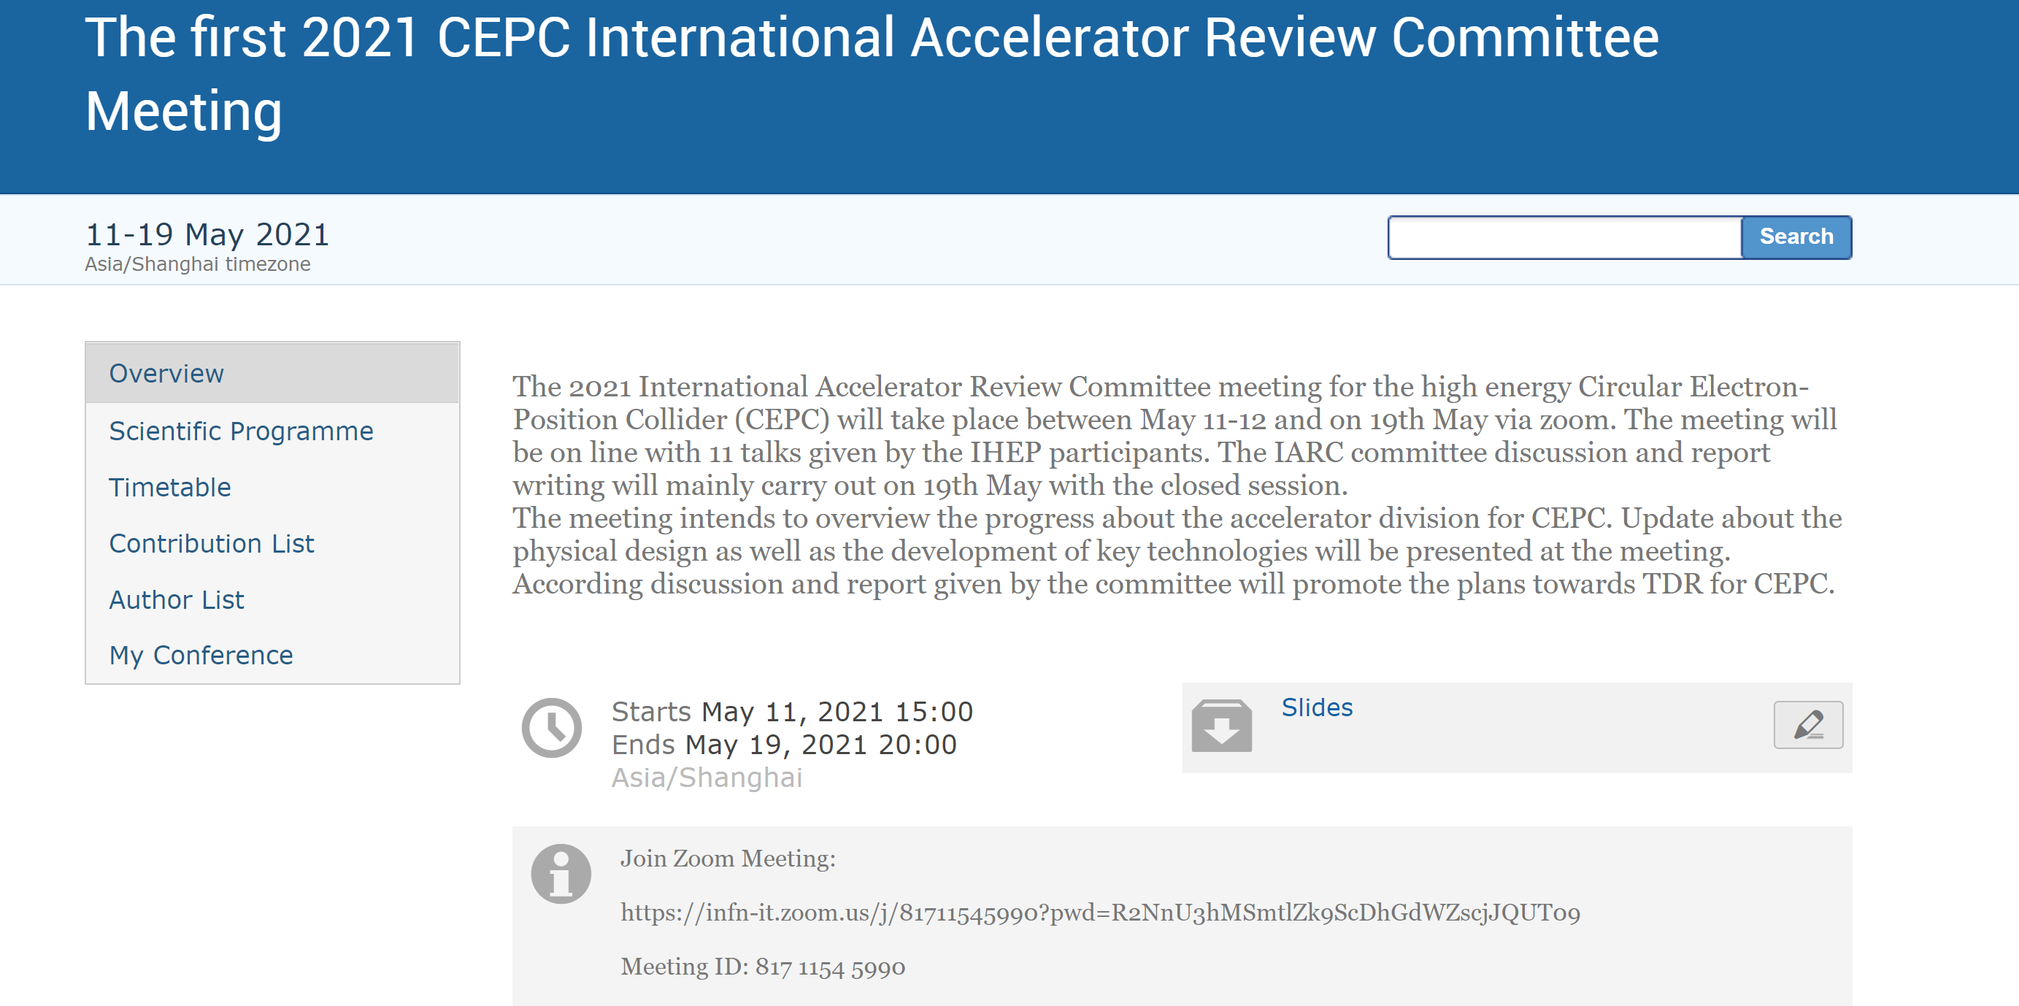
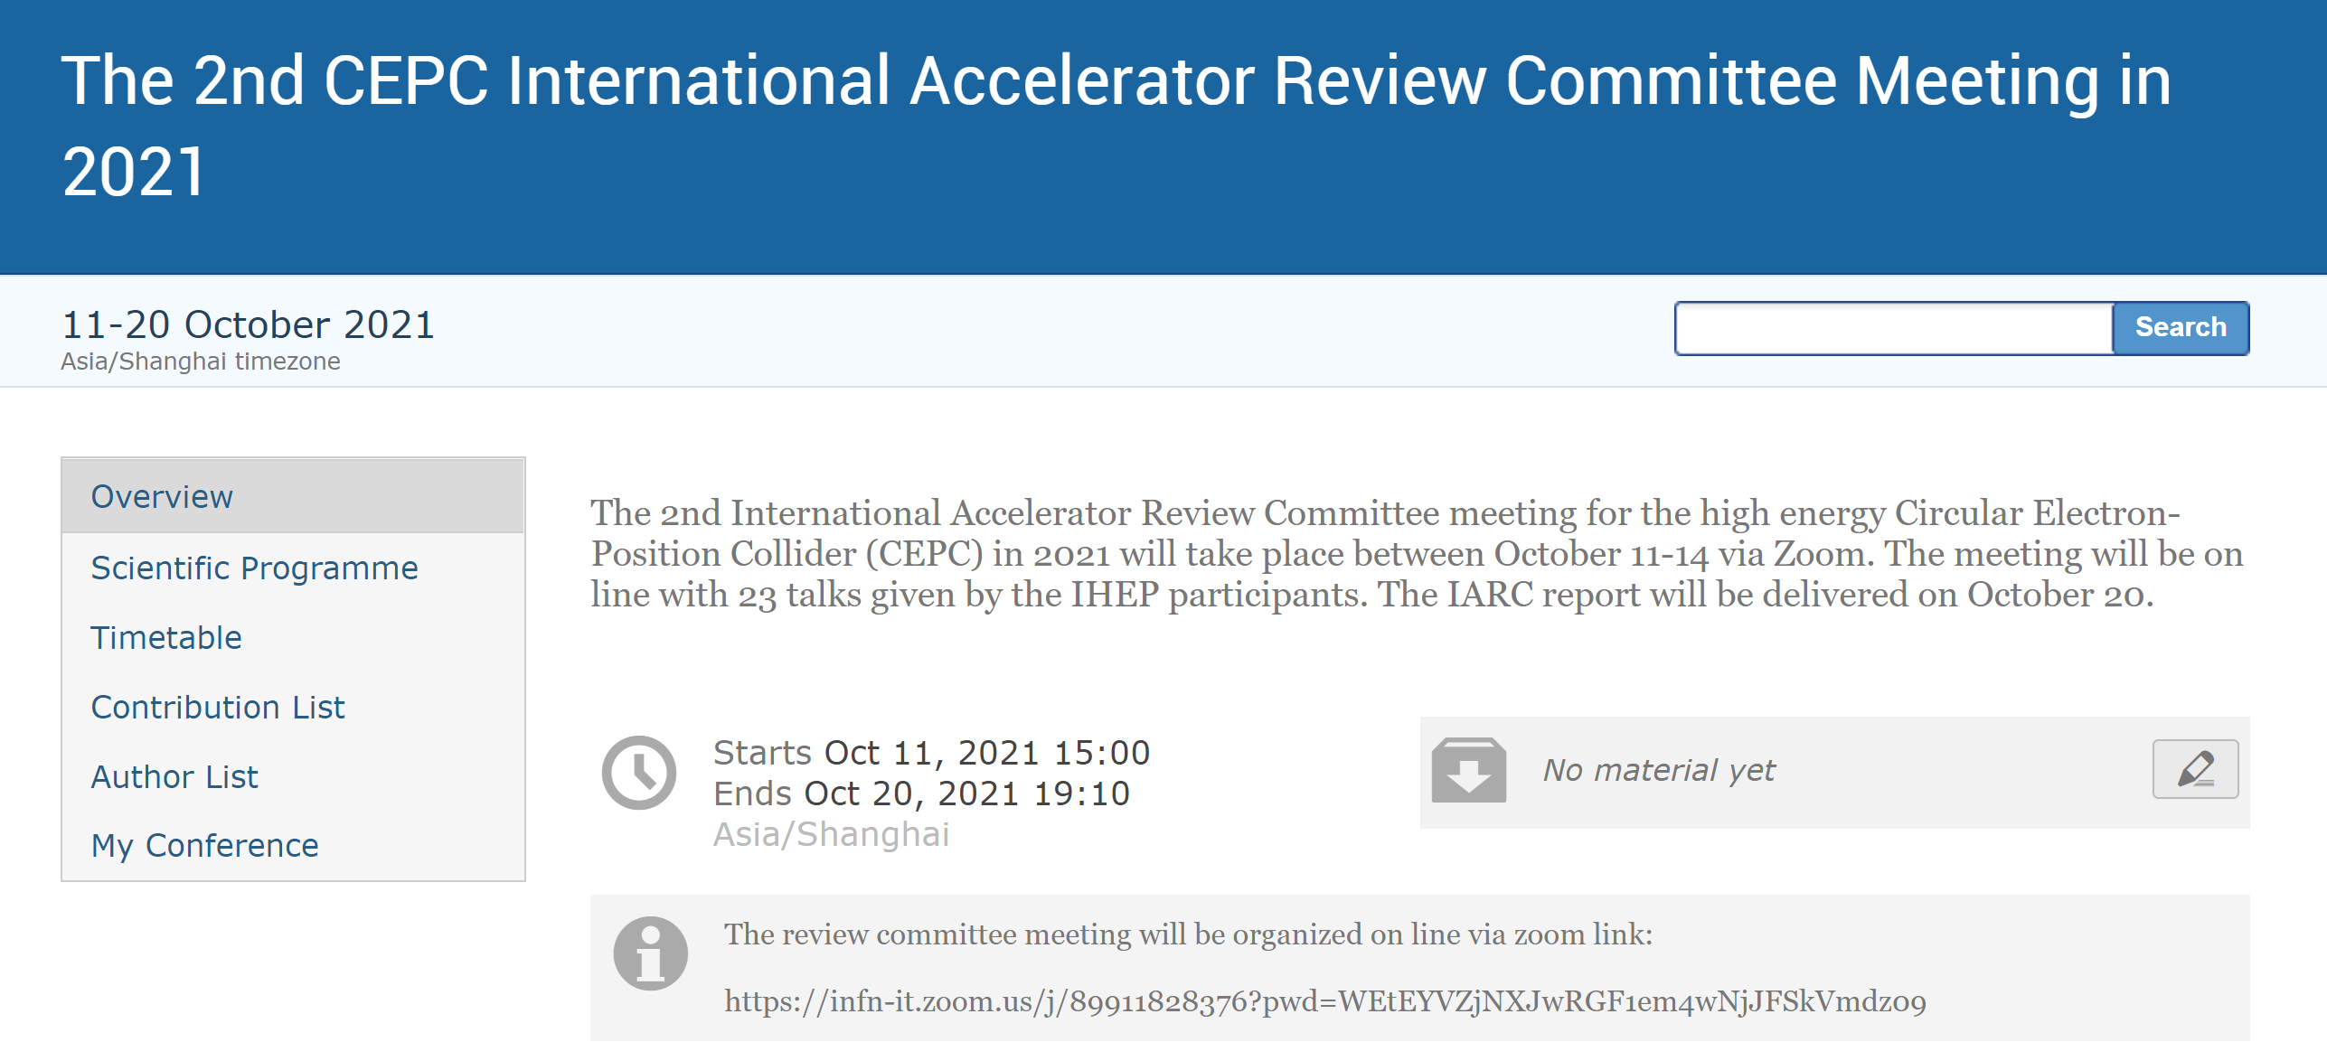
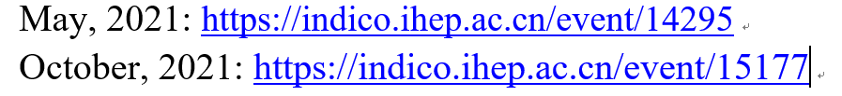
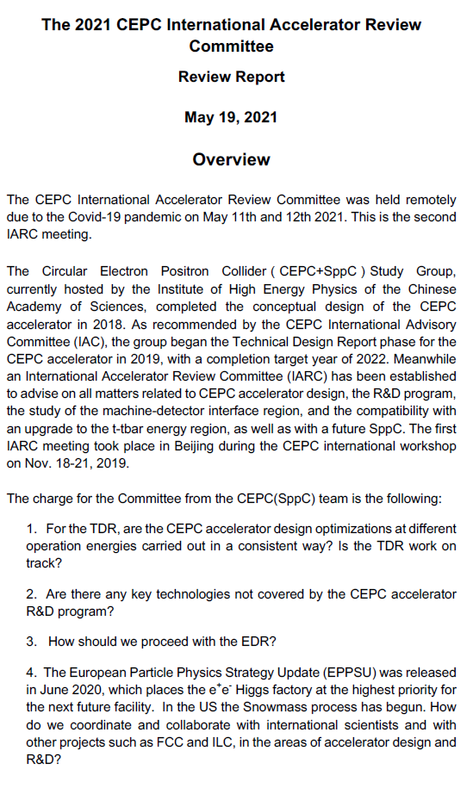
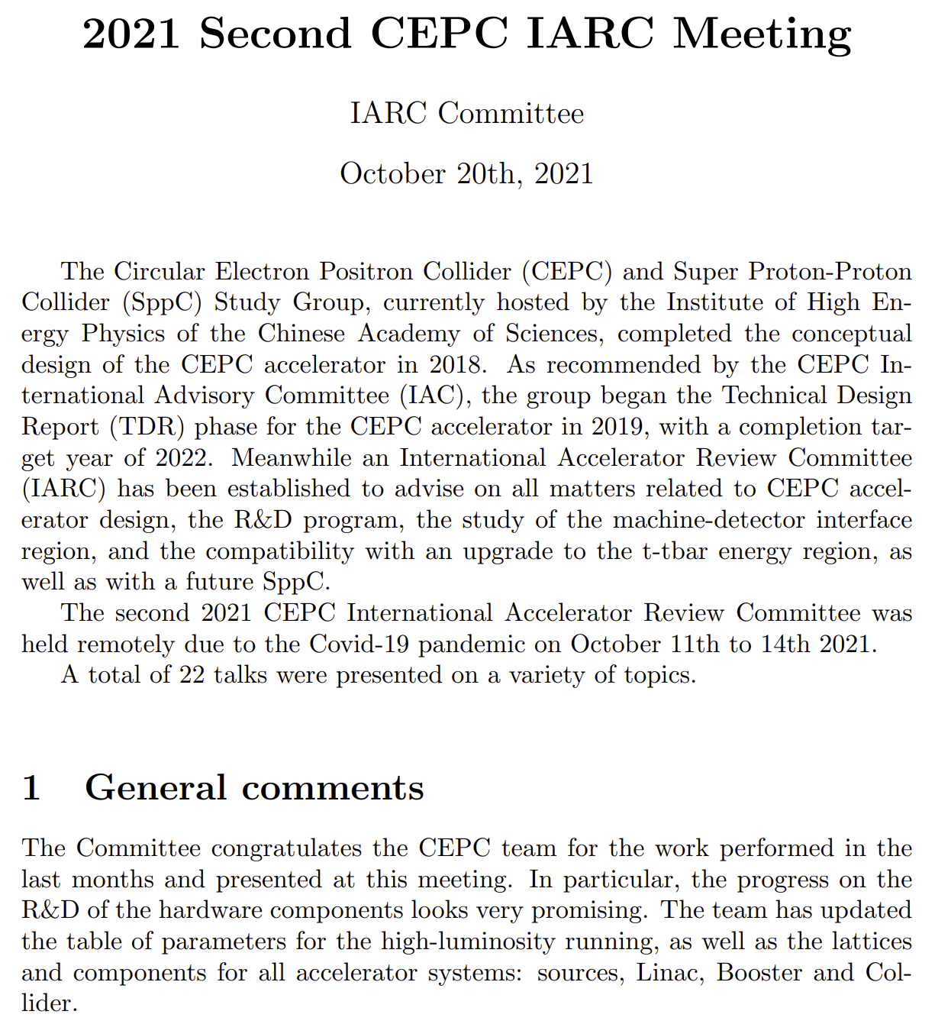
IAC request and IARC in 2021
Two online IARC meetings took place in May and October
Presentations, programs are available:
IARC delivered two dedicated reports to the meetings:

Slide 5
Talks in IARC
IARC in May, 11 talks
IARC in Oct, 22 talks
Coherent BB instability with long. Imped.
Status Overview of CEPC Project
Instrumentation, BPM, …
CEPC Accelerator TDR Status
CEPC accelerator TDR status overview
Normal conducting Mag., dipoles, quads,
Status of CEPC Collider Ring
CEPC collider lattice & error for High Lumi.
Investigation on the Polarization
Status of CEPC Booster Ring
CEPC Booster and Damping Ring Update
Collective instability with high Lumi.
Status of CEPC Linac
S2E simulation Linac & crucial component
Mechanical and MDI pipes & support
Progress on MDI Design
MDI Studies for CEPC
Cyrogenic System
Progress on CEPC RF system
CEPC SRF Progress on Cavities, Modules,...
Installation, Alignment Technologies
Progress on HTS Magnets
High Field Magnet R&D for CEPC/SppC
Timing strategy& Injec/Extrac. philosophy
Progress on High Efficiency Klystrons
650MHz High Efficiency Klystron Progress
Hardware preparation for Injec/Extra.
Progress on Plasma Injection
CEPC Plasma Injection Update
Electromagnet separator Prototype
Progress on IP SC Magnet
Control system challenge & collaboration
Electron dump system and safety issues

Slide 6
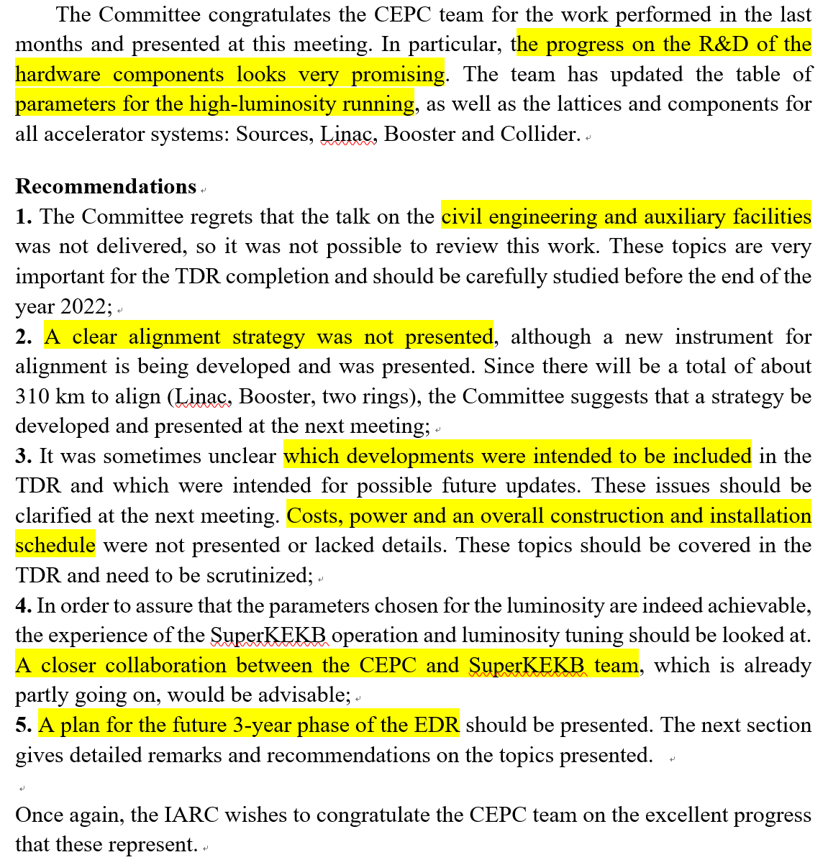
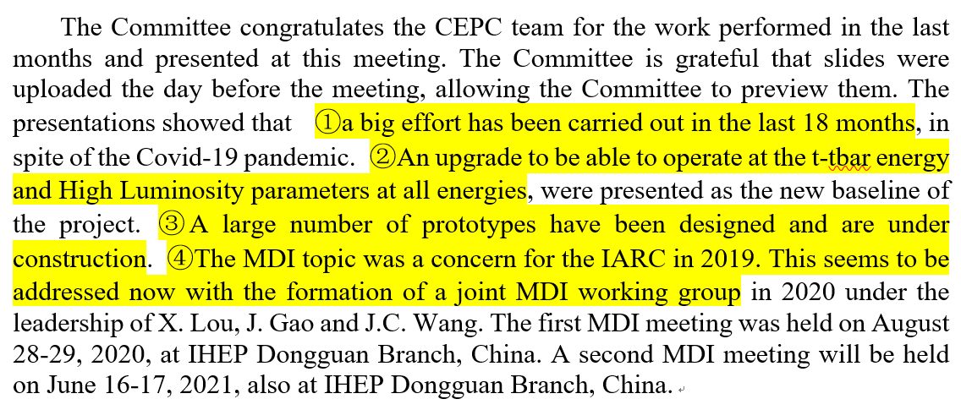
IARC General Comments
IARC in May
IARC in Oct

Slide 7
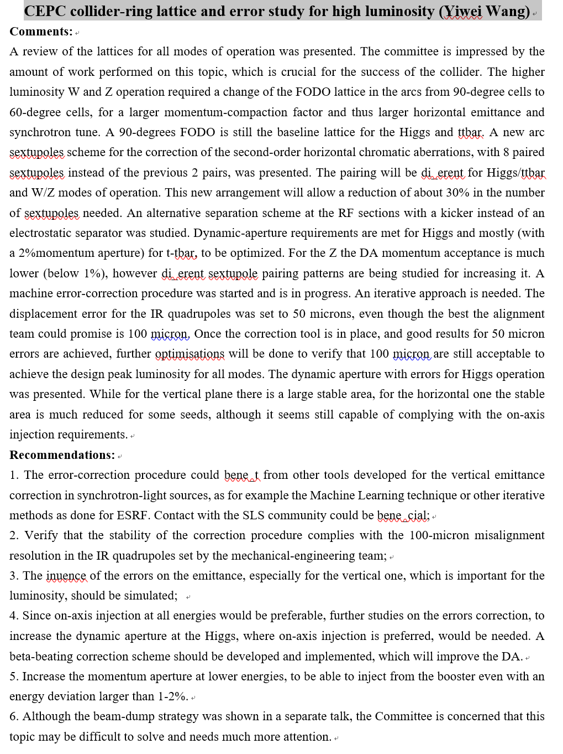
Report representative to single presentation
General Comments:
Progress High lights
Critical analysis
Recommendation:
Encouragement
Suggestions for weak points

Slide 8
Contents
Introductions
Theoretical design high lights and IARC recommendations
Collider ring parameters update
Booster scheme
Linac new baseline
MDI issues
Collective instabilities
III. IARC recommendations to the key technology hardware R&D
SRF development (platform, cavities, cryomodules, …)
650M high efficiency klystrons
Normal temperature magnets (booster dipoles, dual aperture quadrupoles and sextupoles
Electrostatic-magnet deflector
Hardware for injection/extraction
Final focus Superconducting quadrupoles
Mechanics
IV. Summary

Slide 9
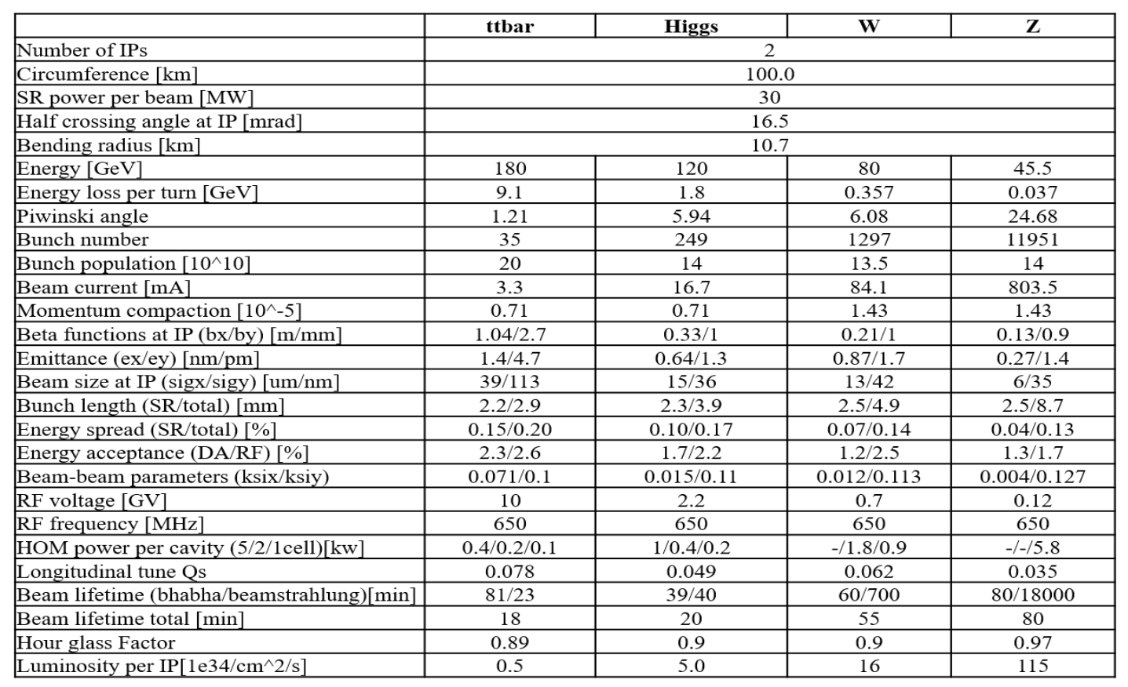
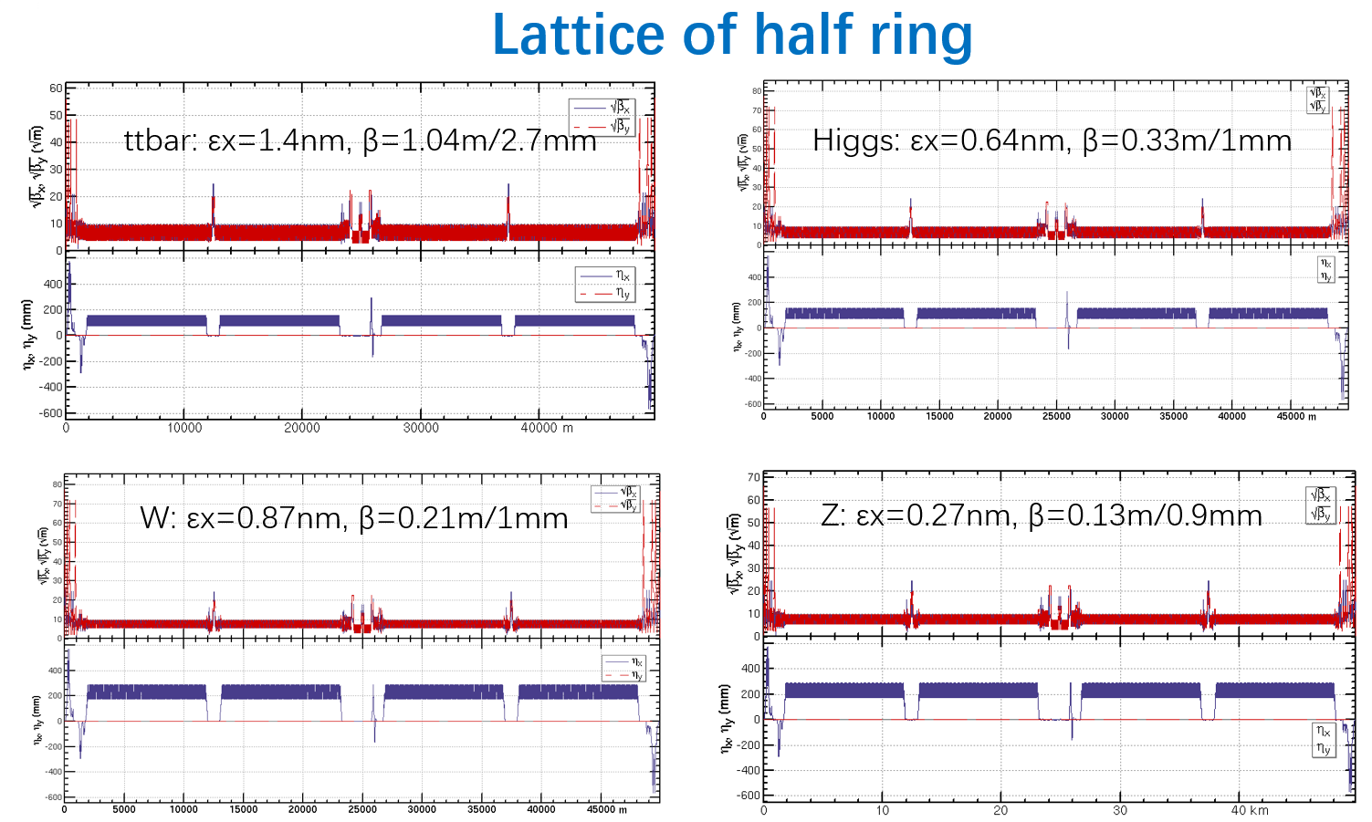
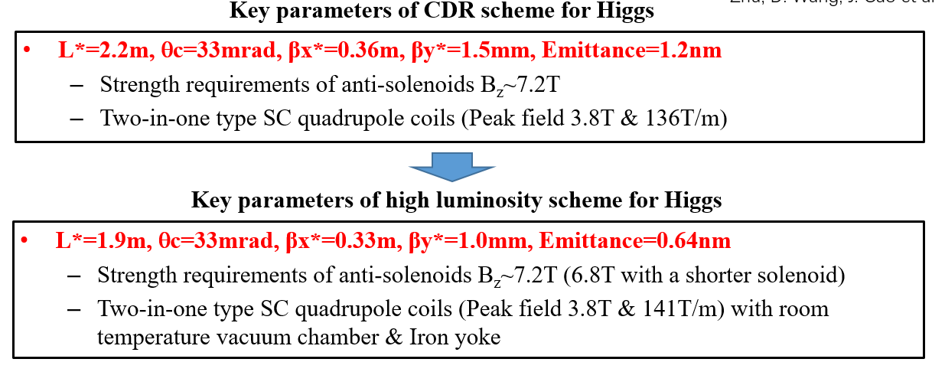
High lights to Collider: Lattice, IP and Main Parameters
Arc and IP region lattice & parameters updated: more arc sextupoles, MDI layout change, lower βy, smaller ε, … → Hi-Lumi & ttbar energy
Phase Advance
90˚
60˚

Slide 10
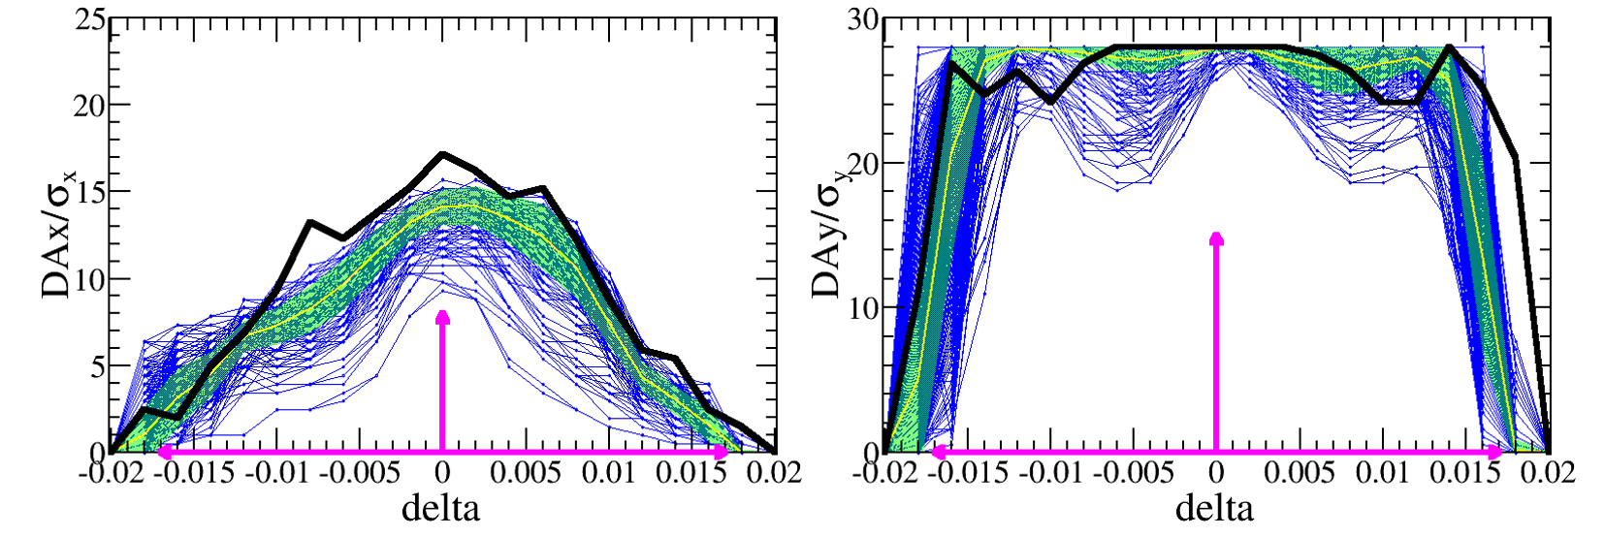
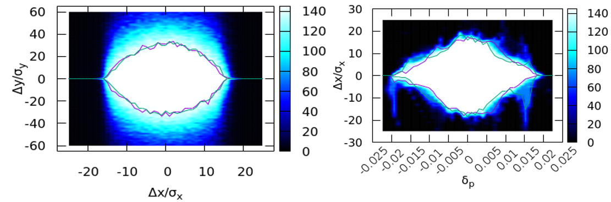
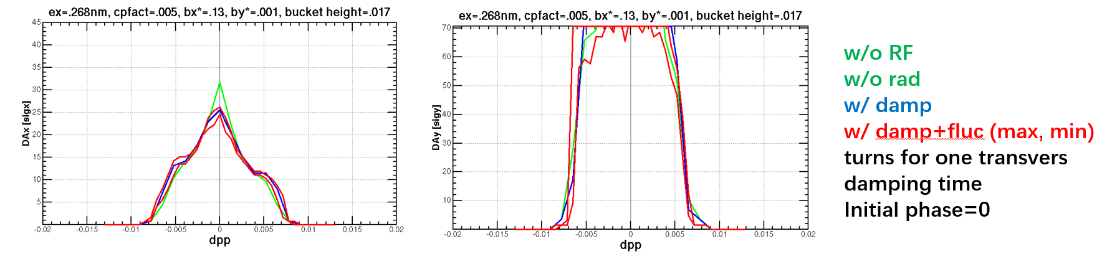
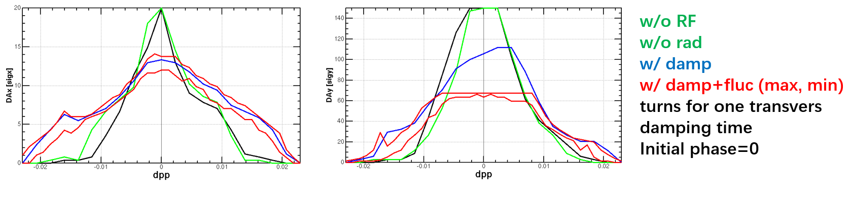
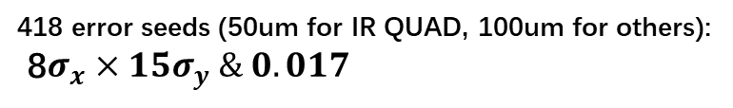
High lights to Collider: Dynamic Aperture and Errors
DA for Higgs and ttbar: 8 sigma-x with 2% momentum aperture; Z and W is on-going
Higgs: On-axis injection; (w/o error): $16σ_{x}×32σ_{y}×1.9\%$
418 error seeds (50um for IR QUAD, 100um for others):
8$σ_{x}×15σ_{y} \& 0.017$
Z: Off-axis injection; momentum acceptance <1%
ttbar: On-axis injection; (w/o error): $12σ_{x}×60σ_{y}×2\%$

Slide 11
Recommendations to Collider
A comprehensive review of DA for all modes: with larger IP errors, bigger momentum acceptance, …
The total diagram for the injection: on-axis for H, injection interference with collision, …
Further studies on error correction to increase the DA for Higgs (on-axis injection) is needed, try beta-beating correction scheme. → Other modes using off-axis with larger DA
Further DA studies: bigger momentum acceptance, bigger DA for H, …
Injection study: on-axis or off-axis to tt,…
Error studies: new method, larger error, impacts to emittance,…
IR QUAD misalignment increasing from 50 microns to 100 to be simulated
Investigations on the error impacts to emittance
Error correction with advanced technologies such as Machine Learning,…
Increase the momentum acceptance, for energy deviation larger than 1-2%
Bunch dump issues,…

Slide 12
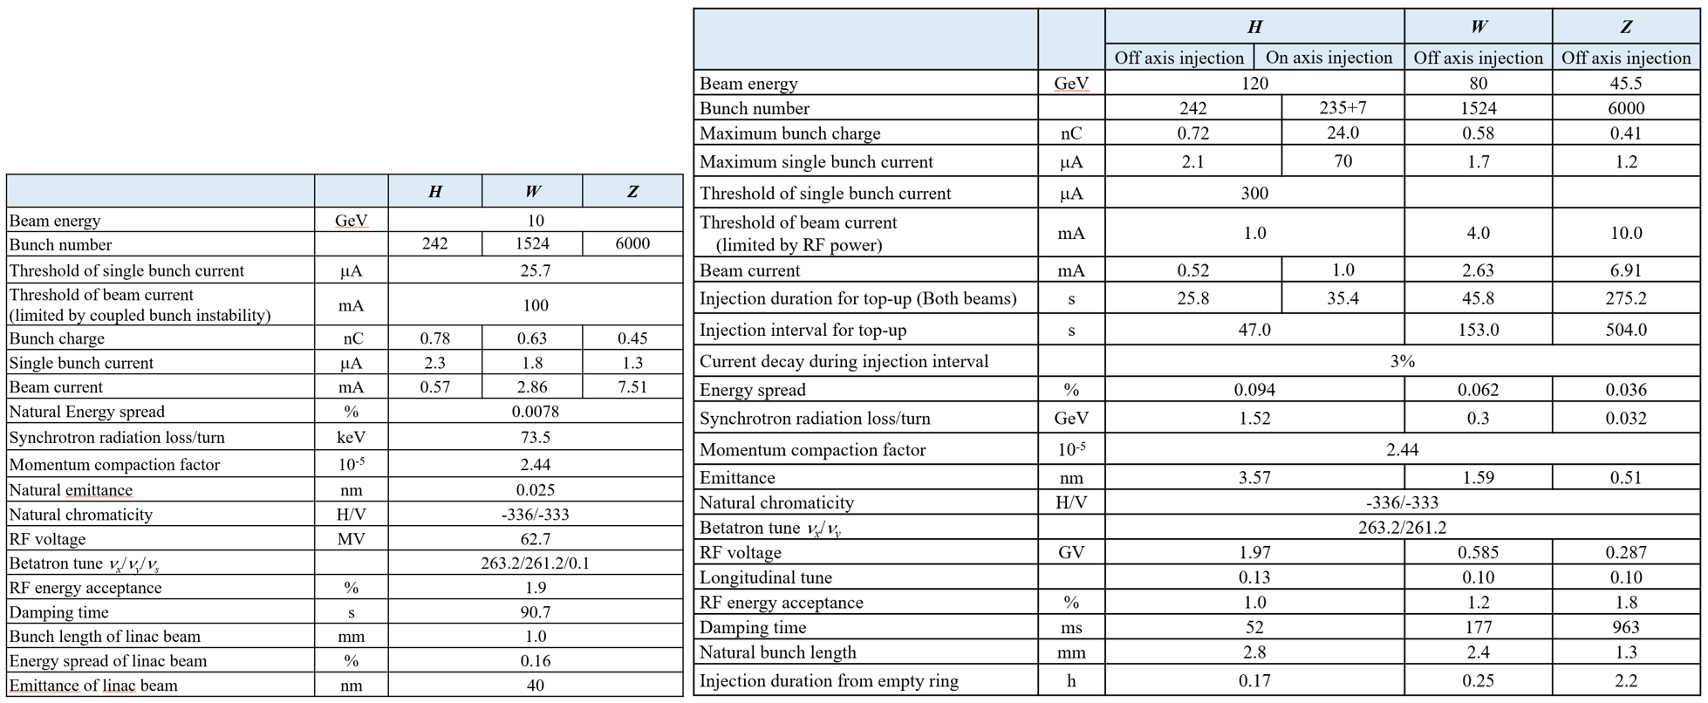
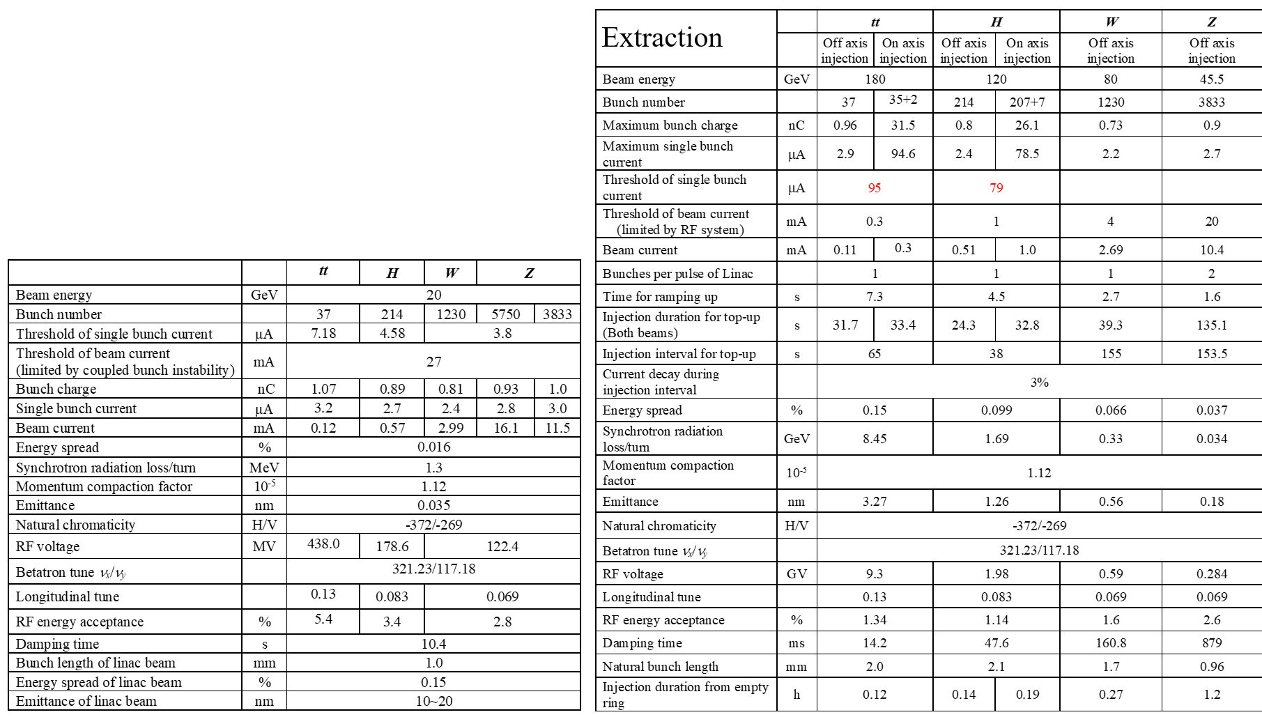
High lights to Booster: Parameters for H-Lumi.
Parameters for H-Lumi: lower extraction emittance, 20GeV Injection energy, 180GeV for tt, …
CDR
High Luminosity

Slide 13
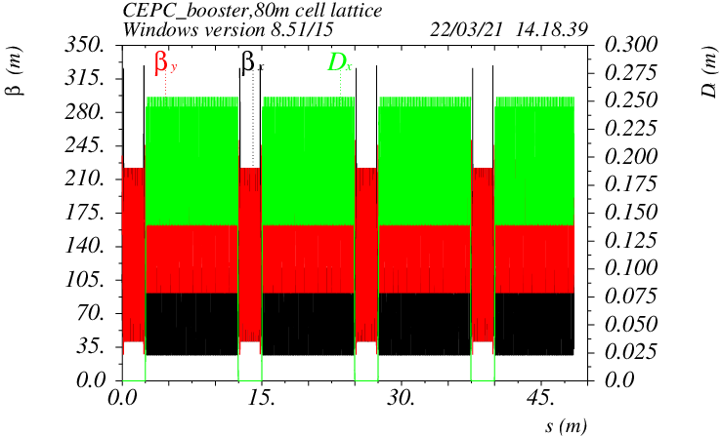
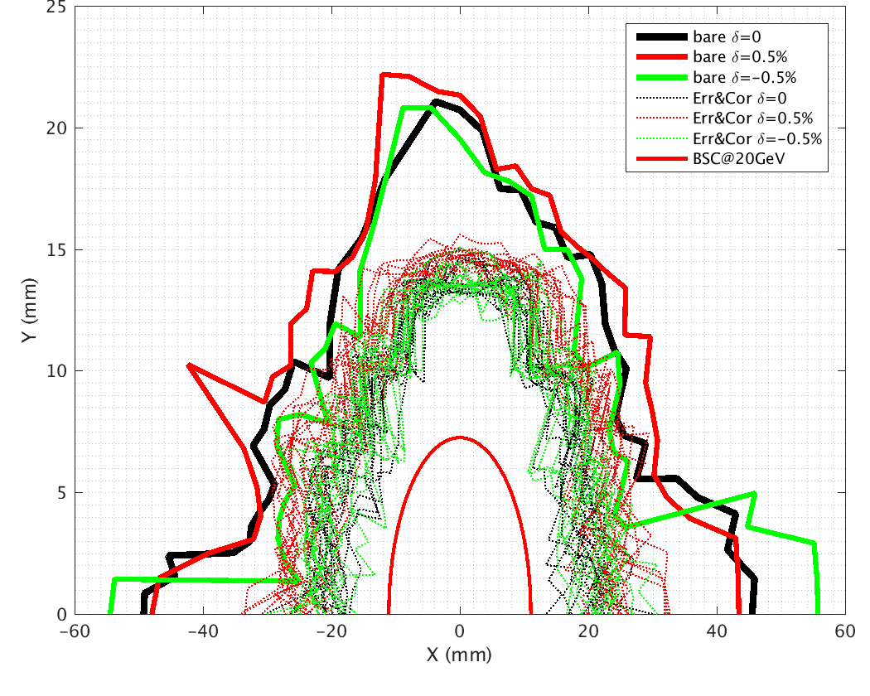
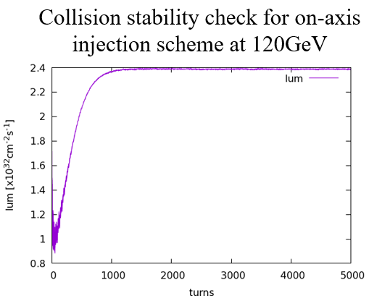
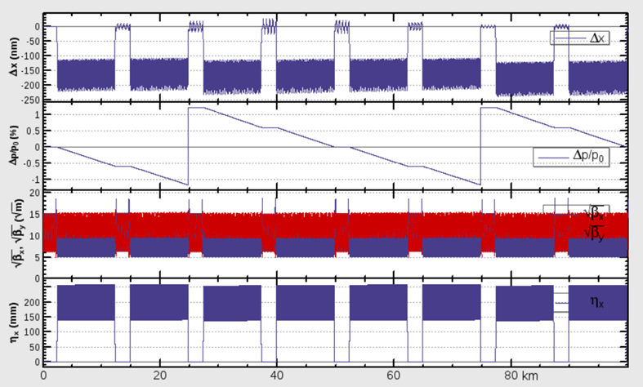
High lights to Booster: Parameters for H-Lumi.
Lattice converge to TME
DA @ 20 GeV with earth field & errors
Beam beam instability for on-axis injection
SR & Sawtooth error & tapered dipole compensation

Slide 14
Recommendations to Booster
Feedback components especially the kicker & high-power amplifiers should be optimized
Timeline of injection complex from e-gun to the full current collider at all energies for on&off-axis
DA including errors should be given
Reconsider the option of bypassing the baseline RF system for high Z current
Hardware check: kicker, dipole, SRF cavities
DA studies with error
Injection details, especially to on-axis injection for Higgs
Develop the error correction procedure for sufficient DA at each energies (100 seeds）
Check booster combined-function dipole strength to ensure required DA at all energies
More detailed studies for the on-axis injection for Higgs

Slide 15
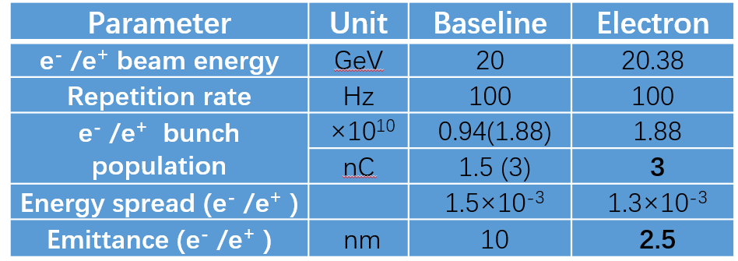
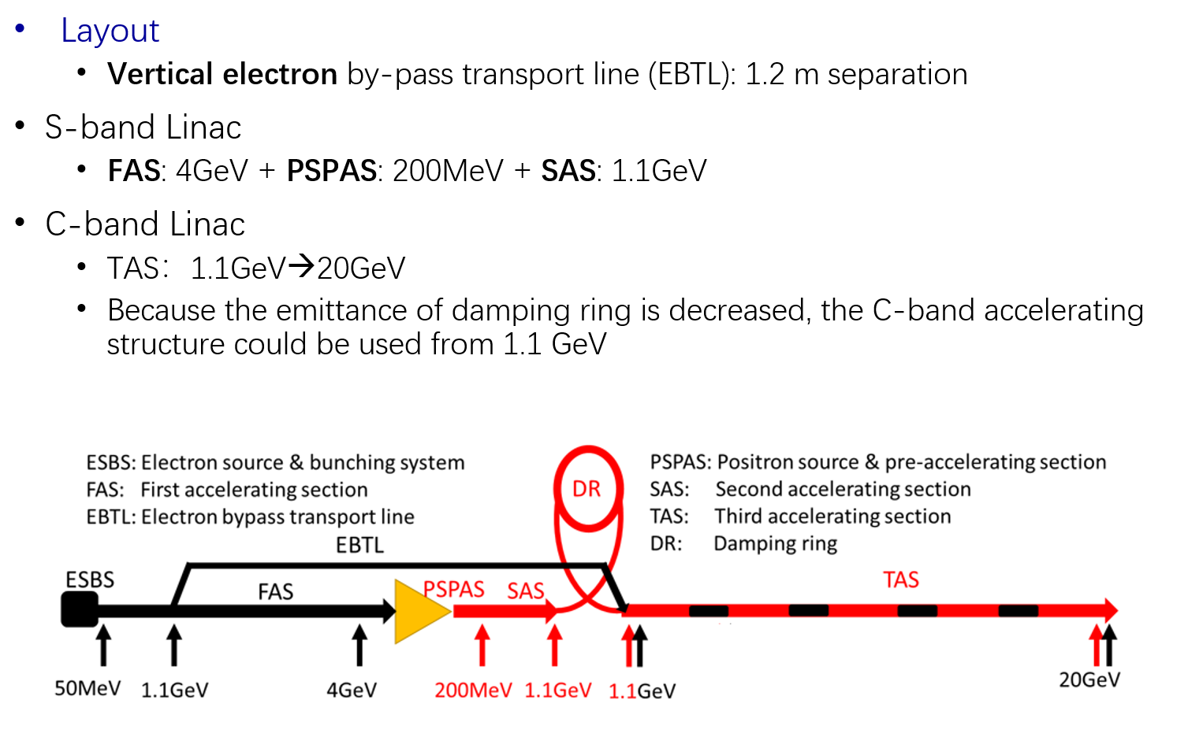
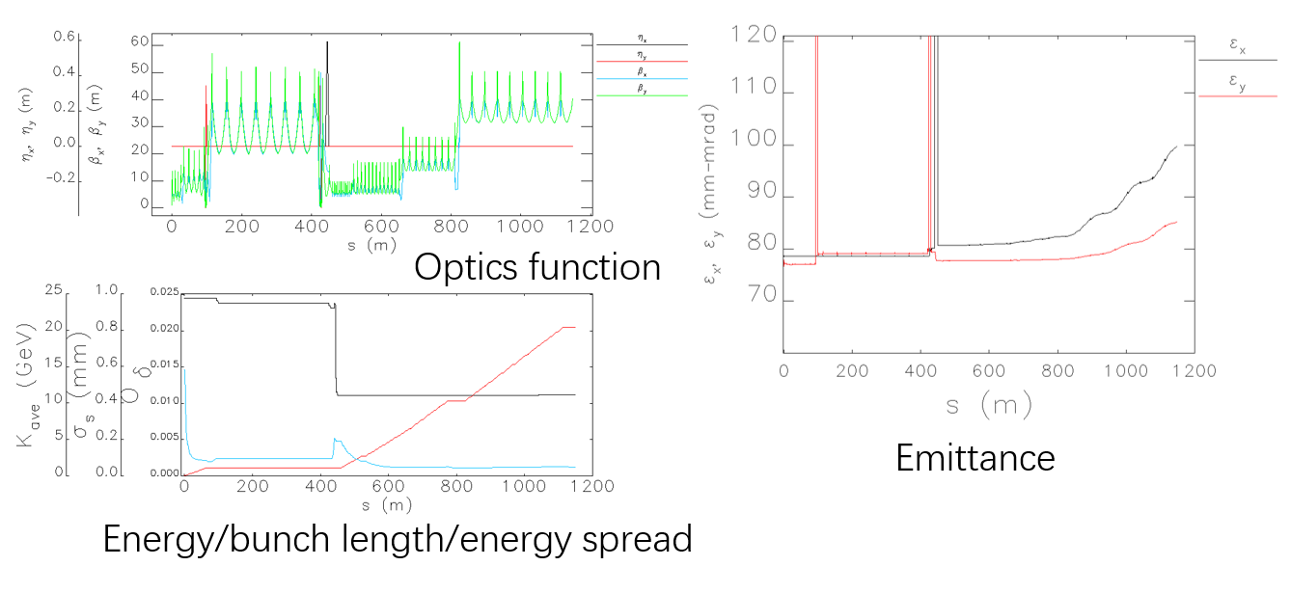
High lights to Linac & Damping ring: New Baseline
New baseline for linac: 20GeV by C-band cavity, lower ε (40nm→10nm), layout optimization, …
S2E simulations for LINAC

Slide 16
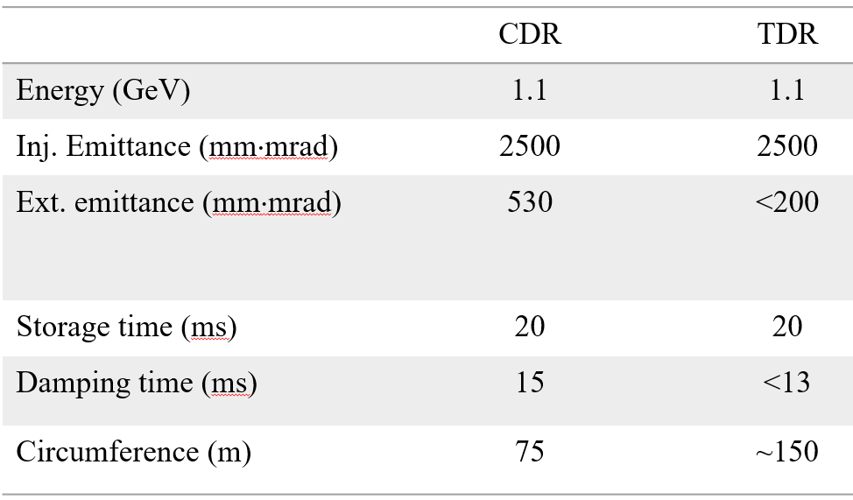
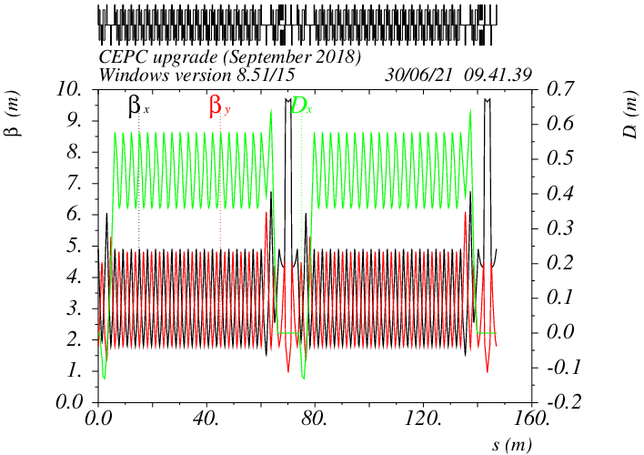
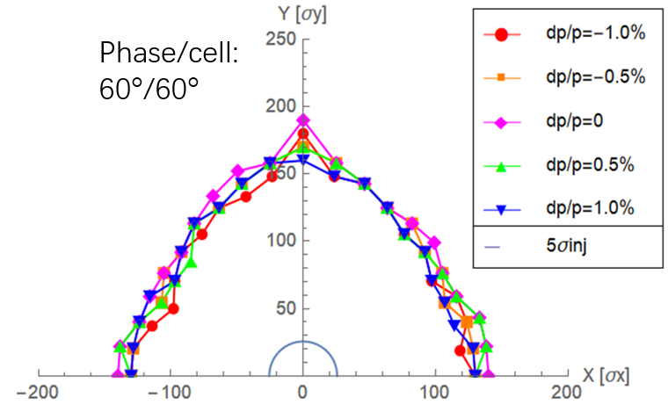
High lights to Linac & Damping ring: Damping Ring
Layout, basic comparison
Lattice design (60°~90° FODO)
Preliminary DA studies
(>5 injection beam size)

Slide 17
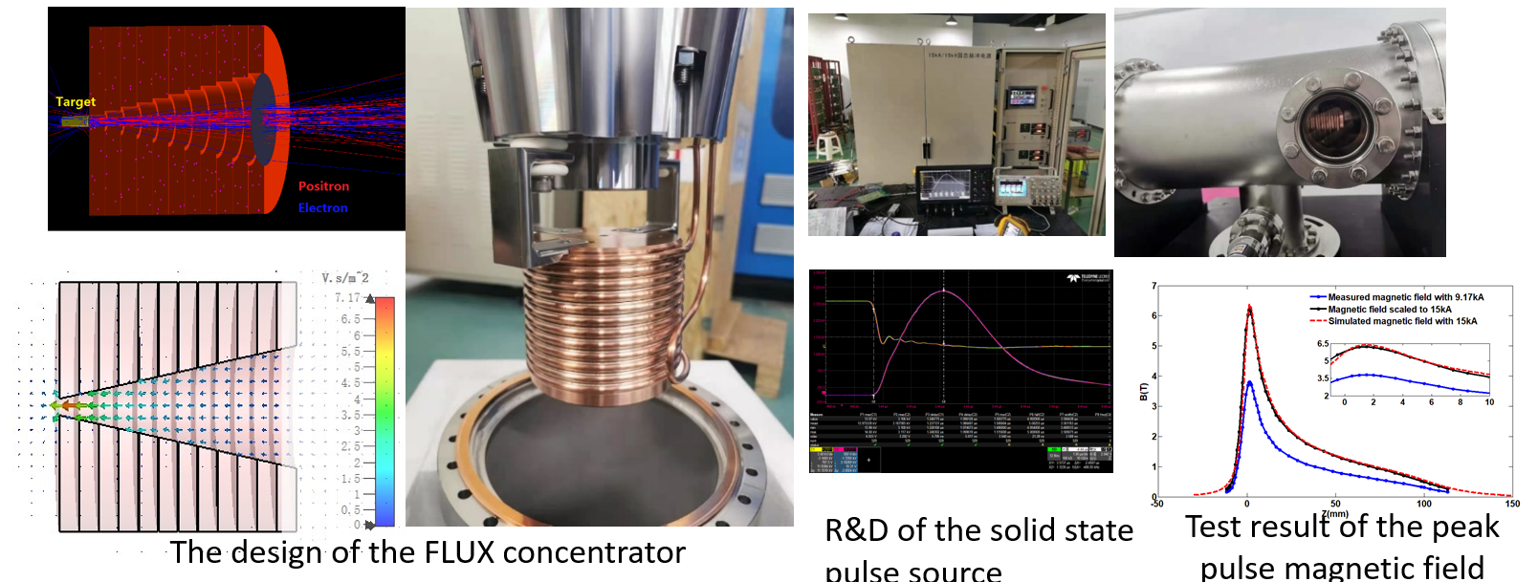
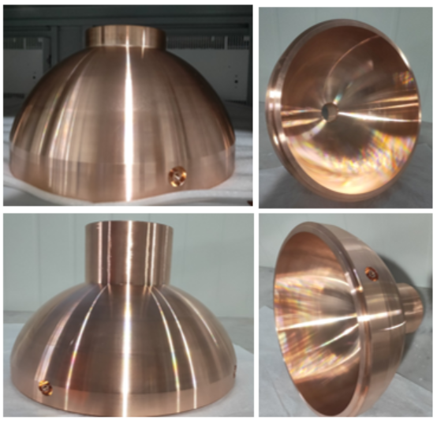
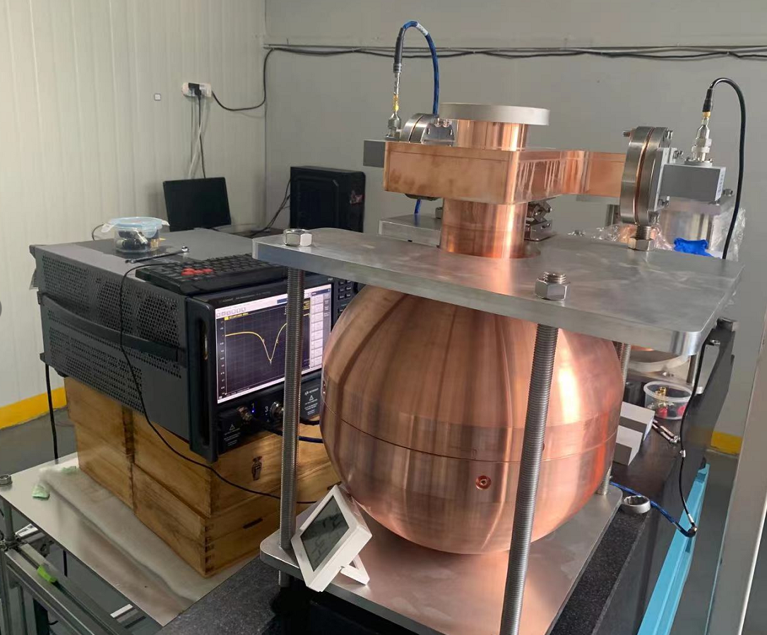
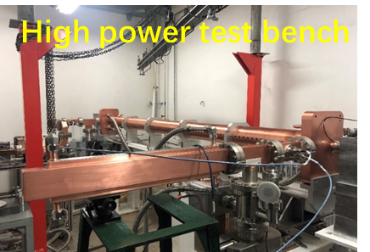
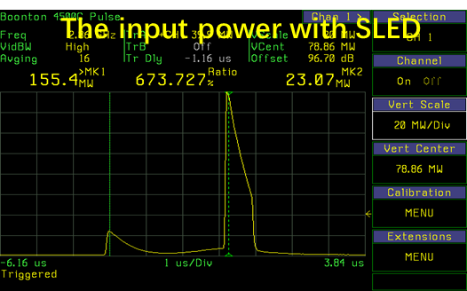
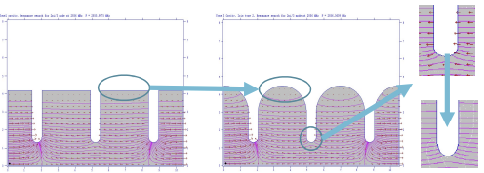
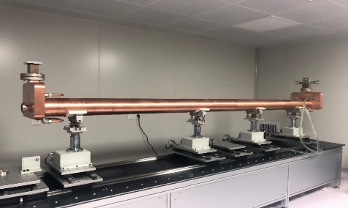
High lights to Linac & Damping ring: Hardware
Flux concentrator for positron source
S band pulse compressor
High perform. S-band Acc. Struc.
pulsed magnetic field of 6 T to 0.5 T
15kA/15kV/50Hz solid state pulse source

Slide 18
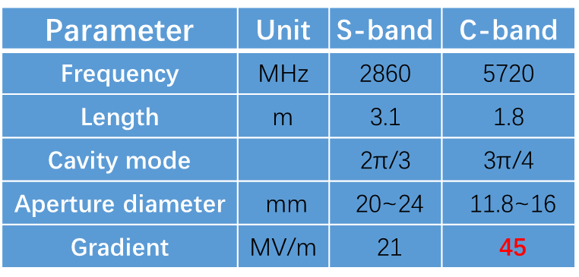
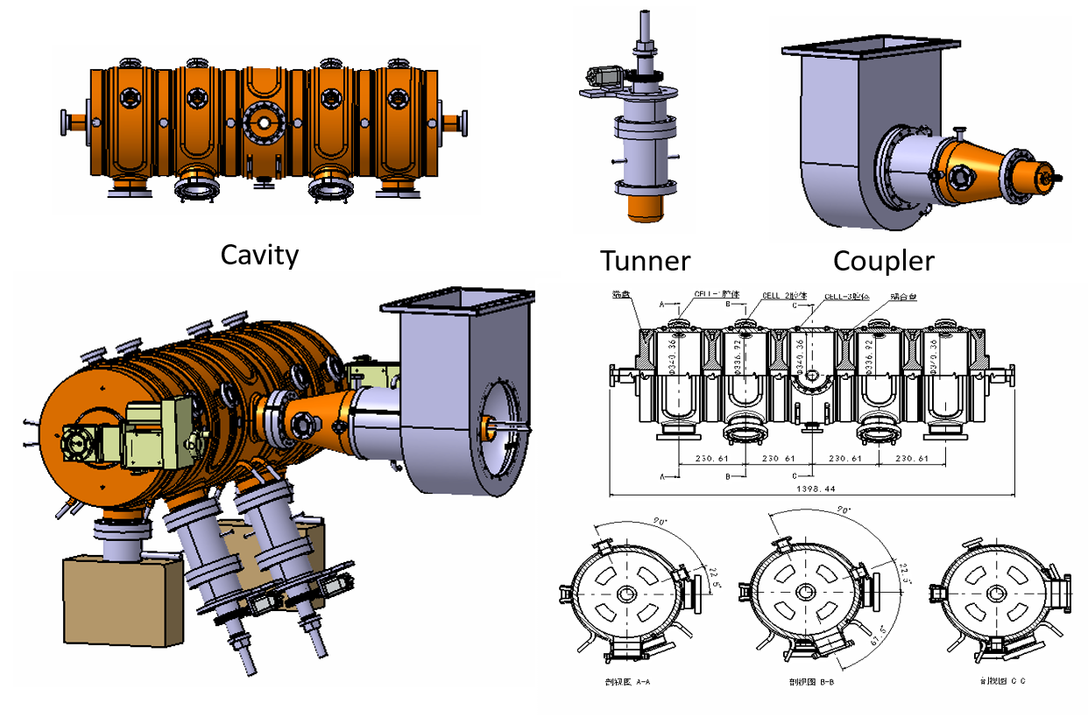
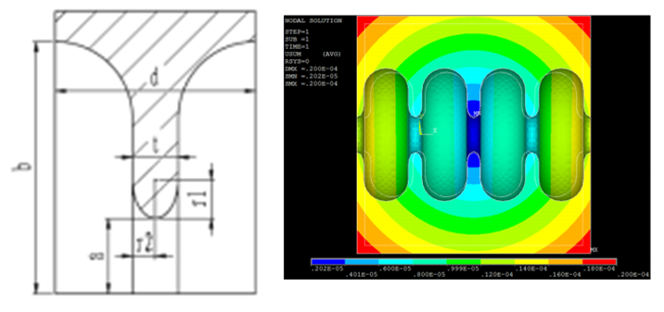
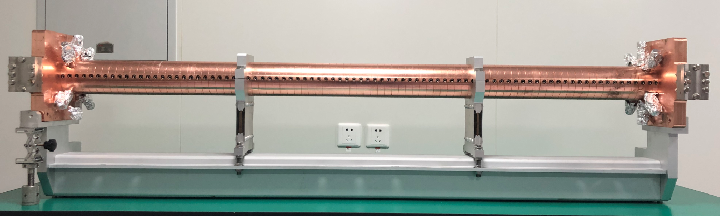
High lights to Linac & Damping ring: Hardware
Preliminary study for C-band Acc. Structure
Design work for 650M DR RF cavity
Waiting for C-band Klystron for the test

Slide 19
Recommendations to Linac & Damping ring
Establish a consistent injection diagram for the collider, booster, damping ring and linac
More info. for C-band structure
Check the injector diagram for all modes from DR and Linac
Check the parameters, including LINAC, consistency for H-Lumi Z
Further studies for DR
DR design seems not mature, reconsider the design based on simulated Positrons from the target through the linac and energy compressor with the realistic distributions
Check the reason of the emittance growth after about 800m even without error
Check all parameters whether compatible with H-Lumi for Z mode

Slide 20
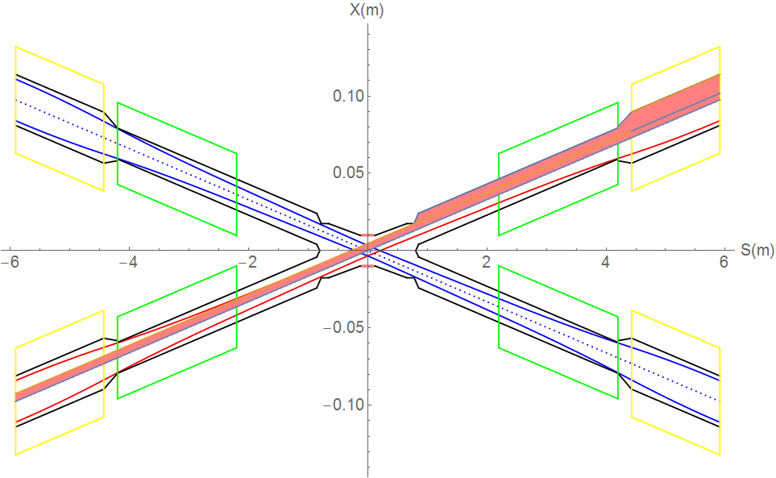
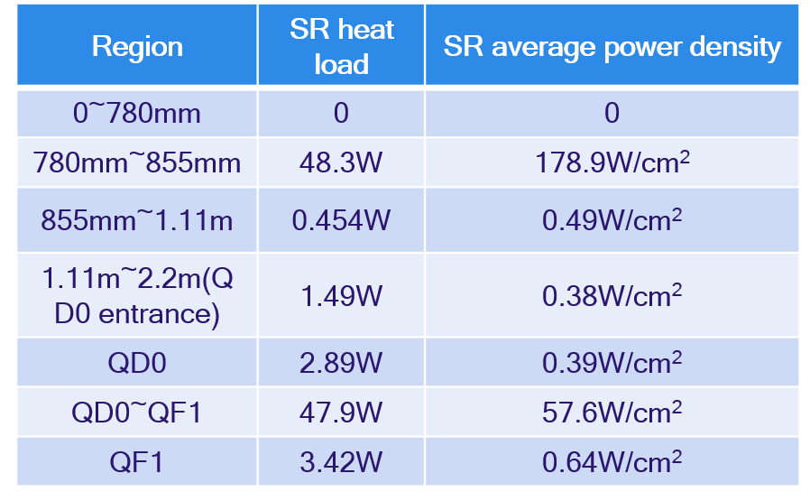
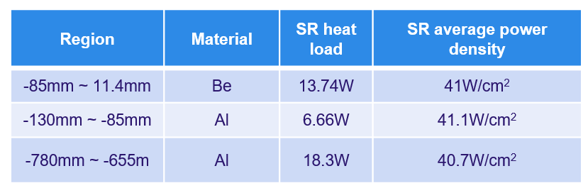
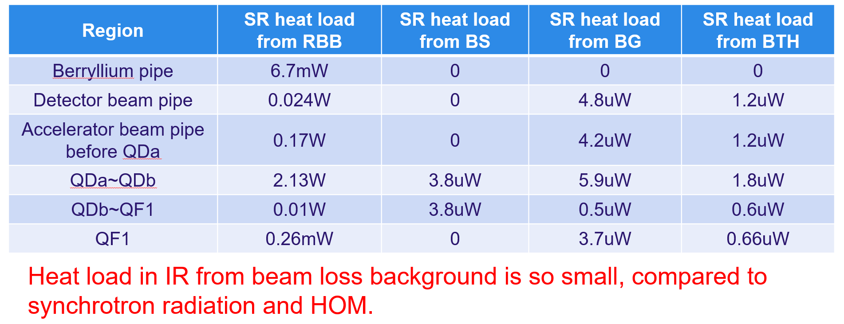
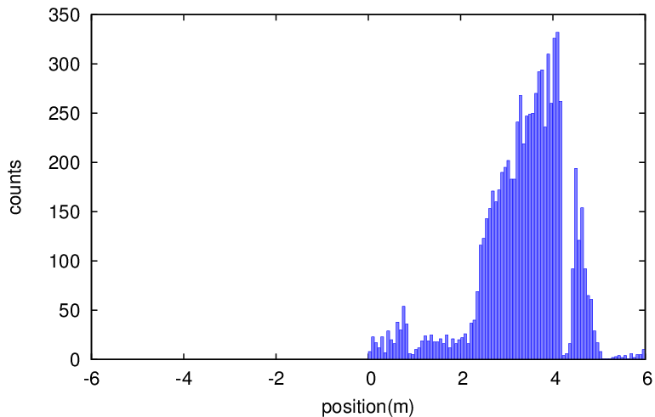
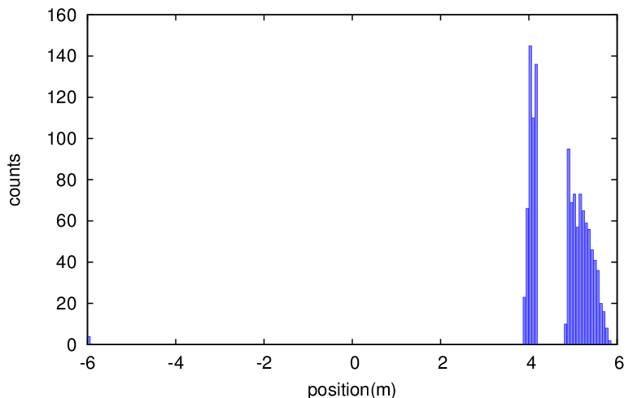
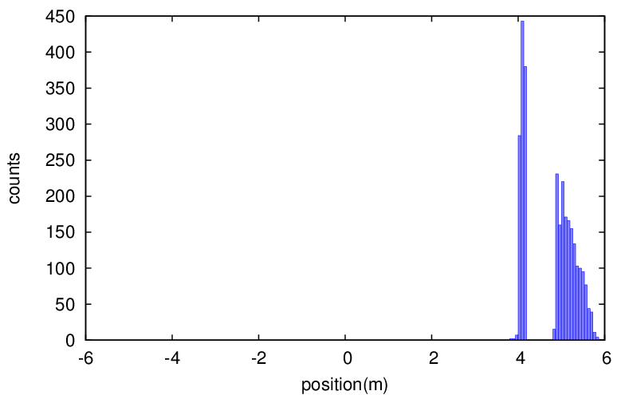
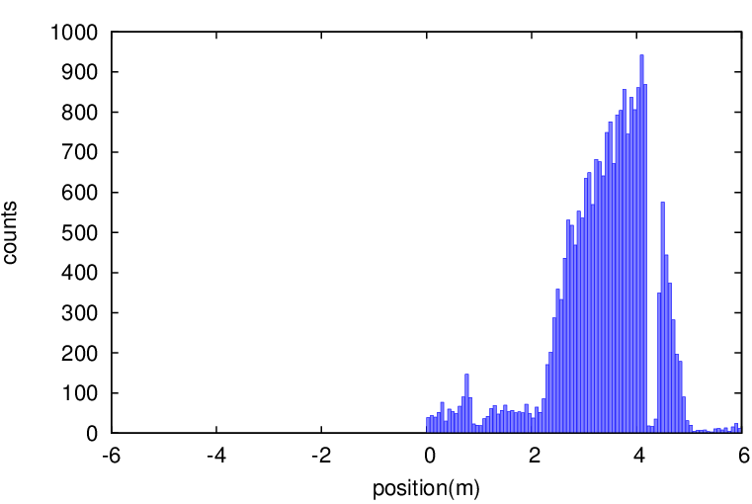
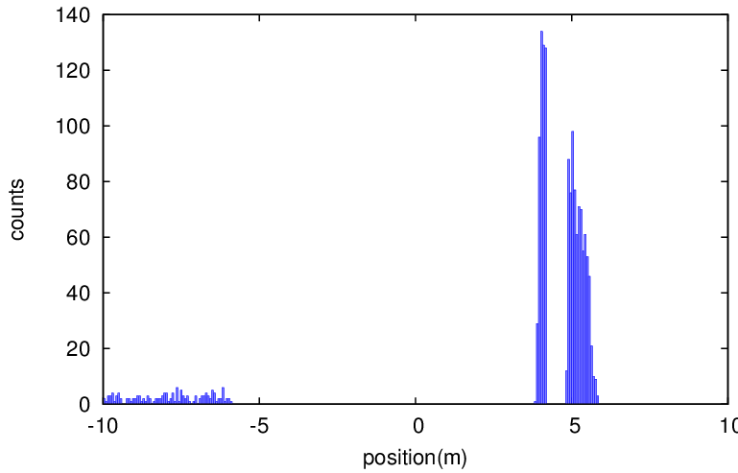

High lights to MDI: SR heat & Beam loss
SR heat load in normal & extreme conditions
Normal Condition
Extreme Condition
Extreme condition, eg, if a magnet power is lost, a large distortion will appear immediately for the whole ring orbit.
In extreme cases ~ at least 10 times per day. The beam will be stopped within 0.5ms when abnormal.
Beam loss effects due to Radiative BhaBha, Beam gas inelastic scattering, Beam thermal photon scattering, with multipole & beambeam
RBB
with BB
BG
with BB
BTH
with BB
RBB
with multipole
BG
with multipole
BTH
with multipole

Slide 21

High lights to MDI: HOM

Slide 22



High lights to MDI: Collimator & Shield
Two pairs of vertical collimators added for one IP in one ring, with which the beam loss background with multipole errors and beam-beam effects reduced 20%.

Slide 23
Recommendations to MDI
A full simulation including detector, to evaluate the impact of beam losses in IR
Heat load for the Hi-Lumi. Z should be investigated
Complete scheme of collimation including near-IR ones
An IP feedback procedure for keeping beams in collision and stable luminosity
Electromagnetic force with interference between the detector-solenoid and compensation coil
Comprehensive simulation with detector
More detailed studies on beam loss effect
Imperfect beam instead of Gaussian for simulations
Take into accound the tungsten shield weight for the cryostat into the deformation/alignment studies
A fast beam-abort system to protect the most sensitive components in detector and SCQ
Beam loss simulations with average effect over many seeds instead of specific seeds; More detailed simulations to each multipole error individually
Extend the detector GEANT4 simulations to include the beam line components some meters around the IP on both sides
Try different charge distribution more than Gaussian for the SR heat load
Beam loss from continuous top-up injection to be analyzed; Tolerances to imperfect beam from booster (large emittance, non-Gausian distribution) should be investigated for collimation-system parameters

Slide 24

High lights to Collective Instability
Impedance budget for H-Lumi. Z

Slide 25



High lights to Collective Instability
Instabilities: MWI & bunch lengthening; Transverse mode coupling; Trans. Resistive wall;

Slide 26


High lights to Collective Instability
Instabilities: beam ion; electron cloud;

Slide 27
Recommendations to Collective Instability
The requirement for the transverse feedback damping time of 3 turns is difficult to realize: fundamental stability limitation of the feedback system & broadband noise injected to the FB works to excite the beam
Develop a dedicated feedback system ofr the resistive-wall instability
Consider the feasibility to the FB requirement

Slide 28
Contents
Introductions
Theoretical design high lights and IARC recommendations
Collider ring parameters update
Booster scheme
Linac new baseline
MDI issues
Collective instabilities
III. IARC recommendations to the key technology hardware R&D
SRF development (platform, cavities, cryomodules, …)
650M high efficiency klystrons
Normal temperature magnets (booster dipoles, dual aperture quadrupoles and sextupoles
Electrostatic-magnet deflector
Hardware for injection/extraction
Final focus Superconducting quadrupoles
Mechanics
IV. Summary

Slide 29


High lights to SRF: 650M 1&2 cell cavity
Cavity | Processing | Result
650S4 (FG) | Bulk BCP 200 um + light EP 20 um + 950C 3h + light EP 20 um + 120C 48h | 2.7E10@ 35.0MV/m
650S7 (LG) | Bulk FP 200 um + 950C 3h + light EP 20 um + 900C 3h + light EP 20 um + 120C 48h | 3.1E10@ 33.0MV/m
650S5 (FG) | Bulk EP 200 um + 120C 48h | 1.5E10@ 37.5MV/m
650S8 (LG) | Bulk BCP 200 um + light EP 20 um + 950C 3h + light EP 20 um + 120C 48h | 4.6E10@ 28.2MV/m
Studies on EP process for 650 MHz 2-cell cavities were carried on.
New jigs and cathodes special for the EP on 650 MHz 2-cell cavities was made.
Parameters were scanned and optimized for the process like voltage, temperatures, flow rates and so on.
Some technological processes like on-site DI water cleaning were re-developed.
The new-treated cavities will be ready soon.

Slide 30
High lights to SRF: 650M 1&2 cell cavity
Cavity | Processing | Result
650S4 (FG) | Bulk BCP 200 um + light EP 20 um + 950C 3h + light EP 20 um + 120C 48h | 2.7E10@ 35.0MV/m
650S7 (LG) | Bulk FP 200 um + 950C 3h + light EP 20 um + 900C 3h + light EP 20 um + 120C 48h | 3.1E10@ 33.0MV/m
650S5 (FG) | Bulk EP 200 um + 120C 48h | 1.5E10@ 37.5MV/m
650S8 (LG) | Bulk BCP 200 um + light EP 20 um + 950C 3h + light EP 20 um + 120C 48h | 4.6E10@ 28.2MV/m
Studies on EP process for 650 MHz 2-cell cavities were carried on.
New jigs and cathodes special for the EP on 650 MHz 2-cell cavities was made.
Parameters were scanned and optimized for the process like voltage, temperatures, flow rates and so on.
Some technological processes like on-site DI water cleaning were re-developed.
The new-treated cavities will be ready soon.

Slide 31




High lights to SRF: SRF beam test facility
Cavity string and module assembly in March to May 2021.
Modul installation in beamline, 2 K cool down test and RT coupler conditioning in May to July. Horizontal and beam test soon.
IR laser output to 116 W. Photo-cathode QE to 5 %. DC gun vacuum to 1.5E-10 Pa, voltage to 350 kV. Buncher cavity high power tested.

Slide 32







High lights to SRF: 1.3 GHz 9-Cell TESLA cavity
IHEP PAPS established in July 2021
Horizontal test stand, 1.3GHz 9cell cavities, and couplers...
1.3 GHz 8x9-cell high Q cryomodule prototype
Component fabrication in 2021 to mid 2022
Assemble and horizontal test in 2022
Ship to Dalian in 2023
1.3 GHz High Q Mid-T Cavity Horizontal Test

Slide 33
Recommendations to SRF Cavity
TESLA type 1.3GHz cavities use HOM couplers with a power limit of ~1W. Verify HOM coupler consistency also for the Hi-Lumi. Z mode.
Continue the successful collaborations with industry
Never mix the long-term R&D, like the one required for the ttbar cavities, with the R&D for routine produced industrial components
Further industrialize the SRF technique
Reinforce and extend international collaborations on critical components
Further improve he collaboration with SCRF groups in China, engaged in FEL and ADS
Maintain and extend collaboration with international laboratories also with strong expertise in SCRF
Pay attention to the Nb material and avoid a single supplier situation

Slide 34



High lights to 650MHz Klystron: Plans & cost saving
Klystron No. 3
Efficiency 80.5%
(2022)
Klystron No. 2
Efficiency 77%
(2021)
CEPC at 800 RMB/MWh and 6000 hours/year
Klystron No. 1
Efficiency 62%
(2020)
Save Money
130M RMB
1 year
90 M RMB
Excessive electricity bill, M RMB
2020
2021
2022
Efficiency, %
Efficiency impact on operation cost (Only considering operation efficiency of 650MHz klystrons)

Slide 35







High lights to 650MHz Klystron: Fabrication Status
Z.S.Zhou
The 650MHz high voltage single beam klystron is fabricated under baking (77% efficiency) and test will start soon in PAPS
The preliminary 3d mechanical drawing of 650MHz multi beam klystron is finished (80% efficiency)

Slide 36
Recommendations to 650MHz Klystron
Test and evaluate carefully the high-efficiency and MBK designs that already have the capability to reach 80% efficiency, before introducing further changes
Consider already large-scale production and system-operation challenge that feed back to the design
The RF sources for the injector and booster should be presented
Complete the 1st high efficiency klystron
MBK fabrication
C-band RF power source: modulator, klystron
The strategy for the injector C-band klystron and modulator system should be included in the plans
A more detailed description of the injector and booster RF systems should be presented at the next meeting
In similar effort for MBKs for other projects, collector stability in some cases not seen in the simulations has been a concern.

Slide 37








High lights to normal conducting magnets in booster
Two kinds of the subscale prototype magnet w/wo iron cores have been developed.
As for the CDR parameters with 10 GeV injection energy the low field performance of the magnet without iron cores meets the requirements whereas the magnet with iron cores not
With the new baseline of 20GeV injection both prototypes fullfill the requirement
The full scale prototypes are under the development

Slide 38









High lights to normal conducting magnets in collider
Item | Value
Center field (Gs) | 141.6@45.5GeV，373@120GeV，568@182.5GeV
Gap (mm) | 66
Magnetic Length (m) | 5.737
Good field region (mm) | ±13.5
Field harmonics | <0.05%
Field adjustability | ±1.5%
Field difference between two apertures | <0.5%
harmonic variations are accepted at different energies.
Full size dual aperture dipole
Trim coil

Slide 39
Recommendations to normal conducting magnets
The IARC expects the normal conducting magnet team to push the magnet study with the prototype in calculation and production forward to the production magnet
Manufacture the full length booster dipoles
Verify the designed quality of the dual-aperture QUAD with measurements
The magnetic field performance of the prototypes should be confirmed by magnetic field measurements as soon as possible to allow the final design of the production magnets
The measurement accuracy of the harmonic coil system should be checked for the low field and high quality magnets

Slide 40





Electrostatic-Magnetic Deflector for Higgs
 | Filed | Effective Length | Good field region | Stability
Electrostatic separator | 2.0MV/m | 4m | 46mm ⅹ11mm | 5ⅹ10⁻⁴
Dipole | 66.7Gauss | 4m | 46mm ⅹ11mm | 5ⅹ10⁻⁴
B. Chen
Schematic of Electrostatic-Magnetic separator
Higgs Energy requires the acceleration of e- & +by both RF stations
Electro-Magnetic Seperator are installed to deflect e-/e+ to inner/outer rings
Layout of RF region

Slide 41






Electrostatic-Magnetic Deflector Manufacture & Test
CEPC Electrostatic-Magnetic Deflector
B. Chen
Index | indicators | Factory test | Test results
Vacuum leakage rate |  | ≤1x10-10Pa.m3/s | 2×10-13Pa·m3/s
Vacuum pressure | ≤2.0×10⁻¹⁰Torr | ≤4.0×10⁻¹⁰Torr | ≤1.0×10⁻¹⁰Torr
Maximum conditioning voltage |  | ±135KV，8 hours non-stop operation，Vacuum ≤ 4.0×10⁻¹⁰Torr | －108KV ＋97.6KV
  The mechanical design of electrostatic separator was completed. The prototype of the separator was fabricated in factory and the factory test had been done.
  The factory test showed that the vacuum reached the target. However, due to the arc of the high voltage test, two power supplies failed to be used.
  The magnet yoke is H-type. The prototype is being fabricated. It is planned to complete production in next month.
Prototypes for Booster power supply and Correctors with Multi-unit combination structure has been fabricated and finished the test.

Slide 42
Recommendations to Electrostatic-Magnetic Deflector
Carry out test of the dipole-magnet prototype to achieve the required performance
Solve the problems and accomplish the test as soon as possible

Slide 43
CPEC Injection & Extraction Hardware Types
 | Sub-system | Kicker Type | Kicker waveform | Septa Type | Thickness of septum
1 | Damping ring inj./ext. | Slotted-pipe kicker | Half-sine/250ns | Horizontal LMS | ф22/3.5mm
2 | Booster LE inj. | Strip-line kicker | Half-sine/50ns | Horizontal LMS | ф55/5.5mm
3 | Booster ext. for CR off-axis inj. | Delay-line dipole kicker | Trapezoid /440-2420ns | Vertical LMS | Ф55/6mm
4 | Collider off-axis inj. | Delay-line NLK kicker | Trapezoid /440-2420ns | Vertical LMS | Ф75x56/2mm
5 | Booster ext. for CR on-axis inj. | Ferrite core dipole kicker | Half-sine/1360ns | Vertical LMS | Ф55/6mm
6 | Booster HE inj. | NLK or Pulsed sextupole | Half-sine/0.333ms | Vertical LMS | Ф55/6mm
7 | Collider swap out inj. | Ferrite core dipole kicker | Half-sine/1360ns | Vertical LMS | Ф75x56/6mm
8 | Collider swap out ext. | Ferrite core dipole kicker | Half-sine/1360ns | Vertical LMS | Ф75x56/6mm
9 | Collider beam dump | Delay-line dipole kicker | Trapezoid /440-2420ns | Vertical LMS | Ф75x56/6mm
The same team is in charge of both HEPS and CEPC inj. & ext. system
Experience gained in HEPS applies for CEPC

Slide 44


Lambertson Septum Prototype for HEPS BST
Stored beam pipe(VP) inner diameter= ø55mm, Thickness=4mm
Injected beam pipe (SS): inner diameter=ø29mm, Thickness=1mm
Septum thickness=4+1+0.5=5.5mm
Magnet gap: 32mm
Winding: W=70mm,H=140mm,T=128
Exciting current=188A
Inductance=0.0682H

Slide 45



Slotted-pipe Kicker Prototype Design & Fabrication

Slide 46






250ns Fast Kicker Pulser
Scheme: 20-stage inductive adder based on SiC-MOSFETs.
The co-axial transformer is configured as bipolar output.
The pulser is located outside tunnel and ten 50 Ω cables with length more than 30m are applied to connect with kicker.
Matching terminal resistor is 10Ω.

Slide 47




Ceramic Vacuum Chamber
ceramic vacuum chamber with special pattern metallic coating is key component for outside-vacuum kicker magnet.
ellipse
octagon
Race track
√
Ceramic material: 99% AL₂O₃
L=1.2m，thickness=5mm
Integrated sintering

Slide 48






Magnetron Sputtering Coating Prepare
According to the experience of coating, the cathode target discharge is unstable for long vacuum chamber more than 600mm and it is easy to cause ignition or local film formation failure.
Sectional coating method by a movable solenoid is proposed for our 1.2m ceramic vacuum chamber. The coating experiment shows uniform coating achieved in one antechamber of 1m.
In order to obtain uniform coating inner racing track shape vacuum chamber, a horizontal movable cathode wire target solution is proposed.
Solenoid coil
Inner diameter=208mm
Length =700mm
Good field region=500mm
1m
The antechamber for HEPS
(inner aperture=6mm)
Movable solenoid
Graduated bellows is used to adjust the horizontal position of cathode wire (compression at one end and tension at the other end)
view window
Cathode wire
Moving track
Cathode pole

Slide 49
Recommendations to Injection & Extraction Hardware
Check the field quality, impedance and associated technical issues, like water cooling, insulation support and HV feedthroughs of the kicker prototype
The design of the dipole and kicker systems need further detailed work
Prototyping the components for CEPC by HEPS
Accumulate the experience on the beam coupling impedance from similar investigations for HEPS
Investigate further the beam coupling impedance for the ceramic vacuum chamber coating

Slide 50


Weight Reduction for the MDI SC Quadrupole
There are big challenges about the weight of SC QUAD
- narrow space; - crosstalk
Focused on reducing the magnet weight of Q1a.
Paths:
  1. Relax the dipole field requirement of crosstalk (<30Gs)
  2. Use special iron material (FeCoV)
  using 1+2, Weight: 78.9Kg (55% of original value 143.6kg)
  3. Reduce coil layer to 1, expecting excitation current 3585A
  using 1+2+3, Weight: 60.2Kg (42% of original value)
High luminosity requirements
Magnet | Central field gradient (T/m) | Magnetic length (m) | Width of GFR (mm) | Minimal distance between two aperture beam lines (mm)
Q1a | 141 | 1.21 | 15.21 | 62.71
Q1b | 84.7 | 1.21 | 17.92 | 105.28
Q2 | 94.8 | 1.5 | 24.14 | 155.11

Slide 51








CEPC QD0 SC Magnet R&D (0.5 m short model)
Magnet name | 0.5m QD0 model magnet
Field gradient (T/m) | 136
Magnetic length (m) | 0.5
Coil turns per pole | 21
Excitation current (A） | 2070
Coil layers | 2
Conductor | Rutherford Cable, width 3 mm, mid thickness 0.93 mm, keystone angle 1.9 deg, Cu:Sc=1.3, 12 strands
Stored energy (KJ) (Single aperture) | 2.6
Inductance (H） | 0.001
Peak field in coil (T) | 3.4
Coil inner diameter (mm) | 40
Coil outer diameter (mm) | 53
Yoke outer diameter (mm) | 108
X direction Lorentz force/octant (kN) | 24.6
Y direction Lorentz force/octant (kN) | -23.7
Net weight (kg) | 25
Fabrication of NbTi Rutherford cable is finished (12 strands). SC quadrupole
coil winding machine, coil heating and curing system has been finished.
Fabrication of QD0 short model magnet is in progress

Slide 52
Recommendations to SC Magnet
Estimate the electromagnetic force between the detector solenoid and the compensation solenoids, iron yokes of the quadrupoles ect
The priority is accomplish the on-going cos2θ type SCQ prototype
Doing the magnet measurement, collect needed data for further studies, such as magnet field crosstalk
Cryostat prototyping with available funding
Comprehensive magnetic force studies including detector coils
Evaluate the load line ratio for each magnet
The field cross-talk between the magnets, such as Q1a and Q1b should be estimated and taken into account in the design
Clarify the required number and kinds of corrector magnets. Collaboration with the optics group is essential
Clarify the structure of the cryostat. Collaboration with the MDI group will be needed
Check the solenoid field profile of the detector solenoid along z, which has a large field gradient in the detector, which produces the large electro-magnetic force on the compensation solenoid

Slide 53


Plasma Acceleration Investigation
W. Lu, D.Z. Li
Booster Requirement
Energy（GeV） | 45.5 (0.2%)
Bunch Charge（nC） | 0.78
Bunch length(um) | <3000
Energy Spread(%) | 0.2
ε_{N}(μm⸱rad) | <800
Bunch Size(um) | <2000
HTR e- acceleration
  Start-to-end simulation performed, CPI requirement to linac updated
  Without extra damping mechanism, the growth of hosing instability from statistical noise is acceptable when transformer ratio is 1-1.5
  There are other powerful damping mechanisms. HTR is still possible
e+ acceleration
  Asymmetry beam scheme is well accepted by PRL reviewers
  More schemes are under consideration
Experiments Plasma dechirper experiment got good results.
  Experiment on SXFEL is still ongoing. Dedicated TF for PWFA is crucial and under consideration
Positron acceleration scheme
Dazhang Li, CPS, September 2019

Slide 54
Recommendations to Plasma Acceleration
Update the simulations to use the parameters for the beams exiting the C-band linac, according to the new baseline
Propose and schedule appropriate experiments to test the new ideas on positron acceleration at the FACET-II facility whenever positions become available
Consider how to shape the linac pulses at the photocathode gun in order to optimize the transformer ratio and avoid hosing instability
Continue the theoretical studies for plasma injection as the backup solution for CEPC
Try PWFA test
Consider relaxing the beam size requirements in the linac and focusing the beam at the entrance to the PWFA stage using a plasma lens
Continue the excellent work on simulation of the PWFA acceleration process for electron and the experimental work on plasma dechirping and plasma lenses
Collaborate with the linac group to understand to what extent the requirements of the PWFA injection can be met by hardware that would be suitable both for PWFA injection or direct injection into the booster. Think its compatibility with the current baseline
Continue to investigate the possibility of a dedicated experimental facility to test the idea

Slide 55


High lights Mechanics: MDI
vacuum chamber
vacuum connector

Slide 56


High lights Mechanics: MDI
SC Magnet Support
Collimator temperature rise

Slide 57
Recommendations to MDI
The space of the detector signal cables, cooling pipes, pressure gas pipe for RVC and the BPM signal cables between the acos line and the outer surface of the magnet cryostat is required
In the mechanical calculation model, the adjustment mechanism for evaluating the deformation of the component due to the electromagnetic field of 270kN should be included
Further studies for the MDI mechanical system
Find solutions for the collimator etc. protection
For evaluating the magnet displacement during beam operation, the thermal contraction of the cold mass and the support rods should be included
In the study of the machine protection, fast sensors to detect the beam loss must be designed and included

Slide 58
Summary
CEPC accelerator system is optimized for the high luminosity operation including ttbar energy.
CEPC key technology hardware R&D is progressing with the aim of TDR accomplishment by the end of 2022
More efforts are needed to the TDR completion and EDR preparation

Slide 59
Acknowledgement
Materials of this presentation are from various talks in the recent IARC meeting
Thanks to the CEPC –SppC accelerator team’s hard works as well as international and CIPC collaborations
Special thanks to the IARC’s contribution: encouragement, critical analysis and suggestions

