Slide 1
MS+UT simulation result
Zhouxk
2021.09.14

Slide 2
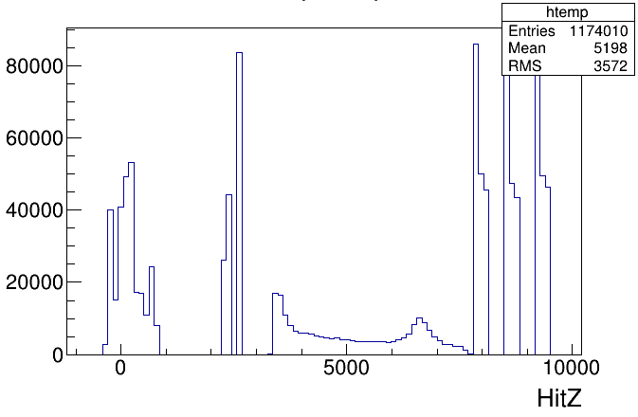
MS simulation (IncluB)
Introduce MSHits with other detector hits
Loop MCParticle
Do not require P
Charge!=0
Reqire <200MCHits on one track
Two dddB samples
Normal UT
Double width UT
VELOHit
UTHit
MSHit
FT/SciFiHit

Slide 3
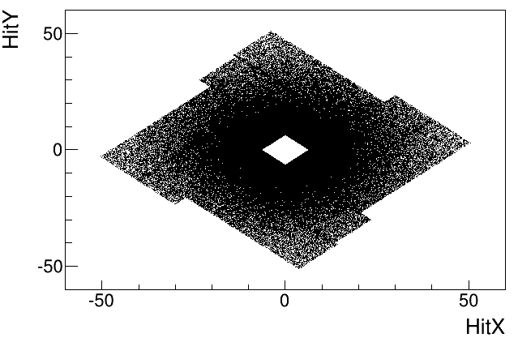
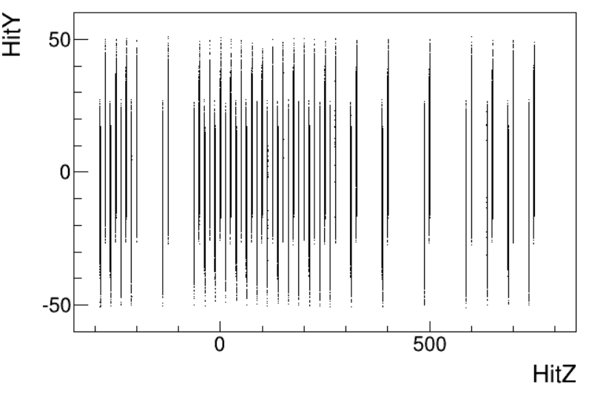
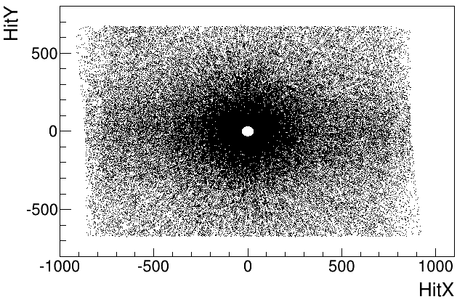
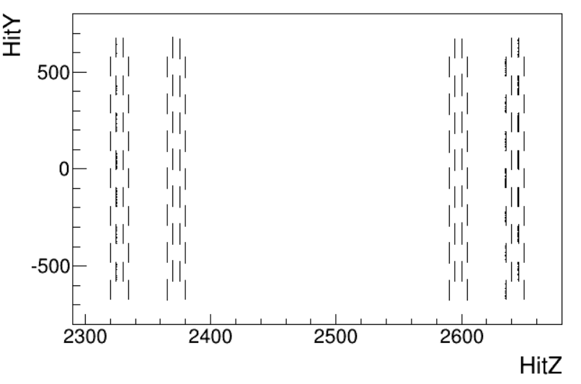
Hit performance
VELO
UT

Slide 4
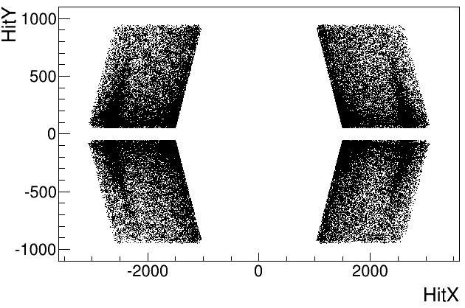
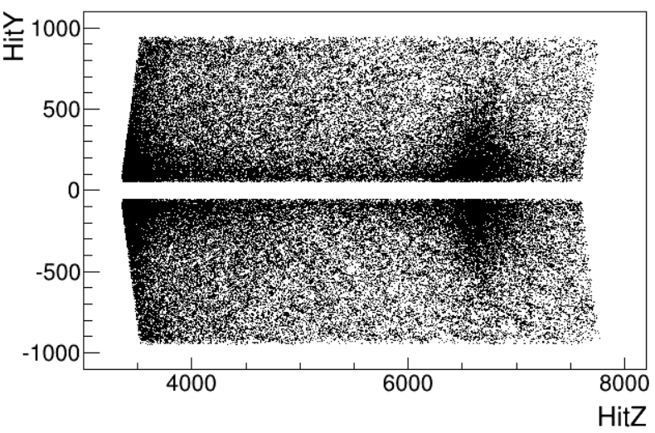
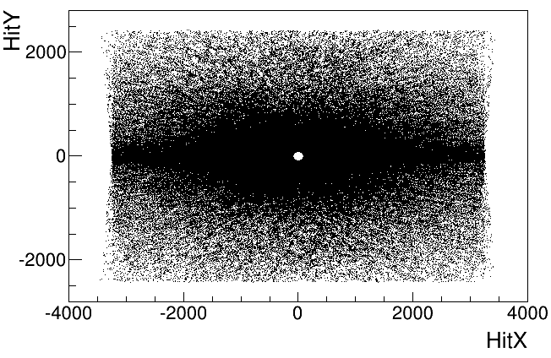
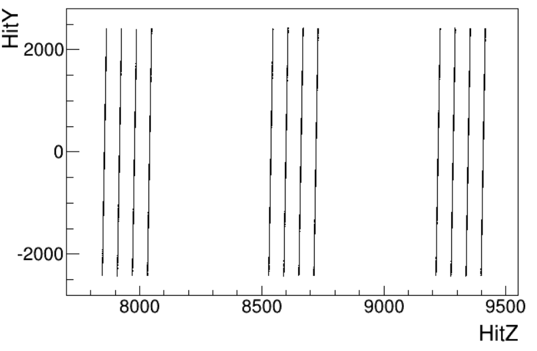
MS
FT

Slide 5
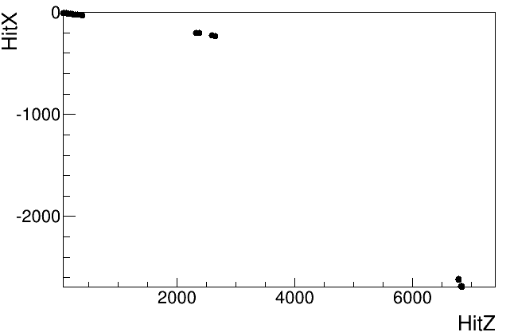
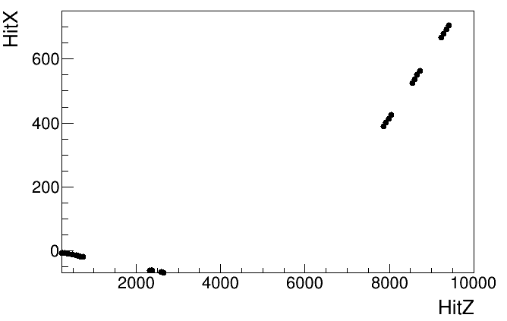
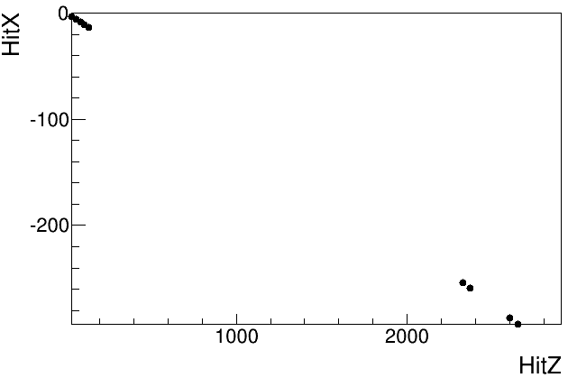
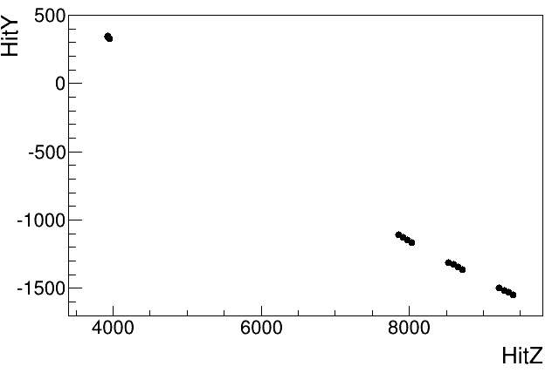
track performance
Pi-: VP+UT+MS P=1346MeV
pi+: VP+UT+FT P=5308MeV
Pi-: VP+UT
P=828MeV
p+: MS+FT
P=804MeV

Slide 6
Count
Total charged MC tracks (nHits>1)
Normal UT: 134374
Double width UT: 137897
Charged tracks | VELO | UT | MS | FT
Normal UT | 44771 | 36473 | 29034 | 64018
DouWidth UT | 45032 | 41952 | 28912 | 63227

Slide 7
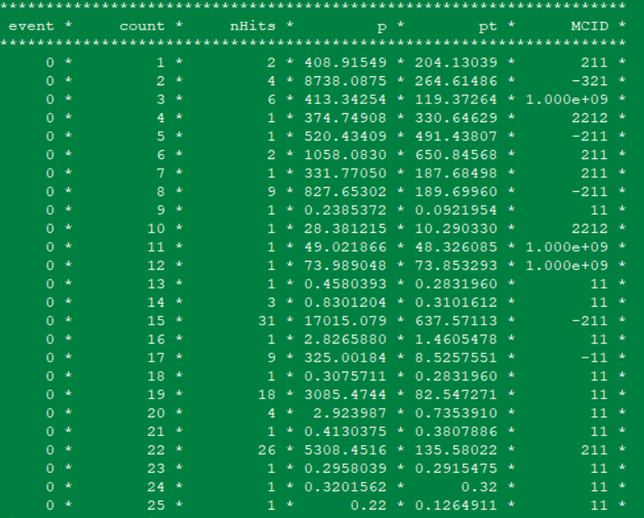
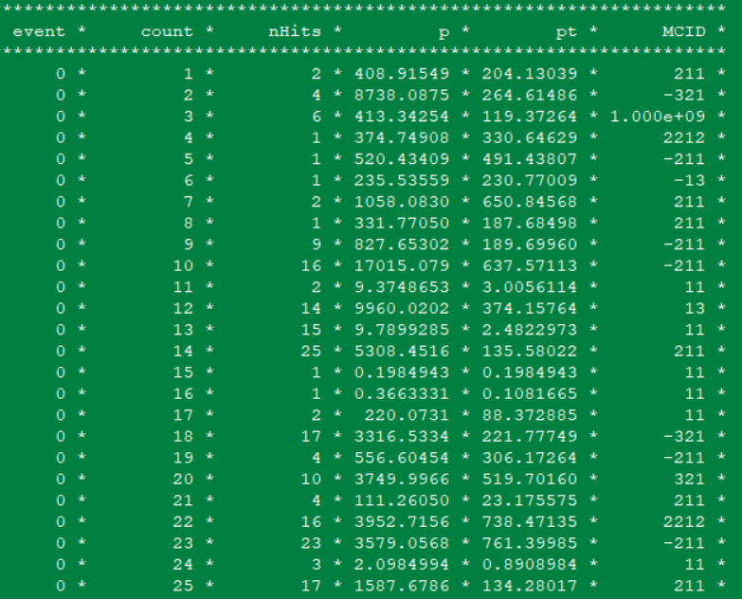
Normal UT
DouWidth UT

Slide 8
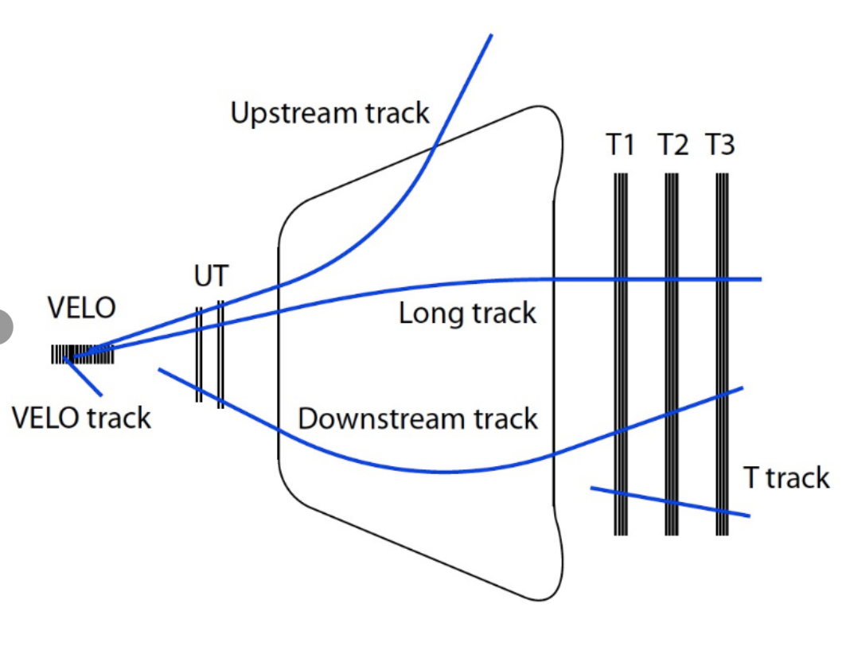
LHCb tracks
Long track: (VELO+UT+FT)
Upstream track: (VELO+UT+MS)
Downstream track: (UT+FT)
VELO track: VELO
T track: FT

Slide 9
Charged tracks | VELO track | Upstream track | Long track | Downstream track | T track
formula | VELO&!UT&!MS&!FT | VELO&UT&MS&!FT | VELO&UT&FT | !VELO&UT&FT | !VELO&!UT&!MS&FT
Normal UT | 25476 | 2683 | 12016 | 2401 | 47922
DouWidth UT | 25139 | 2876 | 11940 | 2316 | 47343
formula | UT&MS&!FT | VELO&MS&!UT&!FT | VELO&UT&MS&FT | !VELO&UT&MS&FT | MS&FT
Normal UT | 5359 | 195 | 123 | 32 | 851
DouWidth UT | 6203 | 54 | 156 | 41 | 874
Conclusion: double the UT width will improve 7% Upstream tracks (require VELO info), if do not require VELO, improve 16% tracks

Slide 10
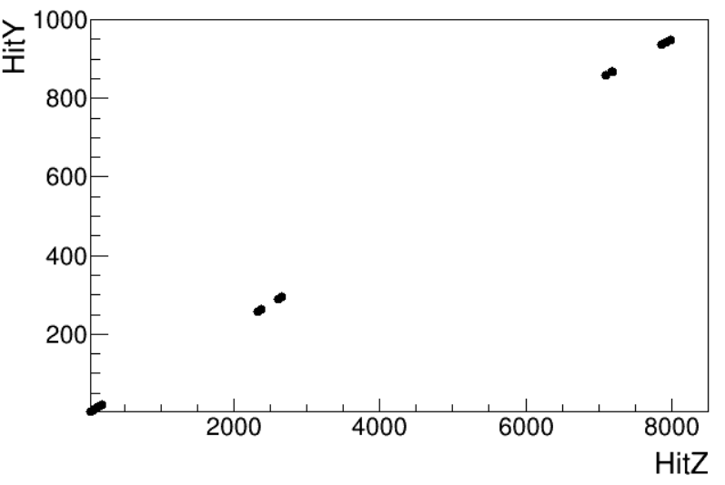
P-: VP+UT+MS+FT
P=2007MeV

Slide 11
