Slide 1
Update on TDAQ Proposal for CEPC Project
Trigger Group
2021.9.15

Slide 2
Outline
Background about trigger meaning and function
New ideas in CEPC and future experiment
  Triggerless=triggerless readout,not triggerless system
  Continuous:L0 based, data driven readout
  Unified link for data and control
  New backend
Proposal
  New idea:UCaML, fast/slow control data sharing
  Compliant to Trigger/triggerless readout in FEE readout
  Simulation
  R&D plan
Summary

Slide 3

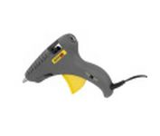

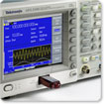
What is Trigger
Trigger
  lever that activates the firing mechanism of a gun（WIKI）
  a small device that releases a spring or catch and so sets off a mechanism, especially in order to fire a gun(bing)
Oscilloscope（Signal catching）
  Trigger Level: Adjustable level to get a stable signal shape on the screen, only sweeps if the input signal reaches the set trigger point; otherwise (on an analog oscilloscope) the screen is blank or (on a digital oscilloscope) frozen on the last acquired waveform.
Digital signal analyzer (debugging)
  Trigger mode: a number of advanced trigger types that enable you to capture a stable waveform even with complex signals. This makes them ideal for troubleshooting glitches, timing violations, overvoltages and dropouts in analog and digital circuits.

Slide 4
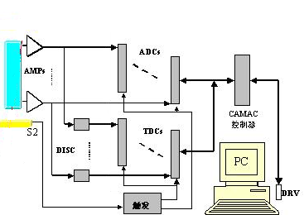
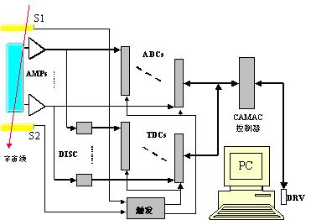
Trigger Function in Small Physics Experiment
Time Reference to ADC/TDC, also readout
  Radiation Source based
    Collimized particle as start of digitization
    Gate for ADC
    Common Start/Stop for TDC
  CosmicRay based
    Coincident cosmic as start of digitization
    Gate for ADC
    Common Start/Stop for TDC
探测器
电子学
读出/DAQ
准直
放射源
DISC

Slide 5
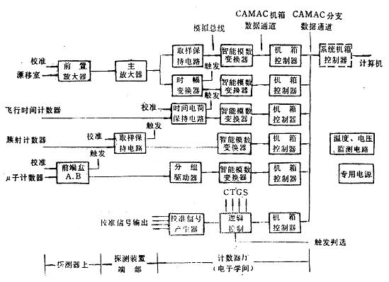
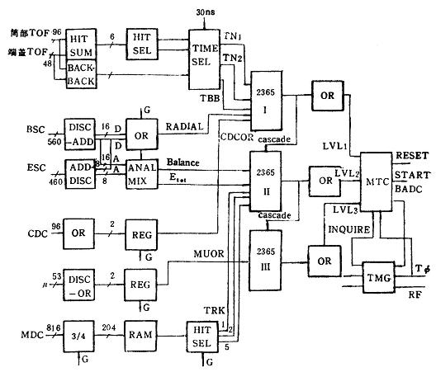
Trigger Function in Large Physics Experiment
BES/BESII Trigger
  Providing timing signals for digitization(B ADC)
    Start
    Reset
  Still reference
  Readout
    LaM from CAMAC

Slide 6
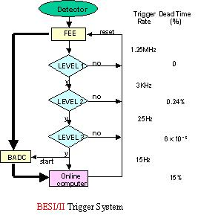
Early Trigger + Online
Process in Levels
  Level 1: Fast signals from Detectors in one collision
  Level 2: Slow signals from slow detectors in second collision
  Processor based processing
1st collision cycle
2nd collision cycle

Slide 7
Nowday’s Trigger + DAQ
对撞点
To keep only pink hexagonal widgets moving down a conveyor belt.
电子储存环
谱仪
对撞周期
Saves only widgets
labeled “y”
Stamp “y” on the pink hexagonal widgets
Stamp “n” on the others
DAQ
Trigger
y/n
y
n
n
y
y
SAVE
The problem is:
Working fast means you make some mistakes !
n
trash

Slide 8
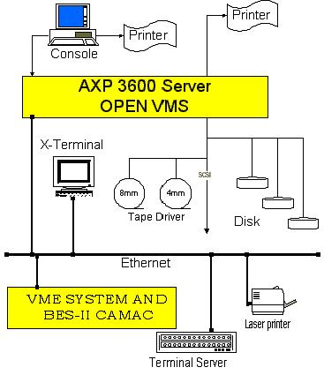
Trigger/DAQ Function in Preset Physics Experiment
Trigger（hardware）
  Providing Index for digitized data(Fast ADC)
    Hardware trigger Output L1Accept
    Known latency L1a
    Pipelined processing
  Fast control
DAQ
  Event Building
  Monitoring
  Run control
  High level trigger
  (Event fildter)
FEE
  ADC
    No gate signal
    Fast continuous
    Pipelined data
  TDC
    No common start/stop
    Reference of Clock edge
    Coarse time of clocks
  Readout
    L1 based
    Window size

Slide 9
Exa：Block Diagram BESIII Trigger System
Near Detectors
Counting Room
FC Daughters
High Lights: Optical Isolation-no ground loop current
Fast Control
TOF FEE
TOFPR
Hit/Seg Count
Global Trigger Logic
Track Match
MDC FEE
MFT
Track Seg. Finder
Track Finder
EMC FEE
Energy Balance
TCBA
TC Sum
Etotal Energy
Cluster Counting
L1P
MU FEE
FastOR
Mu track
BEPCII RF
TTC
499.8 MHz
41.65 MHz
6.4 μs

Slide 10
Network based DAQ as in BESIII

Slide 11
Trigger Definitions
Required rejection is orders of magnitude
  Algorithms to attain required rejection are too sophisticated.
  Accelerator backgrounds can also contribute to the problem
    → e⁺e⁻ vs pp
Level 1 is hardware based
  Crude signatures (hits, local energy deposit over threshold…)
  Operates on reduced or coarse detector data
Level 2 is often a composite
  Hardware to preprocess data
    Some Muon processors, Silicon Triggers
  Software to combine
    Matches, Jet finders, etc.
Level 3 is a farm → General Purpose CPUs
Almost every one uses this scheme
  Vary number and function of levels.

Slide 12
Trigger on LHC
40 MHz
“Local” identification of high Pt objects → use coarse dedicated data
  Electrons /Photons , Hadrons & Jets → Energy clusters
  Muons →Track segments
  Neutrinos → Missing Et
Particle signature (e/g,h,Jet, µ ...) → use final digitized data
  Refine Pt cuts → fine granularity & track reconstruction
  Combine detectors → Converted electron ,“Punchthrough”, decays
Global topology → multiplicity & thresholds
Identification & classification of physics process → trigger menu
  Partial event reconstruction → Vertices , Masses ,Missing Et....
Physics analysis
  “Off-line” type analysis of classified events
L1
100 KHz
L2
1 KHz
3
L3
L3
100 Hz

Slide 13
Trigger Structure on LHC
CMS
ATLAS
Sub- Detectors
40 MHz
Synchronous
Custom made
Hardware pipelined
rigger processor
Level 1
Front end buffers
( ~10⁷ channels)
Level 1
2.5 μs
fixed
1000 - 1500Gbit/s
100 KHz
Region Of Interest
ROI
Asynchronous
Commercial DSPs,
RISCs, etc.
Read Out Buffers
1000-1500 units
few m s
variable
Level 2
1KHz
20 Gbit/s
250-500 Gbit/s
10KHz
100 Mbit/sec
1 Gbit/sec
1000 x1000
256 x 256
Switching Network
(Event builder)
“Virtual”
level 2
Farms of RISCs,
workstations, etc.
Processor farm
(~2 to 5 x 10 MIPS)
High
Levels
Level 3
6
1-10 s
variable
10 Gbit/s
100 Hz
Permanent storage
100 MBytes/sec --> TBytes/day

Slide 14
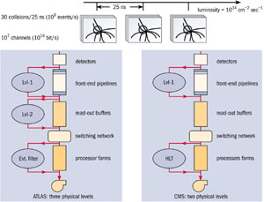
unclear margins
Production Rate
# / sec
8
QCD
10
Hardwired processors
(ASIC , FPGA)
6
10
Level 1
4
H
L
T
10
Level 2
Standard CPUs farms
& Networks
2
Level 3
10
W,Z
0
Top
10
Z’
- 2
Recorded
Events
10
Higgs
25ns
few µsec
~ms
> Sec
- 8
- 6
- 4
- 2
0
2
10
10
10
10
10
10

Slide 15

New trend in FEE
Digitization:
  Faster
  Continuously
Slow control
  Parameter setting
Readout:
  Trigger based or
  data driven
photo
detector
Trigger
logic
clock
Other ROI channels
Array
PMT
Discri
PA
SH
Pulse
Shape
Digitizer
digital filter
LOCAL
BUFFER
crystal
APD
Pipelined register
SiPM
Pixel
ROI Data
E,T,Q

Slide 16
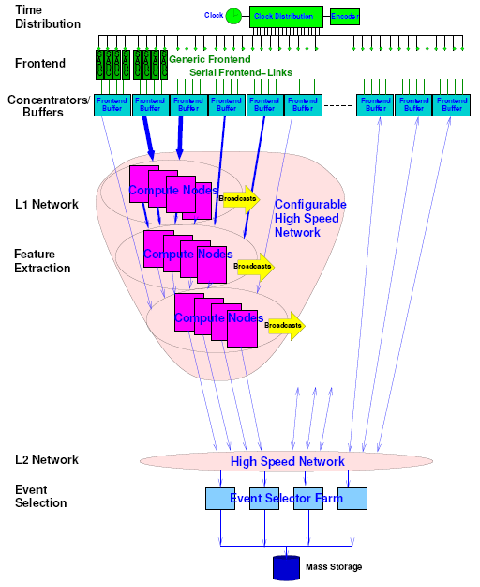
Triggerless readout in PANDA
Self-triggered Data Push Architecture
Timestamp with data production
Triggerless readout
4. Feature extraction as local computing node in level 1 network (ATCA)
5. Event reconstruction and selection(high level trigger) in level 2 on farm

Slide 17
Modern Experiment Architecture
Trigger link
FC link
Physics
FEE
On-detector
Counting Room
off-detector
SubTrg+GTL
For TRG
particle
CLK+FC
Detectors
PA+MA+ Digi
FEE/RO
DAQ storage
Weak signal
SC/PS
Data link
SC link
FEE + TriDAS
FEE(on Detector)
  AM+Digi+triggerbasedROboard(8-12b、40-500MSps、800Mb/s-1.6Gb/sBW)
  triggerPrimitive（signal+data transmitter）
  digitizedParameterSetting（SC）
Off-detector
  FC
  Remote SC
  radiationMonitoring（SEU）

Slide 18
Future Trend of Experiment architecture
Physics
FE Electronics
BE electronics
SW + Farms
clock FC
Subtrg+GTL+DAQ
particles
Shared
HSL
HSL chip
clock + FC
GLT+TCDS
Detectors
PA+MA+ Digi(ASIC)
Console PC
Weak signal
SC
SC
FEE(ASIC)
  12-16b、500M-4GSps、MultiCH,highdensity(high RO BW）
  picoSec timing,largedynamicRange（Hpclocks,synchronized）
HS,MCHlinks:1.6G/4.8G/10Gbps（triggerless continuousRO）
Unified BE（complexRO,trig,clk,FC,SC）

Slide 19
TDAQ Proposal for CEPC
Baselines
  Supports both readout
    Trigger based and
    Triggerless
  Supports continuous /data driven data read
  Develop unified down link to FEE
    Fast control(clock, Synch, BXs, L1,…)
    Slow control(parameter setting, run controls,…)
  Provide FEE high BW data way
    4.8-10 Gbps links
  Provides DAQ
    10-100 Gbps data links

Slide 20
TDAQ Proposal for CEPC(2)
Baselines
  Fiber optics data links
  Open structure to FEE
  xTCA based architecture
    High speed interconnection
    High speed data throughput
  commercial equipment based Post-DAQ (further discussion with LiFei)

Slide 21
Tasks and Plan
Key processor module R&D
  Fast control + TCDS prototyping
  Slow control prototyping
  Processor/computing module prototyping
  Data producer/concentrator module prototyping
Physics Simulation
Trigger/selection simulation
  Starting from a detector system
Test Model system

Slide 22
Roadmap
Hardware Development(Key boards)
Firmware/Software Development
  Simulation
  Emulator
  Data transmission
  FC/SC implementation(FEE/BEE sides)
  Trigger (Detector specific)
  DAQ/RO(general/detector specific)
Demo System
Application/verification with example Detector

Slide 23
Data flow in the Mini-system
PC
PC
Data capture
Data capture
bitFile download
bitFile download
Fiber Loopback
AMC13
ILA capture
ILA capture
Reply
Board
Request
Board
backplane
IP Bus
PC Server
MCH
FEE
BEE
MicroTCA crate
Local Mini-system diagram
2 Fibers(3m each)

Slide 24



Demo system firmware blockdiagram
Firmware design：
  Data path
  Slow control
BEB
FEE emulator
data DEMUX
FEE
PC
data source
FEB emulator
120bit@40Mhz 4.8Gb/s
DAQ
data preparation
MUX FIFO
cluster finding
10Gb/s
Link1.dat
GBT link
Link2.dat
hit finding
Θ-φ angle conversion
Trigger generate
Fake L1A
FEE emulator
FEE
BEB
PC
FEE emulator
120bit@40Mhz 4.8Gb/s
Link2
Slow module
Response command
Slow module
Command
analysis
1Gb/s
GBT link
Link1
Slow module

Slide 25
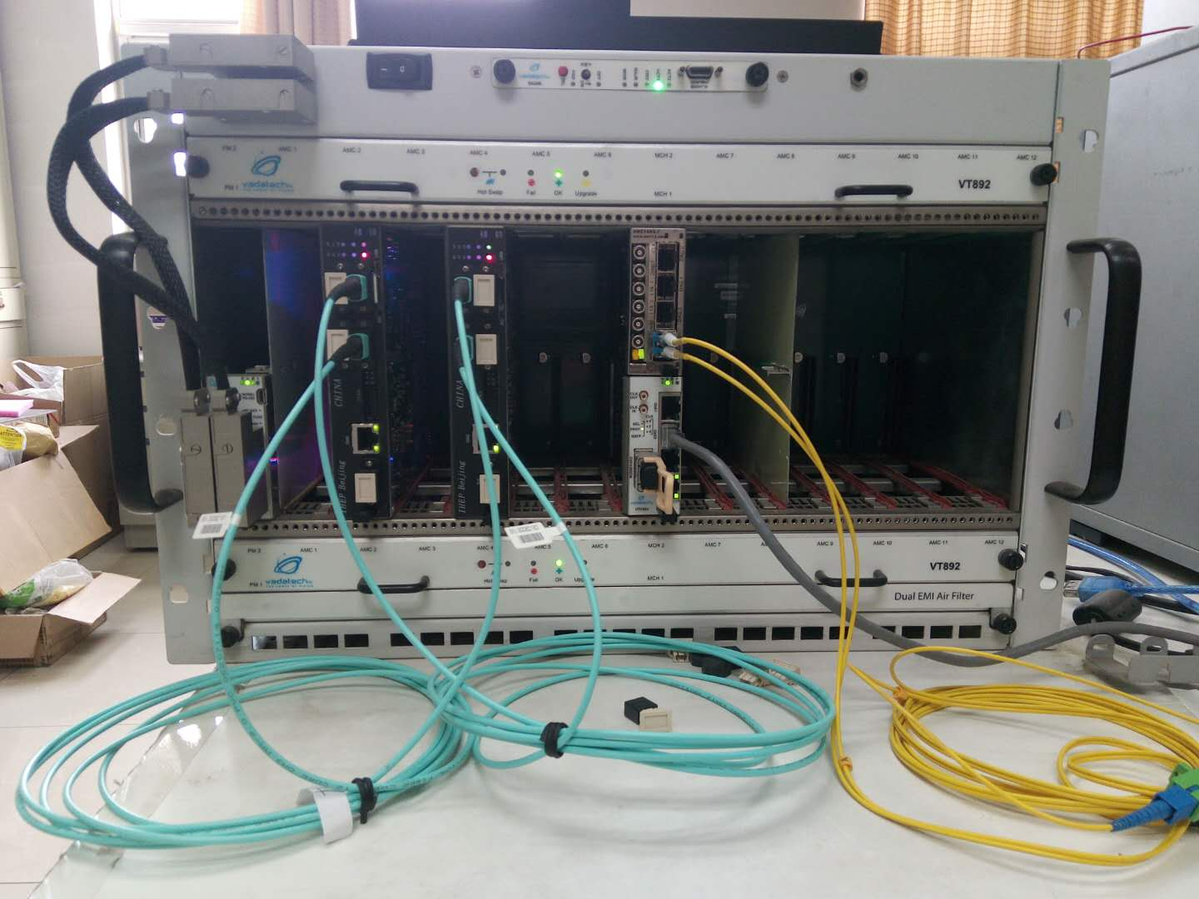
DEMO System
Complete DEMO System FE/BE
  2 ixFP cards
    1 ixFP cards for slow control/processor
    1 ixFP cards for iRPC data source
  1 AMC13
    TTC/TTS
    Management
  1 MCH + 1 PC
    Slow control
    Management + data storage
Functions
  1. Emulation/Development System
  2. Hardware, GBT/GBT based
  3. Detector Simulator/data source
  4. Fast/Slow control, cluster finding, data saving on to disk
BE
uTCA Shelf
FE
AMC13
MCH
PC
Net cable
SC Fiber
Data Fiber
AMC13
fiber

Slide 26
Summary
Some Trigger and DAQ basics are introduced in order to monimize argument on triggerless idea
Some new and future ideas are perspected
A Proposal for TDAQ development is outlined
Tasks and roadmap are forseed
Comments and suggestions are welcome

Slide 27
DAQ系统部署

Slide 28
信号处理与控制的通用仪器装置
模拟信号/数字信号的处理方框图
  Pre-Amplifier（前放）: 预放大微弱信号
  Main Amplifier（主放）: 小信号放大
  Digitizer（ADC/TDC）: 模拟信号转换为数字信号
  Trigger（触发）：是数字化工作
  Readout（读出）: 数据读出
  Processor（处理器）: data analysis and display数据分析与显示
Analog
Trigger/Fast Control
Digital
粒子
Weak Elec. Signals
Processing and Display
FE Electronics
Digitizer
Onl. Readout
Detectors
Amp. + Shaping
Phys. Process
Slow Control
模拟部分
模拟部分
Digital signal
standardization

Slide 29
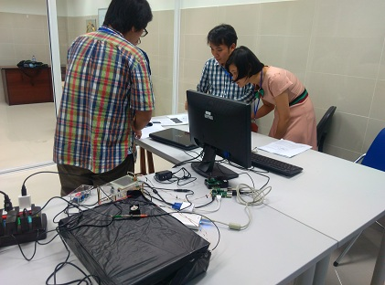
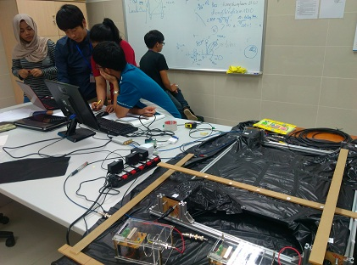
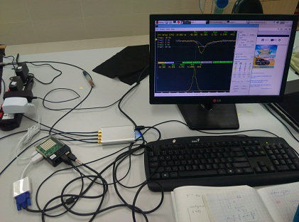
趋势 1: 实验装置的小型化:
低电平／低功耗和快速数据传输
整个实验装置集成到一个小盒子
Trigger/Fast Control
粒子
Weak Elec. Signals
Processing and Display
FE Electronics
Digitizer
Onl. Readout
Detectors
Amp. + Shaping
Phys. Process
Slow Control
PMT(left),TOF( middle, right) exercise setup for RT School 2016

Slide 30
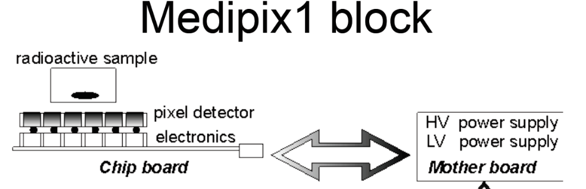
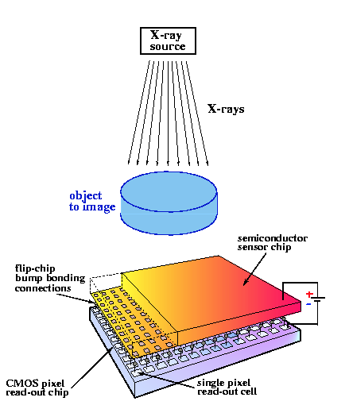
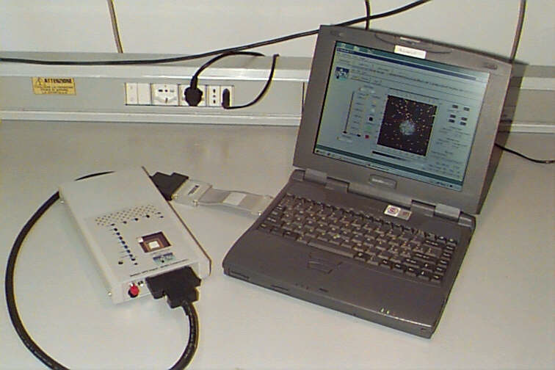
趋势 1: 实验装置的小型化:
低电平／低功耗和快速数据传输（续）
  甚至通过微电子芯片技术集成为手持系统
  ASICs: Application Specific Integrate Circuits专用集成电路
  FPGA:Field Programmable Gate Array现场可编程逻辑阵列
  System on Chip片上系统
  Experiment on Chip片上实验
粒子

Slide 31
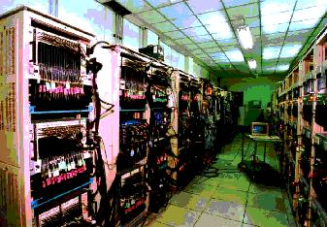
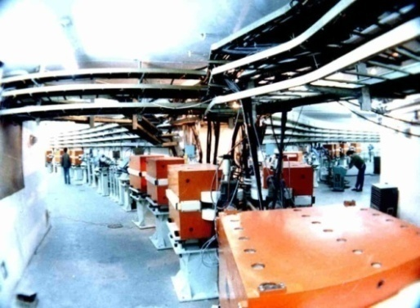
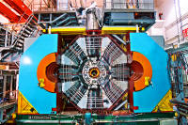
趋势 2: 大规模实验的仪器装置（基于加速器）
海量的探测器单元和电子学通道(几十万),标准化设计
Trigger/Fast Control
粒子
Weak Elec. Signals
FE Electronics
Digitizer
Onl. Readout
Data Storage
Detectors
Amp. + Shaping
Phys. Process
Slow Control
Accelerators
Power/Control
Offline Analysis
Electronics
Control and Data Readout
  Standardized Signal levels
  Standardized Crates
  Standardized Modules
Detectors（BES III）
Accelerators（BEPCII）

Slide 32
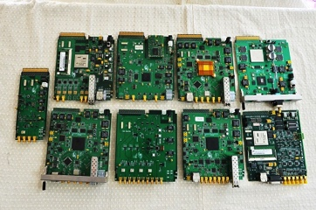
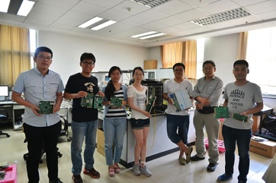
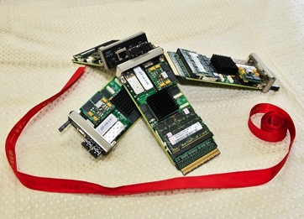
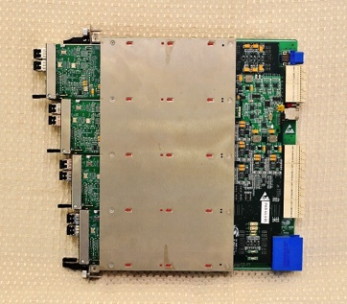
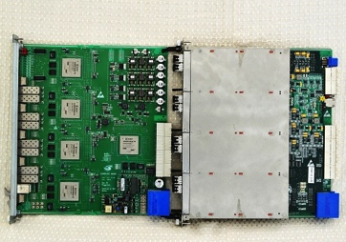
高能所设计范例及应用(1)
AMC/ATCA
for PANDA

