Slide 1






R&D status for vertex detector prototype
Zhijun Liang (IHEP)

Slide 2
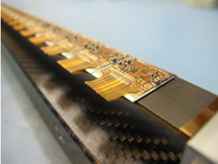
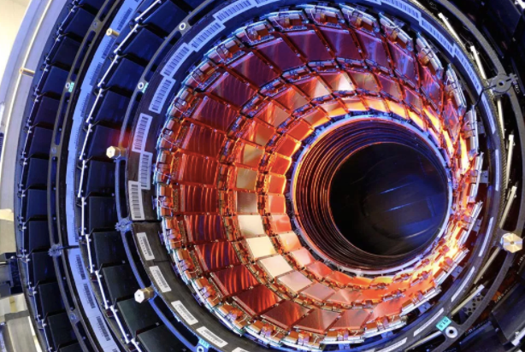

MOST2 vertex detector R & D: Research Goal
Typical module
Produce a world class vertex detector prototype
  Spatial resolution 3~5 μm (pixel detector)
  Radiation hard (>1 MRad)
Preliminary design of prototype
  Three layer, module ~1 cm × 12 cm²
Typical tracker
Resolution
ATLAS/CMS upgrade
（~15 μm）
Alice upgrade
（5~10 μm）
World
leading
This project（3~5 μm）
Notes:
General description highlighting major points and assessment indicators

Slide 3
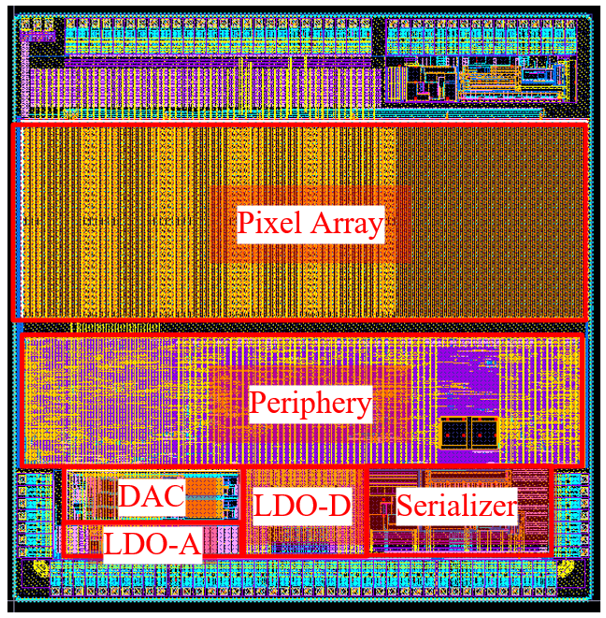
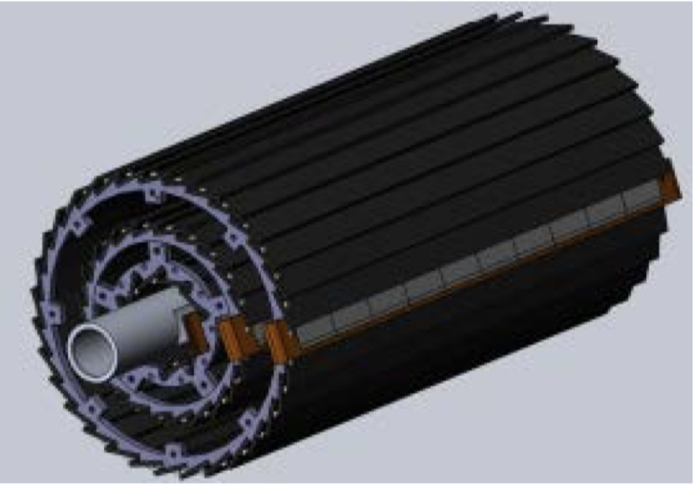
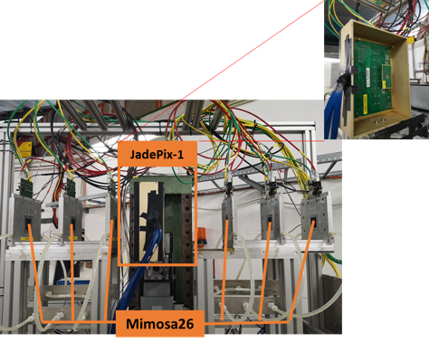
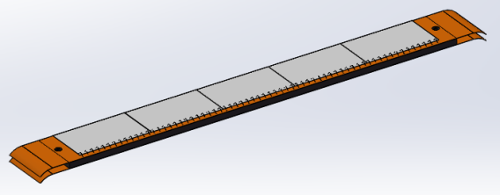
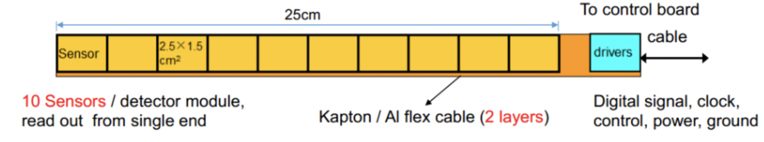
Overview of task2： vertex detector R & D
Can break down into sub-tasks:
  CMOS imaging sensor chip R & D
  Detector layout optimization, Ladder and vertex detector support structure R & D
  Detector assembly
  Data acquisition system R & D
CMOS imaging
sensor prototyping
Detector module (ladder)
Prototyping
Full size vertex detector Prototype
Beam test to
verify its spatial resolution
Notes:
Full size vertex detector

Slide 4
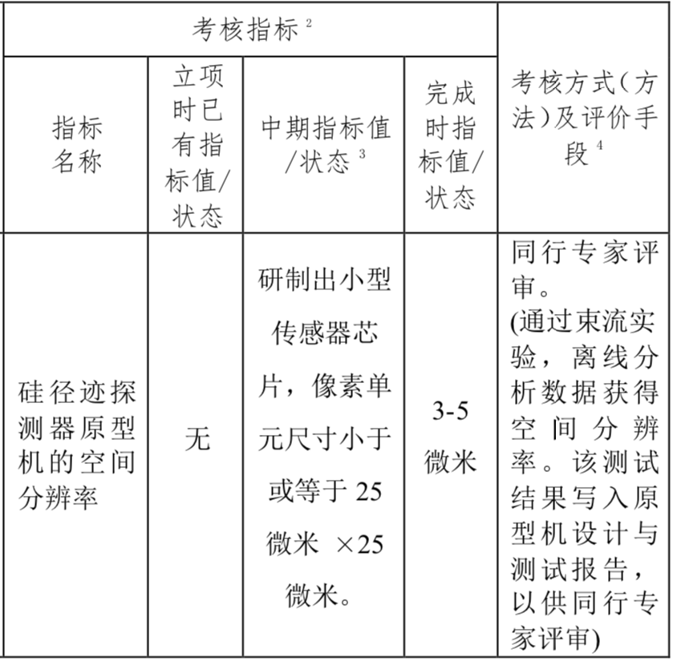
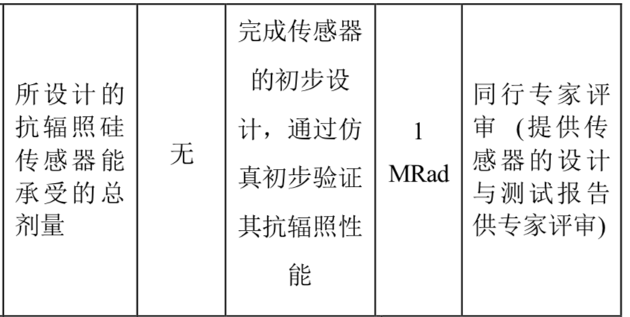
Achievement Presentation and Assessment Methods
Assessment index
Spatial resolution
  - Mid-term: produce 25*25 μm pixel size chip
  - Final : 3-5 μm resolution in Beam test
Silicon Detector
Radiation hardness
  - mid-term: verified by TCAD simulation
  - Final : Total ionization dose >1 Mrad

Slide 5
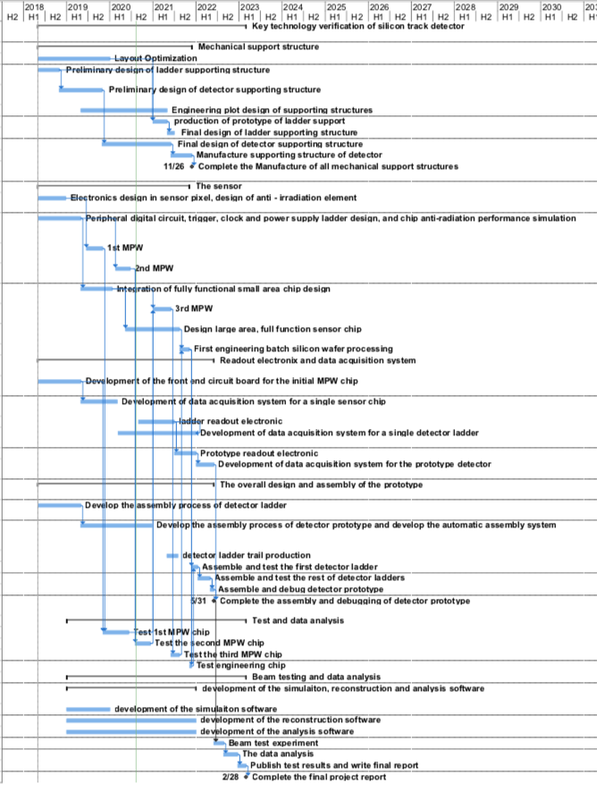
Overall plan of task2： Vertex detector R & D
3rd Year:
  3rd CMOS sensor fabricated and tested
    → skipped , since 2nd MPW chip is working well
  Final support structure engineering design completed
  Fabricated support structure prototype for ladders
4th Year (2021.7 –2022.6) :
  Competed R & D full-size TaichuPix sensor
  Manufactured the support structure for whole detector
  Assembling and installing the detector prototype
  Completed DAQ system for whole detector
5th Year:
  Completed detector assembly and commissioning
  Test beam and data analysis
  Finish assembling of prototype

Slide 6
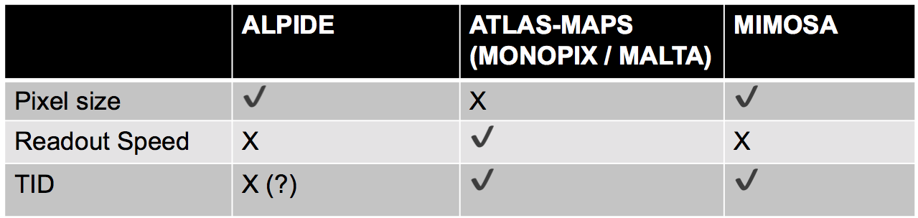
CMOS Sensor chip R & D
The existing CMOS monolithic pixel sensors can’t fully satisfy the requirement
Major Challenges for the CMOS sensor
    Small pixel size -> high resolution (3-5 μm)
    High readout speed (<500ns deadtime @40MHz at Z pole) -> for CEPC Z pole high lumi
    Radiation tolerance (per year): 1 MRad

Slide 7
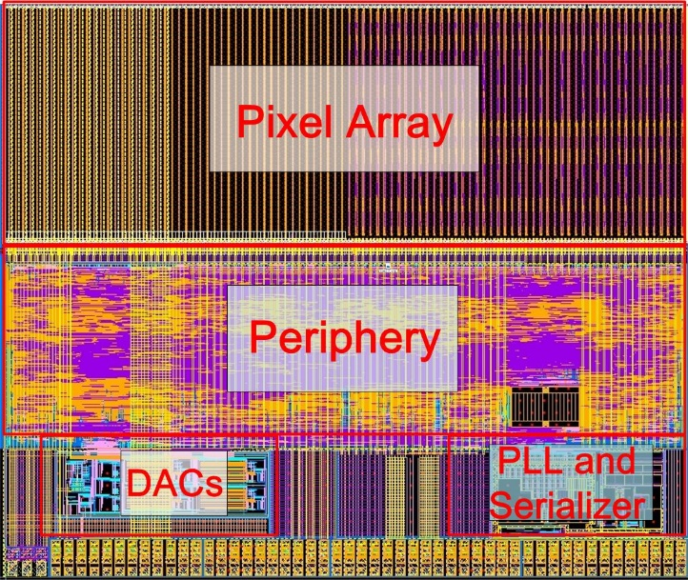
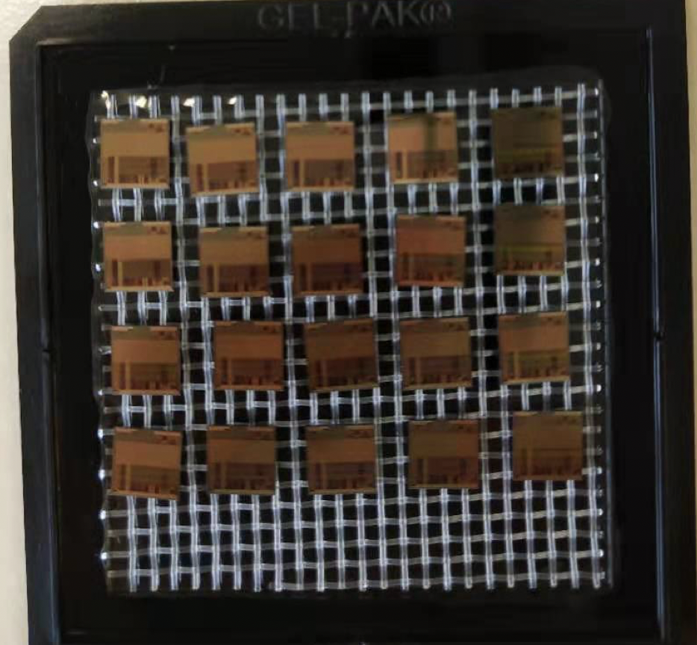
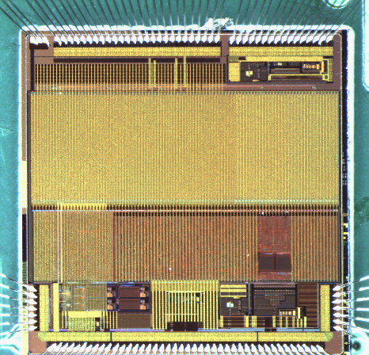
Sensor prototyping
Taichupix1
Chip size：5mm×5mm
Pixel size：25μm×25μm
Completed two round of sensor prototyping
  1st Multi-wafer project chip (Taichupix1)
    Submitted in June 2019, received in November 2019
  2nd Multi-wafer project chip(Taichupix2)
    Submitted in Feb 2020, received in July 2020
    Major bugs fixed in Taichupix1
    Radiation hard design (enclosed gate) in pixel analog
    A full functional pixel array (64×192 pixels)
    Periphery logics
      Fully integrated logics for the data-driven readout
      Fully digital control of the chip configuration
    Auxiliary blocks for standalone operation
      High speed data interface up to 4 Gbps
      On-chip bias generation
      Power management with LDOs
Taichupix2
Chip size：5mm×5mm
Pixel size：25μm×25μm
Taichupix2 on test board

Slide 8
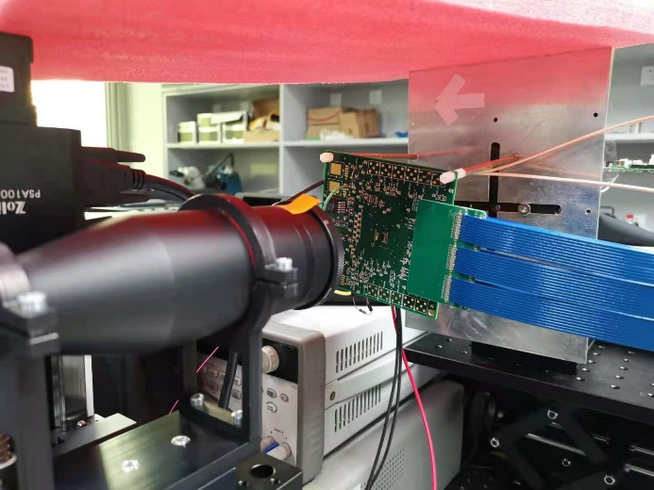
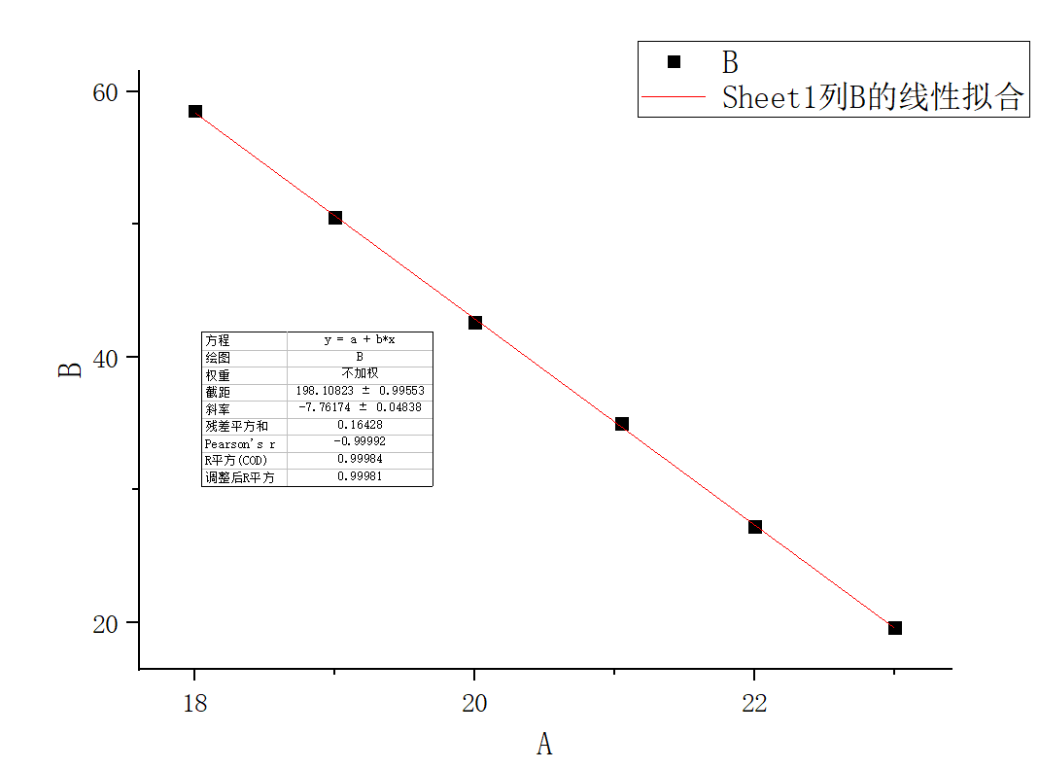
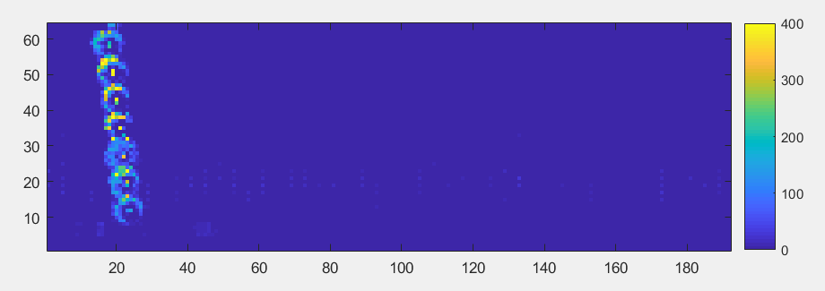
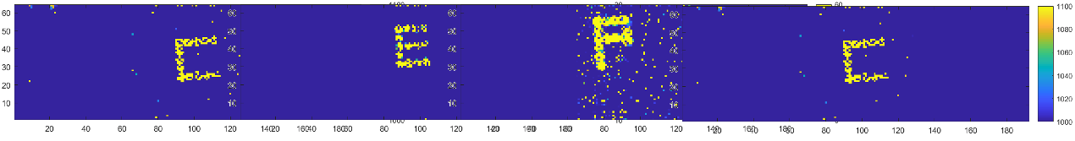
Laser test in last report (coarse scan)
Triggerless mode was used for the laser test → full readout chain verified
Measured positions from Taichupix is consistent with expected laser movements
Light spot fitting for laser moving in y-direction with step of 200 µm
Laser
(1064 nm)
TaichuPix-2

Slide 9
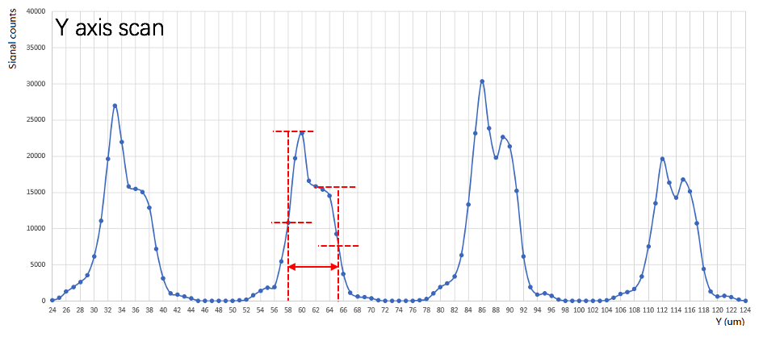
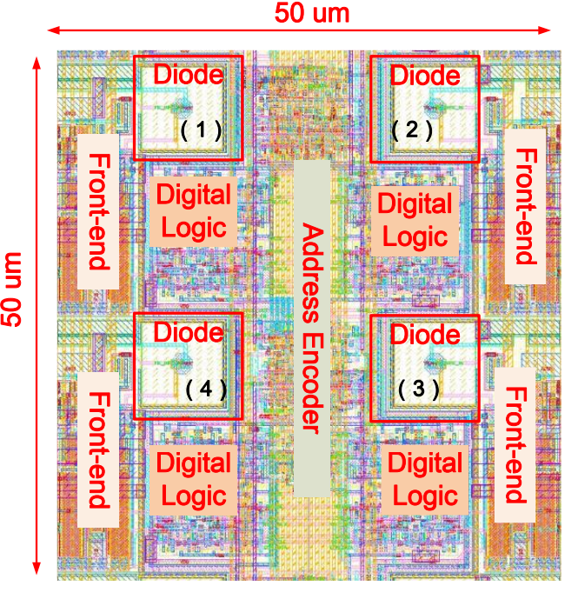
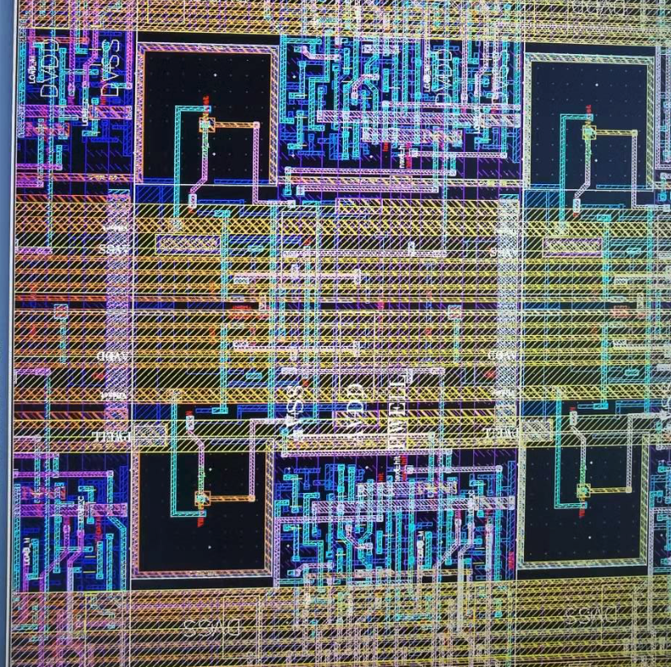
Laser test （fine scan)
Designed diode window width : 9 um
Observed diode window width: 7~8 um
Improved laser setup
  Beam spot focused to few um
Study pixel internal structure
Study Uniformity of response
Scan direction

Slide 10
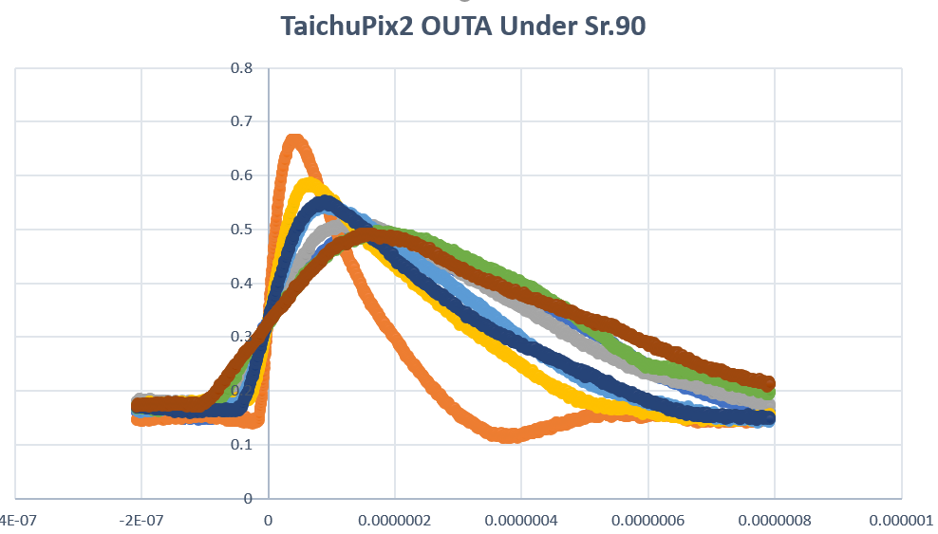
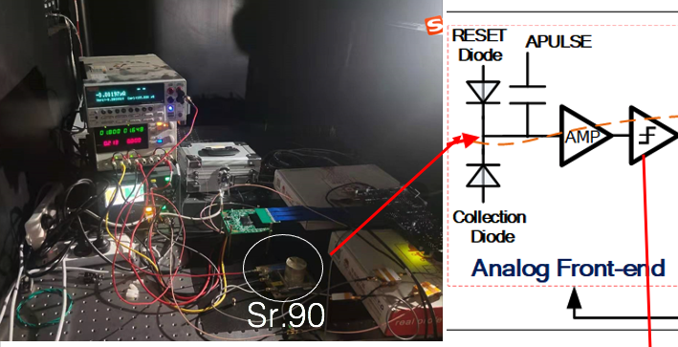
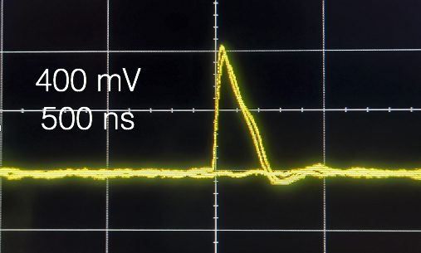
TaichuPix2 test with ⁹⁰Sr source
Analog waveform in beta tests
Digital readout (full chip)
Analog readout (debug mode for one row of pixel)
  High signal to noise ratio found in analog readout
More studies are on-going
typical waveform in beta tests

Slide 11
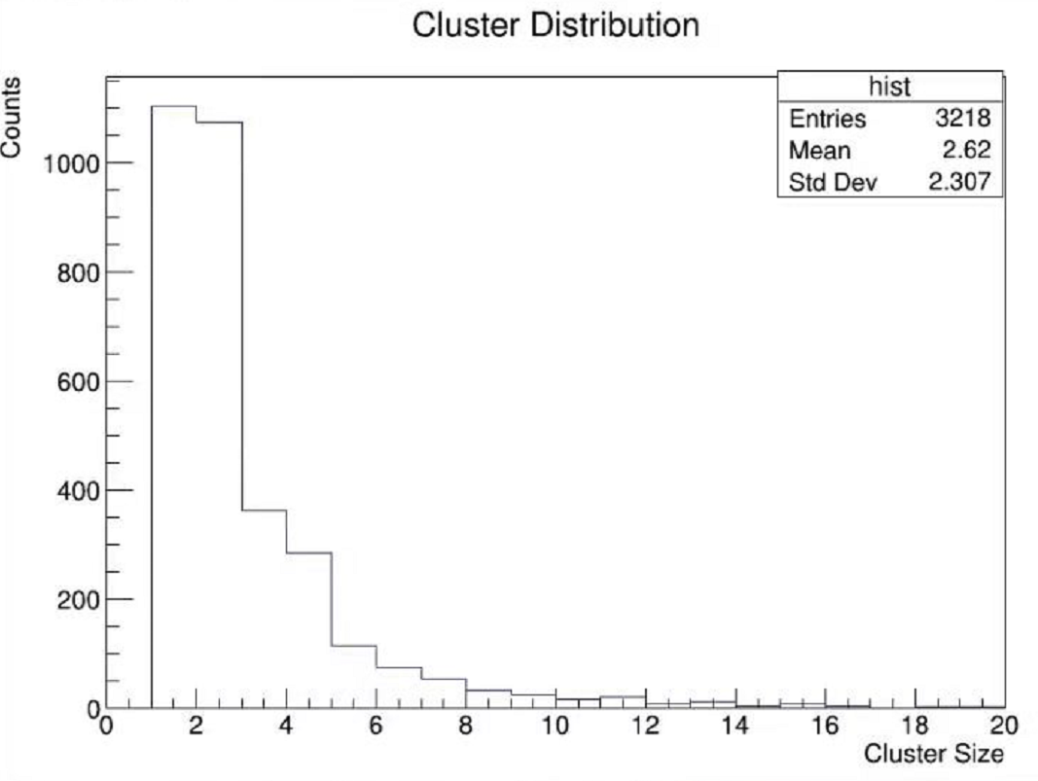
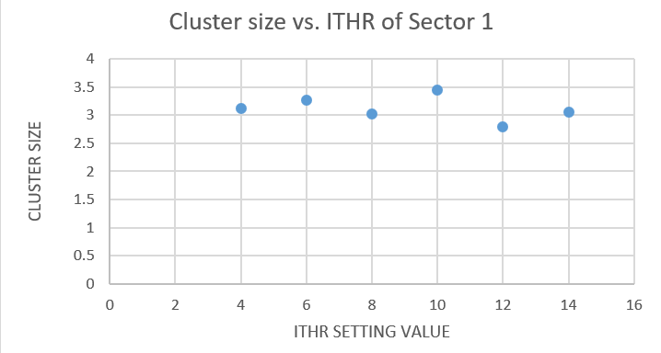
TaichuPix2 test with ⁹⁰Sr source (2)
Cluster size distribution
exposure to ⁹⁰Sr at different threshold (ITHR)
Finding a cluster for adjacent pixels
with a timestamp window of 100 ns
Mean cluster size around 3 for different ITHR
Hit map of TC2 exposure to ⁹⁰Sr for 400 s
<Mean Cluster size> VS Threshold

Slide 12
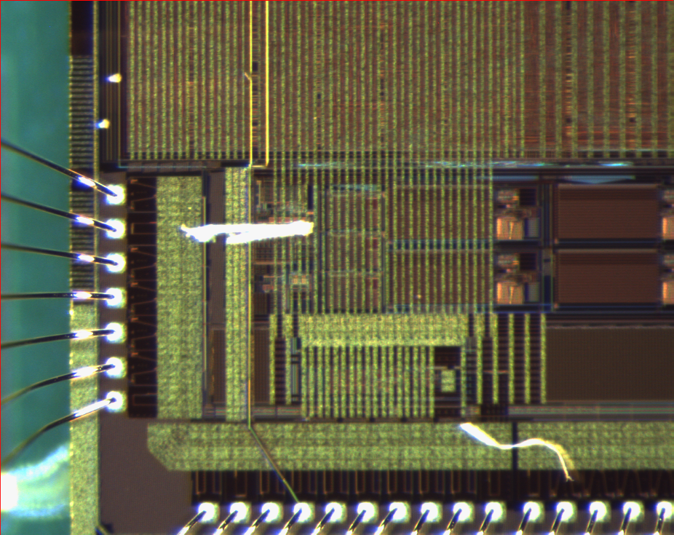
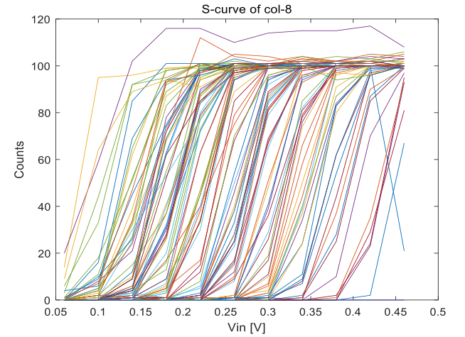
Threshold tuning for TaichuPix2
For TC2, threshold current ITHR can not be set less than 5.4 nA
  unexpected from design (nominal design value 4.5 nA).
  Connected the internal ITHR to an IO-pad through FIB (Focused Ion beam) technology to provide an external ITHR voltage.
  Applying an external voltage @ Pad-A to tune the ITHR current
  ITHR can not as low as expected (min. ~7.8 nA) . Need more investigation.
TC2 chip with a Al connection by FIB
S-curve of one column with external ITHR

Slide 13
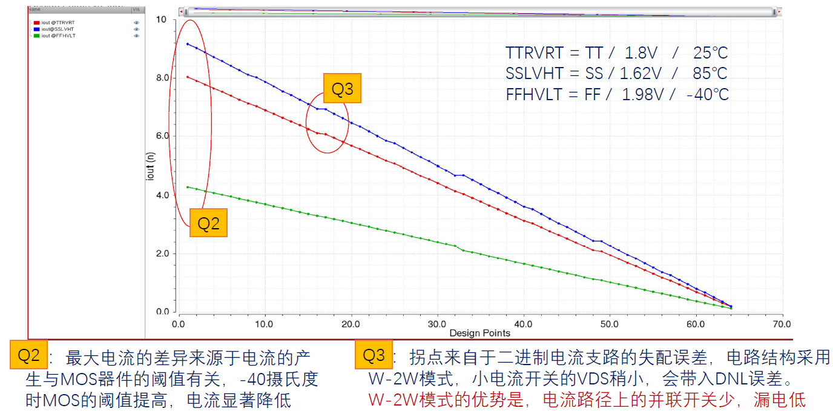
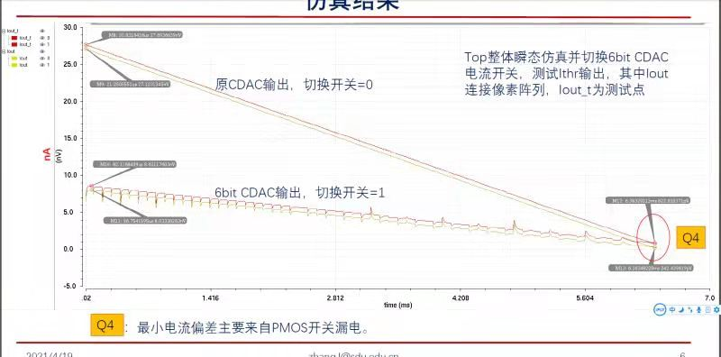
DAC design in the full scale chip TC3
DAC was also modified by adding a optional 6-bit current DAC for the low current biasing
Original design suffers from the leakage current and the output range is too large
  LSB: 0.1nA
  Aiming at: 2~4nA
Modified design tuned the output range specifically for small current:
  Range: 0~8nA

Slide 14
Simulations on DAC of Taichu3
TC2 includes two current DACs to provide ITHR
  One 8-bit DAC same as in TC2
  An optional 6-bit DAC (design LSB of 0.1nA, range of 0-8 nA )
  Simulation results indicate the parasitic resistance increases the DAC output current, and the parasitic extraction rule effects the value of R and then the simulation result. Have not been understood well.
Name | Input code | Output with Simu-sch. | Output with Parasitic R @extraction rule 1 | Output with Parasitic R @extraction rule 2
IBIAS | 1011 | 463.9 nA | 551.2 nA | 481.8 nA
ITHR_8bit | 101100 | 4.7 nA | 9.3 nA | 5.5 nA
ITHR_6bit | 100011 | 4.5 nA | 7.5 nA | ----
IDB | 11000 | 1.02 uA | 1.12 uA | 1.05 uA

Slide 15
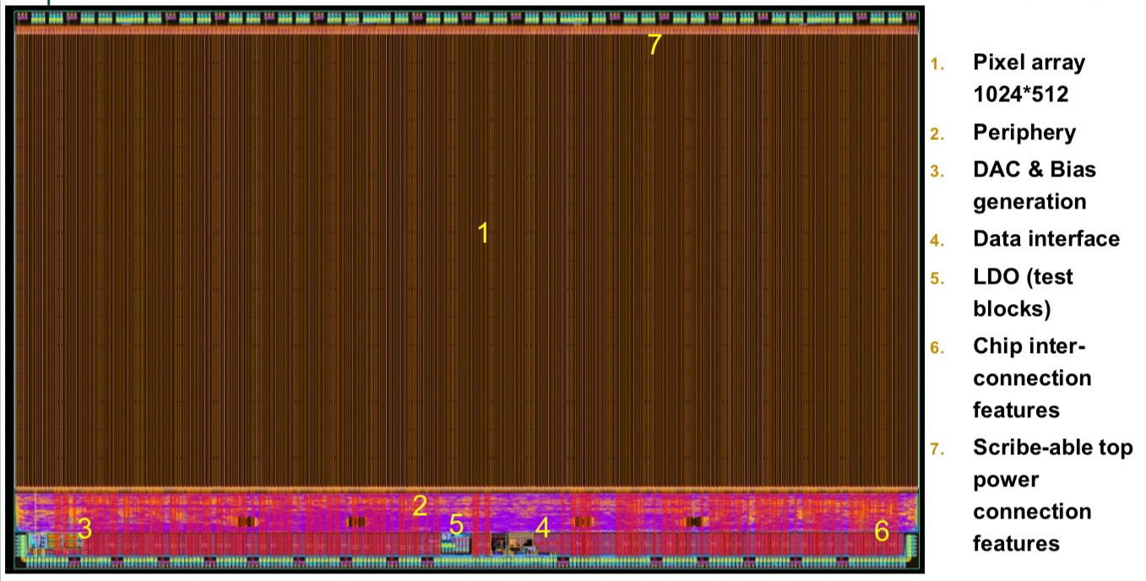
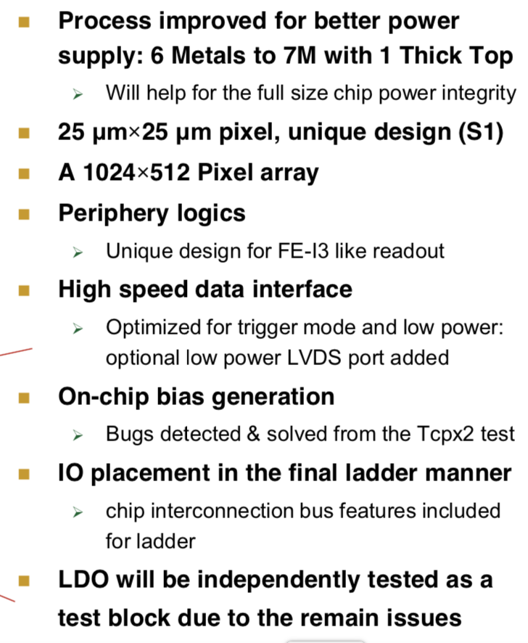
Full-size TaichuPix3 design (engineering run)
Full-size Taichu pixel design ready, passed review, ready for submission
  1024×512 Pixel array (25μm×25μm pixel size), Process: Towerjazz 180nm
  FE-I3 like Periphery digital readout , high speed data interface
    Time stamp precision: 25ns-50ns

Slide 16
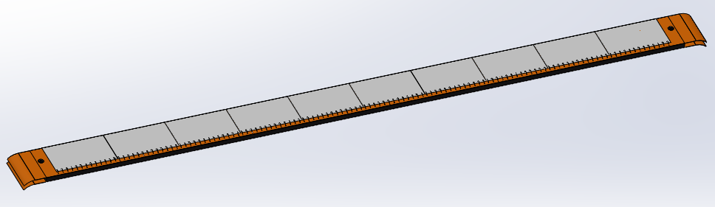
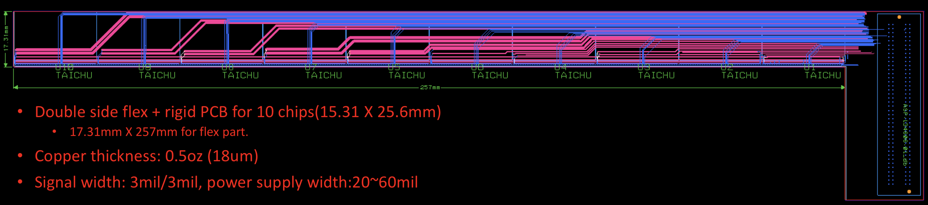
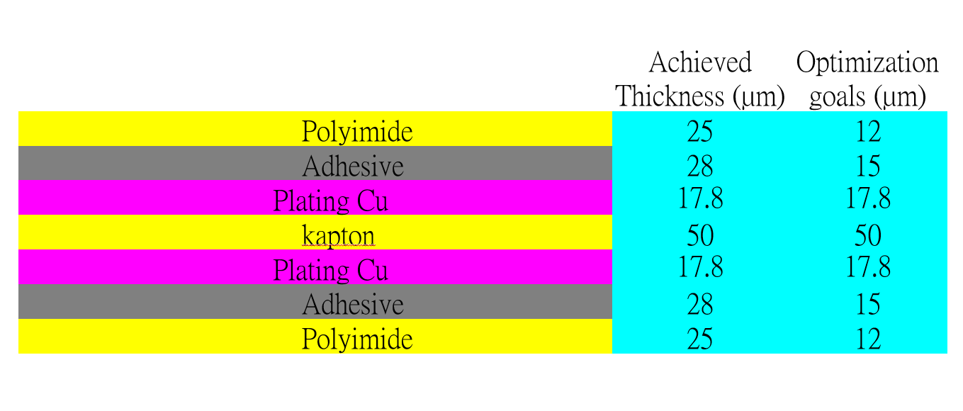
Detector module (ladder) R & D
Completed preliminary version of detector module (ladder) design
  Detector module (ladder)= 10 sensors + support structure+ flexible PCB+ control board
  Sensors will be glued and wire bonded to the flexible PCB
  Flexible PCB will be supported by carbon fiber support structure
  Signal, clock, control , power, ground will be handled by control board through flexible PCB
3D model of the ladder
Schematic of ladder electronics
Profile of flexible PCB
Design of Flexible PCB prototype

Slide 17
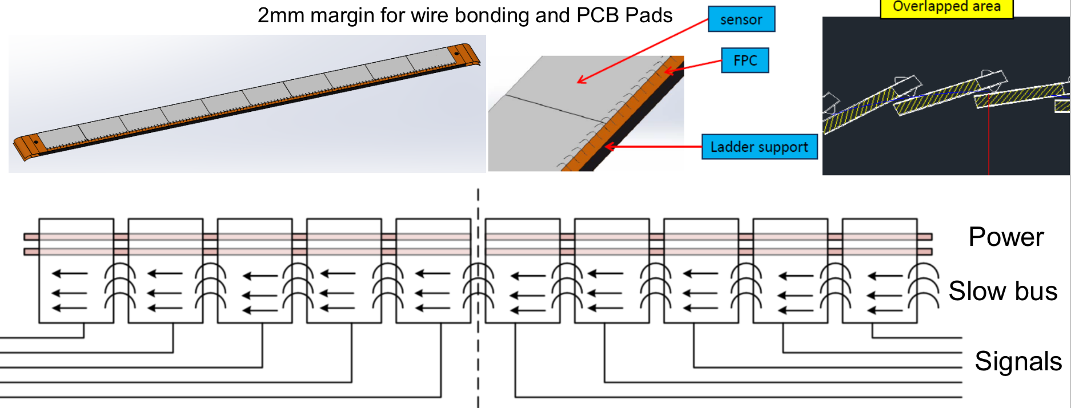
New idea in Taichu pixel design – inter-chip connection
Inter-chip connection for slow controls through wire bonding
→ Save some metal for PCB (reduce material budget)

Slide 18
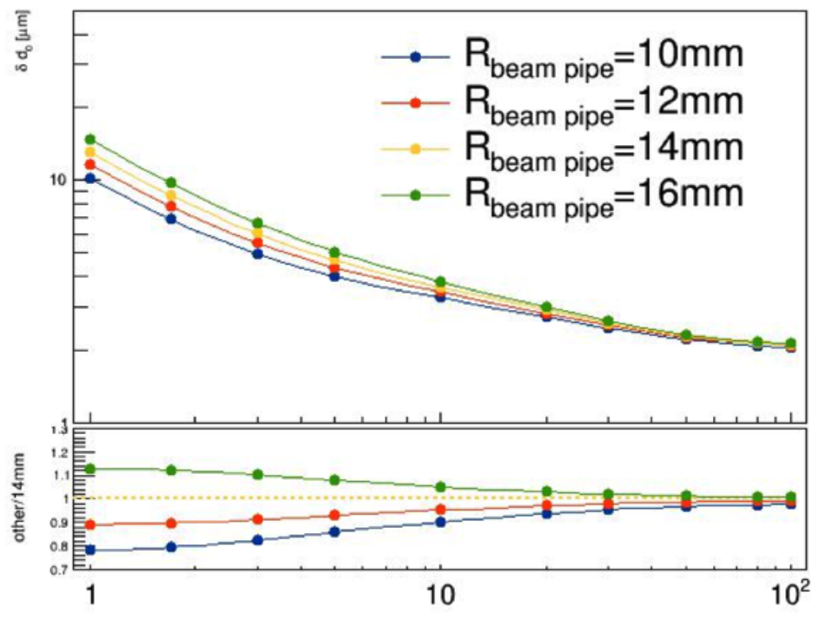
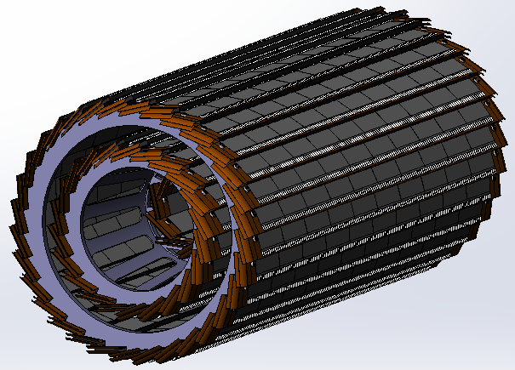
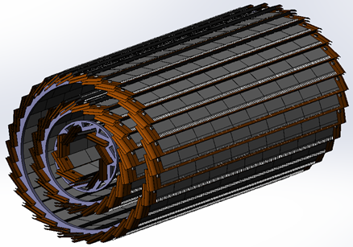
Vertex Detector Prototype R & D
Completed preliminary version of detector engineering design
  3 double layer barrel design
  7 modules in inner layer, 22 modules in 2nd layer, 32 modules in outer layer
Physics simulation to optimize vertex detector layout design.
  The length of inner layer pixel should be the same as other two layers
  Inner pixel radium should be as close to beam pipe as possible
Impact parameter resolution
Vs beam pipe radius
Old design
After optimization

Slide 19
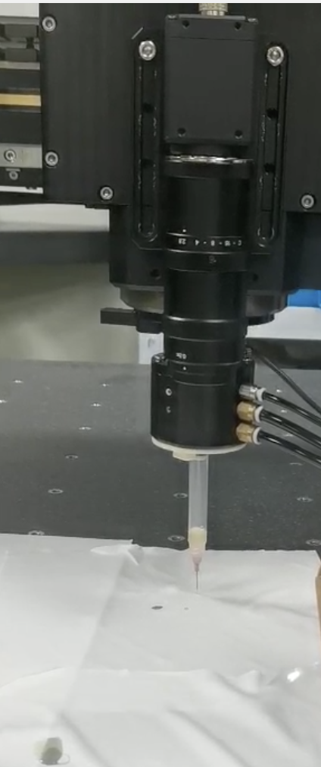
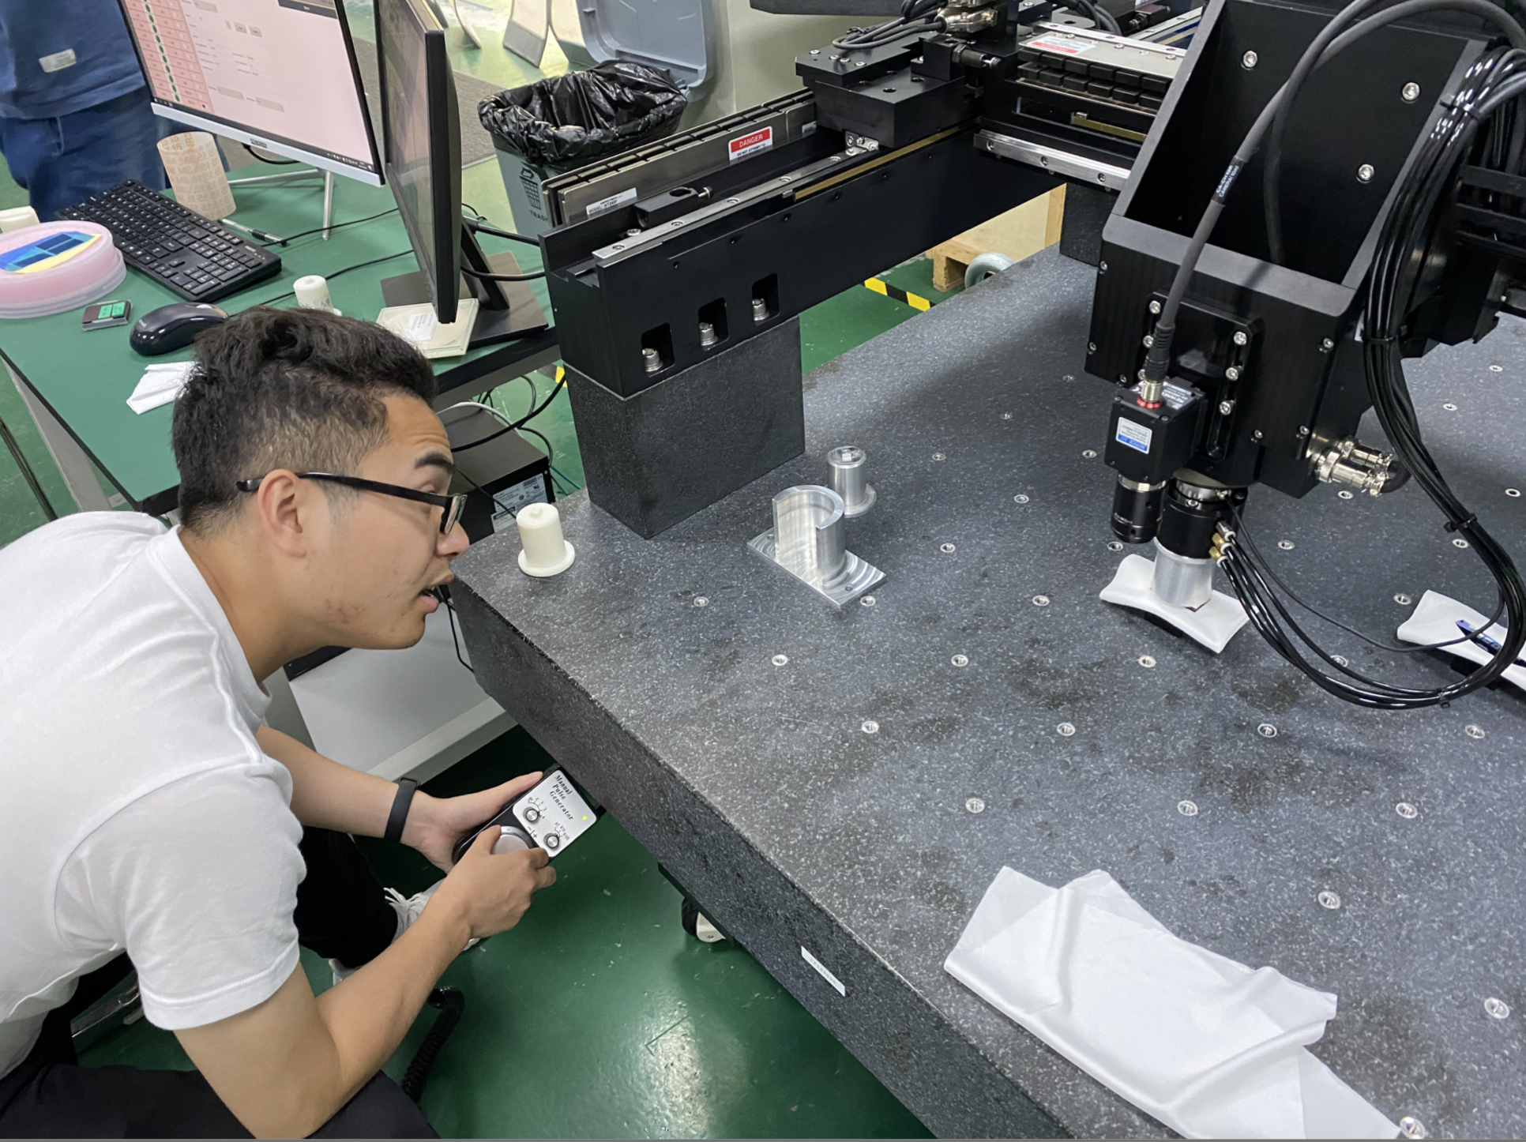
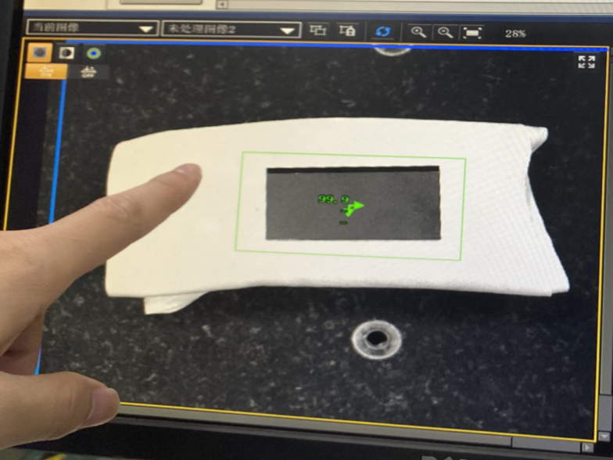
Gantry for vertex detector prototype assembly
3~5um good position resolution require high assembly precision
Cooperate with domestic company on R & D Gantry automatic module assembly.
  Pattern recognition with high resolution camera
  Automatic chip pick-up and positioning
  Automatic Glue dispending
automatic glue dispending
Gantry system
Pattern recognition

Slide 20
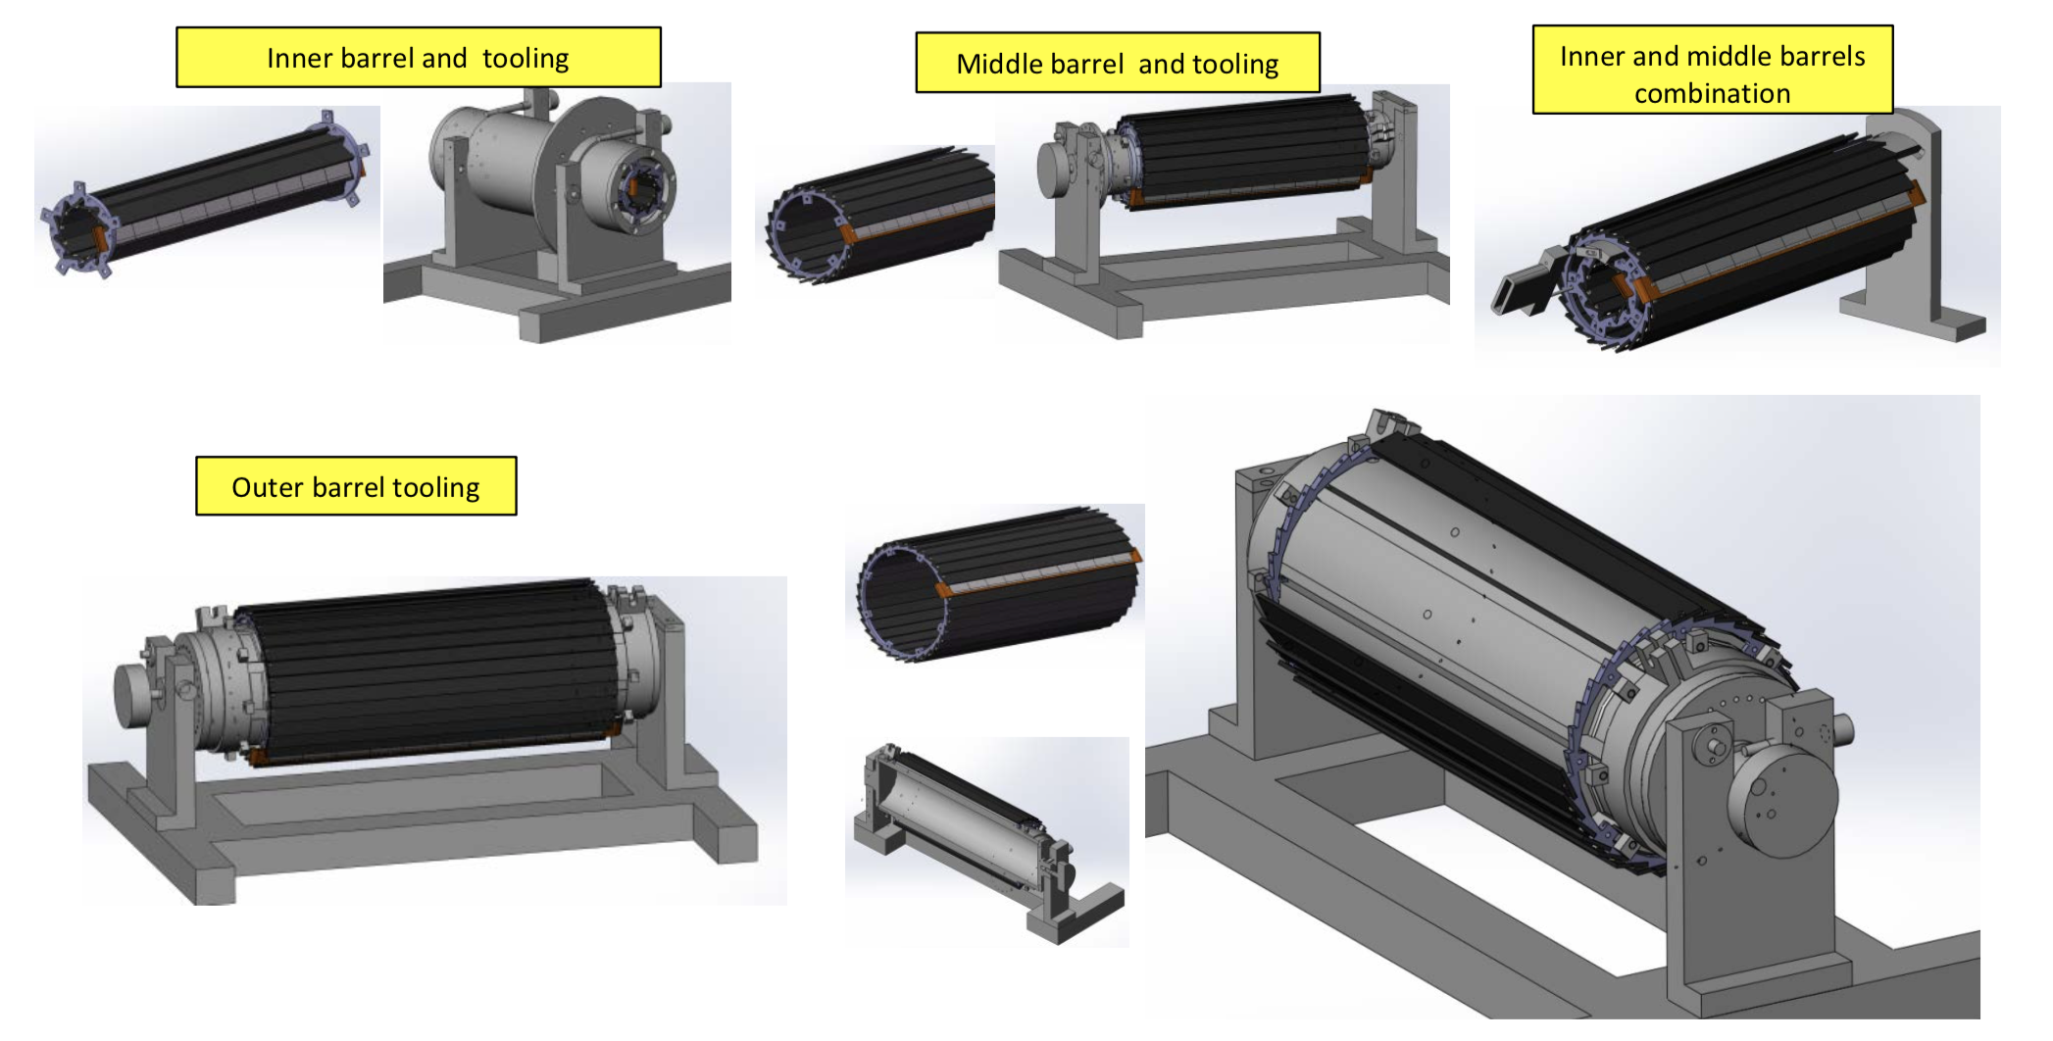
Tooling Design for Barrels Assembling
3 sets of tooling for 3 layer of barrel assembling.
Tooling and special tool for inner and middle barrels assembling.

Slide 21
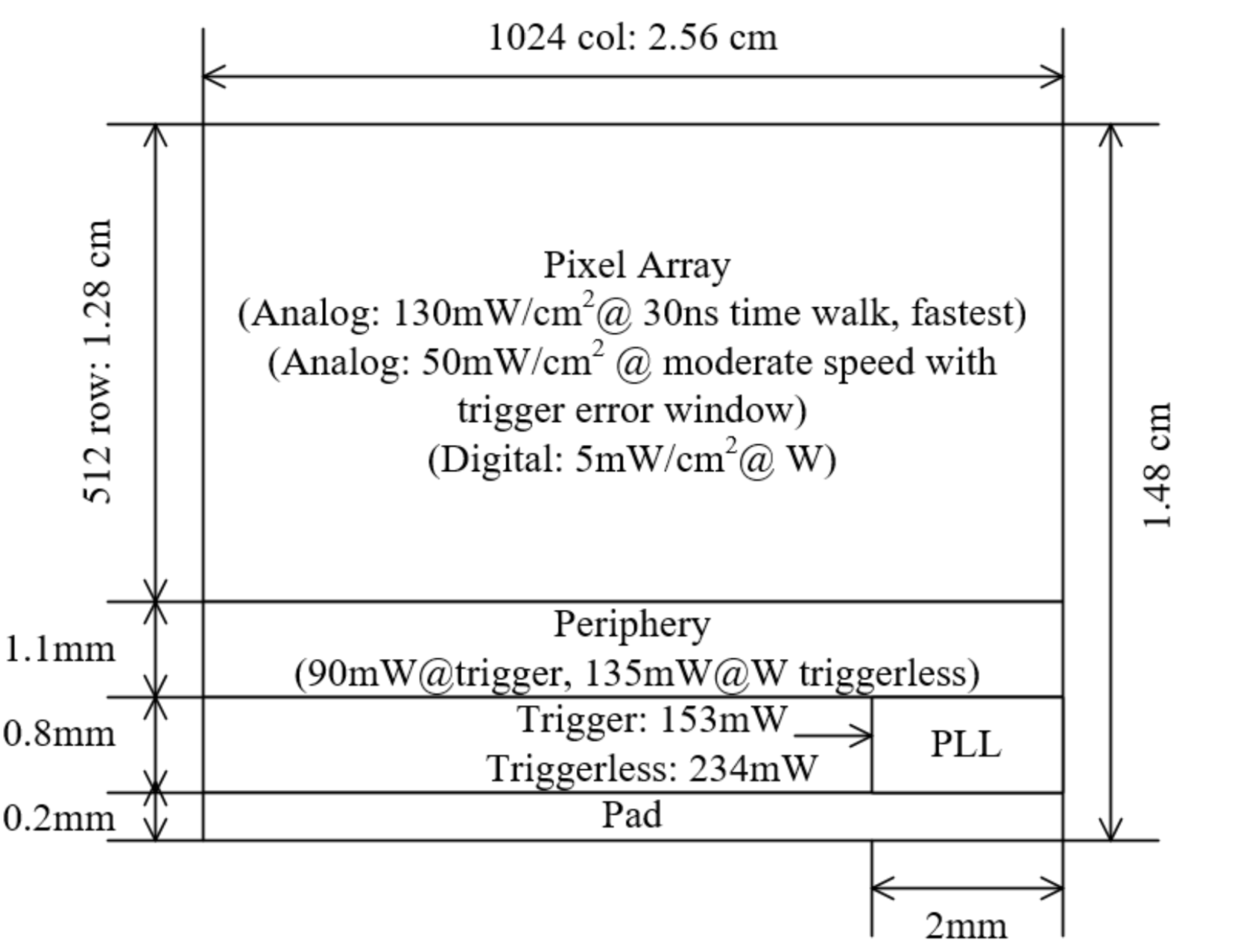
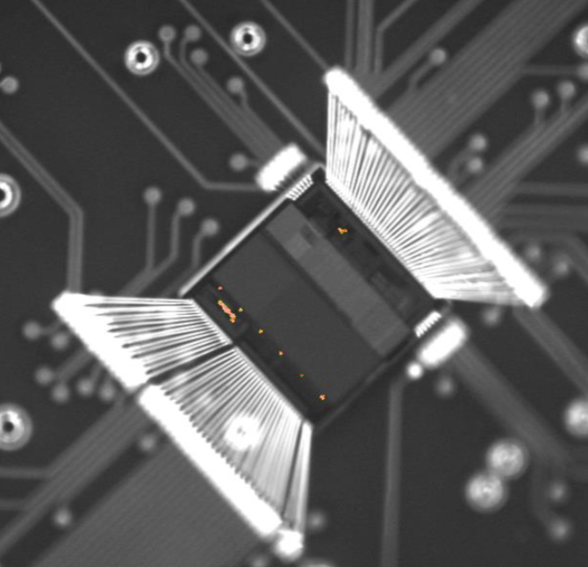
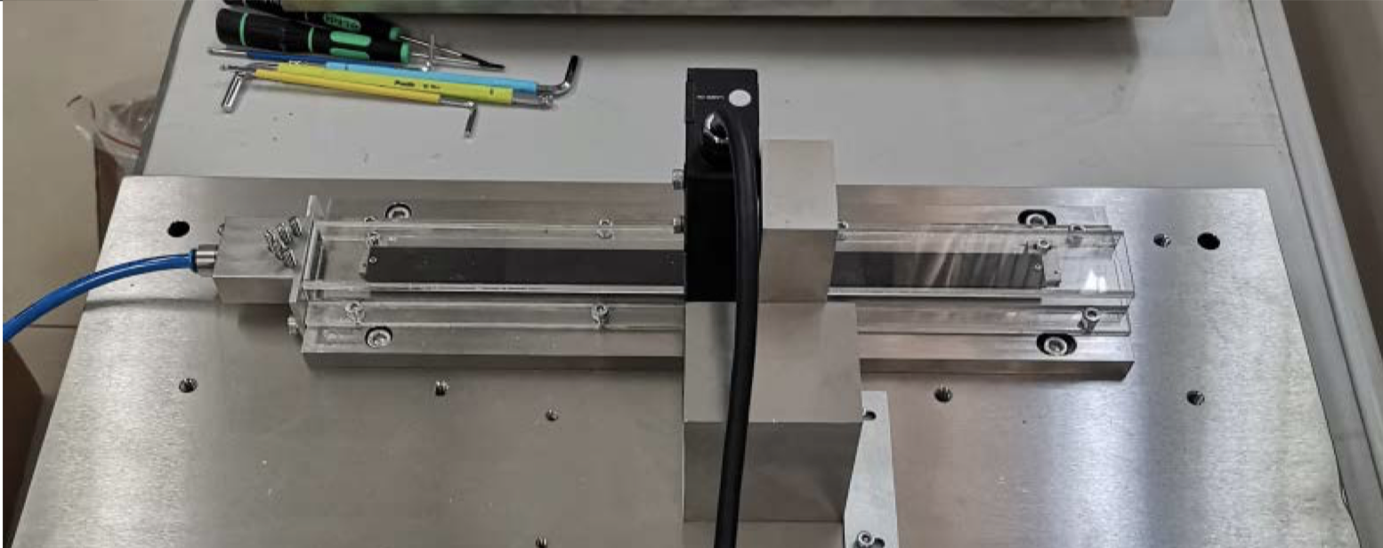
Cooling design
Air cooling is baseline design for CEPC vertex detector
Sensor Power dissipation:
  Taichupix : ≤ 100 mW/cm². (trigger mode) ; CEPC final goal : ≤ 50 mW/cm²
Cooling simulations of a single complete ladder with detailed FPC were done.
  Testbench setup has been designed and built for air cooling , vibration tests
The EMMI
(Emission Microscope)
For Taichupix2
Power consumption
Test setup prototype for ladder cooling
Use compressed air for cooling
(See more from Jinyu’s talk)
Laser interferometer
Air flow
Ladder support

Slide 22
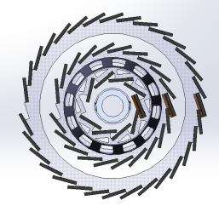
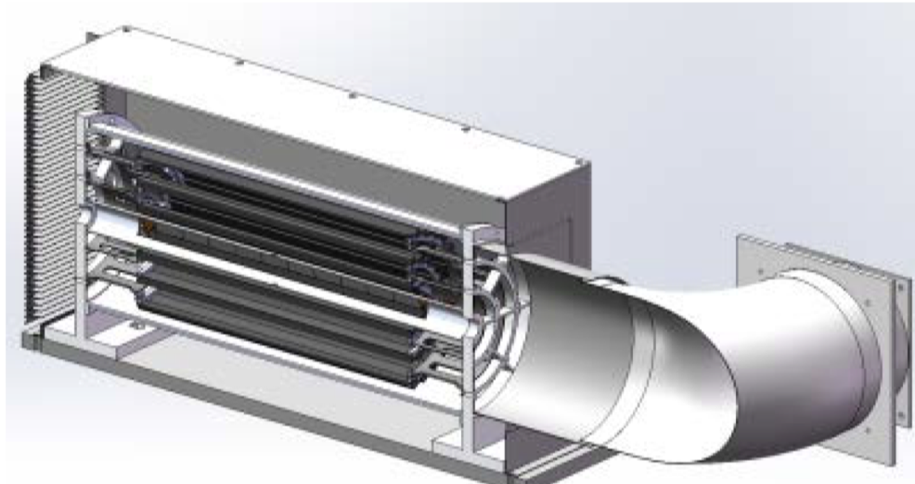
Plan for test beam
Expect to perform beam test in DESY(3 - 7GeV electron beams)
  IHEP test beam facility as backup plan (a few hundreds MeV - 2.5GeV electrons )
Enclosure for detector with air cooling is developed for beam test
  Beam is shooting at one sectors of vertex detectors
Install one sector of ladder in vertex detector
Beam
Beam
Beam

Slide 23
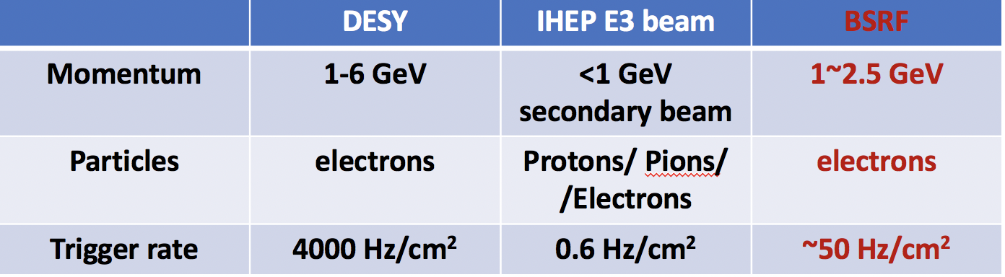
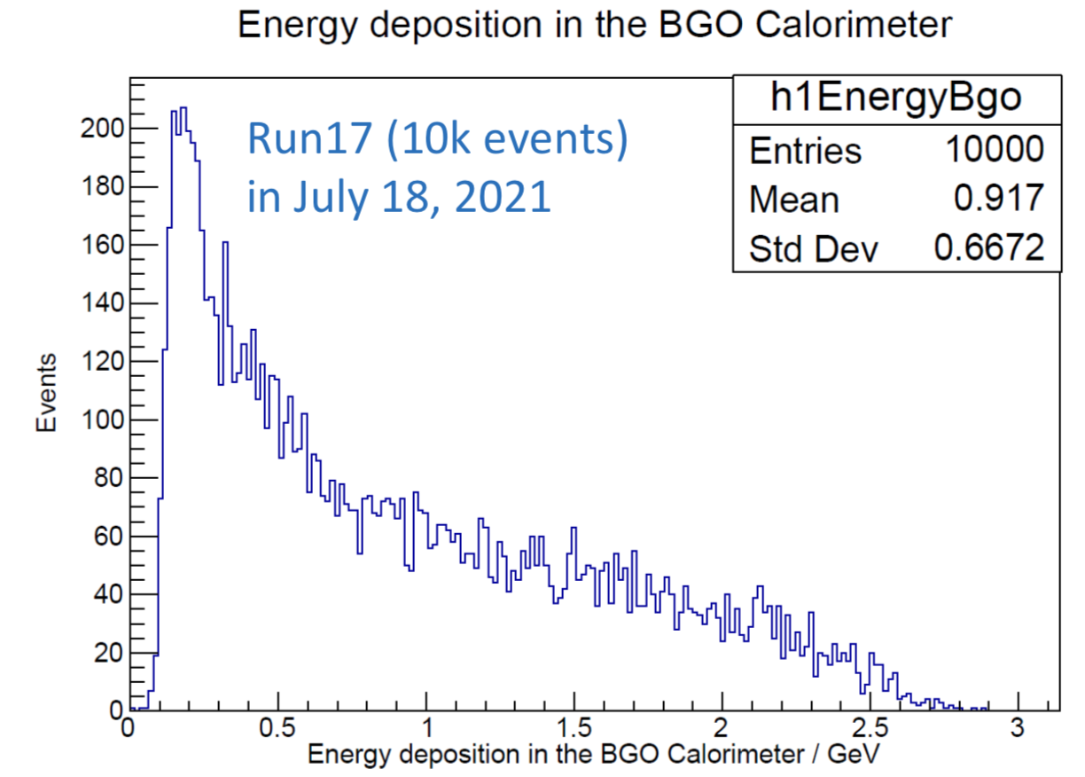


Plan for test beam (2)
New opportunity in Beijing Synchrotron Radiation Facility (BSRF)
  High energy electron (0.2~2.5 GeV) leakage from BEPC
  High trigger rate (up to 50Hz/cm²)
  Need to filter low energy particles for vertex test beam
Energy spectrum measured
by calorimeter (by Yong Liu)

Slide 24
Summary
Sensor:
  Completed two round of CMOS sensor prototyping, finalized full-size sensor design
  New readout architecture to reduce pixel size to 25μm*24μm
    → Reach midterm Assessment index (实现中期指标）
  First irradiation test up to 30 Mrad >1Mrad total ionization dose radiation
Mechanics:
  Build the support structure prototype for ladder prototype
  Finalize the design for full vertex detector
 | Mid-term | Final goal | Status
Spatial resolution | Pixel size less than 25*25 μm | Spatial resolution 3~5 μm | Reach mid-term goal
Radiation hardness | > 1MRad in simulation | >1MRad In radiation test | First test up to 30 Mrad. Chip is still functional

Slide 25

Outlook for the next year
  Competed R & D large area sensor
  Manufactured the support structure for whole detector
  Assembling and installing the detector prototype
  Completed DAQ system for whole detector

Slide 26
Outlook for the next year
  Competed R & D large area sensor
  Manufactured the support structure for whole detector
  Assembling and installing the detector prototype
  Completed DAQ system for whole detector

Slide 27

Backup : Preparation for the full size engineering run
df

Slide 28

Backup : Preparation for the full size engineering run
df

Slide 29
Backup: International collaboration
IFAE(Spain): very active in CMOS Sensor design and testing
Liverpool (UK): Tracker mechanical design,
Oxford(UK): CMOS sensor design validation, thermal design
RAL(UK): Pixel module design
Queen Mary(UK): module mechanical design (Zero mass concept)
Strasbourg (FR): CMOS sensor design, Tracker mechanical design
University of Massachusetts (US): Tracker mechanical design, thermal design
  In 2019, we have one engineer visited Oxford and Liverpool for 4 weeks, learned a lots about silicon.

Slide 30


Main specs of the full size chip for high rate vertex detector
Bunch spacing
  CEPC Z+Higgs (240GeV): 680ns;
  WW threshold scan (160GeV): 210ns;
  CEPC Z pole runing (90GeV) Z: 25ns
High Hit density
  2.5hits/bunch/cm² for Higgs/WW runs
  0.2hits/bunch/cm² for Z pole running

Slide 31

New proposed readout architecture in TaichuPix
New readout architecture
→ reduce power consumption and reduce pixel size
CEPC readout time requirement:
  <500ns deadtime @40MHZ(Z pole)
Taichu-1 Column-drain readout
  Priority based data driven readout; time stamp at EOC
  Dead time: 2 CLK for each pixel (50ns @40MHz CLK)
  Two digital pixel designs: FEI3-like and ALPIDE-like design
2-level FIFO architecture
  L1: column level, to de-randomize injecting charge
  L2: chip level, to match in/out data rate between core and interface
Trigger readout:
  Coincidence by time stamp, matched event read out
df

Slide 32


Pixel Analog design
CEPC time stamping precision requirement:
  25-100ns, better to time stamping each collision at Z pole
Taichu-1 pixel analog design:
  50ns~150ns (based one standard CMOS MAPS tech.)
  Consider to use depleted CMOS MAPS

Slide 33

Backup: Ladder Mechanical testing
Detailed designs of platform and tooling for different test.
Static (different support and load cases)
Vibration and cooling + pressed air (different cases):
  Measure Deformation, temperature, air speed, flow rate, etc.
Goal: Measure vibration to 1μm level with air cooling with laser interferometer

Slide 34



Data acquisition system
DAQ Tests with 5 MIMOSA chips
Preliminary design of data acquisition system(DAQ)
  Ladders are reader by readout boards
  All readout boards connected to computer through a switch
  User interface developed
  DAQ tested in five modules equipped with MIMOSA sensors
DAQ system data display
Tested with MIMOSA modules

Slide 35
Main specs of the full size chip for high rate vertex detector
Bunch spacing
  CEPC Z+Higgs (240GeV): 680ns;
  WW threshold scan (160GeV): 210ns;
  CEPC Z pole runing (90GeV) Z: 25ns
High Hit density
  2.5hits/bunch/cm² for Higgs/WW runs
  0.2hits/bunch/cm² for Z pole running

Slide 36

backup :
pixel threshold vs. TID
Mean threshold of a column vs. TID
pixel noise vs. TID
Mean noise of column vs. TID
Preliminary
  Good chip function and noise performance proved to 2.5 Mrad,

Slide 37

Backup:
Probed pixel pedestal vs. TID
S-curve of pixel (7, 120) in S1
Probed pixel amplitude vs. TID
S-curve of pixel (40, 120) in S3
  The threshold was initially set at the minimum level. After ~1 Mrad, the pedestal level was shifted to see noise floor in S-curves, so the threshold level was set higher.

Slide 38



Publications and International talks
Publication:
JINST 14 (2019) C12012
IEEE ICECS (doi: 10.1109/ICECS46596.2019.8965105.)
International conference talks:
  Joao Guimaraes Da Costa, CepC phys/detectors, Workshop on the Circular Electron-Positron Collider,EU Edition, April 15 - 17, 2019, Oxford, UK
  T. Wu , A full functional Monolithic Active Pixel Sensor prototype for the CEPC vertex detector, in proceeding of International Conference on Electronics Circuits and Systems, Nov. 27-29, 2019, Genova, Italy.
  Xiaomin Wei, High data-rate readout logic design for 1024*512 CMOS pixel array dedicated for CEPC experiment, International workshop on radiation imaging detectors, International workshop on radiation imaging detectors, July 2019, Crete, Greece
  Ying Zhang, Overview of the chip design for the MOST2 CEPC vertex project, Workshop on the Circular Electron-Positron Collider,EU Edition, April 15 - 17, 2019, Oxford, UK
  Wei Wei, Full size pixel chip for high-rate CEPC Vertex Detector，Workshop on the Circular Electron-Positron Collider,EU Edition, April 15 - 17, 2019, Oxford, UK

Slide 39


Task 2: Physics goal
Higgs precision measurement
  H → bb precise vertex reconstruction
  H → μμ (precise momentum measurement)
Main technology
  High spatial resolution technology → pixel detector
  Low-mass detector technology
  Radiation resistance technology
Need tracking detector with
high spatial resolution, low material

Slide 40

Goal for the third year(2020.7 –2021.6)
Achieve the target in task book for the 3rd years
  Build the support structure prototype for ladder
  Finalize the full-size sensor design , and write a design report
  Complete the testing of 2nd MPW Taichu chip, write a testing report
  Complete initial design of readout electronics and DAQ for vertex detector prototype

Slide 41




Electrical test
Electrical performance verified by injecting an external charge into pixel front-end
Analog output of a pixel @ Vin = 0.9 V

Slide 42


Electrical test （2）
Four sectors with FEI3-like digital logic works well
and show similar noise performance for 4 different pixel design.
S1 sector design shows the minimum threshold.

Slide 43



X ray tests and beta source tests
Beta source Tests
Analog output waveform agreed with the simulation
for the small signal, the S/N ratio was also good
X ray tube test

Slide 44


CMOS Monolithic pixel sensor
CMOS Monolithic pixel (CIS process) is ideal for CEPC application
  low material budget (can be thin down to 50μm)
  This project use TowerJazz CIS 180nm technology
Hybrid pixel technology developed by ATLAS and CMS
  Thickness of sensor is about 200~300 μm
  Need to bump bonding with readout ASIC (ASIC thickness is about 300μm)
  Material budget about silicon sensor is about 10 times larger than CIS process
Hybrid pixel

Slide 45
Research Team in task 2
4 institutes
课题2：IHEP - 中国科学院高能物理研究所
                SDU - 山东大学
                NJU - 南京大学
                NWU - 西北工业大学
Institutes | Tasks
IHEP | Full CMOS chip modeling, Pixel Analog, PLL block Detector module (ladder) prototyping Data acquisition system R & D Vertex detector assembly and commissioning
CCNU/IFAE | CMOS sensor chip: Pixel Digital
NWPU | CMOS sensor chip: Periphery Logic, LDO
SDU | CMOS sensor chip: Bias generation, TCAD simulation Sensor test board design
NJU | Irradiation, test beam organization
Notes:
Total 51, average age is 39
Acc: 39=703/18
Silicon: 39=866/22
HCAL: 40=440/11
Total: 39

Slide 46

TaichuPix radiation test
Completed two round of CMOS sensor prototyping
  First Radiation test up to 30Mrad at BSRF , TaichuPix2 is still functional
  TaichuPix-2 irradiated at BSRF 1W2B beamline (6 keV X-ray)
    Dose rate ~17.63 krad/min for the first 2.5 Mrad
    then 211.56 krad/min for 51 min, then 1.24 Mrad/min for 15 min
    Dose rates were calibrated with an ion chamber before test
Radiation test at BSRF for 2nd MPW chip

Slide 47

TaichuPix radiation test (2)
  Good chip function and noise performance proved to 2.5 Mrad,
  no deterioration observed when TID up to 30 Mrad.

Slide 48

TaichuPix radiation test (3)
  No deterioration observed when TID up to 30 Mrad.
Current [mA]
Preliminary

