Slide 1
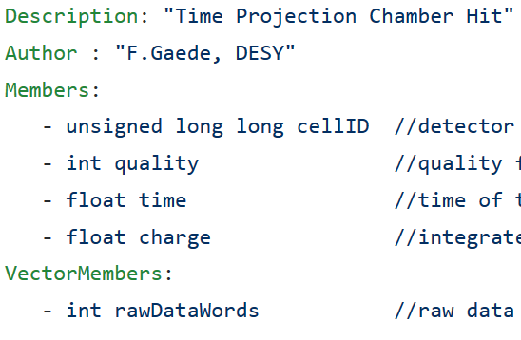
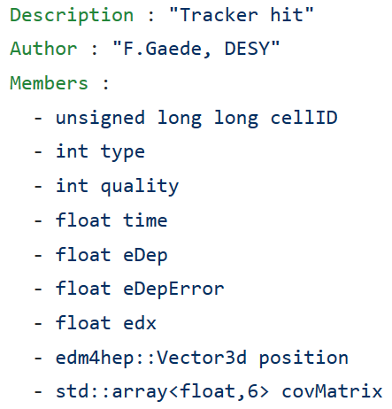
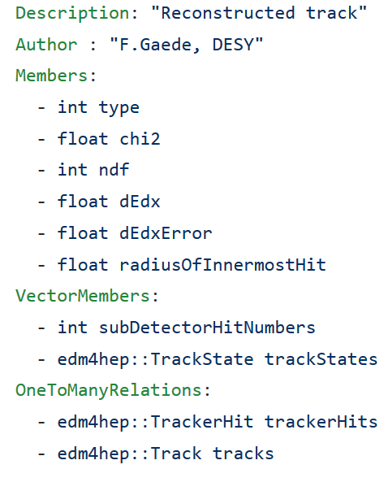
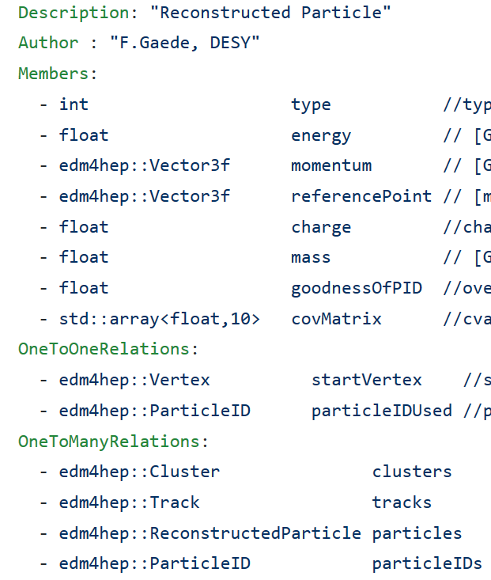
CEPC DC Tracking Data Flow
Questions:
The output of digitization
TrackerHit or TPCHit? -> TrackerHit
Is waveform sim. is in the stage simulation stage or digitization
Same or separate collections for the same rec. object from different rec. algorithm
Naming convensions of edm collection
waveform
detector
Simulation
2
(Primary Ion.)
MCParticle
Time charge
1
Waveform digitization
MCParticle
SimTrackerHit
TPCHit
(Waveform)
TPCHit
Digitization
Waveform rec.
MCRecoTrackerAsso.
TrackerHit
TrackerHit:
Energy & position
TPCHit:
T/Q pair
Truth tracking/Track finding
Track
TrackState
ReconstructedParticle
TrackerHit
MCRecoParticleAsso.(relationship between Particles)
Rec.Particle<->MCParticle
Rec.Track:
5 parameters
dEdx
fittedState
Rec.Particle:
Particle and related rec. object
MCRecoTrackerAsso.(Relationship between hits)
TrackerHit<->SimTrackerHit
Track fitting
Event/vertex reconstruction

