Slide 1
Hough Transformation
Zhang Yang, Song Weizheng
Sep/29/2021

Slide 2
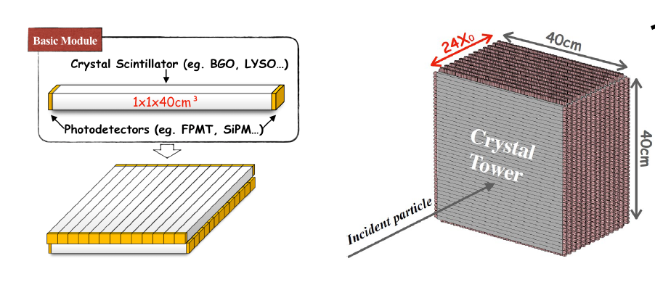
ECal on CEPC
z
x
y

Slide 3
Outline
Motivation of Hough transformation
Definition of local maximum and Hough transformation
Implementation
Examples
Performance for $γ$ in different energies
Summary and next step

Slide 4
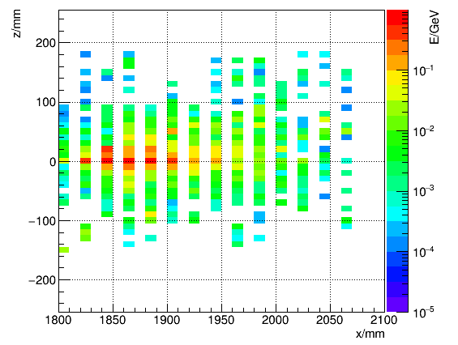
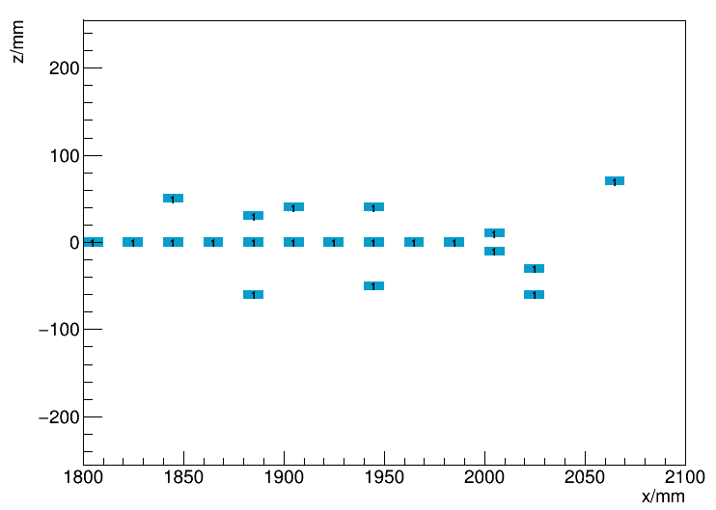
Motivation of Hough transformation
To find the tracks of gamma/mip/hadron,
doing Hough transformation with local maximums
origin
local maximums

Slide 5
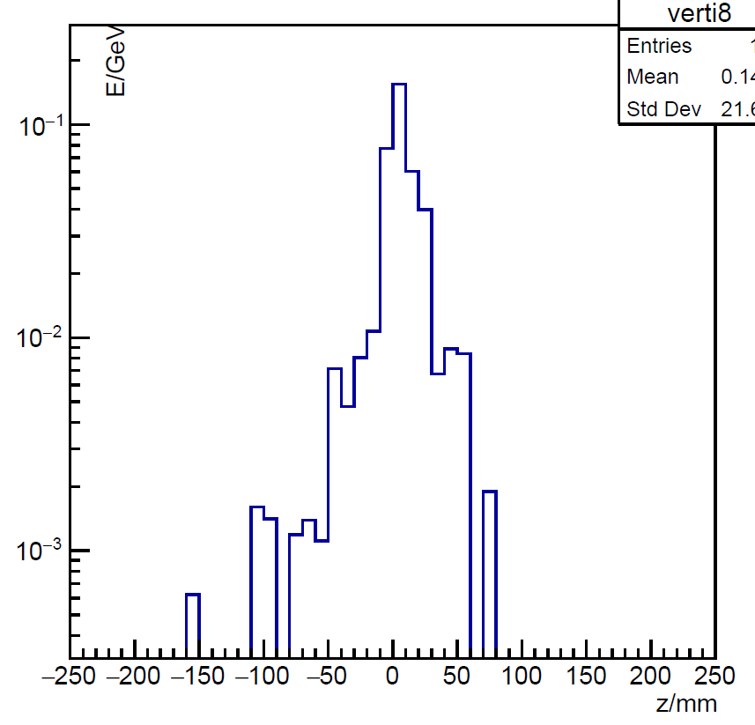
Local maximum
$>5MeV$, greater than both sides
$\frac{1}{2}$mip
Local maximum

Slide 6
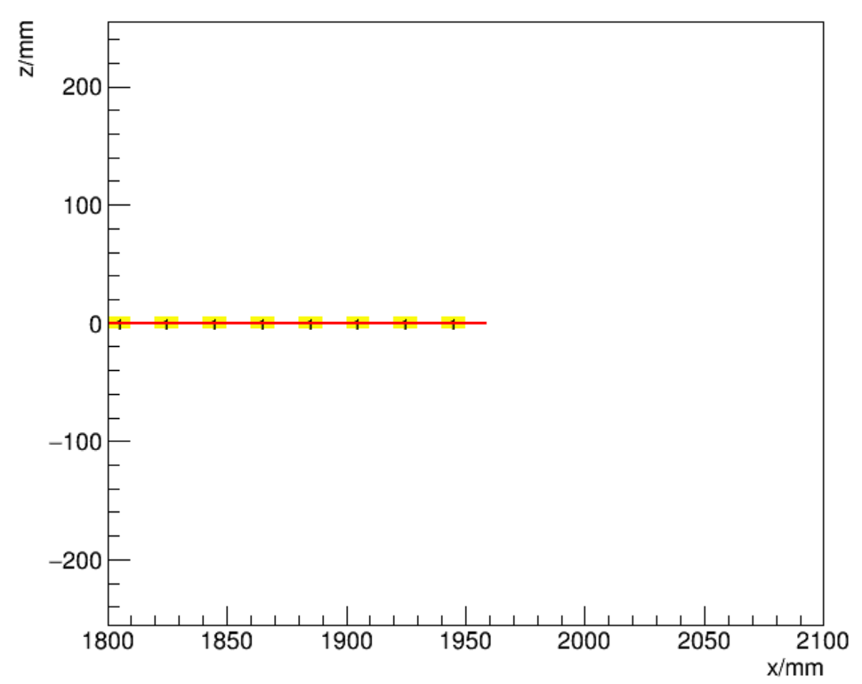
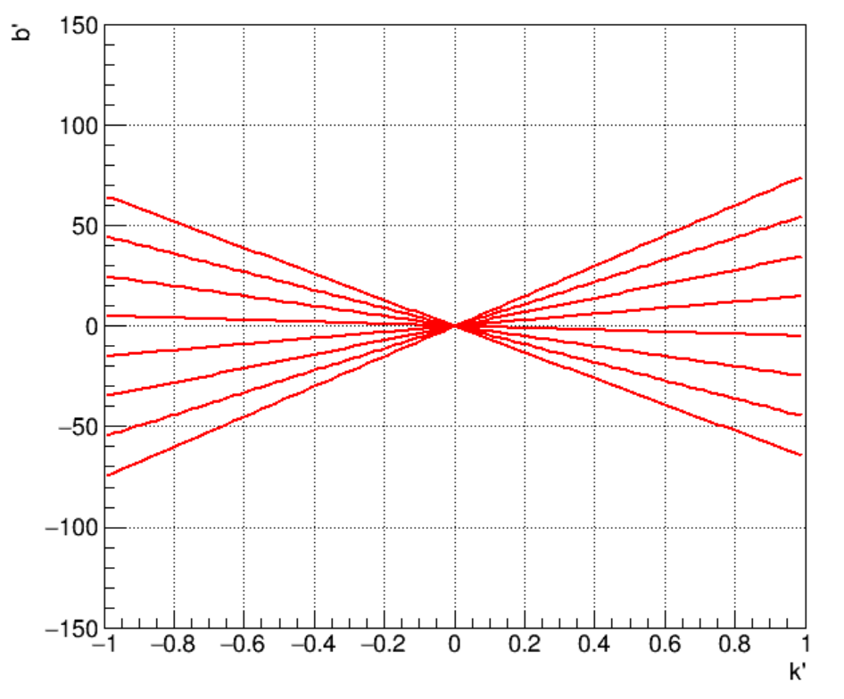
Hough transformation
$$y=kx+b$$
$$b=−xk+y$$
x-y space
k-b space

Slide 7
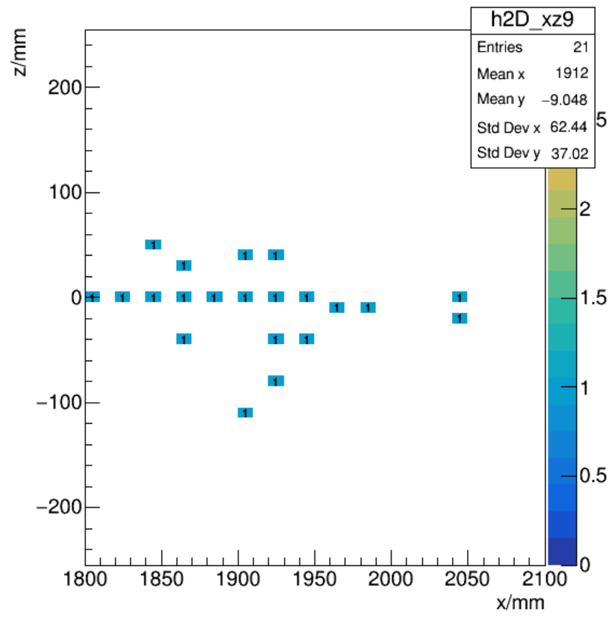
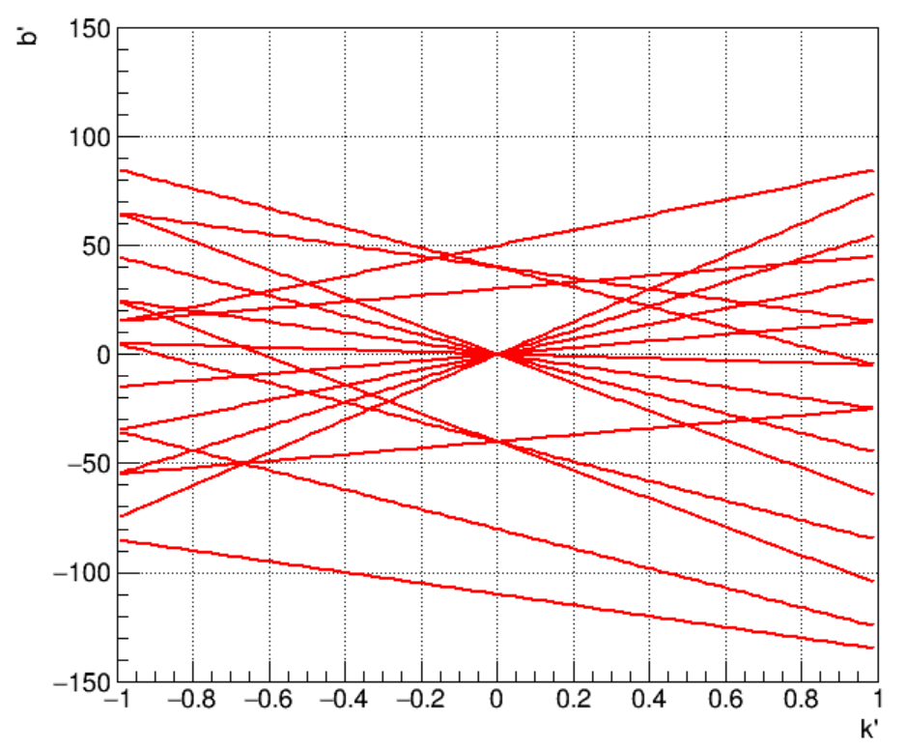
Implementation
1.Hough transformation using 2D local maximum
Hough Transformation
Only bars in superlayer 1~8 are used

Slide 8
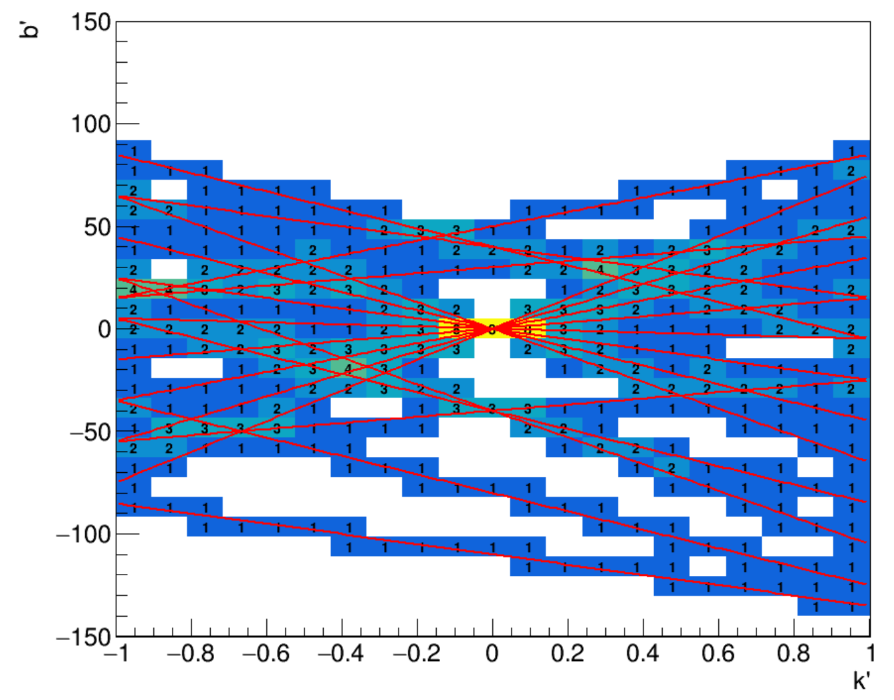
Implementation
2. Divide k-b space into small bins
Then count how many lines passing through each bin

Slide 9
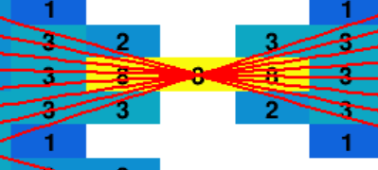
Implementation
2. Divide k-b space into small bins
Then count how many lines passing through each bin
If some bin has over 4 lines and no less than the rest of 8 bins next to it, transform this bin back to x-y space

Slide 10
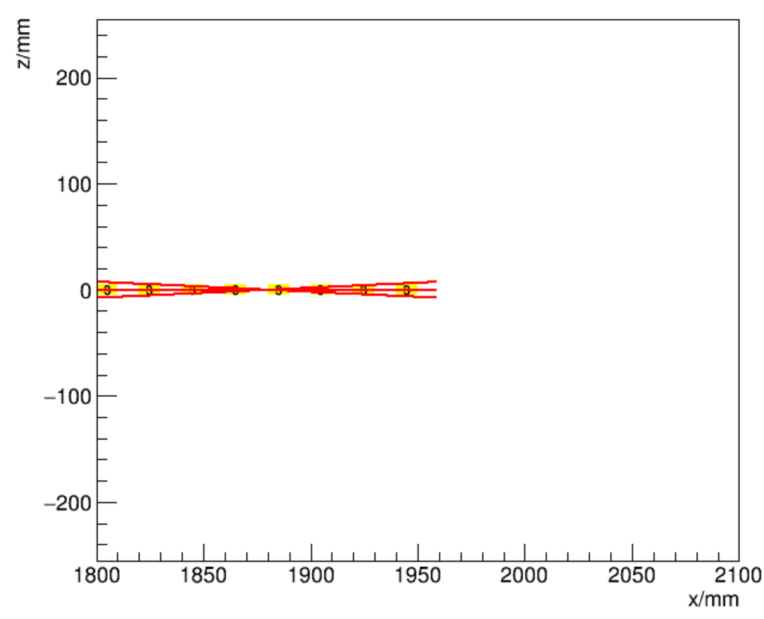
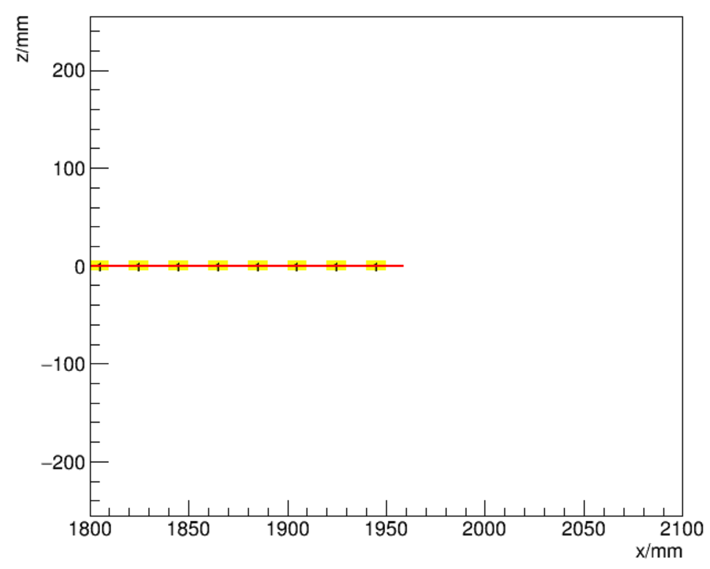
Implementation
3. Transform back
Bins in k-b space
Lines in x-y space(track)
Lines in k-b space
Positions in x-y space
Using smaller bins in k-b space

Slide 11
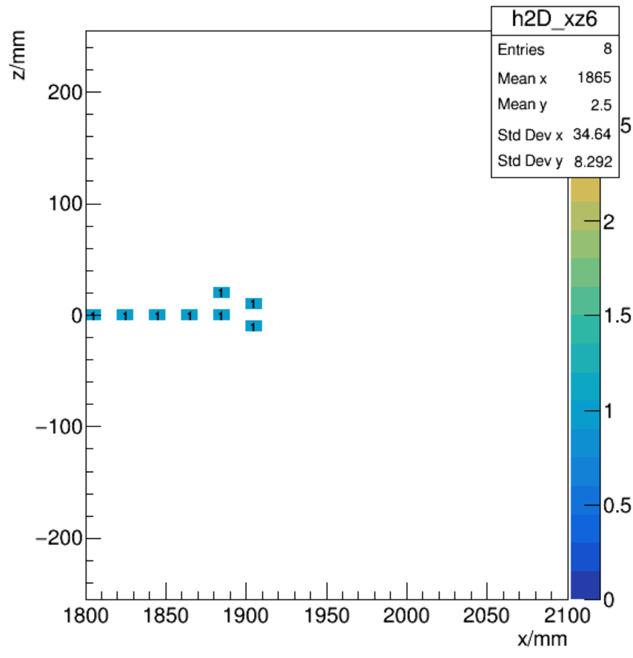
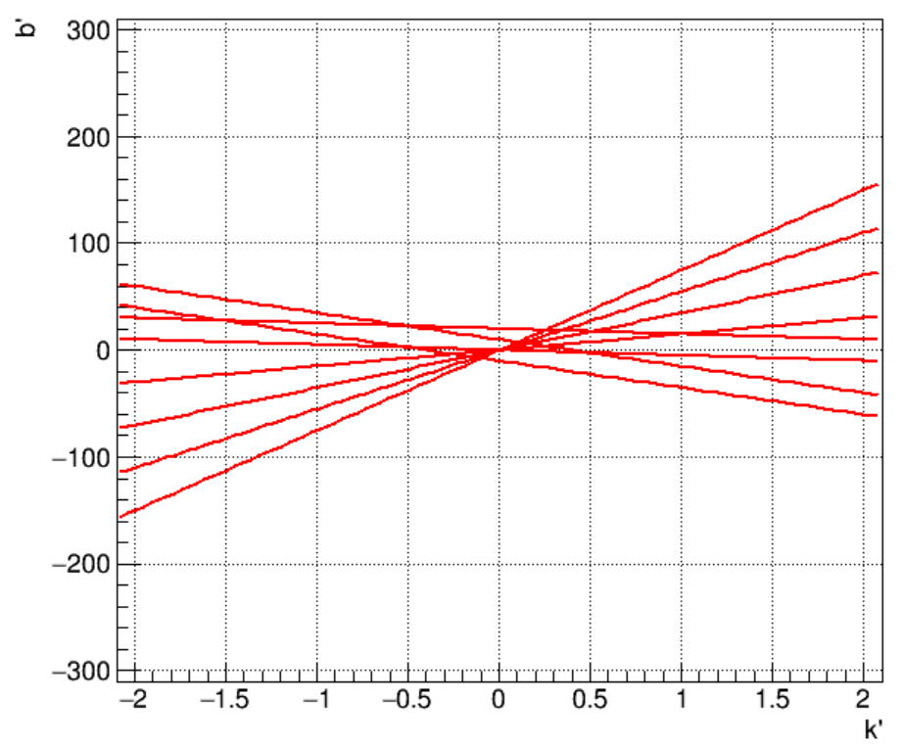
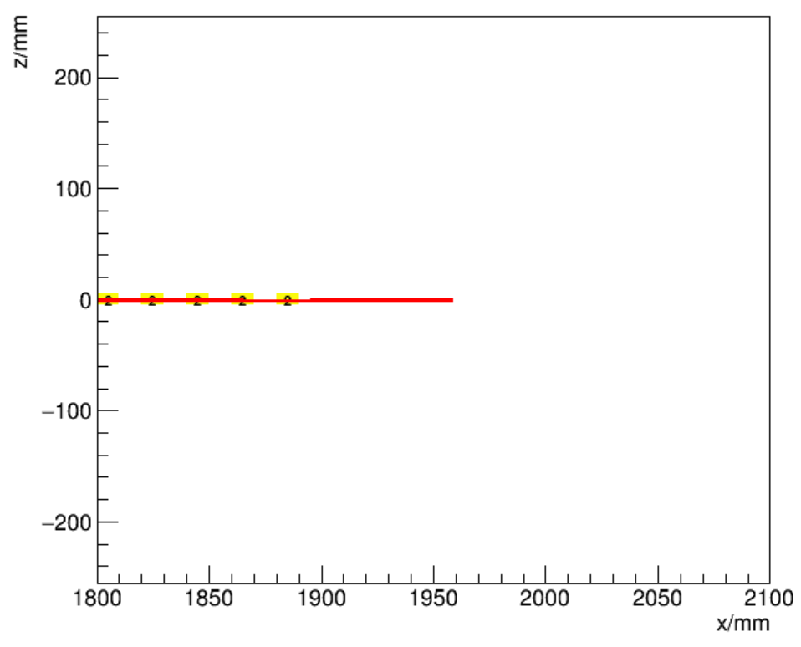
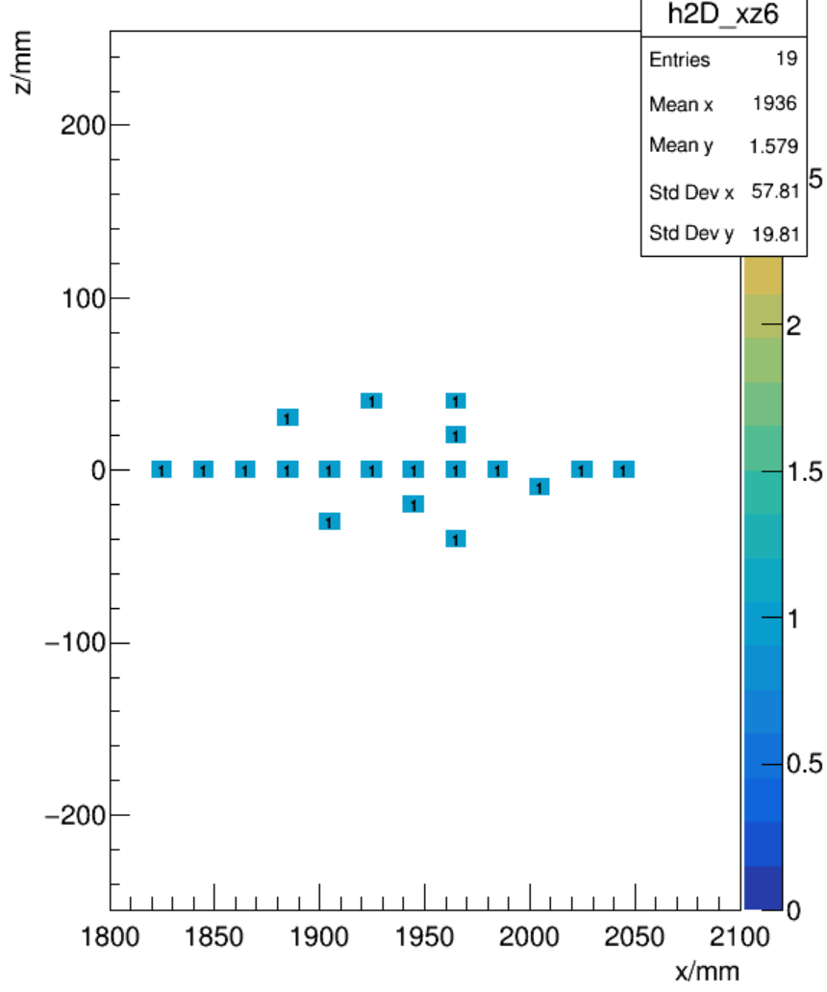
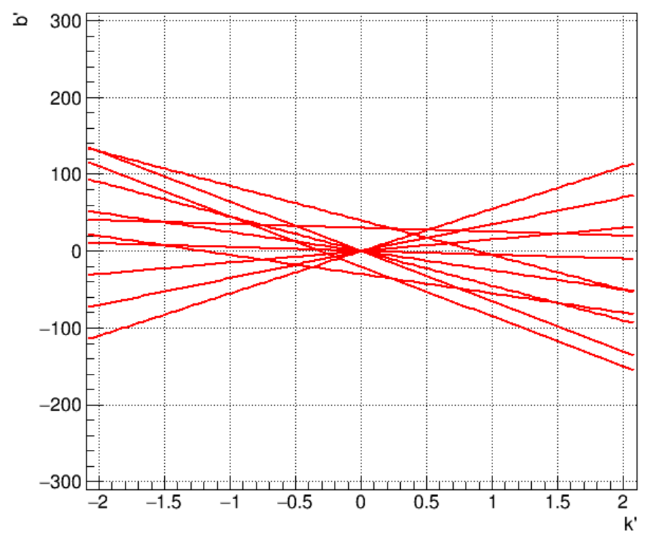
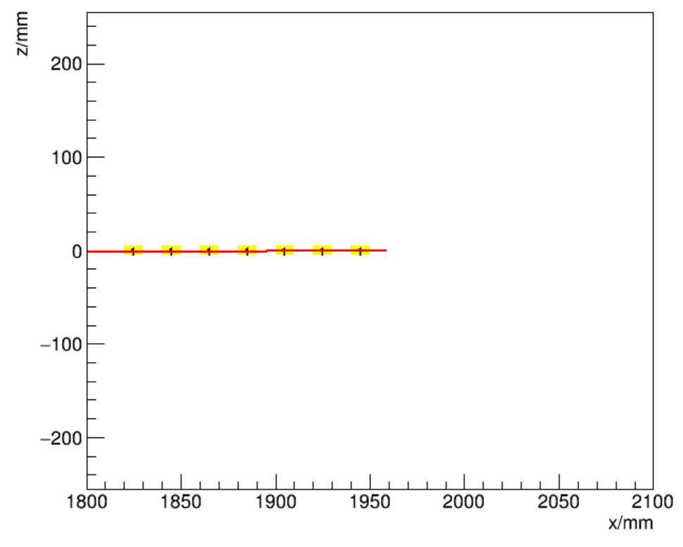
Examples
Gamma
1GeV
Local max
5GeV
Local max

Slide 12
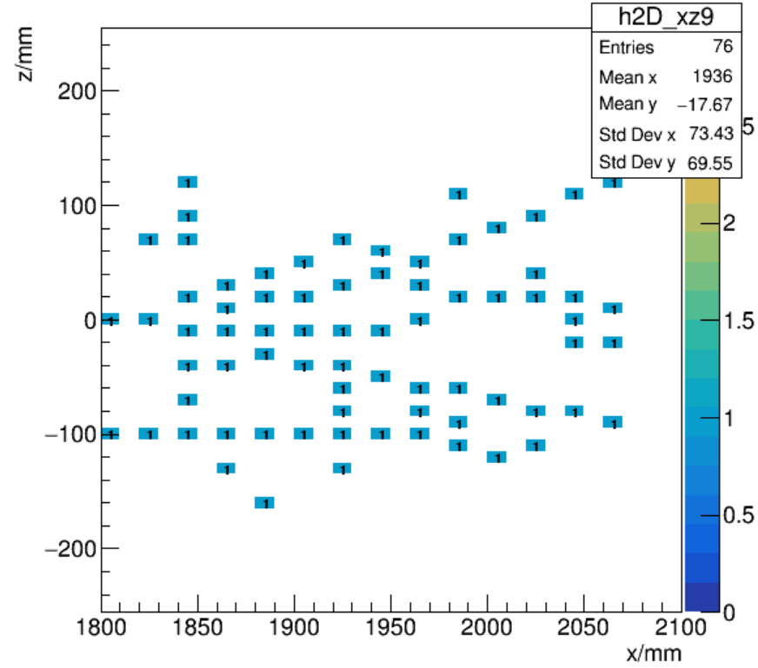
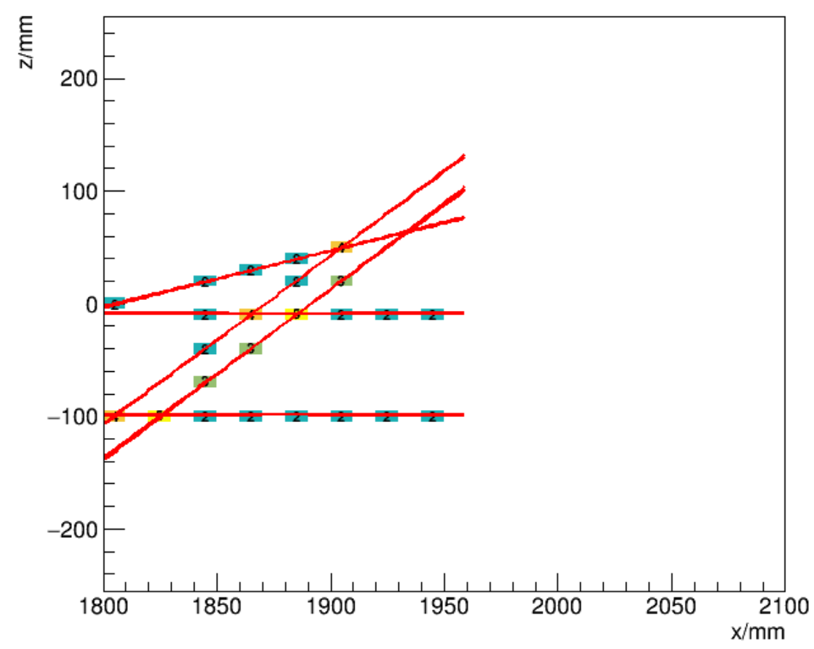
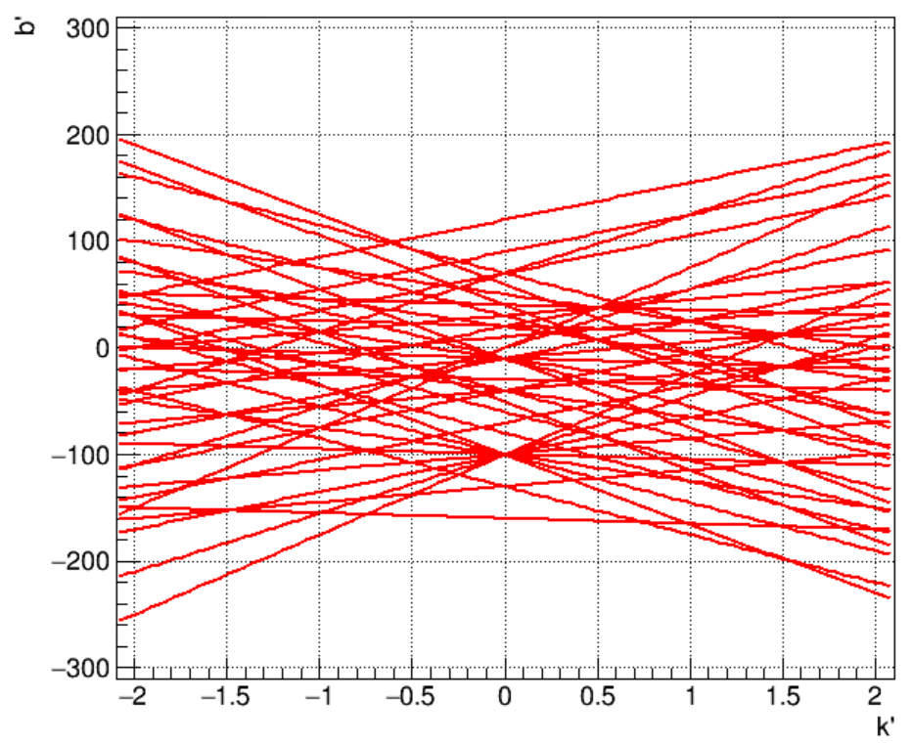
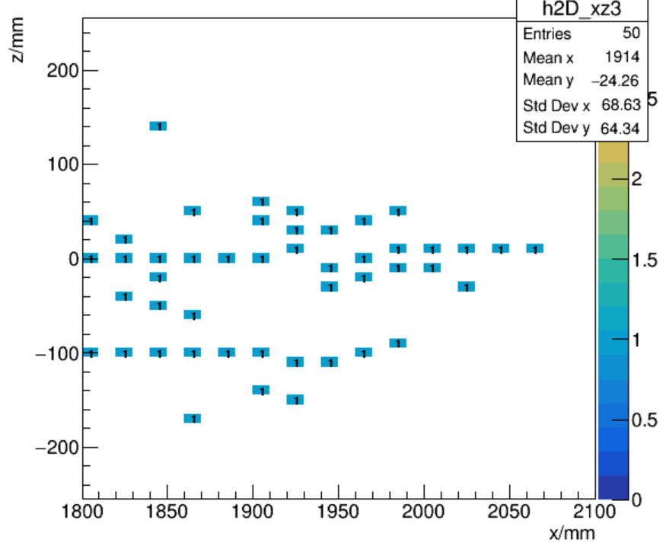
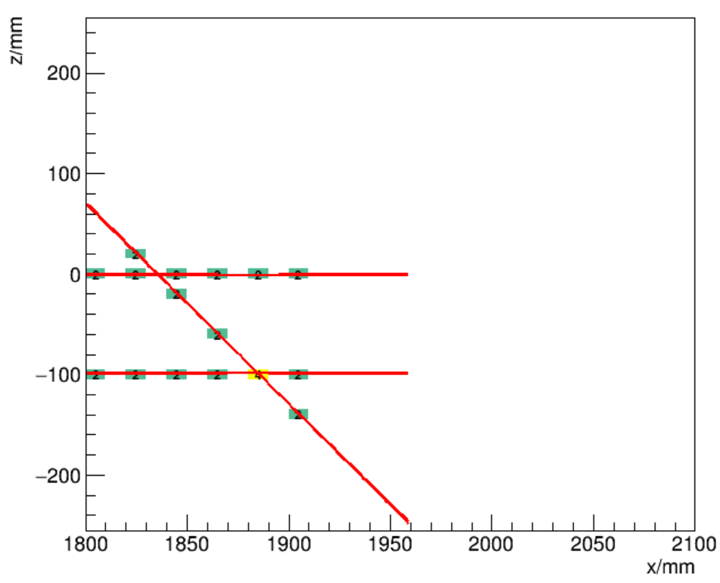
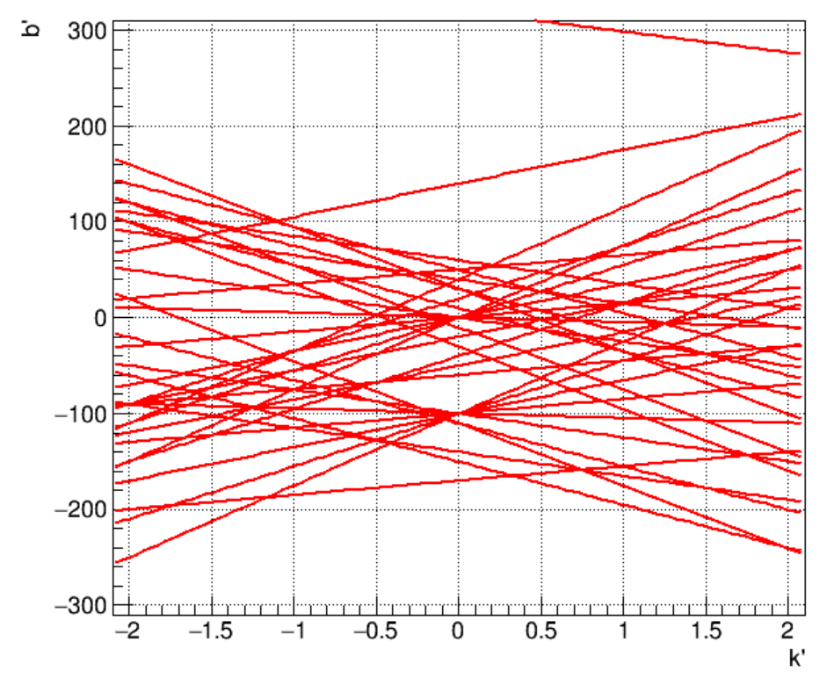
Examples
Gamma & pion

Slide 13
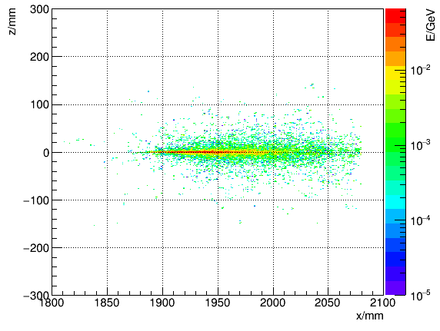
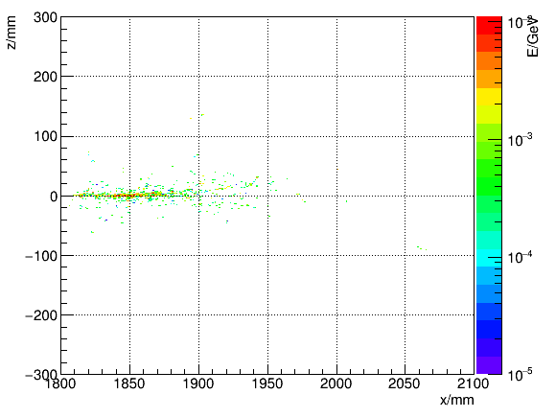
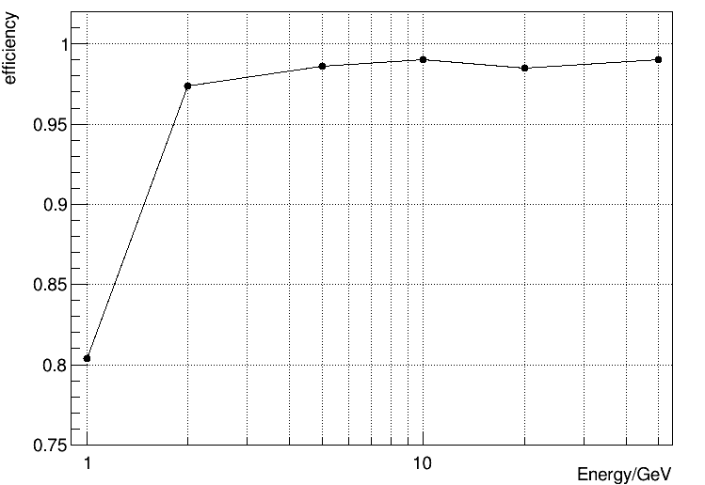
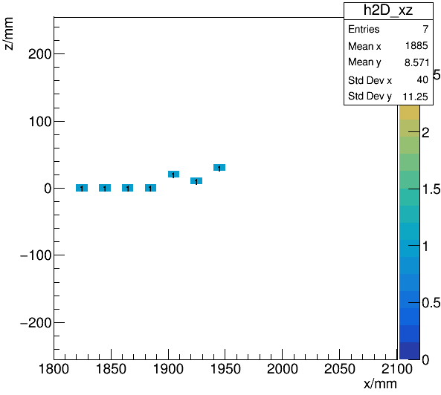
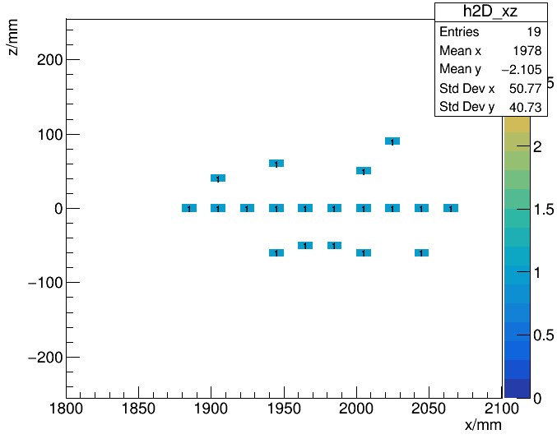
Performance for $γ$

Slide 14
Summary
Hough transformation is done preliminarily
For low energy $γ$(1GeV), nearly 20% are too short to form a track line
About 1% $γ$ start EM shower in the center of Ecal

Slide 15
Next Step
$γ$ with a slope
Performance for hadron
2 incident particles

Slide 16
Back up

Slide 17
Hough transformation in detail
$$b^{′}=−\left(x−1880\right)k^{′}+y$$
$$b^{′}−80k^{′}=−\left(x−1800\right)k^{′}+y$$
$$y=k\left(x−1800\right)+b$$
$$b$$
$$k$$
x-y space
k’-b’ space

Slide 18
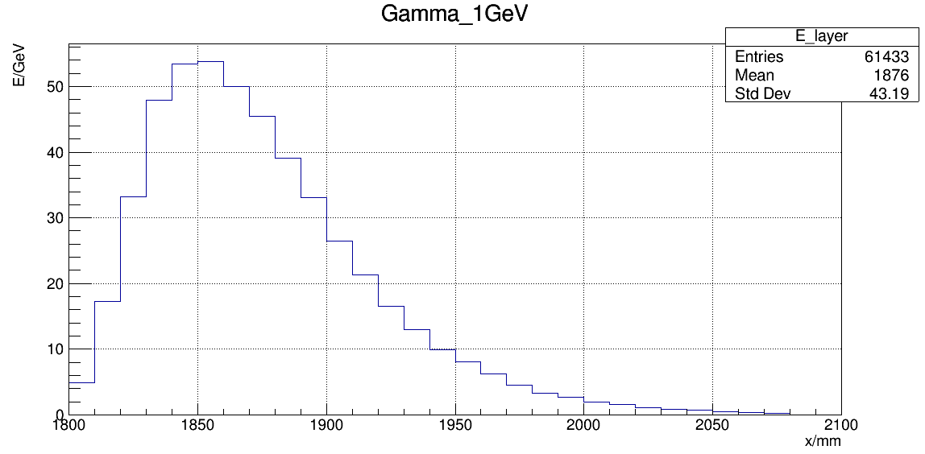
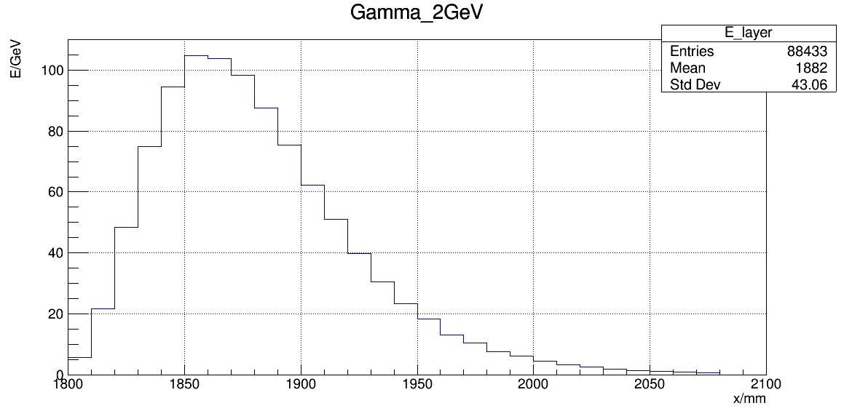
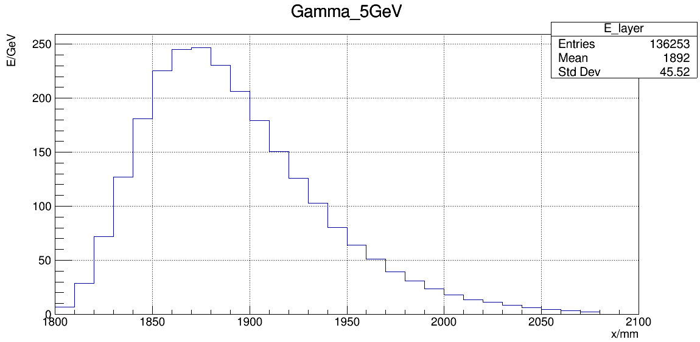
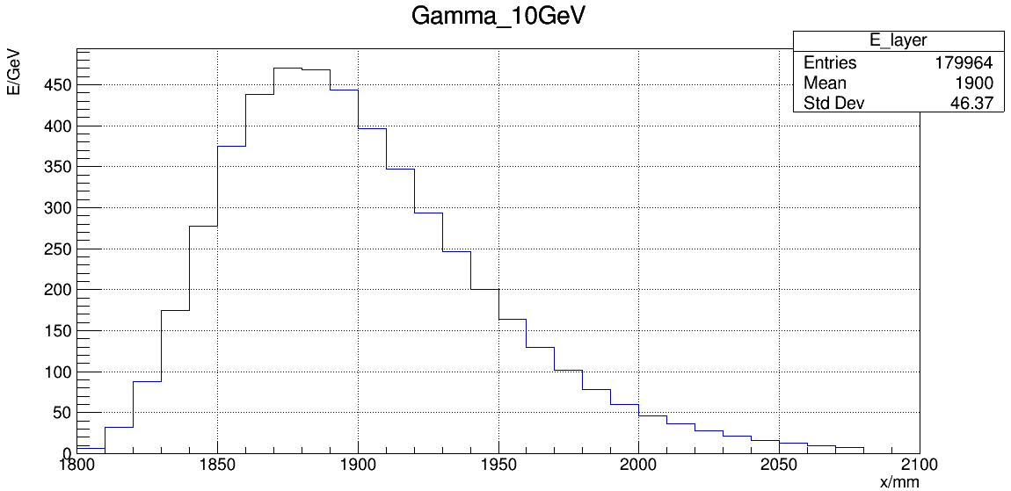
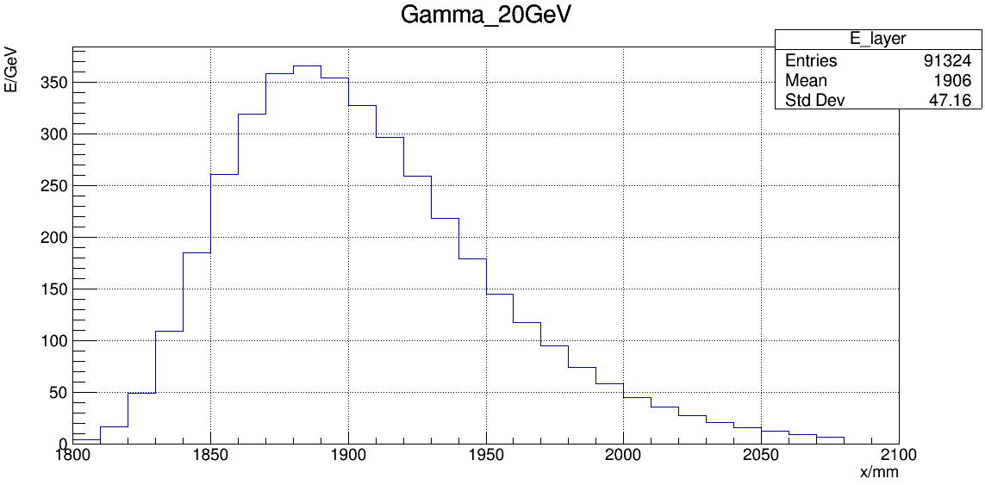
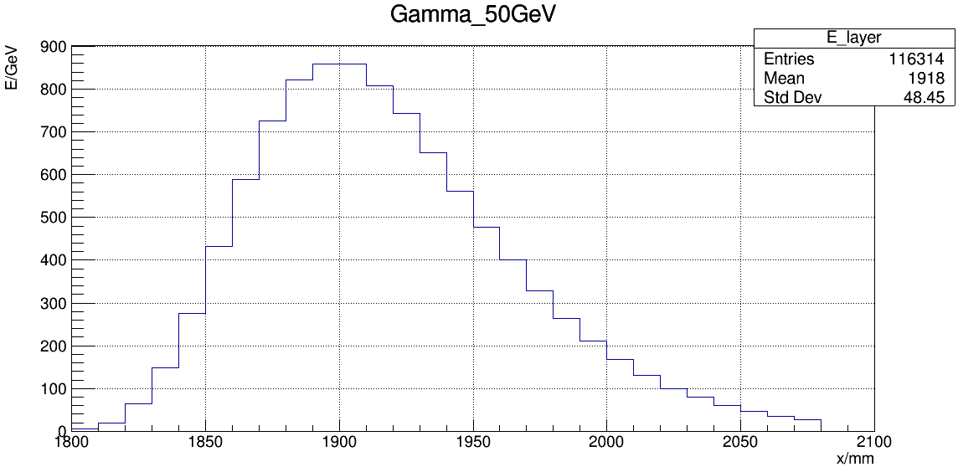
Longitudinal energy distribution of Gamma
$$t_{max}$$
$$t_{max}$$
$$t_{max}$$

Slide 19
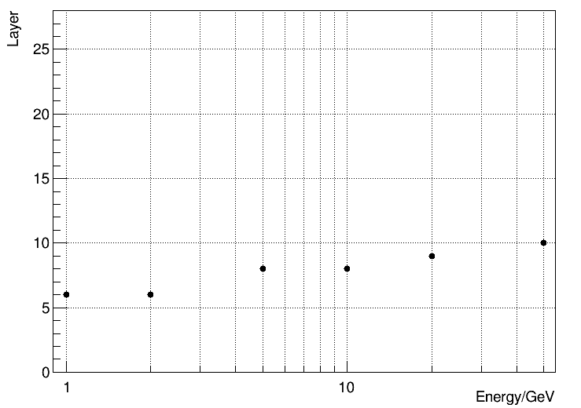
Longitudinal energy distribution of Gamma

