Slide 1
Garfield simulation with different gas mixtures
Siman Liu, Linghui Wu, Guang Zhao, Shuiting Xin , Weimin Song
Cluster Counting Meeting
Sept 30th, 2021

Slide 2
Outline
Introduction
Ionization
Drift velocity
Longitudinal diffusion
Summary

Slide 3
Introduction
The choice of the gas mixture is essential. To improve reliability of the cluster counting, some characteristics would be expected
Low cluster density to achieve high counting efficiency
Low drift velocity helps to identify clusters in time
Small longitudinal diffusion to avoid overcounting on the clusters with more than one electrons
A study with Garfield++ is performed to understand the property of different gas mixtures
He + iC₄H₁₀
He + C₃H₈
He + C₂H₆
He + CH₄
In this talk , data on He+CH4 were added.

Slide 4
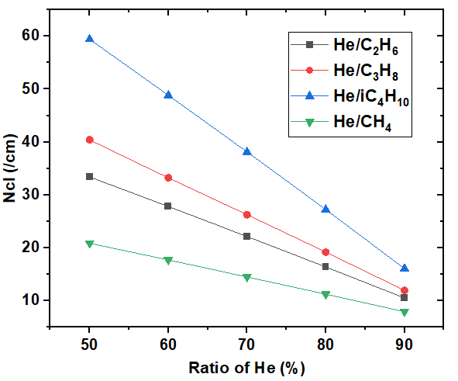
Cluster density
Incident particle: 10 GeV/c pion
Gas pressure: 1 atm
Cluster density : (at the same ratio of He)
iC4H10 > C3H8 >C2H6>CH4
He ratio$↑$ Cluster density$↓$

Slide 5
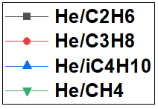
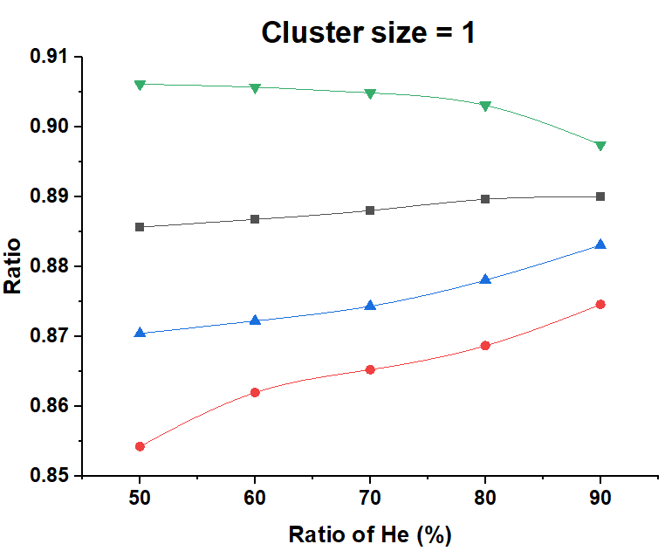
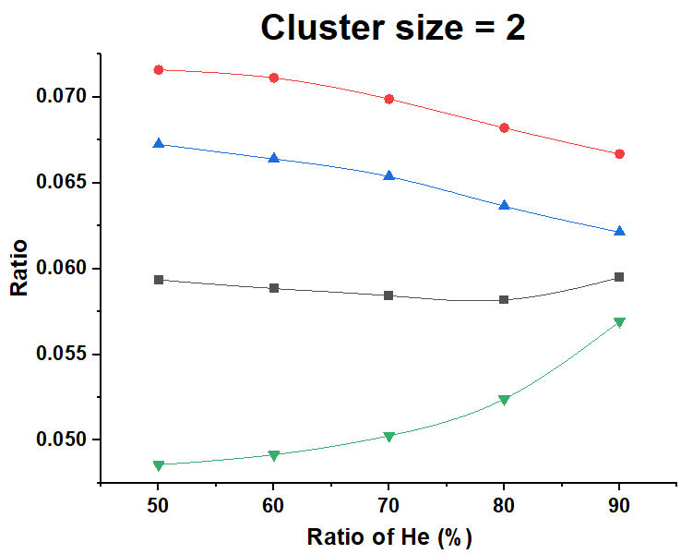
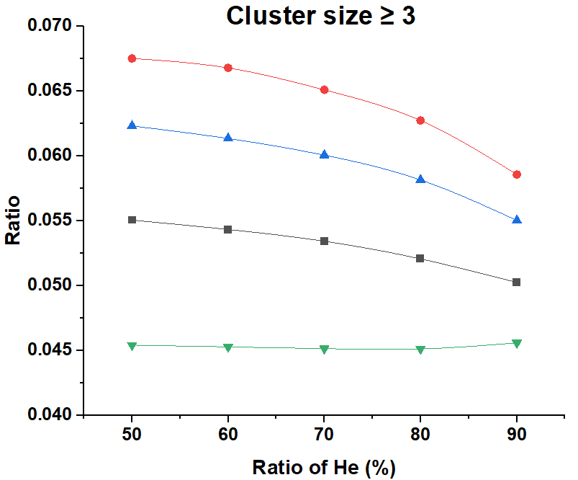
Cluster size
Most clusters have only one electron (85~91%)
A few percent of clusters have more than two electrons

Slide 6
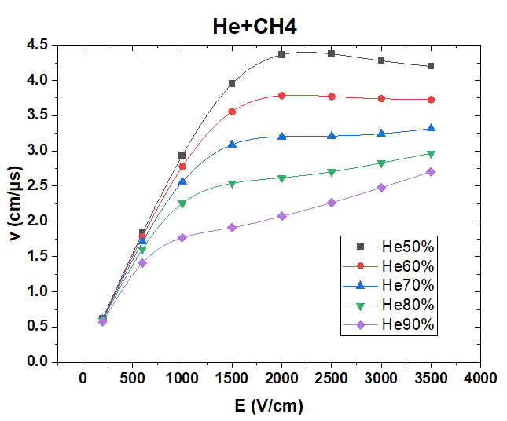
Drift velocity vs E
Gas pressure: 1 atm
Increasing ratio of He helps to reduce the drift velocity

Slide 7
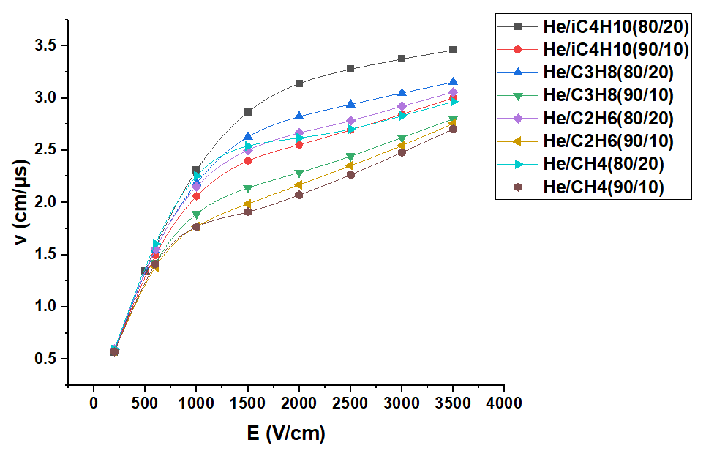
Drift velocity vs E
Gas pressure: 1 atm
With the same ratio of He, He+CH4 has the lower drift velocity

Slide 8
Simulation of drift time to distance relation and diffusion
Configurations:
Electron
Cell size: 2cm × 2cm
High voltage on sense wire: 2500V
Magnetic field : 3T
Gas pressure: 1 atm
Drift distance

Slide 9
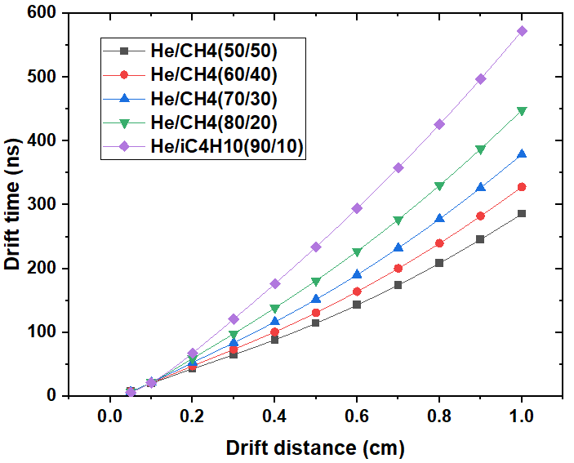
Drift time vs drift distance
Increasing ratio of He helps to reduce the drift velocity

Slide 10
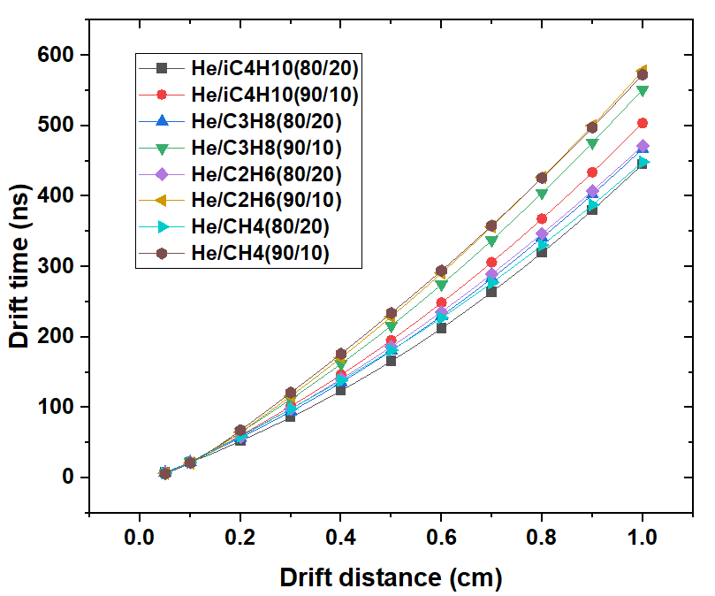
Drift time
When the ratio of He is 90%，
He+CH4 and He+C2H6 have the longer drift time
When the ratio of He is 80%，
He+C2H6 have the longer drift time

Slide 11
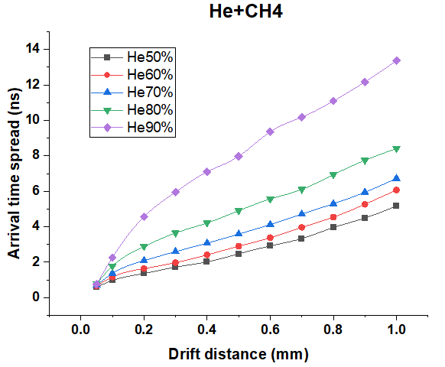
Longitudinal diffusion vs drift distance
The higher ratio of He, the larger diffusion

Slide 12
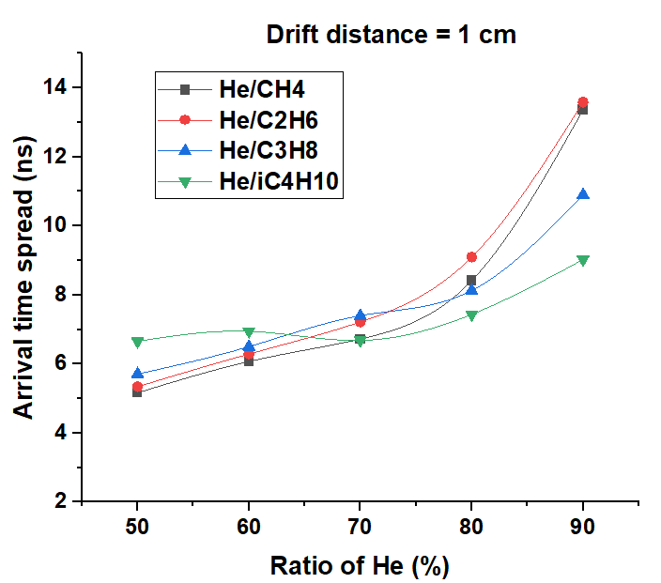
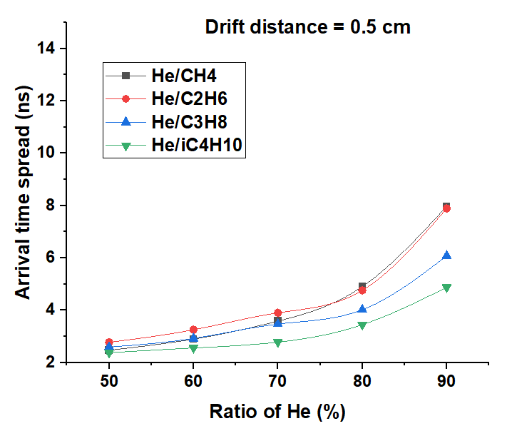
Longitudinal diffusion
With the same ratio of He, diffusion of gas with iC4H10 is smaller in most cases

Slide 13
Summary
Comparison of ionization, drift velocity and diffusion between different gas mixtures performed
Increasing the ratio of He
helps to reduce the cluster density and drift velocity
but causes the diffusion to be more serious
With the same ratio of He
diffusion of gas with iC4H10 is smaller in most cases
the gas with CH4 has lower drift velocity and cluster density

Slide 14
Thanks!

Slide 15
Back up

Slide 16
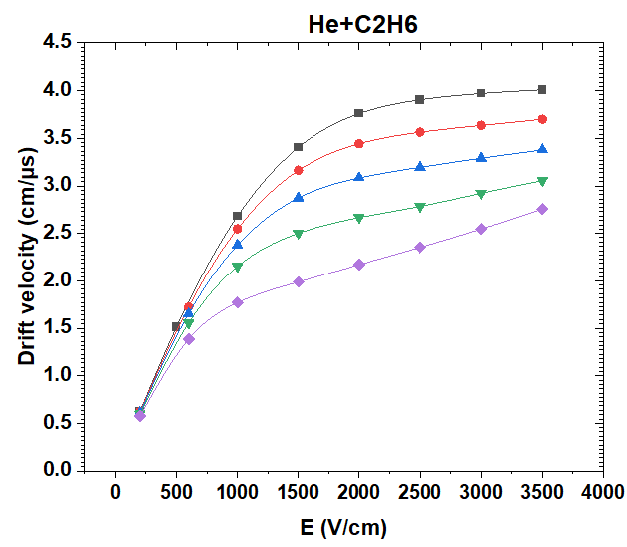
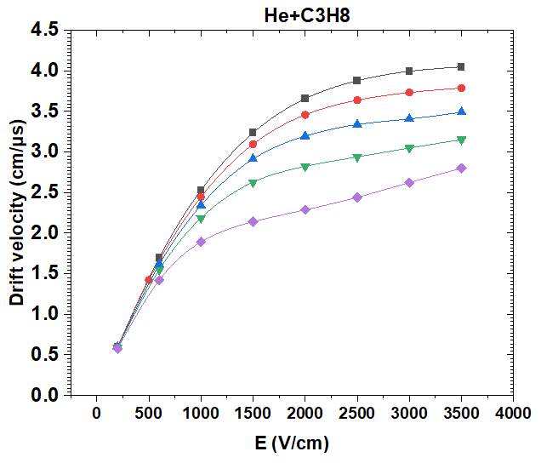
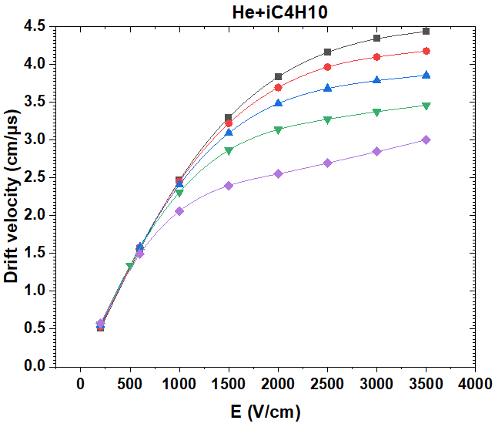
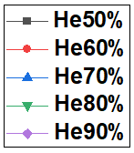
Drift velocity vs E
Gas pressure: 1 atm

Slide 17
Drift velocity
E = 2000 V/cm
gas composition | Drift velocity (cm/μs)
He/IC4H10 (50/50) | 3.835
He/IC4H10 (60/40) | 3.693
He/IC4H10 (70/30) | 3.482
He/IC4H10 (80/20) | 3.139
He/IC4H10 (90/10) | 2.552
He/C3H8 (50/50) | 3.657
He/C3H8 (60/40) | 3.457
He/C3H8 (70/30) | 3.196
He/C3H8 (80/20) | 2.823
He/C3H8 (90/10) | 2.287
He/C2H6 (50/50) | 3.760
He/C2H6 (60/40) | 3.442
He/C2H6 (70/30) | 3.084
He/C2H6 (80/20) | 2.665
He/C2H6 (90/10) | 2.169
He/CH4 (50/50) | 4.364
He/CH4 (60/40) | 3.784
He/CH4 (70/30) | 3.201
He/CH4 (80/20) | 2.619
He/CH4 (90/10) | 2.073
E = 2000 V/cm
gas composition | Drift velocity (cm/μs)
He/IC4H10 (50/50) | 4.435
He/IC4H10 (60/40) | 4.176
He/IC4H10 (70/30) | 3.854
He/IC4H10 (80/20) | 3.460
He/IC4H10 (90/10) | 3.002
He/C3H8 (50/50) | 4.048
He/C3H8 (60/40) | 3.788
He/C3H8 (70/30) | 3.490
He/C3H8 (80/20) | 3.153
He/C3H8 (90/10) | 2.799
He/C2H6 (50/50) | 4.009
He/C2H6 (60/40) | 3.699
He/C2H6 (70/30) | 3.378
He/C2H6 (80/20) | 3.057
He/C2H6 (90/10) | 2.757
He/CH4 (50/50) | 4.199
He/CH4 (60/40) | 3.727
He/CH4 (70/30) | 3.316
He/CH4 (80/20) | 2.966
He/CH4 (90/10) | 2.704

Slide 18
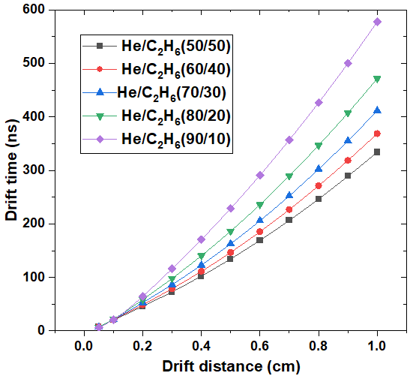
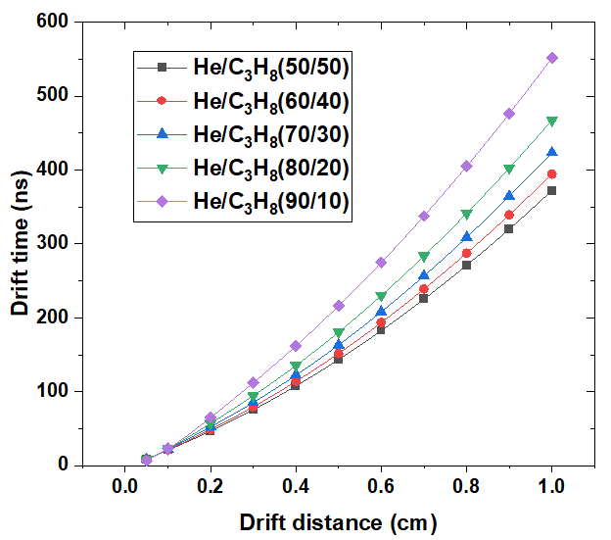
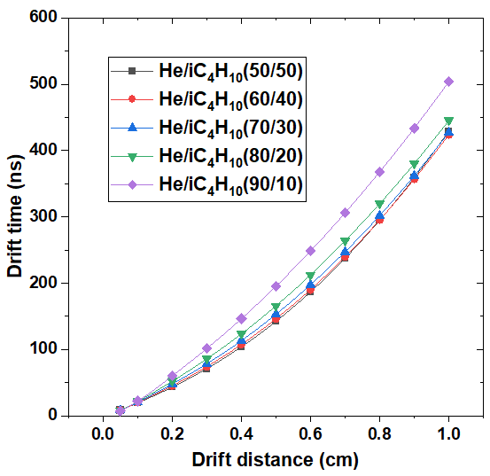
Drift time vs drift distance

Slide 19
Drift time
Drift distance = 0.5 cm
gas composition | Drift time (ns)
He/IC4H10 (50/50) | 142.5
He/IC4H10 (60/40) | 146.3
He/IC4H10 (70/30) | 153.1
He/IC4H10 (80/20) | 165.8
He/IC4H10 (90/10) | 195.4
He/C3H8 (50/50) | 143.4
He/C3H8 (60/40) | 151.8
He/C3H8 (70/30) | 163.1
He/C3H8 (80/20) | 180.6
He/C3H8 (90/10) | 216.1
He/C2H6 (50/50) | 134.4
He/C2H6 (60/40) | 146.6
He/C2H6 (70/30) | 162.8
He/C2H6 (80/20) | 186.3
He/C2H6 (90/10) | 228.8
He/CH4 (50/50) | 114.5
He/CH4 (60/40) | 131
He/CH4 (70/30) | 151.9
He/CH4 (80/20) | 181.3
He/CH4 (90/10) | 234
Drift distance = 1.0 cm
gas composition | Drift time (ns)
He/IC4H10 (50/50) | 429.1
He/IC4H10 (60/40) | 423.9
He/IC4H10 (70/30) | 427
He/IC4H10 (80/20) | 445.2
He/IC4H10 (90/10) | 503.8
He/C3H8 (50/50) | 372.1
He/C3H8 (60/40) | 394.3
He/C3H8 (70/30) | 423.3
He/C3H8 (80/20) | 467.2
He/C3H8 (90/10) | 551.5
He/C2H6 (50/50) | 333.8
He/C2H6 (60/40) | 368.6
He/C2H6 (70/30) | 411.5
He/C2H6 (80/20) | 471.5
He/C2H6 (90/10) | 577.7
He/CH4 (50/50) | 285.8
He/CH4 (60/40) | 327.9
He/CH4 (70/30) | 378.8
He/CH4 (80/20) | 448.4
He/CH4 (90/10) | 572.4

