Slide 1
New idea of Crystal fan Ecal for CEPC
Huaqiao Zhang (IHEP)
With usefull discussion with Yong Liu, Gang Li, Qian Liu, Manqi, Shengsun, Jianbei, Jianchun,Joao et. al…

Slide 2
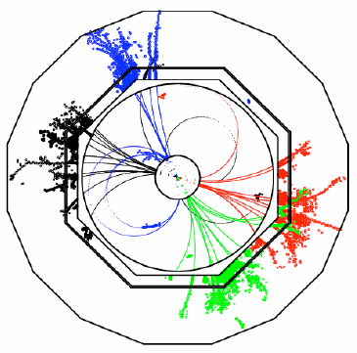
Requirement of a CEPC Ecal
A PFA calorimeter
Good Shower separation
Small Moliere radius (Dense detector)
High granularity/segmentation (~Moliere radius)
Good energy resolution
Critical in some special process
Cost is key issue
Crystal vs silicon vs others
Less readout…
Service and operation…
Overlap removal

Slide 3
Exsiting options
Full silicon + Tunstan (Very popular in ILC/CEPC)
Good position resolution
Timing information
Expensive
Not good energy resolution at low E
Crystal
Good Energy resolution
Relative cheaper compared to Si. option
Not good at granularity (3D postioning difficult)
Develeping:
Crystal bar, dual readout…
2018 JINST 13 P03010

Slide 4
Outline of this talk
New Idea of crystal fan (barrel only for the moment)
Pure crystal fan option
2D readout, 3D position information
Preliminary simulation
Improved Hybrid crystal fan with silicon layers option
Improve near-by shower seperation， r-phi seperation
Summary

Slide 5
Basical idea
Cylindrical coordinate system
（Z, R, phi）
Crystal module
Crystal not pointing back to IP(Z axis)
Angle with inner det. radius is 𝛼
𝛼 = 0; point to IP(Z axis)
𝛼 <= 90 degrees
Segmentation along R
Ex: N_l = 14 layers
Uniform along Z
Ex: 1 cm each seg.
Total crystal volumme
pi*(r2^2-r1^2) * Z
Use BGO as baseline
~20.5 radiation length
Each crystal has a readout at R2 surface
𝛼
D
readout
r2
ȹ
r1
CEPC: Z = 6.7 m
r1 = 1.8 m, r2 = 2.03 m
𝛼=0

Slide 6
Some calculations
3 DoF. determined the full barrel design (For a given R1, R2)
𝛼: [0,90] : pointing angle
N_l:[1,2,3….]:
Z: for the moment choose 1 cm segmentation, uniformly
Crystal length D = sqrt(r2^2 – r1^2*sin(𝛼)^2) – r1*cos𝛼
Crystal bar open phi angle ȹ = acos(r2^2 + r1^2 -D^2)/(2*r1*r2)
Phi segmentation = ȹ/N_l
Total number of crystal bars per Z segmentation: 2*pi*N_l/ȹ
Shower depth along r S_{n} at n^{th} layer:
S_{n} = F_{n+1} – F_{n}
F_{n}= r1* ( sin𝛼 /sin(𝛼 –n*ȹ/N_l) – 1 )
Crystal thickness x_{n}:
x_{n}=S_{n}*sin(𝛼 –n*ȹ/N_l)

Slide 7
Example configuration 1
Crystal module
Take 𝛼 = 0 degrees, transverse 1 layers
D=0.230 m
ȹ=0.0056 (0.32degree）
Crystal: 23 cm *1cm * ~1cm
ȹ/N_l = 0.0056
Each z segmentation
1130 crystals
BES III / CMS like
𝛼
D
r2
ȹ
r1
𝛼=0

Slide 8
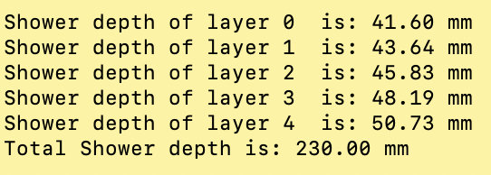
Example configuration 2 (more conf. in backup)
Crystal module
Take 𝛼 = 15 degrees, transverse 5 layers
D=0.237 m
ȹ=0.03 (1.7degree）
ȹ/N_l = 0.006
Each z segmentation
1038 crystals
𝛼
D
r2
ȹ
r1
𝛼=0
Compared to configuration 1, Similar readouts, similar phi segmentation, 5 times more layers along r
Issue: possible confusion on phi/r

Slide 9
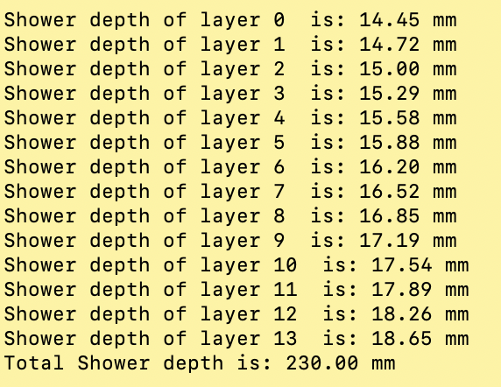
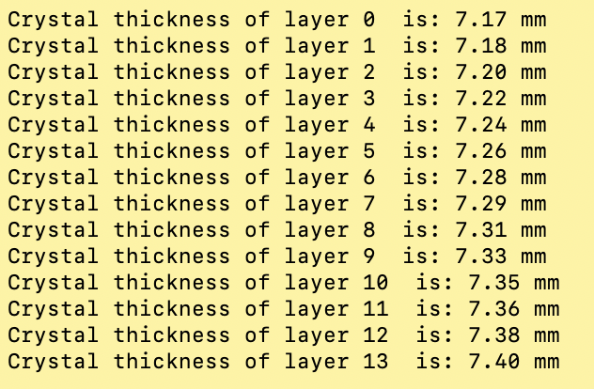
A typical design
Take 𝛼 = 30 degrees, transverse 14 layers
D=0.260 m
ȹ=0.064 (3.7degree）
ȹ/N_l=0.0046
Each z segmentation
1368 crystals
CAD Credit: Xiao Zhao
Crystal bar：261*7.4*10 mm³

Slide 10
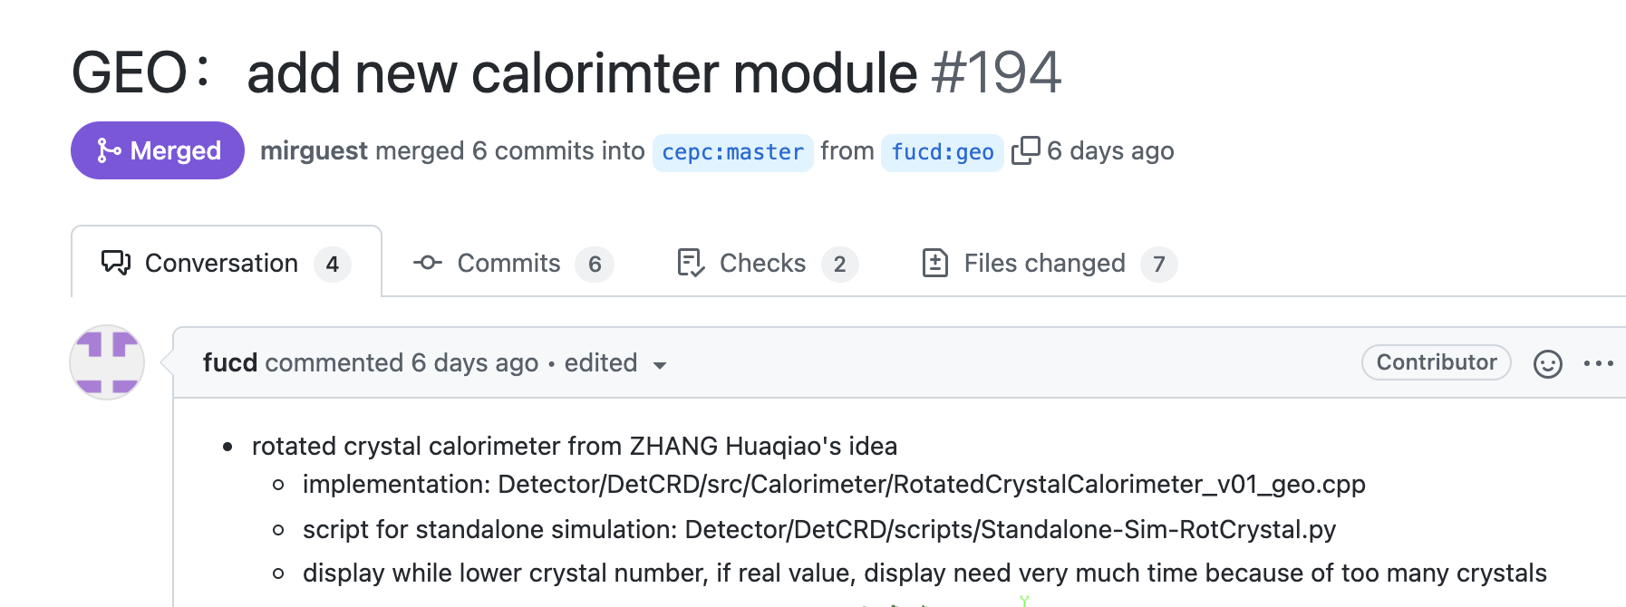
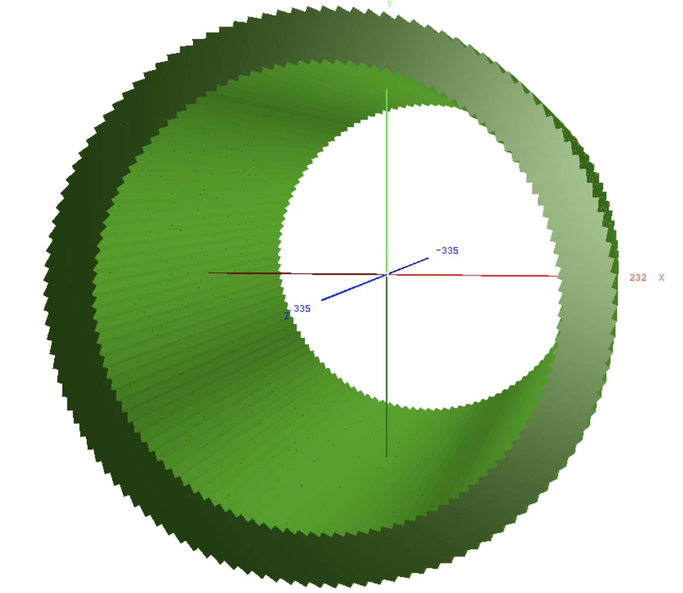
Simulation configuration
Configuarable Geometry already implemented into CEPCSW
Ecal dimension: R1 = 1.9 m; R2 = 2.135m; Z = 6.7 m;
Crystal(BGO) dimention: 26.2 cm * 1cm(Z) * ~0.75 cm (phi)
Alpha = 30 degree; R segementation = 13 -14
Phi segmentation: 1368; Z segmentation = 670
Thanks a lot for Chengdong Fu, super fast implementation

Slide 11
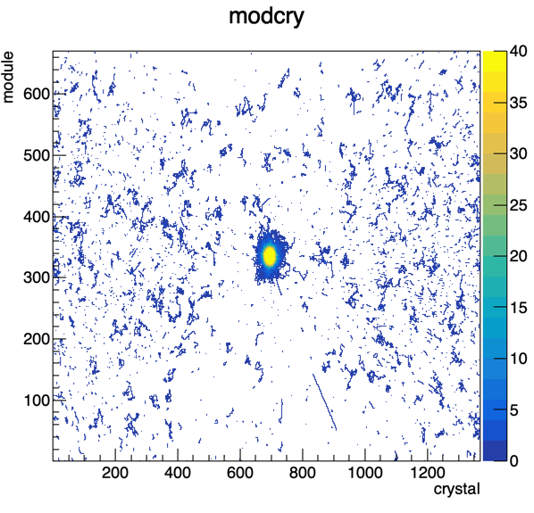
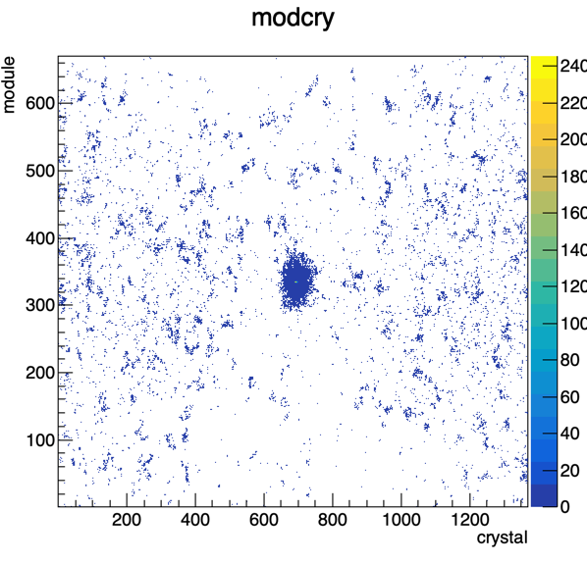
Basical checks (1)
e- particle gun, theta = 90 degree, phi = 180 degree, 100 GeV
40 simulated events, no energy threshold applied yet
Z segmentation
Phi
Energy weighted occupancy
occupancy

Slide 12
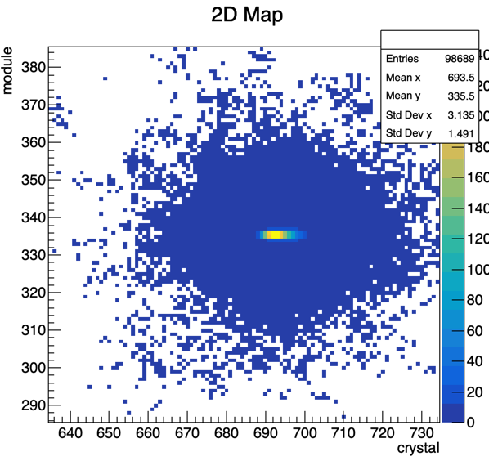
Basical checks (2)
Particle pointing at crystal:
phi ID = 684/685(w.o. correction of curvature in mag.); z ID = 335/336;
Occupancy: phi ID = 694.1 +- 14.6; z ID = 336 +- 12.5
Energy weighted: phi ID = 693.5 +- 3.14; z ID = 335.5 +- 1.5
Step of phi = 0.263 degree; Step of Z = 1 cm
Phi: +-2.6 cm; z +-1.5cm

Slide 13
4D Reconstruction
Very preliminary idea
1: Find the shower cluster in Z-phi plane
2: Use shower edge of phi define shower phi at inner circle (ȹ0, r1)
3: Use phi distance to step 2 shower edge to calculate r_{n} = r1 + Sn; the position of layer n is (ȹ0, r_{n})
4: Z from Z axis index, energy from crystal bar readout
- | - | 1 | 2 | 3 | 4 | 5 | 6 | - | -
0 | 0 | 0 | 0 | 1 | 0 | 0 | 0 | 0 | 0
0 | 0 | 0 | 0 | 3 | 1 | 0 | 0 | 0 | 0
0 | 0 | 1 | 5 | 9 | 7 | 4 | 1 | 0 | 0
0 | 0 | 0 | 2 | 5 | 3 | 1 | 0 | 0 | 0
0 | 0 | 0 | 0 | 1 | 0 | 0 | 0 | 0 | 0
0 | 0 | 0 | 0 | 0 | 0 | 0 | 0 | 0 | 0
0 | 0 | 0 | 0 | 0 | 0 | 0 | 0 | 0 | 0
…4,3,2,1
Z
CAD Credit: Xiao Zhao
ȹ

Slide 14
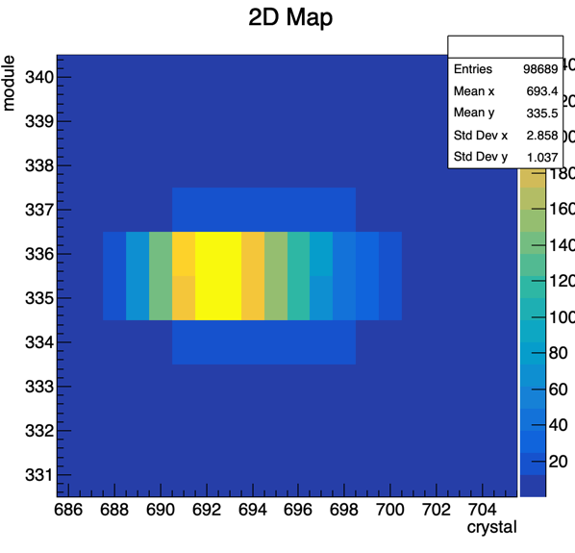
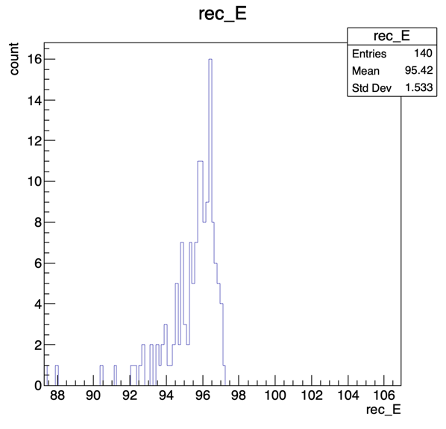
Cluster reco
1 event
40 events
(phi,r1)
Start: 688, due to electron curved in magnetic field (phi=180 degrees pointing between 684 and 685)
Ended at 700
All 13 layers have energy readout (above certain th)
140 events

Slide 15
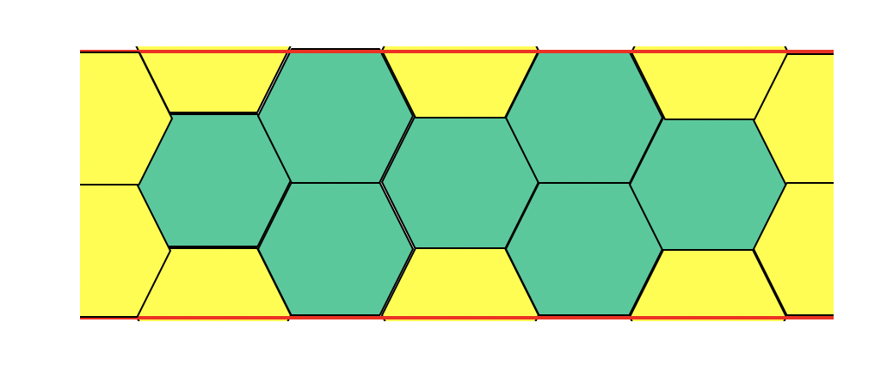
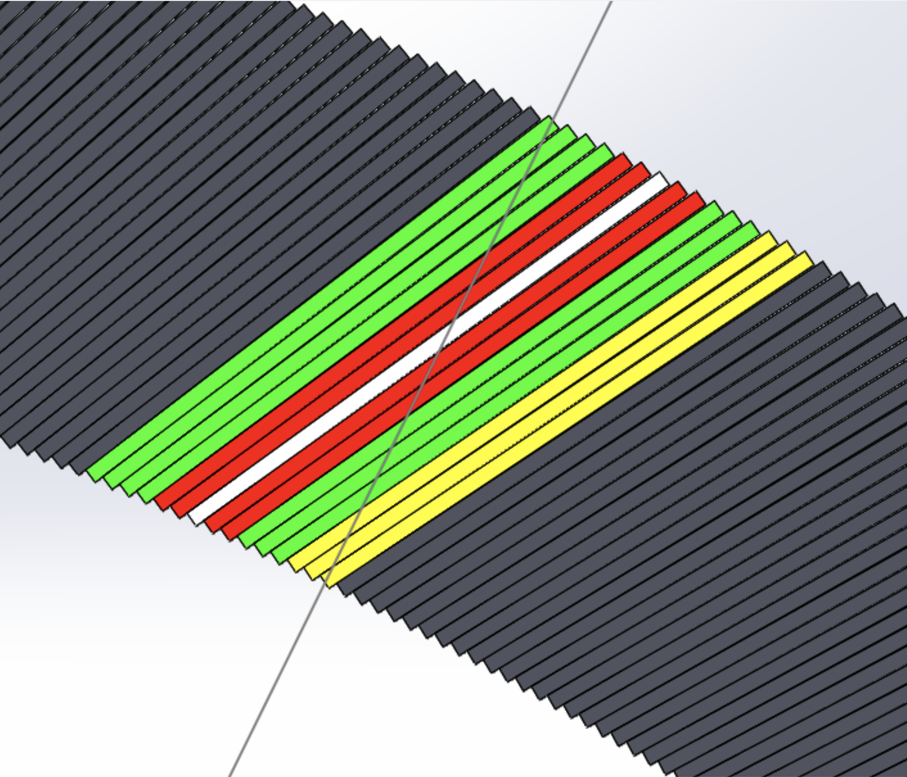
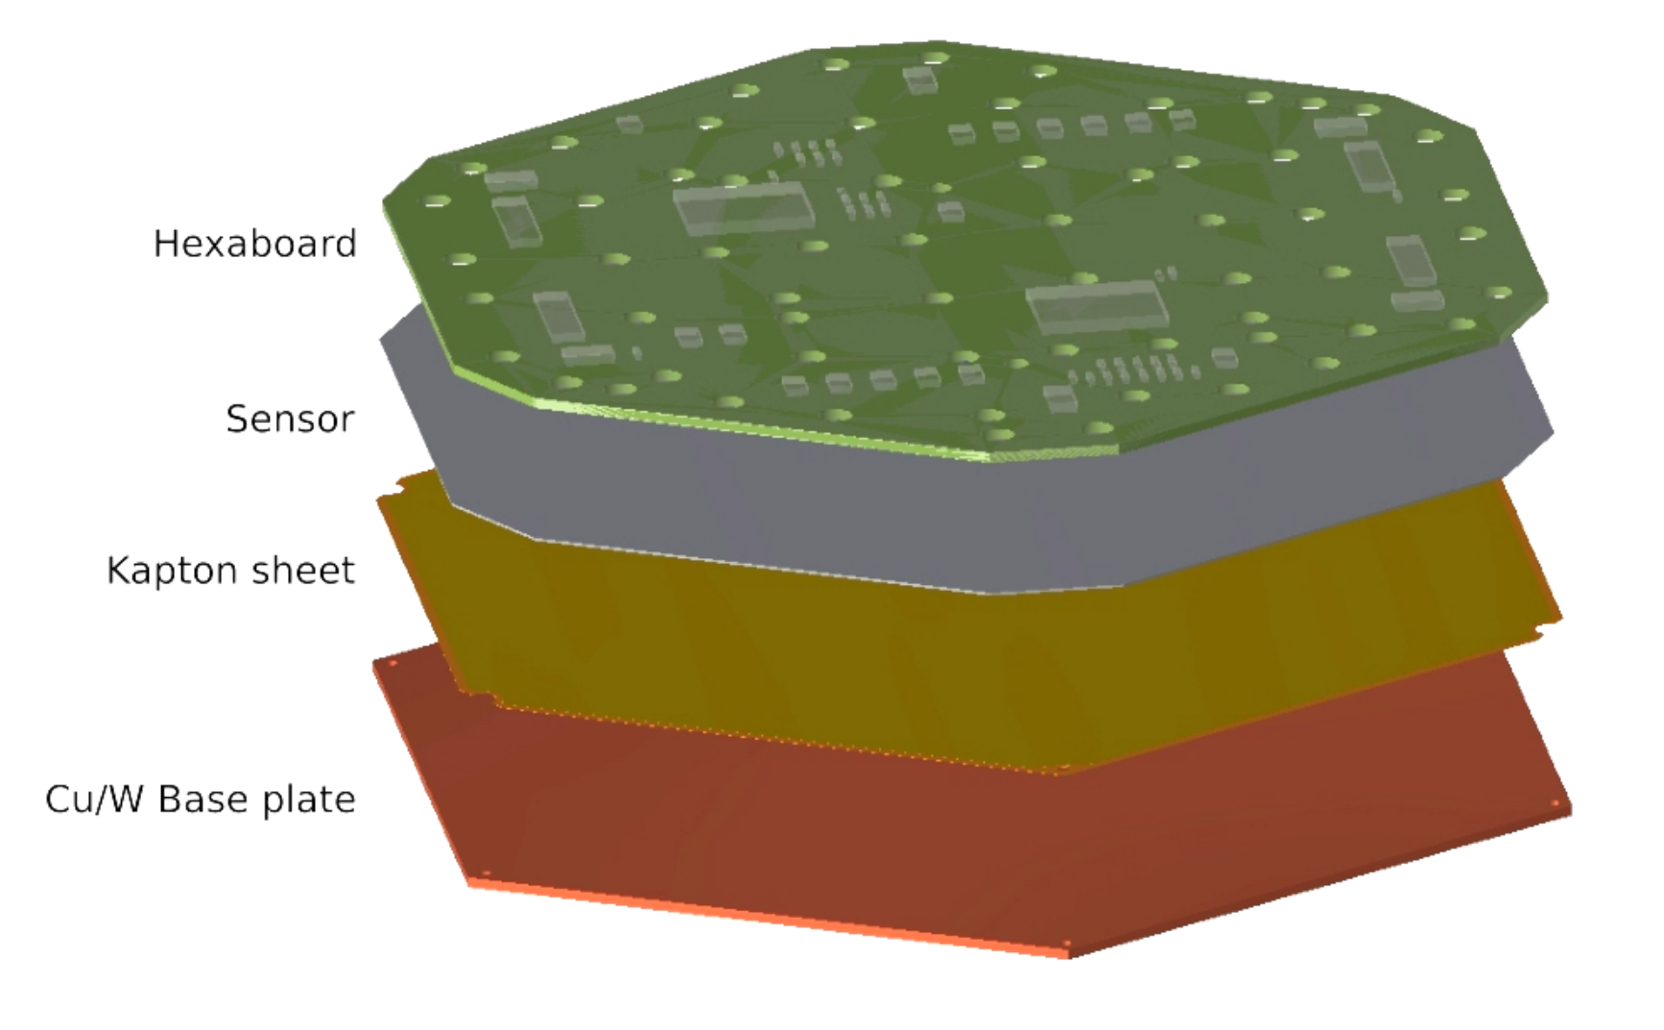
Crystal fan with silicion layers
Silicon layers: plate tiled by hexagon silicon module
Insert along Z axis, replace crystal bars with same phi
Provide r, phi information to reduce crystal r-phi amibigurity
Z
Slicon layer
CAD Credit: Xiao Zhao
SiPIN (or LGAD?) provide accurate 3D position
L= N*83mm, N=2,3,4…
PCB
CMS HGCal like module, 6.4mm thick, could fit alpha=30, 14 layer senario (7.17-7.4mm thick)
CMS HGCal like Module

Slide 16
Current status and next steps
Still at proposal stage, many details need to pin down:
Implemented a baseline crystal fan “geo” (Chengdong)
Generate benchmark objects for performance study
Step 1:
3D segmentation (very preliminary shown here)
Resolution (position, energy)
Single electron sample: principle of 4D reco
Z, R, Phi, E resolution
Step 2: shower seperation
Step 3: BMR
Further Optimization
Supporting, mounting, calibration, service….
Prototying… (if feasible/worth to do… )

Slide 17
Summary
Noval CEPC Crystal fan proposal
Very uniform along Z and phi (Z-phi symetry)
Fine segmentation of Z, Phi, r
2D readout in Z, Phi plane, reduced readout electronics channels
Readout SiPM+electronics behind Ecal crystal
Pro.: Phi-R confusion, near by shower confusion…
Improved Hybrid Crystal fan proposal by insert silicon layers
Help to reduce Phi-r confusion and near-by shower confusion
Timing information
Performance study plan

Slide 18
Bacup

Slide 19
Typical crystals (From Ren-yuan Zhu’s slides)

Slide 20
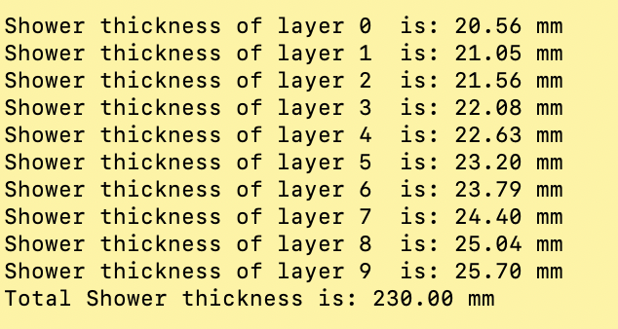
Example configure 3
Crystal module
Take 𝛼 = 15 degrees, transverse 10 layers
D=0.237 m
ȹ=0.03 (1.7degree）
ȹ/N_l = 0.003
Each z segmentation
2077 crystals
𝛼
D
r2
ȹ
r1
𝛼=0

Slide 21
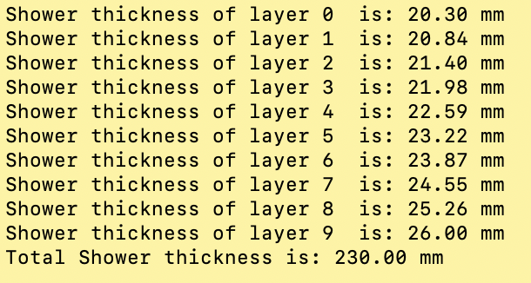
Example configure 4
Crystal module
Take 𝛼 = 30 degrees, transverse 10 layers
D=0.261 m
ȹ=0.064 (3.7degree）
ȹ/N_l=0.0064
Each z segmentation
977 crystals
𝛼
D
r2
ȹ
r1
𝛼=0

Slide 22
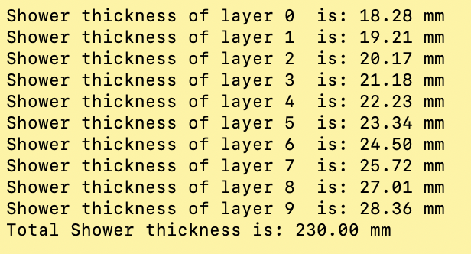
Example configure 5
Crystal module
Take 𝛼 = 60 degrees, transverse 10 layers
D=0.400 m
ȹ=0.17 (9.8degree）
ȹ/N_l = 0.017
Each z segmentation
366 crystals
𝛼
D
r2
ȹ
r1
𝛼=0

