Slide 1
Summary of the Dongguan meeting for MDI
Sha Bai
For CEPC MDI group
CEPC Day
2021-10-28

Slide 2
Accelerator session totally with 4 talks.

Slide 3
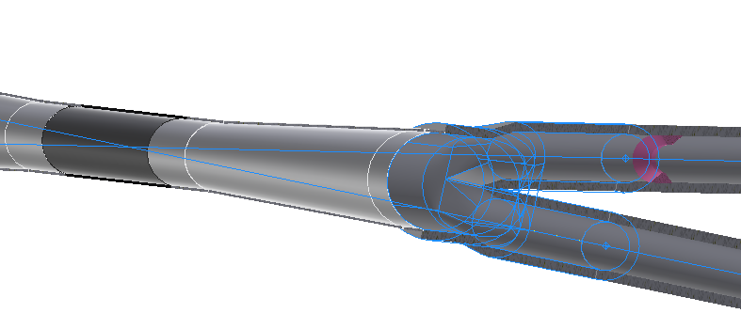
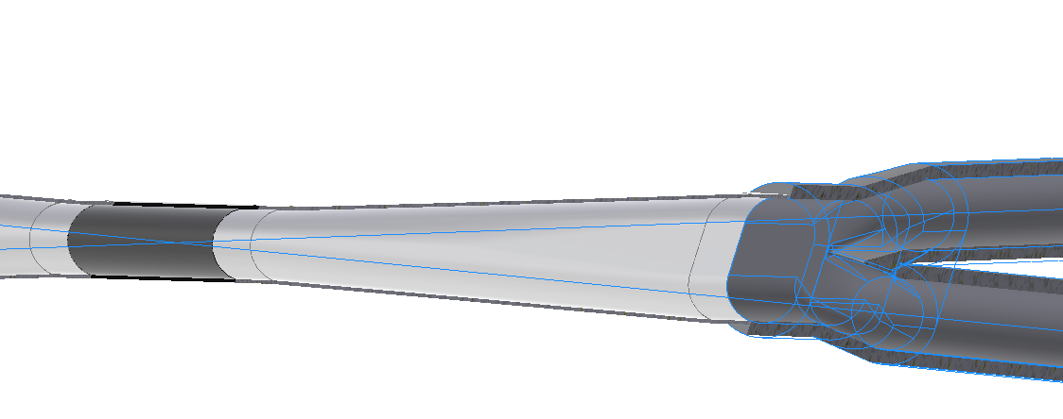
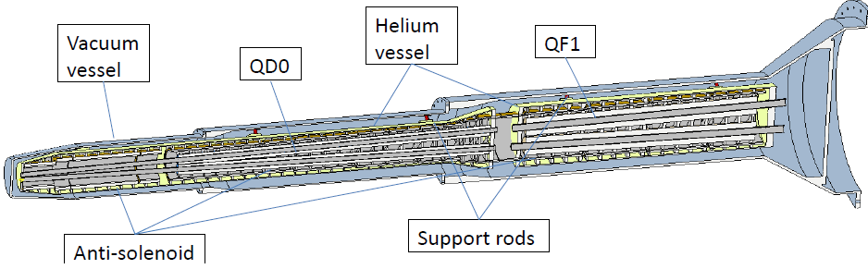
MDI mechanics
IR vacuum chamber with inner diameter at IP (~28mm) is completed, and a new version with inner diameter at IP(~20mm) is under design.
A workable MDI layout has been made. Some key devices such as remote vacuum connector are designed.
The cryostat is about 5.5 m long. The cantilever length is 3.6~5.5 m.
  Two kinds of magnet supports are considered.
  Solid support similar to SKEKB.
  Skeleton support to minimize weight
Integral FEA with cryostat will be studied next step.
Displacement of FD magnets with shielding and from cooling down will be studied.

Slide 4
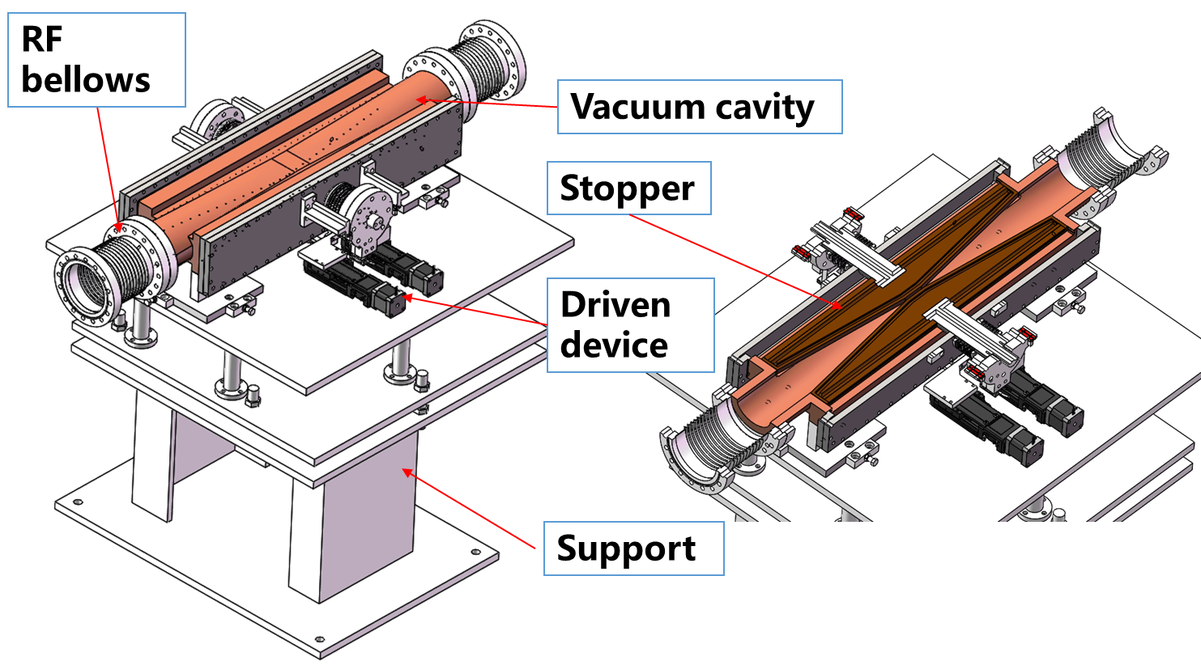
Collimator mechanics
The design is based on the CDR chamber, and will be updated to circle one.
Thermal analysis has been done.
  Maximum temperature raise by particle-material reaction: 2℃
  SR heat load 9.3 kW@30 MW, Higgs ~main power for collimator
  Impedance load
Highest temperature in chamber: 143 ℃
28mm
28mm
37.5mm
28mm

Slide 5
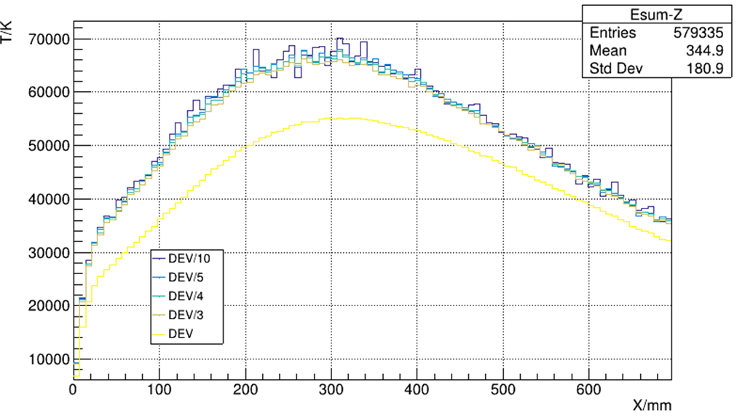
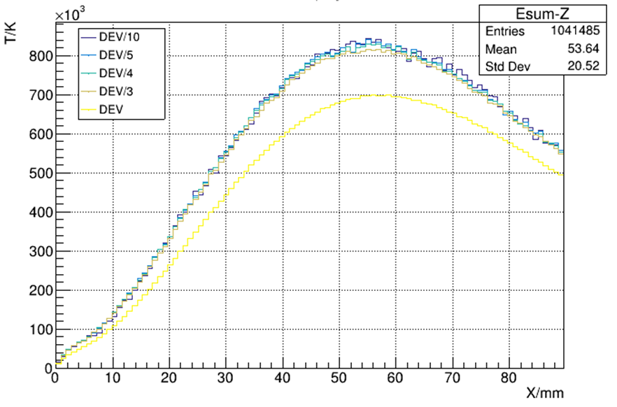
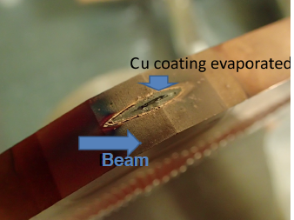
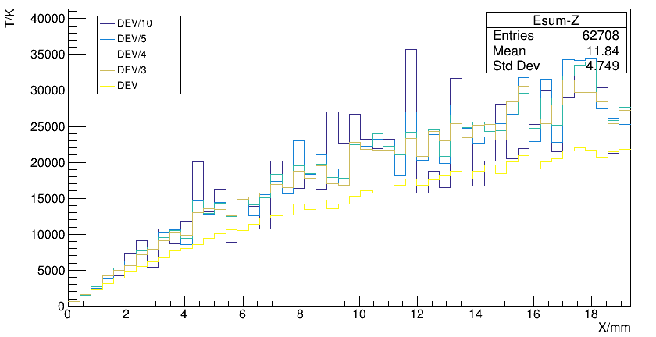
Beam loss failure
The beam loss failure has been considered and preliminary protection scheme with abort system, collimators and reverse switching solenoids are considered.
Material: Cu
Material: C
Broken collimator of
Super KEKB

Slide 6
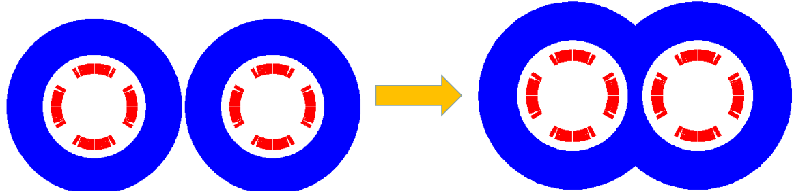
Superconducting magnet
Baseline design: QD0 design of iron option.
  Despite limited space, magnetic field cross talk effect between two apertures is negligible using iron yoke.
  Iron yoke is added outside the collar to enhance the field gradient, reduce the coil excitation current.
Since the distance between the two apertures is much larger, the field cross talk between the two apertures of QF1 is not a problem using iron yoke.
Two HTS options have been studied for the Q1a magnet using high luminosity parameters with L*=1.9m: Cos2θ coil, CCT coil. Both options are feasible. Cos2θ coil has higher magnetic efficiency.
With relaxed dipole field and use FeCoV yoke, the weight of Q1a magnet can be significantly reduced.

Slide 7
SC anti-solenoid
Recently, the design of Detector solenoid is modified (2021.03)
The central field of the first section of the anti-solenoid is the strongest, with a peak value of 6.8T.
The net solenoid field inside QD0 and QF1 at each longitudinal position is smaller than 300Gs.
The total integral solenoid field generated by the detector solenoid and anti-solenoid coils is zero.

Slide 8
0.5m single aperture QD0 short model
Design of QD0 iron option: Collared cos2θ quadrupole magnet with shared iron yoke and crossing angle between two aperture centerlines. In practice, can it be fabricated and really meet the requirement?
  So far, there is no cos2θ SC magnet in China
  In the R&D, the first step is to study and master main key technologies of SC magnet by developing a short QD0 model magent with 0.5m length.
Research on some key technologies of 0.5m single aperture QD0 short model has started (NbTi. 136T/m), in collaboration with HeFei KEYE Company.
Including: quadrupole mechanical design, coil winding technology, fabrication procedure of quadrupole coil with small diameter, stress applying and monitoring, quadrupole magnet assembly and measurement technology, etc.

Slide 9
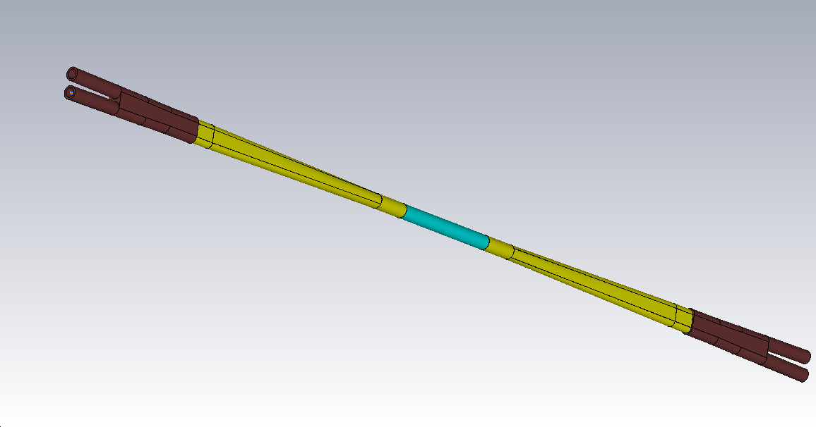
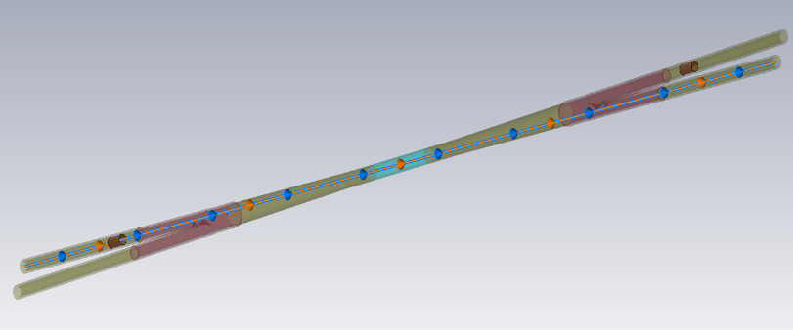
IR HOM heat load
Total length:2220mm
 | CDR beam parameters |  | High Luminosity beam parameters
Power | HOM power(w) | power density（w/cm²） | HOM power(w) | power density(w/cm²）
Be pipe (w) | 25 | 0.227 | 68.45 | 0.622
Al: Transition pipe (w) | 171 | 0.316 | 548.5 | 1.012
Cu: Y-shape crotch (w) | 103.5 | 0.158 | 332 | 0.507
Total power in IR pipe (w) | 296 | 0.234 | 949 | 0.714
Be: 136.9w
Cu: 332w
Al: 548w
With CDR beam current, One feasible IR chamber was derived which can meet the requirements on HOM power and synchrotron radiation.
With beam current for High Luminosity Z, the HOM power will be 3 times higher. HOM absorber may be one choice .
The smaller aperture of beryllium tube may be one choice for lower HOM.
Position | Length(mm) | Higgs(w) | W (w) | Z(w) | High Luminosity Z(w)
Be pipe (w) | 120 | 6.28 | 23.51 | 97.12 | 292.52
Al: Be pipe transition(w) | 85 | 4.45 | 16.65 | 68.79 | 207.20
Al: Transition pipe (w) | 495 | 44.05 | 164.71 | 680.25 | 2048.9
Cu: Y-shape crotch (w) | 155 | 13.79 | 51.57 | 213 | 641.58
Al: Y crtothch to masker | 325 | 19.25 | 72.01 | 297.40 | 895.77
Cu：masker(w) | 50 | 0.063 | 0.238 | 0.984 | 2.964
Al: maser to pipe end | 370 | 0.47 | 1.76 | 7.28 | 21.93
Total | 1600 | 88.353 | 330.448 | 1364.824 | 4110.864

Slide 10
Cryostat
完成了对撞区超导四极铁低温系统的初步设计，采用大流量迫流冷却方案----过冷氦循环系统
完成了低温恒温器的结构初步设计，并进行了不同工况下的结构强度校核和温度场初步分析，正在进行流场的数值模拟----升降温非稳态
完成了安全系统的初步计算，正在与电源系统、磁铁系统和失超保护系统进行综合讨论以确定磁铁失超关键参数----400KJ/2s
低温恒温器与探测器之间的安装空间迭代
真空盒的最终尺寸和材质，然后是真空盒的阻抗热负荷和最大工作温度确定----真空盒外冷屏及支撑设计
超导磁铁正常工作下的受力情况---磁铁加电状态下的受力状态
磁铁/氦池准直要求
存在问题及下一步计划：

Slide 11
Thanks for all in CEPC MDI group

