Slide 1
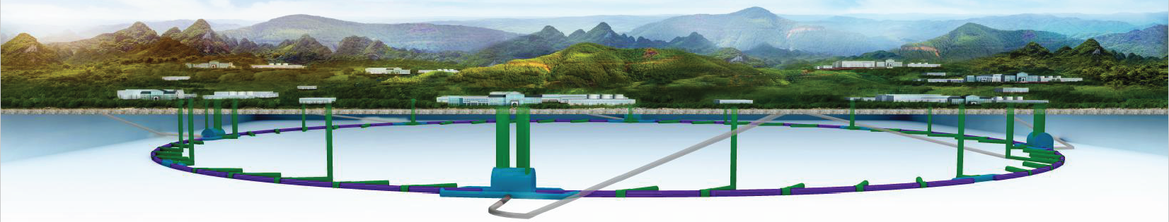
The consideration and status of the Injection/Extraction hardware
CEPC DAY 28 oct.2021
Jinhui Chen, Lihua Huo , Yuwen Wu, Hua Shi , Guanjian Wu, Zilin Chen, Guanwen Wang, Lei Wang, X.H. Cui, D. Wang, Yiwei Wang
Injection group
2021-10-28

Slide 2
Outline
1
Overview of CEPC Inj./Ext. systems
2
Lambertson magnet
3
Slotted-pipe kicker magnet
4
Ferrite core kicker magnet
5
Summary

Slide 3
Overview of the CEPC injection and extraction systems

Slide 4
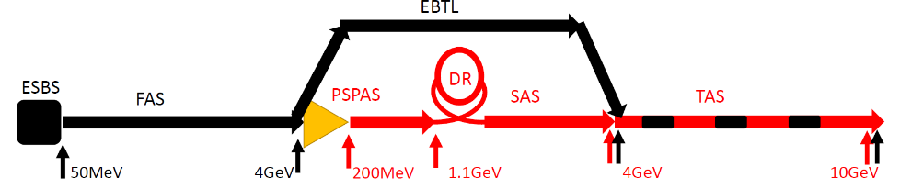
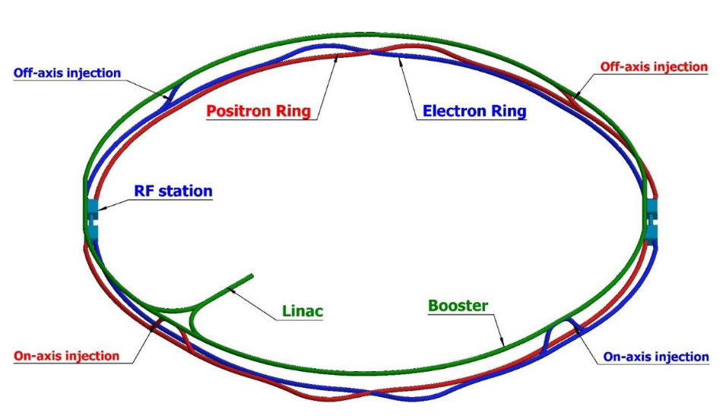
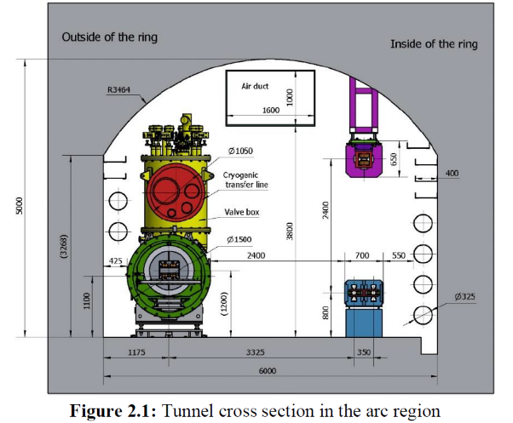
Layout of the accelerator complex
The CEPC accelerator complex consists of a Linac, which including a small damping ring for positron beams, several transport lines, a booster ring and 2 storage rings, all of which are in a single tunnel.
1.2km
120GeV
120GeV
100km
Dump
Damping ring
Dump
e+
e-
10-120GeV

Slide 5
CEPC injection and extraction systems
In CEPC accelerator complex, there are 9 injection and extraction sub-systems, including:
DR injection and Extraction system(e+)
Booster LE injection system (e+,e-)
Booster Extraction system1 (e+,e-)
Collider off-axis injection system (e+,e-)
Booster Extraction system2 (e+,e-)
Booster HE injection system (e+,e-)
Collider swap out injection system (e+,e-)
Collider swap out extraction system (e+,e-)
Collider beam dump system(e+,e-)
Off-axis injection
(in W and Z mode)
On-axis injection
(only in Higgs mode)
③
④
⑤
⑦
①
②
Linac
Booster
⑥
⑧
Collider
⑨
dump
1.1GeV
10~120GeV
120GeV
DR

Slide 6
Main types of inj.&ext. hardware
 | Sub-system | Kicker Type | Kicker waveform | Septa Type | Thickness of septum
1 | Damping ring inj./ext. | Slotted-pipe kicker | Half-sine/250ns | Horizontal LMS | ф22/3.5mm
2 | Booster LE inj. | Strip-line kicker | Half-sine/50ns | Horizontal LMS | ф55/5.5mm
3 | Booster ext. for CR off-axis inj. | Delay-line dipole kicker | Trapezoid /440-2420ns | Vertical LMS | Ф55/6mm
4 | Collider off-axis inj. | Delay-line NLK kicker | Trapezoid /440-2420ns | Vertical LMS | Ф75x56/2mm
5 | Booster ext. for CR on-axis inj. | Ferrite core dipole kicker | Half-sine/1360ns | Vertical LMS | Ф55/6mm
6 | Booster HE inj. | NLK or Pulsed sextupole | Half-sine/0.333ms | Vertical LMS | Ф55/6mm
7 | Collider swap out inj. | Ferrite core dipole kicker | Half-sine/1360ns | Vertical LMS | Ф75x56/6mm
8 | Collider swap out ext. | Ferrite core dipole kicker | Half-sine/1360ns | Vertical LMS | Ф75x56/6mm
9 | Collider beam dump | Delay-line dipole kicker | Trapezoid /440-2420ns | Vertical LMS | Ф75x56/6mm

Slide 7
Hardware R&D plan
One team is in charge of both HEPS and CEPC inj. & ext. system. A part of hardware R&D for 2 projects are overlapping.
Hardware R&D activities:
  Lambertson septa magnets
    Outside vacuum magnet: Septum thickness ≥3.5 mm
    Half in vacuum magnet: Septum thickness =2 mm
  Kicker systems
    Strip-line kicker and super fast pulser（PW=10~50ns）
    Slotted-pipe kicker and fast pulser（PW=250~300ns）
    Ferrite core kicker （outside vacuum） and pusler
      Lumped parameter dipole kicker（PW=1.36us half-sine）
      Distributed parameter dipole kicker（ PW=440~2420ns trapezoid）
      Distributed parameter Nonlinear kicker（ PW=440~2420ns trapezoid）
Overlapping part

Slide 8
Lambertson magnet

Slide 9
LSM requirements
Parameters | Unit | DR-LSM | BST-LEI-LSM | CR-LSM-2
Quantity | - | 2 | 2 | 2×5
Energy | GeV | 1.1 | 10 | 120
Deflection angle | mrad | 120 | 22 | 0.35
Insertion length | m | 0.5 | 0.8 | 1.75
Magnetic field strength for injected/extracted beam | T | 0.883 | 0.9175 | 0.08
Min. Septum thickness（including septum board, inj./ext. beam pipe wall, installation gap) | mm | 3.5 | 5.5 | 2
Field uniformity | - | <±0.05% | <±0.02% | <±0.05%
Leakage field | - | ≤1×10⁻³ | ≤1×10⁻³ | ≤1×10⁻³
Clearance of stored beam at lambertson（H×V） （refer to stored beam orbit） | mm | 36.4×22 | 30×50 | -
Clearance of inj.&ext. beam at lambertson（H×V）（refer to inj.&ext. beam orbit） | mm | 22×11 | 18×29 | -
Physical aperture of stored beam vacuum chamber | mm | 22×22 | 55×55 | 75x56

Slide 10
DR and BST LE inj.
DR inj. & ext.
BST LE inj.
Inj. beam
14mm
Septum=3.5mm
Inj. beam
Septum=5.5mm
Stored beam
11mm
5.5mm
27.5mm
Stored beam
11mm
27.5mm
x
y
x
y
Top view
（mm）
Side view
（mm）
Top view
（mm）
Side view
（mm）
Stored
beam
Stored
beam
Stored
beam
Stored
beam
z
septum
z
z
septum
z
Injected
beam
Injected
beam
Injected
beam
Injected
beam
-30.0
-22.0
-50.0
Injected beam | X(mm) | Y(mm) | Z(mm)
LSM in | -30.0 | -23.75 | -500.0
LSM out | 0 | -20 | 0
Injected beam | X(mm) | Y(mm) | Z(mm)
LSM in | -22.0 | -50 | -800.0
LSM out | 0 | -50 | 0
Stored beam | X(mm) | Y(mm) | Z(mm)
LSM in | 0 | 0 | -500.0
LSM out | 0 | 0 | 0
Stored beam | X(mm) | Y(mm) | Z(mm)
LSM in | 0 | 0 | -800.0
LSM out | 0 | 0 | 0

Slide 11
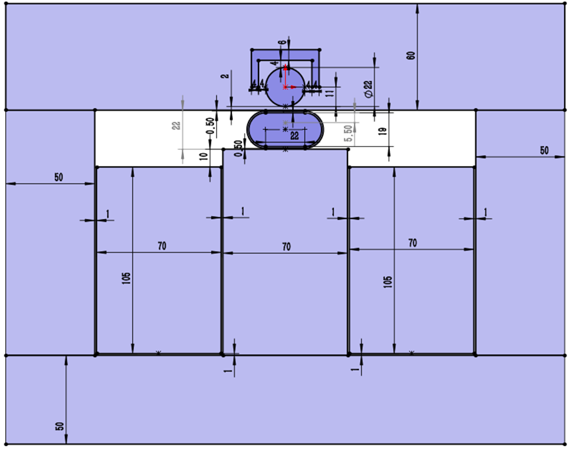
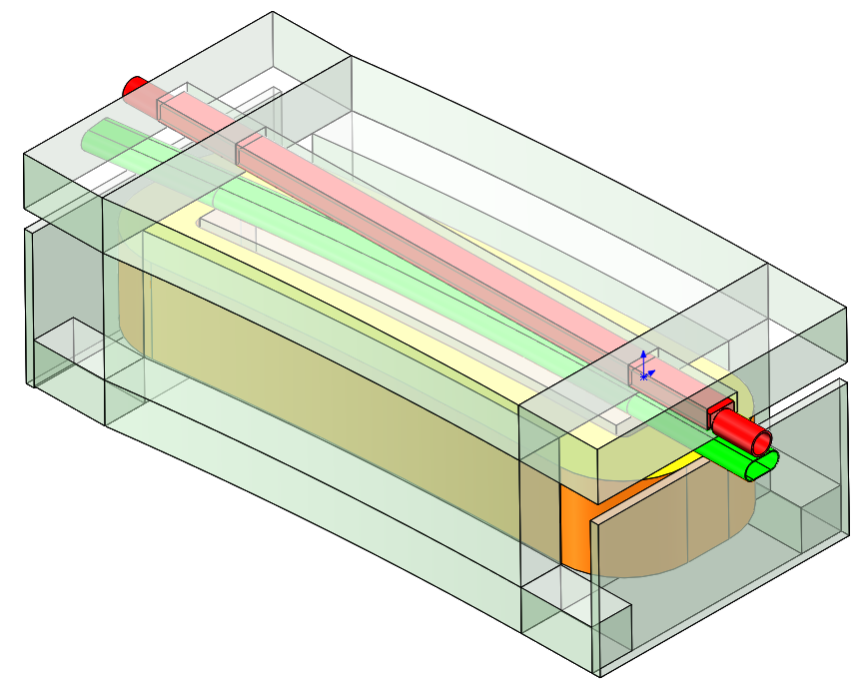
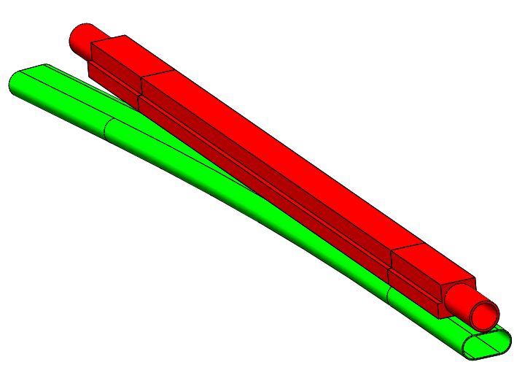
LSM physics design for DR
Stored beam
Φ22mm
Stored beam pipe(VP) inner
diameter= ø22mm,
Thickness=2mm
Injected beam pipe (SS):
W=41mm, H=19mm,
Thickness=1mm
Septum
Thickness=2+1+0.5=3.5mm
Magnet gap: 22mm
Winding:
W=70mm,H=105mm,T=96
Exciting current=166A
Inductance=0.0228H
Yoke
1J22
2mm
0.5mm
1mm
316L
Injected beam
41×19mm
3.5mm
Installation margin
Exit of LSM
Magnet pole
Stored beam
Stored beam chamber
(VP,FeCoV,1J22)
Inj. beam
700×344×268mm
Injected beam chamber
(SS, 316L)
Yoke (DT4)
Winding (96T)
Contributed By Yuwen Wu

Slide 12
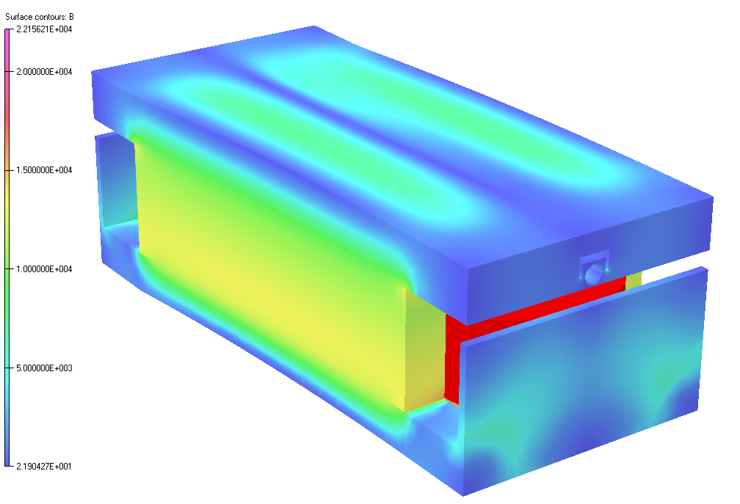
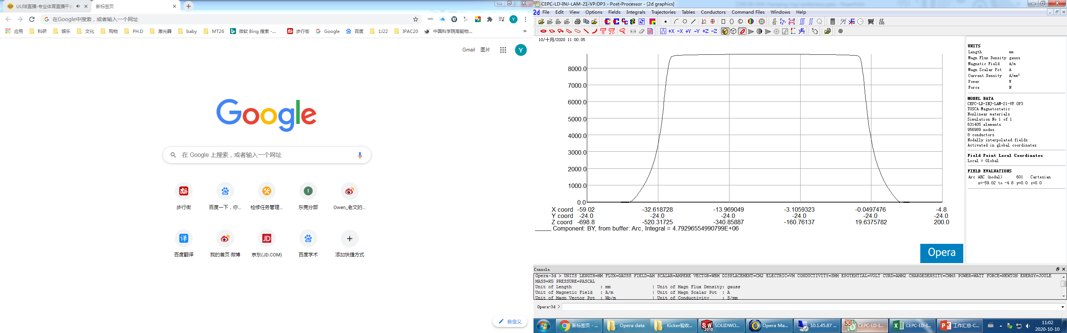
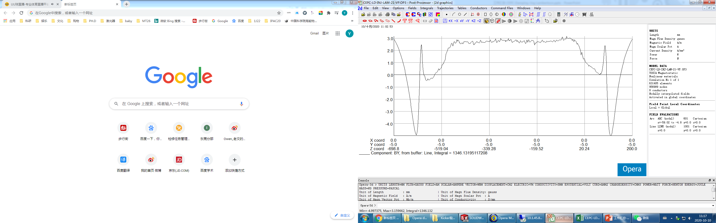
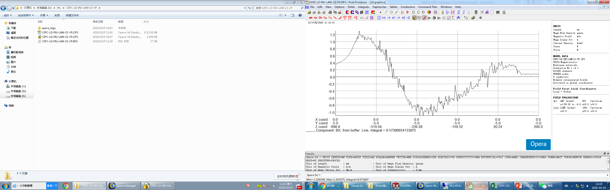
3D simulation
Stored beam vacuum chamber:1J22
Center magnetic field intensity：8836Gauss
Magnet effective length：542mm
Horizontal Leakage field：1.79E-06
Vertical Leakage field：2.81E-04

Slide 13
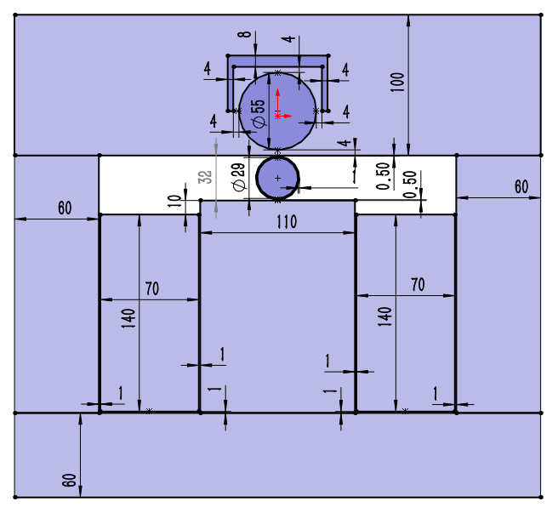
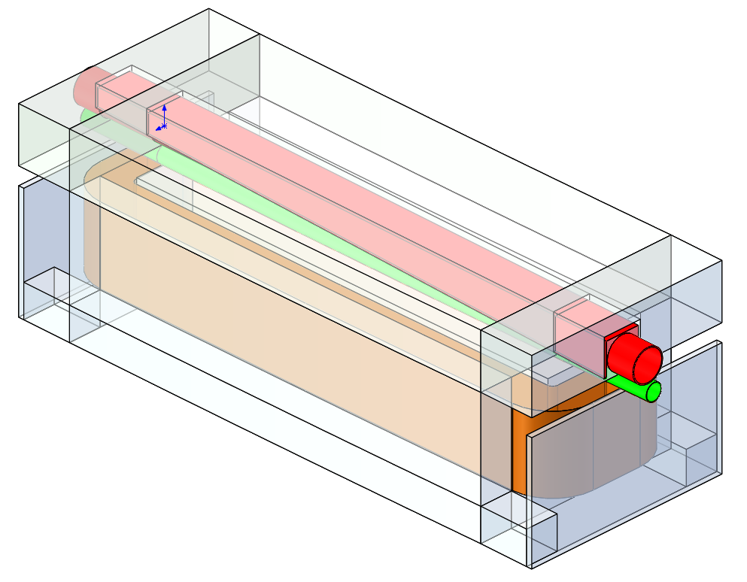
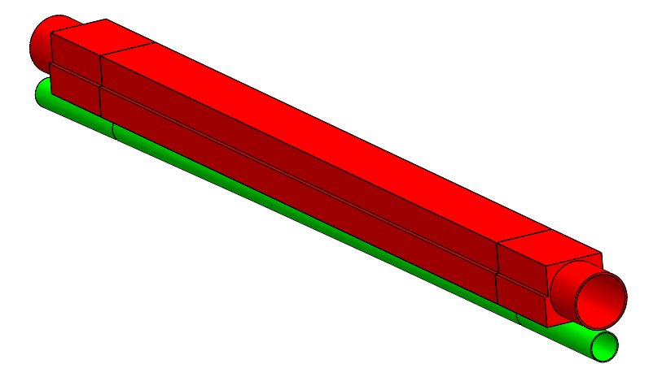
LSM physics design for BST LE-Inj.
Stored beam
Φ55mm
Stored beam pipe(VP) inner
diameter= ø55mm,
Thickness=4mm
Injected beam pipe (SS):
inner diameter=ø29mm,
Thickness=1mm
Septum
Thickness=4+1+0.5=5.5mm
Magnet gap: 32mm
Winding:
W=70mm,H=140mm,T=128
Exciting current=188A
Inductance=0.0682H
Yoke
1J22
4mm
0.5mm
1mm
316L
Φ29mm
5.5mm
Installation margin
Magnet pole
Exit of LSM
Injected beam
Stored beam
Stored beam chamber
(VP,FeCoV,1J22)
Inj. beam
1000×383×343mm
Injected beam chamber
(SS, 316L)
Yoke (DT4)
Winding (96T)
Contributed By Yuwen Wu

Slide 14
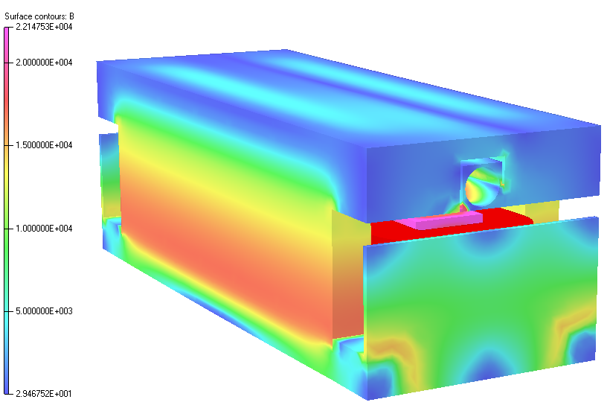
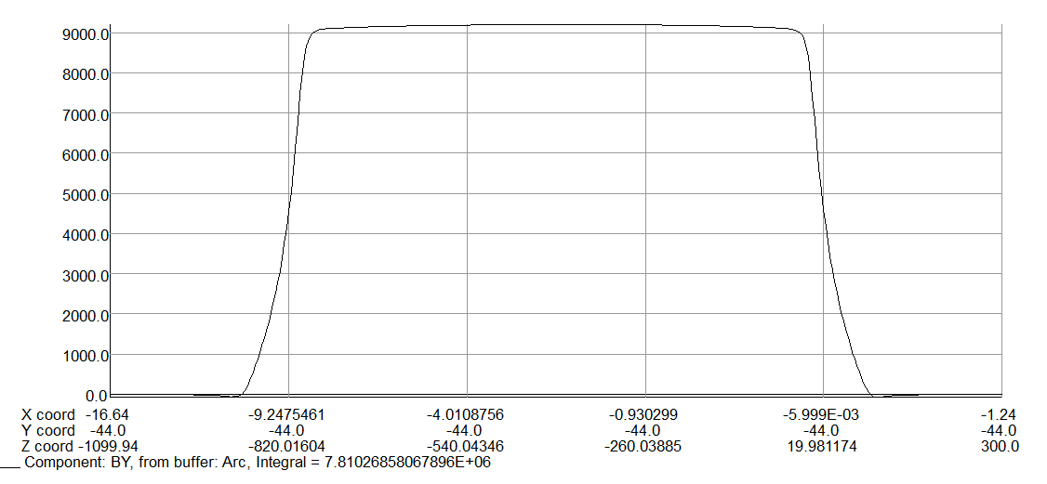
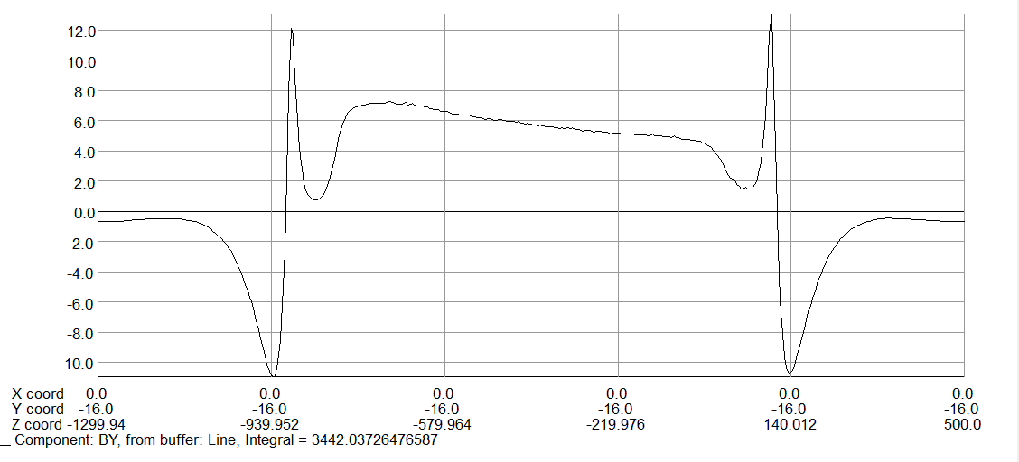
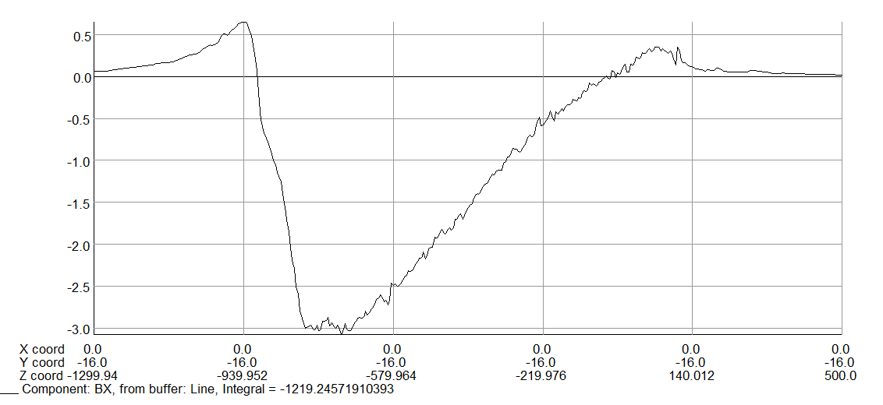
3D simulation
Stored beam vacuum chamber:1J22
Center magnetic field intensity：9200Gauss
Magnet effective length：849mm
Horizontal Leakage field： 1.56E-04
Vertical Leakage field： 4.41E-04

Slide 15
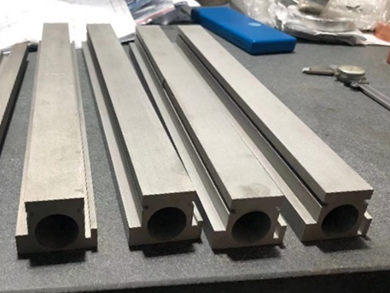
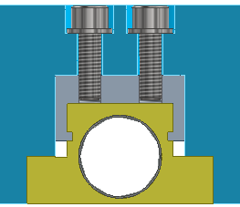
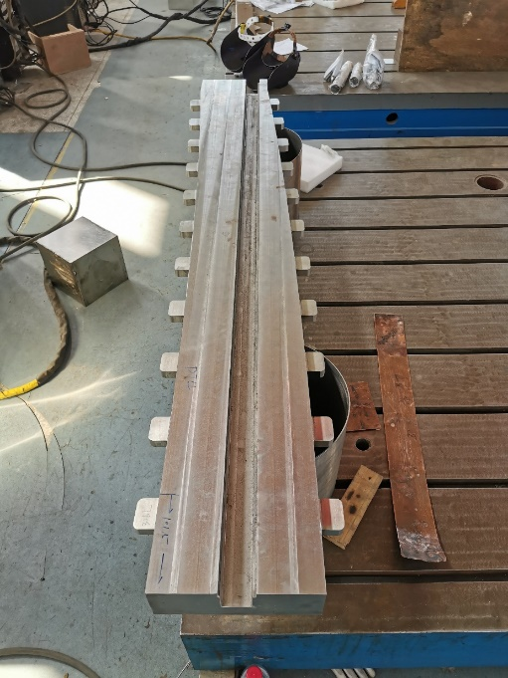
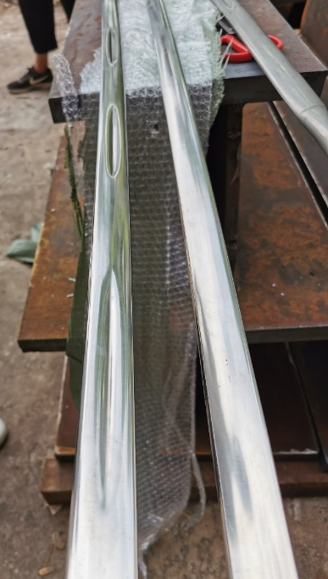
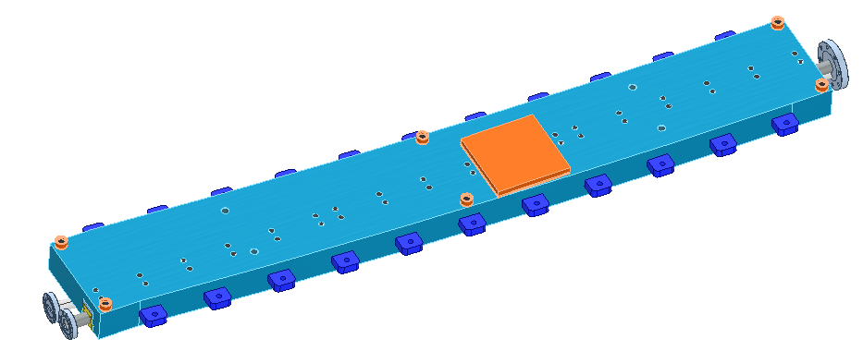
LSM prototype for HEPS BST
FeCoV（1J22）
Fe（DT4）
Stainless Steel(304)
FeCoV（1J22）
Fe（DT4）
Stainless Steel(304)

Slide 16
Slotted-pipe Kicker magnet

Slide 17
DR inj./ext. kicker design parameters
parameter | Unit | DR-kicker
Quantity | - | 2
Type | - | Slotted-pipe kicker
Deflect direction | - | Vertical
Beam Energy | GeV | 1.1
Deflect angle | mrad | 10.7
Magnetic effective length | m | 1.4
Magnetic strength | T | 0.0281
Integral magnetic strength | T·m | 0.03934
Clearance region(H×V) | mm | 32.8×26.6
Good field region(H×V) | mm | 19.8×16
Field uniformity in good field region | - | ±1.5%
Repetition rate | Hz | 100
Amplitude repeatability | - | ±0.5%
Pulse jitter | ns | ≤5
Bottom width of half sine pulse(5%-5%) | ns | < 250

Slide 18
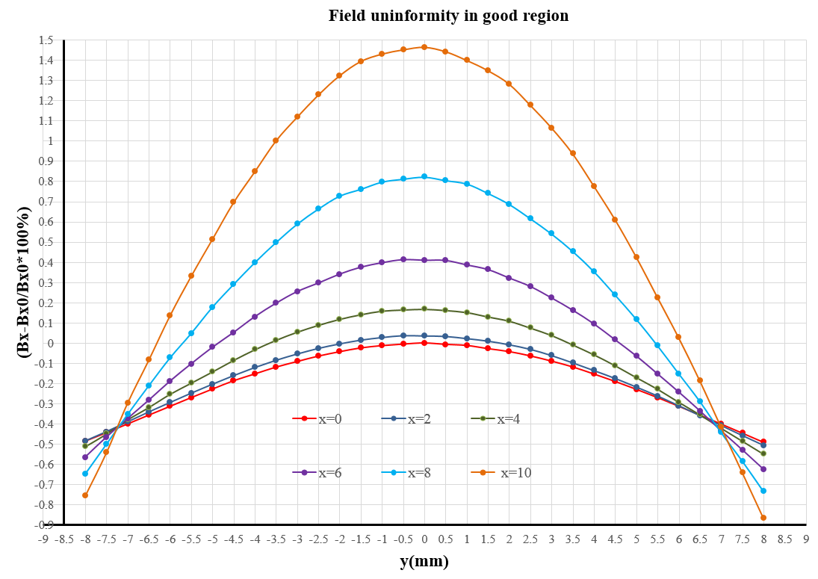
Magnet physics design
2D simulation model
Max. voltage of coil: Umax=10622V
Max. exciting current: Imax=2400A
Magnet coil inductance=387nH
Good field region: 19.8×16mm
Field uniformity: -0.9%~1.5%
x=±10, y=±8
Un.= -0.9%~1.5%
Good field region
19.8×16mm
Contributed By Lihua Huo,Lei Wang

Slide 19
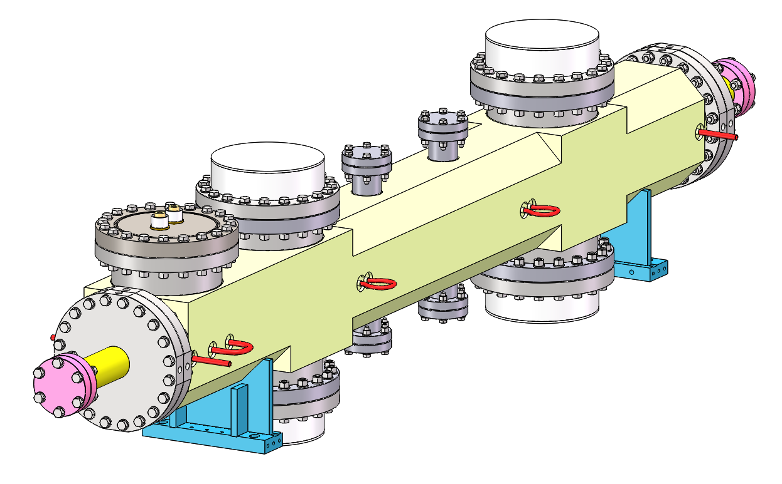
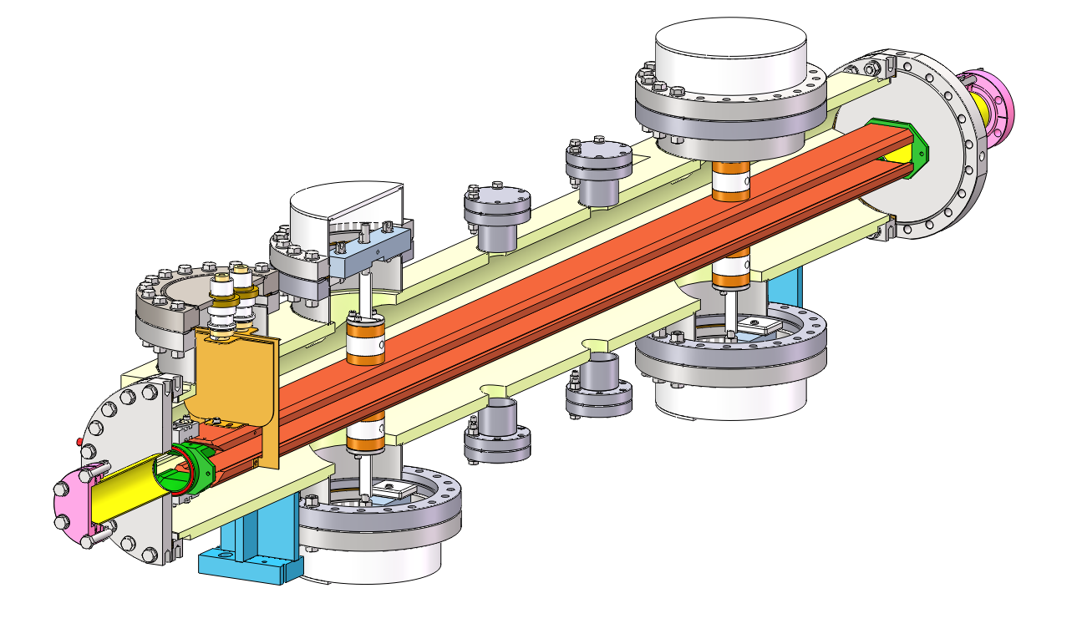
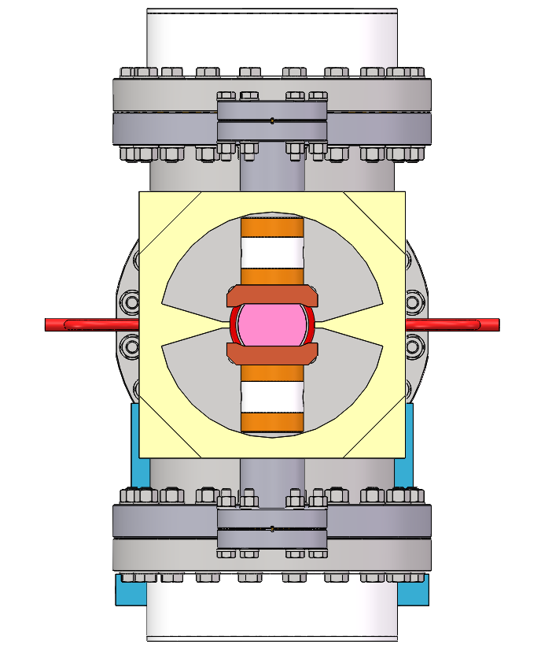
Slotted-pipe kicker engineer design
Outer body (316L)
Cooling water pipe
HV feedthrough
-
+
Busses (FOC)
insulation support (ceramic)
To vacuum pump

Slide 20
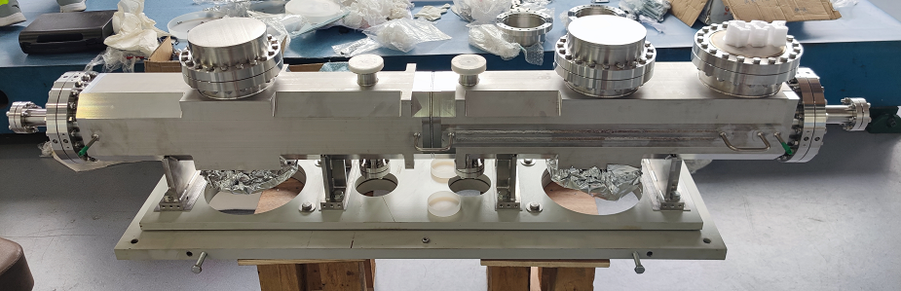
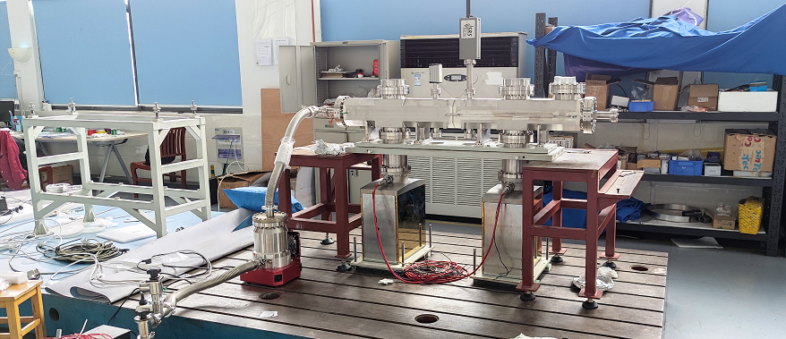
Prototype kicker for HEPS BST

Slide 21
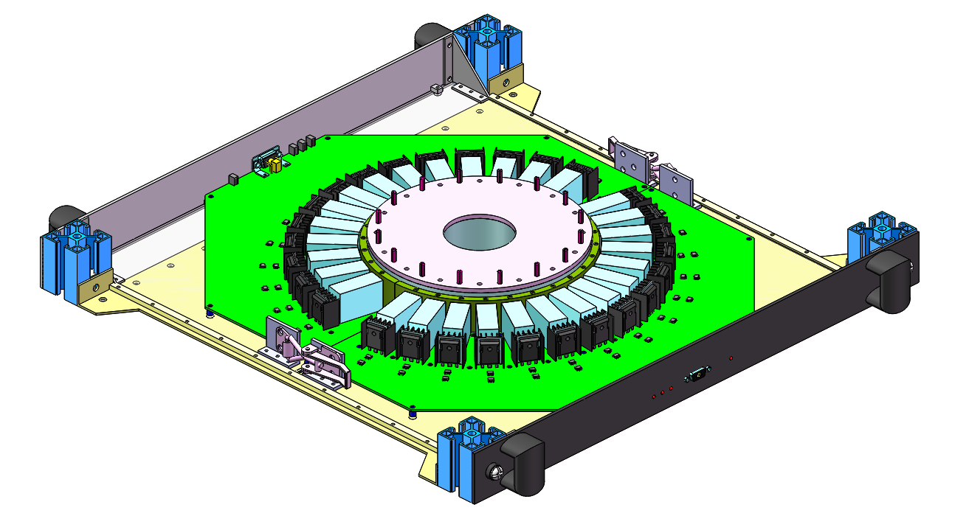
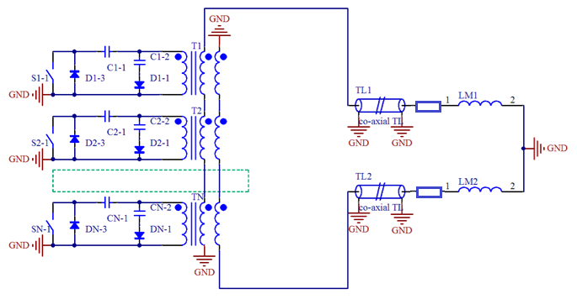
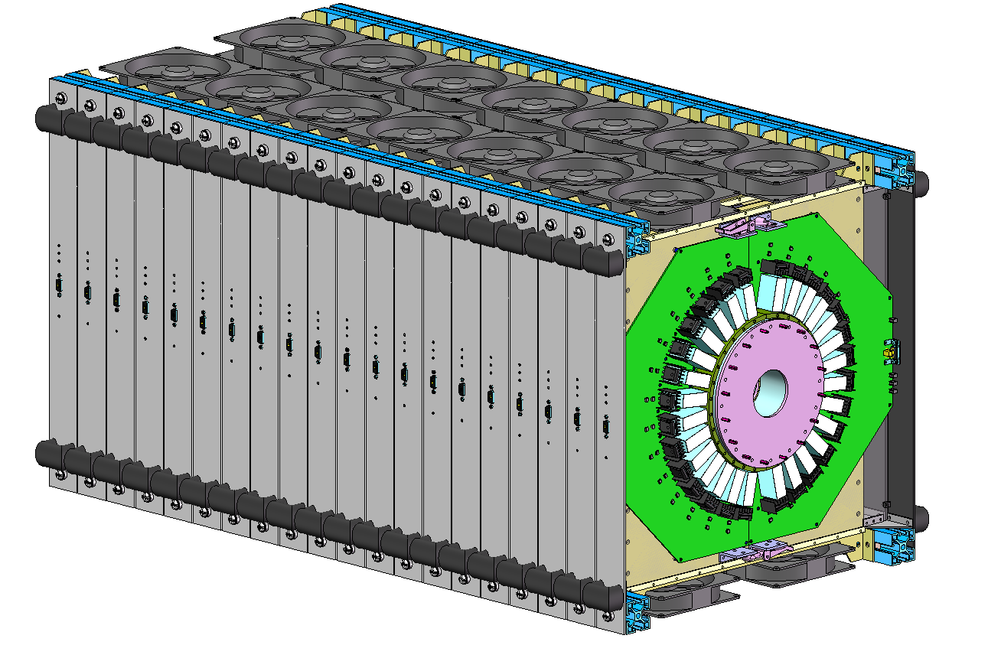
250ns-fast kicker pulser design
Scheme: 20-stage inductive adder based on SiC-MOSFETs.
The co-axial transformer is configured as bipolar output.
The pulser is located outside tunnel and 10 50 Ω cables with length more than 30m are applied to connect with kicker.
Matching terminal resistor is 10Ω.
20-stage inductive adder

Slide 22
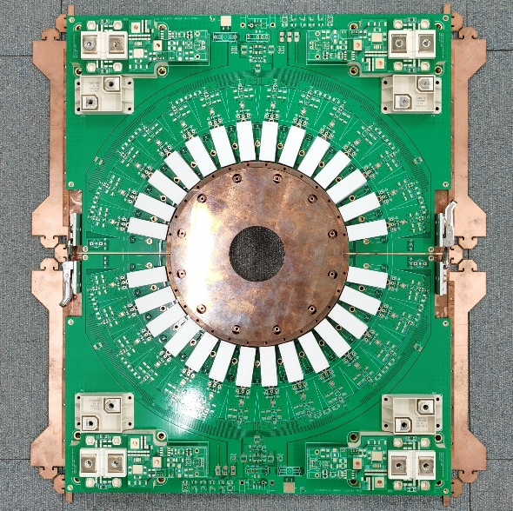
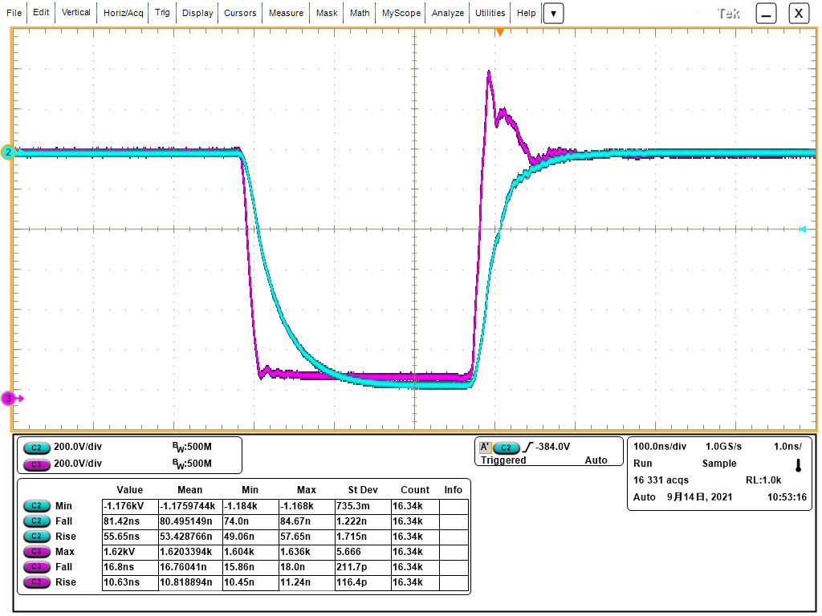
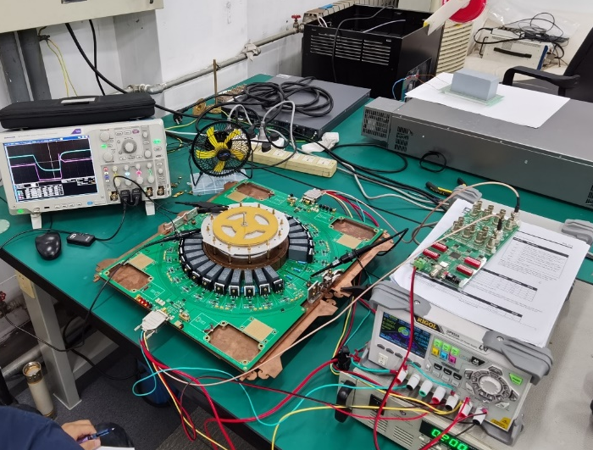
First switching cell prototype test
V_{DS}=1.62kV
V_{DS}=1.2kV
V_{out}=-1.176kV
RL=0.5Ω

Slide 23
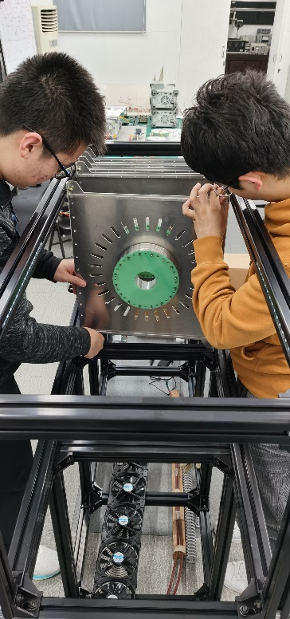
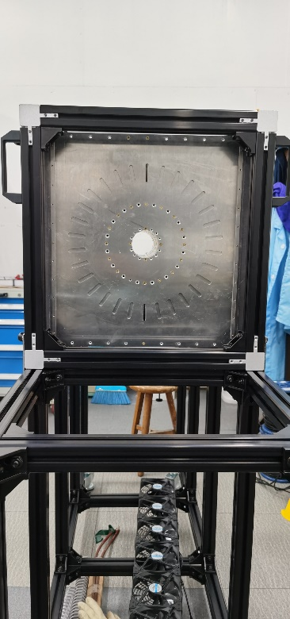
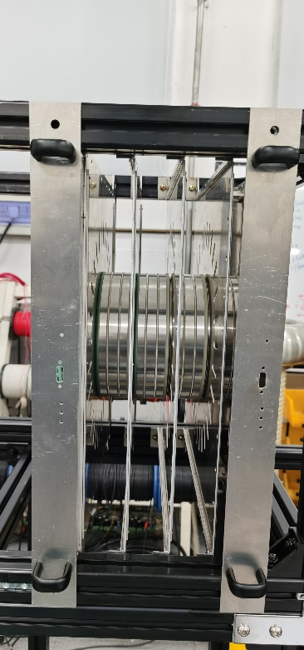
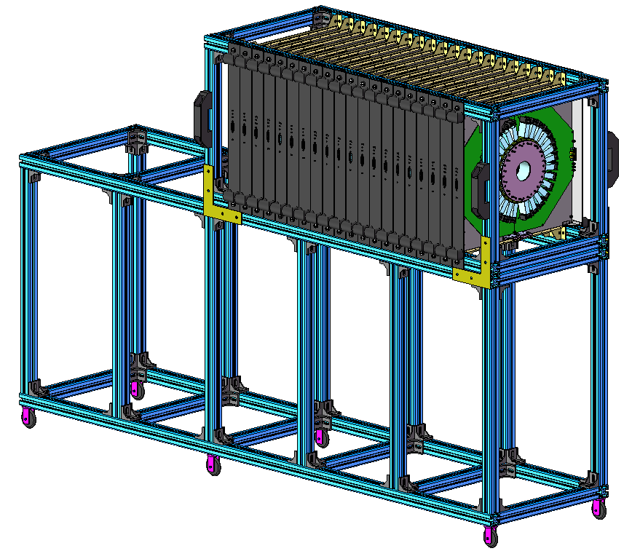
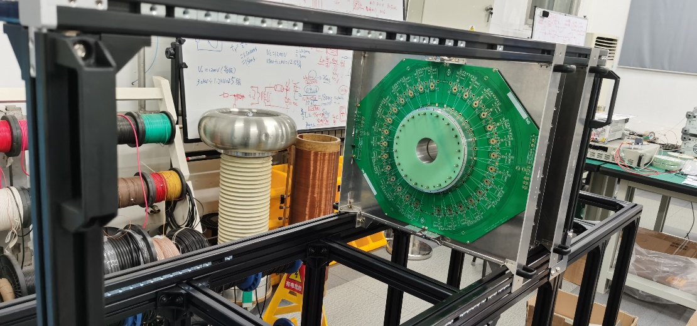
Pulser prototype assembly

Slide 24
Ferrite core kicker magnet

Slide 25
BST EXT kicker design parameters
parameter | Unit | BST-EXT-kicker1 （for CR off-axis inj.） | BST-EXT-kicker2 （for CR on-axis inj.）
Quantity | - | 2 | 2
Type | - | In-air delay-line dipole kicker | In-air lumped parameter dipole kicker
Deflect direction | - | Horizontal | Horizontal
Beam Energy | GeV | 120 | 120
Deflect angle | mrad | 0.2 | 0.1
Magnetic effective length | m | 1.4 | 0.7
Magnetic strength | T | 0.06 | 0.06
Integral magnetic strength | T·m | 0.08 | 0.04
Clearance region(H×V) | mm | 55×55 | 55×55
Good field region(H×V) | mm | ? | ?
Field uniformity in good field region | - | ±1.5%？ | ±1.5%？
Repetition rate | Hz | 1k | 1k
Amplitude repeatability | - | ±0.5% | ±0.5%
Pulse jitter | ns | ≤5 | ≤5
Bottom width of pulse(5%-5%) | ns | Trapezoid：440~2420 | Half-sine：1360
Tr/Tf(5%-95%) | ns | <200 | <680
40~2000ns
1kHz
200ns
200ns
1360ns,1kHz

Slide 26





Kicker magnet physics design
W=68mm
L=$μ_{0}\frac{w}{h}l=4π×{10}^{7}×\frac{68}{64}×1.4=1.8683μH$
4mm
I=$\frac{B}{μ_{0}}h=\frac{0.06}{4π×{10}^{−7}}×0.064=3.056kA$
h=64mm
55mm
$$Z=10Ω$$
U=I$∙Z=3000×10=30kV$
$$τ=\frac{L}{R}=\frac{1.87×{10}^{−6}}{10}=187ns$$
Ferrite core
Kicker magnet type | Pulse discharge mode | Magnetic field rise time Tr (5%-95%)
Lumped parameter | Shorted end | 3τ=561ns
Lumped parameter | Matching | 3τ/2=280.5ns
Delay-line | Matching | τ=187ns
1360ns,1kHz
40~2000ns
1kHz
200ns
200ns

Slide 27
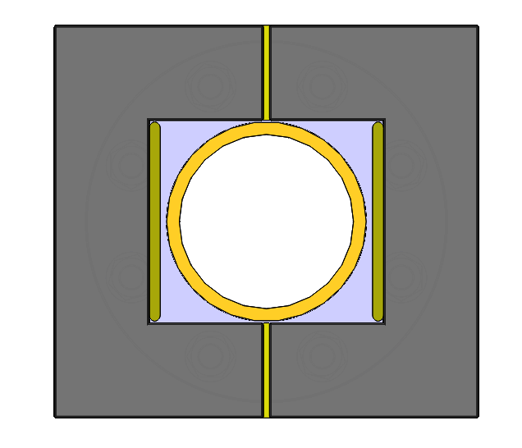
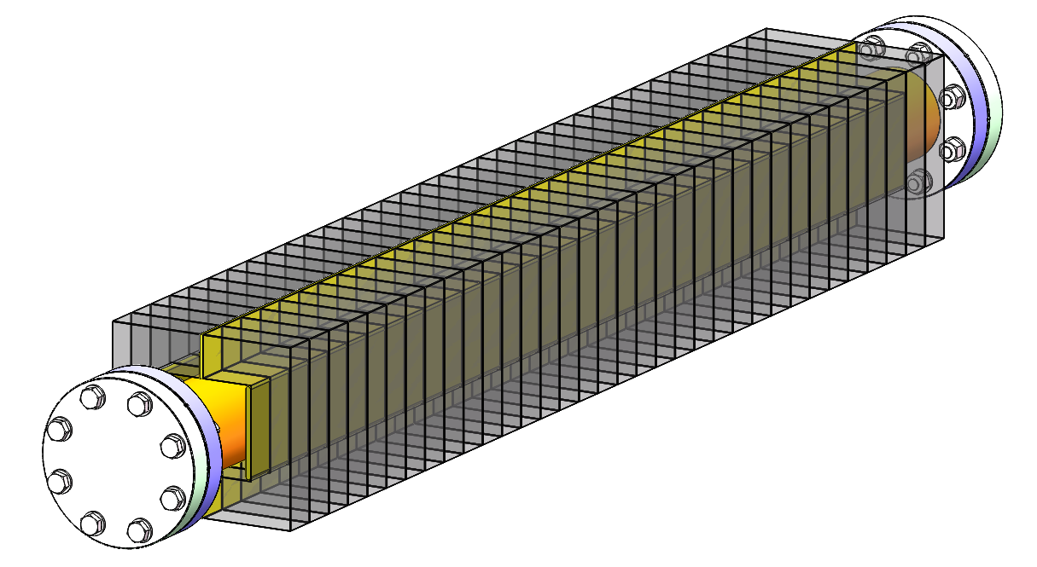
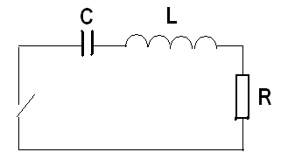
Lumped parameter dipole kicker system
Features:
Out-vacuum kicker with metallic coating ceramic vacuum chamber
Eddy current Shielding plate
<1360ns,1kHz
HV conductor
Ceramic vacuum chamber
Ferrite core

Slide 28
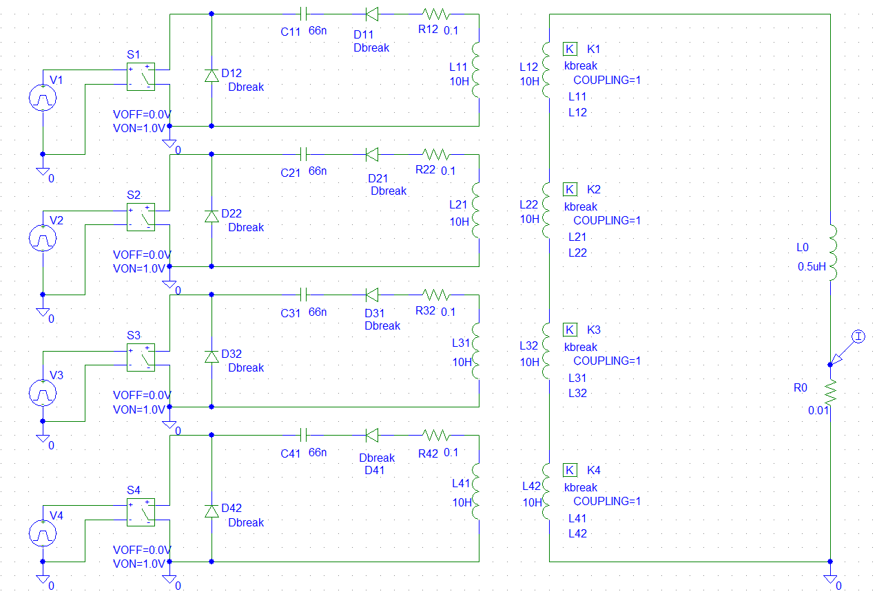
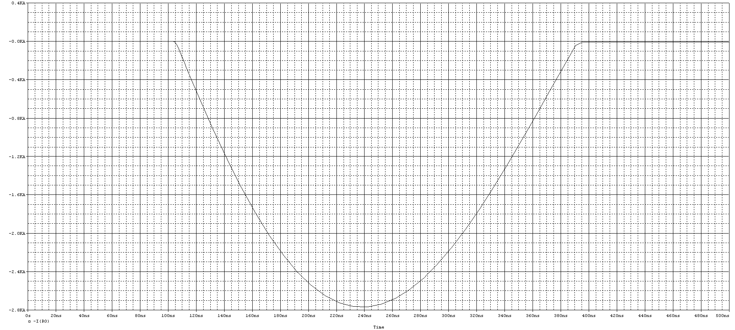
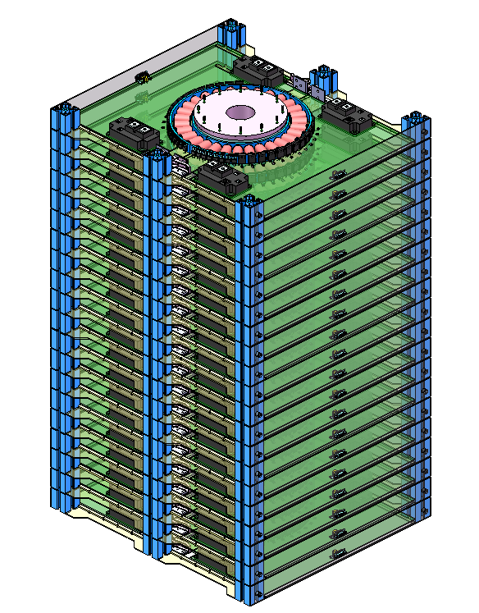
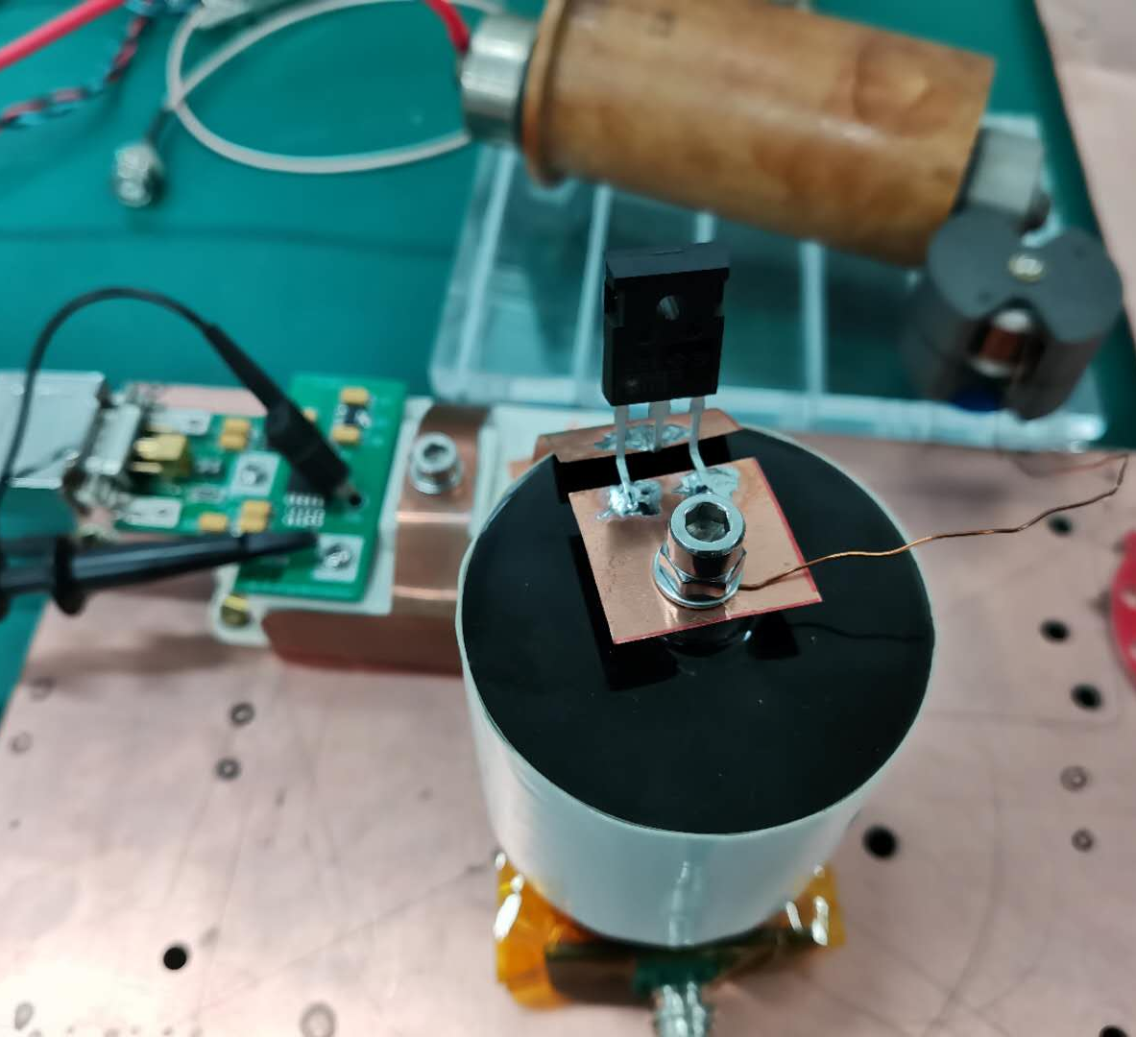
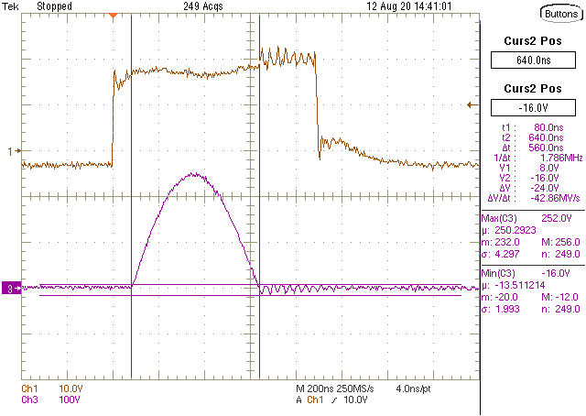
Novel half-sine wave pulser
Inductive adder + LC resonance discharge circuit (IGBT+SBD)
Imax=2326.5A(2500A)
L=194nH(250nH)
C=25nF
Tw=π√LC=248.4ns
Z=√L/C=3.16Ω
U=7357V(8000V)
IGBT quantity=10*4=40
IGBT
SIC 1200V SBD
920mm
564mm
510mm

Slide 29
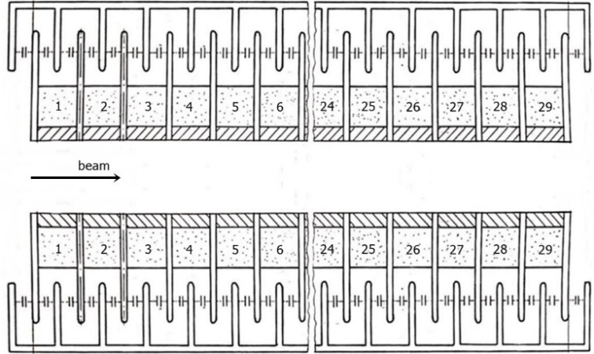
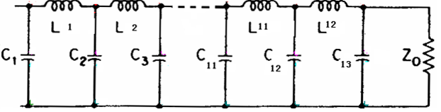

Delay-line dipole kicker system
The structure of delay-line kicker is complicated, but helps to achieve ideal trapezoid waveform.
40~2000ns
1kHz
200ns
200ns
challenges
Delay-line kicker magnet
PFN
Pulser
Delay-line kicker
Lumped parameter kicker

Slide 30



Dual-C type delay-line dipole kicker design
Capacitor plate@
High potential
Capacitor plate @
Ground potential
Ceramic Vacuum chamber
HV conductor
ground potential Lead
Ferrite core
High potential Lead
Eddy current Shielding plate
Base
Ceramic support

Slide 31

Trapezoid wave pulser
Adjustable pulse width trapezoid waveform pulser based on SiC MOSFET
Energy storage component
  Capacitor ： Flat-top dropping compensate topology
  PFN ：low impedance
Power stacking topology
  inductive adder: not fit for long pulse
  Marx generator: hard to control structure impedance
40~2000ns
1kHz
200ns
200ns
challenges
Solid-state switches（SIC MOSFET）
Delay-line kicker magnet
PFN
Or
Cap.
Marx generator
Inductive adder

Slide 32




Ceramic vacuum chamber
ceramic vacuum chamber with special pattern metallic coating is key component for outside-vacuum kicker magnet.
ellipse
octagon
Race track
√
Ceramic material: 99% AL₂O₃
L=1.2m，thickness=5mm
Integrated sintering

Slide 33






Magnetron sputtering coating prepare
According to the experience of coating, the cathode target discharge is unstable for long vacuum chamber more than 600mm and it is easy to cause ignition or local film formation failure.
So, sectional coating method by a movable solenoid is proposed for our 1.2m ceramic vacuum chamber. The coating experiment shows uniform coating achieved in one antechamber of 1m.
In order to obtain uniform coating inner racing track shape vacuum chamber, a horizontal movable cathode wire target solution is proposed.
Solenoid coil
Inner diameter=208mm
Length =700mm
Good field region=500mm
1m
The antechamber for HEPS
(inner aperture=6mm)
Movable solenoid
Graduated bellows is used to adjust the horizontal position of cathode wire (compression at one end and tension at the other end)
view window
Cathode wire
Moving track
Cathode pole

Slide 34





Film pattern study
Metallic coating on the inner wall of ceramic vacuum chamber is provided for beam mirror current as path .
The continuous uniform film on the wall of ceramic vacuum chamber can form large loop eddy current under fast pulse magnetic field, which has a great influence on the magnetic field.
An appropriate coating pattern can solve this contradiction at the same time.The design principles of coating pattern are as follows:
  The upstream and downstream of films are not connected to prevent the occurrence of large loop;
  The films shall cross to form a capacitor structure as far as possible to provide a path for high-frequency beam mirror current.
×
Mesh film
Strip film
Comb film
Ladder film
Spiral film
√

Slide 35




Parts of simulation result
the film square resistance is set to 0.2 Ω (equivalent to 86nm copper film or 1.1 μm TiN film)
Material conductivity is set to 5000S / m, and the corresponding thickness is 1mm.
ferrite
Ceramic vacuum chamber
Metallic film(spiral)
coil
COMSOL 3D Model
Coil exciting current pulse
Central field deformation caused by different pattern films

Slide 36




Delay-line Nonlinear Kicker (NLK)
Thinking about if the nonlinear kicker injection is possible for CEPC, after all this top-up injection scheme should loose the requirement of DA.
Dipole field
Differential mode exciting
Injected bunch
Nonlinear field
stored bunch
Common mode exciting

Slide 37




Delay-line NLK preliminary design
Capacitor plate@
High potential
Capacitor plate @
Ground potential
Ceramic Vacuum chamber
HV conductor
ground potential Lead
Ferrite core
High potential Lead
Base
Eddy current Shielding plate
Ceramic support

Slide 38
Summary
In CEPC accelerator complex，there are 9 inj. and ext. sub-systems. The types of all inj./ext. components are determined. The hardware designs towards TDR are being carried out.
One team is in charge of both HEPS and CEPC inj. & ext. system. A part of hardware R&D for 2 projects are overlapping.
The Lambertson septa with septum=3.5mm and slotted-pipe kicker system with 300ns half-sine wave for HEPS is on the way. R&D of delay-line kicker and ceramic chamber are just started.

Slide 39
END
Thank you for attentions!!!

Slide 40
abstract
The type of CEPC injection and extraction hardware including Lambertson septa，strip-line kicker，slotted-pipe kicker, Lumped parameter ferrite core kicker，and delay-line fast kicker.
The hardware designs towards TDR are being carried out. One team is in charge of both HEPS and CEPC inj. & ext. system. Some hardware R&D are overlapping.

Slide 41
Backup slides

Slide 42
Booster Ring
Booster operating mode | Higgs |  |  | W |  | Z
Beam energy（GeV） | 10 | 120 |  | 10 | 80 | 10 | 45.5
Function | Injection （both） | Extraction （off-axis） | Inj./Ext. （on-axis） | Injection （off-axis） | Extraction （off-axis） | Injection （off-axis） | Extraction （off-axis）
Bunch number | 242（in half ring） |  | 7（in half ring） | 1524（uniform） |  | 6000
Min. bunch spacing （ns） | 680 |  | 23800 | 220 |  | 25
Bunch number per train× train number | - |  | - | - | - | 80×75
Train spacing （ns） | - |  | - | - | - | 2460
Injection（extraction）mode | Bunch by bunch |  |  | Bunch by bunch |  | Bunch by bunch | Train by train
Kicker repetition rate (Hz) | 100 | 1000 |  | 100 | 1000 | 100 | 1000
Kicker pulse width (ns) | 1360 |  |  | 440 |  | 50 | <6900
Kicker flat top（ns） | - |  |  | - |  | - | >1980
Kicker rise（fall）time (ns) | <680 |  |  | <220 |  | <25 | <2460
Timing delay(ns) | <680 |  | <23800 | <220 |  | <2460 | <4400
injection（extraction）period (s) | 2.42 | 0.242 | 0.007 | 15.24 | 1.5 | 60 | 0.075
Kick angle (mrad) | 0.11 | 0.2 | 0.1 | 0.11 | 0.2 | 0.11 | 0.2
Kick Integral field strength (Tm) | 0.004 | 0.08 | 0.04 | 0.004 | 0.05 | 0.004 | 0.03
Beam pipe aperture Φ（mm） | 55
Considering the compatibility of three operating modes:
Function | LE-Injection （both） | HE-Extraction （off-axis） | HE-Inj./Ext. （on-axis）
Kicker repetition rate (Hz) | 100 | 1000 | 1000
Kicker pulse width (ns) | 50 | 440~2420(Adjustable) | 1360
Kicker flat top（ns） | - | 0~1980(Adjustable) | -
Kicker rise（fall）time(ns) | <25 | <220 | <680
injection（extraction）period (s) | 60 | 1.5 | 0.007
Kick angle (mrad) | 0.11 | 0.2 | 0.1
Kick Integral field strength (Tm) | 0.004 | 0.08 | 0.04
Beam pipe aperture Φ（mm） | 55 | 55 | 55
40~2000ns
1kHz
50ns,100Hz
200ns
200ns
1360ns,1kHz

Slide 43
Collider ring
Booster operating mode | Higgs |  |  | W |  | Z
Beam energy（GeV） | 120 |  |  | 80 |  | 45.5
Function | Injection （off-axis） | Injection （on-axis） | Extraction （dump） | Injection （off-axis） | Extraction （dump） | Injection （off-axis） | Extraction （dump）
Bunch number | 242（in half ring）- 7 |  |  | 1524（uniform） |  | 12000
Min. bunch spacing （ns） | 680 |  |  | 220 |  | 25
Bunch number per train× train number | - |  |  | - |  | 80×150
Train spacing （ns） | - |  |  | - |  | 245
Injection（extraction）mode | Bunch by bunch |  |  | Bunch by bunch |  | Train by train
Kicker repetition rate (Hz) | 1000 |  |  | 1000 |  | 1000
Kicker pulse width (ns) | 1360 |  |  | 440 |  | <2460
Kicker flat top（ns） | - |  |  | - |  | >1980
Kicker rise（fall）time (ns) | <680 |  |  | <220 |  | <245
Timing delay(ns) | <680 | <23800 | <680 | <220 |  | <4400
injection（extraction）period (s) | 0.242 | 0.007 | 0.242 | 1.5 |  | 0.15
Kick angle (mrad) | 0.1 | 0.2 | 0.2 | 0.1 | 0.2 | 0.1 | 0.2
Kick Integral field strength (Tm) | 0.04 | 0.08 | 0.08 | 0.027 | 0.05 | 0.015 | 0.03
Beam pipe aperture HxV（mm） | 75×56
Considering the compatibility of three operating modes:
Function | Injection （on-axis） | Injection （off-axis） | Extraction （dump）
Kicker repetition rate (Hz) | 1000 | 1000 | 1000
Kicker pulse width (ns) | 1360 | 440~2420(Adjustable) | 440~2420(Adjustable)
Kicker flat top（ns） | - | 0~1980(Adjustable) | 0~1980(Adjustable)
Kicker rise（fall）time(ns) | <680 | <220 | <220
injection（extraction）period (s) | 0.007 | 1.5 | 1.5
Kick angle (mrad) | 0.2 | 0.1 | 0.2
Kick Integral field strength (Tm) | 0.08 | 0.04 | 0.08
Beam pipe aperture HxV（mm） | 75×56 | 75×56 | 75×56
40~2000ns
1kHz
40~2000ns
1kHz
1360ns,1kHz
200ns
200ns
200ns
200ns

